Slide 1
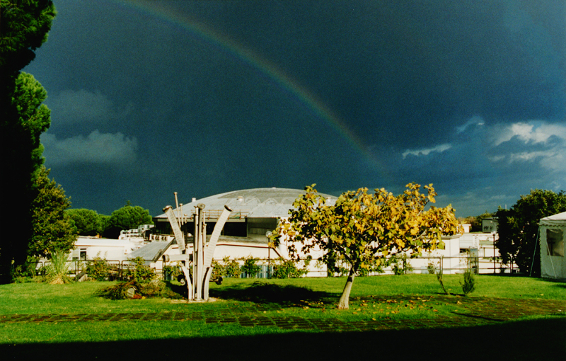


Kaonic atoms beyond SIDDHARTA-2:
future measurements and perspectives at the DAFNE collider
Luca De Paolis
European Nuclear Physics Conference 2022
24-28 October 2022
University of Santiago de Compostela

Slide 2
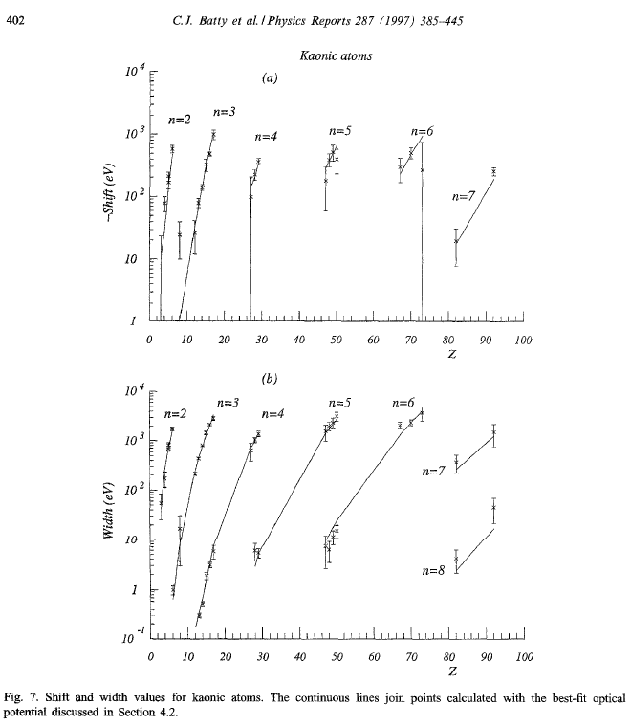
Why (again and still) kaonic atoms?
Except for the most recent measurements at DAΦNE and JPARC on KHe and KH, the whole knowledge on kaonic atoms dates back to 1970s and 1980s
These data are the experimental basis for all the developed theoretical models
These theoretical models are used to derive, for example:
KN interaction at threshold
KNN interaction at threshold
Nuclear density distributions
Possible existence of kaon condensates
Kaon mass
Kaonic atoms cascade models
“ Quinto Incontro Nazionale di Fisica Nucleare INFN 2022", A. Scordo, Laboratori Nazionali del Gran Sasso 10/05/2022

Slide 3
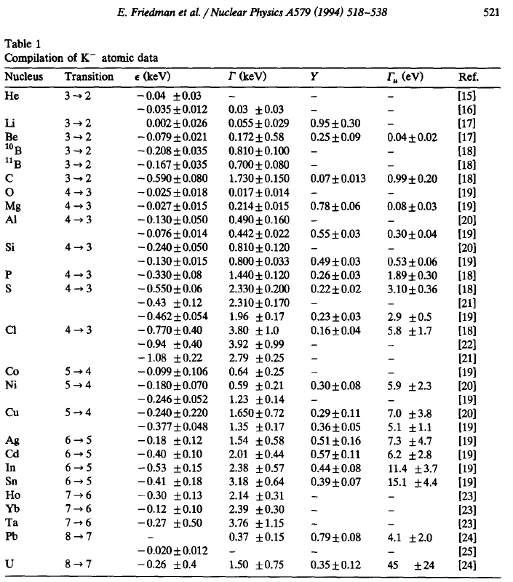
Why (again and still) kaonic atoms?
The available data on “lower levels” have big uncertainties
Many of them are actually UNmeasured
Many of them are hardly compatible among each other
Relative yields with upper levels are not always measured
Absolute yields are basically unknown (except for few transitions)
The REmeasured ones have been proved WRONG
This situation would already be a proper justification for new measurements

Slide 4
Transitions: energies and widths…which detector?
Crystal spectrometers:
High resolution
Low efficiency
0-20 keV range
Energy
SDDs
100 eV max resolution
4-40 keV range
High efficiency
300 keV
100 keV
Cd(Zn)Te
20-300 keV range
FWHM / E ~ %
High efficiency
Room Temperature
40 keV
HPGe
100-1000 keV range
FWHM / E ∼ %
High efficiency
Cooling needed
20 keV
5 keV
10 eV
100 eV
Γ

Slide 5
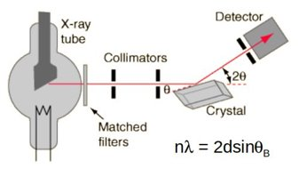
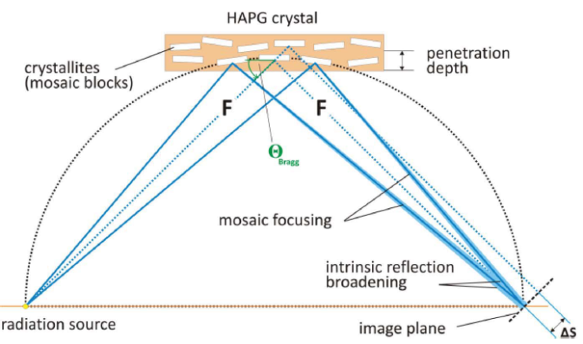
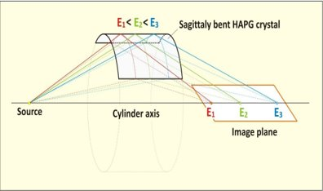
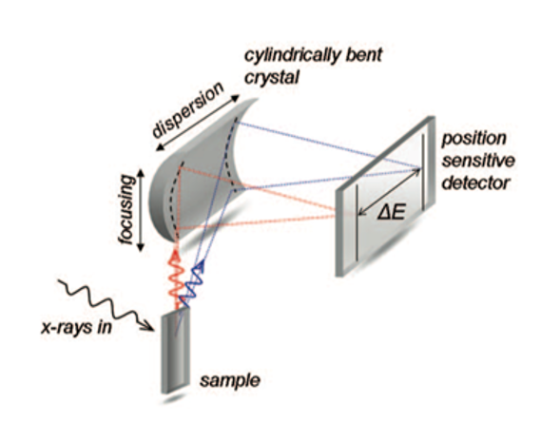
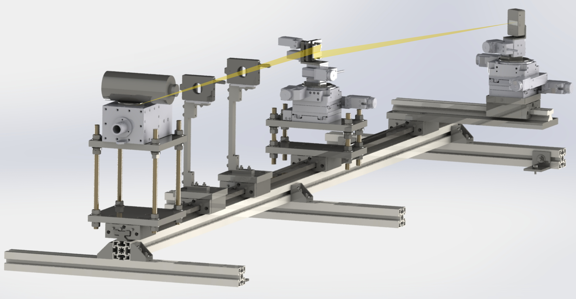
Crystal spectrometers: VOXES
Photons of different energies are reflected in different positions
With a crystal and a position detector, energy spectra with ultra-high resolution can be obtained
For monochromatic sources, also directionality could be tested
FWHM of few eV with NO COOLING
Energy range between 1-20 keV (n=1, depending on the crystal)
Extremely low efficiencies (solid angle)

Slide 6
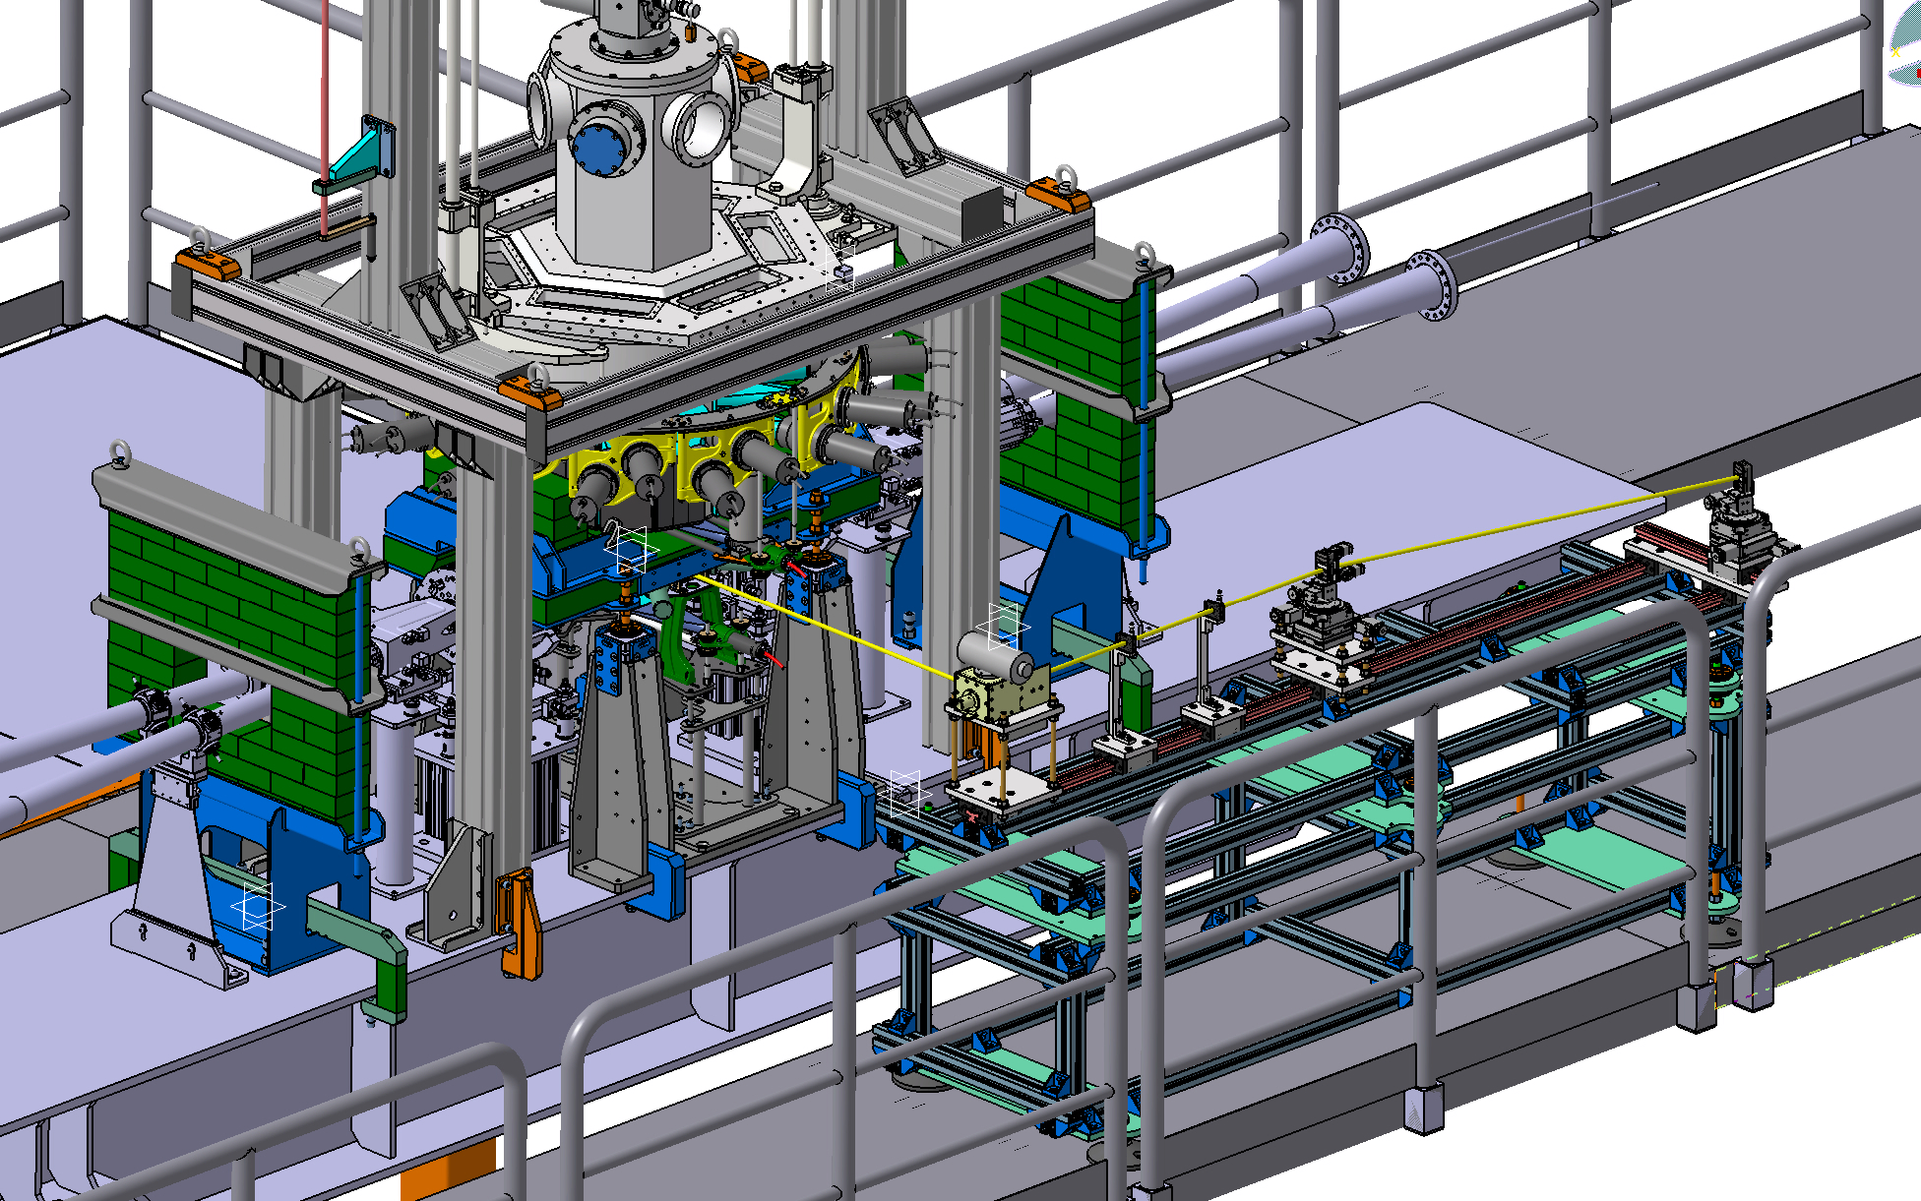
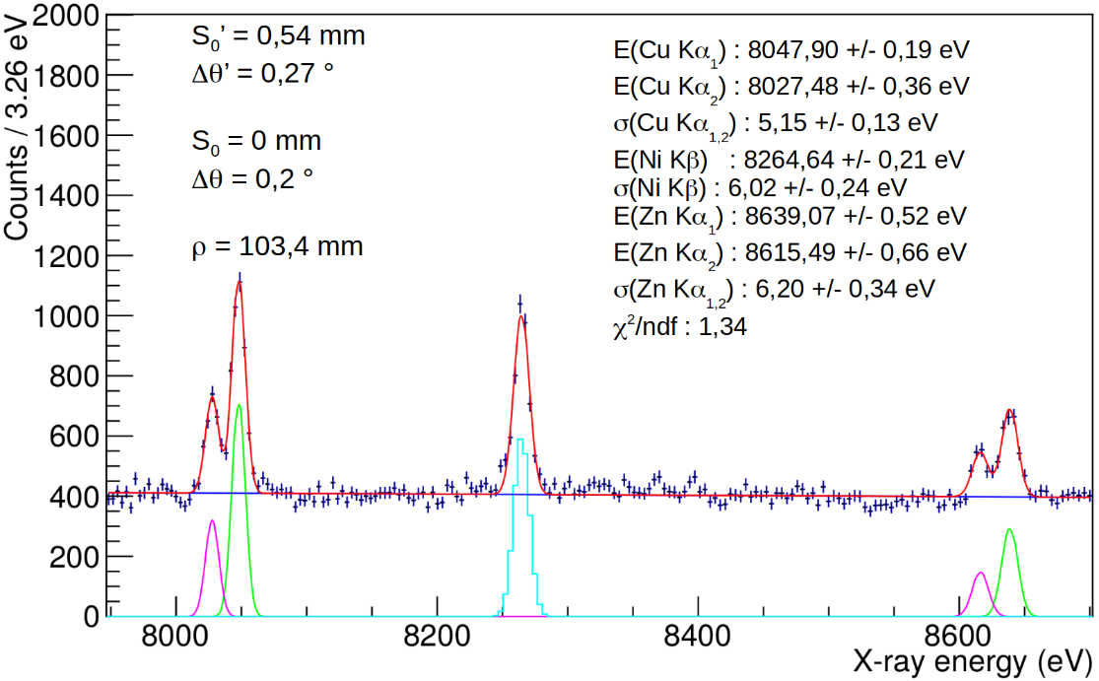
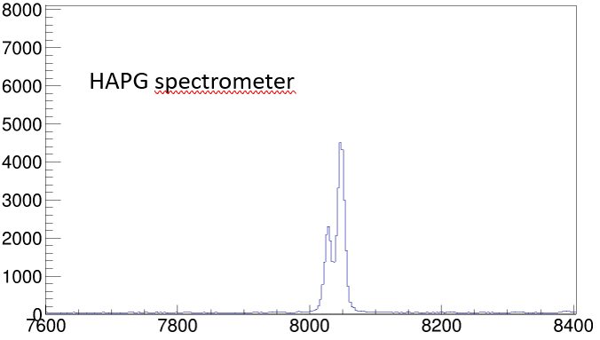
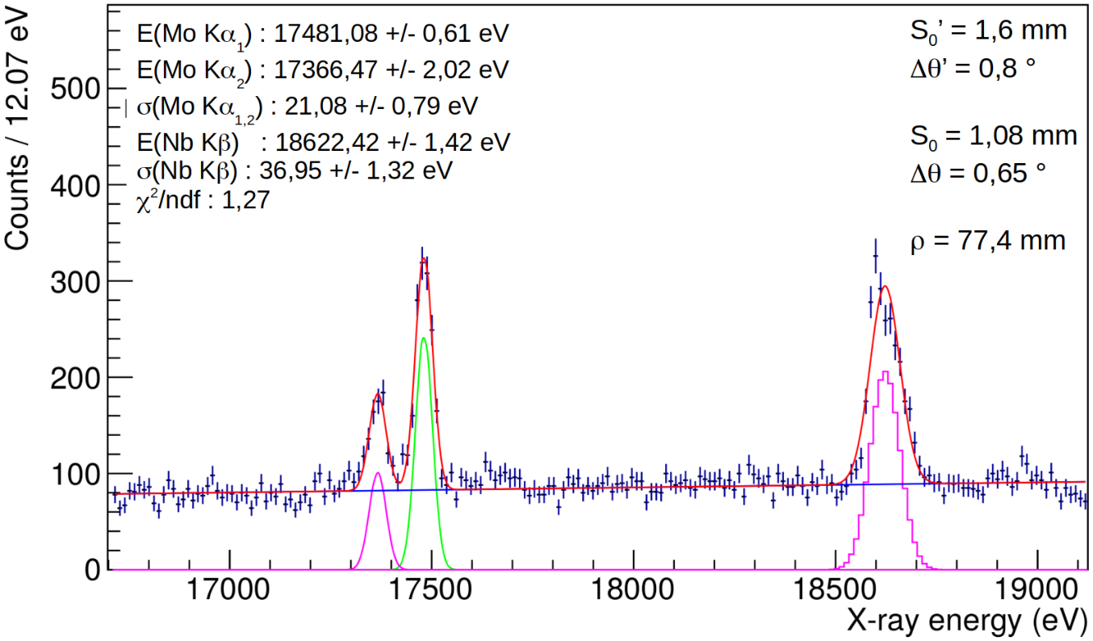
Crystal spectrometers: VOXES
High precision measurements with VOXES in LNF Lab
Possible feasibility test to be done in parallel with SIDDHARTA-2
MAIN GOAL:
assess background and on beam behaviour of crystals and strip detector
Counts
X-ray energy (eV)

Slide 7
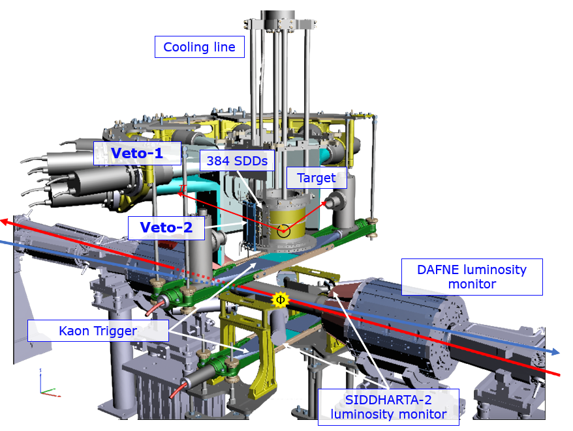
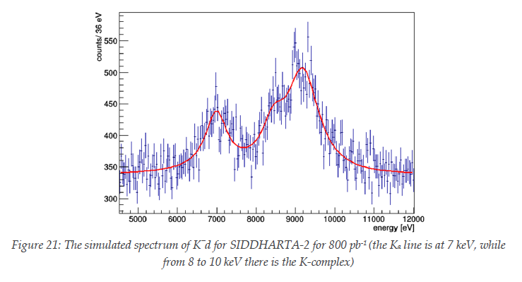
SDDs: present and future at DAΦNE
SIDHARTA-2 SETUP
Assumptions
signal: shift - 800 eV
width 750 eV
density: 5% (LHD)
detector area: 246 cm²
Kα yield: 0.1 %
yield ratio as in K⁻p
SIDDHARTA-2 is now running with 450 μm thick SDDs
Expected:
Δε(1s) = 30 eV
ΔΓ(1s) = 70 eV
Previous talk F. Sgaramella

Slide 8
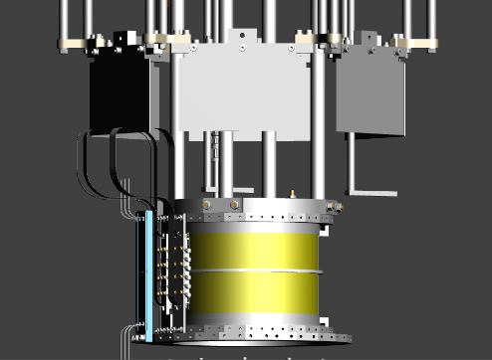
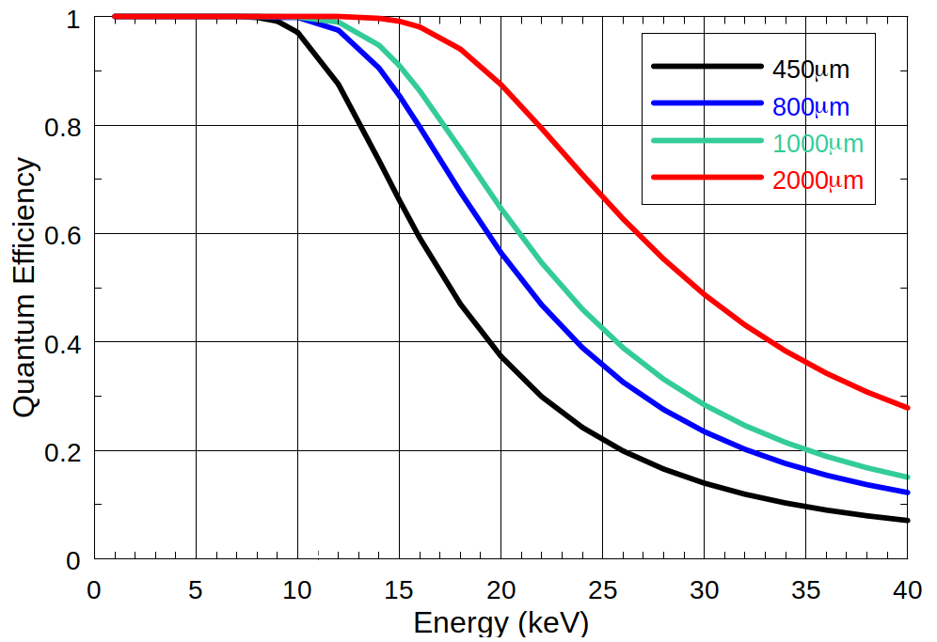
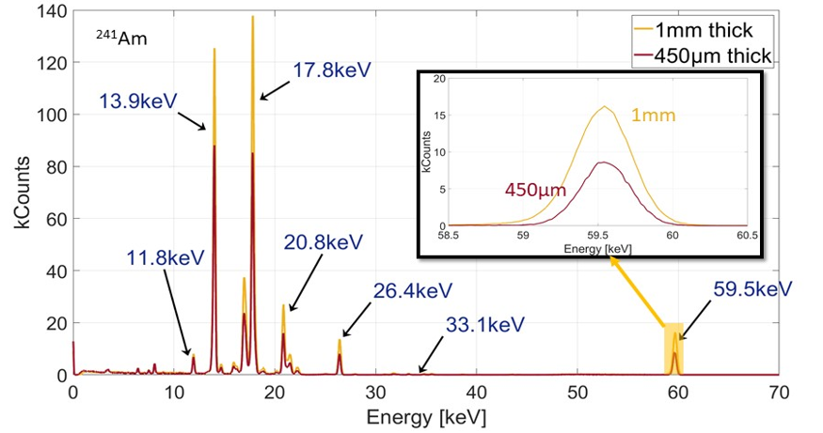
SDD: present and future at DAΦNE
Kaonic Helium transitions on 1s level would be accessible (very difficult):
SIDDHARTA-2 – like setup with 1-2 mm thick SDDs
K³He(2→1) : 33 keV
K⁴He(2→1) : 35 keV
Feasibility:
1-2 mm SDDs already financed by INFN CSN3
Electronics is similar to SIDDHARTA-2 SDDs
800μm and 1mm SDDs prototypes already produced by FBK for ARDESIA (INFN)

Slide 9
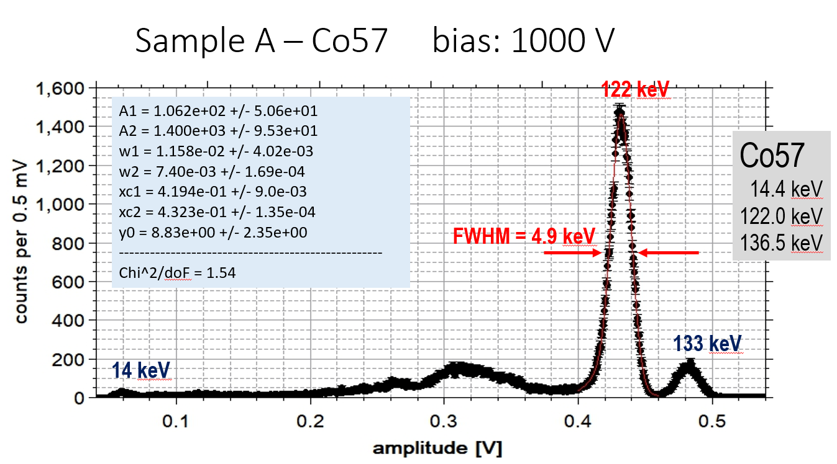
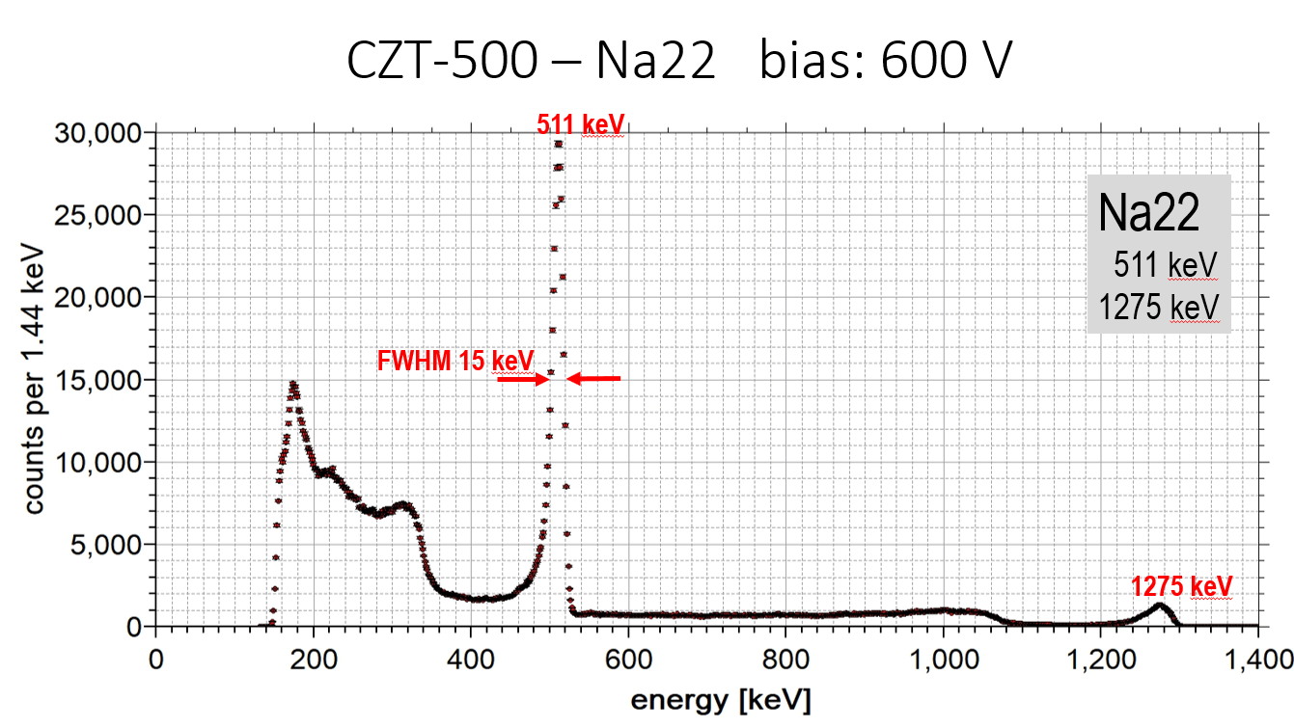
CZT: proposal for new measurements at DAΦNE
Detector Key Points:
High efficiency in the 20-100 keV region
Reasonable efficiencies up to 300 keV
Good resolution (FHWM/E ∼ %)
Fast response and time resolution (< 50 ns)
Precisions < 10 eV (ε) and <20 eV (Γ) are reachable in few months
First prototypes of Cd(Zn)Te delivered by JRA8-ASTRA (STRONG-2020) and tested

Slide 10
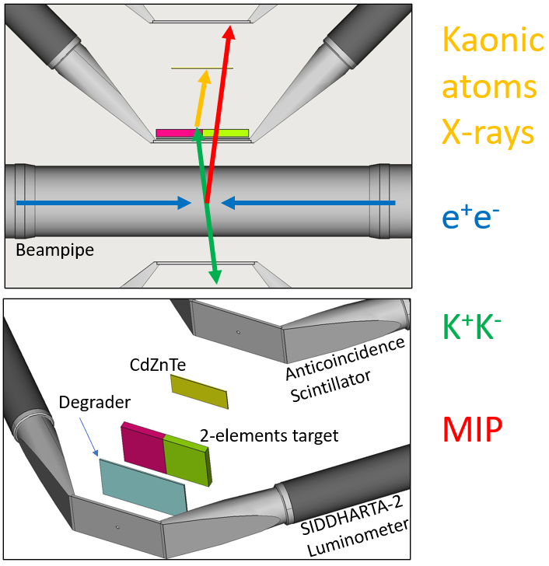
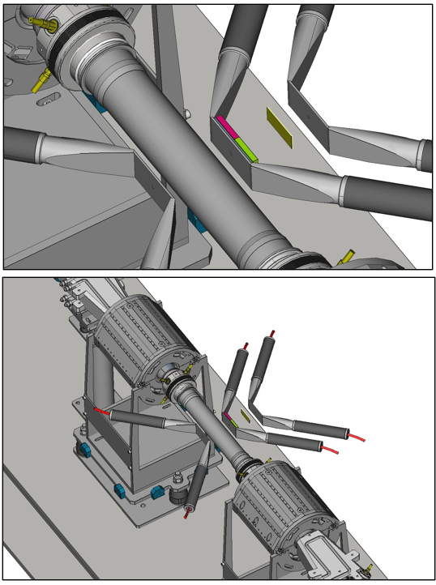


CZT: proposal for new measurements at DAΦNE
Kaonic atoms X-rays
$$e^{+}e^{−}$$
$$K^{+}K^{−}$$
MIP

Slide 11
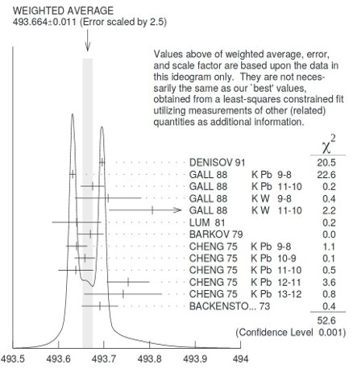
New Kaon Mass measurement with HPGe
The main disagreement is between the two ​most recent and precise measurements (x-ray energies from kaonic atoms):
m_{K}=493.696±0.007 MeV
A.S. Denisov et al. JEPT Lett. 54 (1991)558
K⁻ ¹²C, crystal diffraction spectrometer
m_{K}=493.636±0.011 MeV
K.P. Gall et al.
Phys. Rev. Lett. 60 (1988)186
This puzzle could be addressed, together with the renewal of the kaonic atoms database, again with the recent advancements in radiation detectors.
TES, Bragg Spectrometers, HPGe, SDD, and CdZnTe
M. Tanabashi et al.(Particle Data Group), Phys. Rev. D 98, 030001 (2018).

Slide 12
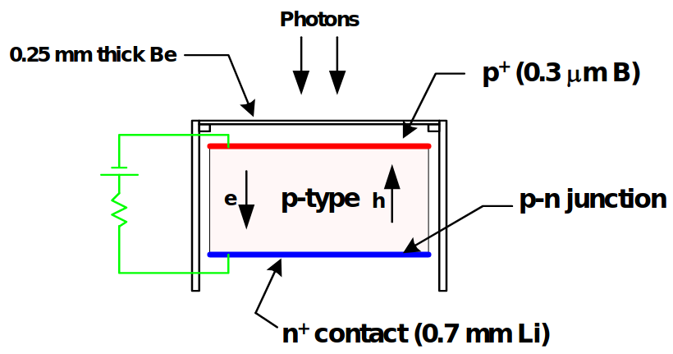
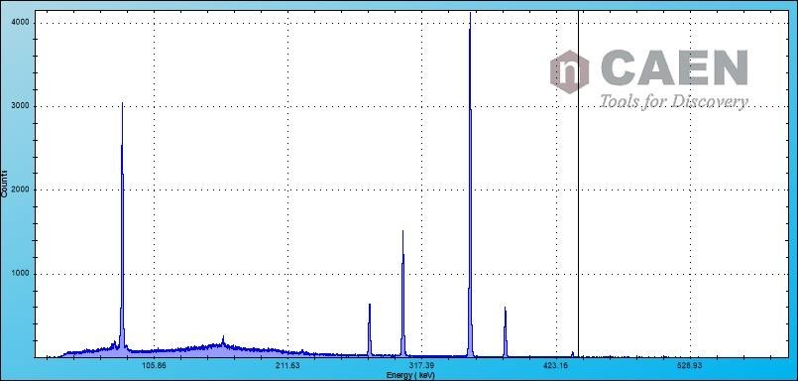
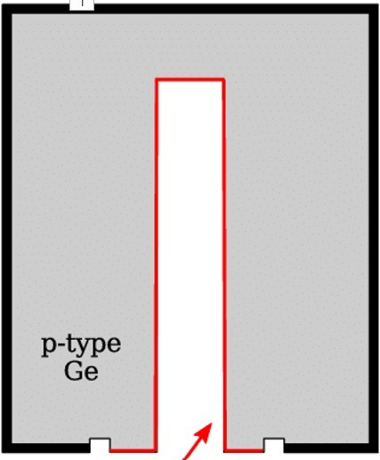
New Kaon Mass measurement with HPGe
High resolutions in a very wide energy range
Cryogenic cooling is needed Subject to radiation damage
The maximum depletion depth for the planar detectors is limited to 1-2 cm.
5 cm is required for efficient detection of MeV photons.
Resolutions (FWHM) obtained with ⁶⁰Co, ¹³³Ba
0.870 keV | @ | 81 keV
1.106 keV | @ | 302.9 keV
1.143 keV | @ | 356 keV
1.167 keV | @ | 1330 keV

Slide 13
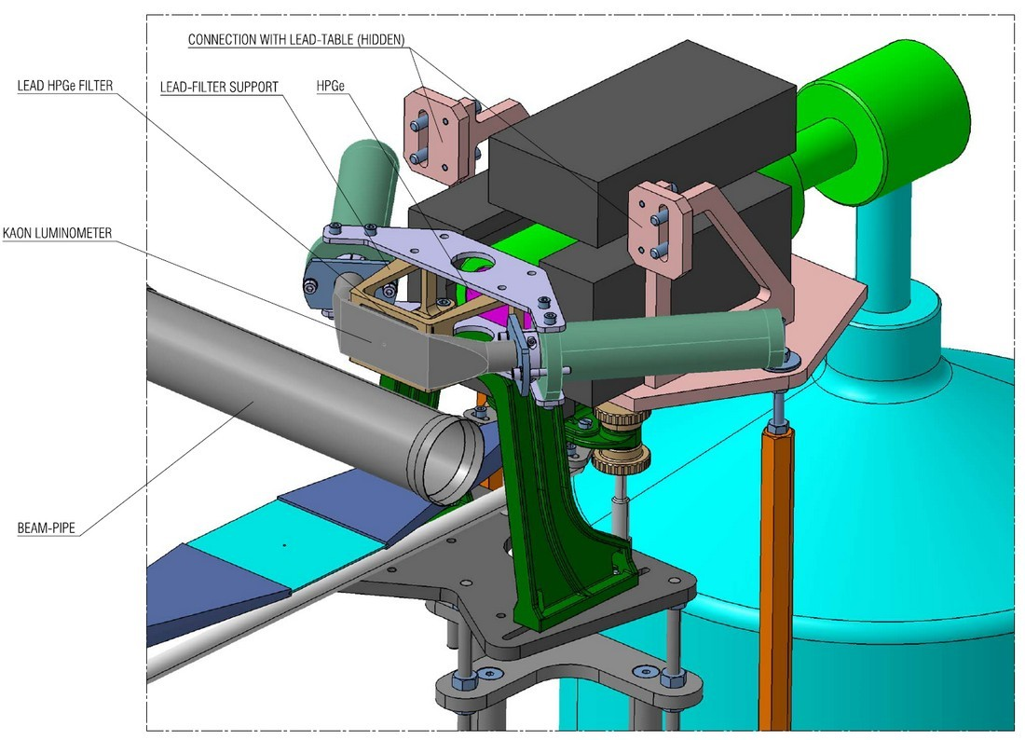
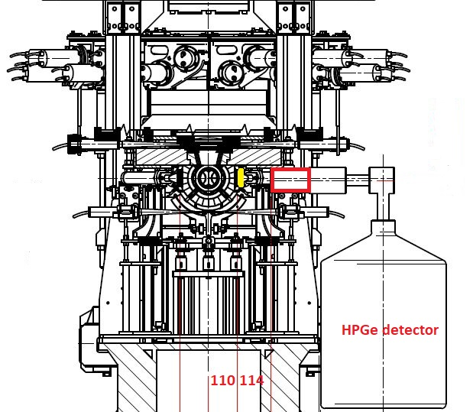
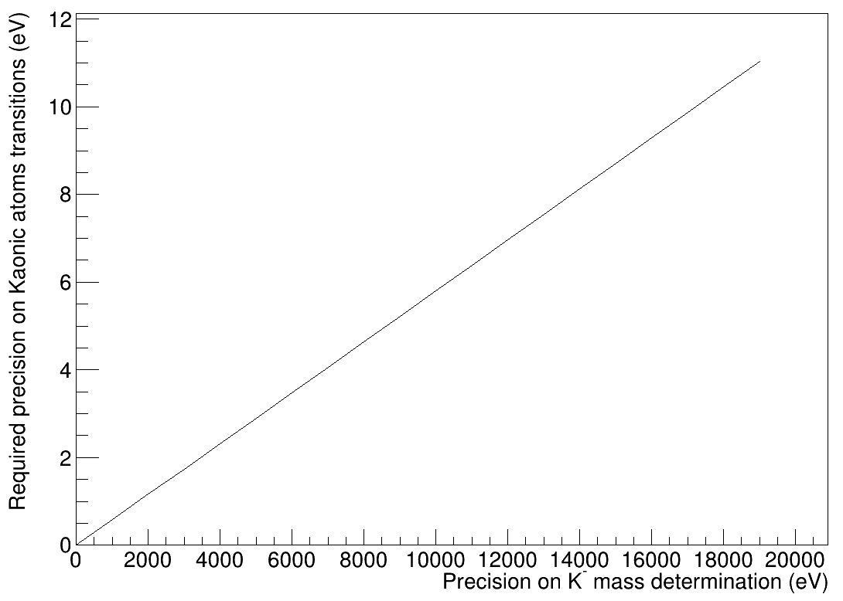
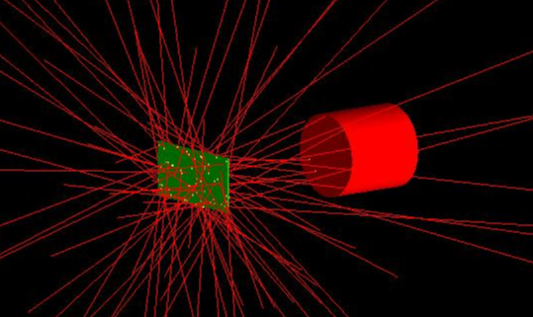
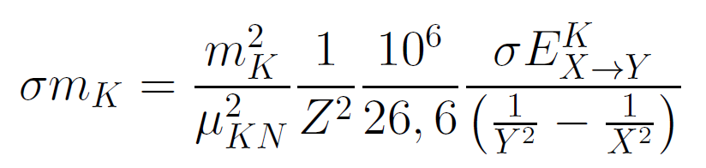
New Kaon Mass measurement with HPGe
Parallel run with SIDDHARTA-2 (already installed):
δE ~ 3 eV needed for δm_{K} = 5 keV
KPb(9→8) : 290 keV
Pb target just behind
the SIDDHARTA-2 luminometer,
which is used as trigger

Slide 14
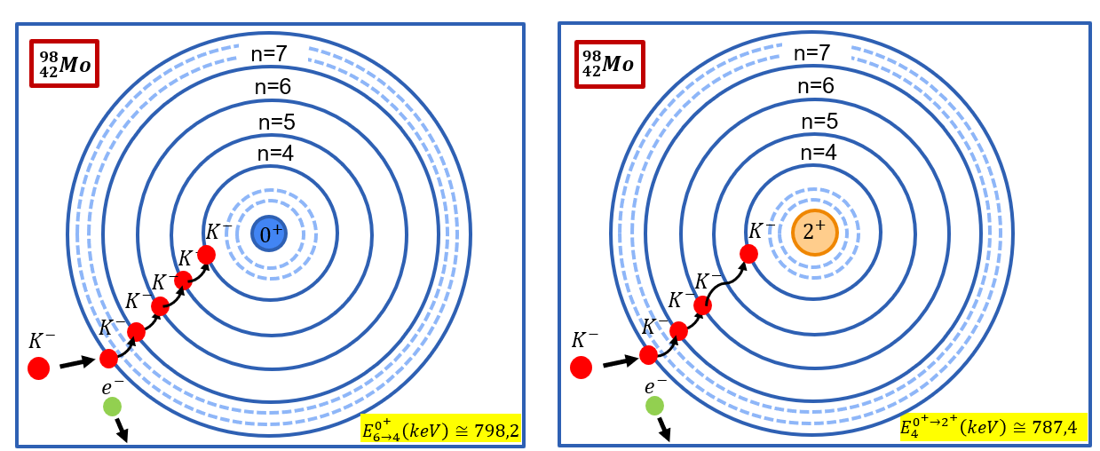
The E2 Nuclear Resonance in Kaonic atoms
In “thicklish nuclei” kaonic atoms, when an atomic de-excitation energy is closely matched by a nuclear excitation energy, a resonance condition occurs, which produces an attenuation of some of the atomic x-ray lines from a resonant versus a normal isotope target – as Mo(98).

Slide 15
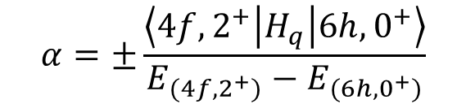
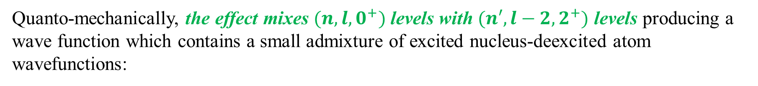
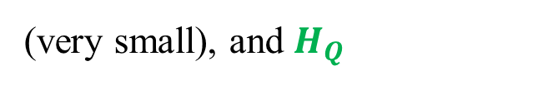
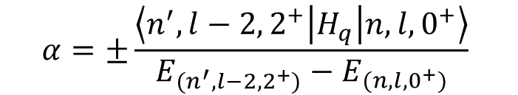
The E2 Nuclear Resonance Effect
The E2 Nuclear Resonance effect is a mixing of the atomic states due to the electrical quadrupole excitations of nuclear rotational states.
Quanto-mechanically, the effect mixes $(n,l,0^{+})$ levels with $(n′,l−2,2^{+})$ levels producing a wave function which contains a small admixture of excited nucleus-deexcited atom wavefunctions:
$$ψ=\sqrt{1−{\left|α\right|}^{2}} φ\left(n,l,0^{+}\right)+α φ\left(n^{′},l−2, 2^{+}\right)$$
where the admixture coefficient
$$α=±\frac{\left\langle n^{′},l−2,2^{+} | H_{q} | n,l,0^{+}\right\rangle }{E_{(n^{′},l−2,2^{+})}−E_{(n,l,0^{+})}}$$
(very small), and $H_{Q}$
expresses the electric quadrupole interaction between hadron and nucleus.
As example, for the nuclear E2 resonance effect in $K^{−}−Mo$ isotopes:
$$ψ=\sqrt{1−{\left|α\right|}^{2}} φ\left(6h,0^{+}\right)+α φ(4f,2^{+})$$
$$α=±\frac{\left\langle 4f,2^{+} | H_{q} | 6h,0^{+}\right\rangle }{E_{(4f,2^{+})}−E_{(6h,0^{+})}}$$
with

Slide 16

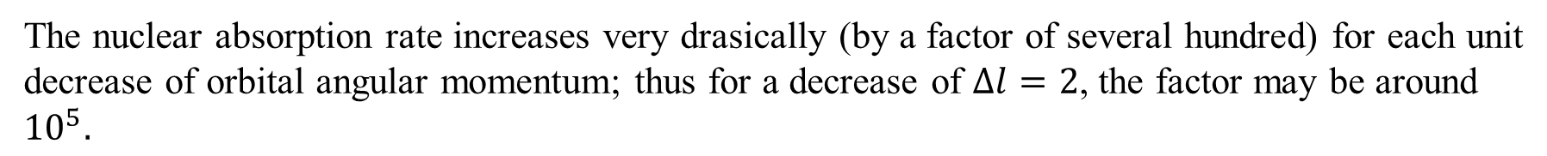
The E2 Nuclear Resonance Effect
HADRONIC ATOMS ARE VERY SENSITIVE TO QUITE AMOUNTS OF CONFIGURATION MIXING
The nuclear absorption rate increases very drasically (by a factor of several hundred) for each unit decrease of orbital angular momentum; thus for a decrease of $∆l=2$, the factor may be around ${10}^{5}.$
A very small admixture coefficient a (typically 1%) can mean a significant induced width!
INDUCED WIDTH:
$$Γ_{n,l}^{Ind}=\left|a^{2}\right|Γ_{n^{′},l−2}^{0}$$
A significant weakening/attenuation of corresponding hadronic x-ray line and any lower lines can be observed.
Moreover, comparing the ratio of intensities (attenuated line/reference) from the resonant isotope (thicklish) to a non resonant one, we have the direct measure of the fraction of hadrons absorbed by the excited nucleus.

Slide 17



First experiment on Mo98 isotope (1975)
An experiment measuring E2 Nuclear Resonance Effects in Molybdenum 98 was performed in 1975 by G. L. Goldfrey, G- K. Lum and C. E. Wiegand at Lawrence Berkeley Laboratory (LBL) in California.
In kaonic molybdenum (98), the energy difference between 6h and 4f levels, 798.2 keV, is very nearly equal to the nuclear excitation energy of 787.4 keV.
$${Mo}_{98}$$
7i
171 keV
$$2^{+}$$
6h
284 keV
787.4 keV
798.2 keV
5g
$$0^{+}$$
4f
514 keV
Experimental apparatus and measurement features:
The experiment was performed with a negative kaon beam, turning the targets of Mo(98), and Mo(92) as reference.
The spectra were collected using germanium detectors feeding a pulse height analyzer.

Slide 18
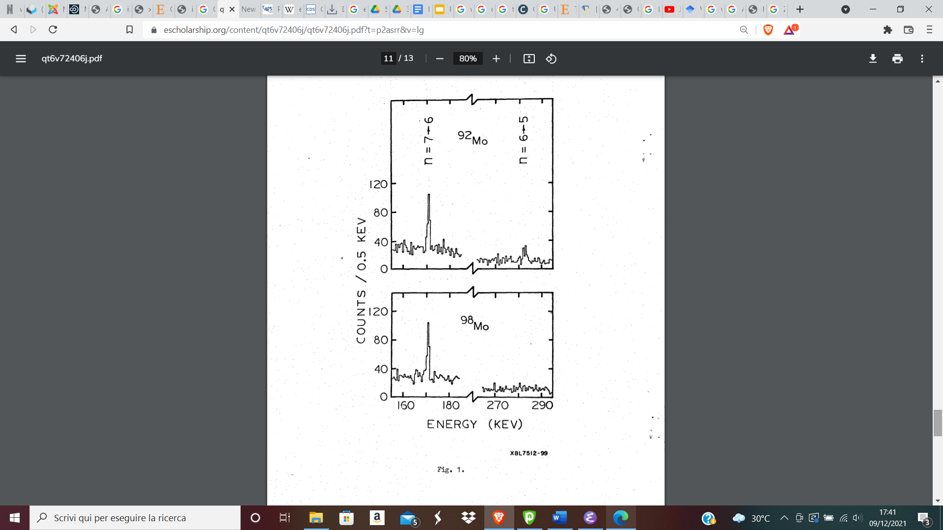
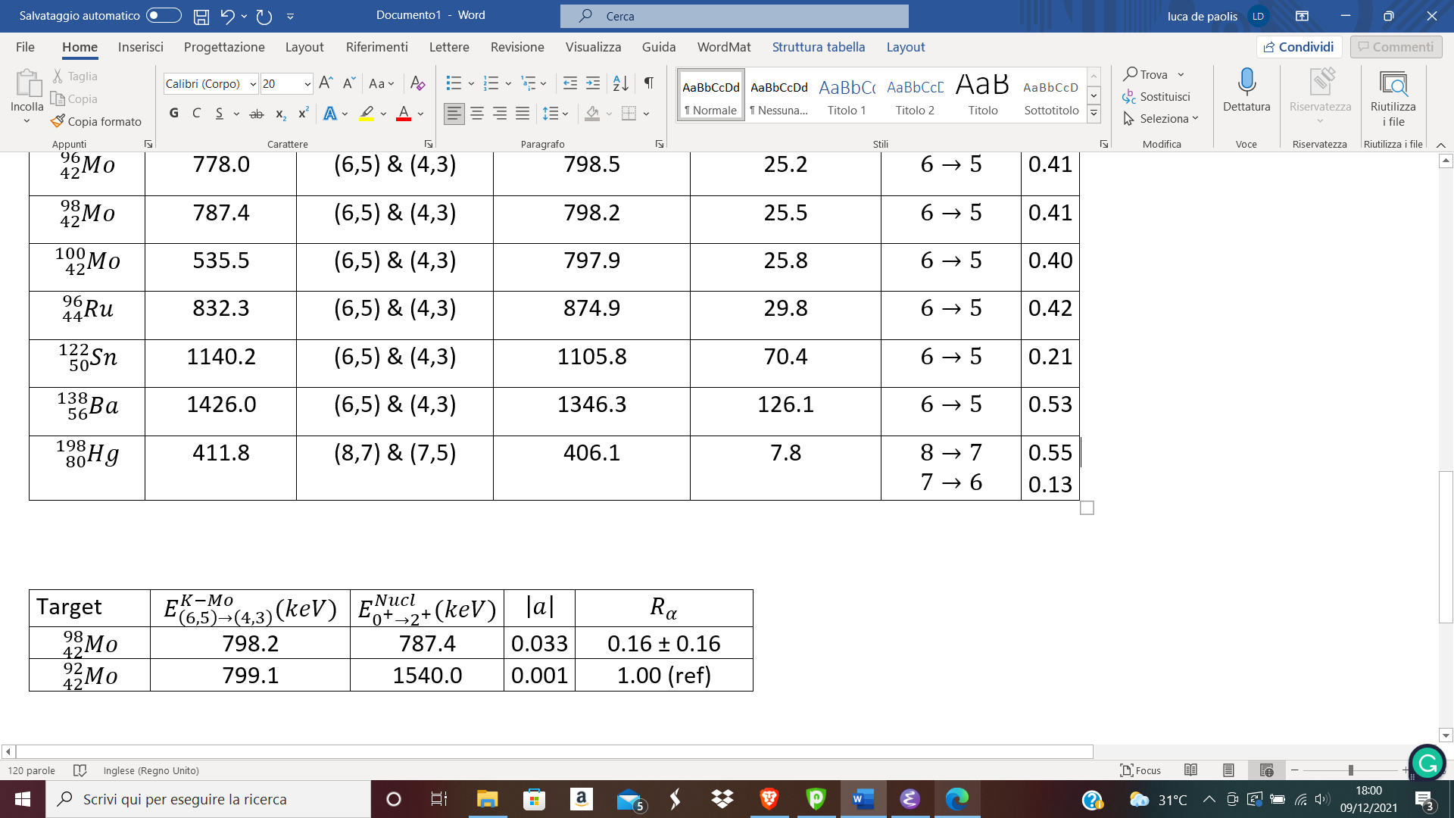
First experiment on Mo98 isotope (1975)
The E2 Nuclear Resonance effect was observed $K^{−}−{}_{42}^{98}{Mo}$, expressed as the attenuation of x-ray line .
Only 25 hours of data taking with K-beam was not enough for a conclusive result!!
IMPROVABLE WITH MODERN DETECTORS AND MORE DATA TAKING TIME

Slide 19
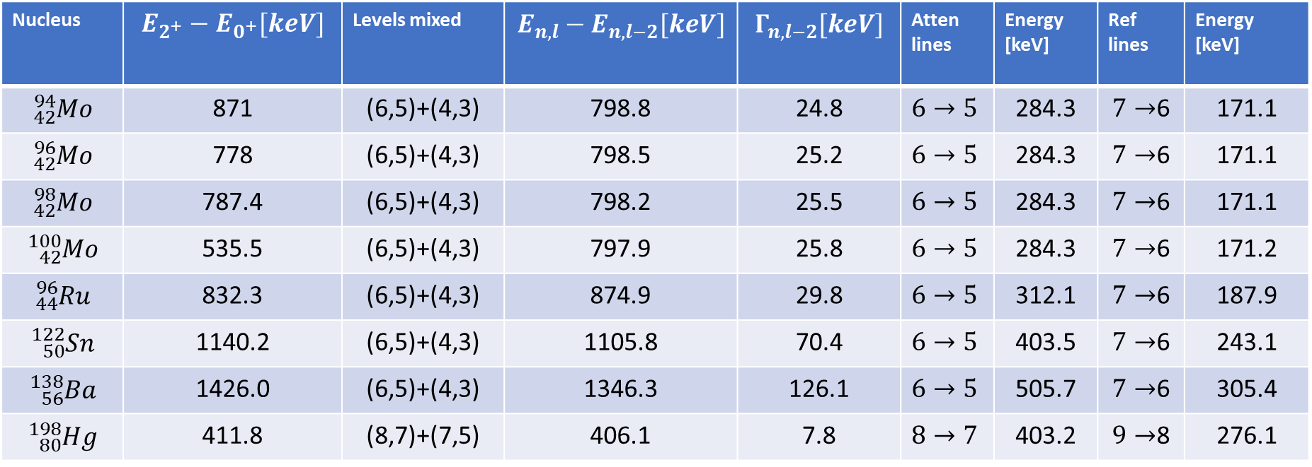
The E2 Nuclear Resonance in Kaonic atoms
Nuclear Resonances are expected also for kaonic atoms. Such predictions have been obtained by integrating the Klein-Gordon equation with a phenomenological kaon-nucleon potential.
Nucleus | $$E_{2^{+}}−E_{0^{+}}[keV]$$ | Levels mixed | $$E_{n,l}−E_{n,l−2}[keV]$$ | $$Γ_{n,l−2}[keV]$$ | Atten lines | Energy [keV] | Ref lines | Energy [keV]
$${}_{42}^{94}{Mo}$$ | 871 | (6,5)+(4,3) | 798.8 | 24.8 | $$6→5$$ | 284.3 | $7→$6 | 171.1
$${}_{42}^{96}{Mo}$$ | 778 | (6,5)+(4,3) | 798.5 | 25.2 | $$6→5$$ | 284.3 | $7→$6 | 171.1
$${}_{42}^{98}{Mo}$$ | 787.4 | (6,5)+(4,3) | 798.2 | 25.5 | $$6→5$$ | 284.3 | $7→$6 | 171.1
$${}_{42}^{100}{Mo}$$ | 535.5 | (6,5)+(4,3) | 797.9 | 25.8 | $$6→5$$ | 284.3 | $7→$6 | 171.2
$${}_{44}^{96}{Ru}$$ | 832.3 | (6,5)+(4,3) | 874.9 | 29.8 | $$6→5$$ | 312.1 | $7→$6 | 187.9
$${}_{50}^{122}{Sn}$$ | 1140.2 | (6,5)+(4,3) | 1105.8 | 70.4 | $$6→5$$ | 403.5 | $7→$6 | 243.1
$${}_{56}^{138}{Ba}$$ | 1426.0 | (6,5)+(4,3) | 1346.3 | 126.1 | $$6→5$$ | 505.7 | $7→$6 | 305.4
$${}_{80}^{198}{Hg}$$ | 411.8 | (8,7)+(7,5) | 406.1 | 7.8 | $$8→7$$ | 403.2 | $9→$8 | 276.1
MOLYBDENUM ISOTOPES OFFER A UNIQUE OPPORTUNITY TO INVESTIGATE THE STRONG $K^{−}−N$ INTERACTION THROUGH THE E2 NUCLEAR RESONANCE EFFECTS.

Slide 20
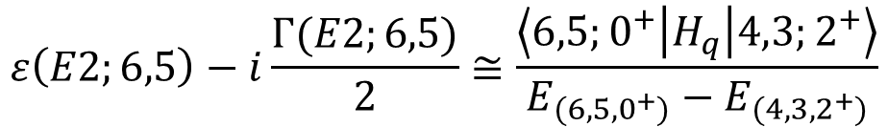
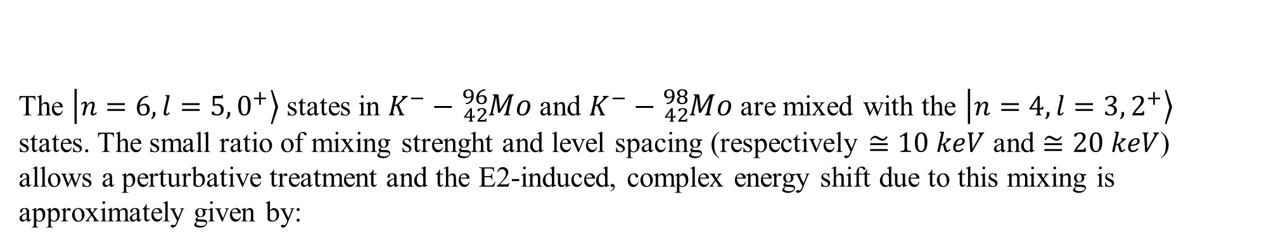
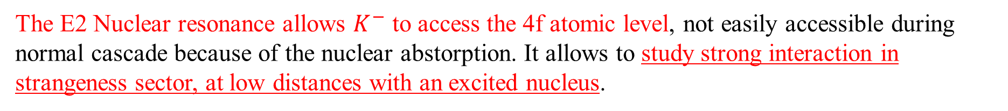
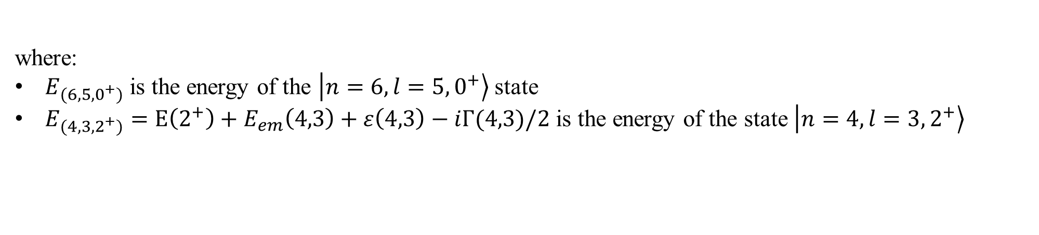
The E2 Nuclear Resonance in kaonic Mo
The $\left.\left|n=6,l=5,0^{+}\right.\right\rangle$ states in $K^{−}−{}_{42}^{96}{Mo}$and $K^{−}−{}_{42}^{98}{Mo}$are mixed with the $\left.\left|n=4,l=3,2^{+}\right.\right\rangle$ states. The small ratio of mixing strenght and level spacing (respectively $≅10 keV$ and $≅20 keV$) allows a perturbative treatment and the E2-induced, complex energy shift due to this mixing is approximately given by:
$$ε\left(E2;6,5\right)−i\frac{Γ(E2;6,5)}{2}≅\frac{\left\langle 6,5;0^{+} | H_{q} | 4,3;2^{+}\right\rangle }{E_{(6,5,0^{+})}−E_{(4,3,2^{+})}}$$
where:
$E_{(6,5,0^{+})}$ is the energy of the $\left.\left|n=6,l=5,0^{+}\right.\right\rangle$ state
$E_{(4,3,2^{+})}=E\left(2^{+}\right)+E_{em}\left(4,3\right)+ε\left(4,3\right)−iΓ(4,3)/2$ is the energy of the state $\left.\left|n=4,l=3,2^{+}\right.\right\rangle$
The E2 Nuclear resonance allows $K^{−}$ to access the 4f atomic level, not easily accessible during normal cascade because of the nuclear abstorption. It allows to study strong interaction in strangeness sector, at low distances with an excited nucleus.
IT OFFERS THE LARGEST NUCLEAR ATOMIC OVERLAP TESTED SO FAR WITH KAONIC ATOMS.
IN 4 COMPARABLE ISOTOPES!!!

Slide 21
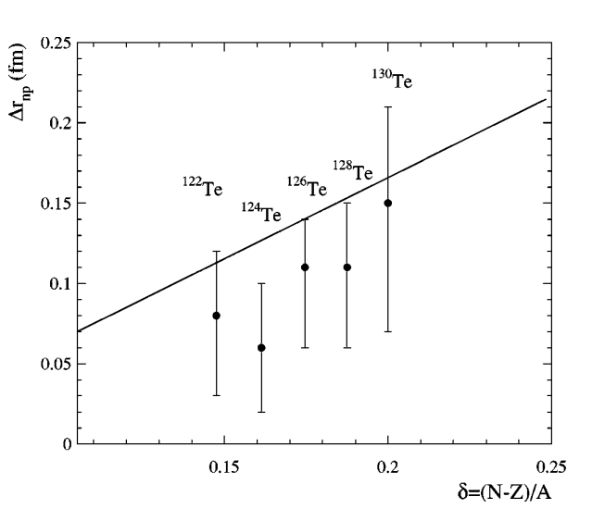
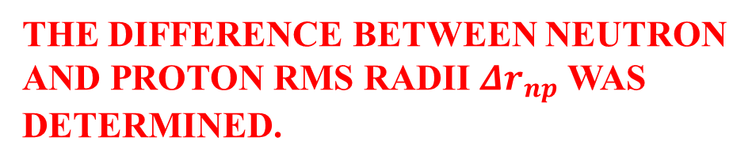
The E2 Nuclear Resonance in Kaonic atoms
The measured level shifts (ε) and widths (Γ) of the energy levels n=6,4 in even-A kaonic molibdenum isotopes allowed the investigation toward the neutron density in nuclear periphery.
AS PERFORMED IN ANTIPROTONIC TE ISOTOPES
Neutron and proton distribution in the Te nuclei were described with two-parameter Fermi model.
The rms neutron radius was adjusted through experimental data.
THE DIFFERENCE BETWEEN NEUTRON AND PROTON RMS RADII $Δr_{np}$ WAS DETERMINED.
B. Klos, S. Wycech et al., PHYS. REV. C 69, 044311 (2004)

Slide 22


Double β decay in Mo-98 and Mo-100 isotopes
Double beta (ββ) decay is a nuclear process in which two neutrons turn in two protons (or vice versa) and two electrons are emitted.
STANDARD double-beta decay:
$${}_{42}^{98}{Mo→{}_{44}^{98}{Ru}+e^{−}+e^{−}+2\overline{ν_{e}}}$$
Lepton number conserved
$${}_{42}^{100}{Mo→{}_{44}^{100}{Ru}+e^{−}+e^{−}+2\overline{ν_{e}}}$$
Neutrinoless double-beta decay:
$${}_{42}^{98}{Mo→{}_{44}^{98}{Ru}+e^{−}+e^{−}}$$
VIOLATION OF LEPTON NUMBER CONSERVATION LAW
$${}_{42}^{100}{Mo→{}_{44}^{100}{Ru}+e^{−}+e^{−}}$$
Neutrinoless double-beta decay is only possible if neutrino is a Majorana particle
The ββ-decay nuclear matrix elements can be calculated using two different theory frameworks: proton-neutron quasiparticle random phase approximation (pnQRPA) and microscopic interacting boson model (IBM-2)
These model depends on the relative distance between the two neutron decays, which is estimated to be:
The measurement of a more precise rms neutron radius in kaonic Mo isotpes could provide further constrains to define relative distance among neutrons in ${}_{42}^{98}{Mo}$ and ${}_{42}^{100}{Mo}$

Slide 23
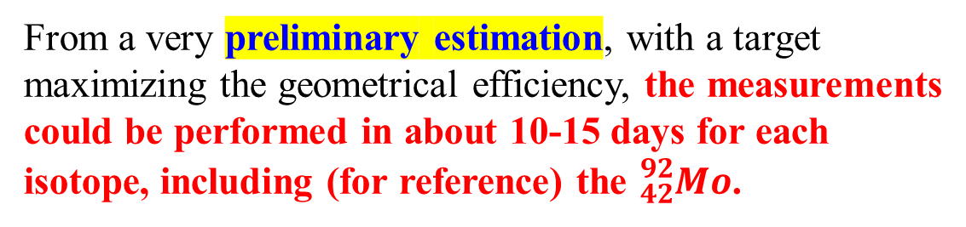
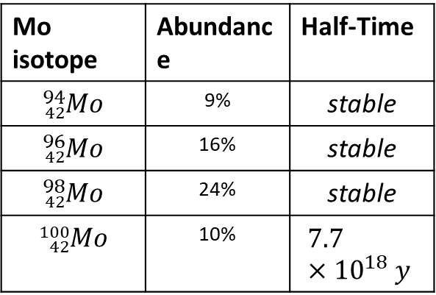
EXPERIMENTAL PROPOSAL: KAMEO
Kaonic Atoms Measuring nuclear resonance Effects Observables
The measurement of Nuclear resonance E2 effects in Molybdenum kaonic isotopes could be performed during the SIDDHARTA-2 data taking period, exploiting the horizontal emitted kaons with dedicated targets and a Germanium detector.
Target parameters will be test with a Monte Carlo Simulation.
Mo isotope | Abundance | Half-Time
$${}_{42}^{94}{Mo}$$ | 9% | stable
$${}_{42}^{96}{Mo}$$ | 16% | stable
$${}_{42}^{98}{Mo}$$ | 24% | stable
$${}_{42}^{100}{Mo}$$ | 10% | $$7.7×{10}^{18} y$$
From a very preliminary estimation, with a target maximizing the geometrical efficiency, the measurements could be performed in about 10-15 days for each isotope, including (for reference) the ${}_{42}^{92}{Mo}$.
Molibdenum solid target

Slide 24
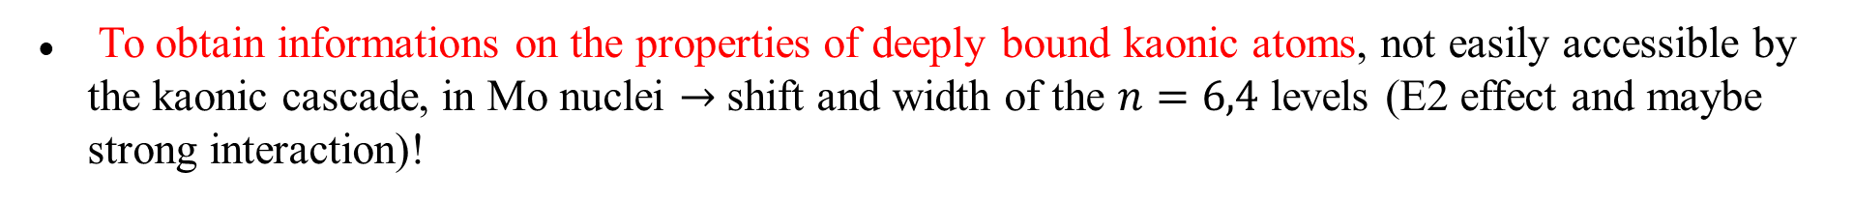
Scientific Relevance of KAMEO
To obtain informations on the properties of deeply bound kaonic atoms, not easily accessible by the kaonic cascade, in Mo nuclei $→$ shift and width of the $n=6,4$ levels (E2 effect and maybe strong interaction)!
In $K^{−}−{}_{42}^{98}{Mo}$ the attenuation coefficient (α) due to the nuclear resonance effect can be measured with higher precision.
The α coefficient can be measured in ${}_{42}^{94}{Mo}$, ${}_{42}^{96}{Mo}$ and ${}_{42}^{100}{Mo}$ for the first time, providing new reference value for theorical models.
The comparison of measurements in ${}_{42}^{94}{Mo}$, ${}_{42}^{96}{Mo}$, ${}_{42}^{98}{Mo}$ and ${}_{42}^{100}{Mo}$ could reveal new properties of strong kaon-nucleon interaction (also ${}_{44}^{96}{Ru}$).
The search for isotope effects in the level shift (ε) and width (Γ) would reveal sign of changes in the nuclear periphery when pair of neutrons are added to the lighest isotope (${}_{42}^{94}{Mo}$)
To study nuclear distribution in ${}_{42}^{98}{Mo}$ and ${}_{42}^{100}{Mo}$, providing important details to investigate neutrinoless double beta (0νββ) and two-neutrino double beta decay (2νββ)

Slide 25





THANK YOU FOR YOUR ATTENTION!!!
$${}_{42}^{94}{Mo}$$
$${}_{42}^{96}{Mo}$$
$${}_{42}^{98}{Mo}$$
$${}_{42}^{100}{Mo}$$

Slide 26
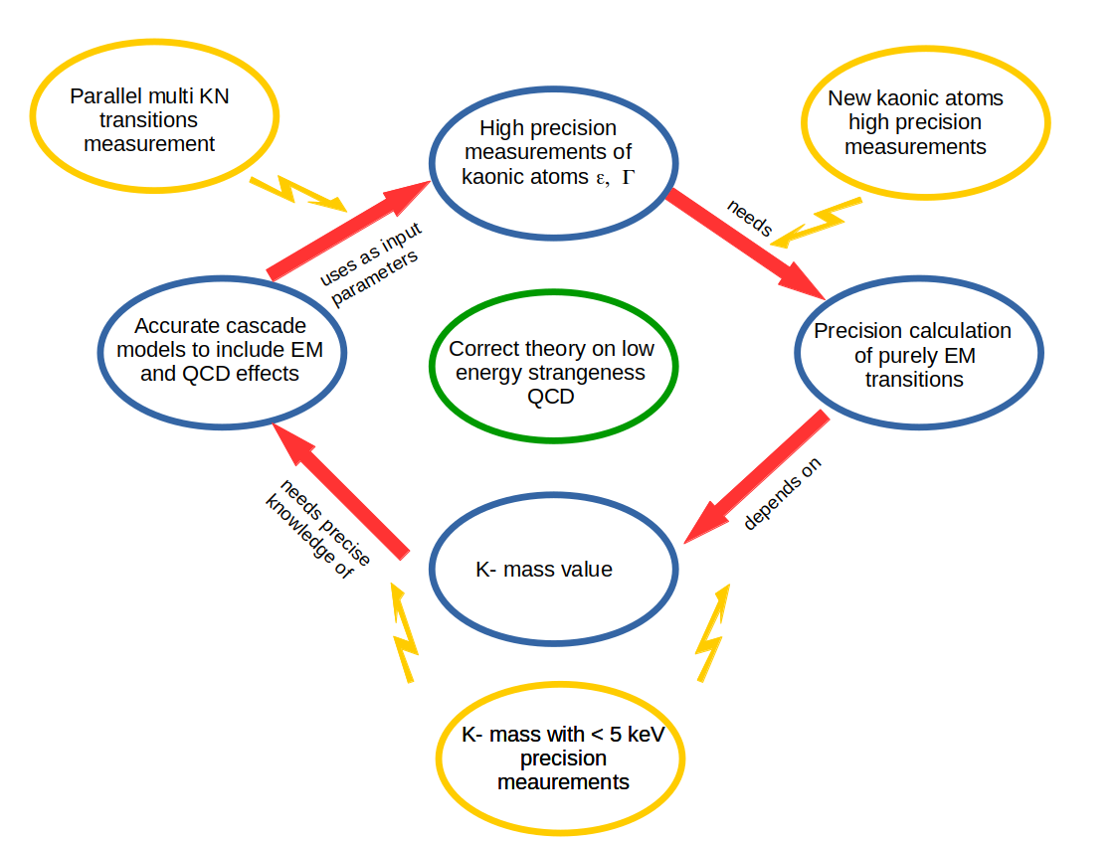
What more can we learn from new measurements?

