Slide 1





Fission decay modes of ²⁵⁴Fm* compound nucleus formed in ¹⁶O+²³⁸U reaction
European Nuclear Physics Conference 2022
(EuNPC 2022))
@ University of Santiago de Compostela,
Santiago de Compostela, Spain, October 24-28, 2022
By:
Amandeep Kaur
Postdoctoral Researcher
Department of Physics, Faculty of Science,
University of Zagreb, Bijenička c. 32,
10000 Zagreb, Croatia
Email address: akaur.phy@pmf.hr, amanganday@gmail.com

Slide 2
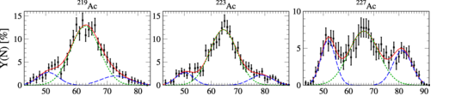
Introduction
Importance of Nuclear fission:
Generation of energy
Stability of superheavy nuclei
Termination of the r-nucleosynthesis process
Generation of exotic nuclear isotopes that are useful in many industrial and medical applications.
²²⁵Ra-²²⁸Ac nuclei exhibit two fission modes : symmetric and asymmetric.
A. Chatillon et al., PRC 106, 024618 (2022)
E. Konecky et al., PLB 45, 329 (1973)

Slide 3
Introduction
Importance of Nuclear fission:
Generation of energy
Stability of superheavy nuclei
Termination of the r-nucleosynthesis process
Generation of exotic nuclear isotopes that are useful in many industrial and medical applications.
²²⁵Ra-²²⁸Ac nuclei exhibit two fission modes : symmetric and asymmetric.
Generally, actinides are known to have an asymmetric fission pattern.
K. Mahata et al., PLB 825, 136859 (2022)

Slide 4
Introduction
Importance of Nuclear fission:
Generation of energy
Stability of superheavy nuclei
Termination of the r-nucleosynthesis process
Generation of exotic nuclear isotopes that are useful in many industrial and medical applications.
²²⁵Ra-²²⁸Ac nuclei exhibit two fission modes : symmetric and asymmetric.
Generally, actinides are known to have an asymmetric fission pattern.
The first observation of a transition from asymmetric (double humped) to symmetric
spontaneous fission has been measured in the region of mass A=254-258 of Fm isotopes.
Y. Miyamoto et al., PRC 99, 051601(R) (2019)

Slide 5
Introduction
Importance of Nuclear fission:
Generation of energy
Stability of superheavy nuclei
Termination of the r-nucleosynthesis process
Generation of exotic nuclear isotopes that are useful in many industrial and medical applications.
²²⁵Ra-²²⁸Ac nuclei exhibit two fission modes : symmetric and asymmetric.
Generally, actinides are known to have an asymmetric fission pattern.
The first observation of a transition from asymmetric (double humped) to symmetric
spontaneous fission has been measured in the region of mass A=254-258 of Fm isotopes.
Similar type of observations has been seen in the case of ²⁵⁴Es nucleus.
M. D. Usang et al., Sci. Rep. 9, 1525 (2019).

Slide 6
Introduction
Importance of Nuclear fission:
Generation of energy
Stability of superheavy nuclei
Termination of the r-nucleosynthesis process
Generation of exotic nuclear isotopes that are useful in many industrial and medical applications.
²²⁵Ra-²²⁸Ac nuclei exhibit two fission modes : symmetric and asymmetric.
Generally, actinides are known to have an asymmetric fission pattern.
The first observation of a transition from asymmetric (double humped) to symmetric
spontaneous fission has been measured in the region of mass A=254-258 of Fm isotopes.
Similar type of observations has been seen in the case of ²⁵⁴Es nucleus.
M. D. Usang et al., Sci. Rep. 9, 1525 (2019).
Aim of this Work
To analyze the spontaneous fission decay modes of Fm isotopes.
To see the role of compact (side-to-side) and elongated (tip-to-tip) oriented configurations on the fission decay dynamics.
To investigate the possibility of multimodal fission of ²⁵⁴Fm* nucleus formed in ¹⁸O+²³⁸U reaction.
To study the impact of the excitation energy E* on the fission fragment mass distribution of ²⁵⁴Fm.

Slide 7



Methodology
Preformed cluster model [PCM ($ℓ$=0$ℏ$, T=0)] and Dynamical cluster-decay model [DCM ($ℓ\text{≠}$0$ℏ$, T≠0)]]
Based on quantum mechanical fragmentation theory (QMFT), which considers mass (or charge) asymmetry coordinate as a dynamical coordinate to study the mass (or charge) transfer in a nuclear decay process, PCM and DCM approach have been developed.
Mass and charge asymmetry
parameters
Mass asymmetry parameter allows a unified description of a few-nucleon or multi-nucleon (a cluster) transfer and a large-mass transfer.
For Complete fusion
For symmetric fission
For asymmetric and super asymmetric fission
J. Maruhn, W. Greiner, Phys. Rev. L Vol. 32, no. 10, 548 (1974).
R. K. Gupta et al., Phys. Rev. L Vol. 35, no. 6, 375 (1975).

Slide 8
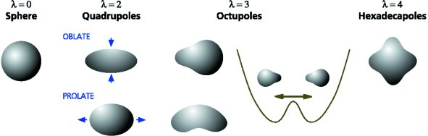
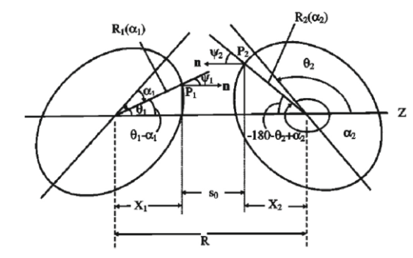
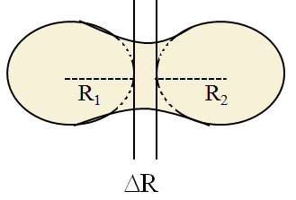

Methodology
Preformed cluster model [PCM ($ℓ$=0$ℏ$, T=0)] and Dynamical cluster-decay model [DCM ($ℓ\text{≠}$0$ℏ$, T≠0)]]
Based on quantum mechanical fragmentation theory (QMFT), which considers mass (or charge) asymmetry coordinate as a dynamical coordinate to study the mass (or charge) transfer in a nuclear decay process, DCM approach has been developed.
Mass and charge asymmetry
parameters
The deformation co-ordinates
β_{λi} (λ =2,3,4.. and i=1,2)
fragments.
The orientation degrees of freedom θ_{i} (i=1,2) of the deformed fragments.
Relative separation (R).
J. Maruhn, W. Greiner, Phys. Rev. L Vol. 32, no. 10, 548 (1974).
R. K. Gupta et al., Phys. Rev. L Vol. 35, no. 6, 375 (1975).

Slide 9
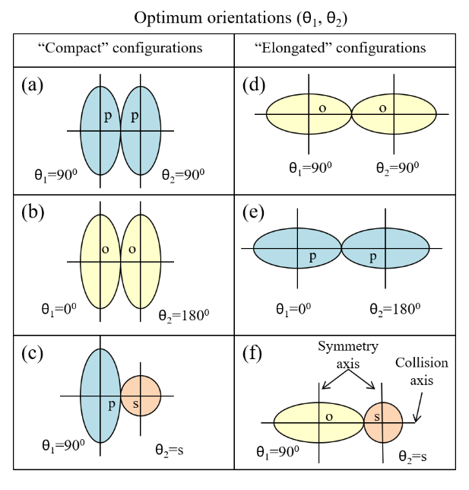
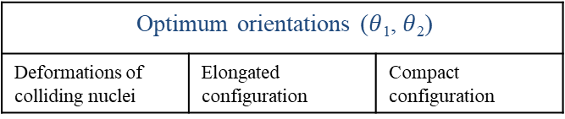
Compact and elongated configurations
The orientation degrees of freedom θ_{i} (i=1,2) of the β₂-deformed fragments.
Optimum orientations ($θ$₁, $θ$₂)
Deformations of colliding nuclei | Elongated configuration | Compact configuration
p - prolate
o - oblate
s - spherical
± - Hexadecupole
R. K. Gupta and W. Greiner et al.,
J. Phys. G: Nucl. Part. Phys. 31, 631 (2005).
A pictorial representation of compact (a)–(c) and elongated (d)–(f) configurations for prolate (p), oblate (o), and spherical (s) shapes of nuclei.
V(R)=V_{C}+V_{P}

Slide 10
Fragmentation potential
By using these coordinates Schrödinger equation is solved in η coordinate to find preformation probability, P₀
Schrödinger equation
With ν= 0, 1, 2, 3….
where (ν = 0) refers to ground state

Slide 11
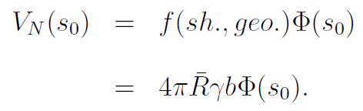
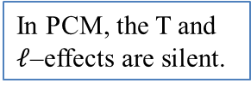
Fragmentation potential
By using these coordinates Schrödinger equation is solved in η coordinate to find preformation probability, P₀
Schrödinger equation
With ν= 0, 1, 2, 3….
where (ν = 0) refers to ground state
The binding energy contains both the macroscopic (liquid drop model) and microscopic (shell-correction) part.
In PCM, the T and $ℓ$–effects are silent.

Slide 12
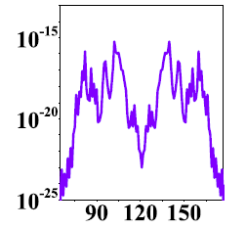
Preformation probability P₀
By using these coordinates Schrödinger equation is solved in η coordinate to find preformation probability, P₀
Schrödinger equation
With ν= 0, 1, 2, 3….
where (ν = 0) refers to ground state
Solution
Preformation
Probability
Preformation probability P₀
Fragment mass A_{i} (i=1,2)

Slide 13
Spontaneous fission of Fm isotopes with mass A=242-260
Using PCM..
Compact
Relative separation R increases
Spherical
Elongated
Amandeep Kaur et al., Phys. Rev. C 103, 034618 (2021)

Slide 14
Spontaneous fission of Fm isotopes with mass A=242-260
Amandeep Kaur et al., Phys. Rev. C 103, 034618 (2021)

Slide 15
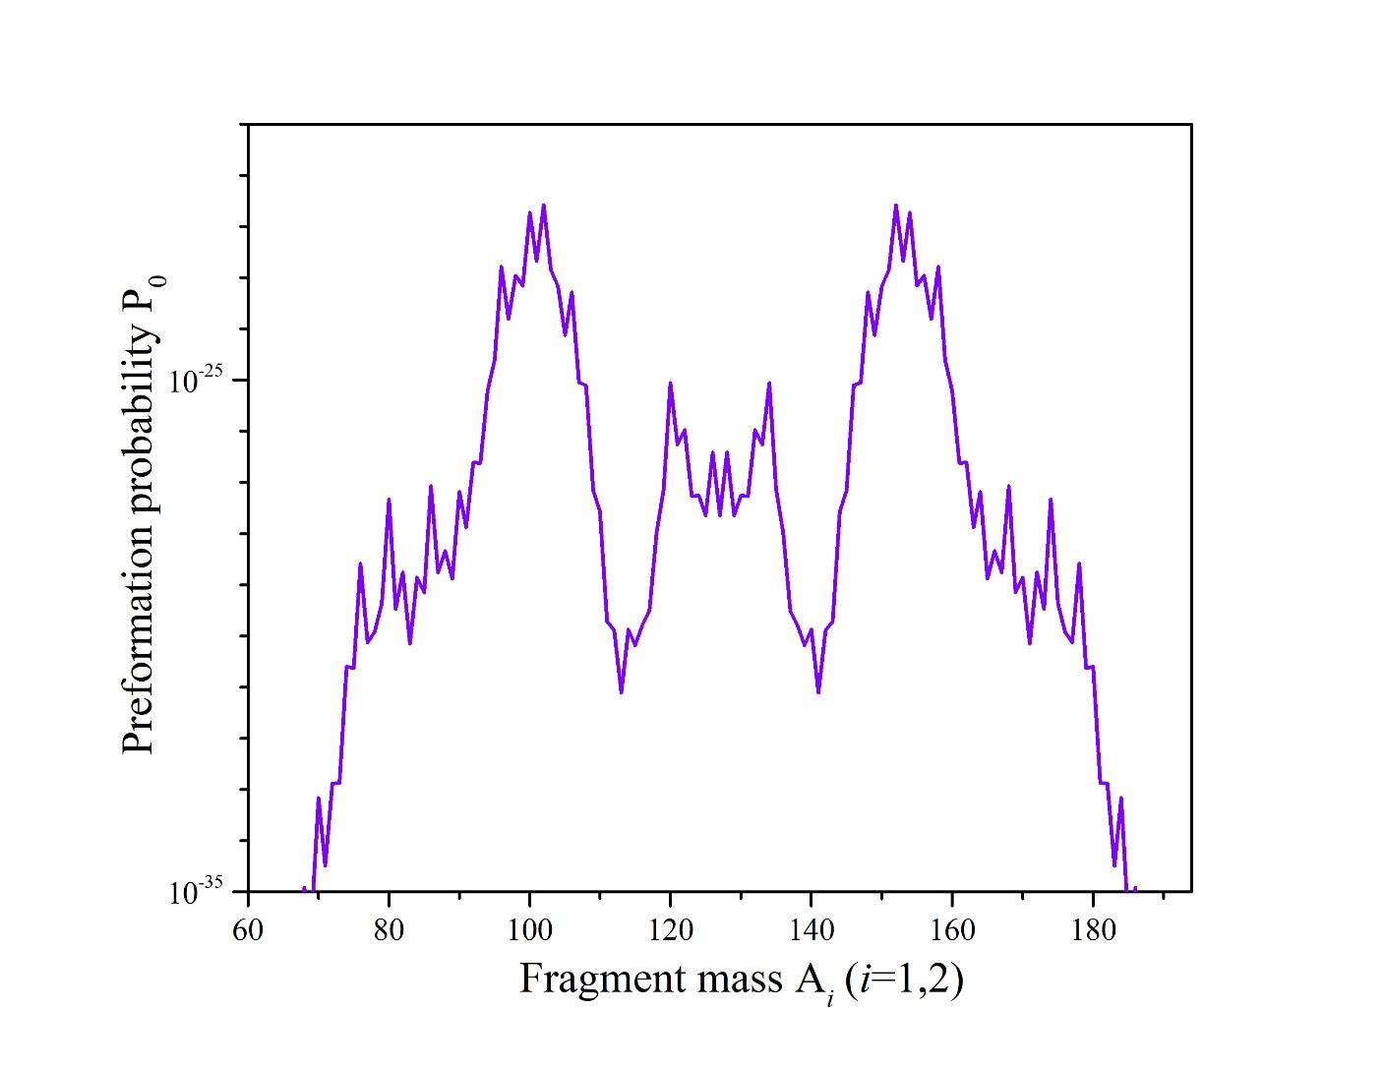
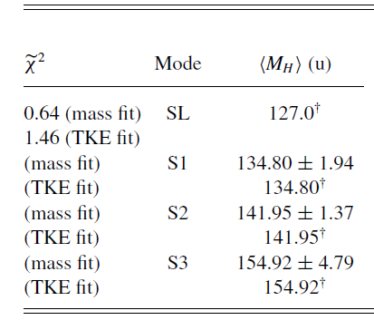
Spontaneous fission of ²⁵⁴Fm
Elongated configurations
A_{H} | β₂(H) | A_{L} | β₂(L)
¹²⁸Sn (Z=50,N=78) | 0.0 | ¹²⁶Sn (Z=50,N=76) | 0.0
¹³⁴Te (Z=52,N=82) | 0.0 | ¹²⁰Cd (Z=48,N=72) | 0.024
¹⁵⁴Nd (Z=60, N=92) | 0.048 | ¹⁰⁰Zr (Z=40, N=62) | 0.064
A_{L}=100,102
A_{H}=152,154
A_{L}=96-106
A_{L}=120,A_{H}=134
A_{H}=148-158
Experimental paper
T. Banerjee et al.,
PRC 105, 044614 (2022)
A_{L}=126,A_{H}=128

Slide 16
Fission decay modes of ²⁵⁴Fm* compound nucleus formed in ¹⁶O+²³⁸U reaction
Preliminary results calculated using DCM
The deformation parameters are also made T-dependent:
β_{λi} (0) = static deformation
T₀ =1.5 MeV at which shell effects start to vanish
β_{λi} (T ) = exp(−T/T₀ )β_{λi}(0),
M. Rashdan, A. Faessler, and W. Waida,
J. Phys. G: Nucl. Part. Phys. 17, 1401 (1991).
Compact
Elongated

Slide 17
Fission decay modes of ²⁵⁴Fm* compound nucleus formed in ¹⁶O+²³⁸U reaction
Preliminary results calculated using DCM
The deformation parameters are also made T-dependent:
β_{λi} (0) = static deformation
T₀ =1.5 MeV at which shell effects start to vanish
β_{λi} (T ) = exp(−T/T₀ )β_{λi}(0),
M. Rashdan, A. Faessler, and W. Waida,
J. Phys. G: Nucl. Part. Phys. 17, 1401 (1991).
Compact
Elongated

Slide 18
Fission decay modes of ²⁵⁴Fm* compound nucleus formed in ¹⁶O+²³⁸U reaction
Preliminary results calculated using DCM
The deformation parameters are also made T-dependent:
β_{λi} (0) = static deformation
T₀ =1.5 MeV at which shell effects start to vanish
β_{λi} (T ) = exp(−T/T₀ )β_{λi}(0),
M. Rashdan, A. Faessler, and W. Waida,
J. Phys. G: Nucl. Part. Phys. 17, 1401 (1991).
Compact
Elongated

Slide 19
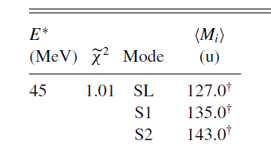
Fission decay modes of ²⁵⁴Fm* compound nucleus formed in ¹⁶O+²³⁸U reaction
Elongated
configuration
Identification of A_{H} and A_{L} fragments
Fission Mode | Heavy mass fission fragment (A_{H}) | Light mass fission fragment (A_{L})
Symmetric Superlong (SL) | ¹²⁷Sn (Z_{H}=50, N_{H}=77) (β₂=0) | ¹²⁷Sn (Z_{L}=50, N_{L}=77) (β₂=0)
 | ¹²⁷Sn (Z_{H}=50, N_{H}=78) (β₂=0) | ¹²⁶Sn (Z_{L}=50, N_{L}=76) (β₂=0)
Asymmetric Standard 1 (S1) | ¹³³Te(Z_{H}=52, N_{H}=81) (β₂=0.001) | ¹²¹Cd (Z_{L}=48, N_{L}=73) (β₂=0.024)
Asymmetric Standard 2 (S2) | ¹⁴⁸Ce (Z_{H}=58, N_{H}=90) (β₂=0.038) | ¹⁰⁶Mo (Z_{L}=42, N_{L}=64) (β₂=0.064)
 | ¹⁵⁴Nd (Z_{H}=60, N_{H}=76) (β₂=0.048) | ¹⁰⁰Zr (Z_{L}=40, N_{L}=60) (β₂=0.064)
SL= two spherical fragments (Z=50)
S1 = one spherical heavy fragment and a deformed light fragment
(Z=50, N=82)
S2 = two moderately deformed fragments (N=60, 88, Z=38)
Experimental paper:
T. Banerjee et al., PRC 105, 044614 (2022)

Slide 20
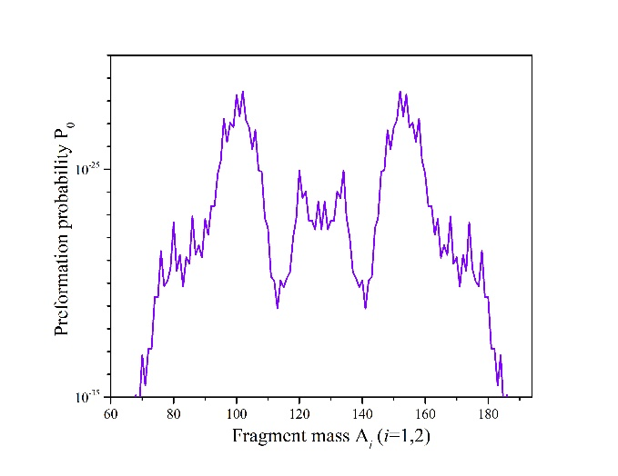
Energy dependence of fission fragment mass distributions
Fusion-fission
Spontaneous fission
²⁵⁴Fm*→A₁+A₂
²⁵⁴Fm→A₁+A₂
A. Kaur et al., PRC 103, 034618 (2021)
Summary
Elongated configurations represent better results in terms of fission fragment mass distributions as compared to the compact orientations.
Spherical/deformed magic shell closures and the excitation energy of compound nucleus play significant role in the division of fissioning nuclei.
It would be interesting to include the pear shaped deformations in the decaying fragments to analyse the possible fission modes of ²⁵⁴Fm* and of other nuclei in this mass region. Also, the TKE of each fission mode will be investigated.

Slide 21



Acknowledgement
This work was supported by the QuantiXLie Centre of Excellence, a project co-financed by the Croatian Government and European Union through the European Regional Development Fund - the Competitiveness and Cohesion Operational Program (Grant KK.01.1.1.01.0004).
For more information please visit:
http://bela.phy.hr/quantixlie/hr/
https://strukturnifondovi.hr/
The sole responsibility for the content of this presentation lies with the Faculty of Science, University of Zagreb. It does not necessarily reflect the opinion of the European Union.

Slide 22
Methodology
Penetrability (P) is calculated by using WKB method as follows:
where R_{a} and R_{b} are the two turning points of WKB integral. R_{a} is defined as
𝑅_{𝑎} = 𝑅₁+R₂+Δ𝑅
In DCM, after getting Preformation and penetrability, for ℓ-partial wave
analysis, the decay cross-sections for each fragmentation is defined as:
Decay Cross-Section (𝞼) in terms of ℓ-partial waves is given as follows:
In PCM, the decay half-life T_{1/2} and the decay constant λ are calculated as
ν₀ is the barrier assault frequency, calculated as

