Slide 1

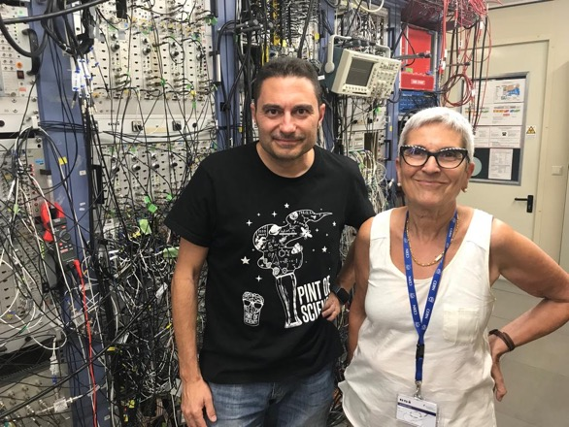
Radiotracers for the study of Marine and Oceanic Ecosystems
Berta Rubio for the REMO project
IFIC
Santiago de Compostela 2022

Slide 2
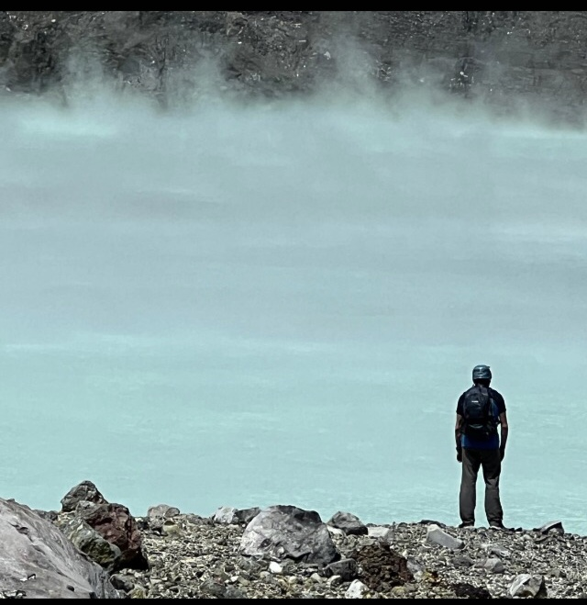
Radiotracers for the study of Marine and Oceanic Ecosystems
Berta Rubio for the REMO project
IFIC
Santiago de Compostela 2022
Enrique Nácher
en Costa Rica

Slide 3
Motivation

Slide 4
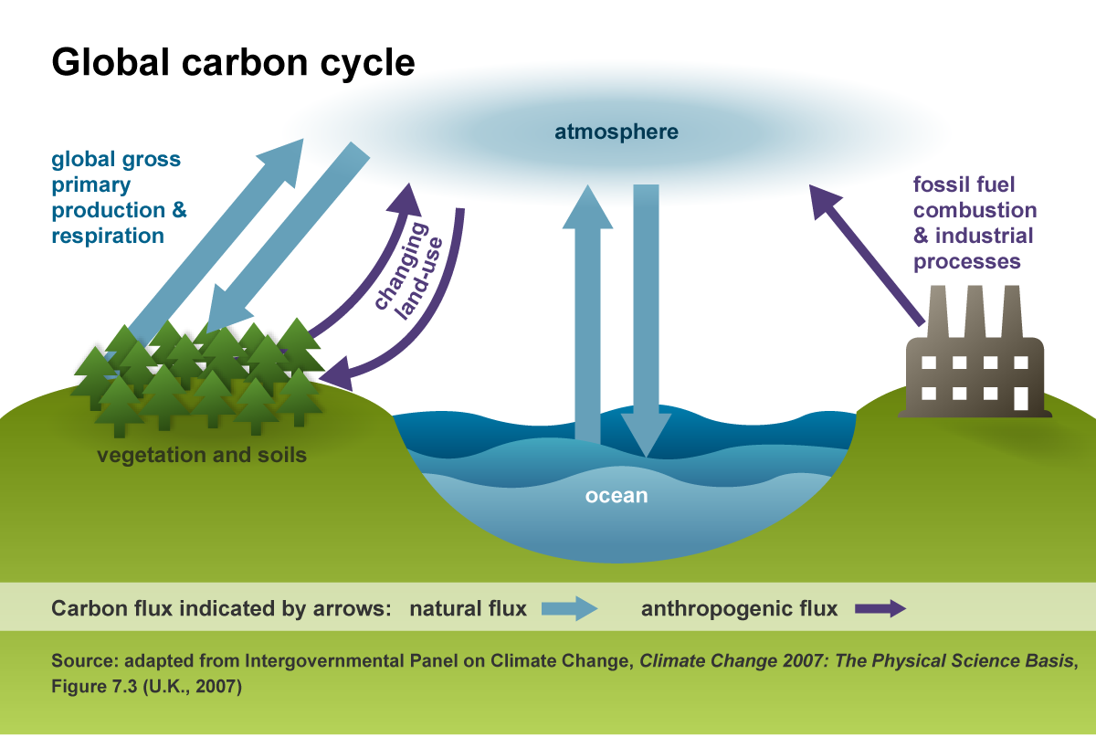
Since the beginning of the industrial revolution, oceans and seas have absorbed about one
third of the carbon dioxide (CO2) released by human activities. This release results in ocean
acidification, often referred to as "the other CO₂ problem", along with global warming.
CO₂
CO₂+H₂O→H₂CO₃
_{Production of Carbonic Acid}
CO₂+2H₂O→CH₂O + O₂+H₂O
(production of carbohidrates)
H₂O

Slide 5
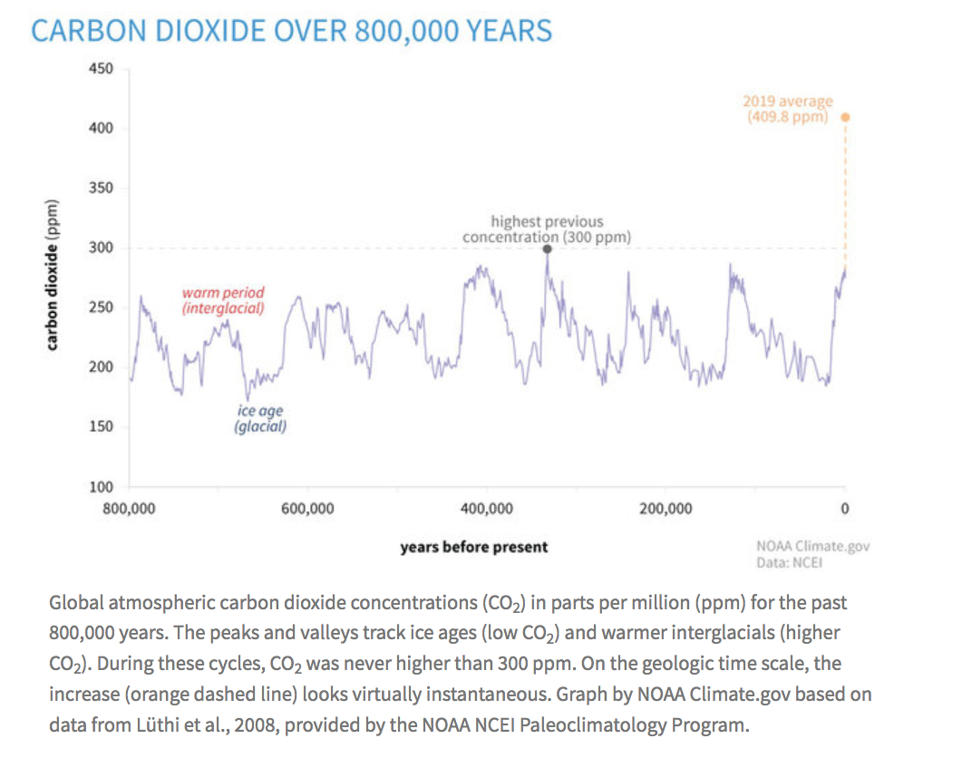

Slide 6
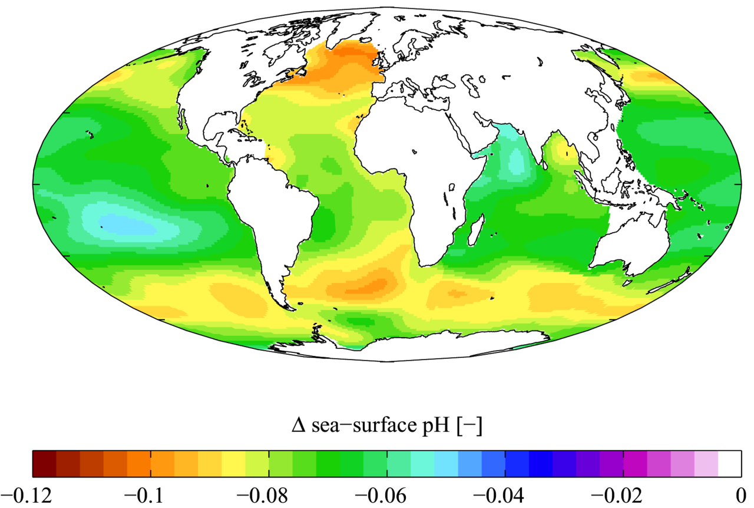
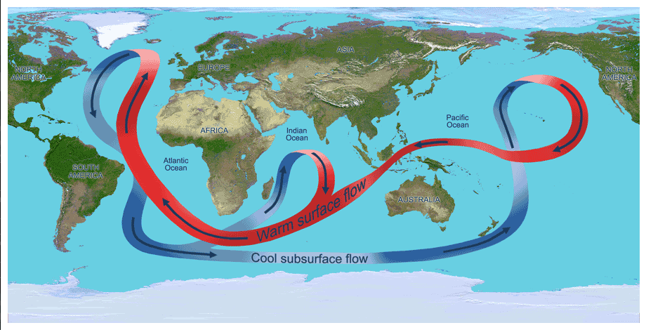
Due to the Oceanic currents,
The increment in acidity affects,
not only the industrialised coasts but
also very remote places such as
the Coral Reefs
Notes:
A recent study expressed a 14% decrease in coral growth in the Great Barrier Reef Australia since 1990, the most significant decrease in coral growth in the last 400 years.

Slide 7
Motivation
Change in acidity:
The increas in accidity can reach 170% compare with pre-industrial times
Velocity of the change:
10 times more than any time before
How this affects the Marine Ecosystem
The REMO project is a tool for diagnosys, it tries to evaluate
how this change in acidity affects the growing of the marine species

Slide 8
REMO Project
Radiotracers for the study of Marine and Oceanic Ecosystems
(Radiotrazadores para el estudio de Ecosistemas Marinos y Oceánicos)
More specifically: we wanted to study the growing of the marine species
and the evolution in time for different acidifiaction conditions of the water
using radiotracers
Starting point: Which species are important and “accessible” to measurements?
Important for food production(economy) or for enviroment
The growing of the species should be adequated to the technique
and the time length of the project (three years)
The spieces should “survive” the measuring procedure (no destruction, no stress)

Slide 9
Which species are important and “accessible” to measurements?
Important for food production(economy) or for enviroment
The growing of the species should be adequated to the technique
and the time length of the project (three years)
The spieces should “survive” the measuring procedure
(no destruction, no stress)

Slide 10
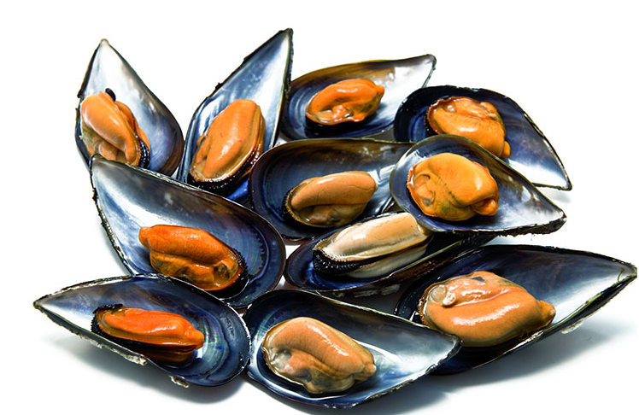
Which species are important and “accessible” to measurements?
Bivalve mollusc are very important for the
Economy of Mediterranean and Atlantic
Countries like Spain: we eat them, export them.
Coral reefs support more species per unit
area than any other marine environment,
including about 4,000 species of fish.

Slide 11
The growing is always incorporating Calcium Carbonate,
CaCO₃, to their skeletons, in both cases is an exoskeleton
How much Calcium they incorparate tell us how much they are growing
The incorporation of calcium is strongly affected by the acidification
The grow goes in the Surface (molusks), or near the Surface (corals)
growing
growing
Notes:
Ocean acidification is caused by rising levels of carbon dioxide in the atmosphere, mostly from burning fossil fuels. The carbon dioxide (CO₂) is absorbed by seawater (H₂O), setting in motion chemical reactions that produce more bicarbonate (HCO₃⁻) and fewer carbonate (CO₃²⁻) ions. Coral polyps—the tiny living soft-bodied coral animals—bring in seawater containing these ions, along with calcium (Ca²⁺) ions, into a “calcifying space” between its cells and the surface of their existing skeletons. They pump hydrogen ions (H⁺) out of this space to produce more carbonate ions (CO₃²⁻) ions that bond with (Ca²⁺) ions to make calcium carbonate (CaCO₃) for their skeletons. Because there are more HCO₃⁻ ions but fewer CO₃²⁻ ions in acidified seawater, the corals have to expend more energy to pump out H⁺ ions from their calcifying space to build skeletons.

Slide 12
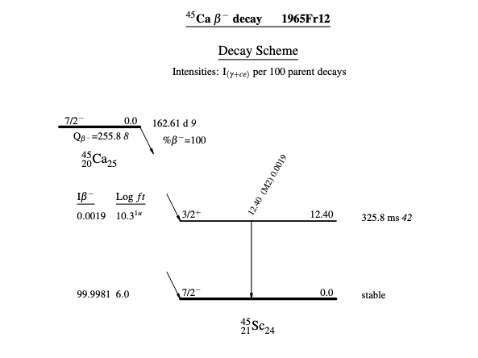
Radiotracer: ⁴⁵Ca
⁴⁵Ca(halflife 163 days)→45Sc (stable) + β particle (electron, up to 256 keV )
The idea is to develop
nuclear instrumentation
Capable to measure
β-particles of approximately 150 keV
located near the surface
of mollusc and corals in a
non-destructive way,
and to study the growing
along the time (1-2 years)

Slide 13

How?
Water enriched
in 45Ca
The aquarium
Ecosystems will be intalled
at Oceanographic
In Valencia
PH 8,1(present)
PH 8,1(present)
Mediterranean
Tropical
PH 7,5 (year 2100, if we do nothing!!)
PH 7,5 (year 2100, if we do nothing!!)

Slide 14
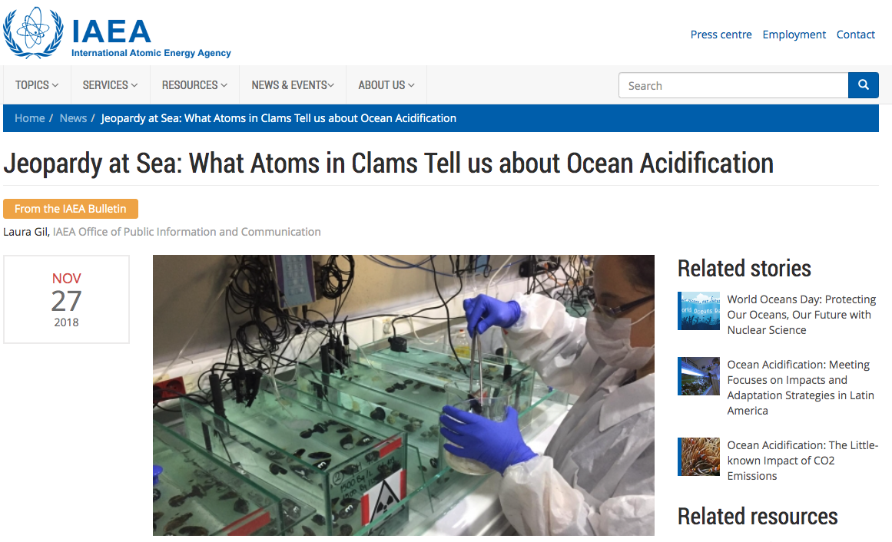
In there a previous experience?
Yes, but the technique I destructive

Slide 15
Our way to measure
Should not destroy the animal

Slide 16
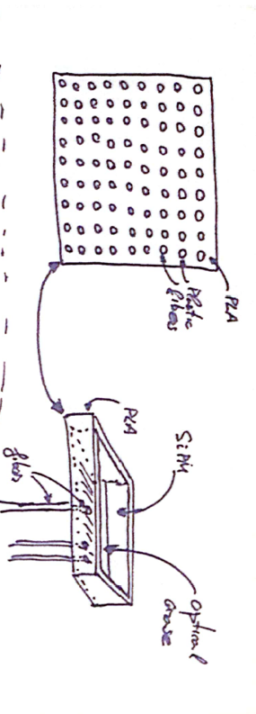
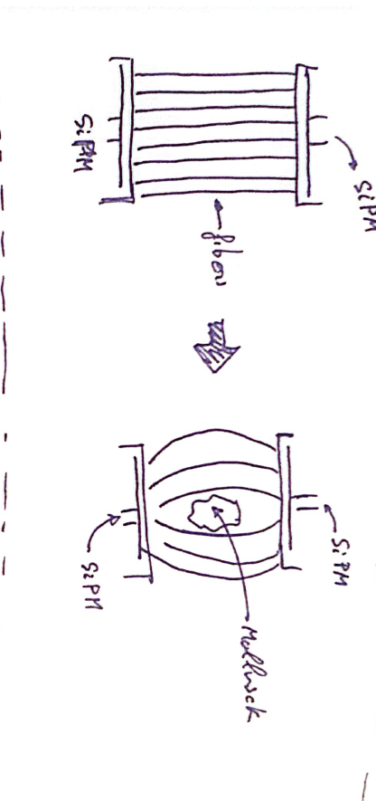
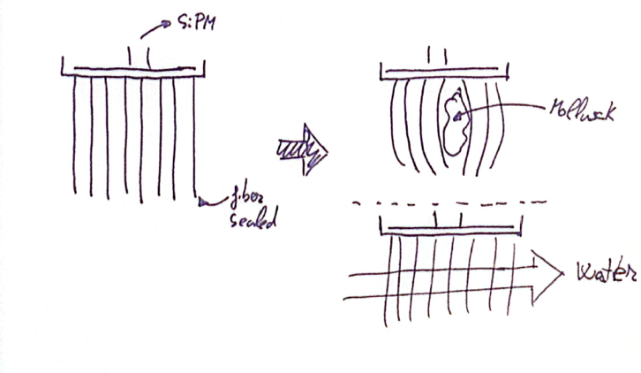
Detector 1: scintillating fibers
2 SiPM+ fibers
1 SiPM+ fibers
Courtesy Javier Balibrea

Slide 17
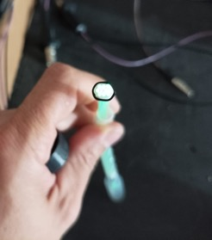
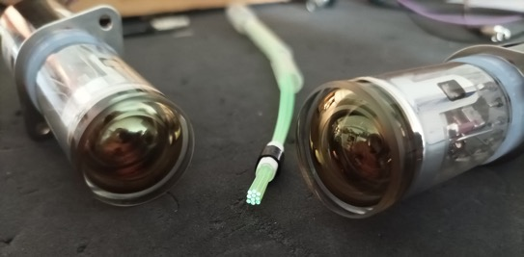
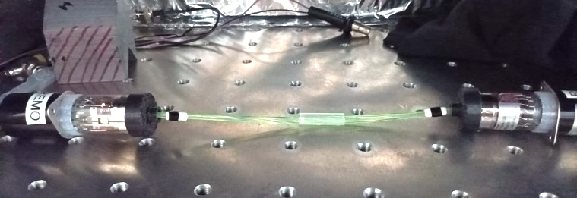
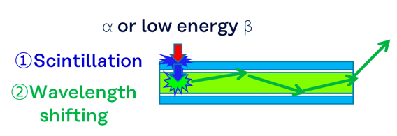
Detector 1: Scintillating optical fibers
Direct coupling to a PM or
We have aquired 3 typen of fibers of Kuraray: SCFS de 0.5 y 1.0 mm, OLS de 1.0 mm (non comertial)
Tests with radioactive sources of 45Ca at IFIC, and with electrons at CIEMAT

Slide 18

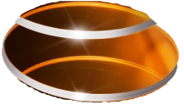
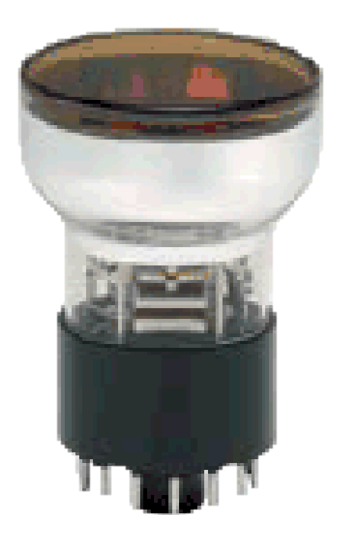
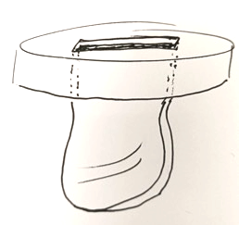
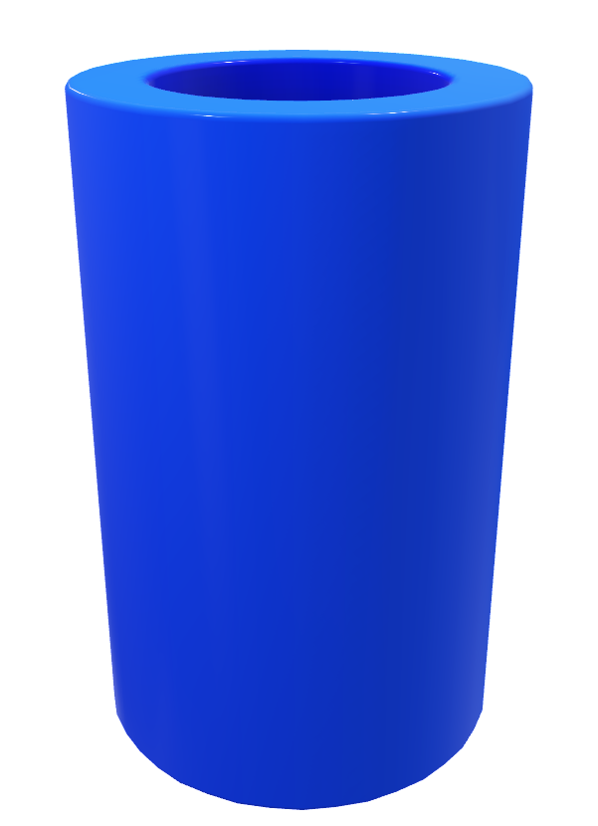
Detector 2: Vessel with liquid scintillator
Coktail
de centelleo
Same idea as standard Liquid Scintillation Counter, but “custom made” to keep the animal alive.
  Bigger vessel
  Ptotection for the animal
Quarz window
PMT

Slide 19
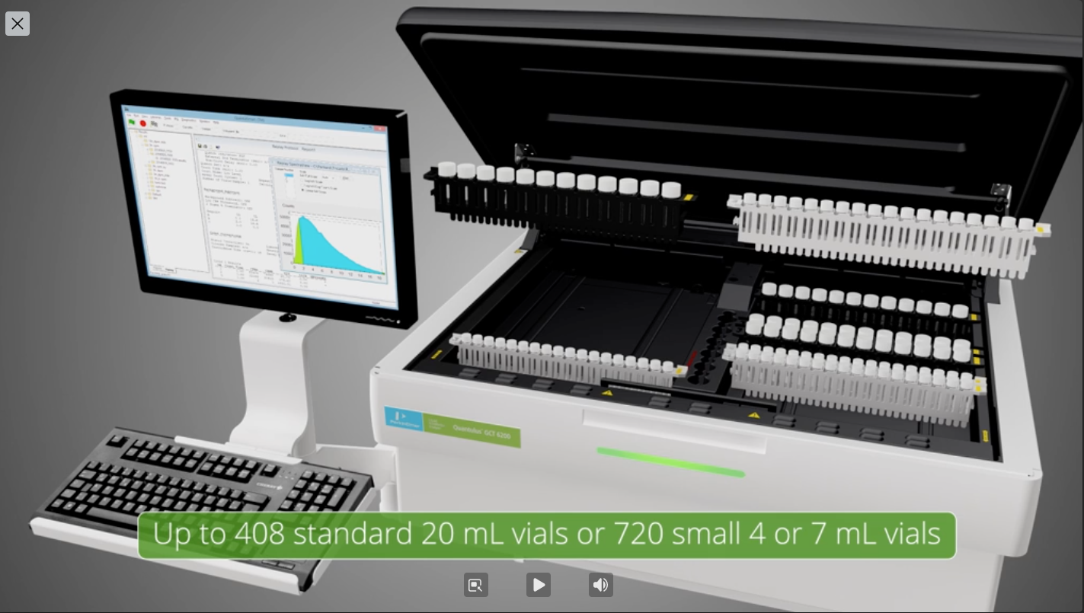
Cross check with standard (destructive) techniques available at LARAMM (Uni. Valencia)
TRI-CARB Liquid Scintillation Counter

Slide 20

Opportunity
EU Resilence funds in Spain:
(1) Biotecnología aplicada a la salud,
(2) Ciencias Marinas,
(3) Comunicación cuántica,
(4) Energía e hidrógeno renovable,
(5) Agroalimentación,
(6) Astrofísica y física de altas energías,
(7) Materiales avanzados y
(8) Biodiversidad.

Slide 21
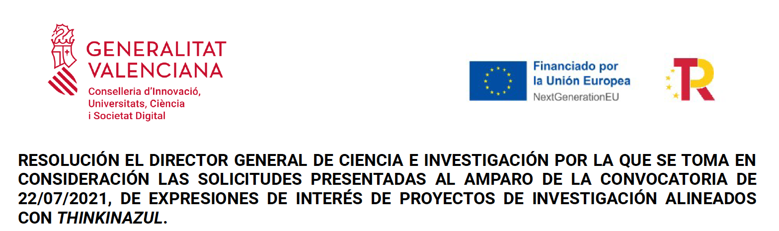
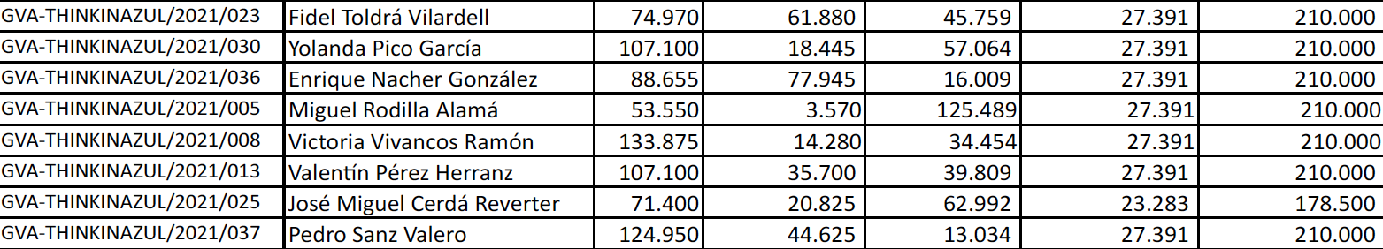

Slide 22
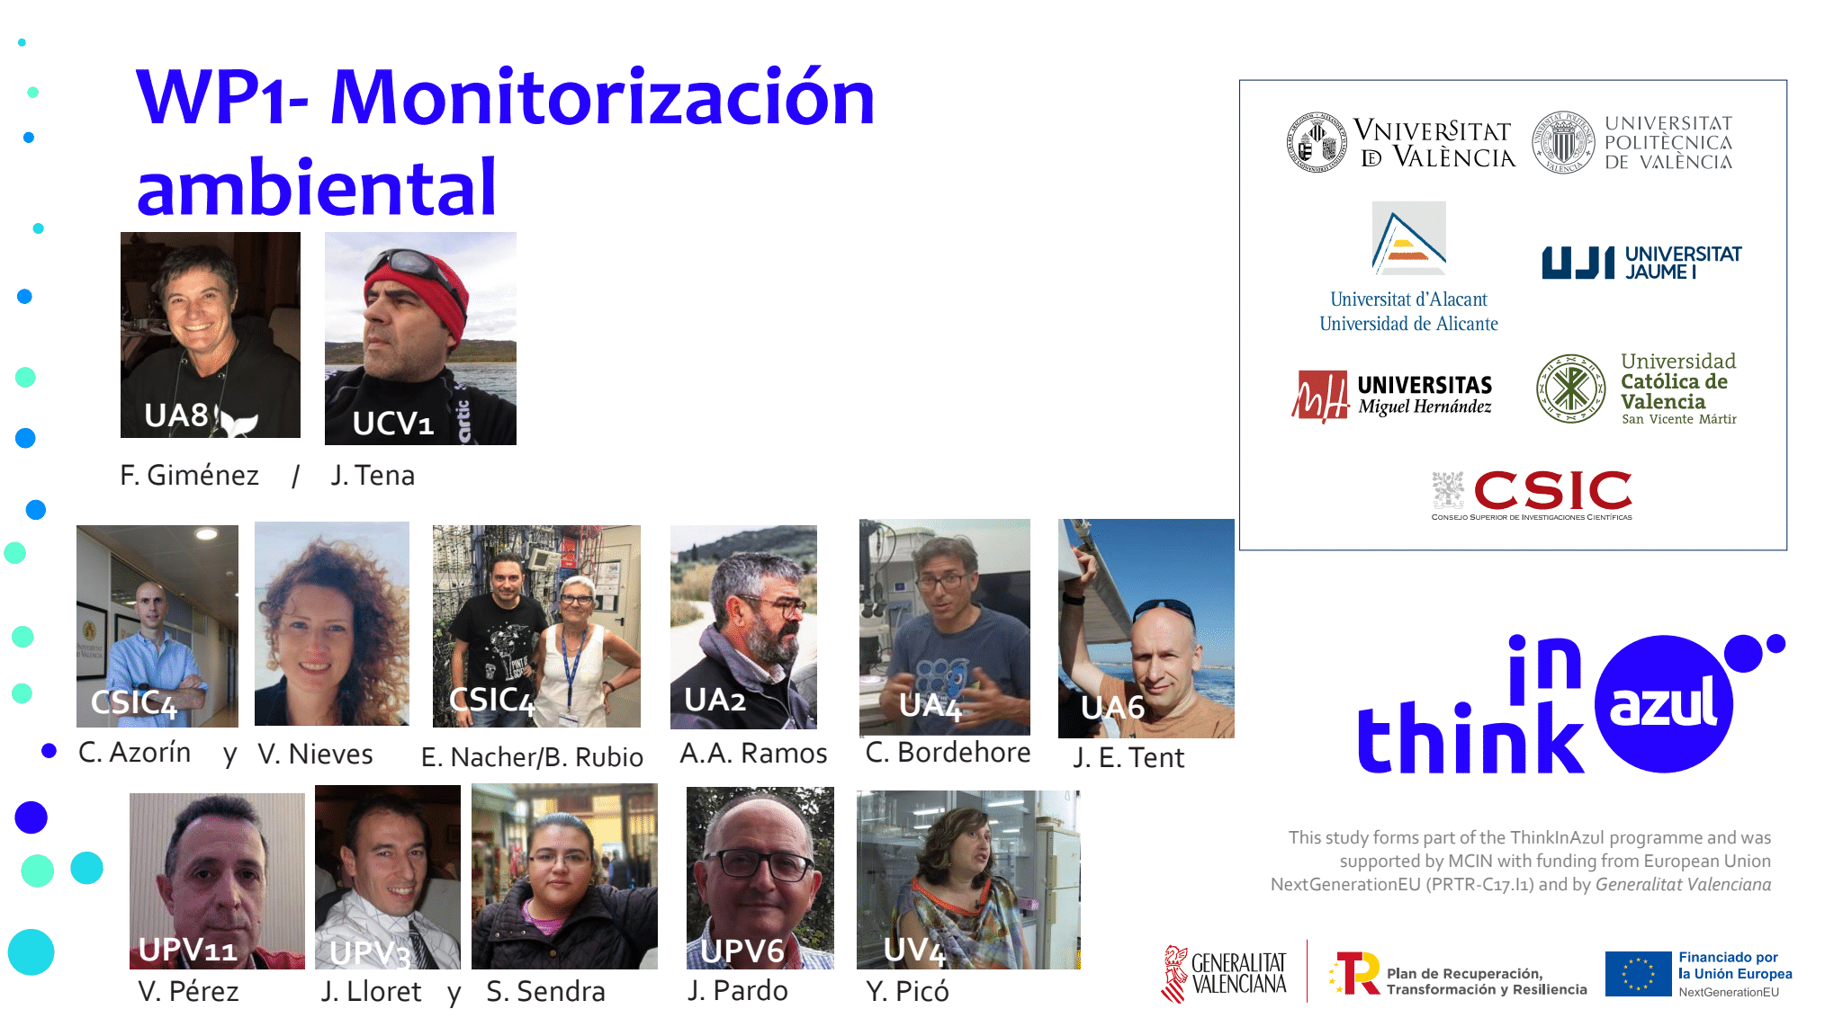
Enviroment
monitoring
From F. Giménez, Uni. Alicante, Kickoff meeting, Torre de la Sal, 27 de junio2022

Slide 23
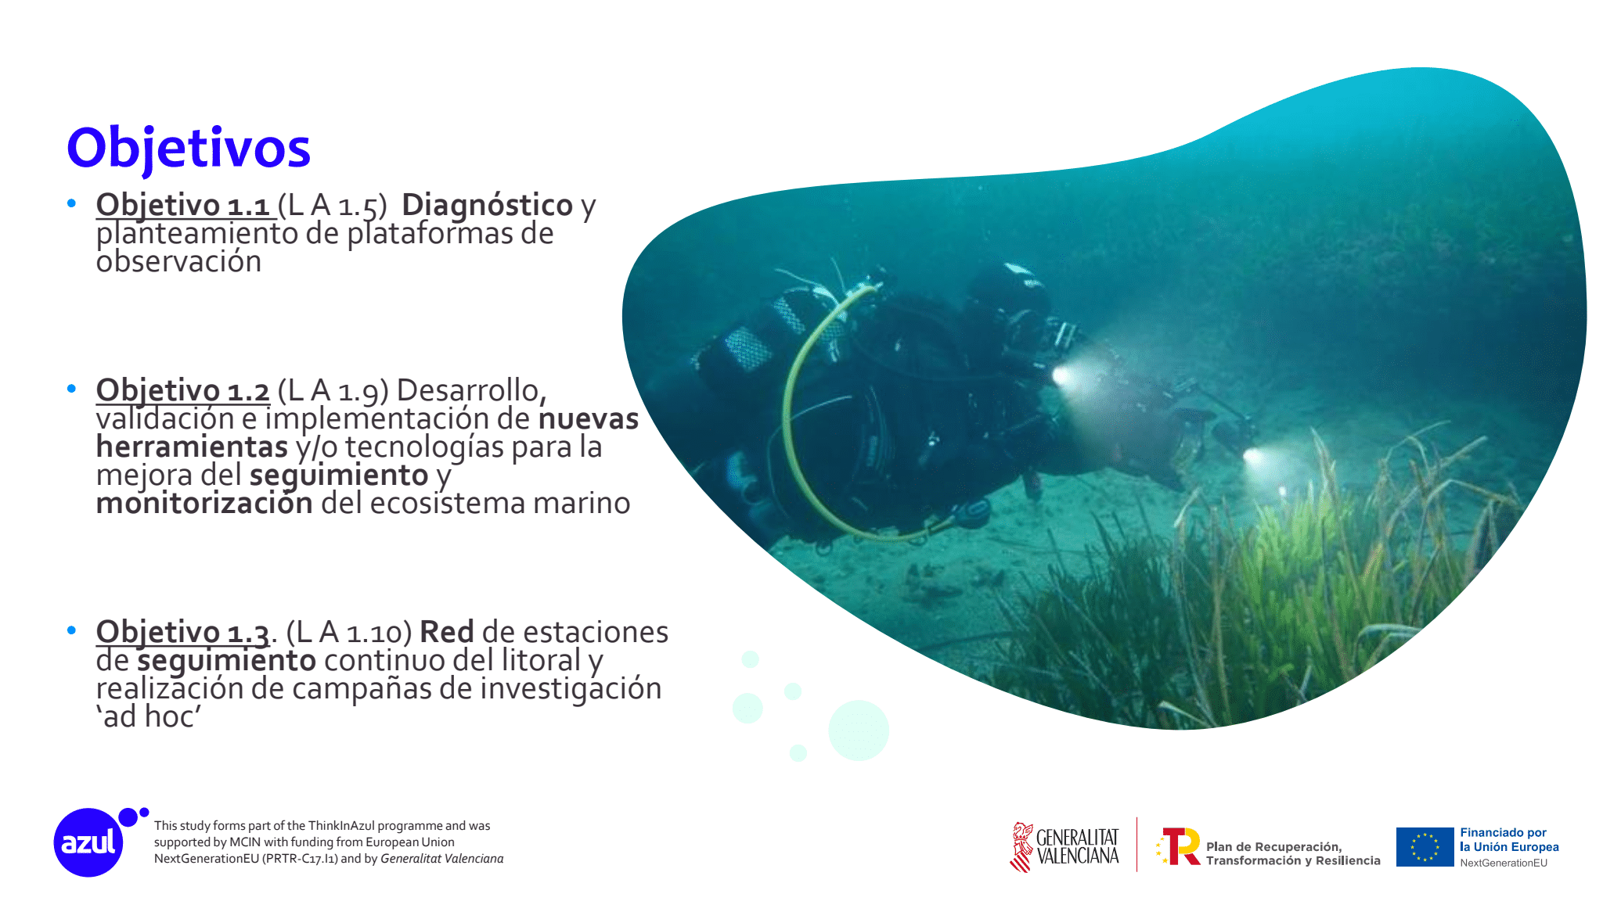
1. Diagnosis
2. New instrumentation for monitoring
3. Coast vigilance: networking
From F. Giménez, Uni. Alicante, Kickoff meeting, Torre de la Sal, 27 de junio2022

Slide 24
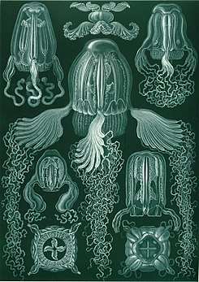
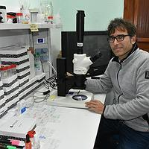
Cesar Borehore,
Uni. Alicante,
Specialised in
Box Jellyfish or Cubozoa

Slide 25
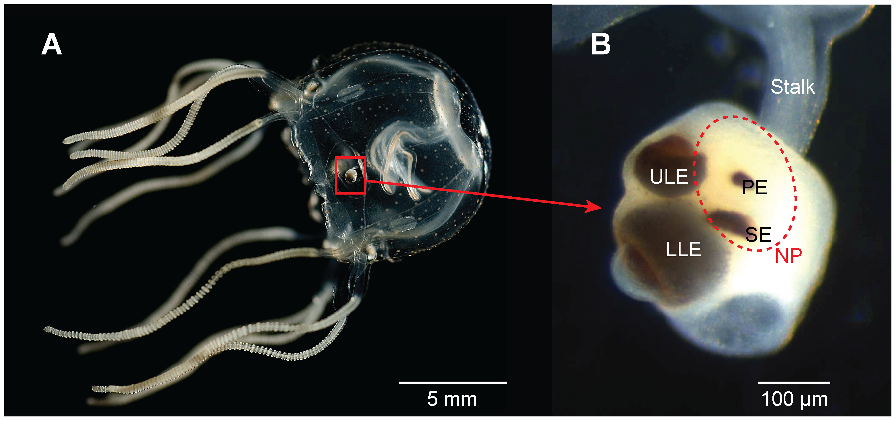
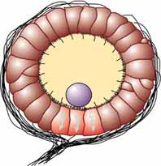
Cube jellyfish have 24 eyes, 4 of them true eyes, looking up, down and to the interior.
Near each true eye ther is a statocyst, a balance and
Accelerometer sensor based on gravity.
The statocyst is formed of Calcium Sulfate, CaSO₄

Slide 26
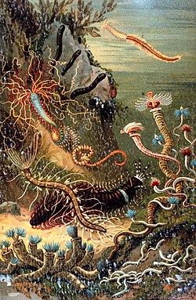
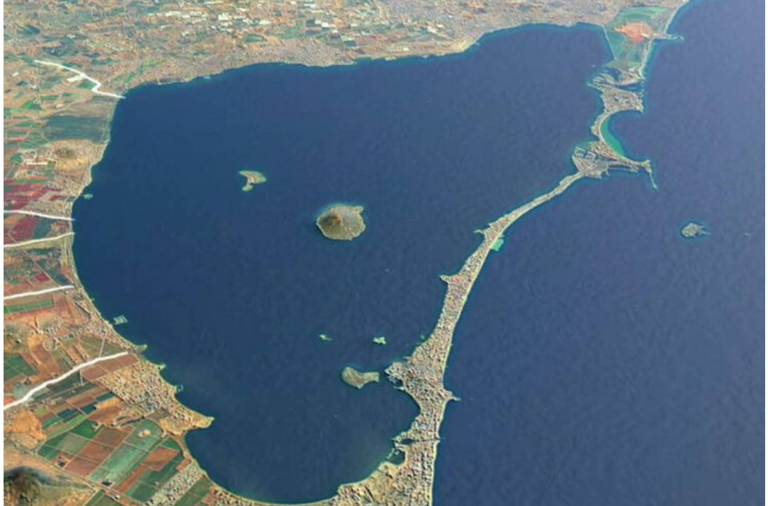
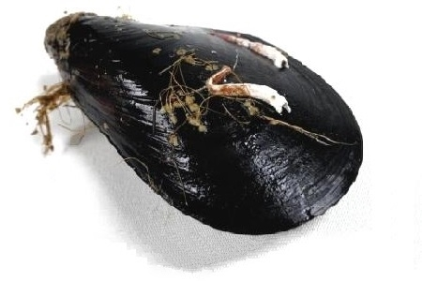
polychaete
They help keeping
the soil in good condition, by filtering the water
And fixing Ca at an incredible speed.
They are part of the food chain,
and can even be bioindicators of
environmental disturbances.
It is important to study the fixing of Ca under different
environmental conditions
https://www.frontiersin.org/articles/10.3389/fmars.2020.531726/full

Slide 27
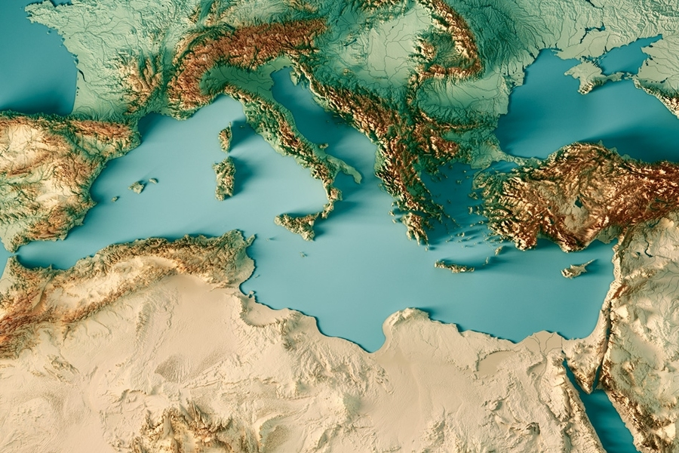
Conclusion:
REMO is a fruitful Interdisciplinary collaborative project
At present is a financed proof of concept
If successful, it could be extended to other marine ecosystems
Perhaps to a vigilance networking along the coast
To have this knowhow in Spain will be very useful
Daniel García
José Luis Crespo,
Mario Roche
Roi Lata
Andrea Spinelli
Enrique Nácher
Berta Rubio
Javier Balibrea
Jorge Lerendegui
Ion Ladarescu
Giacomo de Angelis
Luisa Conte
Giovanna Montagnoli
(Uni. Padova)
Carlos Saavedra
David Cordero

Slide 28
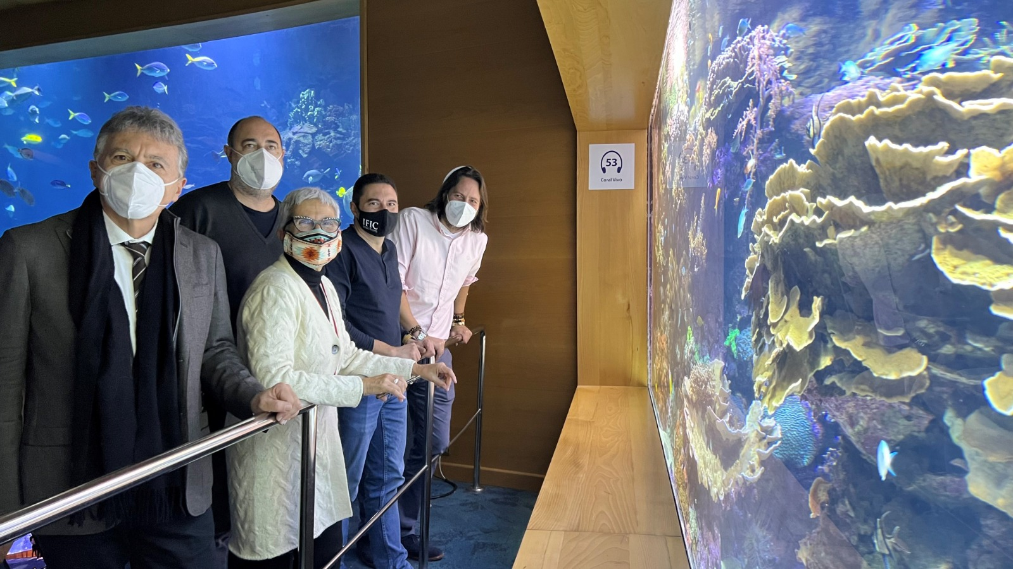
Thank you for your attention

