Slide 1


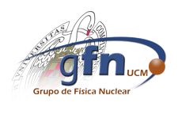
Contribution of meson exchange currents to the lepton-nucleus interaction within a relativistic mean-field model
T. Franco-Munoz, R. González-Jiménez and J.M. Udías
European Nuclear Physics Conference 2022
25/10/2022
Tania Franco Muñoz

Slide 2
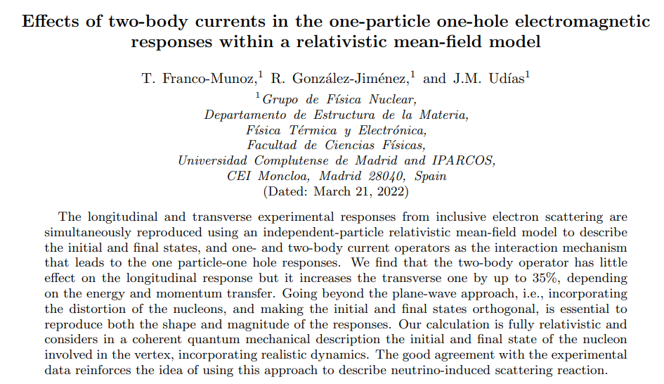
Reference paper
https://doi.org/10.48550/arXiv.2203.09996
Tania Franco Muñoz

Slide 3
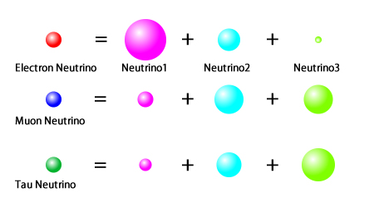
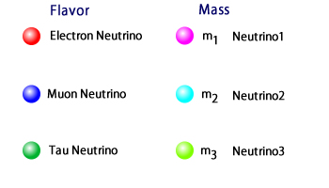
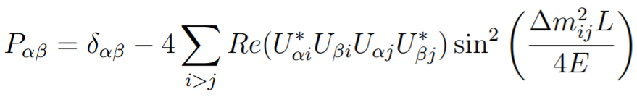
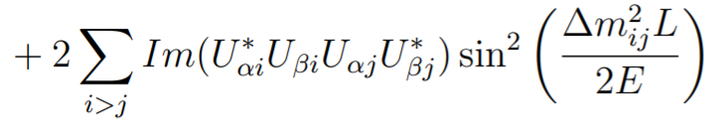
Neutrino oscillation
Neutrinos are classified in terms of flavour and mass eigenstates.
These classifications are mixed with each other.
Neutrinos are produced with a determined flavour, but when they propagate the flavour oscillates with a probability
Neutrino oscillation implies that neutrinos have mass Physics beyond the Standard Model!!!
13/07/2022
Tania Franco Muñoz

Slide 4
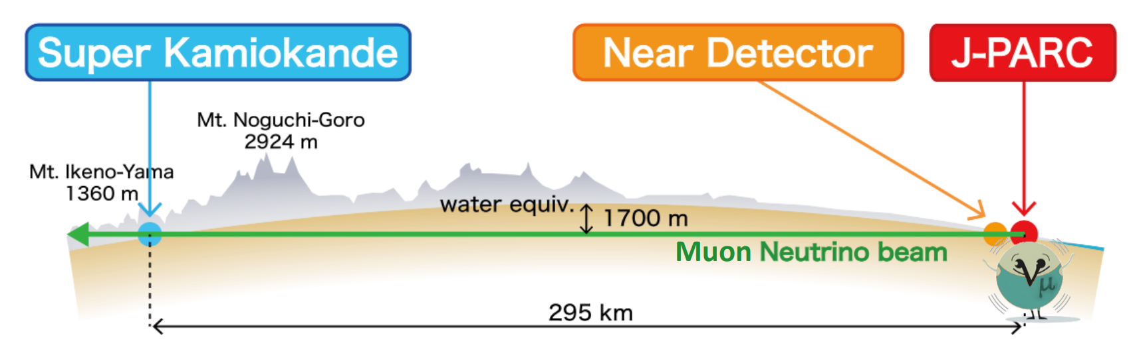
Neutrino oscillation experiments
Tania Franco Muñoz

Slide 5
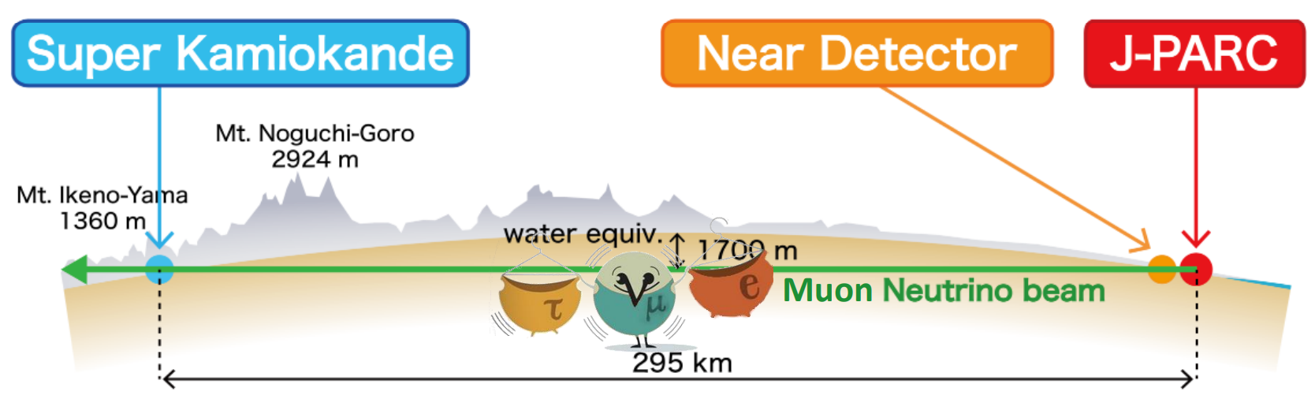
Neutrino oscillation experiments
Tania Franco Muñoz

Slide 6
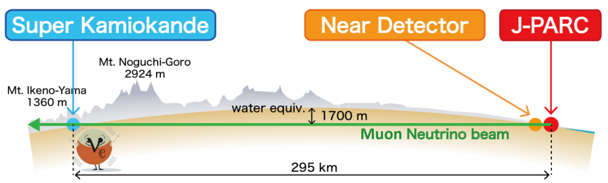
Neutrino oscillation experiments
Tania Franco Muñoz

Slide 7




Neutrino oscillation experiments
We are entering in the precision era of neutrino oscillation experiments, neutrino interaction uncertainties must be reduced for DUNE/Hyper-K to succeed.
Tania Franco Muñoz

Slide 8
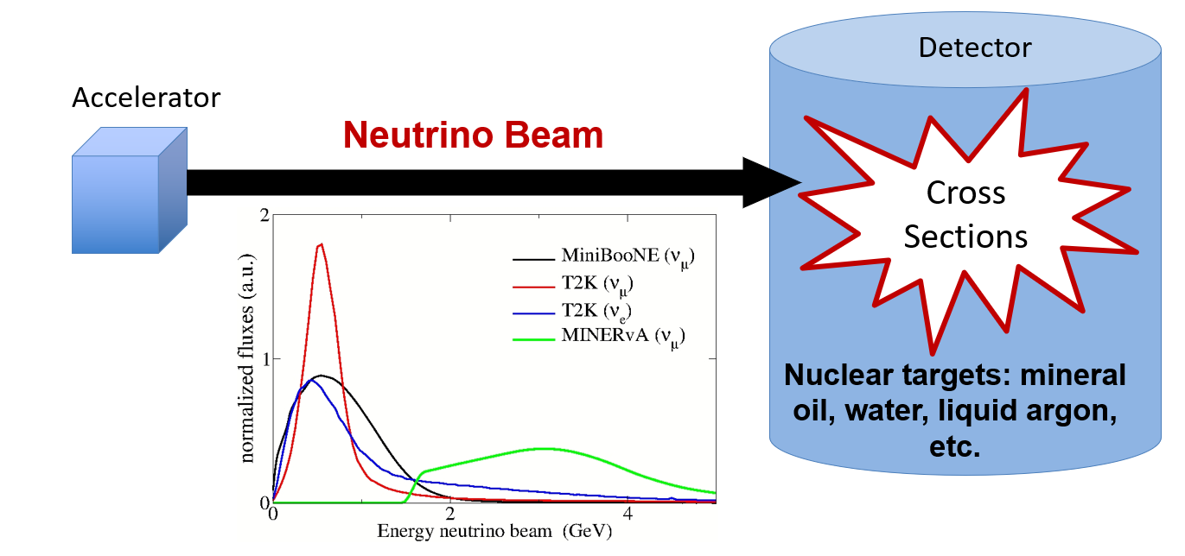
Neutrino oscillation experiments
Both present and future generations of $ν$-oscillation experiments use nuclei as target material.
A good understanding of $ν$-nucleus scattering processes, including nuclear effects, is essential.
Mono-energetic neutrino beams are not available.
Tania Franco Muñoz

Slide 9
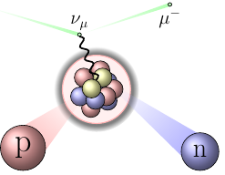
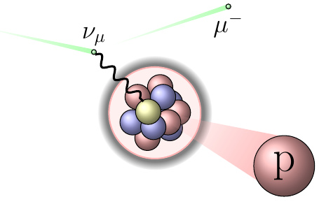
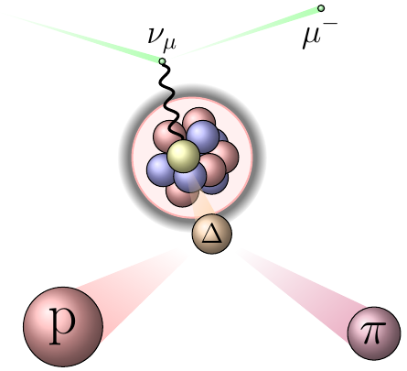
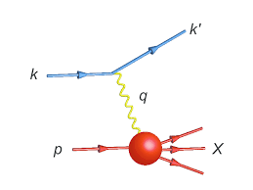
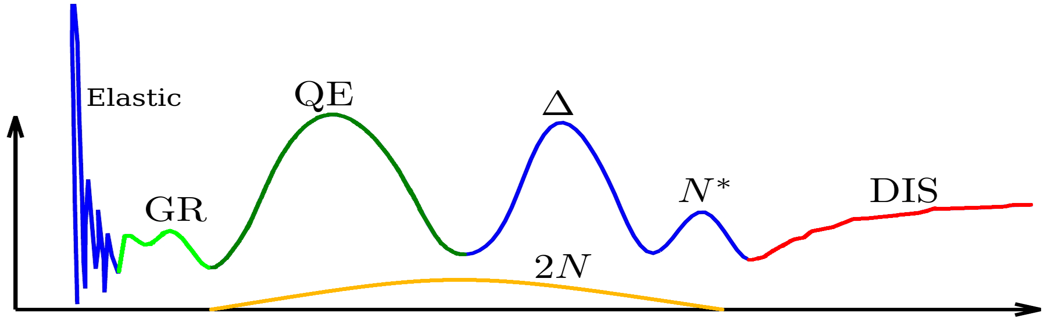
Neutrino-nucleus interactions
We need theoretical models able to describe all possible reaction channels.
Main channels: quasielastic scattering, two-nucleon knockout, resonance production and deep inelastic scattering.
Nuclear response
Energy transfer
Connection between electron and neutrino scattering allows to scrutiny theoretical models by a first comparison to electron scattering data.
Tania Franco Muñoz

Slide 10
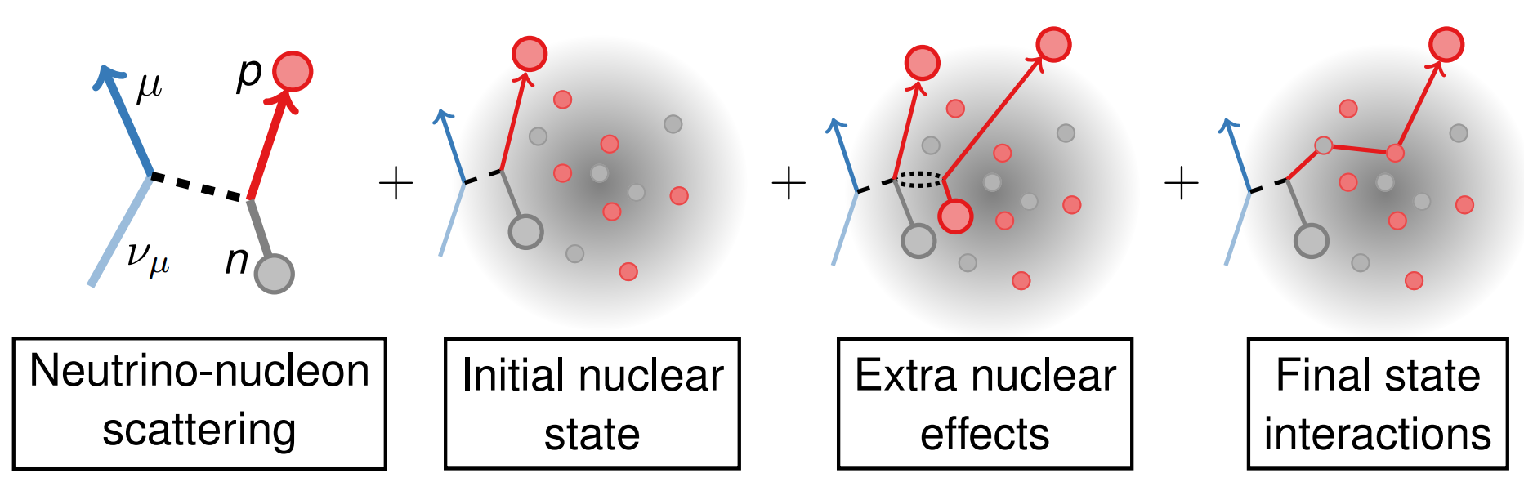
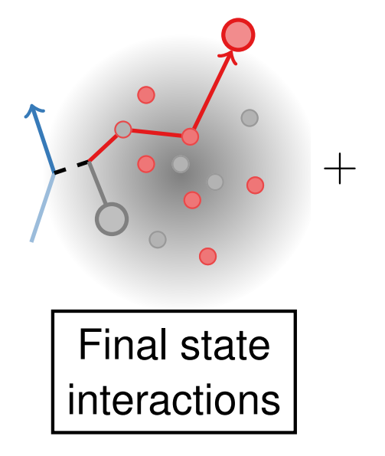
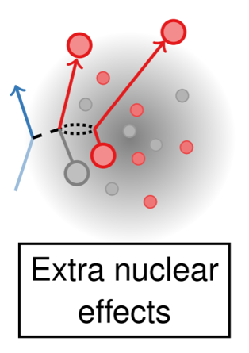
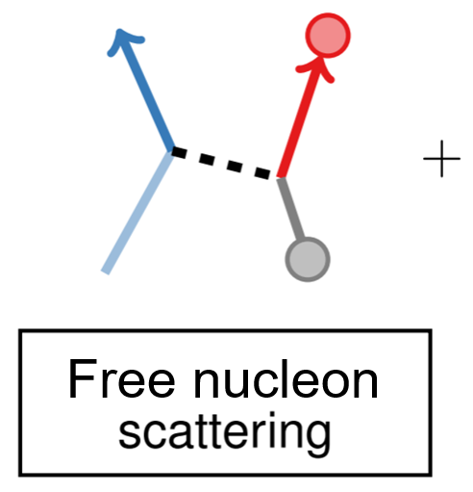
Nuclear dynamics
We focus on quasielastic scattering: interaction between the lepton with a single bound nucleon inside the target nucleus.
Initial nucleon: independent-particle relativistic mean-field (RMF)
Theoretical framework
Nucleus: shell-model occupations and background due to SRC taken from a realistic spectral function
Final nucleon: solution of the Dirac equation with relativistic potential
Tania Franco Muñoz

Slide 11
Nuclear dynamics
We focus on QE scattering: interaction between the lepton with a single bound nucleon inside the target nucleus.
Tania Franco Muñoz

Slide 12
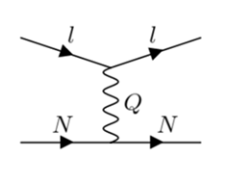
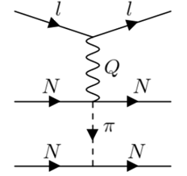
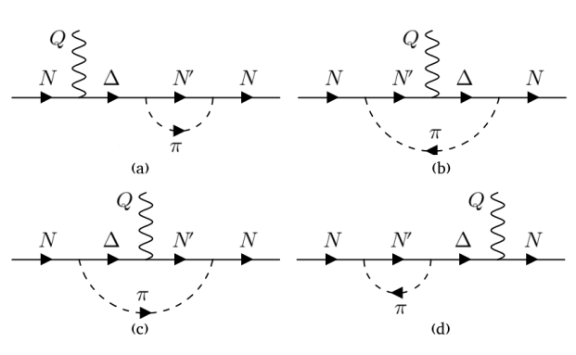
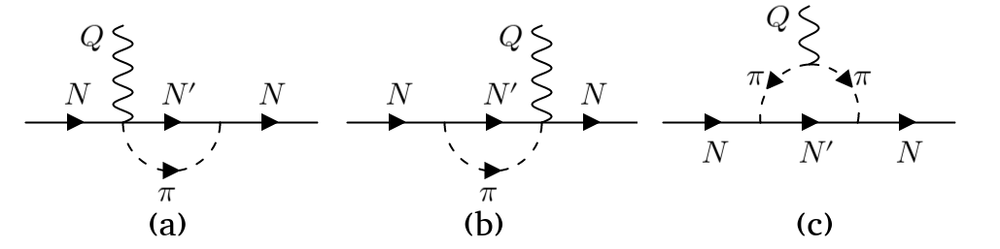
Meson exchange currents
Meson exchange current (MEC) is an one-pion exchange effect where two-body currents are involved.
When the 1p-1h excitation occurs through a two-body current, one of the outgoing nucleons becomes bound to the nucleus again entering in the hole left by the other.
MEC contributions:
Delta resonance mechanism
ChPT background
Tania Franco Muñoz

Slide 13
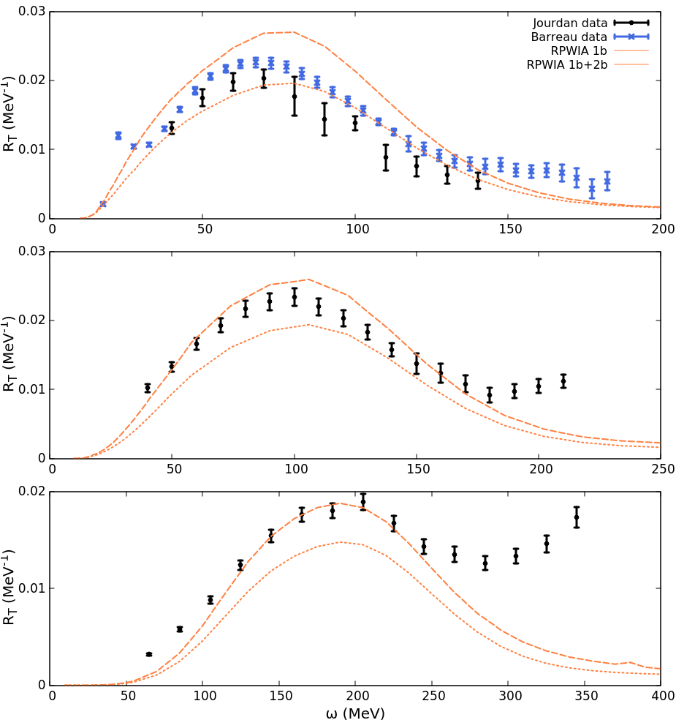
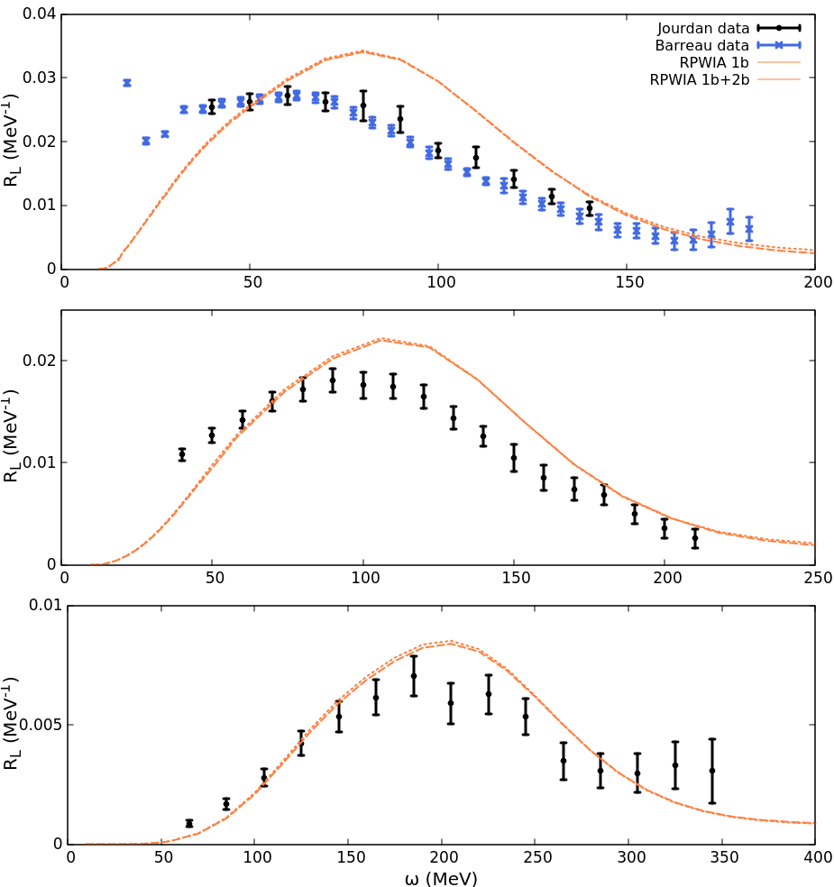
¹²C electromagnetic inclusive responses
$\frac{dσ}{dE_{f}dΩ_{f}}=σ_{Mott}\left\{v_{L}\left(R_{p}^{L}+R_{n}^{L}\right)+v_{T}\left(R_{p}^{T}+R_{n}^{T}\right)\right\}$
q=300MeV/c
q=300MeV/c
q=380MeV/c
q=380MeV/c
J. Jourdan, Nucl. Phys. A 603, 117 (1996).
P. Barreau et al., Nuclear Physics A 402,515 (1983).
ED-RMF: R.González-Jiménez et al. Phys. Rev. C 100, 045501 (2019).
q=570MeV/c
q=570MeV/c
Tania Franco Muñoz

Slide 14
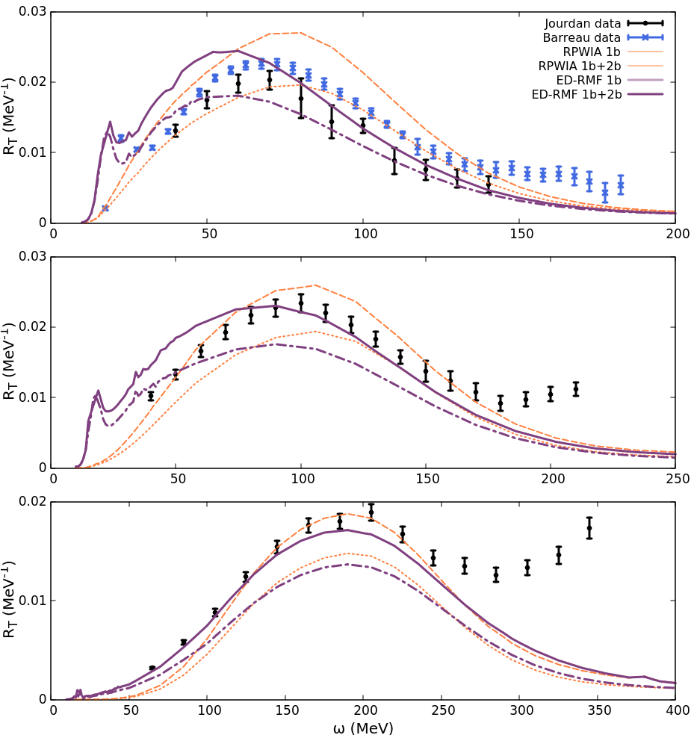
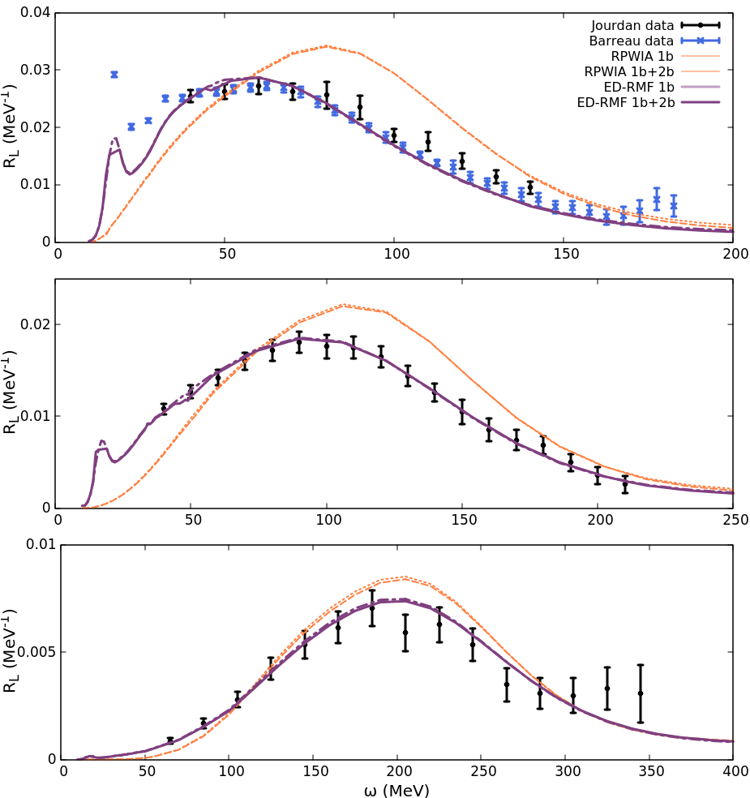

¹²C electromagnetic inclusive responses
FSI are important to describe the DATA
$\frac{dσ}{dE_{f}dΩ_{f}}=σ_{Mott}\left\{v_{L}\left(R_{p}^{L}+R_{n}^{L}\right)+v_{T}\left(R_{p}^{T}+R_{n}^{T}\right)\right\}$
q=300MeV/c
q=300MeV/c
q=380MeV/c
q=380MeV/c
J. Jourdan, Nucl. Phys. A 603, 117 (1996).
P. Barreau et al., Nuclear Physics A 402,515 (1983).
ED-RMF: R.González-Jiménez et al. Phys. Rev. C 100, 045501 (2019).
q=570MeV/c
q=570MeV/c
Tania Franco Muñoz

Slide 15
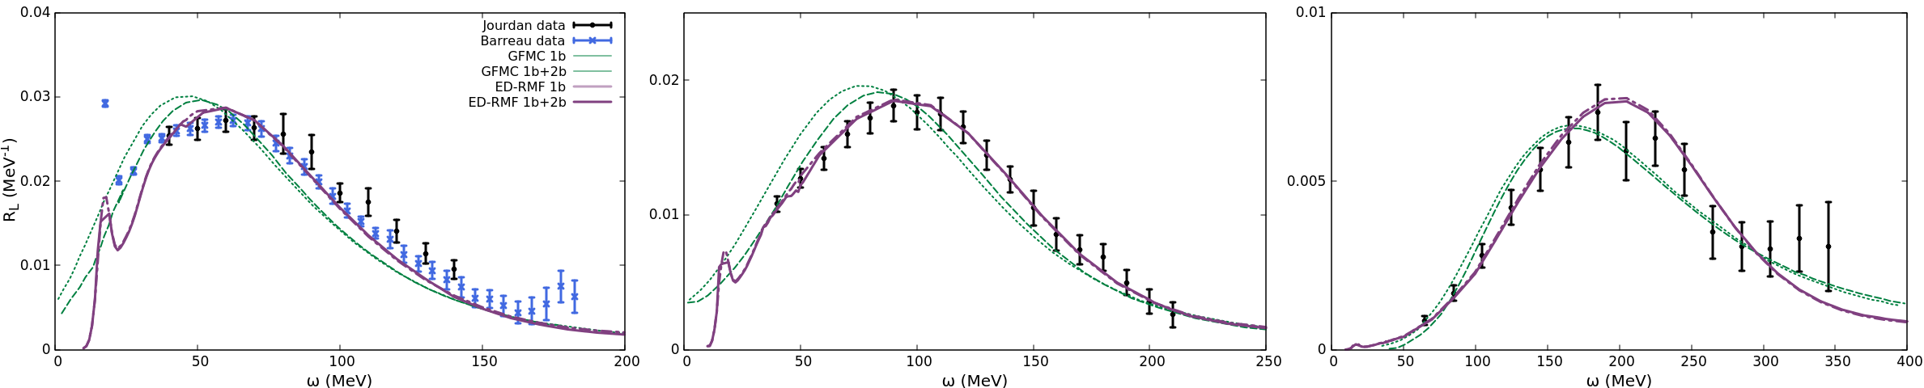
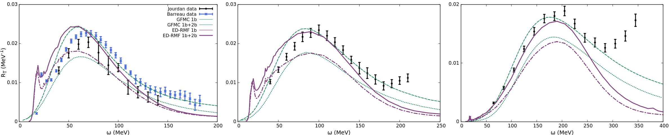
Comparison to previous computations
Two completely different theoretical approaches
  Ab initio non-relativistic Green’s function Monte Carlo (GFMC).
  ED-RMF: fully relativistic model and coherent quantum mechanical description of the nucleonic states, incorporating realistic dynamics and final state interactions
q=300MeV/c
q=380MeV/c
q=570MeV/c
A. Lovato, S. Gandolfi, J. Carlson, S. C. Pieper, and R. Schiavilla, Phys. Rev. Lett. 117, 082501 (2016).
q=300MeV/c
q=380MeV/c
q=570MeV/c
Remarkable good agreement between both ED-RMF and GFMC calculations
Tania Franco Muñoz

Slide 16
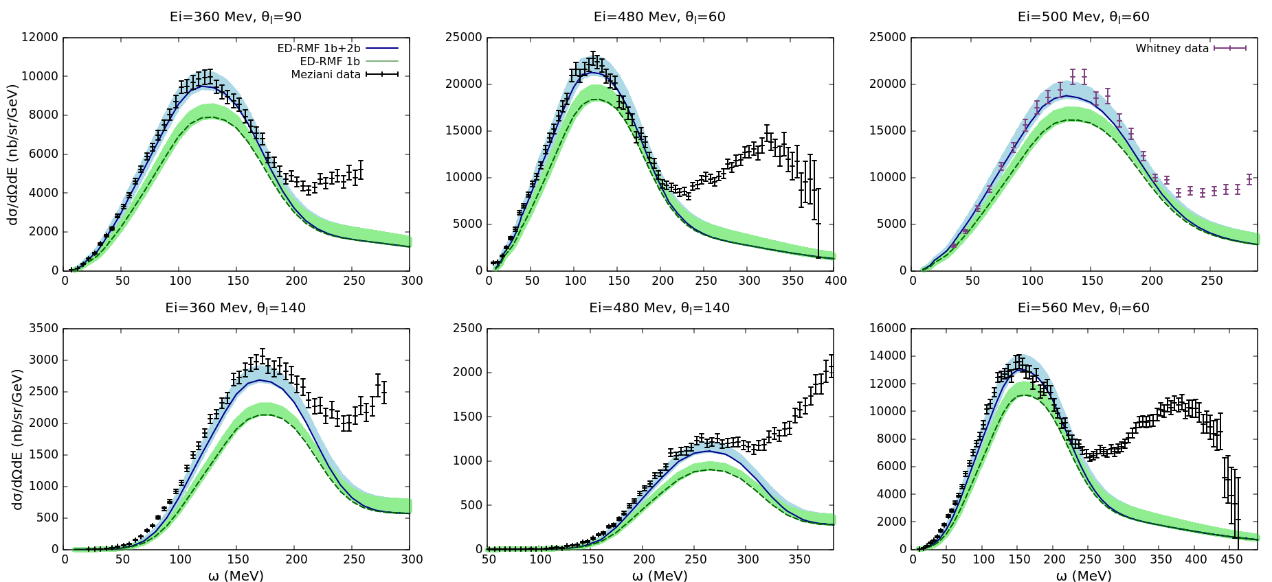
⁴⁰Ca electromagnetic inclusive cross section
The relativistic and quantum mechanical treatment of the process allows its application to heavier nuclei.
Shell model state | 1d_{3/2}+2s_{1/2} | 1d_{3/2} | 2s_{1/2} | 1d_{5/2} | 1p_{3/2}+1p_{1/2} | 1s_{1/2}
Occupation probability | 0.61 ± 0.04 | 0.65 ± 0.05 | 0.53 ± 0.04 | 0.85 ± 0.09 | 0.49 ± 0.07 | 0.89 ± 0.09
Shell model state | Occupation probability
1d_{3/2}+2s_{1/2} | 0.61 ± 0.04
1d_{3/2} | 0.65 ± 0.05
2s_{1/2} | 0.53 ± 0.04
1d_{5/2} | 0.85 ± 0.09
1p_{3/2}+1p_{1/2} | 0.49 ± 0.07
1s_{1/2} | 0.89 ± 0.09
40Ca occupations: Y. Yasuda, Ph.D. thesis, Kyoto University (2012).
Data: discovery.phys.virginia.edu/research/groups/qes-archive/data/40Ca.html
Tania Franco Muñoz

Slide 17
Conclusions and future prospects
Models for the lepton-nucleus interaction using a realistic treatment of the nuclear structure is fundamental to describe the experimental data.
The incorporation of the two-body meson exchange current to the 1p-1h channel is only significant in the transverse channel, leading to an improved description of the data.
After the success of the model in the scrutiny against electron scattering data, it can be applied to neutrino-nucleus scattering.
Tania Franco Muñoz

