Slide 1

CRAB cavity tuning system SPS and LHC
K. Artoos
16/12/2021

Slide 2
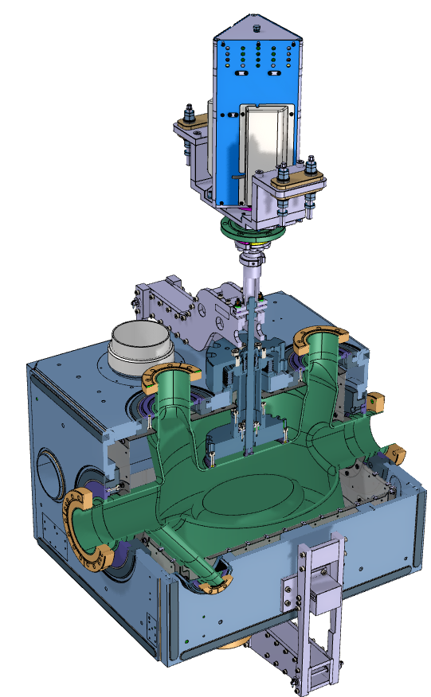
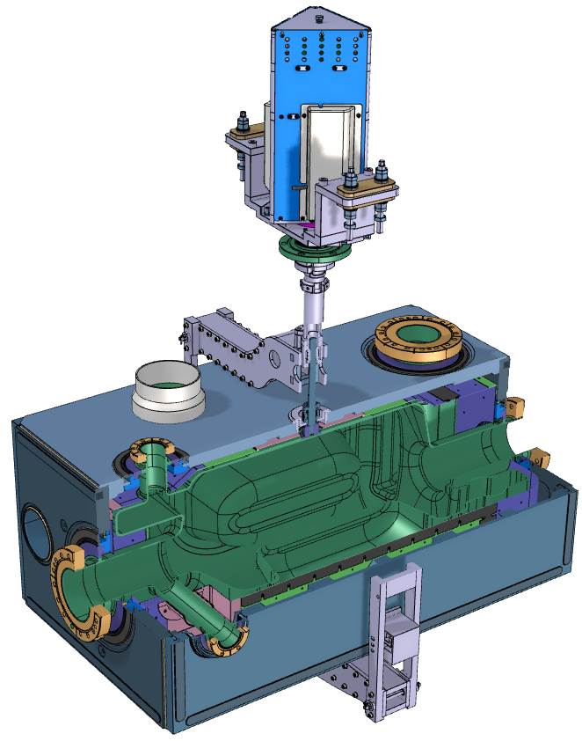
Tuning principle, Range
Range in Spec ± 150 kHz (LHC) (± push/pull)
FINE TUNING PRINCIPLE
Symmetric actuation through tuner frame and concentric tubes. Actuator outside cryostat and floating
DQW
318 kHz/mm*
S. Verdú Andrés
Tuning range
± 509 kHz
±1.6 mm*
elastic range at 2 K
Max. force:
± 3.8 kN
2.2-2.4 kN/mm*
RFD
512 kHz/mm*
E. Cano Pleite
Tuning range
± 1.22 MHz
± 2.38 mm*
elastic range at 2 K
Max. force:
± 6.7 kN
2.8 kN/mm*
*Measured as tuner stroke or Δ distance between 2 plates
Notes:
Remark about elastic limit used

Slide 3
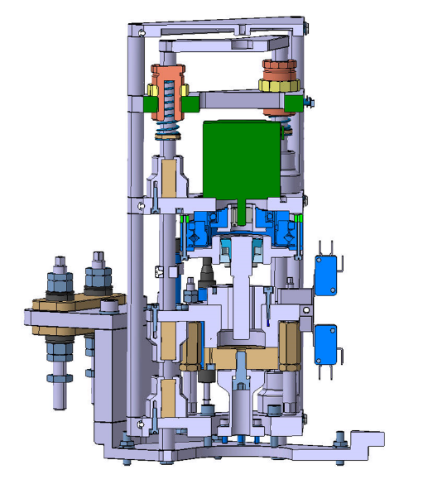
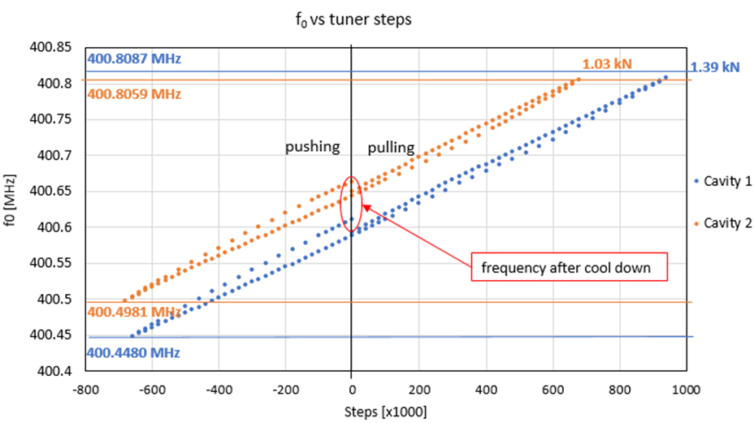
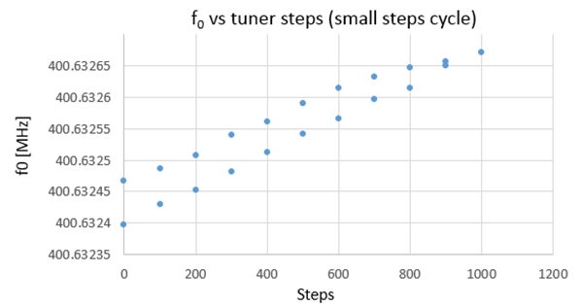
Linear drive set-up, Resolution, speed
EDMS 1994455 SPS DQW Tuner documentation
Motor: 1.3 Nm Bipolar Nema 23 (1.8°)
HD: HFUS-20-100-2SO, ratio i:0.01
Roller screw Rollvis RV 12 x 1 mm lead
Ratio Motor displacement/cavity deformation: 1.5
System stiffness: 1.6 kN/mm
DQW:
Measured at 2 K (SM18)
0.23 Hz/ step resolution
Driver 8000 microsteps
Maximum tuning speed: 2000 steps/ second, because not ramped
25-50 Hz
Hysteresis present

Slide 4
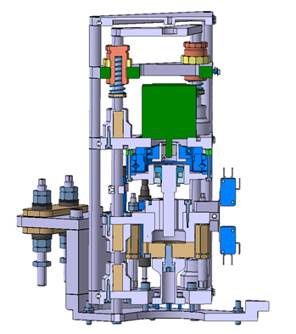
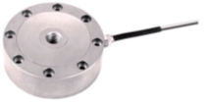
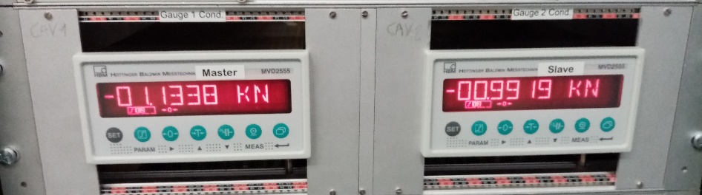
Instrumentation
Load cell Kistler 5 kN (DQW, RFD 10 kN))
4576A55C1 class 0.1
Variables Timber:
Tuner force: ACF.POW.C% :SG_RAW in N
Position: ACF.TUNER.C%:Position in steps
Remark about zeroing position
Potentiometer Megatron RC13-25 M no longer used, resolution not good
Plan is to replace this by resolver with conditioner
Interlock tuner DQW SPS : limit switches, Load cell at ± 2 kN
Request: function to move to zero load position when T He tank > 100K

Slide 5
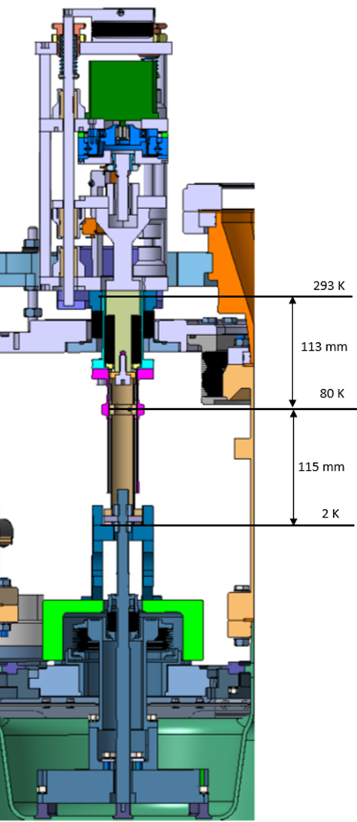
Tuner (load cell) possible perturbations
“Drift”
Feedthrough bellow: sensitive to pressure (atm)
1% change atm >> ~ 3N *
Temperature gradient, change will change tuner load
Thermalisation temperature not measured, refer to FPC thermalisation
He Tank feedthrough + cavity surface
Sensitive to He tank pressure (and temperature when saturated liquid)
1 mbar >~3 N*
* Rough estimate

Slide 6
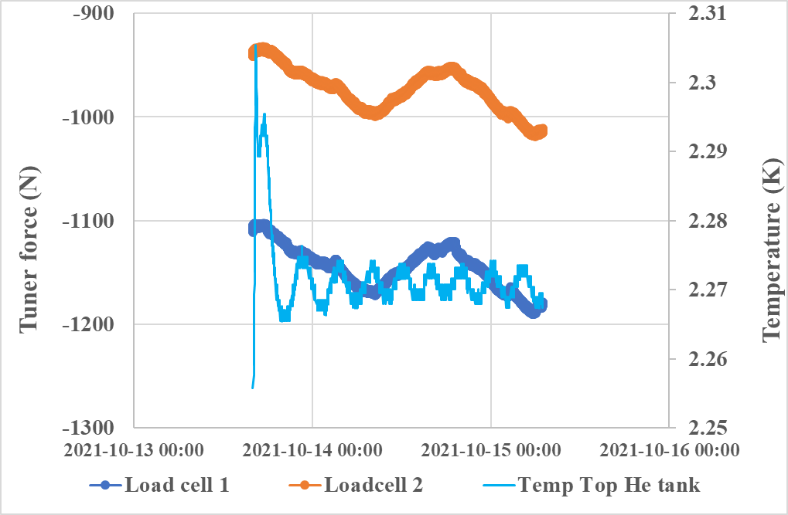
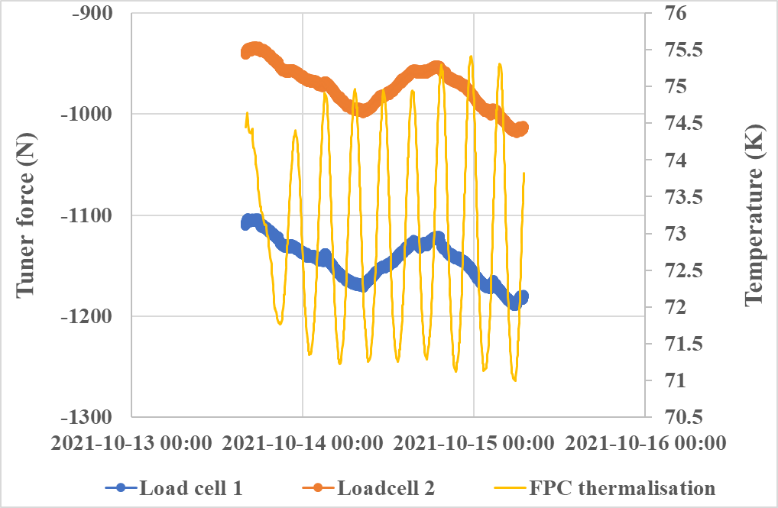
Cavities at 2 K, no tuner changes
Temp He tank
So also pressure
Temp Thermalisation FPC
2nd ripple frequency fits with cryo cycle?

Slide 7
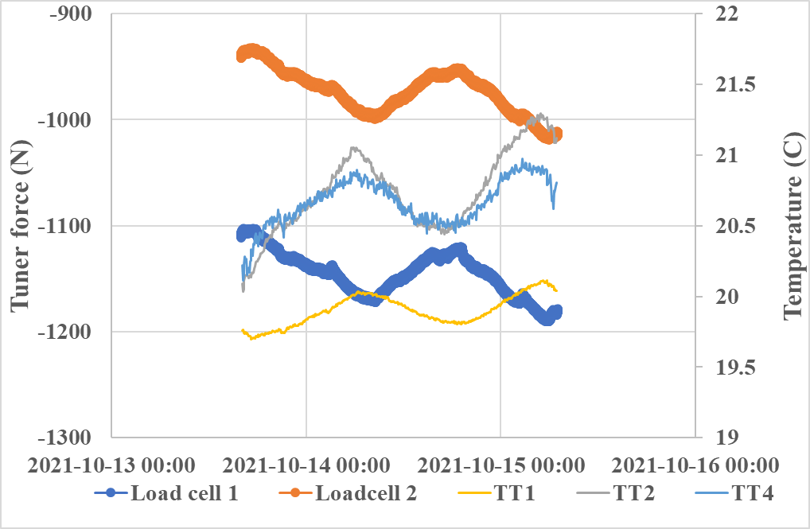
Cavities at 2 K, no tuner changes
Temperature tunnel

Slide 8
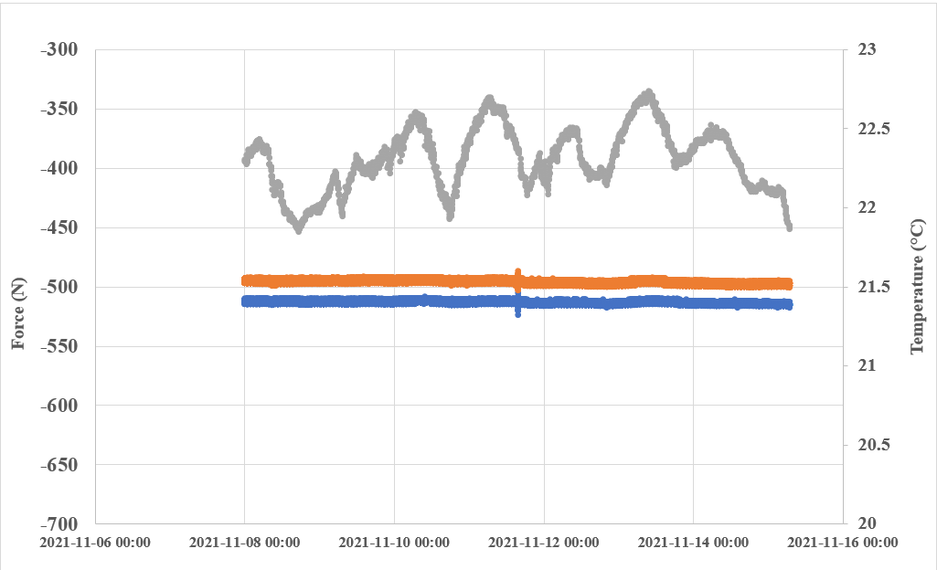
CM stable at room temperature
Check T influence on load cell + cables
No thermal gradient inside CM means no change of tuner force with tunnel temperature

Slide 9
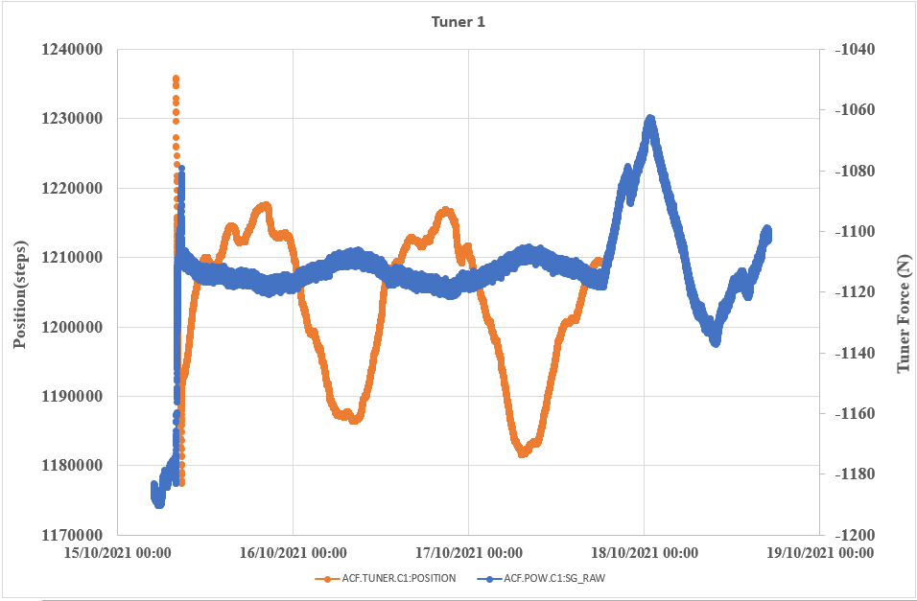
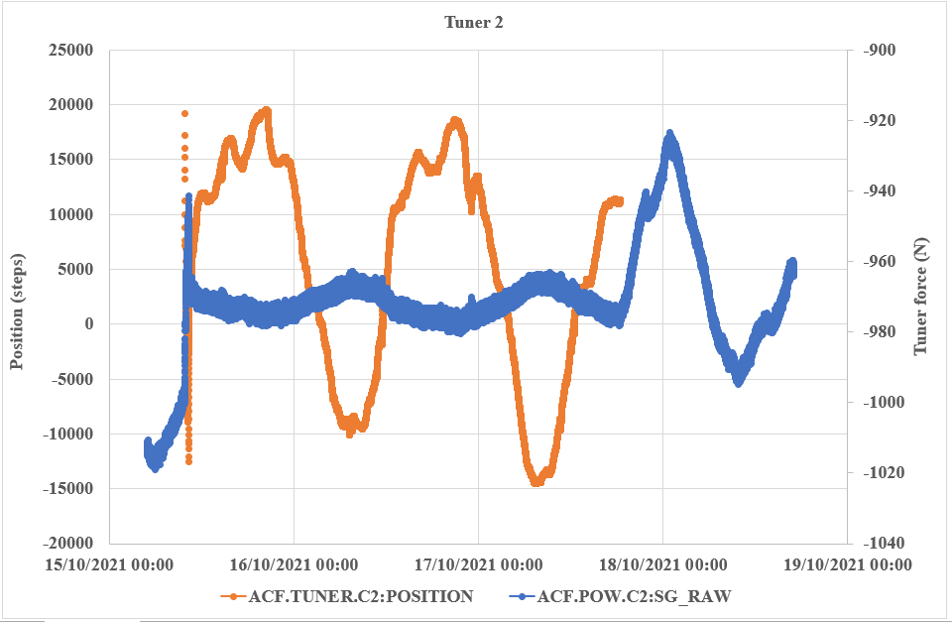
15-18 October
? Feedback with tuner
? Input
Comment: Orange curve are steps sent to the tuner. If no steps are sent there are no points stored in timber. So there was clearly a loop running.

Slide 10
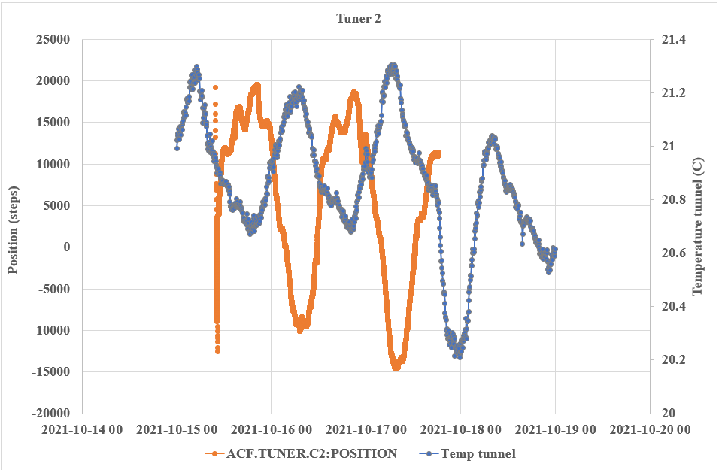
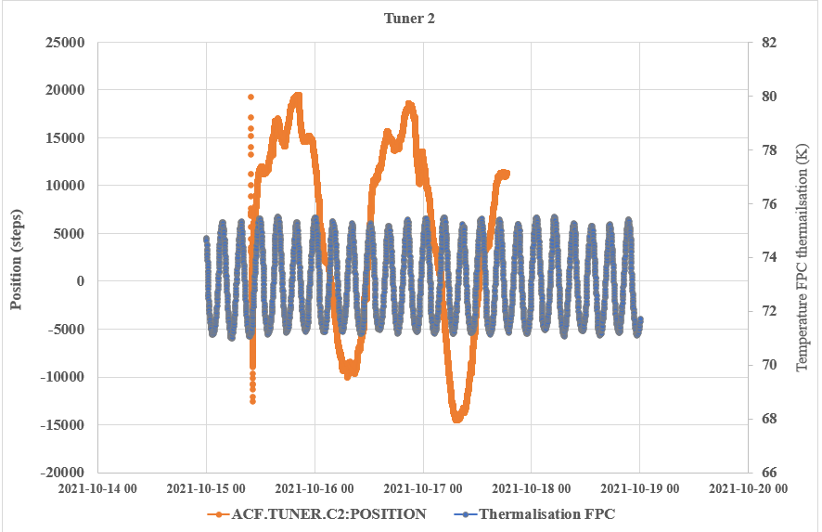
15-18 October
Influence tunnel temperature
+ indications cryo cycle on temperature tunnel
Influence thermalisation temperature
What was the input of the FB control ? Frequency, Power 2 K cryo?
This would indicate that the frequency drift is related to tuner drift and hence temperature drift

Slide 11
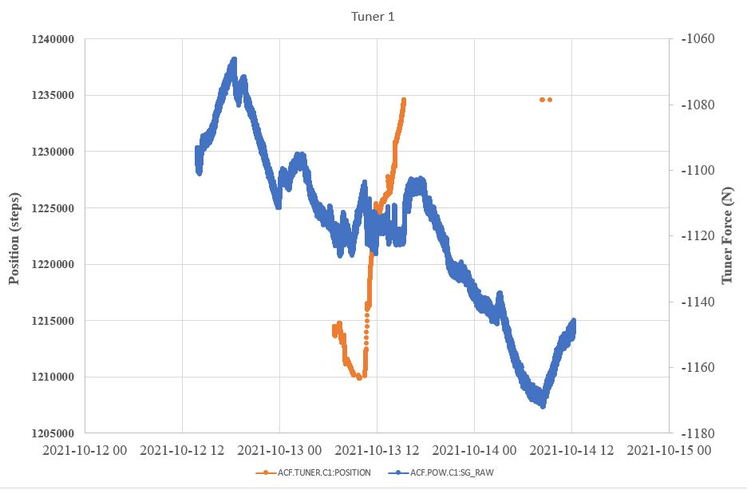
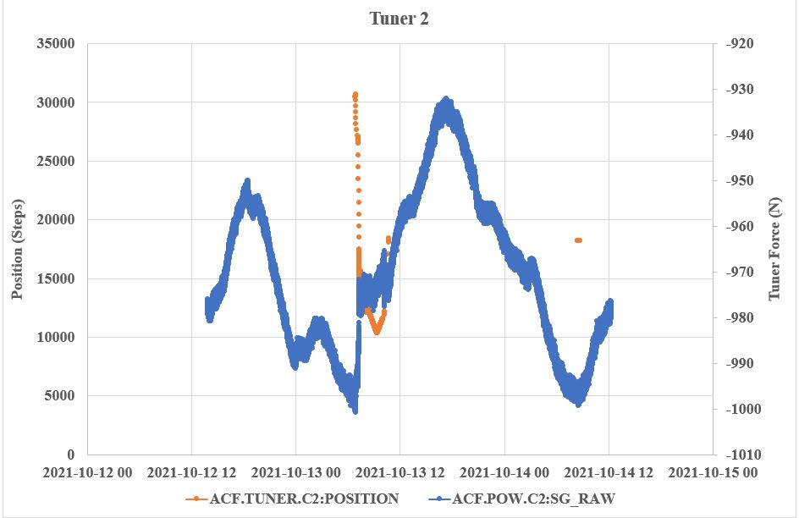
MD

Slide 12
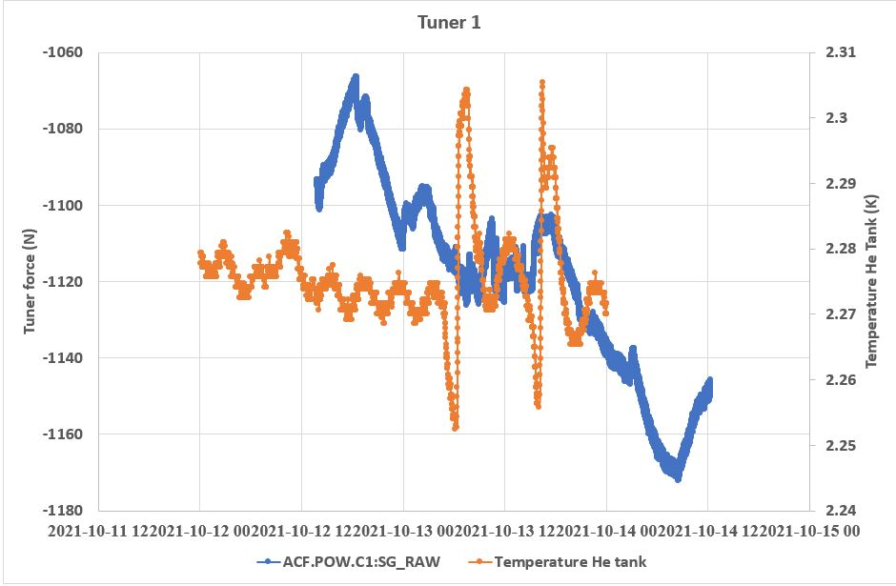
MD
Temperature Cavity

Slide 13
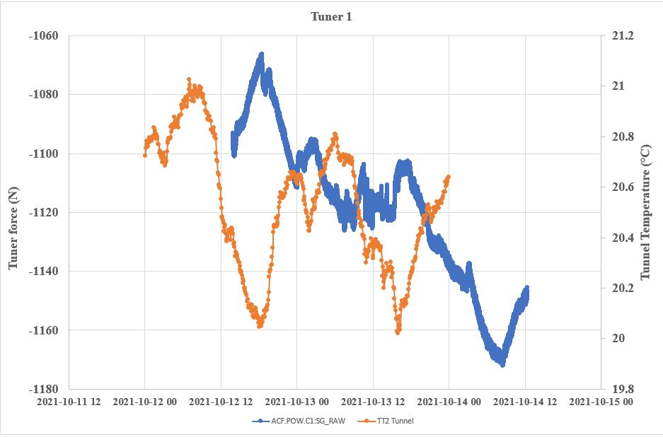
MD
Tunnel temperature

Slide 14
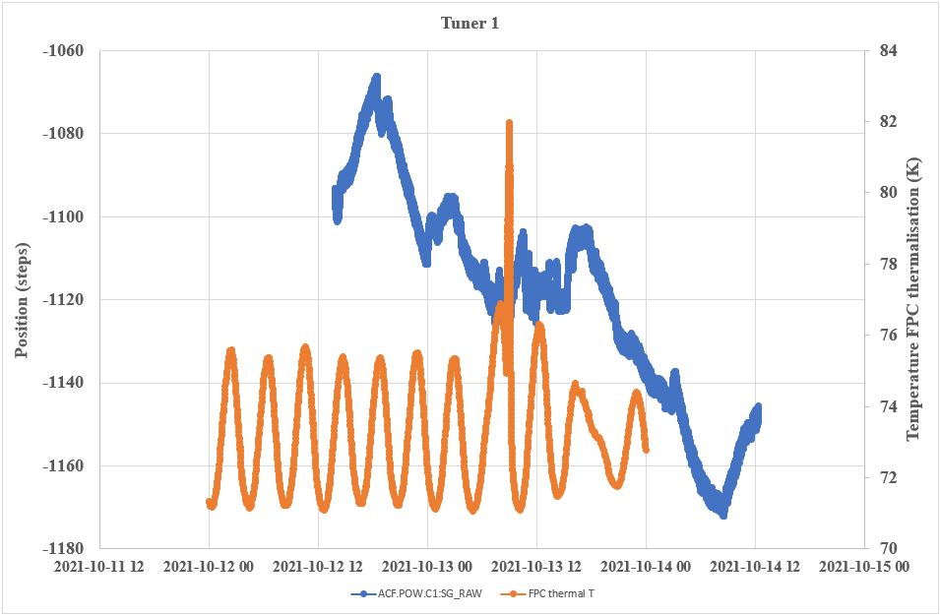

Slide 15
Conclusions
Drift seen on tuner load cells, possibly related to observed frequency drift of cavity, can be attributed to tunnel temperature and to a lesser extend to the 2 K cryo cycle.
Some of the 2 K cryo cycle is found back in the tunnel temperature.
Drift can be compensated with the tuner as demonstrated on 15th to 18th October
Requests to implement in Tuner control: back to zero > 100 K, tuner speed ramp

Slide 16
Thank you for your attention!

Slide 17
Spare slides

Slide 18
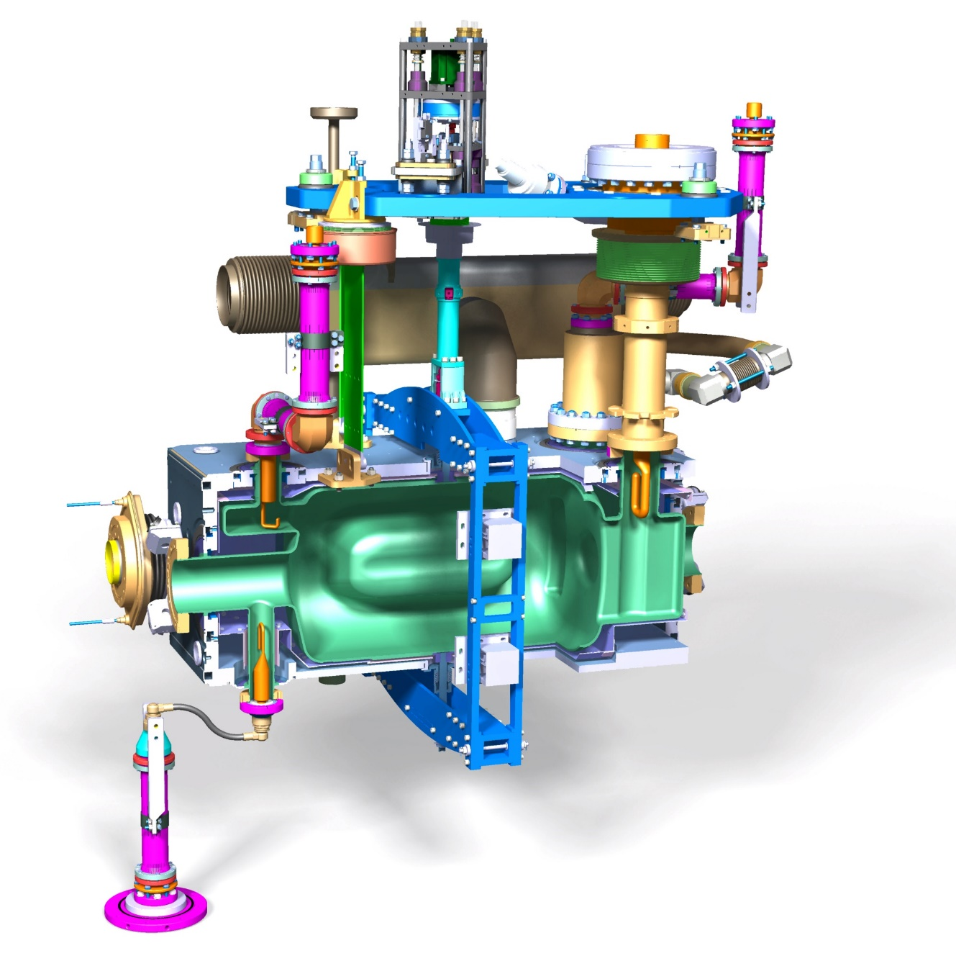
Reminder functioning tuner

Slide 19
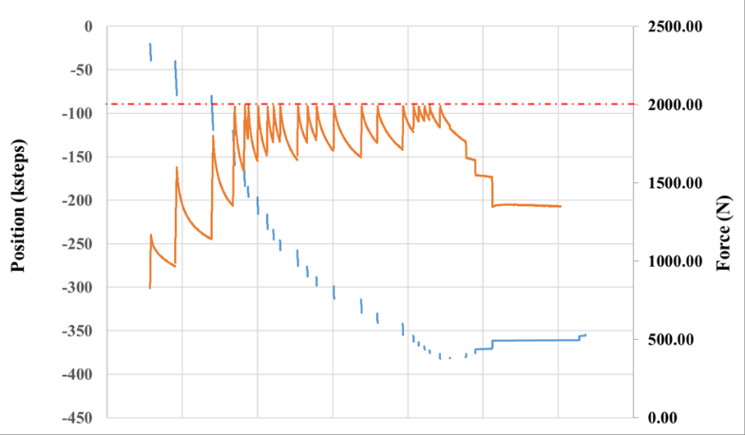
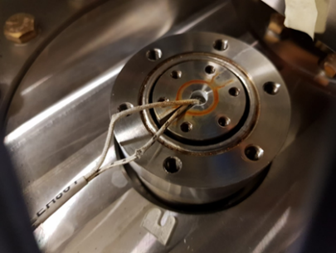
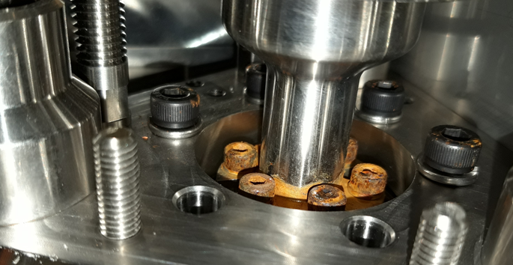
Reminder end of Run1 DQW SPS 2018
Sudden increase of stiffness 2-3 October after thermal cycle
no real blockage
One motor-gear coupling started slipping 19/10
Tuner heaters broken + wires damaged
Possible ice formation
Important observations:
Very hard to dismount motor in-situ or to replace the heater
Impossible to retighten the coupling without full actuator disassembly
No access to set limit switches and hard stop
Potentiometer not needed

Slide 20
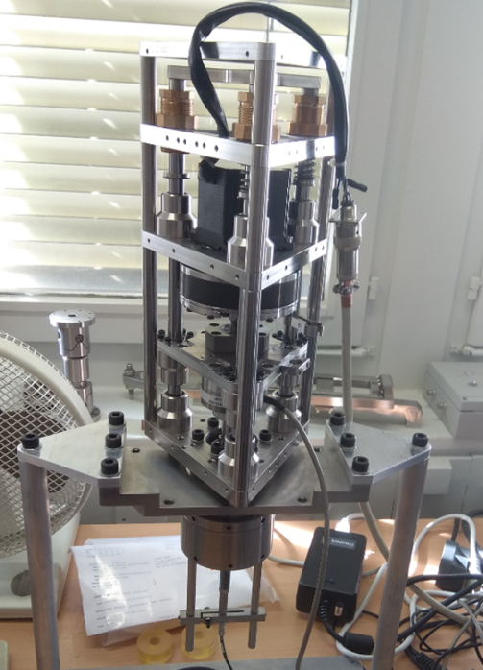
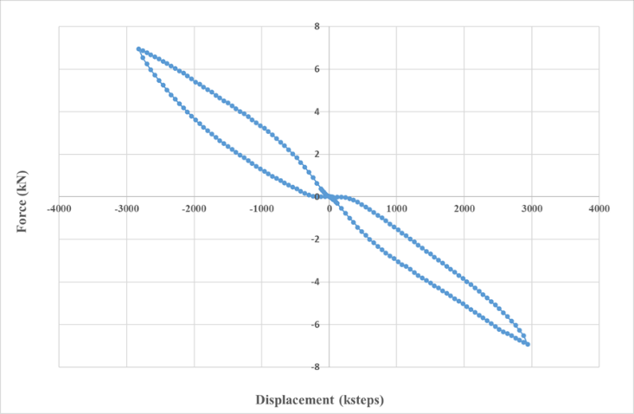
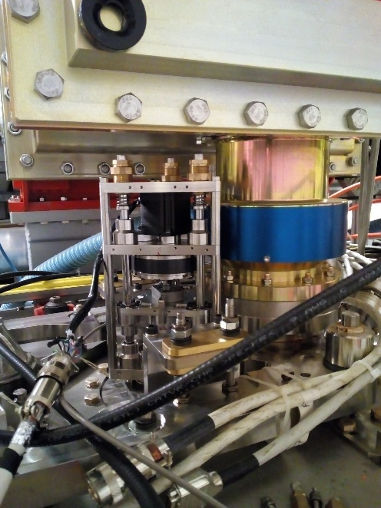
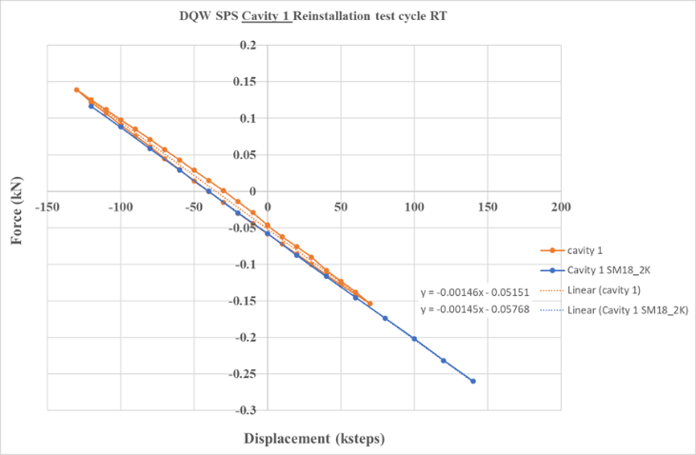
Testing
Elastomer
cycles Up to 7 kN
SPS Room temperature
Same stiffness as SM18

Slide 21
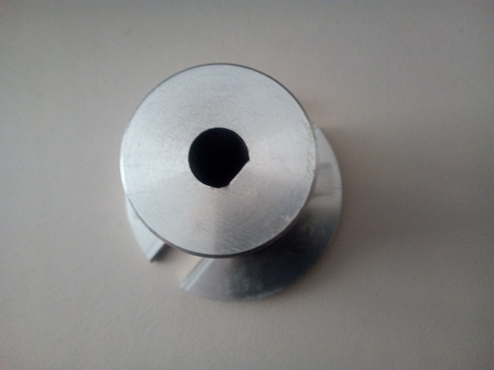
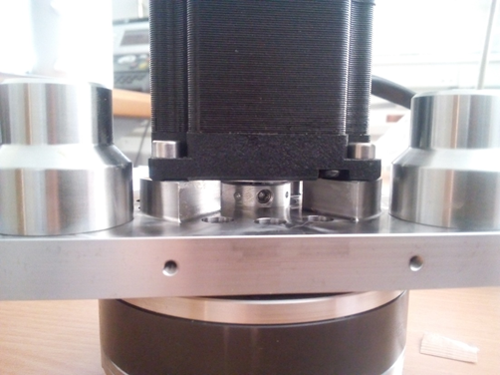
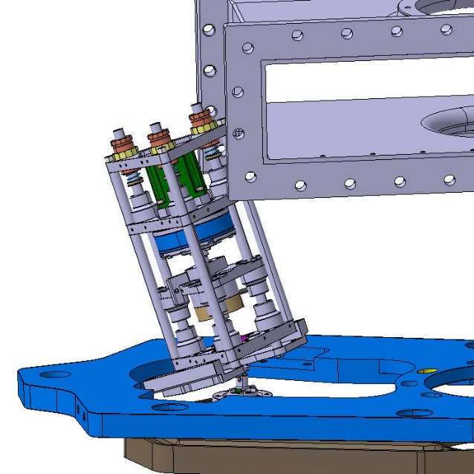
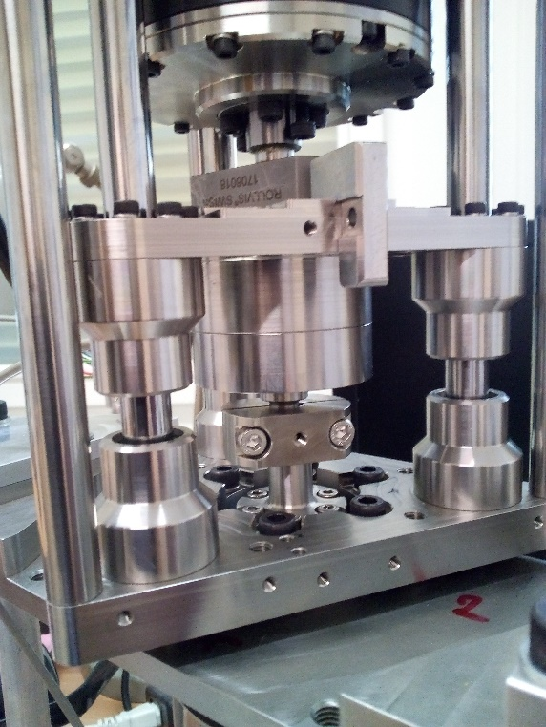
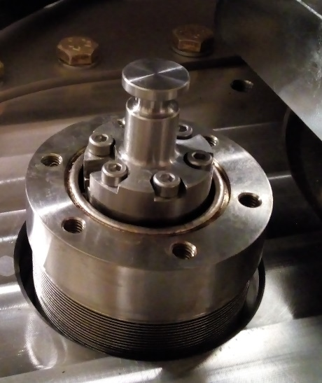
SPS DQW and RFD Upgrade
D-type slip-free Oldham coupling with set screw
Introduction connection clamp
Creation more space
Lowered actuator height
Removed potentiometers
Moved limit switches to front
Only 1 hard stop in front

