Slide 1
Potential shift D2
R. De Maria
WP2 Meeting 15/12/2021

Slide 2
WP3 request
Salut Ezio,
J’ai regardé l’intégration du D2 dans la masse froide.
On pourrait bouger l’ensemble des aimants de 200mm vers le DS.
Aujourd’hui le dog leg D1-D2 est de 64.561m, ca représente donc une variation de 0.31% soit 37.5A de moins sur le D1 et 38.2A sur le D2.
Ca n’est pas énorme mais toujours bon à prendre.
Ce changement n’a aucun autre effet sur l’intégration mécanique du cryo-assemblage : les jacks, jumpers, BPMs et autres interfaces restent là ou elles sont dans la version actuelle de l’optique.
Hervé

Slide 3
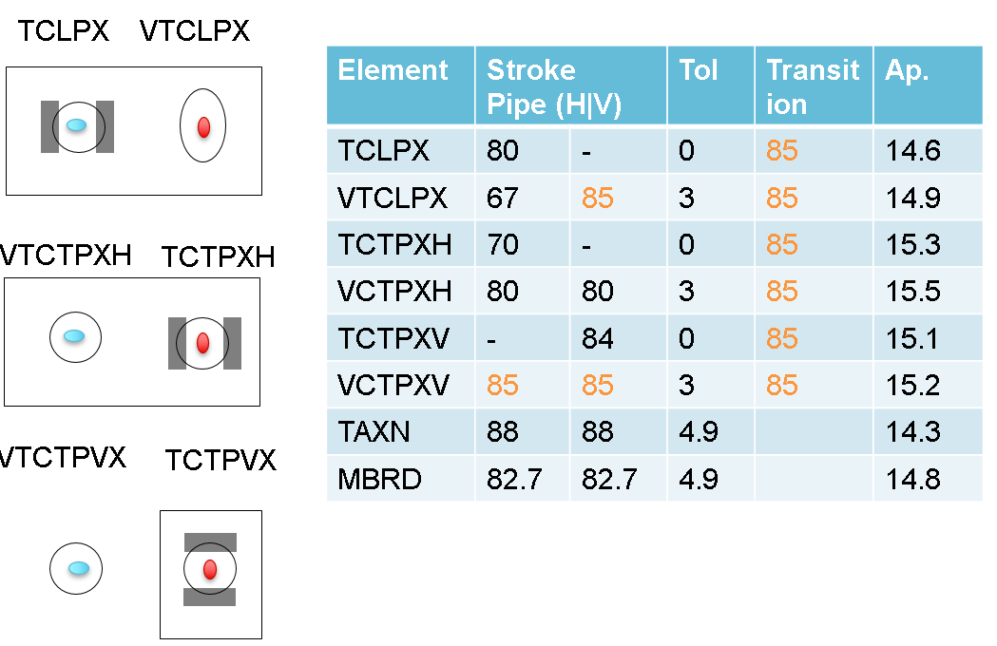
Impact
TCLPX
D2
TAXN
D1
ΔSep
Δs
97 mm
TCTPXV
TCTPXH
A shift in D2 position, reduce the bending angle as well as the beam separation.
Sep = (s-D1)/(D2-D1) 97 mm
ΔSep = - Sep Δs/(D2-D1) 97 mm ~ 0.5 mm
0.3 % gain in field, 1.5% loss in physical aperture.

Slide 4
Conclusion
Shifting D2 by 20 cm reduce field by 0.3 % or 30A.
Beam separation are slightly modified loosing about 0.5 mm in aperture (~1.5 %)
Potential mitigation:
  Displace TAXN – TCLPX as well (e.g. by shortening cryostat)
  Change geometry of TAXN – TCLPX.
Is it a good trade-off without mitigations?

Slide 5
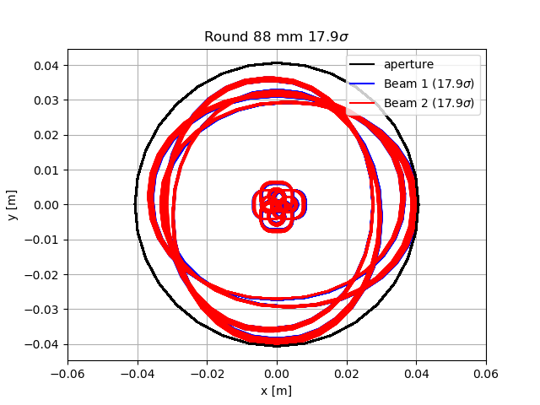
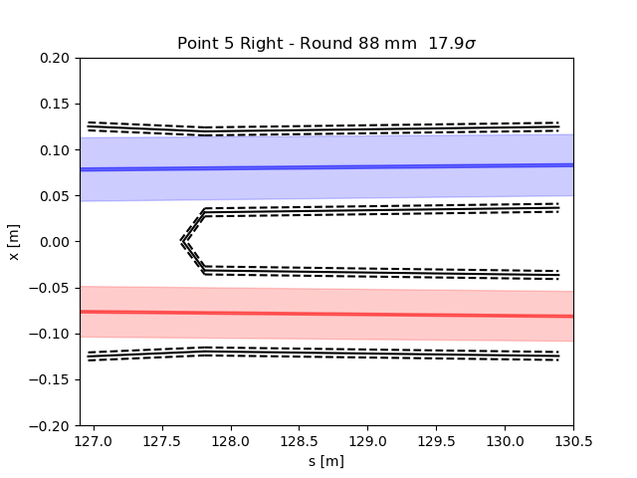
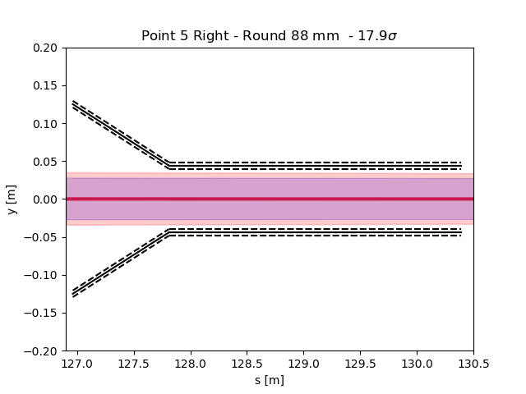
Apertures: Round β*=15 cm, 500 µrad
 | bare | bstol | align | beam | offset
TAXS | 25.1 | 24.1 | 21.6 | 17.6 | 15.4
Q1 | 22.2 | 20.8 | 20.8 | 17.7 | 17.7
Q23 | 16.4 | 15.6 | 15.4 | 13.1 | 13.1
D1 | 17.4 | 16.5 | 16.3 | 13.9 | 13.9
D1 (ext) | 17 | 16.1 | 15.9 | 13.5 | 13.5
TAXN (85mm, old) | 23.6 | 22.7 | 21.3 | 18 | 18
TAXN (85mm, new) | 23.6 | 21.1 | 20.8 | 17.6 | 17.6
TAXN (88mm, new) | 24.5 | 23.0 | 21.7 | 18.4 | 18.4
TCTPV | 22.1 | 22.1 | 22.1 | 18.8 | 18.8
TCTXH | 22.7 | 22.7 | 22.7 | 19.3 | 19.3
TCLX | 23.3 | 23.3 | 23.3 | 19.8 | 19.8
D2 | 24.9 | 24.9 | 23 | 19.3 | 19.3
D2 Corr. | 25.7 | 25.7 | 24 | 20.1 | 20.1
CC (b.s) | 27.8 | 27.8 | 25.9 | 21.8 | 21.8
Q4 Mask | 25.9 | 25.9 | 23.6 | 19.3 | 19.3
Q4 Corr. | 27.6 | 27.6 | 25.2 | 20.6 | 20.6
Q4 | 29 | 29 | 26.9 | 22.2 | 22.2
Q5 Mask | 28.7 | 28.7 | 26.4 | 21.5 | 21.1
Q5 Corr. | 31.4 | 29.8 | 27.4 | 22.3 | 22
Q5 | 31.8 | 30.2 | 27.9 | 22.7 | 22.4
Q6 Mask | 36.5 | 36.5 | 34.1 | 27.9 | 26.7
Q6 Corr. | 37.6 | 37.6 | 35.1 | 28.8 | 27.6
Q6 | 38 | 38 | 35.5 | 29.1 | 28.2
TAXN tol: 4.9 mm

Slide 6
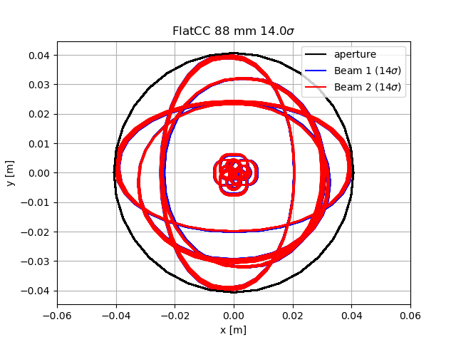
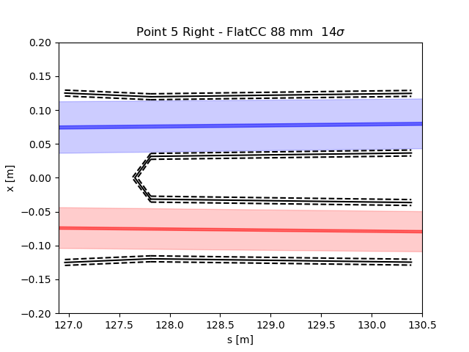
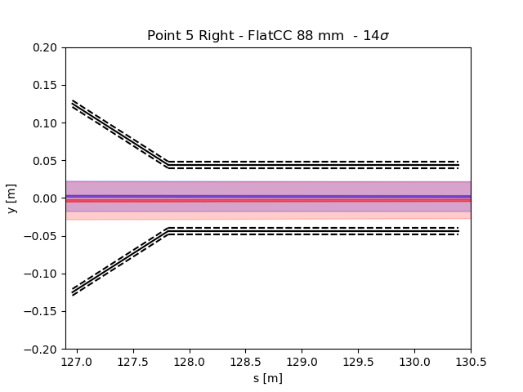
Aperture FlatCC: β*=7.5/18 cm, 480 µrad
 | bare | bstol | align | beam | offset
TAXS | 21 | 20.2 | 18.3 | 15.1 | 13.2
Q1 | 19.4 | 18.5 | 18.4 | 15.9 | 15.9
Q23 | 15.5 | 14.9 | 14.7 | 12.7 | 12.7
D1 | 15.8 | 15.1 | 14.9 | 12.9 | 12.9
D1 (ext) | 15.5 | 14.8 | 14.6 | 12.6 | 12.6
TAXN (85mm, old) | 18.2 | 17.6 | 16.6 | 14.1 | 14.1
TAXN (85mm, new) | 18.2 | 16.4 | 16.2 | 13.8 | 13.8
TAXN (88mm, new) | 18.9 | 17.8 | 16.9 | 14.3 | 14.3
TCTPV | 17 | 17 | 17 | 14.4 | 14.4
TCTXH | 17.2 | 17.2 | 17.2 | 14.7 | 14.7
TCLX | 17.6 | 17.6 | 17.6 | 15 | 15
D2 | 18.9 | 18.2 | 17.1 | 14.5 | 14.5
D2 Corr. | 21.3 | 20.5 | 19.3 | 16.4 | 16.4
CC (b.s) | 20.6 | 19.7 | 18.3 | 15.4 | 15.4
Q4 Mask | 19.2 | 18.3 | 16.7 | 13.6 | 13.6
Q4 Corr. | 20.4 | 19.5 | 17.8 | 14.5 | 14.5
Q4 | 21.4 | 20.6 | 19.1 | 15.6 | 15.6
Q5 Mask | 21.2 | 20.2 | 18.7 | 15.2 | 14.9
Q5 Corr. | 22 | 20.9 | 19.4 | 15.8 | 15.6
Q5 | 22.3 | 21.1 | 19.5 | 15.8 | 15.6
Q6 Mask | 25.8 | 25.8 | 24.1 | 19.7 | 18.9
Q6 Corr. | 28.3 | 26.9 | 25.1 | 20.5 | 19.6
Q6 | 28.3 | 26.9 | 25.1 | 20.5 | 19.9
TAXN tol: 4.9 mm

Slide 7
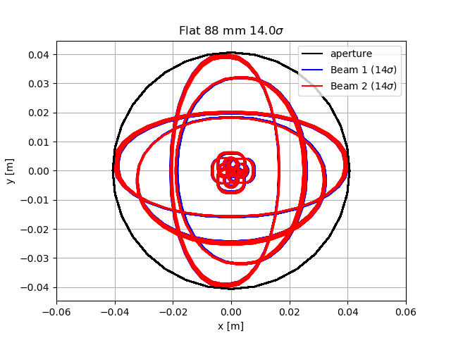


Apertures: Flat β*=7.5/30 cm, 490 µrad
 | bare | bstol | align | beam | offset
TAXS | 21.1 | 20.4 | 18.5 | 15.2 | 13.5
Q1 | 19.4 | 18.5 | 18.5 | 15.9 | 15.9
Q23 | 15.5 | 14.9 | 14.7 | 12.7 | 12.7
D1 | 15.8 | 15.1 | 14.9 | 12.9 | 12.9
D1 (ext) | 15.5 | 14.8 | 14.6 | 12.6 | 12.6
TAXN (85mm, old) | 18.2 | 17.6 | 16.6 | 14.1 | 14.1
TAXN (85mm, new) | 18.2 | 16.4 | 16.2 | 13.8 | 13.8
TAXN (88mm, new) | 18.9 | 17.8 | 16.9 | 14.4 | 14.4
TCTPV | 17 | 17 | 17 | 14.4 | 14.4
TCTXH | 17.3 | 17.3 | 17.3 | 14.7 | 14.7
TCLX | 17.6 | 17.6 | 17.6 | 15 | 15
D2 | 18.9 | 18.2 | 17.1 | 14.5 | 14.5
D2 Corr. | 21.3 | 20.5 | 19.3 | 16.4 | 16.4
CC (b.s) | 20.6 | 19.7 | 18.3 | 15.4 | 15.4
Q4 Mask | 19.2 | 18.3 | 16.7 | 13.6 | 13.6
Q4 Corr. | 20.5 | 19.5 | 17.8 | 14.5 | 14.5
Q4 | 21.5 | 20.6 | 19.1 | 15.6 | 15.6
Q5 Mask | 21.3 | 20.2 | 18.7 | 15.2 | 14.9
Q5 Corr. | 22 | 20.9 | 19.4 | 15.8 | 15.6
Q5 | 22.3 | 21.1 | 19.5 | 15.8 | 15.6
Q6 Mask | 25.9 | 25.9 | 24.2 | 19.7 | 18.9
Q6 Corr. | 28.3 | 26.9 | 25.1 | 20.5 | 19.6
Q6 | 28.3 | 26.9 | 25.1 | 20.5 | 19.9
TAXN tol: 4.9 mm

