Slide 1
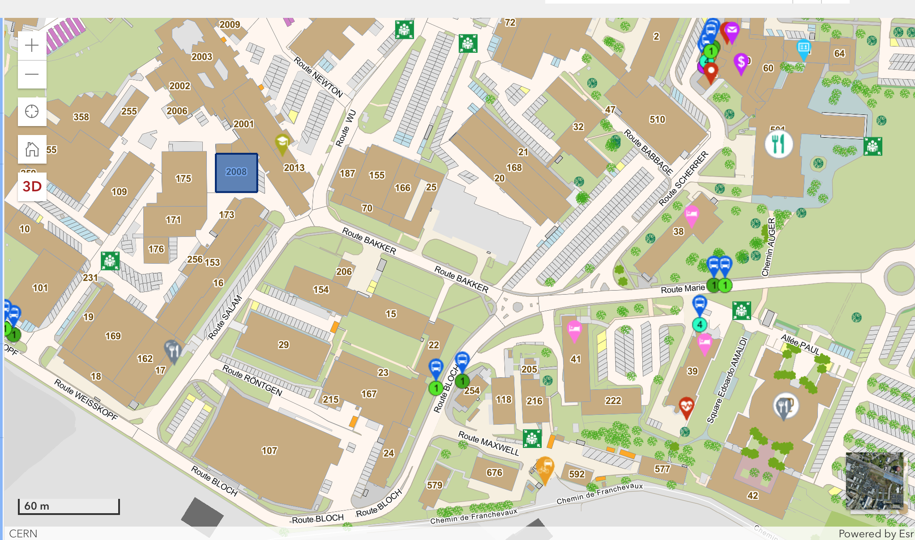

Slide 2

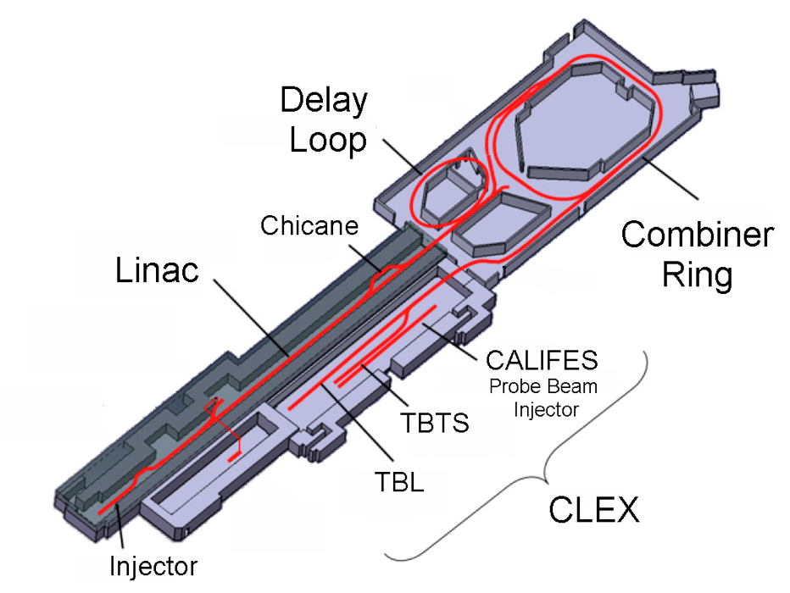
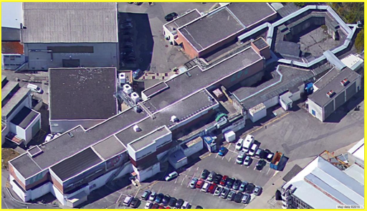
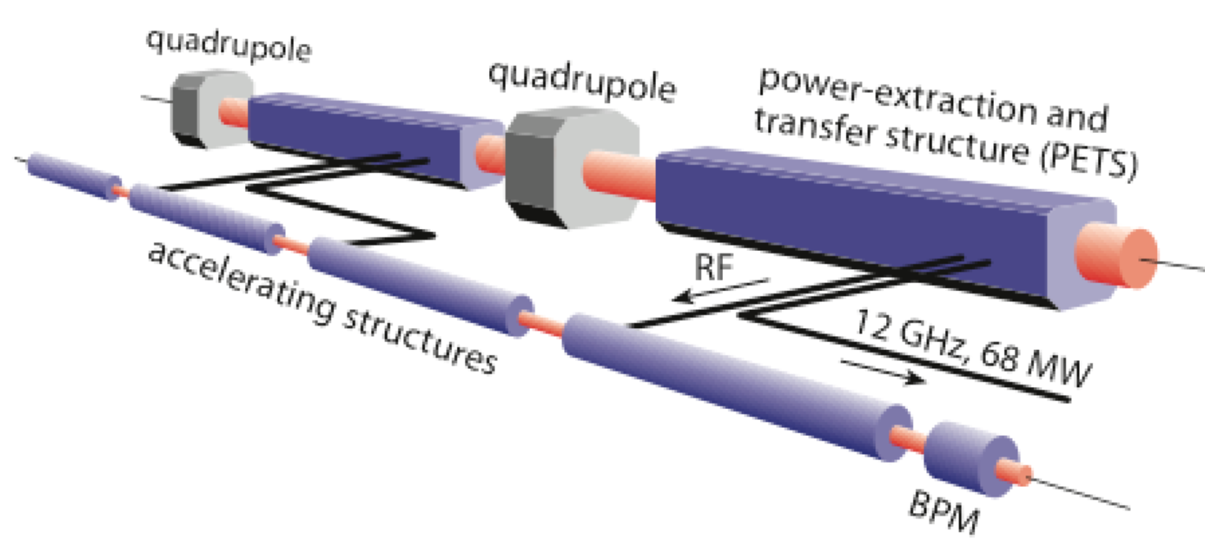
CLIC Test Facility
and CLEAR
CLEAR consists of the experimental hall, CLEX, housing the 200 MeV
S-band electron CALIFES linac.
30 A, 140 ns
120 MeV
30 A, 140 ns
60 MeV

