Slide 1

ASFAP
Atomic and Molecular (+ Optical) Physics
Working group
Introduction series, 08 June, 2022
Abah Obinna
Newcastle University, United Kingdom

Slide 2

What is atomic and molecular physics?
Atomic and molecular physics is the study of the properties, dynamics and interactions of the basic (but not fundamental) building blocks of matter. These dynamics dominate the way atoms and molecules interact with their environment.
Atomic physics
Molecular physics
Chemical bonding
Quantum mechanics
Quantum electrodynamics, …
Electronic structure
Quantum physics and chemistry
Dynamics, Spectroscopy
Physical chemistry, chemical physics, surface science, biology, medicine, condensed matter physics, energy, spintronics, atomtronics, …

Slide 3
Why atomic and molecular physics?
They are gateway to a huge range of fundamental and applied physics
Fundamental
Precise understanding of structure of atoms and molecules and their interaction with electromagnetic fields
Matter-antimatter asymmetry
Studies of extrasolar planets via the spectra of small molecules in our atmosphere
…
Applied
Lasers
Atomic clocks – Cs, H (microwave), Sr, Al (optical)
Quantum simulations, Quantum computations
…
QUANTUM Technologies
Applications of Atomic and Molecular Physics to Astrophysics
Alexander Dalgarno and Stephen Lepp
Springer Handbook of Atomic, Molecular, and Optical Physics pp 1235-1246

Slide 4
Where do Africa research output stand?
Search: Scopus
Keywords -- Atoms/Molecules/Atomic/Molecular/Ions
Years – 2000 – 2022
Country – South Africa, Ghana, Nigeria, Morocco, Tunisia, Algeria, Congo, Kenya, Egypt, Ethiopia
Some Africa countries – population above 700 million
Result: 64,088 documents

Slide 5
Sections:
Atomic structure, properties, and dynamics
Molecular, Chemical and Cluster Physics
Atomic and Molecular Collisions
Cold Quantum Matter
Optical and Laser Physics
Quantum Technologies
Ultrafast, High-field, and X-ray Physics
Astrophysics and Plasma Physics
Atomic, Molecular and Optical Physics
Look up
APS division -- DAMOP
EPS division of AMOP
…
Journal of Physics B: Atomic, Molecular and Optical Physics covers the study of atoms, ions, molecules and clusters, and their structure and interactions with particles, photons or fields.

Slide 6
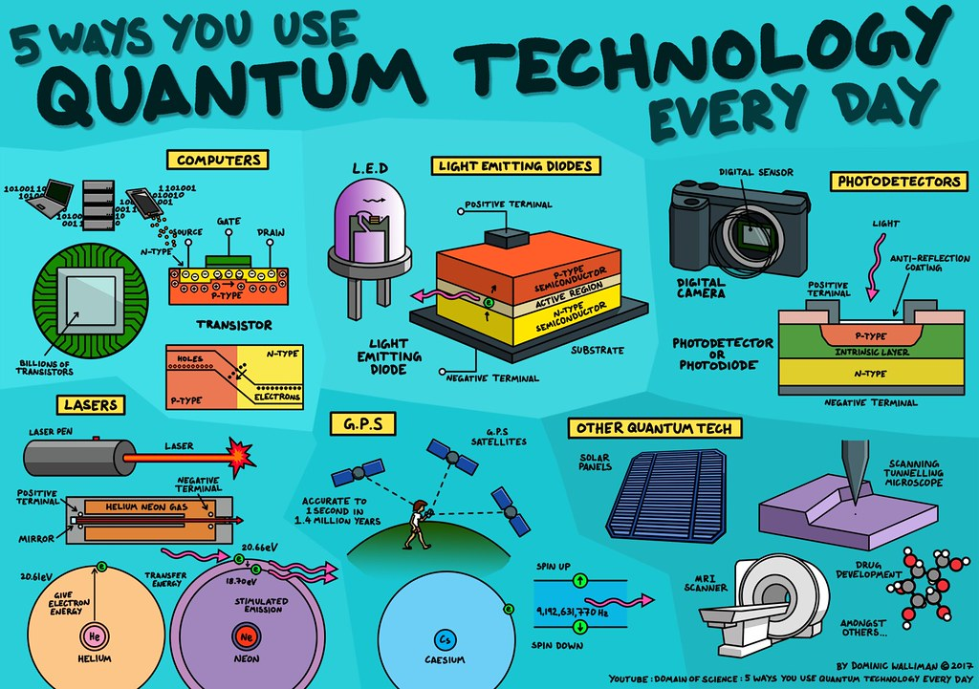
Where is the African Quantum initiatives?

Slide 7

Atomic & Molecular Physics working group
What next for you/us?
Upcoming activities
  Workshop/meetings on LOIs
  AMP school/conference??
  …
Join the working group
Participate in building the community
Submit LOIs
Contribute to physics in Africa
Stephane Kenmoe,
University of Duisburg-Essen, Germany.
Co-convener
Energy and fuels production
from molecules decomposition
asfap-atomicMolecular@cern.ch

Slide 8
Atomic & Molecular Physics working group
Co-convener
+ Optical group
Stephane Kenmoe,
University of Duisburg-Essen, Germany.
Research area:
Energy and fuels production
from molecules decomposition
Come and let’s make Africa great!
asfap-atomicMolecular@cern.ch

