Slide 1
Pandora efficiency monitoring: results on photons and leptons
J. Nardulli, P. Speckmayer
with a lot of help from J.J. Blaising and E. van der Kraaij
PS I apologize, but this is going to be a long talk full of plots !

Slide 2
Outline
The Pandora Efficiency Monitoring algorithm
Results for photons in ILD
Muon Results with Erik’s new PandoraPFA Muon reconstruction algorithm, see
http://ilcagenda.linearcollider.org/getFile.py/access?contribId=301&sessionId=80&resId=0&materialId=slides&confId=4507
Results for electrons
Attempts to recover efficiency for electrons/photons via shower-reconstruction

Slide 3
Outline
The Pandora Efficiency Monitoring algorithm
Results for photons in ILD
Muon Results with Erik’s new PandoraPFA Muon reconstruction algorithm
Results for electrons
Attempts to recover efficiency for electrons/photons via shower-reconstruction

Slide 4
Motivation
Common definition for efficiency and purity
Pandora algorithm: for ILD, SiD and all particle types

Slide 5
MC particle efficiency, purity
Set the PDG code
select “findable” MC particles:
  all MC-PFOs with chosen (user) PDG code
analyze PFOs
  found
    PFO/MC matching PDG code
    >50% E in CaloHits from MC with matching PDG code
    cut:
    (params. can be set by user)
  fake
    PFO has right PDG code
    but criteria not met
  other
    PFO has different PDG code
remaining MCs:
  not found MCs
fake PFO
PFO found
other PFO
MC found
MC not found
findable MCs

Slide 6
MC particle efficiency, purity
Set the PDG code
select “findable” MC particles:
  all MC-PFOs with chosen (user) PDG code
analyze PFOs
  found
    PFO/MC matching PDG code
    >50% E in CaloHits from MC with matching PDG code
    cut:
    (params. can be set by user)
  fake
    PFO has right PDG code
    but criteria not met
  other
    PFO has different PDG code
remaining MCs:
  not found MCs
two PFOs found (MC particle is split)
efficiency can be > 100%
→ can be avoided by adjusting energy cut
MC found

Slide 7
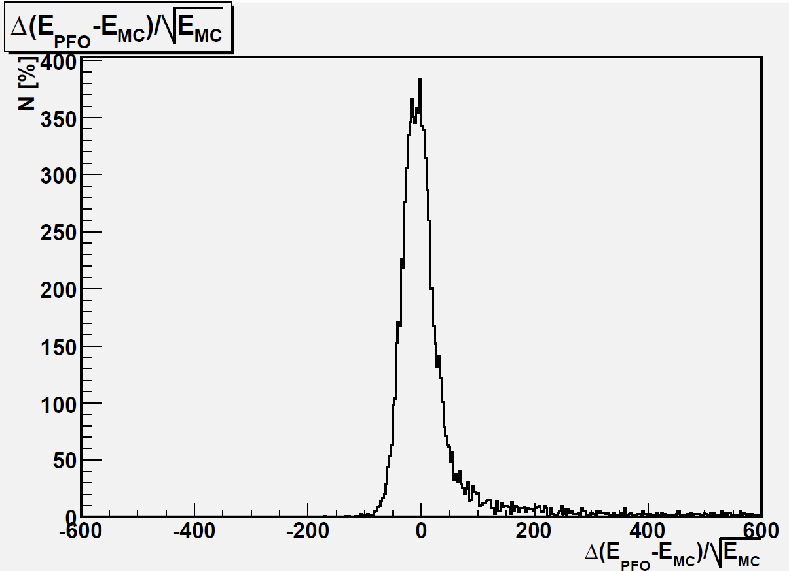
Resolution plots for 100 GeV photons
CLIC_ILD

Slide 8
Definition: efficiency
efficiency → for MC particles
  found MCs/findable MCs
    for all MCs (overall number +plots: eff. vs. theta, eff. vs. E)
    avg. for all MCs per event (overall number)
purity → PFO based
  found PFOs/(found PFOs + fake PFOs)
    for all PFOs (overall number +plots: purity vs. theta, purity vs. E)
    avg. for all PFOs per event (overall number)

Slide 9
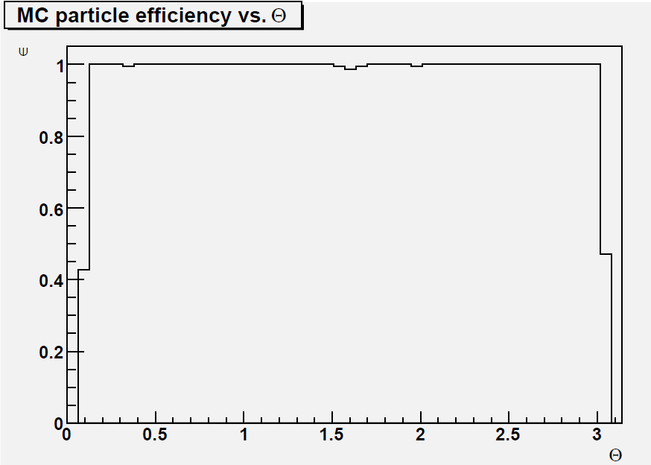
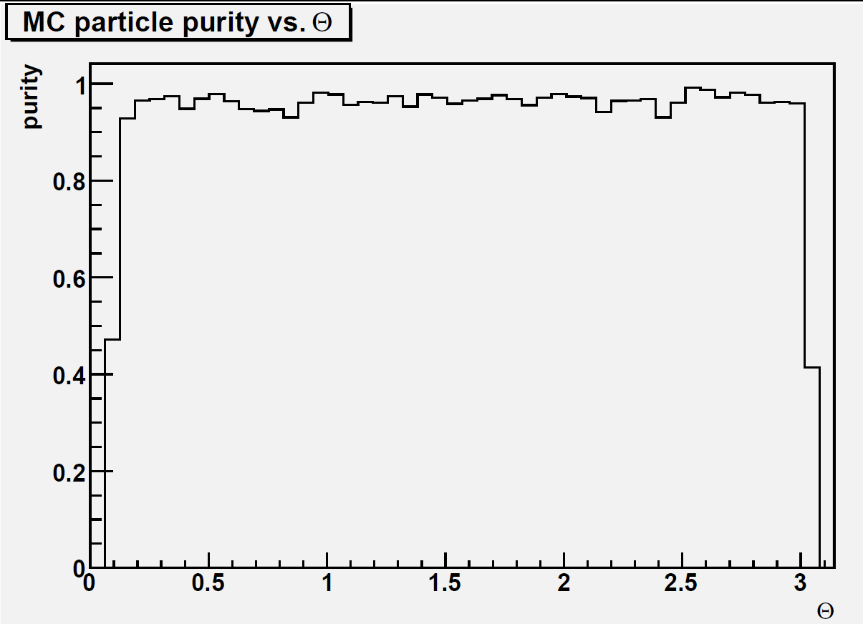
Efficiency and purity vs Theta single 5 GeV photons
CLIC_ILD
Avg. Eff. per event: 98.2%
CLIC_ILD
Avg. Purity Per event: 95.4%
Every plot here has 10000 events

Slide 10
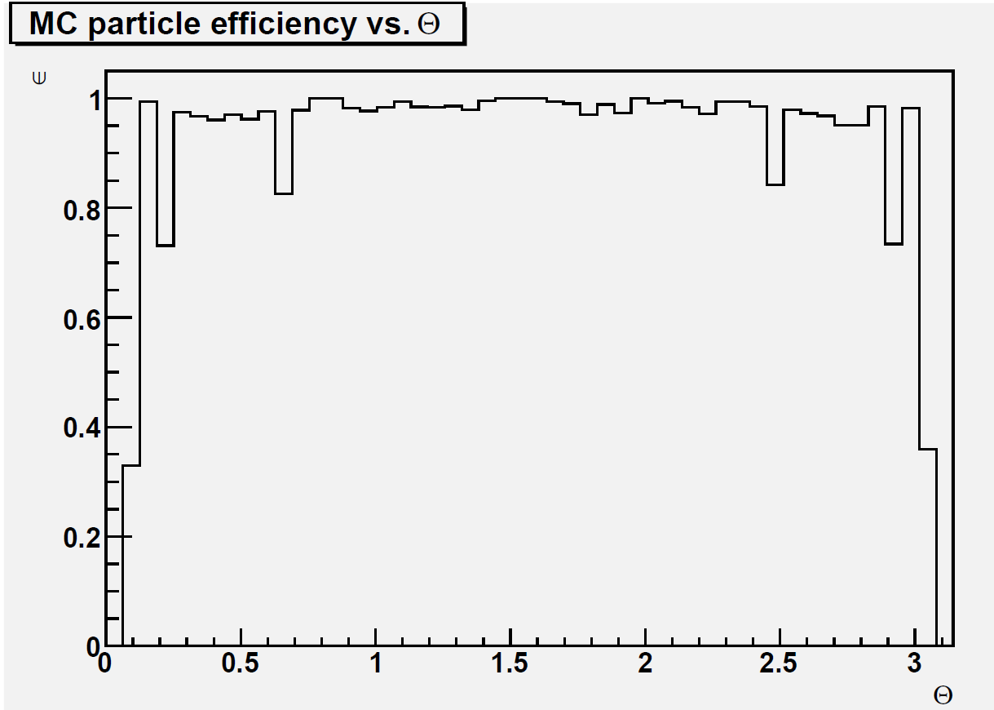
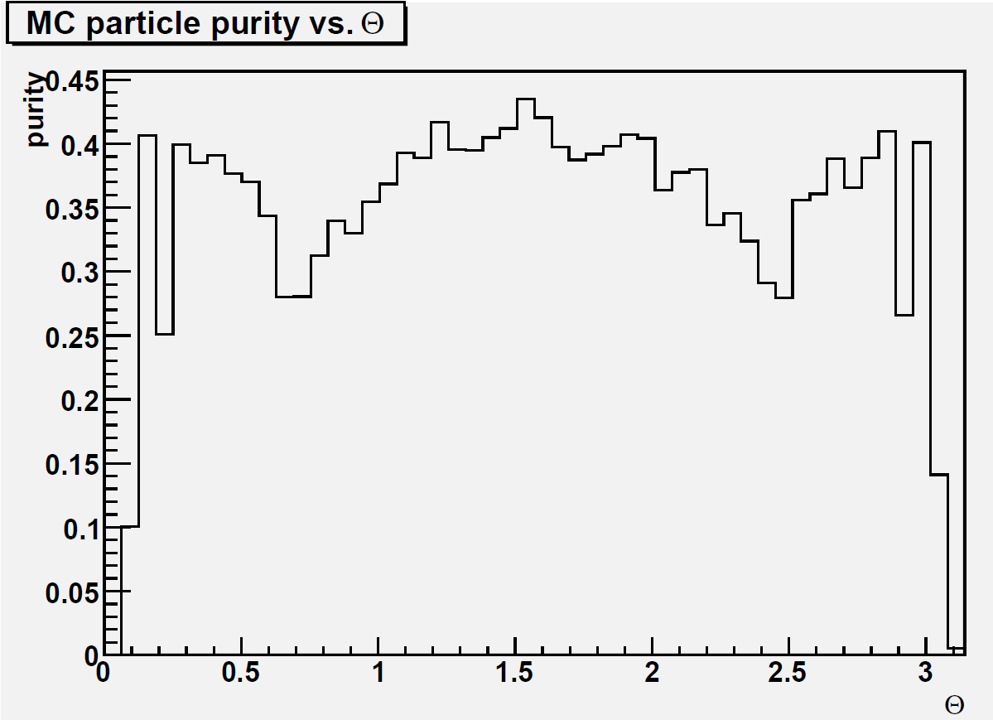
Efficiency and purity vs Theta
Single 100 GeV photons
CLIC_ILD
Avg. Eff. per event: 90.4%
CLIC_ILD
Avg. Purity per event: 47.4%
~10k events

Slide 11
CaloHit efficiency, purity
true positive
false positive
false negative
true negative
CaloHit efficiency for MCs
  truePositive/ (truePositive +falseNegative)
CaloHit purity for PFOs
  truePositive/ (truePositive+falsePositive)
PFO: neutron
PFO: photon
PFO: pion
MC: photon

Slide 12
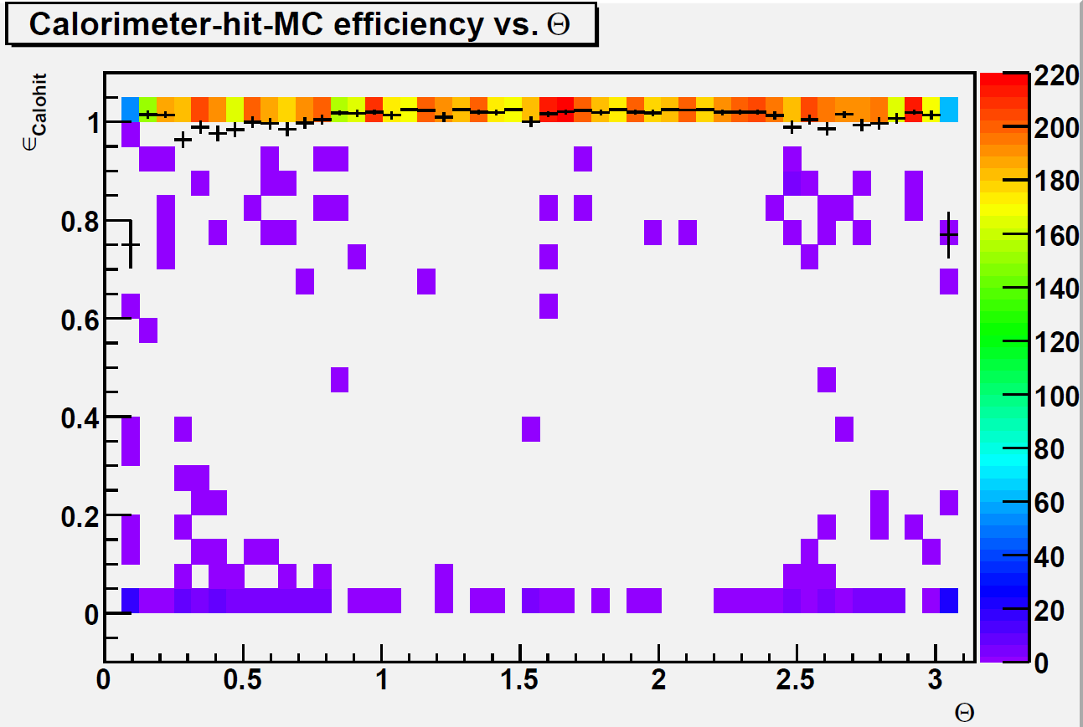
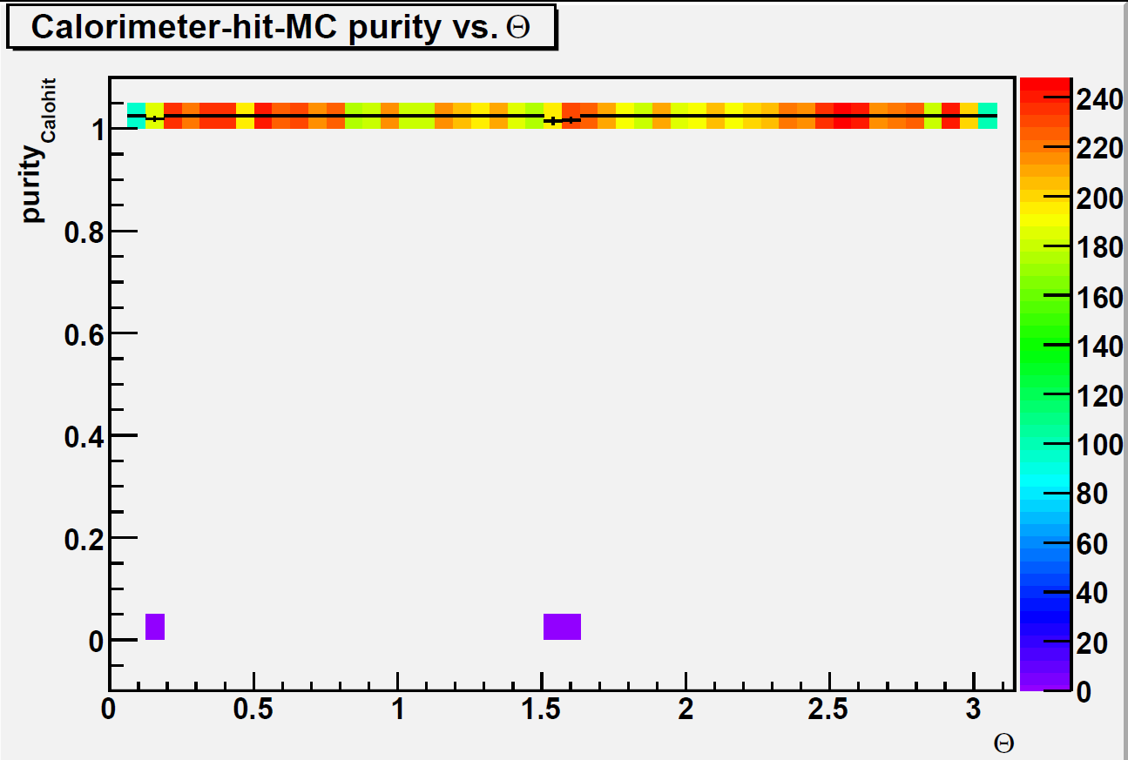
CaloHit Efficiency and purity vs. Theta
5 GeV single photons
CLIC_ILD
CLIC_ILD
Every plot here has 10000 events

Slide 13
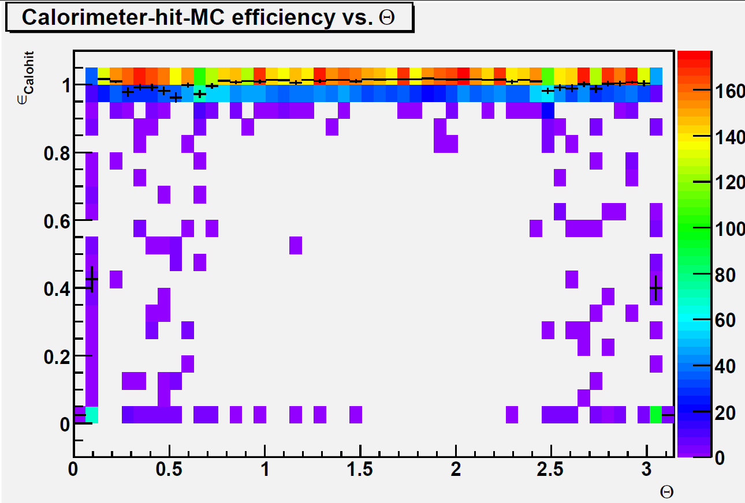
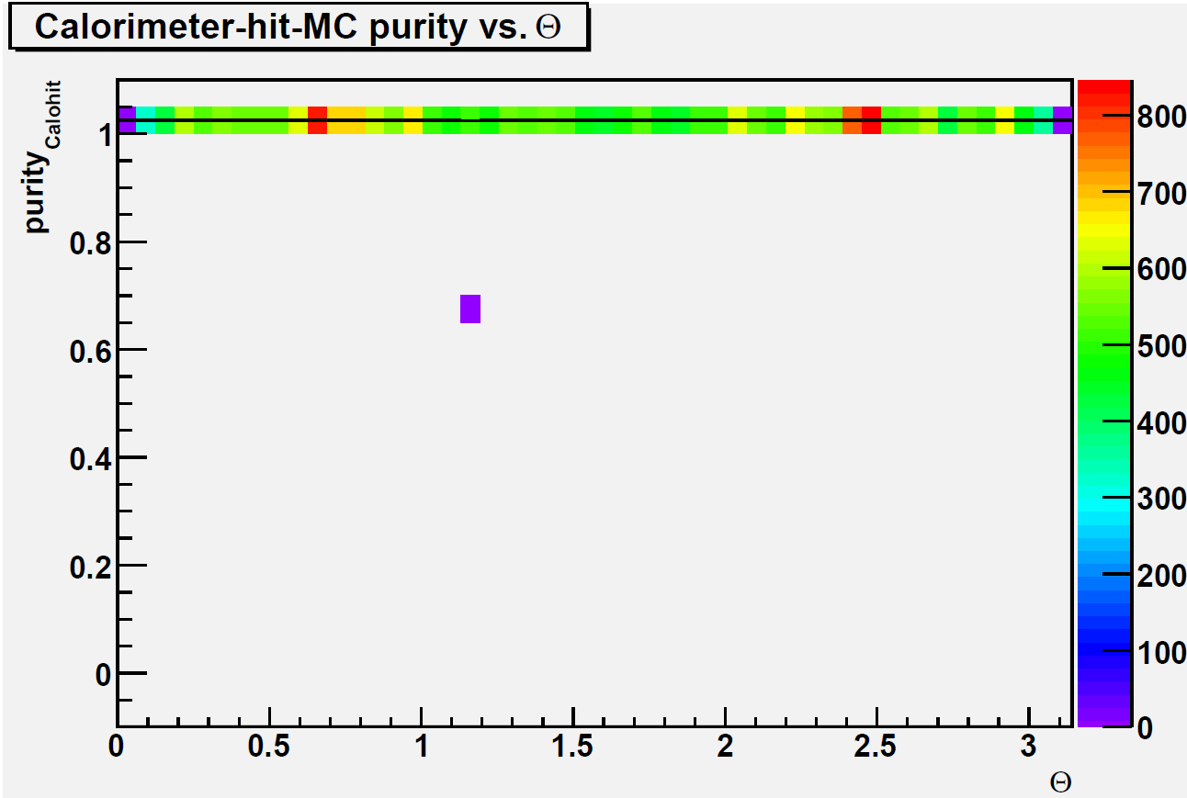
CaloHit Efficiency and purity vs. Theta
100 GeV single photons
CLIC_ILD
CLIC_ILD
Every plot here has 10000 events

Slide 14
Pandora settings snippet
Histogram binning (energy)
(exists as well for theta)
PDG code
Algorithm name
<algorithm type = "EfficiencyMonitoring" description = "effmon">
<ParticleId>22</ParticleId>
<EnergyBinning>550 -1.0 500.0</EnergyBinning>
<CalorimeterResolutionStochasticCut>200.</CalorimeterResolutionStochasticCut>
<CalorimeterResolutionConstantCut>20.</CalorimeterResolutionConstantCut>
<MinCaloHitEnergyFraction>50.</MinCaloHitEnergyFraction>
<MonitoringFileName>effmon.root</MonitoringFileName>
</algorithm>
ROOT filename
Stochastic energy resolution cut (in %)
cut on min. fraction of E from chosen PDG
constant energy resolution cut (in %)

Slide 15
Outline
The Pandora Efficiency Monitoring algorithm
Results for photons in ILD
Muon Results with Erik’s new PandoraPFA Muon reconstruction algorithm, see
http://ilcagenda.linearcollider.org/getFile.py/access?contribId=301&sessionId=80&resId=0&materialId=slides&confId=4507
Results for electrons
Attempts to recover efficiency for electrons/photons via shower-reconstruction

Slide 16
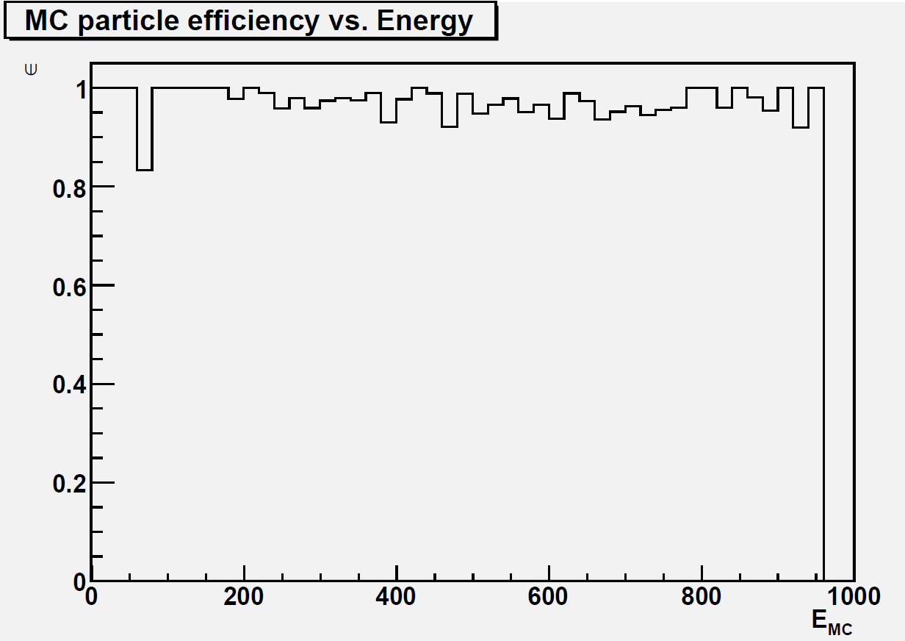
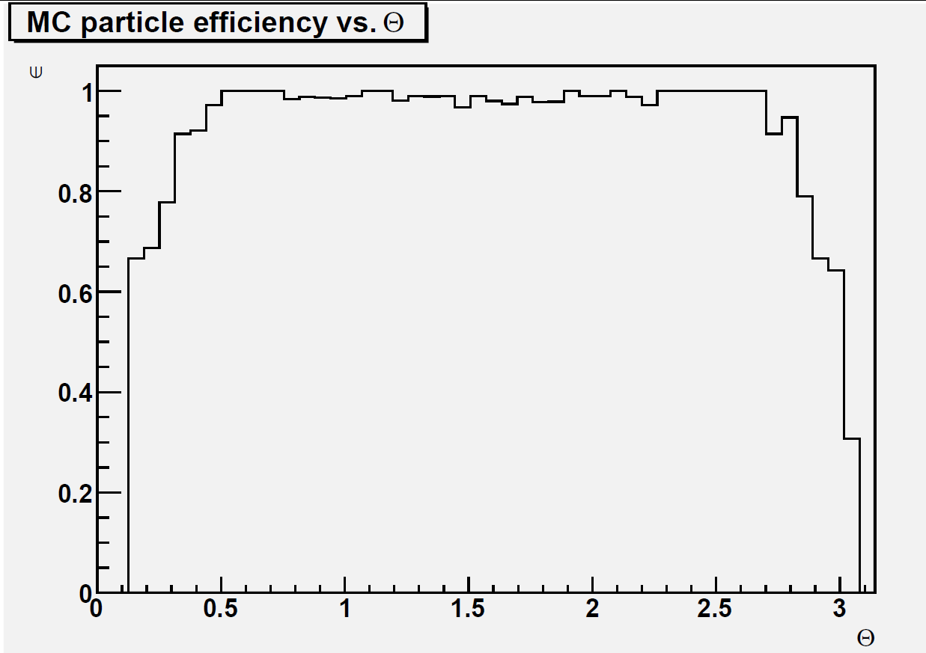
Efficiency: muons from smuons sample
Efficiency vs Energy.
Avg. Eff. per event: 97%
Efficiency vs Theta
Every plot here has 3000 events

Slide 17
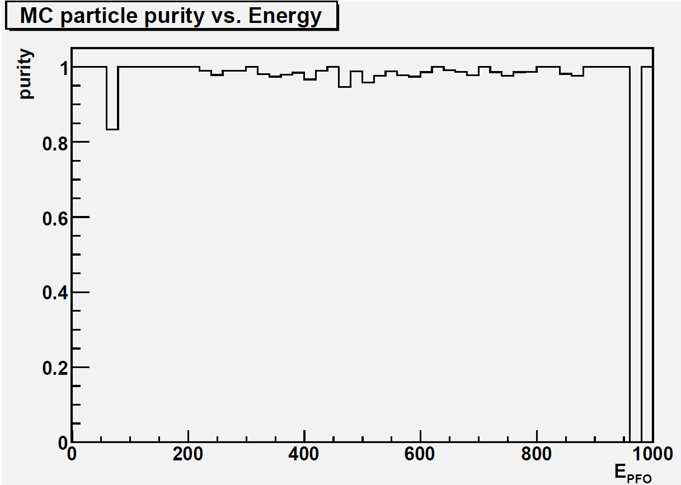
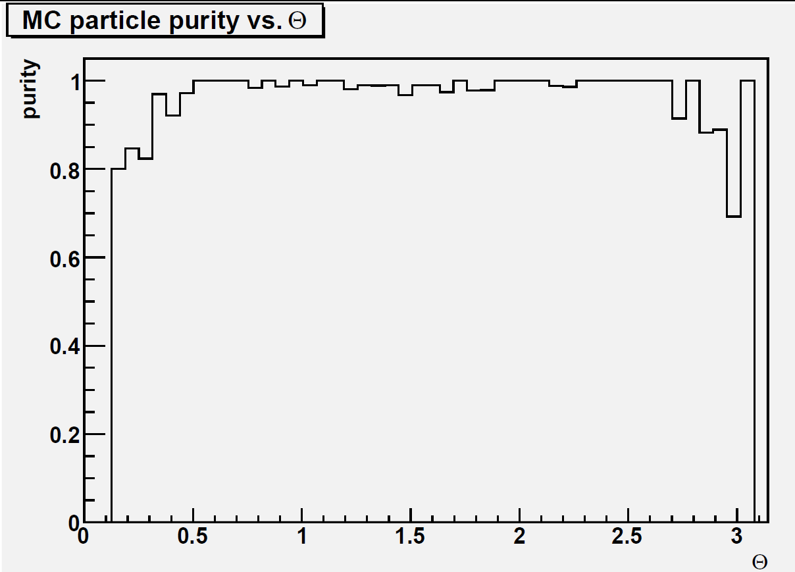
Purity: muons from smuons sample
Purity vs Energy
Avg. Purity per event: 98%
Purity vs Theta
Every plot here has 3000 events

Slide 18
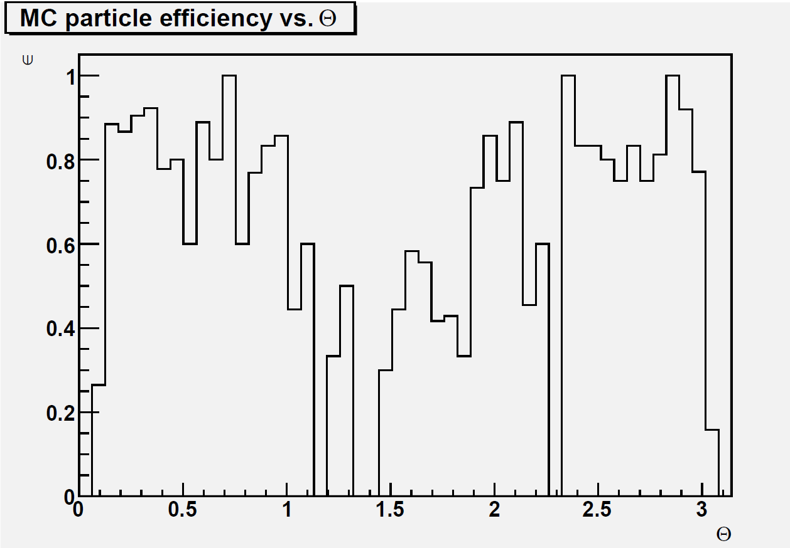
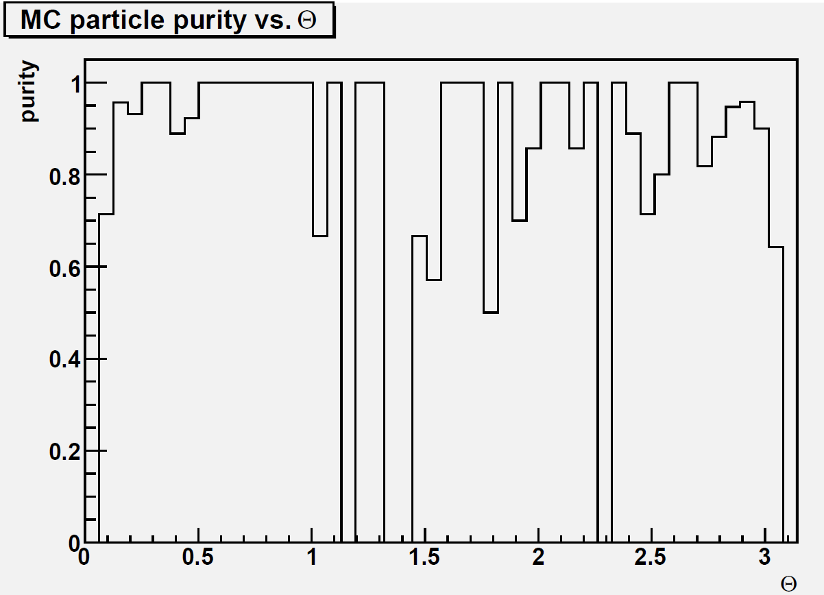
Muons from Z’→bb jets
Eff vs Theta
Avg. Purity per event: 93%
Purity vs Theta
Avg. Efficiency per event: 59%
Every plot here has ~1k events

Slide 19
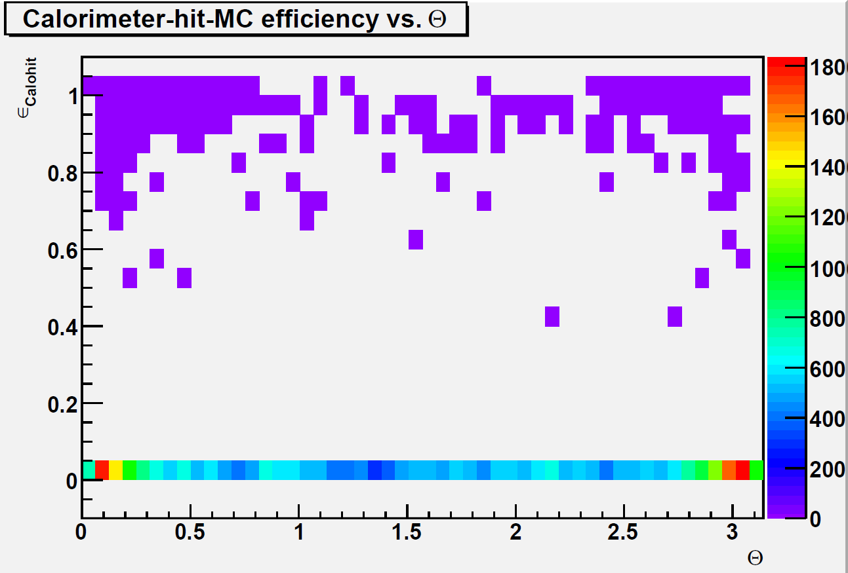
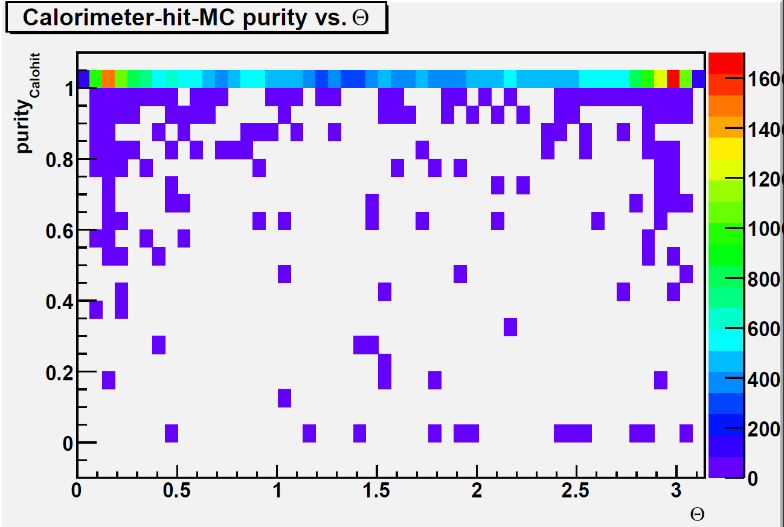
Muons from Z’→bb jets
CaloHit Eff vs Theta
CaloHit Purity vs Theta
What does this mean ?
We have a lot of false Negative → low efficiency
→ many times a PFO in the CAL which was a muon was a assigned as something else
And a few falsePositive → high purity
→ rarely what is “something else” is assigned to be a muon
Every plot here has ~1k events

Slide 20
Outline
The Pandora Efficiency Monitoring algorithm
Results for photons in ILD
Muon Results with Erik’s new PandoraPFA Muon reconstruction algorithm
Results for electrons
Attempts to recover efficiency for electrons/photons via shower-reconstruction

Slide 21
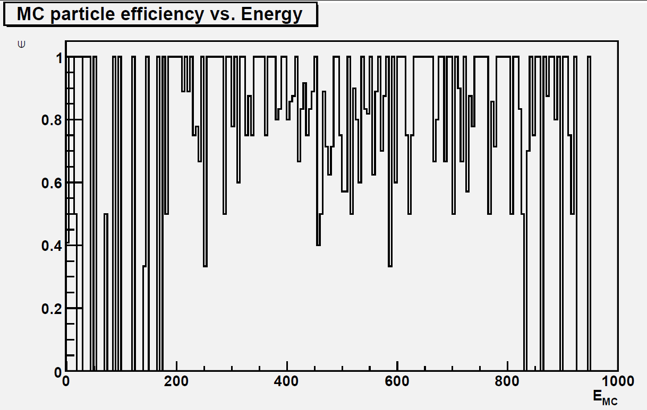
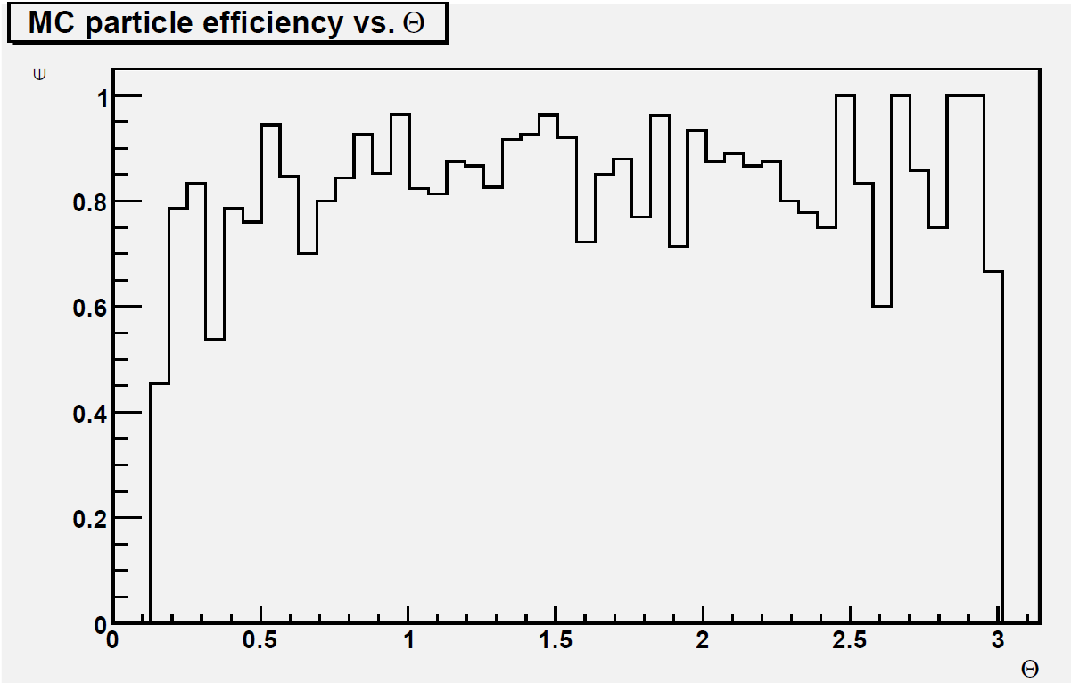
Efficiency: electrons from selectrons sample
Efficiency vs Energy.
Avg. Eff. per event: 84.1 %
Efficiency vs Theta
Every plot here has ~1k events

Slide 22
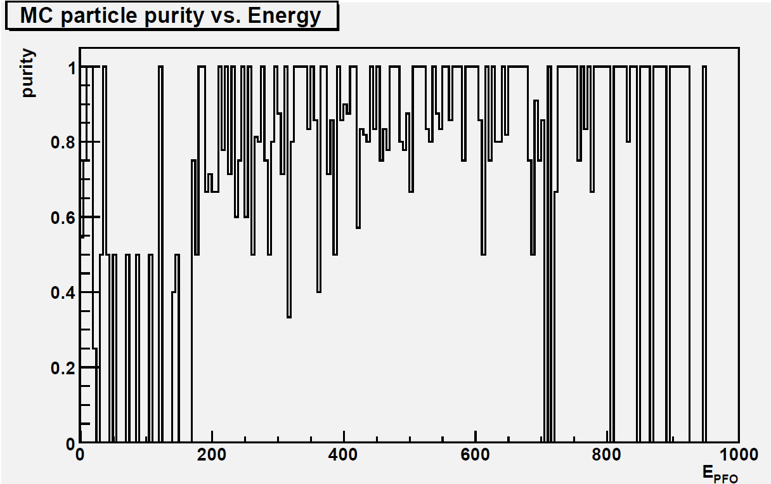
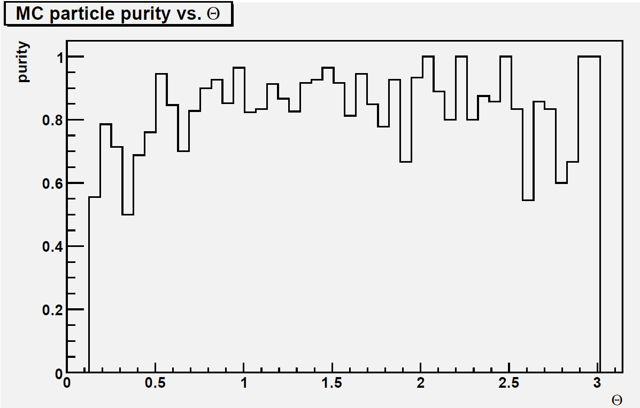
Purity: electrons from selectrons sample
Purity vs Energy
Avg. Purity per event: 85.2%
Purity vs Theta
Every plot here has ~1k events

Slide 23
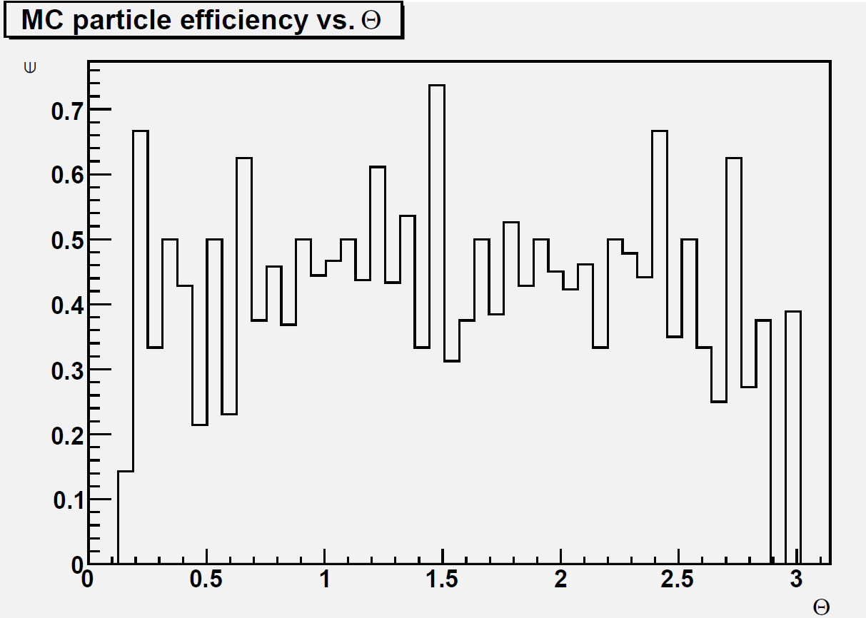
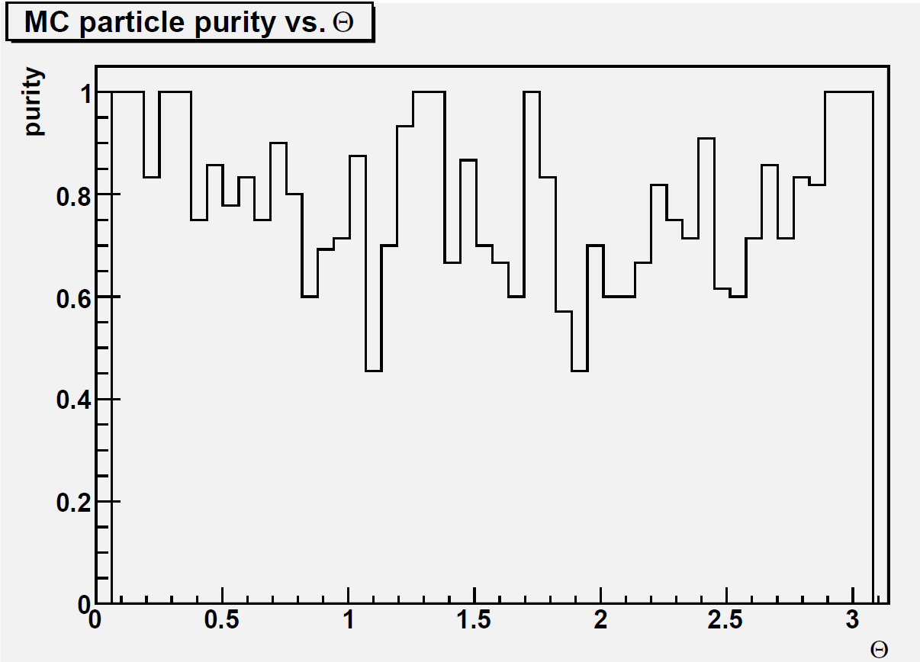
Electrons from Z→uds jets
Eff vs Theta
Avg. Purity per event: 77.2%
Purity vs Theta
Avg. Efficiency per event: 46.2 %
Every plot here has ~1k events

Slide 24
Outline
The Pandora Efficiency Monitoring algorithm
Results for photons in ILD and SiD
Muon Results with Erik’s new PandoraPFA Muon reconstruction algorith
Results for electrons
Attempts to recover efficiency for electrons/photons via shower-reconstruction

Slide 25
Attempts to recover efficiency for electrons and photons
At high energies the identification efficiency for photons and electrons decreases
We are working on an algorithm to try to recover the efficiency loss
The idea is to try to reconstruct the products of the shower

Slide 26
Various possibilities are considered
For electrons
  e- → e- γ ;
  e- → e-e+e-;
  e- → e-e+e- γ;
  e- → e-e+e- γ γ
For photons
  γ → e-e+ ;
  γ → γ e-e+ ;
  γ → γ e-e+ γ
Shower reconstruction based on position and energy of final state particles → No results on this yet
26

Slide 27
Summary
Efficiency/Purity monitoring algorithm for Pandora available
  eff/purity histograms vs. theta/E created
  ROOT TTree with all info created
  committed in SVN (HEAD)
Algorithm has been tested on photons for ILD/SiD → see previous results
And also on electrons and muons from selectrons/smuons samples and from jets
Work is ongoing in writing an algorithm to reconstruct showers

Slide 28
Backup

