Slide 1


Relativistic Description of the Ground State
of Atomic Nuclei Including Deformation
and Superfluidity
Jean-Paul EBRAN
CEA/DAM/DIF
24/11/2010

Slide 2
Goal
  Description of the ground state of atomic nuclei including nuclear deformation and superfluidity
Tool
  RHFB model in axial symmetry

Slide 3
CONTENTS
INTRODUCTION AND CONTEXT
Why a relativistic approach ?
Why a mean field framework ?
Why the Fock term ?
THE RELATIVISTIC HARTREE-FOCK-BOGOLIUBOV MODEL
DESCRIPTION OF THE Z=6,10,12 NUCLEI
Ground state observables
Shell Structure
Role of the pion in the relativistic mean field models

Slide 4
1) Introduction and context 2) The RHFB approach 3) Results
INTRODUCTION AND CONTEXT
A) Why a relativistic approach ?
Non-relativistic nuclear kinematics :
Nuclear structure theories linked to low-energy QCD effective models
➲ Many possible formulations, but not equally efficient
We’ll see that relativistic formulation simpler and more efficient than non-relativistic approach :
Relevance of covariant approach not imposed by the need of a relativistic nuclear kinematics, but rather linked to the use of Lorentz symmetry

Slide 5
1) Introduction and context A. Why a relativistic approach ?
Nucleonic equation of motion:
Dirac equation constructed according to Lorentz symmetry
Involves relativistic potentials S and V
Relativistic potentials :
S ~ -400 MeV : Scalar attractive potential
V ~ +350 MeV : 4-vector (time-like componant) repulsive potential
Use of these relativistic potentials leads to a more efficient description of nuclear systems compared to non-relativistic models

Slide 6


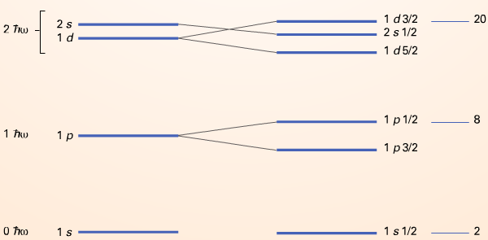
1) Introduction and context A. Why a relativistic approach ?
  S and V potentials characterize the essential properties of nuclear systems :
    Central Potential : quasi cancellation of potentials
    Spin-orbit : constructive combination of potentials
Spin-orbit
Pseudo-doublets quasi degenerate
Relativistic interpretation : comes from
the fact that |V+S|«|S|≈|V|
( J. Ginoccho PR 414(2005) 165-261 )
Pseudo-Spin symmetry
    Nuclear systems breaking the time reversal symmetry characterized by currents
    which are accounted for through space-like component
    of the 4-potentiel :
Magnétism

Slide 7
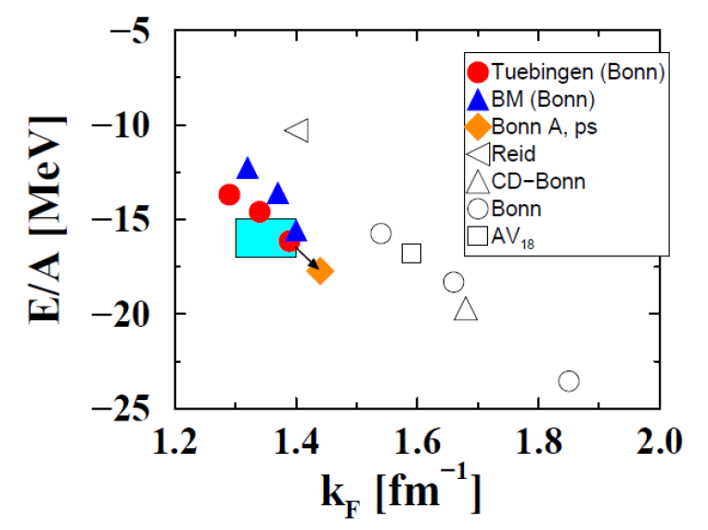
1) Introduction and context A. Why a relativistic approach ?
    Saturation mechanism in infinite nuclear matter
Figure from C. Fuchs
(LNP 641: 119-146 ,
2004)

Slide 8
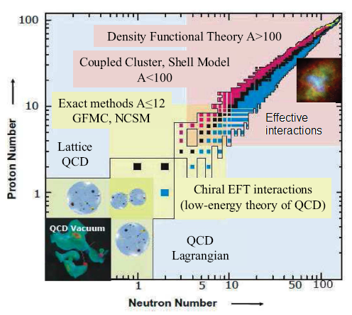
1) Introduction and context B. Why a mean field framework ?
B) Why a mean field framework ?
Figure from S.K. Bogner et al.
(Prog.Part.Nucl.Phys.65:94-147,2010 )
Self-consistent mean field model is in the best position to achieve a universal description of the whole nuclear chart

Slide 9
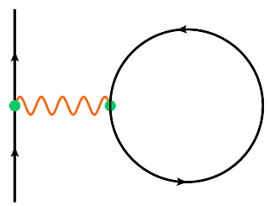
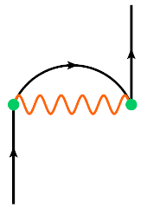
1) Introduction and context C. Why the Fock term ?
C) Why the Fock term ?
Relativistic mean field models usually treated at the Hartree approximation (RMF)
Fock contribution implicitly taken into account through the fit to data
Corresponding parametrizarions (DDME2, …) describe with success nuclear structure data
RHB in axial symmetry
D. Vretenar et al
(Phys.Rep. 409:101-259,2005)
N
N
RHFB in spherical symmetry
W. Long et al
(Phys. Rev.C81:024308, 2010)
N
N
HARTREE
FOCK

Slide 10


1) Introduction and context C. Why the Fock term ?
Effective Mass
Effective mass linked to the fact that :
Interacting nuclear system ⇔ free quasi-particles system with an energy e, a mass M^{eff} evolving in the mean potential V
Two origins of the modification of the free mass :
Spatial non-locality in the mean potential : mainly produced by the Fock term
Temporal non-locality in the mean potential
Explicit treatment of the Fock term induces a spatial non-locality in the mean potential contrary to RMF
➲ Differences in the effective mass behaviour expected between RHF and RMF

Slide 11
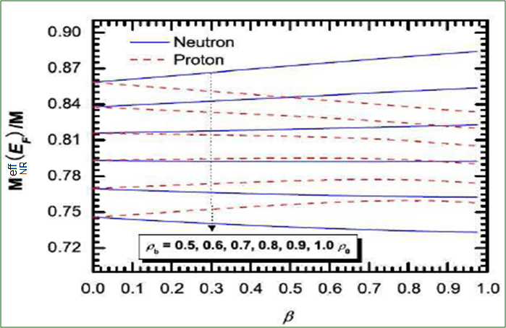
1) Introduction and context C. Why the Fock term ?
Effective Mass
Figures from W. Long et al
(Phys.Lett.B 640:150, 2006)
Effective mass in symmetric nuclear matter obtained with the PKO1 interaction

Slide 12
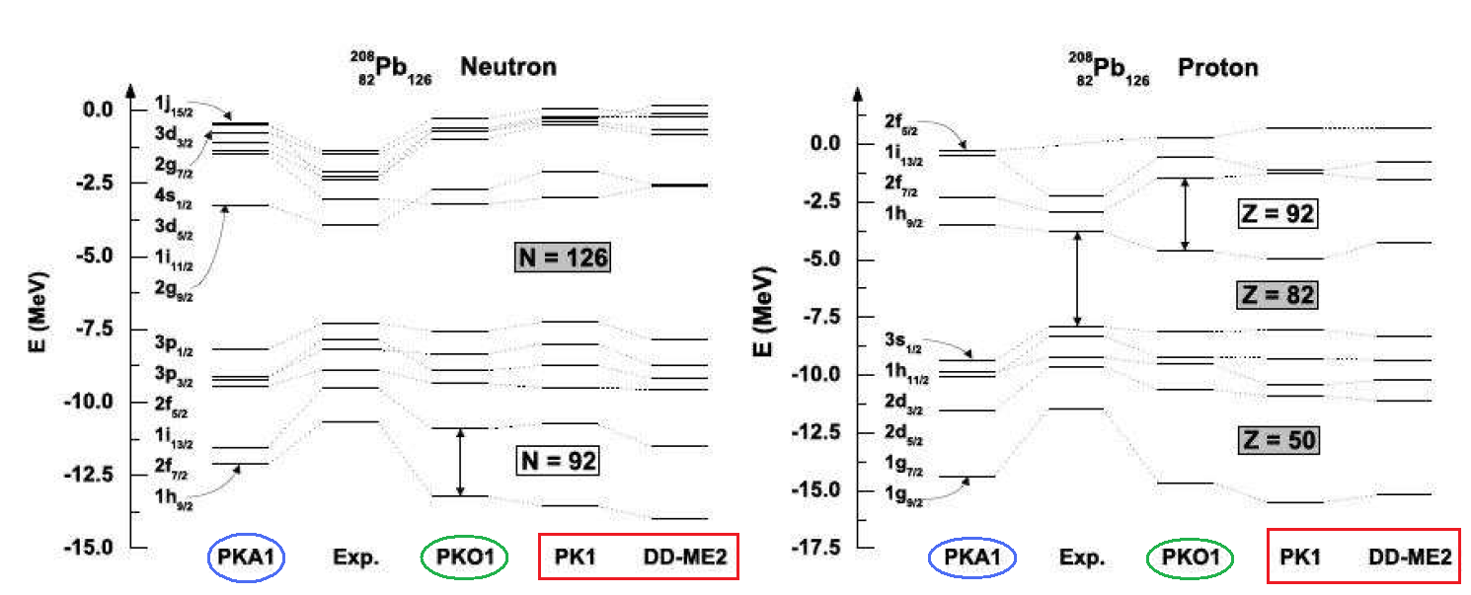
1) Introduction and context C. Why the Fock term ?
Shell Structure
Figure from N. van Giai
(International Conference Nuclear Structure and Related Topics, Dubna, 2009)
Explicit treatment of the Fock term ⇒ introduction of pion + ρN tensor coupling
ρN tensor coupling (accounted for in PKA1 interaction) leads to a better description of the shell structure of nuclei: artificial shell closure are cured fermeture (N,Z=92 for example)

Slide 13
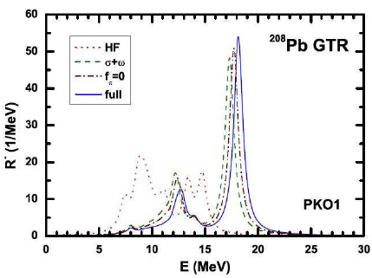
1) Introduction and context C. Why the Fock term ?
RPA : Charge exchange excitation
Figure from H. Liang et al.
(Phys.Rev.Lett. 101:122502, 2008)
RHF+RPA model fully self-consistent contrary to RH+RPA model

Slide 14
1) Introduction and context 2) The RHFB approach 3) Results
Summary
We prefer a covariant formalism : leads to a more efficient desciption of nuclear systems
Choice of a mean-field framework : is at the best position to provide a universal description of the whole nuclear chart
Explicit treatment of the Fock term
In order to describe deformed and superfluid system, development of a Relativistic Hartree-Fock-Bogoliubov model in axial symmetry : at present the most general description
RHB in axial symmetry
D. Vretenar et al
(Phys.Rep. 409:101-259,2005)
RHFB in axial symmetry
J.-P. Ebran et al
(arXiv:1010.4720)
RHFB in spherical symmetry
W. Long et al
(Phys. Rev.C81:024308, 2010)

Slide 15
CONTENTS
INTRODUCTION AND CONTEXT
Why a relativistic approach ?
Why a mean field framework ?
Why the Fock term ?
THE RELATIVISTIC HARTREE-FOCK-BOGOLIUBOV MODEL
DESCRIPTION OF THE Z=6,10,12 NUCLEI
Ground state observables
Shell Structure
Role of the pion in the relativistic mean field models

Slide 16
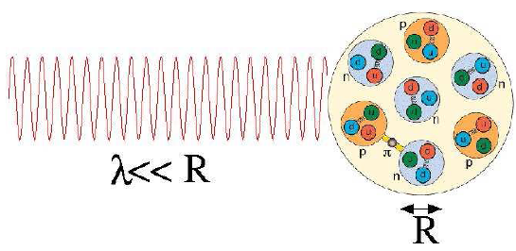
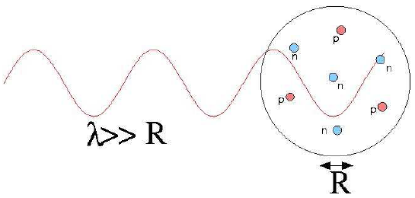
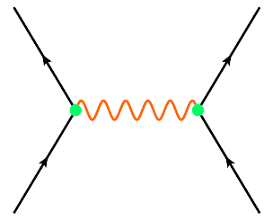
1) Introduction and context 2) The RHFB approach 3) Results
The RHFB Approach
Relevant degrees of freedom for nuclear structure : nucleons + mesons
Figures from R.J. Furnstahl
(Lecture Notes in Physics 641:1-29, 2004)
mesons,photon
N
N
Self-consistent mean field formalism : in-medium effective interaction designed to be use altogether with a ground-state approximated by a Slater determinent
➲ Mesons = effective degrees of freedom which generate the NN in-medium interaction : π(J^{Π},T = 0⁻,1 ) σ(0⁺,0) ω(1⁻,0) ρ(1⁻,1)

Slide 17
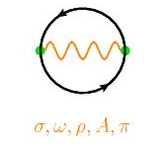
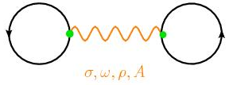
2) L’approche RHFB
Lagrangian
Characterized by 8 free parameters fitted on the mass of 12 spherical nuclei + nuclear matter saturation point
Legendre transformation
Hamiltonian
Quantization
Mean-field approximation : expectation value in the HFB ground state
EDF
N
N
N
N
RHFB equations
Minimization
Resolution in a deformed harmonic oscillator basis
Observables

Slide 18
CONTENTS
INTRODUCTION AND CONTEXT
Why a relativistic approach ?
Why a mean field framework ?
Why the Fock term ?
THE RELATIVISTIC HARTREE-FOCK-BOGOLIUBOV MODEL
DESCRIPTION OF THE Z=6,10,12 NUCLEI
Ground state observables
Shell Structure
Role of the pion in the relativistic mean field models

Slide 19
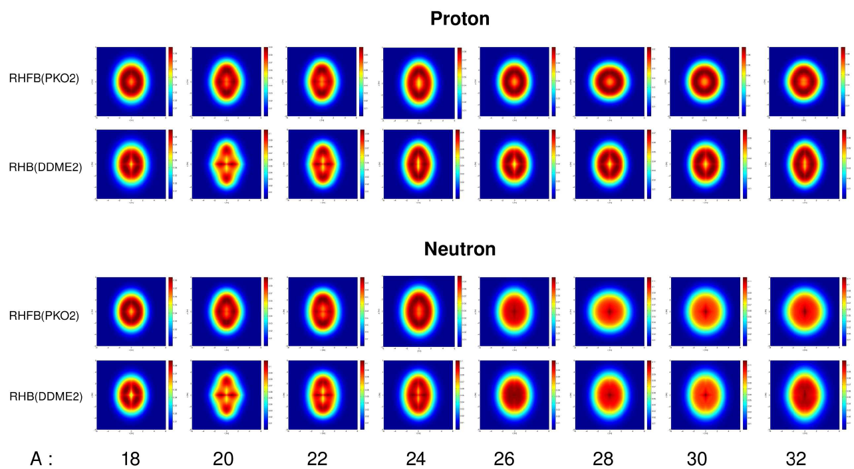

1) Introduction and context 2) The RHFB approach 3) Results
Description of the Z=6,10,12 isotopes
A) Ground state observables
Nucleonic density in the Neon isotopic chain

Slide 20
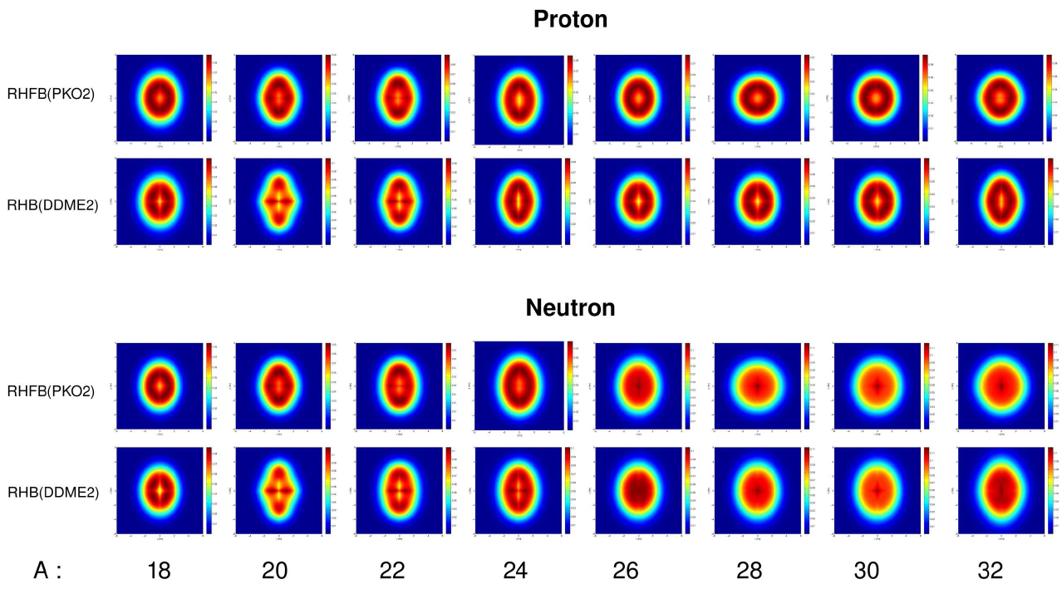

Slide 21
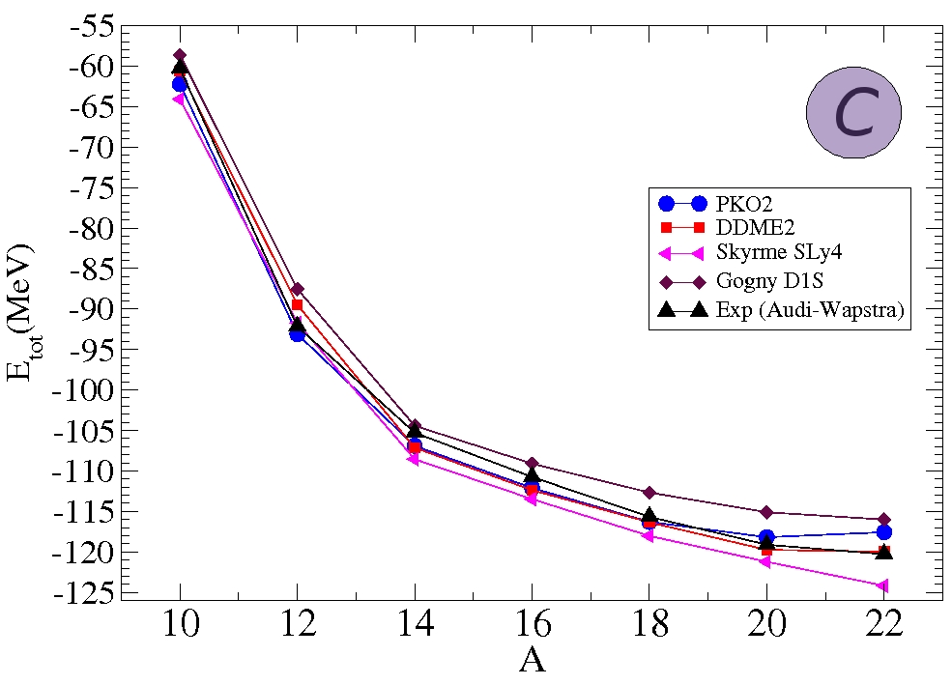
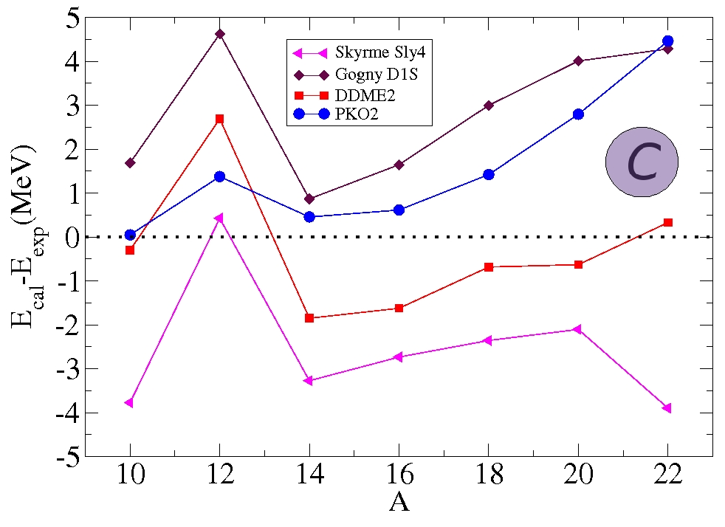
3) Results A. Ground state observables
    Masses
    Calculation obtained with the PKO2 interaction: ¹⁰C, ¹⁴C and ¹⁶C are better reproduce with the RHFB model

Slide 22
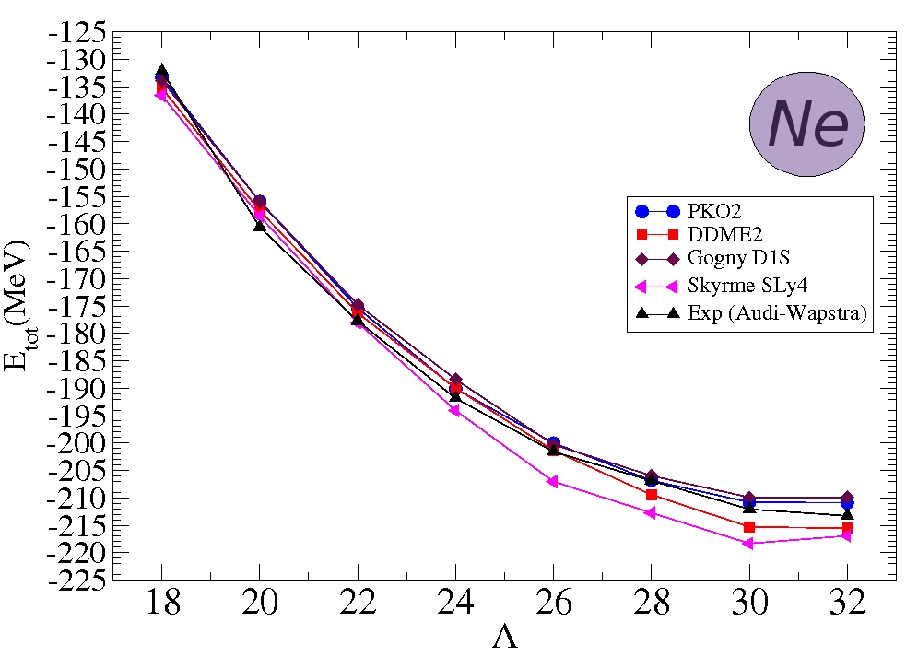
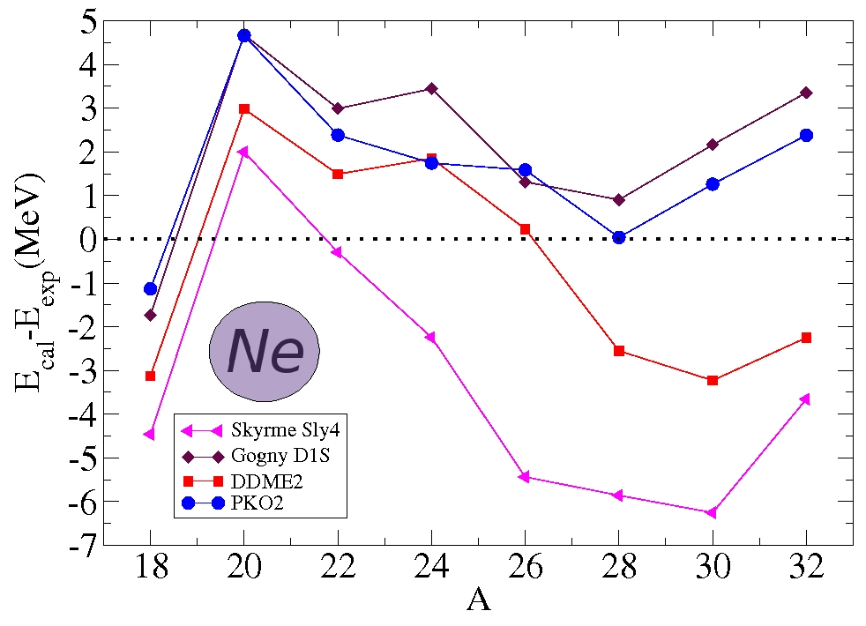
3) Results A. Ground state observables
    Masses
    Good agreement between RHFB calculations and experiment

Slide 23
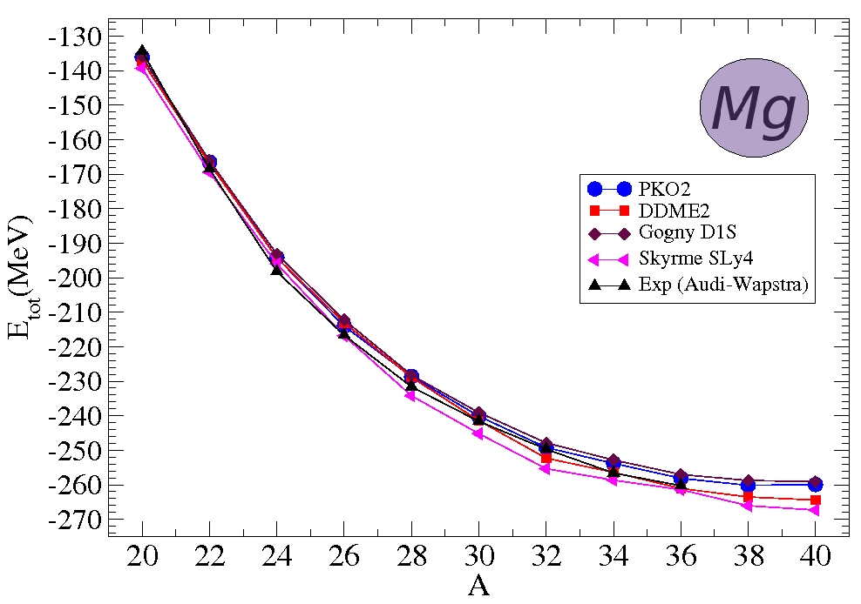
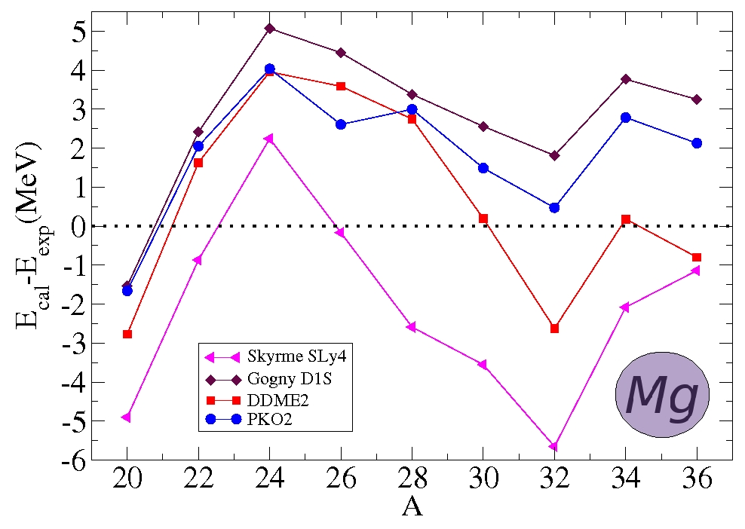
3) Results A. Ground state observables
    Masses
    ➲ RHFB model successfully describes the Z=6,10,12 isotopes masses

Slide 24
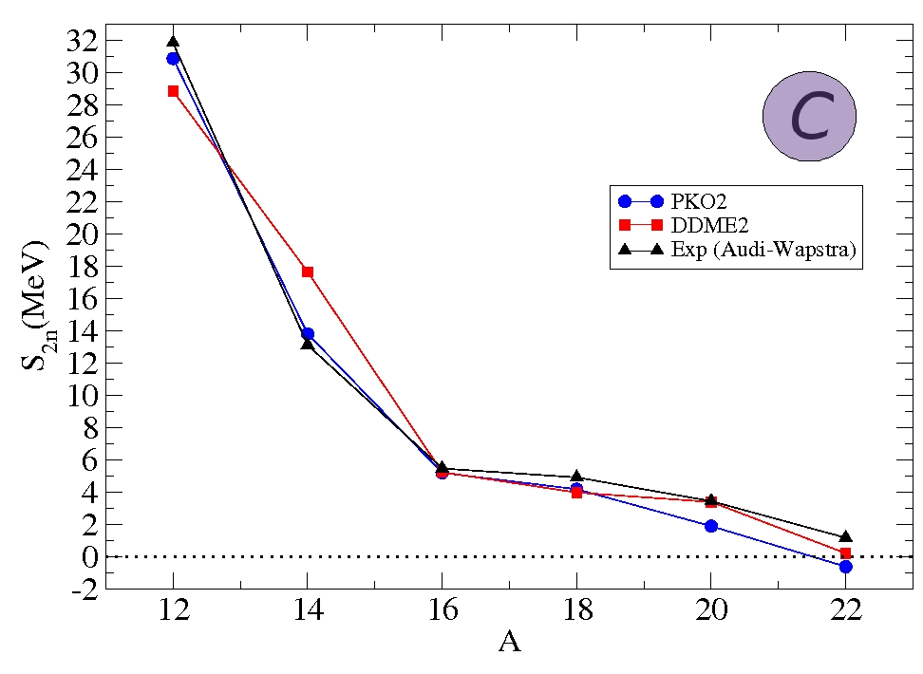
3) Results A. Ground state observables
    Two-neutron drip-line
    Two-neutron separation energy E : S_{2n} = E_{tot}(Z,N) – E_{tot}(Z,N-2). Gives global information on the Q-value of an hypothetical simultaneous transfer of 2 neutrons in the ground state of (Z,N-2)
    S_{2n} < 0 ⇒ (Z,N) Nucleus can spontaneously and simultaneously emit two neutrons ⇒ it is beyond the two-neutron drip-line
    PKO2 : Drip-line between ²⁰C and ²²C

Slide 25
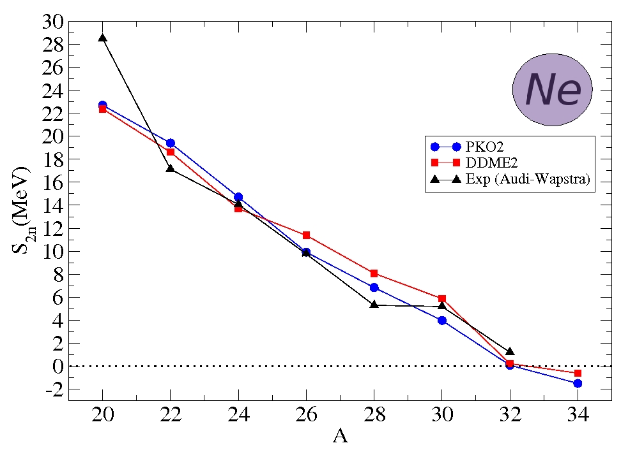
3) Results A. Ground state observables
    Two-neutron drip-line
    PKO2 : Drip-line between ³²Ne and ³⁴Ne

Slide 26
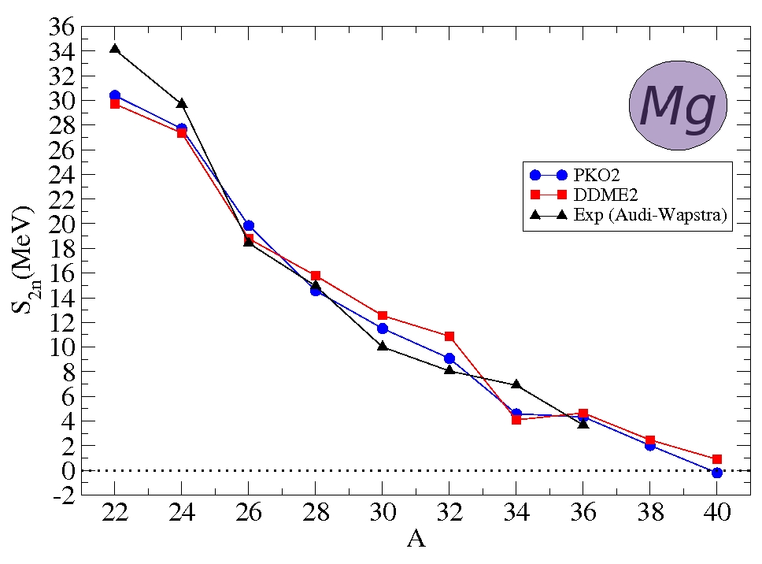
3) Results A. Ground state observables
    Two-neutron drip-line
    In the Z=12 isotopic chain, PKO2 localizes the drip-line between ³⁸Mg and ⁴⁰Mg
    S_{2n} from PKO2 generally in better agreement with data than DDME2.

Slide 27
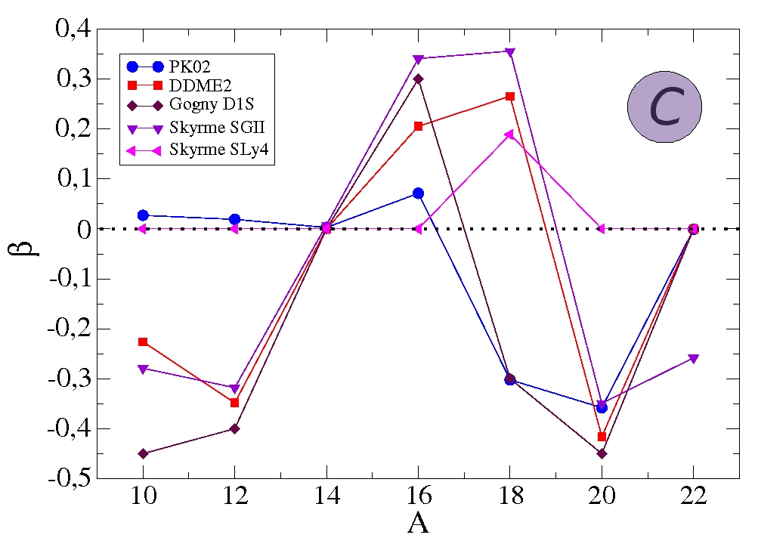
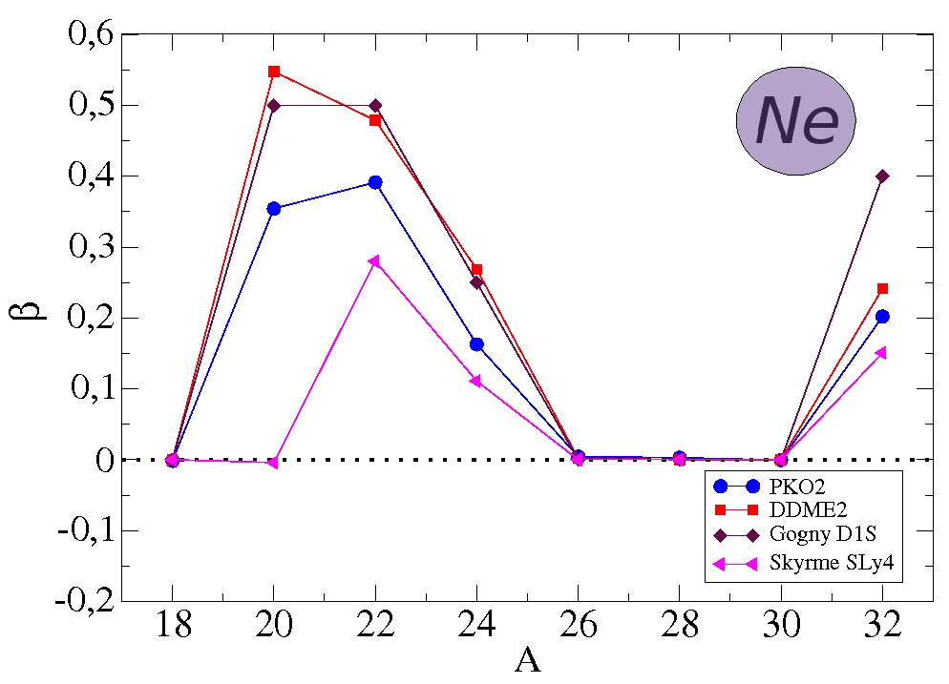
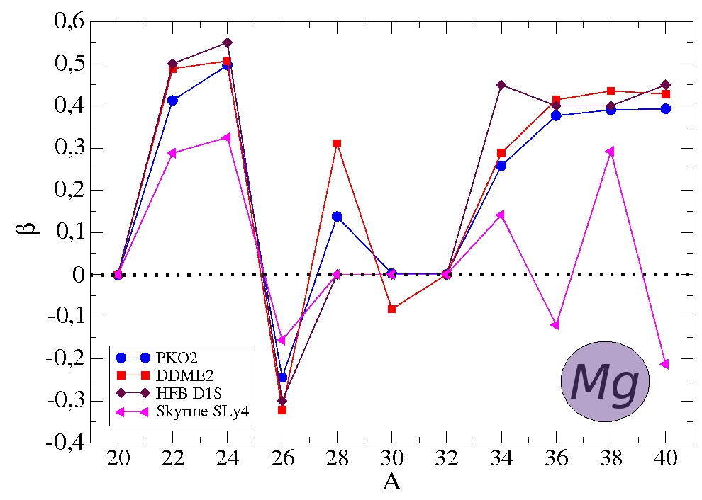
3) Results A. Ground state observables
    Axial deformation
    For Ne et Mg, PKO2 deformation’s behaviour qualitatively the same than the other interactions
    PKO2 β systematically weaker than DDME2 and Gogny D1S one

Slide 28
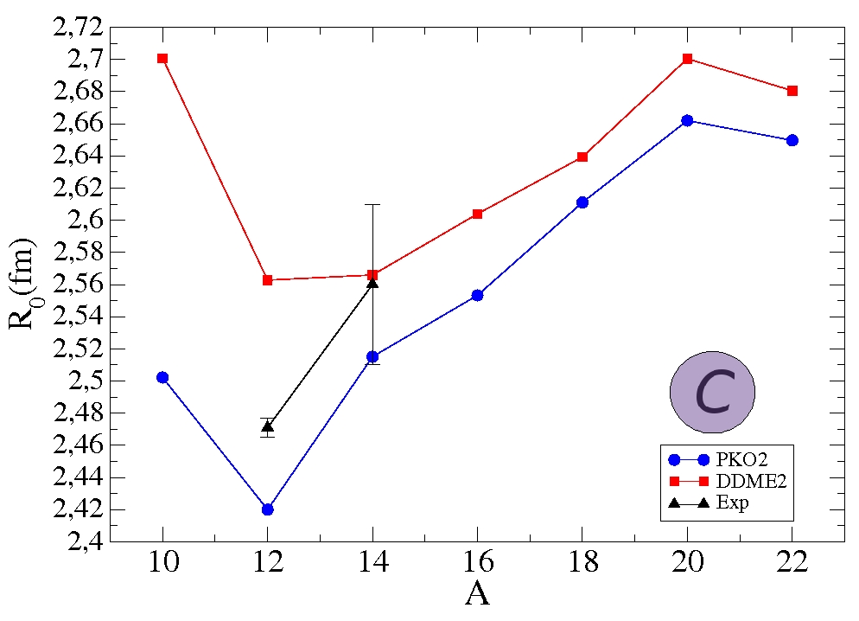
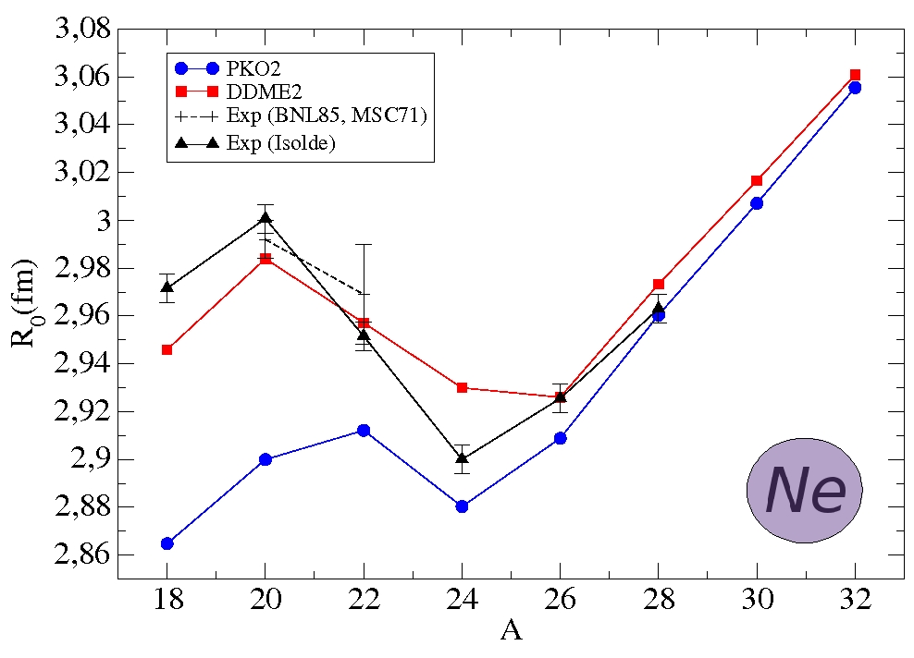
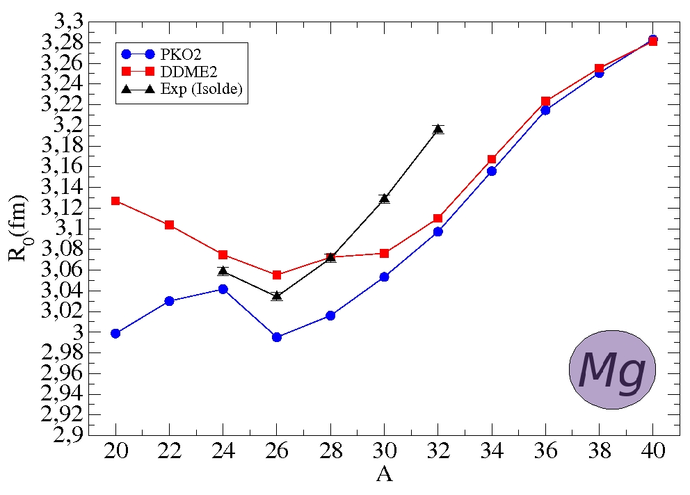
3) Results A. Ground state observables
    Charge radii
    DDME2 closer to experimental data
    Better agreement between PKO2 and DDME2 for heavier isotopes

Slide 29
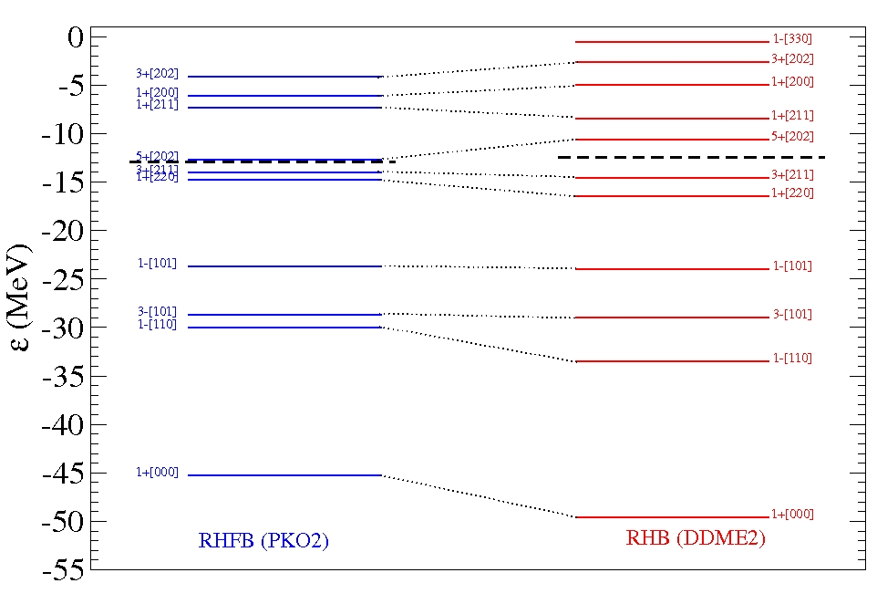
3) Results B. Shell structure
B) Shell structure
Protons levels in
²⁸Mg
Higher density of state around the Fermi level in the case of the RHFB model

Slide 30
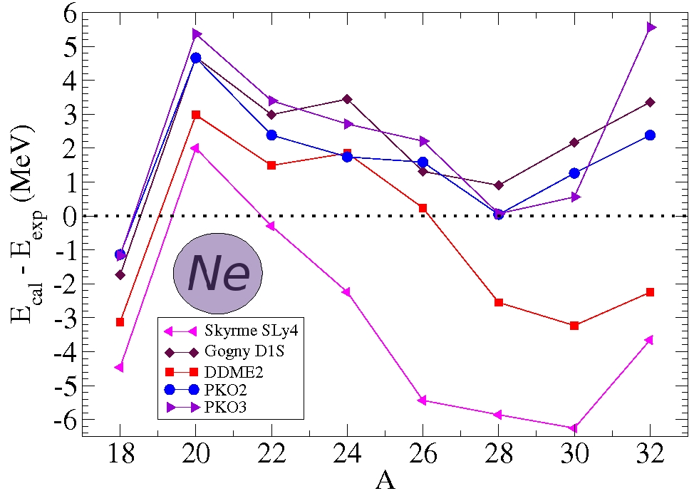
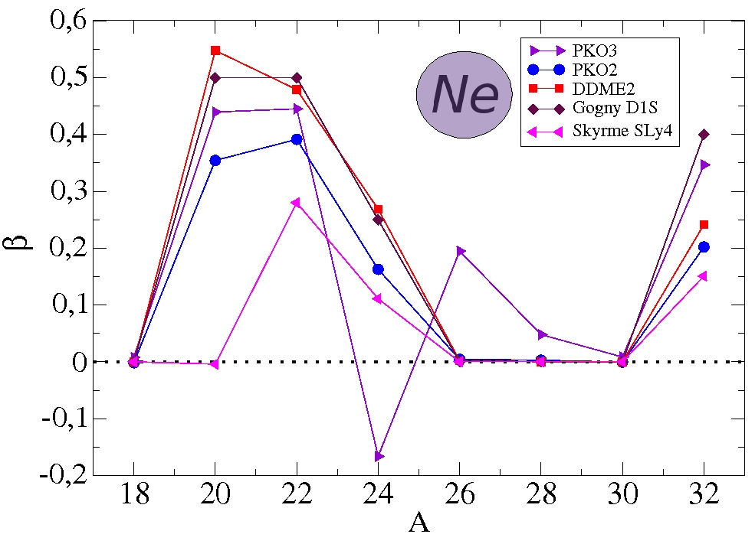
3) Results C. Role of the pion
C) Role of the pion in the relativistic mean field models
PKO3 masses not as good as PKO2 ones
PKO3 deformations in better agreement with DDME2 and Gogny D1S. Qualitative isotopic variation of β changes around the N=20 magic number.

Slide 31
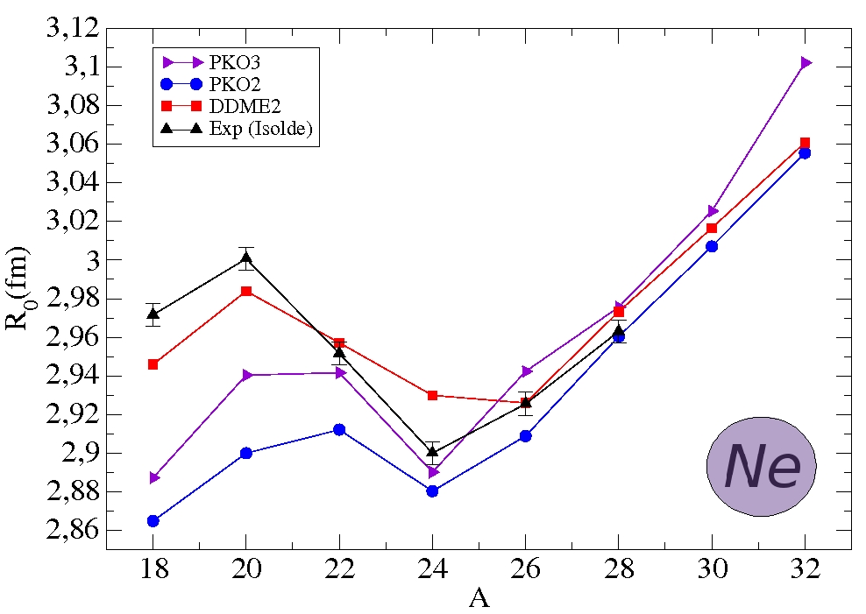
3) Results C. Role of the pion
PKO3 charge radii in the Z=12 isotopic chain systematically greater than PKO2 ones

Slide 32
1) Introduction and context 2) The RHFB approach 3) Results
Summary
    The RHFB model successfully describes the ground state observables of the Z=6,10,12 isotopes
    Deformation parameters and charge radii are systematically weaker in PKO2 than in DDME2
    S_{2n} are better reproduced by PKO2 than DDME2
    Shell structure obtained from the RHFB model around the Fermi level seems in better agreement with experiment than the one resulting from the RMF model
    Explicit treatment of the pion :
    Masses not as well reproduced
    Deformation in better agreement with DDME2 and Gogny D1S
    Better reproduction of the charge radii

Slide 33
1) Introduction and context 2) The RHFB approach 3) Results
Conclusion and perspectives
    Development of a RHFB model in axial symmetry :
    Takes advantage of a covariant formalism leading to a more efficient description of nuclear systems
    Contains explicitly the Fock term
    Is able to describe deformed nuclei
    Treats the nucleonic pairing
    Non-locality brought by the Fock term ⇒ Problem complex to solve numerically speaking. Optimizations are in progress to describe heavier system
    Effects of the tensor term = ρ-N tensor coupling
    Description of Odd-Even and Odd-Odd nuclei
    Development of a (Q)RPA+RHFB model in axial symmetry
    Development of a point coupling + pion relativistic model

