Slide 1





Grid services for Hadron Therapy
Faustin Laurentiu Roman
CERN / IFIC
faustin.roman@cern.ch
Motivation
Project Overview
Grid services
Status
Notes:
PARTNER Project: Marie Curie Initial Training Network in radiotherapy
My project: design and implement a Hadron Therapy Information Sharing Platform using grids.
At CERN since April 2009
associated with IFIC Lab in Valencia
I will tell you about the motivation of having a data sharing platform and how grids are helping to achieve that.

Slide 2
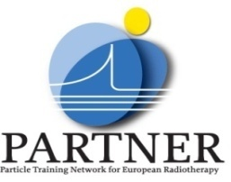
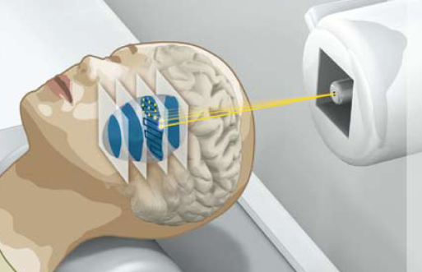

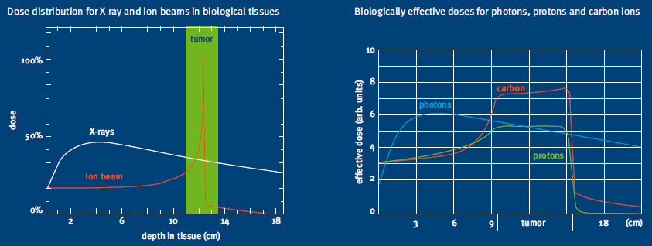
Cancer treatment
CANCER = 2nd largest cause of death & no. 1 for age 45-64 in EU
(E. Niederlaender, Causes of death in Europe, Eurostat KS-08-02-001-EN-C, 2006)
TREATMENT
    Surgery
    Chemotherapy
    Radiotherapy
    HADRON THERAPY (PT) =>
http://www.klinikum.uni-heidelberg.de/fileadmin/pressestelle/pdf/080218HIT_BR_SS_Broschuere_engl.pdf
Notes:
In Europe cancer is the second largest cause of death, responsible for 25% of all deaths and is the biggest killer of people aged 45-64
Particle therapy is a form of radiotherapy that uses beams of energetic protons or ions (also called hadrons) for cancer treatment. Hadron therapy makes use of the Bragg Peak effect and Relative Biological Efectiveness of the hadrons to induce local damage
The goal is to damage as many cancer cells as possible, while limiting harm to nearby healthy tissue.
Outside this room there is also a poster in Spanish explaining the method so you can have a look there or just ask me after the presentation if you are interested in the subject.

Slide 3
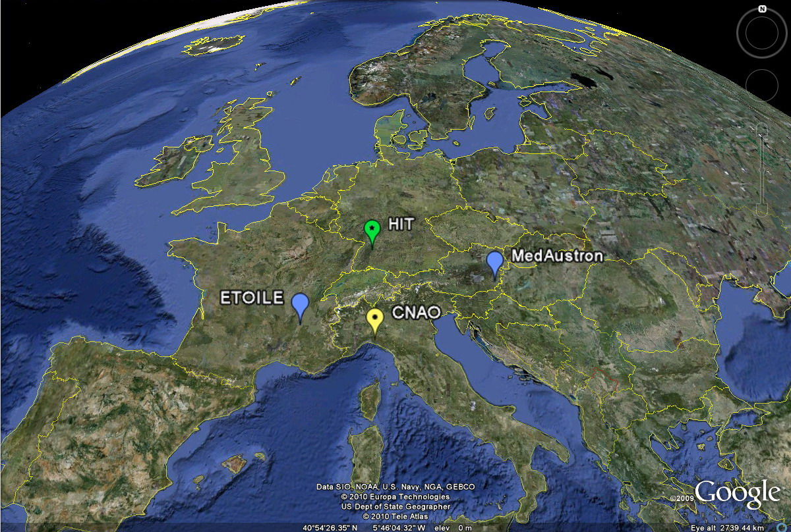
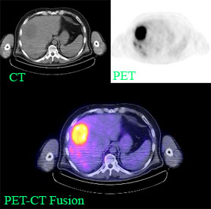
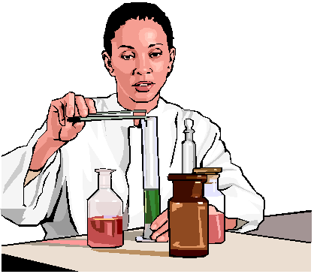
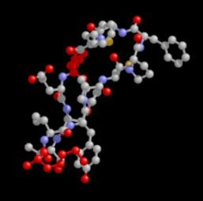
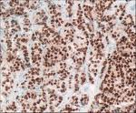
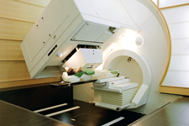

Conditions
Radiology
Research
Patient referral
People
Research
Genetics
Pathology
Prove efficacy
Model treatment
outcome
Information
Physics
Oncology
Notes:
I would like to describe you the situation and motivation of the project. Here is a map with the future HT facilities in EU.
In November 2009 the HIT facility treated the first patient. Next will follow CNAO, ETOILE and MedAustron.
Also in order to fight against cancer one needs a multidisciplinary effort: biology, physics, genetics, imaging…
Currently there is no software platform connecting people, information and research across the hadron therapy community in Europe.
Building such platform would allow to aggregate and reuse data to address the needs of:
Patient referral
Model treatment outcome
Prove the efficacy of ion therapy
In order to fight against cancer one needs a multidisciplinary effort.
ICT bridges gaps between disciplines

Slide 4
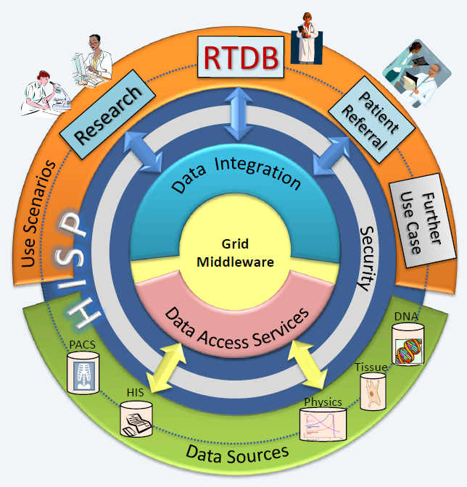


Hadrontherapy Information Sharing Platform (HISP)
CAN GRID HELP? : Coordinated resource sharing and problem solving in dynamic, multi-institutional virtual organizations… (I. Foster et al)
Domain requirements
Service Oriented Architecture
Platform Independence
Service security, interoperability, reliability & responsiveness
APIs based on open standards
“Sandbox” environment for developers
User friendly tools and interfaces
Easy to use web portals
Manuals and accessible proof-of-concepts
Long term sustainability
Thanks to AT, ES, UK medical doctors!
More info @ EGI Technical Forum:
[20] Grid services for hadron therapy
[21] Hadrontherapy Information Sharing Platform
[70] Hadrontherapy and Grids - Issues and Requirements
Notes:
To answer all the challenges and requirements of the Hadron Therapy community we are building a software platform based on Grids and here is the conceptual view of it.
The HISP role is to connect users with data sources.
Conceptually consists of:
A grid middleware for basic services like data storage
A security layer to enforce ethical and legal aspects of medical data
A data integration and access service for semantic linking of data.
A portal for various usecases: cross-border patient referral and research
All these linked by open and standard interfaces

Slide 5

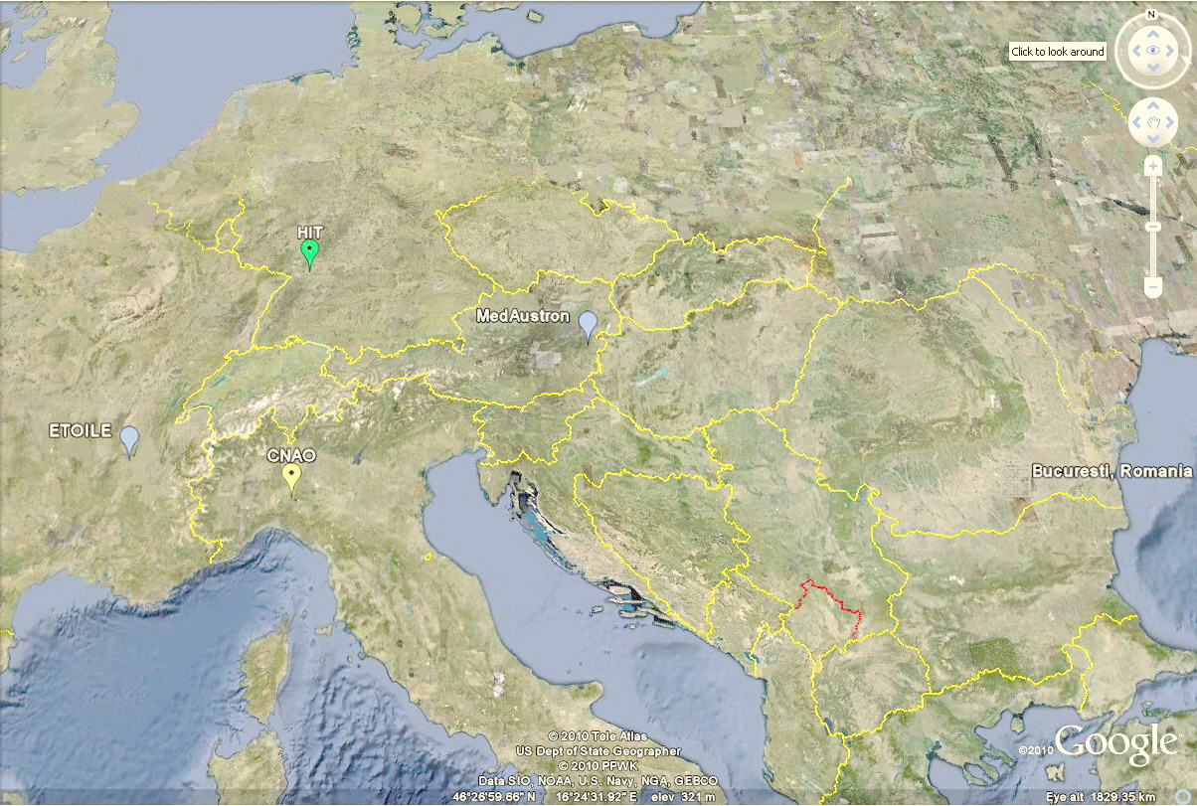
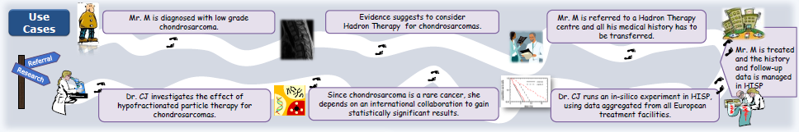
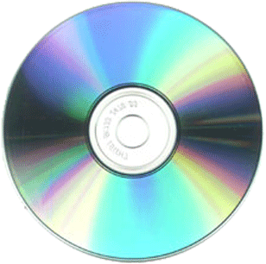
Usecase: eReferral and Research
DIAGNOSTIC
INITIAL TREATMENT
REFERRAL
TREATMENT
FOLLOW-UP
RESEARCH
DISCOVER
TRAINING
INNOVATE
STEPS | DIAGNOSE | INITIAL TREAT | REFFERAL DECISION | REMOTE DECISION | TREAT | FOLOW-UP | RESEARCH | DISCOVERY | DISSEMINATE TRAIN | NOVEL TREATMENT
ACCESS NOW | 1-2 DAYS | VAR | 1-2 WEEKS | 2 WEEKS | WEEKS | WEEKS | WEEKS | YEARS | MONTHS | YEARS
FUTURE ACCESS | 1-2 DAYS | VAR | INSTANT | INSTANT | VAR | INSTANT | INSTANT | MONTHS | DAYS | <YEAR
DATA SIZE | 1Gb | 1.5Gb | 1.5Gb | 1.5Gb | 5Gb | 10Gb | 5Tb
Notes:
Referral example from Romania to Heidelberg Ion Therapy Centre.
Steps involved
Time and data

Slide 6
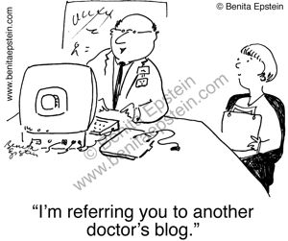
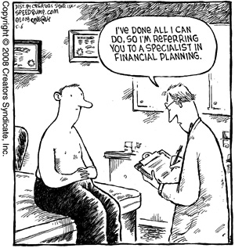
Usecase1: eReferral
How is done now?
Patient data by EMAIL
Images by DVD via POST
Treatment remains @ H
Follow-up difficult to none
Issues…
Security
Time and reliability
Information
History
Any solutions?
SSL/ Grid certs?
Encrypted storage/SSL
Collaborative portal
Personal Health Record
Notes:
How is done now? Are there any problems? Can we do something about it?

Slide 7
Usecase 2: Research
Common needs
  Federated data
  Security
  Provenance
  Workflows
  Simulations
  Visualization
and Special requests
Enhanced Protection
Agreement service
Semantic integration
And ease to use!
because..
Directive 95/46/EC, Directive 2002/58/EC, EC Recommendation (EC Rec. 2008/594/EC)
Country specific: UK DPA 1998, DE BDSG,…
Privacy
Confidentiality
Autonomy
Liability
Adequate, relevant
Informed Consent
(Pseudo)Anonymization
Publish findings
Clinical data
Research data
Notes:
We have coomon neds like other VO
And special
Medical Data exchange presents the challenge of respecting the ethical and legal frameworks.
From hospital internal rules to the EU legislation on data protection we have to ensure that patient rights and the research needs are balanced.

Slide 8
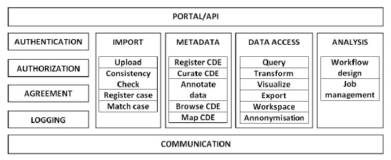
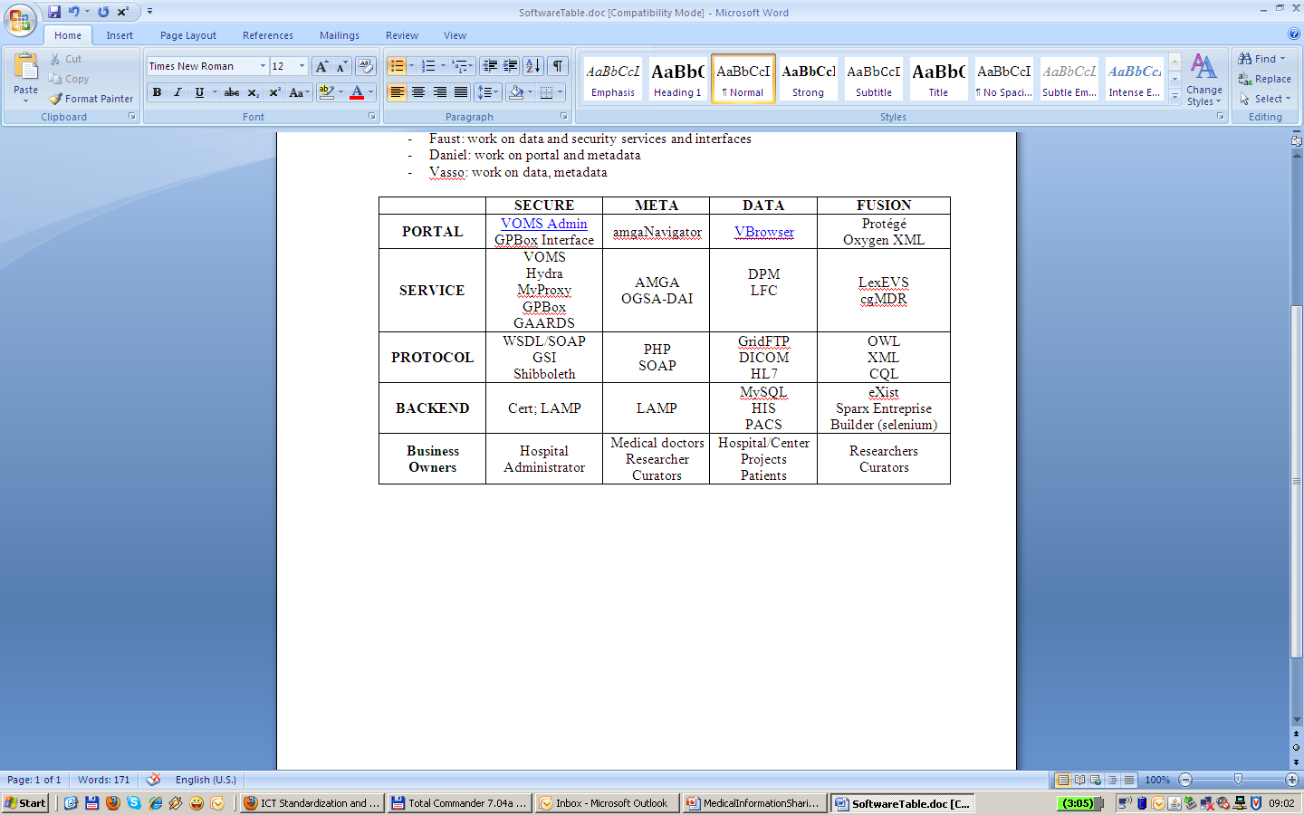
Conceptual Services and functions / Grid tools
Some tools
More tools …
Vine Toolikt: http://vinetoolkit.org/
(Flex, BlazeDS, Liferay)
VOMS, AMGA, cgMDR
Linux, Apache, MySQL, Eclipse…
Notes:
Here are the ingredients of the infrastructure;
Core services based on grid services will agregate data and metadata and provide computational power
Medical data is sensitive data thus requires proper ethical and legal frameworks.
Strong grid security mechanisms will ensure AuthN and AuthZ and patient data will be protected by anonymisation and encryption.
Role-based access: the molecular biologist doesn’t need to know about the patient’s name when doing research but the clinician will need to know when reffering form one site to another…
Standard Interfaces to hospital information systems will ensure proper data aggregation. Also standard languages to query the platform will keep it accessible and extendible to other services and uses.
Semantic layer will add meaning to data and allow ‘smart’ queries to be made.

Slide 9
Architecture
Services
Liferay
SOAP
Layout
Tunnel
CMS
REST
Portlets
VINE API
TOMCAT
SSL
RESOURCES
VOMS
AMGA
cgMDR
HIS
RIS
CE
SE
other..
PACS
Hospital/Centre

Slide 10
Summary
Installed components:
  Liferay, VINE, AMGA, cgMDR
Next steps
VOMS portal integration
Web service connection: AMGA and cgMDR
More on:
https://espace.cern.ch/partnersite/workspace/faust/, e.g.
https://espace.cern.ch/partnersite/workspace/faust/Shared%20Documents/Meetings/EGI_specific_poster.pdf
Soon public: http://twiki.cern.ch/twiki/bin/view/PARTNERitESR

Slide 11
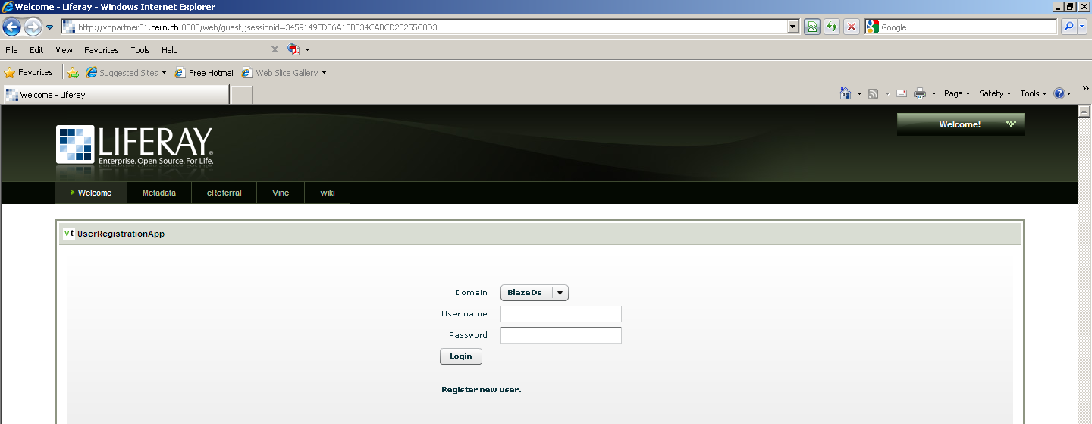
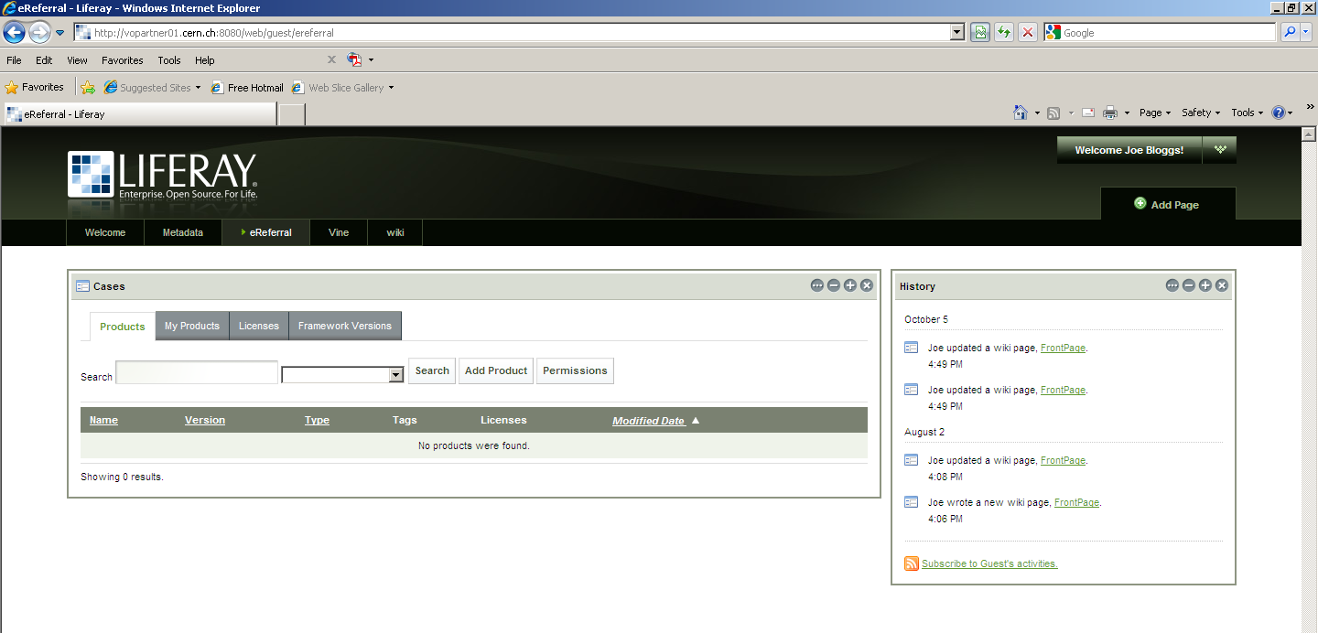
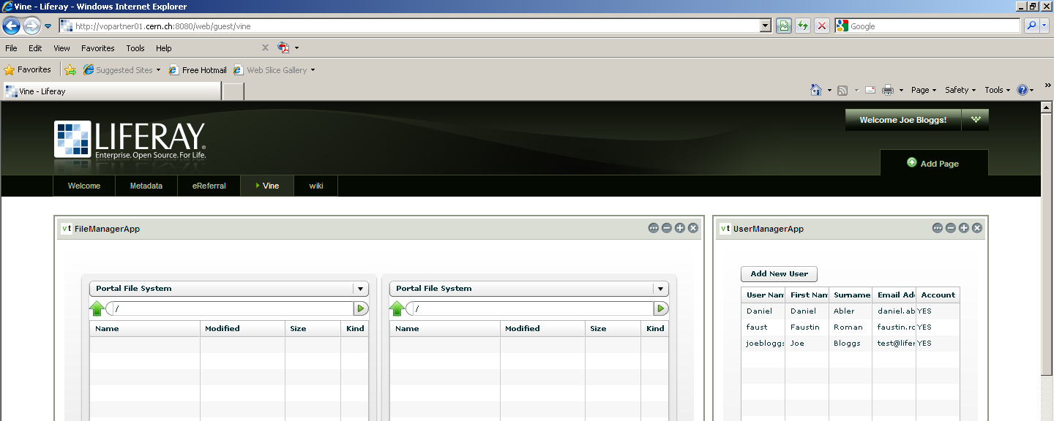
Status @ http://vopartner01.cern.ch:8080/
Notes:
Portal installed

Slide 12
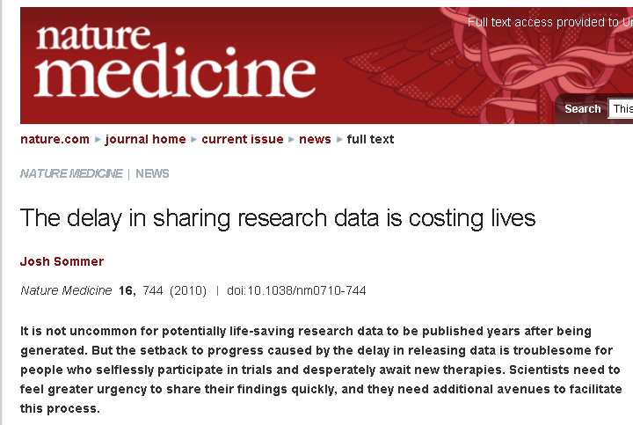
BACKUP: A patient opinion…
http://www.nature.com/nm/journal/v16/n7/full/nm0710-744.html
Notes:
Stressing again the need of sharing data by showing you a patient opinion.
Medicine has a slow pace in using new technologies for a good reason.
But also looking at the advantages of knowledge sharing could bring a big change for patients, clinicians and researchers alike.

