Slide 1


Consolidating and building Collaborations with the CERN Alumni Network CERN & I-DAIR – 17.12.2021 Rachel Bray: Head of CERN Alumni Relations

Slide 2


Slide 3
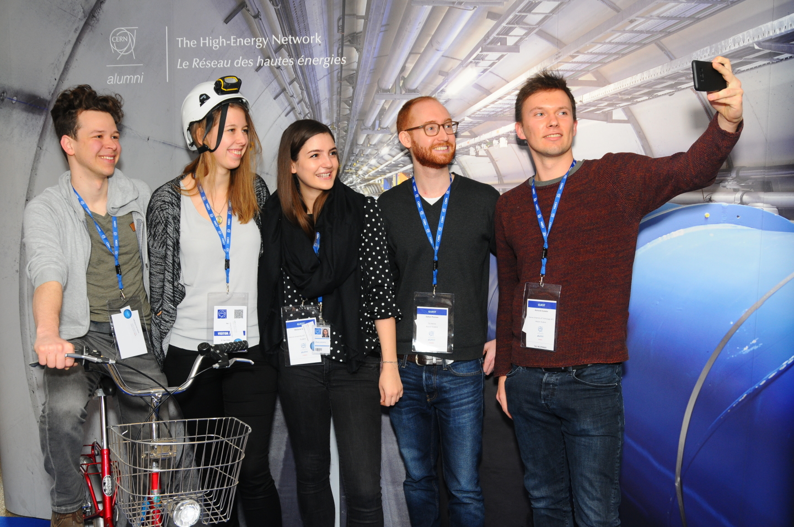
Goals of the CERN Alumni Programme:
Demonstrate impact
Stay connected
Network of ambassadors
Support early careers
Launched June 2017
>7,380 active members

Slide 4
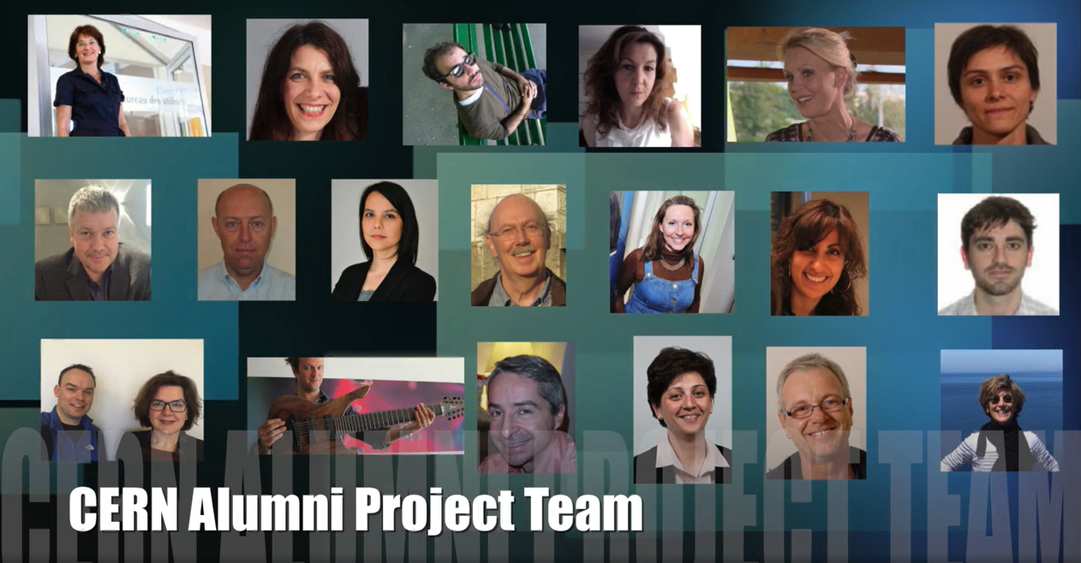
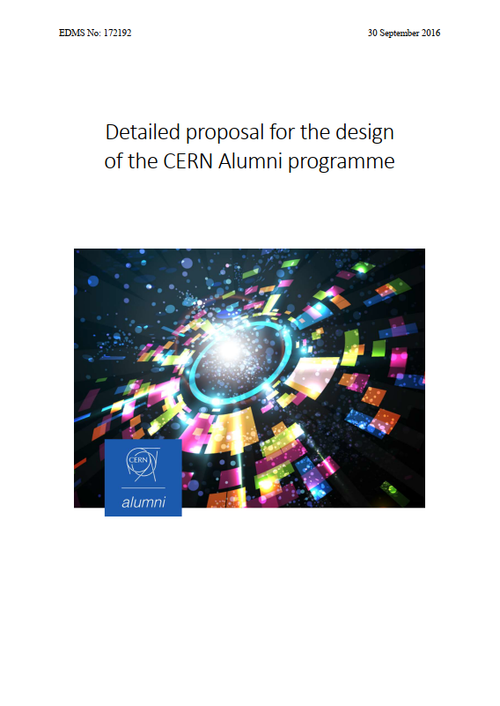
2016

Slide 5

2020
A unique & special place…
A different breed of member… not just anyone can join
A blend of cultures & experiences from which you can learn
A shared purpose & interest in the work conducted at CERN

Slide 6
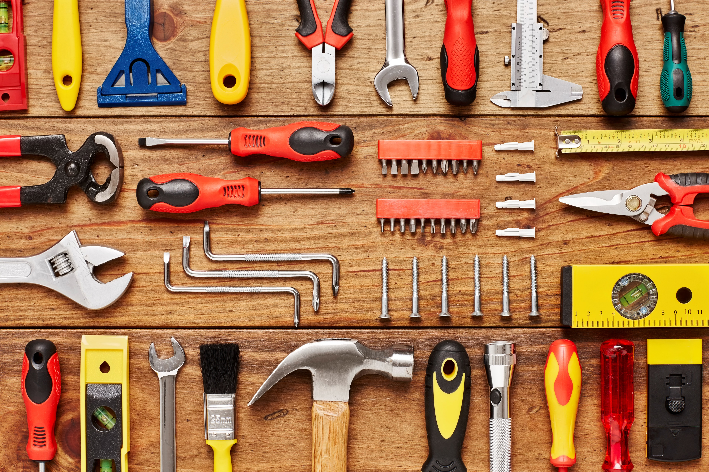

Slide 7
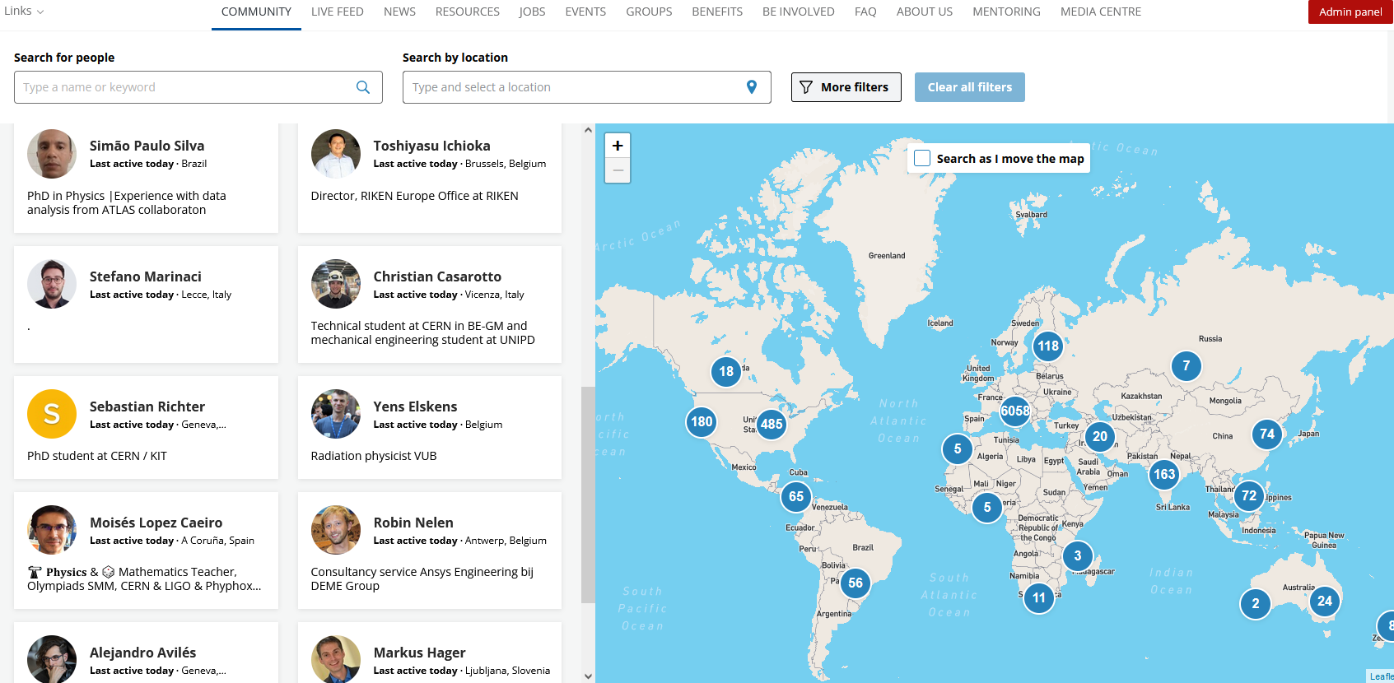
A dedicated platform

Slide 8
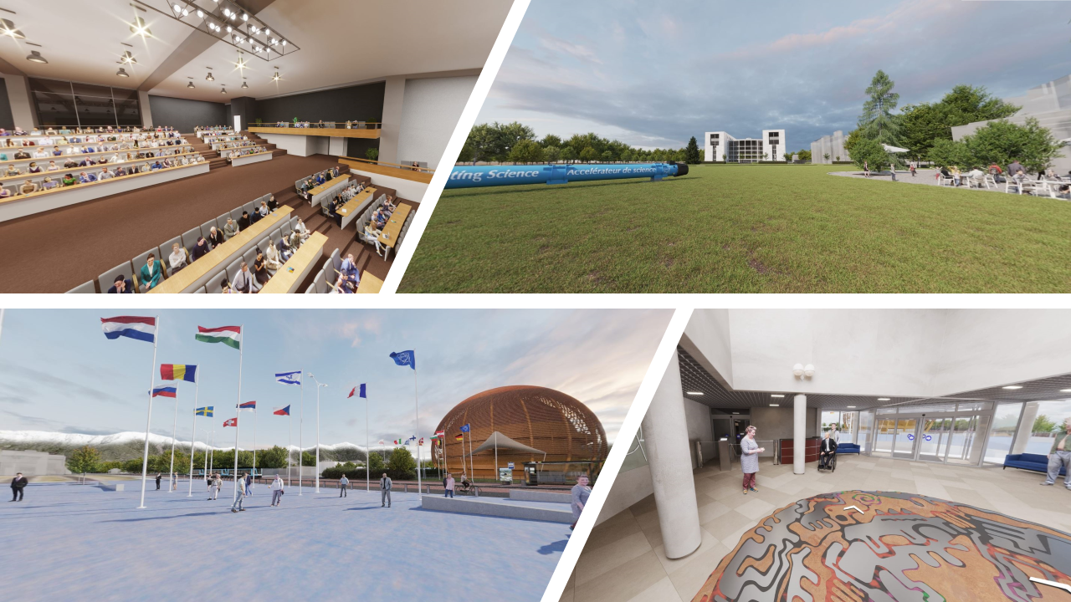
Alumni Reunions – Second Collisions
“Great stories of entrepreneurship and it was amazing to see the impact that CERN Alumni are making in society”
“It created a sense of belonging to a unique community, sharing values (e.g. science) with many people around the globe, from different nationalities, ages, sexes, etc”

Slide 9
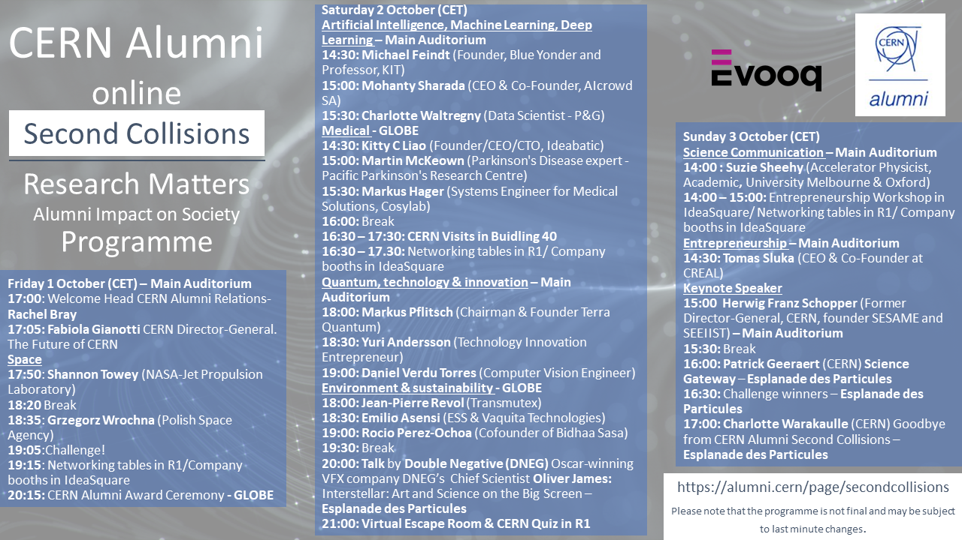
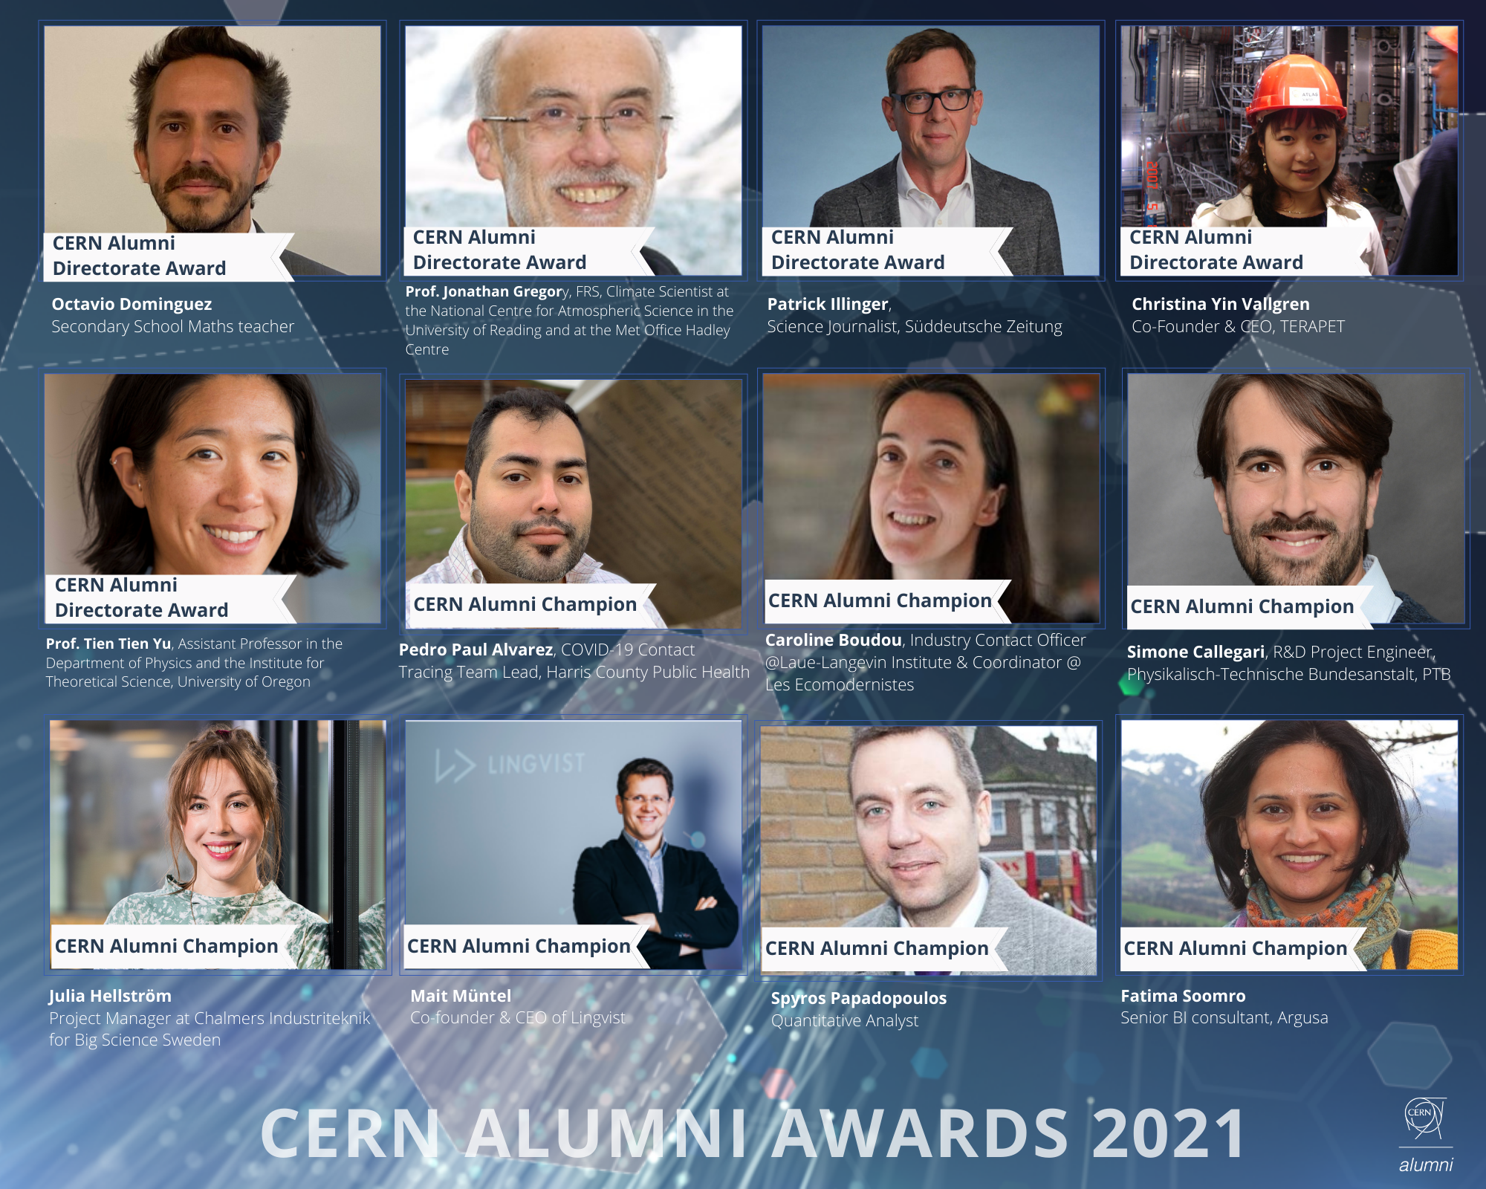
Alumni Reunions – Second Collisions

Slide 10
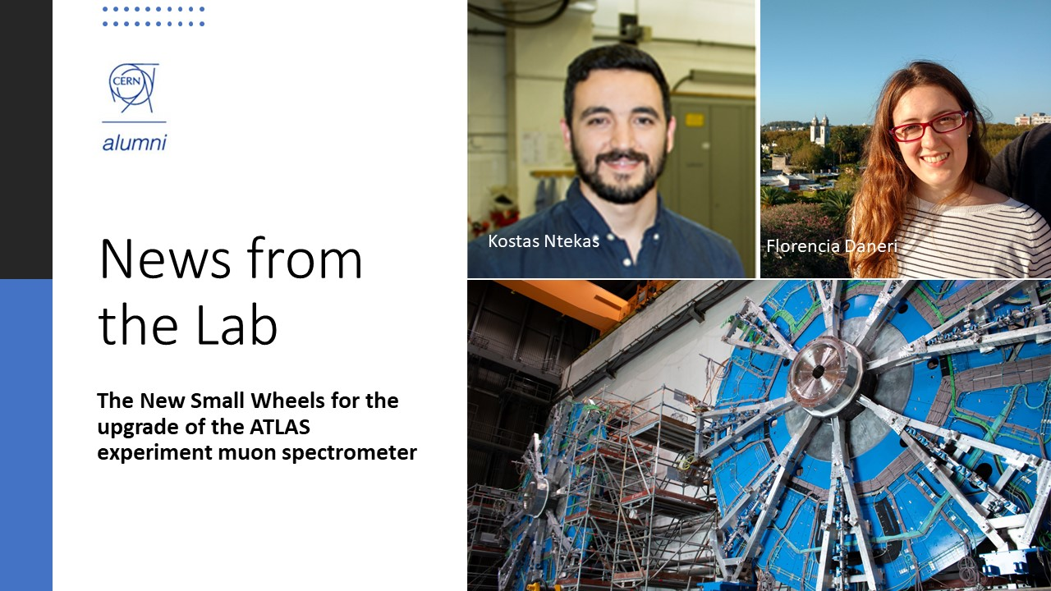
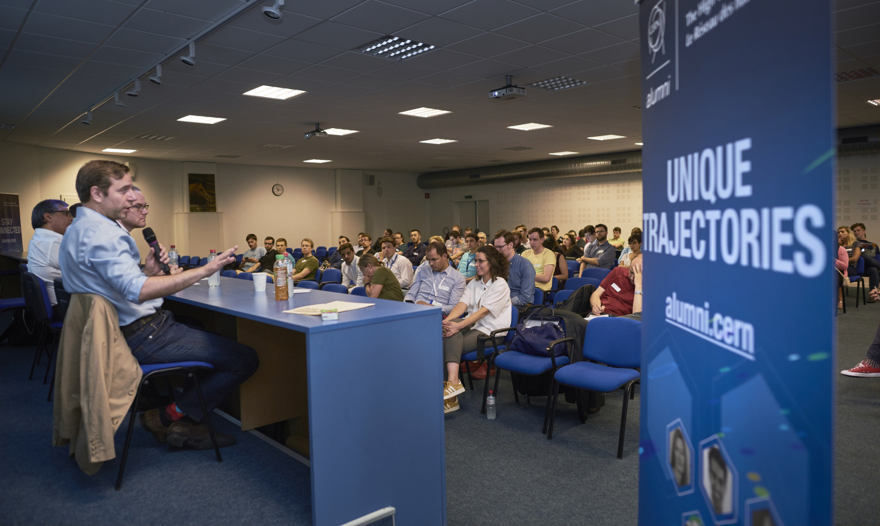
Regular Impactful Events

Slide 11
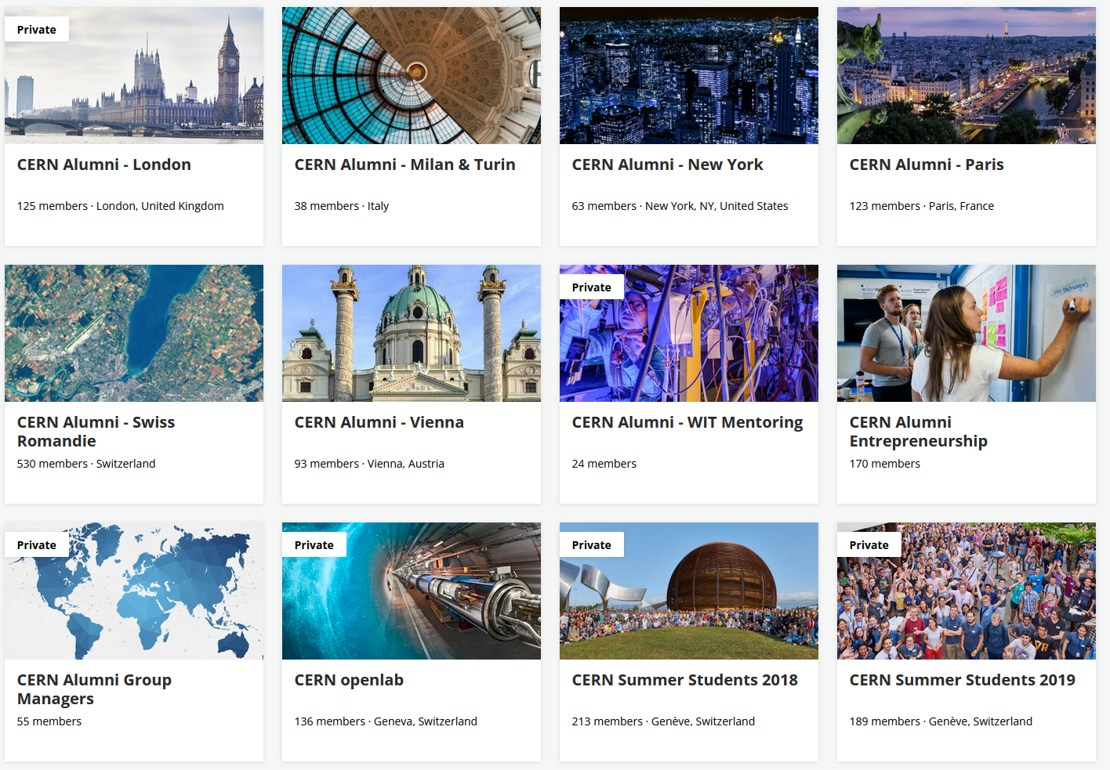
Groups
CERN Partnership (2)
Interest (4)
Regional (10)
Scientific Collaboration (5)
Student programme (5)

Slide 12
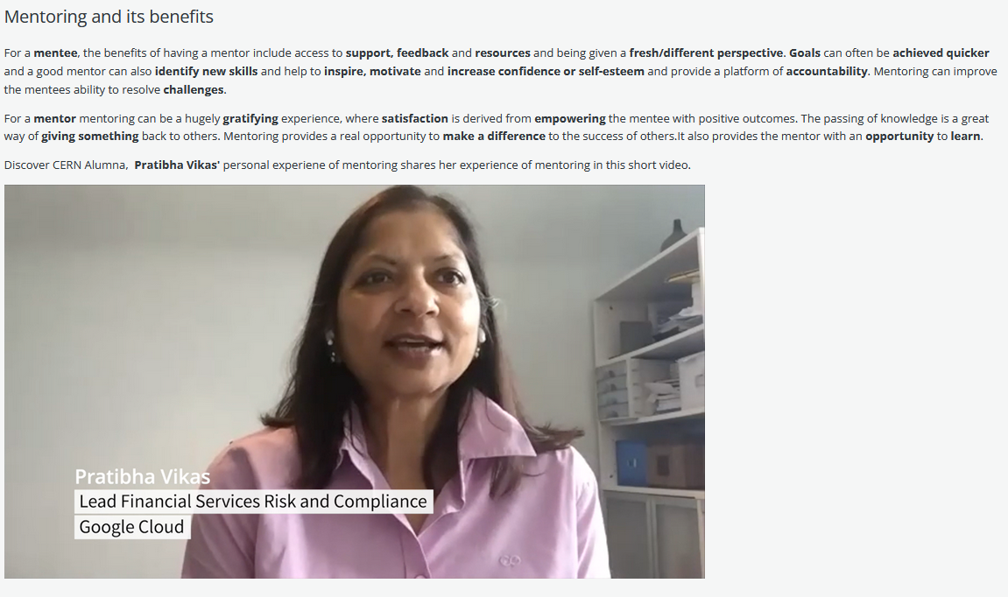
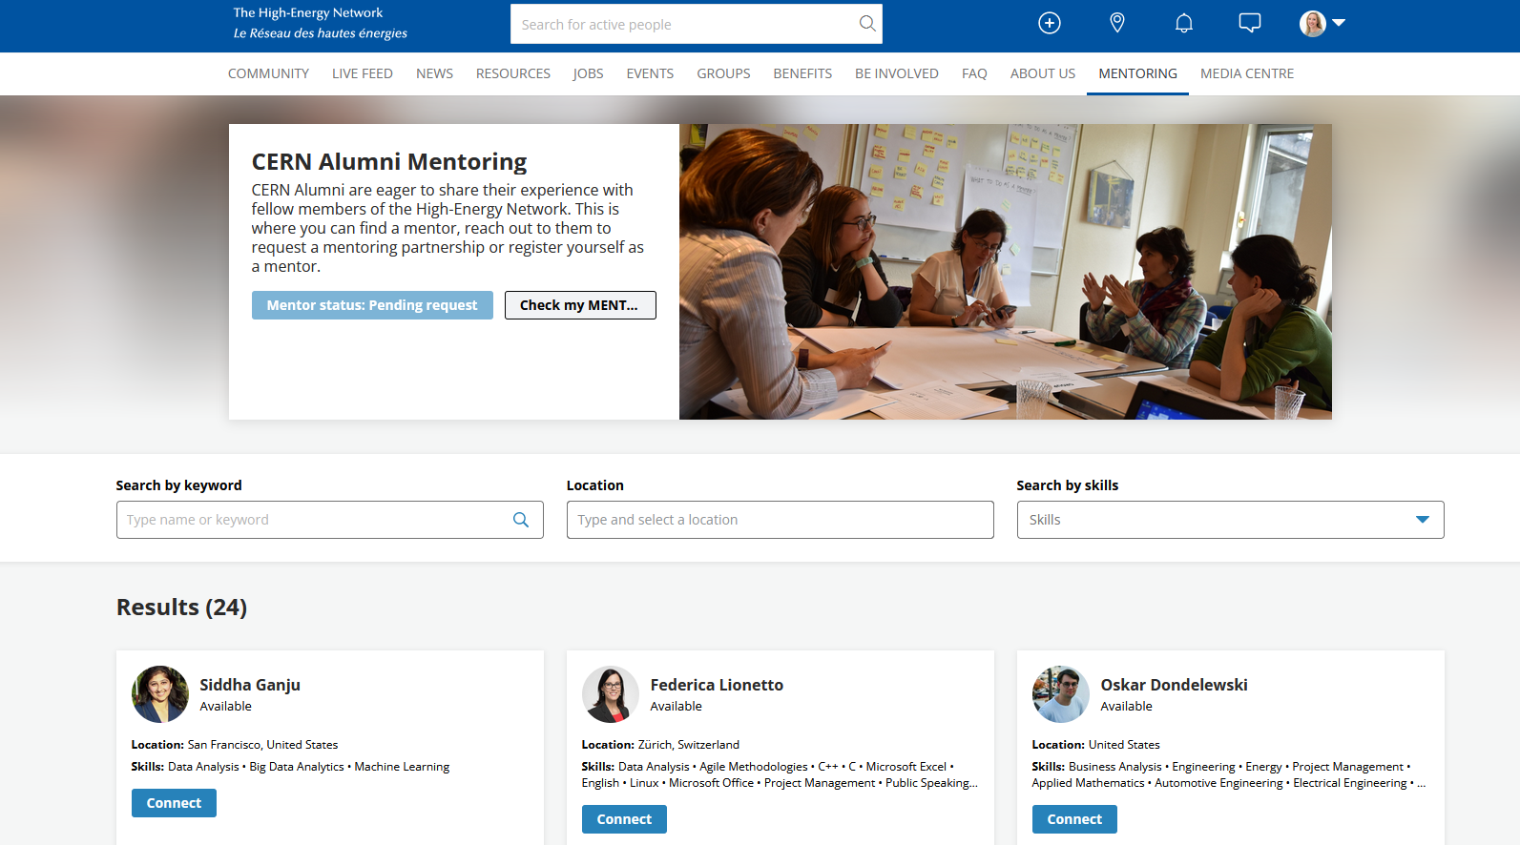
Building an alumni community
Mentoring

Slide 13
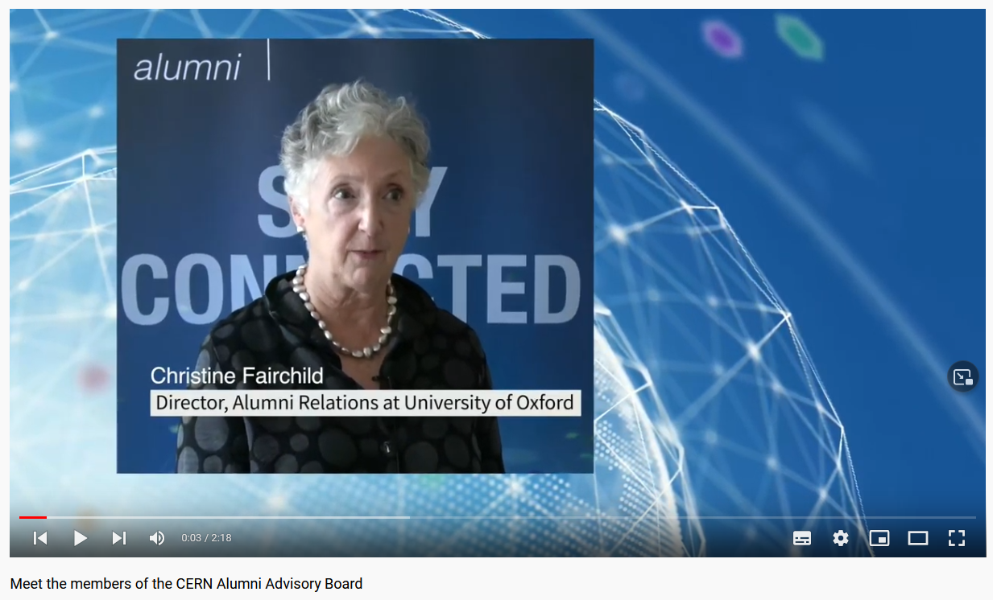
CERN Alumni Advisory Board
provides input, experience and strategic guidance to Director-General
consists of 8 volunteer members: Chair, 6 members of the alumni community and one alumni relations professional.

Slide 14
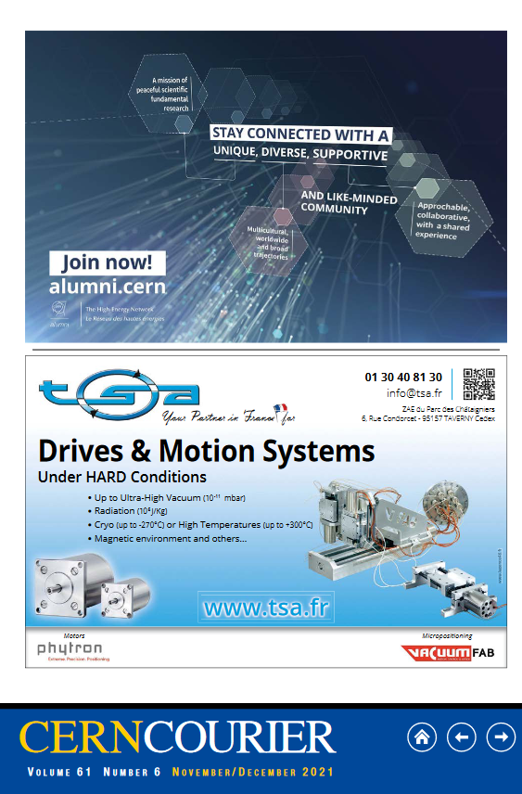

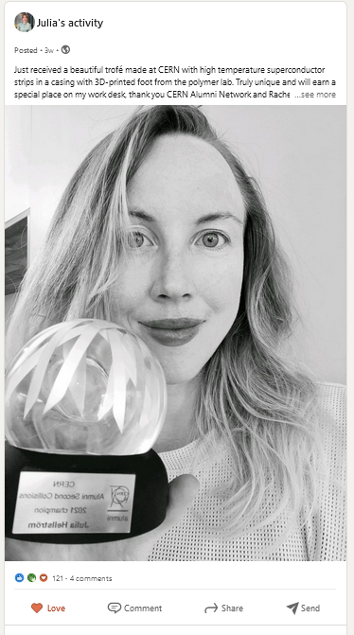
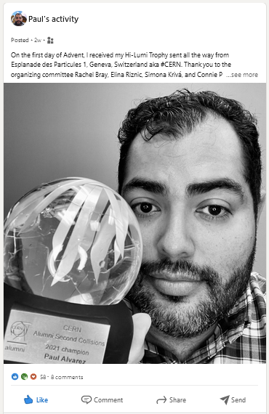




Consolidation
This Photo by Unknown Author is licensed under CC BY-NC
This Photo by Unknown Author is licensed under CC BY-SA
This Photo by Unknown Author is licensed under CC BY

Slide 15
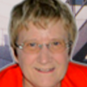
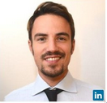
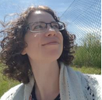
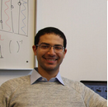
Keep up the good work. I appreciate the Alumni info as it keeps me in touch with the big CERN family.
Testimonials
Morna Robillard
Retiree
The Alumni network, is probably one of the best initiatives I have seen at CERN.
Thank you, CERN Alumni, for organizing job-search events. It helped me to find my 1st job in business:
Matteo Di Cosmo
Soon to be alum
I found my job from interacting with someone in the CERN alumni platform! So I can attest that it works!
Anna Kropivnitskaya
Senior Data Scientist
Othmane Rifki
Principal Applied Scientist

Slide 16
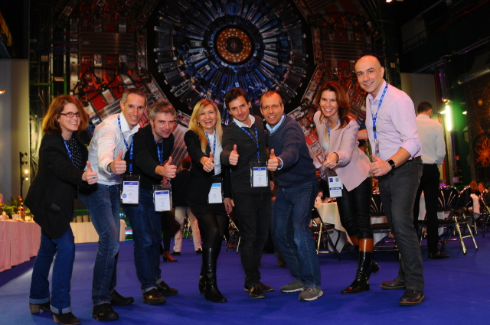
Thank you!
Contact:
Rachel Bray
Head of CERN Alumni Relations
CERN – International Relations Sector
Rachel.Bray@cern.ch
alumni.relations@cern.ch

Slide 17
> 7380 network members
85% alumni or alumni within a year

Slide 18
Where are members located?
90% of members reside in 20 countries
81% in CERN Member States

