Slide 1
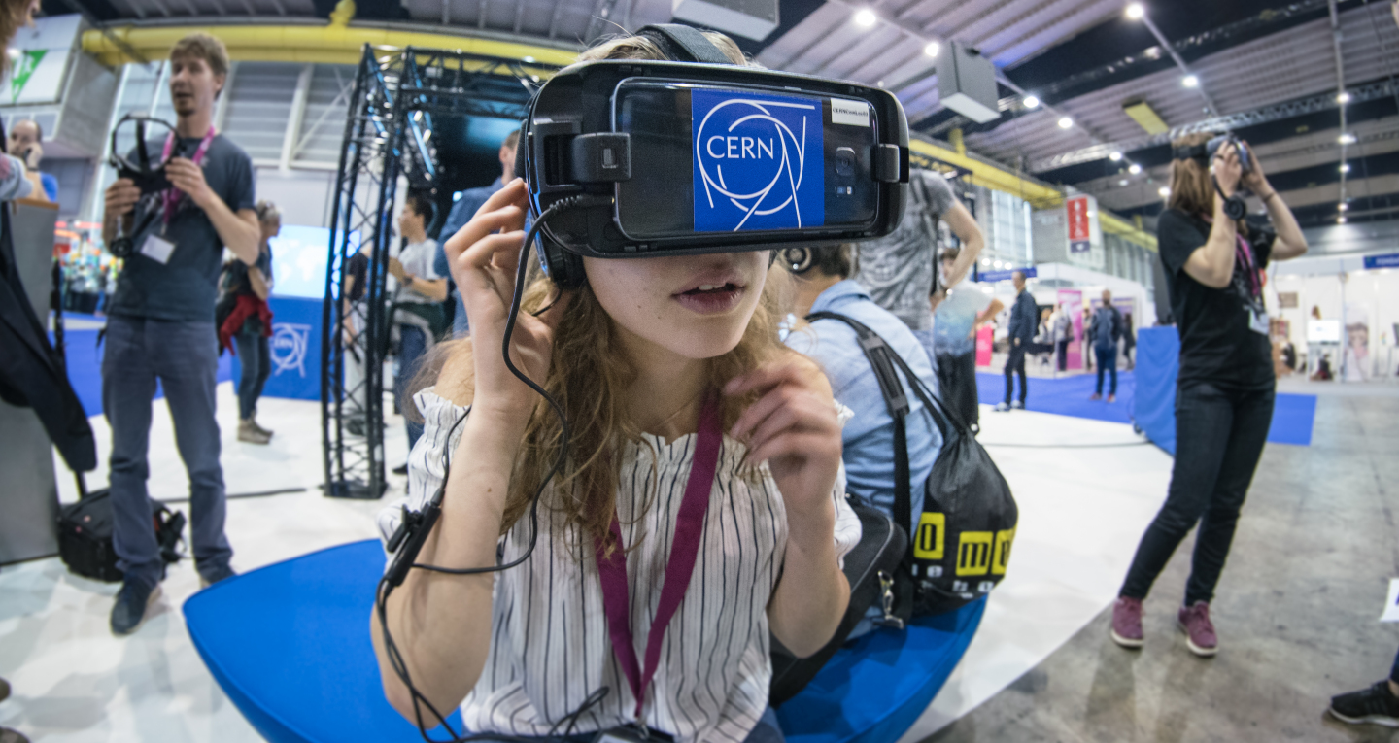
Education, Communications and Outreach
CERN I-DAIR Meeting 17 December 2022
Anais Rassat, Head of Media and Digital Communications

Slide 2

Four pillars underpin CERN’s mission
Research
Technological innovation
International collaboration
Education and training
The pillars are the platforms for CERN communications and outreach.

Slide 3
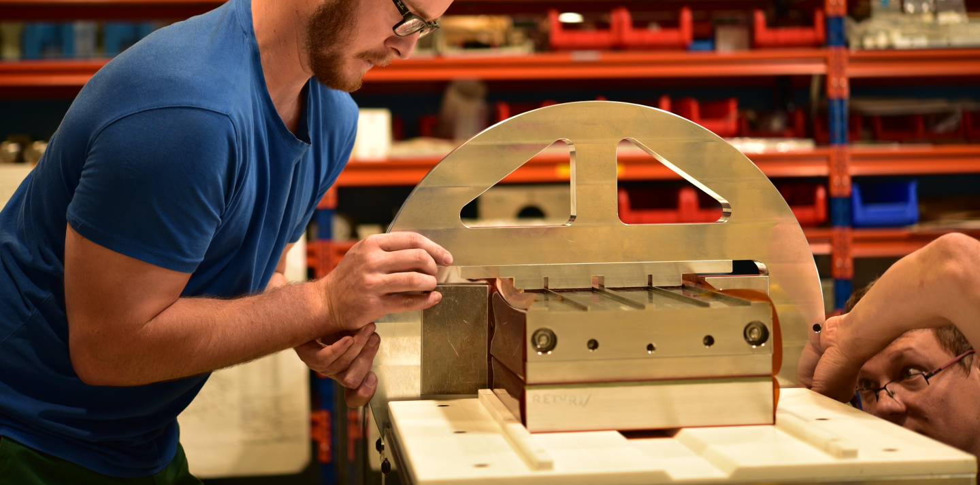
WHY DO WE COMMUNICATE?
Support for CERN
Awareness and engagement with CERN’s activities and their impact on society
Attract future generation of physicists and engineers
Be a voice for the value of fundamental research
Community-building
Notes:
Duty as a publicly funded organisation
- explain both the complex aspects related to science and technology
- also the role that science and technology and an organisation like CERN has on society.
Future generation of physicists and engineers, but also science funders
Internal communication - managmeent

Slide 4
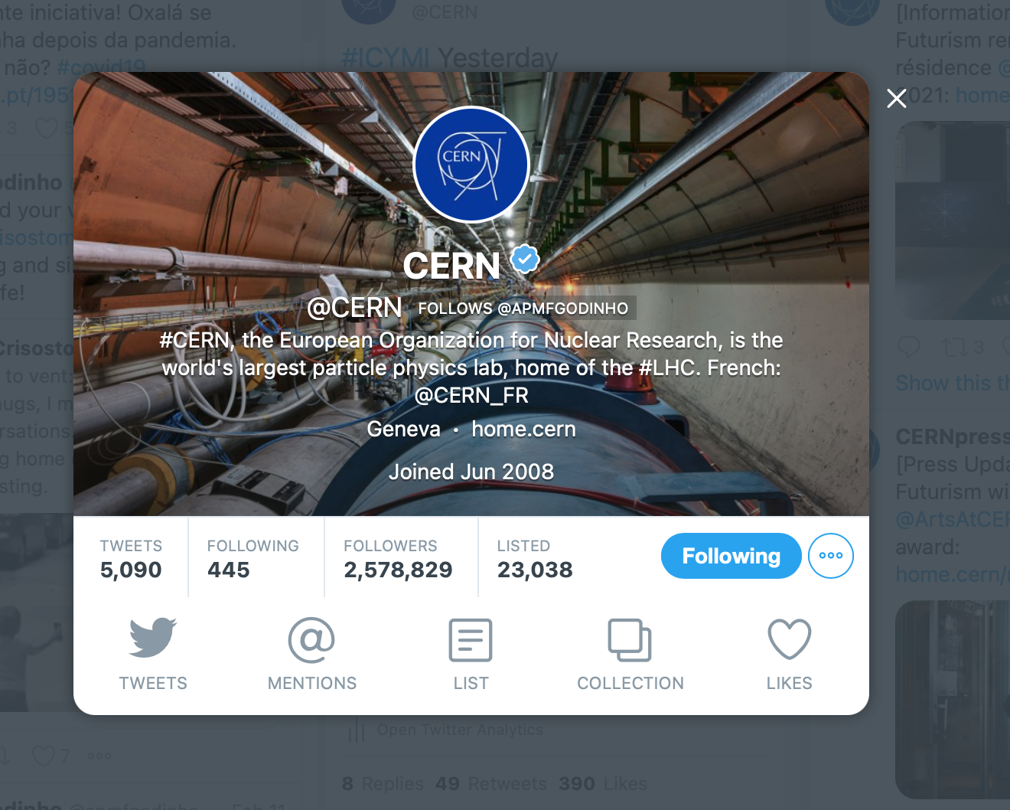
HOW DO WE COMMUNICATE?
Digital channels
home.cern & other .cern websites
CERN Bulletin
CERN Courier
http://cern.ch/go/social-media-guidelines
Notes:
Institutional accounts + 20+ associate accounts (e.g. from experiments, projects, high visibility departments / activities at CERN

Slide 5
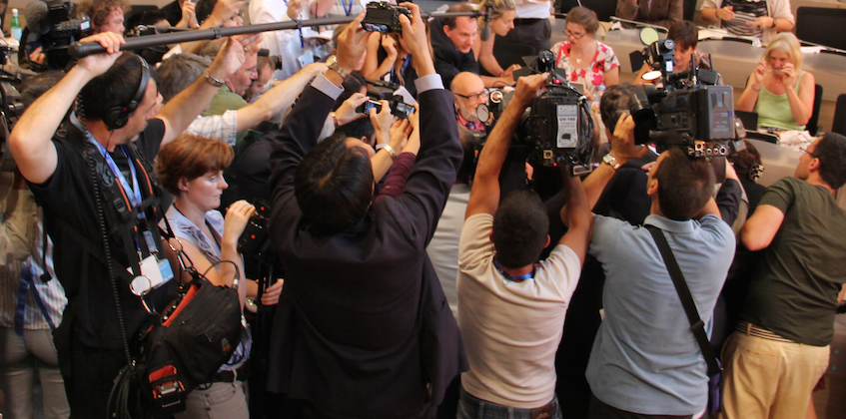
HOW DO WE COMMUNICATE?
Via the media
Media relations
Press releases/updates on physics results and more
On-site / online media visits
Media training
Identifying media ambassadors
https://press.cern

Slide 6
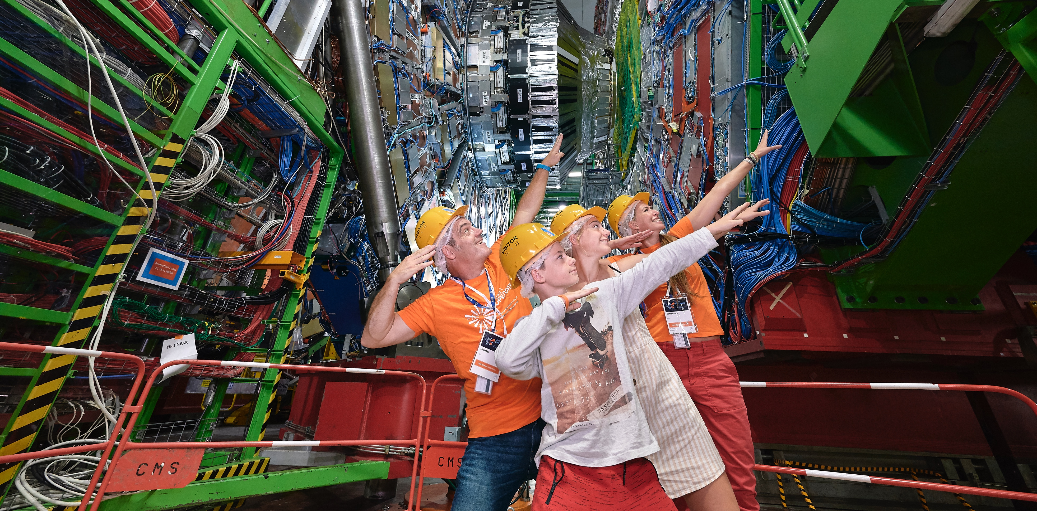
HOW DO WE COMMUNICATE?
The power of face-to-face
Guided tours (150K visitors/year)
Public events @CERN (Open Days, Researchers’ Night, Sparks!)
Going out into the local community (schools, local events)
S’Cool LAB workshops for high-schools
Teacher programmes
https://visit.cern
https://cern.ch/scoollab
https://voisins.cern
https://sparks.cern

Slide 7
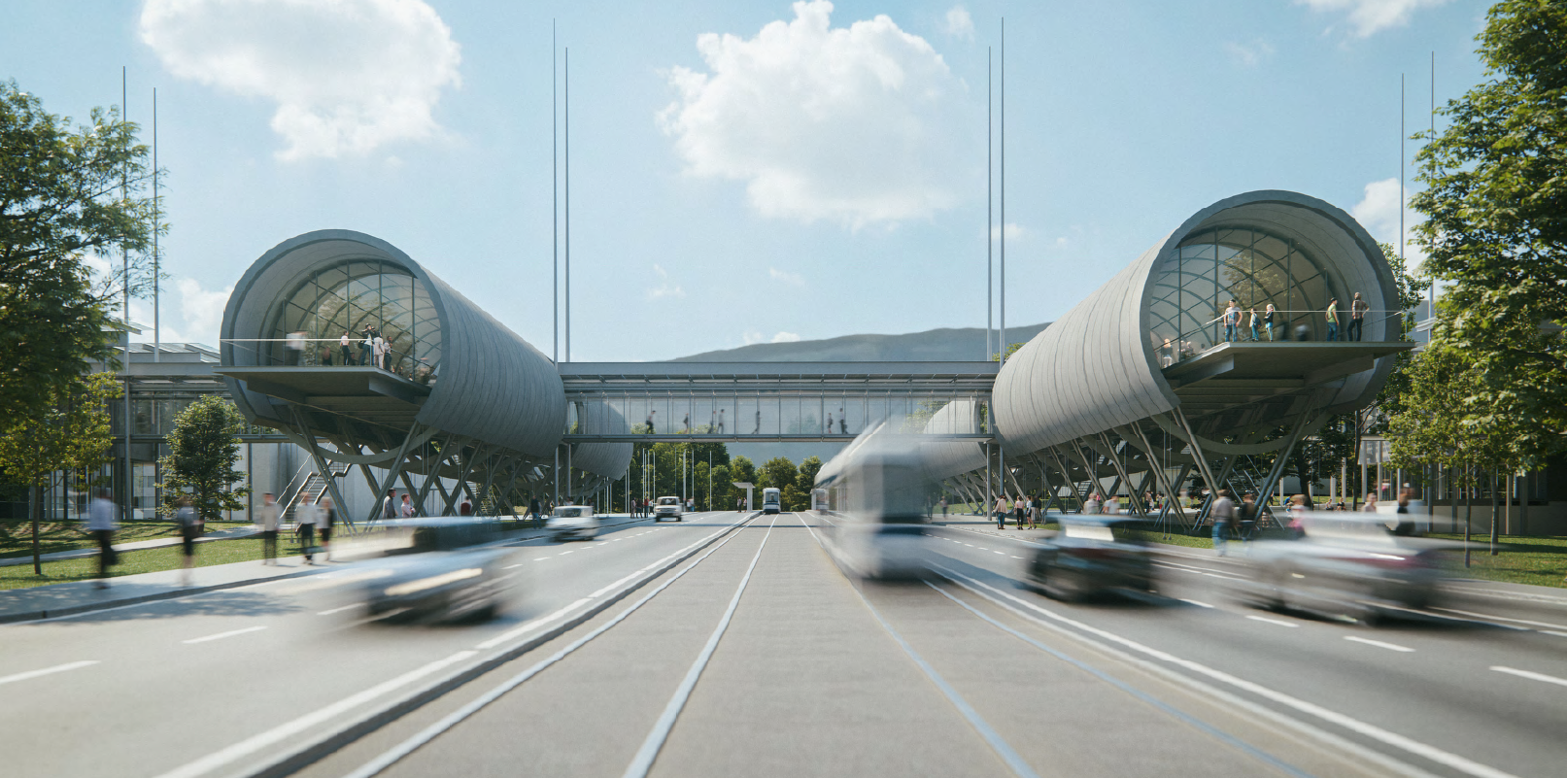
HOW DO WE COMMUNICATE?
Science Gateway
CERN’s new education and outreach centre
For audiences aged 5+
Immersive exhibitions, education labs, events and science shows
Opening 2023
https://sciencegateway.cern

Slide 8
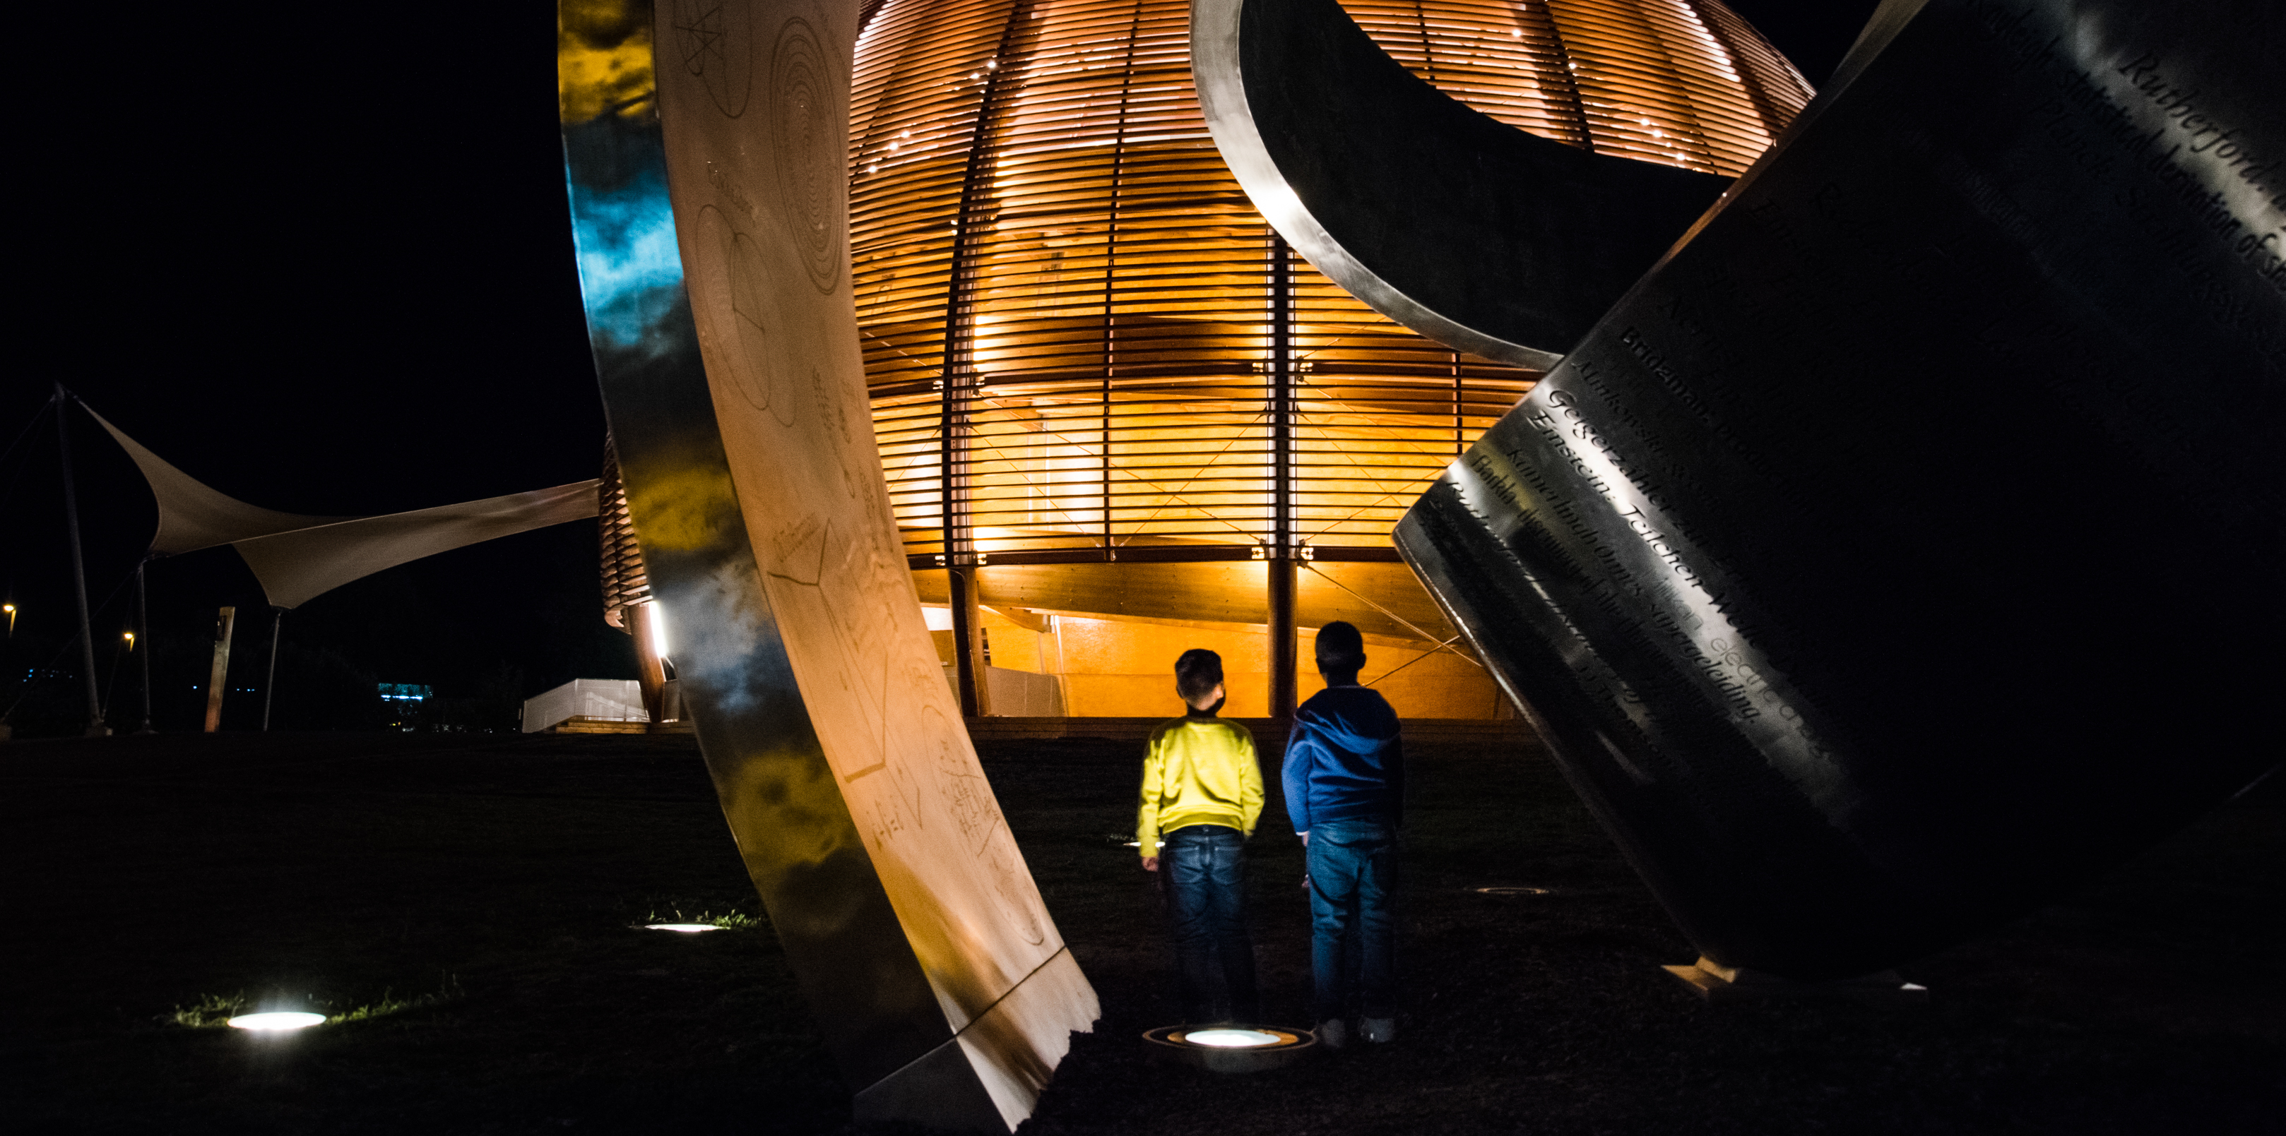
HOW TO CONTACT ECO?
Submit a story for the CERN website or social media: http://cern.ch/go/submit-a-story
CERN guides: cern.ch/guides
Outreach volunteers (check Bulletin announcements)
S’Cool LAB tutors: https://cern.ch/scoollab/cernies
https://cern.ch/communications

