Slide 1
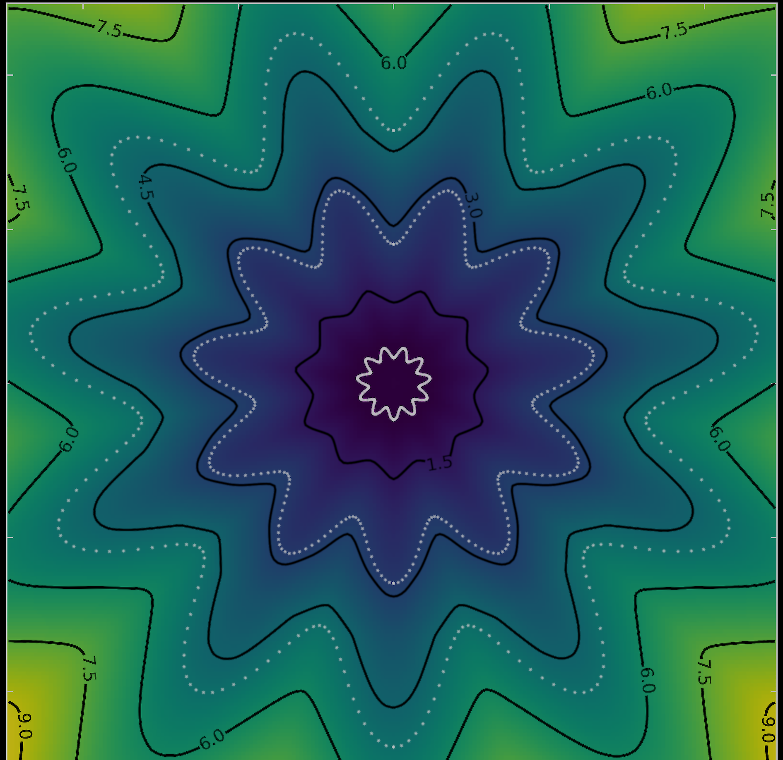



Neural Estimation of Energy Mover’s Distance
NEEMo
Ouail Kitouni

Slide 2
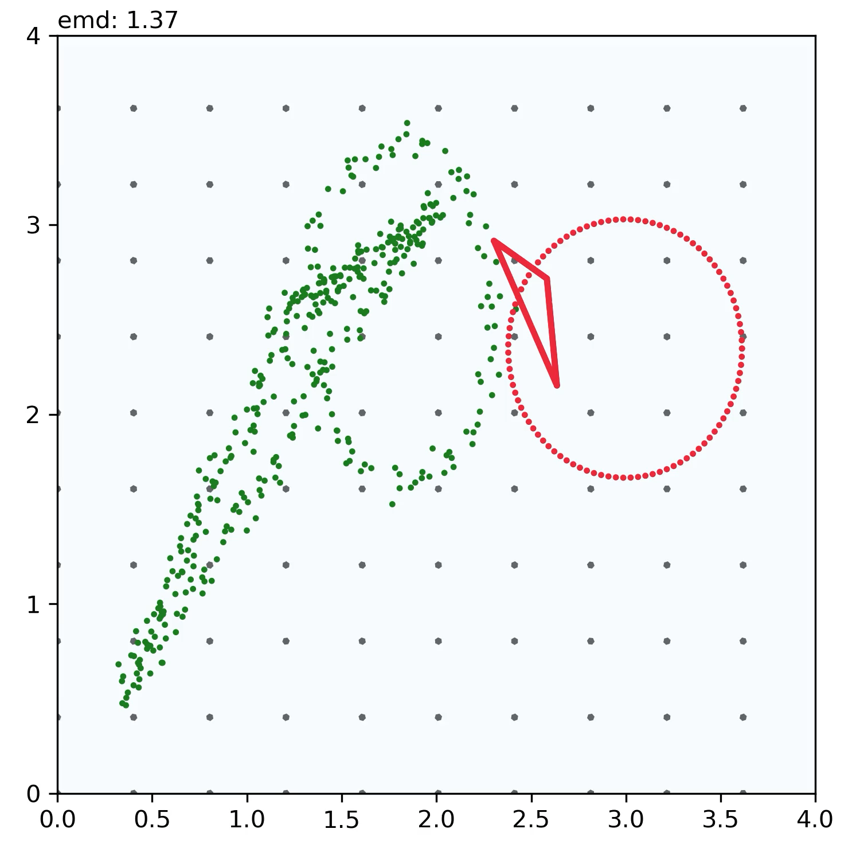
Fitting Arbitrary Geometries

Slide 3
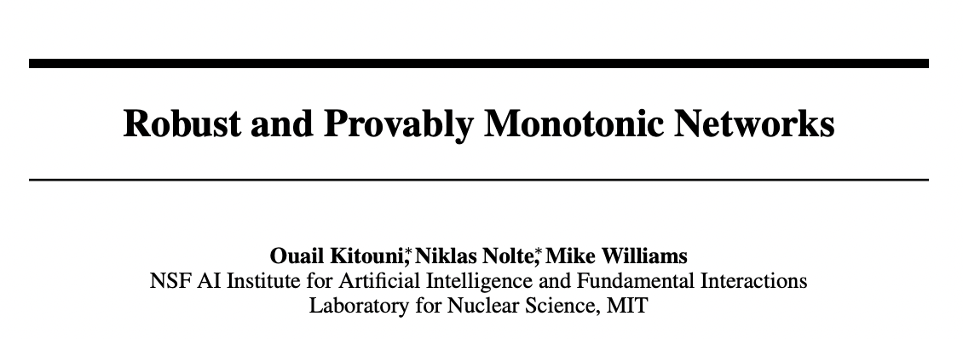


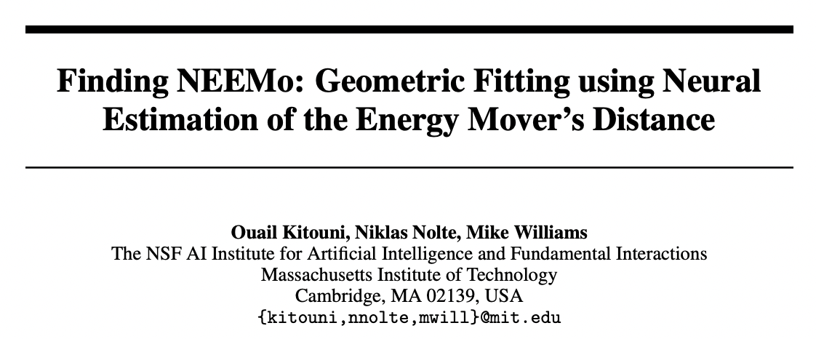
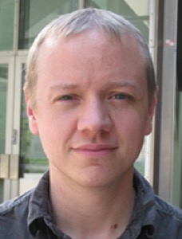
Niklas Nolte
Ouail Kitouni
Mike Williams

Slide 4
Part 1
Lipschitz Networks

Slide 5
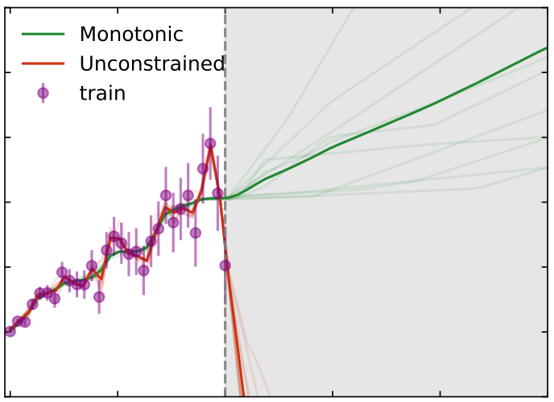
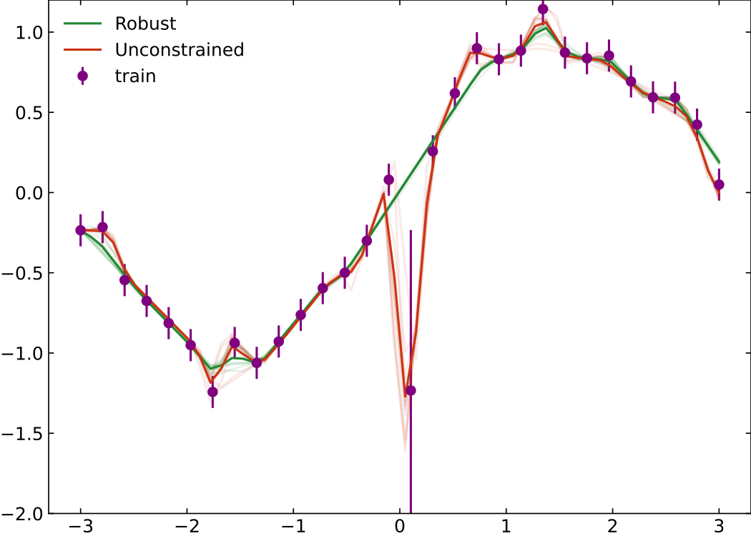
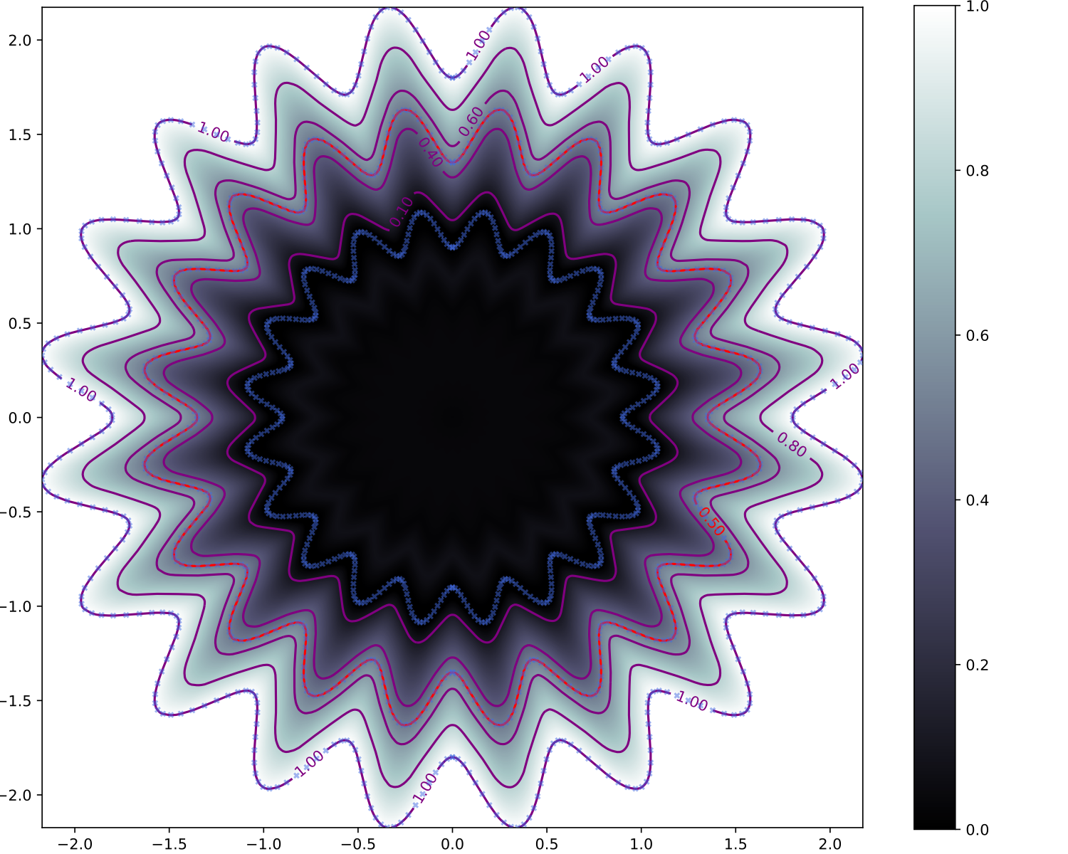
  Robust to outliers
Monotonic functions
Arbitrarily complex decision boundaries*

Slide 6

MontoneNorm
https://github.com/niklasnolte/MonotOneNorm
  pip install monotonenorm
  conda install monotonenorm -c okitouni

Slide 7
How does it work?

Slide 8
Robustness: Definition (more formally)
Small changes in the input should not lead to large changes in the output:
$|f(x+ϵ)-f(x)|≤λϵ∀ϵ>0$
Thus we would like our Neural Network to represent a Lipschitz continuous function.

Slide 9
Robustness: Definition (more formally)
Robustness is achieved by constraining the operator 1-norm of the weight matrices of each layer such that
where λ is Lipschitz constant of the resulting network with respect to the
∞-norm.
Universal Lipschitz-λ function approximation requires activations with gradient 1 almost everywhere.
→ GroupSort*: reorders inputs
$$\overset{L}{\underset{l=0}{∏}}∥W^{l}∥_{1}≤λ$$
*Sorting out Lipschitz function approximation [https://arxiv.org/abs/1811.05381]

Slide 10
Monotonicity using weight norm
g(x) is a λ-Lipschitz neural network. Adding the following residual connection
makes output monotonic since
$$f(x)=g(x)+λ\underset{i∈I}{∑}x_{i}$$
$$\frac{∂f}{∂x_{i}}=\frac{∂g}{∂x_{i}}g(x)+λ≥0∀i∈I$$

Slide 11
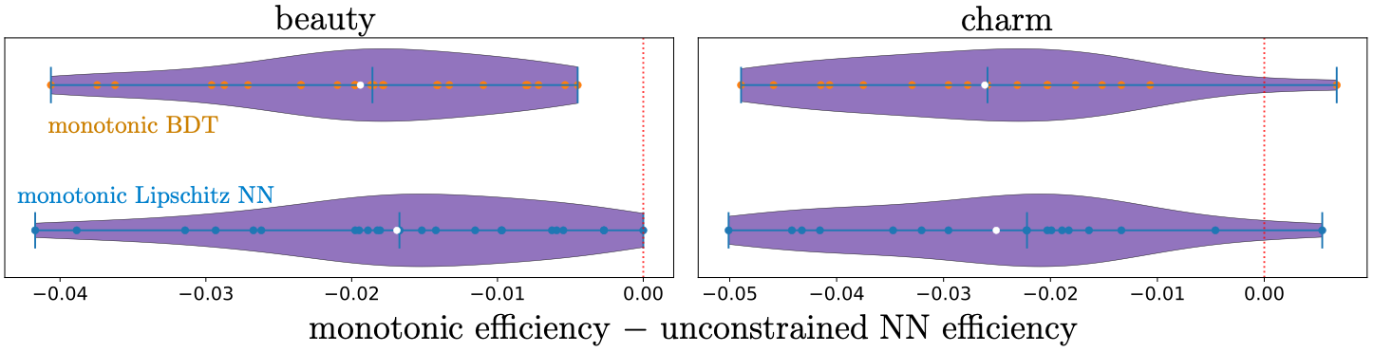
Monotonic Lipschitz Networks LHCb RUN 3 trigger
This architecture is being used in the LHCb heavy-flavor RUN 3trigger.

Slide 12
Part 2
Neural Estimation of Energy Mover’s distance

Slide 13
Niklas Nolte
Ouail Kitouni
Mike Williams

Slide 14
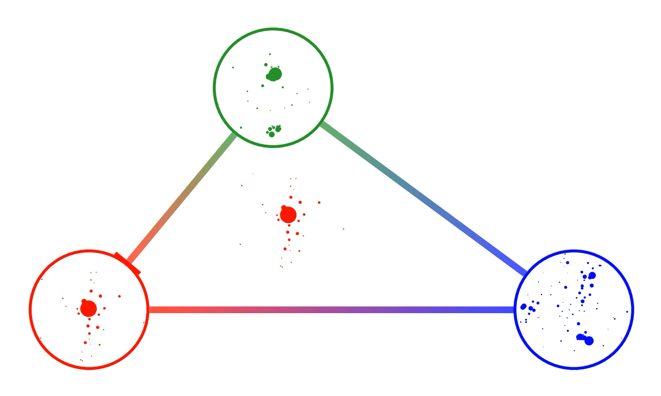
Optimal Transport - Energy Mover’s Distance
The Metric Space of Collider Events [arxiv.org/abs/1902.02346]

Slide 15
Earth Mover’s Distance
The primal formulation of the EMD is an optimization over joint probability distributions
$$EMD(P,Q)=\inf_{γ∈Π(P,Q)}E_{(x,y)∼γ}[||x-y||_{2}],$$
Energies
Event 1
Event 2
Spatial Coordinates

Slide 16
Kantorovich-Rubinstein - Dual Formulation
The dual formulation is an optimization over 1-Lipschitz continuous functions
$$EMD(P,Q)=\sup_{||f||_{L}≤1}E_{x∼P}[f(x)]-E_{x∼Q}[f(x)],$$
Kantorovich potential

Slide 17
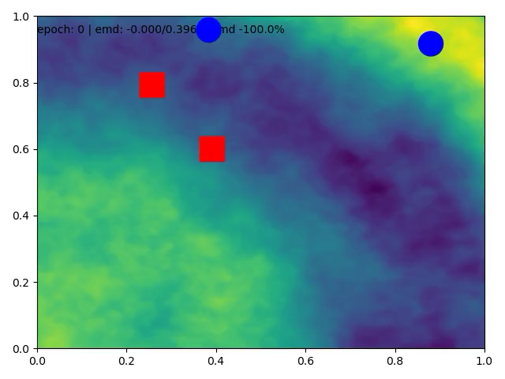
Event with two particles
  Minimizing the EMD between the two events using
  $P$: blue points
  $Q$: red points

Slide 18
NEEMo Algorithm
Parametrized shape: $θ$
Minimize
$$θ→θ-∇_{θ}{EMD}_{ϕ}$$
EMD estimation
$${EMD}_{ϕ}(P_{θ},Q)$$
Parametrized Distribution$P=\{w_{θ}^{i},y_{θ}^{i}\}_{i=1}^{m}$
Maximize $ϕ→ϕ+∇_{ϕ}{EMD}_{ϕ}$
Target Distribution$Q=\{e^{i},x^{i}\}_{i=1}^{n}$
Lipschitz Network
$$f_{ϕ}(x)$$
Forward pass
Backward pass

Slide 19
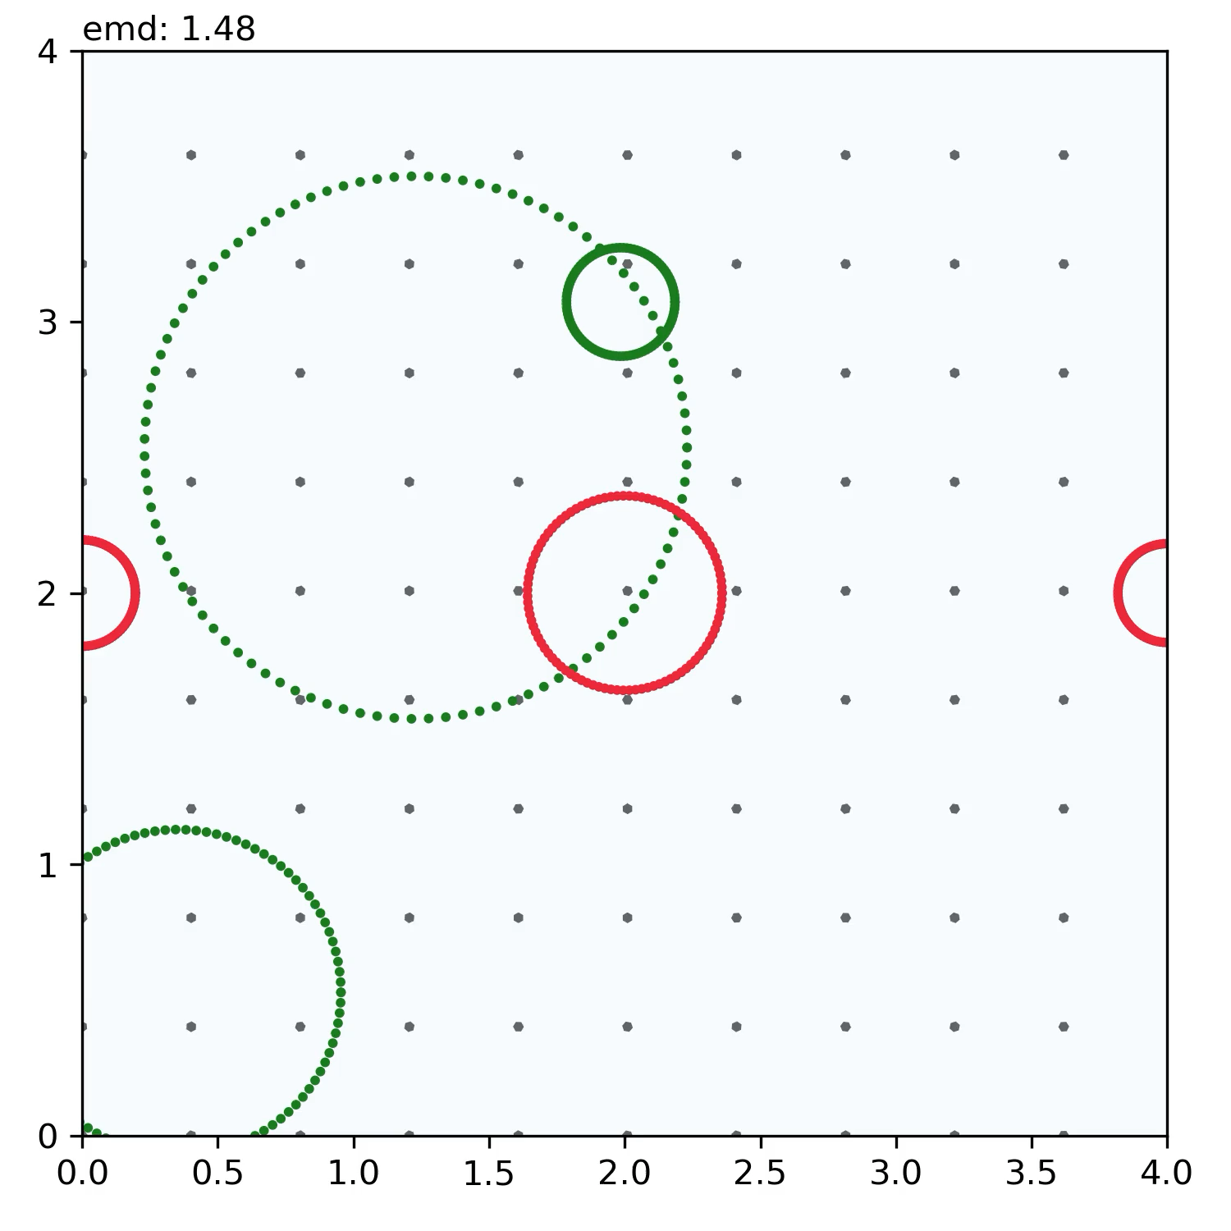
Fitting Arbitrary Geometries
Possible use cases:
Floating term for a uniform background to mitigate pileup
Clustering with jet energy estimation
Variable shape clusters (learned radii, ellipses, arbitrary shapes, etc.)
New (and old) observables: N-subjet, N-circle, triangularness, etc.
All in a unified framework given by the Energy Mover’s Distance*
*Can You Hear the Shape of a Jet [https://indi.to/rbQ5j]

Slide 20
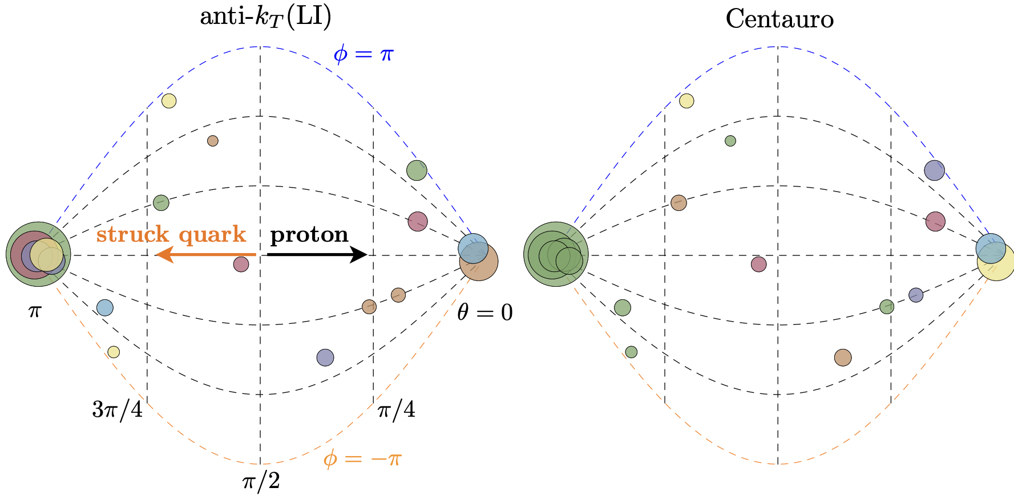
EIC - Applications
Hand-designed algorithms
Flexible learned algorithms
Asymmetric jet clustering in deep-inelastic scattering
[arxiv.org/pdf/2006.10751.pdf]

Slide 21


Questions
NEEMo
https://github.com/okitouni/EnergyMover-Dual/tree/neurips2022
Monotonenorm
https://github.com/niklasnolte/MonotOneNorm
pip install monotonenorm
conda install monotonenorm -c okitouni
https://arxiv.org/abs/2112.00038
https://arxiv.org/abs/2209.15624

Slide 22
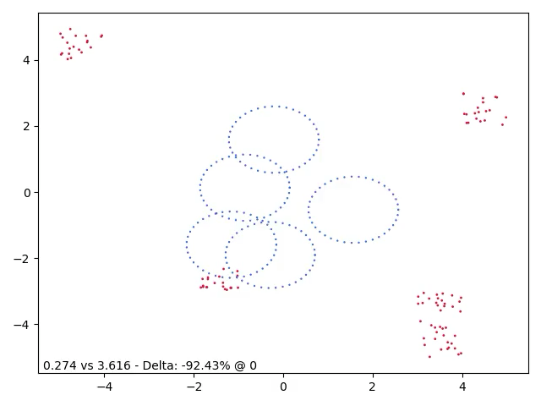
Clustering with Lipschitz Networks

Slide 23


Niklas Nolte
Ouail Kitouni
Mike Williams
Jesse Thaler
Rikab Ghambir

Slide 24
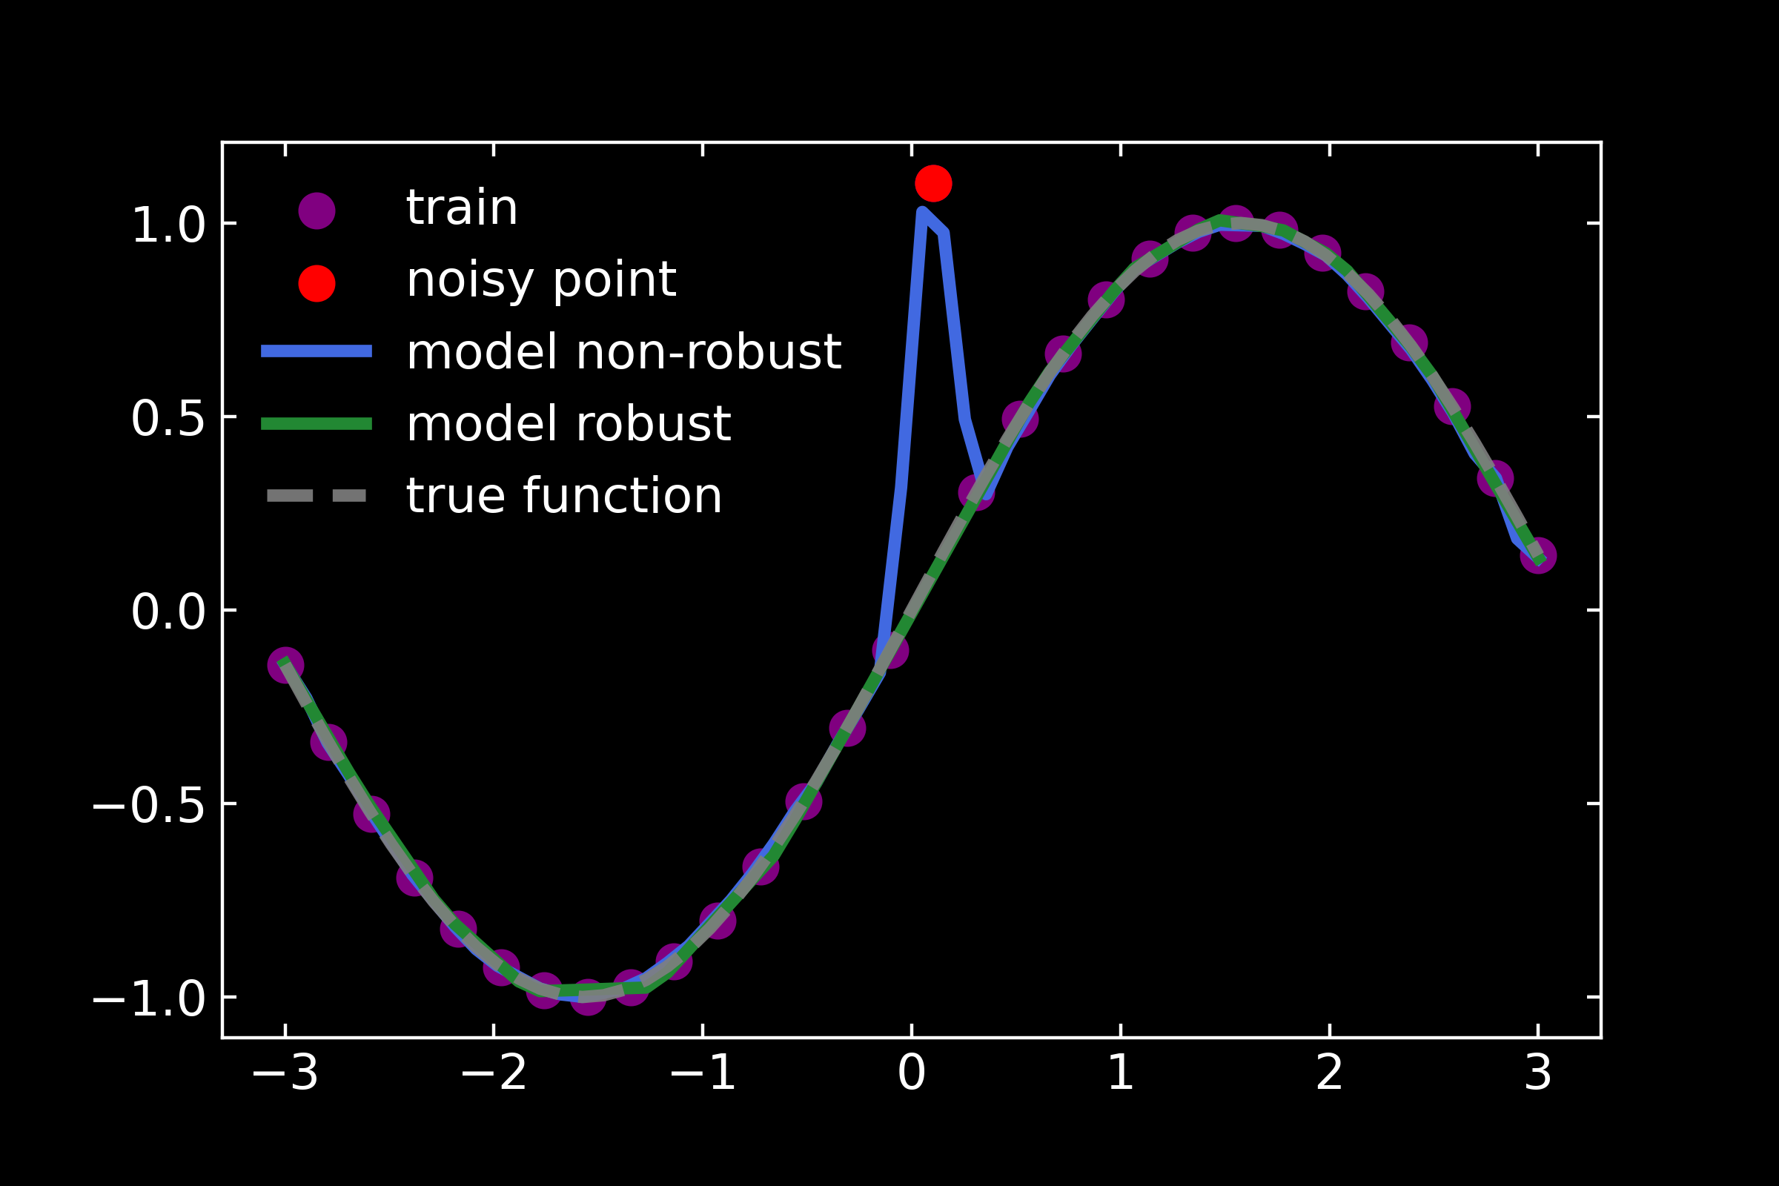
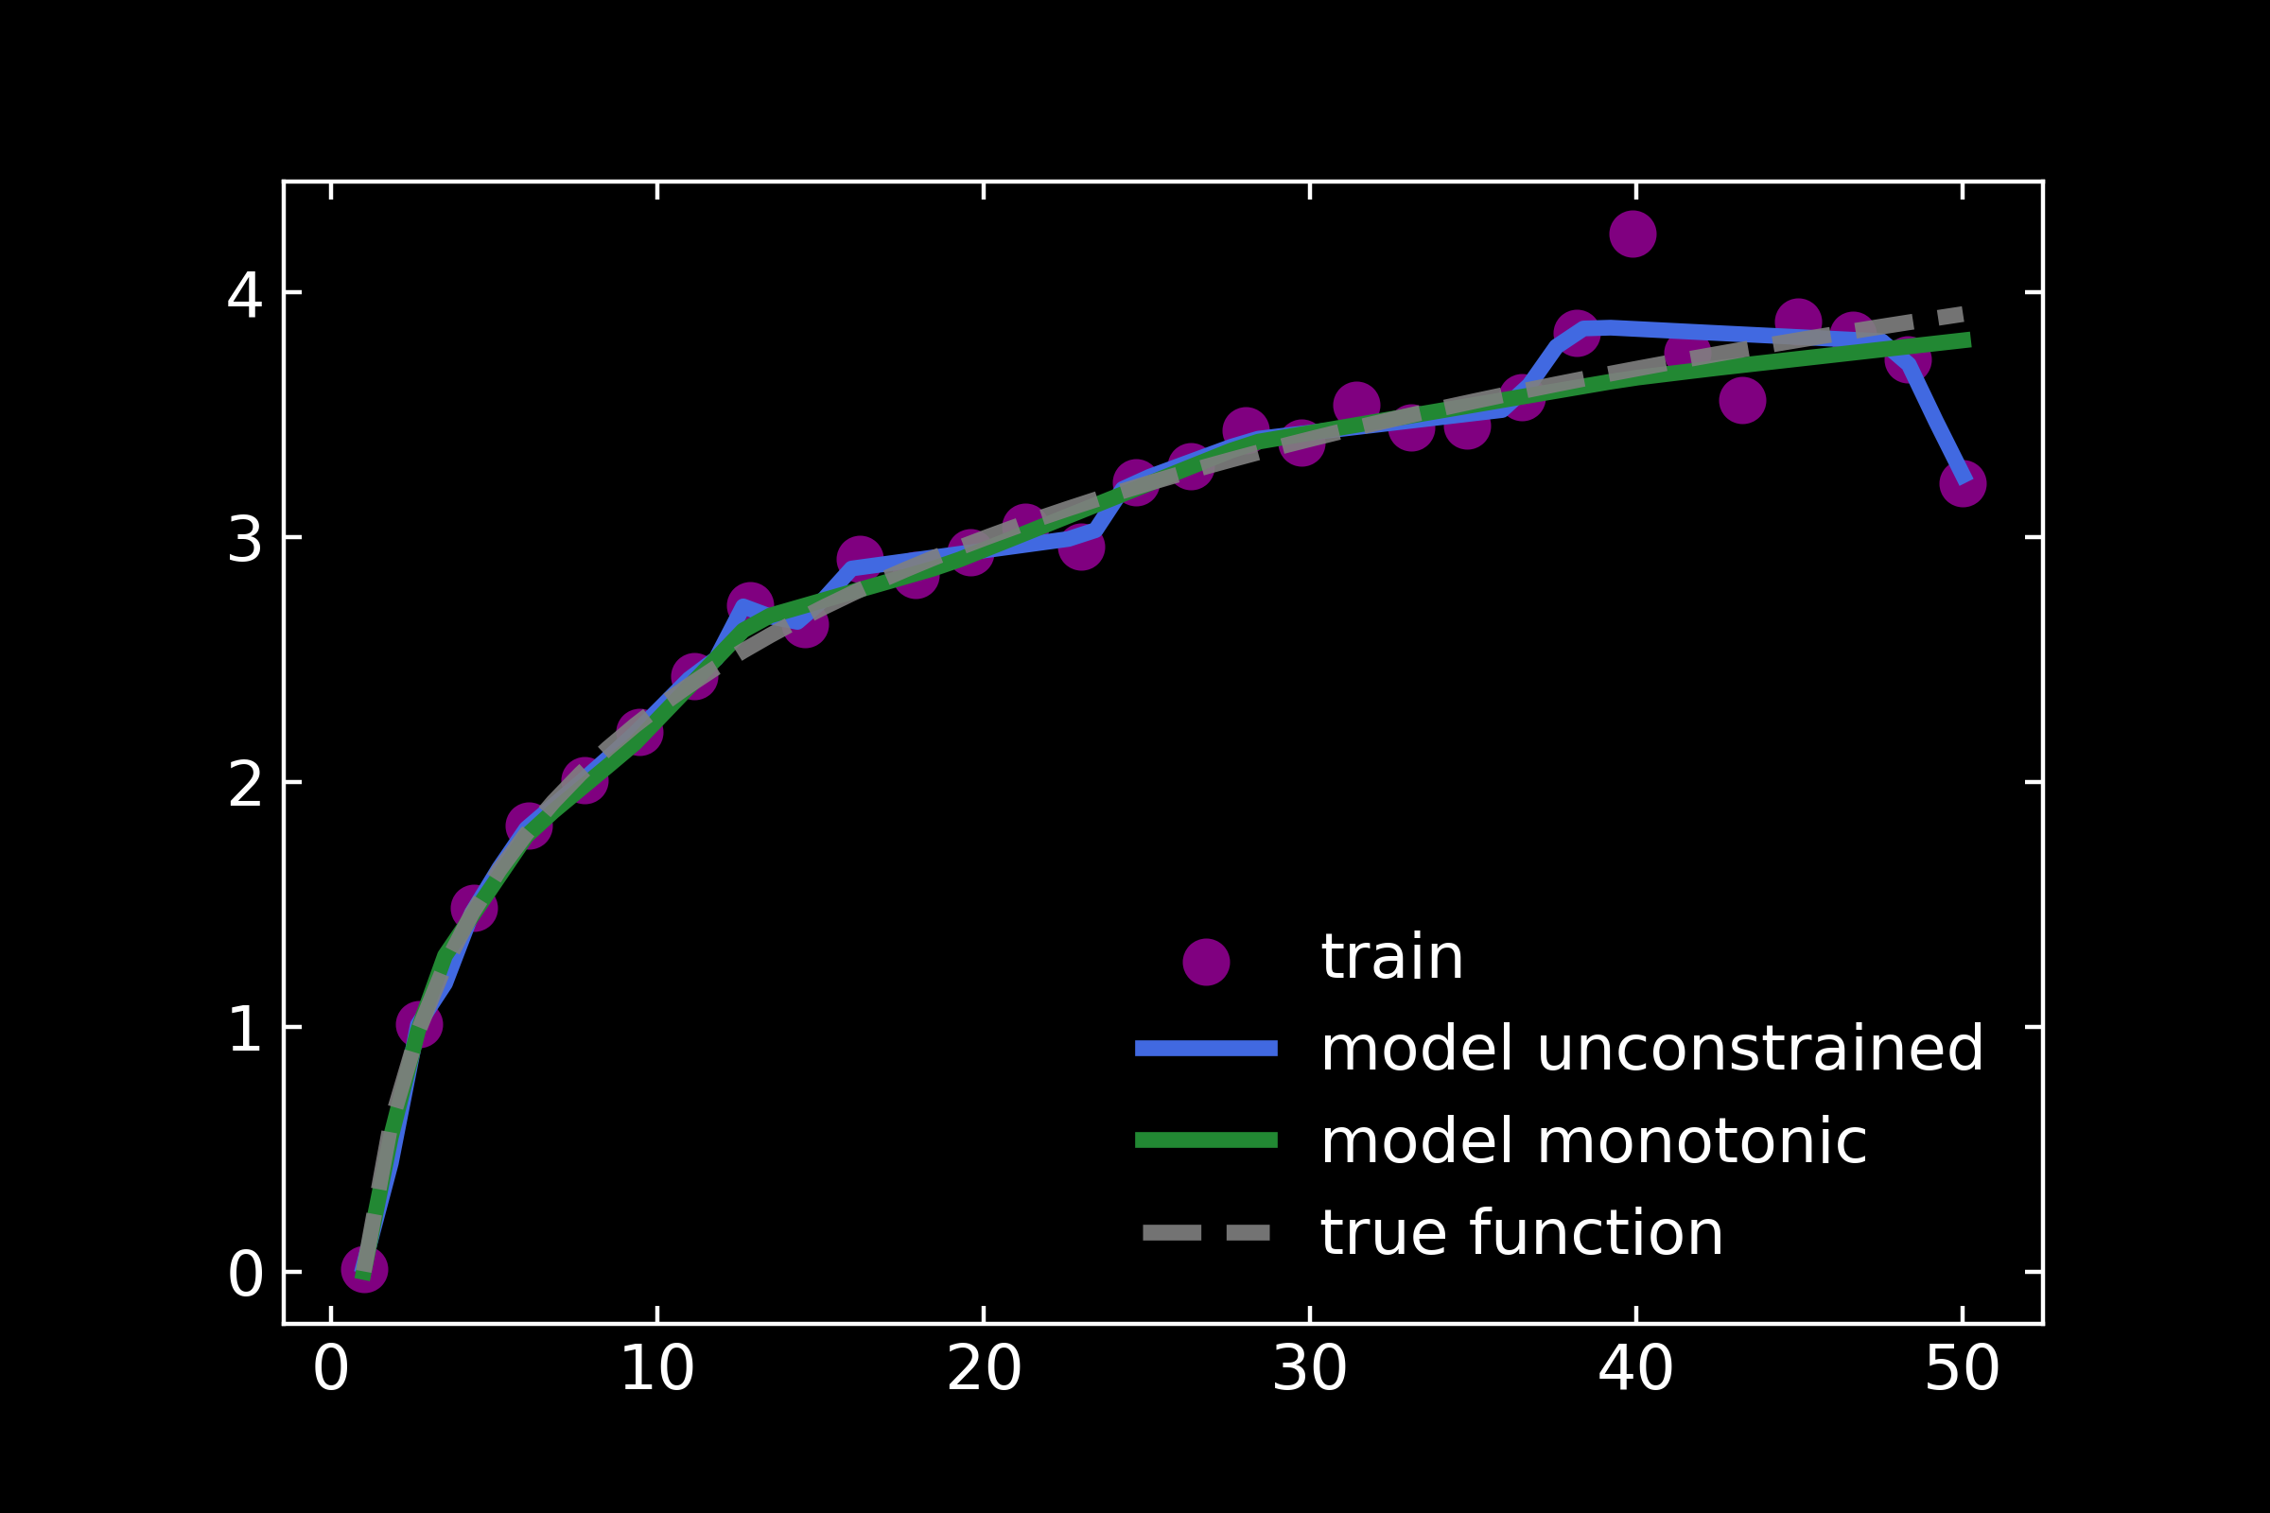
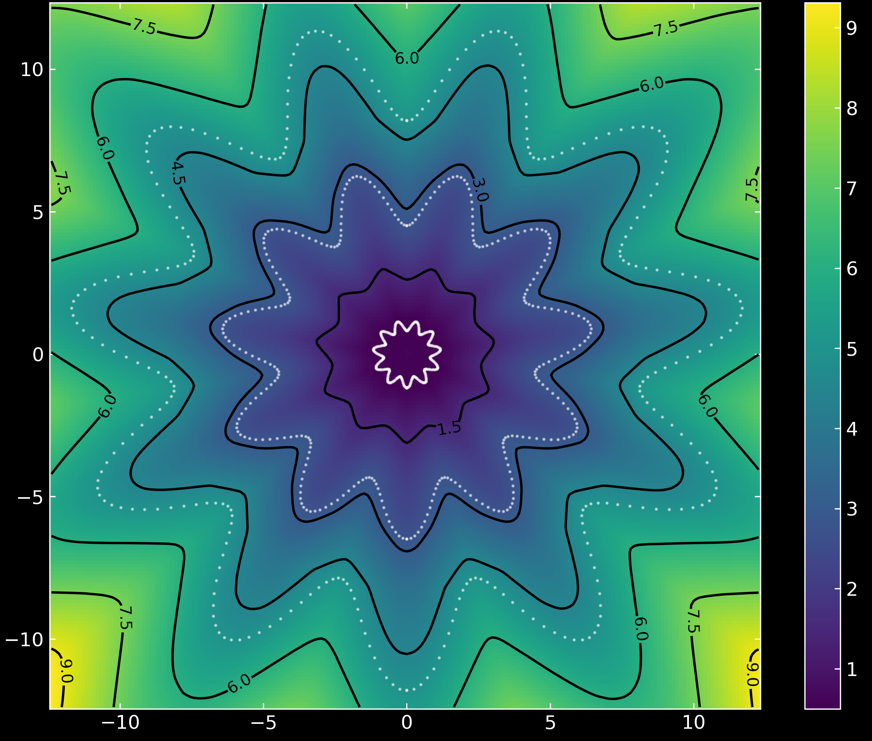
Promises
Monotonic functions
Robust to outliers
Arbitrarily complex decision boundaries*

Slide 25
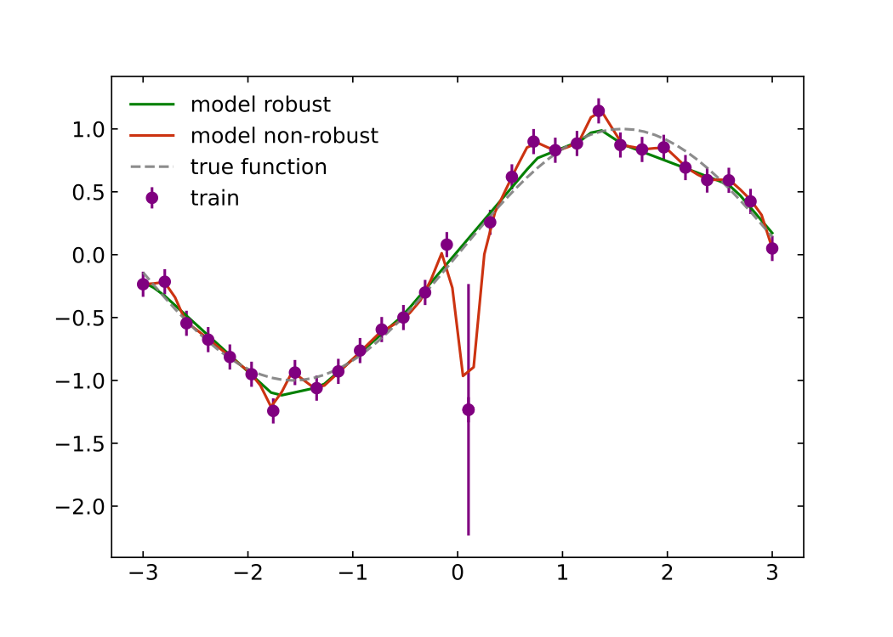
  Robust to outliers
Monotonic functions
Arbitrarily complex decision boundaries*

Slide 26
Robustness: Definition
Robustness to adversarial attacks
  more realistically data-corruption in a physics scenario
Learning in the presence of outliers

Slide 27
Robustness: Definition
The existence of adversarial examples shows that NN learning can be very brittle

Slide 28
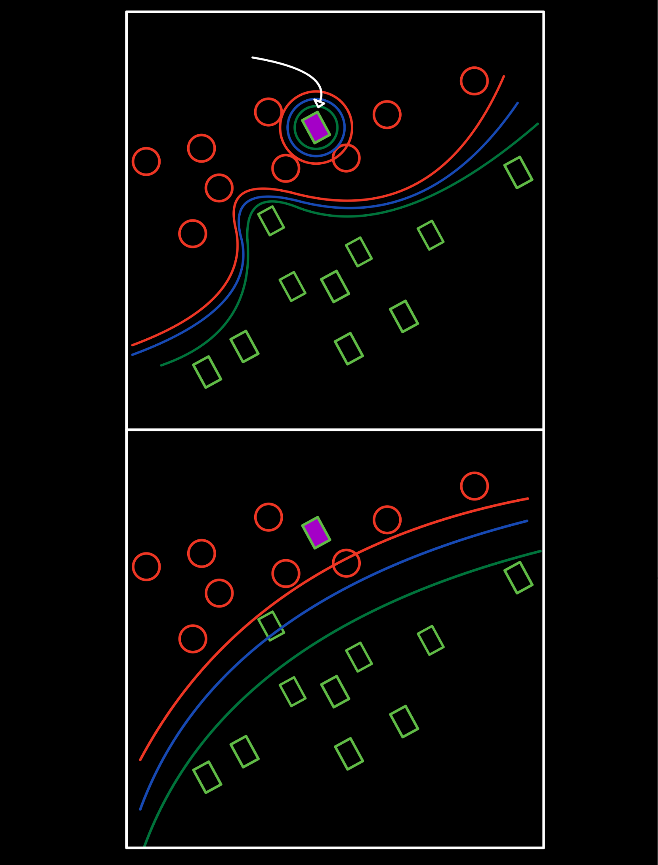
Robustness a cartoon picture
Noisy
example
Non-robust NN
Steep boundary leads to instability in predictions
Deep wells due to overfitting noisy training examples
Overly-complex boundary
-1
+1
Robust NN
moderate slope at the boundary
Robust to noise in training (no deep wells)
No “unnecessarily-complex” boundary
-1
+1

Slide 29
Possible solution

Slide 30
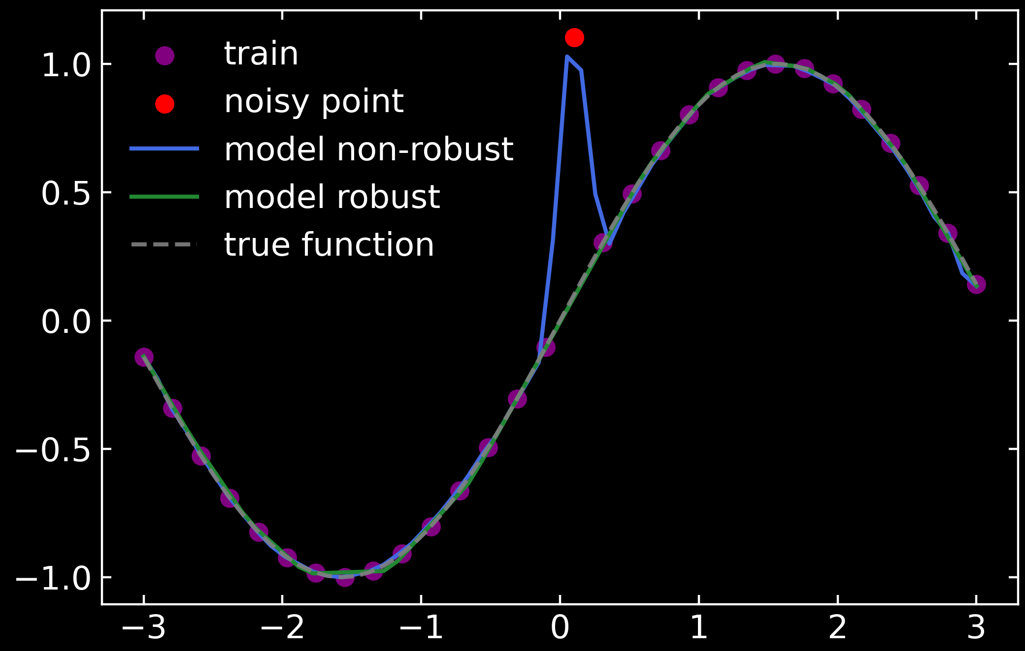
Robustness

Slide 31
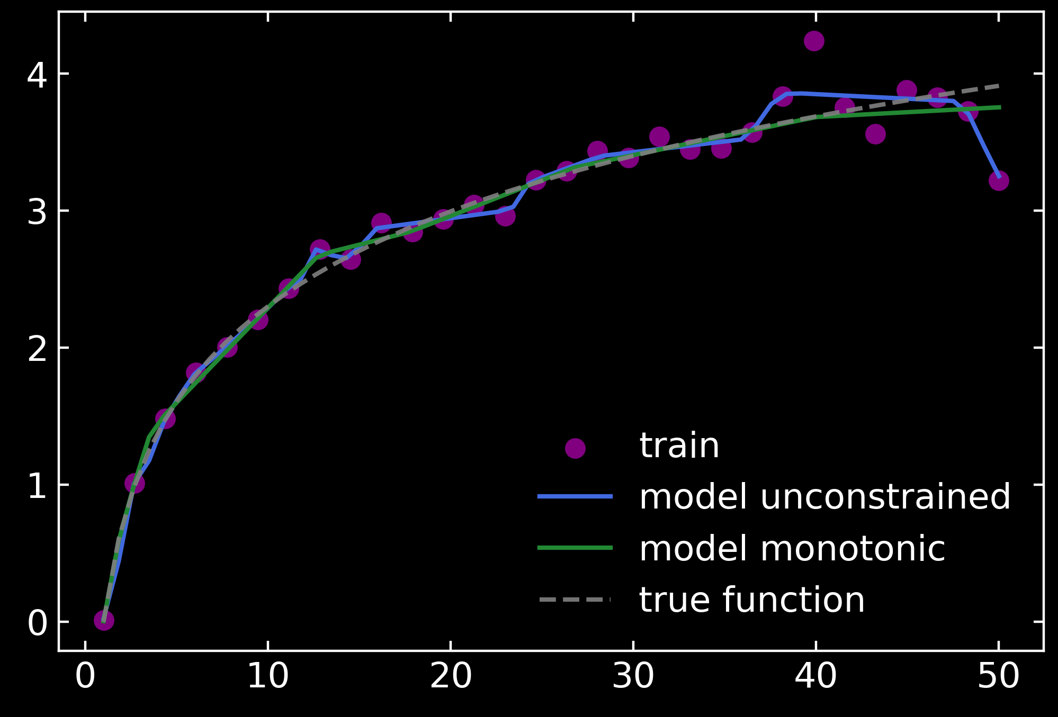
Monotonicity Inductive Bias

Slide 32
Complex decision boundaries*
*with the appropriate objective in classification

Slide 33
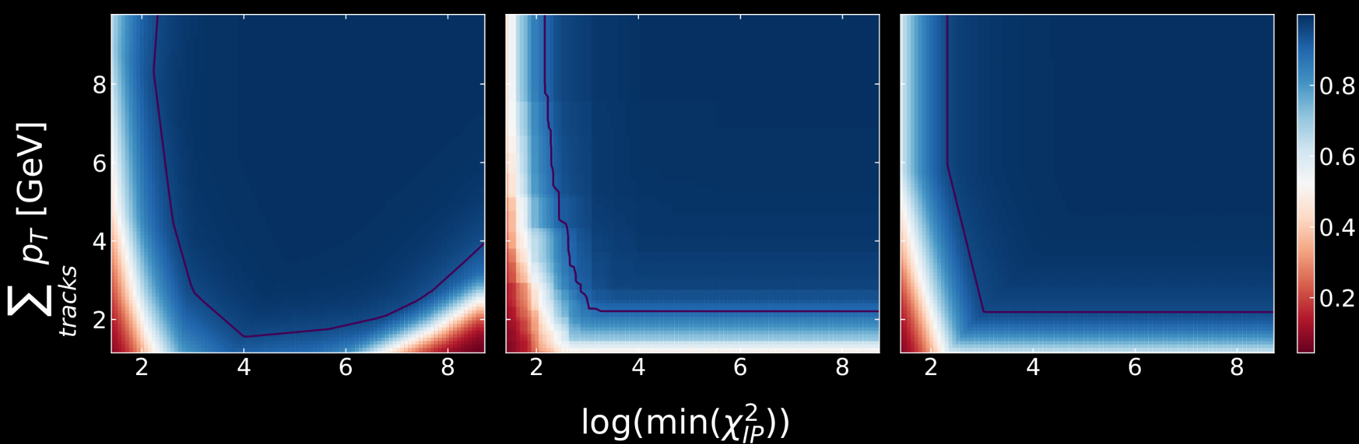
LHCb Trigger
unconstrained NN monotonic BDT Lipschitz NN
decision barrier:
monotonic in both inputs

Slide 34
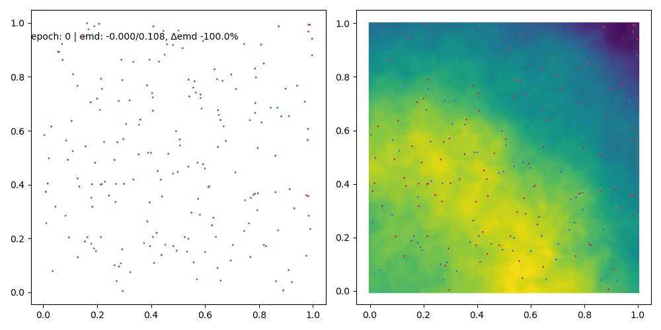
EMD with Lipschitz Networks

Slide 35
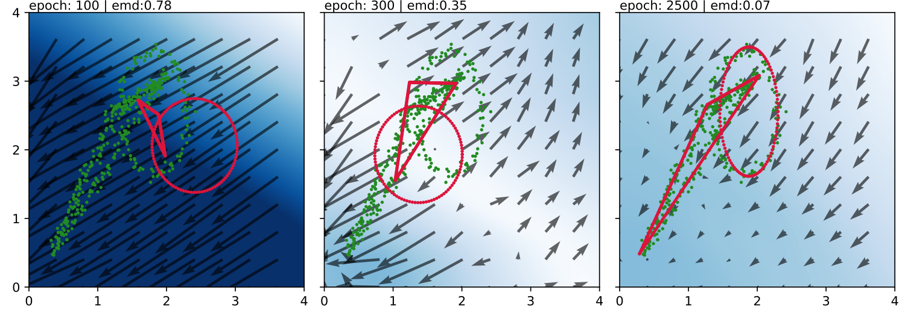

Slide 36
How?
Robustness is achieved by constraining the operator 1-norm of the weight matrices of each layer such that
where λ is Lipschitz constant of the resulting network with respect to the
∞-norm.
Universal Lipschitz-λ function approximation requires activations with gradient 1 almost everywhere.
→ GroupSort: reorders inputs
$$\overset{L}{\underset{l=0}{∏}}∥W^{l}∥_{1}≤λ$$
g(x) is a λ-Lipschitz neural network. Adding the following residual connection
makes output monotonic since
$$f(x)=g(x)+λ\underset{i∈I}{∑}x_{i}$$
$$\frac{∂f}{∂x_{i}}=\frac{∂g}{∂x_{i}}g(x)+λ≥0∀i∈I$$

