Slide 1


Quantum Computing of the 6Li nuclei via ordered unitary coupled cluster
Oriel Kiss
Keypoint: We study the ordering of fermionic operators and compute low energy nuclear eigenstates with the Variational Quantum Eigensolver.
Paper: Kiss et al., Phys. Rev. C 106, 034325 (2022)

Slide 2
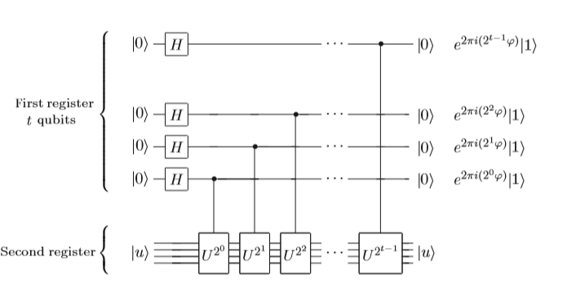

Quantum Phase Estimation
Estimate the eigenvalue (phase) of an eigenstate $|\left.u\right\rangle$ of H
QFT⁻¹
N bit precision of the phase.
Problem: requires fault tolerance!
U = exp(-iH)
Nielsen, M., & Chuang, I. (2010). Quantum Computation and Quantum Information

Slide 3
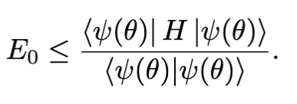
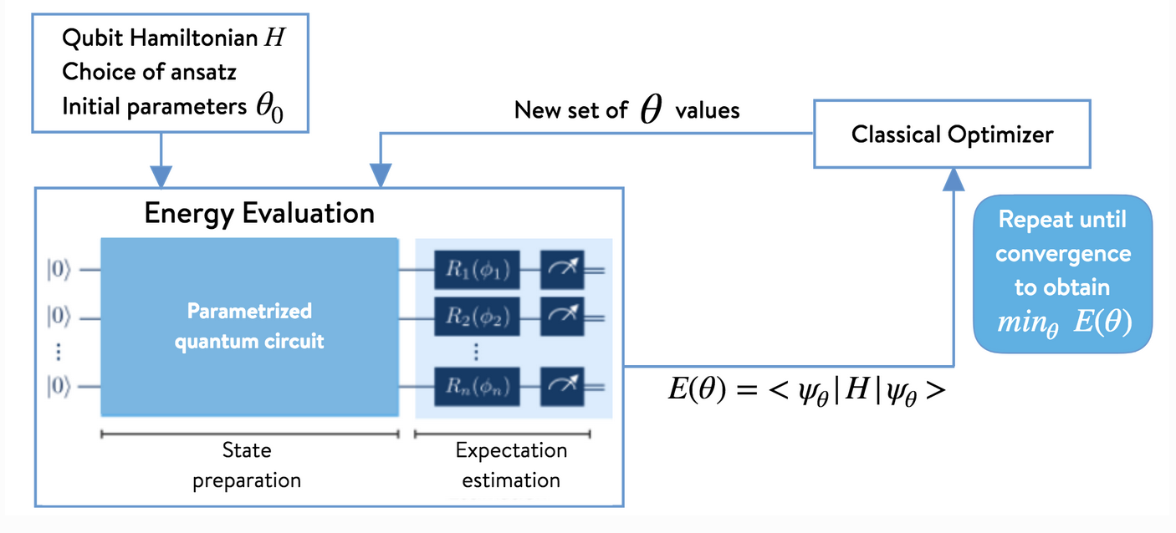
An overview of the Variational Quantum Eigensolver
Goal: obtain the ground state energy of an Hamiltonian by using the Variational principle.
Image Credit: 1QBit
Peruzzo A. et al., Nat. Commun. 5, 4123 (2014).

Slide 4
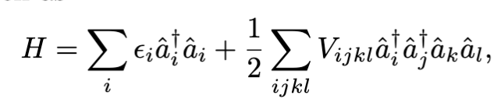
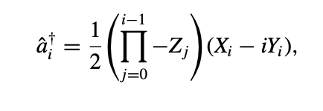

Nuclear shell model (Cohen-Kurath)
Map to qubit Hamiltonian with the
Jordan-Wigner transformation.
Single particle energies
Two body interaction
Frozen Helium core
0p1/2 and 0p3/2 harmonic oscillator orbitals for the neutron and proton.
12 orbitals (6 protons and 6 neutrons)
Additional information about J_{z}
Groundstate has total angular momentum projection of -1, 0 or 1.
First excited state has total angular momentum projection of -3, -2, 2 or 3.
radial, angular, spin, spin projection, isospin
Dumitrescu E. F. et al., Phys. Rev. Let. 120 210501 (2018).
Stetcu I. et al, Pjus. Rev. C 105 064308 (2022).

Slide 5
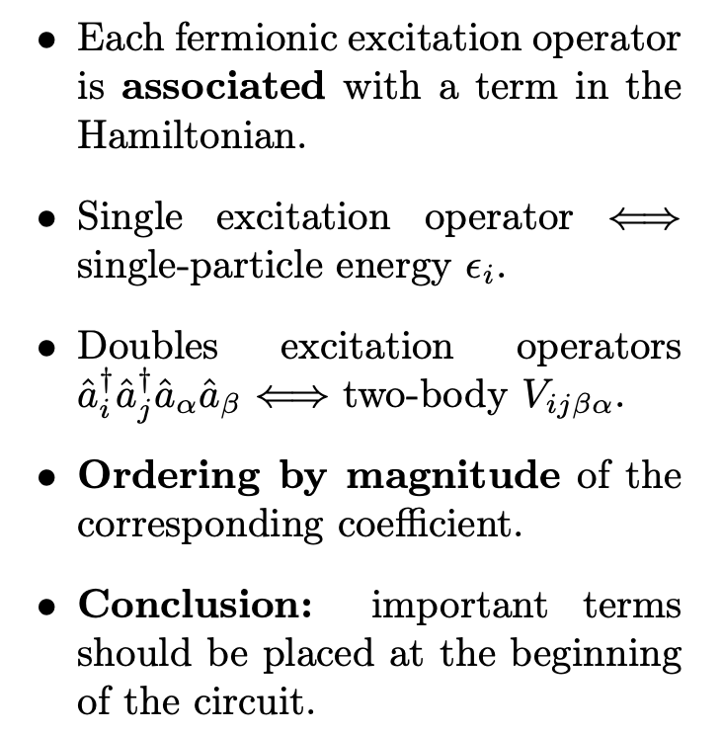


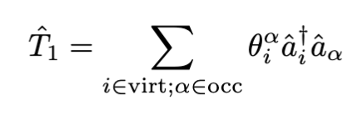
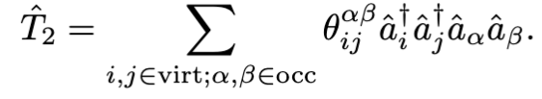
Quantum Circuit Ansätze
We manually select only the operators that preserve J_{z} (Important).
Unitary Coupled Clusters (UCC)
Ordering of the excitation operators
Hartree Fock solution
1 Step Trotterization
Cluster operators
Single fermionic excitation terms
Double fermionic excitation terms
Maped to qubit via Jordan Wigner

Slide 6
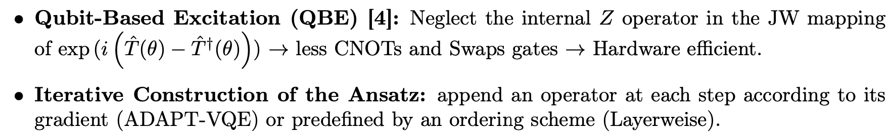
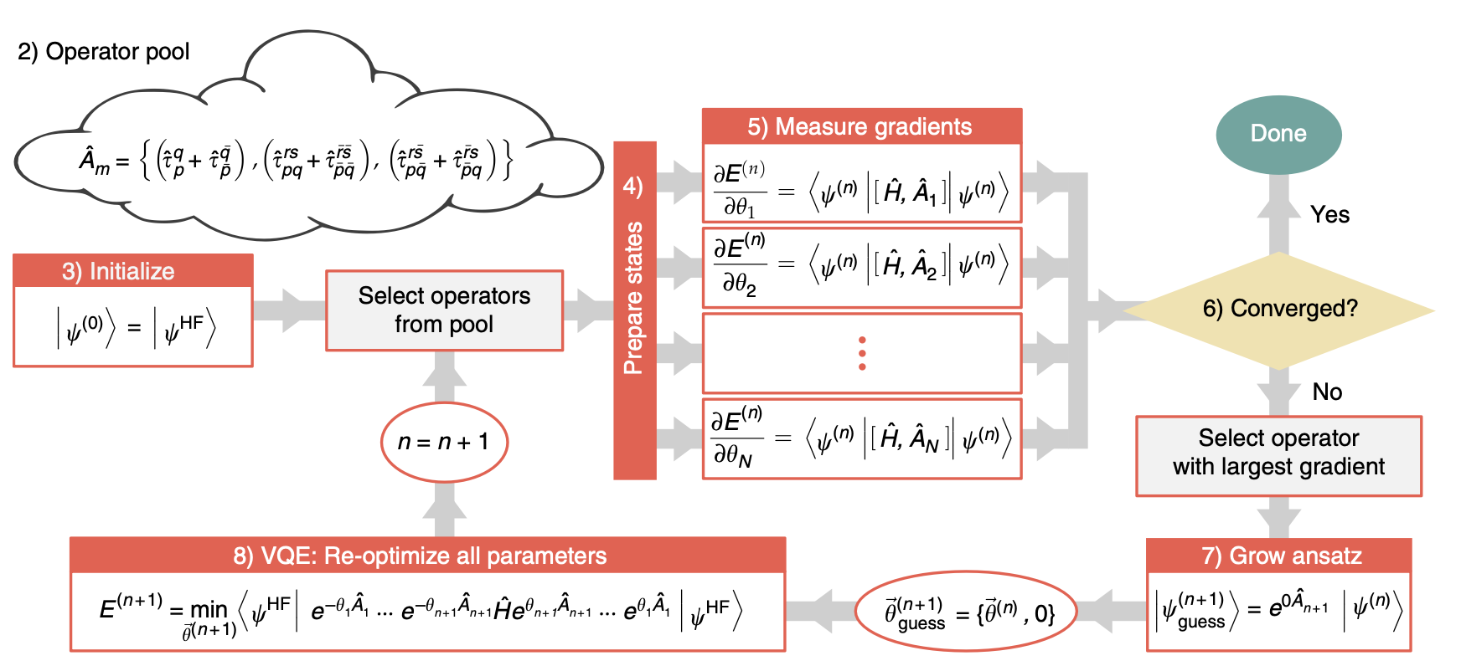
Variante of the UCC Ansätze
[4] Yordanov Y. S. et al., Phys. Rev. A. 102 062612, (2020).
Grimsley, H.R., Economou, S.E., Barnes, E. et al. Nat Commun 10, 3007 (2019).
LL
Train the first term for k steps.
Add a second term according to the ordering.
Repeat until all operators have been added.

Slide 7
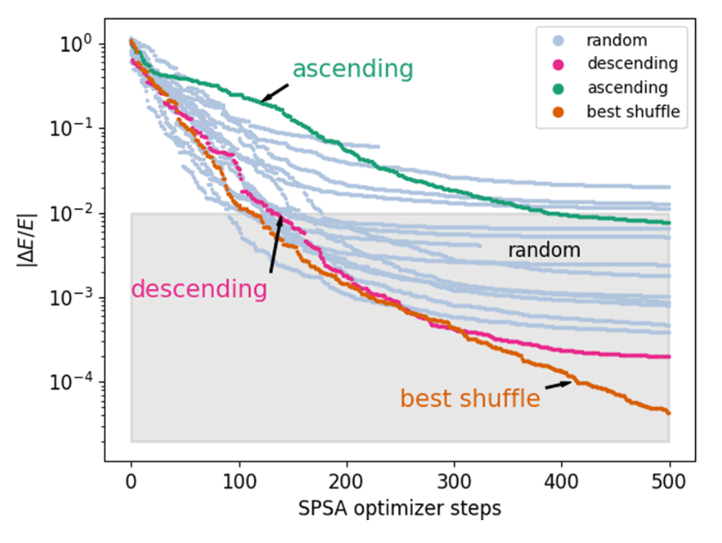
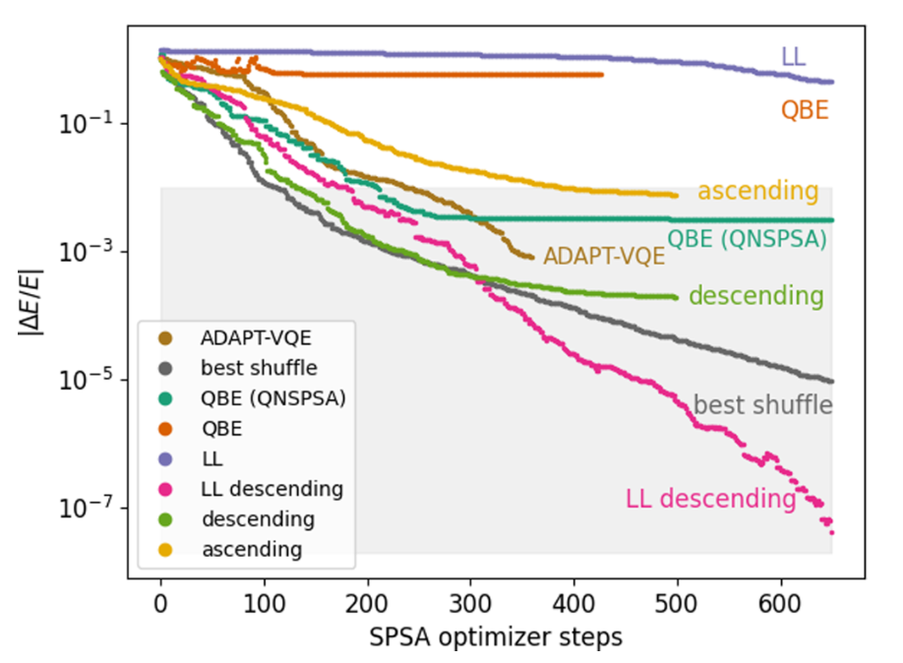
Results (Simulations)
Kiss et al., Phys. Rev. C 106, 034325 (2022)
Best approach: train the ansatz recursvily in descending order.
Qubit Based Excitation UCC: adapted to NISQ devices
The effect of shuffling the fermionic excitations operators.
We should order them in descending order.
Optimizer: gradient free SPSA
1% barrier needed for most applications

Slide 8
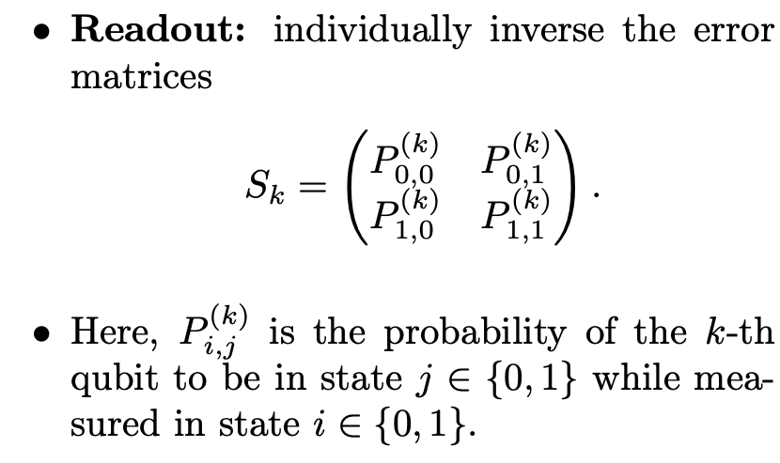
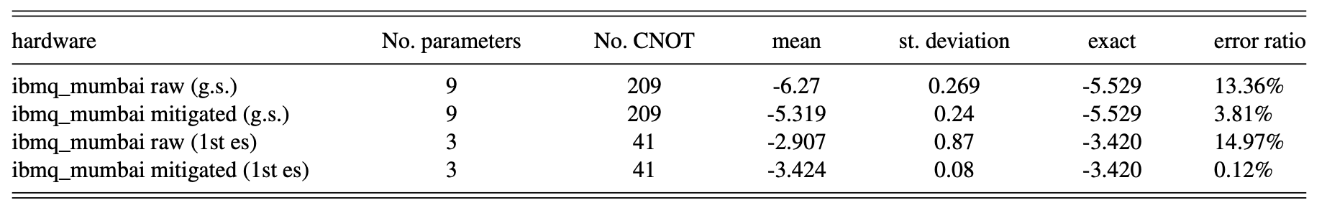
Hardware results (IBMQ)
Error mitigation
Start from the classical solution (warm start).
Qubit Based Excitation descending UCC Ansatz.
10 runs on the 27 qubits IBMQ mumbai chip.

Slide 9
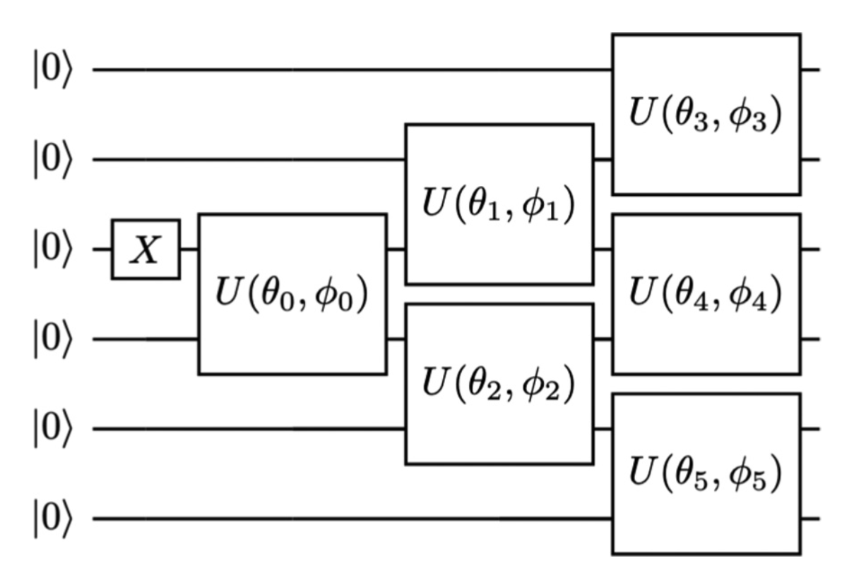
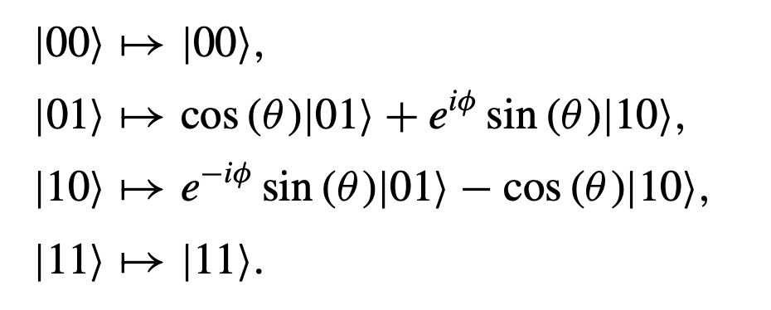
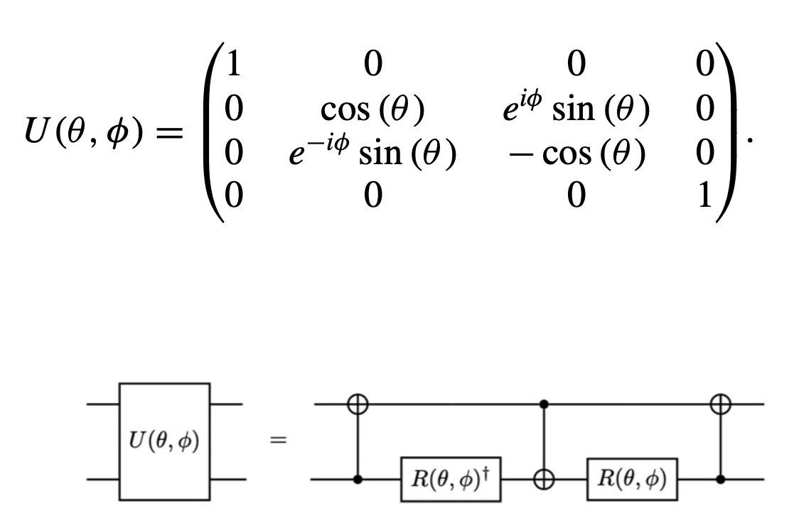
Alternative Ansätze
Excitation Preserving Hardware Efficient Ansatz
Two-qubit gate which maps
Circuit Construction
Initial state
Preserve excitations
Gate Decomposition
Problems:
Does not know about the total angular momentum.
Non trainable, barren plateaus.

Slide 10
Conclusions
We computed the ground and first excited state of the 6Li nucleus with a quantum computer.
Operators associated with large coefficients should be placced first.
Layerweise learning can improve the convergence.
Error mitigation is vital for NISQ devices.

Slide 11
Thanks for your attention!
Questions?
Kiss et al., Phys. Rev. C 106, 034325 (2022).
Peruzzo A. et al., Nat. Commun. 5, 4123 (2014).
Dumitrescu E. F. et al., Phys. Rev. Let. 120 210501 (2018).
Stetcu I. et al,, Pjus. Rev. C 105 064308 (2022).
Yordanov Y. S. et al., Phys. Rev. A. 102 062612, (2020).
oriel.kiss@cern.ch

