Slide 1



Quantum Neural Networks force fields generation
Oriel Kiss, Francesco Tacchino, Sofia Vallecorsa and Ivano Tavernelli
Keypoint: We propose a quantum neural network (QNN) for the computation of energy and forces and use it successfully on simple molecules.
Paper: Kiss, et al., Mach. Learn.: Sci. Technol. 3 035004 (2022)

Slide 2
Molecular Force Fields
Methods:
Approximate methods from first principles (density-functional theory (DFT) or coupled clusters (CC):
- precise
- expensive and slow (on the fly) .
Machine learning (ML)
- trained on DFT or experimental data set
- really fast once trained
Quantum neural networks:
- seems to be more expressive
Goal: compute the energy and forces between atoms in a molecule, given its configuration.
Why: Being able to run molecular dynamics (MD) by integrating Newton’s equations of motion.
Useful in: computational physics, chemistry, material sciences, drug design, etc.

Slide 3
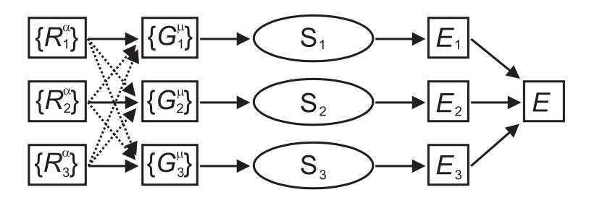
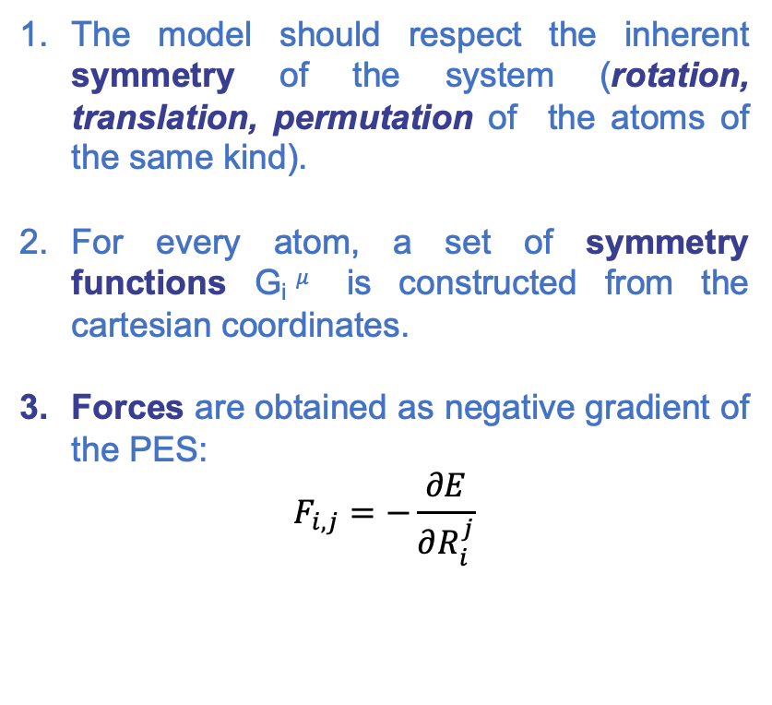
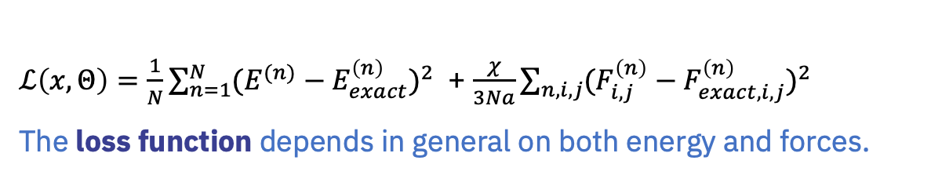
Classical NNs for Potential Energy Surface (PES) [1]
Symmetry functions
The model should respect the inherent symmetry of the system (rotation, translation, permutation of the atoms of the same kind).
For every atom, a set of symmetry functions G_{i}$μ$ is constructed from the cartesian coordinates.
Forces are obtained as negative gradient of the PES:
$$F_{i,j}=−\frac{∂E}{∂R_{i}^{j}}$$
PES
Cartesian
coordinates
Sub neural networks
$ℒ\left(x,Θ\right)=\frac{1}{N}\sum_{n=1}^{N}{{(E^{(n)}−E_{exact}^{\left(n\right)})}^{2}}$ + $\frac{χ}{3Na}\sum_{n,i,j}{{(F_{i,j}^{\left(n\right)}−F_{exact,i,j}^{\left(n\right)})}^{2}}$
The loss function depends in general on both energy and forces.
[1] Jörg Behler and Michele Parrinello. Generalized Neural-Network Representation of High-Dimensional Potential-Energy Surfaces. In: Physical Review Letter 98, 146401 (Sept. 2006)

Slide 4
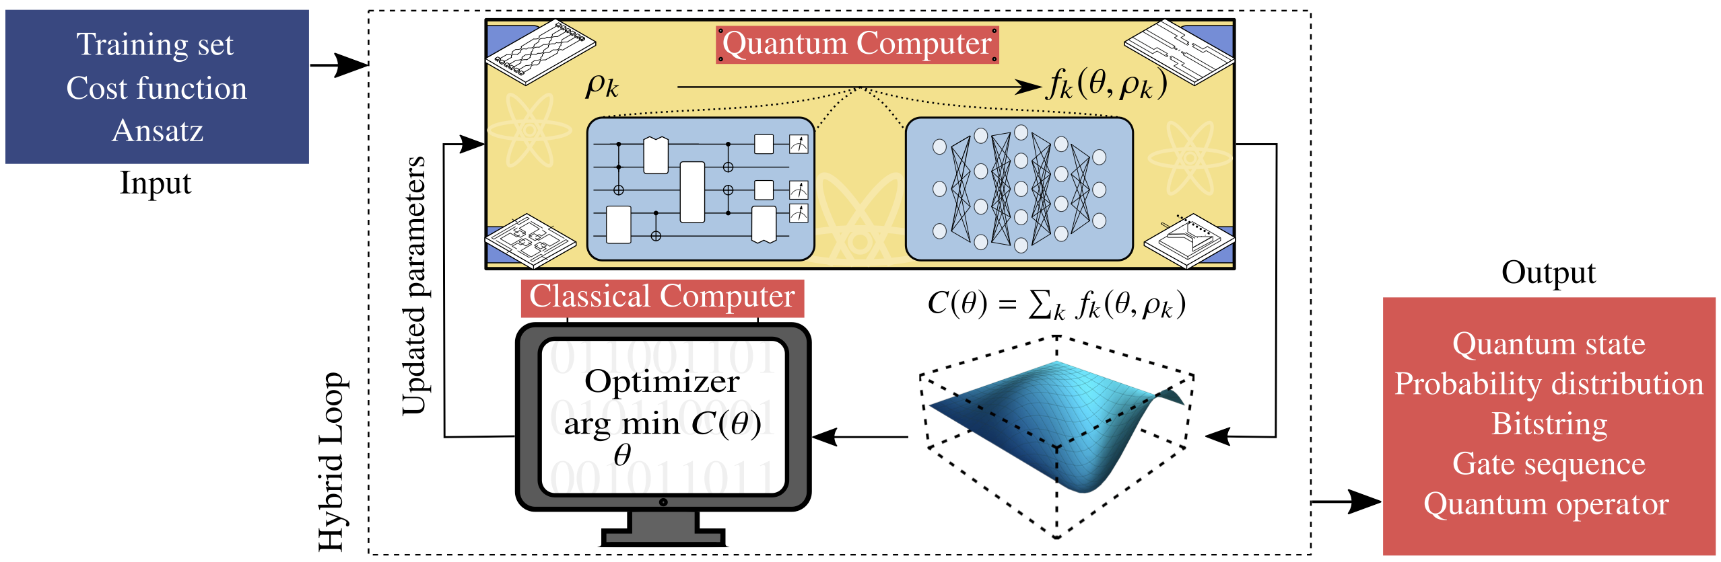
Quantum machine learning models
Quantum circuits as heuristic machine learning models.
Cerezo et al., Nat Rev Phys 3, 625–644 (2021)

Slide 5
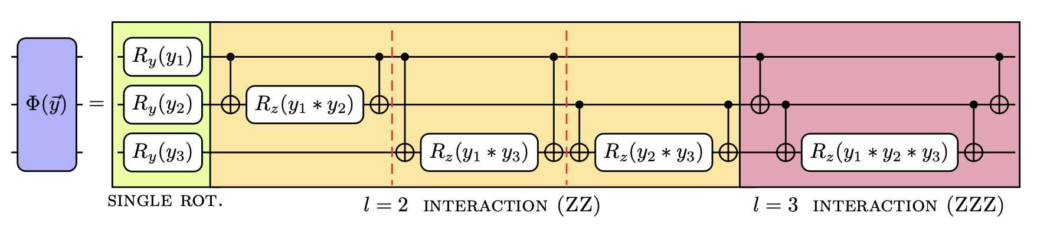
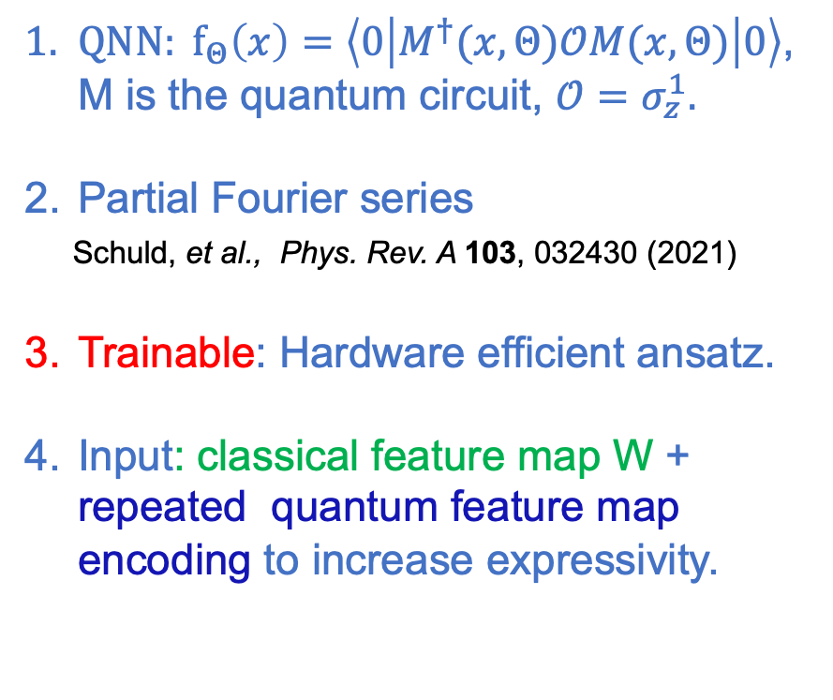
Pre processing
Quantum Neural Networks
Symmetry function
${QNN: f}_{Θ}\left(x\right)=\left\langle 0 | M^{†}(x,Θ)𝒪M(x,Θ) | 0\right\rangle$, M is the quantum circuit, $𝒪=σ_{z}^{1}.$
Partial Fourier series
Schuld, et al., Phys. Rev. A 103, 032430 (2021)
Trainable: Hardware efficient ansatz.
Input: classical feature map W + repeated quantum feature map encoding to increase expressivity.
Initial state
Trainable
parameters
Loss
Kiss, et al., Mach. Learn.: Sci. Technol. 3 035004 (2022)

Slide 6
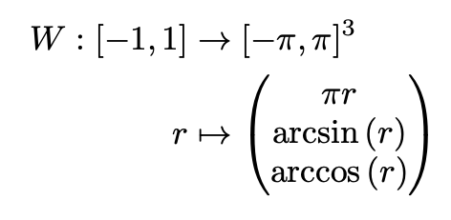
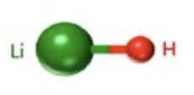
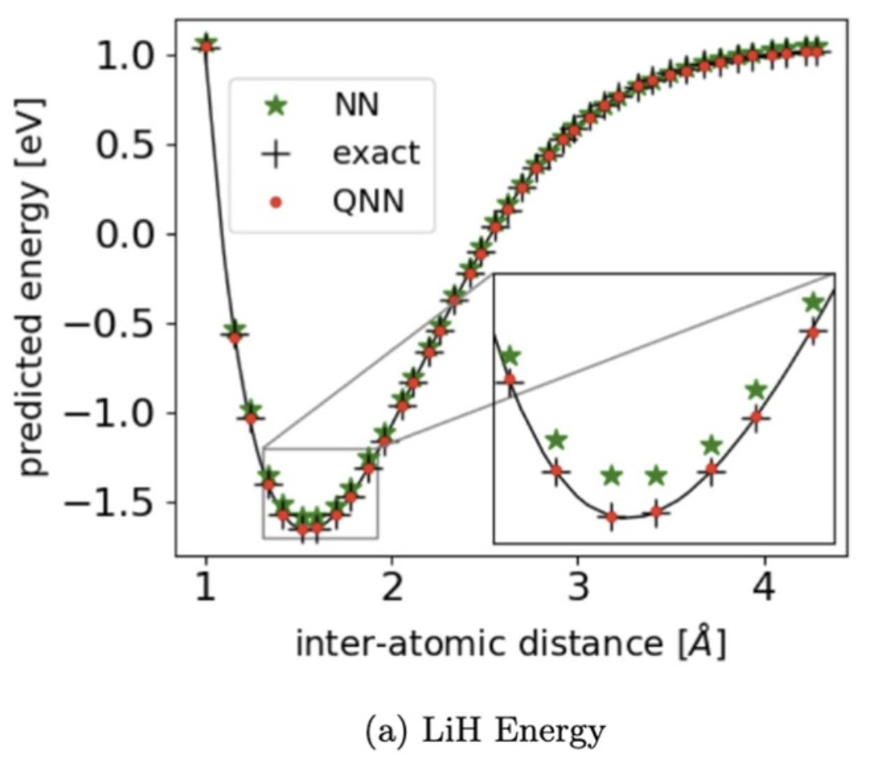
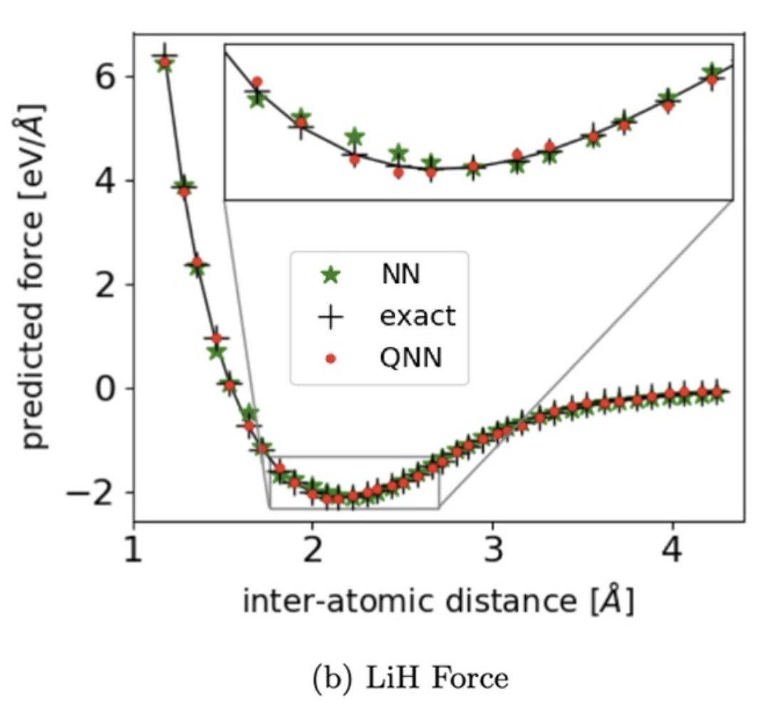
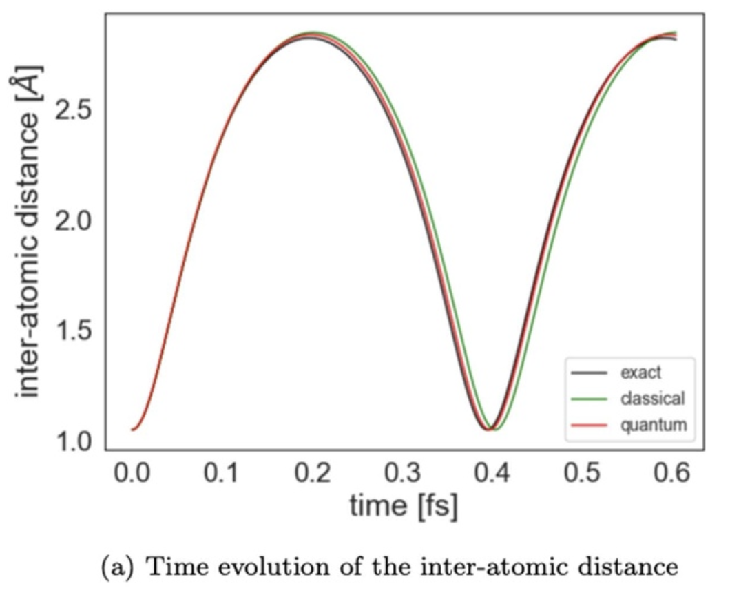

Application to Force Fields (Chemistry)
Kiss, Tacchino, et al., Mach. Learn.: Sci. Technol. 3 035004 (2022)
bond length r
QNN with 10 layers (50 parameters)
Li-H
Comparison with a neural network of equal complexity
$$\vec{F}=−{\vec{∇}}_{r}E(r)$$
Molecular Dynamics

Slide 7
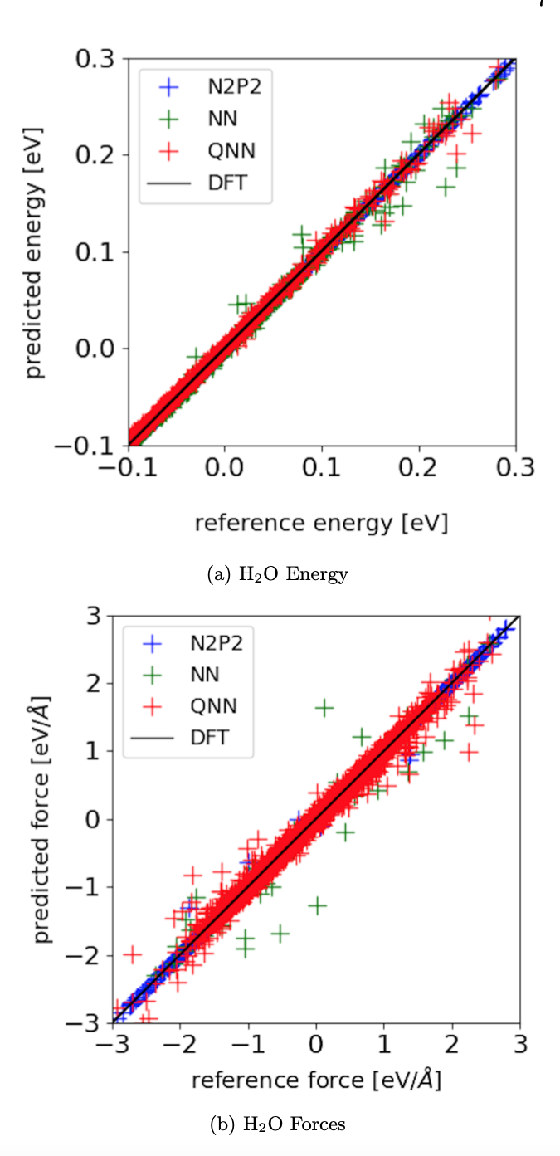
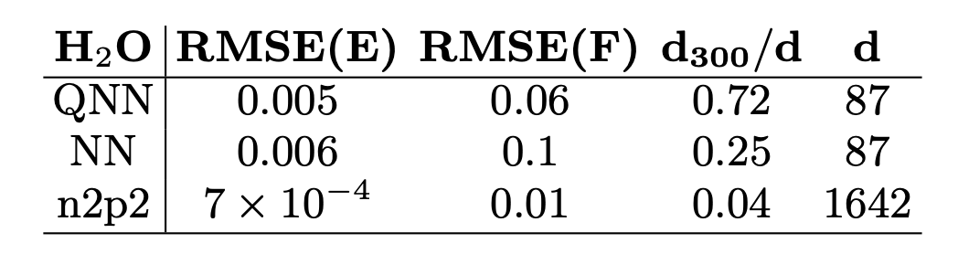
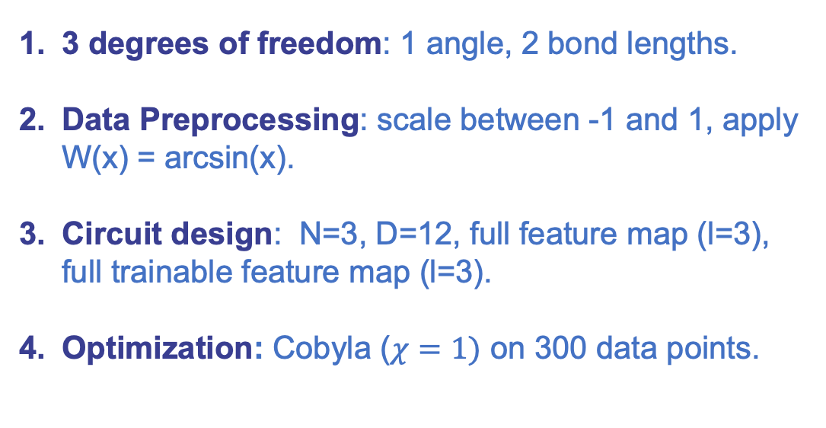
Triatomic Molecule (H2O)
3 degrees of freedom: 1 angle, 2 bond lengths.
Data Preprocessing: scale between -1 and 1, apply W(x) = arcsin(x).
Circuit design: N=3, D=12, full feature map (l=3), full trainable feature map (l=3).
Optimization: Cobyla ($χ=1)$ on 300 data points.
Energy
Effective dimension
# params
Forces
Abbas et al, the power of quantum neural networks, In Nat. Comput. Sci Comput. Sci 1 403–409, (2021)
Notes:
expressivity

Slide 8
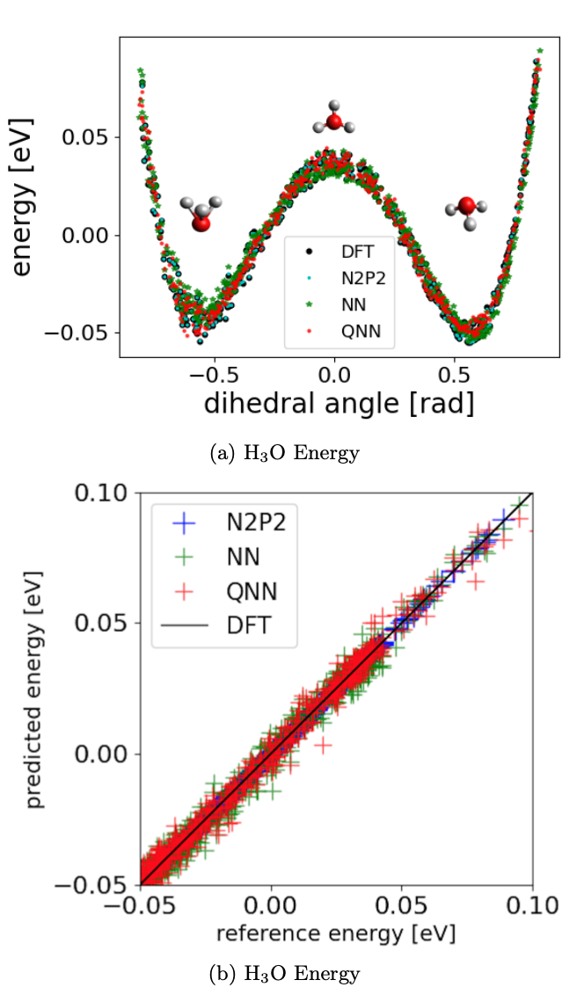
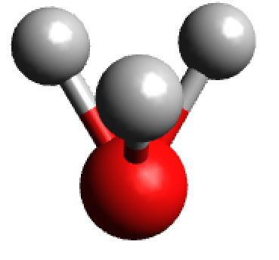
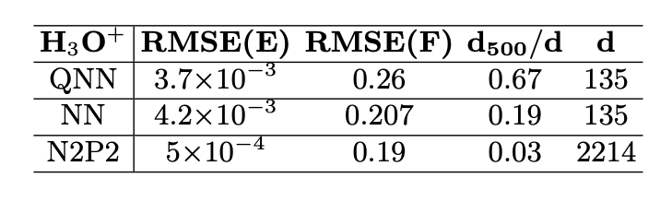
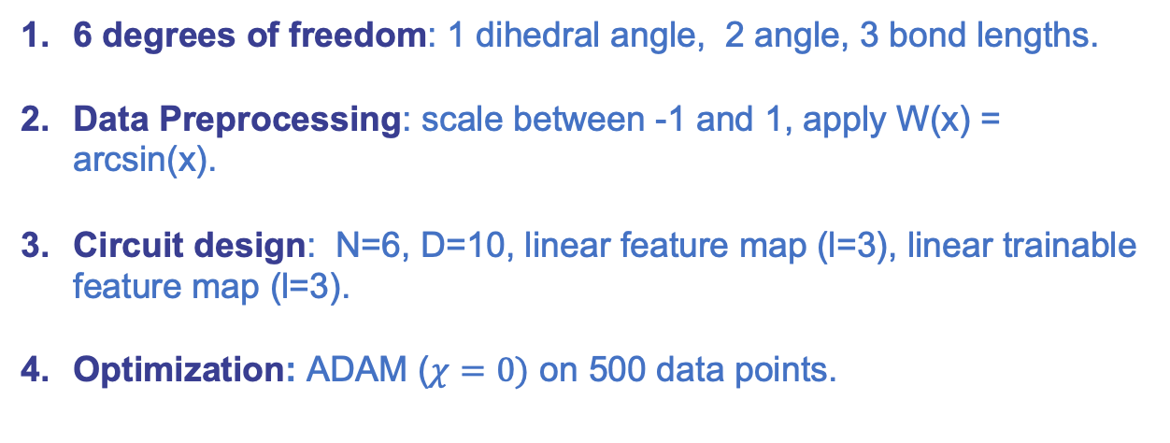
Umbrella motion of Hydronium (H₃O)
6 degrees of freedom: 1 dihedral angle, 2 angle, 3 bond lengths.
Data Preprocessing: scale between -1 and 1, apply W(x) = arcsin(x).
Circuit design: N=6, D=10, linear feature map (l=3), linear trainable feature map (l=3).
Optimization: ADAM ($χ=0)$ on 500 data points.

Slide 9
Conclusions, potential advantages & outlook
QNNs are able to compete with similar neural networks in the task of learning PES and force fields.
Potential quantum advantages are primarily linked to the better expressivity and higher effective dimension of QNNs with respect to classical counterparts.
Future work:
        - More complex architectures (quantum convolutional NN) or equivariant QNN.
- Work with quantum data (from dynamical VQA).
- Incorporate fragmentation techniques.

Slide 10
Thank you for your attention!
Questions?
Kiss, Tacchino, et al., Mach. Learn.: Sci. Technol. 3 035004 (2022)
Jörg Behler and Michele Parrinello. : Physical Review Letter 98, 146401 (2006)
Schuld et al., Phys. Rev. A 103, 032430 (2021)
Abbas et al., In Nat. Comput. Sci 1 403–409, (2021)
oriel.kiss@cern.ch

