Slide 1

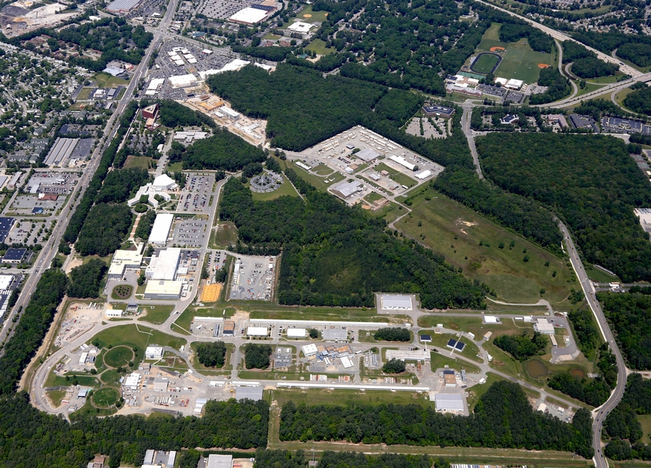


Gaussian process for calibration and control of GlueX Central Drift Chamber
The AI for Experimental Controls (AIEC) Team:
Diana McSpadden, Torri Jeske, Nikhil Kalra, Thomas Britton, Naomi Jarvis*, and David Lawrence
Thomas Jefferson National Accelerator Facility, VA, USA
*Carnegie Mellon University, PA, USA
ACAT 2022
Notes:
Hello,
I'm Diana McSpadden a data scientist at Jefferson Lab and I work with the AI for Experimental Controls, or AIEC team from both Jefferson Lab and Carnegie Mellon University.
I am presenting about our project using a Gaussian process for calibration and control of the GlueX central drift chamber,
I’ll tell a story of how when seeking to solve a regression problem using machine learning we ultimately learned about machine learning uncertainty quantification and approaches to using prediction uncertainty.
The Thomas Jefferson National Accelerator Facility, shown in this picture, is located in Newport News, Virginia, on the east coast of the United States. The lab's Continuous Electron Beam Accelerator Facility includes the particle accelerator and four experimental halls.
######
ABSTRACT:
We have developed and implemented a machine learning based system to calibrate and control the GlueX Central Drift Chamber at Jefferson Lab, VA, in near real-time. The system monitors environmental and experimental conditions during data taking and uses those as inputs to a Gaussian process (GP) with learned prior. The GP predicts calibration constants in order to recommend a high voltage (HV) setting for the detector that maintains consistent detector performance (gain and resolution) throughout data taking. This approach is in stark contrast to traditional detector operations in which the detector operates at fixed HV and its calibration parameters vary quite considerably with time. Additionally, the ML based system utilizes uncertainty quantification to correct the recommended control parameters when appropriate. We will present results from the ML system autonomously during the Charged Pion Polarizability (CPP) experiment conducted in Hall D at Jefferson Lab.
Gaussian process for calibration and control of GlueX Central Drift Chamber

Slide 2
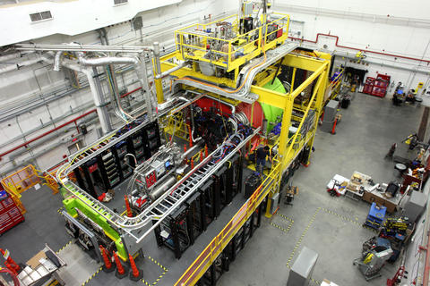
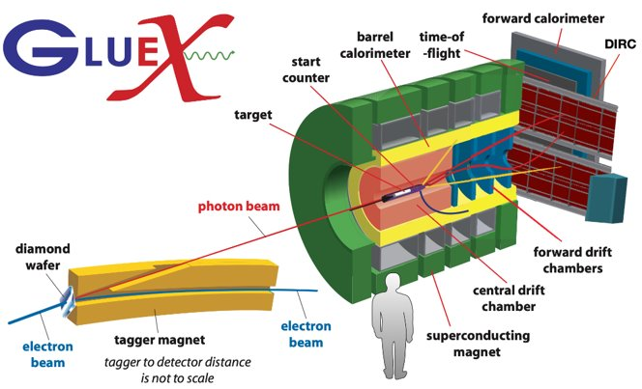
GlueX Experiment at Jefferson Lab
Designed to search for exotic hybrid mesons produced in photoproduction reactions and study the hybrid meson spectrum
Notes:
The AIEC project has been focused on Jefferson Lab's Hall D, and the Gluonic Excitations or GlueX experiment.
The GlueX detector system is comprised of several sub-detector systems, shown in both the image and the schematic.
Here I have outlined two humans to show the scale of the GlueX detector.
For the AIEC project initially we focused on the Central Drift Chamber or CDC
######
We detect charged particles and photons which allows us to reconstruct the particles that were produced in the interaction of the photon with the target proton.

Slide 3
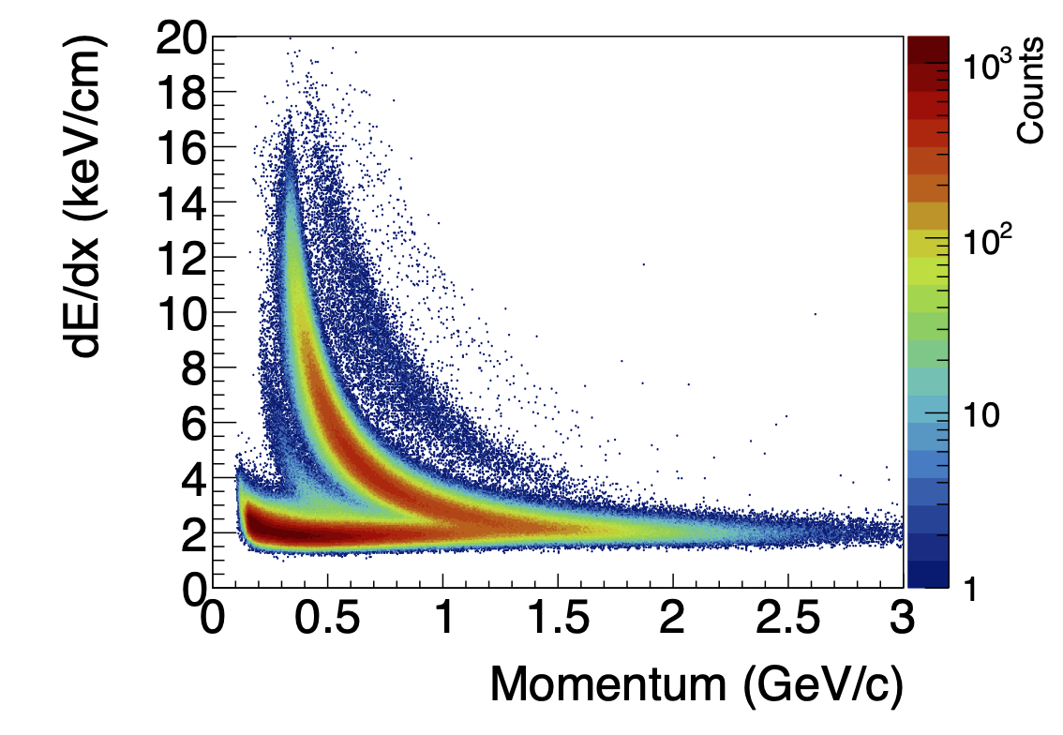
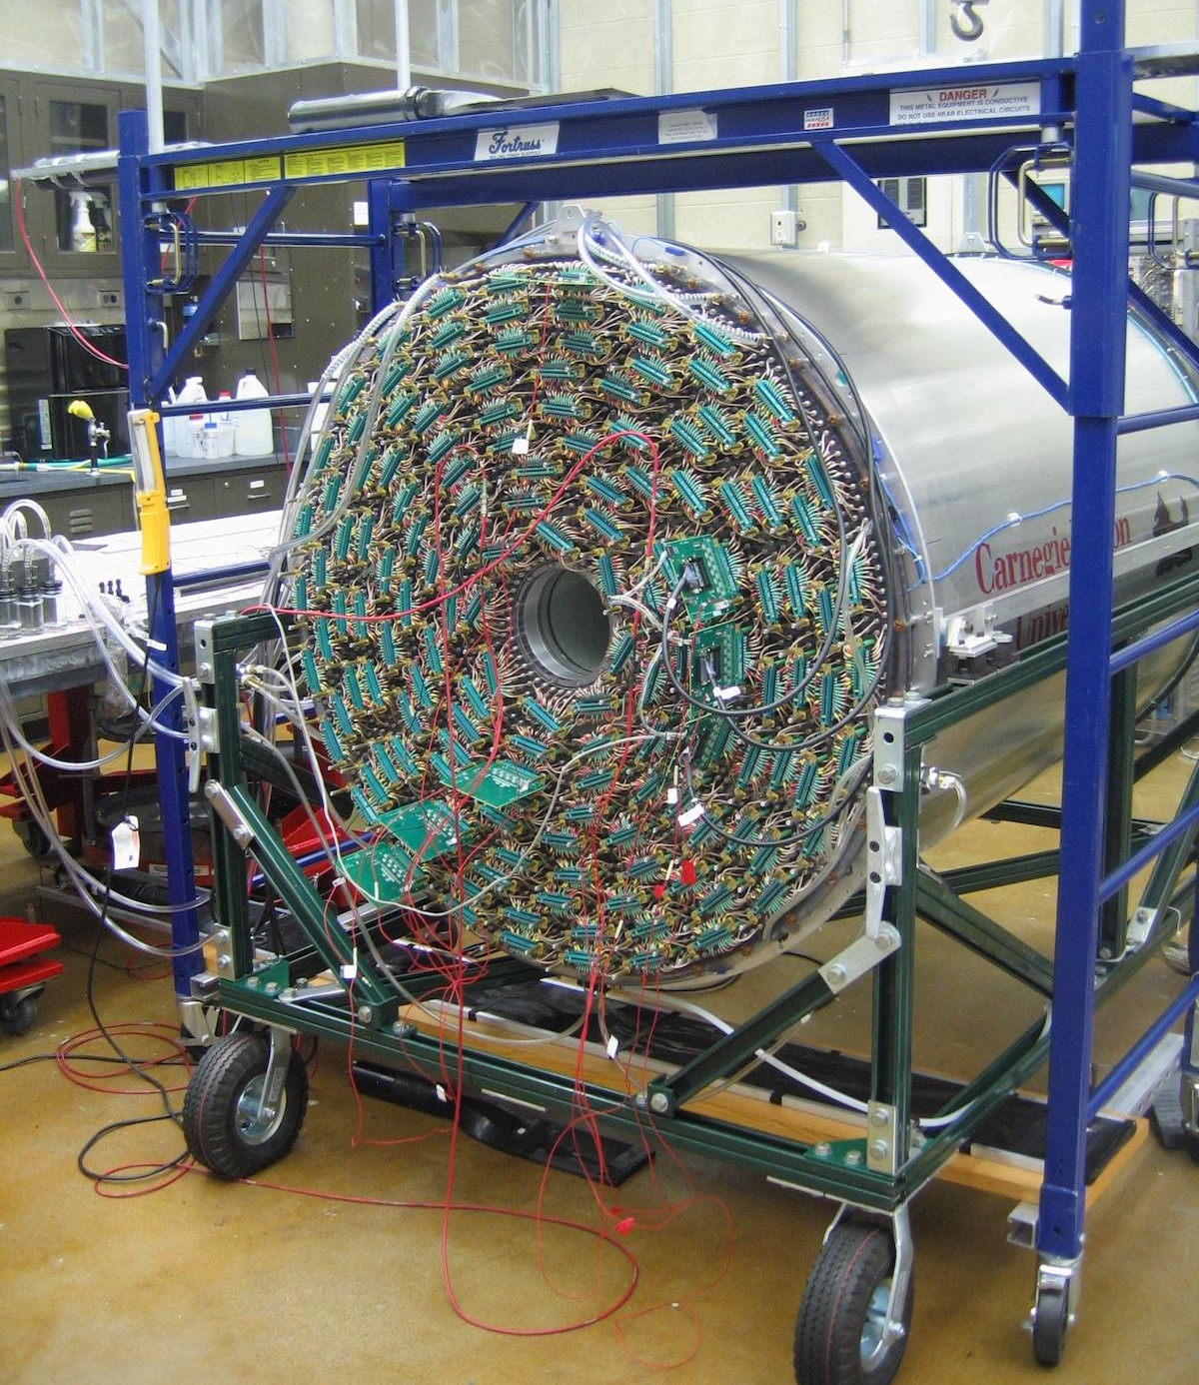
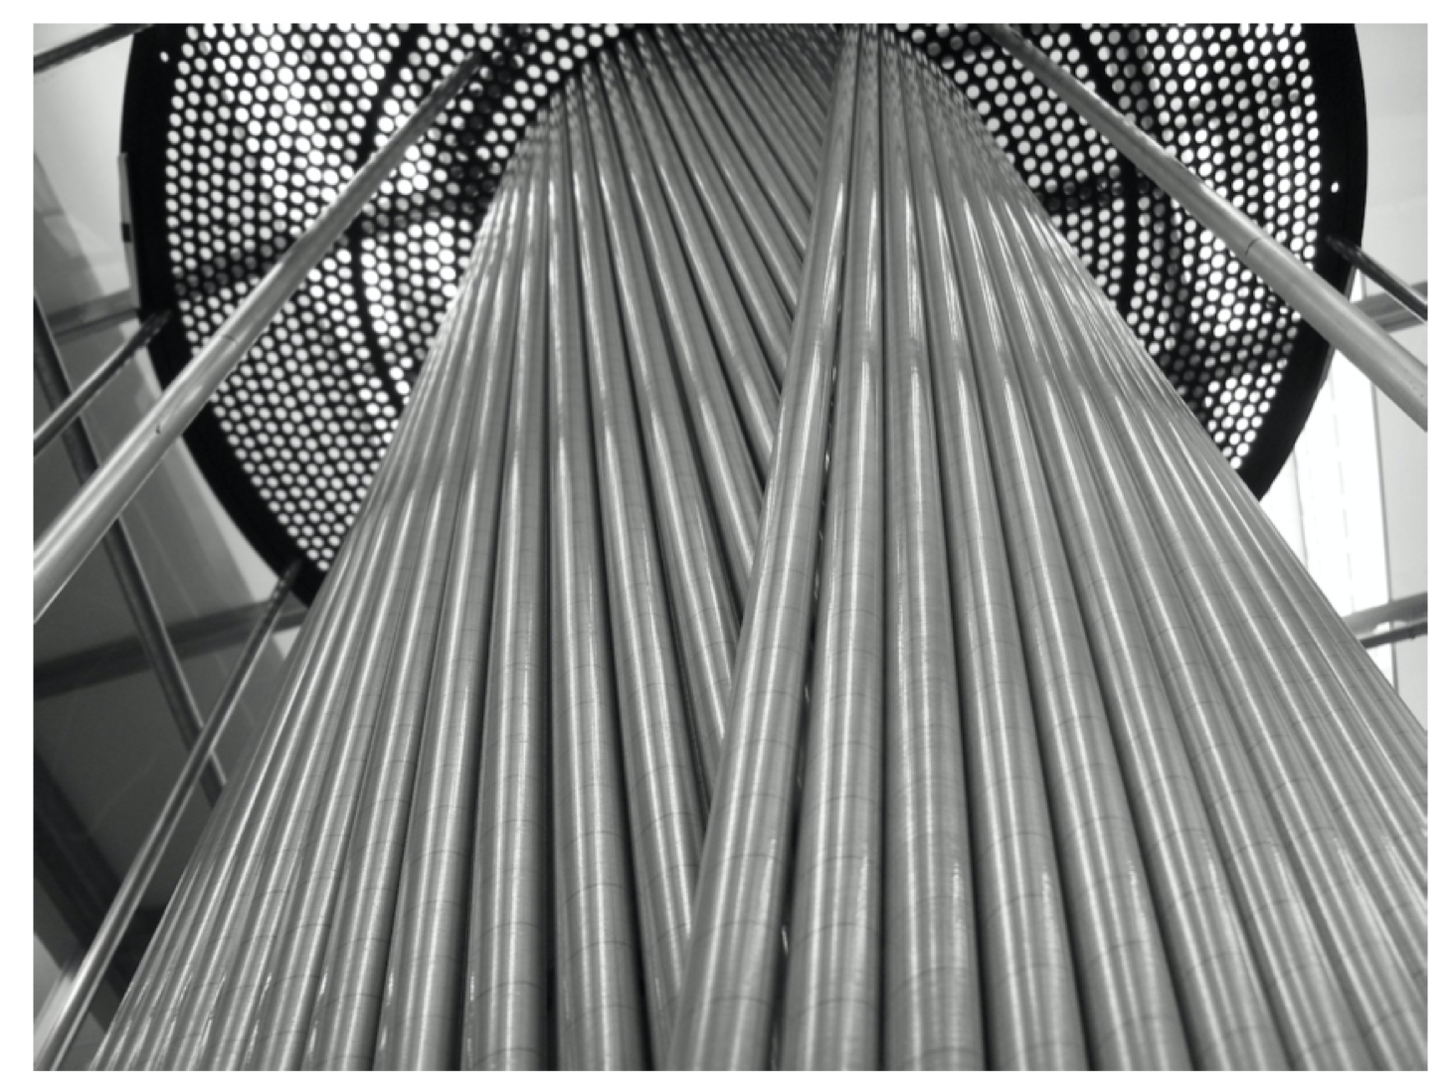
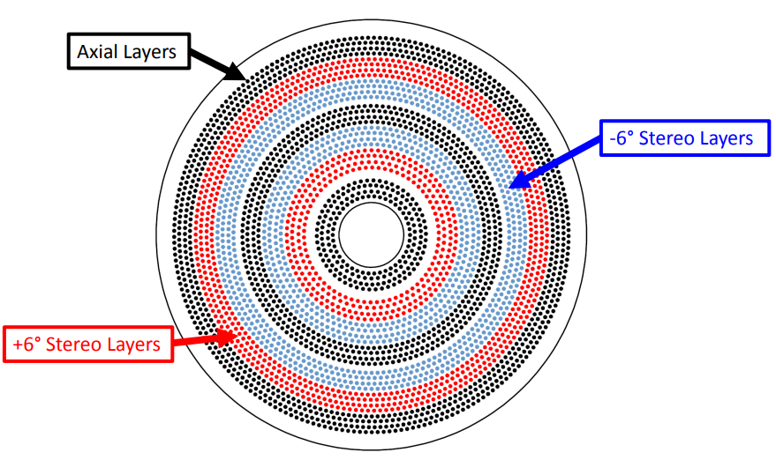
GlueX Central Drift Chamber (CDC)
Requires two calibrations: gain and drift time-to-distance
  Gain Correction Factor (GCF):
    GCF calibrations have most variation +/- 15%
Has one control: operating voltage
Used to detect and track charged particles with momenta p > 0.25 GeV/c
Use for particle identifcation
dE/dx: measure of deposited energy per unit of track length
  1.5 m long x 1.2 m diameter cylinder
  3522 anode wires at 2125 V inside 1.6 cm diameter straws
  50:50 Ar/CO₂ gas mix
deuteron
proton
K⁺
pi⁺
Notes:
####
The CDC requires 2 calibrations: chamber gain, the focus of this talk, and a time-to-distance calibration.
The gain calibration is the most straightforward and varies the most, +/- 15%
There is one CDC control available: the operating voltage.
The measure of deposited energy per unit length of track, or dE/dx, is an important feature of particle identification. The measurement of dE/dx is affected by the gas density of the Argon CO2 mixture within the chamber and experimental conditions.
Chamber gain must be calibrated because gain affects the cuts made to the data to separate different particle types – and separating particle types is the point.
Traditionally, calibration constants are generated per "run". A run is approximately 2 hours of beam time data. Why two hours you ask, well..
An Argon CO2 gas mixture flows through the CDC. Charged particles pass through the chamber and ionize the gas along their path.
This creates hits on CDC wires.
The pattern of hits on the wires is used to construct the particle tracks.
The associated charge deposited on the wires is used together with the track length to calculate dE/dx (or a measure of deposited energy per unit of track length).
DE/dx is an important feature of particle identification.
Why does chamber gain need to be calibrated?
We call it chamber gain, but it is really gas density gain of the Argon C02 gas. And is known to be affected by the atmospheric pressure, temperature, and beam conditions.
###########################
The CDC is used to detect, identify, and track charged particles.
Within the CDC are over 35 hundred anode wires in Aluminized Mylar tubes filled with a gas mix- [prop]: I am holding one of the unused tubes.
CLICK
The CDC requires 2 calibrations: chamber gain, the focus of this talk, and a time to distance calibration.
The gain calibration is the most straightforward and varies the most, +/- 33%
There is one CDC control available: the operating voltage.
######
Cylindrical, straw tube drift chamber. The gas mixture is 50:50 ArCo2 and it is kept just above atmospheric pressure. Used to detect and track charged particles with momenta p greater than 0.25 GeV/c
There are two calibrations for the CDC: the chamber gain and time to distance

Slide 4
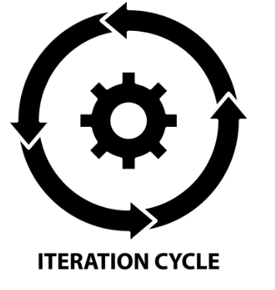

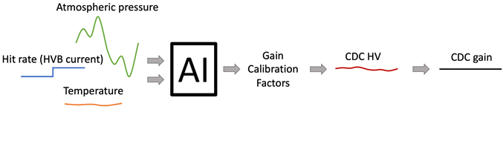
Conventional Calibration and Motivation for ML
Motivation: Conventional vs. Online, ML Calibration Paradigms
Conventional
Calibrate: calibration values iteratively, produced after the experiment
  ~2 hour runs
Control: CDC operating voltage is fixed at 2125 V
Online and ML
Control: Stabilize detector response to changing environmental/experimental conditions by adjusting CDC HV
Calibrate: online calibration values produced during the experiment
ML
Notes:
Conventionally, data is taken in ~2-hour “runs” because that is the time for which experimental and environmental conditions are stable enough for calibration.
Traditionally, the CDC expert has also had to keep an eye on the weather and has had to call shift workers if a storm is rolling through and ask them to stop and re-start a new run in order to have data that may be calibrated.
Conventionally, CDC high voltage is fixed to 2125 volts.
Solution is,
A data-driven, online control and calibration system could control the CDC high voltage based on conditions.
So, we can stabilize the CDC HV and change the GCF through offline calibration, this is the conventional method
--OR--
stabilize the GCF and change the HV - this is what we want to do so that we are calibrating via control, while online.

Slide 5
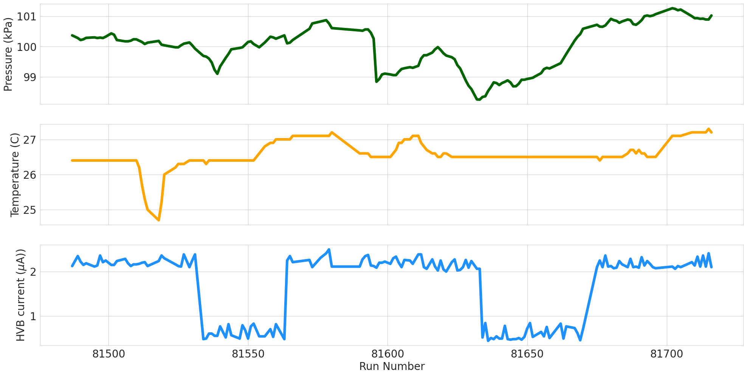
Q1: Can we predict GCFs? Input variables
Can we predict GCFs using data that are readily available as a run begins?
Data extracted from Experimental Physics Industrial Controls System (EPICS)
  Atmospheric pressure
  Gas temperature
  Current drawn from CDC HV boards (proxy for beam current)
Readily available during the experiment
Not dependent on other detectors
No reconstruction!
Notes:
Can we predict GCFs using past data, and determine the stabilizing high voltage?
We want to only use data available prior to track reconstruction, and not use any data from a different detector sub-system that could be unused or unavailable for a particular experiment or run.
We began with over 100 possible features, but winnowed them down based on our criteria and feature importance evaluation to three features
atmospheric pressure,
Gas temperature and
The current drawn from the CDC high voltage boards, which is a proxy for electron beam current.
All are readily available during an experiment, not dependent on other detectors, and do not rely on reconstruction.
############
Additionally, we wanted data available in near real-time because we don’t want to limit ourselves to controlling the CDC for each 2 hour run, we want to design a system from the beginning that could control the CDC more frequently.
NEED:
a backup slide showing that current drawn from CDC HV board is a proxy for beam current
Update the figure for a different group of data
EMPHASIS ON KNOWING THESE QUANTITIES IN ESSENTIALLY NEAR REAL TIME!!!

Slide 6
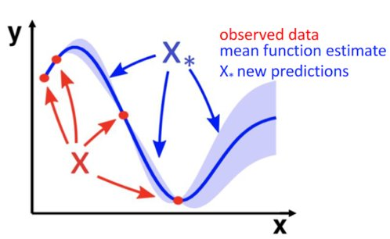
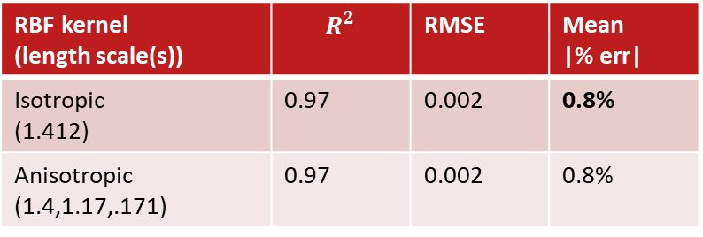
Q1: Can we predict GCFs? The Gaussian process model
ML Technique
Gaussian Process (GP)
3 input features
1 target: the traditional Gain Correction Factor (GCF)
GP calculates PDF over admissible functions that fit the data
GP provides the standard deviation
We used a popular GP kernel:
  Radial Basis Function + White
Illustration training a Gaussian process
We can exploit the standard deviation for uncertainty quantification (UQ).
Our goal was better than a 5% error
RBF kernel (length scale(s)) | $$R^{2}$$ | RMSE | Mean |% err|
Isotropic (1.412) | 0.97 | 0.002 | 0.8%
Anisotropic (1.4,1.17,.171) | 0.97 | 0.002 | 0.8%
Notes:
We tried a few machine learning techniques,
And selected a Gaussian process model because of its accuracy and ability to provide uncertainty.
The method assumes a multivariate Gaussian distribution of data.
The posterior is conditioned on the evidence provided by training data.
The GP calculates a probability density function over all admissible functions that fit the data.
The probabilistic representation of the prediction includes the mean and standard deviation, which we can exploit for uncertainty quantification.
[TODO: Need a backup slide with more GP information]
Predictions are based on distance measures between samples in the higher dimensional space.
We experimented with several basic kernels and landed on a radial basis function (or squared exponential) kernel and a white kernel to estimate noise.
[CLICK]
Our target threshold was better than 5% error and our Gaussian process did quite well with a mean absolute percent error of .8% on our holdout dataset.
##############
A Gaussian process transforms input feature space into a higher dimensional space using a kernel.
Our training and holdout data consisted of runs from 2020 and 2021 run periods. We pressure balanced the orthogonal datasets to include equivalent proportions of high, medium, and low pressure runs.
Our target value is the traditionally calculated gain correction factor.
Don't yet say "do not set", make it a question at this point in the slide deck
In machine learning, the radial basis function kernel, or RBF kernel, is a popular kernel function used in various kernelized learning algorithms.
Bold uncertainty quantification – this is the main point of the presentation
Could foreshadow the basic GP kernel – is it sufficient "stay tuned"

Slide 7
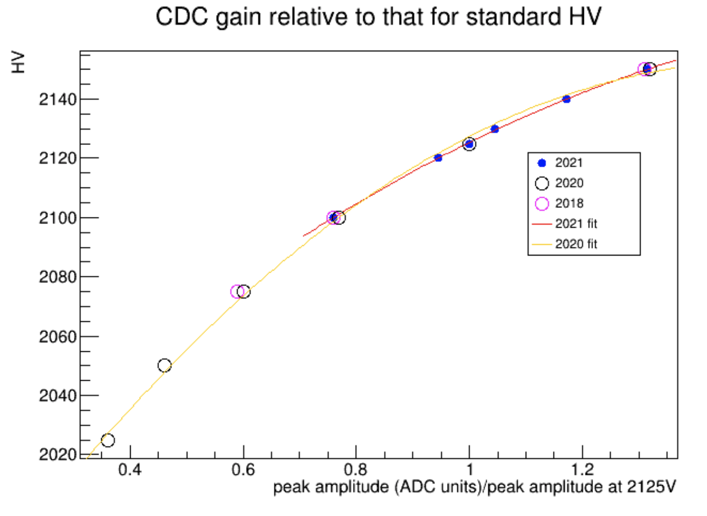
Q1: Can we predict GCFs? HV Recommendation
GCF is related to HV
Recommended HV setting obtained from fit to HV as a function of relative peak amplitude
Notes:
There is a known relationship between detector gain and HV which we exploit for our HV calculation using our predicted GCF.
######
To calculate the HV control setting from the predicted gain correction factor we exploited the known relationship between GCF and high voltage by fitting HV as a function of relative peak amplitude.
This relationship was confirmed for 3 run periods with different experimental conditions (i.e. beam intensity)
This analysis and plot are how we use the GP-predicted GCF to calculate the recommended HV for the CDC to stabilize gain.

Slide 8
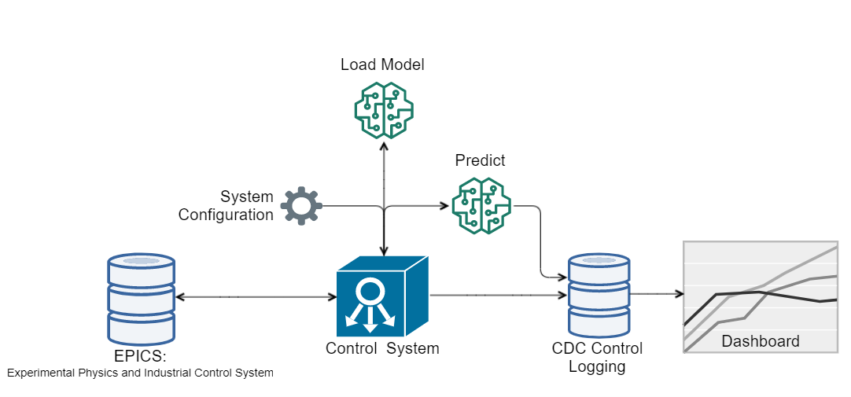
Q2: Can we control HV to stabilize gain? RoboCDC, a modular ML system for control
Notes:
#########
So we have a model we can use.
Our second research question is whether we can control the CDC HV using model recommendations and does HV control result in stabilized gain?
We developed a system we informally call RoboCDC.
[CLICK]
The control system retrieves configurations from a json file.
[CLICK]
The model is loaded.
[CLICK]
The control system retrieves input variable statistics from EPICS for model input, and the system can predict and control at configured time intervals, or the system can be configured to run in an on-demand mode, or in a predict-only mode (with logging but no HV control).
If configured to control HV, the Control System sets the EPICS variable that controls CDC high voltage.
[CLICK]
All predictions are logged to a database that is used to as the source for a real-time dashboard using Grafana.
##########################
[CLICK]
The control system retrieves configurations, including model files, prediction and control time intervals, and behavior when uncertainty is high (which I will talk about more in a moment), from a json file.
[CLICK]
When the system is initialized or the json file is updated the model is loaded.
[CLICK]
The control system retrieves input variable statistics from EPICS for the previous 15 seconds for model input, and the system can either predict and control at configured time intervals, or the system can be configured to run in an on-demand mode, or in a predict only mode (with logging but no HV control).
If a prediction is configured to control HV, the Control System sets the EPICS variable that controls CDC high voltage
[CLICK]
All predictions are logged to a database that is used to as the source for a real-time dashboard using Grafana.

Slide 9
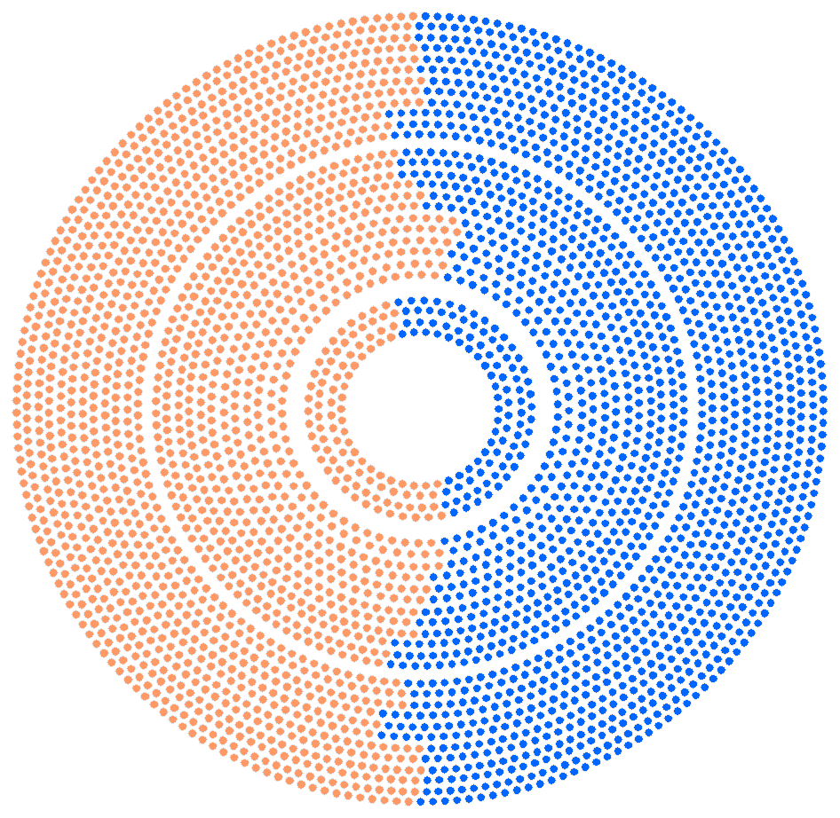
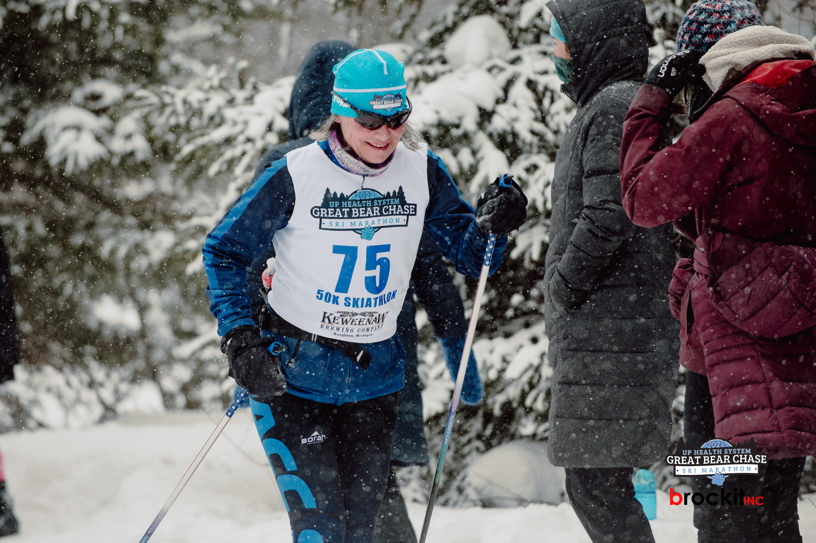
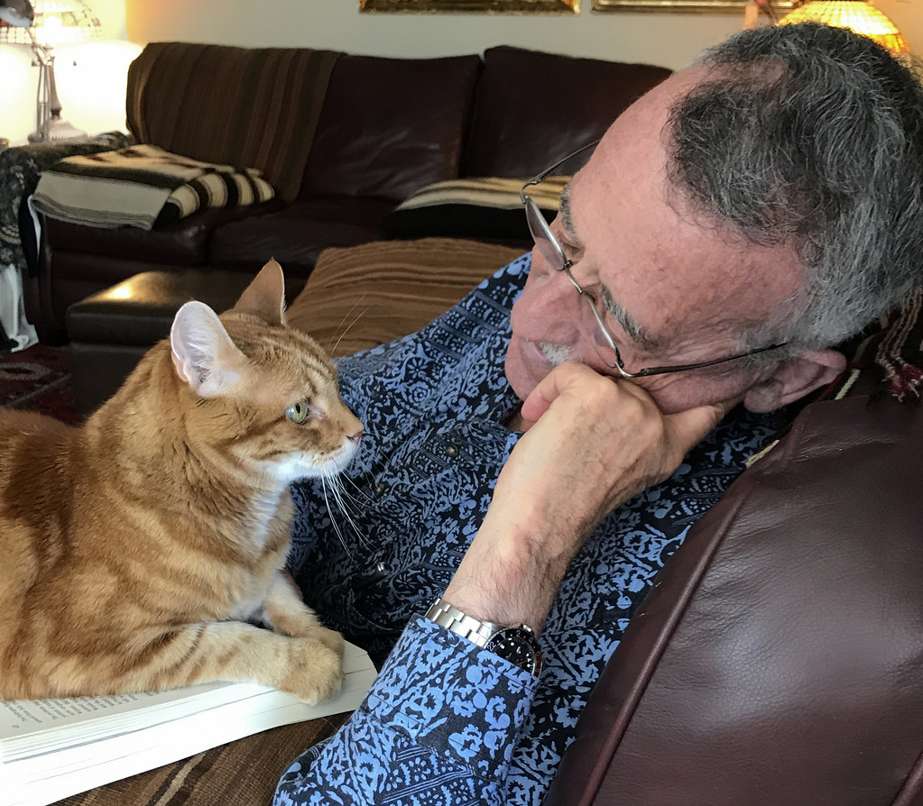
Q2: Can we control HV to stabilize gain? Does RoboCDC work?
Cosmic Ray Experiment
Split the CDC into 2 halves
  Leave one side at a fixed HV (conventional)
  Let the ML control the other
    Autonomously adjust HV every 5 min
Should see the ML side’s gains stabilized
Conventional in orange
ML-tuned in blue
Notes:
To verify RoboCDC we had an opportunity to test the system with cosmic ray data, which is free as apposed to electron beam time.
For the cosmic ray experiment, there is no electron beam. We set the current input parameter to 9 micro amps, which was the current for which we had the most training data.
We tested the system by dividing the straws of the CDC into 2 halves using software
The orange half was kept at 2130V.
We predicted GCF, and HV recommendation every minute and logged the results to our logging database.
Every 5 minutes the blue half’s high voltage was controlled using the model’s high voltage recommendation.
[CLICK]
Half the physicists went on vacation during the experiment (that’s our detector expert in a skate ski race), and the other half monitored from their living room. This was truly autonomous.
[CLICK]
We should see stabilized gains on the ML-controlled side
…
#####

Slide 10
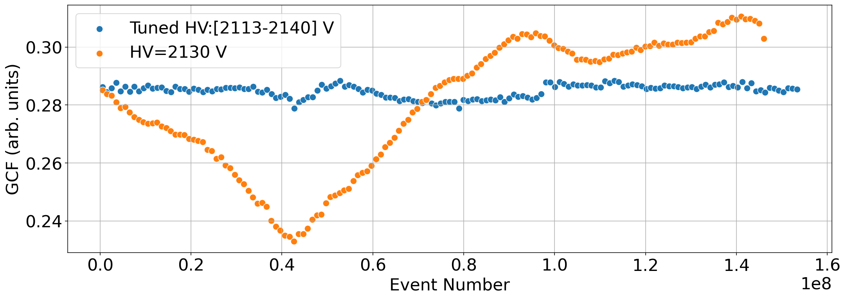
Q2: Can we control HV to stabilize gain? Cosmic Ray Test Results
SUCCESS!
Conventional in orange
ML-tuned in blue
Notes:
The plot shows the traditionally calculated gain correction factor for the controlled orange side vs. the blue fixed side.
We hoped the blue would be more stable than the orange and …
[CLICK]
It is much more stable. SUCCESS!

Slide 11

Trust and Uncertainty Quantification
Does the system generalize for differing conditions?
  Do we trust interpolations and extrapolations?
  First self-driving particle detector we know of – it must be trusted
  Uncertainty quantification (UQ)
  Uncertainty quantification (UQ)
  Uncertainty quantification (UQ)
  …
Uncertainty
by craiyon.com
Notes:
After the cosmic ray test we get into trickier territory for the novel use of a data-driven approach to control a particle detector.
Our available training data does not include all possible conditions.
To be trusted by the CDC expert and the GlueX collaboration we all need to understand how our proposed system generalizes for differing conditions.
Do we trust its interpolations and extrapolations?
This leads to an interesting area of active machine learning research into uncertainty quantification.
######
Removed this bullet point
How do the ML-generated calibration constants compare to those generated using the conventional approach?
Physics tolerances

Slide 12
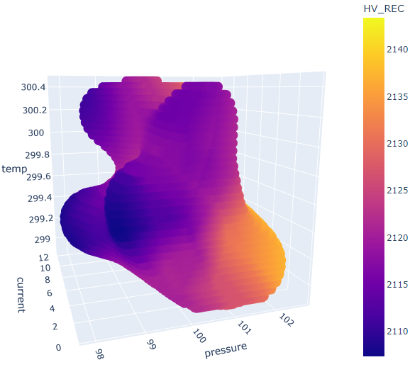
Q3: Does the system generalize for differing conditions? An experiment
Charged Pion Polarizability (CPP)
  Used RoboCDC at the start of each run in the experiment (summer 2022)
At the start of each run:
  the HV setting was predicted, and CDC HV controlled.
  Used Recommended HV
    when standard deviation <= 3% ideal GCF
  Used the closest “certain” HV in Euclidean distance on the uncertainty mesh
    when standard deviation > 3% of GCF
Notes:
RoboCDC was then used during a beam on experiment, the Charged Pion Polarizability experiment this last summer.
At the start of each run the HV setting was predicted and the HV was controlled (except for empty target runs)
We used an uncertainty threshold of 3%
When standard deviations were within 3% of ideal gain correction factor we used the recommended HV.
When standard deviations were greater than 3%, we projected to the closest in Euclidean distance HV recommendation and used that recommendation.
Here is the plot of the 3% threshold with HV heatmap.
####
we used with high voltages predicted for every .5 kiloPascal, .5 microamps, and .5 kelvin within ranges slightly outside our training data.
Mesh was for atmospheric pressure every .5 kPa
Temperature every .5 K
HVBI every .5 microamps

Slide 13
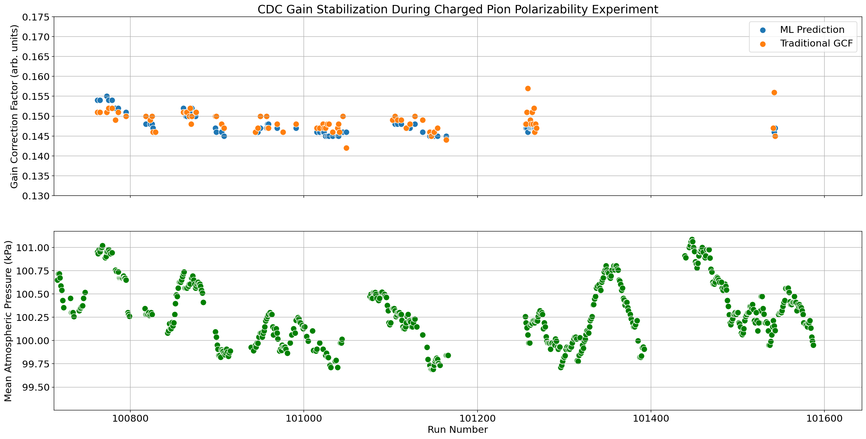
Q3: Does the system generalize for differing conditions? An experiment
Charged Pion Polarizability (CPP)
  Used RoboCDC at the start of each run in the experiment
PRELIMINARY
Notes:
Here are the preliminary results from CPP. These are really quite good, AND CPP was interesting because beam intensity was much lower than our training data.
In the upper plot, you can see that the model predictions are close to the traditionally calculated values (blue vs. orange), and that the gain was much more stable than the atmospheric pressure in the green plot, which has the strongest affect on CDC gain.
#####
The ML predictions were within NEED TO GET % DIF
####
TODO: what is the % diff?
, so the model was extrapolating the gain correction factor relationship with current.

Slide 14
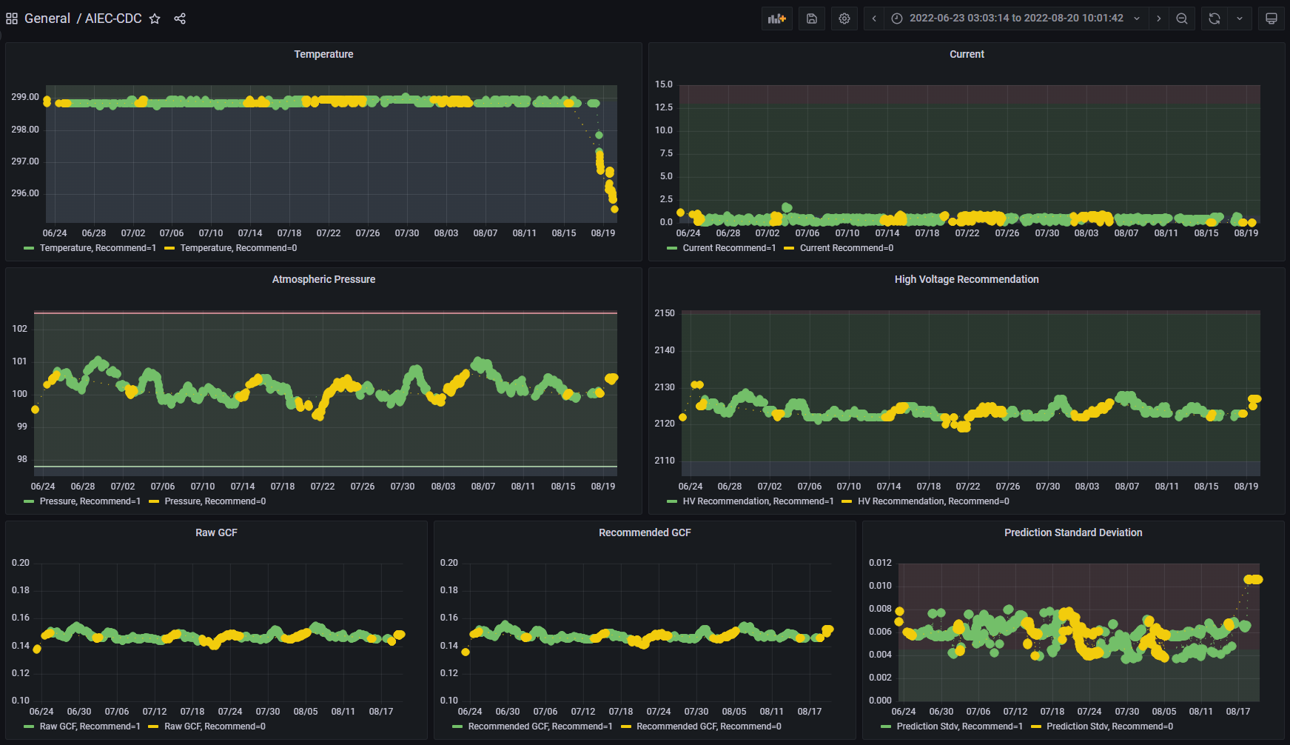
Q3: Does the system generalize for differing conditions? CPP
Notes:
This is our dashboard from the CPP experiment, showing the input features (Temperature, Current, and Atmospheric Pressure), GCF prediction, high voltage recommendation, and standard deviation from the model
I will show zoomed in plots in a moment.
But first,
The yellow points are when we were only predicting and not controlling CDC high voltage, probably empty target runs.
The green points are when we were predicting high voltage.
#########################
# Explain yellow and green
# Explain plots
####

Slide 15
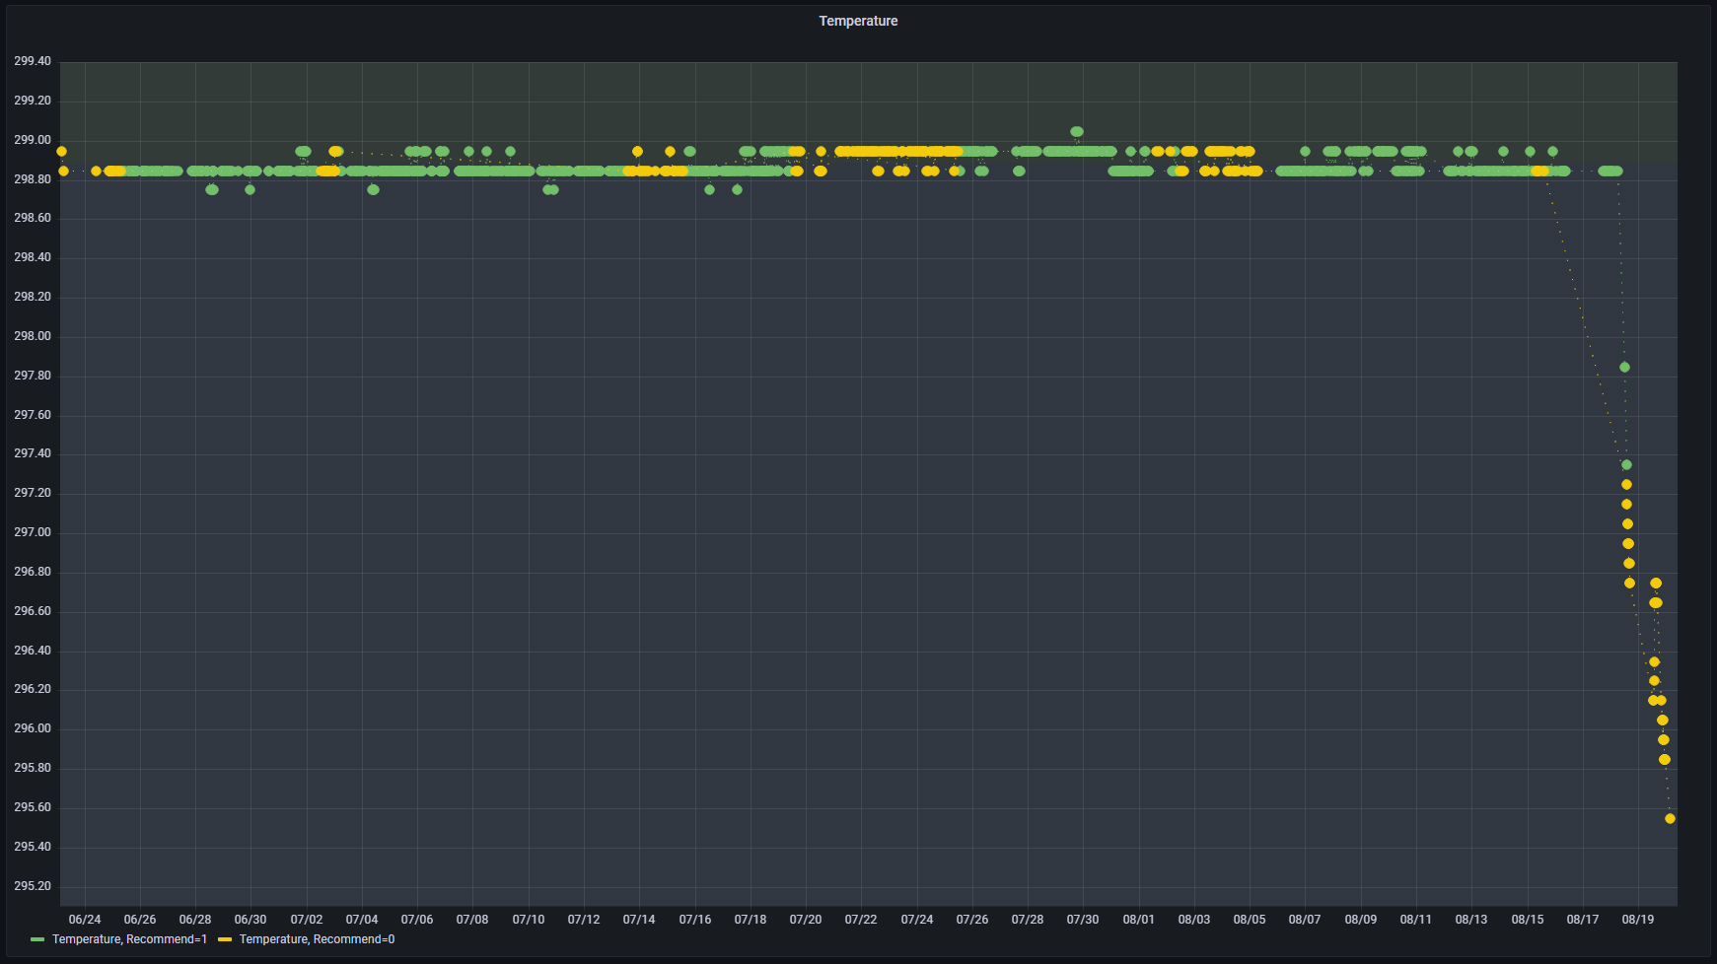
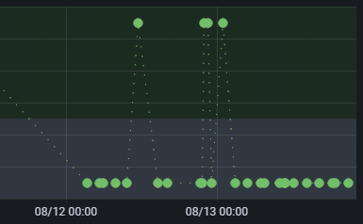
Q3: Does the system generalize for differing conditions? CPP
Notes:
Here is the temperature plot zoomed in.
The red lines I drew to mark the boundary of where we had and did not have training data. We did have training data above ~ 298.9K, but not below.
For CPP oscillated above and below the training data boundary.
####
Here I show a boundary ~298.9K of where we did and did not have training data.

Slide 16
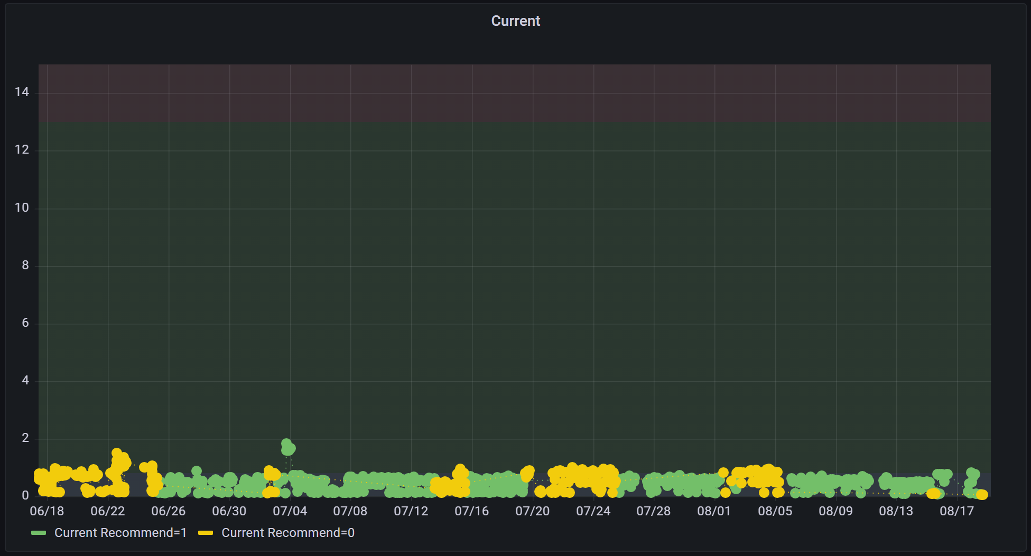

Q3: Does the system generalize for differing conditions? CPP
Notes:
For current, we were under the threshold of where we had training data. We did not have training data for lower currents.
####
residuals are normalized using the standard deviation and a normal distribution of errors is assumed.
Steps:
For each quantile (default 1:100):
# Computer lower and upper bound for quantile
norm = stats.norm(loc=0, scale=1)
lower_bound = norm.ppf(0.5 - quantile / 2)
upper_bound = norm.ppf(0.5 + quantile / 2)
# Compute proportion of normalized residuals within lower to upper bound
residuals = y_pred - y_true
normalized_residuals = residuals.reshape(-1) / y_std.reshape(-1)
num_within_quantile = 0
for resid in normalized_residuals:
if lower_bound <= resid and resid <= upper_bound:
num_within_quantile += 1.0
proportion = num_within_quantile / len(residuals)

Slide 17
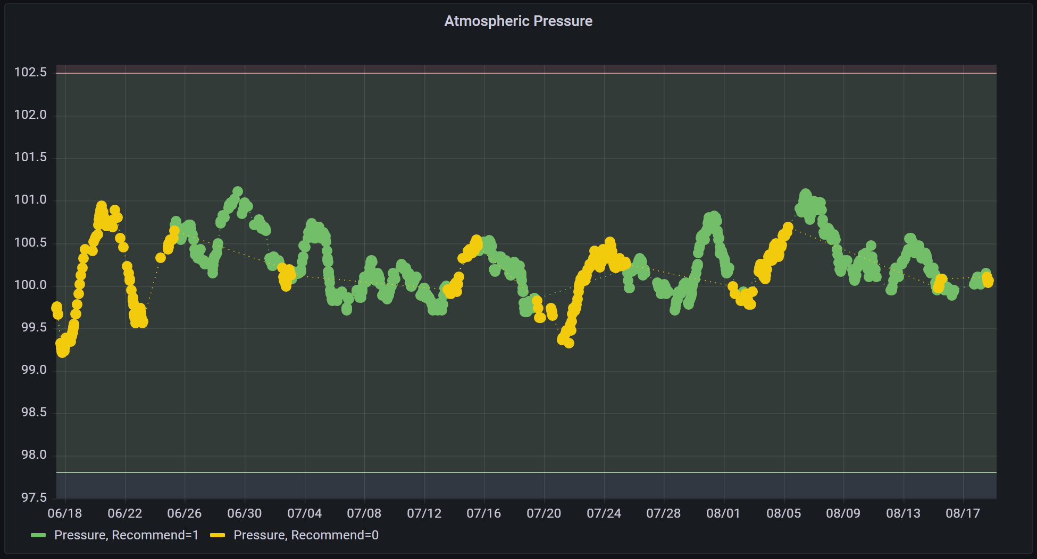
Q3: Does the system generalize for differing conditions? CPP
Notes:
Atmospheric pressure was within our training data boundaries throughout CPP.
####
residuals are normalized using the standard deviation and a normal distribution of errors is assumed.
Steps:
For each quantile (default 1:100):
# Computer lower and upper bound for quantile
norm = stats.norm(loc=0, scale=1)
lower_bound = norm.ppf(0.5 - quantile / 2)
upper_bound = norm.ppf(0.5 + quantile / 2)
# Compute proportion of normalized residuals within lower to upper bound
residuals = y_pred - y_true
normalized_residuals = residuals.reshape(-1) / y_std.reshape(-1)
num_within_quantile = 0
for resid in normalized_residuals:
if lower_bound <= resid and resid <= upper_bound:
num_within_quantile += 1.0
proportion = num_within_quantile / len(residuals)

Slide 18
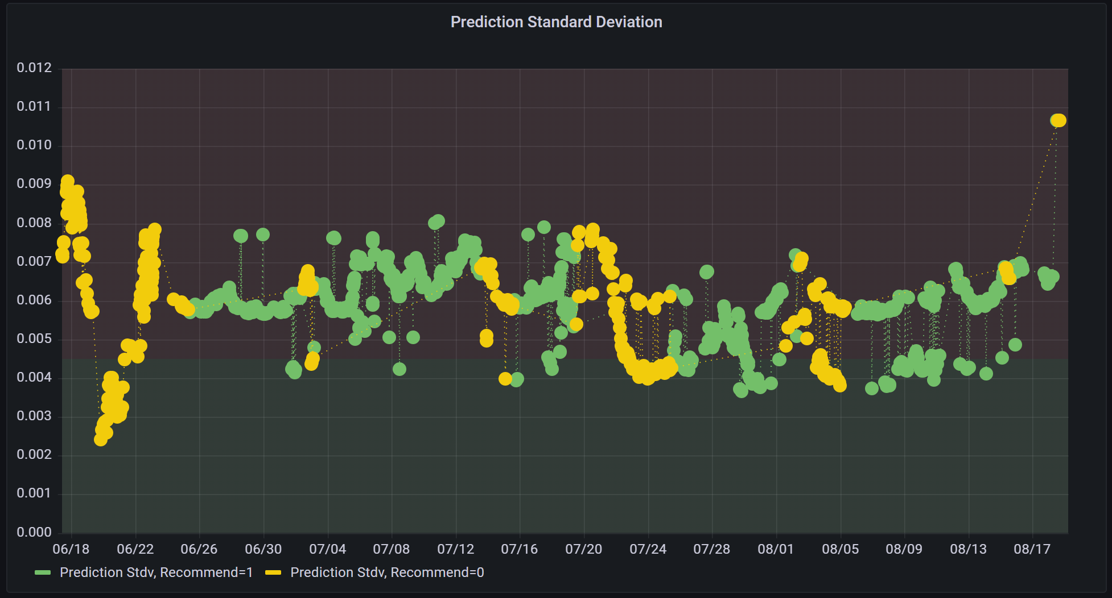
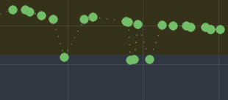
Q3: Does the system generalize for differing conditions? CPP
Notes:
Here is the plot of the prediction standard deviations:
We were at higher uncertainty than our threshold for most of CPP, thus we were projecting to the nearest certain HV recommendation.
Remember our good preliminary results from CPP? Those results made us feel pretty good about our uncertainty correction strategy since it was utilized throughout CPP.
####
3% of the ideal gain correction factort is 0.00497 and uncertainty was greater than our threshold for more CPP runs than it wasn't.

Slide 19
Q3: Does the system generalize for differing conditions? An experiment
Charged Pion Polarizability (CPP)
  Used RoboCDC at the start of each run in the experiment
PRELIMINARY
Notes:
Here are the preliminary results from CPP. These are really quite good, AND CPP was interesting because beam intensity was much lower than our training data.
In the upper plot, you can see that the model predictions are close to the traditionally calculated values (blue vs. orange), and that the gain was much more stable than the atmospheric pressure in the green plot, which has the strongest affect on CDC gain.
#####
The ML predictions were within NEED TO GET % DIF
####
TODO: what is the % diff?
, so the model was extrapolating the gain correction factor relationship with current.

Slide 20
Acknowledgements
Jefferson Science Associates, LLC operated Thomas Jefferson National Accelerator Facility for the United States Department of Energy under U.S. DOE Contract No. DE-AC05-06OR23177
This work was supported by the US DOE as LAB 20-2261.
The Carnegie Mellon Group is supported by the U.S. Department of Energy, Office of Science, Office of Nuclear Physics, DOE Grant No. DE-FG02-87ER40315.
GlueX acknowledges the support of several funding agencies and computing facilities: www.gluex.org/thanks.

Slide 21
References
S. Adhikari et al. The GlueX beamline and detector. Nuclear Instruments and Methods in Physics Research Section A: Accelerators, Spectrometers, Detectors and Associated Equipment, 987:164807, jan 2021. doi:10.1016/j.nima.2020.164807.
N.S. Jarvis, C.A. Meyer, B. Zihlmann, M. Staib, A. Austregesilo, F. Barbosa, C. Dickover, V. Razmyslovich, S. Taylor, Y. Van Haarlem, G. Visser, and T. Whitlatch. The Central Drift Chamber for GlueX. Nuclear Instruments and Methods in Physics Research Section A: Accelerators, Spectrometers, Detectors and Associated Equipment, 962:163727, May 2020. doi:10.1016/j.nima.2020.163727.
AJ Kozubal, LR Dalesio, JO Hill, and DM Kerstiens. Experimental Physics and Industrial Control System. In ICALEPCS89 Proceedings, volume 288, 1989.
[
JeffersonLab. Jefferson Lab Calibration Constants Database Wiki. URL: https://github.com/JeffersonLab/ccdb/wiki.
Sean Gillies et al. Shapely: manipulation and analysis of geometric objects, 2007–. URL: https://github.com/shapely/shapely.
F. Pedregosa, G. Varoquaux, A. Gramfort, V. Michel, B. Thirion, O. Grisel, M. Blondel, P. Prettenhofer, R. Weiss, V. Dubourg, J. Vanderplas, A. Passos, D. Cournapeau, M. Brucher, M. Perrot, and E. Duchesnay. Scikit-learn: Machine learning in Python. Journal of Machine Learning Research, 12:2825–2830, 2011.
David Barber. Bayesian Reasoning and Machine Learning. Cambridge University Press, 2012.
Youngseog Chung, Ian Char, Han Guo, Jeff Schneider, and Willie Neiswanger. Uncertainty toolbox: an open-source library for assessing, visualizing, and improving uncertainty quantification. arXiv preprint arXiv:2109.10254, 2021.
Edmon Begoli, Tanmoy Bhattacharya, and Dimitri Kusnezov. The need for uncertainty quantification in machine-assisted medical decision making. Nature Machine Intelligence, 1(1):20–23, 2019.

Slide 22
Thank you

Slide 23
Backup slides

Slide 24
CDC Calibrations
Gain affects PID selections in analysis
  Sensitive to environmental conditions
    Atmospheric pressure
    Temperature
  Sensitive to experimental conditions
    Beam conditions change with the experiment
deuteron
proton
K⁺
pi⁺
  Traditionally:​
    GCF obtained from Landau fit to dE/dx​
    Calibration constants are generated per run​
      Approximately 2 hours of beam time
Notes:
CDC gain affects particle identification.
As shown on the previous slide a Argon CO2 gas mixture flows through the CDC. Charged particles pass through the chamber and ionize the gas along their path.
The liberated electrons drift towards the CDC's anode wires, which are maintained at a high positive voltage. Electrons create a pulse, or hit on the wires. These hits are read out by the detector's electronics. The pattern of hits on the over 3500 wires is used to construct the particle tracks. The associated charge deposited on the wires is used together with the path length of a track to calculate dE/dx (or a measure of deposited energy per unit of track length). DE/dx is an important feature of particle identification.
Why does chamber gain need to be calibrated?
Gain is known to be affected by the atmospheric pressure, temperature, and beam conditions – remember the Argon, CO2 gas, that gas density is effected by environmental conditions.
[CLICK]
Traditionally, the gain correction factor is obtained from a Gaussian fit to dE/dx amplitude, an example of the dE/dx plot is shown here.
Calibration affects the cuts made to the data to separate different particle types. (some examples of different particle type peaks are shown on this plot)
Traditionally, calibration constants are generated per "run". A run is approximately 2 hours of beam time data. Why two hours you ask, well...
############
. A 50:50 Ar:CO2 gas mixture flows through the chamber. Charged25
particles passing through the chamber ionize the gas along their path, and the liberated avalanche of
electrons drifts towards the anode wires, which are maintained at high positive voltage (HV), and
creates a pulse ’hit’ on the wire which is read out by the detector’s electronics. The pattern of hits on28
the 3522 wires is used to reconstruct the track(s) of the particle(s). The associated charge deposited29
is used together with the path length of the track through the straw tubes of the CDC to calculate30
dE/dx, a measure of energy deposited per unit length as a particle travels through the detector, an31
important feature of particle identification. The chamber gain, the ratio of final to initial number of32
electrons in the avalanche, is sensitive to the gas density. The CDC is operated at close to atmospheric33
pressure, thus the variation in gain with atmospheric pressure and gas temperature can be accounted
Time to distance: track fitting, vertex and dE/dx resolution
Non-analytic fit function generates 6 unique calibration constants

Slide 25
Q1: Can we predict GCFs? The Gaussian process model
ML Technique
Gaussian Process (GP)
3 features:
  atmospheric pressure within the hall
  Gas temperature within CDC
  CDC high voltage board current -> a measure of charged particle track rate within the CDC
601 runs from 2020 and 2021 run periods
  536 and 65 respectively
  Pressure balanced for low, medium and high pressure
  80 / 20 train test split
1 target: the traditional Gain Correction Factor (GCF)
GP calculates PDF over admissible functions that fit the data
GP provides the standard deviation
  we can exploit for uncertainty quantification (UQ)
We used a popular GP kernel:
  Radial Basis Function + White
  Compared isotropic (1 length scale) and anisotropic (length scale per input variable) kernels
Illustration training a Gaussian process
We can exploit the standard deviation for uncertainty quantification (UQ).
Our goal was better than a 5% error
RBF kernel (length scale(s)) | $$R^{2}$$ | RMSE | Mean |% err|
Isotropic (1.412) | 0.97 | 0.002 | 0.8%
Anisotropic (1.4,1.17,.171) | 0.97 | 0.002 | 0.8%
Notes:
We tried a few machine learning techniques,
And selected a Gaussian process model because of its accuracy and ability to provide uncertainty.
The method assumes a multivariate Gaussian distribution of data.
The posterior is conditioned on the evidence provided by training data.
The GP calculates a probability density function over all admissible functions that fit the data.
The probabilistic representation of the prediction includes the mean and standard deviation, which we can exploit for uncertainty quantification.
[TODO: Need a backup slide with more GP information]
Predictions are based on distance measures between samples in the higher dimensional space.
We experimented with several basic kernels and landed on a radial basis function (or squared exponential) kernel and a white kernel to estimate noise.
[CLICK]
Our target threshold was better than 5% error and our Gaussian process did quite well with a mean absolute percent error of .8% on our holdout dataset.
##############
A Gaussian process transforms input feature space into a higher dimensional space using a kernel.
Our training and holdout data consisted of runs from 2020 and 2021 run periods. We pressure balanced the orthogonal datasets to include equivalent proportions of high, medium, and low pressure runs.
Our target value is the traditionally calculated gain correction factor.
Don't yet say "do not set", make it a question at this point in the slide deck
In machine learning, the radial basis function kernel, or RBF kernel, is a popular kernel function used in various kernelized learning algorithms.
Bold uncertainty quantification – this is the main point of the presentation
Could foreshadow the basic GP kernel – is it sufficient "stay tuned"

Slide 26
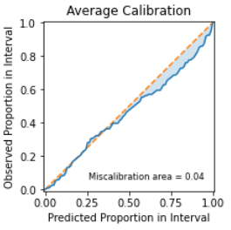
Q3: Does the system generalize for differing conditions? Evaluating Uncertainty
Do we trust our uncertainties?
We checked our “uncertainty calibration” using Uncertainty Toolbox
https://github.com/uncertainty-toolbox/uncertainty-toolbox
Predicted proportion of the test data expected to lie inside the prediction interval (x-axis)
Proportion of the test data observed inside the prediction interval (y-axis)
We are marginally underconfident with a 4% global miscalibration area.
For example, the 0.75 prediction interval aims to include observed values 75% of the time.
Youngseog Chung, Ian Char, Han Guo, Jeff Schneider, and Willie Neiswanger. Uncertainty toolbox: an open-source library for assessing, visualizing, and improving uncertainty quantification. arXiv preprint arXiv:2109.10254, 2021.
Notes:
Again, a Gaussian process makes a distributional prediction: a mean and standard deviation.
The predicted mean lets us evaluate accuracy.
The prediction standard deviation lets us quantify the model’s uncertainty.
We must evaluate how well the uncertainties are calibrated.
[CLICK]
The Uncertainty Toolbox, from Chung, Char, Goo-oo, Schneider, and Niece-wonger is a python library for predictive UQ calibration, metrics, and visualizations.
One of the UQ evaluations we performed was the average calibration test on our holdout data.
On the x-axis of the average calibration plot shows the predicted proportion of the test data expected to lie inside the prediction interval.
The y-axis plots the observed proportion in the holdout data predictions that lie within the interval. A perfectly calibrated uncertainty would show 75% of the observed values lying within the 75th quantile.
Our uncertainty had a miscalibration area of 4% showing we are marginally overconfident in our predictions.
This made us feel pretty good about our uncertainties.
####
residuals are normalized using the standard deviation and a normal distribution of errors is assumed.
Steps:
For each quantile (default 1:100):
# Computer lower and upper bound for quantile
norm = stats.norm(loc=0, scale=1)
lower_bound = norm.ppf(0.5 - quantile / 2)
upper_bound = norm.ppf(0.5 + quantile / 2)
# Compute proportion of normalized residuals within lower to upper bound
residuals = y_pred - y_true
normalized_residuals = residuals.reshape(-1) / y_std.reshape(-1)
num_within_quantile = 0
for resid in normalized_residuals:
if lower_bound <= resid and resid <= upper_bound:
num_within_quantile += 1.0
proportion = num_within_quantile / len(residuals)

Slide 27
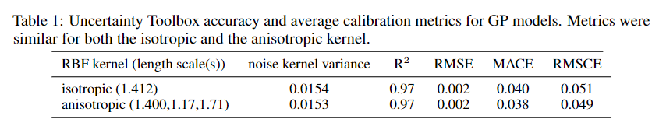
Q3: Does the system generalize for differing conditions? Evaluating Uncertainty
Do we trust our uncertainties?
We checked our “uncertainty calibration” using Uncertainty Toolbox
https://github.com/uncertainty-toolbox/uncertainty-toolbox
Notes:
If Time:
Describe MACE and RMSCE
####
residuals are normalized using the standard deviation and a normal distribution of errors is assumed.
Steps:
For each quantile (default 1:100):
# Computer lower and upper bound for quantile
norm = stats.norm(loc=0, scale=1)
lower_bound = norm.ppf(0.5 - quantile / 2)
upper_bound = norm.ppf(0.5 + quantile / 2)
# Compute proportion of normalized residuals within lower to upper bound
residuals = y_pred - y_true
normalized_residuals = residuals.reshape(-1) / y_std.reshape(-1)
num_within_quantile = 0
for resid in normalized_residuals:
if lower_bound <= resid and resid <= upper_bound:
num_within_quantile += 1.0
proportion = num_within_quantile / len(residuals)

Slide 28
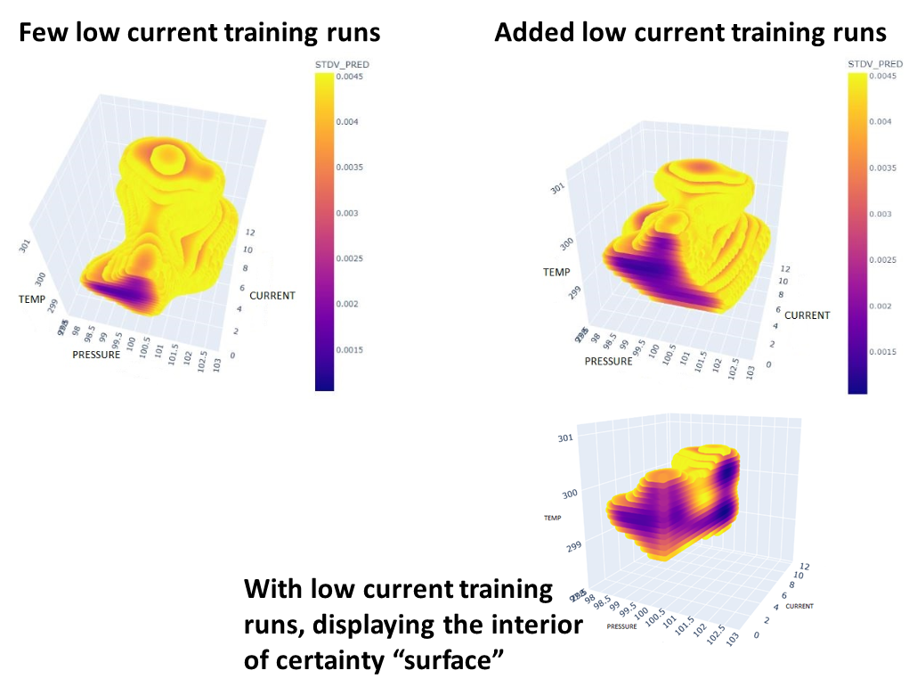
Q3: Does the system generalize for differing conditions? Uncertainty quantification
The Gaussian process provides uncertainty quantification.
  Important not to set the HV when uncertain, but how do we use uncertainty?
First, we thought of an uncertainty threshold "surface".
Plots of a grid mesh of the input feature space for predictions with Gaussian process standard deviation <= 3% of the ideal GCF:
  As expected, the "surface" increases for low current runs, when more low current runs were added to training data.
Notes:
Our third question is trickier trust in a data-driven self-driving detector.
We get uncertainty from the Gaussian process model.
This is great, because a trustworthy model must be able to not only provide a prediction but also be able to communicate "I don't know if this is accurate".
So, we want UQ, but what do we want to do with it?
We would be remiss to set the CDC high voltage to an uncertain value. The last thing we want to do is increase the difficulty of calibrating the raw data.
To better understand the uncertainty and we initially thought of it as a "surface“ of our input parameters between where the model was certain and uncertain.
[CLICK]
Because we have three input features (pressure, temperature, and high voltage board current) we can plot the surface.
Here are some plots of the uncertainty "surface" at a threshold of standard deviation of 3% of the ideal gain correction factor. All plotted points are within our certainty threshold.
In the upper row you see two plots. The plot on the left is for training data that included few low current runs.
The surface plot on the right shows when low current runs were added to the training data. As expected the part of the plot facing us, corresponding to low current runs, has a larger area when low current training data was provided to the model.

Slide 29
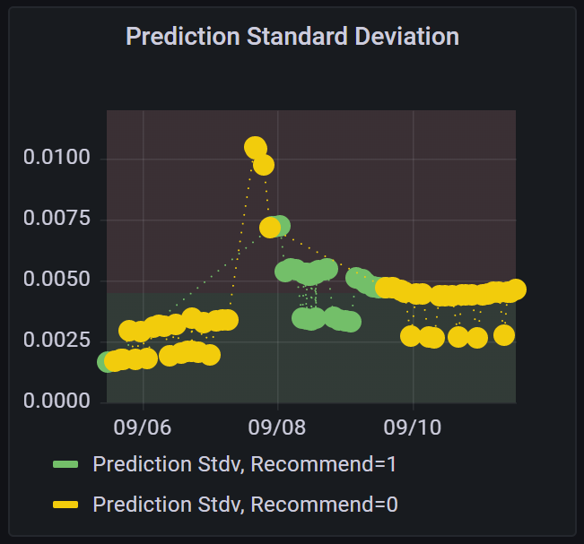
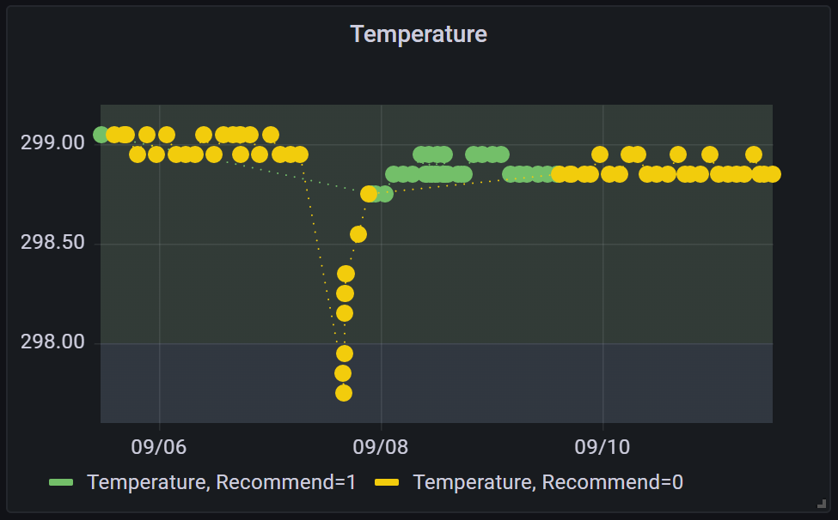
Q3: Does the system generalize for differing conditions? CPP
Notes:
Then the temperature dropped in to a range where we had no training data.
The standard deviation increased.
AND

Slide 30
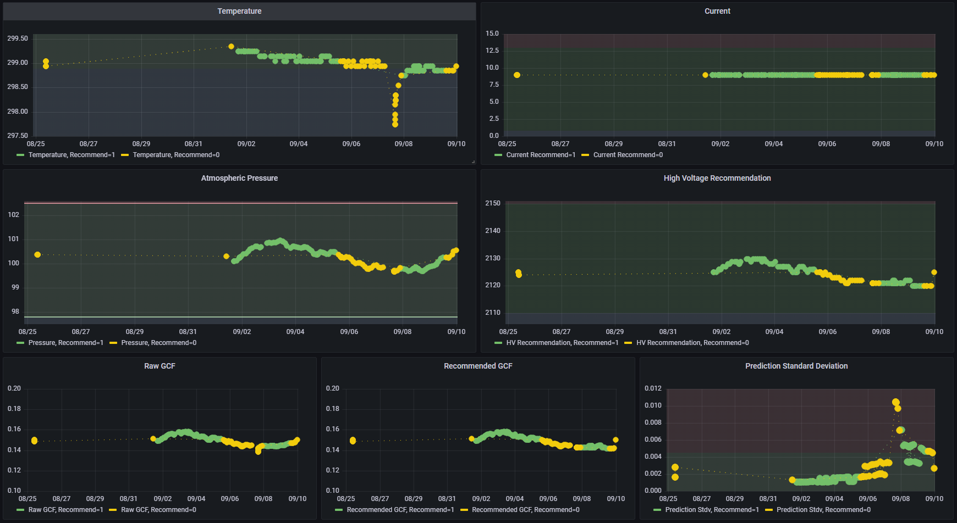
Q3: Does the system generalize for differing conditions? PrimeX
Notes:
Then, we then ran for the PrimeX experiment.
PrimeX had temperatures similar to CPP but slightly lower than the training data.
Current and atmospheric pressure were well within our training data.
For the time outlined in the read box temperature was a tenth of a Kelvin lower than our threshold, and our uncertainty was above our 3% threshold.
And ...
####
residuals are normalized using the standard deviation and a normal distribution of errors is assumed.
Steps:
For each quantile (default 1:100):
# Computer lower and upper bound for quantile
norm = stats.norm(loc=0, scale=1)
lower_bound = norm.ppf(0.5 - quantile / 2)
upper_bound = norm.ppf(0.5 + quantile / 2)
# Compute proportion of normalized residuals within lower to upper bound
residuals = y_pred - y_true
normalized_residuals = residuals.reshape(-1) / y_std.reshape(-1)
num_within_quantile = 0
for resid in normalized_residuals:
if lower_bound <= resid and resid <= upper_bound:
num_within_quantile += 1.0
proportion = num_within_quantile / len(residuals)

Slide 31
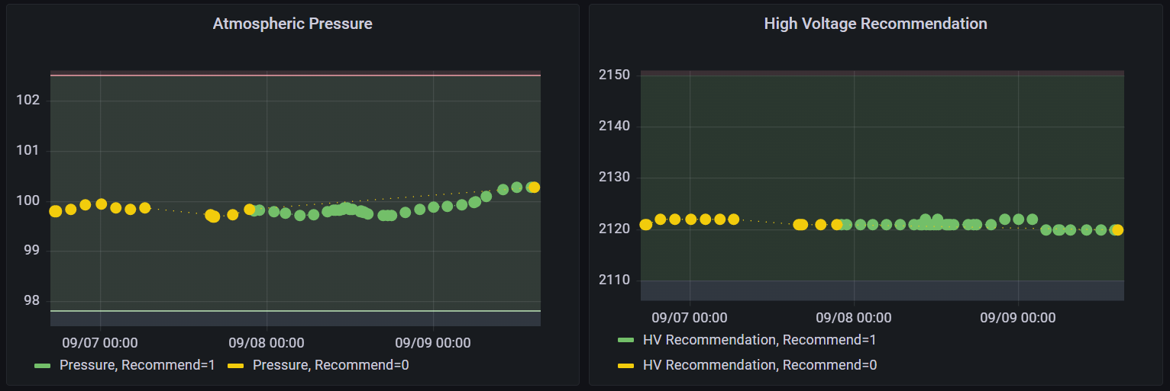
Q3: Does the system generalize for differing conditions? CPP
Notes:
Then we noticed that because of the high uncertainty and the Euclidean projection to the closest certain point, we saw atmospheric pressure continuously increasing but the recommended high voltage decreasing, then remaining flat.
This is a multi-dimensional problem, not solely an atmospheric pressure problem, but the detector expert found this behavior surprising and disturbing, and the team re-grouped to better understand our uncertainty and our uncertainty correction behavior.
We have spent quite a bit of time thinking about system responses to quantified uncertainty.

Slide 32
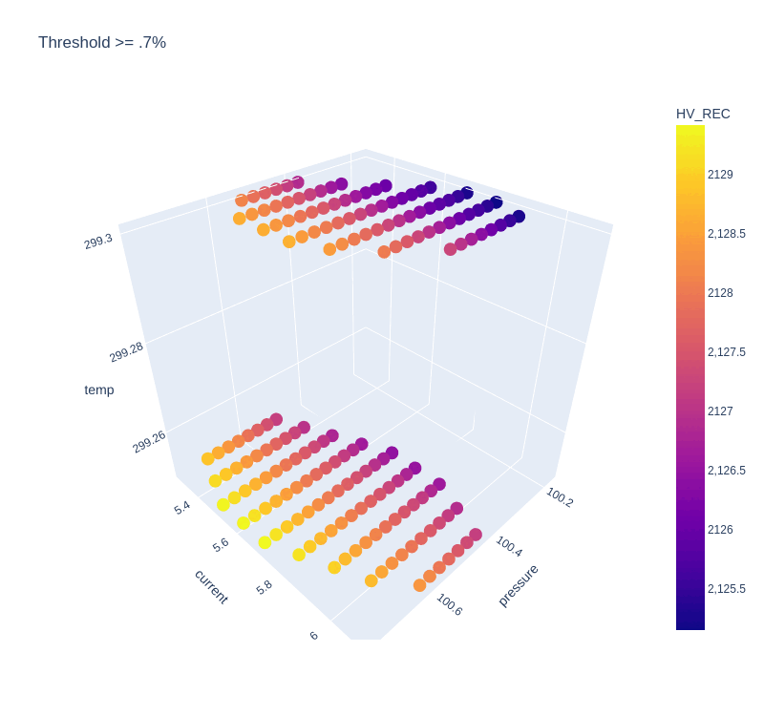
How Can We Use Uncertainty Quantification?
Temp vs. Current vs. Pressure for different uncertainties
Can we use uncertainty to guide new data acquisition?
Notes:
Discussion of self-running control vs. data-taking experiment

Slide 33
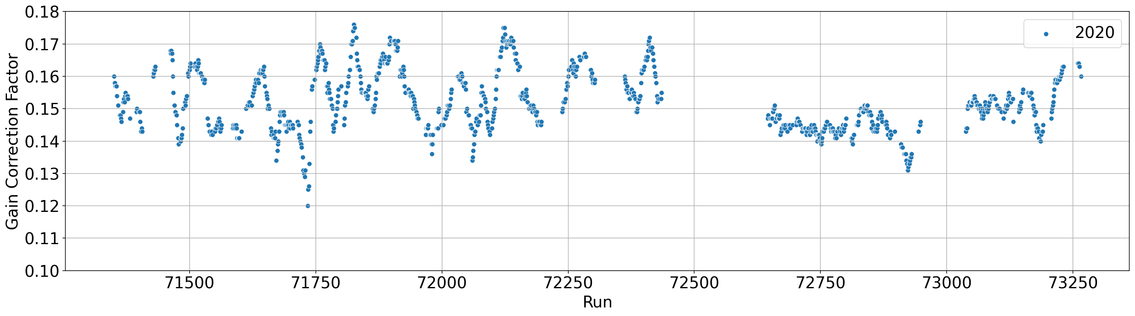
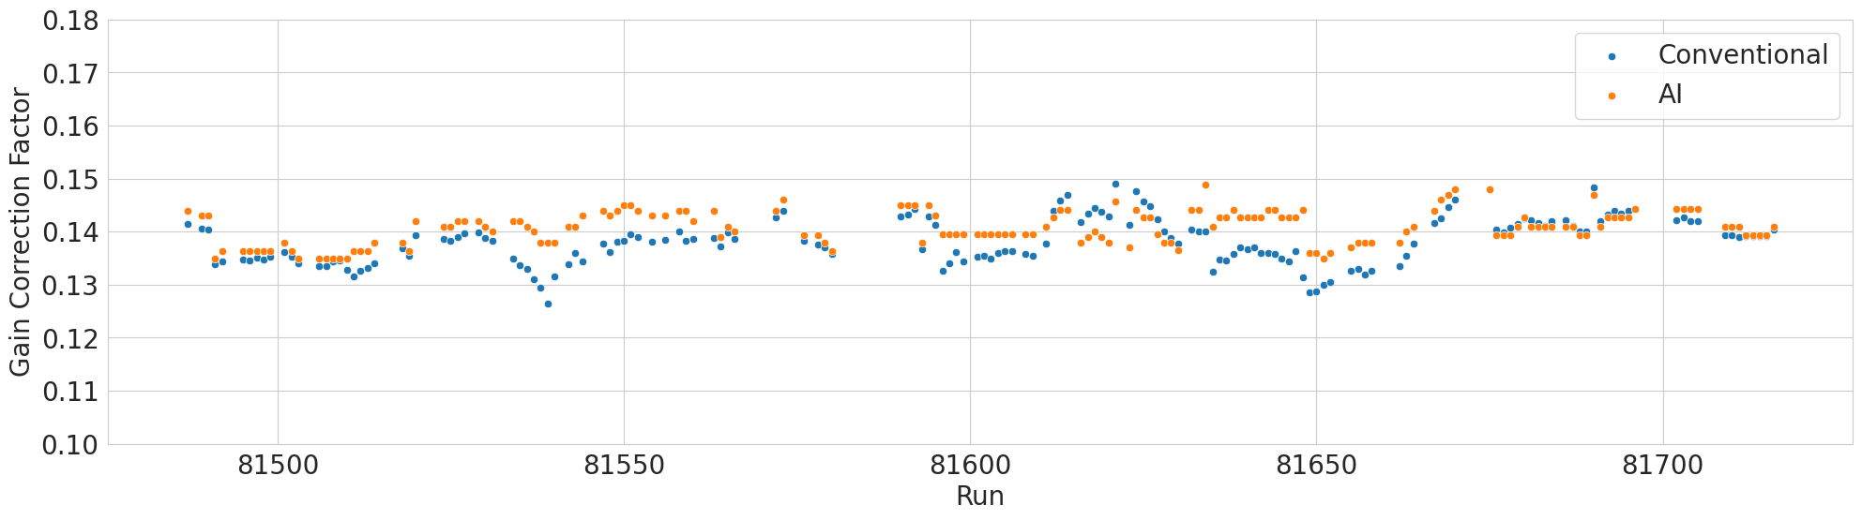
Calibrations with AI: Gain
AI generated calibration constants agree with conventional gain calibration results
GCF are more stable compared to GlueX 2020 run period

Slide 34
Summary and Outlook
Diana McSpadden, Torri Jeske, Nikhil Kalra, Naomi Jarvis, Thomas Britton, and David Lawrence
roark@jlab.org
Ability to predict existing calibration constants using GPR models using environmental and detector specific data
Compared calibrations with conventional and AI-generated starting values
System is implemented and has been used for 3 experiment run periods.
Application to additional drift chambers in progress
This work was supported by the US DOE as Lab 20-2261
The Carnegie Mellon Group is supported by the U.S. Department of Energy, Office of Science, Office of Nuclear Physics, DOE Grant No. DE-FG02-87ER40315
GlueX acknowledges the support of several funding agencies and computing facilities: www.gluex.org/thanks

Slide 35
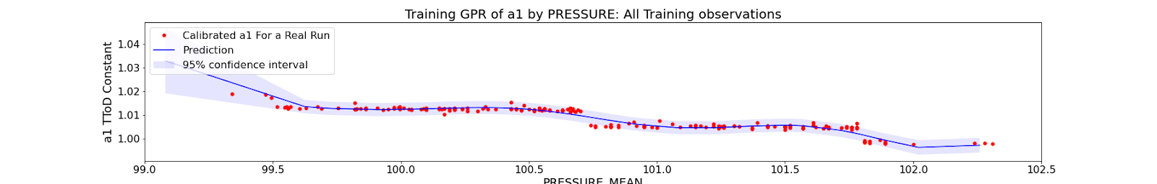
Current TToD Model: Gaussian Process Regression
Same input features as GPR for gain
Targets: Existing TToD calibration constants from GlueX 2020 run period
Evaluation metric:
Illustration only
Mean Pressure (kPa)
Notes:
** more details on time to distance function in the back up slides

Slide 36
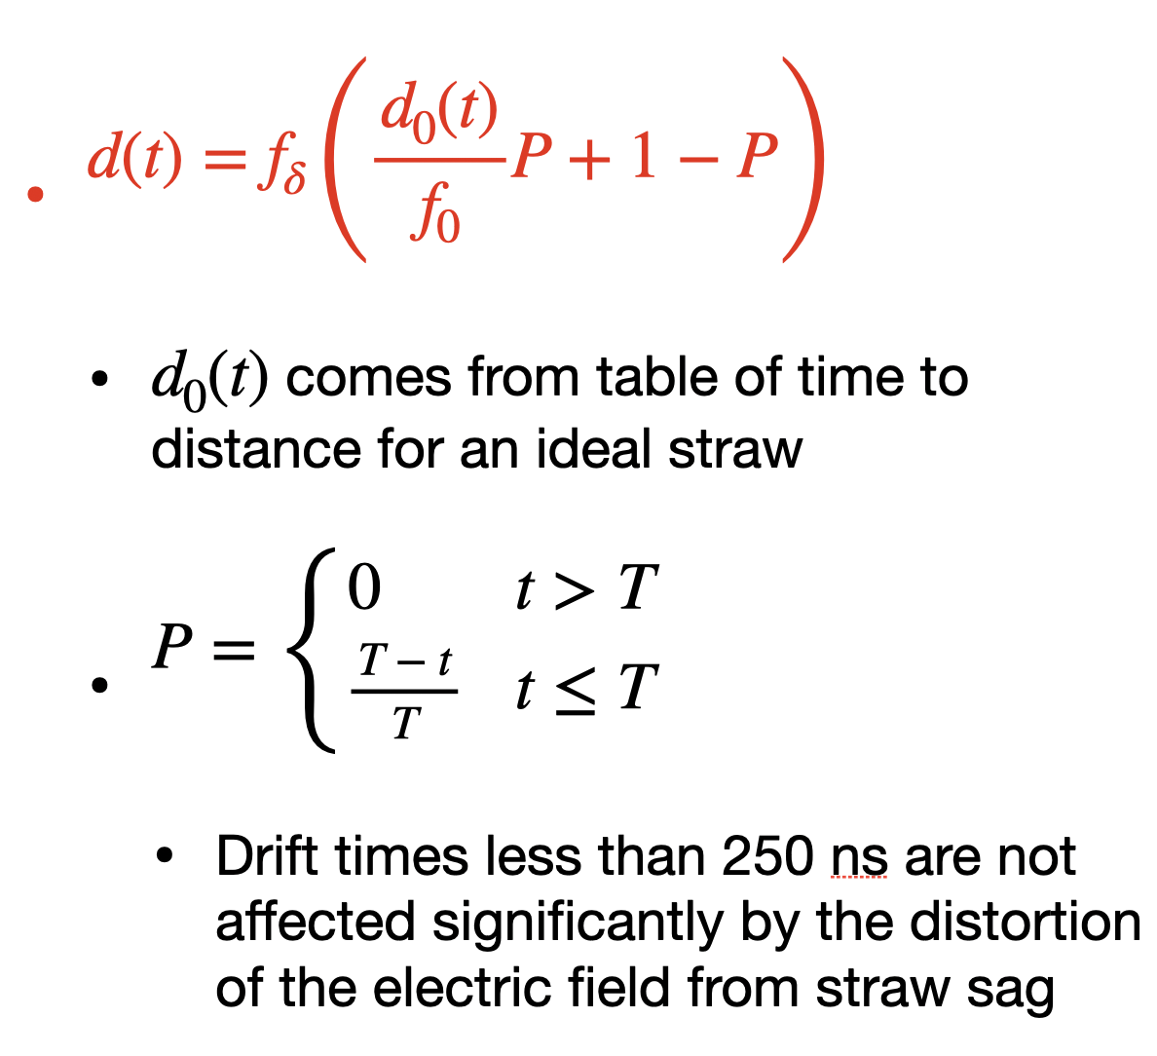
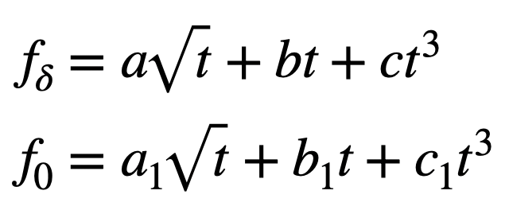
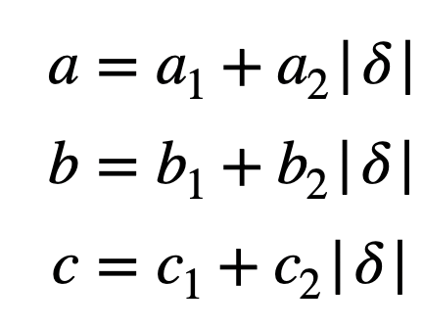
TToD Fit function

