Slide 1


Affine Parametric Neural Networks
For high-energy physics
Luca Anzalone^{1,3}, Tommaso Diotalevi^{1,2,3}, and Daniele Bonacorsi^{1,3}
University of Bologna, CERN, INFN Bologna
24/10/22
ACAT 21st
luca.anzalone2@unibo.it

Slide 2
Introduction
Signal-bkg classification
HEPMASS-IMB

Slide 3
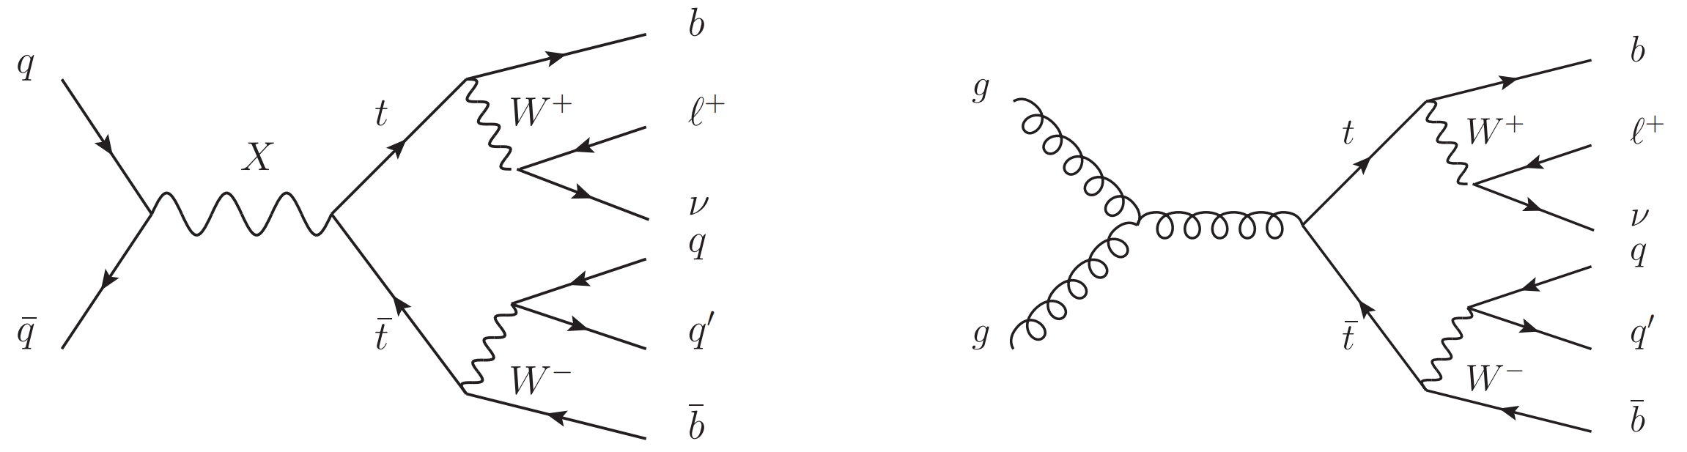
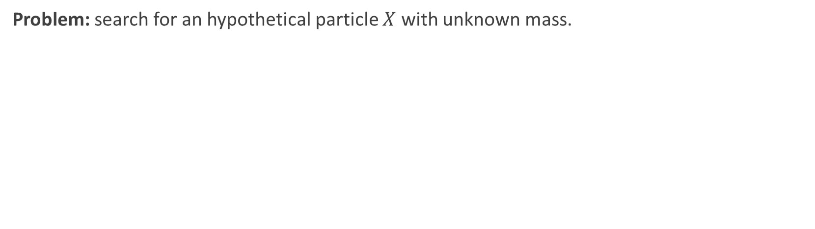
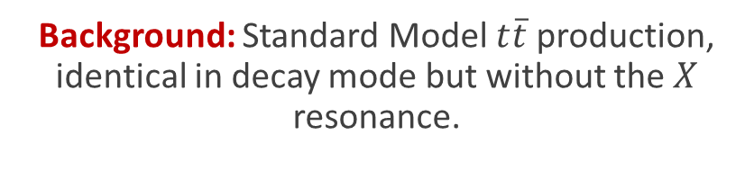
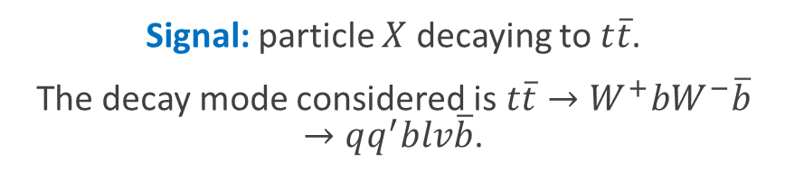
Signal-bkg Classification with HEPMASS
HEPMASS (UCI)
Parameterized Neural Networks for High-Energy Physics
Problem: search for an hypothetical particle $X$ with unknown mass.
Signal: particle $X$ decaying to $t\overline{t}$.
The decay mode considered is $t\overline{t}→W^{+}bW^{−}\overline{b}→qq^{′}blv\overline{b}$.
Background: Standard Model $t\overline{t}$ production, identical in decay mode but without the $X$ resonance.
There are five mass hypotheses for the signal: $m_{X}=\{500,750,1000,1250,1500\}$ GeV.
Luca Anzalone
ACAT 21st

Slide 4
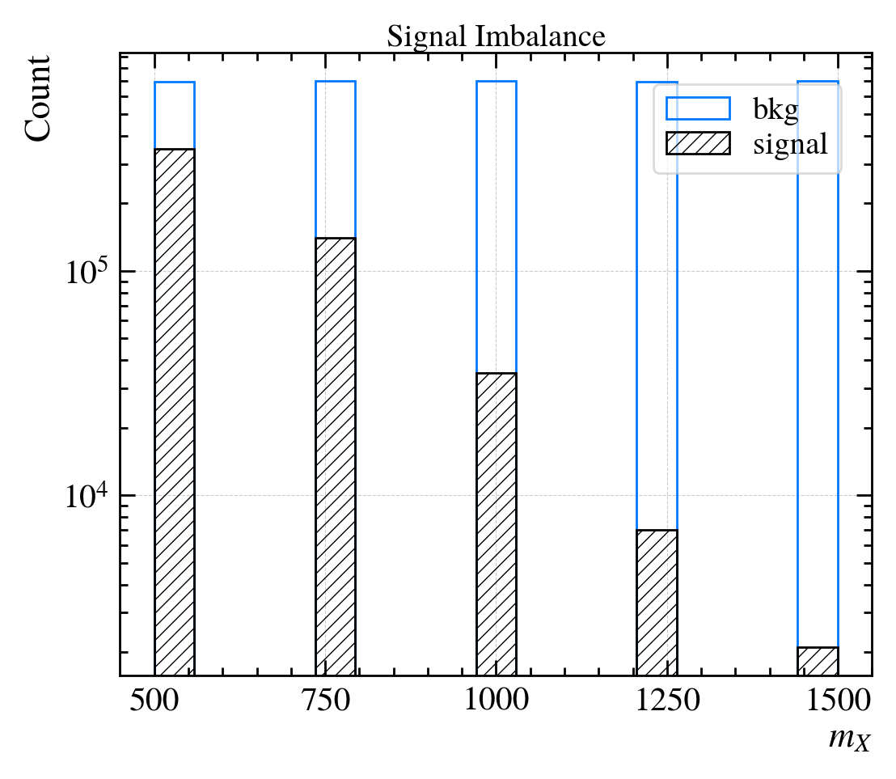
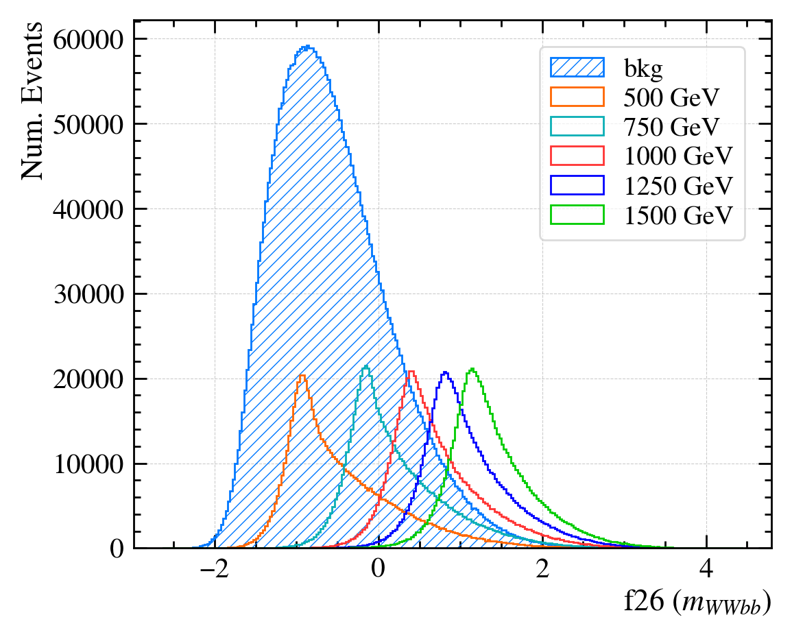
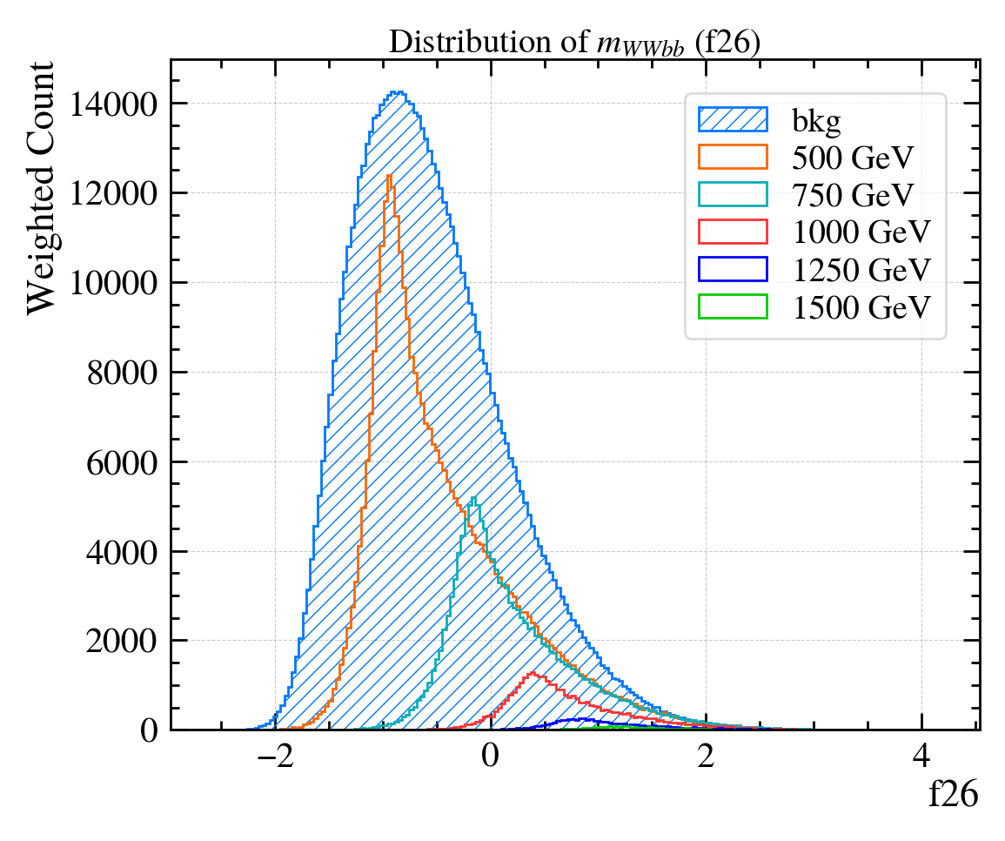
HEPMASS-IMB
HEPMASS-IMB (Zenodo)
Both class and mass are imbalanced!
Double-imbalanced version of HEPMASS:
HEPMASS-IMB
(bkg weighted by 1/5, for visualization)
HEPMASS
Luca Anzalone
ACAT 21st

Slide 5
Parametric Neural Networks
Baldi’s pnn
Conditioning
Affine pnn

Slide 6
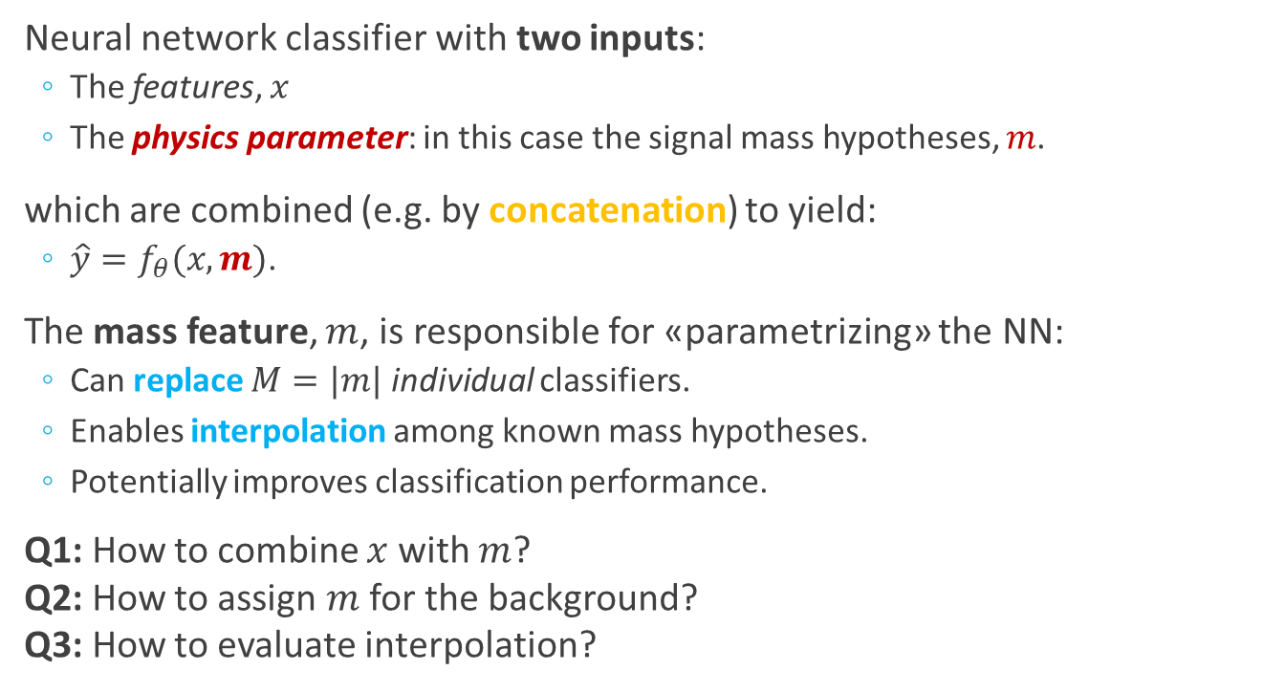

Parametrized NNs
Parameterized Neural Networks for High-Energy Physics
features
mass
x
m
Neural network classifier with two inputs:
  The features, $x$
  The physics parameter: in this case the signal mass hypotheses, $m$.
which are combined (e.g. by concatenation) to yield:
  $\hat{y}=f_{θ}(x, m)$.
The mass feature, $m$, is responsible for «parametrizing» the NN:
  Can replace $M=|m|$ individual classifiers.
  Enables interpolation among known mass hypotheses.
  Potentially improves classification performance.
Q1: How to combine $x$ with $m$?
Q2: How to assign $m$ for the background?
Q3: How to evaluate interpolation?
Concatenate
Dense
ReLU
Dense
ReLU
Dense
Sigmoid
$$\hat{y}$$
Luca Anzalone
ACAT 21st
Notes:
Standard pNN uses 5 dense layers with 500 units each: >1M params!

Slide 7
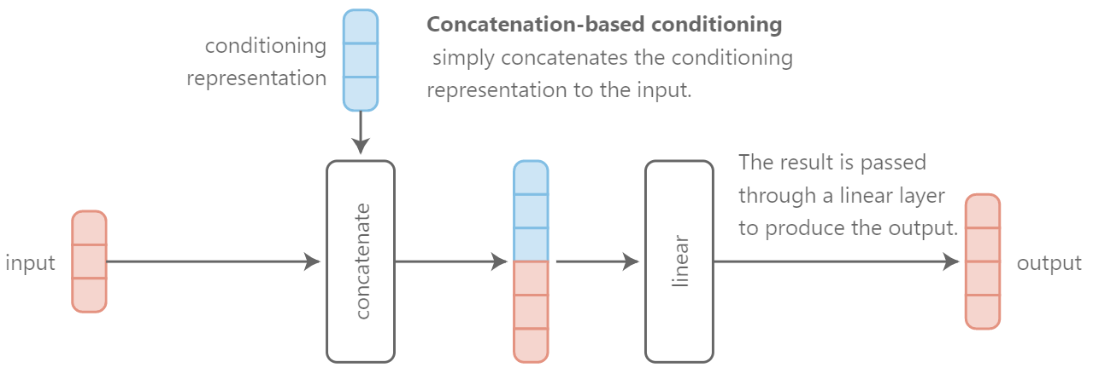

Concatenation-based Conditioning
Feature-wise transformations
A simple conditioning mechanism:
$$z=W\left[x m\right]+b$$
Parametric = conditioning on a physics parameter.
Luca Anzalone
ACAT 21st

Slide 8
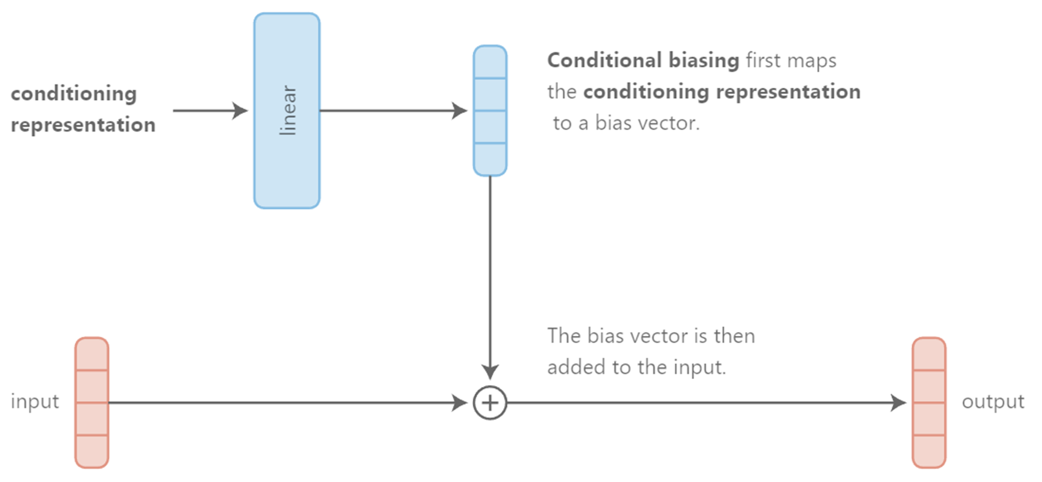

Conditional Biasing
Feature-wise transformations
Equivalent to concatenation-based conditioning (prev. slide):
$$z=(Wm+b)+x$$
Luca Anzalone
ACAT 21st

Slide 9
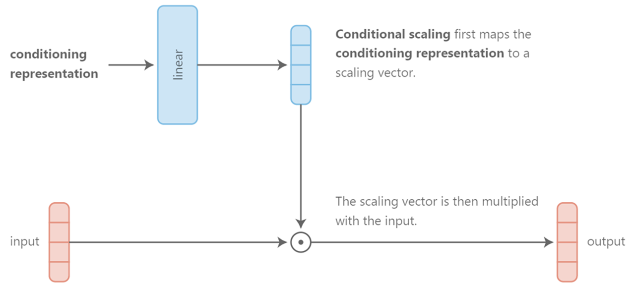

Conditional Scaling
Feature-wise transformations
Alternative to concatenation and biasing:
$$z=x⊙(Wm+b)$$
Luca Anzalone
ACAT 21st

Slide 10

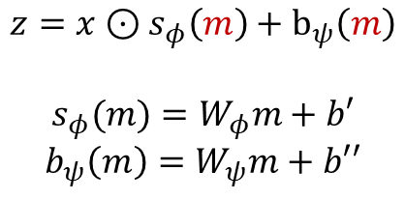





Affine Conditioning
Feature-wise transformations
Improving Parametric NNs for High-Energy Physics (and Beyond)
Q1:
A combination of conditional scaling and conditional biasing:
$$z=x⊙s_{φ}\left(m\right)+b_{ψ}\left(m\right)$$
$$s_{φ}(m)=W_{φ}m+b′$$
$$b_{ψ}\left(m\right)=W_{ψ}m+b′′$$
$$b$$
Linear
$$m$$
$$s$$
Linear
$$z$$
$$x$$
Luca Anzalone
ACAT 21st

Slide 11
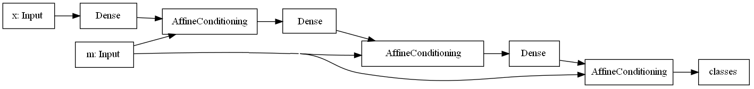

Affine Parametric Neural Networks
Improving Parametric NNs for High-Energy Physics (and Beyond)
Interleave multiple affine-conditioning layers in between dense layers, to better condition the neural network on the mass feature, $m$:
Full architecture:
  Four dense layers with 300, 150, 100 and 50 units: for a total of ~70k parameters.
  ReLU activation.
  Dropout ($p=25\%$) after each affine-conditioning layer.
Luca Anzalone
ACAT 21st

Slide 12
Improving pNNs
background mass distribution
Balanced training

Slide 13
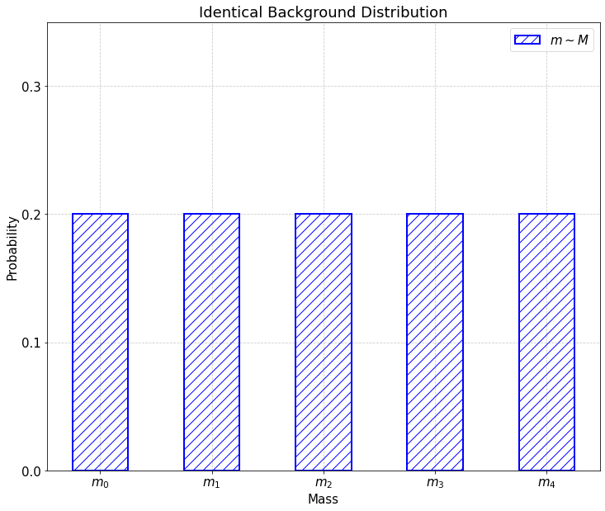
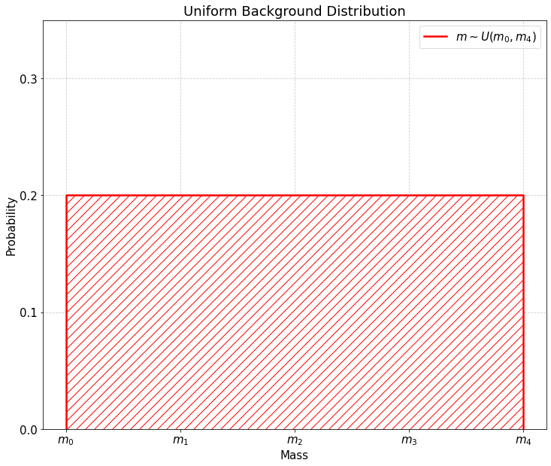
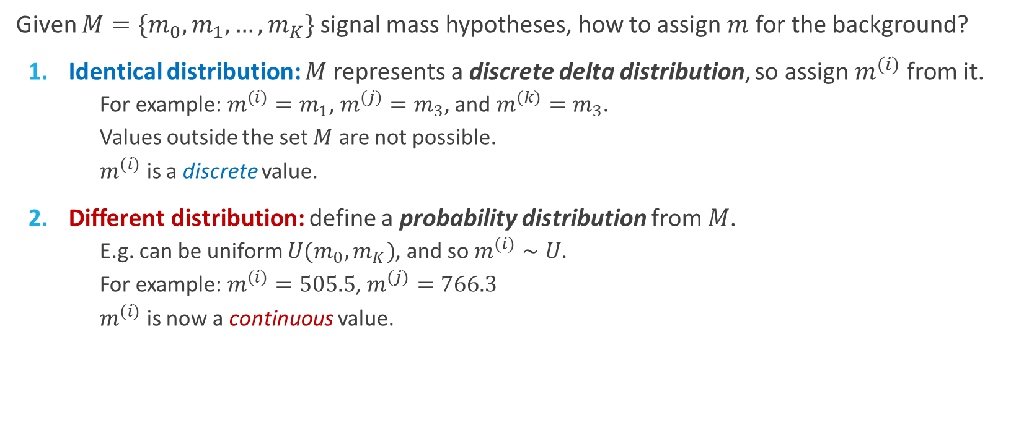
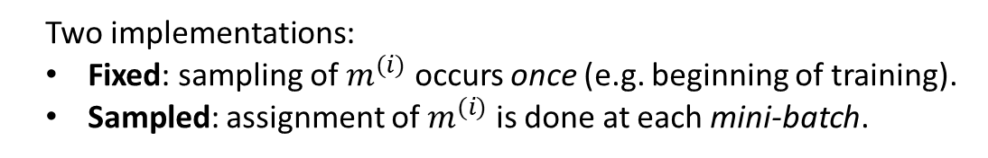
Background’s Mass Distribution
Improving Parametric NNs for High-Energy Physics (and Beyond)
Q2:
Given $M=\{m_{0},m_{1},…,m_{K}\}$ signal mass hypotheses, how to assign $m$ for the background?
Identical distribution: $M$ represents a discrete delta distribution, so assign $m^{(i)}$ from it.
  For example: $m^{(i)}=m_{1}$, $m^{(j)}=m_{3}$, and $m^{(k)}=m_{3}$.
  Values outside the set $M$ are not possible.
  $m^{(i)}$ is a discrete value.
Different distribution: define a probability distribution from $M$.
  E.g. can be uniform $U(m_{0}, m_{K})$, and so $m^{(i)}∼U$.
  For example: $m^{(i)}=505.5$, $m^{(j)}=766.3$
  $m^{(i)}$ is now a continuous value.
Two implementations:
Fixed: sampling of $m^{(i)}$ occurs once (e.g. beginning of training).
Sampled: assignment of $m^{(i)}$ is done at each mini-batch.
Luca Anzalone
ACAT 21st
Notes:
4 possibilities in total.

Slide 14



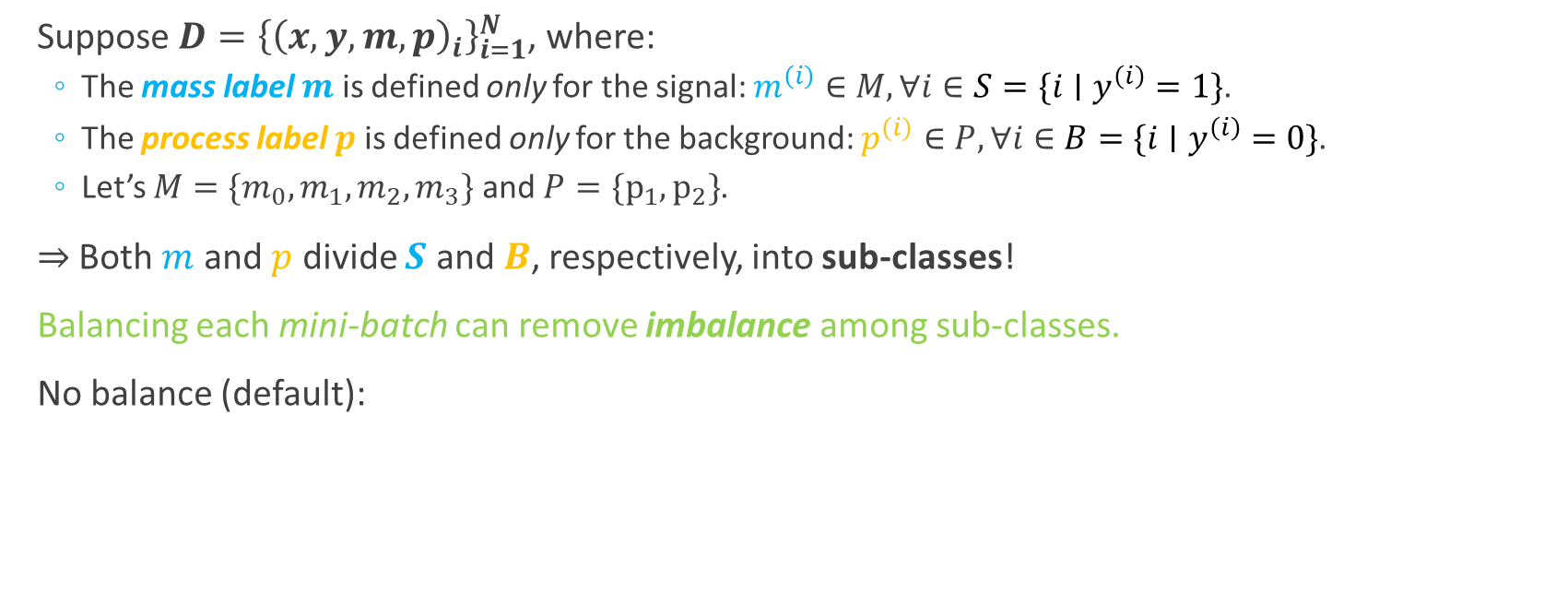


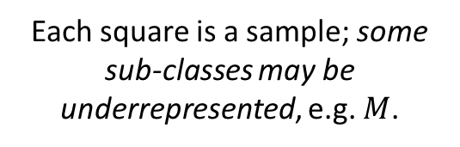


Balanced Training
Improving Parametric NNs for High-Energy Physics (and Beyond)
Exploit the structure of the dataset for training
Suppose $D={\left\{{\left(x,y,m,p\right)}_{i}\right\}}_{i=1}^{N}$, where:
  The mass label $m$ is defined only for the signal: $m^{\left(i\right)}∈M,∀i∈S=\{i∣y^{\left(i\right)}=1\}$.
  The process label $p$ is defined only for the background: $p^{(i)}∈P,∀i∈B=\{i∣y^{\left(i\right)}=0\}$.
  Let’s $M=\{m_{0},m_{1},m_{2},m_{3}\}$ and $P=\{{\text{p}}_{1},{\text{p}}_{2}\}$.
$⇒$ Both $m$ and $p$ divide $S$ and $B$, respectively, into sub-classes!
Balancing each mini-batch can remove imbalance among sub-classes.
No balance (default):
Notation
$$s$$
$$b$$
$$p_{1}$$
$$p_{2}$$
$$m_{0}$$
$$m_{1}$$
$$m_{1}$$
Each square is a sample; some sub-classes may be underrepresented, e.g. $M$.
mini-batch
Luca Anzalone
ACAT 21st

Slide 15















Balanced Mini-batches
Improving Parametric NNs for High-Energy Physics (and Beyond)
Mini-batches:
Class balance:
$$|s|=|b|$$
signal
background
Background balance:
$$m_{2}$$
Class balance: same num. of samples per class, $y$ (regardless $m$ and $p$).
Background balance: same num. of samples per bkg process, $p$.
Signal balance: same num. of samples per mass, $m$.
Full balance: same num. of samples per tuple ($y$, $m$, $p$).
|$p_{1}|=|p_{2}|$
signal
background
Signal balance:
$$m_{0}$$
$$m_{1}$$
$$m_{2}$$
$$m_{3}$$
$$m_{2}$$
$$|m_{0}|=|m_{1}|=…={|m}_{3}|$$
signal
background
Full balance:
$$m_{0}$$
$$m_{1}$$
$$m_{2}$$
$$m_{3}$$
$$|s|=|b| ∧|p|=|m|$$
signal
background

Slide 16
Results
Metrics
Baselines
Interpolation

Slide 17
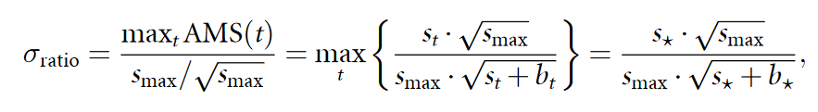
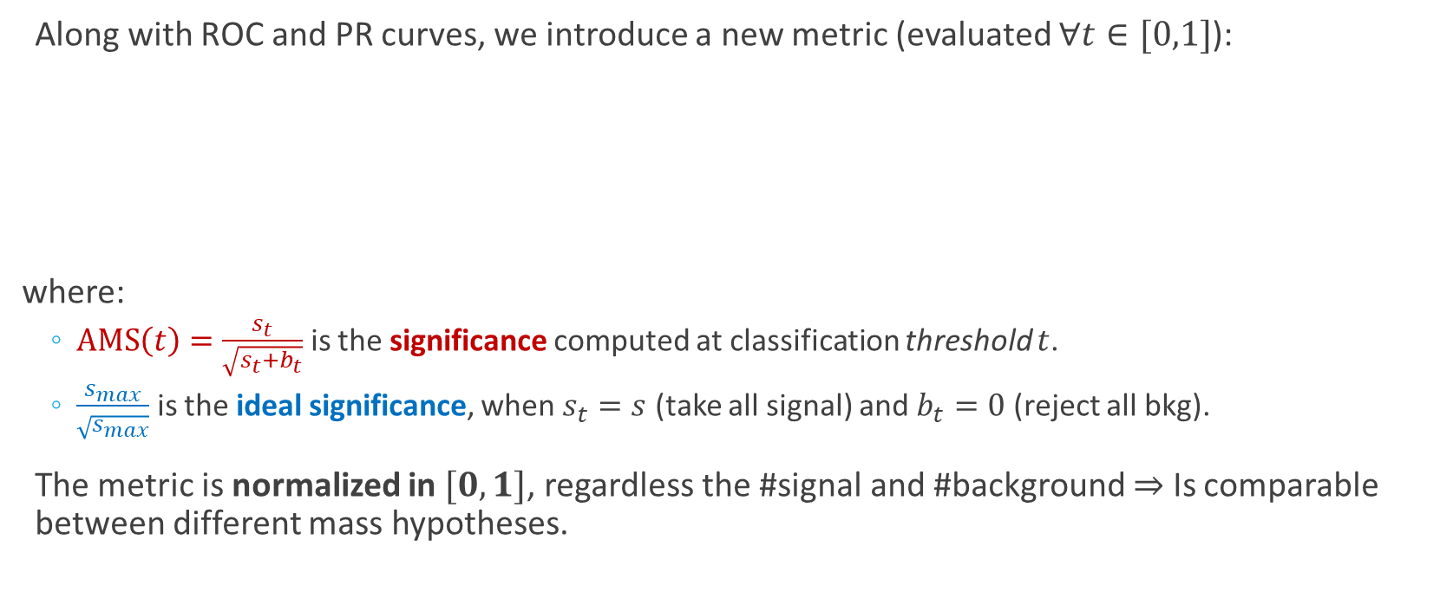
The Significance Ratio Metric
Improving Parametric NNs for High-Energy Physics (and Beyond)
Along with ROC and PR curves, we introduce a new metric (evaluated $∀t∈[0,1]$):
where:
  $\text{AMS}\left(t\right)=\frac{s_{t}}{\sqrt{s_{t}+b_{t}}}$ is the significance computed at classification threshold $t$.
  $\frac{s_{max}}{\sqrt{s_{max}}}$ is the ideal significance, when $s_{t}=s$ (take all signal) and $b_{t}=0$ (reject all bkg).
The metric is normalized in $[0, 1]$, regardless the #signal and #background $⇒$ Is comparable between different mass hypotheses.
Luca Anzalone
ACAT 21st

Slide 18
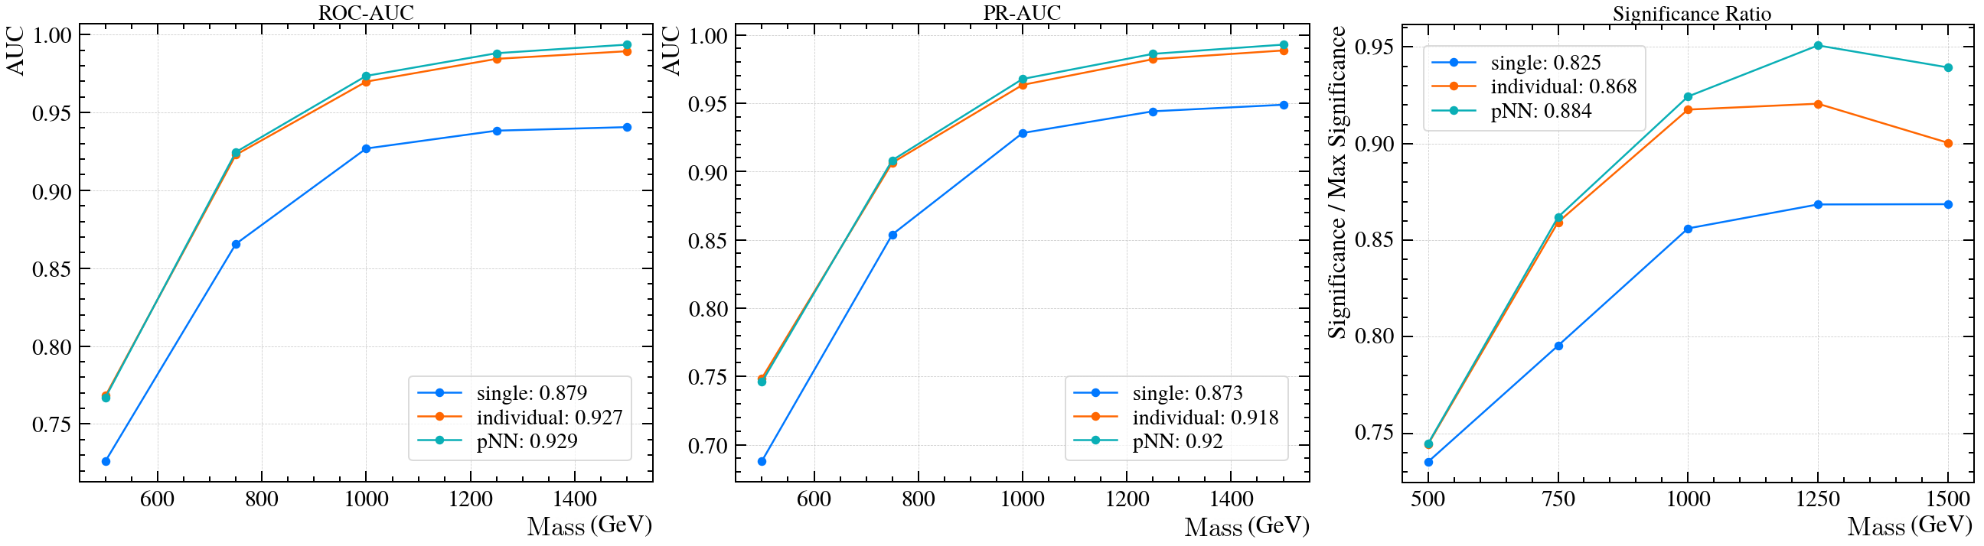

Baseline Models
Improving Parametric NNs for High-Energy Physics (and Beyond)
The pNN outperforms even the set of individual neural networks.
There are three baselines:
  Single-NN: one neural network trained on all $M$ mass points, but without the mass feature, $m$, as input – so not parametrized.
  Individual-NNs: a set of $|M|$ neural networks, each trained
  on the corresponding mass
  point, $m_{i}∈M$.
  pNN: Baldi’s like parametric
  neural network, without
  our improvements.
Luca Anzalone
ACAT 21st

Slide 19
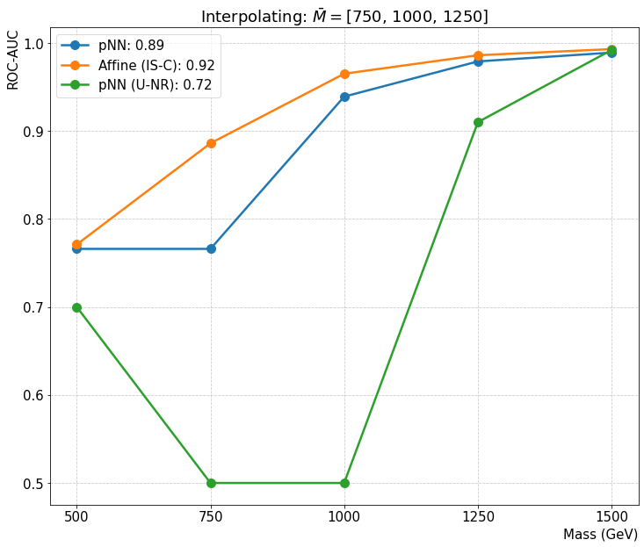
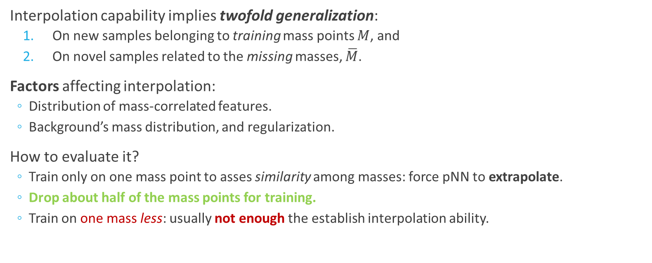
Interpolation
Improving Parametric NNs for High-Energy Physics (and Beyond)
Interpolation capability implies twofold generalization:
  On new samples belonging to training mass points $M$, and
  On novel samples related to the missing masses, $\overline{M}$.
Factors affecting interpolation:
  Distribution of mass-correlated features.
  Background’s mass distribution, and regularization.
How to evaluate it?
  Train only on one mass point to asses similarity among masses: force pNN to extrapolate.
  Drop about half of the mass points for training.
  Train on one mass less: usually not enough the establish interpolation ability.
IS-C: Identical-sampled; class-balance.
U-NR: Uniform; no regularization.
Q3:
Luca Anzalone
ACAT 21st
Notes:
Training on one mass less gives little information: maybe the pNN interpolates the missing point thanks to luck.
In real-world, you may want to remove variables correlated with mass.

Slide 20
Conclusions
Summary
references

Slide 21
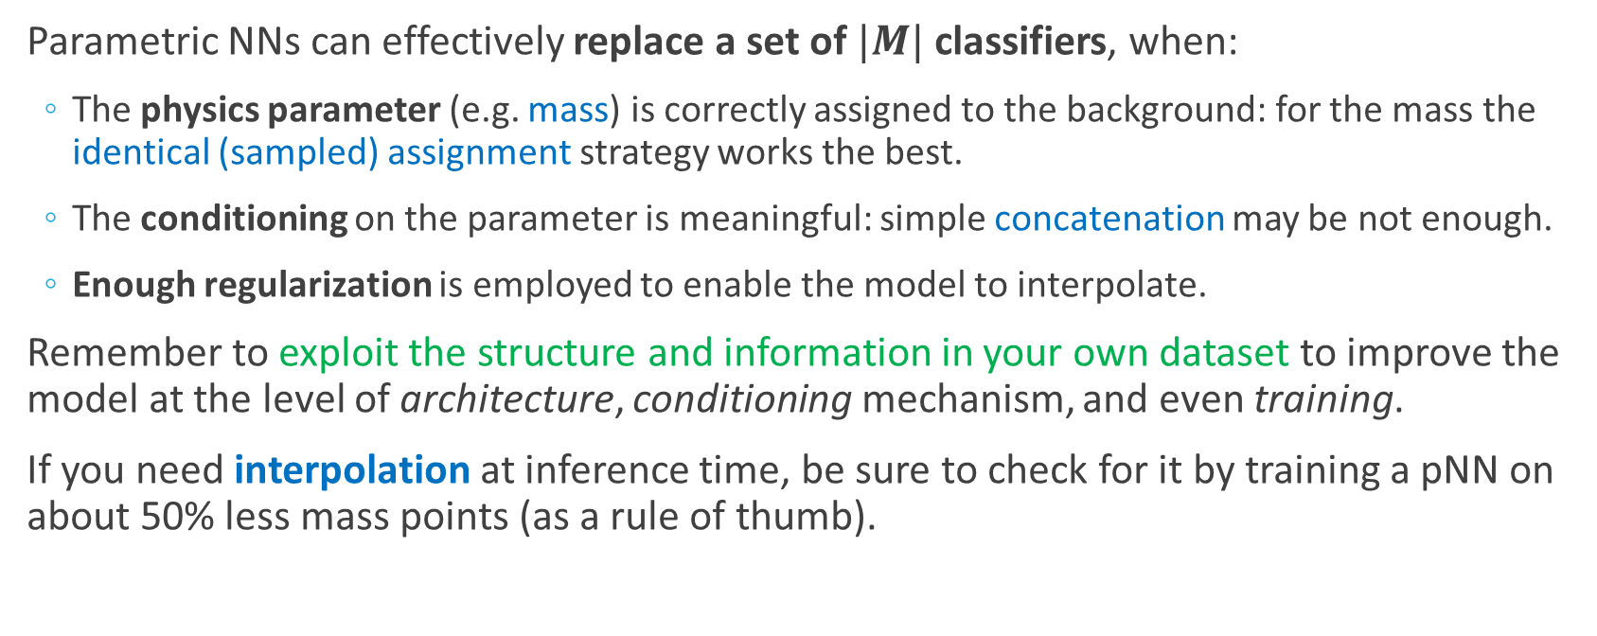
Summary
Parametric NNs can effectively replace a set of $|M|$ classifiers, when:
  The physics parameter (e.g. mass) is correctly assigned to the background: for the mass the identical (sampled) assignment strategy works the best.
  The conditioning on the parameter is meaningful: simple concatenation may be not enough.
  Enough regularization is employed to enable the model to interpolate.
Remember to exploit the structure and information in your own dataset to improve the model at the level of architecture, conditioning mechanism, and even training.
If you need interpolation at inference time, be sure to check for it by training a pNN on about 50% less mass points (as a rule of thumb).
Luca Anzalone
ACAT 21st

Slide 22
References
Parameterized Neural Networks for High-Energy Physics – P. Baldi et al. 2016, EPJ
HEPMASS – UCI ML Repository
Feature-wise Transformations – Distill.pub, 2018
Improving Parametric Neural Networks for High-Energy Physics (and Beyond) – L. Anzalone et al, 2022, MLST, code (github).
HEPMASS-IMB – Zenodo
Luca Anzalone
ACAT 21st

Slide 23
github.com/luca96/affine-parametric-networks
Thanks for the Attention!
Questions?
Contacts:
luca.anzalone2@unibo.it

