Slide 1
Enthusiasm for Engineering
Engineering at CERN
David Nisbet
CERN Technology Department

Slide 2

What is CERN?
A European laboratory that both ENABLES and PERFORMS fundamental physics research
Provides high energy particle beams for international experimental collaborations
Plays a major role coordinating the experimental programs
CERN requires a huge amount of engineering expertise to design, construct and run the accelerator facilities

Slide 3
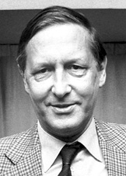
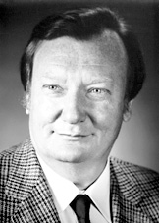
Accelerators need engineers!
Award of the Nobel Physics prize in 1984
  Rubbia and Van der Meer
  Discovery of the W and Z boson at the SPS collider using intense beams created in the ISR
A former Nobel Laureate expressed his opinion about the CERN project with the following words:
van der Meer made it possible, Rubbia made it happen.
Simon Van der Meer spent many years of his career as a Power Electronics Engineer ☺
  http://nobelprize.org/nobel_prizes/physics/laureates/1984/presentation-speech.html

Slide 4

The life of a particle accelerator
Using the LHC as an example
Identify the big questions and the appropriate instrument
  The LHC as a ‘discovery’ machine
Study the broad feasibility
  Reuse the LEP tunnel, cryogenics, superconducting magnets, etc
  Often leads to a Conceptual Design Report (CDR)
Study the detailed feasibility
  Research key technologies (superconducting magnets)
  Leads to a Technical Design Report (TDR)
Design, construct and commission
CERN Finance Committee 1994
See Lyn Evans presentation: https://edms.cern.ch/document/1075090/1.0

Slide 5
If the LHC did not use superconductivity…
The LHC has a circumference of 26.7 km, of which some 20 km of main superconducting magnets operating at 8.3T.
The cryogenic system of the ring will consume approximately 40 MW and the LHC power converters 60 MW.
An equivalent machine based on conventional electromagnets (copper coils, iron core) operating at 1.8 T would have a circumference of ~100 km, and would consume approximately 1000 MW of electric power (one unit of nuclear plant ) dissipated by Joule effect
Its investment costs and operational expenses would be prohibitive

Slide 6
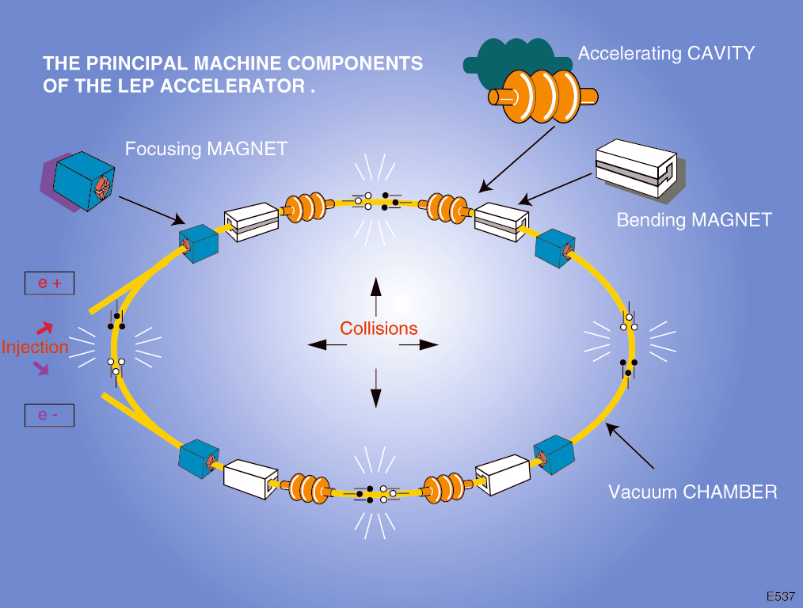
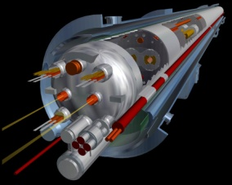
What do accelerators need?

Slide 7

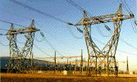
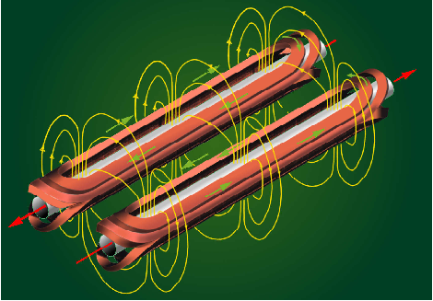
What do accelerators need?
  General infrastructure
    Buildings (or tunnels)
    Electrical
    Cooling
    Mechanical
  Magnets
  RF
  Control and communication
  Detectors

Slide 8
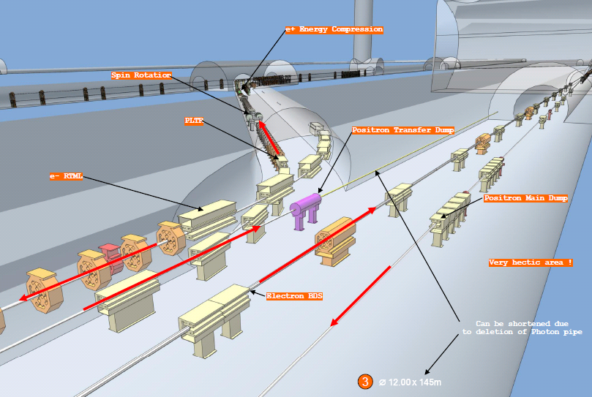
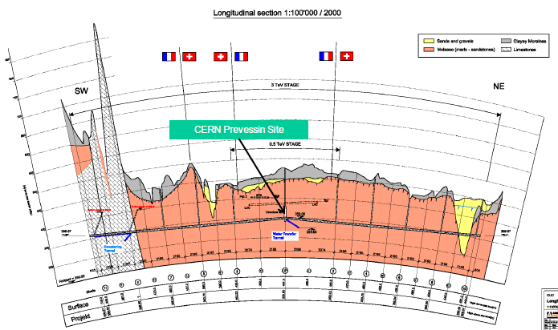
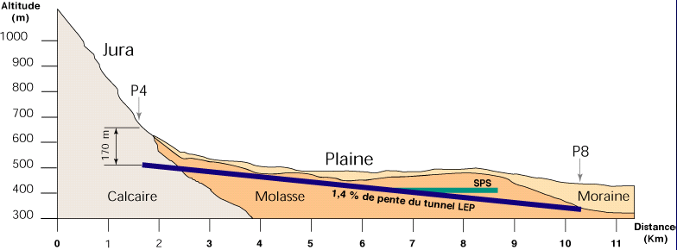
Tunnels, tunnels,…

Slide 9
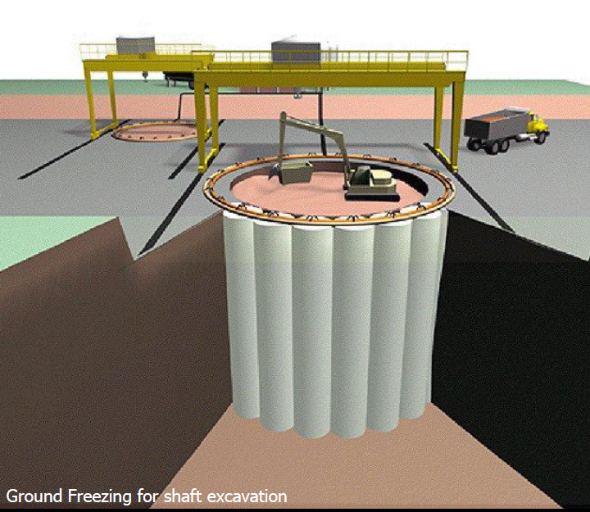
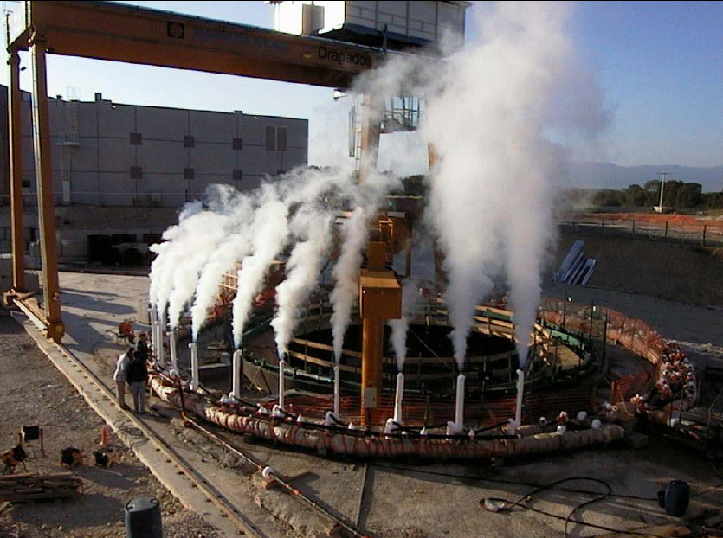
Civil Engineering

Slide 10
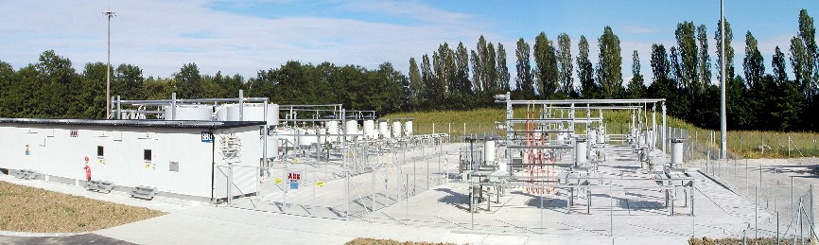
Electrical Distribution
SVC for SPS

Slide 11
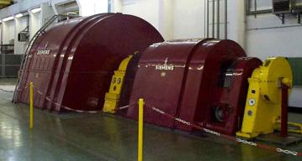
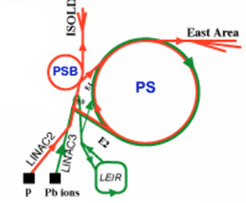
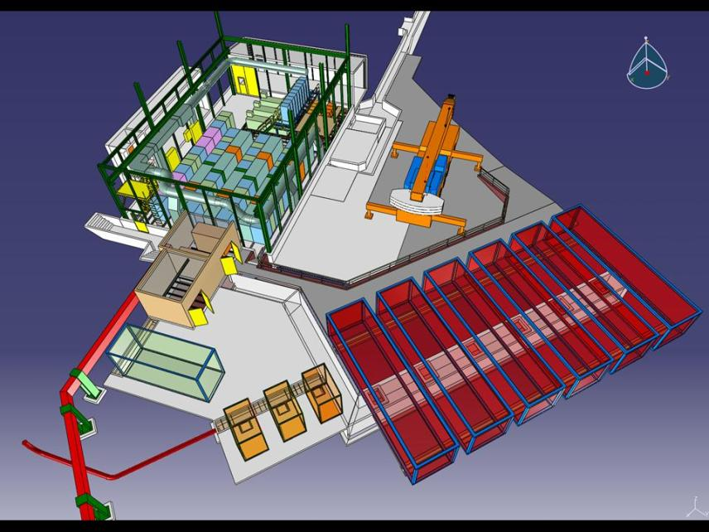
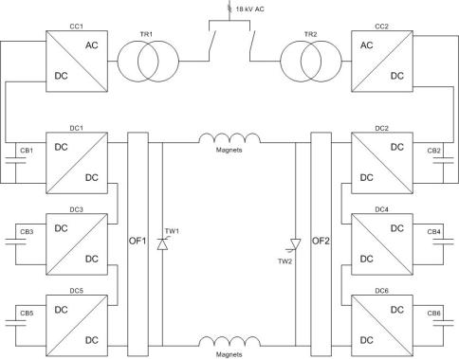
PS 60MW Power System
2009-2010: Last year(s) of operation for the PS rotating machine!
New power converter to exchange energy between capacitor banks and the PS magnets

Slide 12
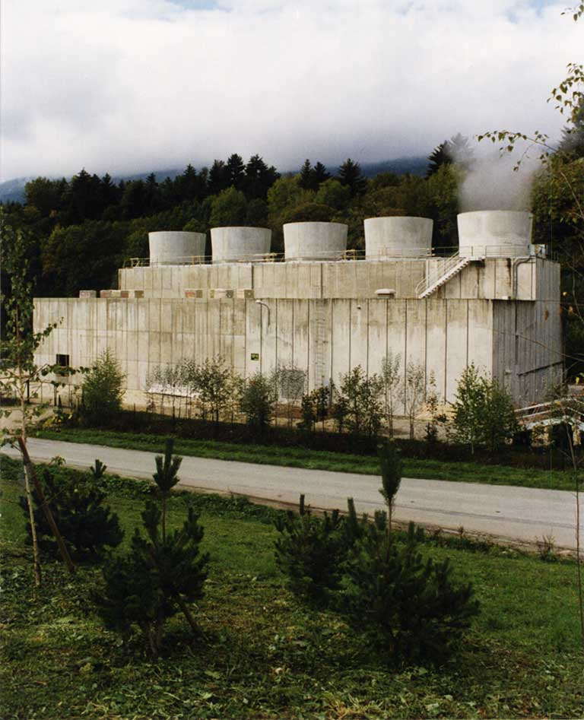
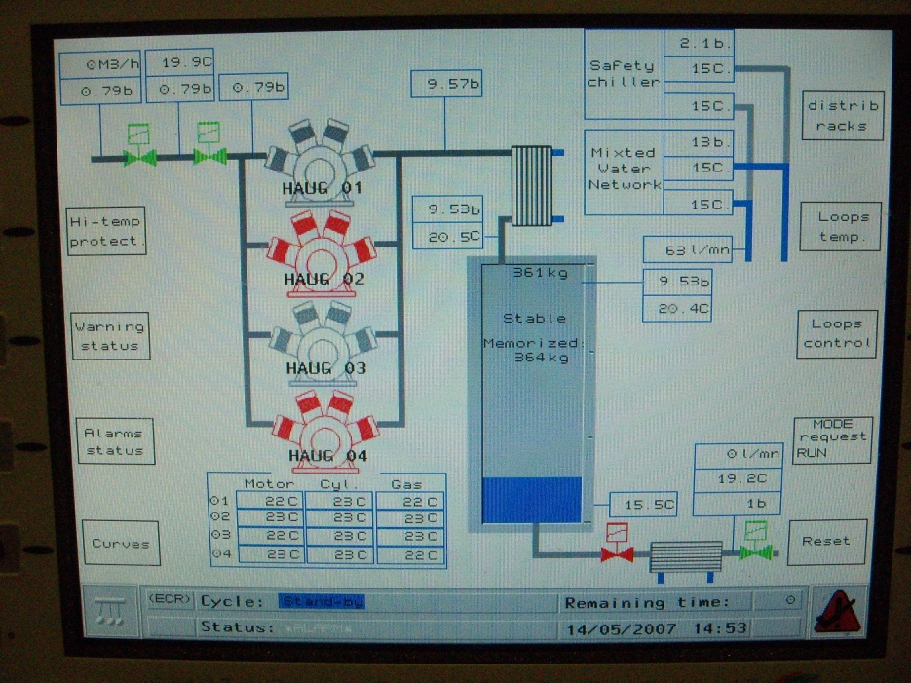
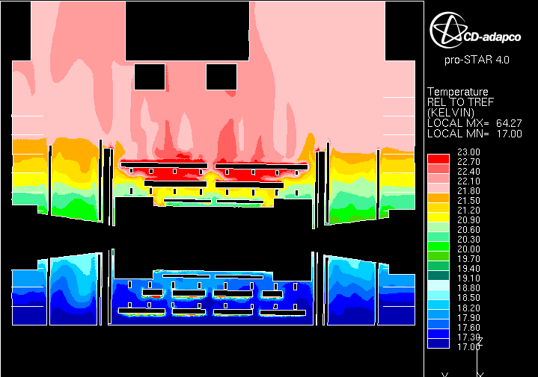
Cooling & Ventilation

Slide 13
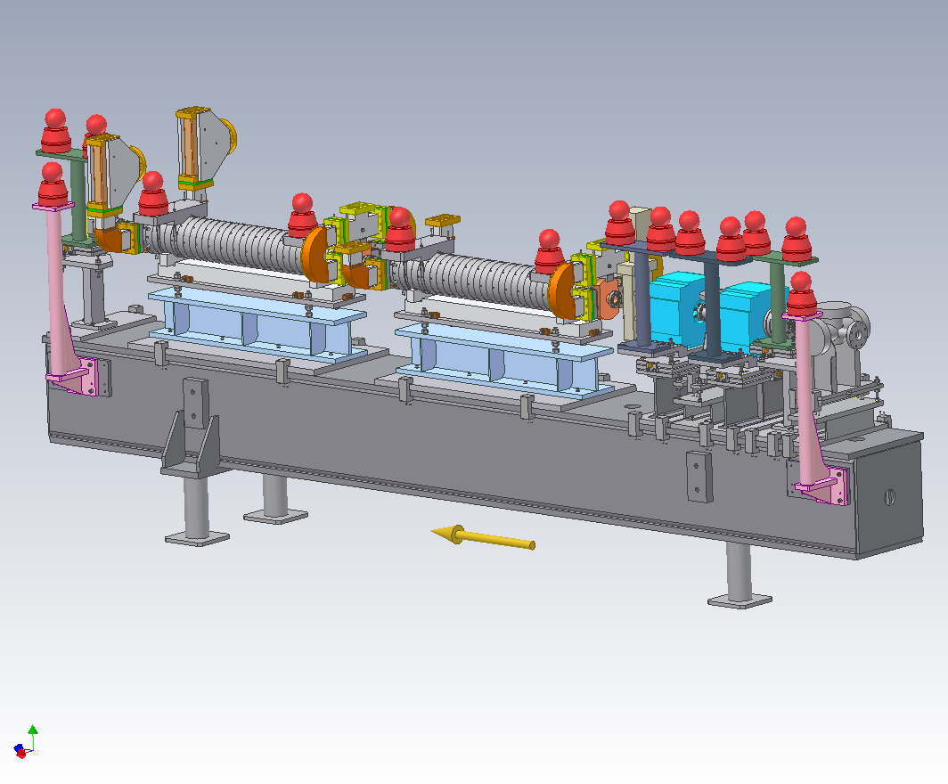
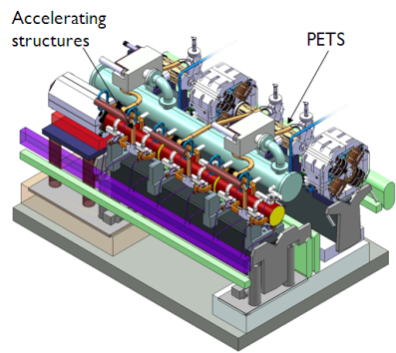
Mechanical Design & Integration
Mechanical Design from understanding the requirements up to the 3D model

Slide 14
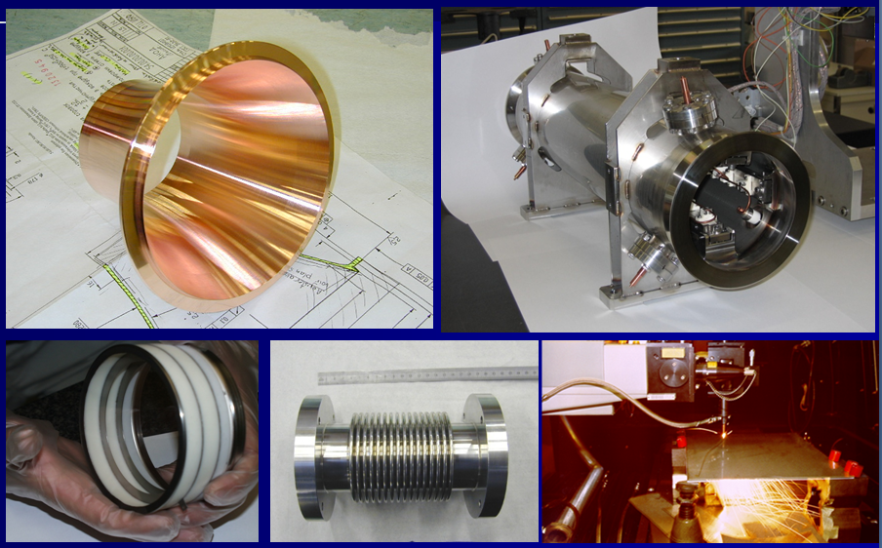
Mechanical design
Machining, forming, assembly, control,…

Slide 15
What do accelerators need?
  General infrastructure
  Magnets
    Electromagnetics
    Cryogenics
    Power
  RF
  Control and communication
  Detectors

Slide 16
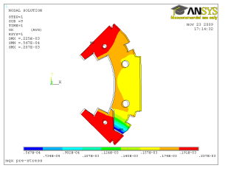
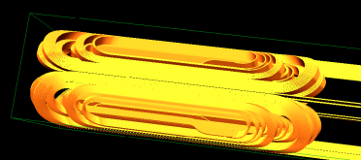
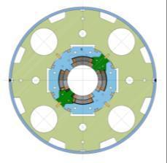
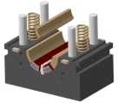
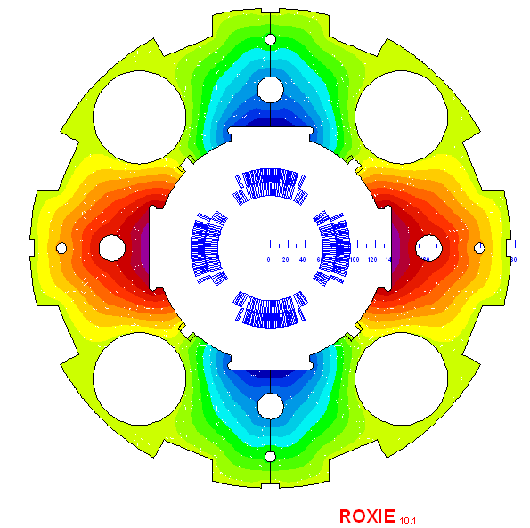
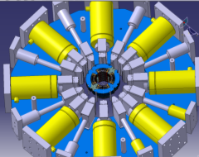
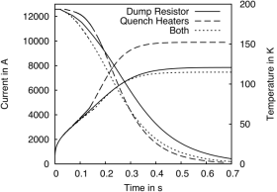
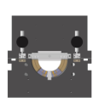
Magnet Design
Coil layout
Mechanical analysis of the low-β
quadrupole for the upgrade phase I
Coil E-Modulus Press
Cross-section
Collaring press
Quench simulation
Field plot

Slide 17
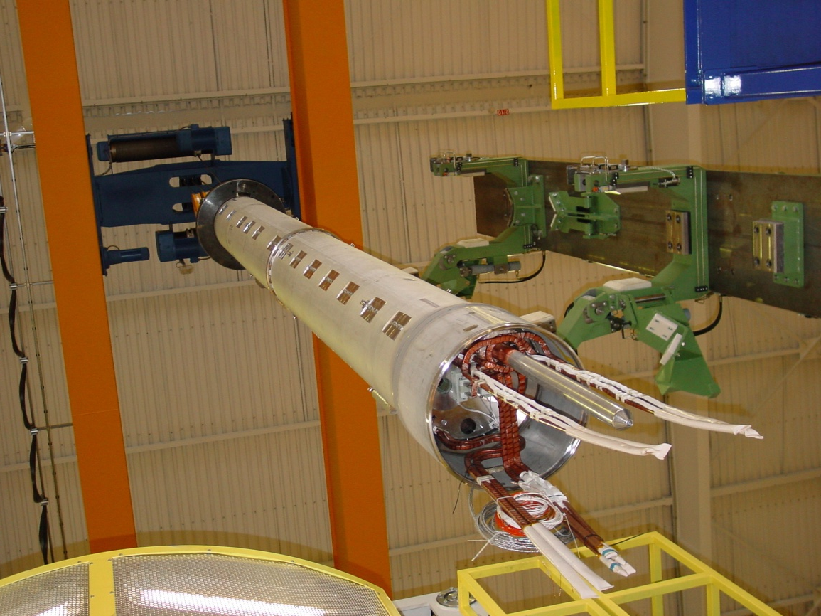
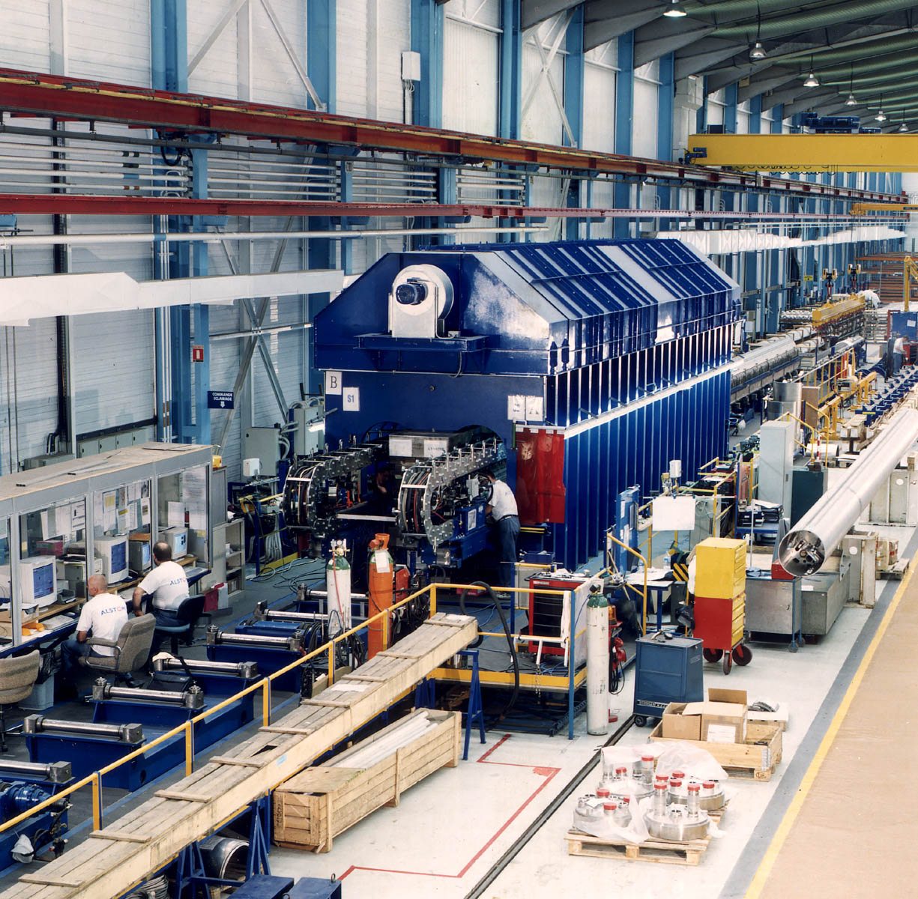
Magnet production
Cold Mass assembly in Industry
Welding operation of dipole: the welders are in front of the computer
Assembly of a quadrupole

Slide 18
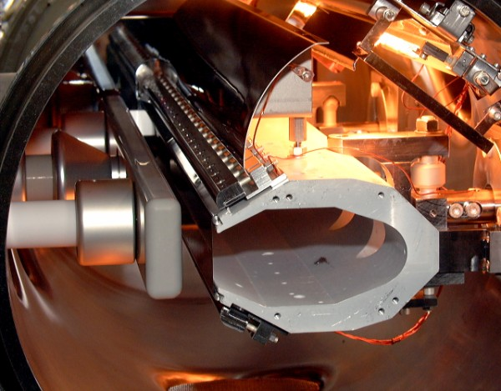
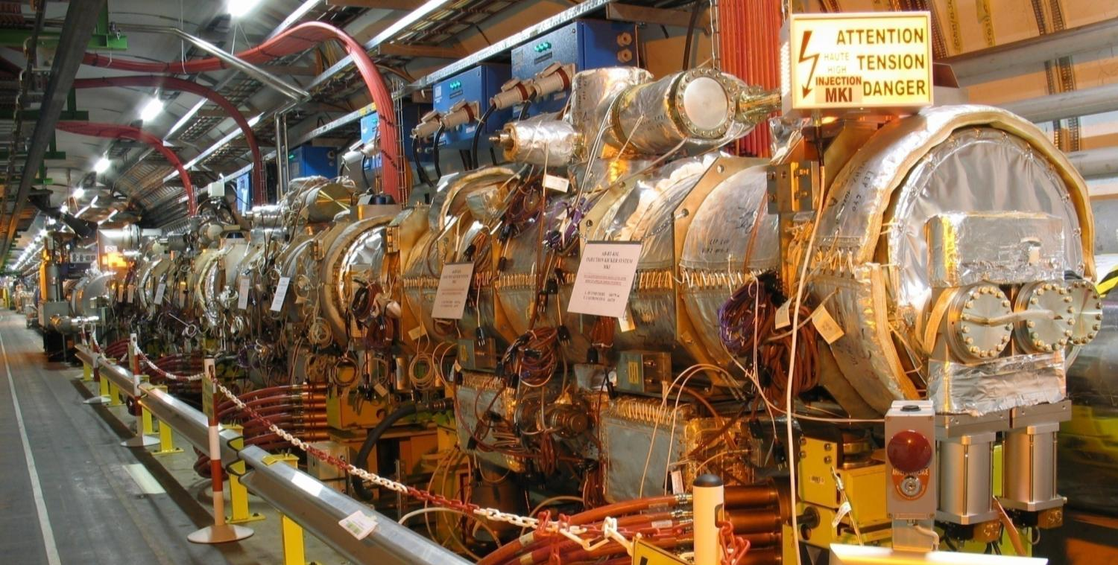
(Fast) Magnets
HV deflector
LHC injection kickers
foil tensioners
insulators
HV electrode
beam screen
thin foil (or wires)

Slide 19
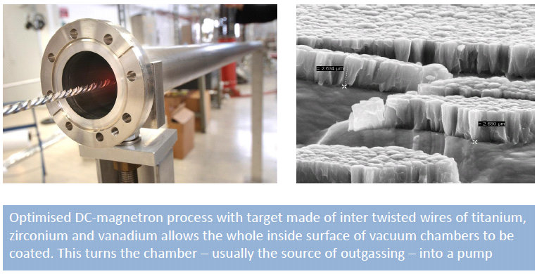
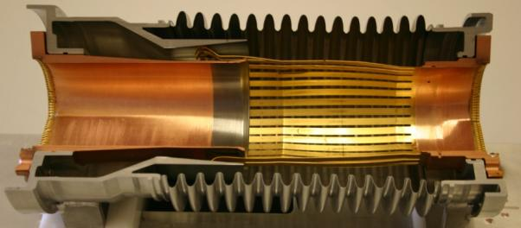
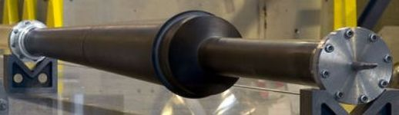
Vacuum
Experiment IP Vacuum pipe
Vacuum interconnect

Slide 20
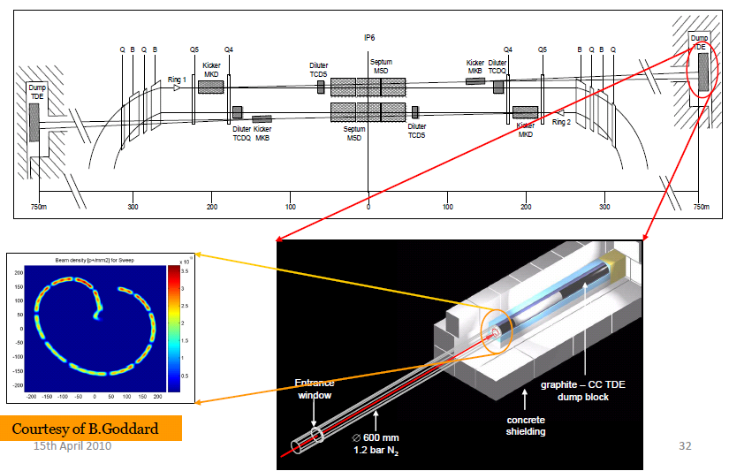
Beam Dump System

Slide 21
What do accelerators need?
  General infrastructure
  Magnets
    Electromagnetics
    Cryogenics
    Power
  RF
  Control and communication
  Detectors

Slide 22
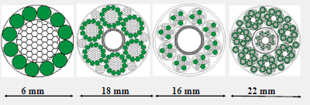
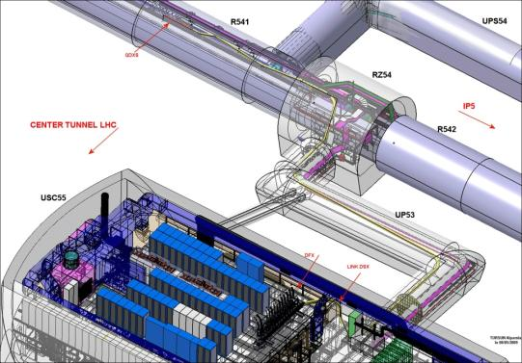
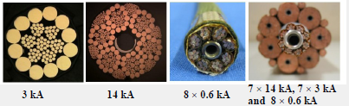
Superconducting Cable Links
SC link
Reached 15 kA w/o quench !!!
Reached 11 kA w/o quench !!!
22

Slide 23
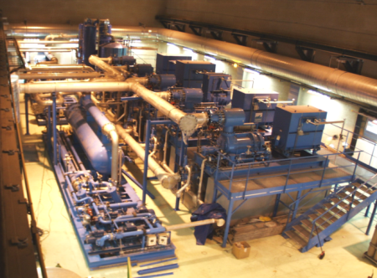
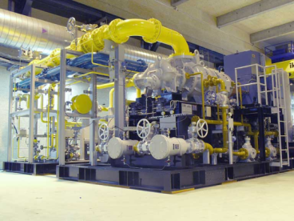
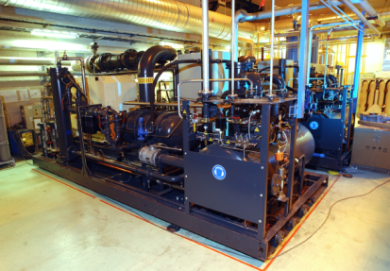
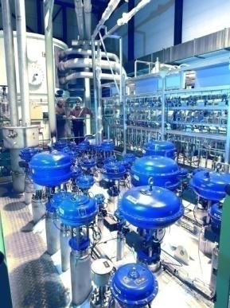
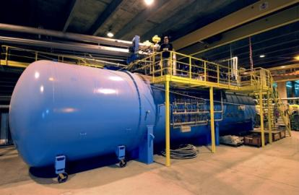
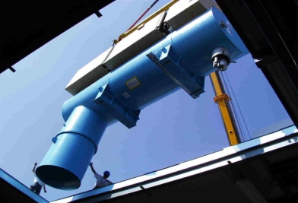
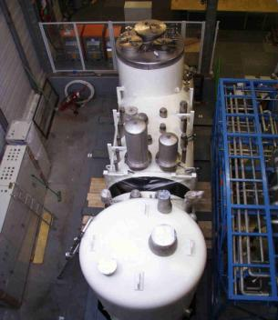
Cryogenics
4.5 K Refrigerators
(up to18 kW @ 4.5 K)
1.8 K refrigeration units
(up to 2.4 kW @ 1.8 K)

Slide 24
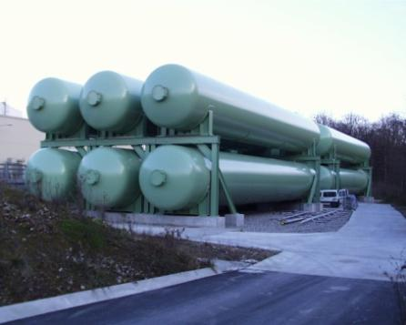
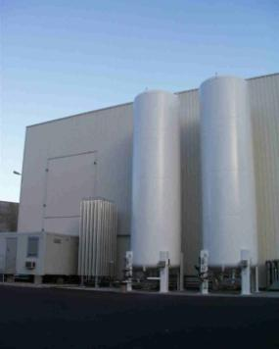




Cryogenics
Vertical transfer line
GHe storage LN2 storage
Cryo-magnet Distribution line (QRL) Interconnection box

Slide 25
What do accelerators need?
  General infrastructure
  Magnets
    Electromechanics
    Cryogenics
    Power
  RF
  Control and communication
  Detectors

Slide 26






LHC Magnet Electrical Circuits
Notes:
26

Slide 27



Magnet Current leads

Slide 28

Magnet Design
The LHC Dipole

Slide 29
What do accelerators need?
  General infrastructure
  Magnets
  RF
  Control and communication
  Detectors

Slide 30






The LHC RF Systems
Electrical power
  350 m³ , 100kV, up to 4MW DC
SC Cavity Cryomodules
16 Klystrons
400MHz, 300kW
Control electronics

Slide 31






LINAC4 RF Systems
Transfer line to PSB
160 MeV
100 MeV
50 MeV
The CCDTL
LINAC4
Pi-Mode Structure (PIMS)

Slide 32
What do accelerators need?
  General infrastructure
  Magnets
  RF
  Control and communication
    Coordination of all systems , machine safety systems…
  Detectors

Slide 33



Application Software

Slide 34

Control and Communication
Beam Interlock Controller at IP6
received dump request
- 50 μs later (anti clockwise signal)
- 180 μs later (clockwise signal)
Beam Dump 561.523 ms
Beam Interlock Controller at IP8
received dump request at 561.437 ms

Slide 35
What do accelerators need?
  General infrastructure
  Magnets
  RF
  Measurements
  Control and communication
  Detectors
    Mechanics, Electrical, Electronics, Computing,…

Slide 36


ATLAS and CMS

Slide 37


ALICE and LHCb

Slide 38



Microchips for Megastructures
Front-End ASIC
CMS experiment on the LHC accelerator at CERN
Silicon Tracker Hybrid

Slide 39






Typical ASIC designs at CERN
128ch pre-amp, analog memory chipset
4ch 40Msps 12-bit ADC
4ch data readout chip
Gigabit Optical Link
MEDIPIX1 Pixel chip
Rad-Tol FPGA
Typical ASIC designs:
  Analog circuits with complex full custom designs
  Mixed Signal with large high performance analog and small digital circuits
  Digital circuits not exceeding 100K gates.

Slide 40

Computing

Slide 41

Computing
Data acquisition
  Detector computing hardware
  Detector sensors
  Radiation tolerant
Data analysis
  GRID computing
  Networks
  Databases
  See also http://innocentonnice.web.cern.ch/innocentOnNice/ska0509talk.ppt

Slide 42
What do accelerators need?
  General infrastructure
  Magnets
  RF
  Measurements
  Control and communication
  Detectors
  Technology Transfer

Slide 43





Technology Transfer
Sulicium detector for a Compton camera for nuclear medial imaging
Radionucleide production for medical applications
Radiography of a bat using a GEM detector
Medipix : Medical radiodiagnostic with improved image contrast and reduced radiation dose

Slide 44

Enthusiasm for Engineering
Ofelia Capatina, mechanical engineering
Michelle Batistin,
Detector cooling
Sonia Infante, CERN power grid
P. Moreira, ASIC design

Slide 45
Engineering at CERN
A tour of some examples of the engineering at CERN
Engineering at CERN is a highly inter-disciplinary subject, involving a variety of modern engineering technologies
Engineering excellence is the foundation upon which high energy particle physics depends
There are many exciting opportunities for today’s physics students - the engineers and physicists of tomorrow!

Slide 46
End

Slide 47
Lab Visits
Module | Supervisor | Module Theme | Timetable
1) Electrical Engineering | Dr. Sonia Infante. Section Leader EN/EL/CO | CERN power Grid, electrical power distribution, high-voltage equipment, infrastructure supervision and monitoring | 14:00-16:30. 2h 30min
2) Mechanical and Material Engineering | Dr. Ofelia Capatina. Section Leader EN/MME/ES | Mechanical structure design, fabrication and testing | 13:45-16:30. 2h 45min
3) Detector Cooling | Dr. Michele Battistin. Section Leader CV/DC | Simulation of heat transportation, material thermal properties, liquid and gasses flow, CERN cooling systems | 14:30 – 15:301h 15:30 – 16:30 1h (2 groups)
4) Integrated circuit and FPGA design | Dr. Kostas Kloukinas, PH-ESE | The full cycle of a chip fabrication will be presented from the design, to simulation, fabrication and final testing. FPGA design as well. | 14:30 – 15:301h 15:30 – 16:30 1h (2 groups)

Slide 48


1. Electrical Engineering
The mean power reaches 130 MW in summer time with the Proton Synchrotron (PS) and SPS accelerators in operation and a peak power of around 200 MW to 210 MW, as these are pulsed machines.
With the LHC in operation, the mean power increases to 230 MW.
The expected annual electricity consumption will reach some 1000 GWh when all accelerators are in operation. The domestic electricity consumption of Wales was 5399 GWh shared among 1.3m customers.
400/18-KV 90 MVA transformers
RTE 400KV line
A SCADA GUI screenshot

Slide 49
2. Mechanical Engineering
Mechanical Design from understanding the requirements up to the 3D model:

Slide 50


3. Cooling and Ventilation
A three dimensional simulation of full UX15 performed to predict the thermal behaviour and the air flow distribution around the ATLAS Experiment under the heat loads of different detectors. The cooling is obtained thanks to a dedicated cavern ventilation system.
Set-up
Buoyancy driven flow
k-ε turbulent model/low Reynolds numbers
SIMPLE solver
Steady state simulation
  Run over 12÷20 Openlab nodes
  Development time 1,5 years
  ~12 Mcells
50

Slide 51
4. Microchip Design
128ch pre-amp, analog memory chipset
4ch 40Msps 12-bit ADC
4ch data readout chip
Gigabit Optical Link
MEDIPIX1 Pixel chip
Rad-Tol FPGA
Typical ASIC designs:
  Analog circuits with complex full custom designs
  Mixed Signal with large high performance analog and small digital circuits
  Digital circuits not exceeding 100K gates.

