Slide 1
RF design and tolerance study of the X-band BOC pulse compressor
Ping Wang, Alexej Grudiev
12.01.2022

Slide 2
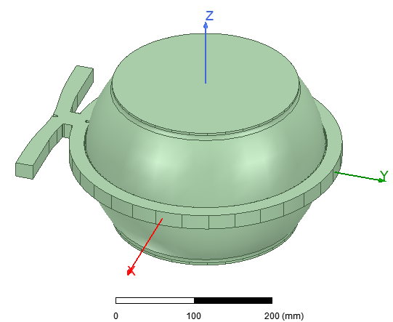
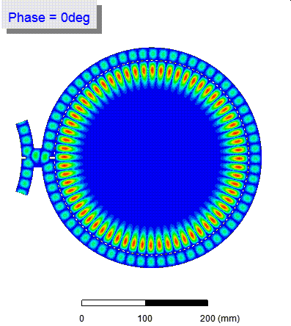
Full picture of the BOC pulse compressor
Mode: TM_{1,1,32}

Slide 3
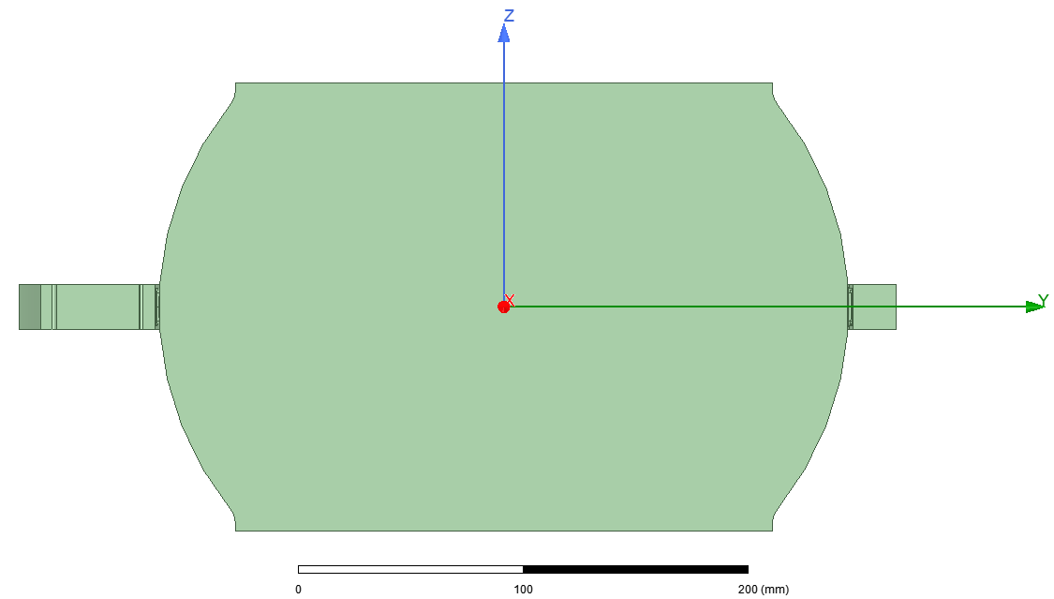
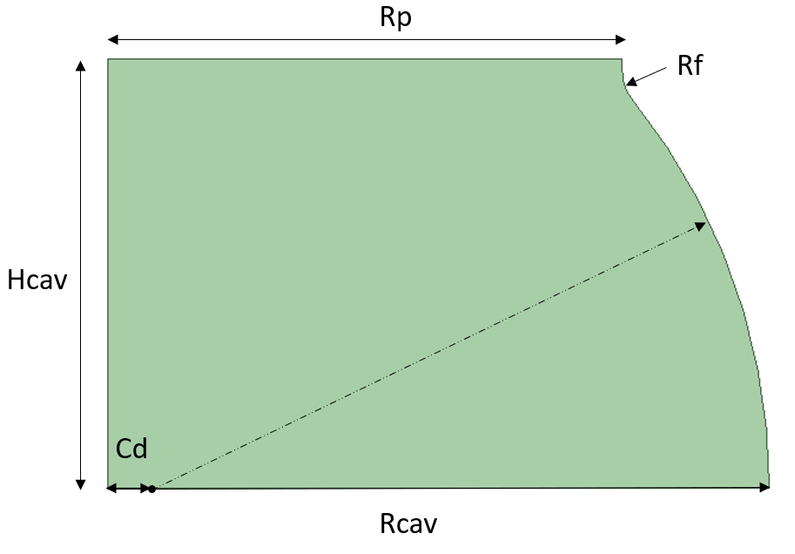
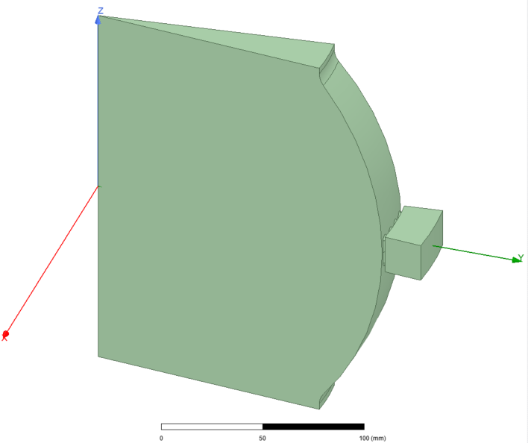
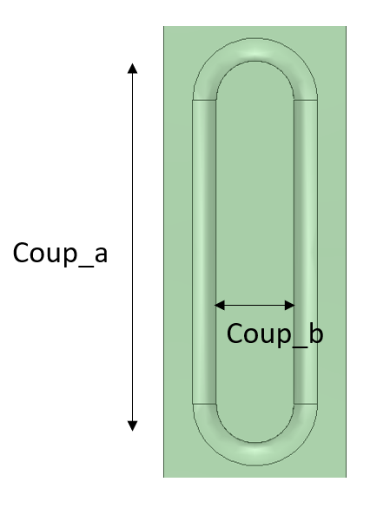
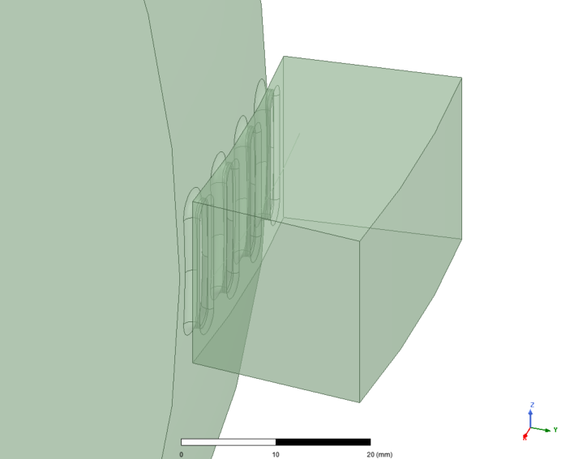
Parameters of the BOC pulse compressor
tw
2*wgb
w₀

Slide 4
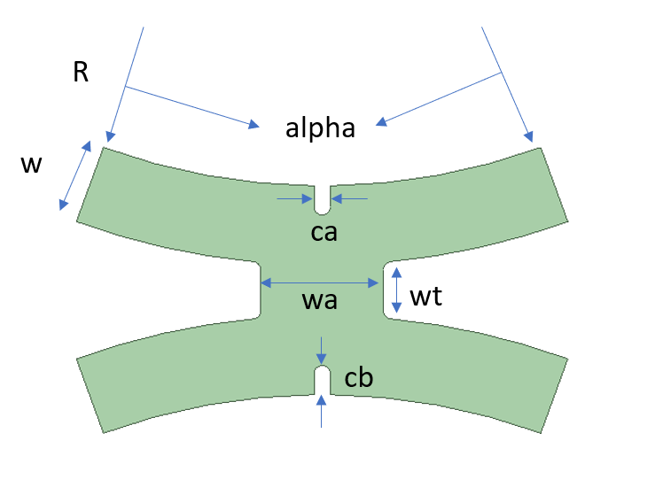
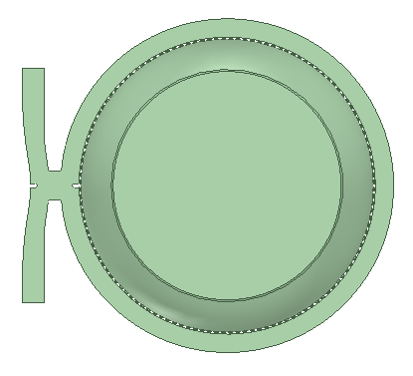
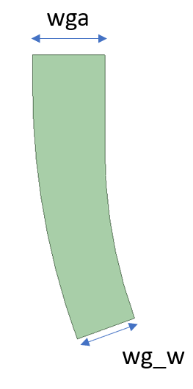
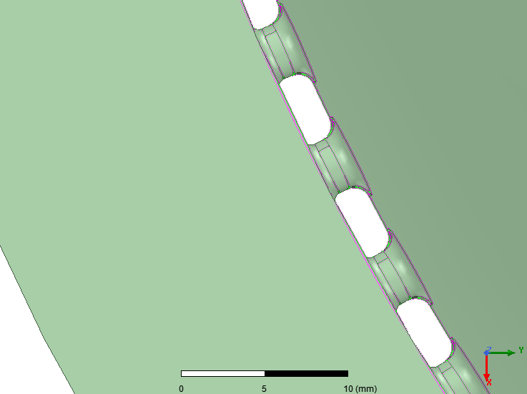
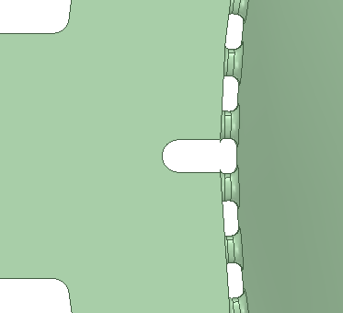
Parameters of the BOC pulse compressor
Number of coupling holes: 128
w₀
0.5 mm
coup_b
ca
1.0 mm
For the ca and coup_b, the smaller the better

Slide 5
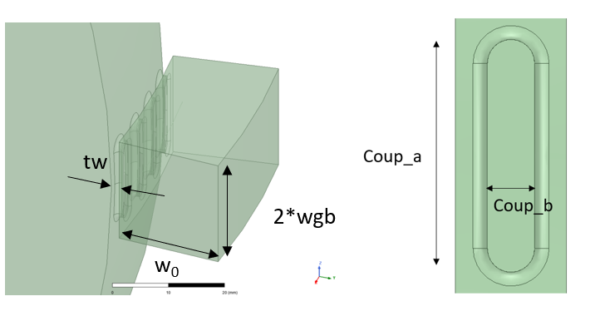
Nominal values of all the parameters
w₀
No. | Parameters | Values | Unit
1 | Rp | 120.0 | mm | Cavity
2 | Rf | 10.0 | mm | Cavity
3 | Rcav | 154.103 | mm | Cavity
4 | Cd | 10.00 | mm
5 | Hcav | 100.0 | mm
6 | Coup_a | 16.00 | mm | Coupling hole
7 | Coup_b | 3.30 | mm
8 | tw | 2.00 | mm
9 | w₀ | 19.308 | mm | Waveguide
10 | wgb | 10.16 | mm
No. | Parameters | Values | Unit
1 | r | 156.103 | mm
2 | w₀ | 19.308 | mm
3 | alpha | 20 | deg
4 | ca | 4.0 | mm
5 | cb | 7.118 | mm
6 | wa | 29.98 | mm
7 | wt | 10.027 | mm
8 | wga | 22.86 | Mm
9 | wgb | 10.16 | mm
10 | wg_hs | 20.0 | mm

Slide 6
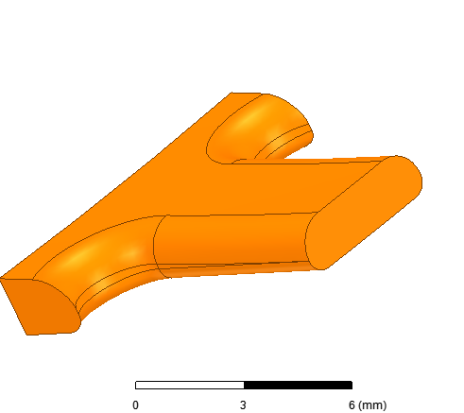
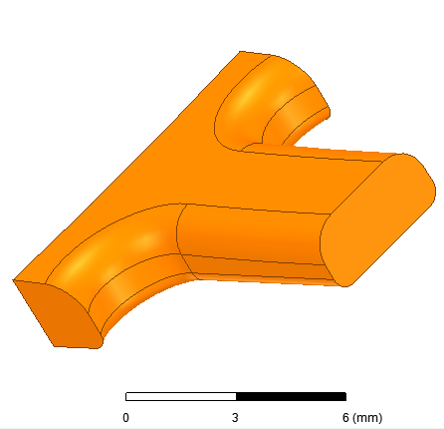
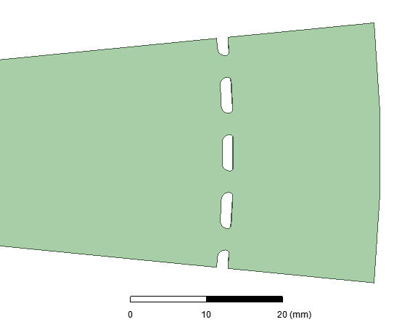
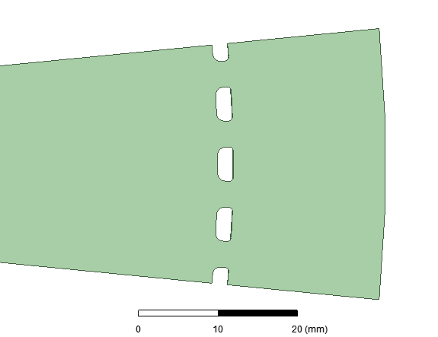
Comparison of two kinds of coupling holes
6.62mm^2
8.10mm^2
 | tw = 1.5 mm | tw = 2.0 mm
Q₀ | 237000 | 234000
Beta | 7.41 | 7.42
Coup_b | 2.84 mm | 3.3 mm
4.31 mm
4.77 mm
1.5 mm
2.0 mm
2.84 mm
3.3 mm

Slide 7
Tolerance study of the parameters
No. | Parameters | Values | Unit | Sensitivity |  |  | Recommended range
 |  |  |  | Q₀ (/mm) | Beta (/mm) | Frequency (MHz/mm)
1 | Rp | 120.00 | mm | -423 | -0.006 | 4.0e-4 | > ±0.1 mm
2 | Rf | 10.00 | mm | -223 | -0.007 | 3.2e-4 | > ±0.1 mm
3 | Rcav | 154.103 | mm | -19350 | -0.322 | -77.8 | ± 0.07 mm
4 | Cd | 10.00 | mm | 328 | -0.023 | 0.71 | > ±0.1 mm
5 | Hcav | 100.00 | mm | -164 | -0.008 | 2.2e-3 | > ±0.1 mm
6 | Coup_a | 16.00 | mm | 1673 | 0.789 | -0.55 | > ±0.1 mm
7 | Coup_b | 3.30 | mm | -7317 | 16.208 | -4.26 | ± 0.06 mm
8 | tw | 2.00 | mm | -1391 | -14.590 | 0.11 | ± 0.07 mm
9 | w0 | 19.308 | mm | 115 | -1.925 | -0.03 | > ±0.1 mm
10 | wgb | 10.16 | mm | -2359 | -0.681 | -4.0e-4 | > ±0.1 mm
Criterion | Criti |  |  | <50000 | <10 | <50

Slide 8
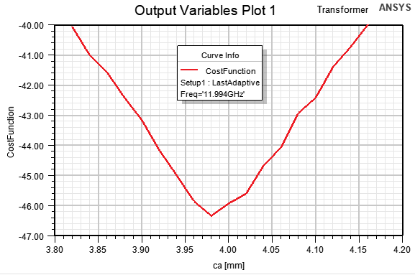
Tolerance study of the parameters
CostFunction = db10(1-mag(s12)^2) < -40 dB
R = Rcav+tw
No. | Parameters | Values | Recommended range | Unit
1 | R | 156.103 | -0.03, +0.05 | mm
2 | w₀ | 19.308 | ± 0.04 | mm
3 | alpha | 20 | > ± 2 | deg
4 | ca | 4.0 | > ± 0.1 | mm
5 | cb | 7.118 | -0.04, +0.03 | mm
6 | wa | 29.98 | ± 0.06 | mm
7 | wt | 10.027 | -0.09, +0.07 | mm
8 | wga | 22.86 | > ± 0.1 | mm
9 | wgb | 10.16 | > ± 0.1 | mm

