Slide 1
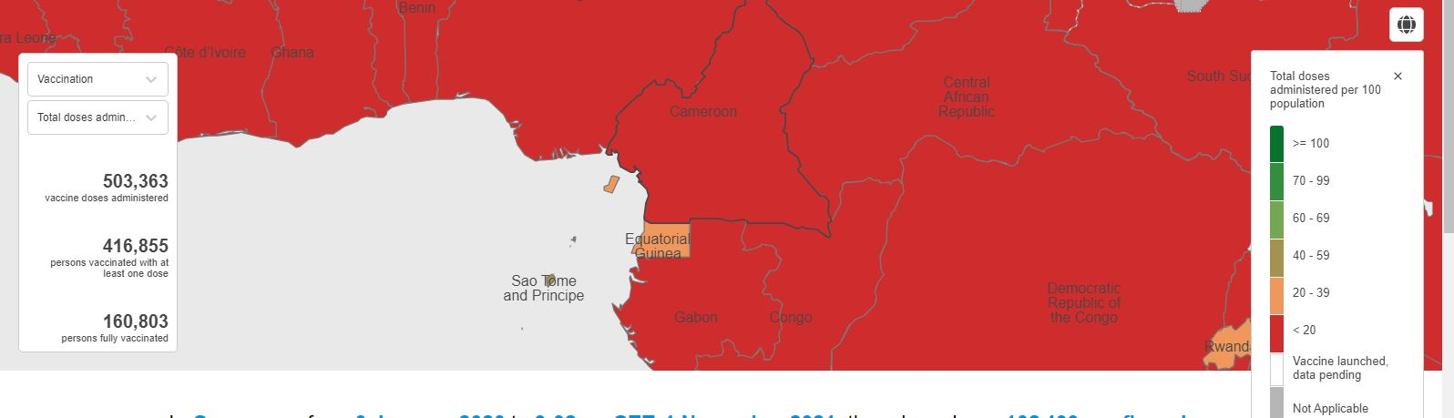
Vaccination Vs total dose administered per 100 populations
In Cameroon, from 3 January 2020 to 9:32 am CET, 1 November 2021, there have been 102499 confirmed cases of COVID-19 with 1686 deaths, reported to WHO. As of 27 October 2021, a total of 503363 vaccines doses have been administerd.
12 April 2021 first vaccination start
503, 363 total doses administered
1,9 total doses administered per 100 populations

Slide 2
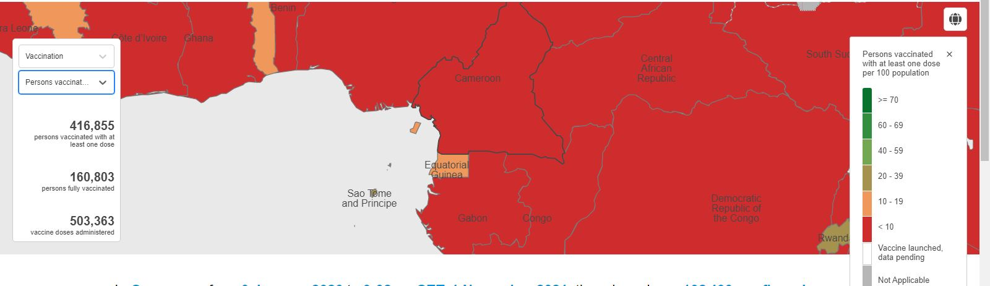
Vaccination Vs persons vaccinated with at least one dose per 100 population
416,855 persons vaccinated with at least one dose
1,57 persons vaccinated with at least one dose per 100 population

Slide 3
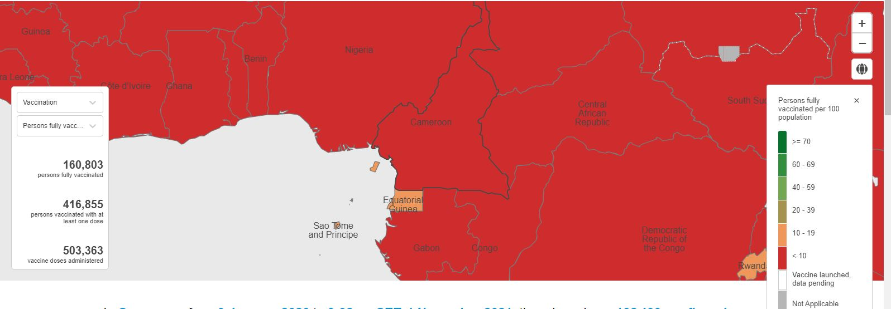
Vaccination Vs persons fully vaccinated per 100 population
160,803 persons fully vaccinated
0,61 persons fully vaccinated per 100 populations

