Slide 1



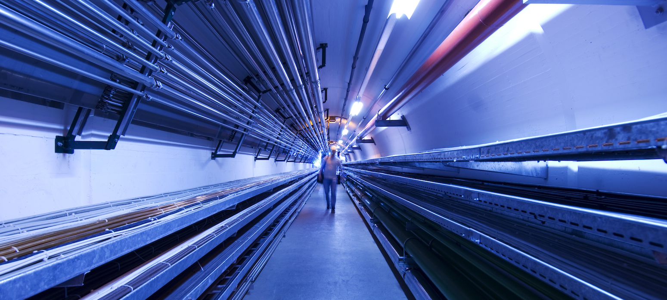
RP considerations for a neutrino-induced dose model
C. Ahdida, P. Vojtyla, M. Widorski, H. Vincke
Muon Collider Project Meeting
14 – 17/02/2022

Slide 2
Overview of work related to a dose model
MC simulations
Dose surface map
Dose assessment
Operational scenarios
Sensitivity analysis
Demonstration of compliance
Folding w realistic source term
Optimization process

Slide 3
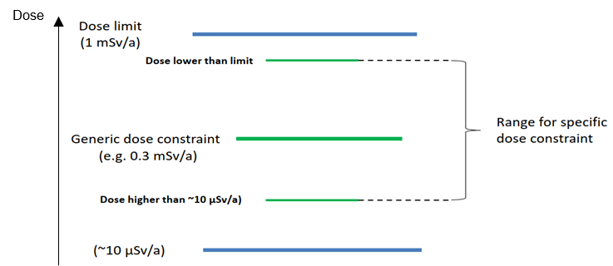
Dose assessment
Aim is to optimize the facility such as to keep the dose at O(10) µSv/year for members of the public
Identify representative person from public for a dose assessment
Take all exposure pathways to ν-induced radiation* into account
External
Directly from secondary particle shower and ν
Indirectly via activated/contaminated material (soil, air)
Internal:
Inhalation of activated/contaminated air
Ingestion of activated/contaminated water and food
ICRP recommendations and IAEA Safety standards – Relationship between dose limit, generic and specific dose constraint, and optimization level
Prompt radiation
Negligible
Residual radiation
IAEA Safety Standards, General Safety Guide, No. GSG-9
* Other sources of radiation from MUC (e.g. from target area) can be considered negligible at location where ν break the ground
100 rem = 1 Sv

Slide 4
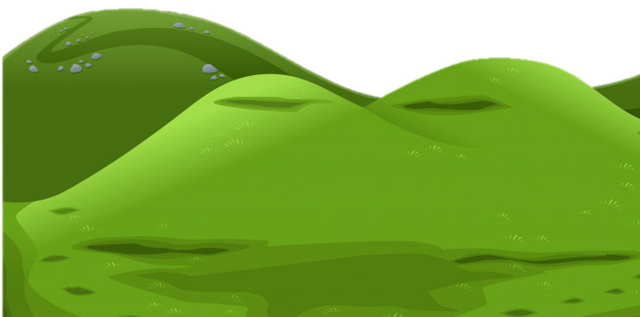

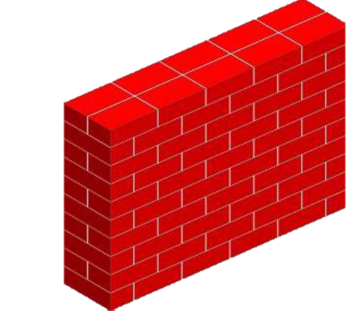

External exposure
ν
The radiation hazard arises primarily from particle showers initiated by ν interactions in material near the person
ν
100 rem = 1 Sv

Slide 5
External exposure
General worst case scenario: maximum exposure and irradiation conditions (e.g. sick person in bed 24/7 at location of max. dose)
→ Optimization to O(10) μSv/year to be aimed at for whole collider!
Depending on the dose surface map, for certain regions of higher dose (e.g. for critical straight sections), possible exclusion of such a worst case scenario even for the far future
→ Dose modifying factors for realistic population groups could possibly allow to decrease the dose estimate for certain regions
Depends on acceptance by authorities
Needs to take possible future developments into account
Uncertainty of the dose surface map
ν
ν
100 rem = 1 Sv

Slide 6
Occupancy dose modification factor
Occupancy factor (f_{OC}): fraction of time regularly spent in the area of concern while being exposed to a given radiation source
International guidelines give default values, but site studies provide more precise estimates
f_{OC} = 1 not unlikely at place of residence (e.g. ill/very old persons, persons working at home)
For workers (incl. farmers) 50 weeks with 40 h/w is typically assumed (f_{OC} = 0.23)
Site specific occupancy factors to be studied in the future, BUT depend on acceptance by authorities
Also how to control developments for the far future (even for lakes/oceans such as wind electricity plants)?
Examples of occupancy factors based on international guidelines
Exposure situation | Adults | Children/ adolescents
Residence | 1.0 | 1.0
Work (school) | 0.2 | 0.09
Irrigated field (farmer) | 0.2 | 0.06
Gardening | 0.06 | 0.06
Presence at a river bank | 0.18 | 0.12
Immersion in water | 0.03 | 0.03
Boating | 0.02 | <0.02
More information can also be found in: P. Vojtyla, EDMS 2010454 and NCRP 123

Slide 7
Exclusion areas
Exclusion areas seem attractive, but problems to be considered:
Public acceptance | Public awareness of „dangerous areas next door due to a particle accelerator at far distance“ Fencing-off impact area may attract public interest and create doubts on actual control
Acceptance by authorities | Acceptance by authorities also for exclusion areas required
Other aspects | Uncertainties connected to the surface dose map to be well-understood Impacted area may be very large High costs

Slide 8
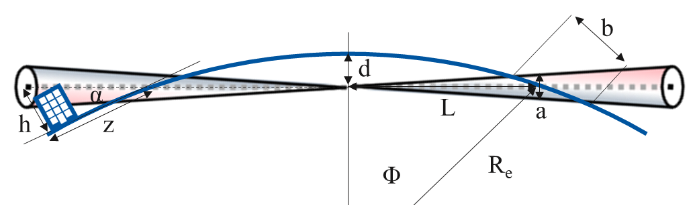
Simplified geometrical considerations
See paper from Johnson, Rolandi and Silari, Radiological Hazard Due to Neutrinos from a Muon Collider, 1998
Assumptions: Earth as perfect sphere, no beam divergence, no collider inclination
~1/γ_{μ}
L – distance, d – depth, R_{e} – Earth radius
Exit angle of ν radiation is very small, wherefore impacted area can be of several km (depending on ground profile)
Even when ν travel above-ground, persons may be exposed to it and its secondaries (e.g. in tall buildings)
Dose evolution above-ground to be understood w MC studies
Surface map to show also impacted above-ground area
E_{com} [TeV] | 3 | 10 | 10 | 14 | 14
d (m) | 100 | 200 | 300 | 400 | 500
L (km) | 36 | 51 | 62 | 71 | 80
a (m) | 2.5 | 1.1 | 1.3 | 1.1 | 1.2
b (m) | 449 | 135 | 135 | 96 | 96
α (rad) | 0.006 | 0.008 | 0.010 | 0.011 | 0.013
z (km) for h = 50 m | 9 | 6 | 5 | 4 | 4
See 2nd Muon Community Meeting
Impacted area may be very large and still several kilometers behind where the ν break the ground!

Slide 9
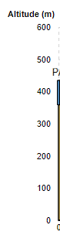
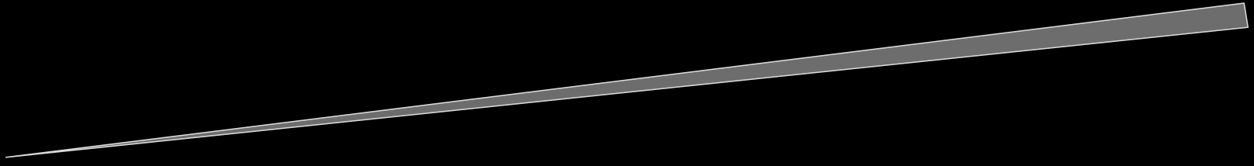
Optimization of collider placement
For illustration only
Optimization of orientation
Optimization of inclination

Slide 10

Critical sections of muon collider
IP
Previous studies (see references [1-3] and 1st Muon Community Meeting) have shown substantial dose at far distance particularly from straight sections around the Interaction Point (IP)
→ Focus at first on refined dose estimation on the Earth’s surface for the 4 radiation cones coming from the 2 IPs for E_{com} = 10 TeV
ν
ν
μ ⁺
μ⁻
IP
ν
ν
[1] King, B. J.: Proc. 1999 Particle Accelerator Conf., p. 318 (1999).
[2] Mokhov, N. V., Van Ginneken, A.: Proc. 1999 Particle Accelerator Conf., p. 3074 (1999).
[3] N.V. Mokhov and A. Van Ginneken, Neutrino radiation at muon colliders and storage rings, Proc. 9th Int. Conf. Rad. Shielding, J. Nucl. Sci. Tech. S1 172 (2000); Fermilab-Conf-00/065.

Slide 11
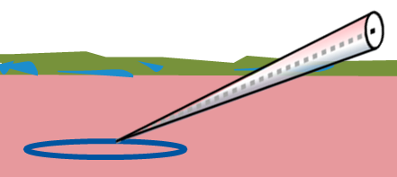
Risk of neutrino-induced activation?
The ν-induced radiation could also cause activation of soil and to a lesser extent air
In addition to the prompt radiation, persons could then be exposed to residual radiation at the location where ν break the ground
It can be assumed that the collider is deep underground inside the impermeable molasse → no contact with shallower aquifers and not suitable for exploitation of drinking water
Therefore, only activation in the more shallow moraine region would be relevant
What levels of radiation would cause a substantial soil activation?
Moraine
ν
Groundwater
Molasse
Example of siting in the Geneva area

Slide 12
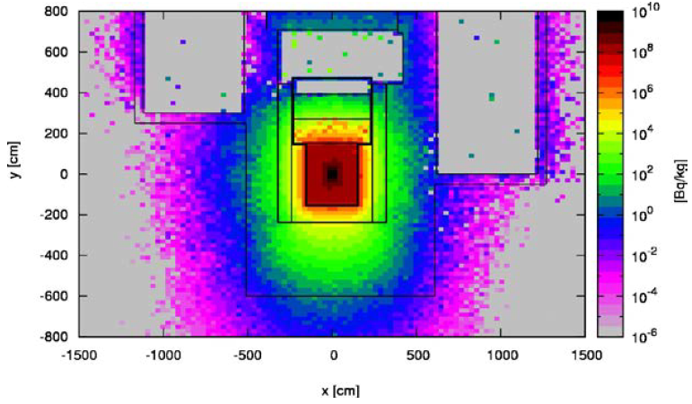
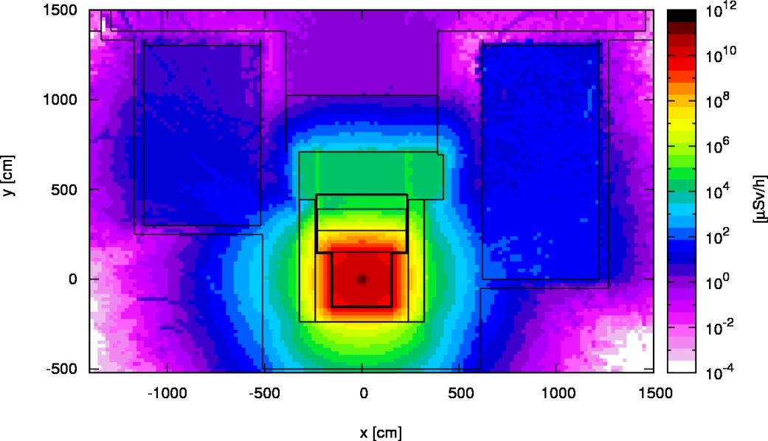
CENF Earth activation studies
Cross-sectional views of CENF target area
H-3 activity concentration
Earth activation and groundwater contamination studies were performed in the past for the proposed CERN Neutrino Facility (CENF)
Particularly soluble radionuclides likely to pass through the karstic system are critical for the protection of groundwater resources
To minimise related radiological risks, the specific activities of the leachable radionuclides H-3 and Na-22 should remain below the following design goals:
H-3 < 10 Bq/kg, Na-22 < 2 Bq/kg
When studying the relation between the prompt radiation and the soil activation for the CENF facility, it was found that the above-given limits are not exceeded with prompt dose rates of 1 mSv/h or below
Prompt ambient dose equivalent rate
Neutron- dominated

Slide 13
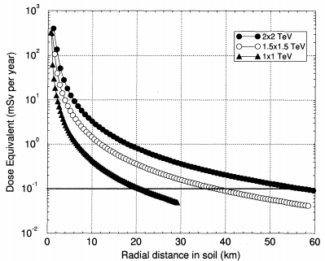
Expected activation levels for MUC
MARS - Annual dose equivalent
Reminder: optimization goal is to O(10) uSv/y, where ν break the ground
A dose rate of 1 mSv/h corresponds to an annual dose of 4e3 mSv/y when assuming 180 days of operation
Previous MARS simulations show the annual prompt dose for 2/3/4 TeV com as a function of the radial distance in soil from the collider ring center
Several orders of magnitude margin to the limit where soil activation becomes relevant
Also for 10 TeV case with different secondary particle fields, the soil activation is expected to be negligible, but to be confirmed with FLUKA simulations
Air activation where the ν break the ground is expected to be even less critical in view of the optimization goal of O(10) uSv/y above-ground
1.2E+21 μ decays / y
100 uSv/y
N.V. Mokhov and A. Van Ginneken, Neutrino radiation at muon colliders and storage rings, Proc. 9th Int. Conf. Rad. Shielding, J. Nucl. Sci. Tech. S1 172 (2000); Fermilab-Conf-00/065.

Slide 14
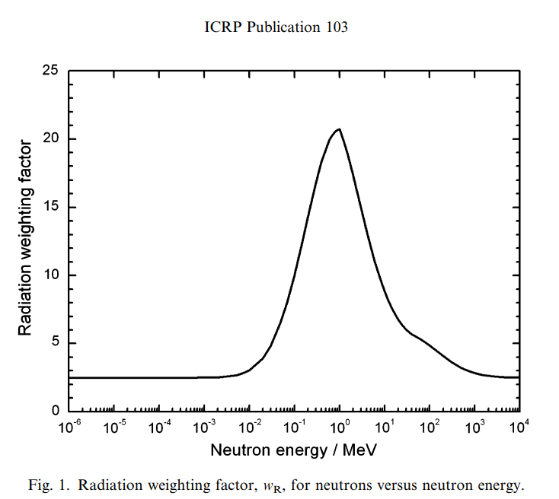
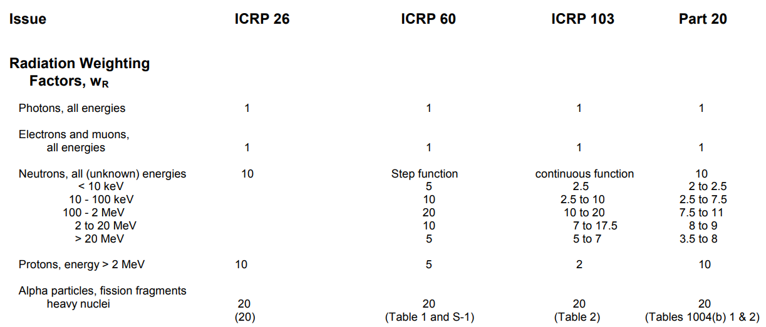




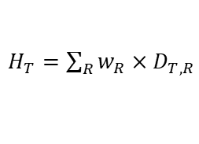

Dosimetric quantities
One must be careful when comparing results of different studies as the dosimetric quantities can differ (only few discussed here):
.
Absorbed dose
Dose equivalent
$$D=\frac{∆E}{∆m}$$
ICRP60:
$H_{T}=\sum_{R}{w_{R}{×D}_{T,R}}$
ICRP26:
$H_{T}=D_{T} ×Q×N$
$$\left[J∗{kg}^{−1}\right]=[Gy]$$
$$\left[J∗{kg}^{−1}\right]=[Sv]$$
Does not take biological aspects into account, but same dose not necessarily same risk
Absorbed dose in organ/tissue adjusted for radiation type w radiation weighting factors
*
$$Q$$
$$w_{R}$$
$$w_{R}$$
$$w_{R}$$
*ICRP 116 (2010), which is available in FLUKA, uses same factors as ICRP 103
Source: US NRC

Slide 15
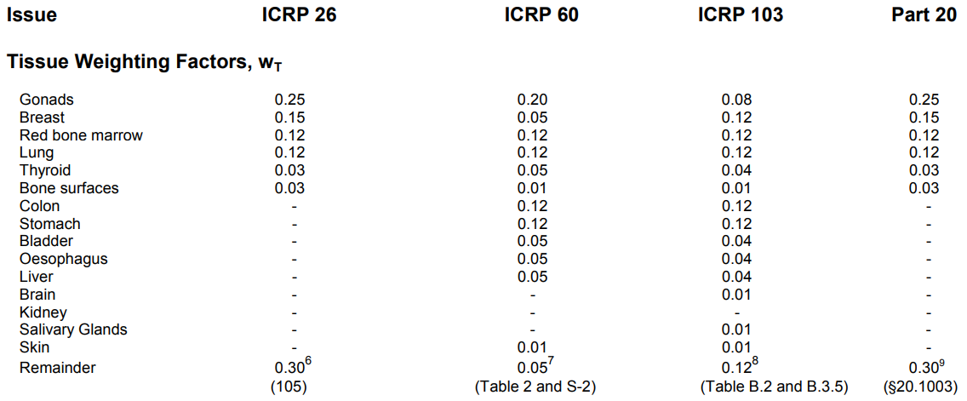
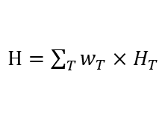


Dosimetric quantities
One must be careful when comparing results of different studies as the dosimetric quantities can differ (only few discussed here):
.
Absorbed dose
Dose equivalent
Effective dose
$$D=\frac{∆E}{∆m}$$
ICRP60:
$H_{T}=\sum_{R}{w_{R}{×D}_{T,R}}$
ICRP60:
$H=\sum_{T}{w_{T}{×H}_{T}}$
ICRP26:
ICRP26:
Protection quantities
$H_{T}=D_{T} ×Q×N$
$H_{E}=\sum_{T}{w_{T}{×H}_{T}}$
$$\left[J∗{kg}^{−1}\right]=[Gy]$$
$$\left[J∗{kg}^{−1}\right]=[Sv]$$
$$\left[J∗{kg}^{−1}\right]=[Sv]$$
Does not take biological aspects into account, but same dose not necessarily same risk
Absorbed dose in organ/tissue adjusted for radiation type w radiation weighting factors
Whole body dose is obtained by organ/tissue weighting factors
*
$$w_{T}$$
*
$$Q$$
$$w_{R}$$
$$w_{R}$$
$$w_{R}$$
*ICRP 116 (2010), which is available in FLUKA, uses same factors as ICRP 103
Source: US NRC

Slide 16
Dosimetric quantities
One must be careful when comparing results of different studies as the dosimetric quantities can differ (only few discussed here):
.
Absorbed dose
Dose equivalent
Effective dose
$$D=\frac{∆E}{∆m}$$
ICRP60:
$H_{T}=\sum_{R}{w_{R}{×D}_{T,R}}$
ICRP60:
$H=\sum_{T}{w_{T}{×H}_{T}}$
ICRP26:
ICRP26:
Protection quantities
$H_{T}=D_{T} ×Q×N$
$H_{E}=\sum_{T}{w_{T}{×H}_{T}}$
$$\left[J∗{kg}^{−1}\right]=[Gy]$$
$$\left[J∗{kg}^{−1}\right]=[Sv]$$
$$\left[J∗{kg}^{−1}\right]=[Sv]$$
Does not take biological aspects into account, but same dose not necessarily same risk
Absorbed dose in organ/tissue adjusted for radiation type w radiation weighting factors
Whole body dose is obtained by organ/tissue weighting factors
Ambient dose equivalent H*(d)
Inconsistencies between the various protection and operational quantities arise as a consequence of their respective definitions
According to ICRP the “effective dose is used for regulatory purposes worldwide” to provide means of demonstrating compliance with dose limits
Dose equivalent at a depth d in the ICRU sphere.
This is an operational quantity for area monitoring
d
Operational quantity
ICRU sphere ,∅ - 300 mm

Slide 17
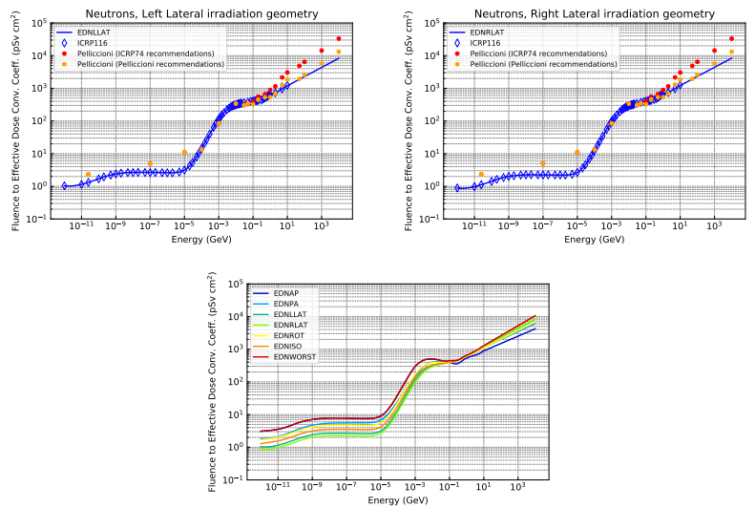
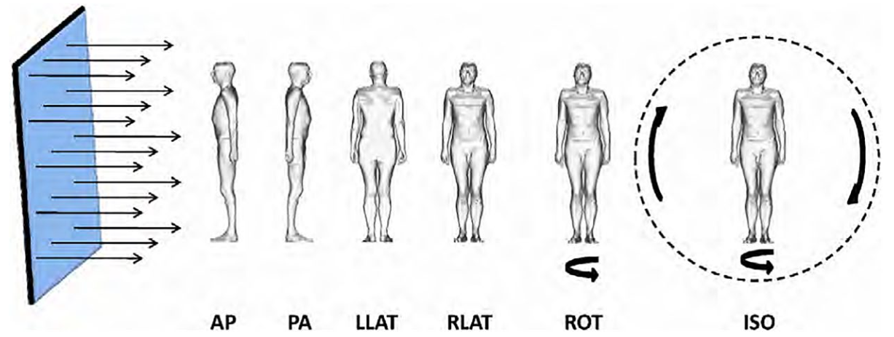
Conversion coefficients
Fluence-to-effective dose conversion coefficients for neutrons
Protection quantities, such as effective dose, are not measurable
Conversion coefficients provide numerical links between protection and physical field quantities (e.g. particle fluence)
These coefficients are defined for Reference Person (anthropomorphic phantoms)
ICRP/ICRU reference conversion coefficients are available
Conversion coefficients w extrapolated values 10 GeV - 10 TeV in FLUKA
Use of max. value of all irradiation geometries (WORST)
D. Bozzato, EDMS 243988

Slide 18
Conclusions
Optimization to O(10) μSv/year to be aimed at for whole collider!
Occupancy dose modifying factors for realistic population groups could possibly be applied for certain regions of higher dose
→ BUT depends on acceptance by authorities
→ Possible future developments and uncertainties to be taken into account
→ Impacted area may be very large and still several kilometers behind where the ν break the ground
→ Orientation and inclination of the collider can help to minimize the impacted area
Exclusion areas seem attractive, but applying this protective measure seems to be unrealistic
No risk of ν-induced activation in public areas is expected
Be aware of differences between the various protection and operational quantities as a consequence of their respective definitions
Effective dose is to be used for regulatory purposes worldwide to provide means of demonstrating compliance with dose limits

Slide 19

Thank you
for your attention!

Slide 20
Critical sections of muon collider
IP
Previous studies (see references [1-3] and 1st Muon Community Meeting) have shown substantial dose at far distance particularly from straight sections around the Interaction Point (IP)
→ Focus at first on refined dose estimation on the Earth’s surface for the 4 radiation cones coming from the 2 IPs for E_{com} = 10 TeV
ν
μ ⁺
μ⁻
→ Evaluate if there are significant contribution from other straight sections
[1] King, B. J.: Proc. 1999 Particle Accelerator Conf., p. 318 (1999).
[2] Mokhov, N. V., Van Ginneken, A.: Proc. 1999 Particle Accelerator Conf., p. 3074 (1999).
[3] N.V. Mokhov and A. Van Ginneken, Neutrino radiation at muon colliders and storage rings, Proc. 9th Int. Conf. Rad. Shielding, J. Nucl. Sci. Tech. S1 172 (2000); Fermilab-Conf-00/065.

Slide 21
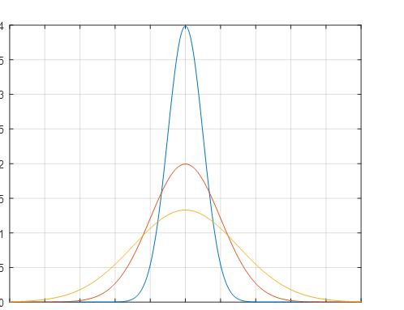
Additional dose spread
Assumptions: Earth as perfect sphere, no beam divergence, no collider inclination
~1/γ_{μ}
L – distance, d – depth, R_{e} – Earth radius
Next to widening of dose distribution due the μ decay, add. spread due to:
Secondary particle shower → evaluated by MC simulations
Beam divergence → evaluated from collider lattice (dominant)
Even when ν travel above-ground, persons may be exposed to it and its secondaries (e.g. in tall buildings)
Feature for determining when ν are higher than a given height above the ground will be taken into account in the surface map
Also dose evolution above-ground to be better understood with MC studies
Impacted area may be very large and still several kilometers behind where the ν break the ground!
Generic dose profile - for illustration only
→ decrease peak dose
w. spread due to secondaries
w. spread due to secondaries + beam divergence

Slide 22
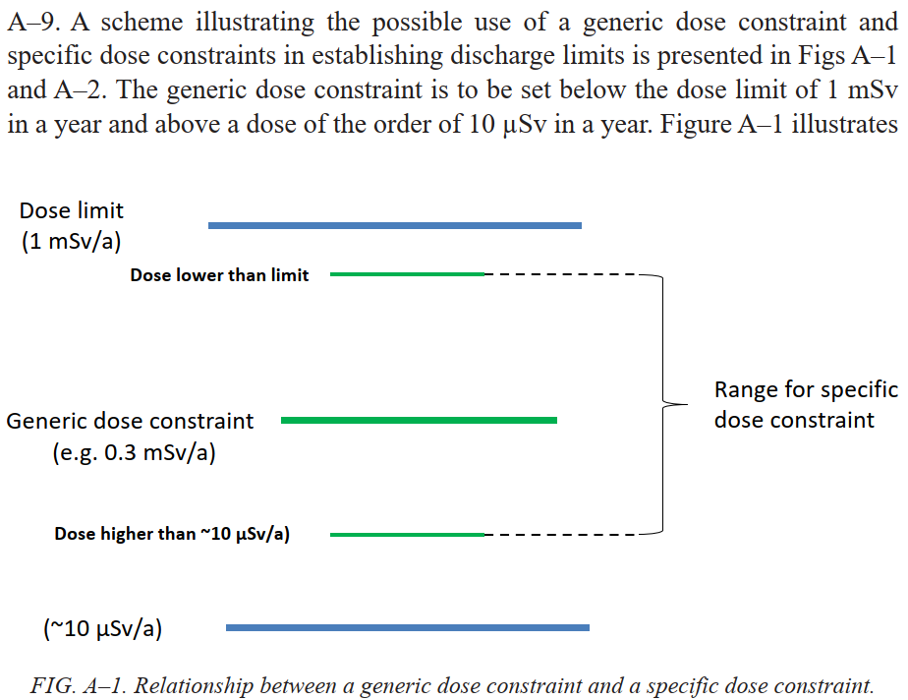
Optimization for public exposure
Figure from GSG9 Regulatory Control of Radioactive Discharges to the Environment
IAEA GSG-8
Exemption from regulatory control if doses remain at O(10 µSv/year) and < 1 mSv/year for low probability events (10⁻² per year)
→ Common practice for nuclear installations to stay below 10 µSv/year (in France even 1 µSv/year)
CERN Safety Code F
Optimisation can be considered as respected if the practice never gives rise to an annual dose above 10 µSv for members of the public
Dose
1 uSv/y effective dose not measurable anymore
→ To be aimed at keeping doses at O(10) µSv/year!
https://edms.cern.ch/ui/file/335729/LAST_RELEASED/F_E.PDF
100 rem = 1Sv

