Slide 2
Some thoughts on potential polarimeter locations
J. Wenninger, M. Hofer
13/01/2022

Slide 3
Constraints on polarimeter location (1)
Laser insertion. Monitoring and extraction:
  Free space to inject and extract the laser beam into the vacuum chamber.
  Accessible Laser Interaction Region (LIR), i.e. not inside a magnet.
    For example to install monitoring screens for alignment and optics characterization.
  Distance injection/extraction points – LIR depends on the crossing angle beam-laser (aim for α ~1-3 mrad), the vacuum chamber size and the mirror layouts: assume distance ~15-30 m from laser injection to LIR.
drift space (no magnets)
~ 15-30 m
y
LIR
α
z
alignment screen

Slide 4
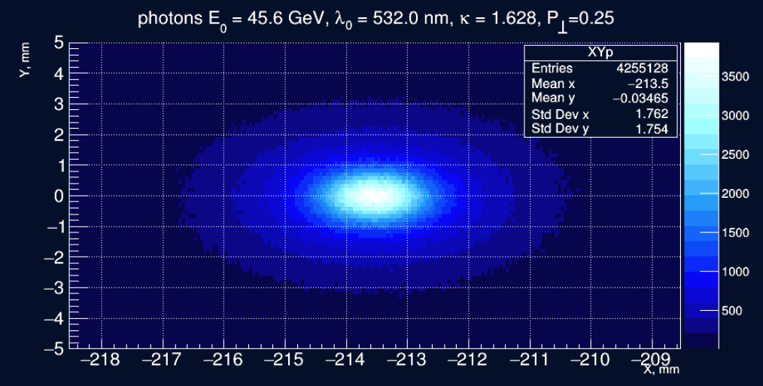
Constraints on polarimeter location (2)
Compton photon detection: transverse polarization measurement
  Space for the Compton photons to propagate from the LIR with a dipole to bend away the main e+/e- beams: distance > 50m (to be confirmed by simulations).
    Signal (in mm) improves with distance, optimum depends on shower width and beam characteristics @ LIR.
  Modest detector dimensions (strip/pixel detector), transverse size ~100 mm.
10 mm
10 mm
N. Muchnoi, previous meeting, distance LIR – detector ~ 100m (no shower simulation?).
> 50 m
Compton γ
~ 100 mm
LIR

Slide 5
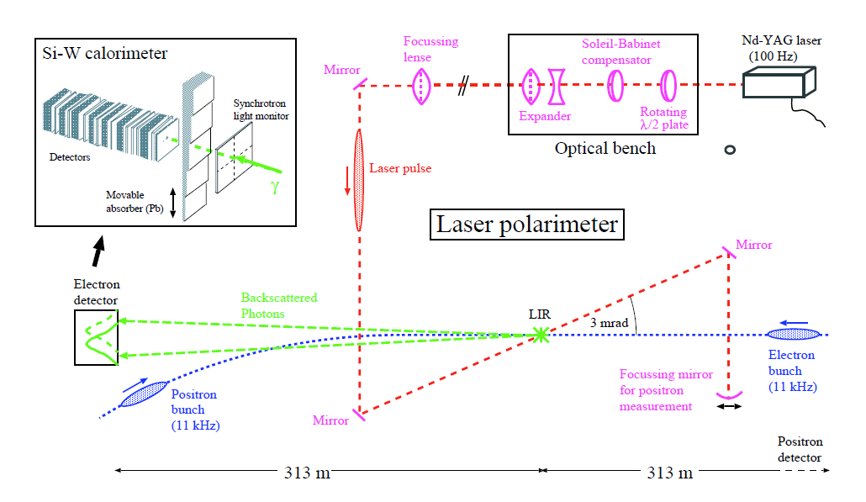
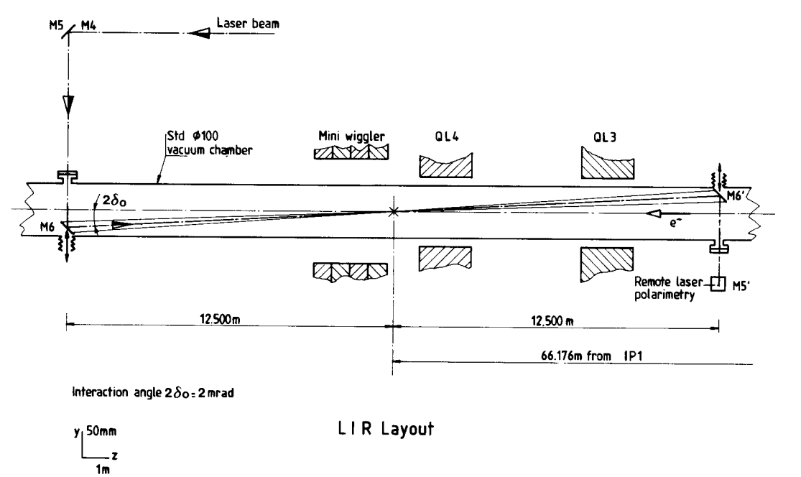
LEP Compton polarimeter (1)
LEP had only a Compton photon polarimeter.
  Laser-beam crossing angle 2δ = 3 mrad, in the middle of the long straight section.
  Compton photon detector ~300 m downstream at the beginning of the arc.
Initial drawings

Slide 6
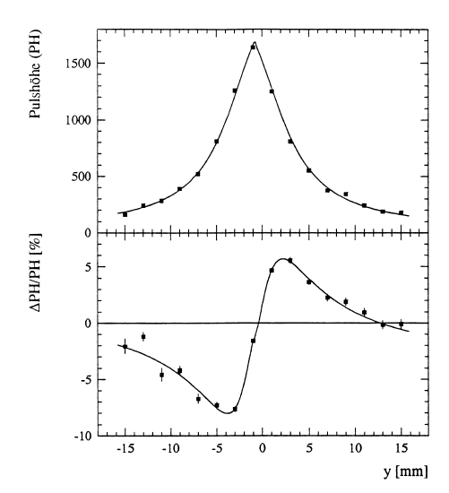
LEP Compton polarimeter (2)
At 45 GeV the vertical LEP photon profile (~ shower max) had a width of ~ 1 cm.
  SI-strip detector with 16 strips, 2 mm strip width.
Vertical profile @ detector, 45 GeV
~1 cm
Vertical profile asymmetry for the 2 laser helicities @ P_{T} = 57%

Slide 7
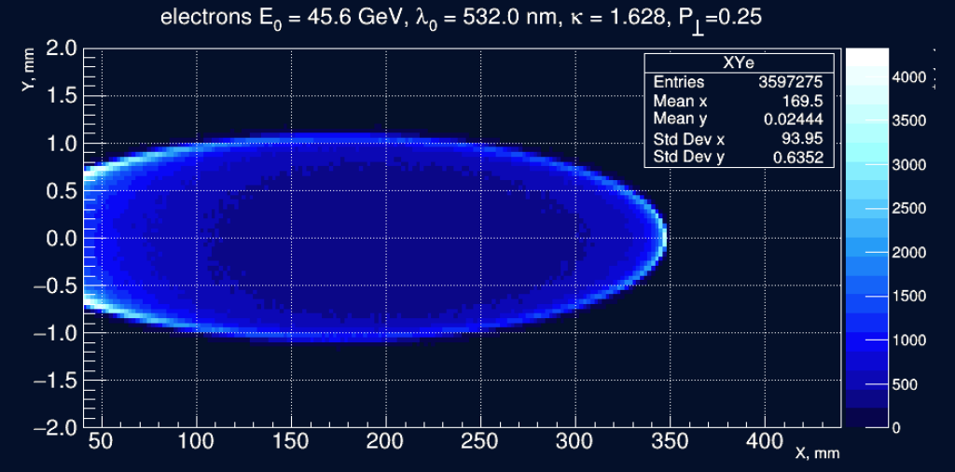
Constraints on polarimeter location (3)
Compton e+/e- beam detection:
  Dipole magnet with ~2 mrad bending a short distance downstream of the LIR.
    Dipole needs a high precision field map.
  Field free space of ~100 m for the Compton e+/e- to propagate from the LIR.
  Transverse detector dimension ~500 mm in horizontal plane.
4 mm
300 mm
N. Muchnoi, previous meeting, distance LIR – detector ~ 100m.
~100 m
LIR
~ 2 mrad
~500 mm

Slide 8
Laser-beam interaction region (LIR)
Interaction of a long laser bunch and a short e+- bunch with a crossing angle α.
Interaction region dimensions can be obtained from the expressions for the interaction of two bunches with unequal dimensions (σ_{xi,yi,zi} , i=1,2).
  Effective sizes Σ_{u} (u=x,y,z)
Piwinski angle Φ_{p} :
Dimension of the luminous region σ_{L}(rms):
α
e bunch
Laser

Slide 9
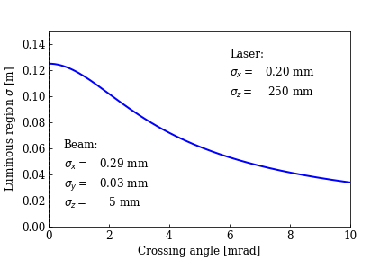
LIR longitudinal dimension (Z)
Assumption for laser pulse length: ~3ns full length ~ 4σ_{z} ≈ 1m.
  Shorter is clearly better and leads to shorter longitudinal dimensions (and higher rates).
  For colliding bunches with σ_{z} ~10-15 mm the laser pulse length dominates, ≈ no change.
Beam parameters correspond to non-colliding bunch at the Z.
For crossing angle α = 1-3 mrad, the luminous region rms length ~8-12 cm.
Taking into account BPMs, vacuum flanges etc a 2m long free space between two magnets should be adequate.

Slide 10
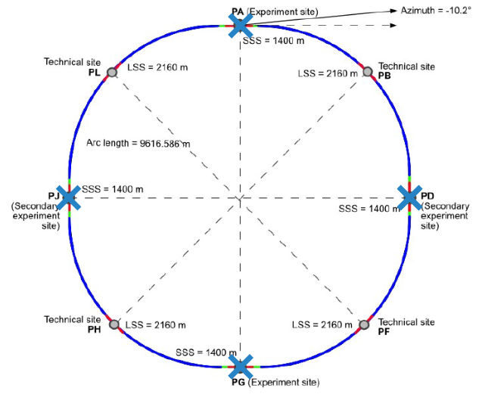
Polarimeter location – non-IP straights (1)
The main constraint on the polarimeter location arises from the Compton e+/- detection, recoil photon detection is much less constraining.
In the RF / non-IP straights there is currently lack of adequate space for a Compton e detector:
  Incoming beams on the outside, the crossing from outside to pushes scattered e towards the counter-rotating beam.
PL, PH, PF, PB
30 cm
Compton e+/e- fans

Slide 11
Polarimeter location – non-IP straights (2)
The situation could be improved if the distance between the vacuum chambers could be increased to ~80-100 cm in one of the straights (from 30 cm).
  The e detector could fit between the vacuum chambers.
  Photon detector ok, on the side opposite of other beam.
Adequate layout (free drift space for Compton e) and optics to be confirmed.
  Avoid L & H (RF) → in B or F?
PF, PB
~80-100 cm

Slide 12
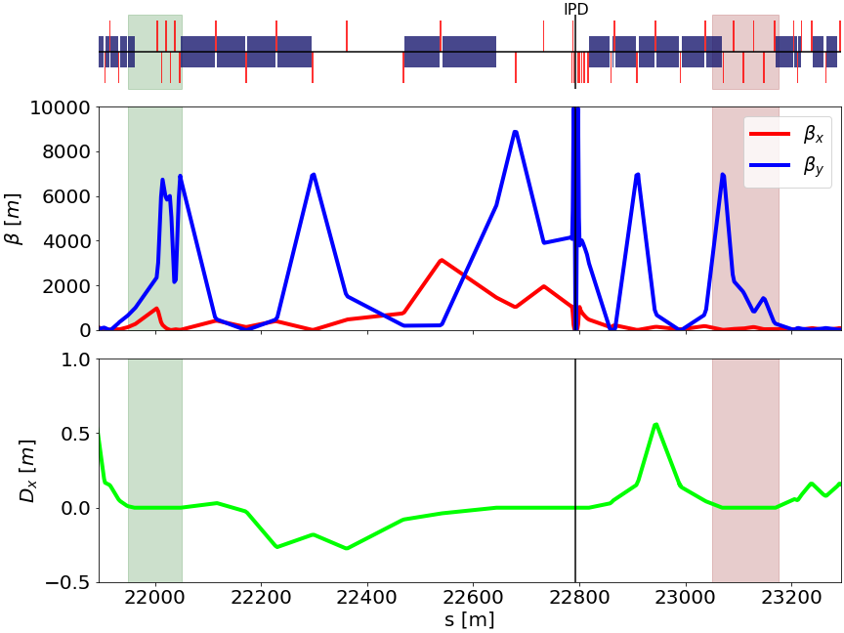
Polarimeter location – IP straight sections (1)
Incoming beam line
Outgoing beam line
In the experimental straight sections, two potential locations on the incoming and outgoing beam lines were identified by M. Hofer (Meeting #1, Oct 2021)

Slide 13
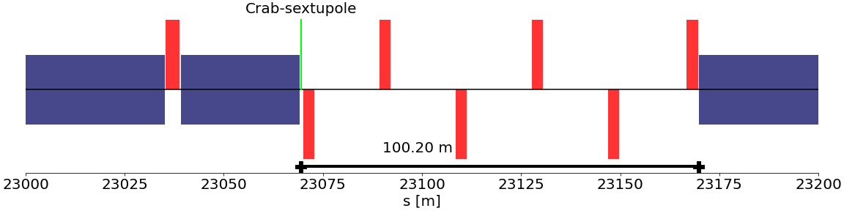
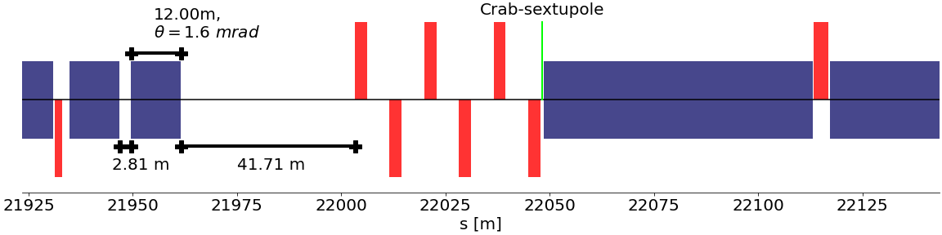
Polarimeter location - IP straight sections (2)
Insufficient field free space – would need to rearrange layout (crab sext location!).
Outgoing beam line
1.6 mrad bend,
~ 3m space for LIR,
~40m free space (e-det).
Incoming beam line
Not “too far off” from the 2 mrad & 100 m proposed by N. Muchnoi

Slide 14
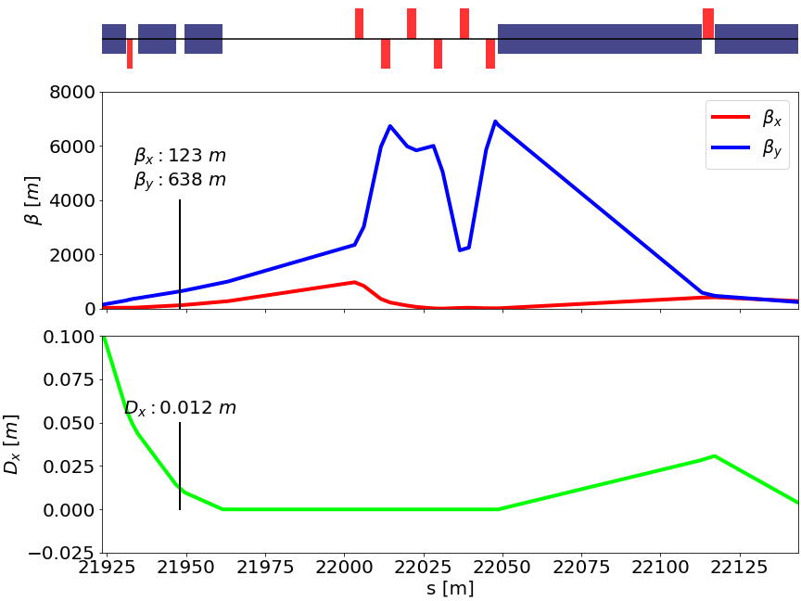
Polarimeter location – incoming beam line
Dispersion close to zero.
Betatron functions are reasonable, horizontal beam size ~0.2 mm, probably well matched to laser.

Slide 15
Summary
Despite its size there are not so many options to place an e + γ Compton polarimeter in FCCee.
A possible location could be on the incoming beamline in the IP long straight section.
  Free space currently only ~40 m vs 100 m proposed by N. Muchnoi.
  Coupling with the already complex layout and optics.
The non-IP straight sections do not fit well with the current configuration, but increasing the beam separation by removing bends(ing) around the dispersion suppressors could generate new options for the polarimeter locations. Option to be investigated.

