Slide 1
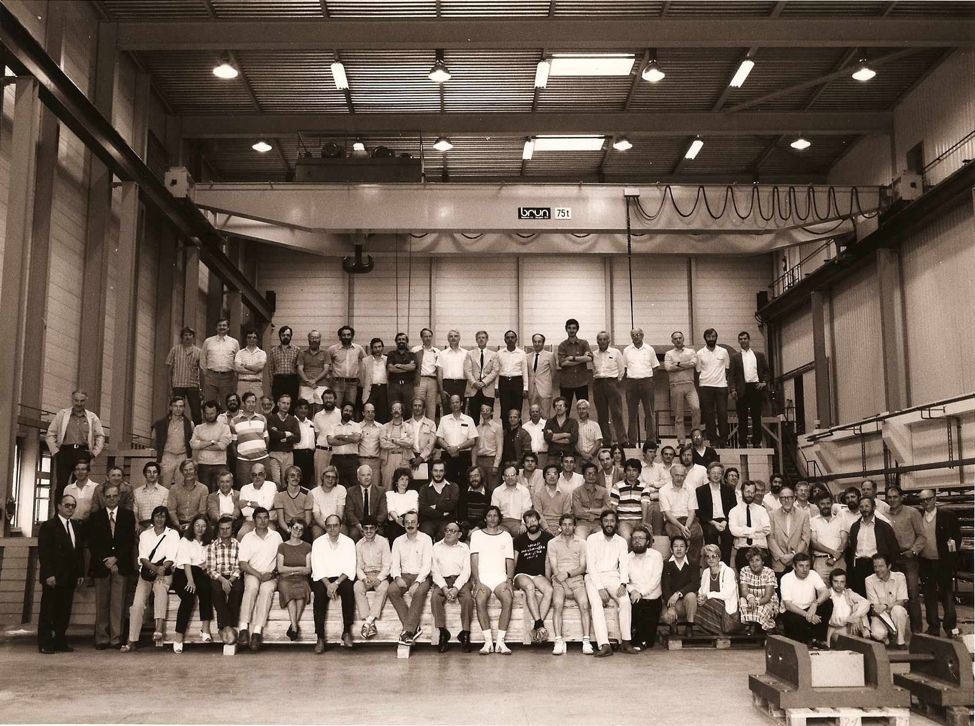
Welcome to the OPAL Party !!!

Slide 2
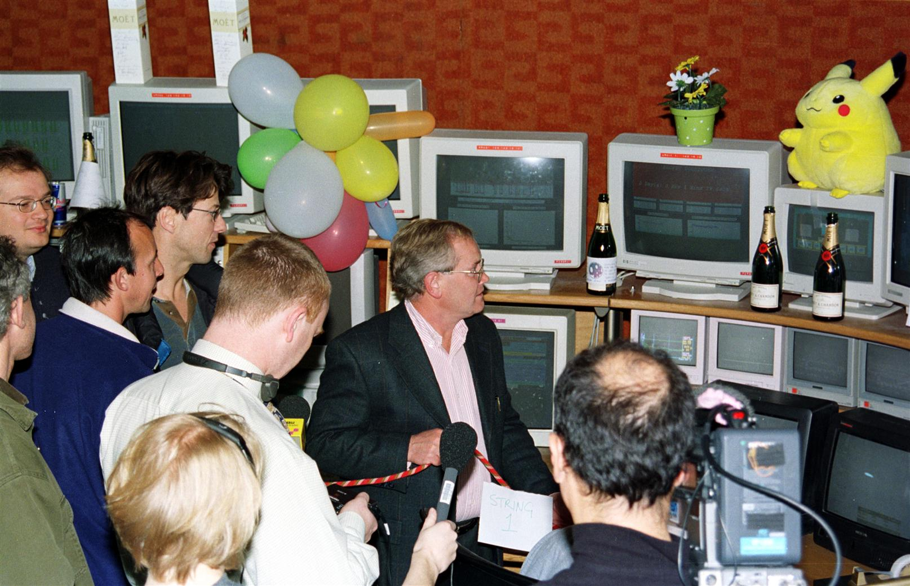

Slide 3
Agenda
  Welcome – David
  Jet Chamber, and 1st days of Running – Michael
  Pb-glass Calorimeters - Tomio
  DAQ - Frans
  Energy Calibration – Pippa
  Coffee/tea
  Early Days - Albrecht
  Hadron Calorimeter : outside Plenaries - Giorgio
  Zedometry - Tatsuo
  Higgs Race - PIK
  OPAL Physics Highlights - Richard (Hawkings)

Slide 4
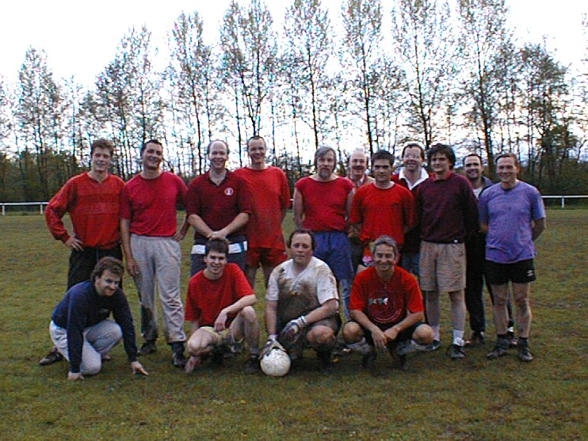

Slide 5
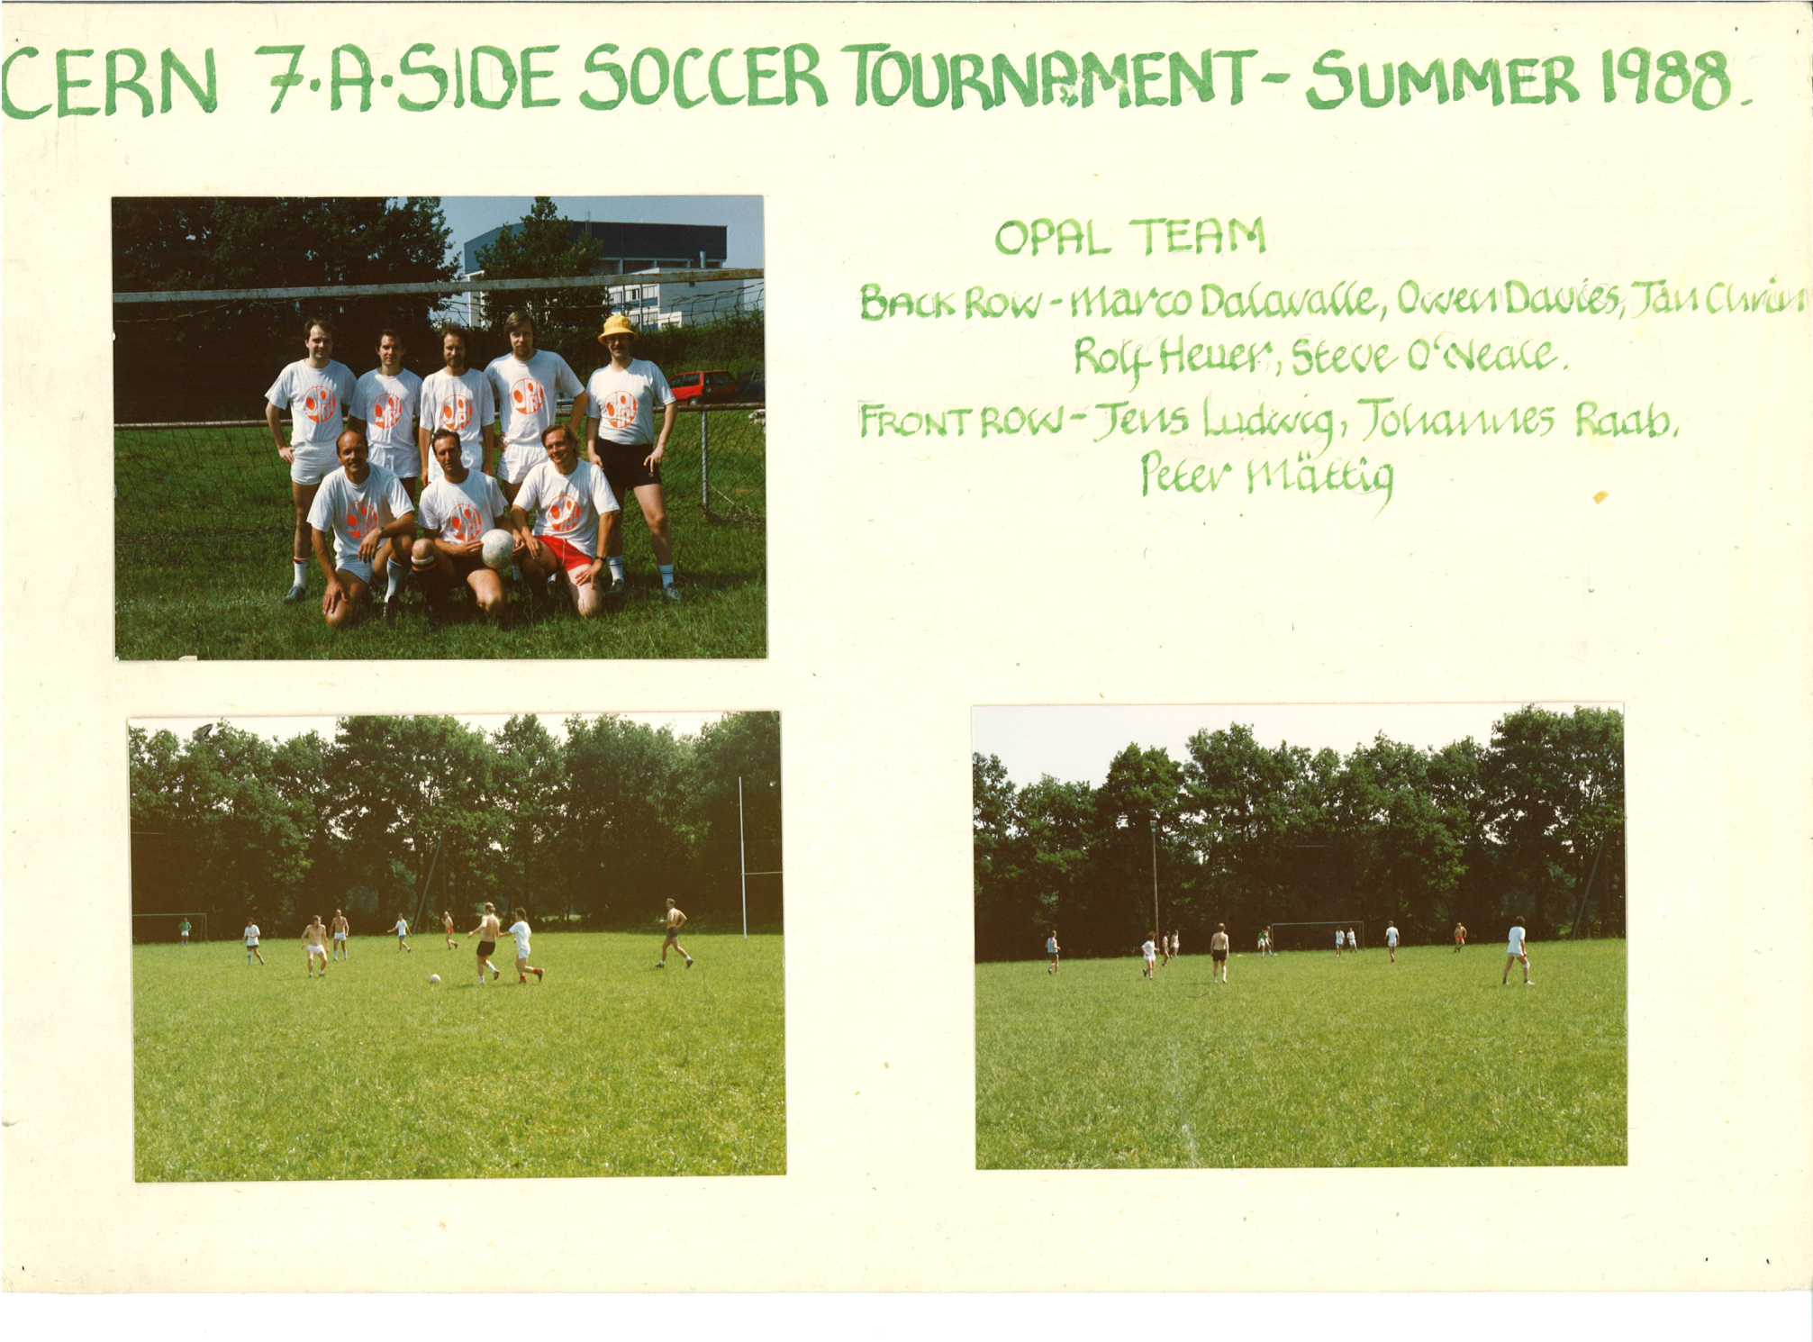

Slide 6
Agenda
  Welcome – David
  Jet Chamber, and 1st days of Running – Michael
  OPAL Pb-glass Calorimeters - Tomio
  DAQ - Frans
  Energy Calibration – Pippa
  Coffee/tea
  Early Days - Albrecht
  Hadron Calorimeter : outside Plenaries - Giorgio
  Zedometry - Tatsuo
  Higgs Race - PIK
  OPAL Physics Highlights - Richard (Hawkings)

Slide 7
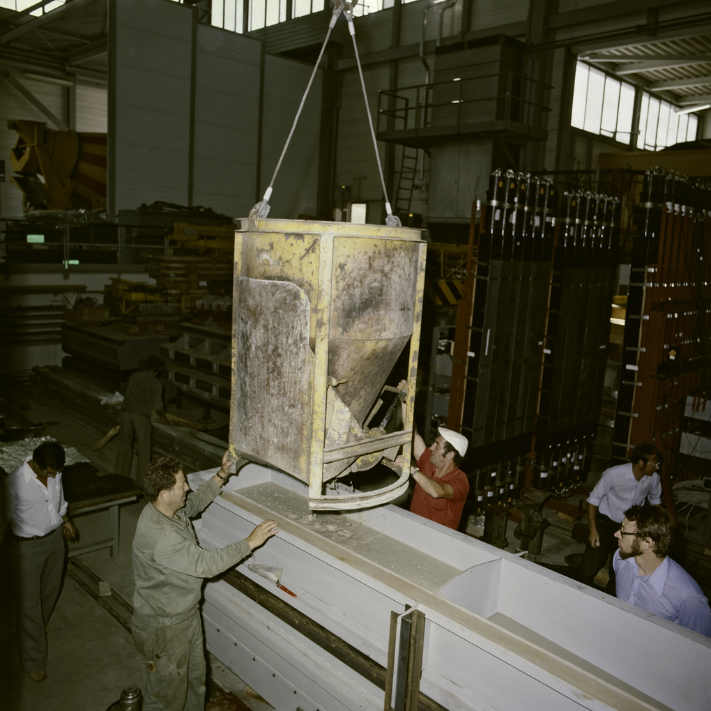

Slide 8
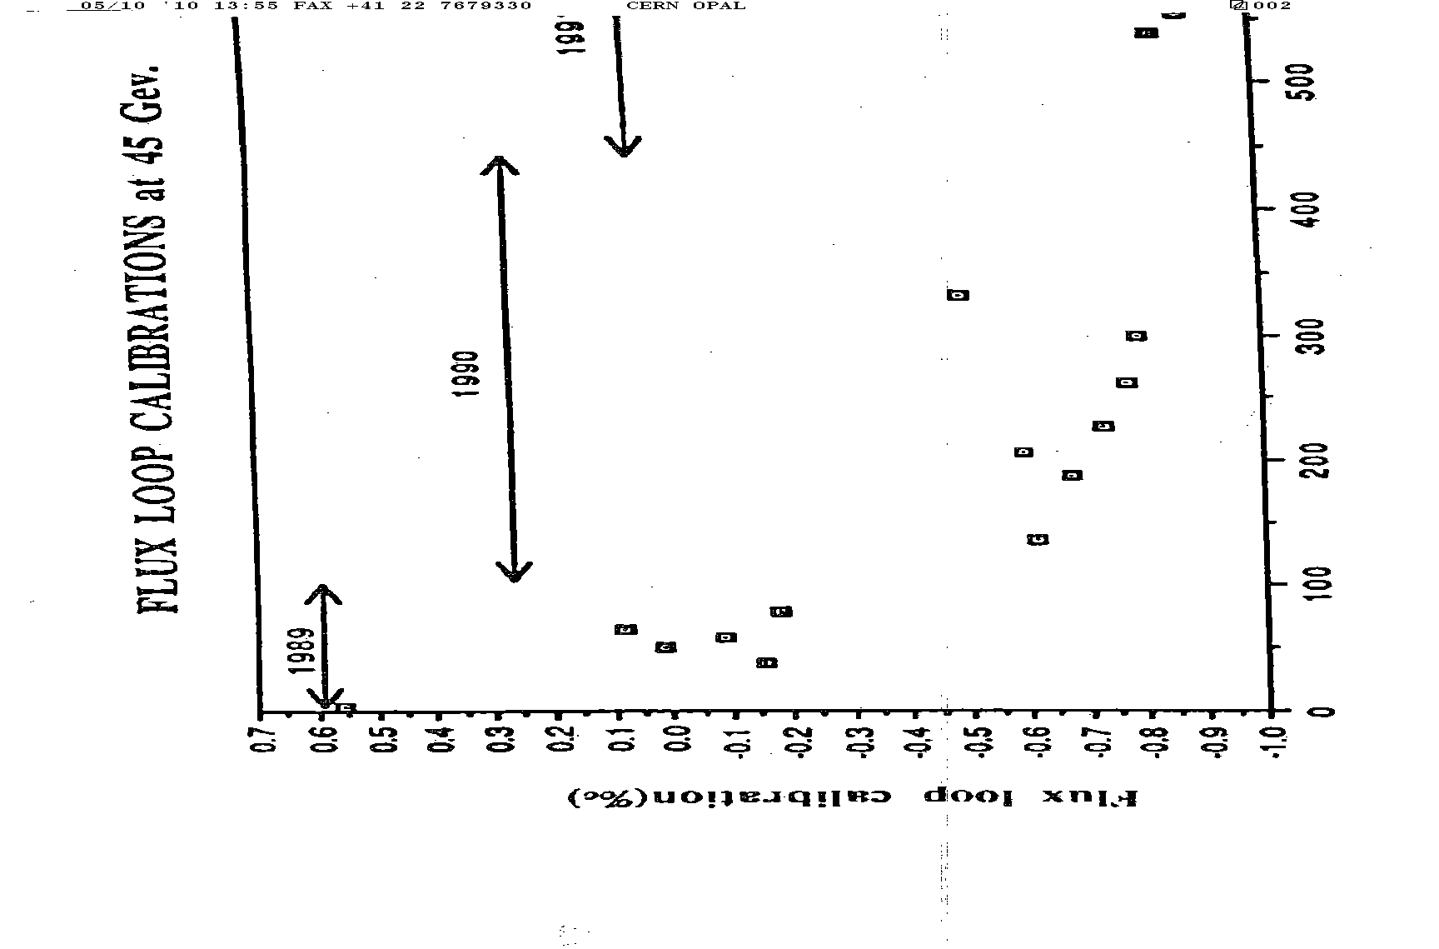

Slide 9
Agenda
  Welcome – David
  Jet Chamber, and 1st days of Running – Michael
  OPAL Pb-glass Calorimeters - Tomio
  DAQ - Frans
  Energy Calibration – Pippa
  Coffee/tea
  Early Days - Albrecht
  Hadron Calorimeter : outside Plenaries - Giorgio
  Zedometry - Tatsuo
  Higgs Race - PIK
  OPAL Physics Highlights - Richard (Hawkings)

Slide 10
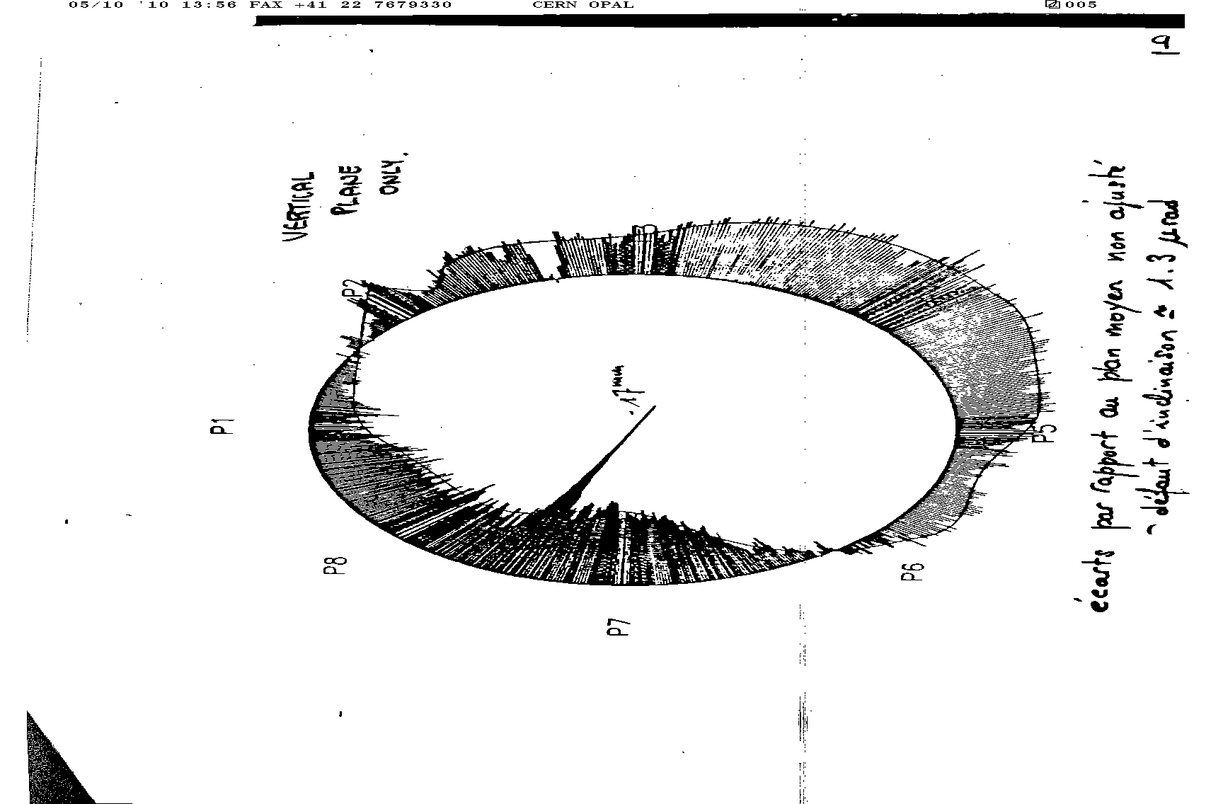

Slide 11
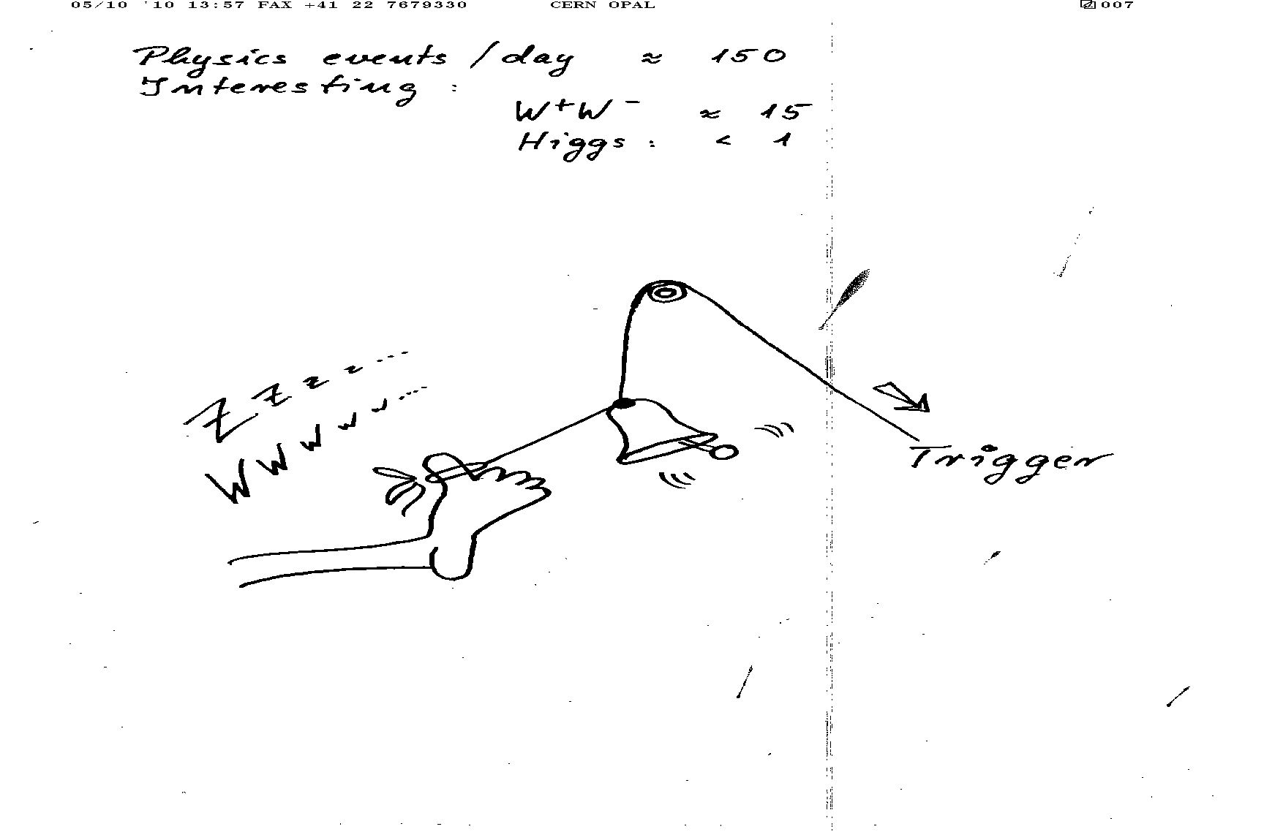

Slide 12
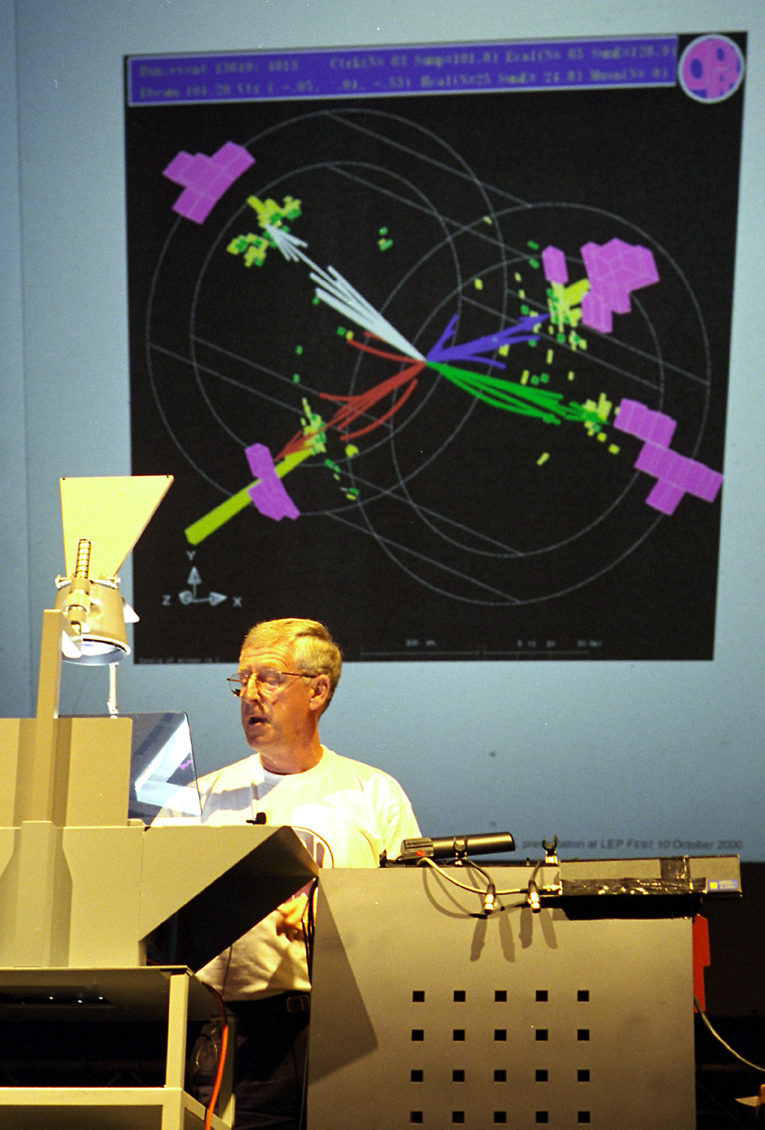

Slide 13
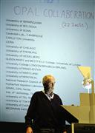
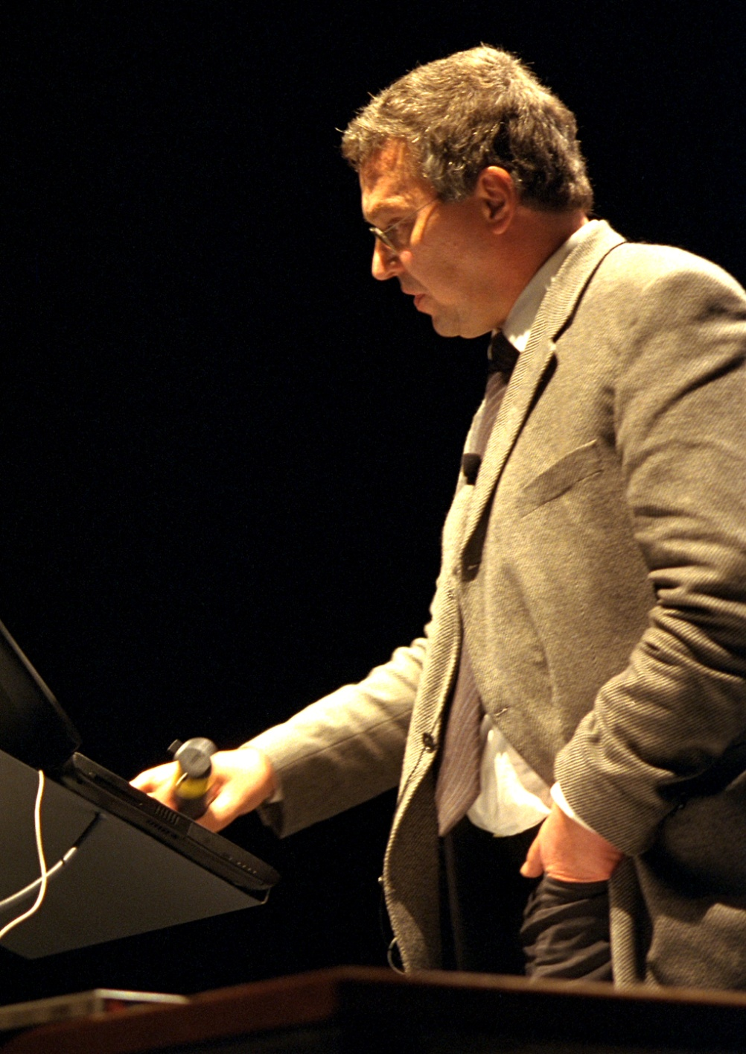

Slide 14
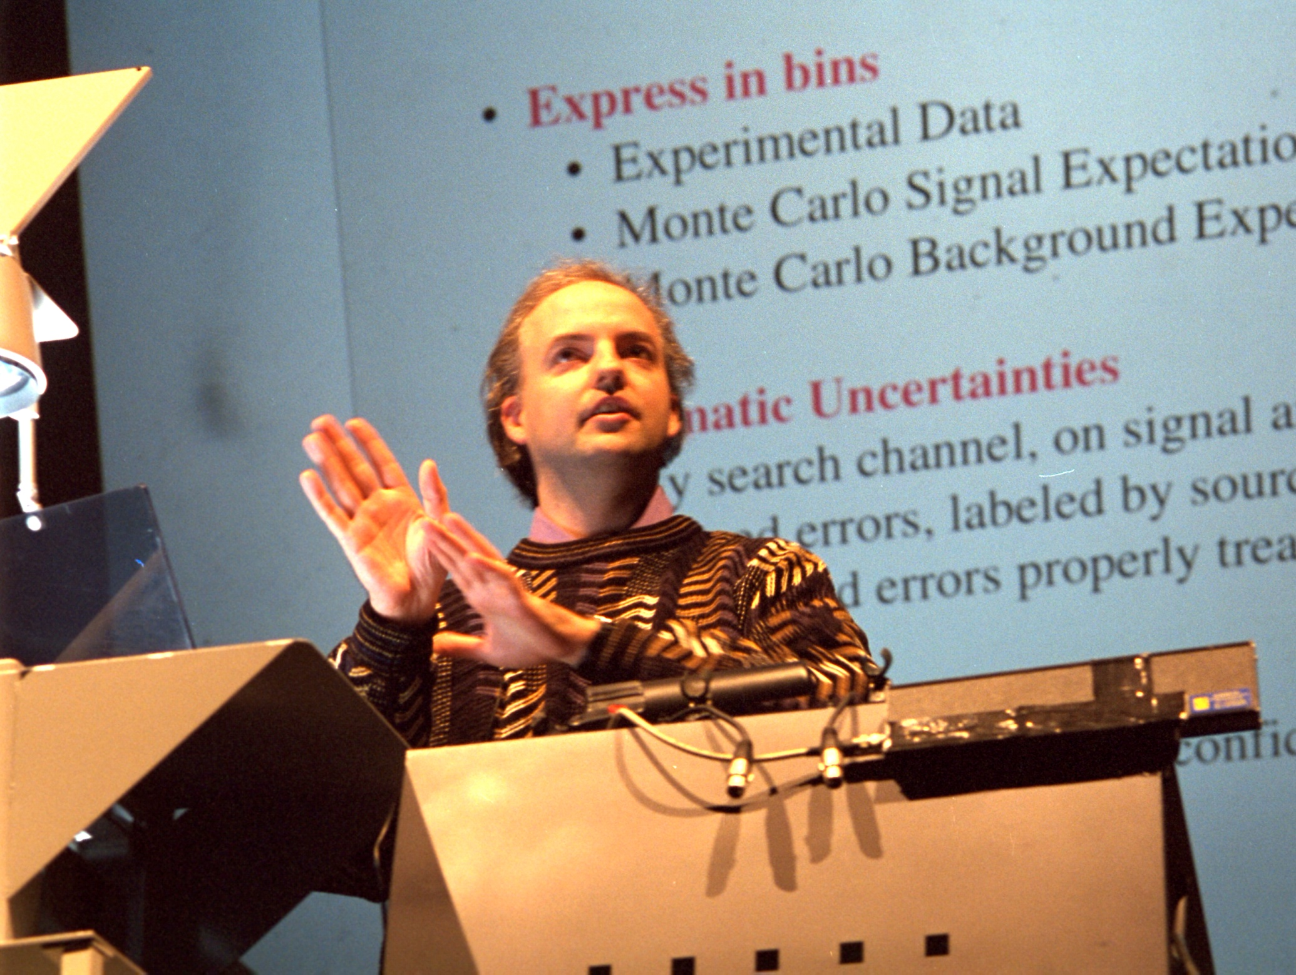

Slide 15
