Slide 1
Metallic XYV readout production
“YXV metallic read-out is crucial at high rates to remove ambiguities”
Fabio Sauli
Rui De Oliveira RD51 WG6 09/02/2022

Slide 2
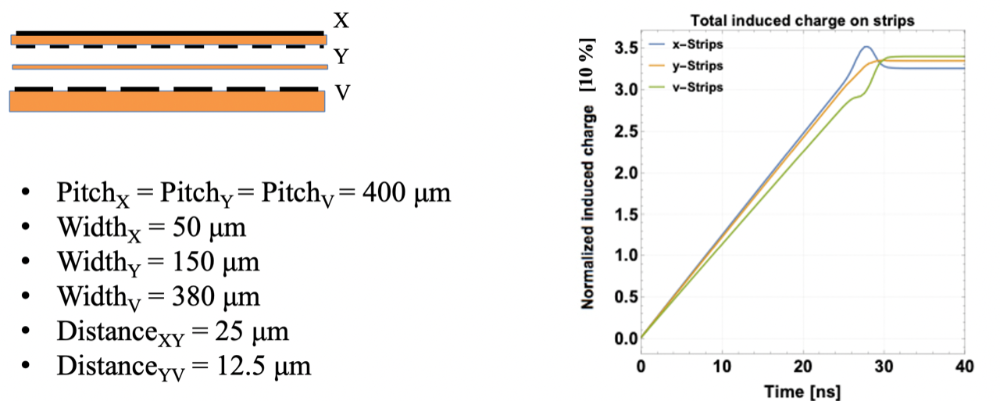
XYU R/O board
difficult
Initial request (Djunes simulation)

Slide 3
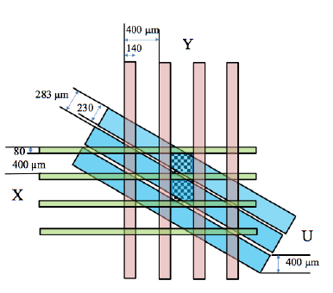
Pitch X/Y: 400µm
X width: 80µm
Y width: 180µm
Distance X/Y =12µm
Pitch U: ~283µm
U width: 220µm
Distance Y/V= 14µm
Final production parameters
New proposal from Fabio
to simplify production

Slide 4
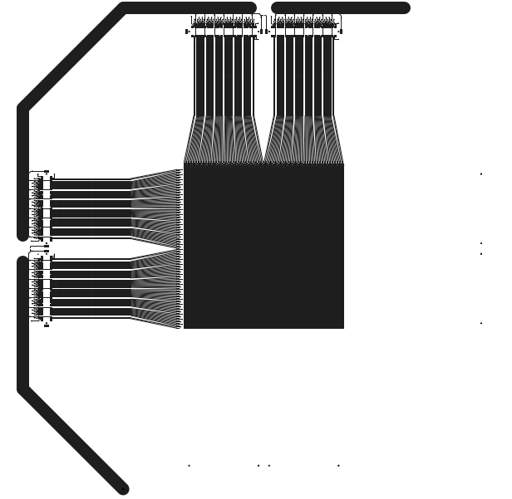
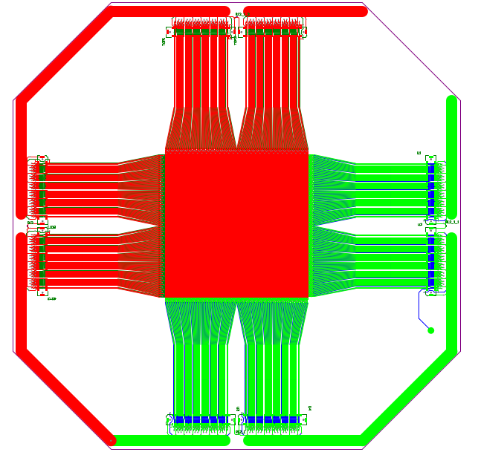
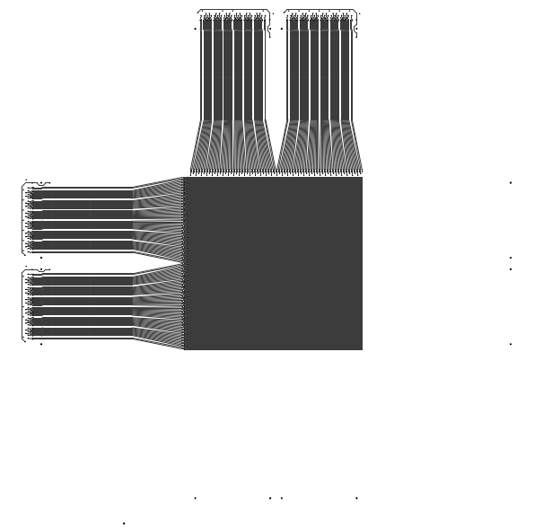
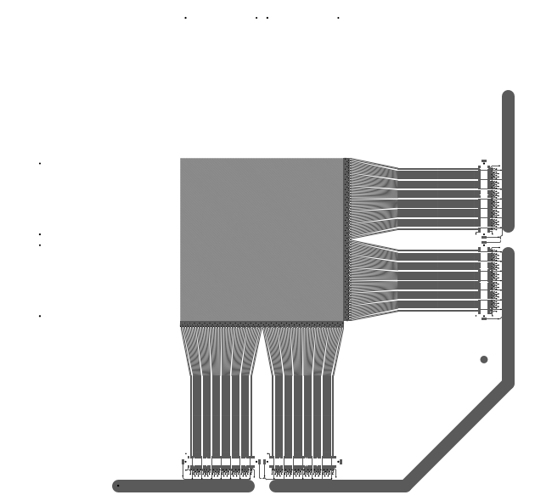
10 cm x 10cm R/O area
X
Y
V

Slide 5
XYV R/O stackup
Copper
Polyimide
Epoxy glue
X
5um
12,5um
Y
5um
12,5um
2-4 um
V
5um
2,4mm or else
50 um pre-preg
Glass epoxy board

Slide 6
XYV R/O full Process
1/ Pattern V strips on one side of a 12um foil , strip the copper on the other side → easy
2/ Glue V strips foil on thick epoxy substrate with 50um pre-preg → easy
3/ Y strips patterning on a 12um separate foil , keeping the full copper on the X side → easy
4/ Glue Y strips foil on the previous V strip/thick epoxy stack with thin epoxy glue → medium difficulty
5/ Drill holes in the periphery to collect all the contacts → easy
5/ Plate holes and top side copper side → easy
6/ Pattern X strips and all the lines to reach the connector pattern on top → easy
7/ Proceed with 3 successive dielectric etching → we have to be careful
8/ Cut the board → easy
9/ proceed with connector assembly → easy
Main Difficulties :
  Epoxy glue thickness uniformity
  Polyimide over-etch
  Epoxy glue over-etch

Slide 7
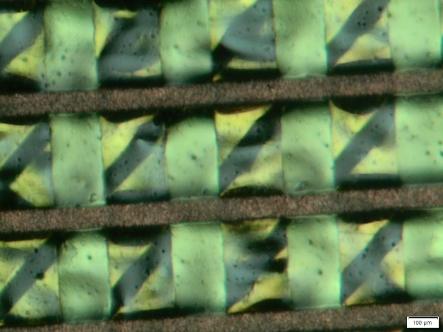
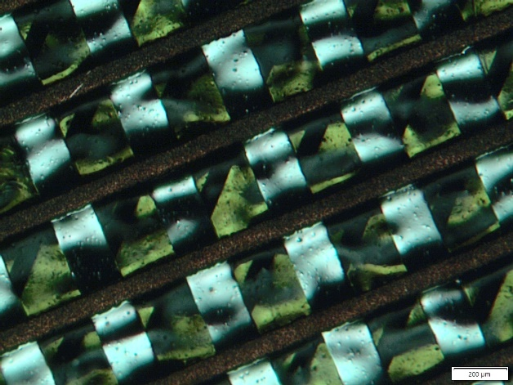
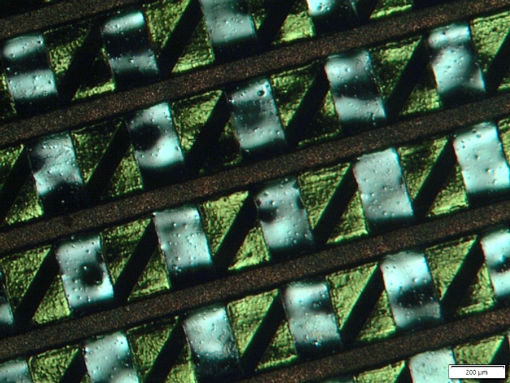
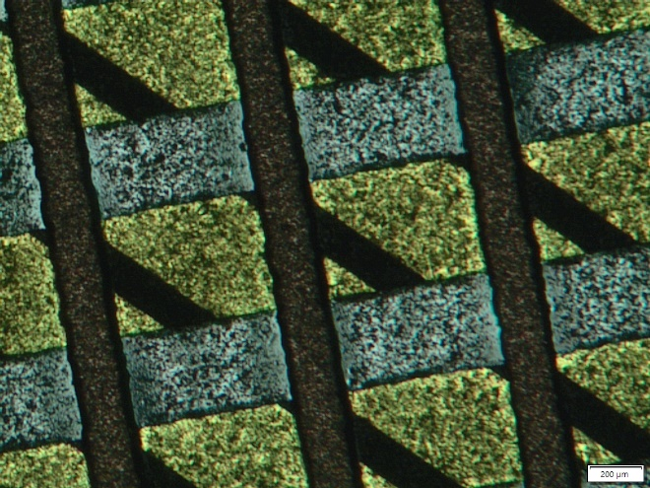
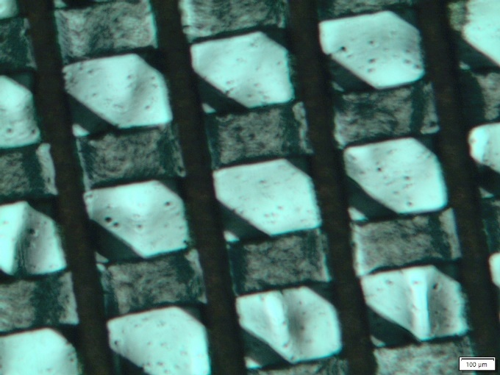
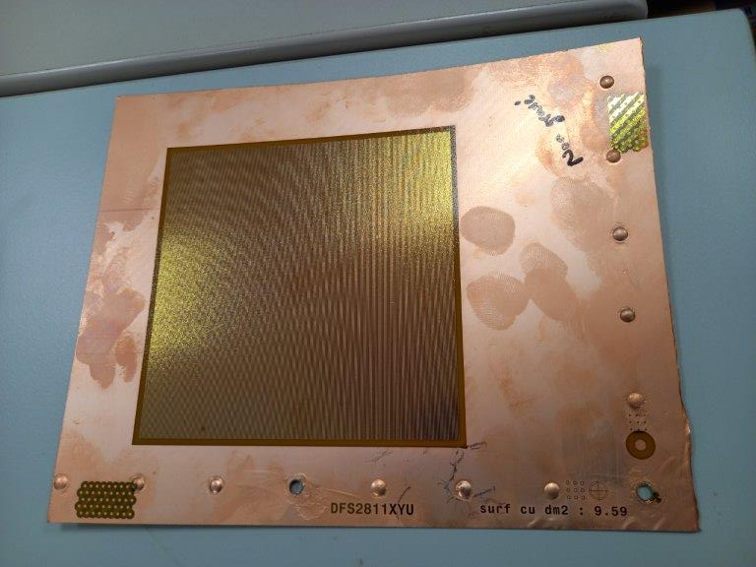
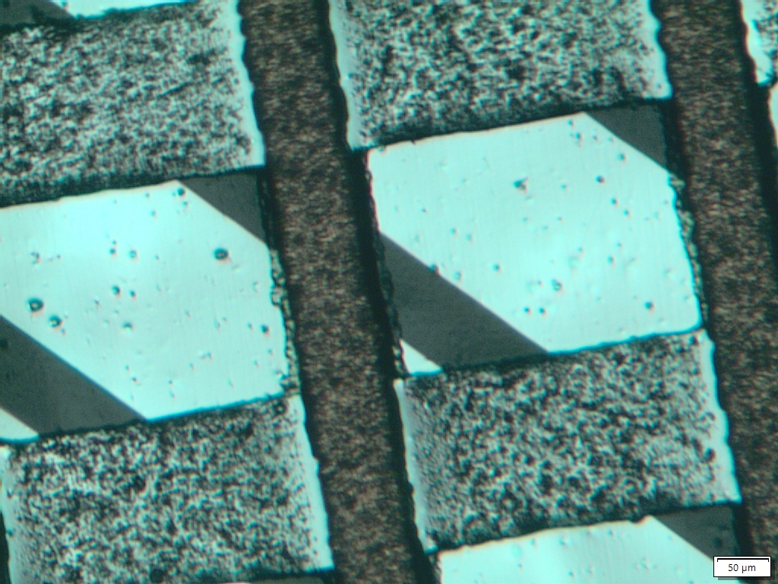
3 successive dielectric etching
Full stack before any dielectric etching
1/ X to Y 12um Polyimide etching
2/ Y to V 4um epoxy glue etching (Sulphuric acid)
3/ Final Y to V 12 um Polyimide etching
Sand blasting to prepare
Y to V Polyimide etching
Y
V
X

Slide 8
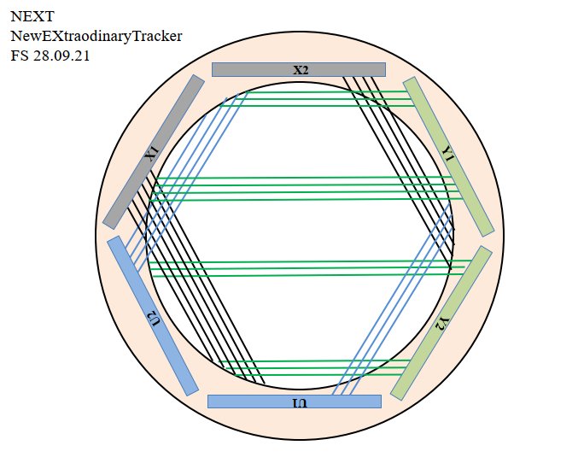
NEXT
-Round Chamber
-Perfect for XYV R/O
-Good for uniform GEM tensioning
-Symmetry around the Beam
-Could be optimum for example for a Compass upgrade

Slide 9
Conclusion
The production process is now ok.
We should deliver a few pieces with final design within 1 month.
Based on real measurements we will then adjust the lines.

