Slide 1
Resistive detectors Electrical cleaning
Rui De Oliveira
RD51 WG6 09/02/2021

Slide 2
outline
Which parameters influence spark damage .
Spark Energy versus detector type.
Electrical cleaning
Conclusion
Future plans

Slide 3
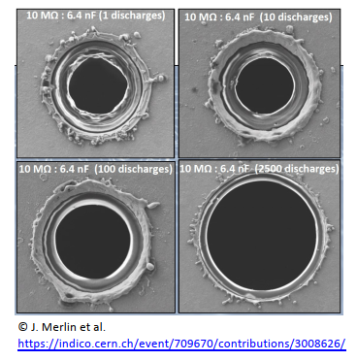
Spark damages are due to local temperature increase versus max temperature capability of materials.
The peak temperature is linked to :
  Energy released → θ
  Electrode and dielectrics mass → θ
  Thermal conductivity and specific heat of materials → θ
It is quite difficult to change materials
  Most of them are imposed by production processes
But we can reduce energy !
Copper melts at 1080°C.
In air , Kapton lose nearly
100% of its mass at 1000°C.

Slide 4
Energy released by one spark
The spark energy is the one stored in the detector capacity: ½ CV²
GEM: 50um thick, 10cm x 10cm @ 500V , 6nF →0.75mJ
THGEM: 1mm thick, 10cm x 10cm @ 4000V, 0.3nF →2.4mJ
uRwell: 50um thick , 10MOhms/sqr @ 500V, 0.6 pF →0.000075mJ
A spark in a uRwell (10M) release around 10000 time less energy than in a GEM 10cm x 10cm

Slide 5
But even with this energy reduction:
µRwell detectors develops sometime a permanent current leak.
It happens only at really high voltage and seems to be linked to the presence of humidity.
DI water US cleaning remove the leak.
we had never seen any visible damages due to sparks on a µRwell. ☺
Energy reduction clearly cancel damages.
but we can still create nasty conductive compounds if we keep the detector constantly sparking !
In production , this is forcing us to repeat wet cleanings and electrical tests to get good detectors → time consuming.
Our first idea was to create a smart power supply able to reduce again the released energy by HV pulsing .
Not yet ready ! And probably useless…

Slide 6
Summer 2021
Really high RH in the lab , sometimes above 80% .
30% RH in our desiccator @20°C.
20% RH in our gas box flushed with dry air (but 2 days capacity only) .
Detector test was taking weeks→ we were obliged to make really slow voltage ramp up to avoid permanent leaks.
Strange situation because during winter the humidity is also in the range of 20-30 % in open air , and the test is not problematic.
Is the air humidity the only problem ?
What about moisture in the materials ?
Came the idea to remove moisture from air and in material by drying the detector in an oven, and do the test in the oven.
Even with 80% RH in the lab, the RH in an oven set @80°C is below 1%
A µRwell can easily handle 180°C
Why not giving a trial?

Slide 7
uRwell qualification criteria in desiccator (Air-30% RH-@20°C) before summer 2021
Good quality :
  630V with leakage current < 20nA
  Typically 30% of the productions
  Gains above 10^4
Medium quality (but delivered):
  600V to 630V with leakage current < 20nA
  Typically 50% of the productions
  Gain around 10^4
Bad quality (rejected) :
  below 600V with leakage current > 20nA
  Typically 20% of the productions

Slide 8
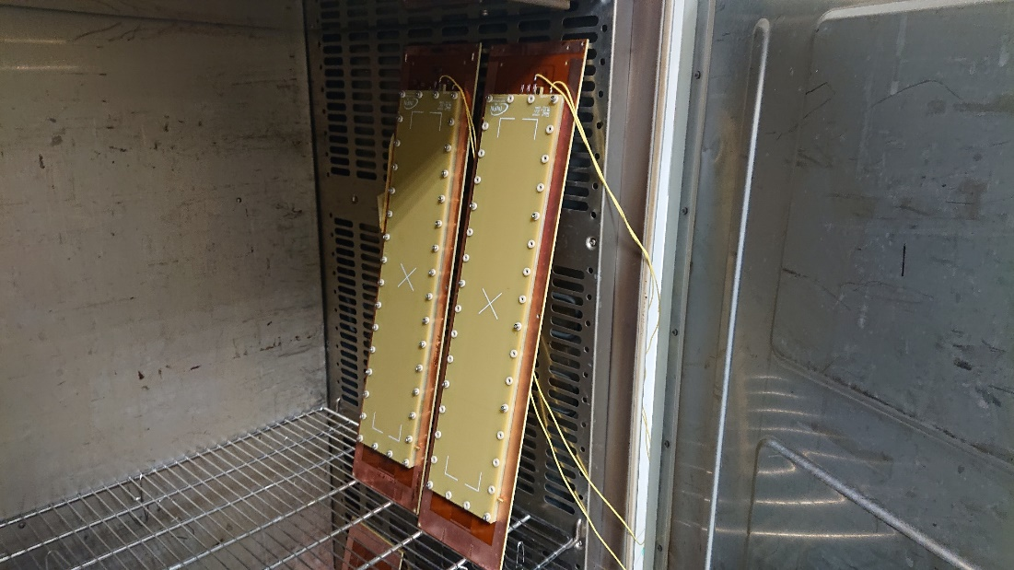
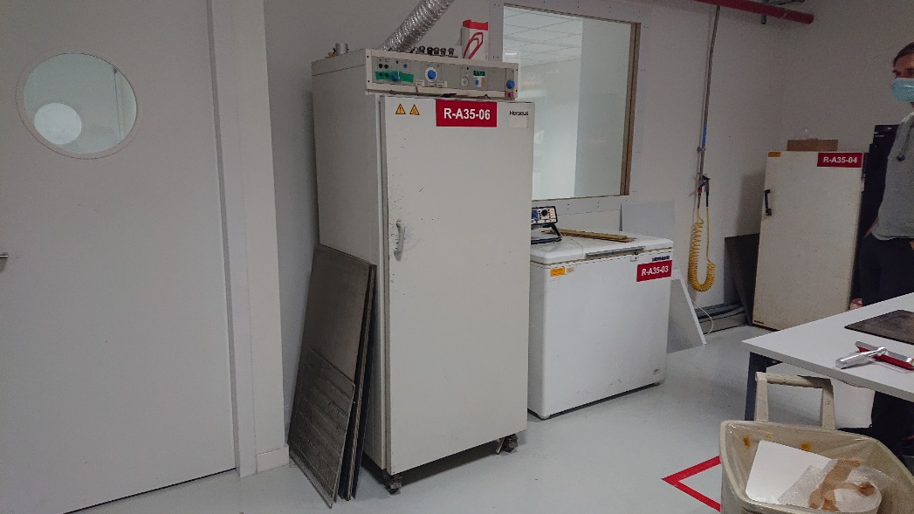
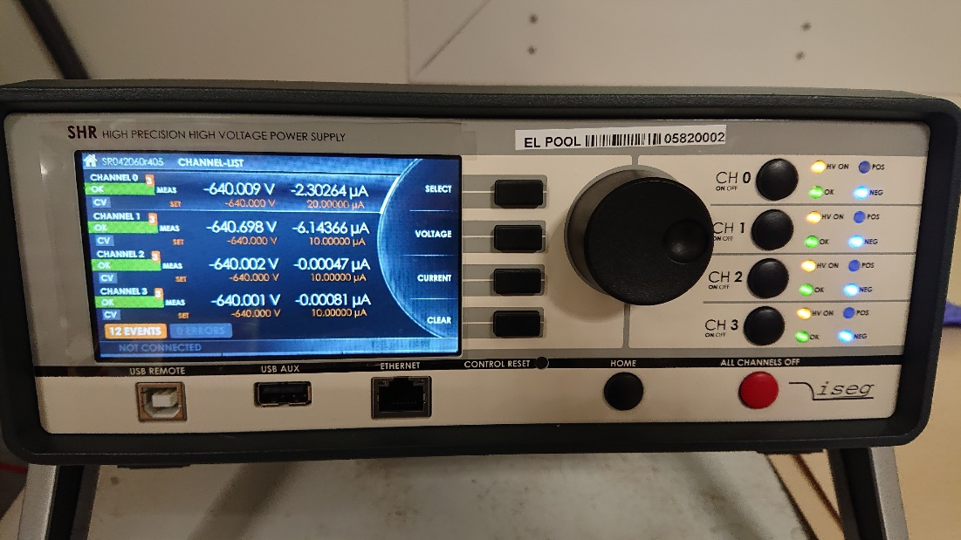
Set-up
HV
connections
Assembled detectors
Oven
HV Power supply

Slide 9
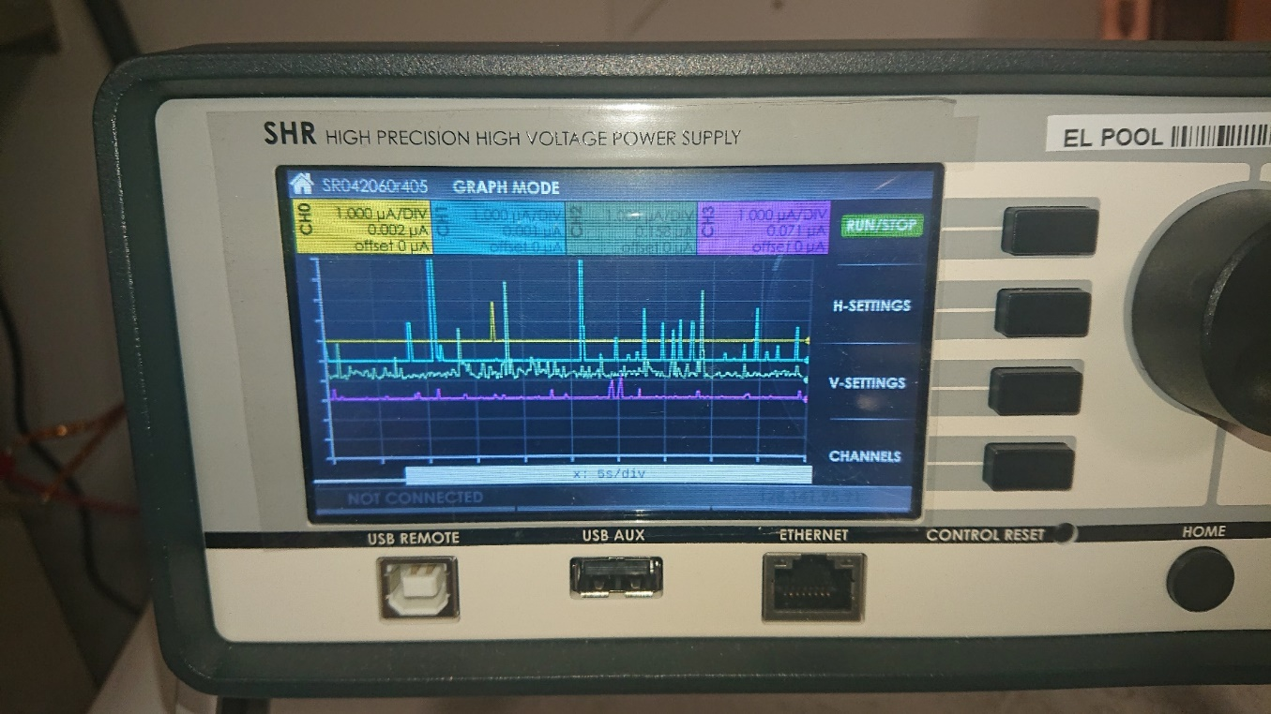
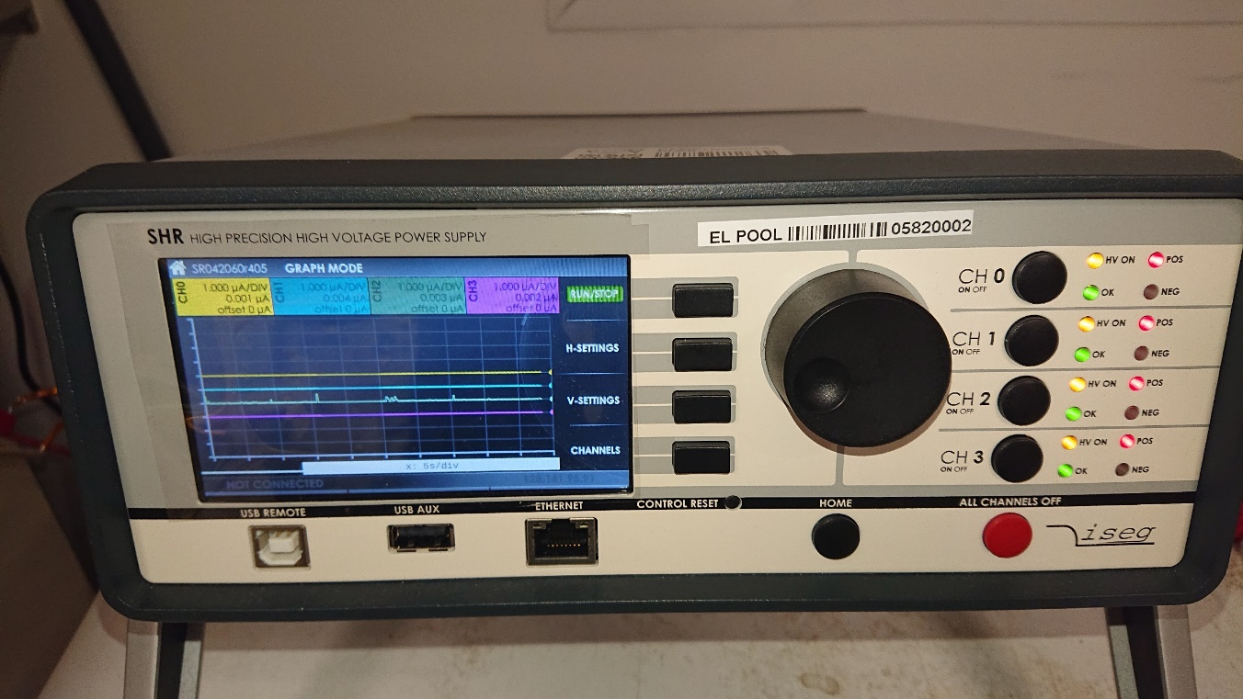
Correct polarization
Copper grid (cathode)→0V DLC (Anode)→ +HV resistive value : 10 to 100MOhms/square
CH0 to CH3 → 4 bad detectors
Setting : 500V/20uA max/100°C
Y: 1uA/div X: 5s/div
Current instabilities up to 15uA
CH0 to CH3
Setting : 640V/20uA max/100°C
Y: 1uA/div X: 5s/div
1 to 4 nA leakage current, no instability
12 Hours
later
The detectors never shown a permanent leak stopping the power supply

Slide 10
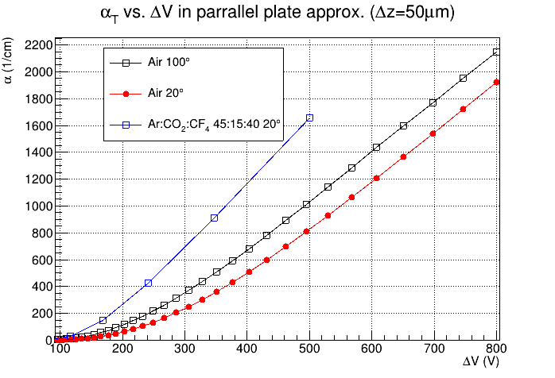
Townsend coefficient versus Temperature
Plot from
Gianfranco Morello
INFN Frascati
500 V @ 100°C → 550V @ 20°C
640 V @ 100°C → 690V @ 20°C
700 V @ 100°C → 760V @ 20°C

Slide 11
Full picture
We’ve cleaned 20 µRwells chemically :
  10 detectors 10cm x 10cm + 10 detectors 40cm x 5cm
  Only 20% were good @ 630V in our desiccator
  80% were considered medium or bad → some of them having a 5uA leak at 500V
After electrical cleaning @ 640V 100°C during 12 Hours
  All passed the test in our desiccator above 690V
We have then pushed the cleaning on one larger µRwell @ 100°C
  30cm x 30cm active area (single electrode).
  Starting with 5uA leakage current at 500V ☹ (really bad)
  Power supply current limitation 40uA , voltage adjustment 4 times a day to maintain 15uA current peaks .
  2 days →640V → less than 20nA
  3 days →660V → less than 20nA
  4 days →680V → less than 20nA
  7 days →690V → less than 40nA → from time to time the detector seems to light up
  → 700V may be reachable , it correspond in theory to 760V @ 20°C!
  At this voltage (760V) , I think that measurements in our lab are not anymore possible @20°C (even during best winter conditions) .
  The measurement will only be possible with a dry detector in operational condition → few % RH gas flushing.

Slide 12
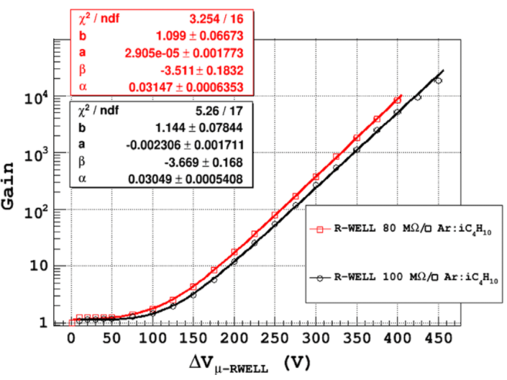
Example of gain curves
obtained without E-cleaning
(Marco Poli Lener)
With E-cleaning we are now able to increase typically by 20% the max voltage .
E-cleaning applied to these 2 detectors , should allow them in theory to reach gains above 10^5.

Slide 13
Wrong polarization
Copper grid (Cathode)→+HV DLC (Anode) → 0V
We took 1 good detector and inverted the voltage
We observed a slow but constant degradation up to many tens of µA in less than 12 hours
We put back the voltage with the right polarity and the detector was fully clean after 24 hours.

Slide 14
Tentative to explain the phenomena
I think purely geometrical
Correct polarization → improves
Wrong polarization → degrades
Copper evaporation
0V
+640V
Ion
beam
Ion
beam
DLC evaporation
+640V
0V
Evaporated Cu + Pi compounds
are pulled out from the hole
Evaporated DLC + PI compounds
can condense on the walls
We can clearly see material pulled out from GEM holes after sparks
For sure we can’t see this with uRwell, but I do not see why the principle should be different

Slide 15
uRwell qualification criteria in our desiccator now
Good quality :
  690V to 700 V with leakage current < 20nA (630V previously)
  All the detectors we have produced up to now have reached this number
Bad quality (rejected) :
  below 690V with leakage current > 20nA

Slide 16
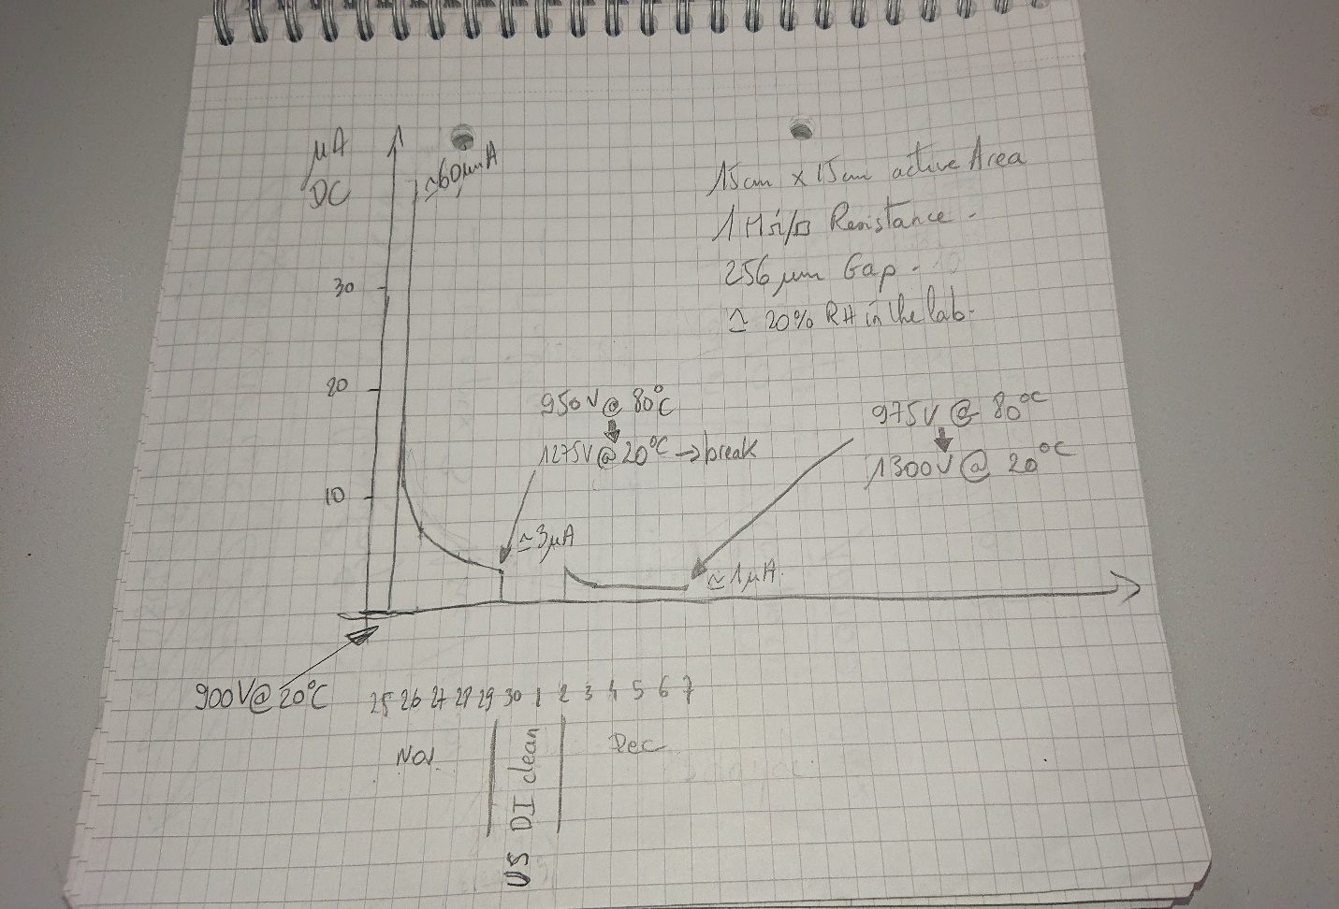
Micromegas (1Mohms/square):
It is known that leakage current increases with temperature above 30°C in pillars due to Pyralux material.
  https://inspirehep.net/files/c892734516cf69fca3c57fd035ca5ec1
  luigi longo , J-Samarati , P-Iengo ,J-Wotschack
I originally thought that this will cancel the possibility to do electrical cleaning at high temperature .
I’ve put anyway a detector 256um gap (handling maximum 900V @ 20°C) in the oven @80°C .
The DC current due to the pillars went immediately over 60µA after a few min , and stabilized down to 1µA after 13 days !!!
During these 13 days we’ve increased regularly the voltage to keep instabilities : 1 to 10 µA peaks on top of the DC current.
After 13 days we reached a stable situation : 975V @ 80°C with 1µA DC and no more peaks , I stopped the test.
We have then been able to raise the voltage to 1300V @ 20°C with only a few nA leak

Slide 17
Conclusion
We can now precisely define the maximum voltage of a µRwell with no risk to create a leak .
The electrical cleaning is incredibly better than chemical cleaning : possibility to increase by 100V the margin and may be more !
The electrical cleaning process is not symmetric !
What do we know about the nature of the harmful compound :
  Created only in presence of H20 during spark material evaporation.
  It dissolves in water.
What do we know now about the risk to create this compound:
  Evap of Cu + (PI + H2O) in ( Air + H2O) → Summer conditions → + + + +
  Evap of Cu + (PI + H2O) in dry Air → improved Summer conditions → + + +
  Evap of Cu + (PI + low H2O) in ( Air + low H2O) → Winter conditions → + +
  Evap of Cu + dry PI in dry Air ! → Oven conditions → no risk
I think we can conclude that we need to reduce H2O in the gas and materials during operation.
We have now a simple way to quantify the moisture trapped in Micromegas detectors materials.

Slide 18
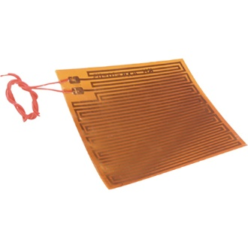
Future plans or ideas
Look at the impact of the resistive value on the cleaning .
Improve detector design to include moisture barriers ( play with metallic layers design ).
Verify that low humidity gas constantly flushing can deeply dry detectors with these barriers.
Check electrical cleaning at room temperature , when H2O in material is really low .
Make a sensor , able to give a real time concentration of H20 in materials.
Introduce a heater in the R/O PCB (really easy) → only adding one more layer to the stack:
    To remove constantly moisture from materials by soft heating at 30 °C , and why not during operation .
    To bring at high temperature (50 to 80°C) to perform a fast cleaning if needed at any time.
    To alternate drying /operation periods ( ex : few hours drying per day or per week depending on moisture barriers efficiency and season)

Slide 19
Thanks

