Slide 1

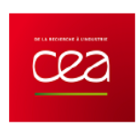

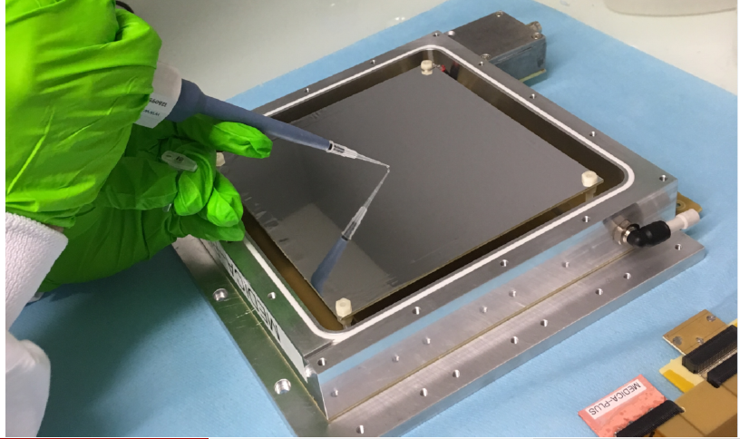
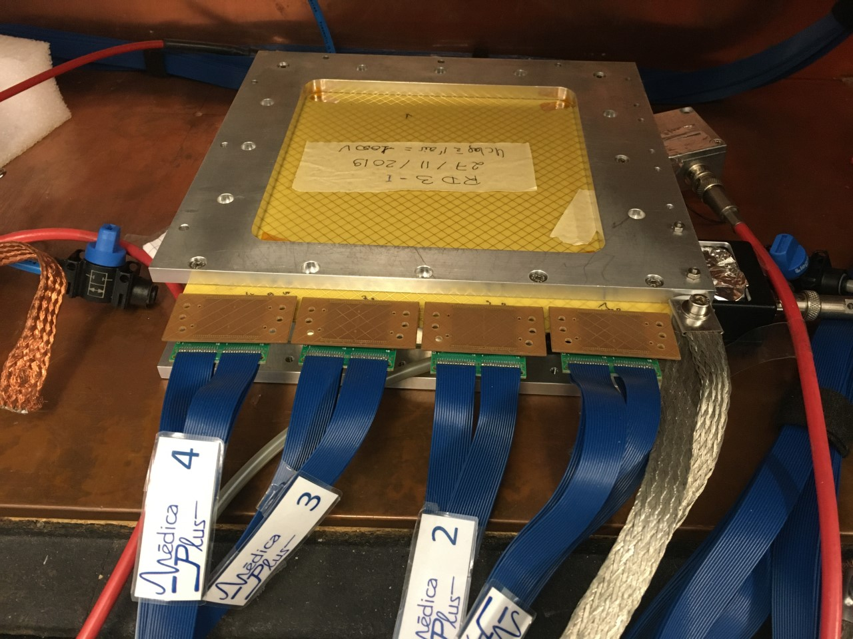
Medica-Plus: a Micromegas detector for sub-Bq tritium activity assessment at the service of oncological research
A. Cools, E. Ferrer Ribas, T. Papaevangelou, M. Vandenbroucke
CEA-Saclay/IRFU/DEPHYS
F. Beau, C. Malgorn, F. Malloggi
Institut Joliot Curie and Iramis
CEA-Saclay
1

Slide 2
PLAN
CONTEXT
Biological context
Radiolabelling techniques
Medica-Plus steps
EXPERIMENTAL SET-UP WITH A MICROMEGAS DETECTOR
RESULTS
First experiment
Second experiment
First activity measurement method
Second activity measurement method
CONCLUSION and PERSPECTIVES
2

Slide 3
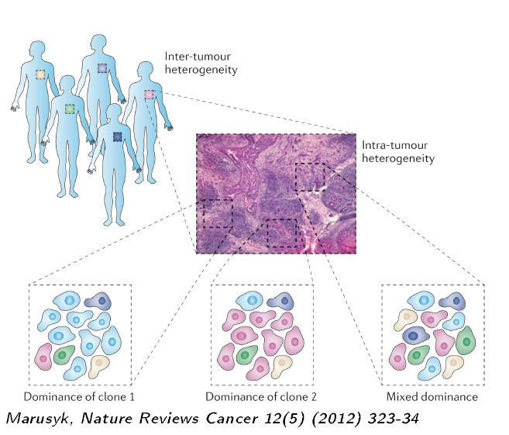
Recent progress in oncology : tumoral heterogeneity !
Variability between tumours
Different cell types
Decrease targeting drug efficiency
Tumour heterogeneity
Oncological research issue : heterogeneity effect on drug targeting ?
Tumoral heterogeneity requires better detection sensibilities
3

Slide 4
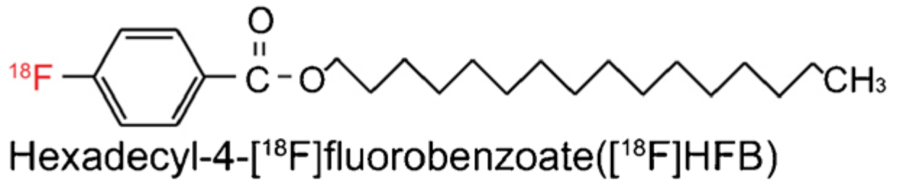
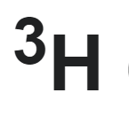
Molecule labelling and tracking
Measure the drug concentration per single cell (estimated 0.5 Bq)
Several techniques available
Fluorescence → large groups
Isotopic marking does not modify drug’s chemical behaviour!
Pharmaceutical needs at the cell level for drug development :
Assess the drug distribution within cancer vs. host cells
Evaluate the impact of the cell heterogeneity on drug biodistribution
4

Slide 5
Molecule labelling and tracking
Measure the drug concentration per single cell (estimated 0.5 Bq)
Several techniques available
Fluorescence → large groups
Isotopic marking does not modify drug’s chemical structure!
Medica-Plus detection intention
At the cell level : Quantification of ³H concentration in single cell samples
An innovative cooperation between the involved disciplines !
5

Slide 6
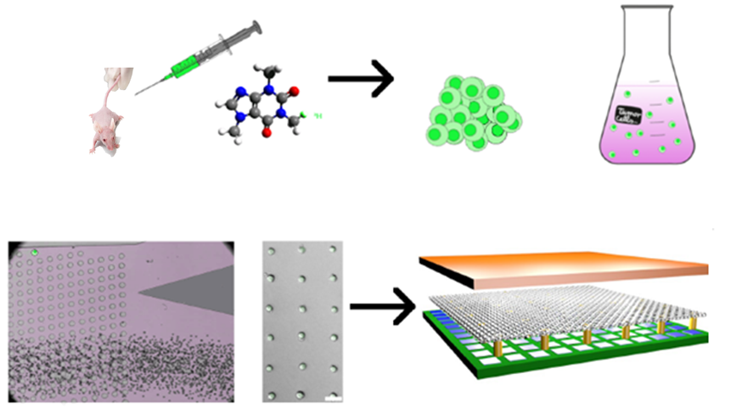
Medica-Plus steps
Tumoural cells collected from an animal – Tritium tracking
Cellular culture
Cell deposit by microfluidics techniques
Tritium activity counting with gaseous detector
6

Slide 7
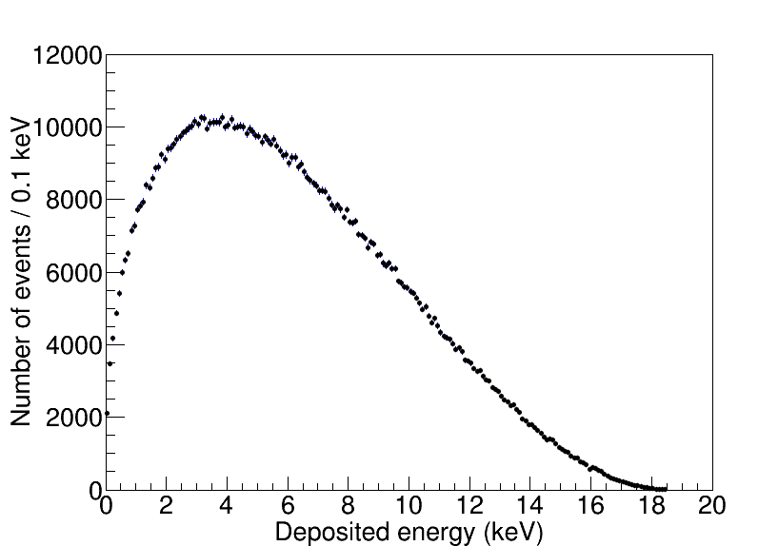
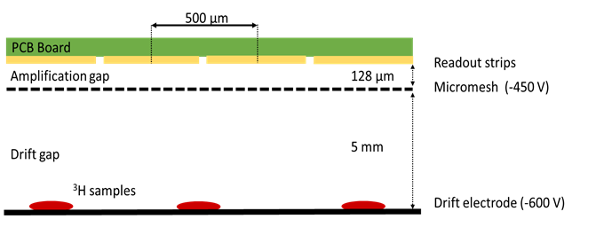
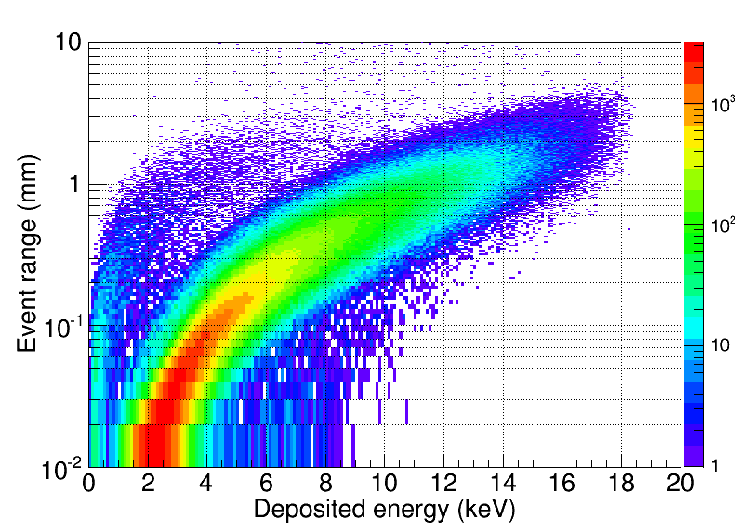
Detection of ³H with micromegas
Theoretical ³H energy spectrum
Micromegas for ³H counting : samples deposited on replaceable drift electrode
³H Beta range
β
Medica-Plus detector
Active zone 12 x 12 cm²
Unidirectional copper strips, 500 µm pitch
Gas : Ar-5% Isobutane
DREAM electronics : self-triggering mode
Low energy threshold
Good spatial resolution
Good background rejection capabilities
For this application: ³H samples inside the gas volume
Acker et al., NIM A 957 2020 163423
7

Slide 8
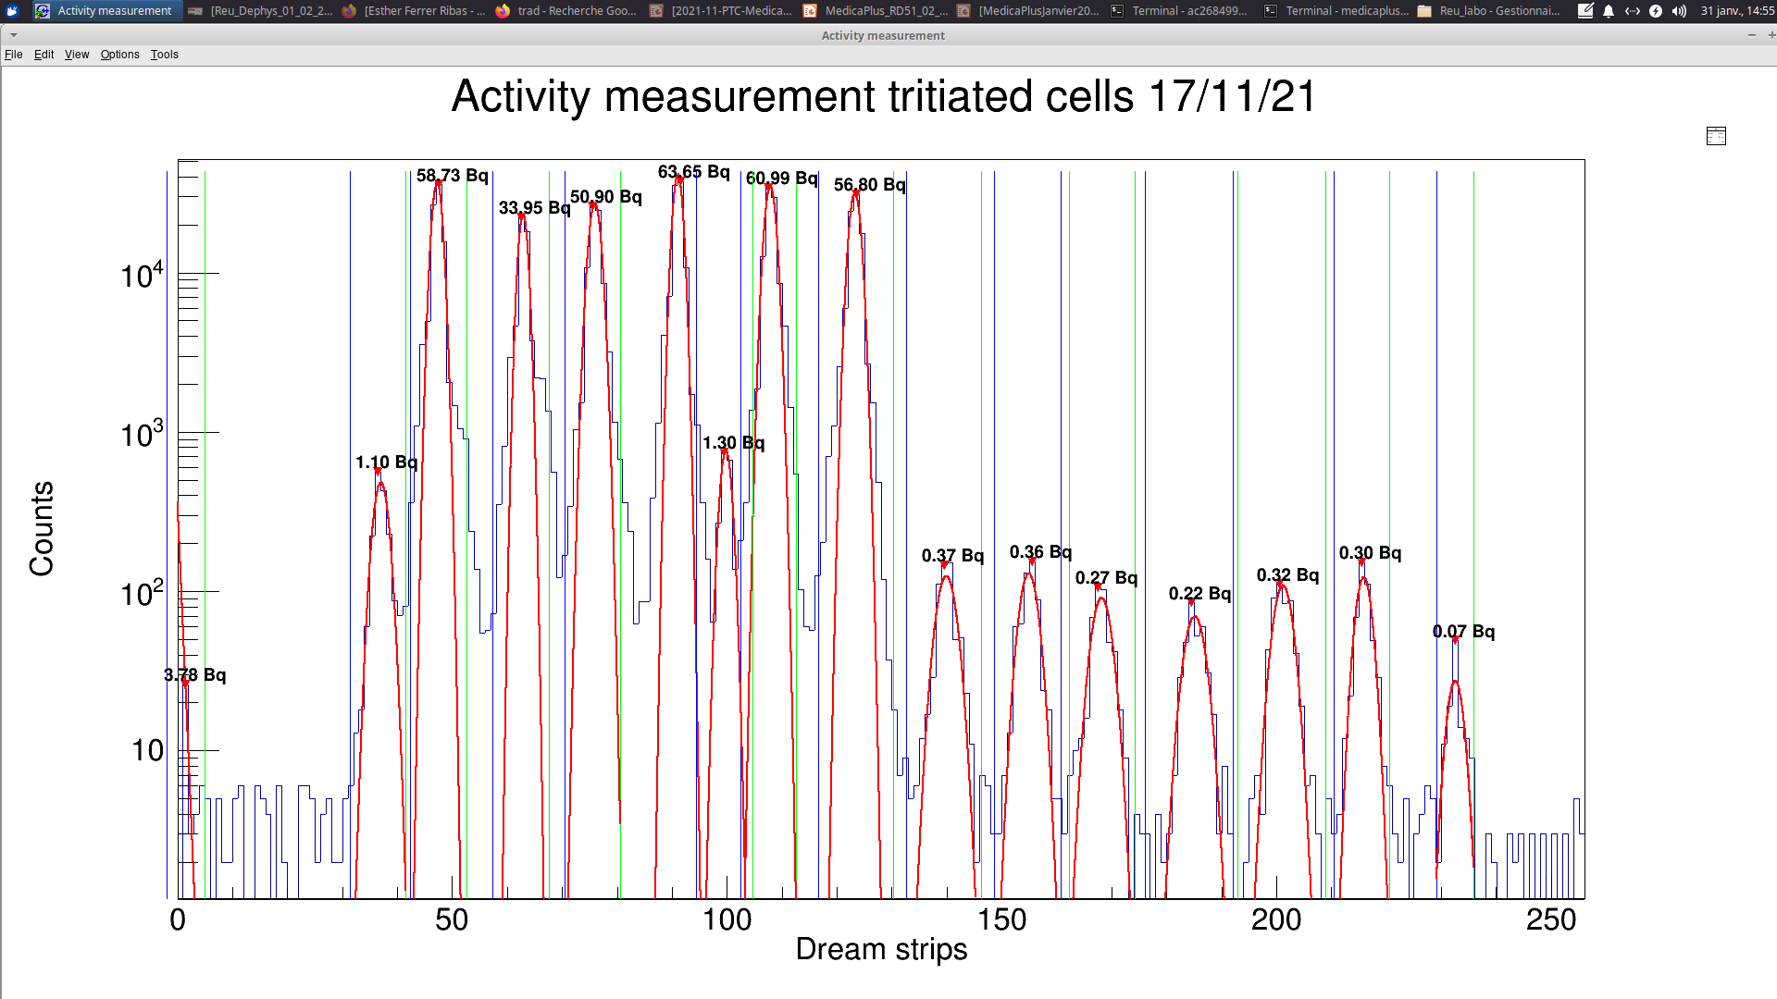
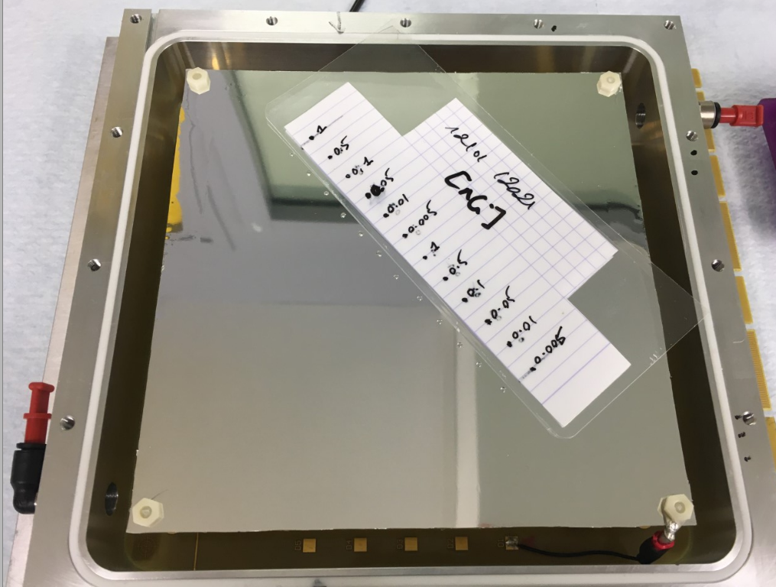
Medicaplus results
1st deposit with tritiated glucose : 0.4 Bq – 40 Bq
Proof of concept
2nd deposit with low activity cells and glucose : 0.3 Bq – 100 Bq
Clustering
1st method : Integration algorithm
2nd method : Peak association algorithm
Methods comparison
8

Slide 9
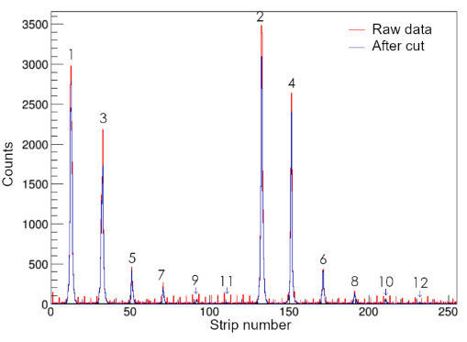
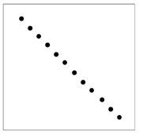
Tritiated glucose signals positions
1st deposit with tritiated glucose : 0.4 Bq – 40 Bq
Glucose drops deposit on the cathode
Glucose drops
1
3
5
7
9
11
2
4
6
8
10
12 drops from 0,4 Bq to 40 Bq
11
Cathode
9

Slide 10
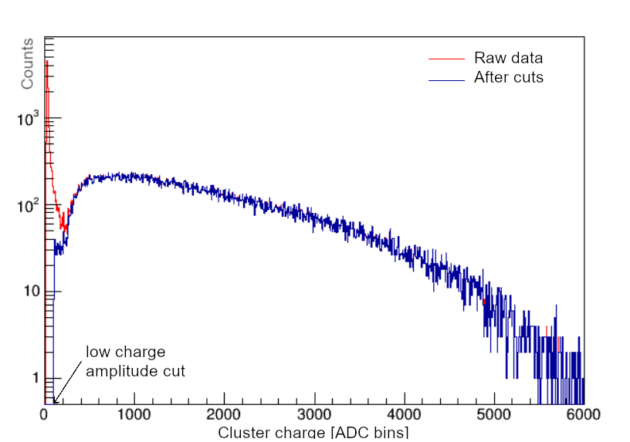
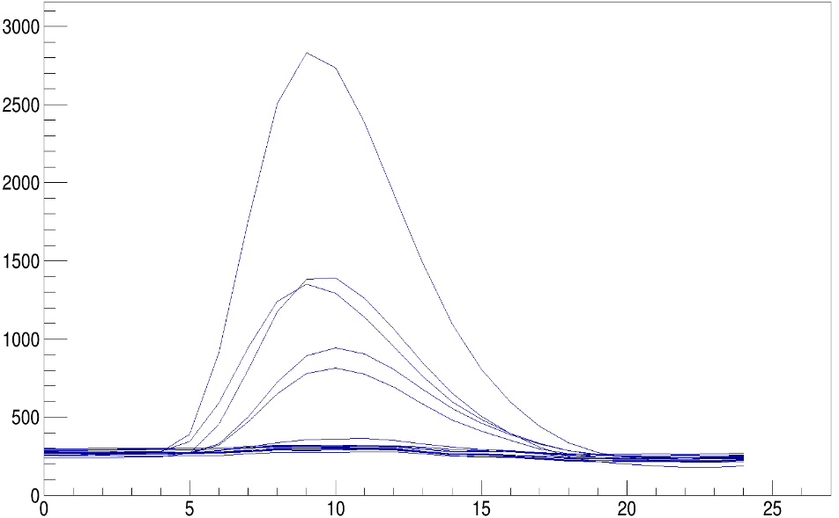
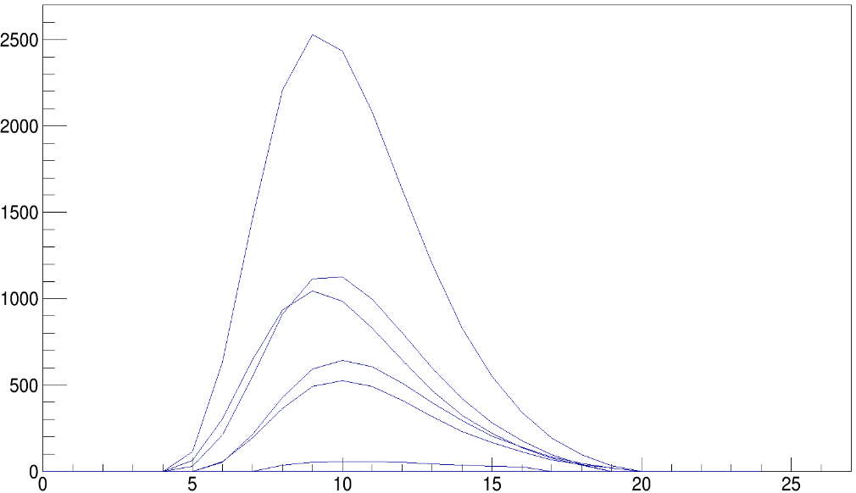


1st deposit with tritiated glucose : 0.4 Bq – 40 Bq
Measured ³H amplitude spectrum
Medica-Plus detector
ADC
Amplitude signals for one event
ADC
Amplitude signals for one event
Common noise suppression
Low amplitude cut (4σ)
Time samples (8 ns)
Time samples (8 ns)
10

Slide 11
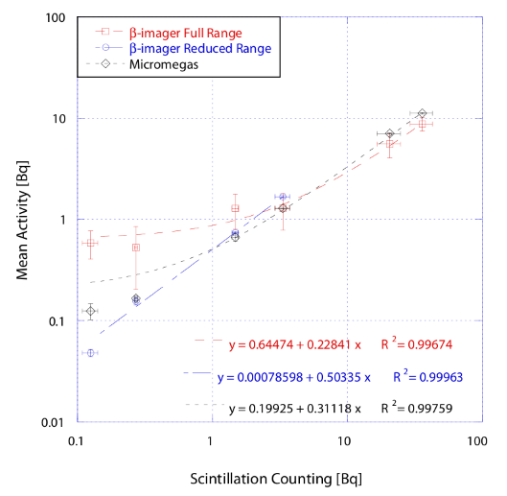
Proof of concept
Tritiated glucose events positions
Basic algorithm without clustering
Activity measurement for Micromegas :
Better error and linearity than β-imager in full range mode
Similar results compared to reduced range mode
F. Jambon et al. NIMA 1027 (2022) 166332
11

Slide 12
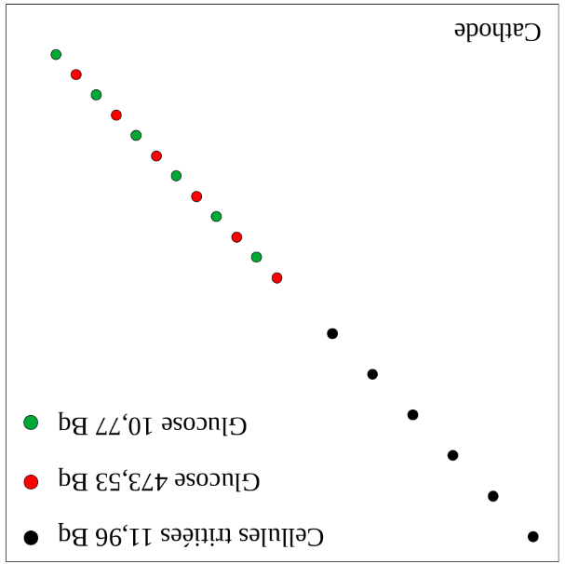
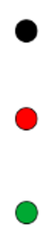
Medicaplus results
2nd deposit with low activity cells and glucose : 0.3 Bq – 100 Bq
0.3 Bq cells
High activity
Low activity
5 mm
1 cm
Cathode
Medica-Plus mylar drift electrode with samples
Glucose and cell deposit on the cathode
12

Slide 13
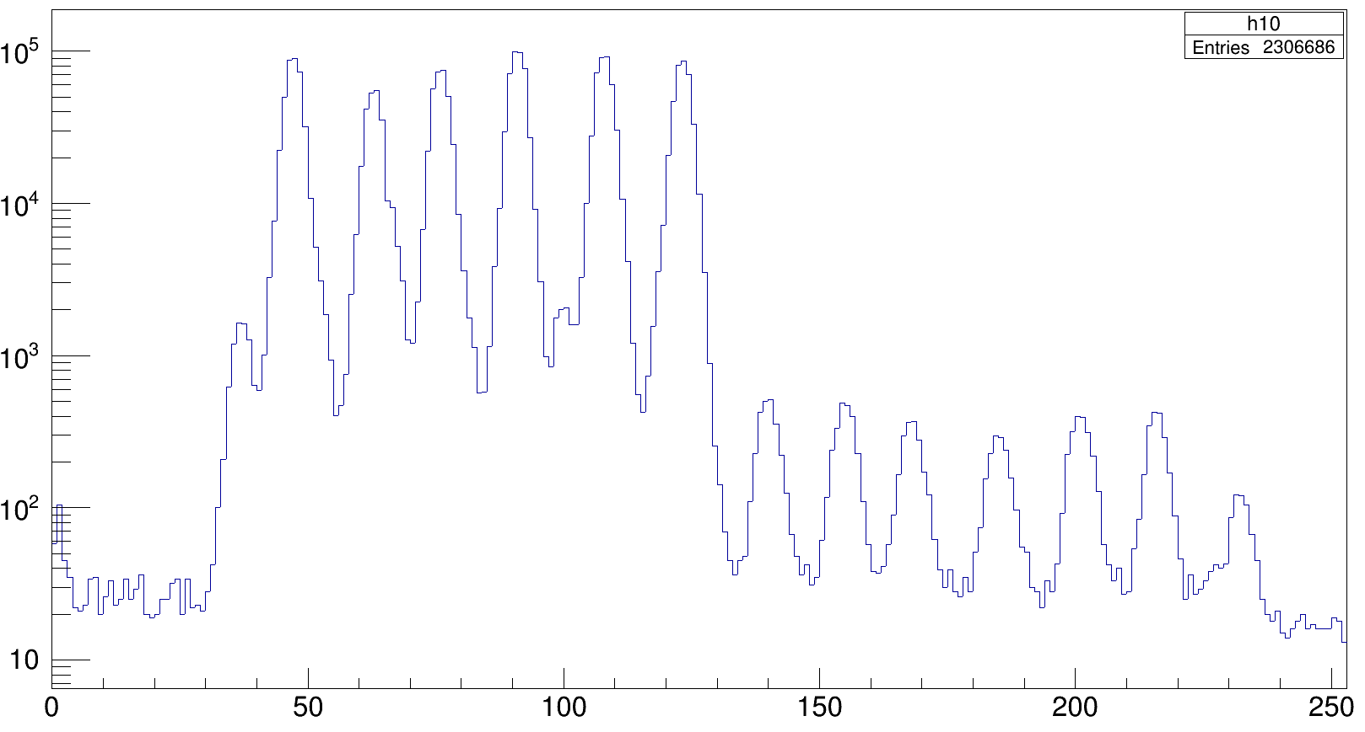
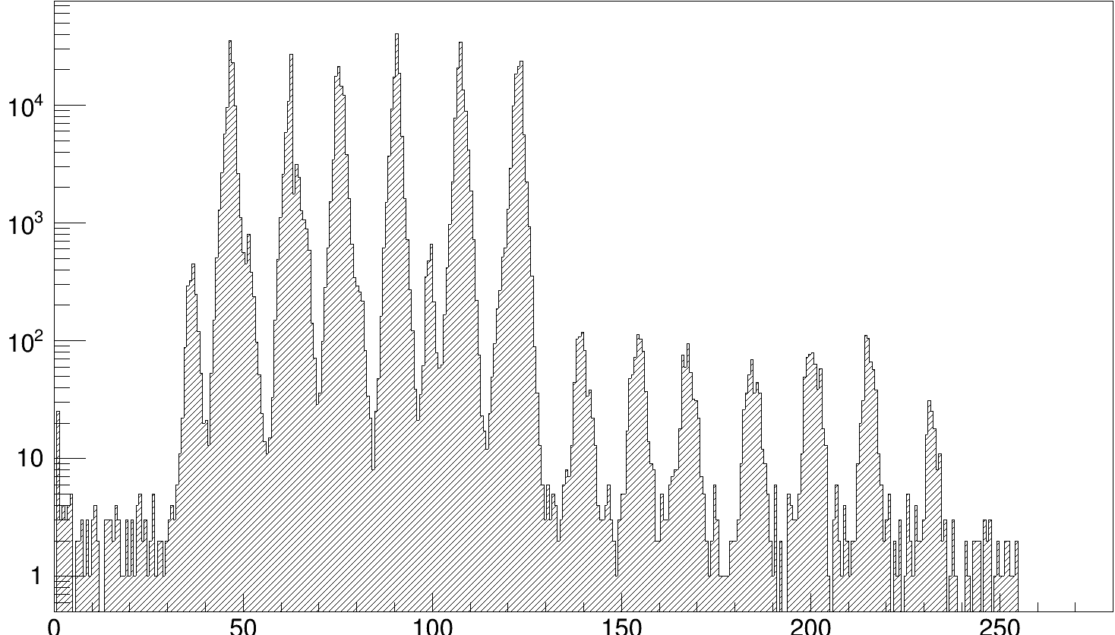
Clustering
Raw data : signals positions
Counts
6 high activity and 6 low activity
6 very low activity cells
Strip number
Clustering
Counts
Clusters centroid
Strip number
13

Slide 14
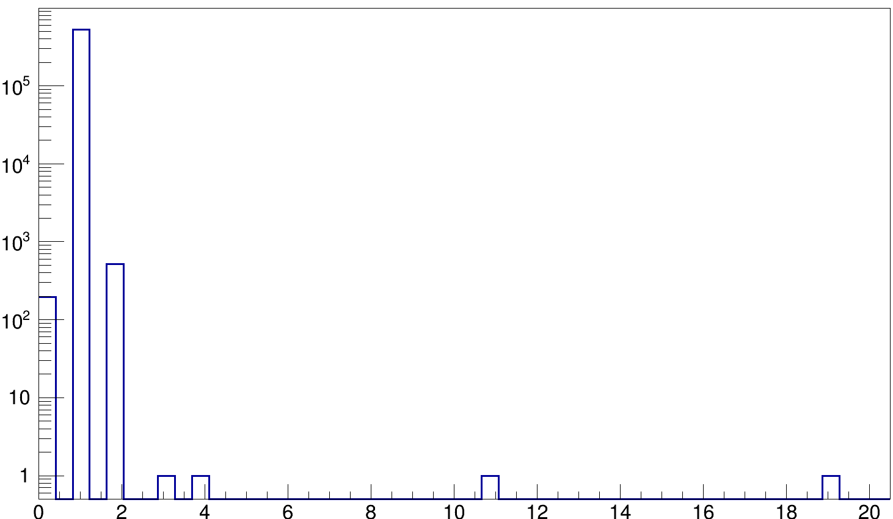
Event multiplicity
Histogram of the number of clusters per event
Tritium multi clusters probability : 0.002%
Events
Multi clusters events
Log scale
Number of clusters
Single cluster events
Events which don’t fulfil cluster conditions
14

Slide 15
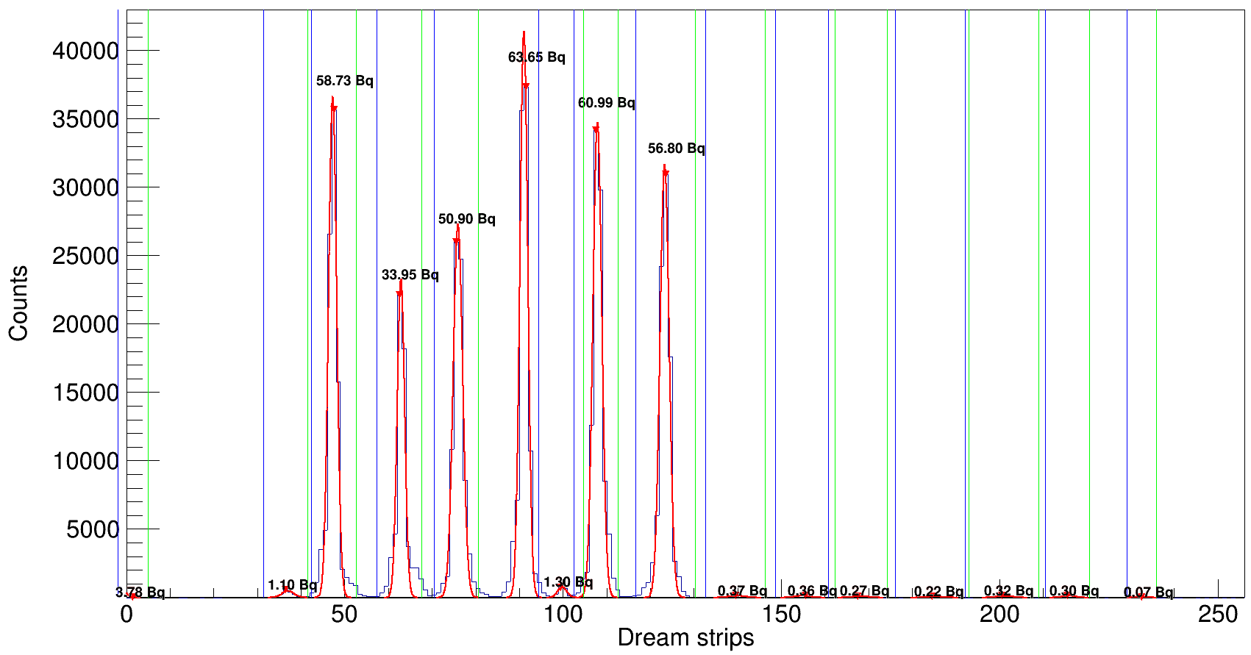
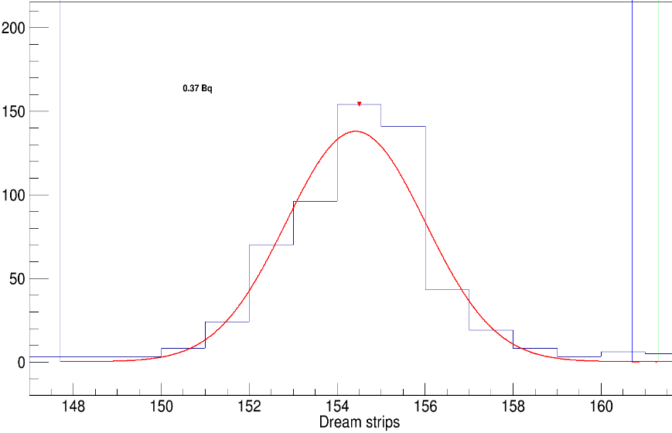
Activity measurement – 1st method : Integration
Blue and green lines : left and right limits of the gaussian pic→ ± 4σ.
Blue curve : Histogram of the number of events.
Red curve : Gaussian fit of the histogram.
Activity measurement : Ratio between the integral of the fit and the time of the full acquisition.
Gaussian fit and integration for activity measurement
Log scale
Single gaussian fit
15

Slide 16
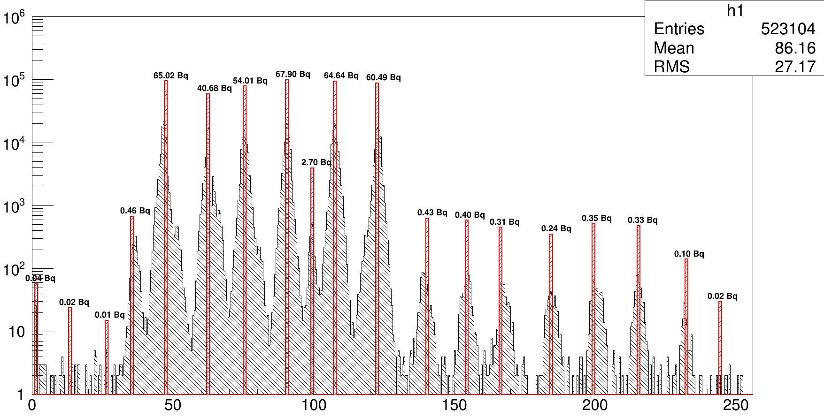
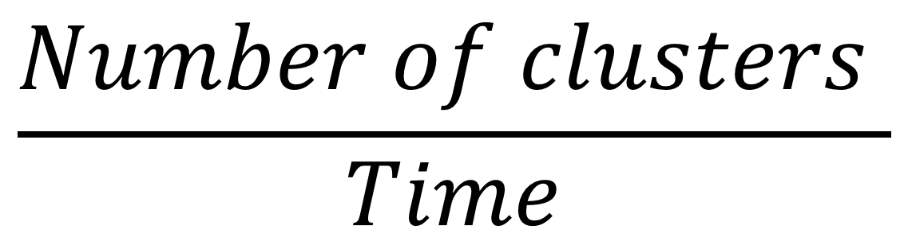
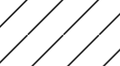
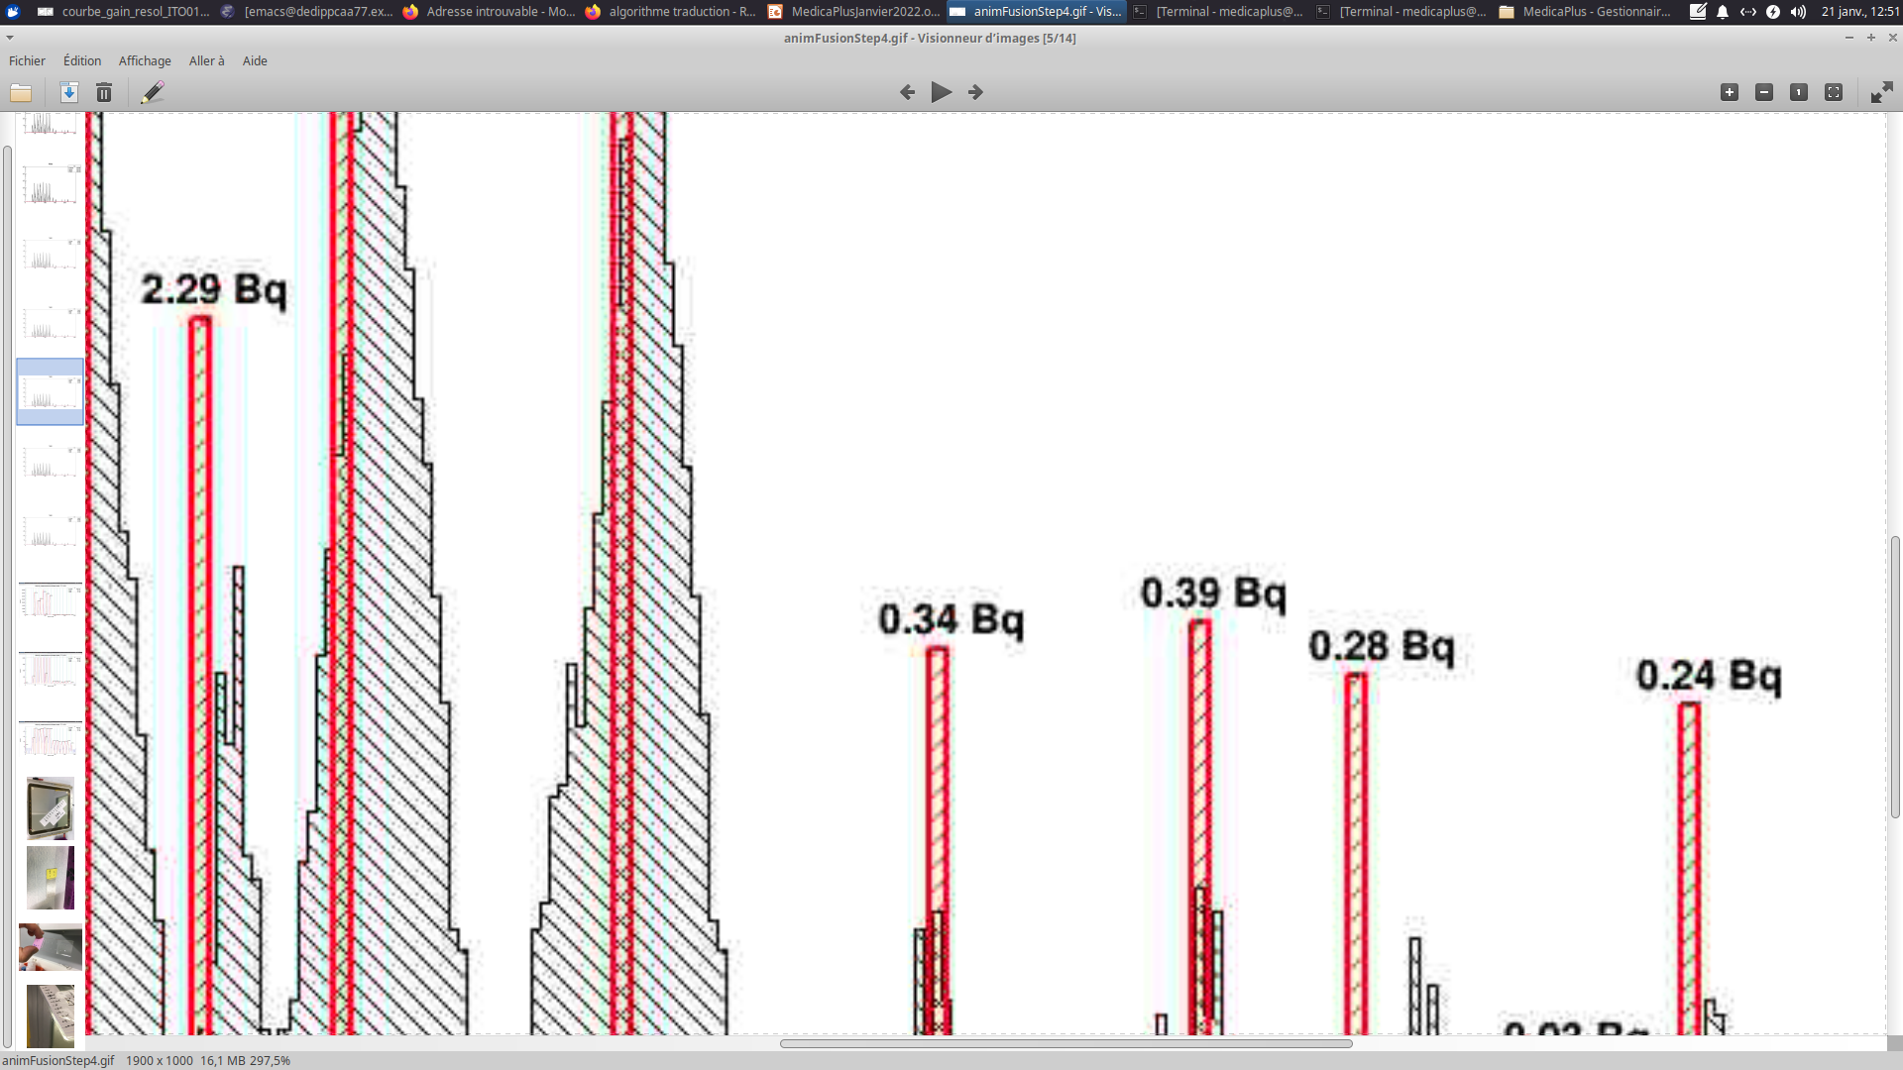
Activity measurement – 2nd method : association Algorithm
The algorithm evaluates a peak activity at every step of the events loop
Initialisation : Creates a peak with the first identified cluster
If the event cluster’s position is close enough to a peak position :
→ Associate the cluster to the peak
If the cluster is too far from the peak
→ Creates a new peak → Initialisation
Event loop
Activity measurement by peak association
Peak
- Position
- Number of clusters
- Time
- Activity =
Number of clusters
Data from the fit
Data from the algorithm
Strip number
16

Slide 17
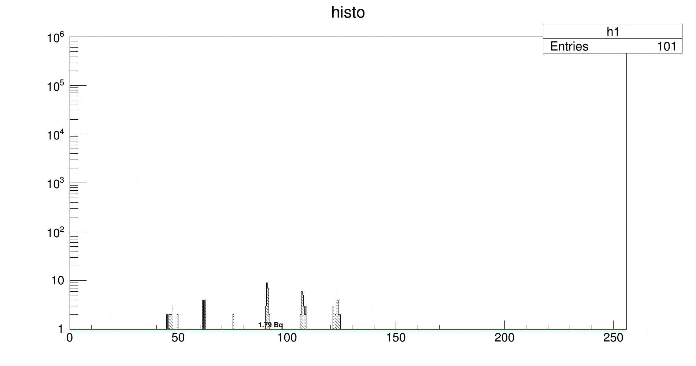
Activity measurement – 2nd method : association Algorithm
At the beginning : Reliable activity and position but some peaks are missing.
At the end : Activity and position have a better precision.
Number of clusters
Strip number
17

Slide 18
Activity measurement – Methods comparison
Integration (Bq) | Integration statistical error | Association algorithm (Bq) | Association statistical error | Methods accordance
59,07 | 0,003 | 65,04 | 0,003 | 90.8 %
31,24 | 0,004 | 40,66 | 0,004 | 76.8 %
51,74 | 0,003 | 54,03 | 0,003 | 95.7 %
64,33 | 0,003 | 67,89 | 0,003 | 94.7 %
62,12 | 0,003 | 64,66 | 0,003 | 96 %
57,87 | 0,003 | 60,47 | 0,003 | 95.7 %
0,38 | 0,042 | 0,43 | 0,040 | 88.3 %
0,37 | 0,043 | 0,4 | 0,041 | 92.5 %
0,26 | 0,051 | 0,31 | 0,048 | 83.8 %
0,23 | 0,054 | 0,24 | 0,053 | 95.8 %
0,32 | 0,046 | 0,35 | 0,044 | 91.4 %
0,31 | 0,047 | 0,33 | 0,045 | 93.4 %
Methods match 0,3 Bq
Methods agree at 90%
18

Slide 19
CONCLUSION AND PERSPECTIVES
Medica-Plus with standard micromegas
Validation of an experimental set-up with tritiated cells and glucose deposit
Efficient clustering and several activity measurement methods validated
Activities below 1 Bq were measured over 6 samples
Next steps :
Explore the lowest activity detection threshold of the detector
Use other gases (CF4) to limit transverse diffusion over a factor 2
Perspectives : Optical readout
19

Slide 20
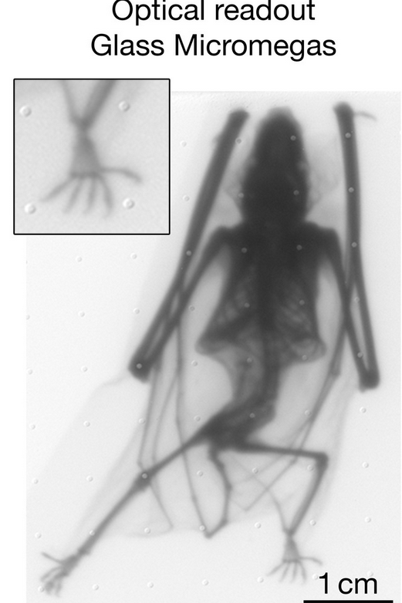
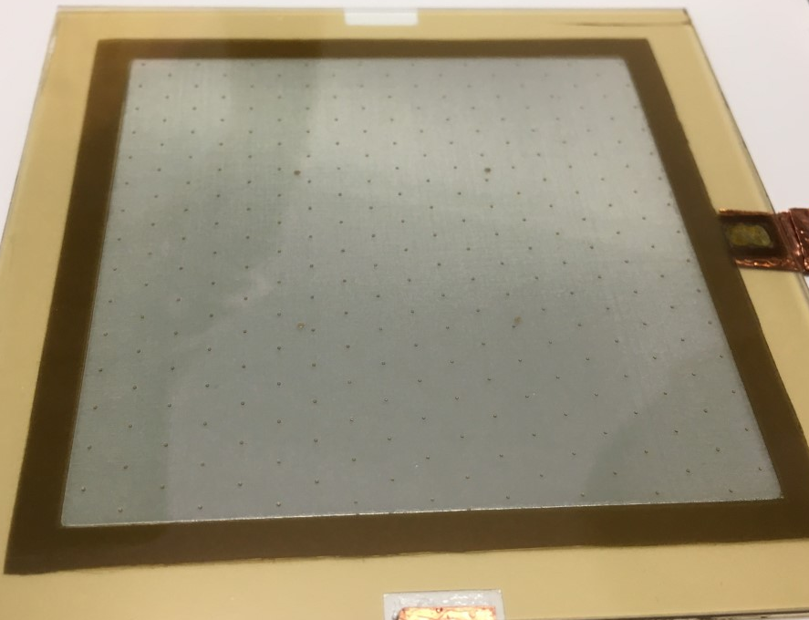
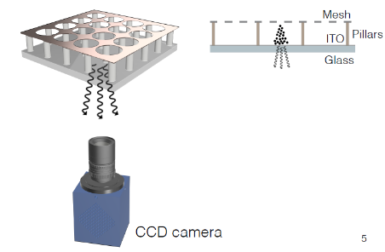
OPTICAL READOUT
Record scintillation light emitted during electron avalanche multiplication
Full 2D pixelized readout for high spatial resolution
Availability of commercial suitable cameras
Flexibility with lenses and mirrors for adjustable magnification and camera positioning
Transmission X-ray radiography of a small bat with glass Micromegas detector,
F.M. Brunbauer et al. NIMA 955 (2020) 163320
Glass Bulk detector for Micromegas detector built at CEA-Saclay
20

Slide 21
BACK UP
21

Slide 22
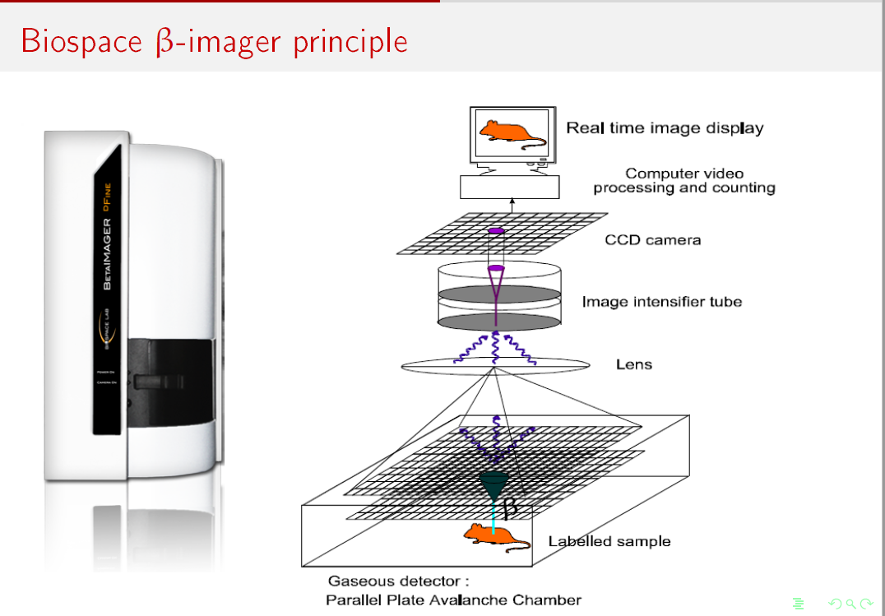
22

Slide 23
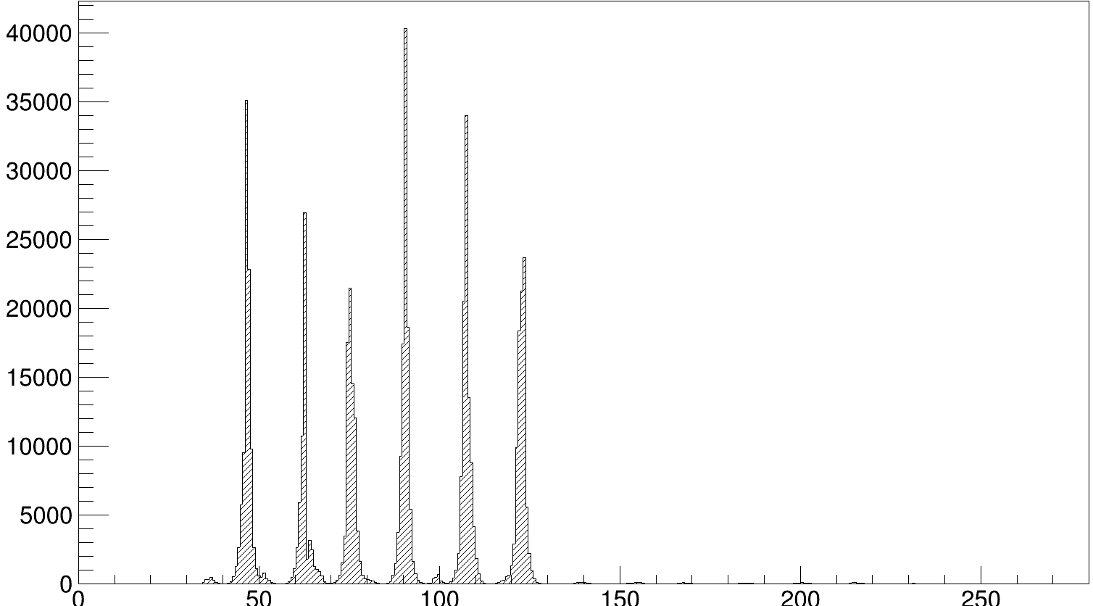
Medicaplus results - CLustering
Cluster Position Histogram
Clustering process
Online
Trigger on one of the 256 strips
Records 25 samples for each channel
Offline
Amplitude cut-offs
Common noise suppression
Strip number
Analyses the signal amplitude of each sample for every strips
Associates the signal to a cluster if the amplitude is above the threshold
Log scale
Compute the cluster position, amplitude, centroid...
23

Slide 24
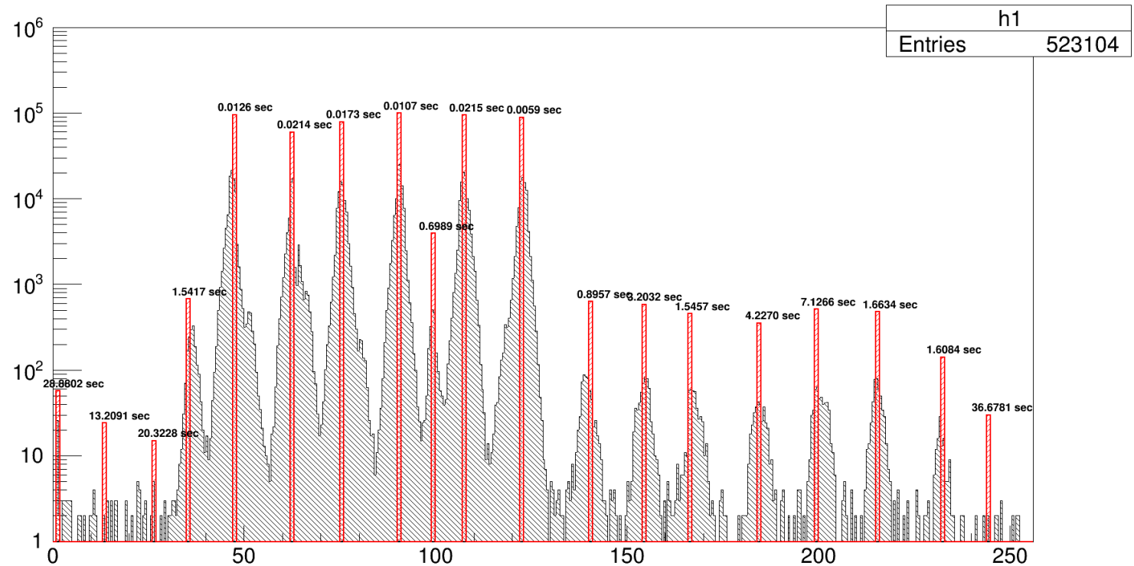
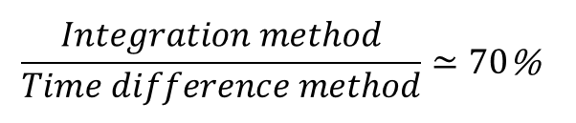
Activity measurement – 3rd method : Time difference
Number of clusters
Strip number
Measurement of the mean time difference between two consecutive events of a same peak.
The inverse of the time difference gives the activity.
24

