Slide 1
Plans for FTM test beam in 2022
Antonello Pellecchia
Piet Verwilligen
Dipartimento di Fisica, Università degli studi di Bari
INFN, sezione di Bari
RD51 Mini-week – Feb 10, 2022

Slide 2
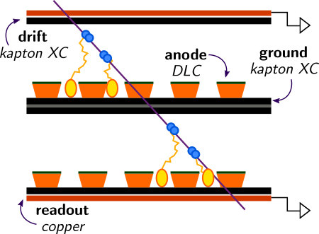
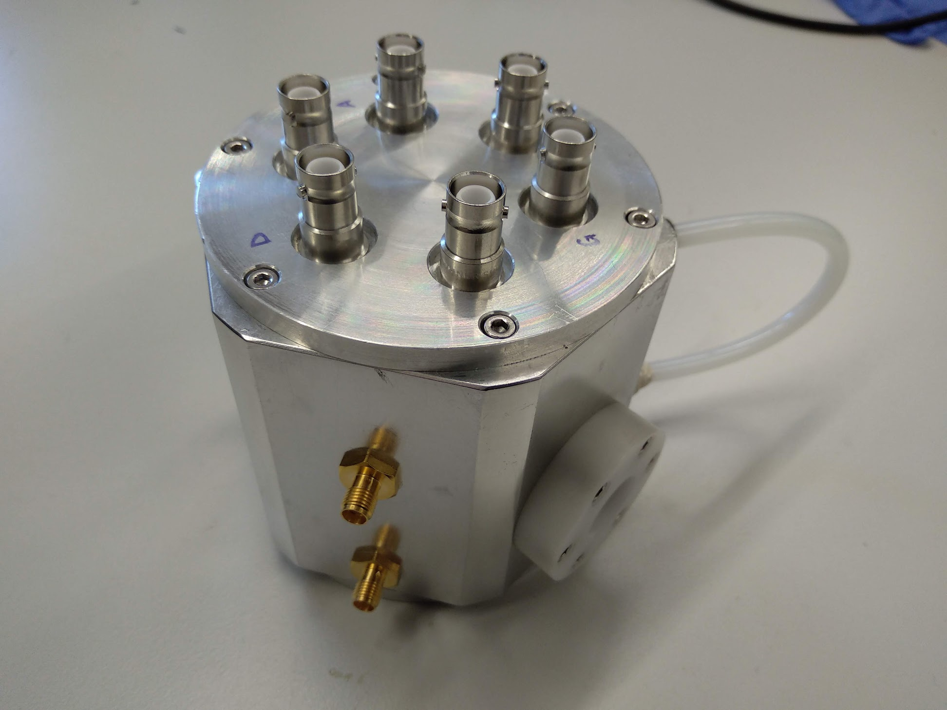
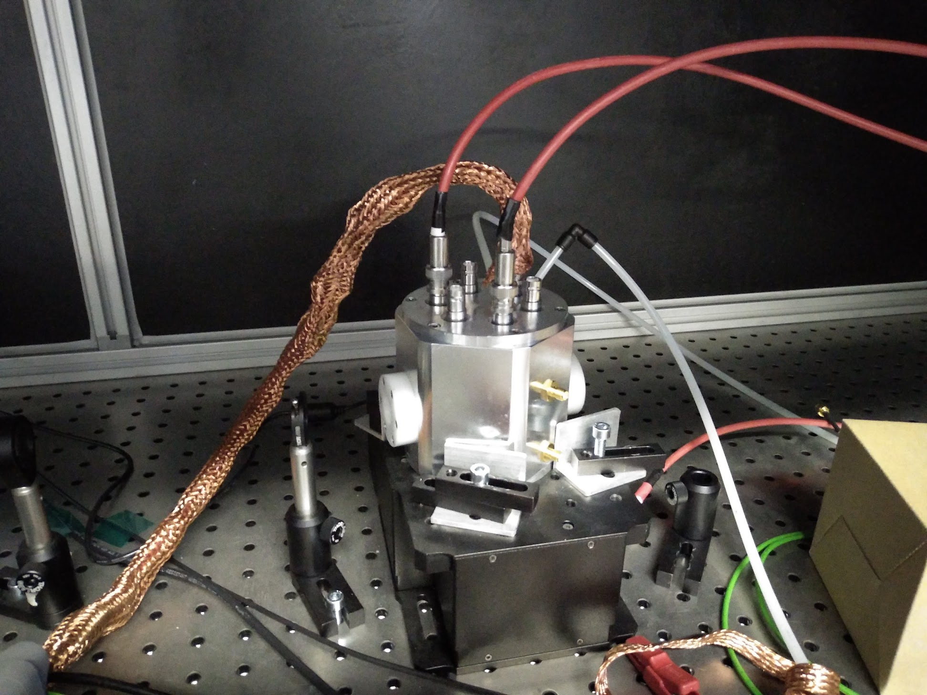
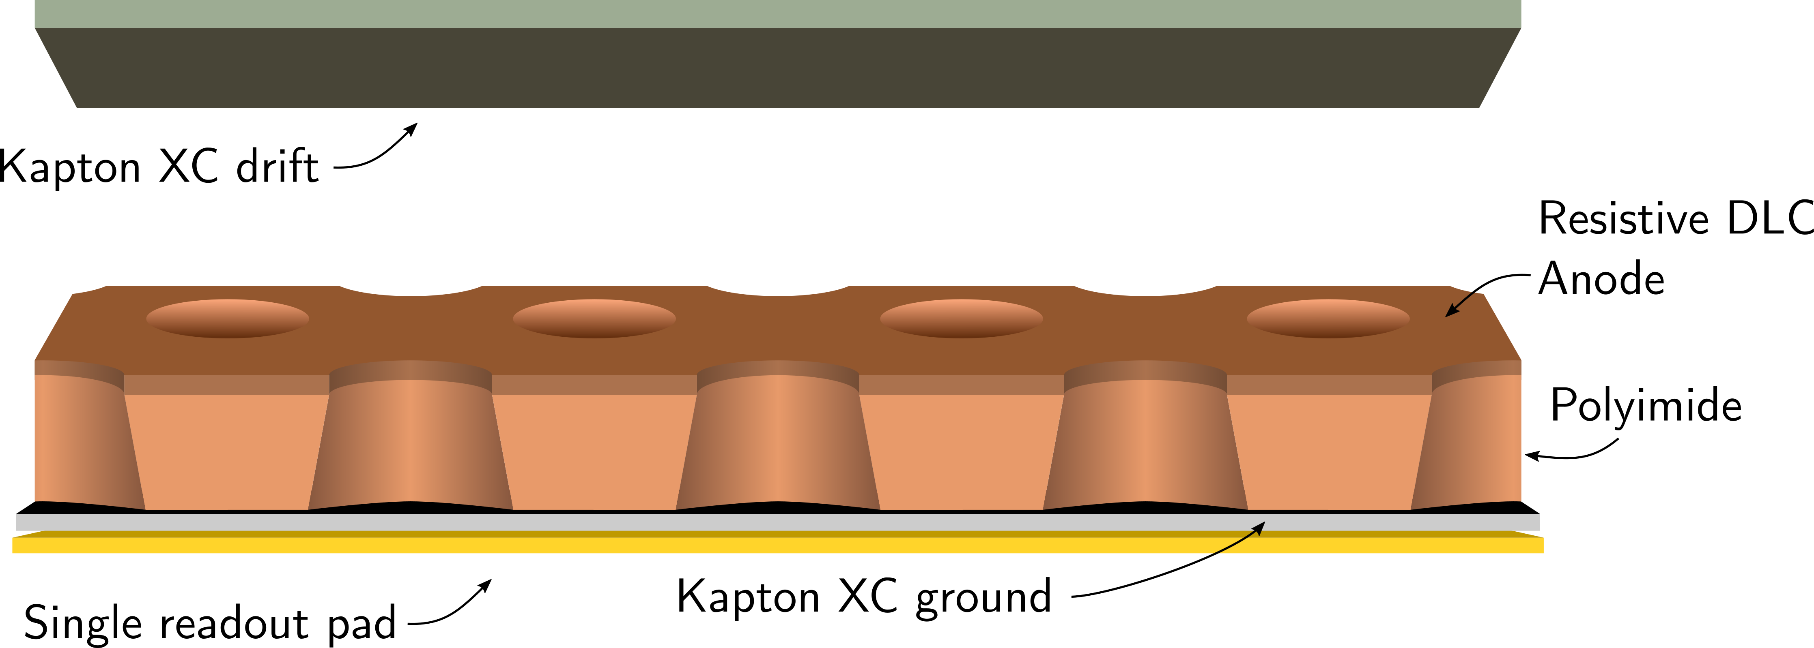
Reminder on FTM layout and goals
FTM goal:
Achieve O(100 ps) time resolution fully resistive multi-layer MPGD
2-layer FTM layout
Present R&D on:
DLC foil stability to high fields
High enough effective gain (>10⁴)
Good efficiency and R/O capacitance improvements
Multi-layer readout coupling
Dedicated readout electronics
done!
ongoing
Test beam goals:
Prove good efficiency with muon and pions
Demonstrate time resolution dependency on number of layers on a small surface
Advertisement drawing
Single foil, single pad readout
-1000 V
0 V
500 V
Pictures of small FTM prototype to be tested

Slide 3
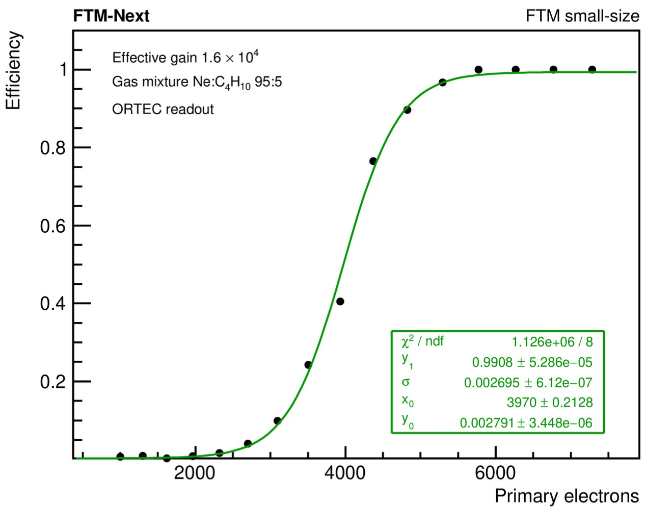
FTM Status – gain and efficiency
Results on single-layer prototype from results in various gas mixtures
OUTDATED
(thank god!)
Gain: good 👍 (over 10⁴ in Ne/iC₄H₁₀)
Currents measured with picoammeter
Source: laser
We should be able to see MIPs
Maximum achievable gain always lower than μ-RWELL
Efficiency: bad 😕 (5000e⁻ primary charge)
Primary charge measured by picoammeter
Source: laser
Readout: ORTEC 142PC (4 mv/fC)
Cannot see MIPs despite good charge amplification
Evidence of readout coupling issues

Slide 4
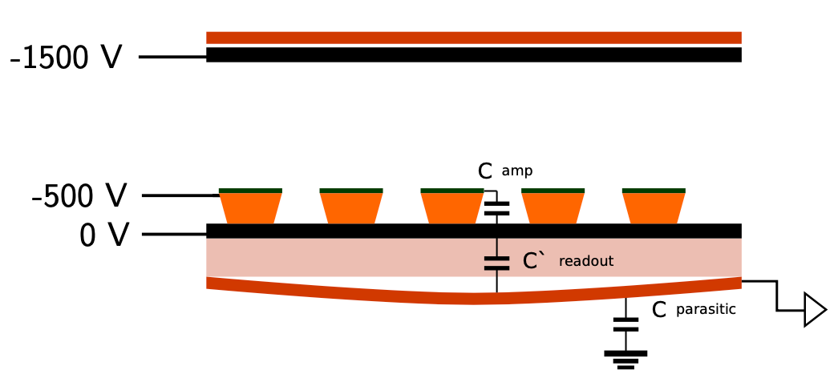
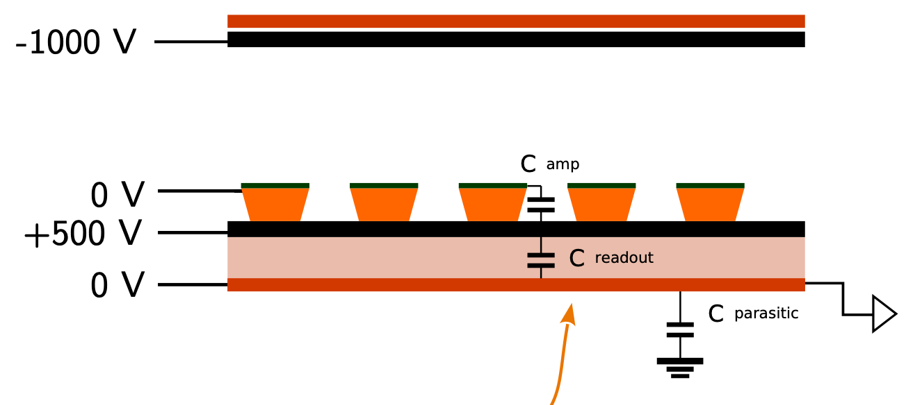
Efficiency, Foil deformation and r/o capacitance
We realized the low efficiency is related to readout electrode deformation
→ visible deformation (100 μm)
→ low attachment of R/O to bottom electrode
→ reduced R/O capacitance, signal invisible
Solution: ensuring attachment of R/O to amp bottom by electrostatic force
Ongoing tests to verify efficiency with new HV distribution
Plan in test beam: verifying minimum attachment voltage for good efficiency
Alternative solution: FTM with read-out plane glued with bottom electrode

Slide 5
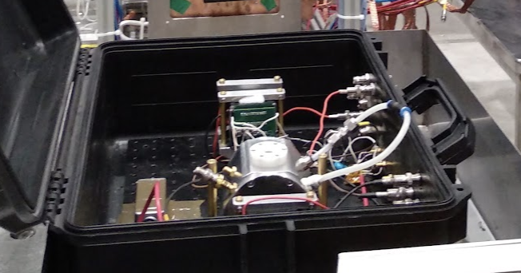
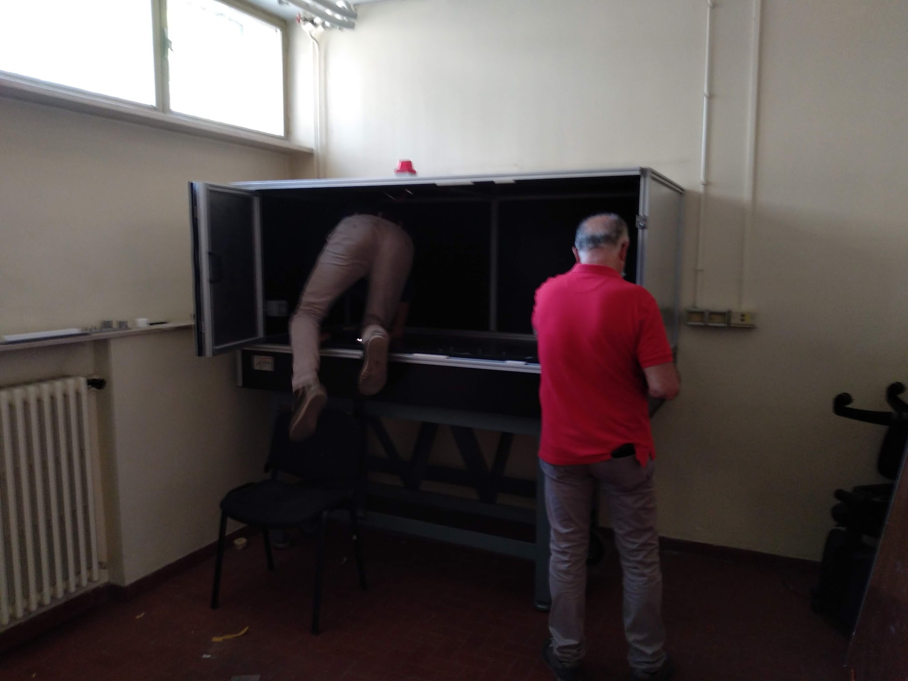
FTM test beam setup
Dark box*
MCP-PMT
FTM
HV
MaPMT
MaPMT
DAQ PC
MCP-PMT
FTM
MaPMT
Desiderata
Ne:iC₄H₁₀ 95:5
Vertically moving table if available
Scope
20 GS/s
4 GHz
TRG
Acquisition and analysis
Reference: 2xMaPMT (trigger) + MCP-PMT (timing)
All waveforms saved and analyzed offline
  Local waveform saving on scope: several kHz
  Real-time transfer to DAQ PC (ethernet): < 200 Hz (??)
  Other options? (USB, GPIB, transfer on separate thread…)
* Also useful for hiding from your boss

Slide 6
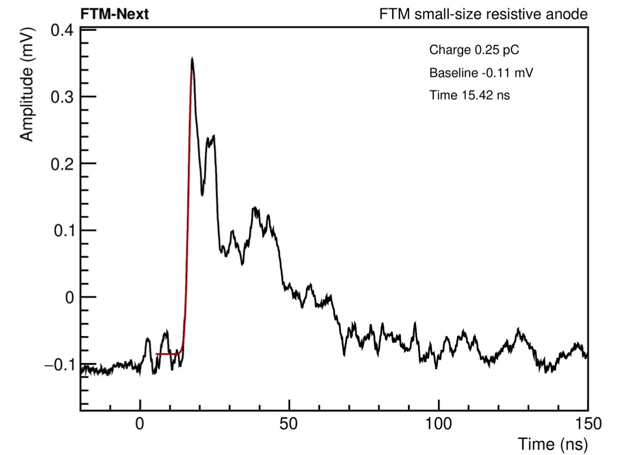
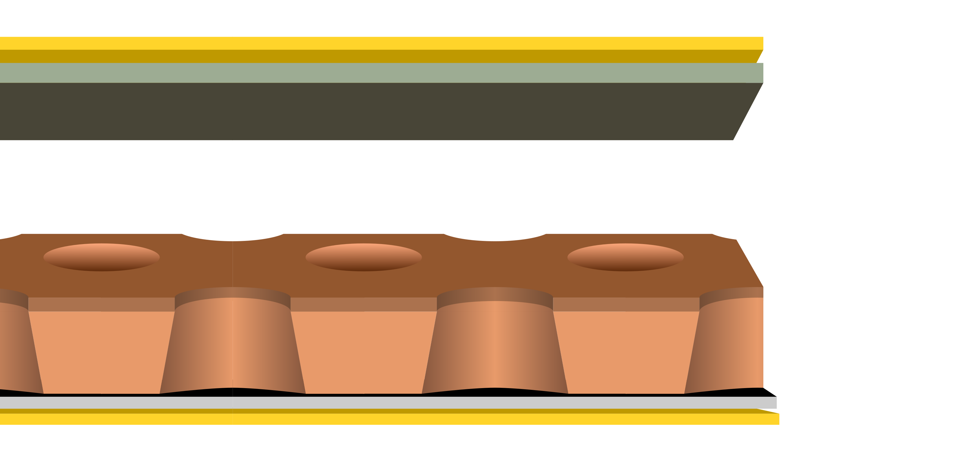
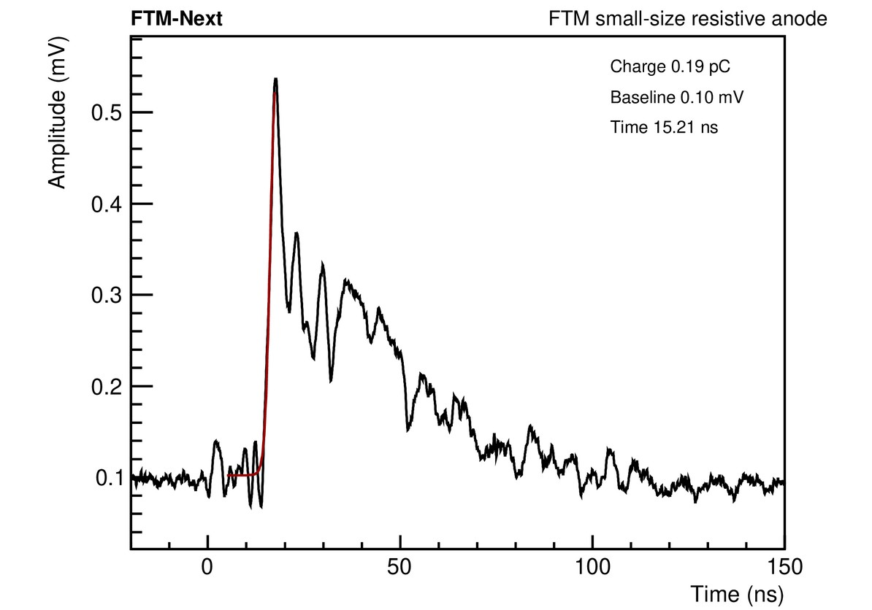
FTM readout
Scheme 1
Scheme 2
Top
Cividec C2-HV
Ortec 142 PC
For timing and efficiency
For signal transparency measurement
Bottom
Ortec 142 PC
Ortec 142 PC
Ortec 142 PC
Charge amplifier
Long integration time (> 100 ns)
High S/N ratio
Cividec C2-HV
Linear amplifier
Fast shaping
Low S/N ratio
Signal transparency already observed with laser, to be confirmed with MIPs

Slide 7
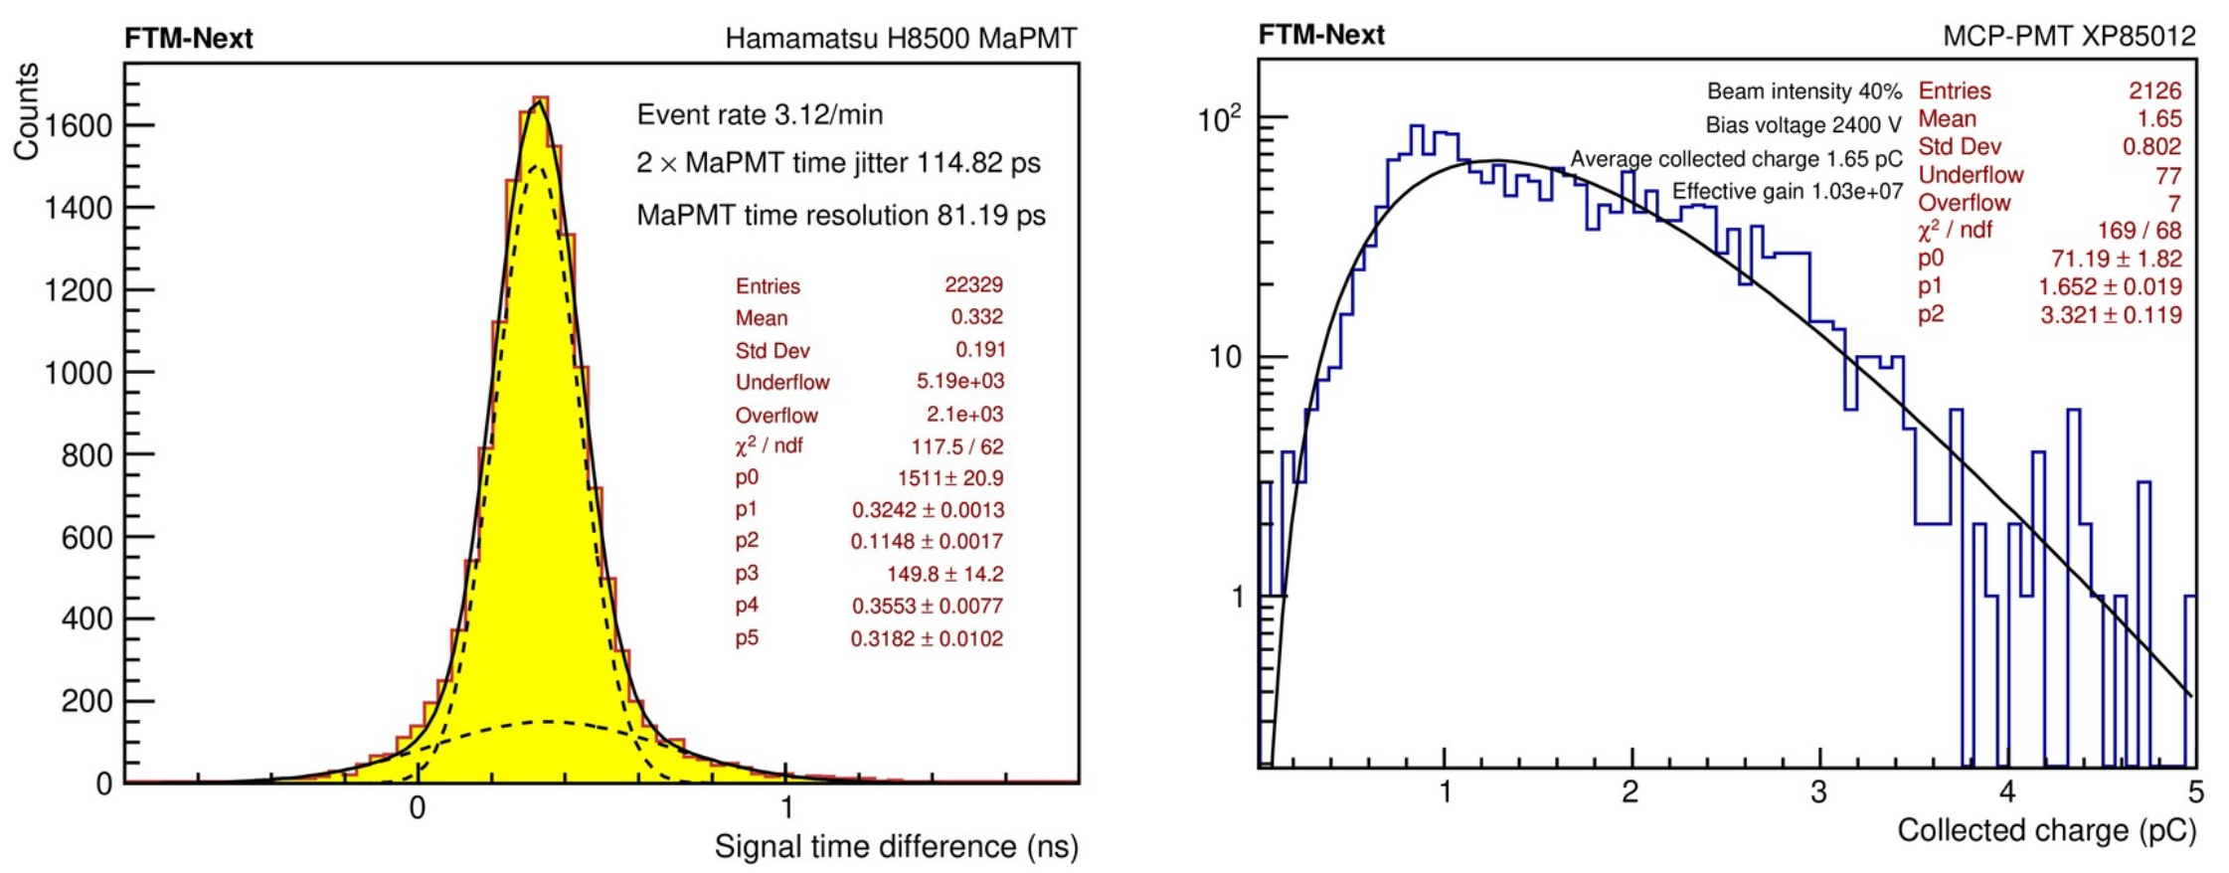
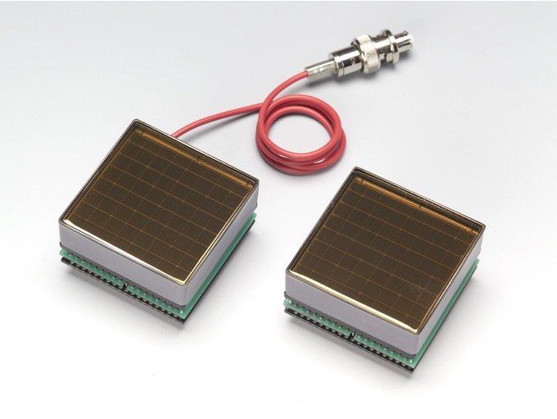
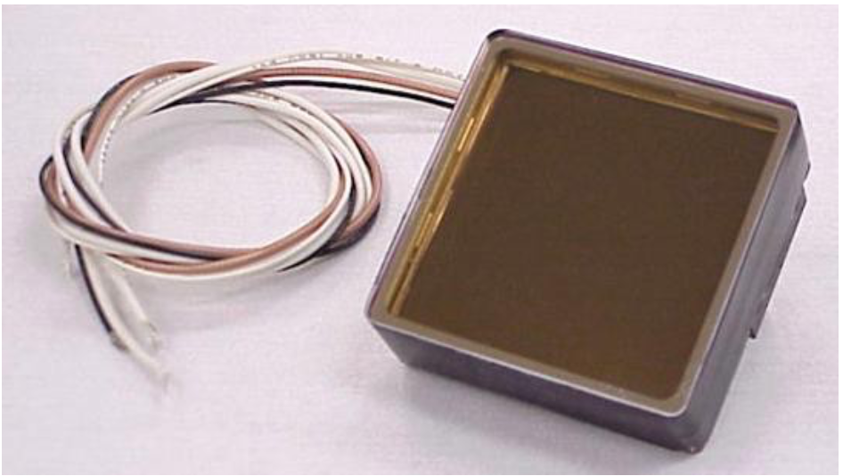
On the reference detectors
Trigger
H8500 MaPMT (x2)
81 ps time resolution
measured with cosmics
(2xPMTs in coincidence)
Timing
XP85012 MCP-PMT
10⁶-10⁸ gain measured with UV laser
Could not measure good time performance from MaPMTs
(expected 37 ps for single e⁻)
Single e⁻ charge 1.65 pC
Gain 1.03 × 10⁷

Slide 8
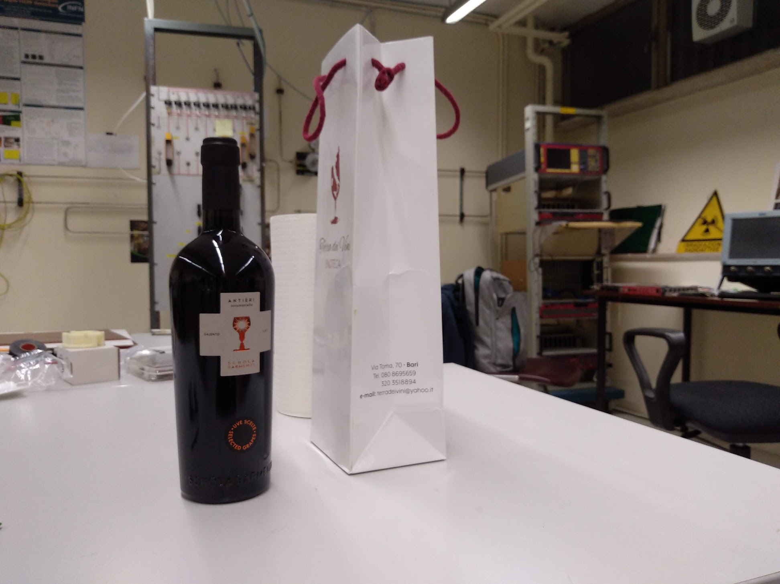
Alternative plans
If this does not work…
Getting drunk in the lab

Slide 9
Backup
????

Slide 10
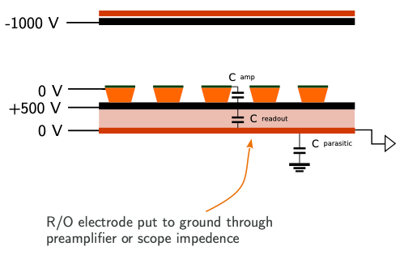
Solution for low readout capacitance
If the ground and readout electrodes are put at a high voltage difference, they will stick together preventing the decrease in the readout capacitance
→ Electrode voltages to be slightly revised

Slide 11
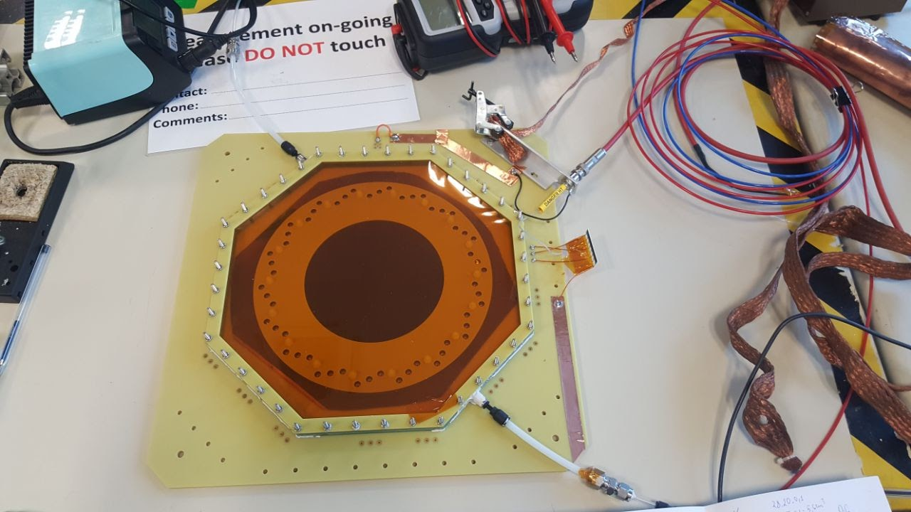
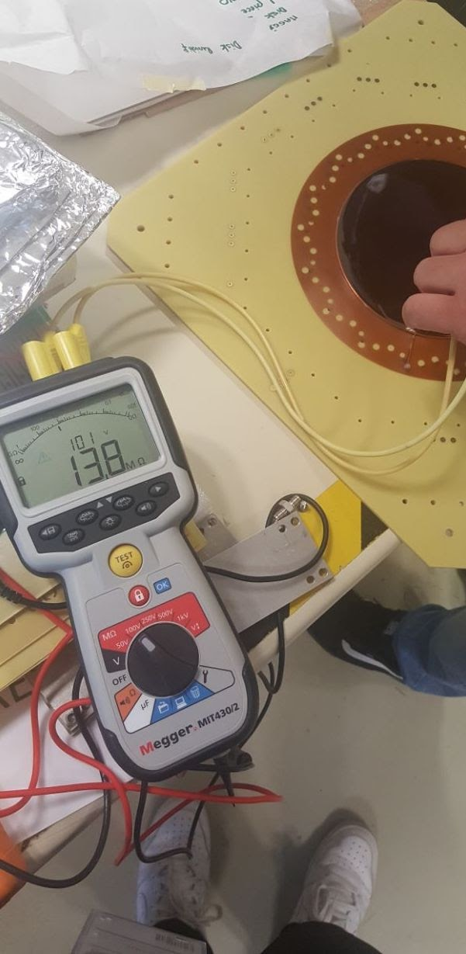
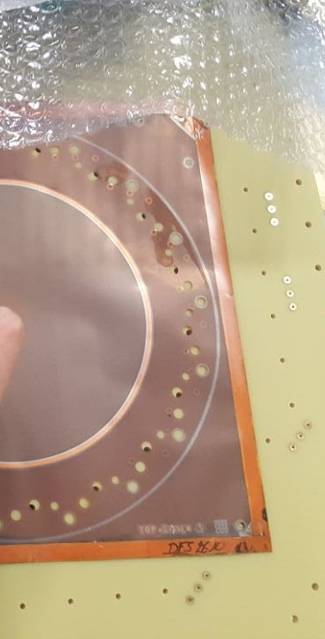
Outcome of the tests
Test performed on Marcello’s prototype at CERN:
Adhesion test by observing arrachment in clean room en plein air
500 V applied with Megger between ground (kapton XC) and readout (copper)
Signals with x-ray and increasing HV between ground and R/O
Outcome:
No adhesion up to 1 kV
However, if we apply less than 500 V between amplification top and ground, we see the amplification foil attaching to the ground. So maybe the R/o foil is too stiff?
No signals with x-ray up to 500 V between ground and R/O
However, without laser it is difficult to quantify the point of efficiency (not possible to change primary charge at wish)

Slide 12

Considerations and plans
Induction tests to be performed on small size prototype (smaller foils, more flexible)
Options for longer term:
Having ground and electrode foils glued
Could the charge collection be improved by having amplification and bottom produced already glued?
Possibility to have all three electrodes already glued? (à la μ-RWELL I think)

Slide 13
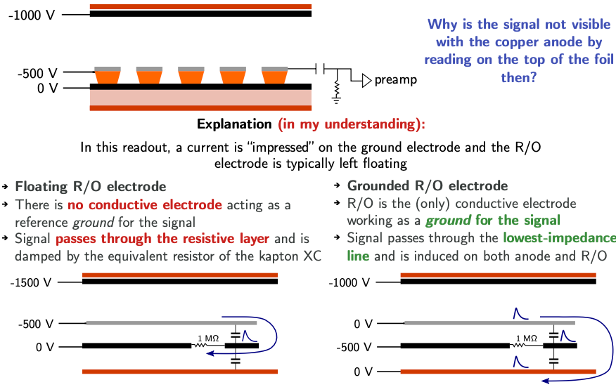
About the u-RWELL mode

Slide 14
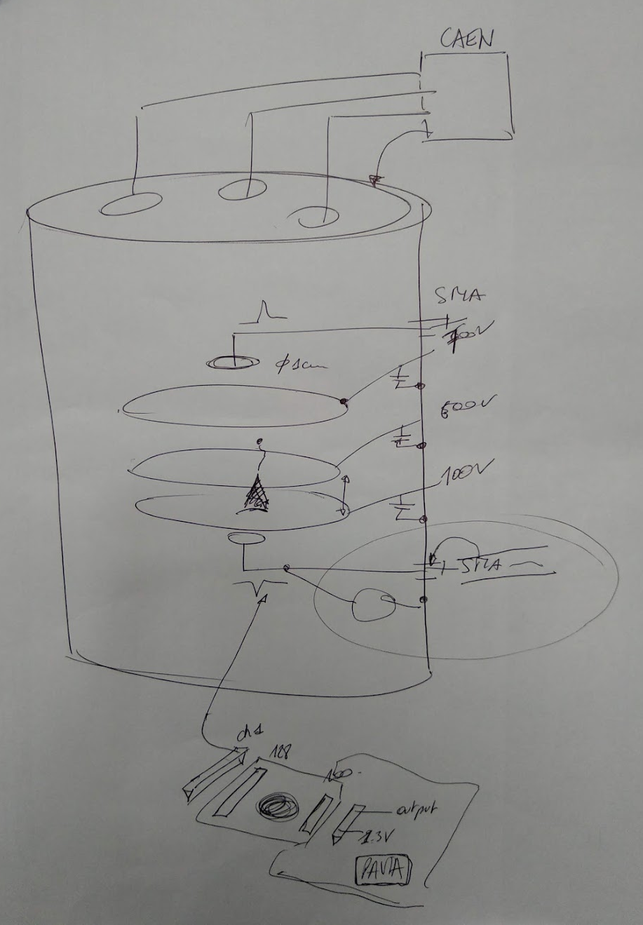
FTM scheme

