Slide 1
Keys an bladders cross sections
Proposal for FalconD

Slide 2
From the previous experience on Nb₃Sn magnets two axes of work:
  Quality of coils – Winding, thermal treatment tools.
  Stress management in the structure – limit peaks of compression in the coils.
Take the time to carry out winding tests – Check if tools can be improved.
Design ‘intrinsically safe’ structures. Identify and manage effect of tolerances on coil compression.

Slide 3
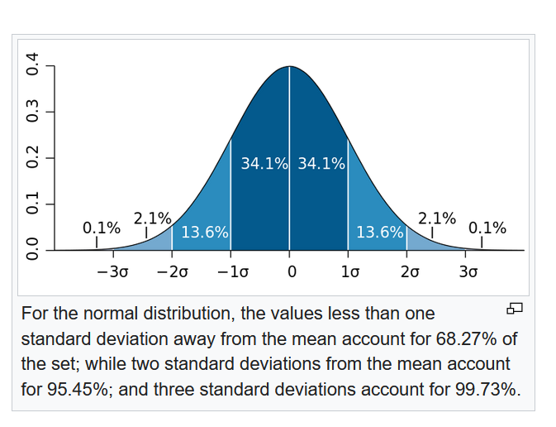


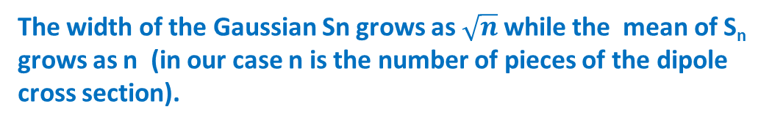
A Sum of Gaussian Random Variables is a Gaussian Random Variable
S_{n} sum of n statistically independent random variables x_{i}
The mean value of the sum is the sum of the individual means.
The variance of the sum is the sum of the individual variances.
If all the individuals x_{i} have the same probability density we have:
The width of the Gaussian Sn grows as $\sqrt{n}$while the mean of S_{n} grows as n (in our case n is the number of pieces of the dipole cross section).
Reduce the number of pieces to be less sensitive to tolerances

Slide 4
Intrinsically safe structure
Work with closed cavities (whenever possible)
  To protect the coils from over stresses.
  To control unbalanced stresses. The alignment precision of long presses or long ‘force’ tools is limited.
Rigid material. Collars or paddles.
Soft material. Coils.

Slide 5
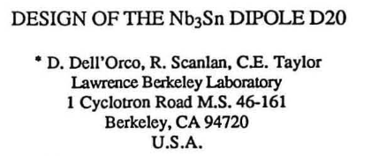
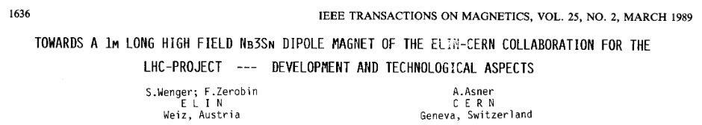
Effect of horizontal interference
Compression is added at the top inner corner of the coil. This is the first place to loose the contact with the collars at energization.
Traction is added at the coil midplane inner radius. This is the place where the compression is maximal at energization.
Compression
F
F
Traction
A moderate horizontal interference can help to control stresses in the coils.
In the past some dipoles were built and tested using this principle but with large interference. Good and less good results.
1992

Slide 6
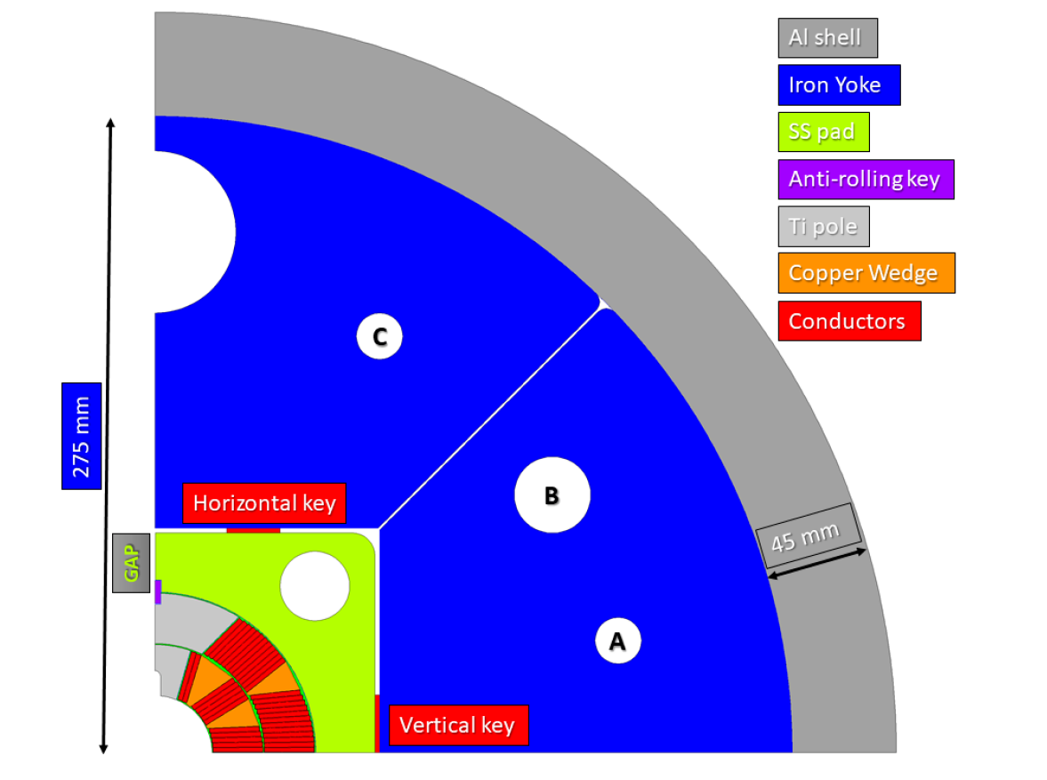
Cross section presented in FalconD TDR
INFN/Code-19/001
Reduce nº of pieces
Prevent coil over stresses

Slide 7
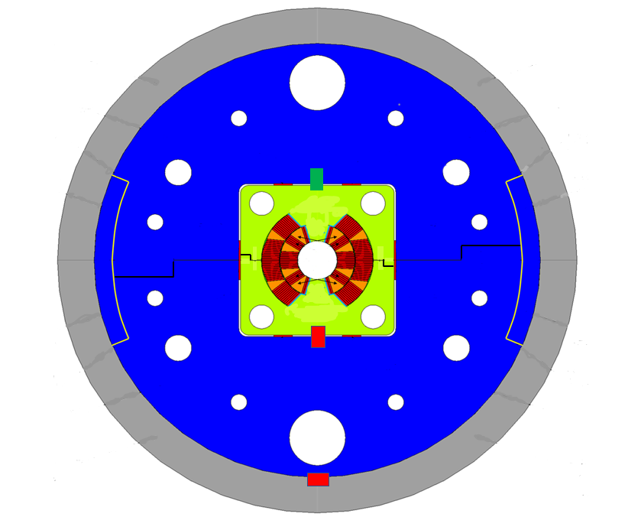
Proposed cross section
Horizontal gap closed after cool down. Closed cavity.
Tight tolerances for the cavity but coil shims. Angles are important.
Pushing key. Large horizontal clearance (0.2 – 0.3 mm)
Horizontal gap always open.
Large tolerances.
Aluminium insert. Longer than in the picture. Just to easy the assembly. Aluminium cylinder heated and slightly forced on the two half yokes kept at the right position by the inserts.
Horizontal alignment of the iron yoke halves. 0.0 – 0.1 mm clearance of undeformed parts for assembly.
Clearance absorbed by the horizontal pushing key.
Horizontal alignment of the paddles. 0.0 – 0.1 mm clearance of undeformed parts for assembly.
Clearance absorbed by the horizontal pushing key.
Fix line. Longitudinally free key. Horizontal clearance just to insert it (0.05 – 0.1 mm).
Pushing key. Horizontal clearance just to insert it (0.05 – 0.1 mm)
Moderate coil prestress at room temperature (50-60 MPa). Higher compression at the end of cool down (70-80 MPa).

Slide 8
Proposed longitudinal section
Do we need the inside tie rods? Or tie rods in general?
They weaken the pads where there is the need of space for the bladders.
  Suppress the tie rods in the pads.
  Fix the end plate to the outside aluminium cylinder with sector inserts.
  Use an end cage to load the first turns of the ends and not only the last (as it would happen with tie rods and friction).
Aluminium cylinder
End plate
Inserts
Iron yoke
Tie rods
Pads
End cage
FalconD TDR
Proposed modifications

Slide 9
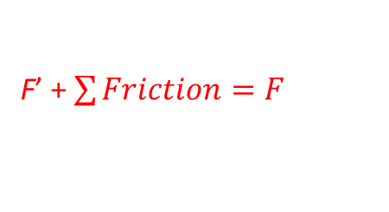
End cage working principle – longitudinal compression of first turns.
Surfaces with friction
Iron laminations
F’ + $\sum{Friction=F}$
Collar laminations or pads
Iron laminations
Coil end 2nd layer
Coil end 1st layer
F’
F
Load from bullet gages
Preloaded bolts to compress longitudinally the coil ends in a controlled way.
Iron laminations
Collar laminations or pads
F’’’
F’’
Load from bullet gages

Slide 10
Programm of the FEM computations (FalconD and more).
Study of the nominal configuration.
  Linear coils.
  Non linear coils.
  Austenitic stainless steel pads (contraction 3 mm/m).
  High manganese steel pads (contraction 1.9 mm/m).
Effect of tolerances.
  Variation of one parameter per time.
  Montecarlo approach.
Study of an alternative, low number of pieces cross section.
Compute a ‘12 T coil configuration’, double aperture, in view of the construction of an instrumented mock-up.

Slide 11
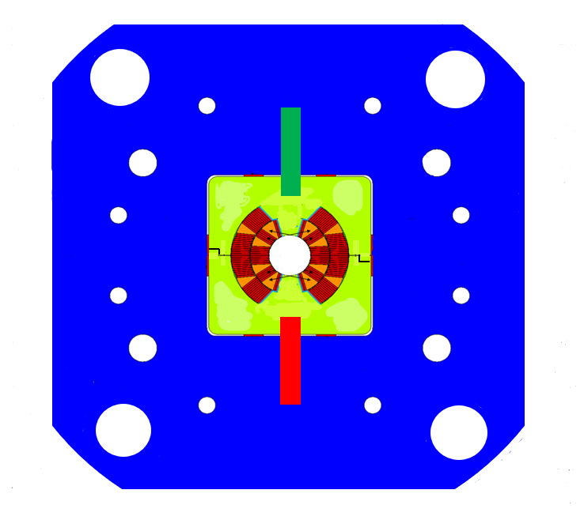
Single iron lamination, large tolerances.
Invar inserts.

