Slide 1



FalconD – FEM Analysis
Preliminary results
High Field Magnet Program
Przemysław Wąchal
TE-MSC-SMT/HNINP
11.01.2022

Slide 2
Outline
Introduction
  Basic magnet cross-section – general view
  Changes in the geometry of the magnet structure – proposed configuration
  FEM Analysis
    Assumptions
    Material properties, Loads & BC
    Optimized cases
    Optimized case – Kawasaki SS Pad
    Optimized case - Shims

Slide 3
Basic magnet cross-section – general view
Technical Design Report
INFN/Code-19/001
Basic geometry of the magnet – 2D cross-section

Slide 4
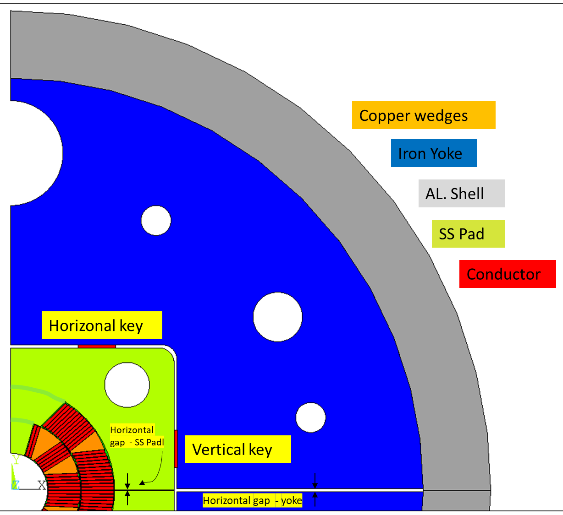
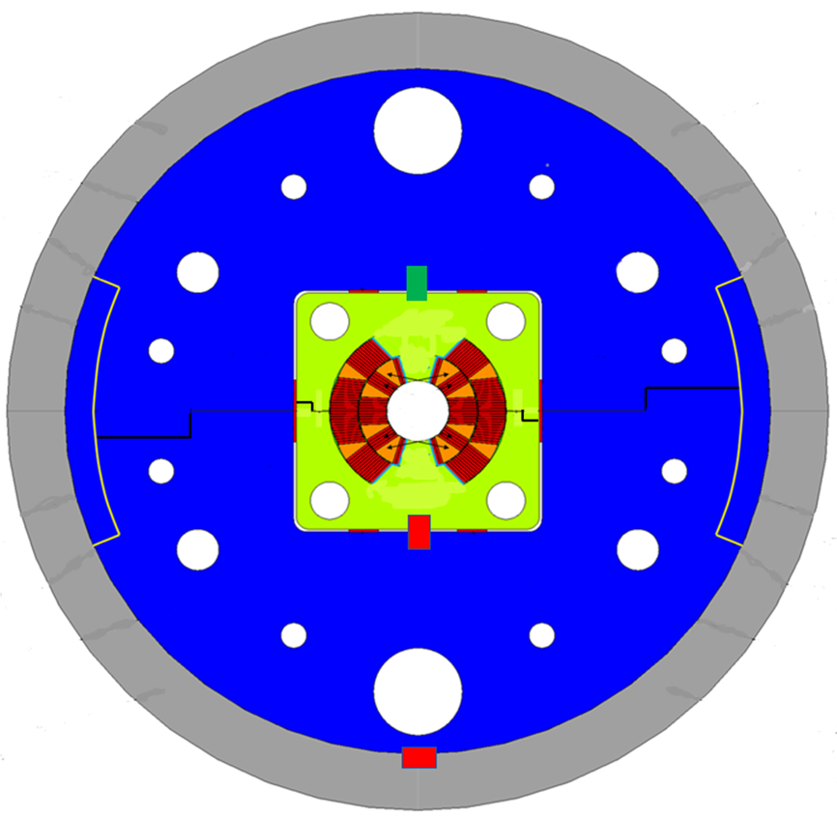

Proposed geometry of the magnet structure – general view
$$≅$$
Proposed geometry of the magnet– 2D cross-section

Slide 5
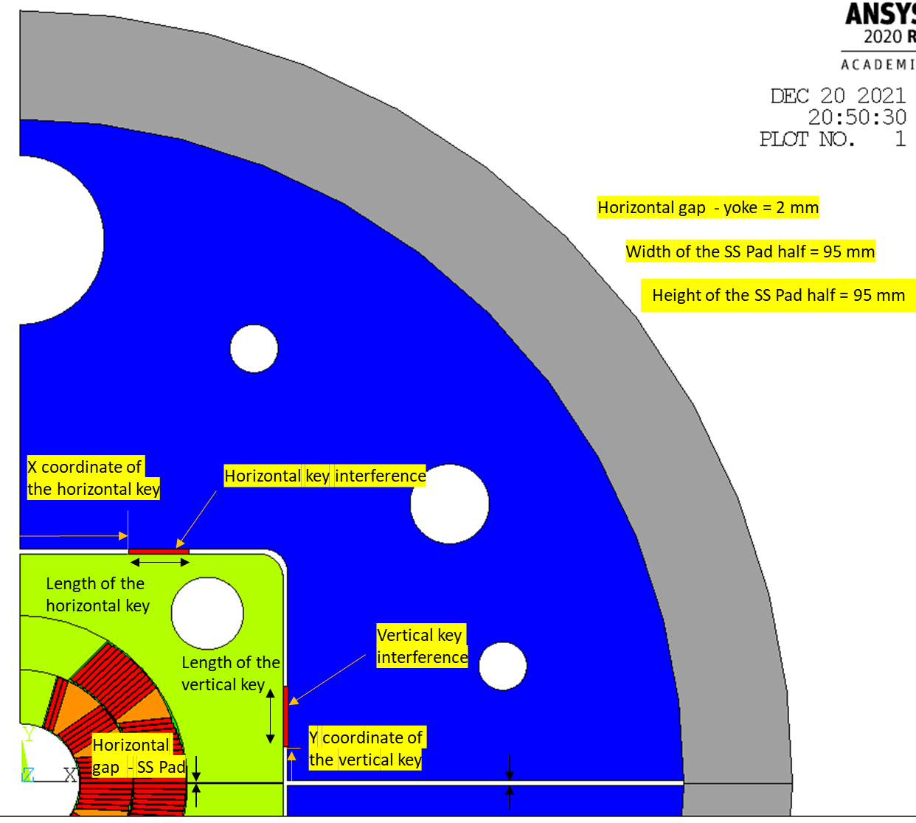
FEM Analysis - assumptions
Optimization of the structure – 1st stage
Design variables:
  X coordinate of the horizontal key; 0-60mm
  Y coordinate of the vertical key; 0-60mm
  Length of the horizontal key; 20-30mm
  Length of the vertical key; 20-30mm
  Horizontal key interference; 0.001-0.5mm
  Vertical key interference; 0.001-0.5mm
  Horizontal gap between SS Pad halves;
  0-0.7mm
  Constants:
    Horizontal gap between yoke halves
    Width of the SS Pad
    Height of the SS Pad
Description of the design variables

Slide 6
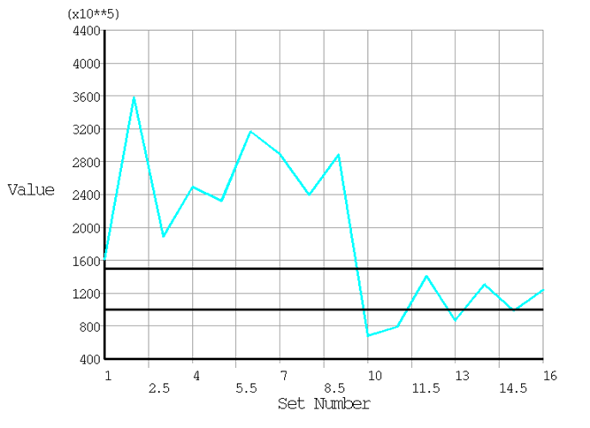
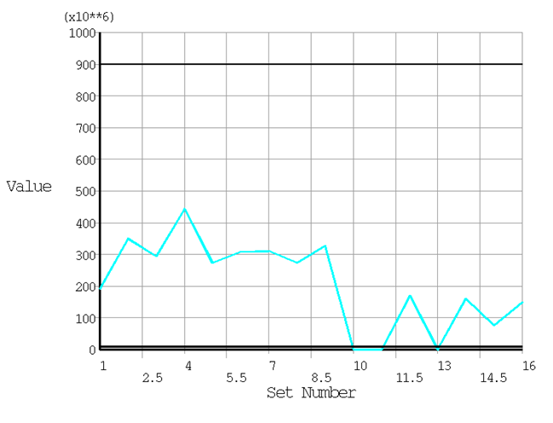
FEM Analysis - assumptions
  Azimuthal stress at 3rd load step
Optimization of the structure – 1st stage
State variables:
  Azimuthal stress at 1st load step; 10-70 MPa
  Azimuthal stress at 2nd load step; 70-110 MPa
  Azimuthal stress at 3rd load step;110-150 MPa
  Non zero value (above zero) of the contact pressure between coils and SS Pad at pole region; >0 MPa
  Objective function:
    Von Mises stress at 3rd load step – energization; up to 150 MPa
Max contact pressure between coils and SS Pad
Assumed stress limit in the coils at energization load step = 150 MPa

Slide 7
FEM Analysis - assumptions
Tuning of the final parameters – 2nd stage
  Azimuthal stress at 3rd load step
Design variables:
  X coordinate of the horizontal key
  Y coordinate of the vertical key
  Length of the horizontal key
  Length of the vertical key
  Horizontal key interference
  Vertical key interference
  Horizontal gap between SS Pad halves
  Tuning +/- of the design parameter (if needed)
  Final parameters

Slide 8
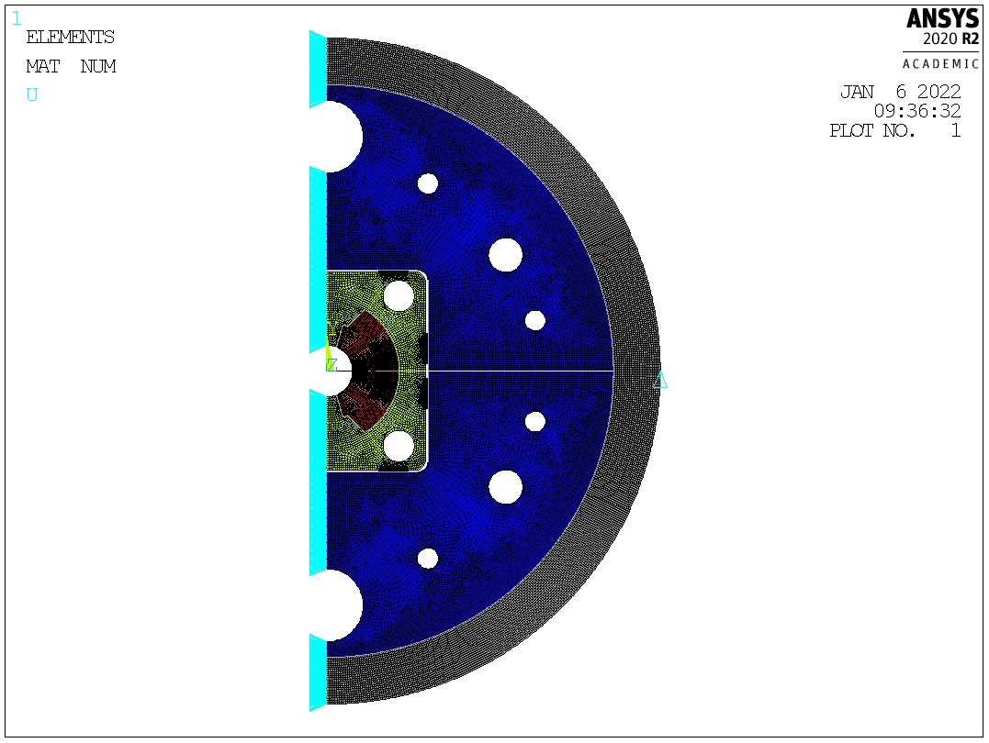
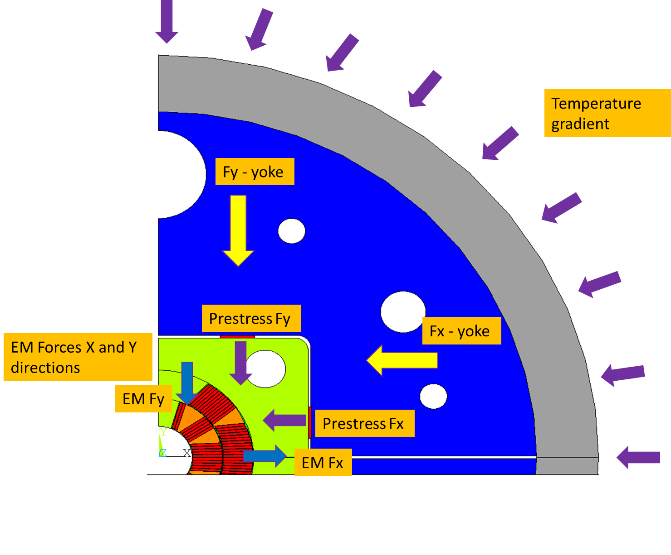
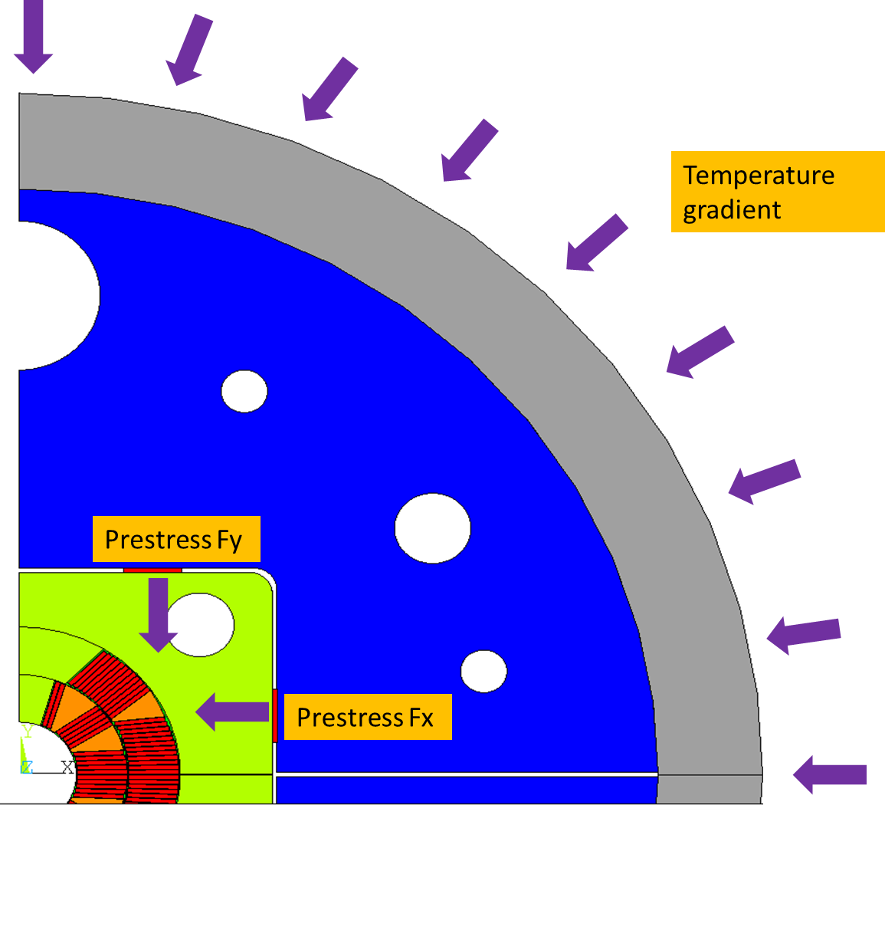
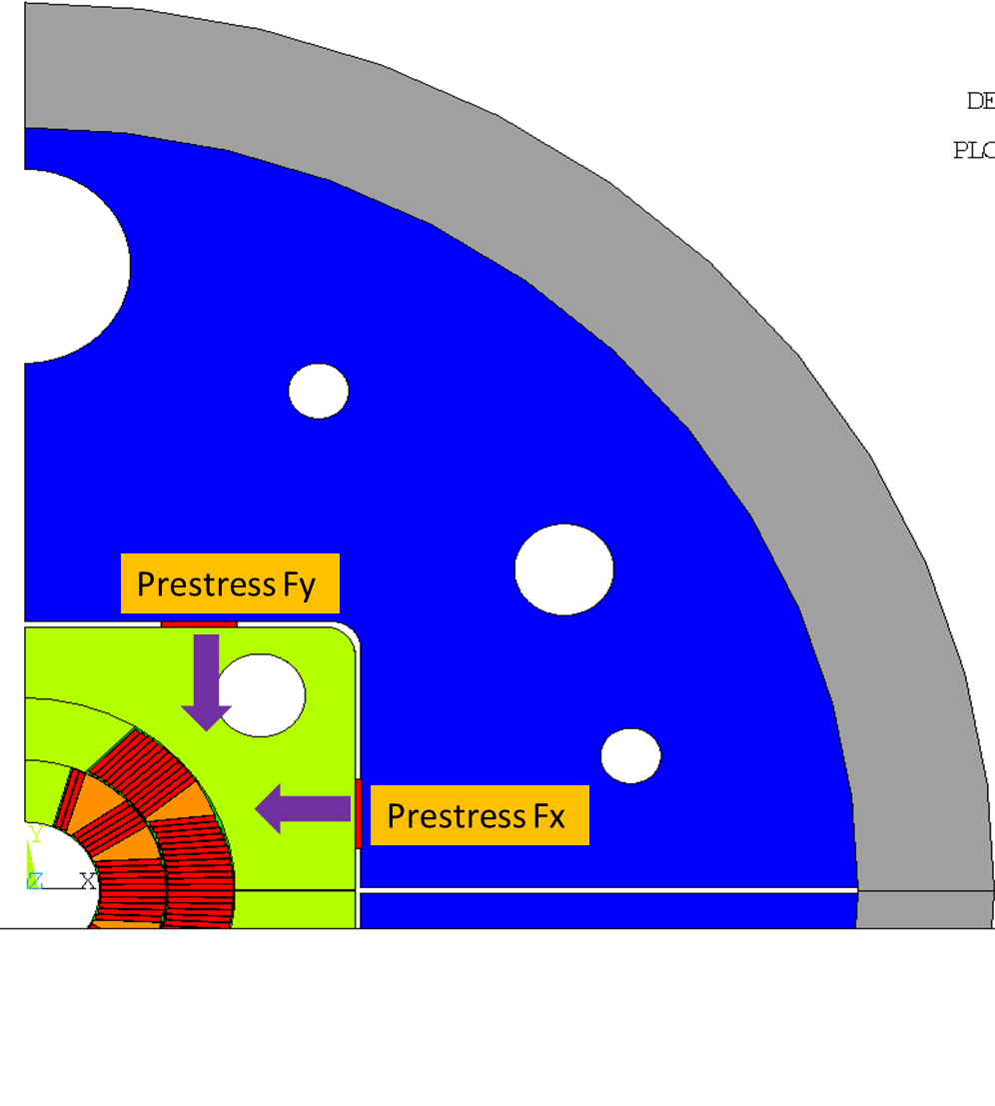
FEM Analysis – Materials, Loads&BC
  Constrained one point in Y direction
EM Force component | Value [kN/m]
Coils
Fx | 3575
Fy | -1781
Yoke
Fx | -474
Fy | 235
Three load steps:
Assembly – prestress at RT
Cool-down
Energization – EM forces
  Symmetry in X direction
Material | E [GPa]; RT (1.9K) | ν [-] | α *10^-3
Conductor | 25 (25) | 0.3 | 3.8
SS Pad | 191 (210) | 0.28 | 2.8
Al7075 shell | 72 (79) | 0.3 | 4.2
Ferromagnetic iron | 204 (225) | 0.28 | 2.0
Fiberglass | 25 (27.5) | 0.2 | 2.5
Kawasaki SS | 186 (186) | 0.28 | 1.8
  Half of the magnet cross section is modeled
  Energization
  Linear elastic material properties [1,2]
  Cool-down
  Assembly

Slide 9
FEM Analysis – Materials, Loads&BC
Three load steps:
Assembly – prestress at RT
Cool-down
Energization – EM forces
  Cool-down
  Assembly
  Energization
  Introduce compression
  Introduce traction – counteract EM forces

Slide 10
FEM Analysis – Materials, Loads&BC
Three load steps:
Assembly – prestress at RT
Cool-down
Energization – EM forces
  Assembly
  Cool-down
  Energization
  Al. Shell shrinks more than other components
  Closing the cavity

Slide 11
FEM Analysis – Materials, Loads&BC
Three load steps:
Assembly – prestress at RT
Cool-down
Energization – EM forces
  Assembly
  Energization
  Cool-down
  Closed cavity and prestress should keep the coils in right position during energization

Slide 12
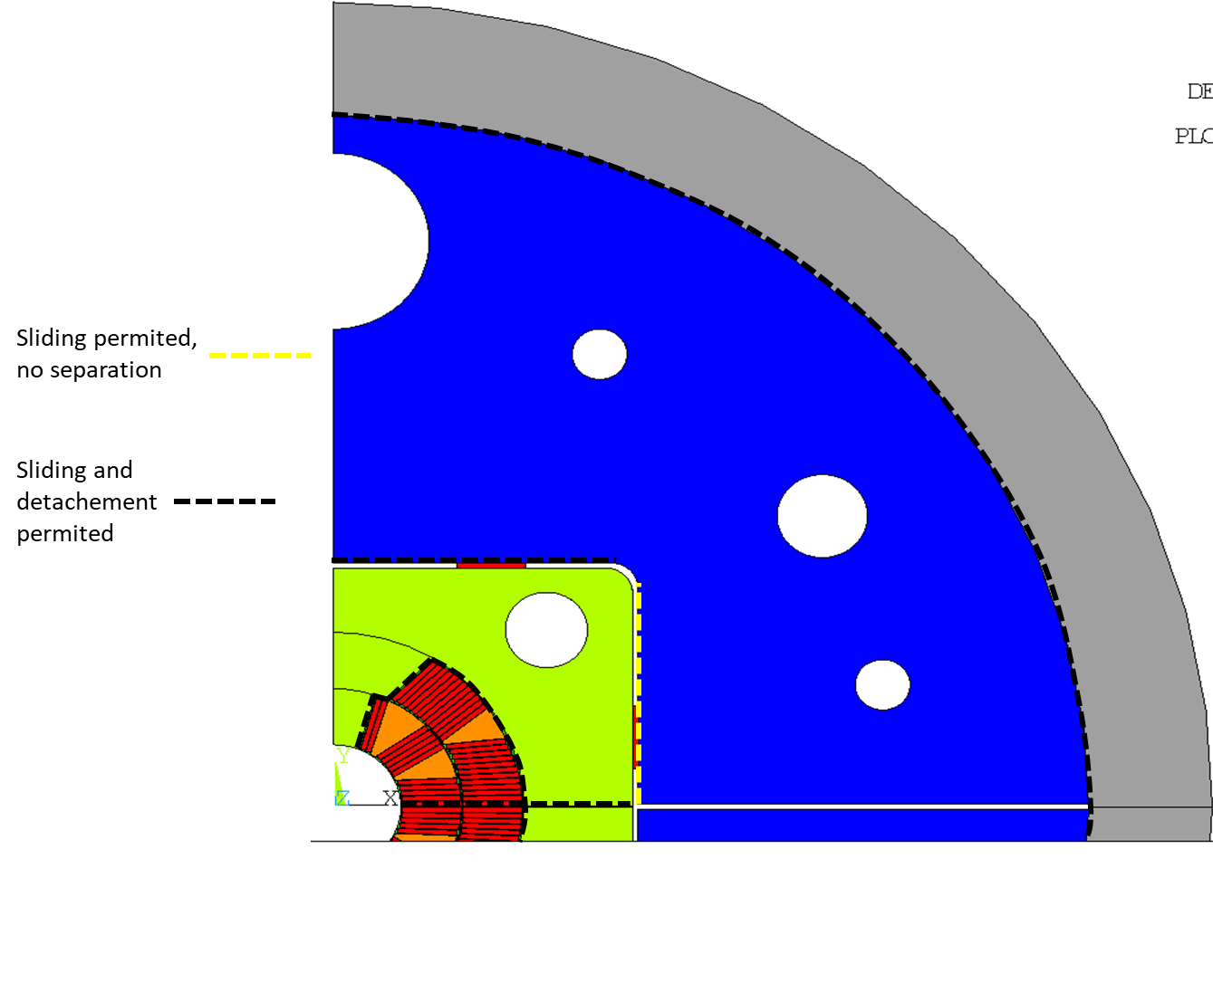
FEM Analysis – Materials, Loads&BC
  µ=0.2
Contact conditions

Slide 13
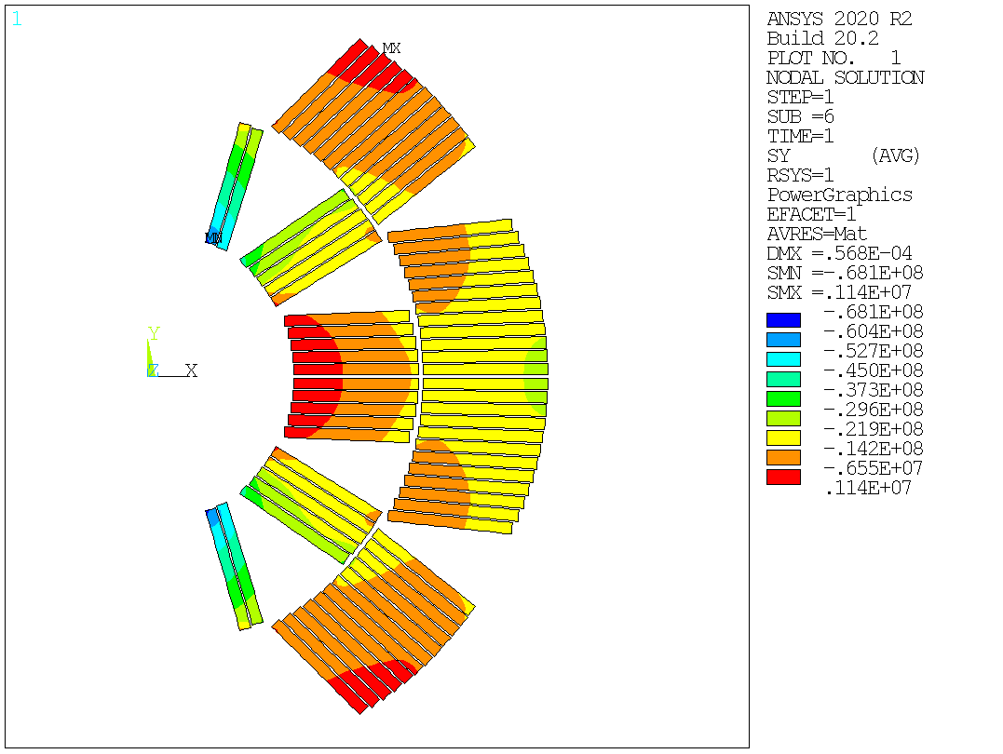
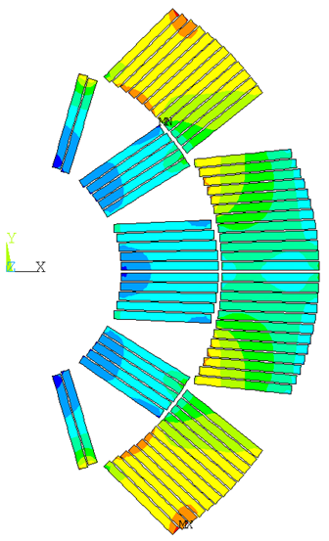
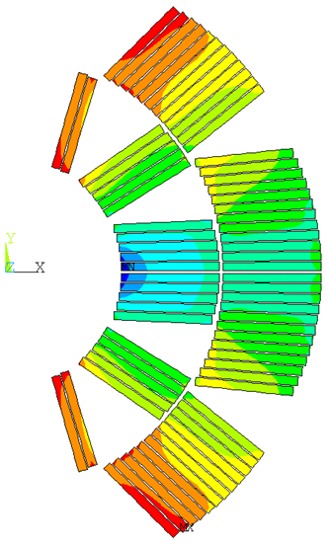
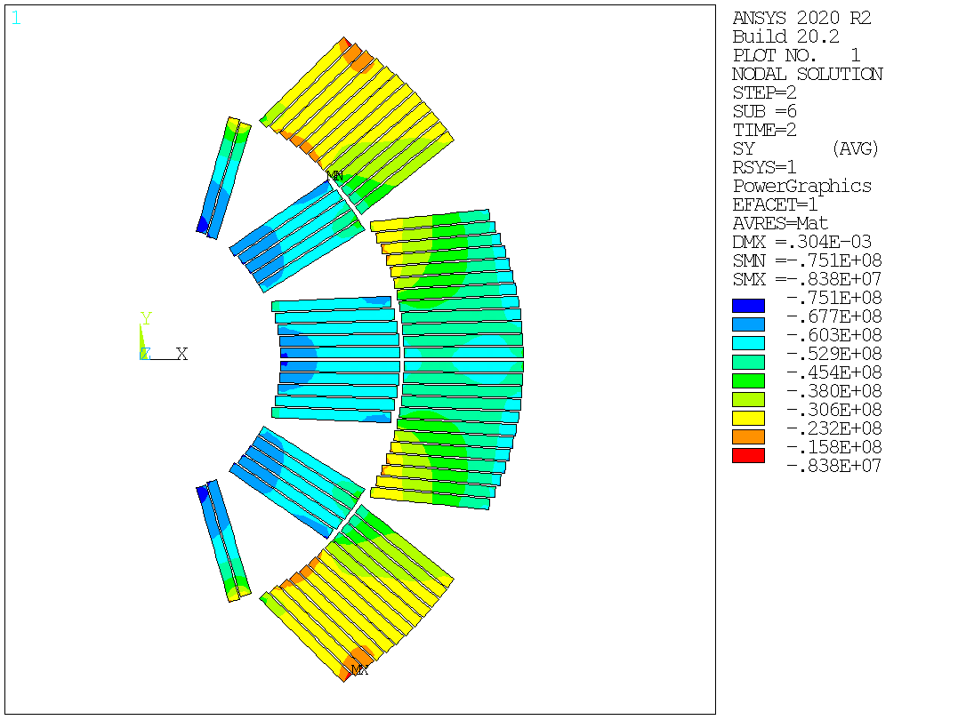

FEM Analysis – preliminary results
Optimized case 1
Parameter | Value [mm]
Vertical key interference | 0.17
Horizontal key interference | 0.04
Length of the key - vertical | 26
Length of the key - horizontal | 28
X coordinate of the horizontal key | 51
Y coordinate of the vertical key | 16
Horizontal gap dimension between SS Pad halves | 0.28
Horizontal gap dimension between yoke halves | 2
Width of the SS Pad half | 95
Height of the SS Pad half | 95
Minimum Azimuthal stress during load steps
Load step | Value [Mpa]
1 | -68.1
2 | -75.1
3 | -132.0
Azimuthal stress
[Pa]
[Pa]
[Pa]
Cool-down
Energization – EM forces
Assembly – prestress at RT

Slide 14
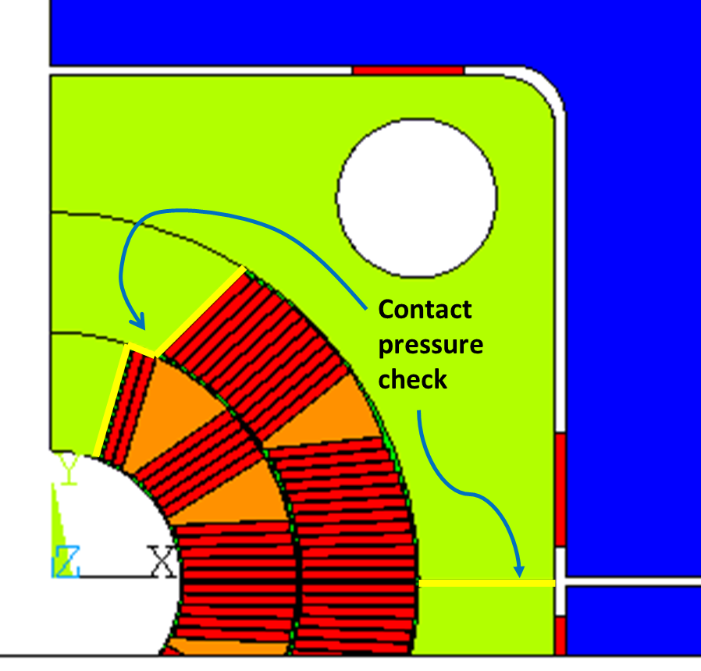
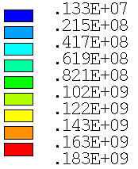
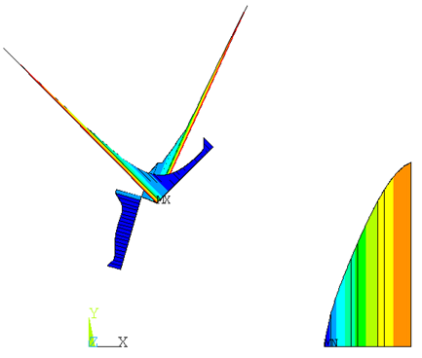
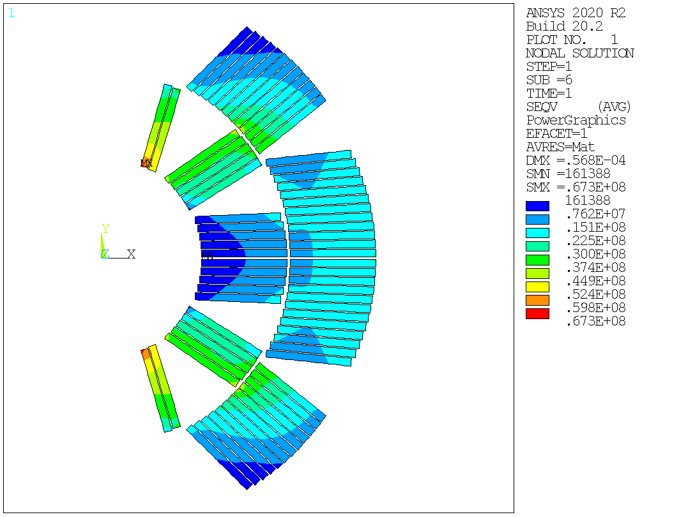
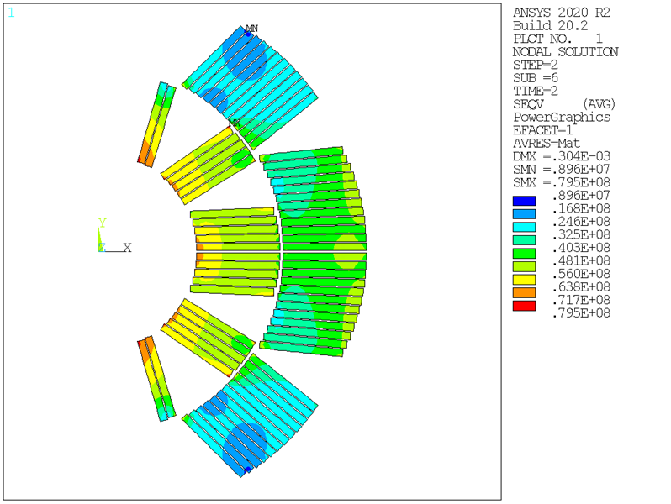
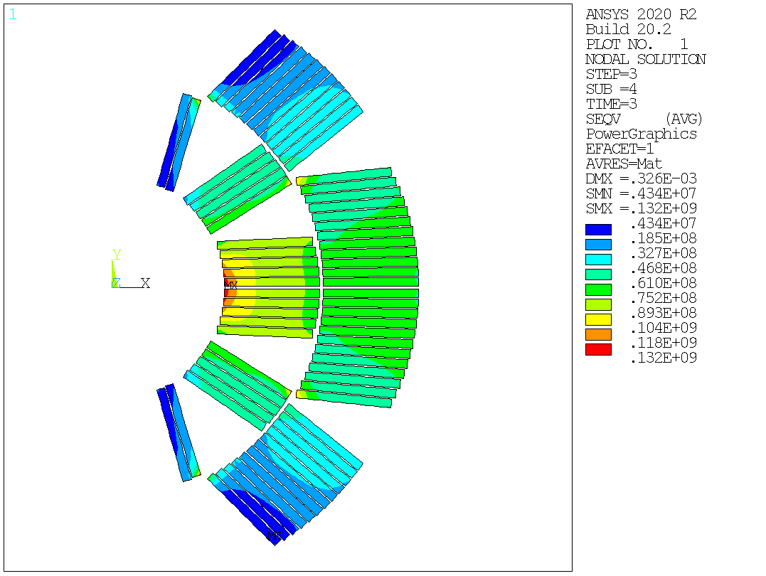
FEM Analysis – preliminary results
Contact pressure between coils and SS Pad
[Pa]
Optimized case 1
Parameter | Value [mm]
Vertical key interference | 0.17
Horizontal key interference | 0.04
Length of the key - vertical | 26
Length of the key - horizontal | 28
X coordinate of the horizontal key | 51
Y coordinate of the vertical key | 16
Horizontal gap dimension between SS Pad halves | 0.28
Horizontal gap dimension between yoke halves | 2
Width of the SS Pad half | 95
Height of the SS Pad half | 95
Maximum VM stress during load steps
Load step | Value [Mpa]
1 | 67.3
2 | 79.5
3 | 132.0
Contact pressure between SS Pad halves
Von Mises stress
[Pa]
[Pa]
[Pa]
Cool-down
Energization – EM forces
Assembly – prestress at RT

Slide 15
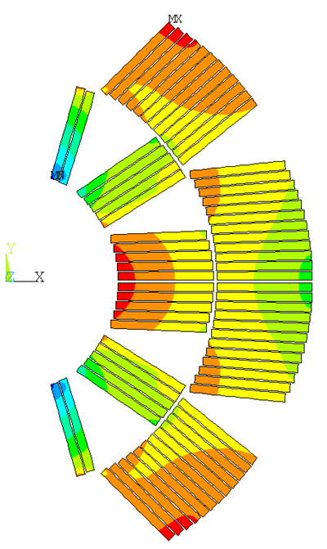
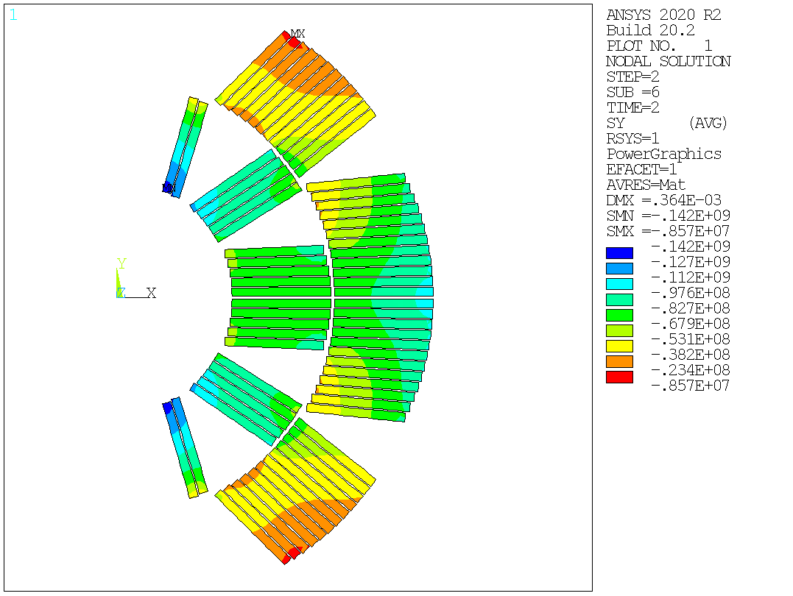
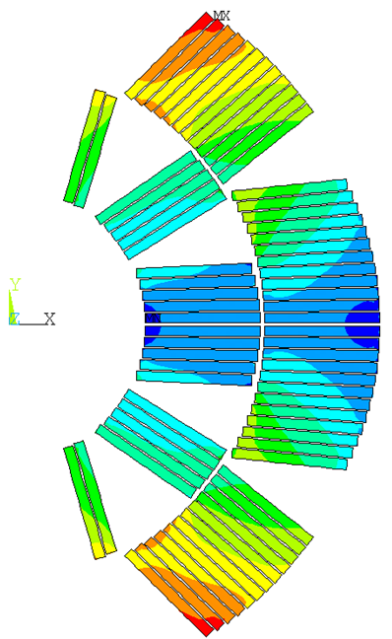
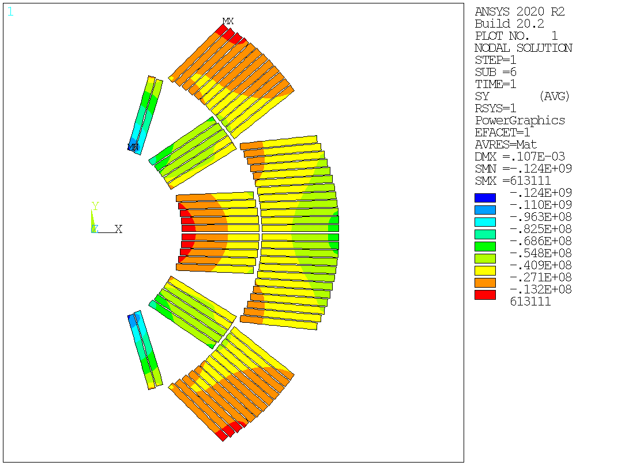
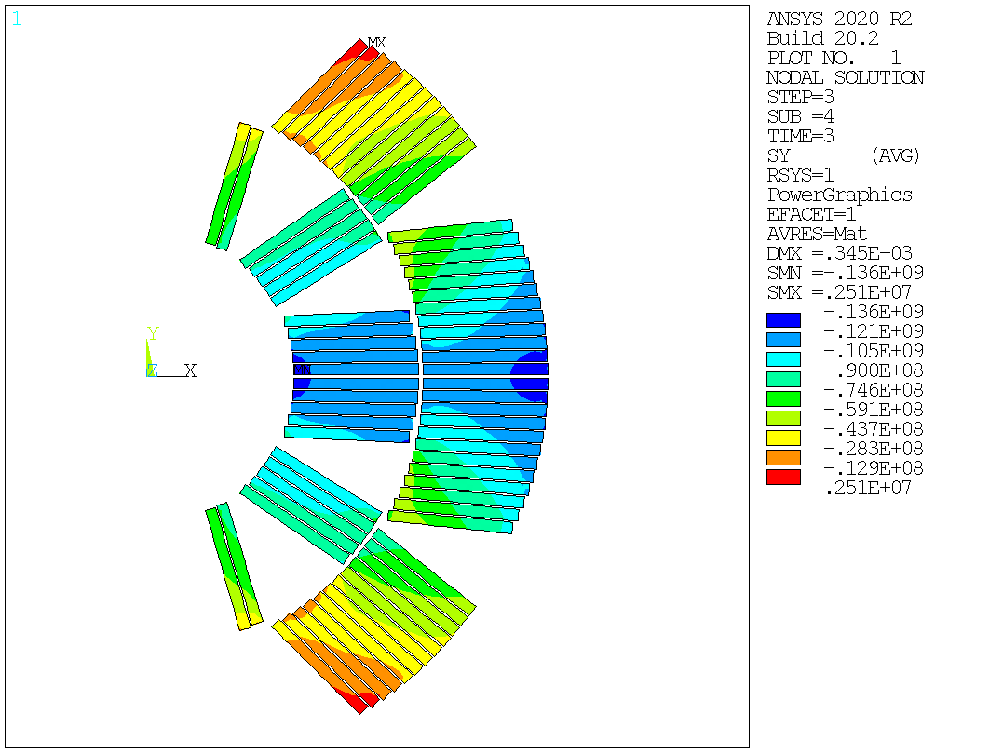
FEM Analysis – preliminary results
Optimized case 2
Only azimuthal stress at 3rd load step as a State Variable
Parameter | Value [mm]
Vertical key interference | 0.26
Horizontal key interference | 0.21
Length of the key - vertical | 29
Length of the key - horizontal | 28
X coordinate of the horizontal key | 56
Y coordinate of the vertical key | 7
Horizontal gap dimension between SS Pad halves | 0.42
Horizontal gap dimension between yoke halves | 2
Width of the SS Pad half | 95
Height of the SS Pad half | 95
Minimum Azimuthal stress during load steps
Load step | Value [Mpa]
1 | -124
2 | -142
3 | -136
Azimuthal stress
[Pa]
[Pa]
[Pa]
Cool-down
Energization – EM forces
Assembly – prestress at RT

Slide 16
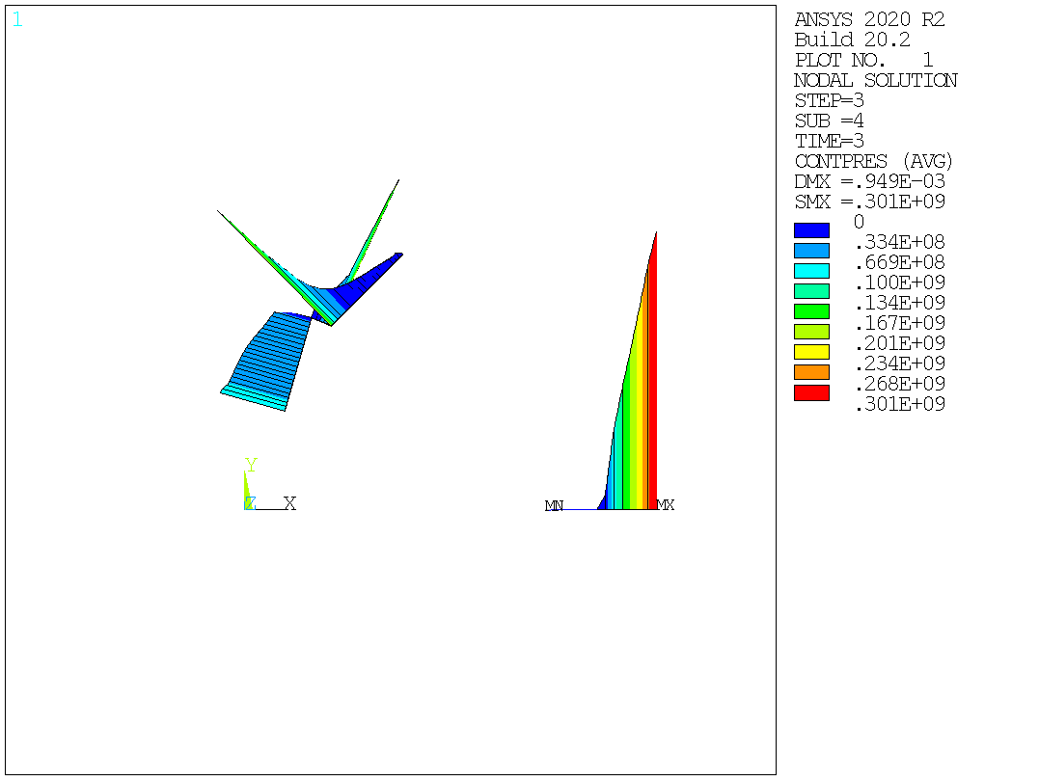
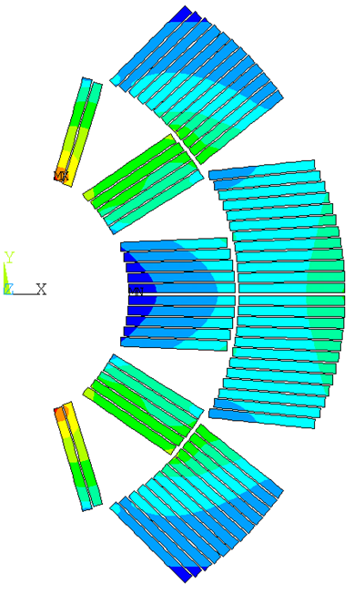
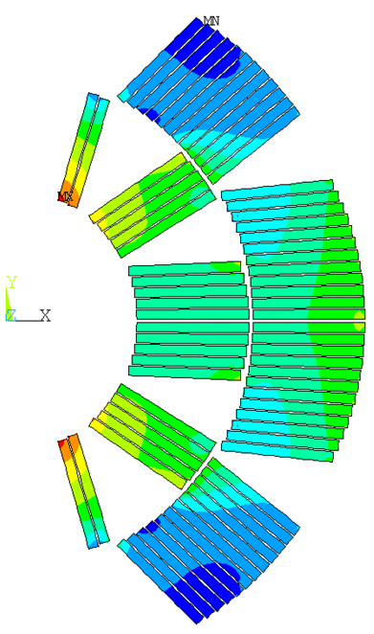
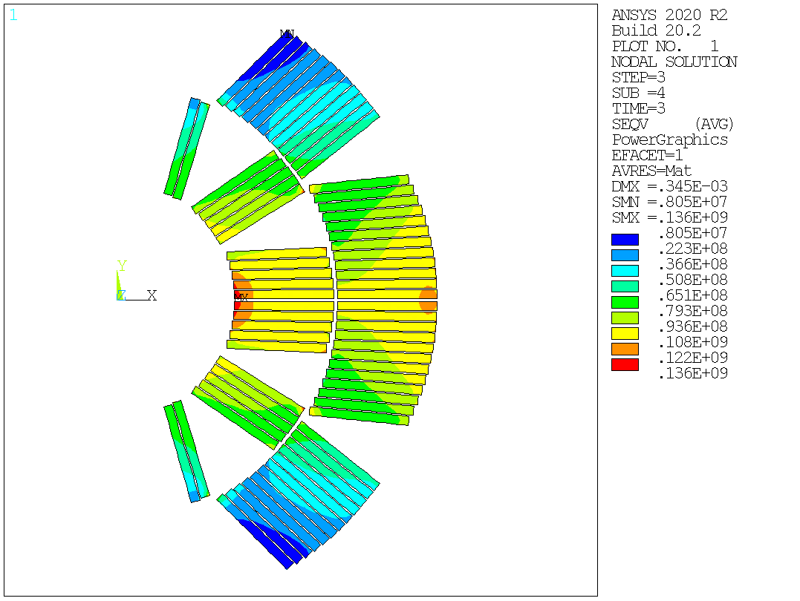

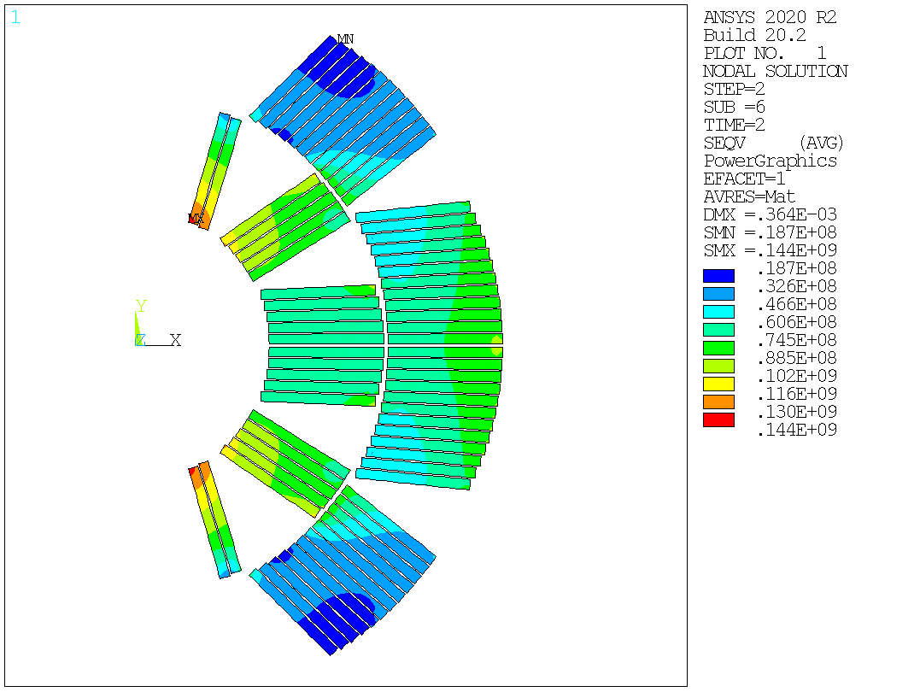
FEM Analysis – preliminary results
Contact pressure between coils and SS Pad
[Pa]
Optimized case 2
Parameter | Value [mm]
Vertical key interference | 0.26
Horizontal key interference | 0.21
Length of the key - vertical | 29
Length of the key - horizontal | 28
X coordinate of the horizontal key | 56
Y coordinate of the vertical key | 7
Horizontal gap dimension between SS Pad halves | 0.42
Horizontal gap dimension between yoke halves | 2
Width of the SS Pad half | 95
Height of the SS Pad half | 95
Maximum VM stress during load steps
Load step | Value [Mpa]
1 | 122
2 | 144
3 | 136
Contact pressure between SS Pad halves
Von Mises stress
[Pa]
[Pa]
[Pa]
Cool-down
Energization – EM forces
Assembly – prestress at RT

Slide 17
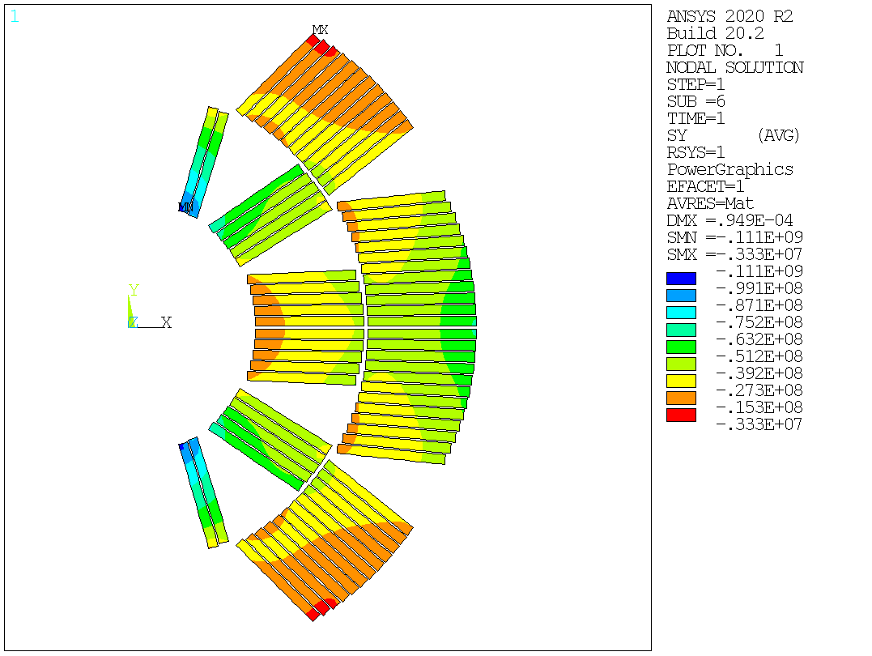
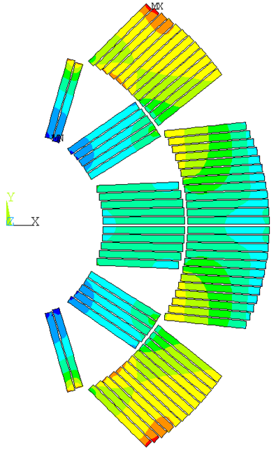
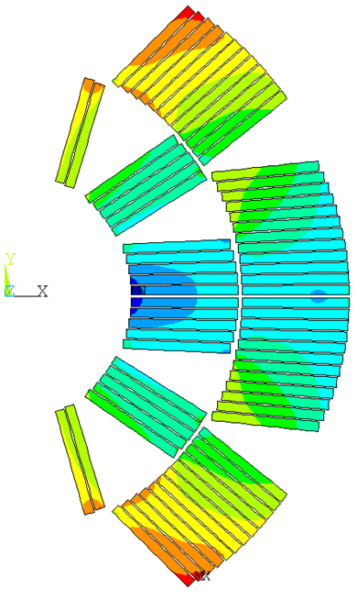
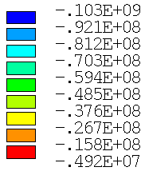
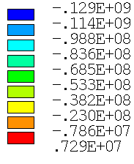
FEM Analysis – preliminary results
Optimized case – Kawasaki SS Pad
Parameter | Value [mm]
Vertical key interference | 0.20
Horizontal key interference | 0.29
Length of the key - vertical | 29
Length of the key - horizontal | 28
X coordinate of the horizontal key | 56
Y coordinate of the vertical key | 7
Horizontal gap dimension between SS Pad halves | 0.44
Horizontal gap dimension between yoke halves | 2
Width of the SS Pad half | 95
Height of the SS Pad half | 95
Minimum Azimuthal stress during load steps
Load step | Value [Mpa]
1 | -111
2 | -103
3 | -129
Azimuthal stress
[Pa]
[Pa]
[Pa]
Cool-down
Energization – EM forces
Assembly – prestress at RT

Slide 18
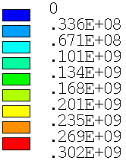

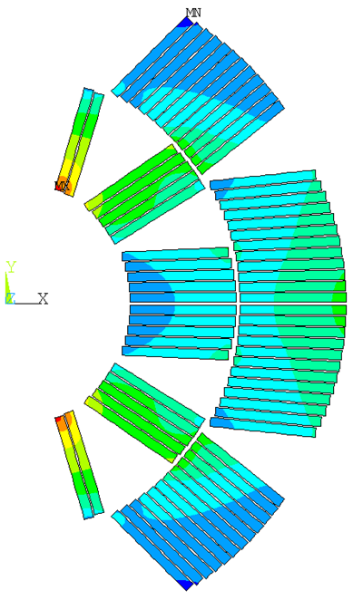
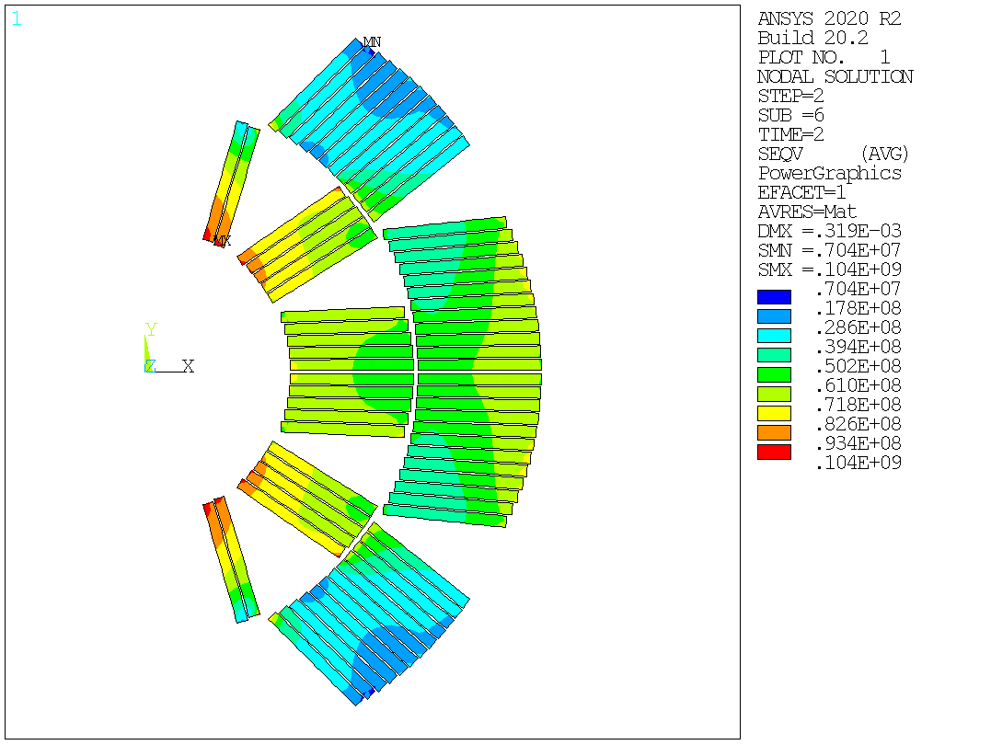
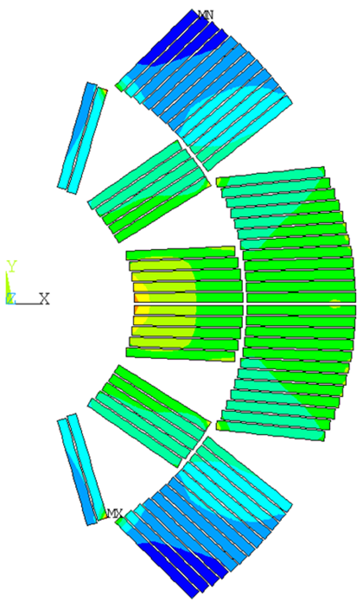
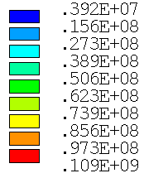

FEM Analysis – preliminary results
Contact pressure between coils and SS Pad
[Pa]
Optimized case – Kawasaki SS Pad
Parameter | Value [mm]
Vertical key interference | 0.20
Horizontal key interference | 0.29
Length of the key - vertical | 29
Length of the key - horizontal | 28
X coordinate of the horizontal key | 56
Y coordinate of the vertical key | 7
Horizontal gap dimension between SS Pad halves | 0.44
Horizontal gap dimension between yoke halves | 2
Width of the SS Pad half | 95
Height of the SS Pad half | 95
Maximum VM stress during load steps
Load step | Value [Mpa]
1 | 109
2 | 104
3 | 153
Contact pressure between SS Pad halves
Von Mises stress
[Pa]
[Pa]
[Pa]
Cool-down
Energization – EM forces
Assembly – prestress at RT

Slide 19
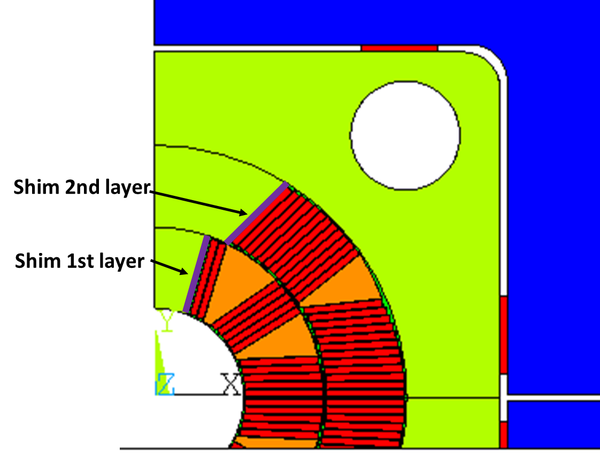
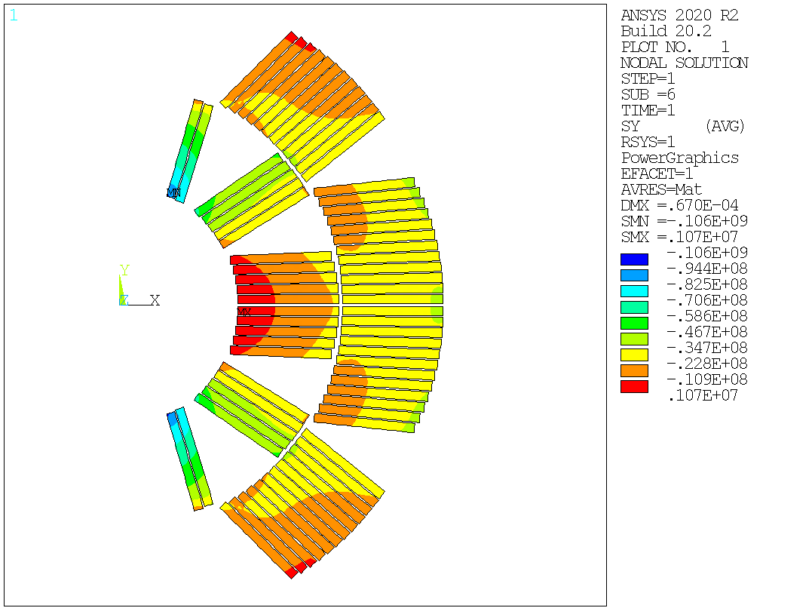

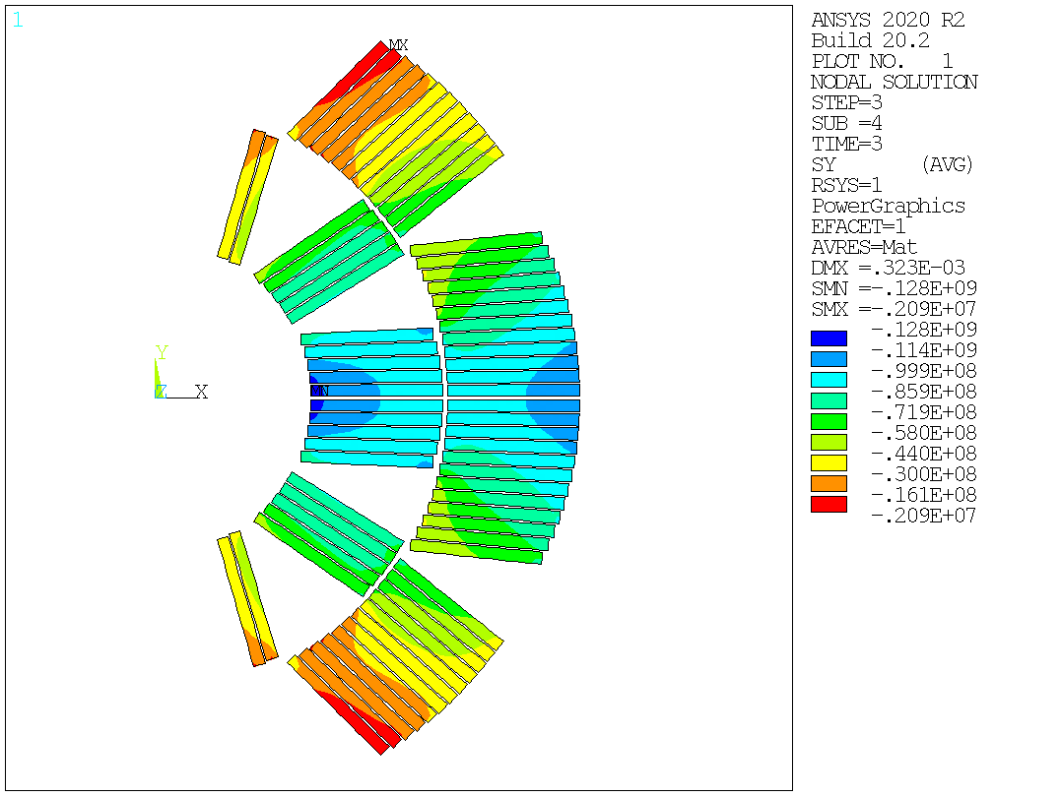
FEM Analysis – preliminary results
Optimized case – shims
Parameter | Value [mm]
Vertical key interference | 0.21
Horizontal key interference | 0.08
Length of the key - vertical | 25
Length of the key - horizontal | 27
X coordinate of the horizontal key | 50
Y coordinate of the vertical key | 7
Horizontal gap dimension between SS Pad halves | 0.28
Horizontal gap dimension between yoke halves | 2
Width of the SS Pad half | 95
Height of the SS Pad half | 95
Shim thickness 1st layer | 3
Shim thickness 2nd layer | 3
Minimum Azimuthal stress during load steps
Load step | Value [Mpa]
1 | -106
2 | -111
3 | -128
Azimuthal stress
[Pa]
[Pa]
[Pa]
Cool-down
Energization – EM forces
Assembly – prestress at RT

Slide 20
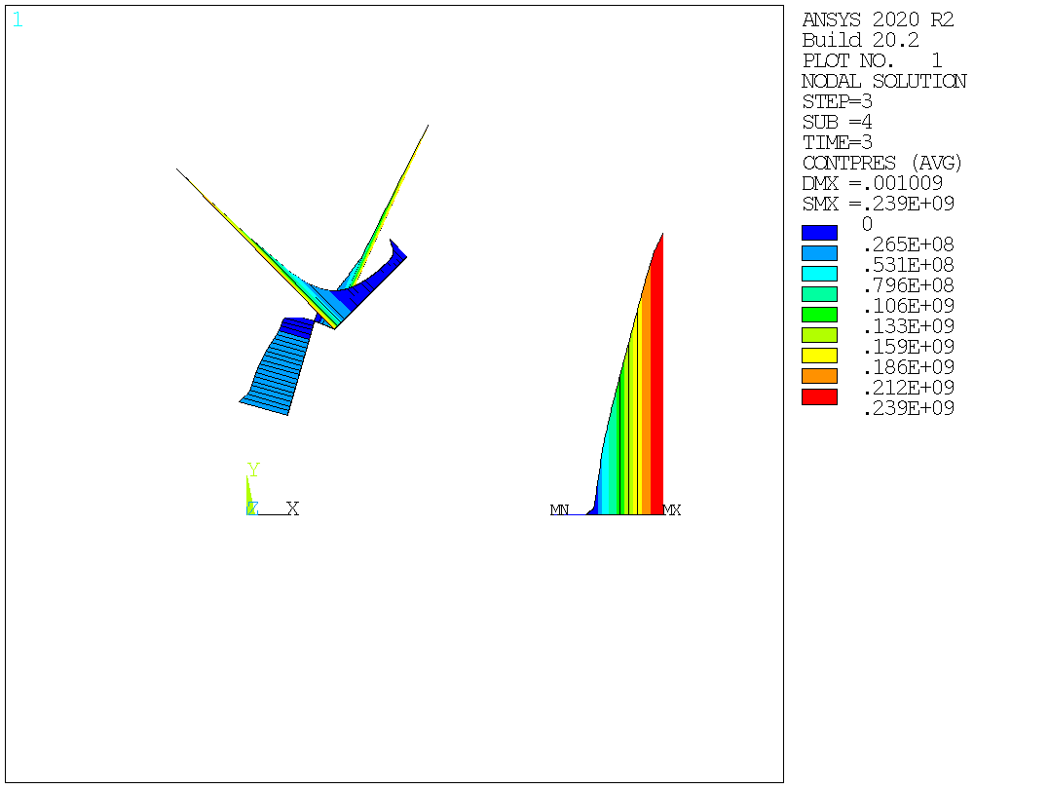
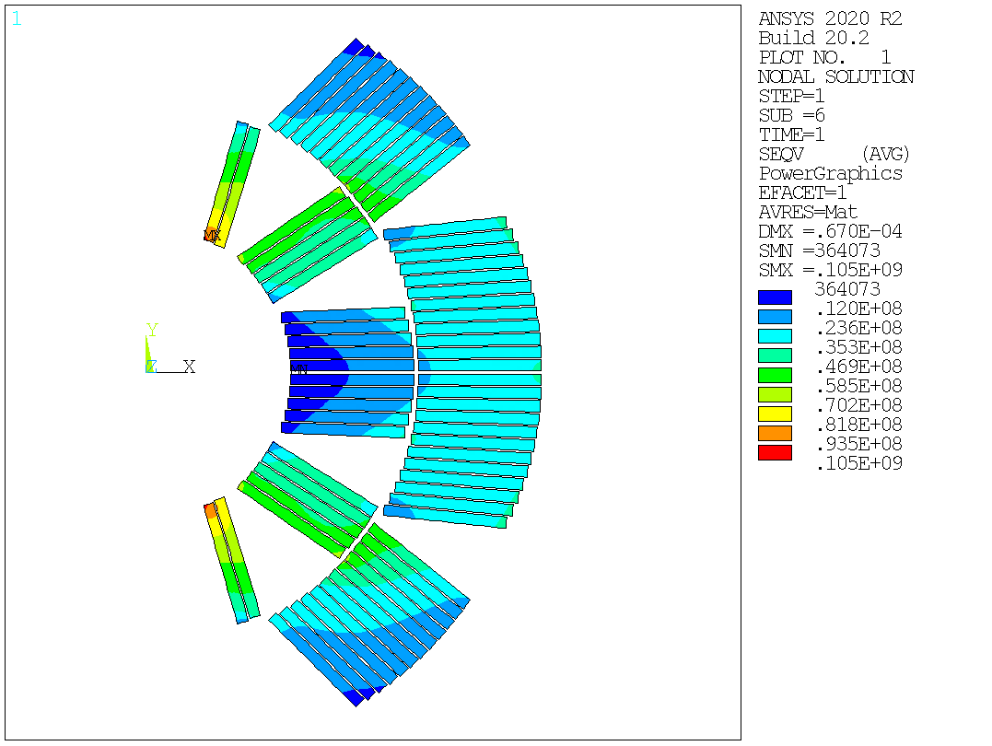
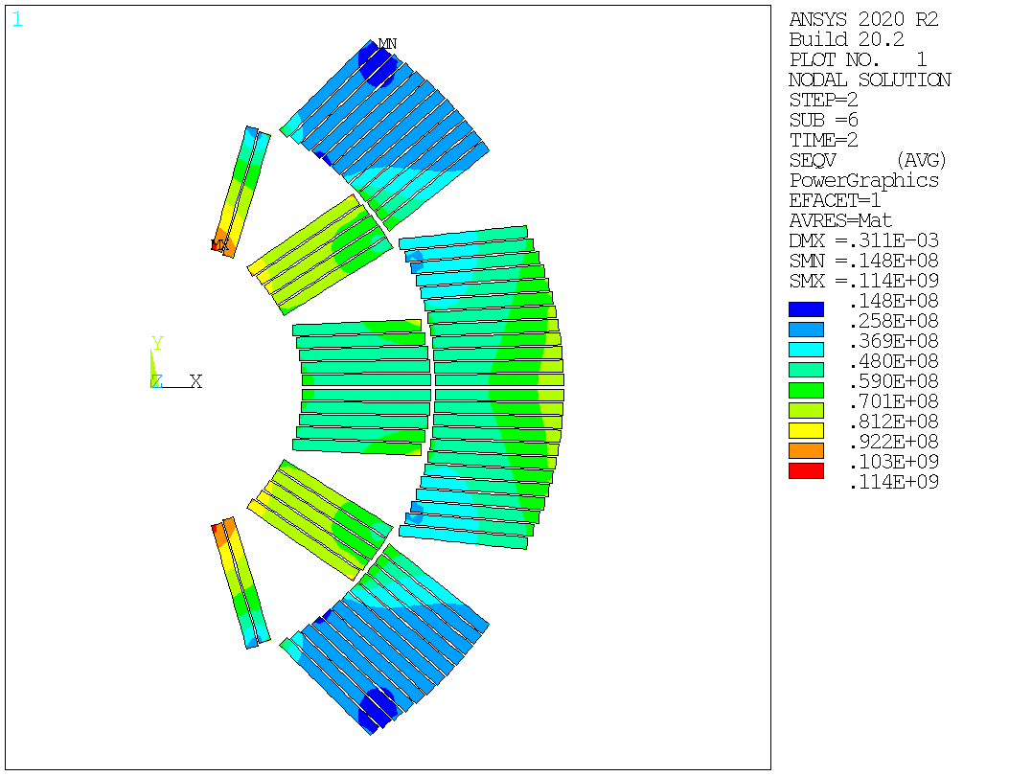
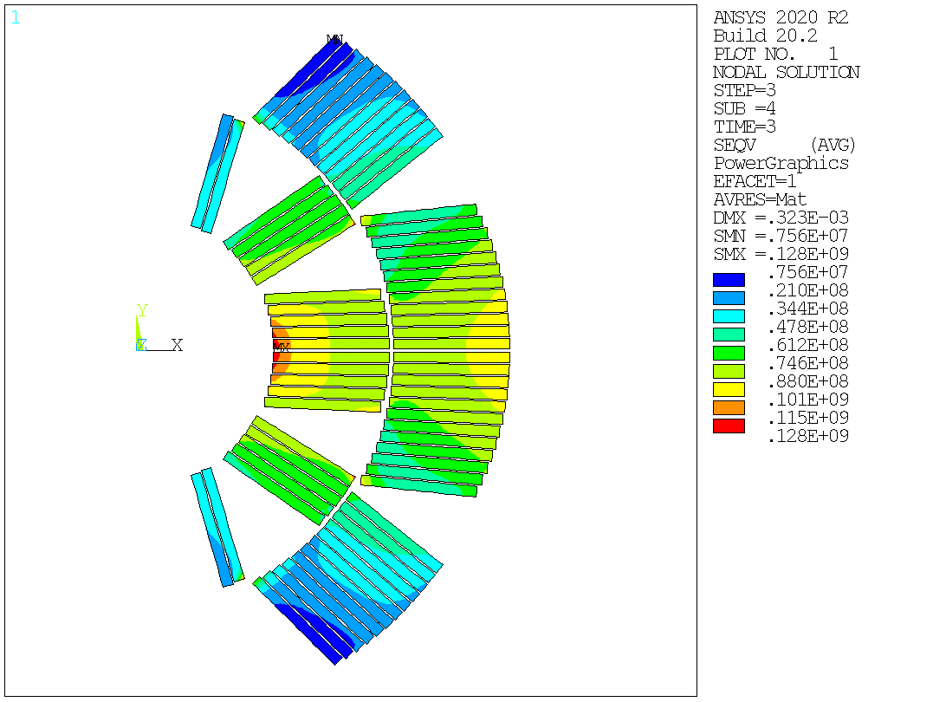
FEM Analysis – preliminary results
Contact pressure between coils and SS Pad
[Pa]
Optimized case – shims
Parameter | Value [mm]
Vertical key interference | 0.21
Horizontal key interference | 0.08
Length of the key - vertical | 25
Length of the key - horizontal | 27
X coordinate of the horizontal key | 50
Y coordinate of the vertical key | 7
Horizontal gap dimension between SS Pad halves | 0.28
Horizontal gap dimension between yoke halves | 2
Width of the SS Pad half | 95
Height of the SS Pad half | 95
Shim thickness 1st layer | 3
Shim thickness 2nd layer | 3
Maximum VM stress during load steps
Load step | Value [Mpa]
1 | 105
2 | 114
3 | 128
Contact pressure between SS Pad halves
Von Mises stress
[Pa]
[Pa]
[Pa]
Cool-down
Energization – EM forces
Assembly – prestress at RT

Slide 21
Conclusions
New cross section of the magnet was proposed and checked for the dipole in B&K technology
The proposed geometry gives a good possibilities when it comes to stress managements in the coils
Starting with quite high stresses in assembly step, it is possible, however, to obtain stress values in the energization step that are below the limit (still having a safety margin)
After the preliminary results, it can be concluded that the proposed structure allows for a fairly "flexible" way to adjust the parameters of the magnet
The preliminary results are promising and offer the possibility of a deeper study of the proposed magnet structure

Slide 22
Future plans&work
Including details in the target structure
Collect nonlinear material data and calculate nonlinear coils
Study the effect of the tollerances
Alternative, low numer of pieces cross section
Study of the ‘12 T coil configuration’, double aperture, taking into account the construction of an instrumented mock-up

Slide 23
Future plans&work
Including details in the target structure
Collect nonlinear material data and calculate nonlinear coils
Study the effect of the tollerances
Alternative, low numer of pieces cross section
Study of the ‘12 T coil configuration’, double aperture, taking into account the construction of an instrumented mock-up
References:
[1] TDR, INFN/Code-19/001
[2] C. Lanca, D.Perini, CHARACTERISTICS OF THE AUSTENITIC STEELS USED IN THE LHC MAIN DIPOLES,
LHC Project Report 537,
Thank you for your attention!

