Slide 1
ECFA survey
ECFA/RC/10/388

Slide 2
Motivation:
Survey of particle physics in Europe carried out in 2009 to inform CERN Council Strategy Update which is scheduled to complete mid 2012
Acknowledgements:
Bulk of organisation performed by P. Hansen.
Support for WWW-based collection of statistics from K. Huyser, NIKHEF.

Slide 3
Definitions:
Survey counts persons:
  Fractional research activities (FRAs):
    Person who spends at least 20% of his/her time on PP research was counted with a weight of 1
    The split of a persons time between two or more projects is counted as fractions which add up to 100%, i.e.:
      Individual with 50% of his/her working time to spend on research and who splits this research time 75% on ATLAS and 25% on DØ would ‘score’:
        1 FRA; 0.75 attributed to ATLAS, 0.25 attributed to DØ

Slide 4
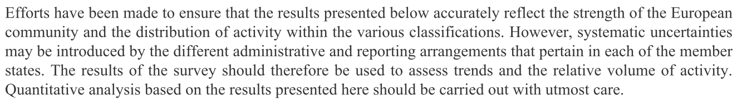
Update to presentation at 86th Plenary ECFA:
Updates since P. Hansen’s presentation to P-ECFA 26th November 2009:
  Recheck of totals reported in the document;
  Minor editorial changes;
  Indication of uncertainty in the results added:
    Our feeling:
      ‘Results good to ~10%’

Slide 5
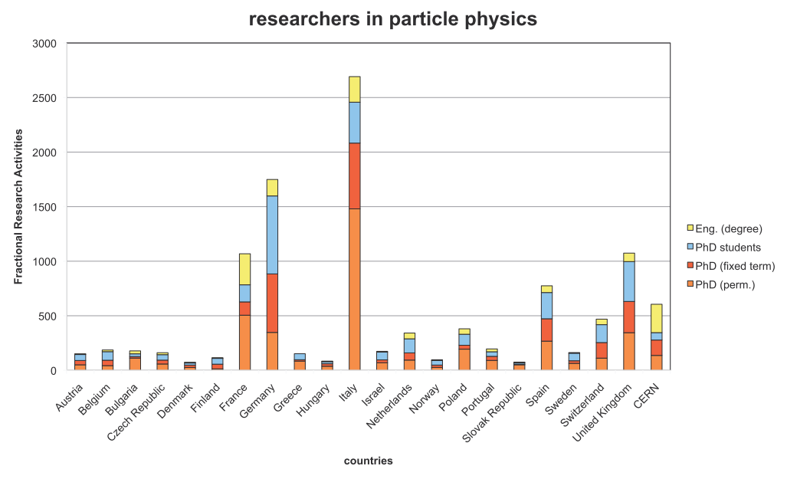

Slide 6
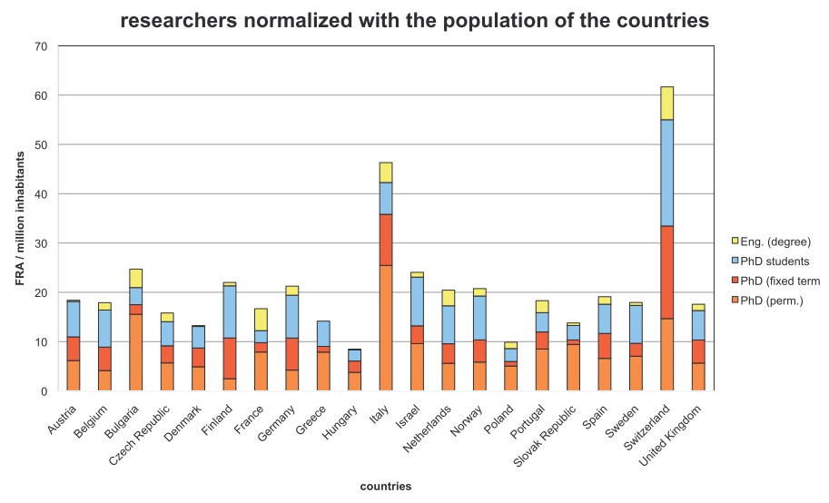

Slide 7
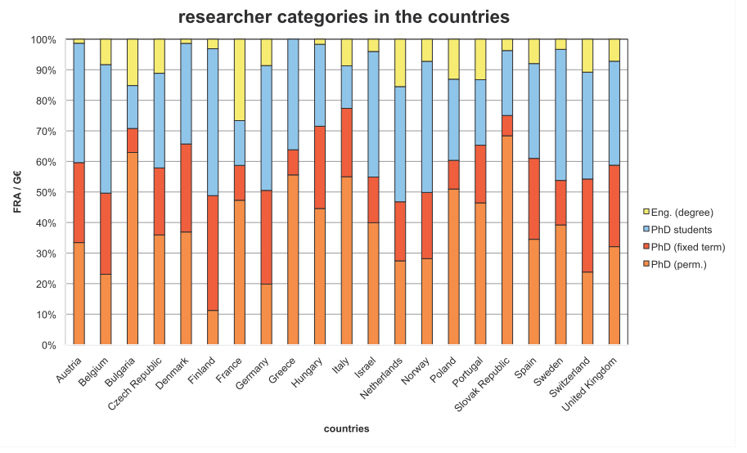

Slide 8
