Slide 1
RECFA-CERN
NOVEMBER 25th 2010
LNF UPDATES
Mario Calvetti
Frozen (sorry) LNF Director

Slide 2
DAΦNE present achievements & perspectives
 | DAΦNE upgrade SIDDHARTA | DAΦNE KLOE | DAΦNE FINUDA
L_{peak} [cm⁻²s⁻¹] | 4.53•10³² (5.0•10³²) | 1.5•10³² | 1.6 •10³²
L_{∫day} [pb⁻¹] | 14.98 | 9.8 | 9.4
L_{∫1 hour} [pb⁻¹] | 1.033 | 0.44 | 0.5
I⁻_{MAX} in collision [A] | 1.52 | 1.4 | 1.5
I⁺_{MAX} in collision [A] | 1.0 | 1.2 | 1.1
N_{bunches} | 105 | 111 | 106
ξ_{y} | 0.0443 (0.074) | 0.025 | 0.029
Scaling the present data from the luminosity monitor:
  L_{∫day} ≥ 20. pb⁻¹ seems possible!
  Assuming 80% collider uptime ⇒ L_{∫month}~ .5 fb⁻¹
The Crab-Waist collision scheme has been widely recognized as a major advance in the field of the beam-beam interaction in lepton colliders.
(Courtesy of Catia Milardi)

Slide 3
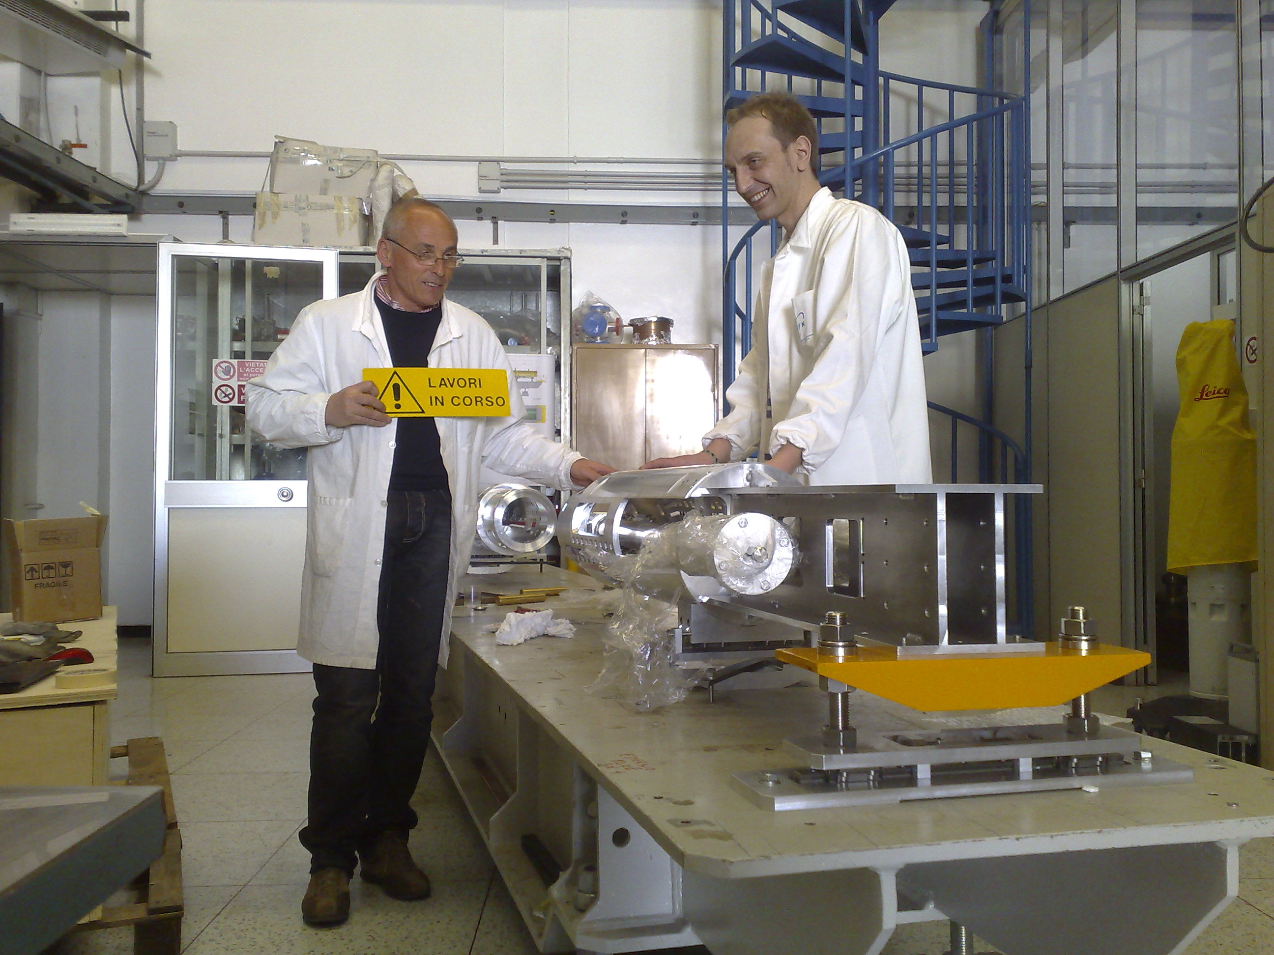
DAFNE is UP and running again

Slide 4
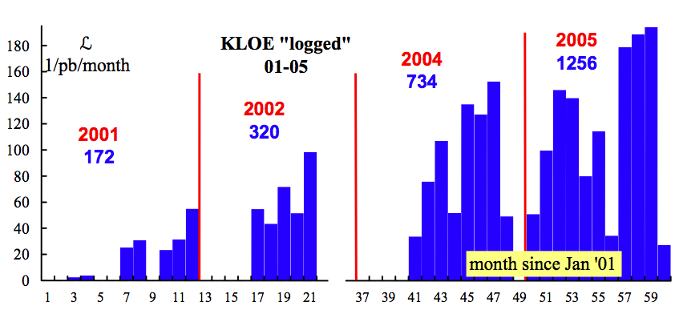
KLOE
Between years 2000 and 2006 DAΦNE has delivered to KLOE 2.5 fb^{–1} of data at the Φ(1020) peak plus additional 250 pb^{–1} off-peak
L_{int}/ month (pb⁻¹)
Best day: 10 pb⁻¹
Best month: 194 pb⁻¹

Slide 5
Using these data, KLOE has published about 50 physics papers, addressing several fundamental topics in the fields of flavour and hadronic physics. Among our results one can list:
The complete set of measurement of neutral and charged kaon decay parameters to allow the precision measurement of V_{us} setting the best unitarity limit on the CKM matrix
A precise determination of the hadronic contribution to the g-2 of the muon
The best limit published so far on LFV in K_{e2} decays
The most detailed studies on the nature of scalar mesons
The measurement of some of the rarest branching ratios of the K_{s} and η mesons

Slide 6
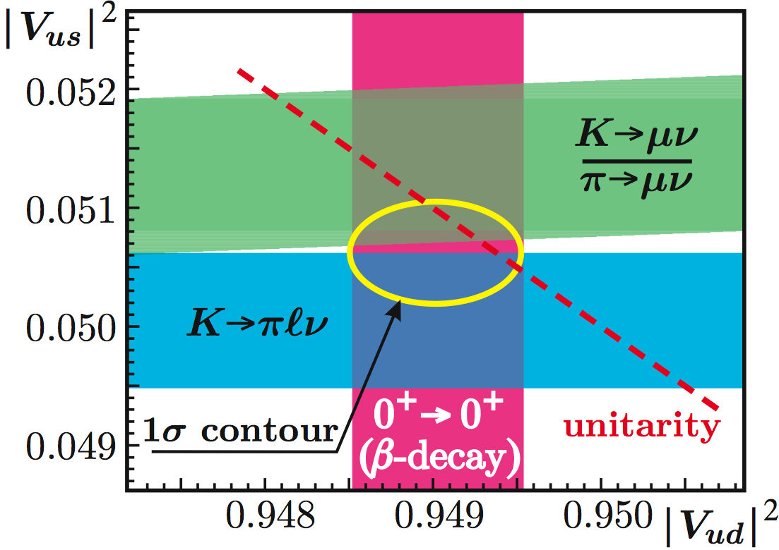
V_{us} determination and CKM unitarity
Fit on
V_{us} from K_{l3}
V_{us}/V_{ud} from K_{μ2} /π_{μ2}
V_{ud} from 0⁺→0⁺ β decays
|V_{us} | = 0.2249 ± 0.0010
|V_{ud} | = 0.97418 ± 0.00026
1 – |V_{us} |² − |V_{ud} |² = 0.0004 ± 0.0007
was 0.0031 ± 0.0015 in PDG04

Slide 7
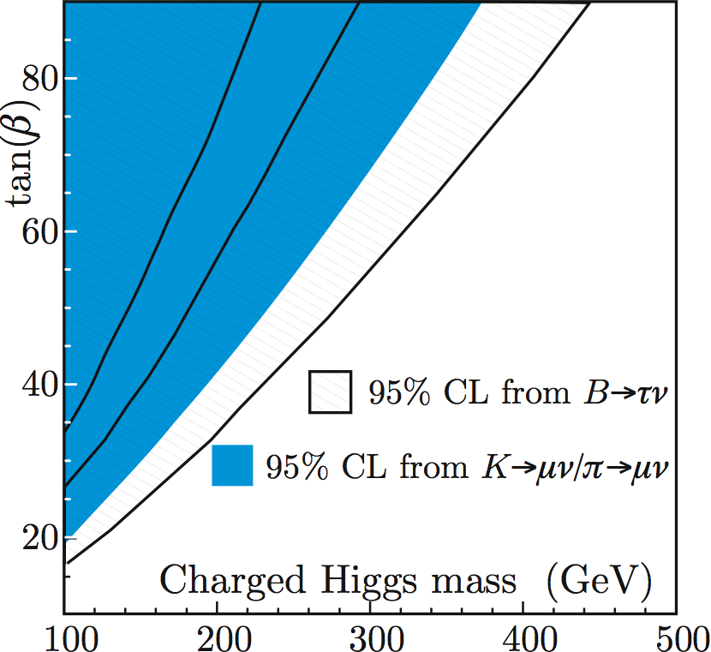
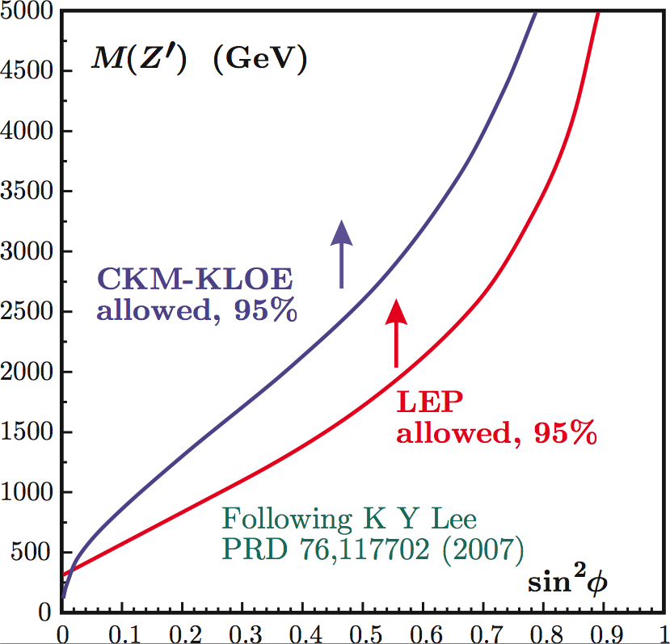
Tree level breaking of unitarity in models with non-universal gauge interaction
Constraints on New Physics

Slide 8
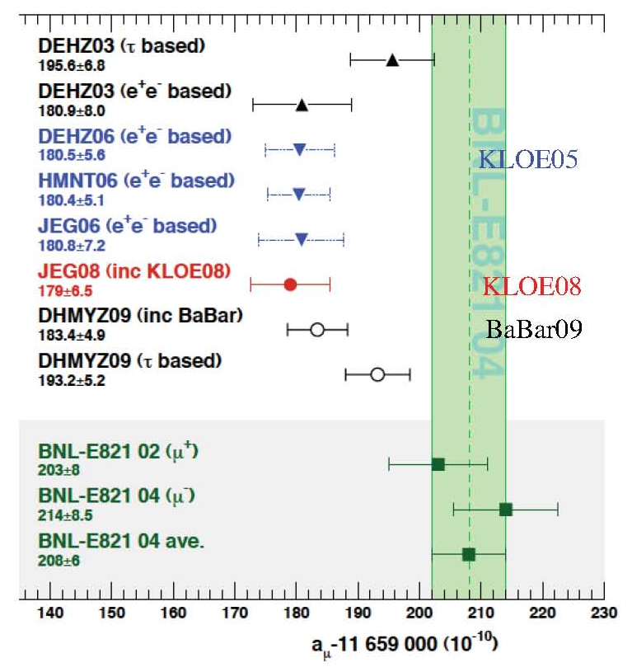
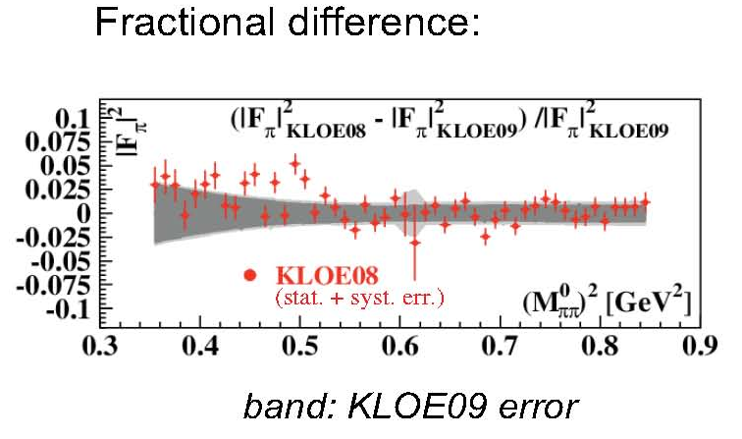
Hadronic contribution to muon g-2
Discrepancy between a_{μ}SM and a_{μ}^{EXP} at 3.2σ level
New KLOE analysis , with different selection criteria confirms KLOE08

Slide 9
SIDDHARTA short story:
- run on upgraded DAΦNE 2008-2009 (first experiment !)
- Measurements:
Kaonic Hydrogen - best measurement in the world– paper in preparation
Kaonic deuterium – first ever exploratory measurement; paper in preparation
Kaonic helium 4 – first gaseous target measurement: Phys. Lett. B 681 (2009) 310; another paper in preparation;
Kaonic helium 3 – first measurement in the world; paper submitted PLB and Ph D

Slide 10
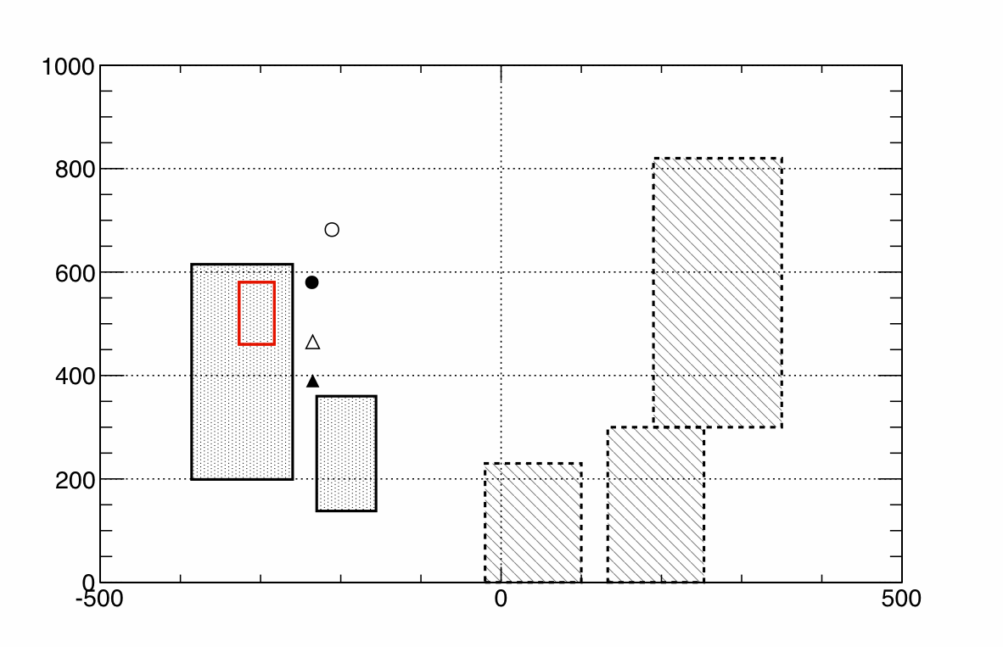
Kaonic hydrogen result
Recent theoretical values
Phys Rev Lett. 94 (2005) 213401
Empty : using Deser-Trueman formula
Full : by including isospin breaking corrections
Circle : their theory (Chiral SU(3) effective field theory)
Rectangle : with fit restricted to the DEAR data
SIDDHARTA
preliminary
Width [eV]
Izycki
KEK
DEAR
Davies
Bird
Shift [eV]
Error : statistical only

Slide 11
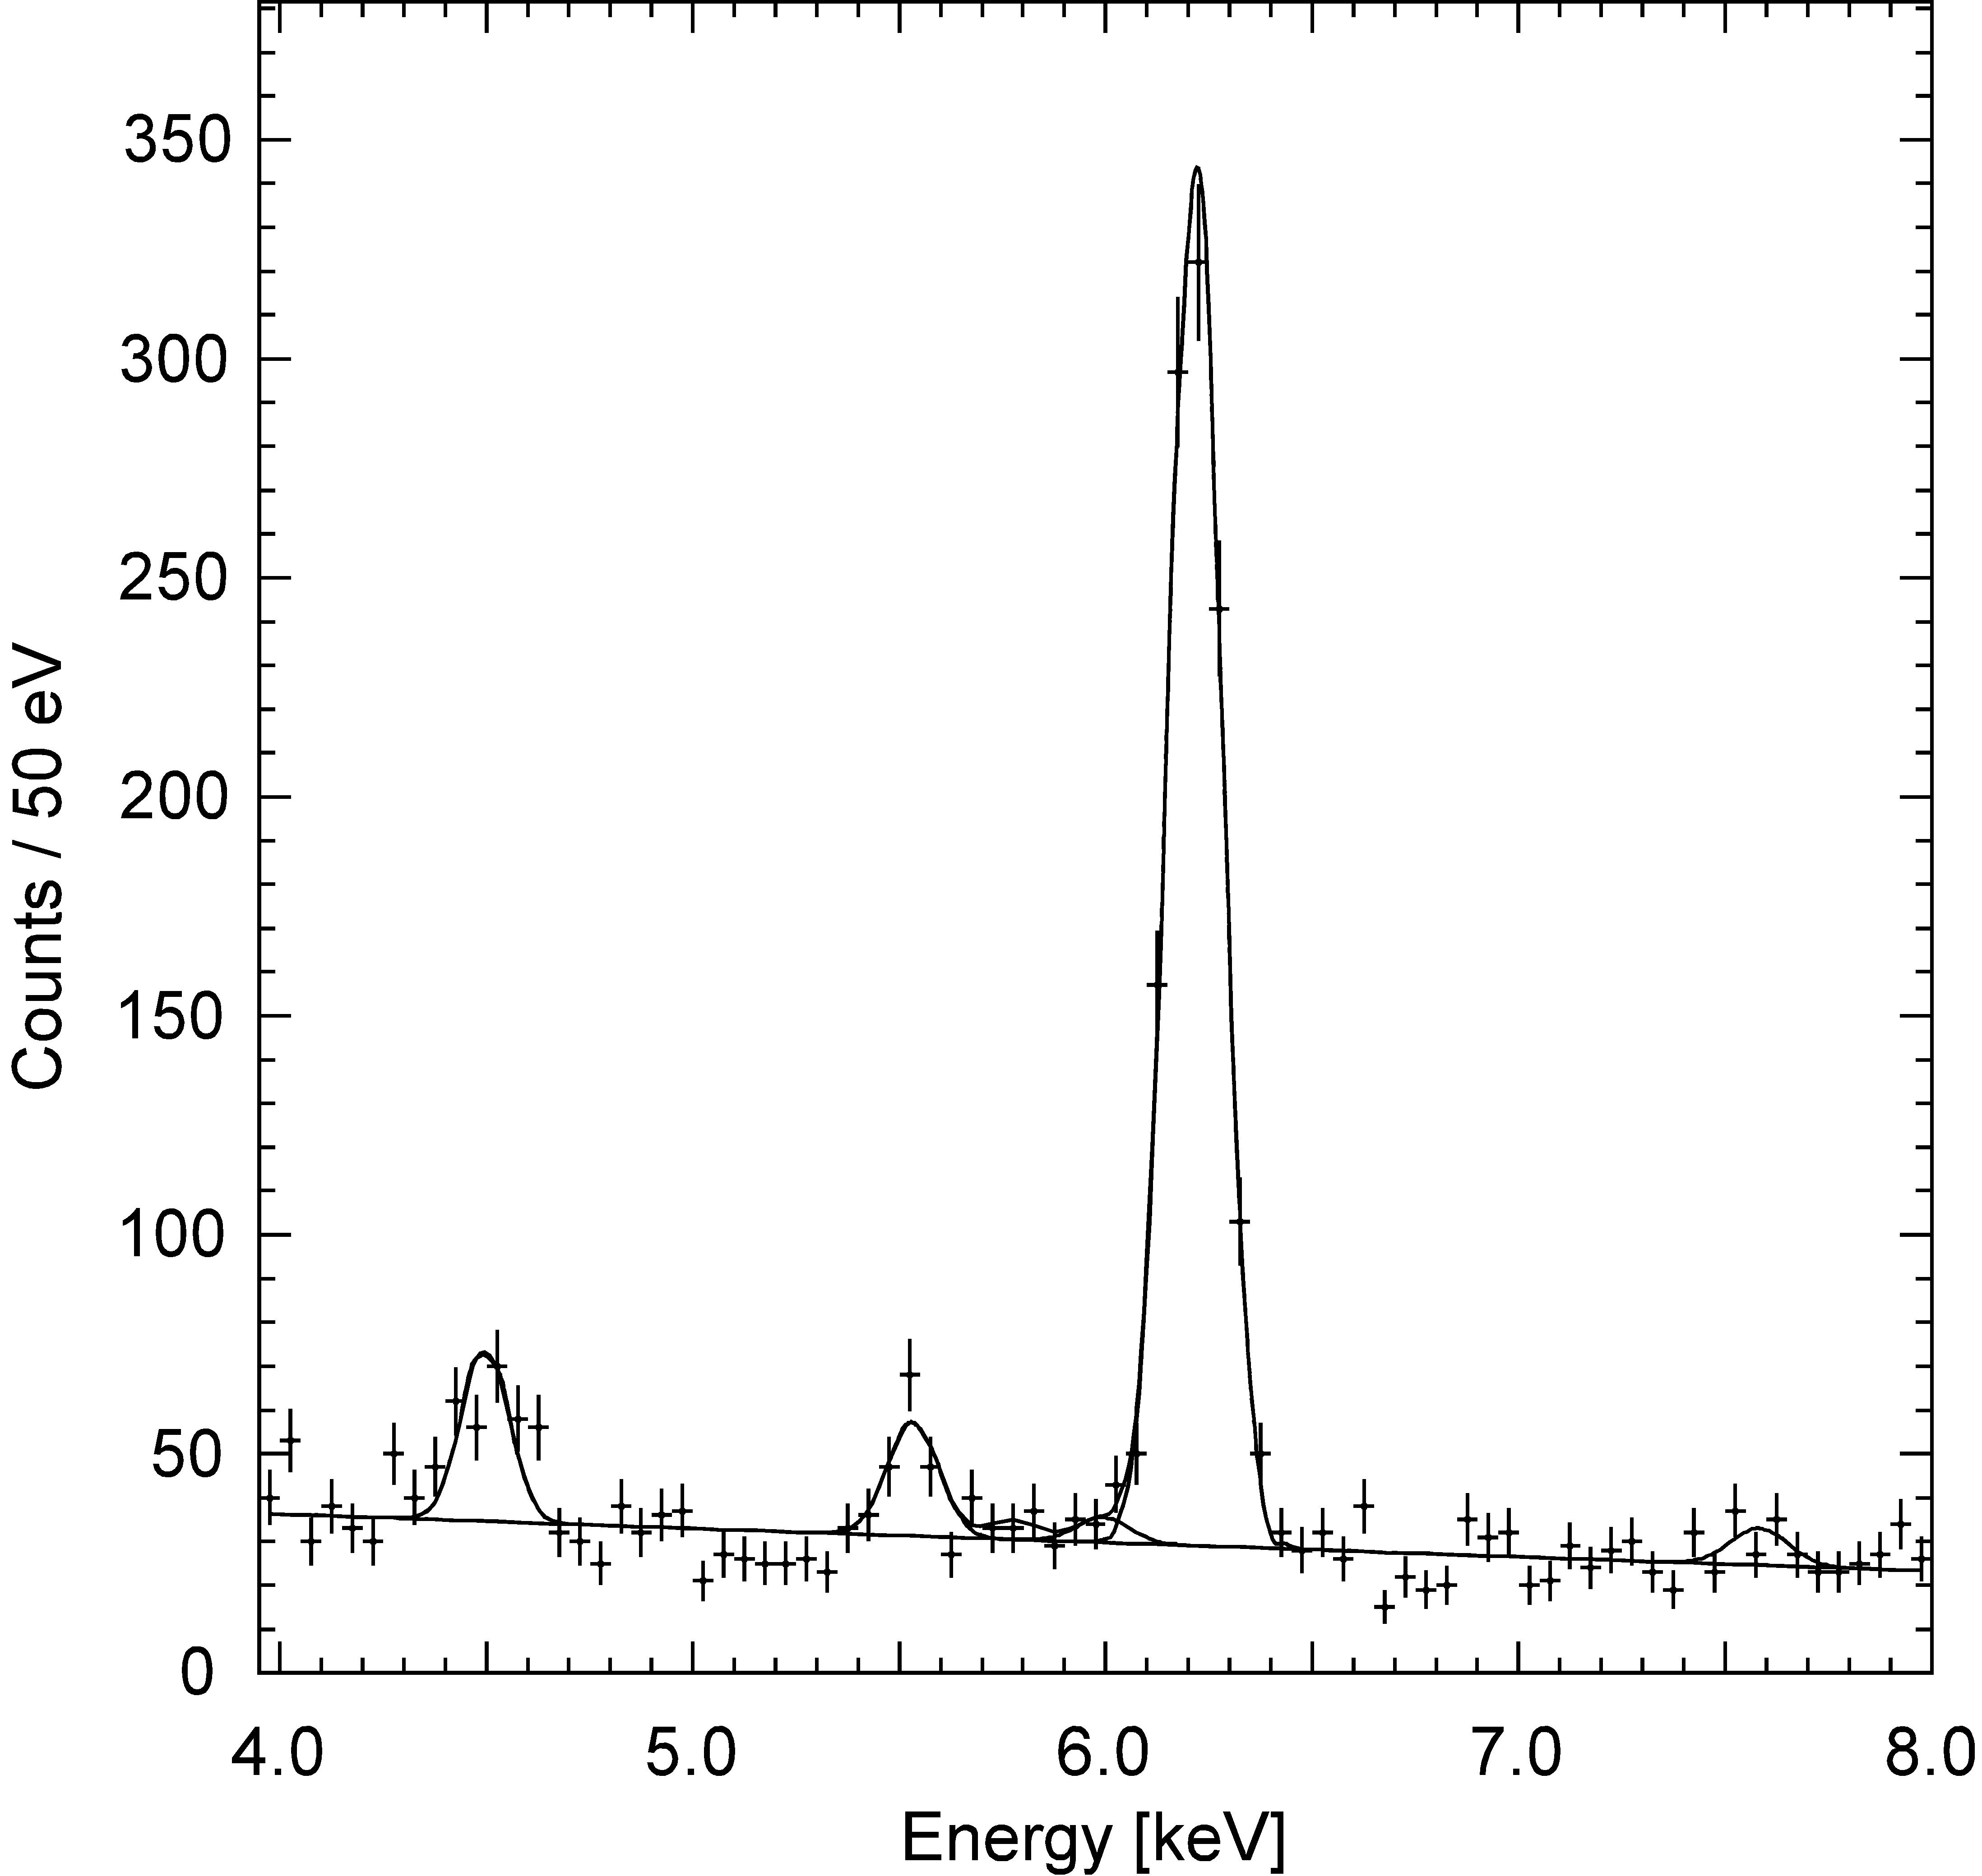
Kaonic Helium-3 spectrum
First observation of kaonic He-3 X-rays
X-ray energy of K-3He 3d-2p
K-³He (3d-2p)
QED value:
Ti Ka
K-C
K-O
K-N
arXiv:1010.4631
Submitted to PLB

Slide 12
DAFNE- LIGHT
Syncrotron ligth from DAFNE
SPARC
Conventional sources
Two new soft X-ray lines
under construction
A new UV clean exp-hall in coll.
with the Florence university

Slide 13

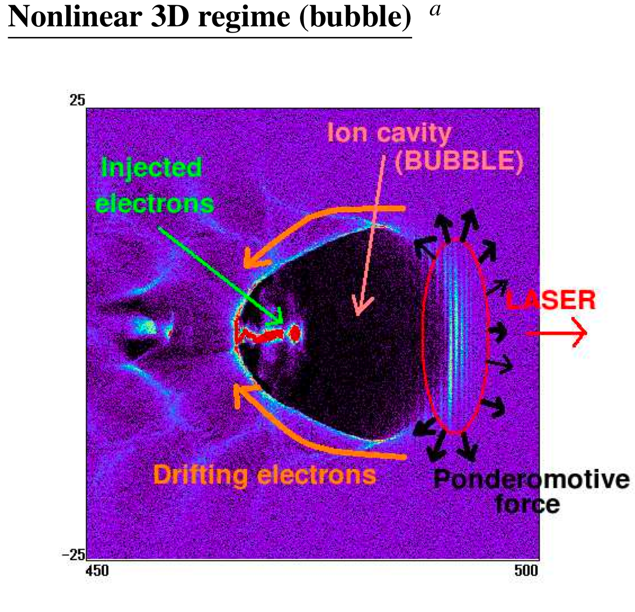
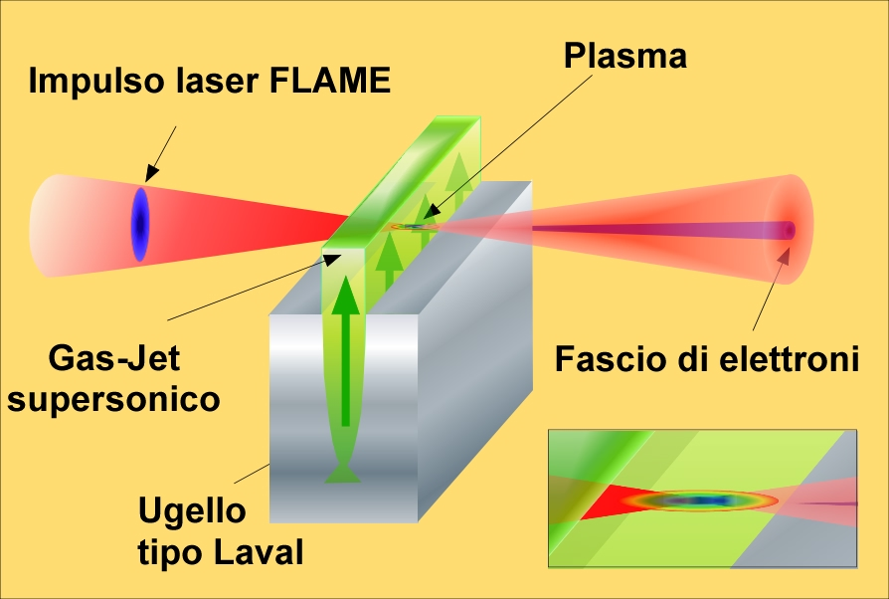

GeV ACCELERATION WITH SELF INJECTION
Main set up parameters
See: L.A. Gizzi et al., EPJ-ST, 175, 3-10 (2009)

Slide 14
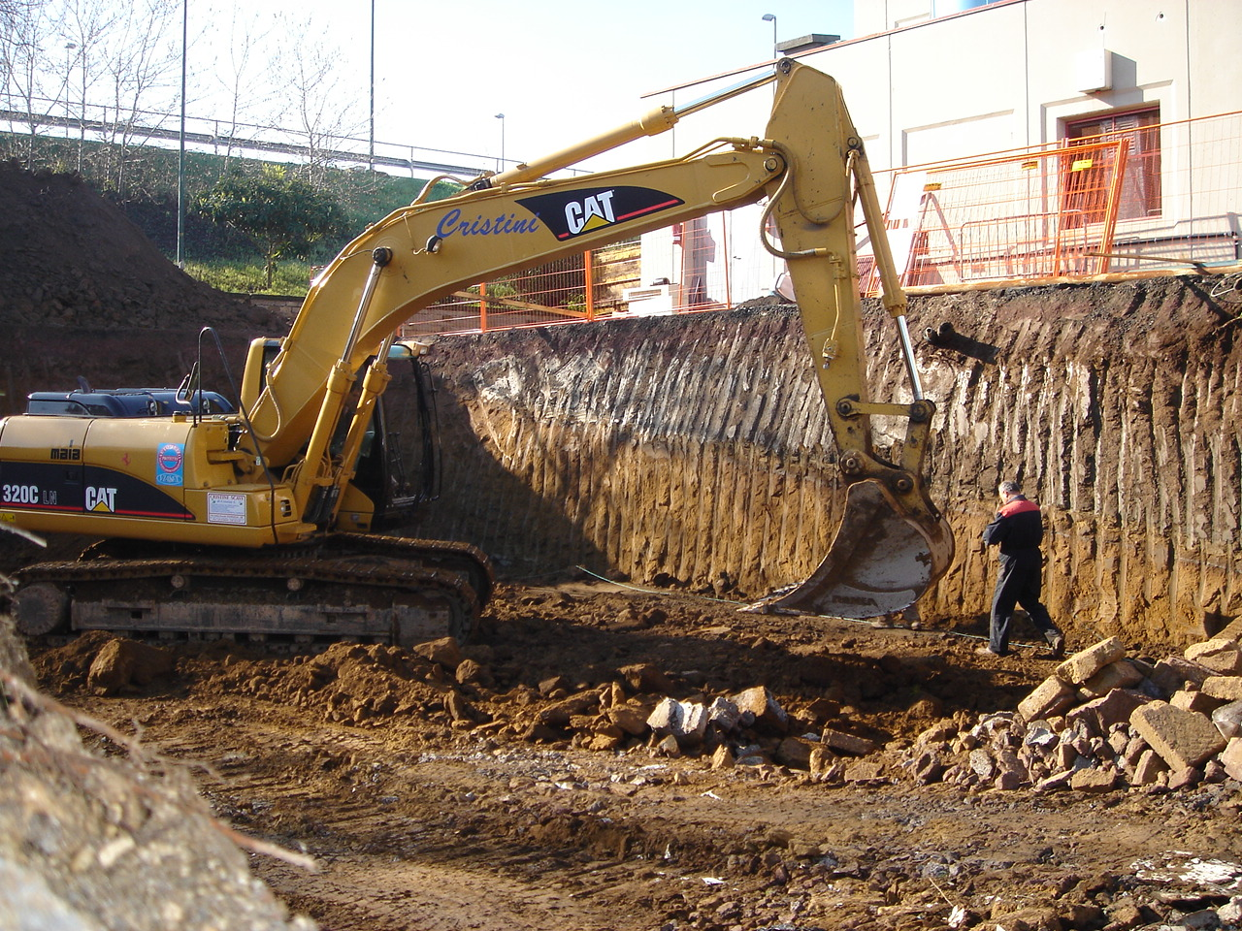
2007 - FLAME
High Power Lasers Lab

Slide 15
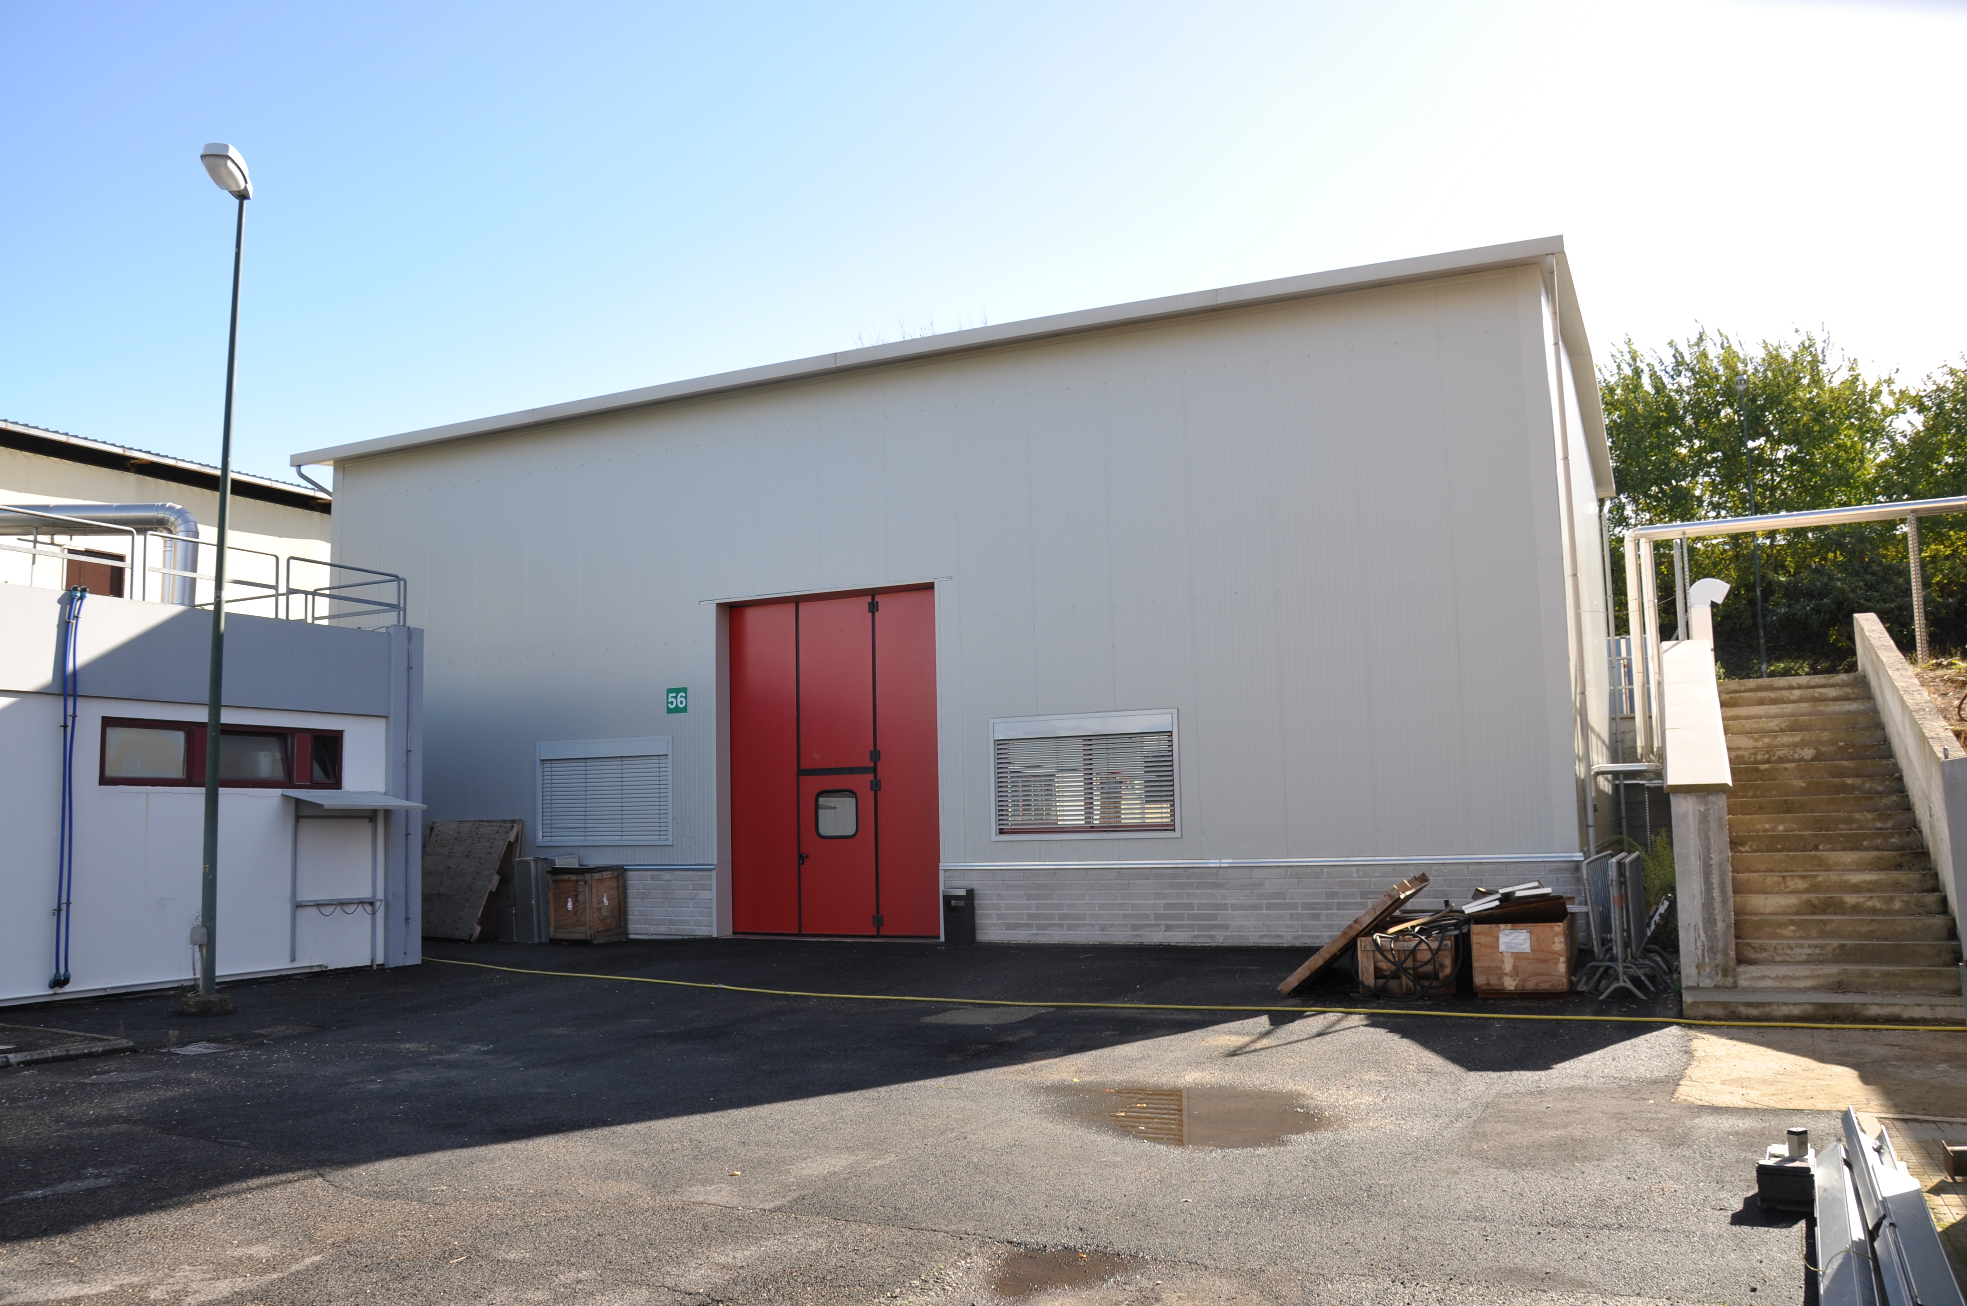
2009 - FLAME
High Power Lasers Lab

Slide 16
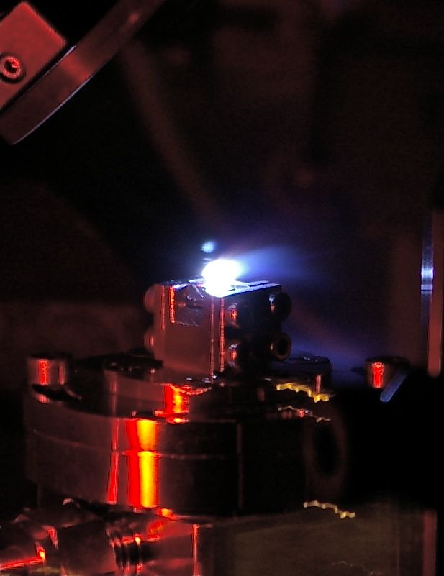

Slide 17
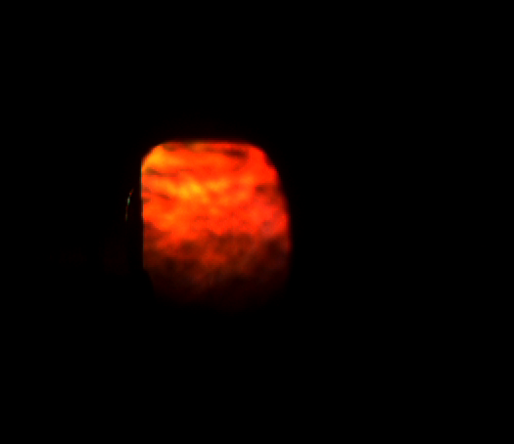
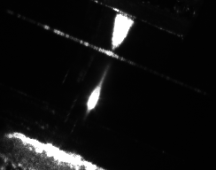
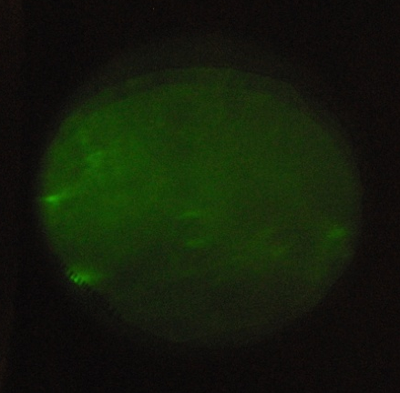
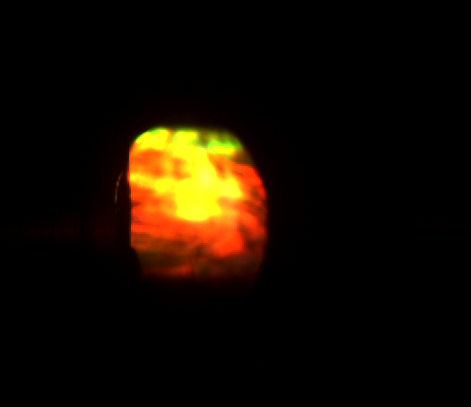
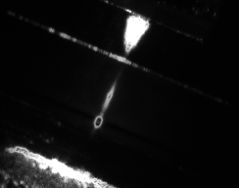
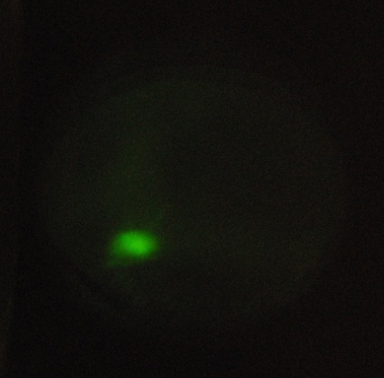
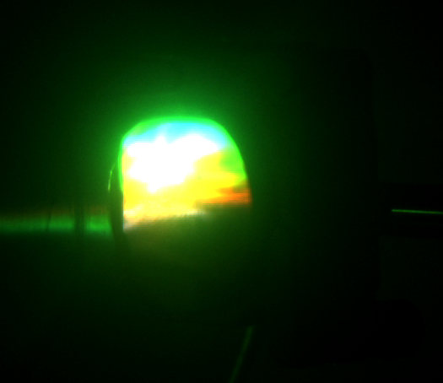
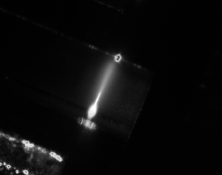
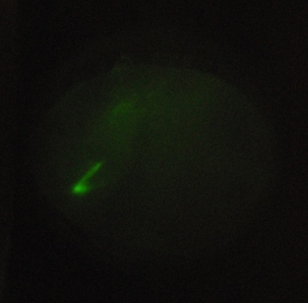
Thomson
Light
Electrons on
LANEX
FLAME - S.I.T.E.
Preliminary
DATA
Transmitted
Light
No
electrons collimation
Medium
electrons collimation
HIGH
electrons collimation
Bye, Tadzio Levato

Slide 18
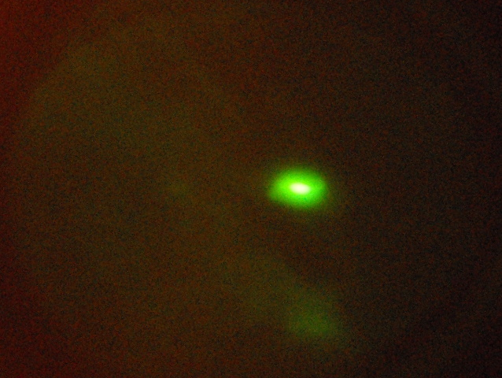
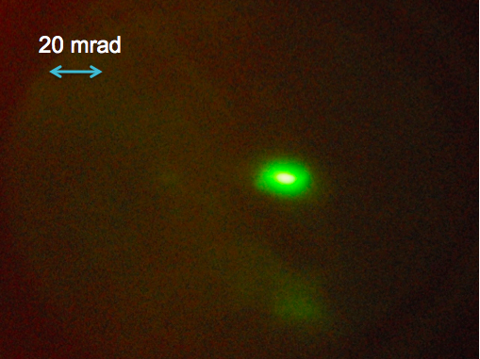
20 mrad
Electrons from
FLAME SELF INJECTION
2010 - FIRST ACCELERATION OF ELECTRONS AT 200MEV
Now:
1) Learn how to obtain stable beams and multiple accelerations
(10⁸ electrons/bunch in 100fs)
2) External injection
3) Electron beam self-acceleration with plasma waves

Slide 19
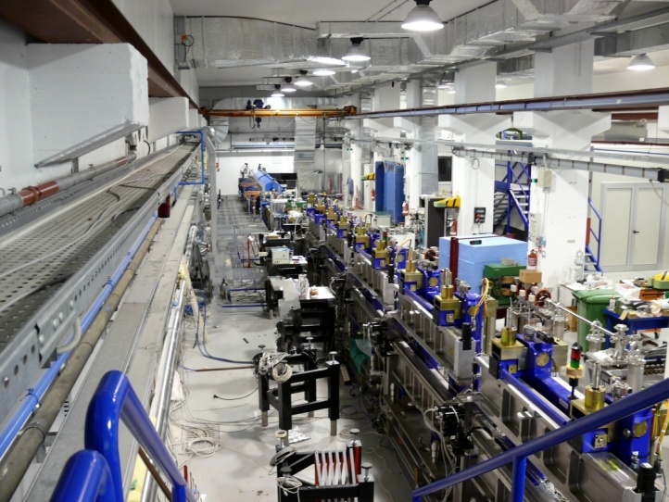
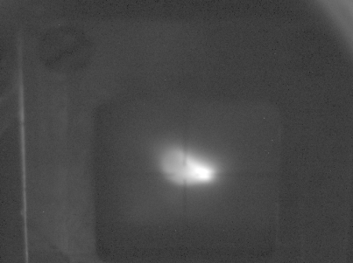
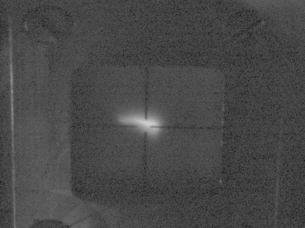
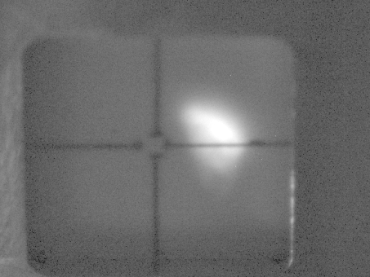
SPARC - FEL
Notes:
19

Slide 20
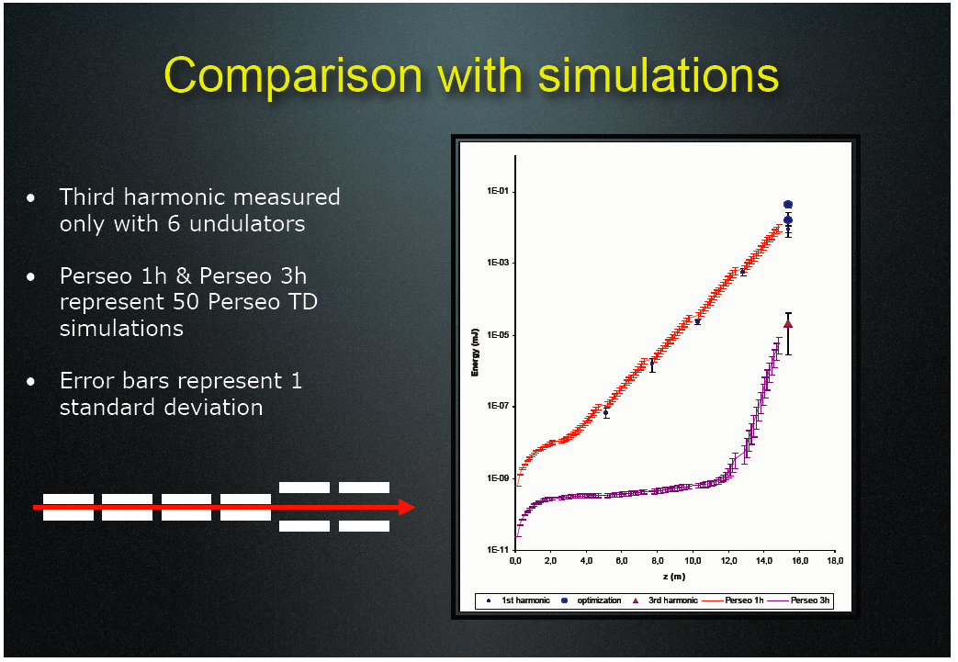

Slide 21
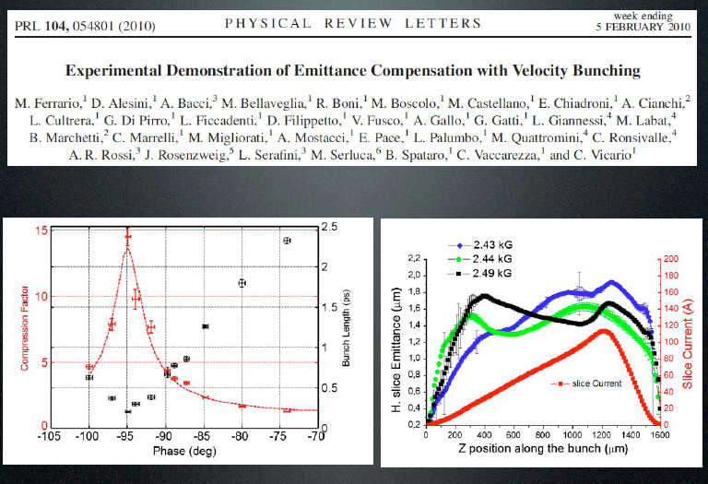

Slide 23
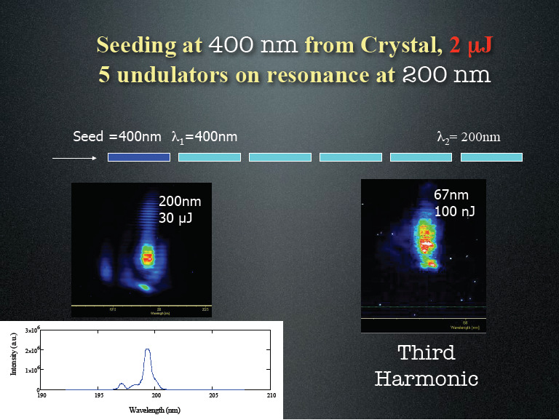

Slide 24
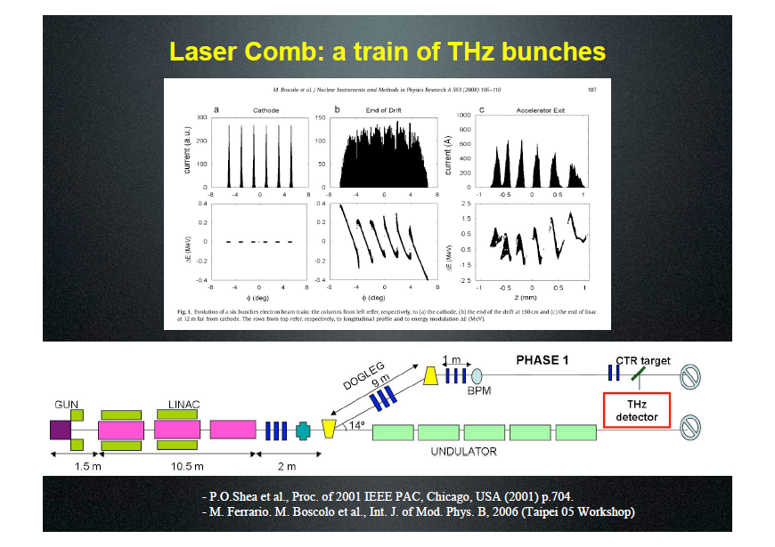

Slide 25
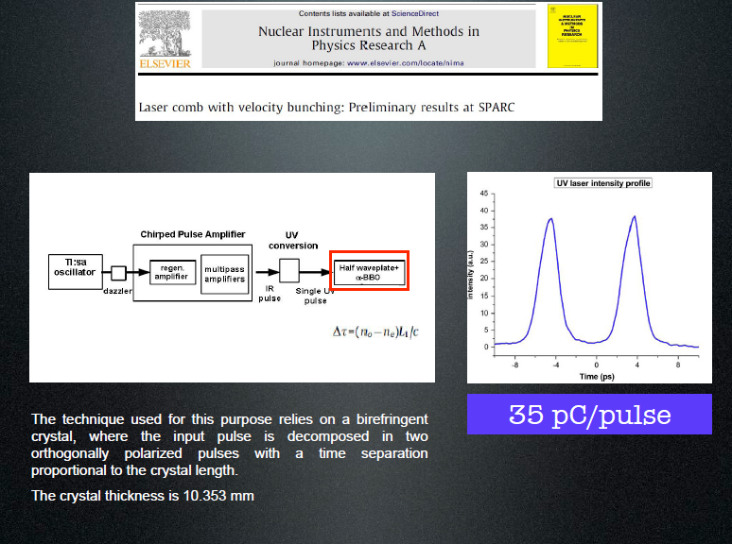

Slide 26
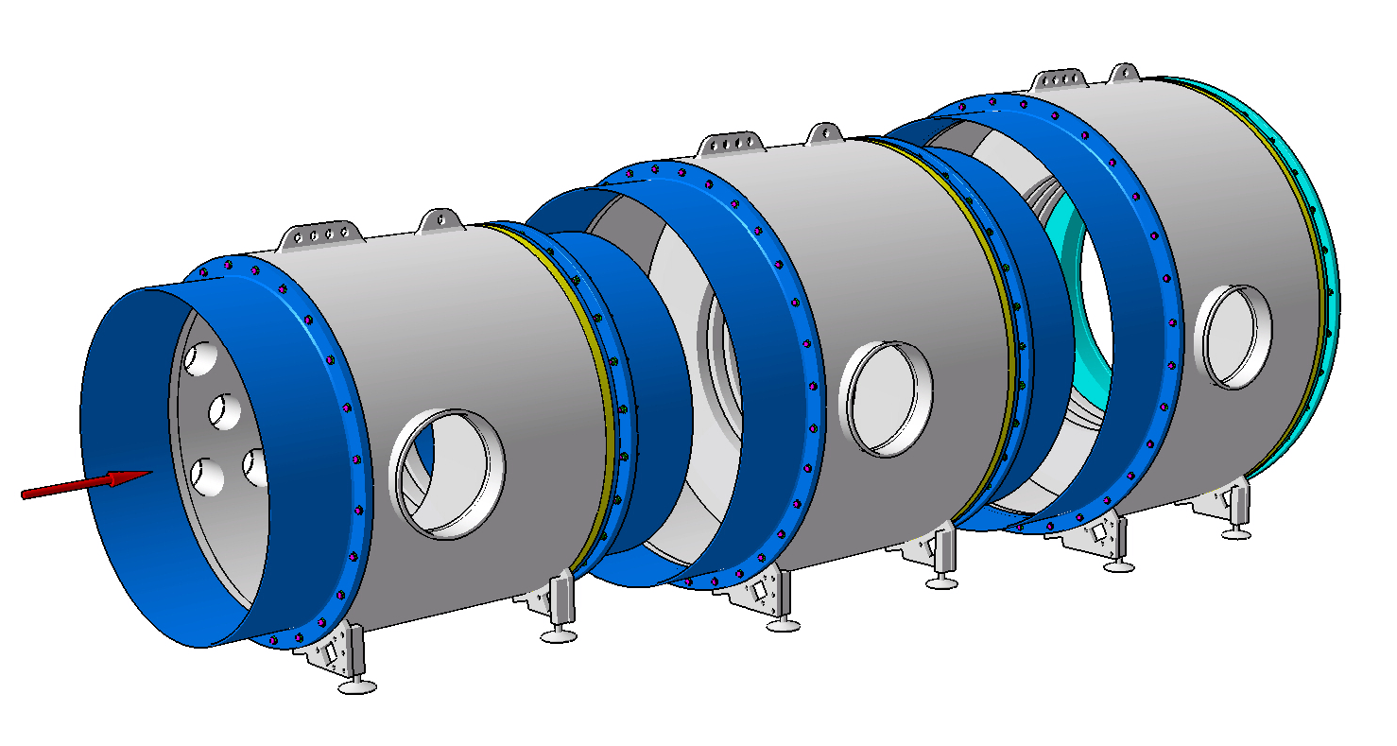
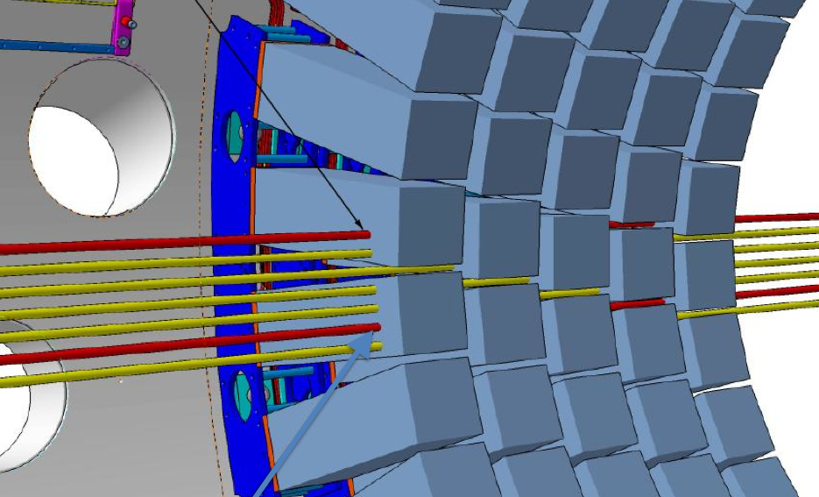
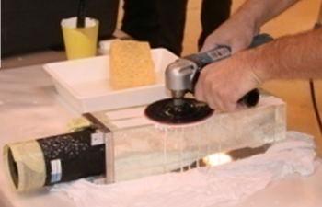
LAV layout and FEE
12 stations of increasing diameter to cover hermetically the range θ = 7–50 mrad
Mass construction started in 2009, 3 stations completed as of November 2010
New FE electronics,
responsibility of LNF
Read ~ 3000 ch’s, allow dynamic range of ~ 2
Linearity maintained @ better than %
σE/E = 9%/√E(GeV) + 5%/E(GeV) + 2.5%
LNF - NA62 PHOTON VETO CONSTRUCTION
~10000 SF4 lead crystals
  used in OPAL e.m. calorimeter
  we re-use part of the barrel
  8 different crystal shapes
  ρ=5.6 g/cm³, X₀=1.5cm,R_{M}=2.6 cm
Rearrange crystals in 4 or 5 staggered layers
Install rings inside vacuum vessel
~10000 SF4 lead crystals
  used in OPAL e.m. calorimeter
  we re-use part of the barrel
  8 different crystal shapes
  ρ=5.6 g/cm³, X₀=1.5cm,R_{M}=2.6 cm
Rearrange crystals in 4 or 5 staggered layers
Install rings inside vacuum vessel
~10000 SF4 lead crystals
  used in OPAL e.m. calorimeter
  we re-use part of the barrel
  8 different crystal shapes
  ρ=5.6 g/cm³, X₀=1.5cm,R_{M}=2.6 cm
Rearrange crystals in 4 or 5 staggered layers
Install rings inside vacuum vessel
~10000 SF4 lead crystals
  used in OPAL e.m. calorimeter
  we re-use part of the barrel
  8 different crystal shapes
  ρ=5.6 g/cm³, X₀=1.5cm,R_{M}=2.6 cm
Rearrange crystals in 4 or 5 staggered layers
Install rings inside vacuum vessel

Slide 27
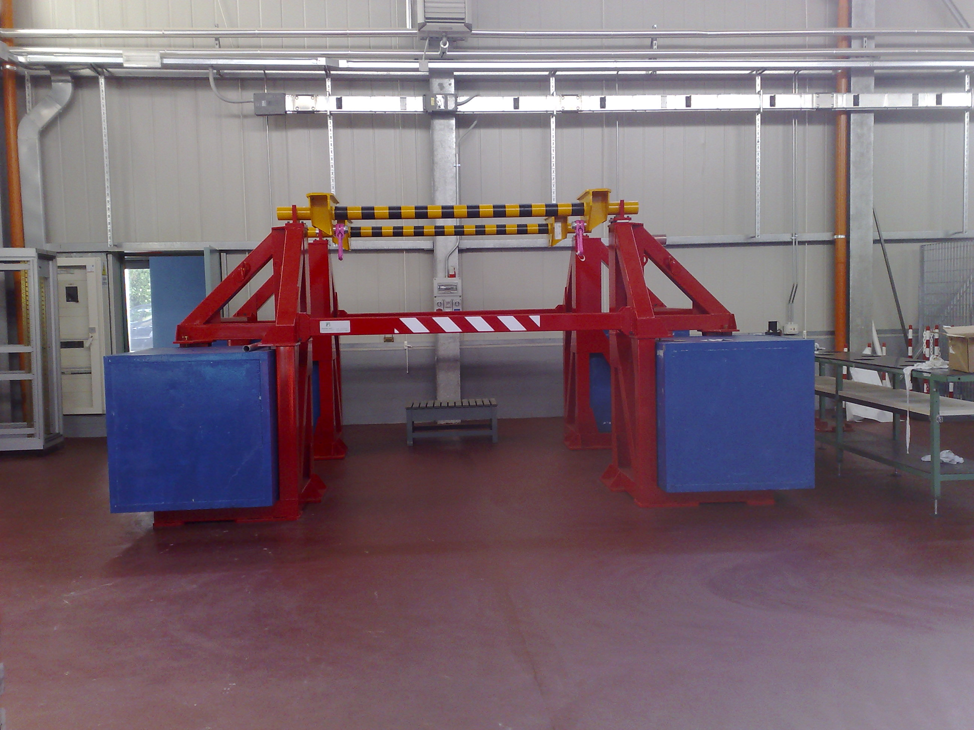
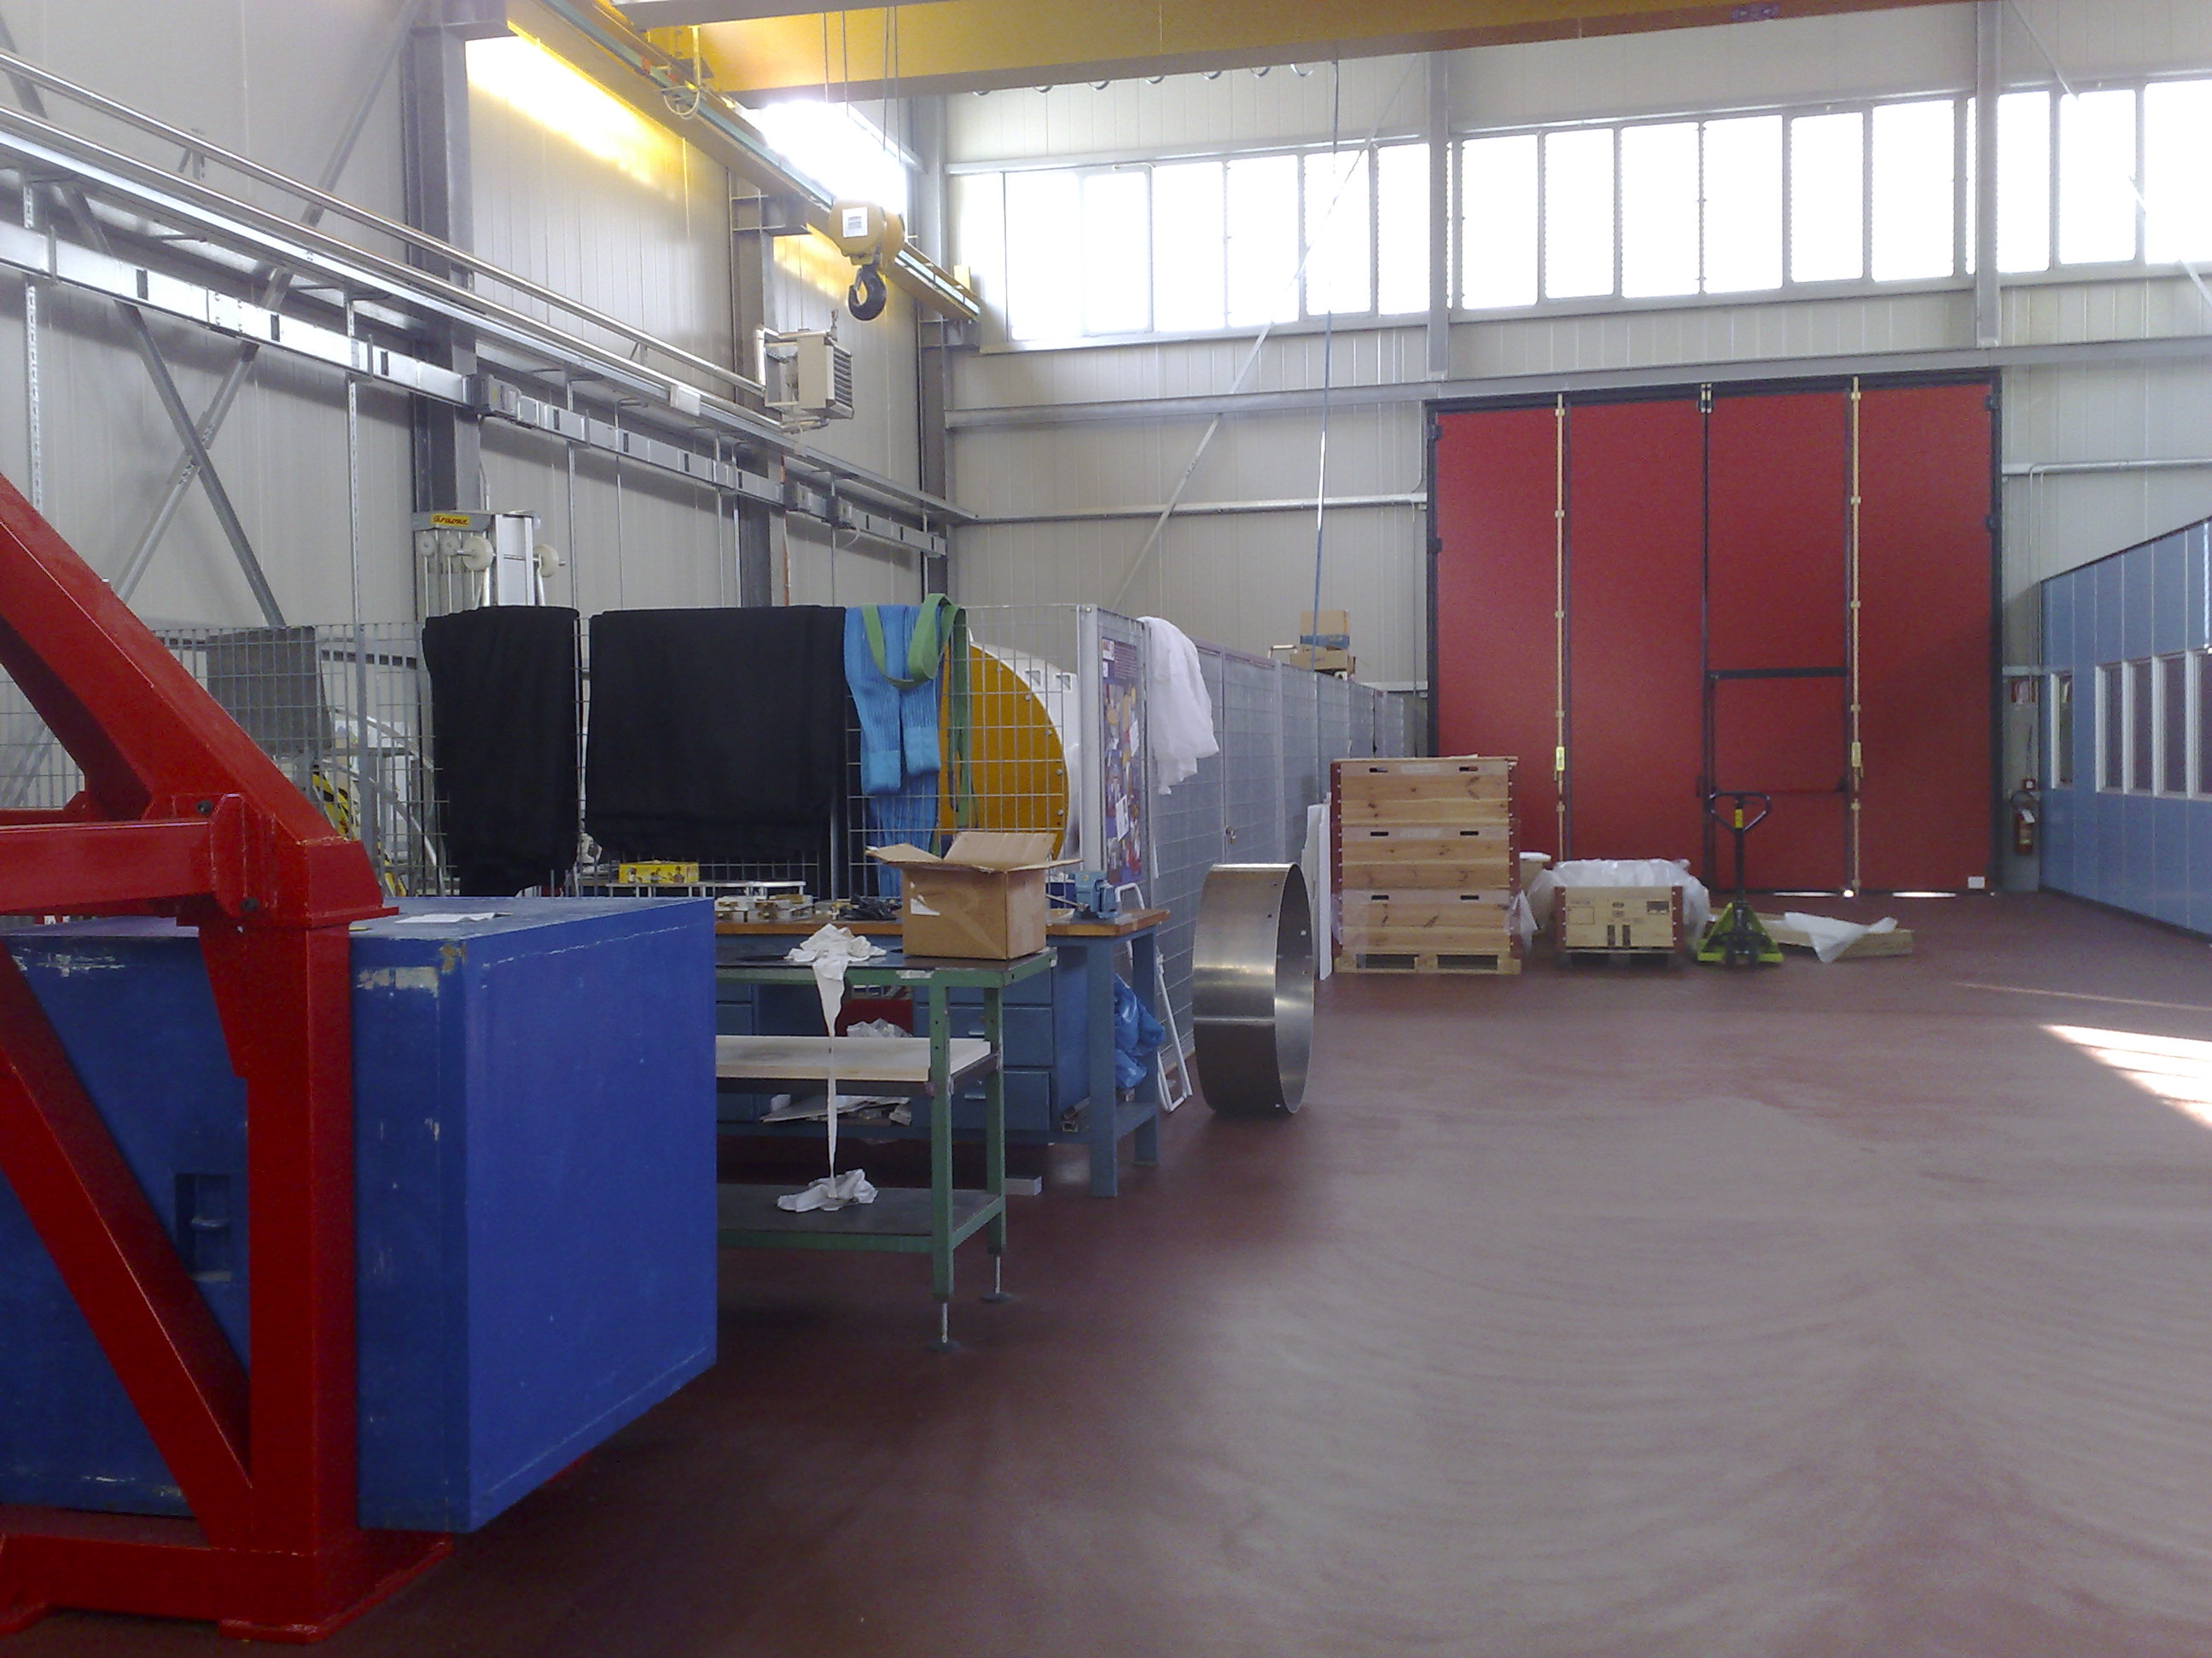
NA62 IN LNF WORKSHOP AT LNF

Slide 28
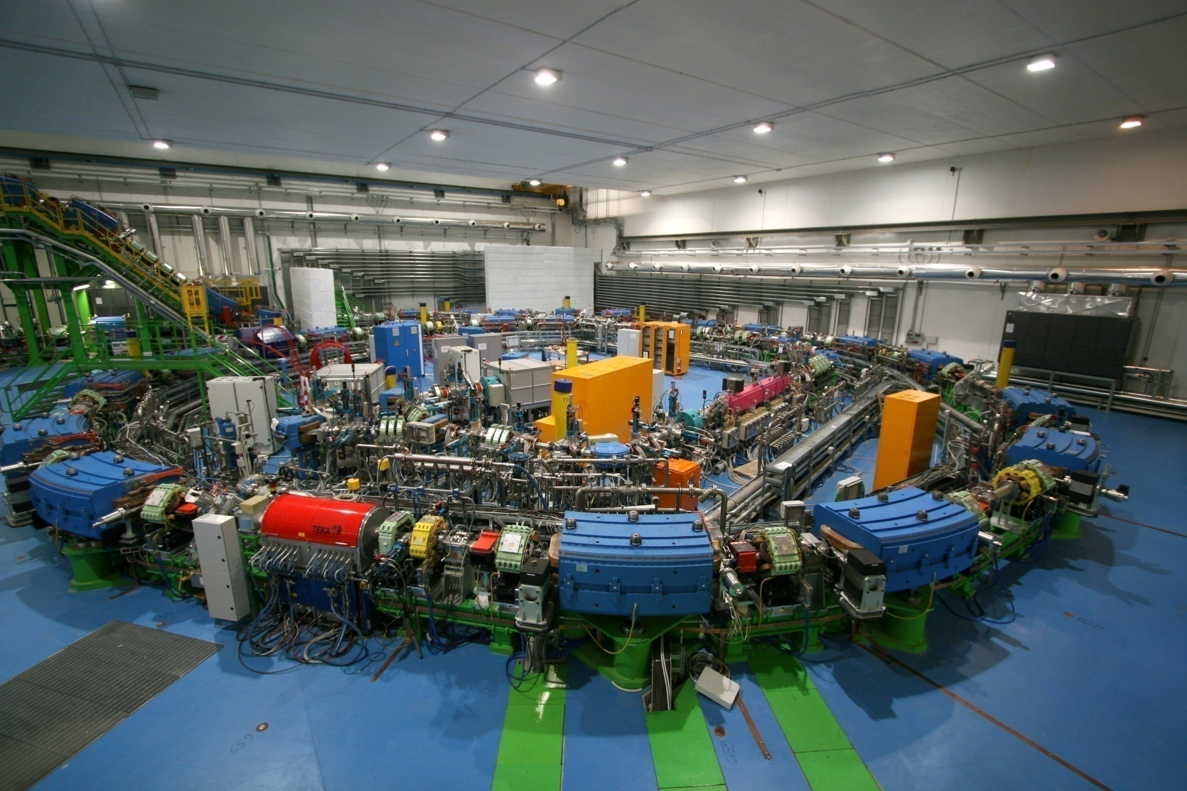
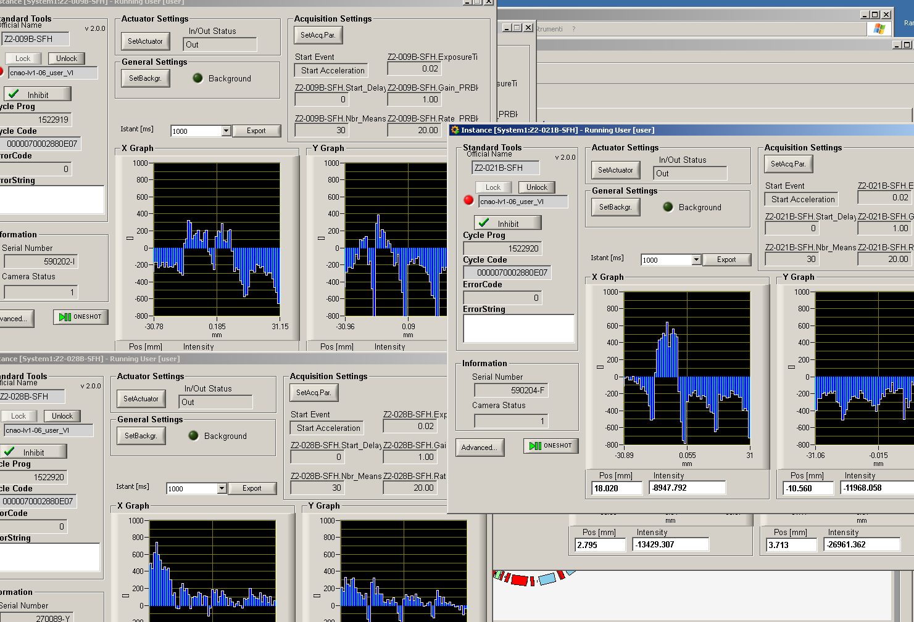
CNAO – The Accelerator Complex
First H⁺ accelerated beam in the “Z” treatment room
October 26, 2010
C.Sanelli C.Biscari
…and Thanks to the LNF staff

Slide 29

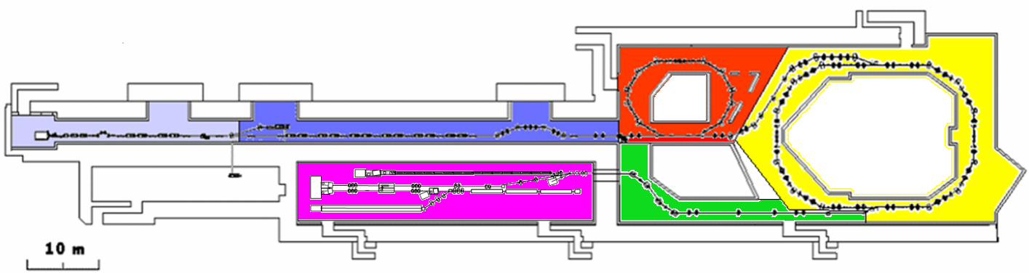
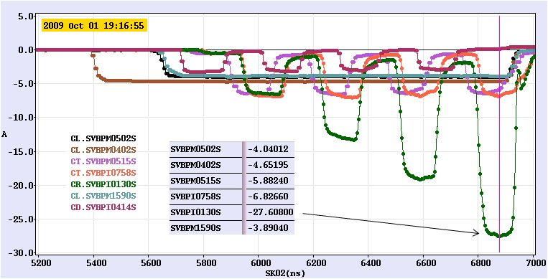
Measured currents in CTF3:
[28A in CR]
CRM
TL1
DL
CR
TL2
CLEX
CLIC

Slide 30
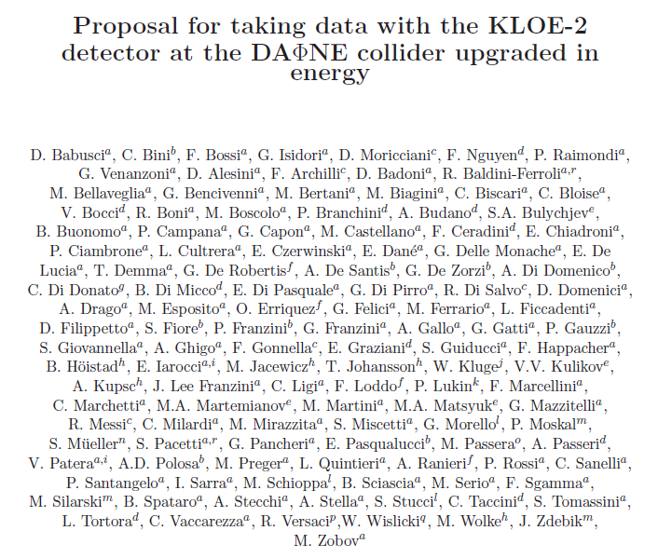

Slide 31
FUTURE:
1)THREE YEARS OF DAFNE RUNNING WITH KLOE
2) SPARC, PLASMONX, COMB, LIFE
3) LHC EXPERIMENTS AND NA62
4) CONCLUSION OF CDF DATA TAKING
5) BTF AND DAFNE-L EXPLOITATION
6) PHYSICS IN SPACE
7) NAUTILUS RUNNING
8) JLAB EXPERIMENTS
9) DETECTOR R&D (Gruppo 5°)
DAFNE UPGRADE WITH KLOE2 (AND AMADEUS)
SECOND GENERATION EXPERIMENTS AT LIFE
SPARCX?
SECOND CNAO IN ITALY?

