Slide 1
Edge-TCT measurements of heavily irradiated HPK p-type sensors
G.Kramberger, V. Cindro, I. Mandić, M. Mikuž, M. Milovanović, M. Zavrtanik
Jožef Stefan Institute
Ljubljana, Slovenia

Slide 2
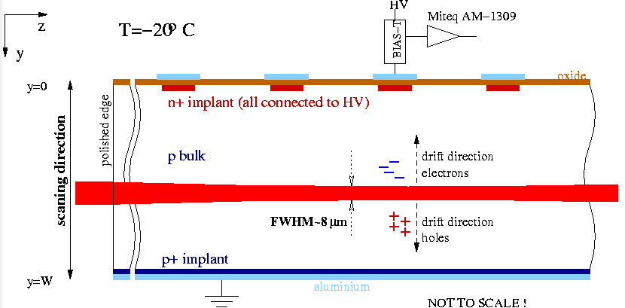
Edge-TCT
1.5 GHz scope
laser
1060 nm
100 ps pulse
200 Hz – 1MHz repetition
detectors on Peltier cooled support in dry air atmosphere
(down to -20ºC)
lens system
Advantages (compared to pixel test beam – grazing technique):
Position of e-h generation can be controlled by 3 sub-micron moving tables (x,y,z)
The amount of injected e-h pairs can be controlled by tuning the laser power
Easier mounting and handling
Not only charge but also induced current is measured – a lot more information
Drawbacks:
Light injection side has to be polished to sub-micron level to have a good focus – depth resolution
It is not possible to study charge sharing due to illumination of all strips
Absolute charge measurements are very difficult

Slide 3
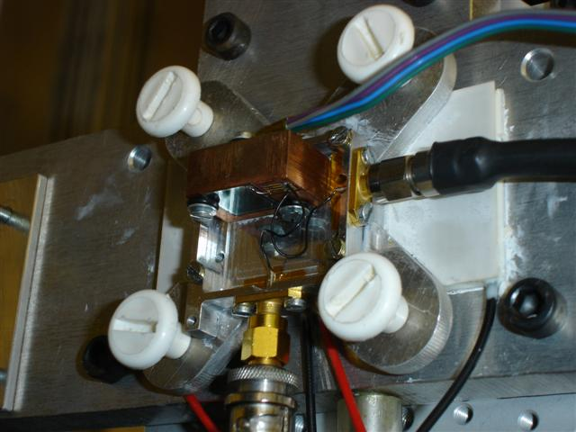
Samples
Samples | Fluences | Annealing
HPK (ATLAS-07 run) 1x1 cm2, 300 μm thick, 80 μm pitch p-type isolation: p-stop + p-spray initial V_{fd}~190 V | non-irradiated 1,2,5,10∙10¹⁵ cm⁻² irradiated in steps | sequential steps at 60ºC up to 80 min (0,10,20,40 min) at each fluence
Neutron irradiated samples
Measurements done at -20ºC
Annealing done with samples mounted in the setup to ensure that the same spot in the detector is illuminated at different annealing times

Slide 4
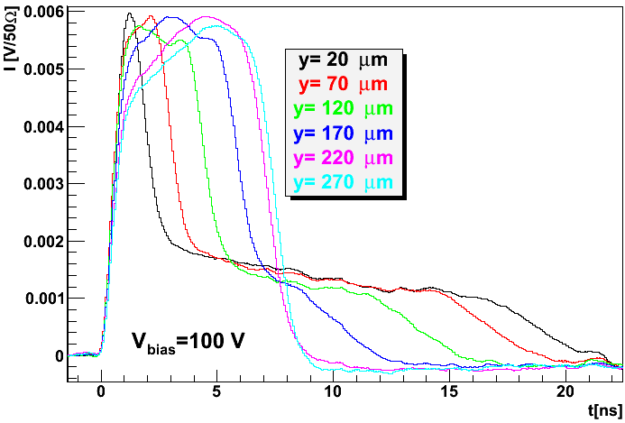
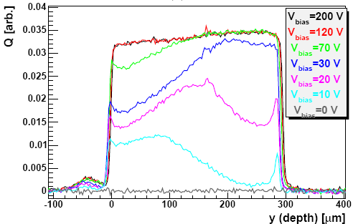
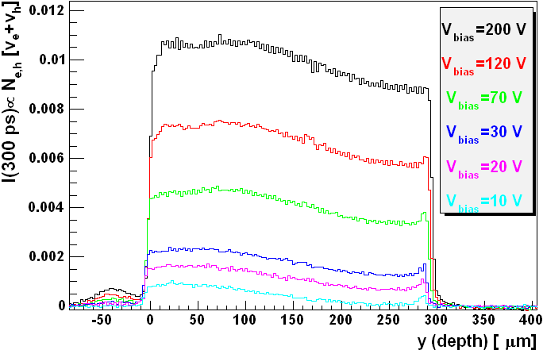
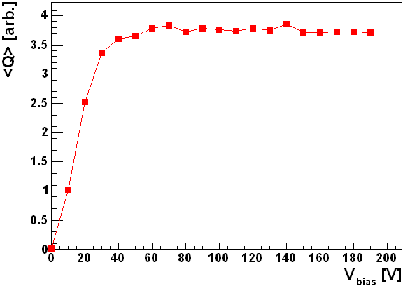
Charge collection and velocity profiles
RD50 Micron p-type sensor
CHARGE COLLECTION PROFILE
V_{fd}~16 V
VELOCITY PROFILE
v_{e}+v_{h} [arb.]
charge collection for mip

Slide 5
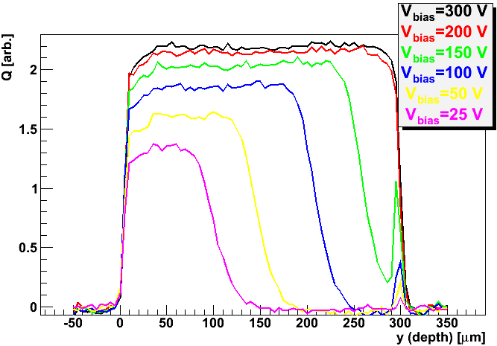
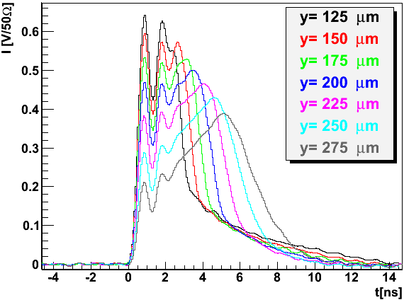
HPK (non-irradiated)
200 V
V_{fd}=180 V from CV (10 kHz, RT), at 200 V the detector is fully efficient
For V<Vfd there is a region with E field at the back (p-p+ contact).
growth of ”active region (y_{act})” with bias voltage can be observed (agrees with homogenous N_{eff})
The current pulses show expected behavior:
the reflections with HPK are larger than with Micron (impendence issue?)
Long tail from drift of holes
Increase of signal from drift of electrons

Slide 6
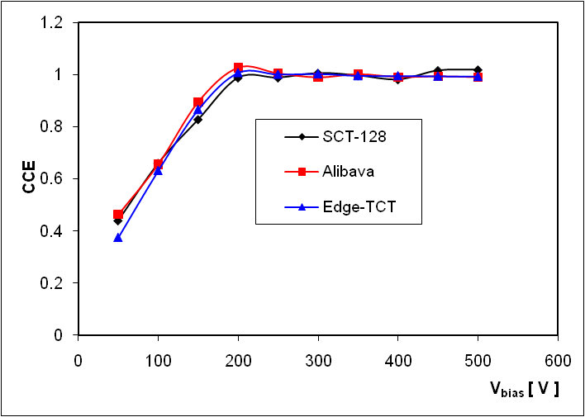
HPK (non-irradiated)
The <Q> from Edge-TCT was compared with ⁹⁰Sr setups using Alibava and SCT128A !
  A very good agreement was observed for all three measurements – validation of the <Q> technique

Slide 7
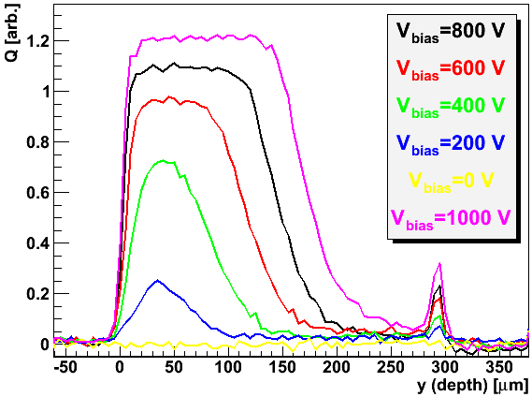
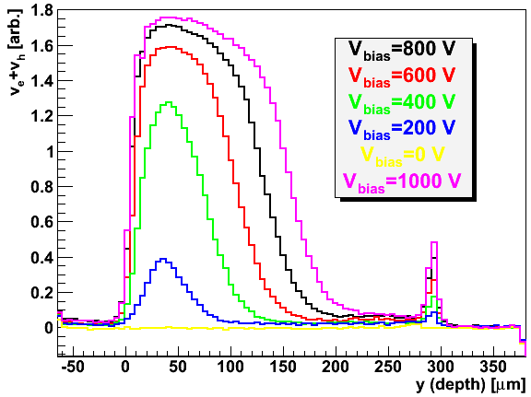
HPK (Φ_{eq}=10¹⁵ cm⁻² )
as irradiated/no annealing
charge collection profile
velocity profile
Shape of Q(y) is not much different from that of a non-irradiated detector -> the device model is the same as for non-irradiated detector
  Electric field at the back is much smaller than at front - “double junction effect” is small due to oxygen lean detectors and neutron irradiations
  Once the charge is injected in the region with electric field the Q(y<y_{act}) is constant
The velocity profile confirms the Q(y)

Slide 8
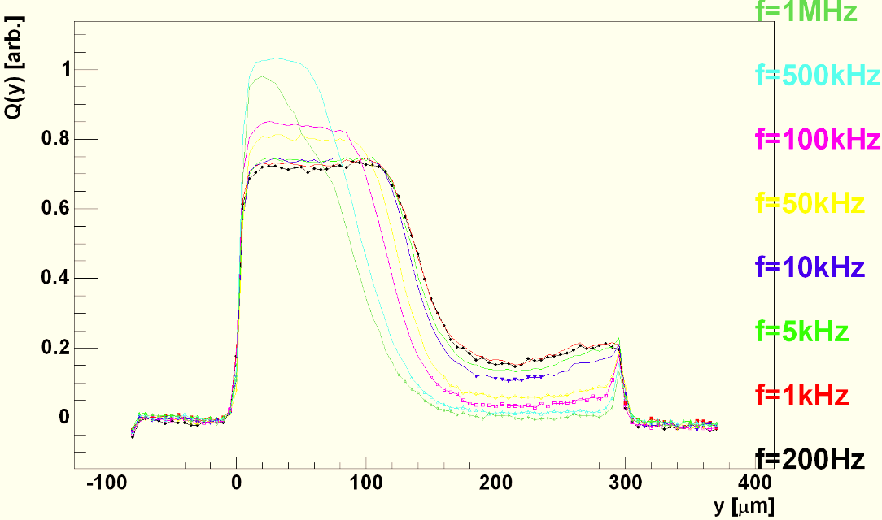
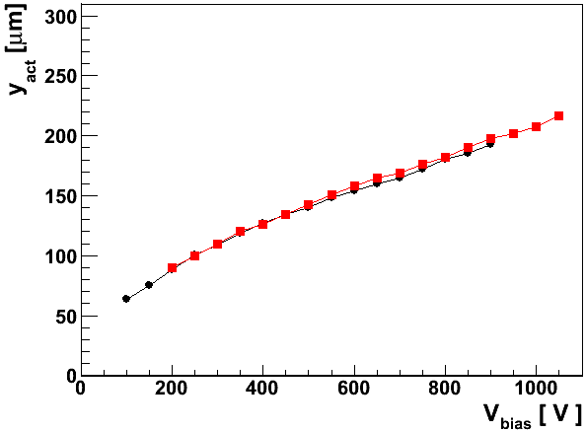
Impact of pulse frequency and amplitude
The signal from “non-active” region depends on the pulse frequency (studies triggered by accident ☺)
  low for high frequency
  high for low frequency
Simplistic explanation: more electrons get trapped leading to increase of N_{eff} and less voltage is dropped in the non-active region
500 V
Q(y)->0 , 100 kHz
50% drop in Q(y) , 200 Hz
The active region is defined as a point where Q(y) drops to 50% from the peak-plateau – see figure
There is 30 μm difference between 100 kHz and >1 kHz
For measurements at 100 kHz this point coincides with Q(y)->0
v_{e}+v_{h}->0 coincides with y_{act} measured at 200 Hz

Slide 9
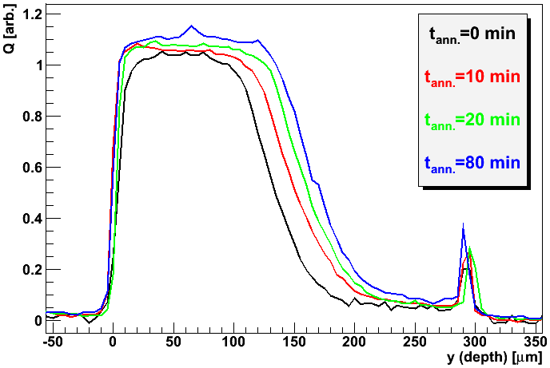
HPK (Φ_{eq}=10¹⁵ cm⁻² ) – beneficial annealing
700 V
beneficial annealing is close to that at lower fluences – the method gives a possibility to measure it also at such high fluences
The improvement in <Q> is around 30% at 700 V
the predicted active region (N_{eff}=const.) is very close to the measured
In agreement with expectations based on RD48 and RD50 data – up to 10¹⁵ cm⁻² the device behaves in accordance with expectations derived at lower fluences.

Slide 10
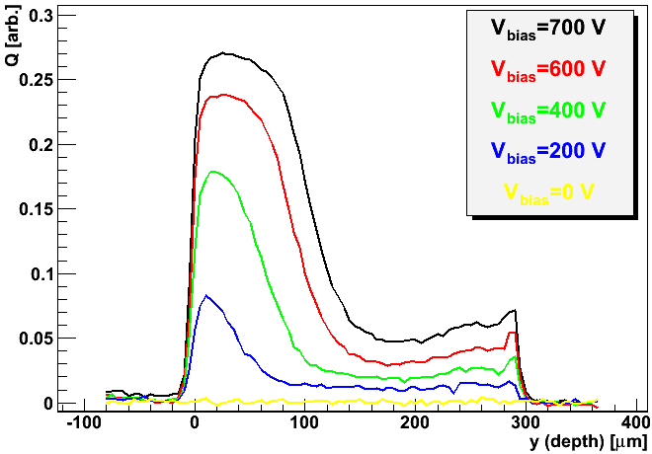
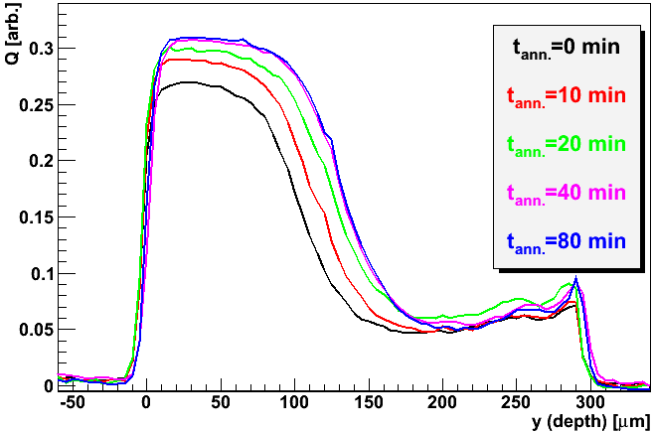
HPK (Φ_{eq}=2∙10¹⁵ cm⁻² )
700 V
The “active region” is reduced with respect to lower fluence - as expected
charge collection in “non-active” region becomes significant – should be even more at lower frequencies!
Q(y<<y_{act}) is not flat - two possible reasons
  charge multiplication
  less effective trapping in high fields

Slide 11
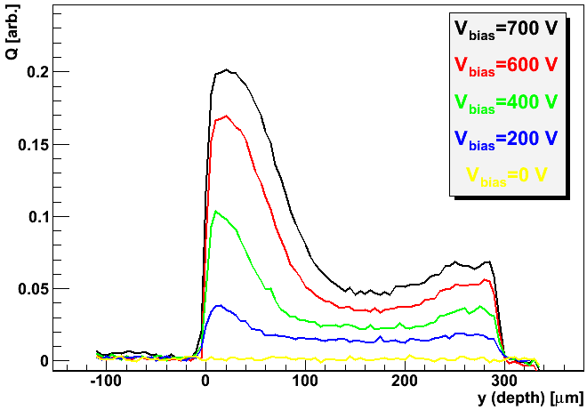
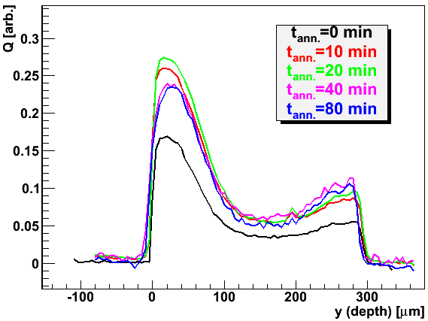
HPK (Φ_{eq}=5∙10¹⁵ cm⁻² )
600 V
Important contribution for y>y_{act}
Reduction of y_{act}(Φ_{eq})
Annealing (note “CERN scenario”) influences mainly trapping – the shape of the Q(y) remains the same
At low voltages E is almost homogenous in the entire detector

Slide 12
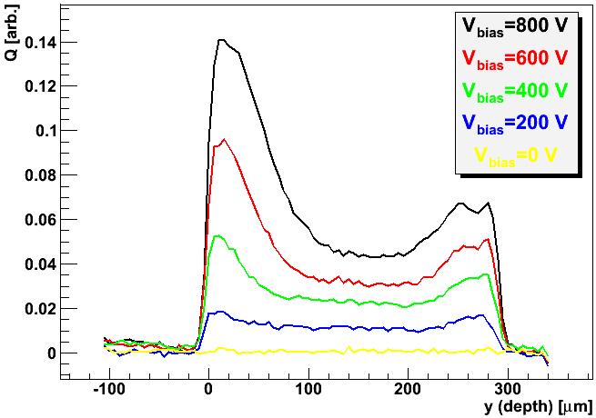
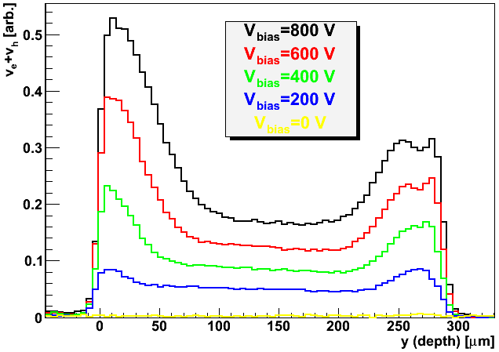
HPK (Φ_{eq}=10¹⁶ cm⁻² )
if v is close to saturation …
E saddle>0.3 V/μm
Only the measurement after irradiation was possible – break down after first annealing step destroyed the detector
Electric field is established in the whole detector – more pronounced double junction profile
The electric field in the saddle should be more than E>0.3 V/μm
At lower voltages electric field is uniform or even larger at the back

Slide 13
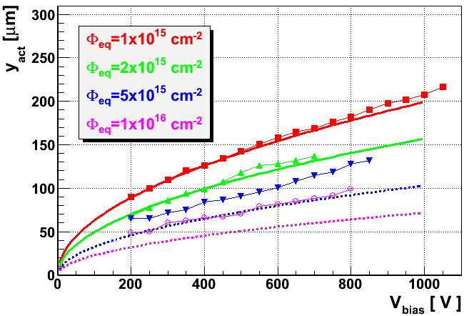
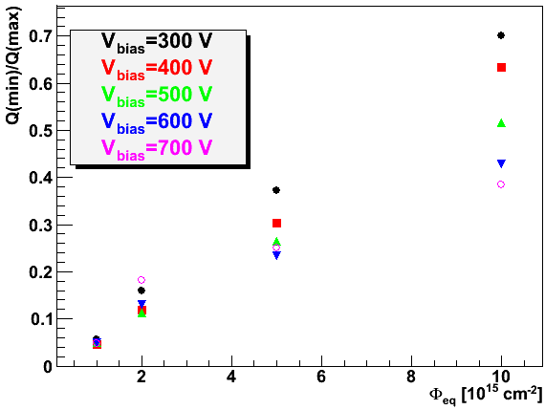
Active region
Estimated V_{fd}
(denoted by line)
2270 V
3650 V
8480 V
17450 V
bias
fluence
Active region decreases with fluence
  as predicted at low fluences
  less than predicted at high fluences
The difference between highest and lowest efficient region decreases with fluence and increases with bias
Conclusions:
V_{fd} predicts the y_{act} up to 2∙10¹⁵ cm⁻²
Substantial E is established in whole detector for Φ_{eq}> 2∙10¹⁵ cm⁻²
The non-active region y>y_{act} becomes more important – y_{act} loses importance
Charge multiplication close to the strips only adds to this beneficial effects

Slide 14
Conclusions
  V_{fd} retains the validity as the parameter determining active region (high CCE region) up to 1-2∙10¹⁵ cm⁻² for neutron irradiated HPK sensors
    The charge collection profile shows no significant deviation from N_{eff}=const.
    The expected active region agrees well with predicted from RD48/50 measurements
Substantial electric field is present in whole detector at high fluences already for moderate voltages
  The difference between efficiency of different regions in the detector is reduced with fluence
  Large injection rate reduces the charge collection from “non-active” region (i.e. active bulk)
  The field in the middle of detector at 10¹⁶ cm⁻² is of order 0.5 V/μm at 700 V
Annealing impacts the performance in positive way
  before significant contribution from amplification the beneficial annealing is similar to the predicted from low fluence data
Future plans
  repeating the measurements with HPK sensors
  studies on pion irradiated sensors
  Edge-TCT parallel with strips (charge sharing, weighting field impact)

