Slide 1


A novel two-dimensional microstrip sensor for charge division readout
17th RD50 Workshop, CERN Nov 18th 2010
D. Bassignana, M. Lozano, G. Pellegrini
CNM-IMB (CSIC)
M. Fernández, R. Jaramillo, F.J. Muñoz, I. Vila
IFCA (CSIC-UC)

Slide 2
_Outline
Sensor’s working principle.
Prototype manufacturing.
Electrical characteristics.
Laser and radioactive source characterization.
Test beam @ SPS.
Conclusions and outlook.

Slide 3
_Charge division concept
Charge division used in wire chambers to determine the coordinate along the sensing wire.
Same concept with conventional microstrips with slightly resistive electrodes
Resistive material
Al
L_{1a}
L_{2a}
L_{3a}
L_{4a}
L_{5a}
L_{6a}
X
Y
S₁
S₁=f(y)
S₂=f(L-y)
Particle
S₂
P₁
P₂
P₃
P₄
P₅
P₆
t
t₂
t
t₁
Ampl1
Ampl2
1
P₄
V
L_{1b}
L_{2b}
L_{3b}
L_{4b}
L_{5b}
L_{6b}

Slide 4
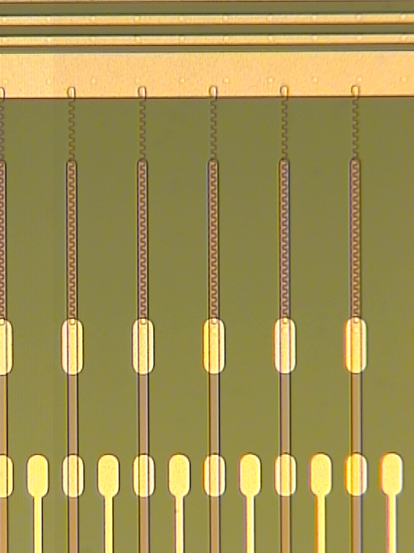
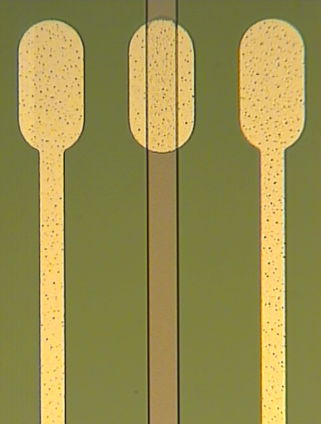

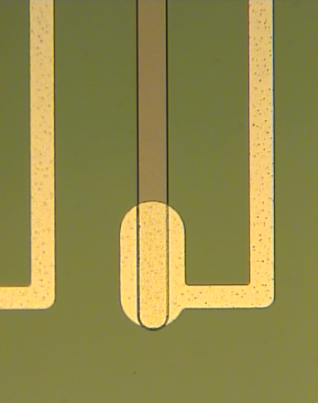
_Concept Demonstrator: P-Si sensor
Designed and produced at IMB-CNM.
standard technology
of silicon microstrip detectors.
P-on-n, 300 μm thick detectors.
Resistive material = highly doped polysilicon.
strip length= 14 mm.
Two different prototypes with different strip widths:
20 μm and 40 μm.
metal guides to drive the contact pads at the same edge of the detector.
implant pitch= 160 μm
read out pitch= 80 μm
Multiple guard rings.
Only one chip
to read out
the detector

Slide 5
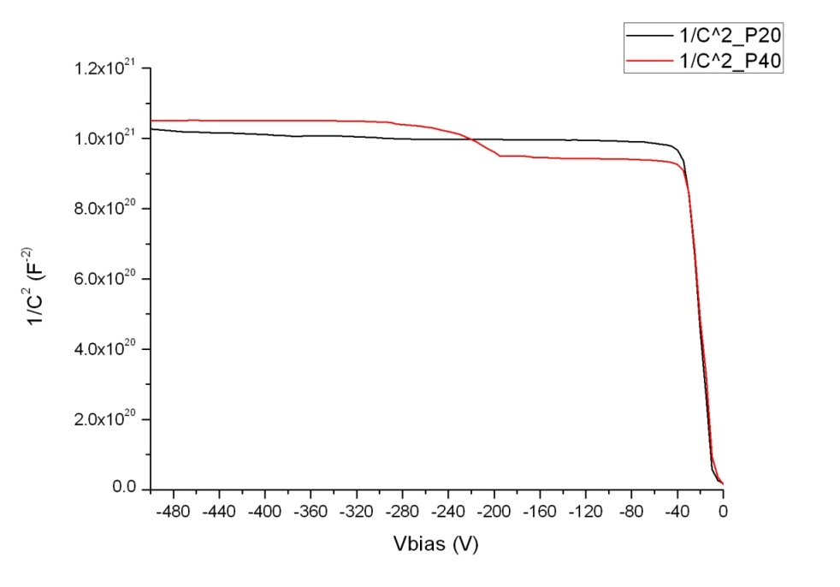
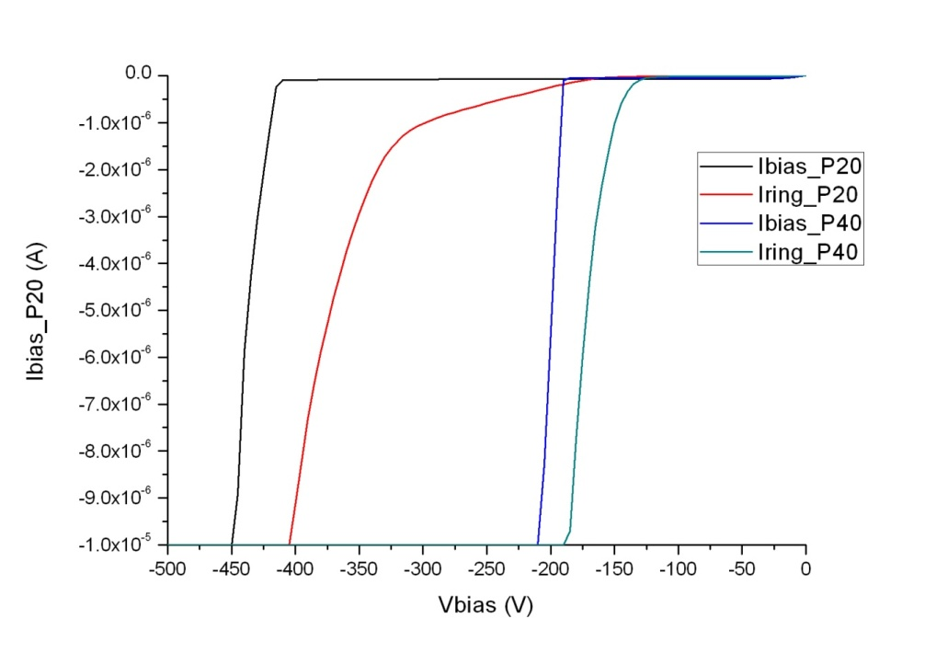
_Electrical Characterization
Strip Width | V_{depl} | V_{bd} | R_{bias} | R_{int} | C_{int} | C_{coupl} | R_{electrode}/ □ | R_{electrode}/μm
20μm | 40 V | > 400 V | 1,31 MΩ | > GΩ | 1,32 pF | 248 pF | 400 Ω/□ | 20 Ω/μm
40μm | 40 V | > 200V | 1,37 MΩ | > GΩ | 1, 60 pF | 487 pF | 400 Ω/□ | 10 Ω/μm

Slide 6
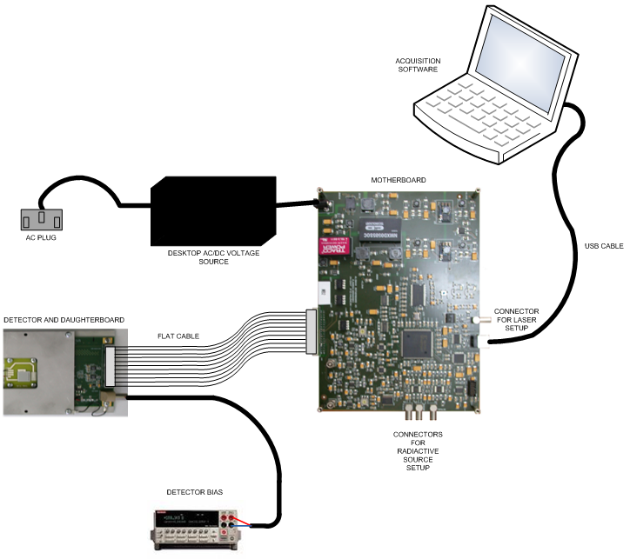
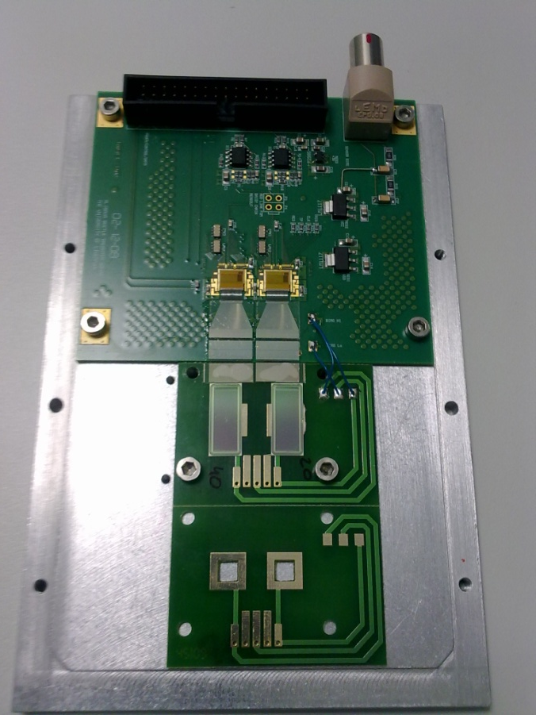
_Readout Electronics
ALIBAVA SYSTEM – Sensors P20 & P40 bonded at IFIC

Slide 7
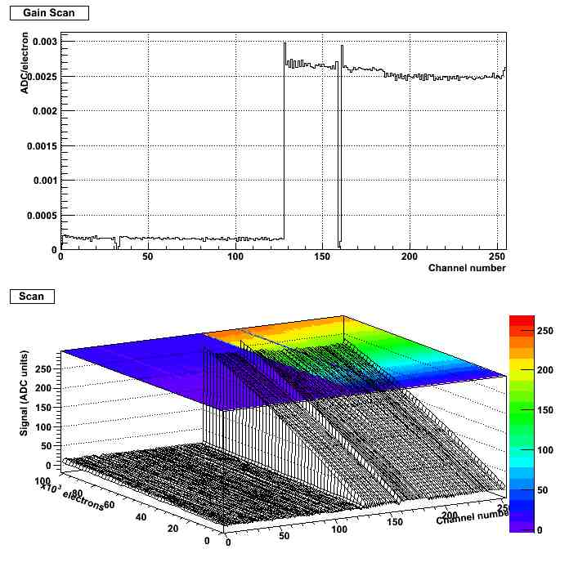
FE chip calibration
400 electrons/ADU
P20 channels
68
Chip 1 did not perform calibration

Slide 8
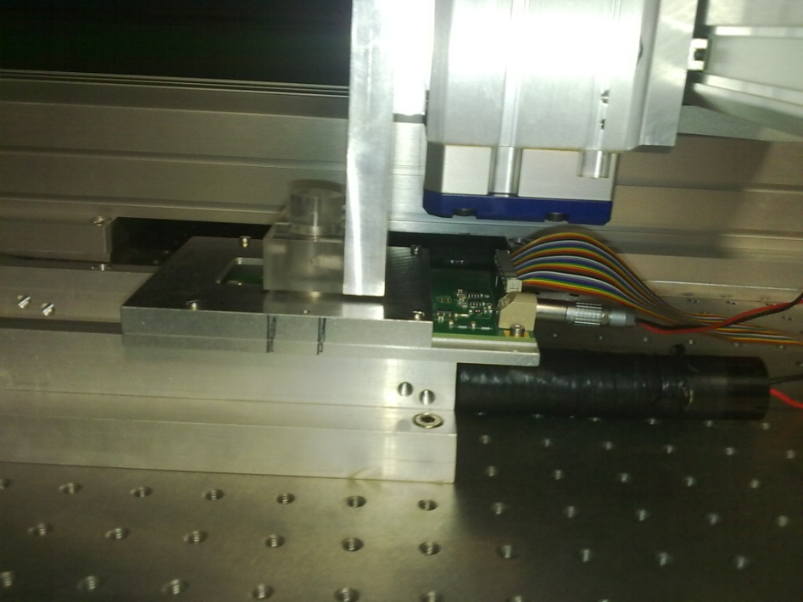
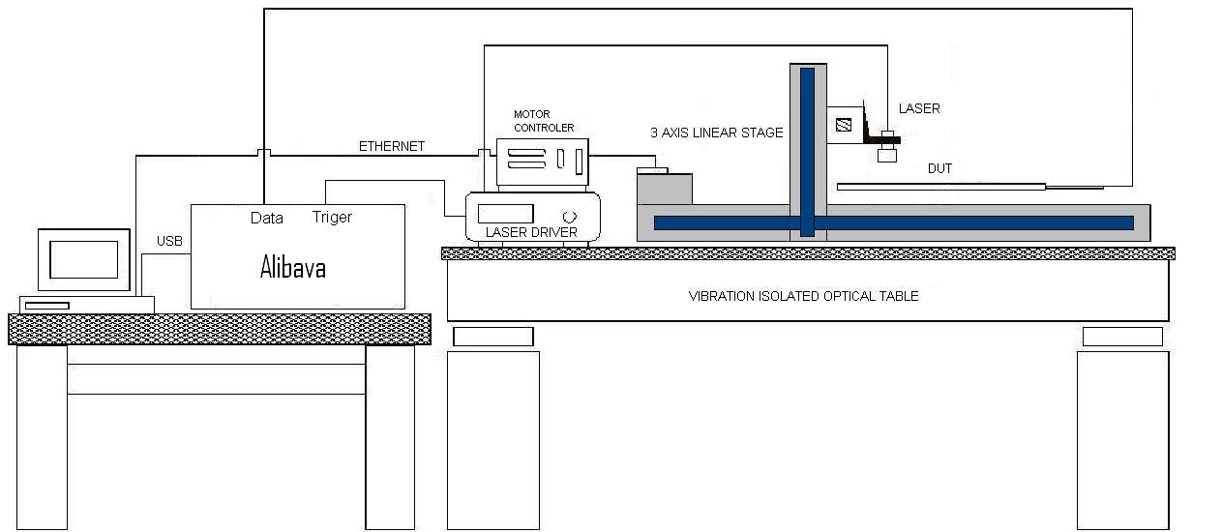
Laser characterization: test stand
Laser head on 3D platform (∼ 5 um accuracy):
  Gaussian profile with microspot width 2σ < 10um
  Wavelength 1080 nm
  Pulse duration < 1ns
  Pulse energy ∼ 10% gaussian fluctuation.

Slide 9
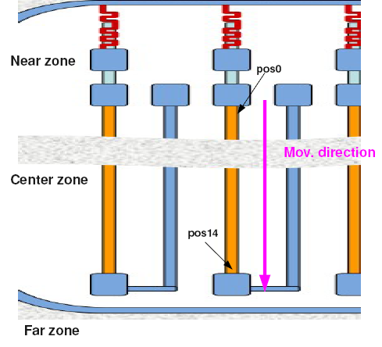
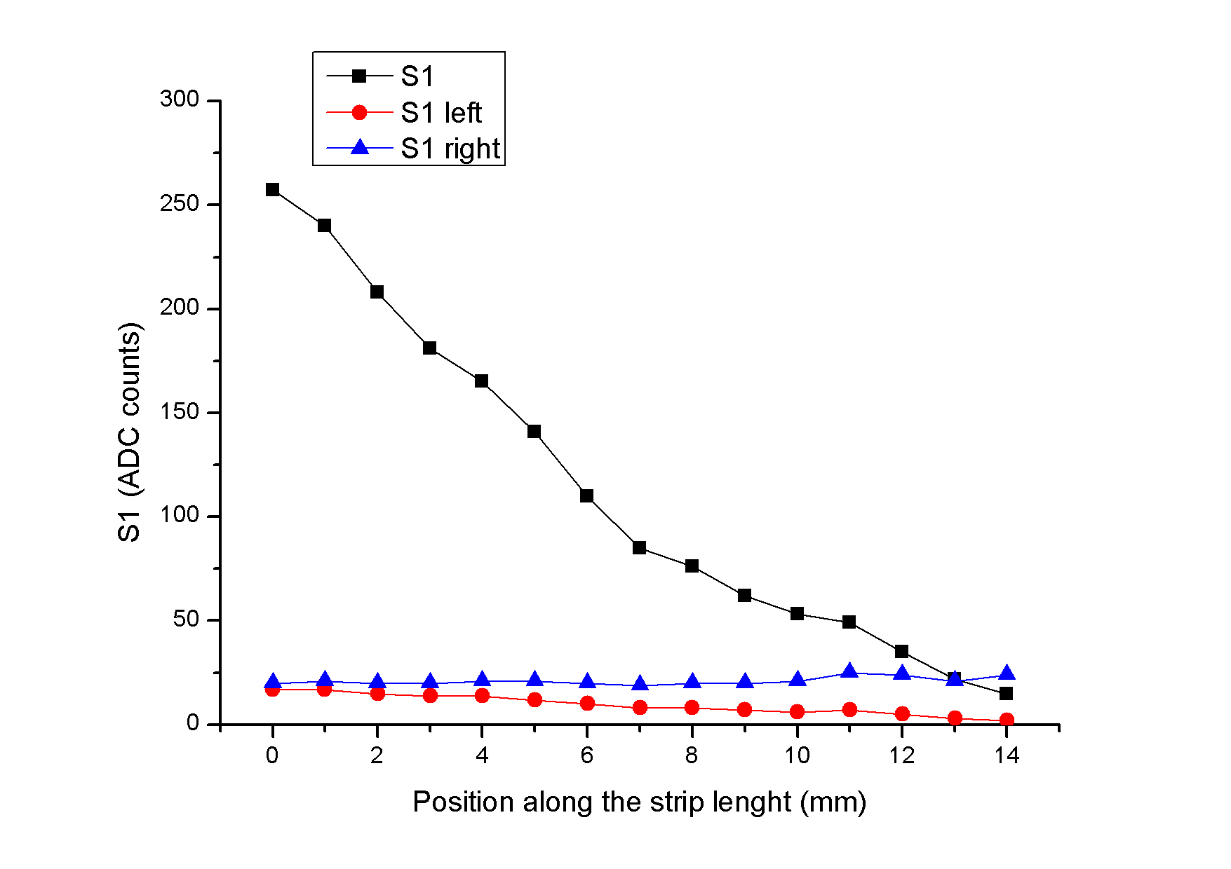
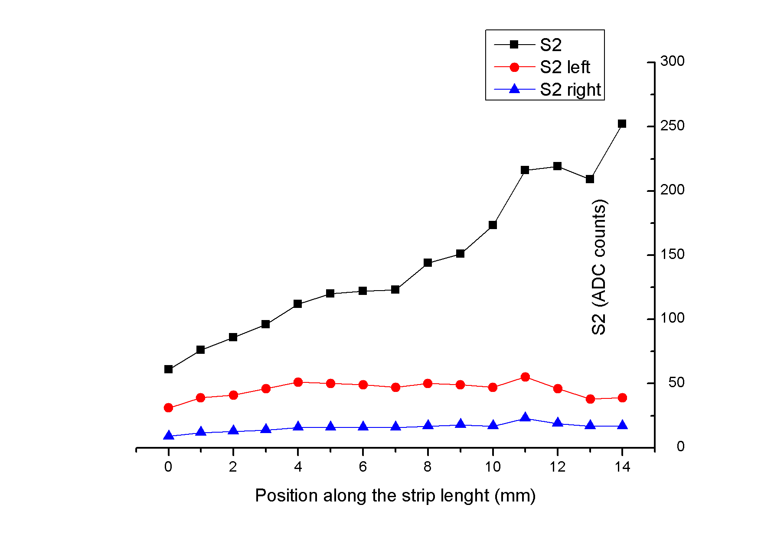
Laser Longitudinal scan
. Laser scanned along the polysilicon electrode
(S1_{L} S1 S1_{R} )
(S2_{L} S2 S2_{R})
. Poly-Si Electrode
Near Side
. Al via
Far Side

Slide 10
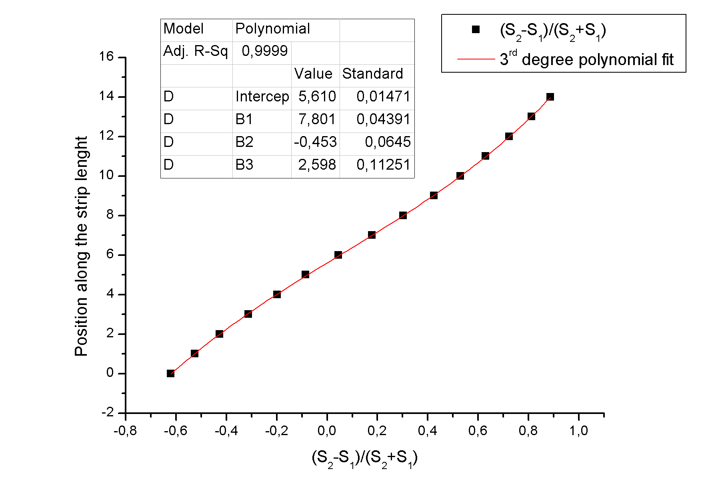
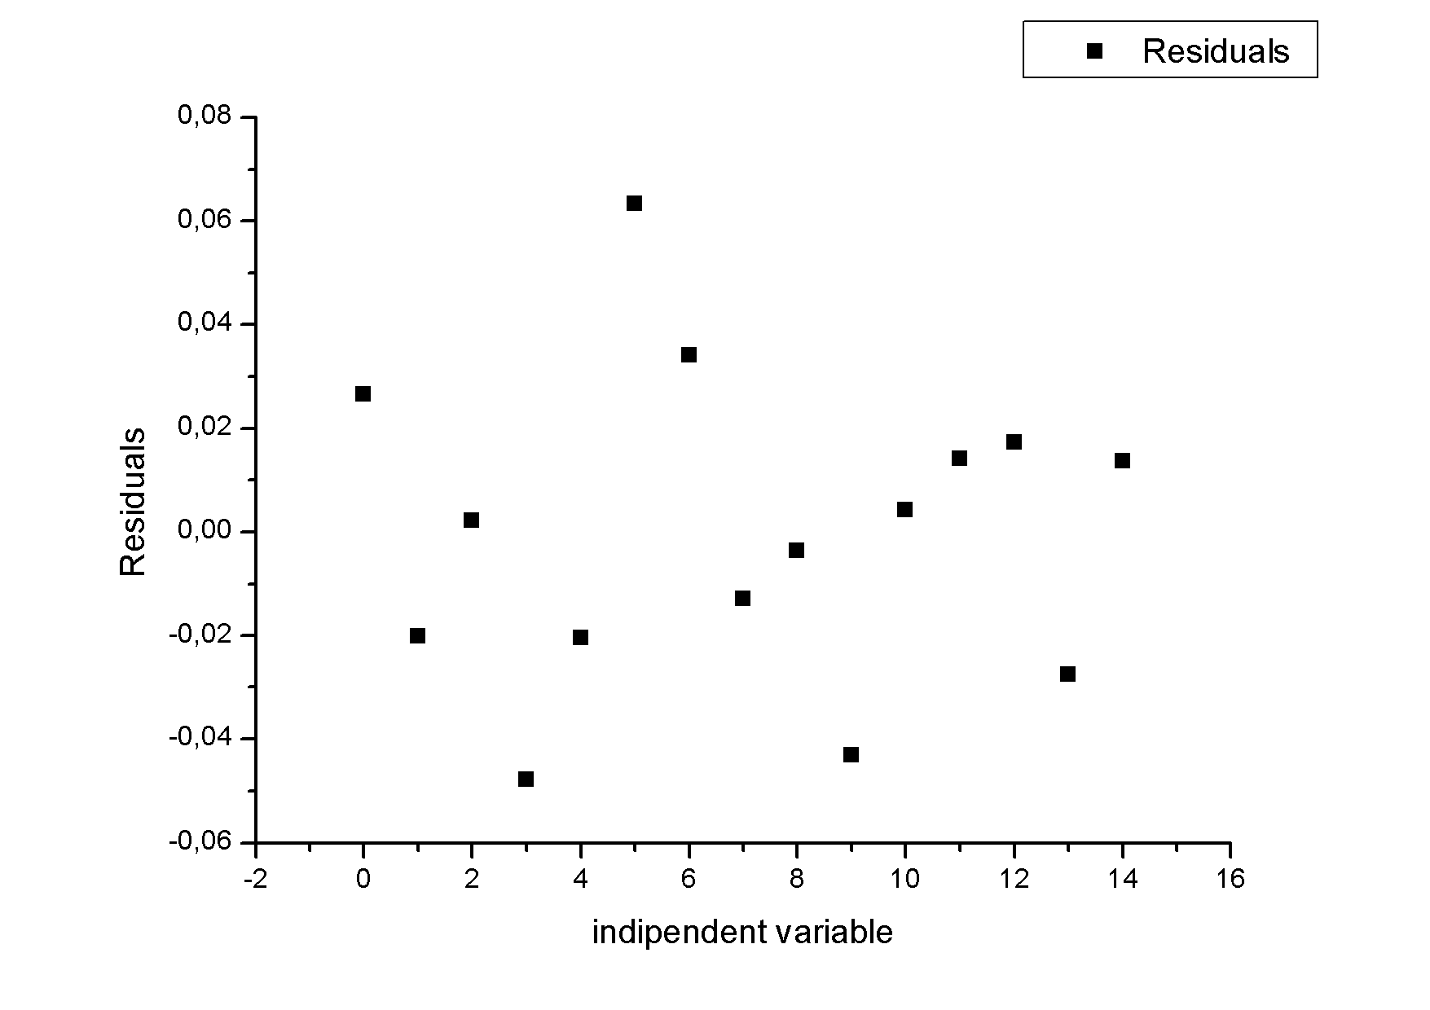
Longitudinal coordinate from Q_{div}
Naïve computation of position along the strip:
[mm]
Fit residuals within ± 50 um band !!!

Slide 11
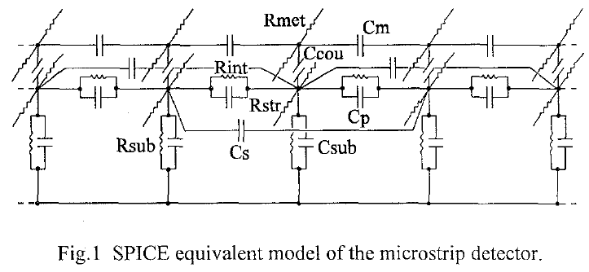
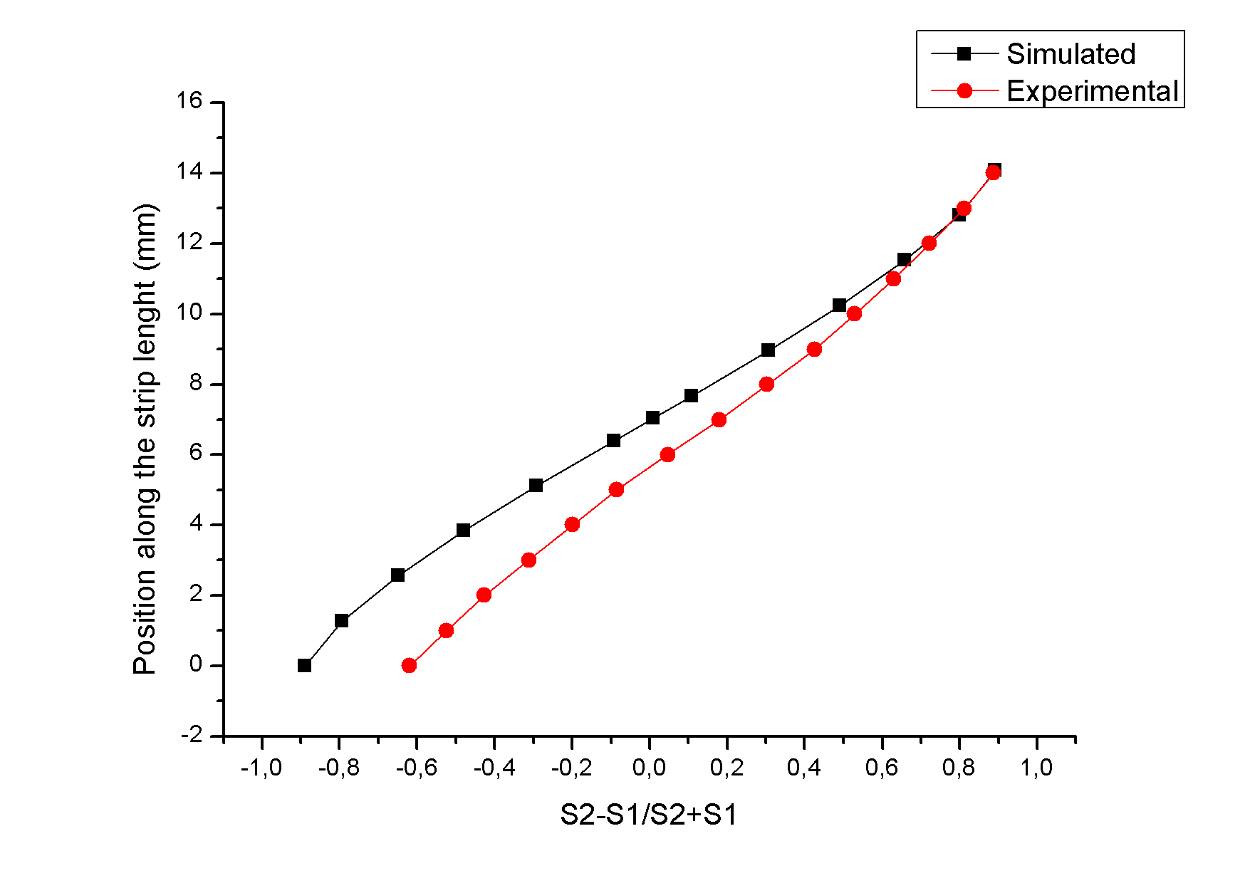
Longitudinal coordinate:
Simulation vs. measurement
Spice simulation using electrical parameters
five strips (R_{str}, C_{cou}, R_{met}).
interstrip circuital elements (C_{int}, R_{int}, C_{m,} C_{p}).
bulk representation (R_{sub}, C_{sub}).
Overall shape reproduced.
Bias introduced by direct coupling of the pulse to the Al via.

Slide 12
SNR determination
Laser characterization demonstrated the soundness of the charge division method for strip sensors.
Increased level of noise but not much (900 ENC)
In the real world:
  What signal/noise ratio we should expect for a MIP particle ?
  ↓
  Sr90 beta source
  120 GeV Pion test beam at SPS.

Slide 13
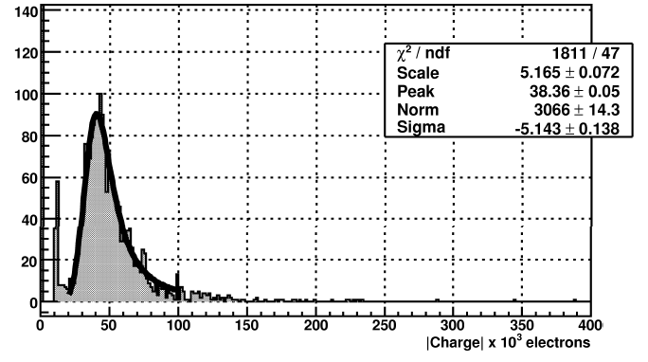
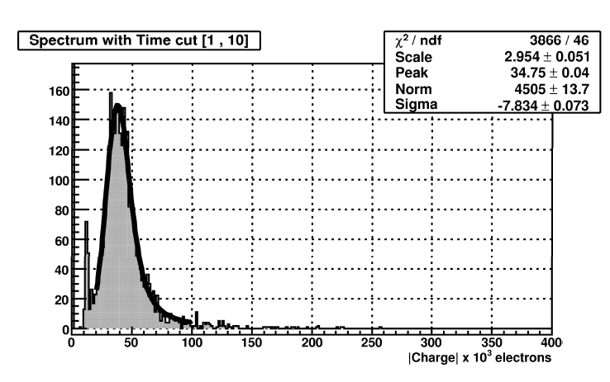
Sr90 Beta source
Collimated (1mm) β-source, at the strip center
Signal / Noise ∼ 15
15000 Electrons
14000 Electrons

Slide 14
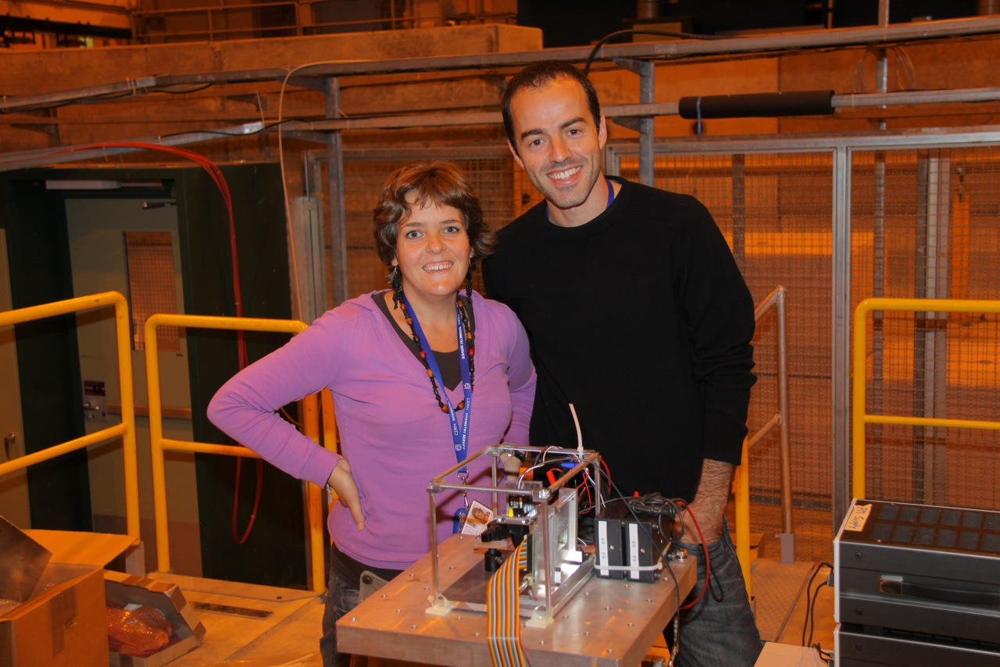
Test Beam @ SPS
During the first week of October testing at SPS pion beam in parasitic mode:
  Standalone Testing (ALIBAVA daq) around 800Kevt.
  Inside the EUDET mimosa telescope (APV25 daq)

Slide 15
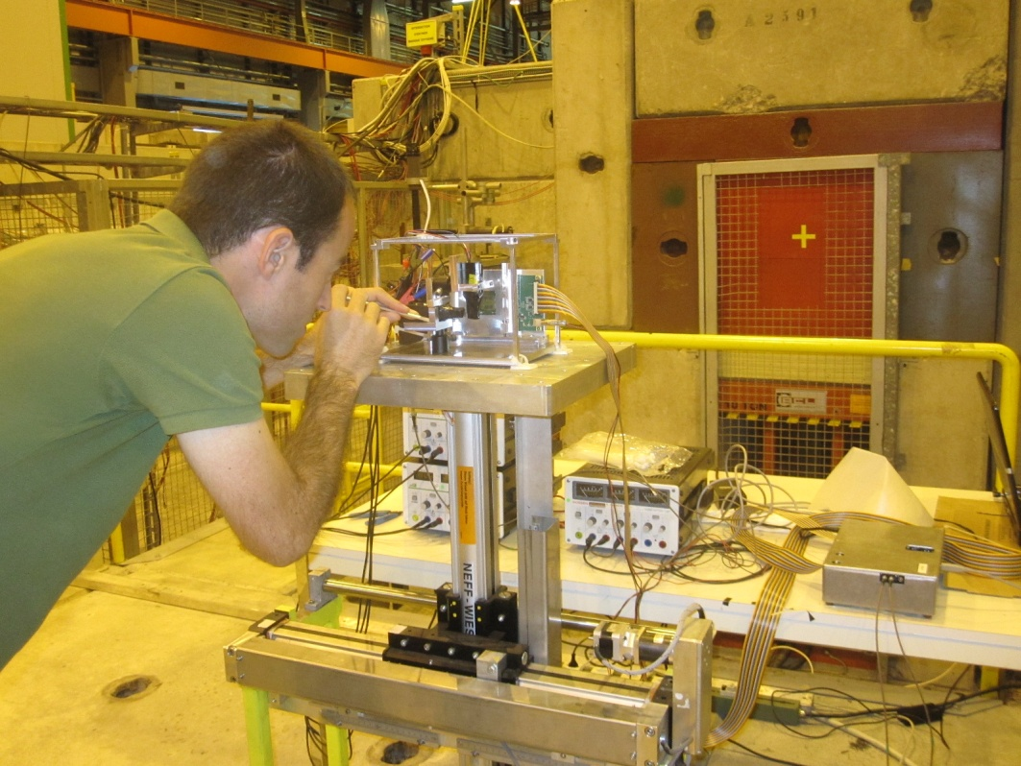
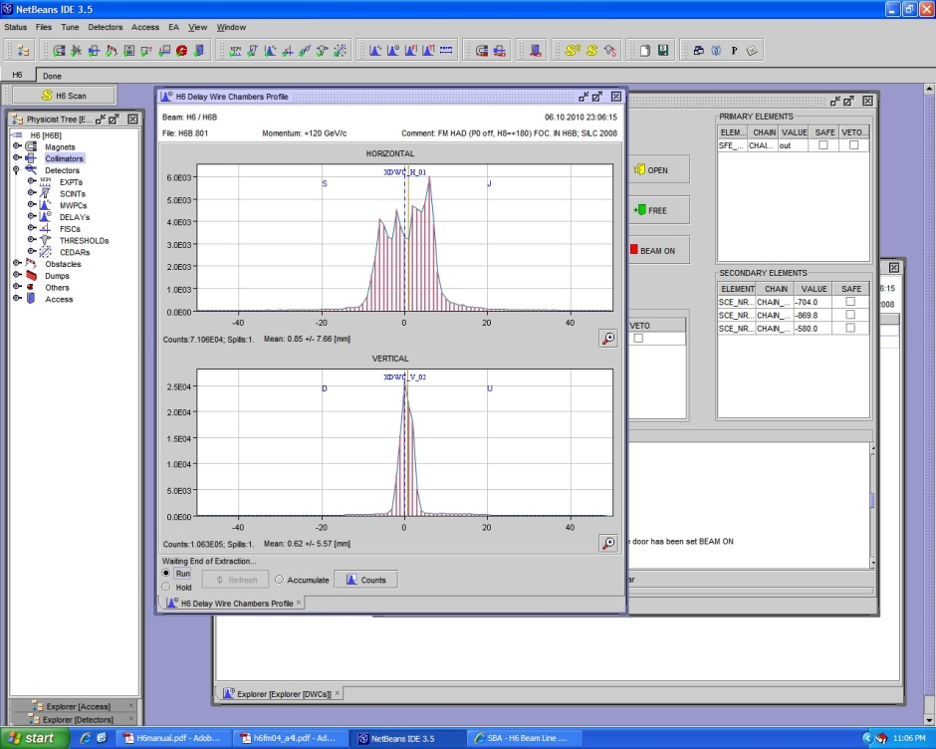
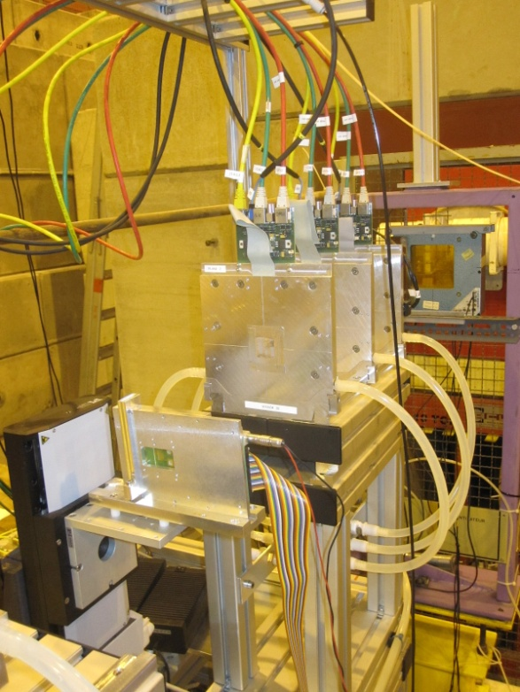
Test Beam @ SPS (2)
SPS beam very stigmatic along the longitudinal (strip) direction.
Last run with ALIBAVA as DUT inside EUDET telescope (BUT TLU too long trigger delay)

Slide 16
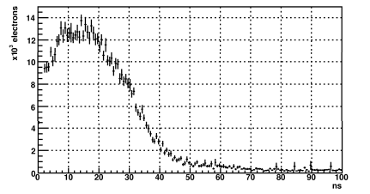
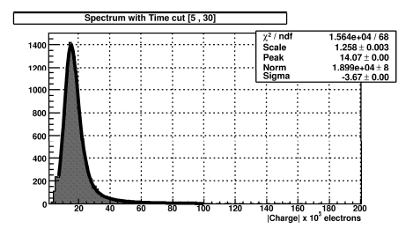
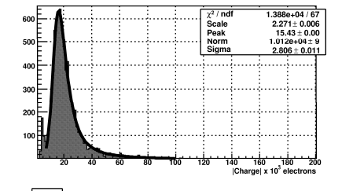
Test Beam @ SPS (3)
Signal Spectrum
& pulse shapes

Slide 17
Short term plans
Almost all the data to be analyzed from the test beam: ALIBAVA & AVP25 (Including EUDET telescope tracking).
New 2D strip sensor of larger dimensions (∼3 cm) already produced at CNM.
Designed with contacts at both strip ends to be read out by two independent FE chips.

Slide 18
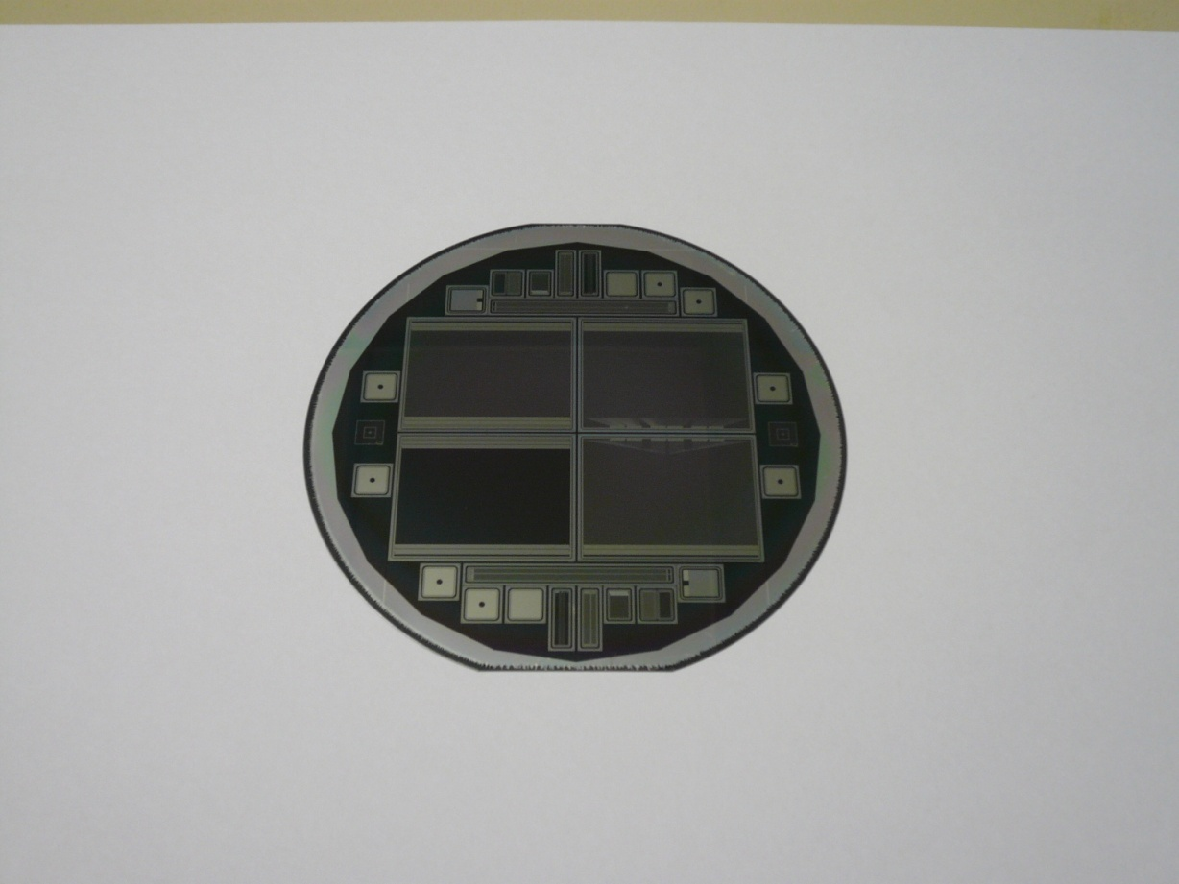
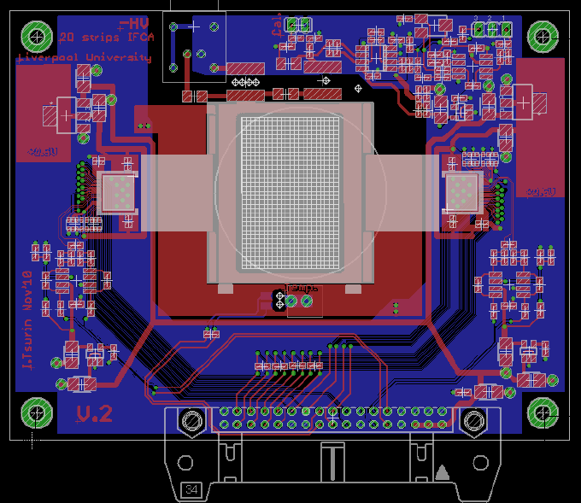
A longer desmostrator
Each wafer: one reference sensor, poly sensor and two DML integrated PA sensors
Reduced polysilicon resistivity (366 and 84 Ohm/□)
Modified ALIBAVA daughter board to boh side read out

Slide 19
Conclusions
We have demonstrated the feasibility of the charge division method in microstrip sensors to determine the coordinate along the strip.
Resolution in the determination of the strip coordinate about few tens of micron.
We have used the standard (cheap) technology to produce this genuine 2D single sided strip detector.
Possible application targets:
  Future detector outer trackers (trigger capable modules)
  Ion tracking systems.
  Neutron imaging (+ conversion element).
  Space applications.
New few cm long demonstrator under preparation

Slide 20
THANK YOU

Slide 21
BACK-UP

Slide 22
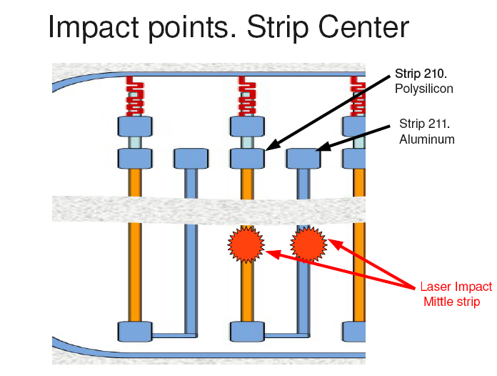
Signal directly induced in the metal via from sensor far side (1)

Slide 23
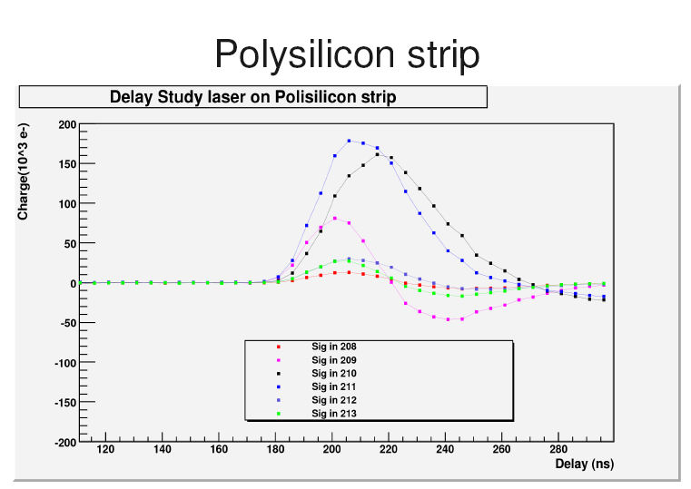
Signal directly induced in the metal via from sensor far side (2)

Slide 24
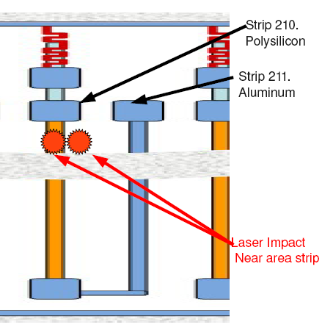
Signal directly induced in the metal via from sensor far side (3)

Slide 25
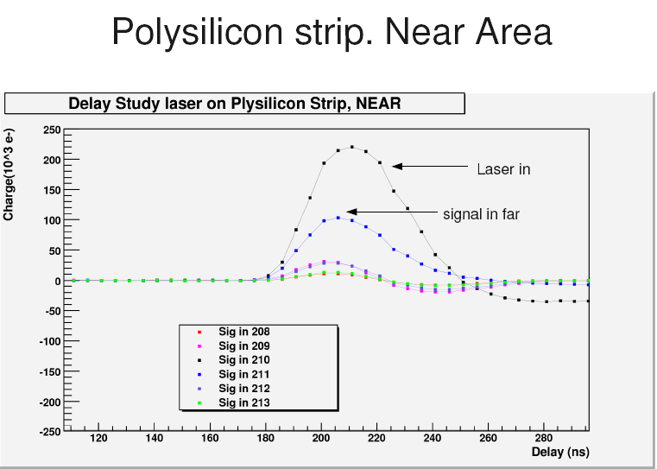
Signal directly induced in the metal via from sensor far side (4)

