Slide 1

Annealing in n and p-side readout of silicon microstrip detectors after irradiation to LHC and sLHC doses
G. Casse, A. Affolder, P. P. Allport, V. Chmill, P. Dervan, A. Greenall, I. Tsurin, T. Huse, C. Wigglesworth, J. Vossebeld

Slide 2
CONTEXT:
Two rather recent results from studies performed for preparing high resolution sensors for the future supercolliders (sLHC at CERN) have proven that silicon detectors can be used for tracking minimum ionising particles (mip’s) after doses above 2x10¹⁶ n_{eq} cm⁻². These are the discovery of the charge multiplication mechanism taking place in irradiated n-in-p silicon detectors and the suppression of the reverse annealing. A discussion of this last feature is here presented with the implications for the running scenario in the actual experiments.

Slide 3
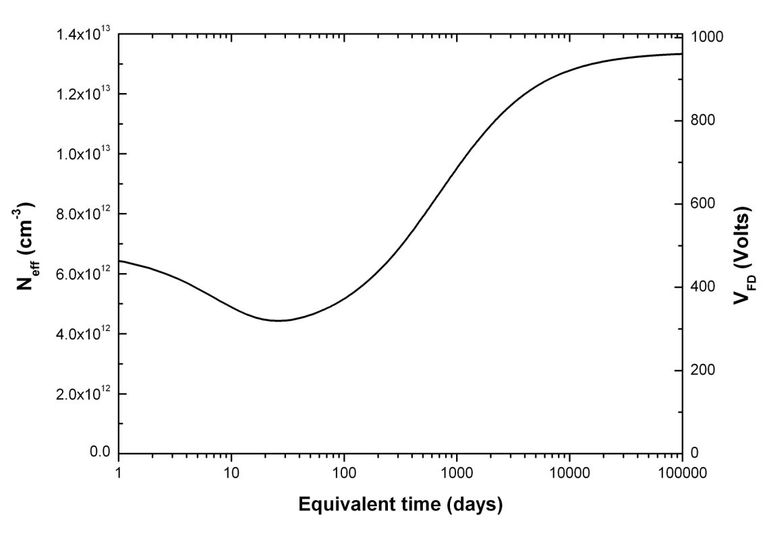
Evolution of Sensor Properties After Irradiation
Sensor leakage current (I_{LEAK}), depletion voltage (V_{DEP}) and charge collection efficiency (CCE) are all affected by irradiation.
Evolution of V_{DEP} shows dependence on both temperature and time
spent after irradiation.
Require full depletion (and some) of sensor in order to optimise CCE.
I_{LEAK} Shows strong temperature.
(Typical behaviour for a silicon microstrip sensor).
Need to avoid the sensors being warm (> 0 ºC) for long periods of time!

Slide 4
Comparison of Hamburg Model and ATLAS TDR Parameterisation
The Hamburg parameterisation is believed to best fit the available data to predict V_{DEP}.
However, large differences observed between the predictions of the TDR model and the Hamburg model.
Origin is in reverse annealing contribution ΔN_{Y} to the predicted change in effective doping concentration ΔN_{EFF}:
TDR model parameterised reverse annealing as a second order process
(dN_{Y}=-k·dN_{X}²·dt) N_{Y}(t)=N_{X,0}(1-(1+k·N_{X,0} ·t)⁻¹).
Hamburg model parameterises reverse annealing as a modified first order process.
(dN_{Y}=-1/τ·dN_{X}·dt) N_{Y}(t)=N_{X,0}(1-exp(-t/τ))
Need high fluence + long annealing data to compare to predictions of both models.

Slide 5
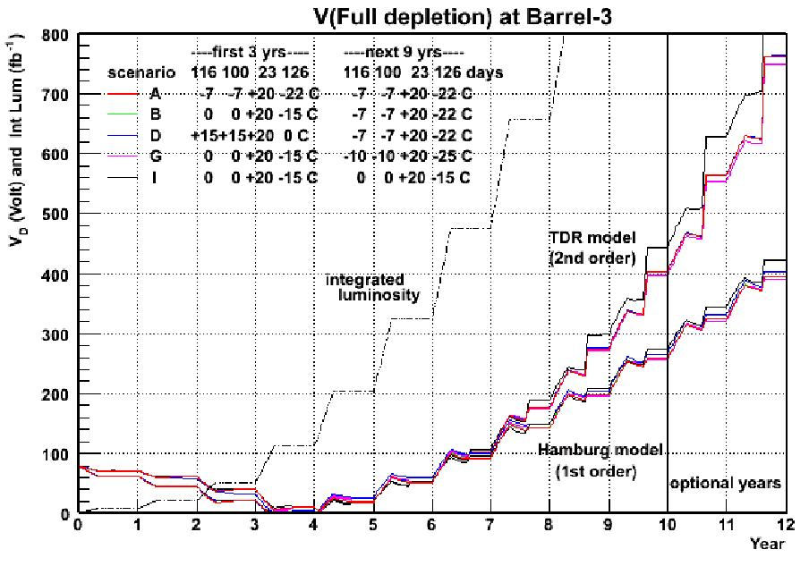
Re-Evaluating the Evolution of V_{DEP} and I_{LEAK} in the SCT
An updated LHC luminosity profile now exists.
Maintenance/shutdown time and cooling temperatures reviewed in line with:
Achievable coolant temperatures.
Insertable B-Layer installation.
Possibly longer maintenance.
V_{DEP} predictions suggest 450 V (max for SCT) is sufficient for at least 10 years operation.
Paul Dervan, Joost Vossebeld, Tim Jones (Liverpool), Taka Kondo (KEK), Graham Beck (QMUL), Georg Viehhauser (Oxford), Steve McMahon (RAL), Koichi Nagai (Brookhaven), Kirill Egorov (Indiana), Richard Bates, Alexander Bitadze (Glasgow).

Slide 6
Programme of Accelerated Annealing Measurements
Sensor performance traditionally studied by determining V_{DEP} from CV measurements.
The rate of annealing is a function of temperature, therefore it is possible to slow it down or accelerate it relatively to a given temperature. Previous studies have found an Arrhenius relation for temperature dependence of the reverse annealing of V_{DEP} with an activation energy Ea = 1.31 eV. With a reference temperature of 20ºC, the acceleration factors are about 540 at 60ºC and 7350 at 80 ºC.
In Liverpool the focus has been on measuring the annealing of CCE
The p-in-n case.
Manufacturer | HPK
Wafer Tech. | FZ
Structure | p-in-n
Size | 1 cm x 1 cm
Thickness | 285 µm
New programme of accelerated annealing measurements on ATLAS mini sensors.
Pair of sensors irradiated with neutrons at Ljublijana (V. Cindro et al) to 2x10¹⁴ 1 MeV n_{eq} cm⁻²
(new prediction for SCT = 1.6x10¹⁴ 1 MeV n_{eq} cm⁻²).
One sensor used for CCE measurements and one sensor used for V_{DEP} measurements.
Both sensors annealed together at same temperature for same length of time.

Slide 7
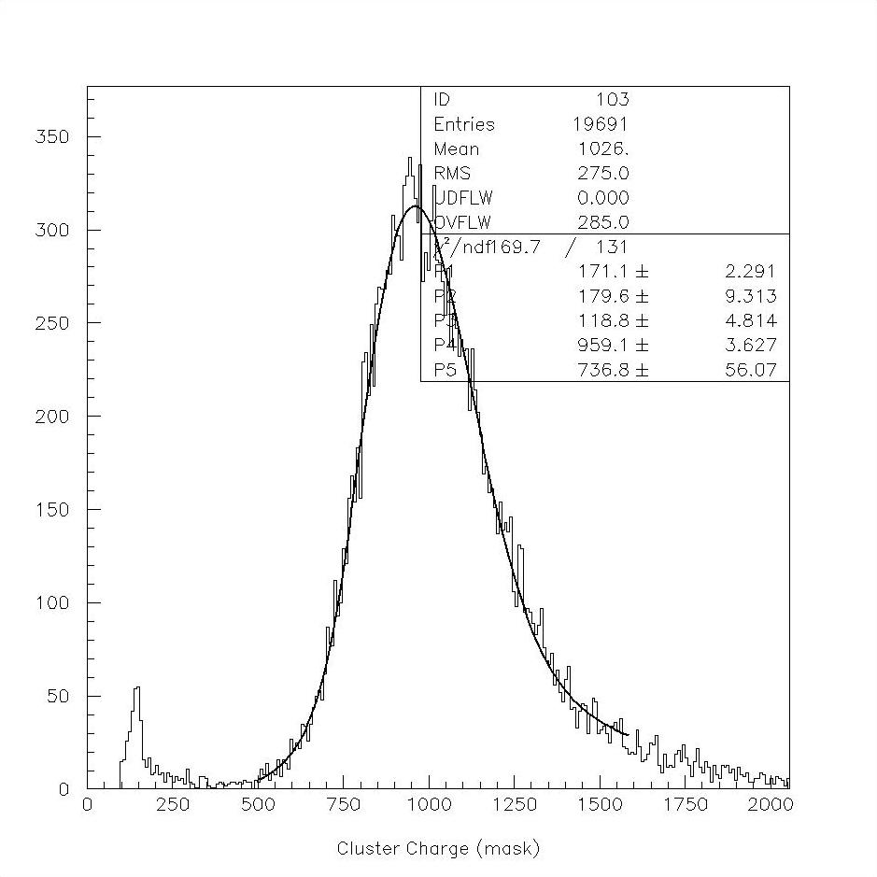
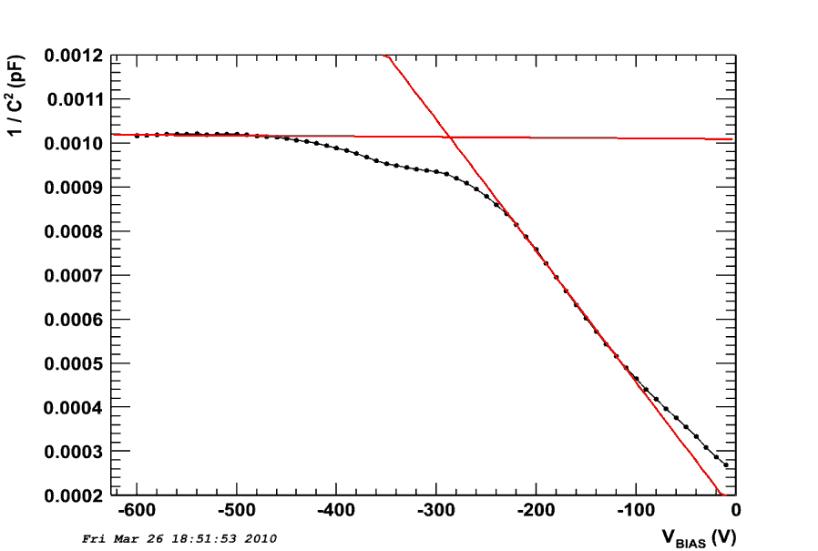
Experimental Setup and Analysis Procedure
Charge Collection Measurements
⁹⁰Sr fast electron source used to generate signal.
Readout triggered by scintillator.
Charge collection measured using
analogue electronics chip (SCT128A or Beetle) clocked at LHC speed (40 MHz clock, 25 ns shaping time).
System calibrated to most probable value of MIP energy loss in non-irradiated 300 μm thick sensor (~ 23000 e).
Depletion Voltage Measurements
V_{DEP} Determined by standard method of measuring the V_{BIAS} at which 1/C² saturates.
Both sets of measurements performed in freezer at temperature of ~-25 ºC with N² flush.
@ 1 kHz

Slide 8
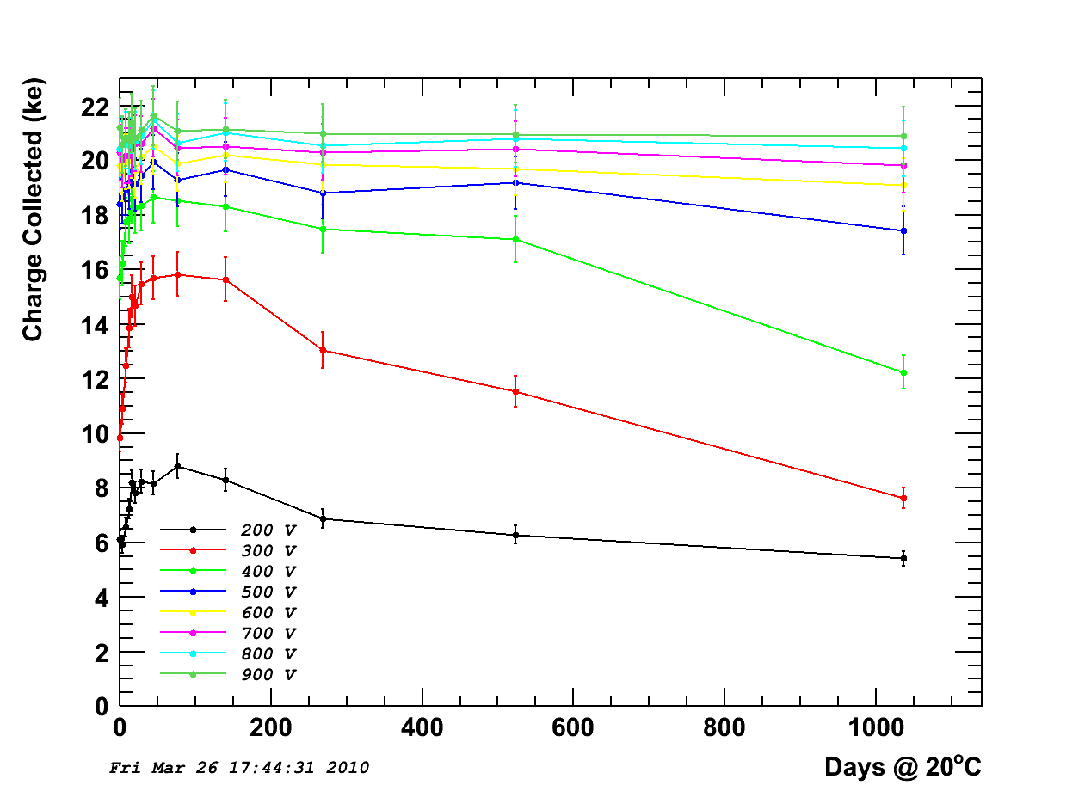
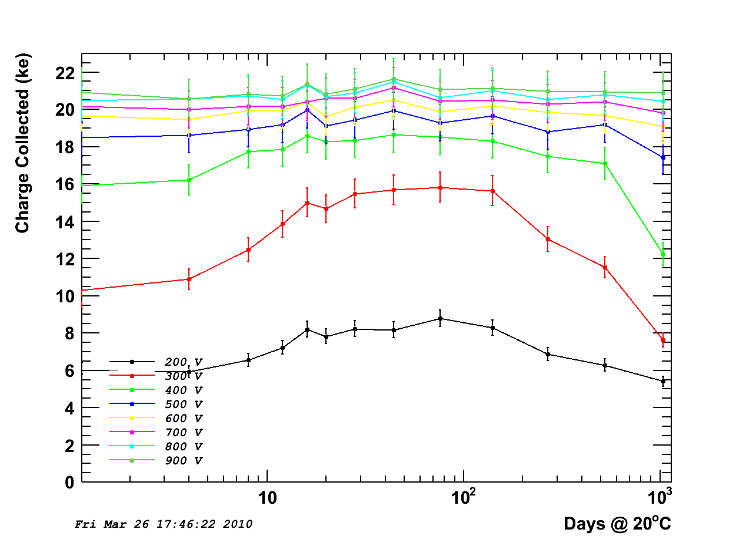
Results of Charge Collection Measurements
Above ~ 500 V collected charge remains almost constant in time
Smooth fall off after ~ 100 days @ 20 ºC
SCT Default threshold 1 fC (~ 6.2 ke)
No sharp drop in the collected charge

Slide 9
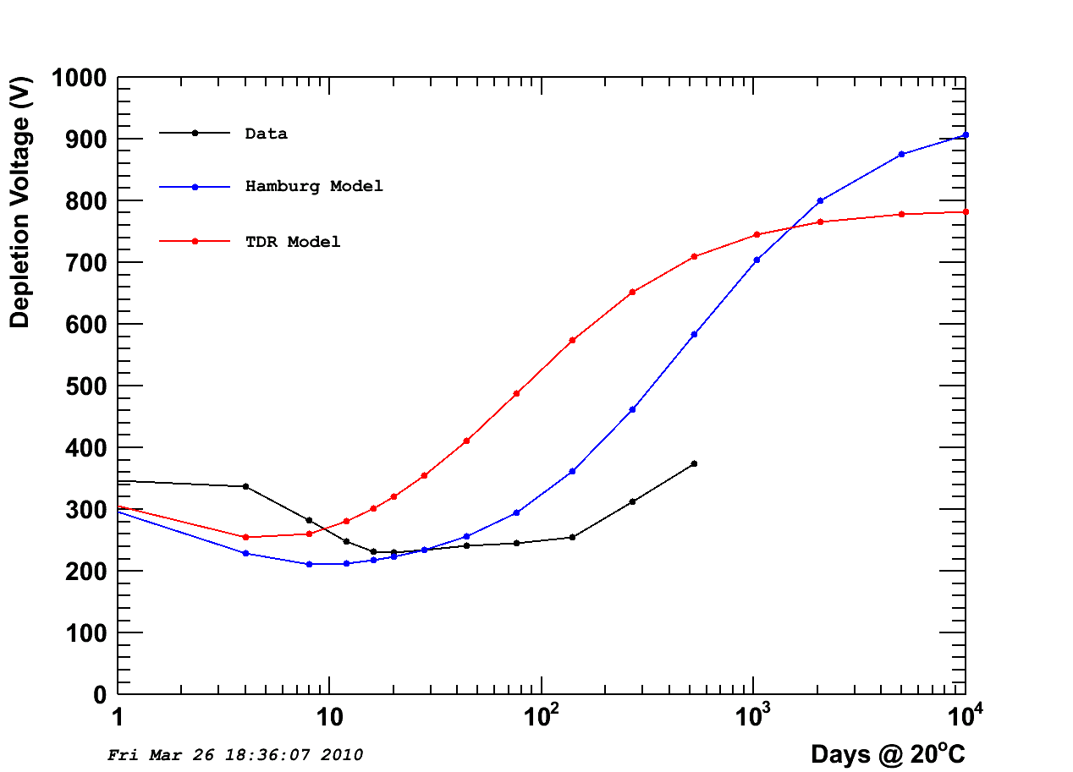
Comparison of Predicted V_{DEP} and Measured V_{DEP}
Data shows a slower annealing effect than the two models

Slide 10
This discussion is relevant to the present tracker sensors in the LHC experiments. The future experiments on sLHC will make large use of n-side readout sensors, possibly n-in-p.
The annealing of n-in-p sensors is different again: the reason is that the effect of charge multiplication plays a role.

Slide 11
140 and 300 μm n-in-p Micron microstrip sensors after 5x10¹⁵ n_{eq} 26MeV p
Evidence of a charge multiplication effect: not only the whole charge is recovered, but increased by f = 1.75/2.1
11

Slide 12
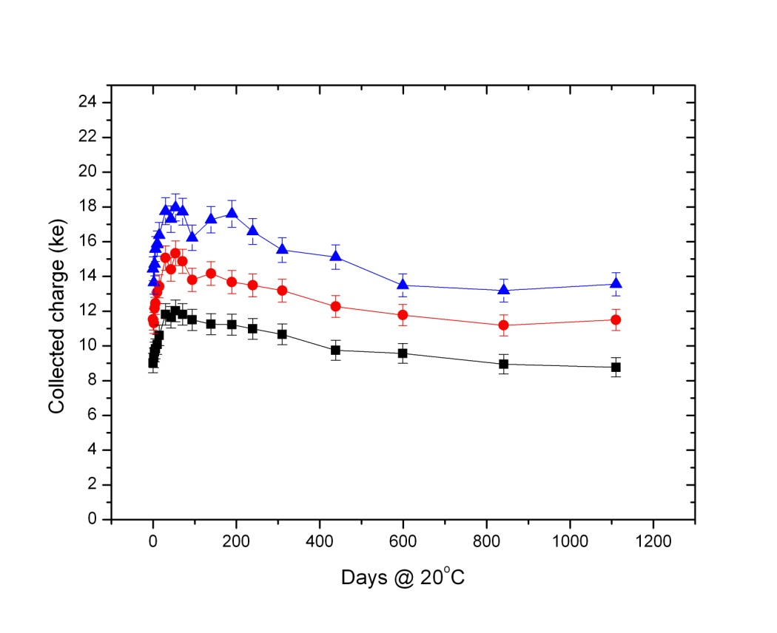
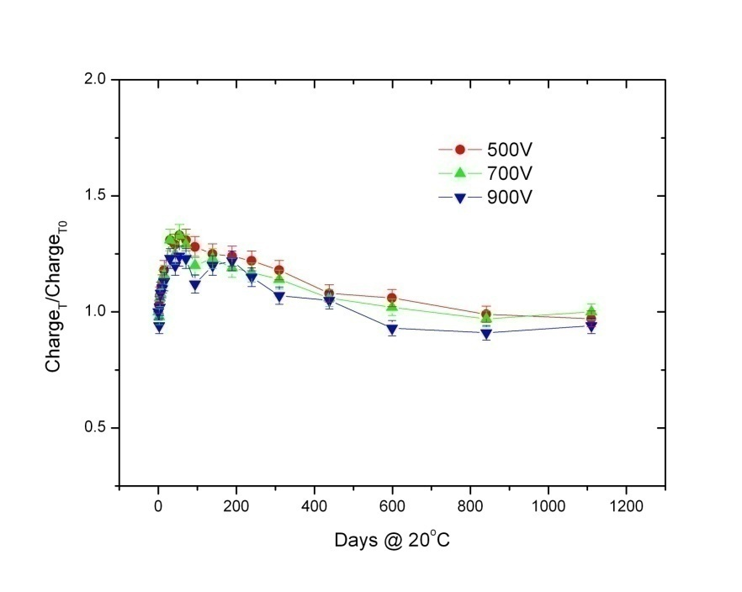
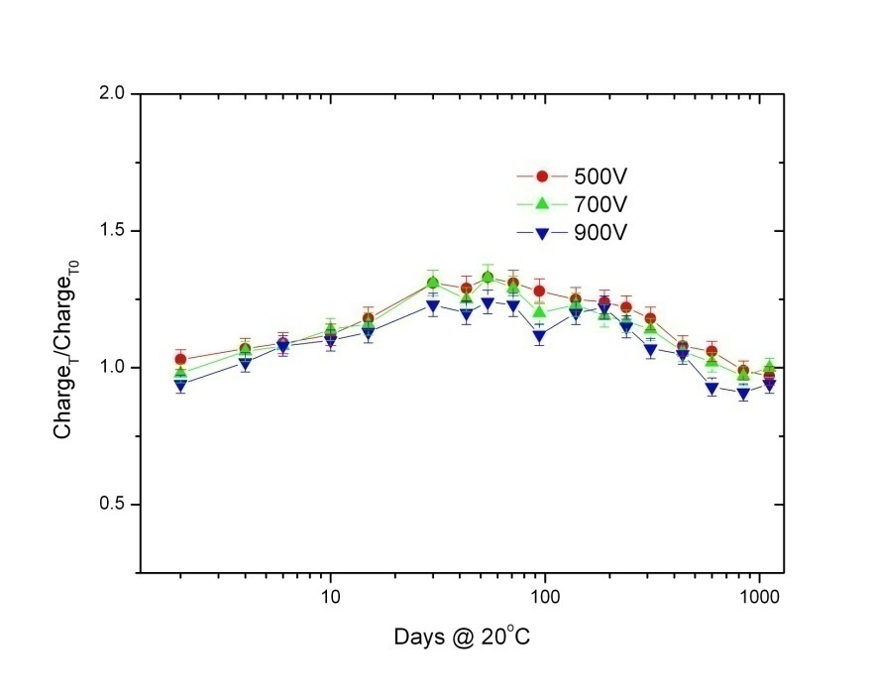
Accelerated Annealing of the collected charge, case of n-in-p sensors. HPK FZ n-in-p, 1E15 n_{eq} cm⁻²
Neutron irradiations in Ljubljana, neutrons are dominating the radiation damage > 25 cm radius.

Slide 13
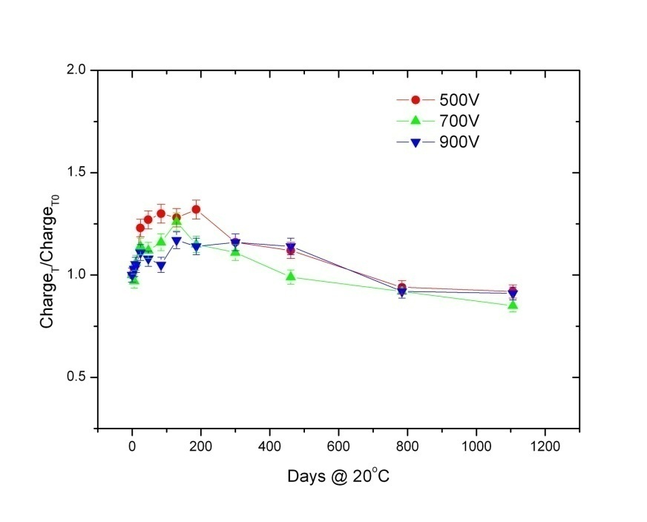
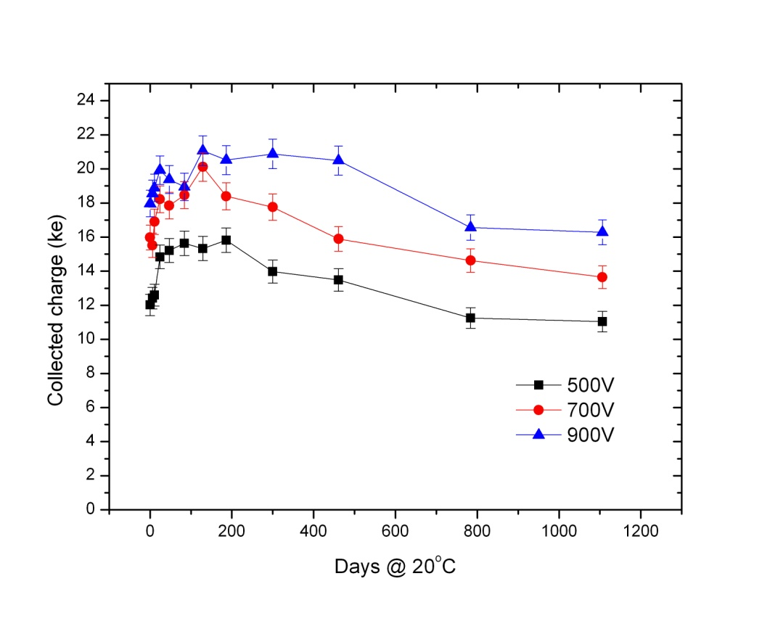
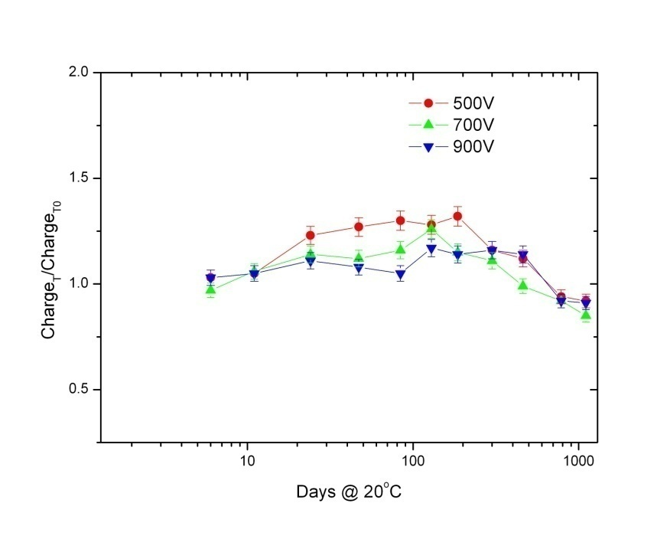
Annealing of the colleted charge, Micron FZ n-in-p, 1E15 n cm⁻² (26MeV p irradiation)

Slide 14
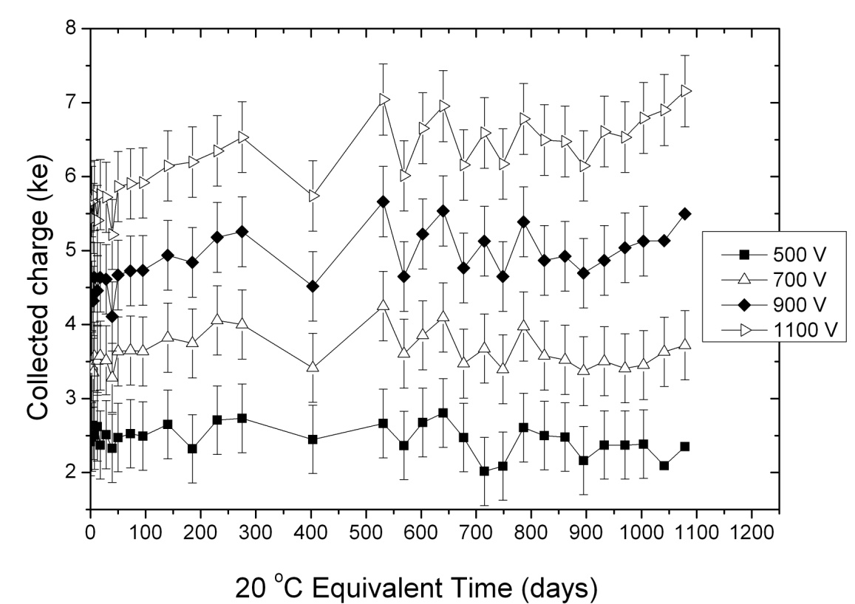
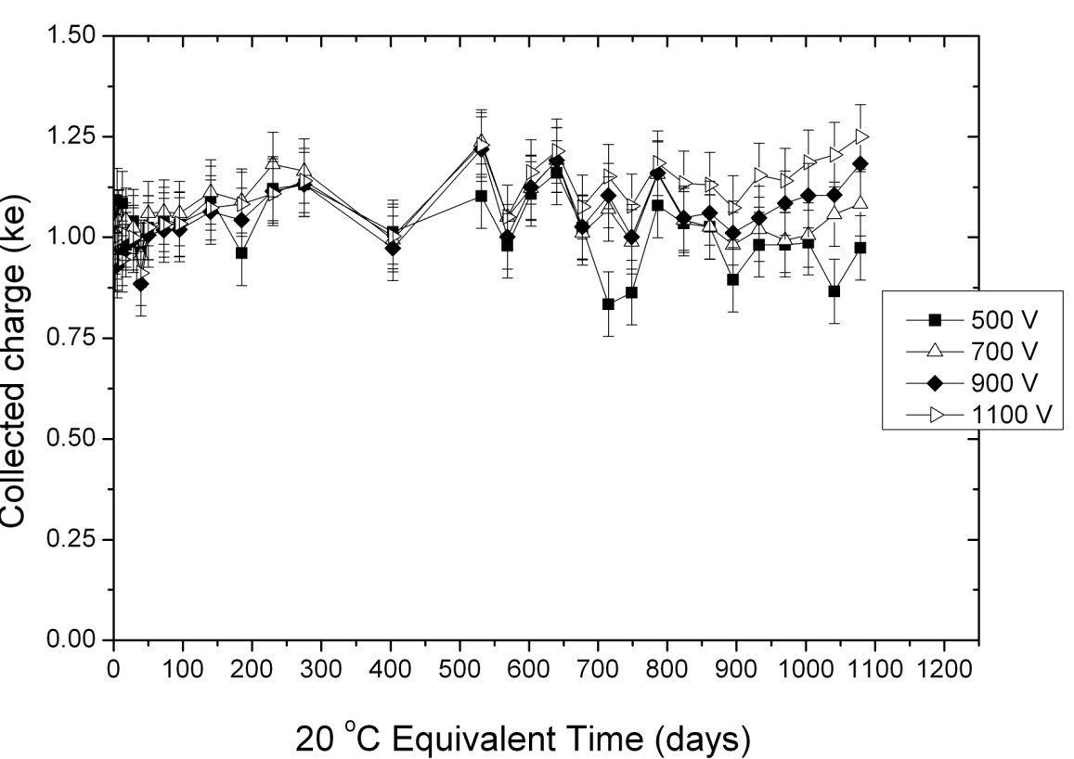
Accelerated CCE Annealing 1.5E16 n_{eq} cm⁻² (Micron sensors)
Irradiated with 26MeV protons (Karlsruhe).

Slide 15
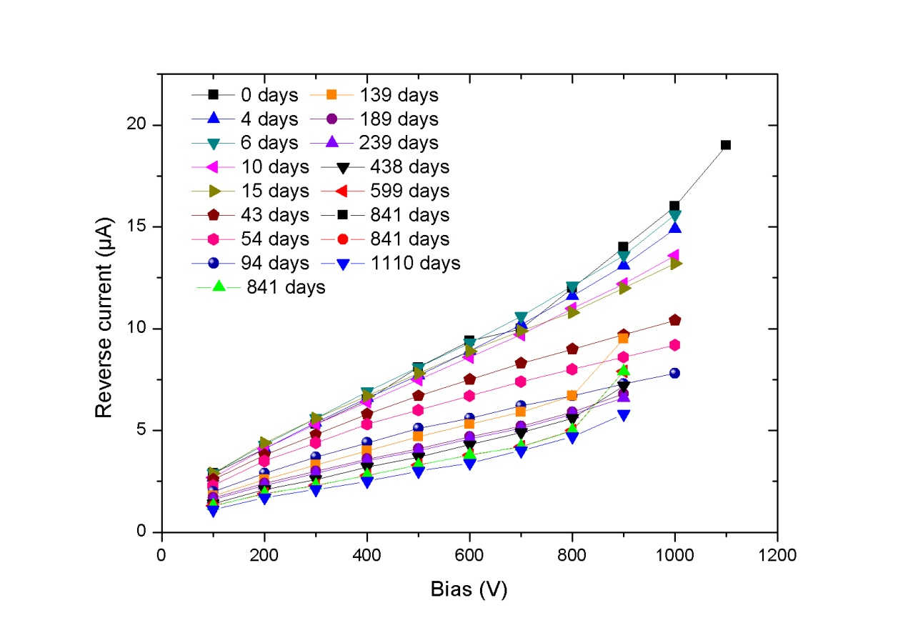
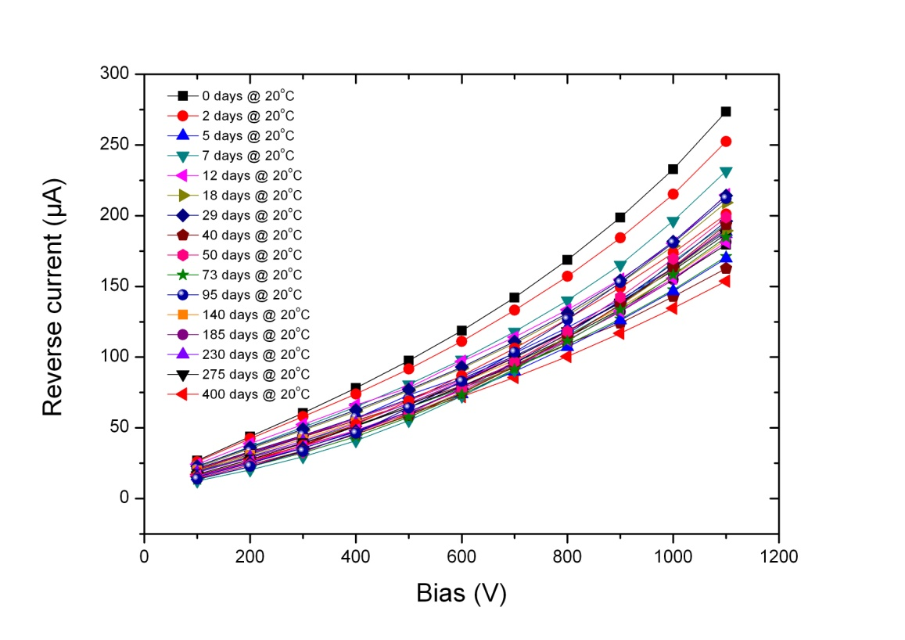
Annealing of the reverse current, n-in-p sensors, 1E15 and 1.5E16 n cm⁻²

Slide 16
Room Temperature Annealing of the collected charge, HPK FZ n-in-p, 2E15 n cm⁻² ( 26MeV p irradiation)
We make large use of accelerating annealing: is this a safe and correct approach?

Slide 17
Room Temperature Annealing of the collected charge, HPK FZ n-in-p, 1E16 n cm⁻² (26MeV p irradiation)
We make large use of accelerating annealing: is this a safe and correct approach?

Slide 18
Room Temperature Annealing of the reverse current, n-in-p sensors, 2 and 1E16 n cm⁻² (26MeV p irradiation)
NOISE

Slide 19
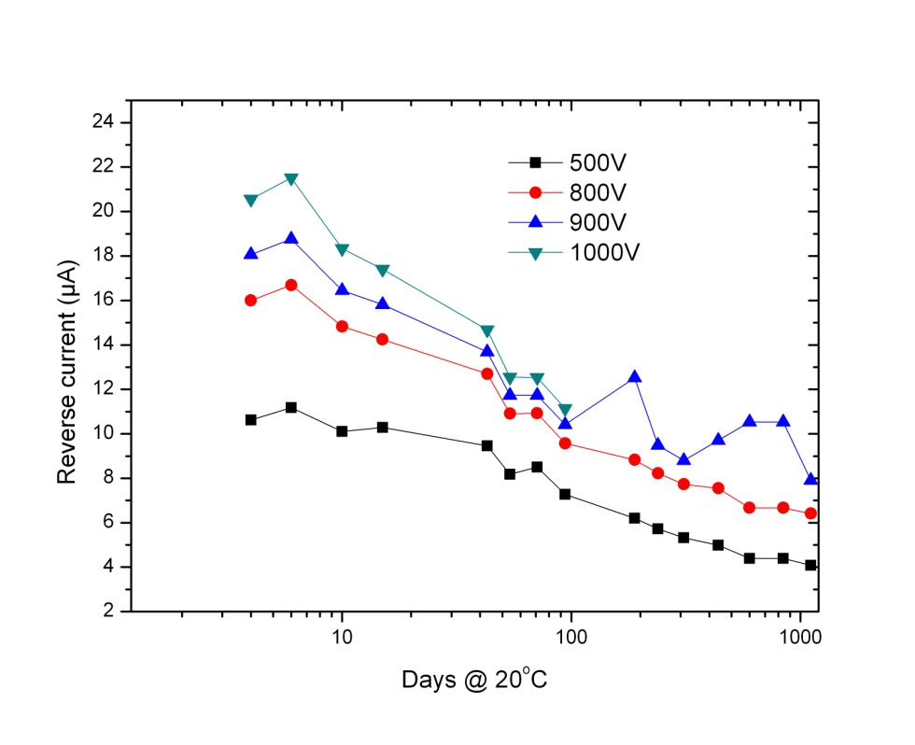
Comparison of the Accelerated and Room Temperature Annealing of the reverse current, HPK FZ n-in-p, 2E15 and 1E16 n_{eq} cm⁻²

Slide 20
CONCLUSIONS
The CCE measurements with both p-in-n and n-in-p sensors show discrepancies with accepted annealing features as measured with CV methods and as predicted by widely accepted parameterisations. In practical terms, the changes with annealing of the CCE sensors after LHC doses (microstrip sensors) are less severe than anticipated.
With n-in-p sensors the reverse annealing seems suppressed when the study is performed by accelerating the annealing at 60 and 80 ºC (maximum voltage 1100V). Nonetheless the rescaling of the accelerated annealing to RT could be wrong at least when applied to the CCE. The reason could be the rescaling criterion itself, or a different evolution of the effective space charge triggered by temperatures between 20 and 60-80 ºC.
Controlled annealing (at 20⁰C) is still a very useful tool to reduce power dissipation and recover fraction of S/N in heavily irradiated silicon detectors. The discrepancies between the accelerated and RT annealing need to be studied to base the prediction for the changes of CCE with time according to the real operation and maintenance temperatures in the experiments.

