Slide 1
K-Mode CLIC Module RF Network
Matthew
09-11-2022

Slide 2
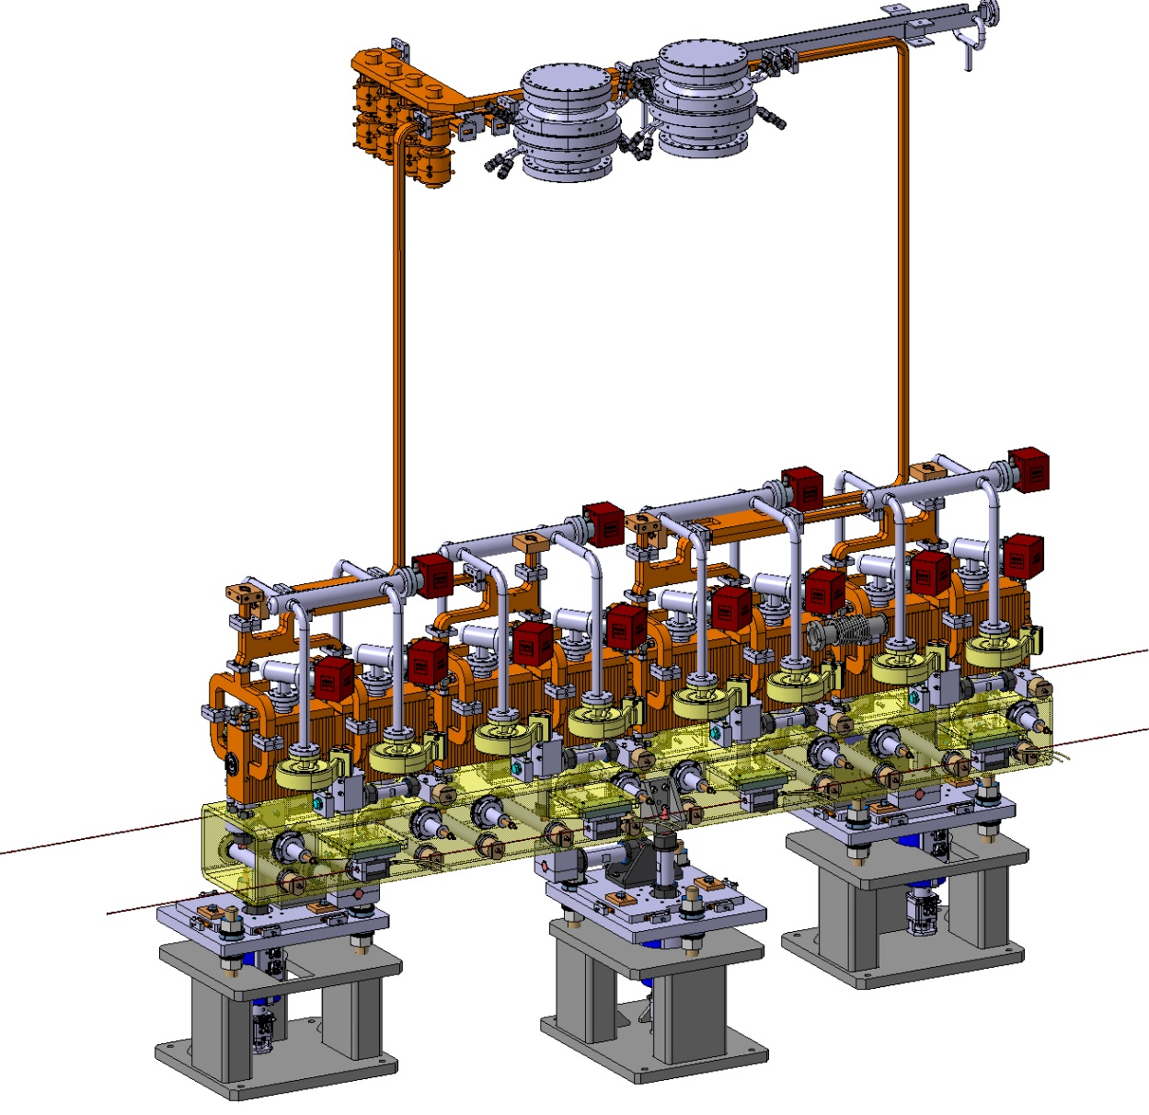
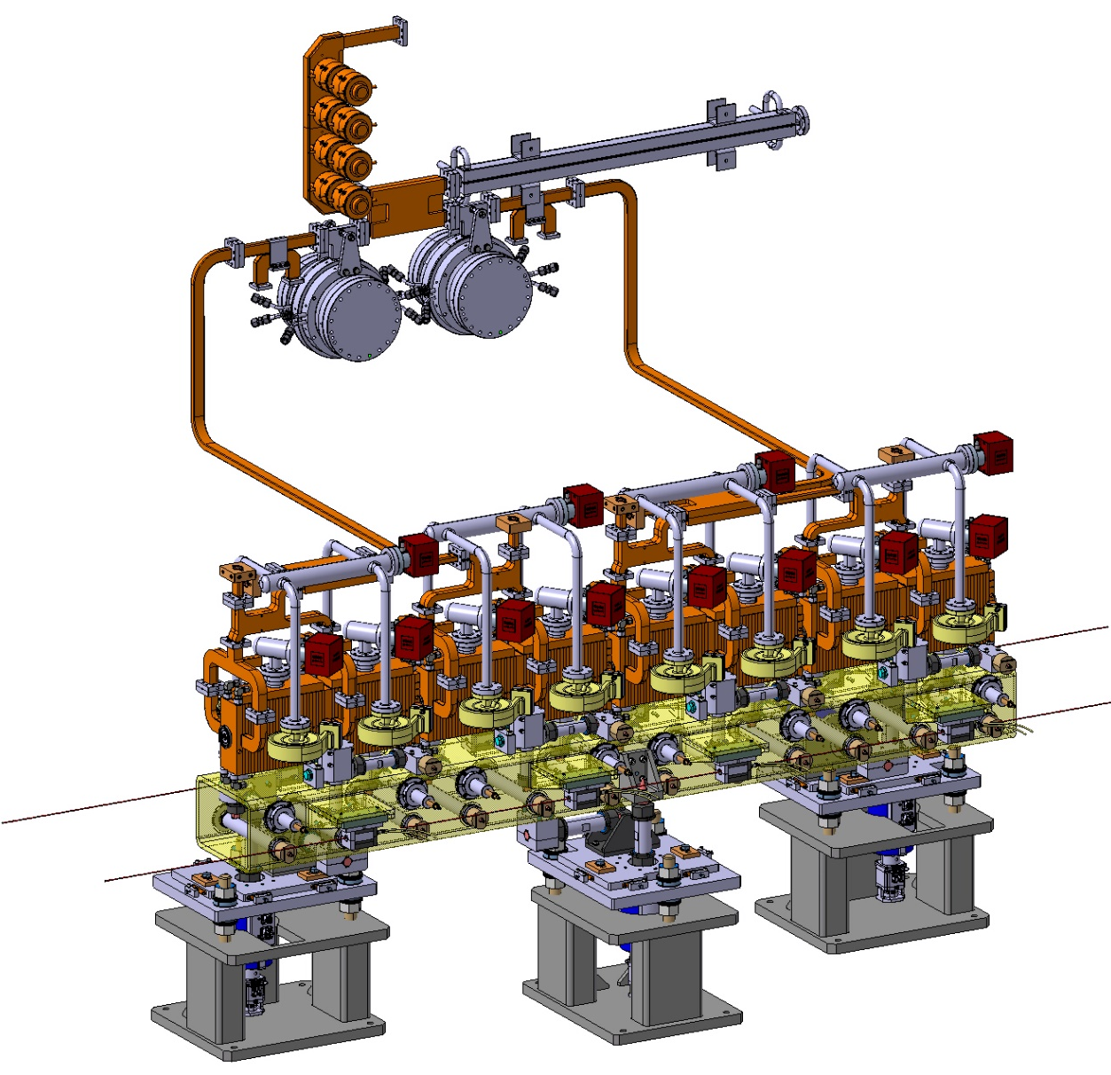
Module RF Network

Slide 3
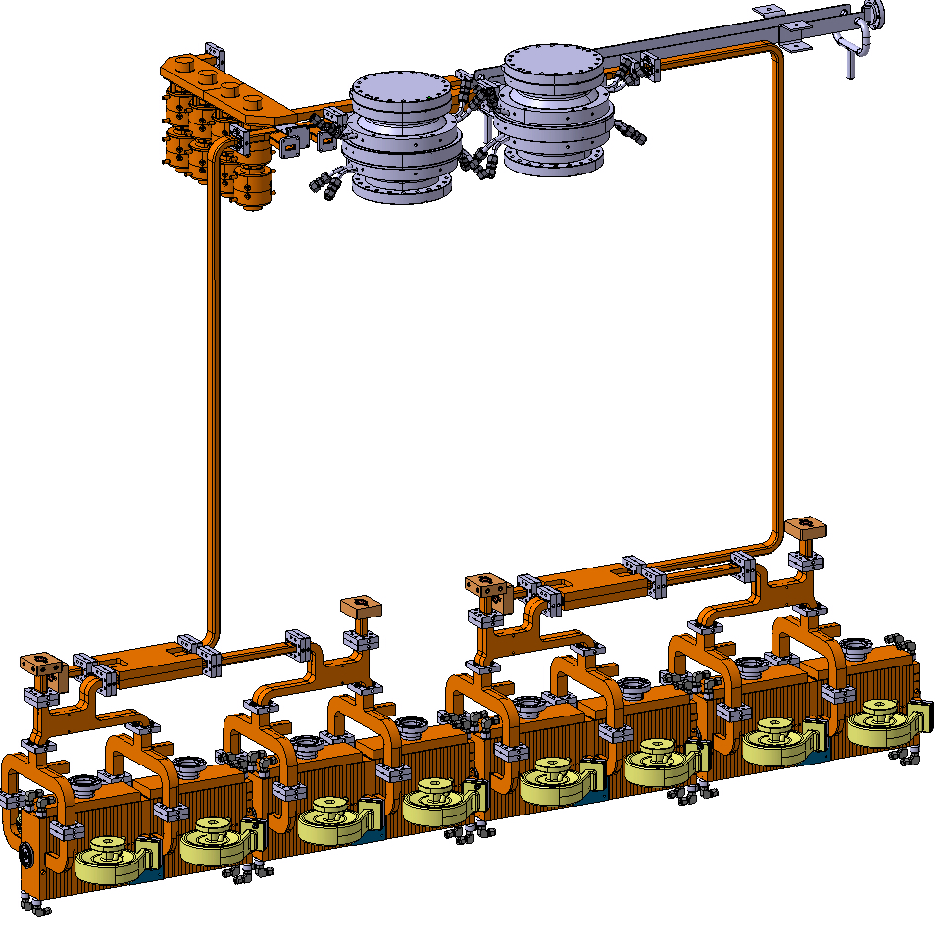

Module RF Network
BOCs mounted directly above the module

Slide 4
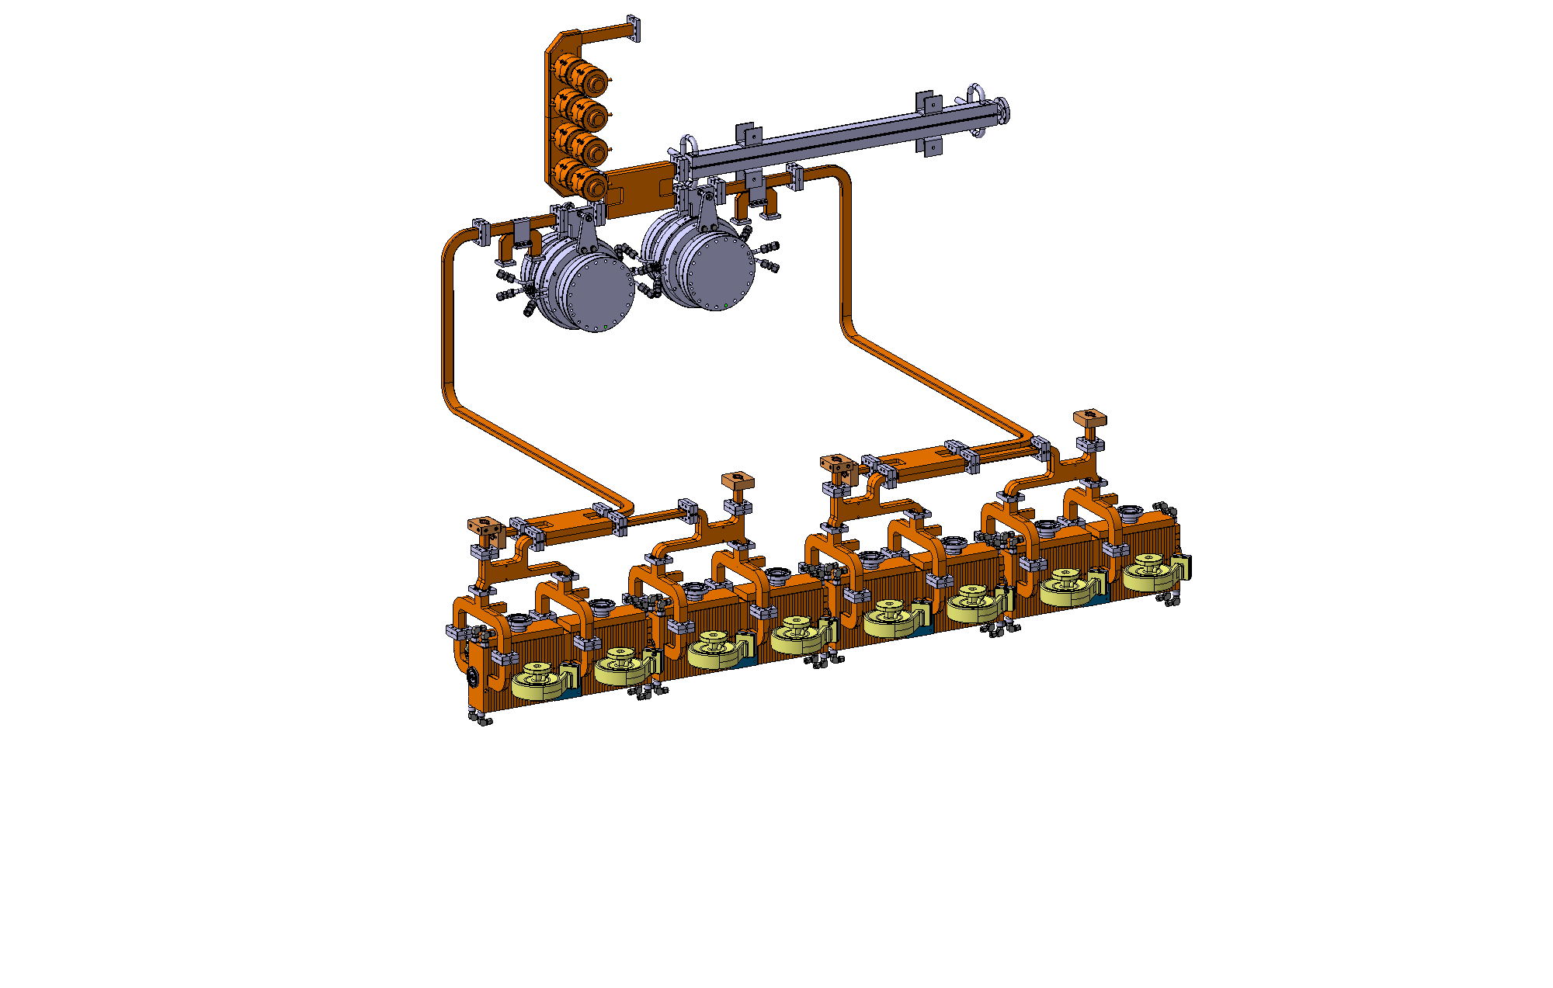

Module RF Network
BOCs mounted to the wall next the module

Slide 5
Module RF Network
Questions:
  Which configuration is preferred?
  Is the RF network layout correct?
    Correction cavities, BOCs, loads etc.
  Would double height waveguide be used?
    Where?
  Do the waveguides need pumping?
    Large RF Load
    BOCs
    Correction cavities
  Number of flanges
    Are we intending to braze the hybrids, splitters, structures in a single operation?
  WG to Klystron
  Supporting systems

Slide 6
Structure RF Network

Slide 7


Slide 8
DEFT

Slide 9
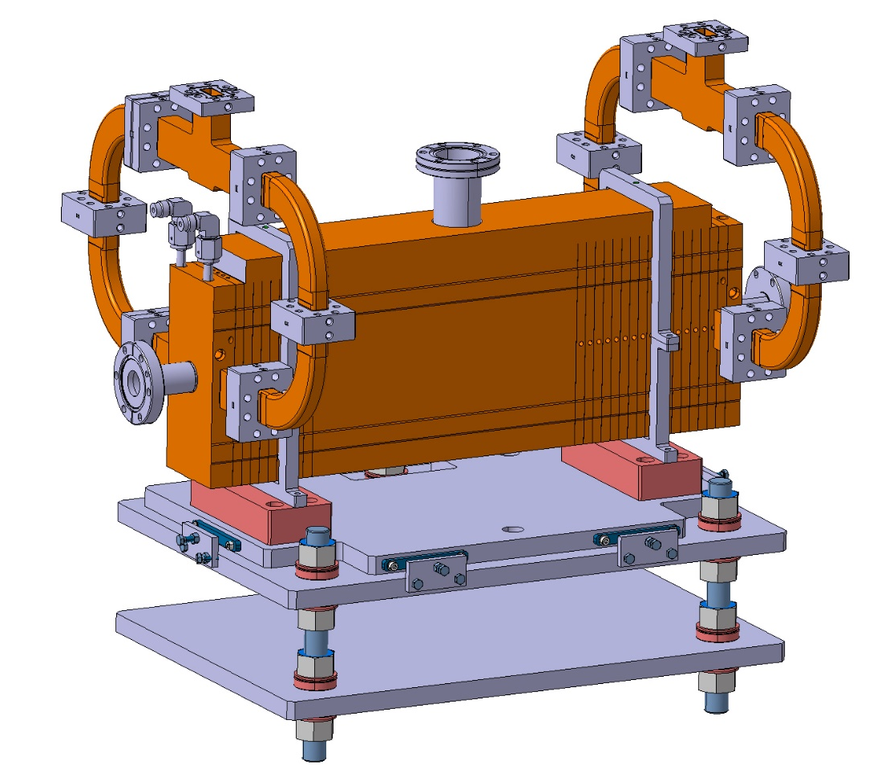
DEFT
Previously put together model of a FLASH/DEFT structure positioning system.
Uses a simple (and outdated) structure model.
  Can be updated to correct disc, coupler, waveguide model
Simple screw based adjustment
  Sufficient for the 100µm precision suggested
  Needs to be discussed/confirmed with the Survey Team
No consideration for Girder type and integration
No consideration for RF Network integration with girder, e.g. rotating the structure, passing waveguide along the girder i.e. PSI.

