Slide 1
Accelerating structure and BOC pulse compressor for klystron-based CLIC
Ping Wang, Alexej Grudiev
16.11.2021

Slide 2
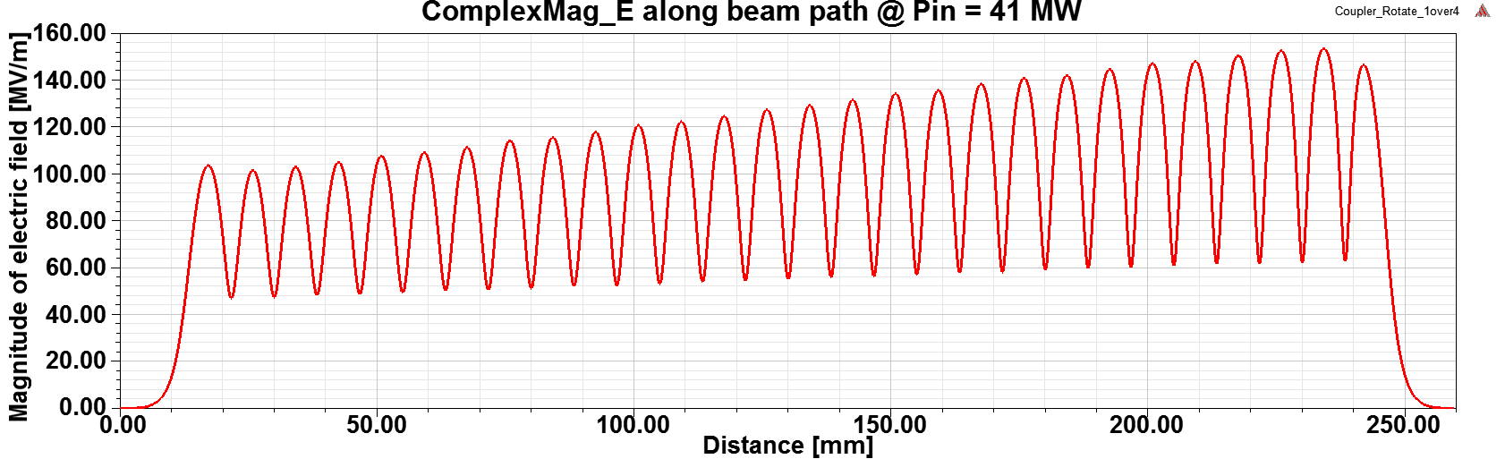
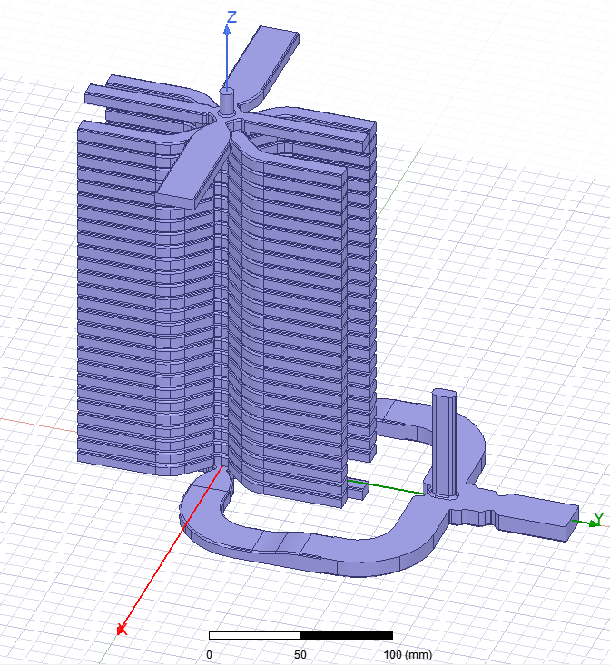
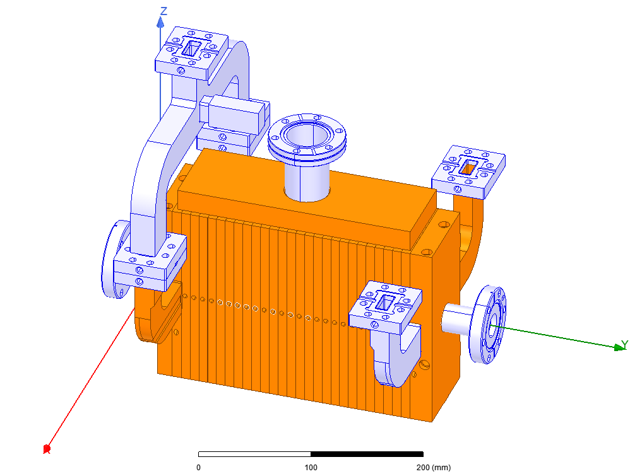
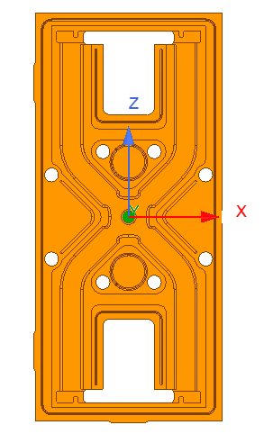
RF design of the CLIC-K structure
Position of flanges
HOMagic-T
Bend2
Taper
Bend1
3D model from Pedro Morales Sanchez

Slide 3
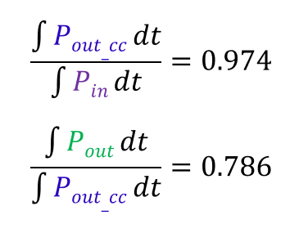
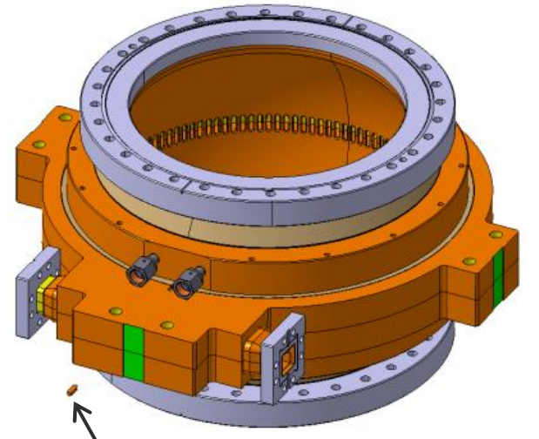
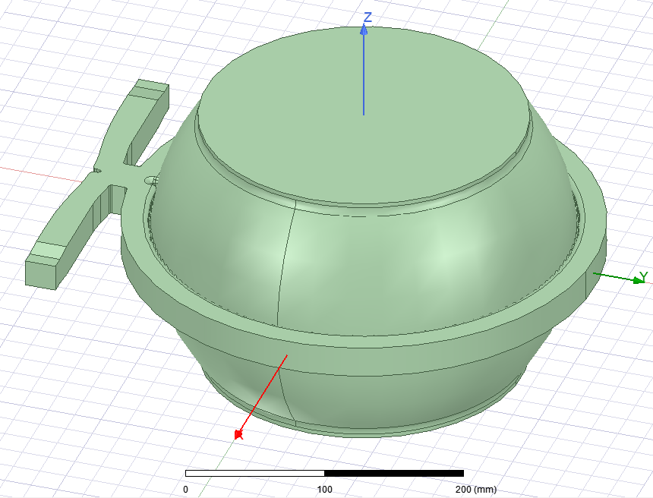
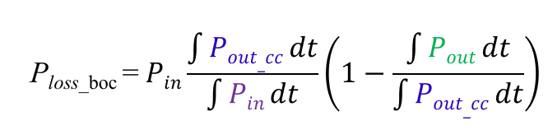
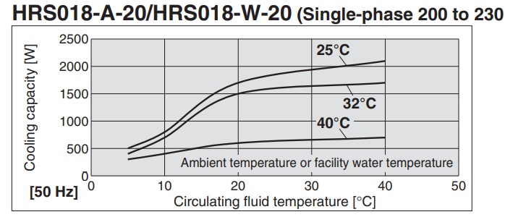

BOC pulse compressor
Parameters of the klystron
Peak power [MW] | 50
Pulse length [μs] | 2.5
Repetition rate [Hz] | 50
Average power [kW] | 6.25
3D model from Emmanuel Berthome
$≈0.21$P_{in} = 1.3 kW
Heat Q: 1300 W
Water speed v: 1 m/s
Cross Section A: 100.7 mm2
heat capacity of water Cp: 4182 J/(kg°C)
Water density ρ: 997 kg/m3
ΔT = Q Δt/(A*v* Δt *ρ*Cp) = Q /(A*v*ρ*Cp) = 3.1 °C

Slide 4
Frequency control requirement
α = 17 μm/m/K
Temperature range: ± 5 K
Rcav = 154.104 mm
154.104e-3*17* ±5 = ± 13 μm
77.8(MHz/mm)* ±13 μm = ± 1 MHz
0.5 %
dT = 1 K
0.2 MHz offset
If Pg reduction is smaller than 0.005, the temperature change should be smaller than 0.1 K

Slide 5
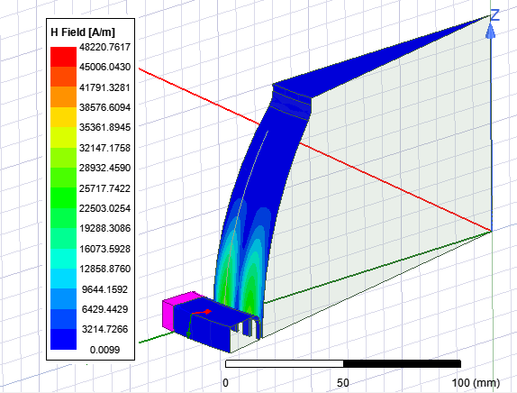
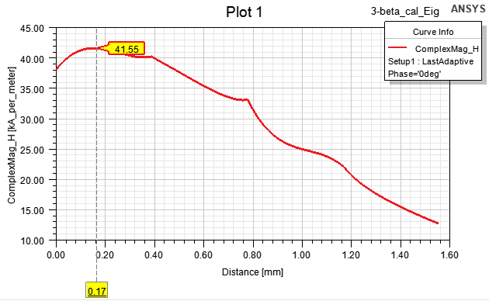
Surface fields parameters
1 J in the full model
1/64 J in the one segment model
 | 50MW | 100MW | Limit
Max E field [MV/m] | 9.9 | 10.4 | 100
Max Sc [MW/mm^2] | 0.33 | 0.66 | 2.0-4.0
Temperature rise [K] | 24 | 48 | 40-50
C0 = (41.55e3)^2/2
=0.86e9 A^2/(m^2·J)

