Slide 1

Status of collimation at β*=20 / 15 cm
B. Lindström
Thanks to A. Abramov, R. Bruce, R. De Maria, J. Molson,
P. Hermes , S. Redaelli, F. van der Veken
18th January 2022 – HLLHC WP2 meeting

Slide 2
Introduction
Previous HLLHC beam loss studies are ~three years old
Significant changes in optics and layout since then (v1.3 to v1.5)
Operational scenario for RunIV has changed from the baseline*
Relaxed collimator settings requested for beam stability
→ Collimation studies need update:
  Global cleaning efficiency
  IR7 dispersion suppressor losses
  Loss spikes/clusters in other cold sections
  TCT shower simulations (experiment backgrounds)
  Asynchronous beam dumps
  Beta beating and orbit errors
*R. Tomás – Update on Optics, Layout and Run4 operational scenario
https://indico.cern.ch/event/1079026/contributions/4544728

Slide 3
Collimator Settings $\left(ε_{n}=2.5μm⋅rad\right)$
Run V
Run IV
 | TDR Baseline (tight settings) | Relaxed Settings
 | 15 cm β* | 15 cm β* | 20 cm β* | 100 cm β*
TCP IR7 | 6.7 | 8.5 | 8.5 | 8.5
TCS IR7 | 9.1 | 10.1 | 10.1 | 10.1
TCLA IR7 | 12.7 | 14.0 | 13.7 | 13.7
TCLD IR7 | 16.6 | n/a** | n/a** | n/a**
TCP IR3 | 17.7 | 17.7 | 17.7 | 17.7
TCS IR3 | 21.3 | 21.3 | 21.3 | 21.3
TCLA IR3 | 23.7 | 23.7 | 23.7 | 23.7
TCS IR6 | 10.1 | 11.1 | 11.1 | 11.1
TCDQ IR6 | 10.1 | 11.1 | 11.1 | 11.1
TCL IR1/5 | 14.2 | 14.2* | 16.4* | 38 – 44*
TCT IR1/5 | 10.4 | 11.4* | 13.2* | 23 – 35*
Prot. Aperture IR1/5 | 11.8 | 12.8 | 14.6 | >24.4
TCT IR2 | 43.8 | 43.8 | 43.8 | 43.8
TCT IR8 | 17.7 | 17.7 | 17.7 | 17.7
TDIS | park | park | park | park
TCLD IR2 | park | park | park | park
* gap in mm is set to final (15 cm) value and kept constant throughout squeeze
** likely n/a for runIV, status for runV to be confirmed

Slide 4
Recap from previous presentations
15 % larger DS losses in v1.5 optics vs v1.3
  cause understood – can be solved
7 % larger DS losses with relaxed collimator settings
Large IR1 TCT losses with relaxed settings at 15 cm β*
  cause understood – workarounds under study
To validate relaxed settings, FLUKA power deposition in IR7 DS necessary
  no estimated time of delivery as of now – discussions ongoing
Further details:
11th HL-LHC Collaboration Meeting: https://indico.cern.ch/event/1079026
LBS#109: https://indico.cern.ch/event/1073308

Slide 5
Recap from previous presentations
15 % larger DS losses in v1.5 optics vs v1.3
  cause understood – can be solved
7 % larger DS losses with relaxed collimator settings
Large IR1 TCT losses with relaxed settings at 15 cm β*
  cause understood – workarounds under study
To validate relaxed settings, FLUKA power deposition in IR7 DS necessary
  no estimated time of delivery as of now – discussions ongoing
Action: Incorporate patches to aperture model in LayoutDB – ongoing
(9th ABP-NDC section meeting – joint LNO https://indico.cern.ch/event/1033415 )
Action: Solve the degradation of the cleaning in v1.5 optics + relaxed settings – ongoing
(Special Joint HiLumi WP2/WP5 Meeting https://indico.cern.ch/event/1063931 )
Further details:
11th HL-LHC Collaboration Meeting: https://indico.cern.ch/event/1079026
LBS#109: https://indico.cern.ch/event/1073308

Slide 6
TCP beta function rematching

Slide 7
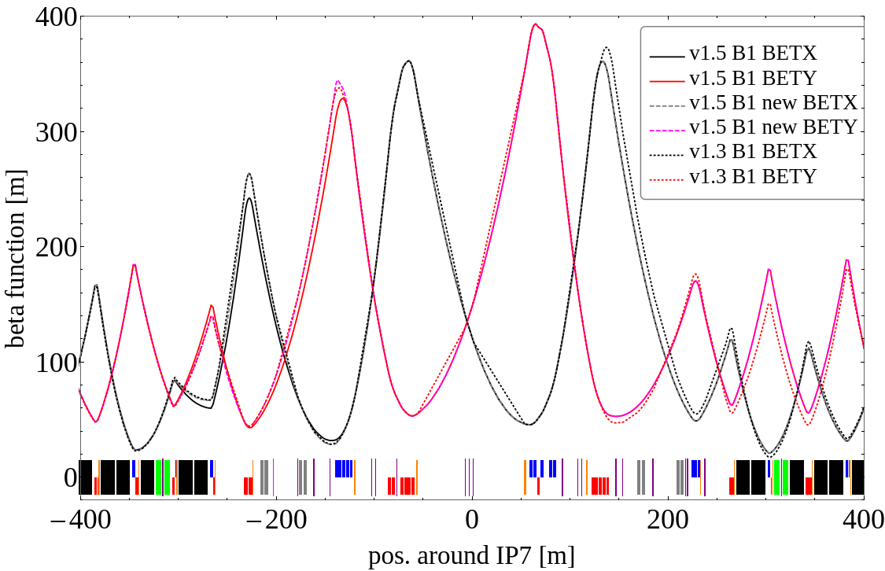
TCP beta functions
DS losses 15 % worse in v1.5 vs v1.3 due to smaller TCP beta functions
Large beta functions means large normalized kicks -> improved cleaning
  Studied in detail for LHC by R.Bruce et al (https://accelconf.web.cern.ch/ipac2021/papers/mopab006.pdf)
  Not considered yet for HLLHC
Rematching v1.5 betas to v1.3 values improves cleaning
TCP betx: 141 -> 150 m
bety: 75 -> 83 m

Slide 8
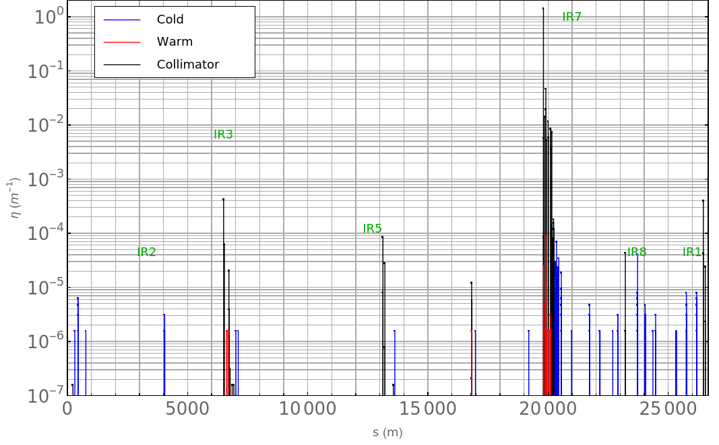
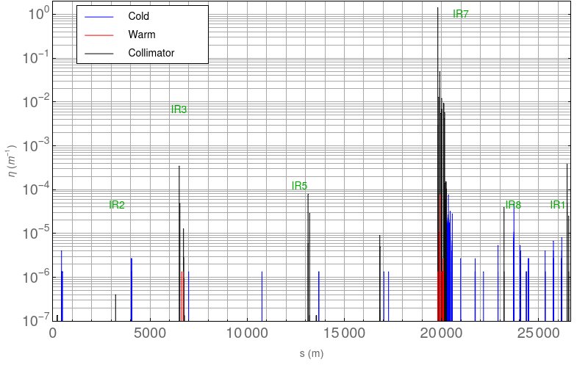
Rematching TCP beta functions
B1H – standard case
15 cm β*
Impact: 4 µm
8e6 particles / 200 turns
General notes:
DS losses improved from 8.5e-4 to 7.7e-4
Global inefficiency improved from 9.2e-4 to 8.5e-4
Increased losses in IR7 TCS, lower in IR7 TCL
Note: still increased DS losses due to relaxed settings
B1H – TCP betas rematched

Slide 9
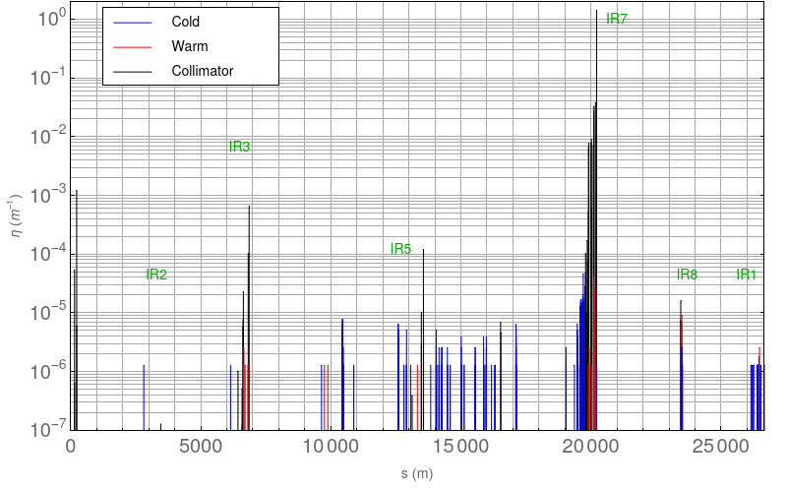
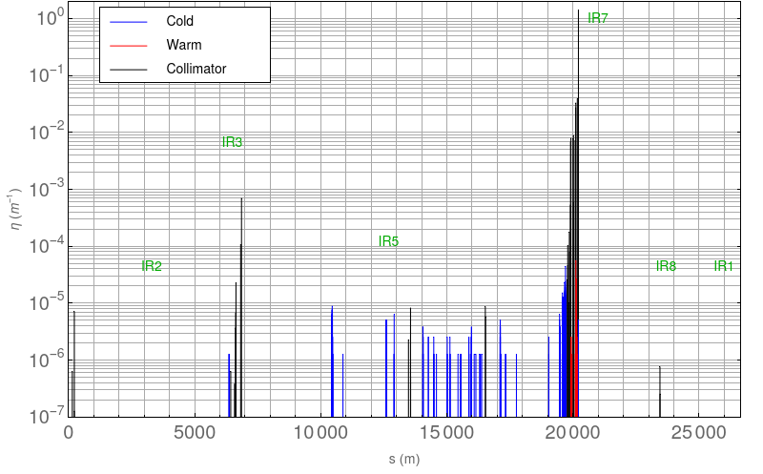
Rematching TCP beta functions
B4V – 15 cm
Impact: 4 µm
8e6 particles / 200 turns
General notes:
Large losses IR1 TCT for 15 cm
due to bad phase advance from TCPs
TCT losses are no concern for 20 cm
Otherwise similar results between 15/20 cm
B4V – 20 cm

Slide 10
TCT loss alleviation

Slide 11
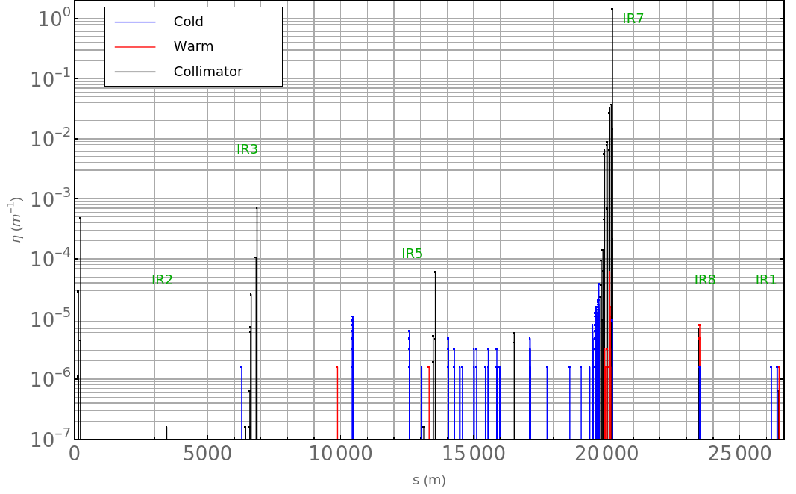
TCT relaxed 0.5 sigma

Slide 12
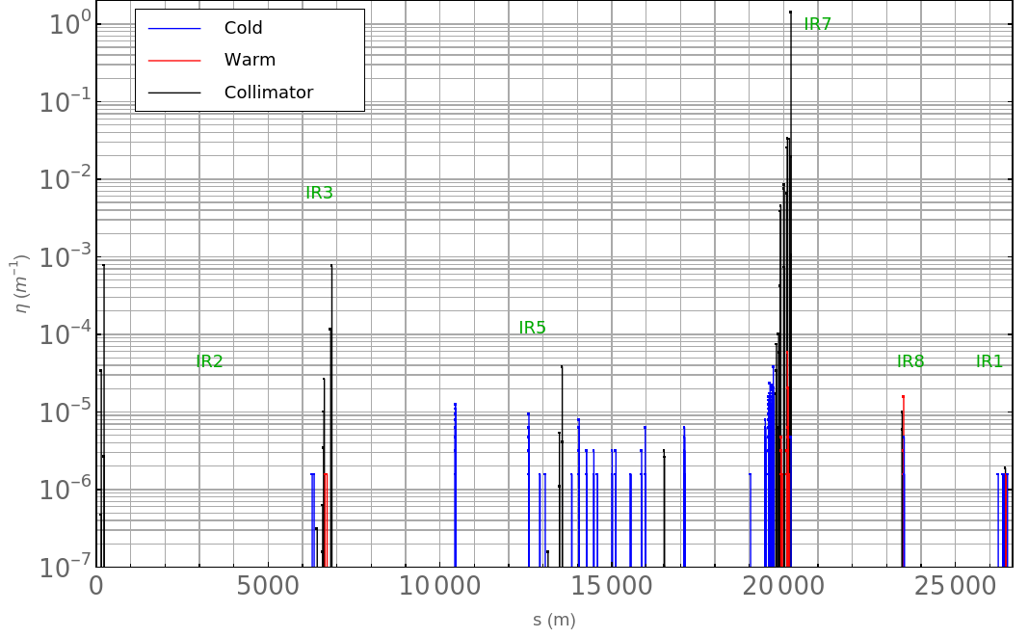
TCP inserted 0.5 sigma
worse DS losses

Slide 13
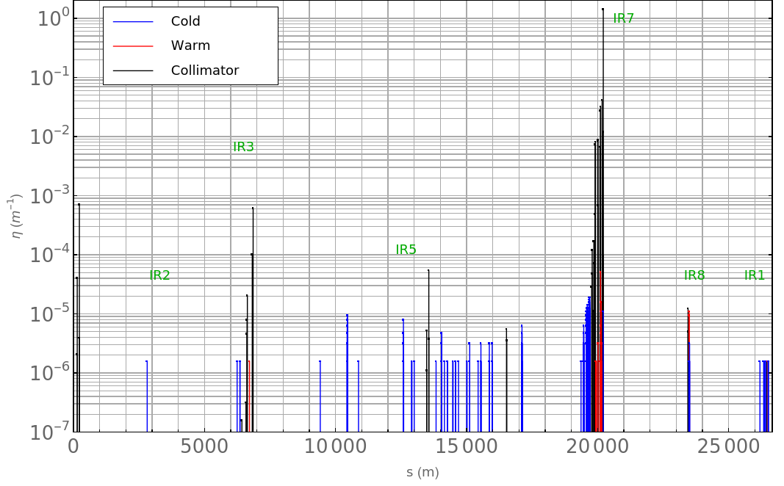
TCS inserted 0.4 sigma
better DS losses

Slide 14
IR7 DS loss alleviation – in case of no TCLD

Slide 15
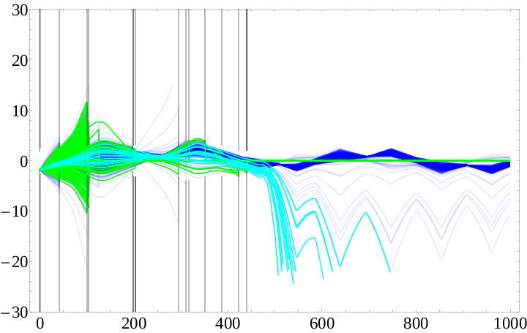
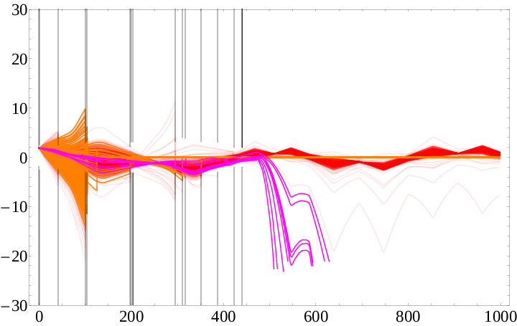
TCP cleaning efficiency jaw asymmetry
A factor of ~2 difference in cleaning efficiency between left/right jaws
Right jaw: phase of betatron motion adds up with the dispersion
Left jaw: phase of betatron motion counteracts the dispersion
Three outcomes:
Adding dispersion could equalize efficiency of the two jaws
Shifting the center of the TCP jaws could equalize efficiency
Shifting the center of the last two TCLs could help absorb some of the extra leakage from the right jaw

Slide 16
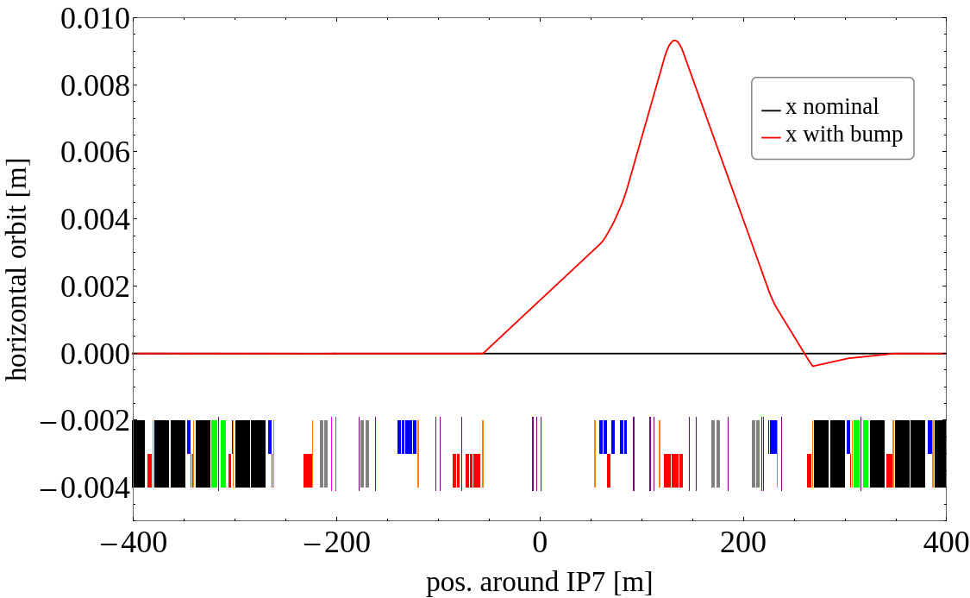
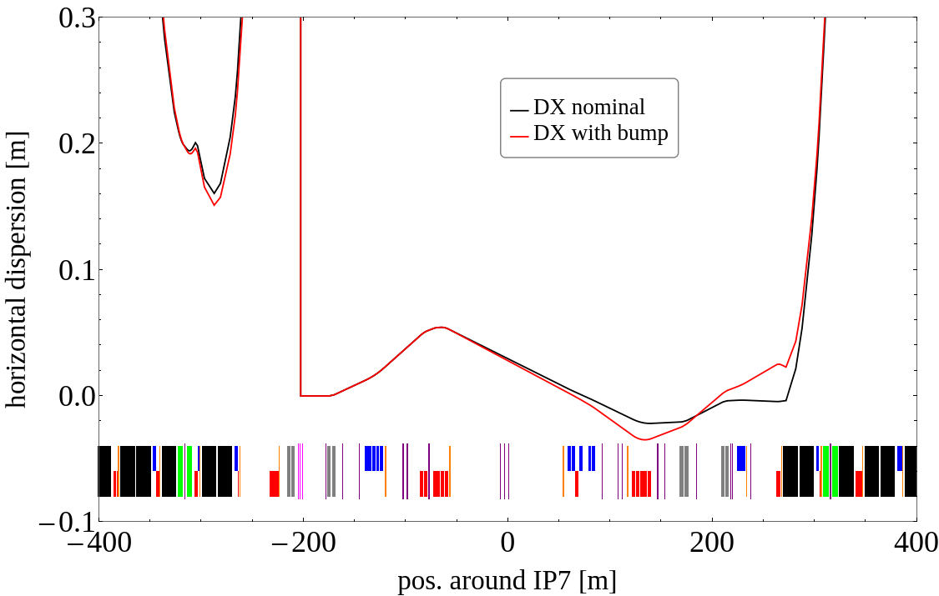
Single pass dispersion
Normally, dispersion is created by the D1
Four horizontal corrector magnets to create an orbit bump + dispersion (MCBWH.4L7, MCBWH.5R7, MCBCH.7R7, MCBCH.9R7)
9 mm bump leads to similar efficiency between left/right jaws

Slide 17
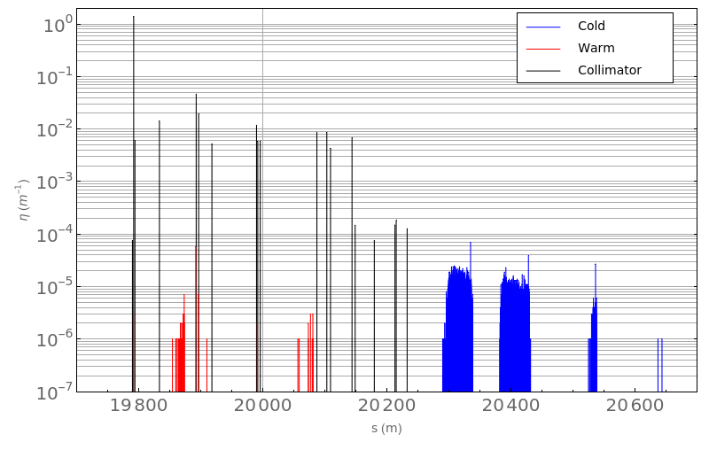
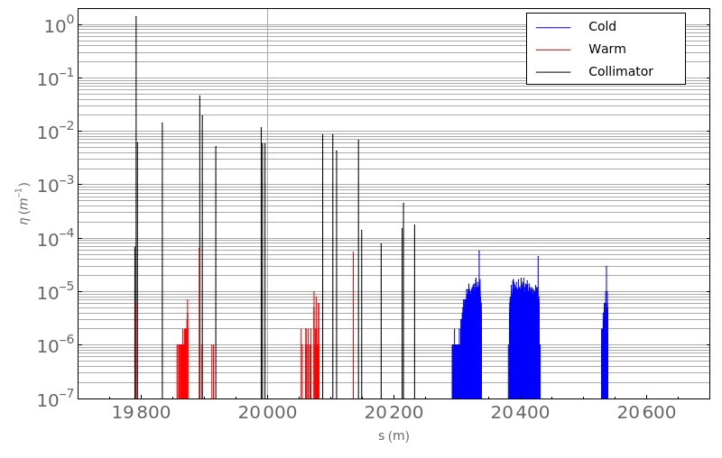
Loss maps – nominal vs bump+3sigma offset
60 % decrease of losses in CL1
CL2 is not affected
 | DS cluster 1 | DS cluster 2 | Global inefficiency
reference | 10.4e-6 | 7.4e-6 | 9.5e-4
dispersion | 8.3e-6 | 7.5e-6 | 8.5e-4
dispersion + TCL offset | 4.4e-6 | 7.1e-6 | 6.7e-4
MD is foreseen to test these methods
More details ColUSM #147: https://indico.cern.ch/event/1105248

Slide 18
Scenario [15 cm β*] | inefficiency [e-4] | MaxCold [e-5] | MaxWarm [e-5] | DS cl1 [e-6] | DS cl2 [e-6] | MaxTCT [e-4]
B1 v1.5 tight H/V | 8.6 / 7.1 | 6.9 / 5.2 | 5.0 / 4.5 | 9.2 / 6.7 | 6.8 / 6.0 | 2.3 / 0.6
B1 v1.5 relaxed H/V | 9.3 / 7.7 | 6.9 / 6.7 | 9.0 / 6.6 | 9.9 / 7.2 | 7.2 / 6.4 | 4.0 / 0.8
B1 relaxed New Beta | 8.5 / 7.4 | 7.6 / 5.1 | 7.7 / 5.6 | 8.9 / 6.8 | 6.7 / 6.3 | 3.8 / 0.9
B2 v1.5 tight H/V | 8.8 / 6.8 | 4.9 / 3.3 | 6.7 / 5.0 | 9.2 / 6.5 | 6.4 / 5.1 | 0.4 / 3.2
B2 v1.5 relaxed H/V | 9.9 / 7.2 | 5.6 / 3.2 | 7.3 / 7.0 | 10. / 6.8 | 7.0 / 5.5 | 0.6 / 12
|---- TCP inserted V | 8.1 | 3.8 | 5.9 | 7.4 | 6.5 | 7.8
|---- TCSG inserted V | 6.2 | 1.9 | 5.1 | 5.5 | 4.9 | 7.1
|---- TCT relaxed V | 7.3 | 3.8 | 6.0 | 6.7 | 5.7 | 4.8
B2 relaxed New Beta | 8.4 / 7.1 | 7.6 / 4.7 | 7.3 / 4.1 | 8.9 / 6.6 | 5.9 / 5.6 | 0.5 / 12
B1 v1.5 relaxed TCLD | 2.1 / 1.3 | 13. / 5.8 | 7.2 / 4.5 | 3.9 / 2.3 | 0.03/0.03 | 3.4 / 0.9
B2 v1.5 relaxed TCLD | 2.0 / 1.3 | 14. / 8.9 | 6.9 / 7.6 | 3.4 / 2.0 | 0.02/0.02 | 0.6 / 12
Scenario [20 cm β*]
B1 v1.5 relaxed H/V | 9.4 / 7.6 | 8.0 / 7.1 | 7.4 / 6.3 | 10. / 6.8 | 7.3 / 6.4 | 1.8 / 0.3
B1 relaxed New Beta | 8.4 / 7.5 | 6.6 / 5.1 | 7.0 / 5.5 | 9.0 / 7.3 | 6.6 / 6.1 | 2.0 / 0.4
B2 v1.5 relaxed H/V | 9.5 / 7.3 | 6.4 / 3.6 | 7.0 / 7.6 | 10. / 6.9 | 6.7 / 5.6 | 0.1 / 0.1
B2 relaxed New Beta | 8.2 / 7.1 | 7.3 / 4.5 | 8.0 / 5.6 | 8.6 / 6.6 | 5.8 / 5.4 | 0.1 / 0.1
* 4 µm impact parameter, 6 to 10 million particles

Slide 19
Summary
v1.5 optics with a more detailed aperture
  Aperture requires some patching
  → work ongoing together with Riccardo & layout team
  15 % larger DS losses in v1.5 optics
  → due to smaller TCP beta functions, can be corrected
Relaxed collimator settings
  7 % larger DS losses (up to 23 % increase v1.5 relaxed vs v1.3 tight settings)
  Higher TCT losses, in particular IP1 for B4 vertical
  TCT losses not expected to be an issue at 20 cm
  Input for TCT shower simulations has been sent to FLUKA team
Need FLUKA simulations of power deposition in IR7 DS before new collimator settings are validated
Open points:
Determine solution for TCT losses at 15 cm
  (preliminary) retracting TCT by 0.5 sigma, inserting TCP / TCSG by 0.5 / 0.4 sigma
Determine IR7 DS loss alleviation strategy in case of no TCLD
  (preliminary) Increase TCP beta functions, add dispersion in IR7, asymmetric TCPs / TCLs

Slide 21

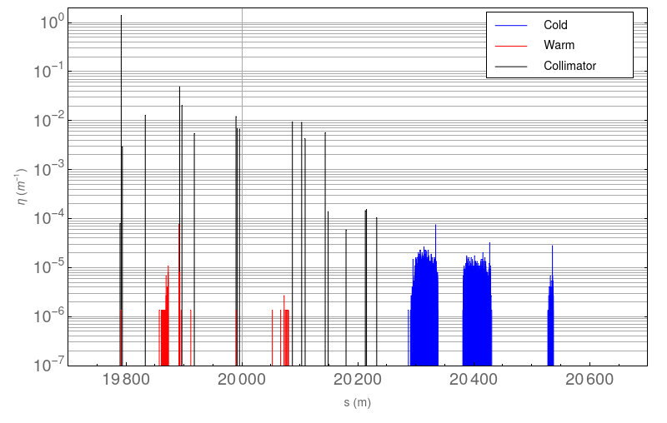
Rematching TCP beta functions
B1H – standard case
15 cm β*
Impact: 4 µm
8e6 particles / 200 turns
General notes:
DS losses improved from 8.5e-4 to 7.7e-4
Global inefficiency improved from 9.2e-4 to 8.5e-4
Increased losses in IR7 TCS, lower in IR7 TCL
Note: still increased DS losses due to relaxed settings
B1H – TCP betas rematched

Slide 22
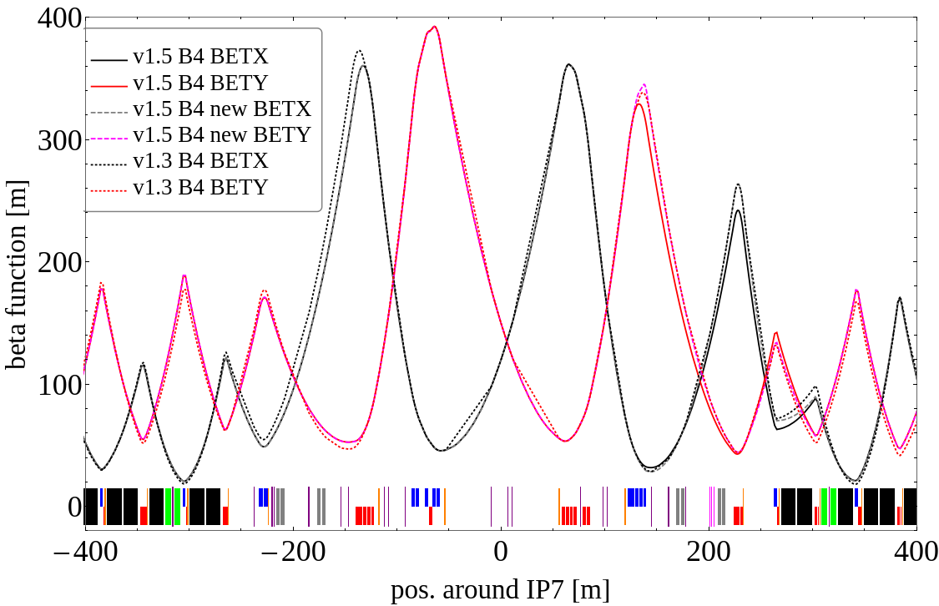
Rematched beta functions – B4

Slide 23
Scenario | inefficiency [e-4] | MaxCold [e-5] | MaxWarm [e-5] | DS cl1 [e-6] | DS cl2 [e-6] | MaxTCT [e-4]
B1 v1.3 tight H/V | 7.4 / 6.6 | 6.1 / 5.2 | 1.1 / 0.8 | 8.0 / 6.5 | 5.6 / 5.2 | 2.3 / 1.0
B1 v1.3 relaxed H/V | 8.1 / 7.2 | 6.1 / 6.3 | 0.6 / 0.6 | 8.8 / 6.9 | 6.0 / 5.5 | 3.3 / 1.0
B2 v1.3 tight H/V | 8.6 / 5.9 | 4.6 / 2.5 | 0.5 / 0.6 | 9.4 / 6.1 | 5.8 / 4.4 | 0.4 / 3.7
B2 v1.3 relaxed H/V | 9.5 / 6.5 | 5.4 / 3.2 | 0.6 / 1.6 | 10. / 6.7 | 6.2 / 4.7 | 0.6 / 13
B1 v1.5 tight H/V | 8.6 / 7.1 | 6.9 / 5.2 | 5.0 / 4.5 | 9.2 / 6.7 | 6.8 / 6.0 | 2.3 / 0.6
B1 v1.5 relaxed H/V | 9.3 / 7.7 | 6.9 / 6.7 | 9.0 / 6.6 | 9.9 / 7.2 | 7.2 / 6.4 | 4.0 / 0.8
B2 v1.5 tight H/V | 8.8 / 6.8 | 4.9 / 3.3 | 6.7 / 5.0 | 9.2 / 6.5 | 6.4 / 5.1 | 0.4 / 3.2
B2 v1.5 relaxed H/V | 9.9 / 7.2 | 5.6 / 3.2 | 7.3 / 7.0 | 10. / 6.8 | 7.0 / 5.5 | 0.6 / 12
|---- TCP inserted V | 8.1 | 3.8 | 5.9 | 7.4 | 6.5 | 8.0
|---- TCSG inserted V | 6.2 | 1.9 | 5.1 | 5.5 | 4.9 | 8.1
|---- TCT relaxed V | 7.3 | 3.8 | 6.0 | 6.7 | 5.7 | 4.8
B1 v1.5 relaxed TCLD | 2.1 / 1.3 | 13. / 5.8 | 7.2 / 4.5 | 3.9 / 2.3 | 0.03/0.03 | 3.4 / 0.9
B2 v1.5 relaxed TCLD | 2.0 / 1.3 | 14. / 8.9 | 6.9 / 7.6 | 3.4 / 2.0 | 0.02/0.02 | 0.6 / 12
FLUKA B1 v1.5 tight* | / 2.8 | / 3.5 | /657 | / 2.8 | / 2.3 | / 0.7
FLUKA B1 v1.5 relaxed* | / 3.1 | / 3.4 | /699 | / 3.0 | / 2.4 | / 1.0
FLUKA B2 v1.5 tight | / 2.4 | / 3.7 | /499 | / 2.5 | / 2.1 | / 3.3
FLUKA B2 v1.5 relaxed | / 2.8 | / 5.6 | /572 | / 2.3 | / 2.3 | / 13
* 1.5 µm impact parameter, the rest are 4 µm
** 15 cm beta*, results for 20 cm are similar except TCT losses

Slide 24
Layout Changes
v1.5 (latest) introduces several differences from v1.3:
  Optics
  IR1/IR5 element positions up to half-cell 4
  TCL.5R{1,5} and TCT.6L{1,5} positions
  DFXJ, D2 lengths
  2x Crab cavities per beam/IP/side removed
  D2 aperture
  11T dipole moved from cell 8 to 9
  1 MQWA in IR7 removed, pos of remaining changed
  ...
Aperture improved using layout database*
IR7 TCLD likely not available for RunIV
  → strong impact on cleaning efficiency
*layout.cern.ch

Slide 25
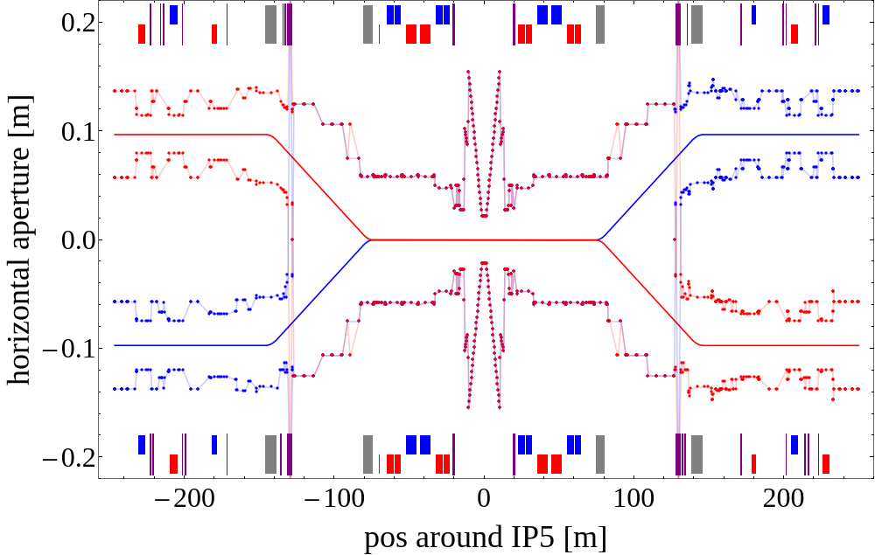
Aperture model
Sources:
  MAD-X files on AFS
  Inherited file with
  VSS/BPM markers
  Layout database
Updates to do:
  LayoutDB requires some patches: inconsistent positions, aperture definitions, extensive yet incomplete
  LHCb VELO+SMOG not available
https://gitlab.cern.ch/collteam/generate_aperture/-/tree/bjlindst/HLLHC/v1p5

Slide 26
Optics version comparison – v1.3 vs v1.5

Slide 27
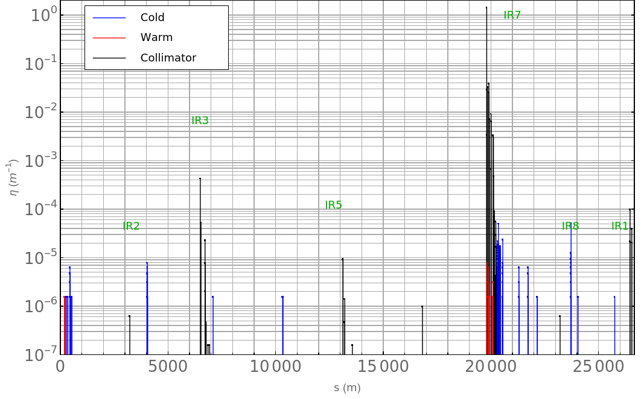
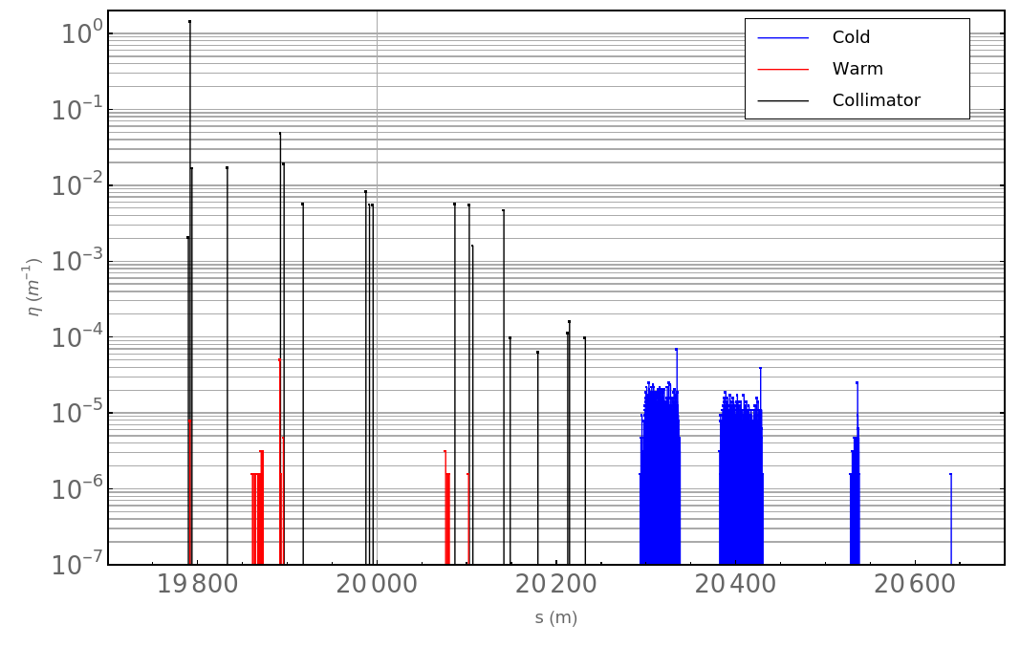
TDR baseline with tight collimator settings
B1V – v1.3
15 cm β*
Impact: 4 µm
6.4e6 particles / 200 turns
General notes:
Collimator loss distributions mostly consistent, except for some TCT losses
b1: ~15 % more DS losses in v1.5
b2: ~5 % more DS losses in v1.5
TCP
Dispersion suppressor (DS)

Slide 28
Simulation method comparison –
K2 vs FLUKA

Slide 29
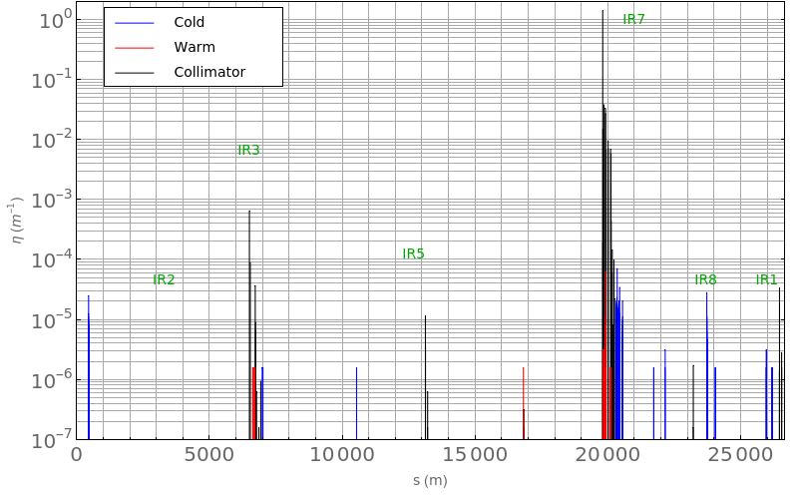
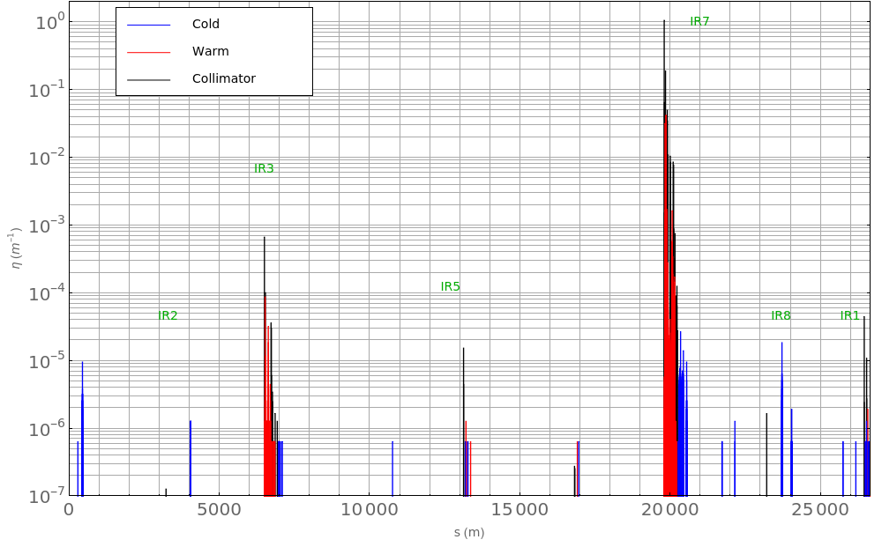
K2 vs FLUKA
K2
K2 is a built-in scattering module in SixTrack
FLUKA is an extensive tool for simulating particle-matter interactions – can be coupled to SixTrack for collimator interactions
B1V – v1.5 optics
20 cm β*
Impact: 4 µm
6.4e6 particles / 200 turns
General notes:
Collimator loss distributions mostly consistent
Increase in TCT4 losses
Leakage from TCP is larger
FLUKA

Slide 30
Collimator settings comparison
– Tight Settings vs Relaxed Settings

Slide 31
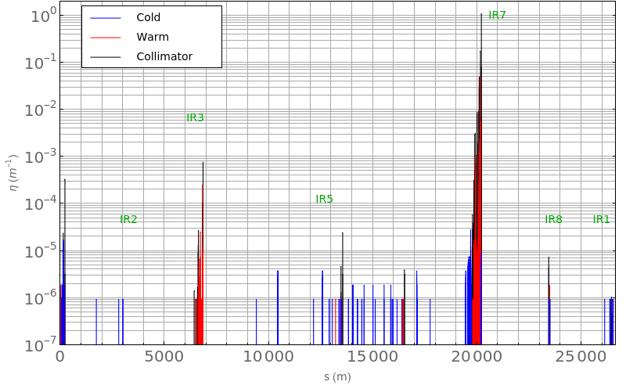
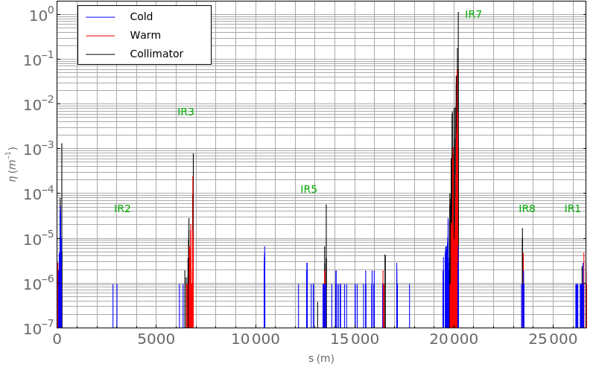
Tight vs Relaxed collimator settings
B4V – tight settings
FLUKA
15 cm β*
Impact: 4 µm
10e6 particles / 200 turns
~10 % worse global inefficiency with relaxed settings
~7 % larger DS losses with relaxed settings
B4V – relaxed settings

Slide 32
Tight vs Relaxed collimator settings
B4V – tight settings
FLUKA
15 cm β*
Impact: 4 µm
10e6 particles / 200 turns
~10 % worse global inefficiency with relaxed settings
~7 % larger DS losses with relaxed settings
B4V TCT losses in IR1 reach 1.2e-3
  Could affect background in IP1
B4V – relaxed settings

Slide 33
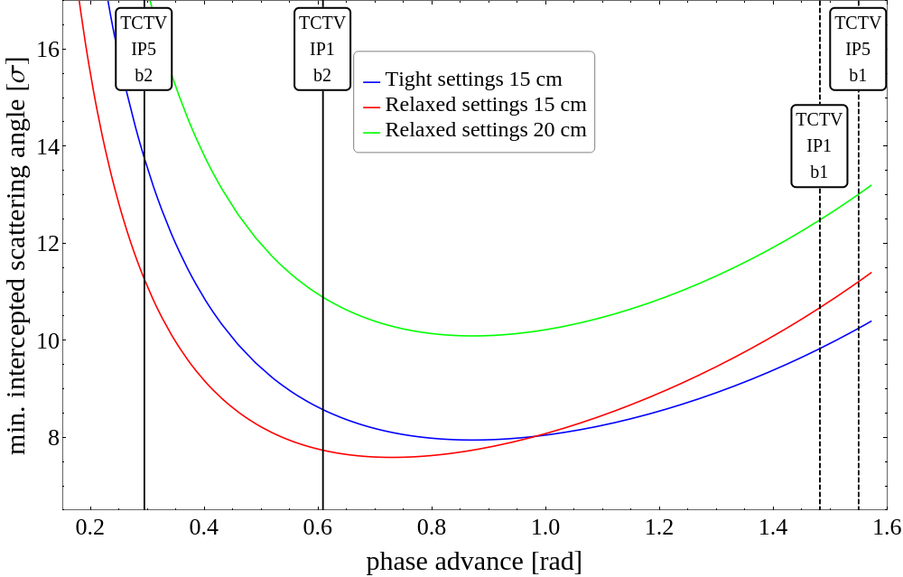
Normalized cut on scattering angle
Minimum angle that a particle can be scattered and be absorbed by a downstream collimator depends on phase advance and collimator settings
TCP to IR1 TCT phase advance almost optimal with new collimator settings
Not a concern at 20 cm (run IV)

Slide 34
Normalized cut on scattering angle
Minimum angle that a particle can be scattered and be absorbed by a downstream collimator depends on phase advance and collimator settings
TCP to IR1 TCT phase advance almost optimal with new collimator settings
Not a concern at 20 cm (run IV)
Solutions if relaxed settings to be used at 15 cm?
Adjust phase advance?
Retract TCTV in IR1 by 0.5 sigma
(reduces margin in 15 cm optics)
Insert TCP.D by 0.5 sigma
(increases impedance)
Insert TCS by 0.4 sigma
(increases impedance)
  more details, see presentation by R. Bruce, ”Studies of IR7 optics”: https://indico.cern.ch/event/828666

Slide 35
20 cm β* with Relaxed Settings

Slide 36
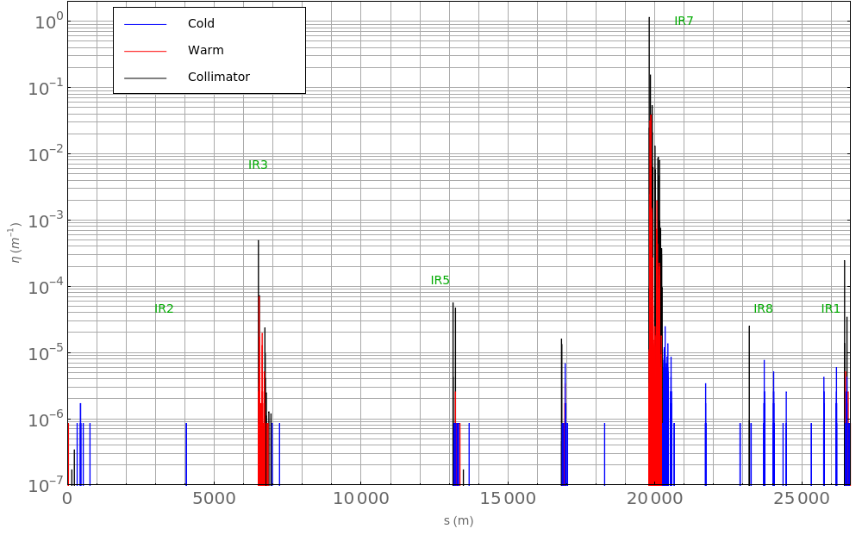
B1H – 20 cm
Relaxed collimator settings
v1.5 optics
Impact: 5 µm
10e6 particles / 200 turns
General notes:
20 cm results similar to 15 cm, except TCT losses
64 cm results similar to 20 cm, except TCT losses and inefficiency (~6 % worse)

Slide 37
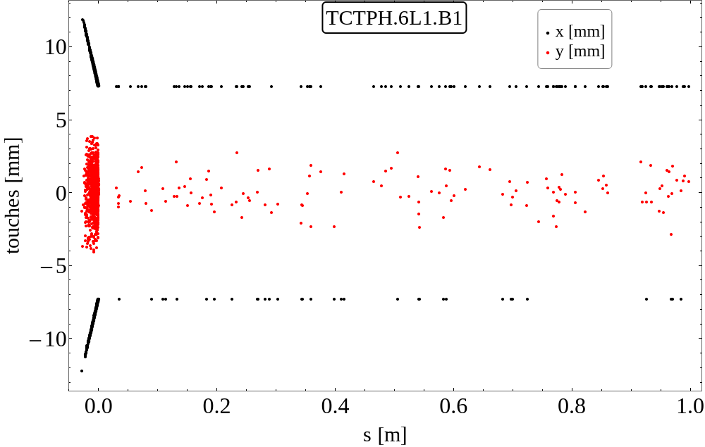
B1H – 20 cm
Relaxed collimator settings
v1.5 optics
Impact: 5 µm
10e6 particles / 200 turns
General notes:
20 cm results similar to 15 cm, except TCT losses
64 cm results similar to 20 cm, except TCT losses and inefficiency (~6 % worse)
TCT losses worst in IR1, for B1H
Touch maps have been sent to FLUKA team for experiment background simulations

Slide 38
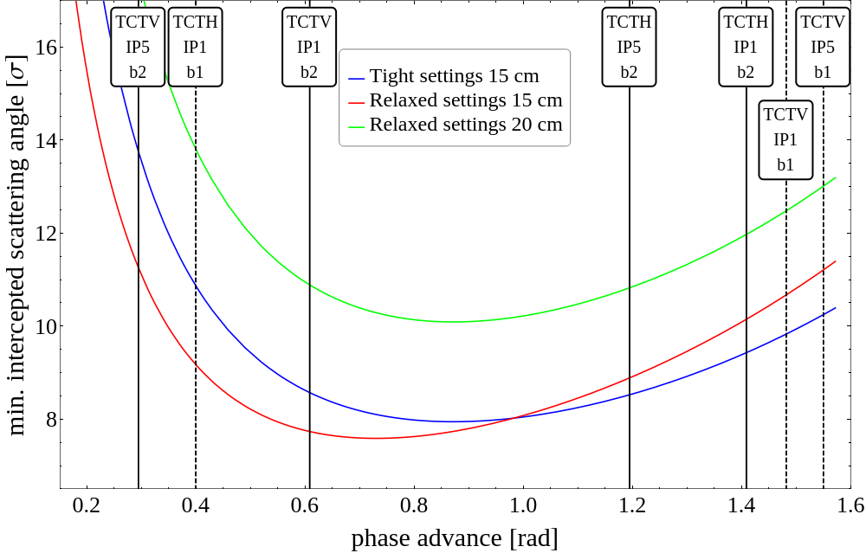
Normalized cut on scattering angle

Slide 39
v1.5 optics – relaxed settings at 20 cm and 64 cm

Slide 40
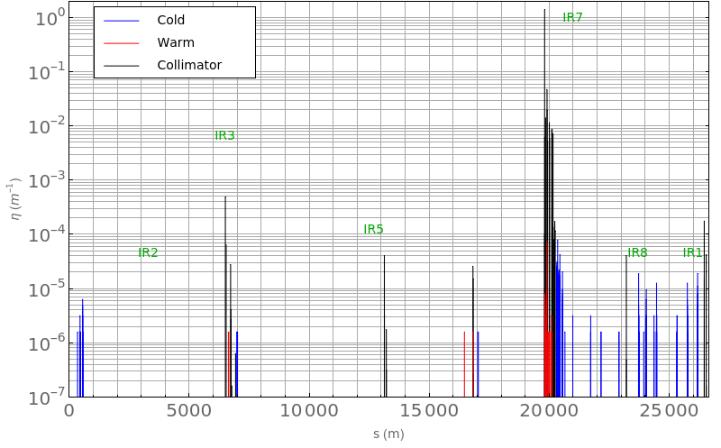
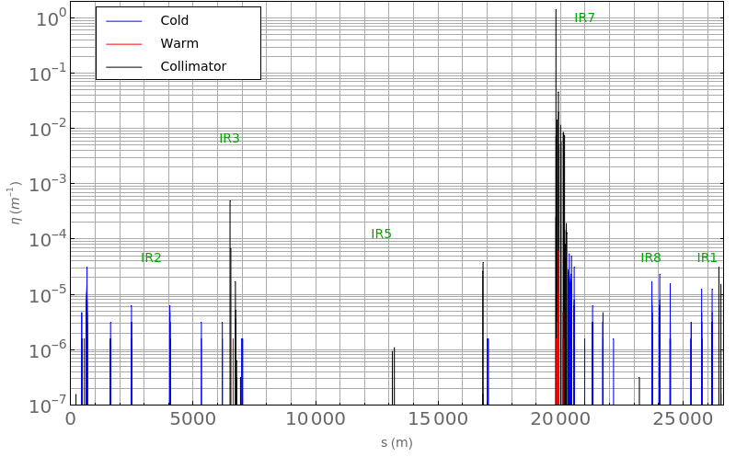
B1H – 20 cm
Relaxed collimator settings
v1.5 optics
Impact: 4 µm
6.4e6 particles / 200 turns
General notes:
20 cm results similar to 15 cm, except TCT losses
64 cm results similar to 20 cm, except TCT losses and inefficiency (~6 % worse)
B1H – 64 cm

Slide 41
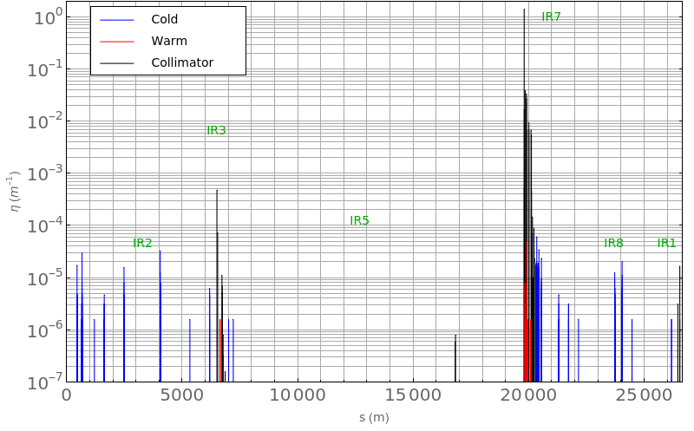
B1V – 20 cm
relaxed collimator settings
v1.5 optics
Impact: 4 µm
6.4e6 particles / 200 turns
General notes:
20 cm results similar to 15 cm, except for TCT losses
64 cm results similar to 20 cm, except TCT losses and global inefficiency (~5 % worse)
B1V – 64 cm

Slide 42
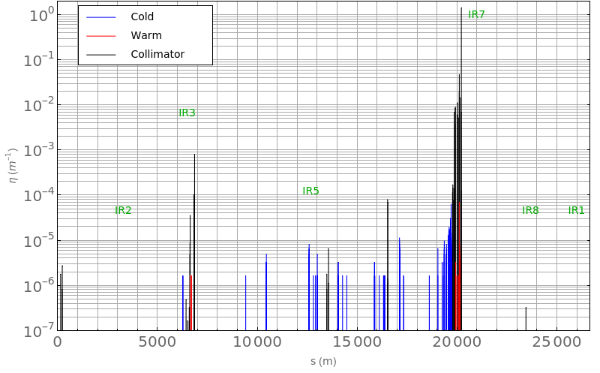
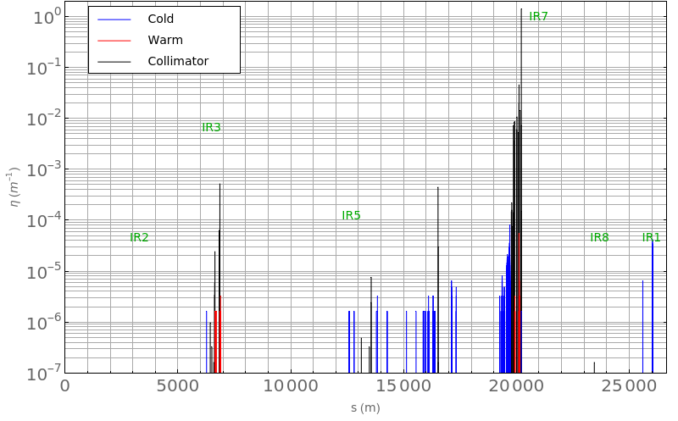
B4H – 20 cm
relaxed collimator settings
v1.5 optics
Impact: 4 µm
6.4e6 particles / 200 turns
General notes:
20 cm results similar to 15 cm, except for TCT losses
64 cm results similar to 20 cm, except TCT losses and global inefficiency (~5 % worse)
B4H – 64 cm

Slide 43
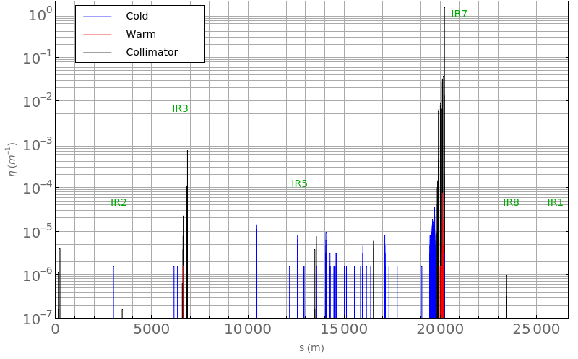
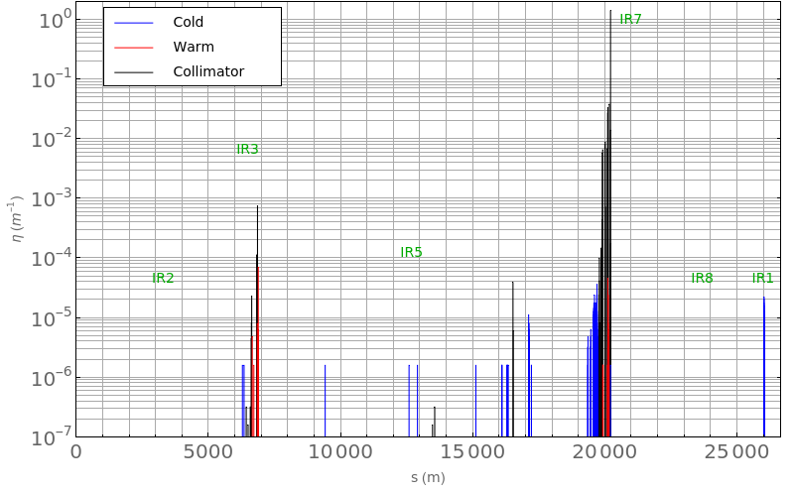
B4V – 20 cm
relaxed collimator settings
v1.5 optics
Impact: 4 µm
6.4e6 particles / 200 turns
General notes:
20 cm results similar to 15 cm, except for TCT losses
64 cm results similar to 20 cm, except TCT losses and global inefficiency (~5 % worse)
B4V – 64 cm

Slide 44
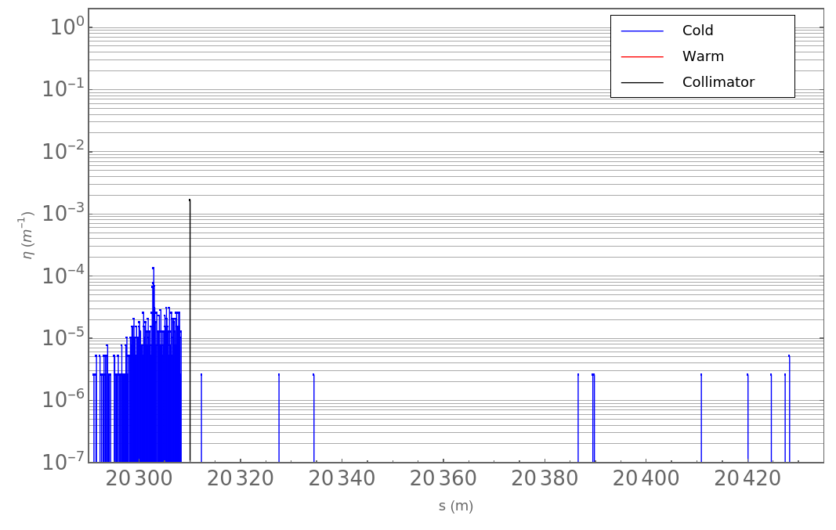
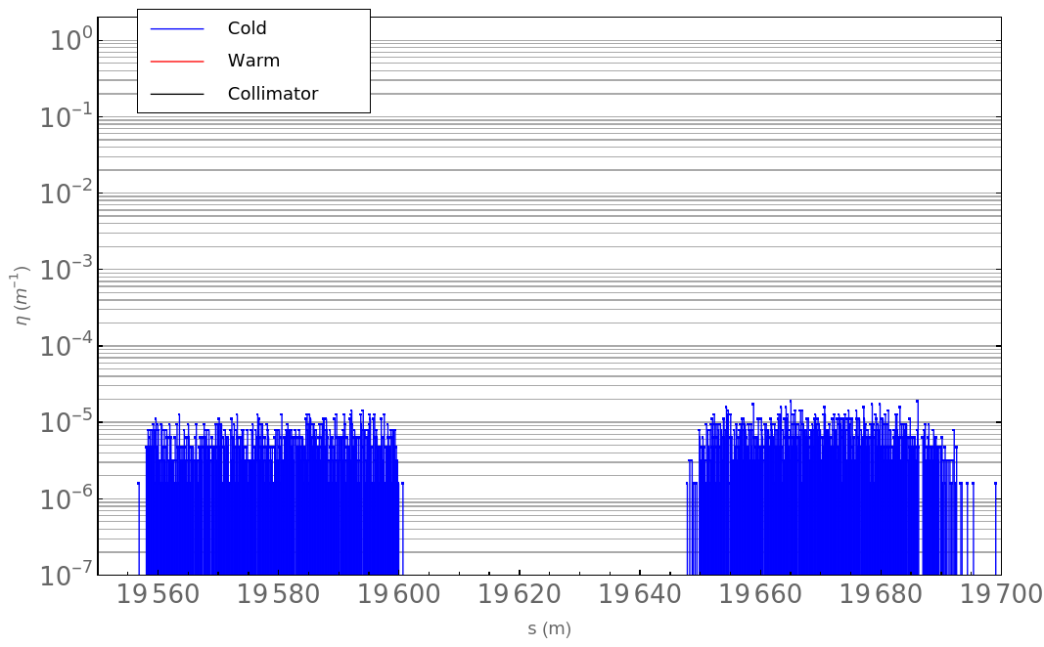
TCLD in IR7 dispersion suppressor
Plan to exchange 1x main dipole with 2x 11T dipoles
Provides space for the TCLD
Installation postponed, unlikely to occur before RunIV
→ must consider configurations without TCLD
IR7 DS beam losses
TCLD

Slide 45
B4V large TCT losses – mitigations

Slide 46
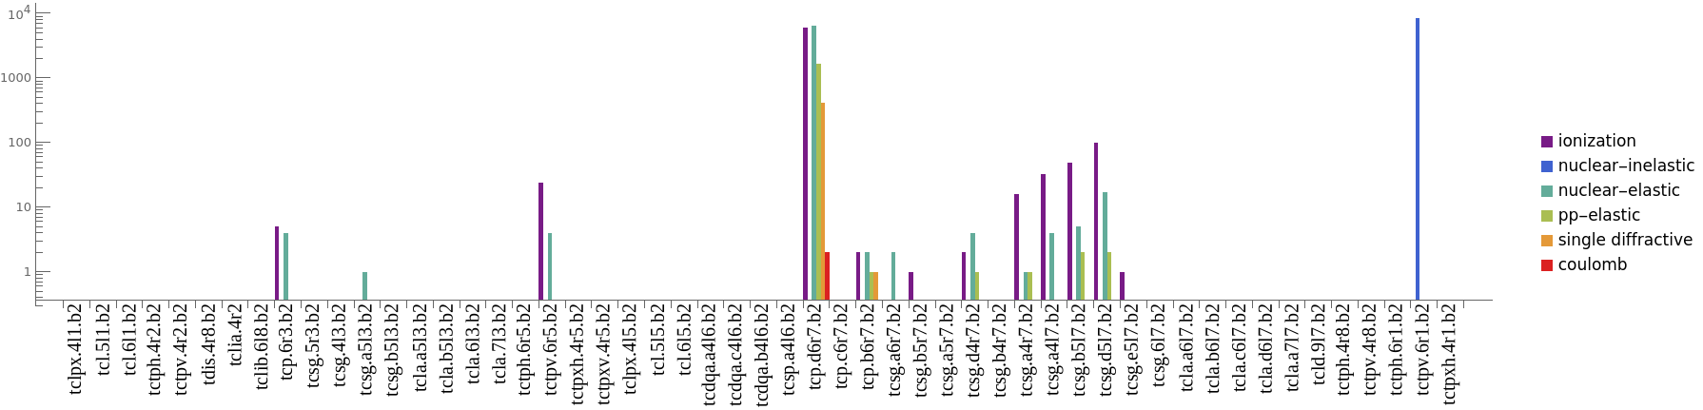
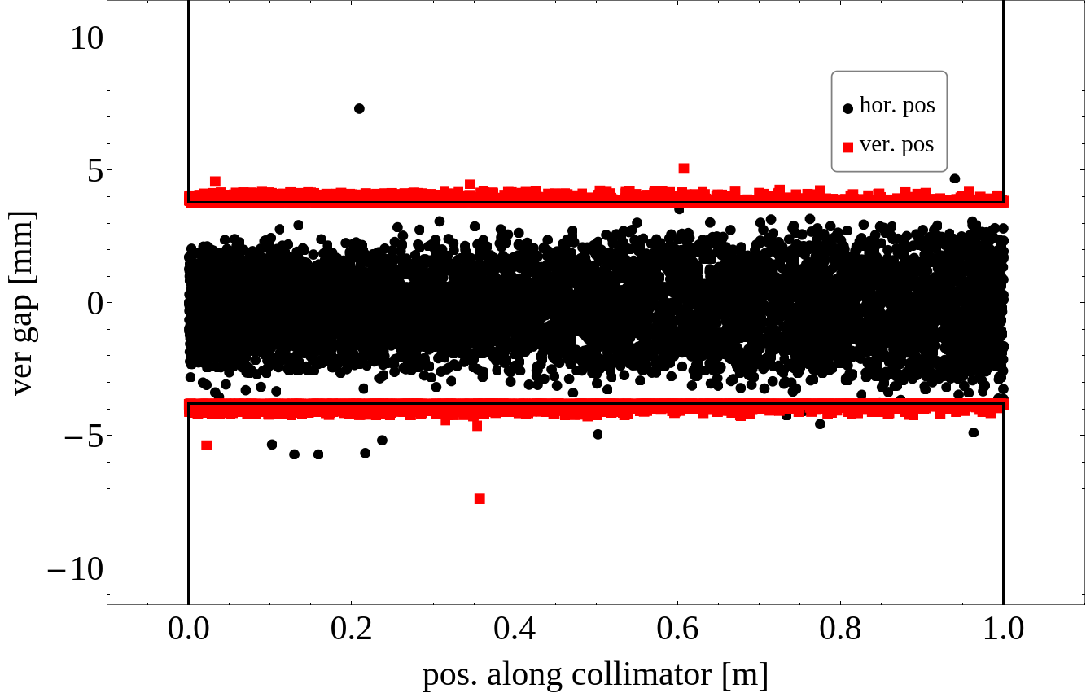
B4V – large TCT losses
Losses at 1.3e-3 in the TCTs could risk cause beam dumps, should be rectified
  n.b. – in 20 cm optics, TCTs are at 13.2 sigma and losses are insignificant
Mostly elastically scattered protons in TCP, betatron oscillations
Superficial hits on TCT
90 % particles within
impact param 0.5 sigma

Slide 47
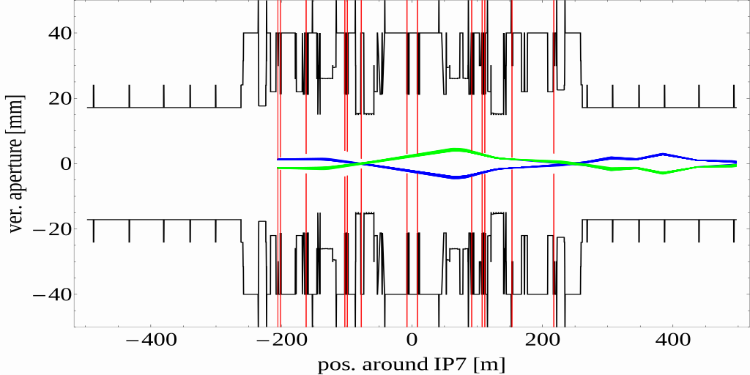
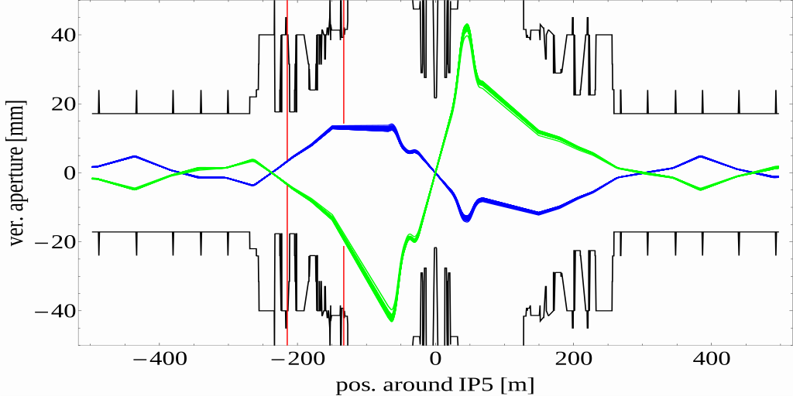
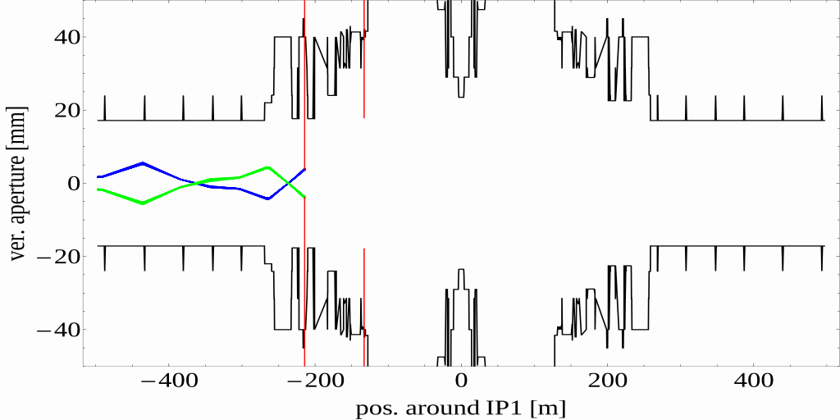
B4V – tracks
TCSG.B5L7.B2
TCSG.A4L7.B2
Solutions?
  Retract TCT1 by 0.5 sigma
  (reduces margin in 15 cm optics)
  Insert TCP.D by 0.5 sigma
  (increases impedance)
  Insert TCS by 0.4 sigma
  (increases impedance)
TCP.D6R7.B2

