Slide 1
DA at collisions
as a function of bunch length
S. Kostoglou, G. Sterbini
199th Hi-Lumi WP2 meeting 18/01/2022
Notes:
1

Slide 2
Motivation
Longer bunch length to be considered for Run 4 to improve transverse & longitudinal stability.
Evaluate impact of bunch length on DA for start & end of luminosity leveling.
Bunch length of 9 cm was used in previous DA studies. Results to be compared against 7.61 cm (-15%).
Note: Not comparing equal luminosities as intensity is considered ct (2.3 & 1.3x10¹¹ ppb). Leveling to equal lumi for ↓ bunch length requires ↓ intensity → better DA (conservative approach for ↓ bunch length).
2

Slide 3
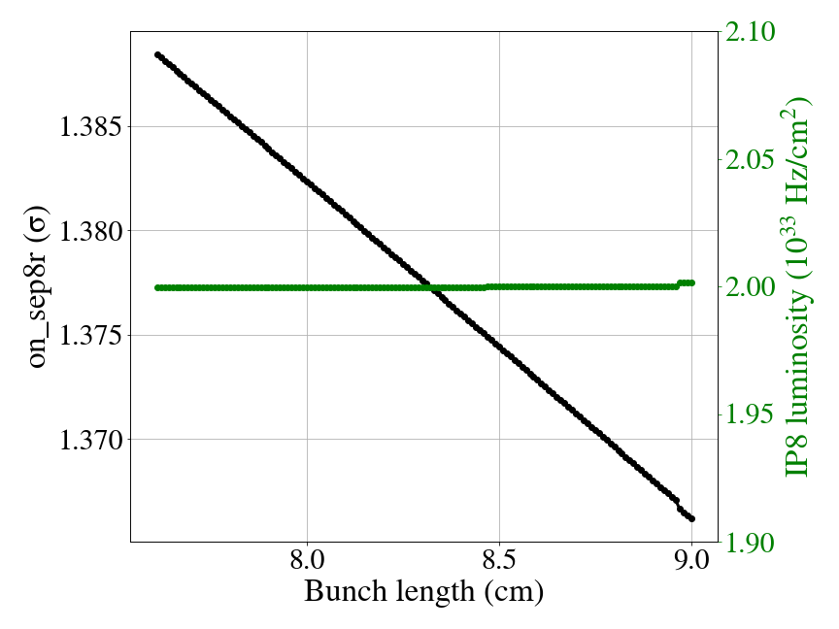
Motivation
Bunch length mainly impacts:
  Transverse: Luminosity leveling in IP8/IP2.
3

Slide 4
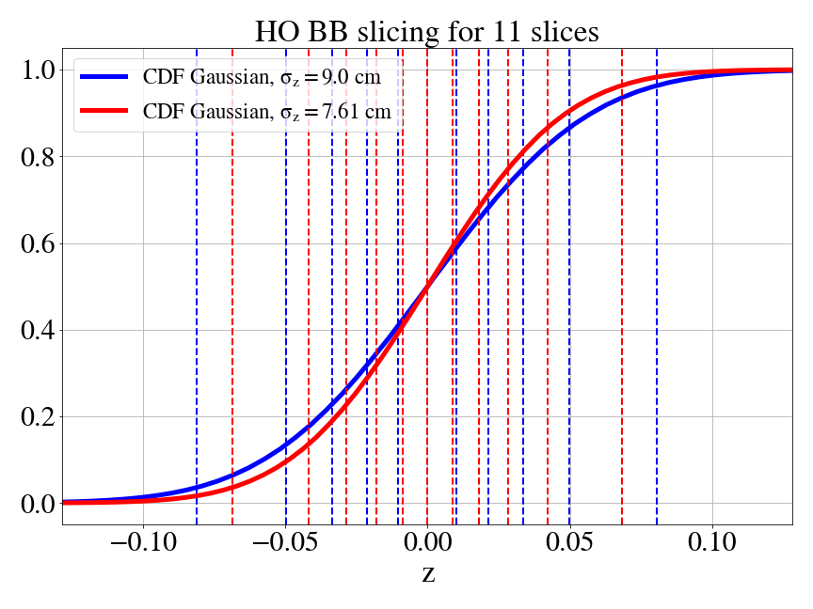
Motivation
Bunch length mainly impacts:
  Transverse: Luminosity leveling in IP8/IP2.
  Longitudinal: HO BB slicing.
Gaussian distribution
Longitudinal position of HO BB lenses for 11 slices based on constant charge for 9 cm & 7.61 cm
4

Slide 5
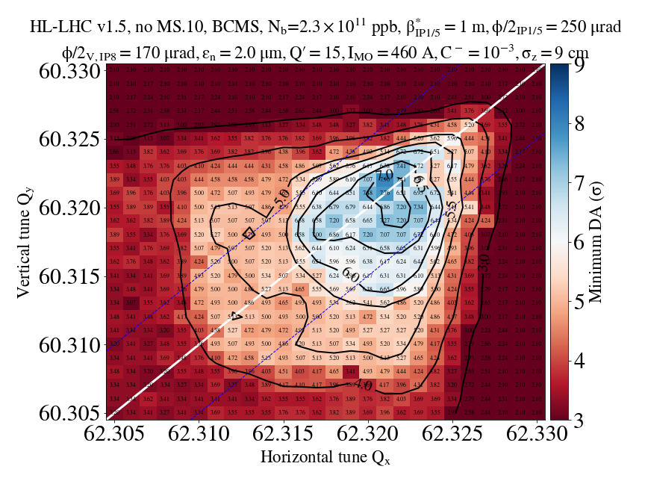
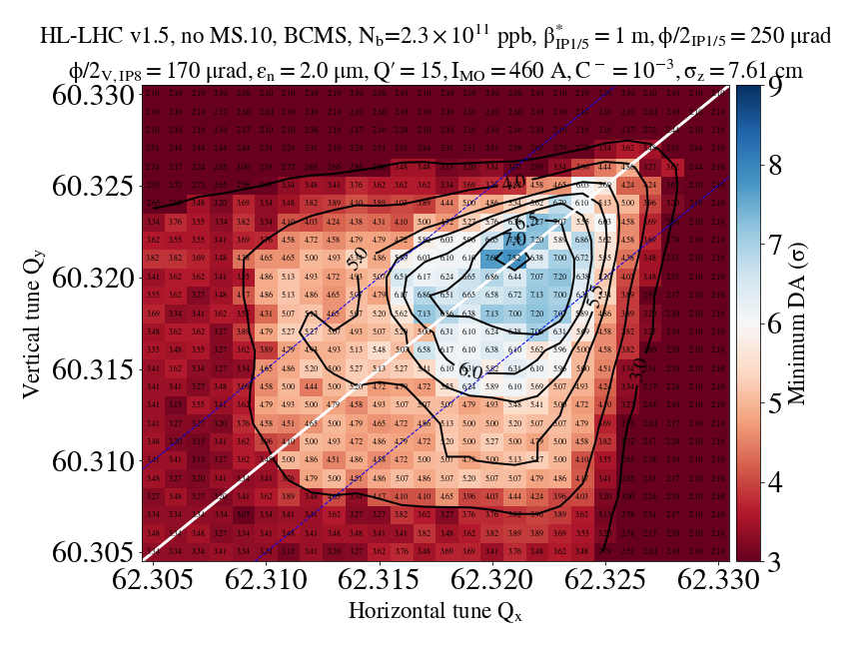
Start of β*-leveling
9 cm
on_disp=0
7.61 cm
5

Slide 6
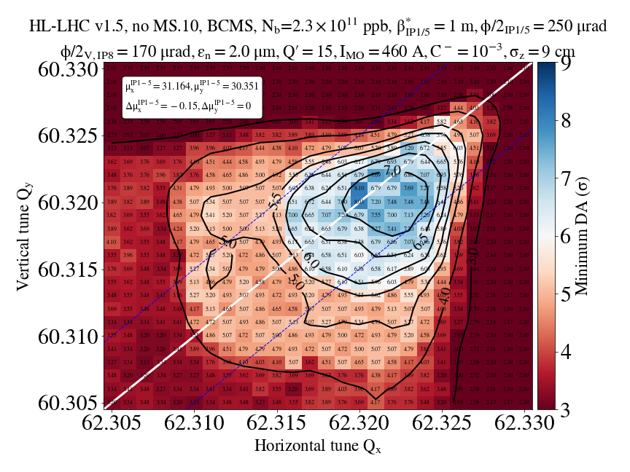
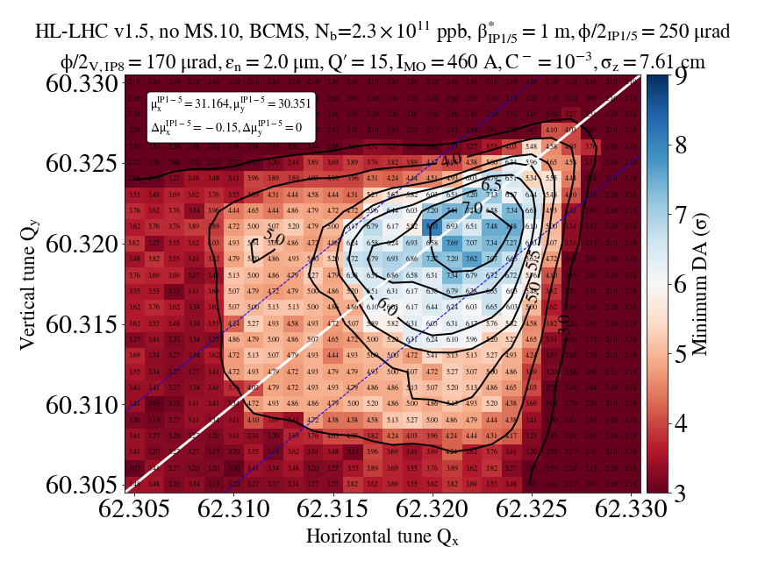
Start of β*-leveling with IP1-5 phase advance optimization
9 cm
on_disp=0
7.61 cm
6

Slide 7
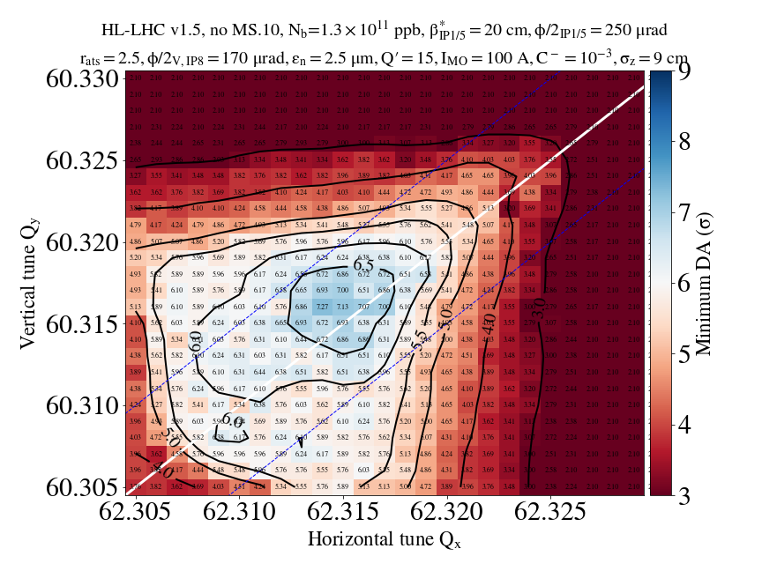
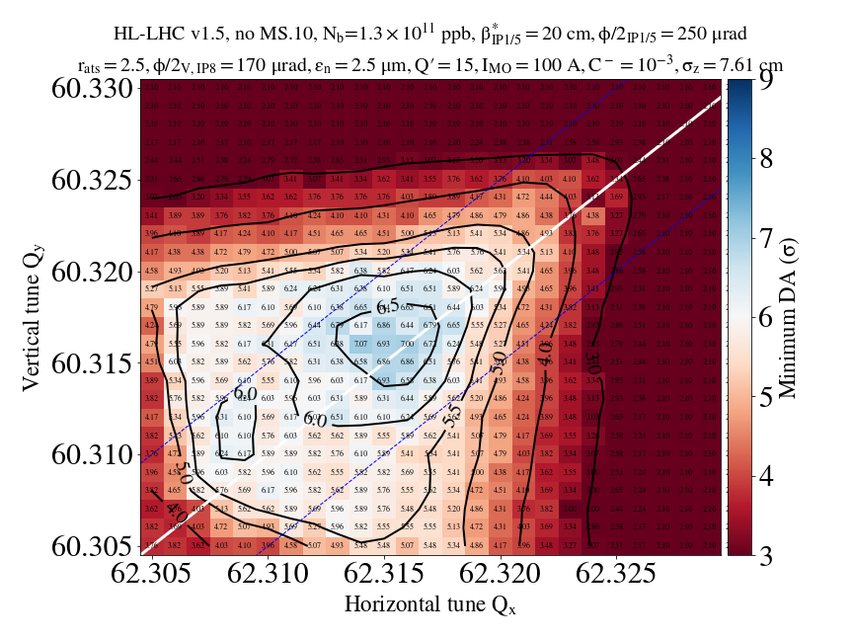
End of β*-leveling
9 cm
on_disp=1
7.61 cm
→ Mild sensitivity of DA on bunch length
7

Slide 8
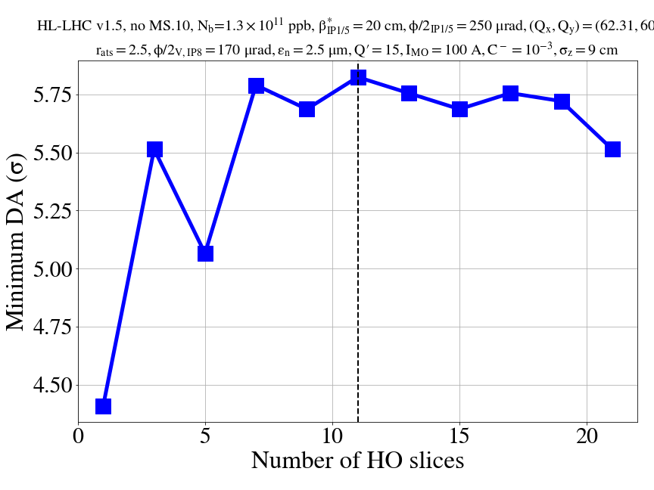
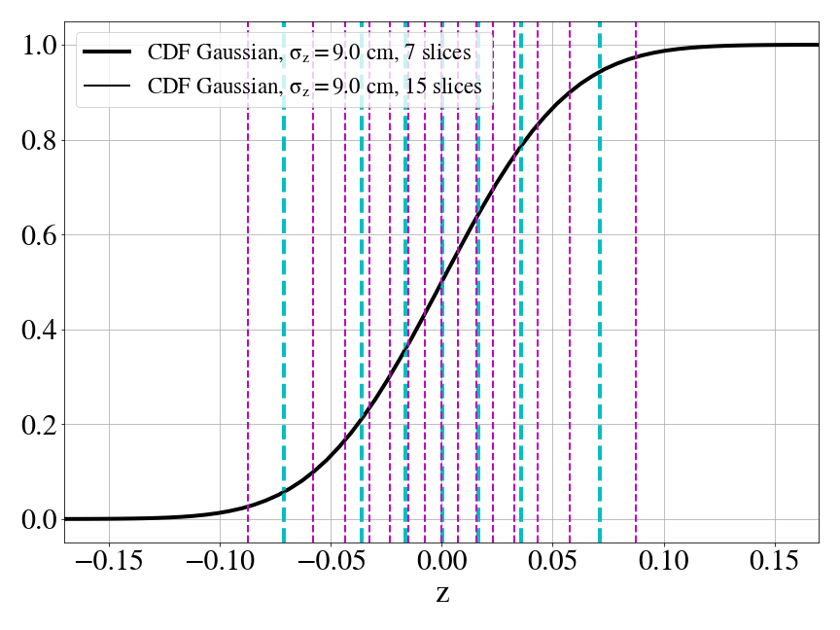
Impact of distribution type
on HO BB slicing
Step 1: Sensitivity to HO BB slicing
Gaussian distribution
DA convergence as a function of number of HO BB slices
Example of 7 & 15 slices
DA converges when HO BB slices ≥ 7, but in general mild sensitivity of DA on HO BB slicing (for ≥ 3)
8

Slide 9
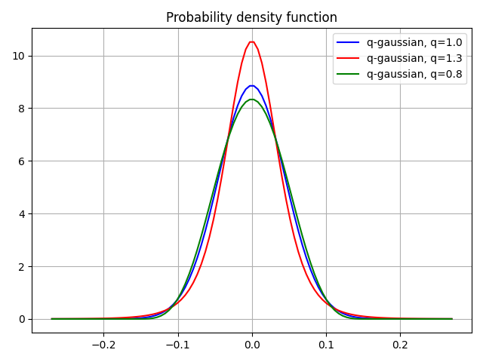
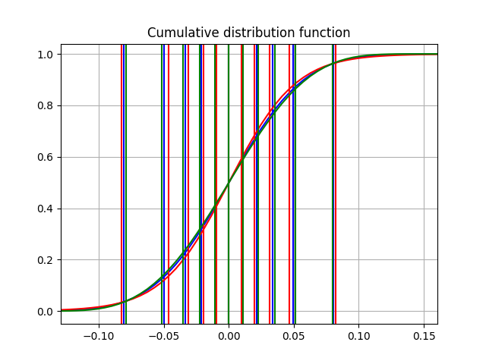
Impact of distribution type
on HO BB slicing
Step 2: Comparison of HO BB slicing for Gaussian & q-Gaussian for fixed number of slices (11)
HO slicing for different distribution PDFs: https://codimd.web.cern.ch/6-C3KN88TsaIFU5qeQWwmA
Gaussian
Heavy-tails
Light-tails
Despite PDF differences, CDF is much less sensitive to tails→Small longitudinal displacement of slices w.r.t Gaussian.
Due to mild sensitivity of DA on position/number of HO BB slices, this small displacement not expected to have an impact on DA.
9

Slide 10
Summary
In terms of DA studies, bunch length mainly impacts:
  Separation in IP8 during luminosity leveling.
  Longitudinal position of head-on beam-beam slices.
A comparison of the tunescans with 9 cm & 7.61 cm yields (with ct intensity):
          Very mild deterioration for smaller bunch length.
          Conclusions remain the same for SOL (need for IP1-5 phase advance optimization for BCMS beams and I_{oct}=460 A ) & EOL (DA target is comfortably reached) considering both 9 & 7.61 cm.
10

Slide 11
Summary
Impact of tails on DA:
          HO BB slicing:
            Convergence study for DA & number of HO slices in Gaussian distribution: No significant DA change depending on number and thus, longitudinal position of HO BB slices.
            For fixed number of HO slices (11), small longitudinal displacement of HO BB lenses between Gaussian, heavy-tailed & light-tailed q-Gaussian.
          IP8 lumi leveling:
            Separation in IP8 will change based on distribution density, however mild impact of IP8 on DA for HL-LHC.
          Conclusion: DA is not expected to be significantly sensitive to the tails of the distribution.
11

Slide 12
Backup
12

Slide 13
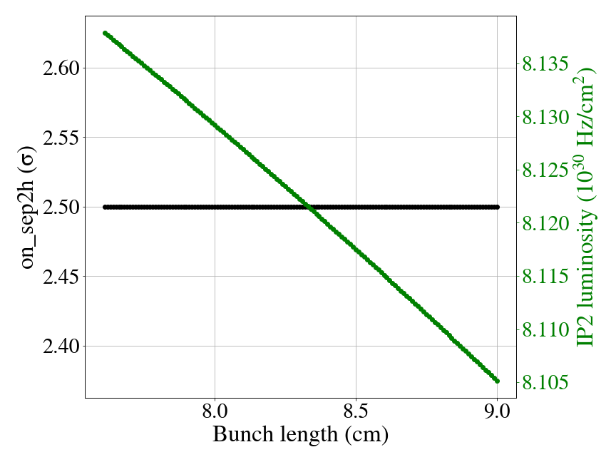
Motivation
Bunch length mainly impacts:
  Transverse: Luminosity leveling in IP8/IP2.
13

