Slide 1

Crab cavity impedances & RFD HOM Measurements
On behalf of SY-RF-AC and HL-LHC WP4

Slide 2
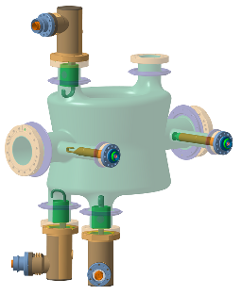
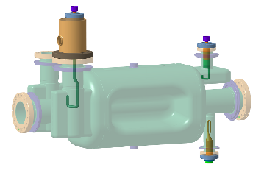
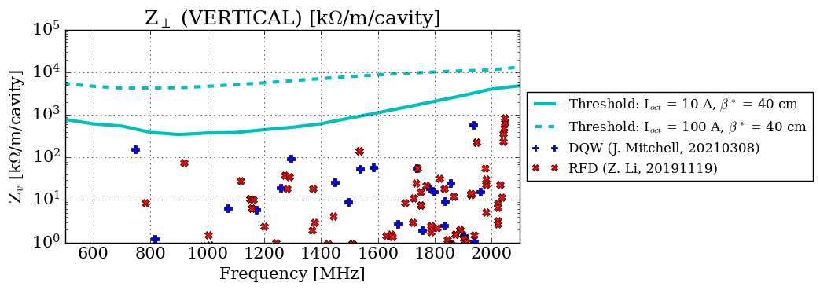
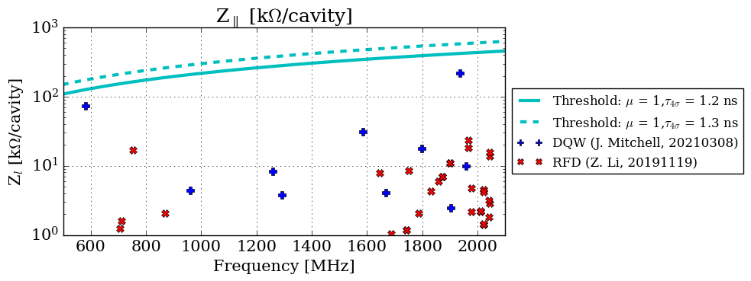
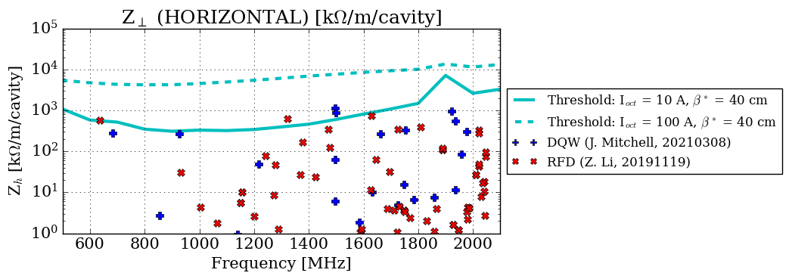
Impedance spectra
DQW RFD
EDMS 2488213

Slide 3
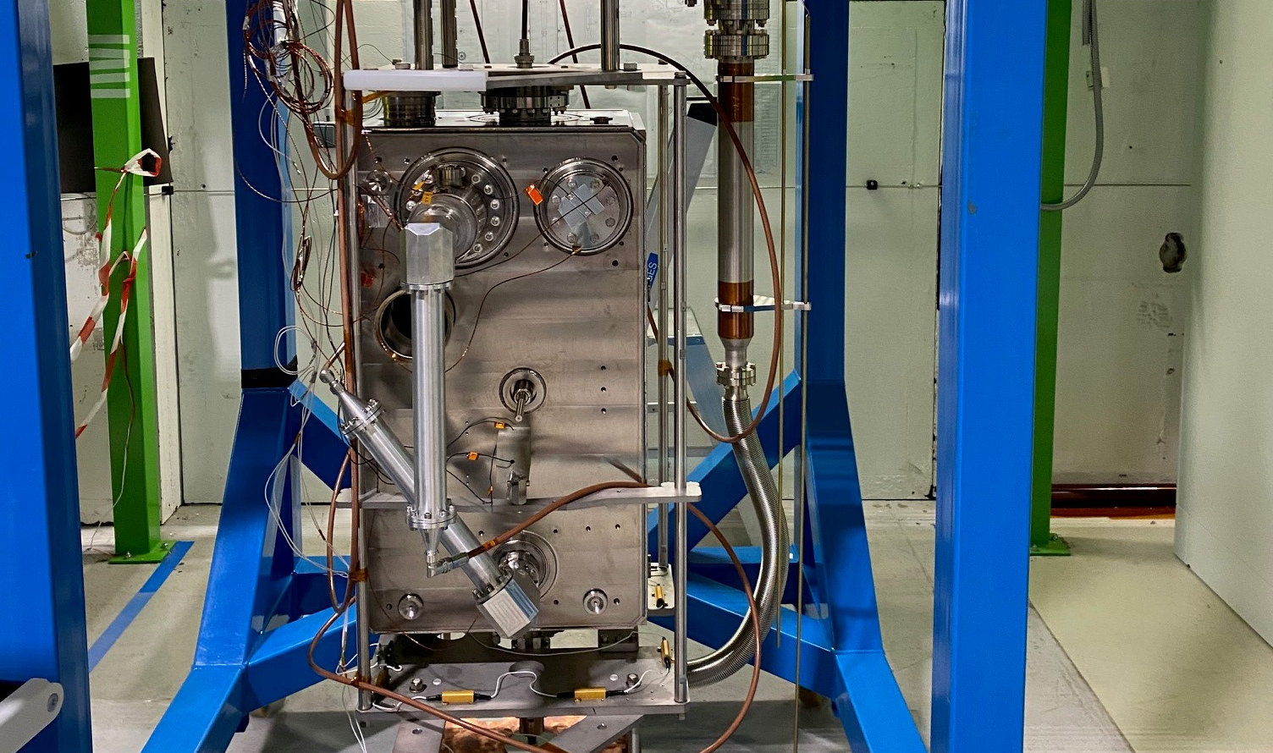
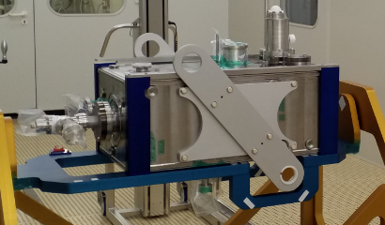
RFD HOM Measurements
RFD 001
RFD 002

Slide 4
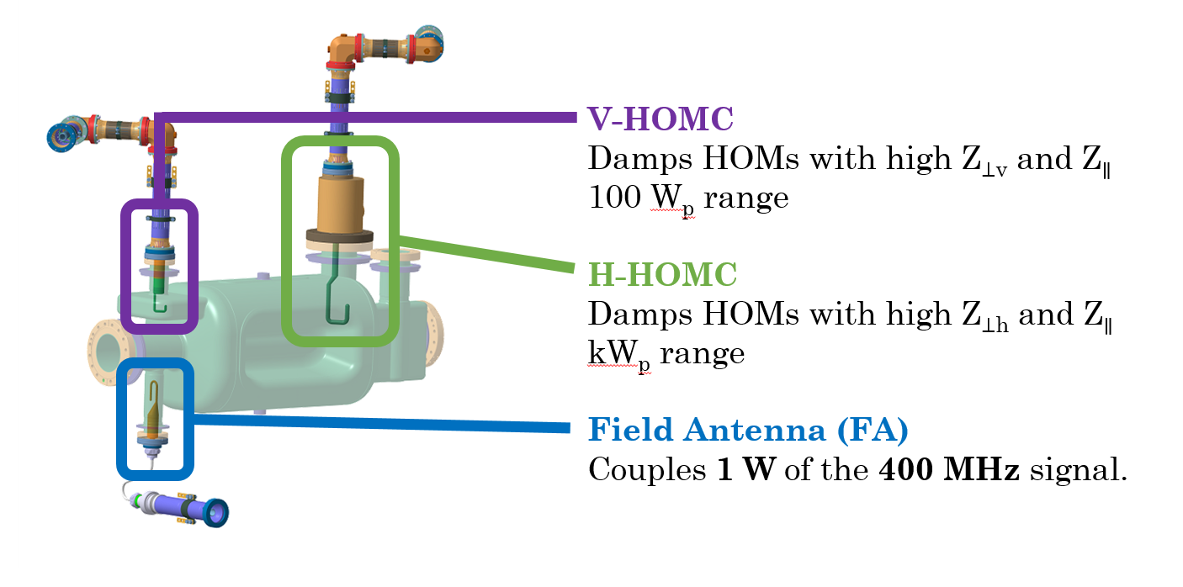
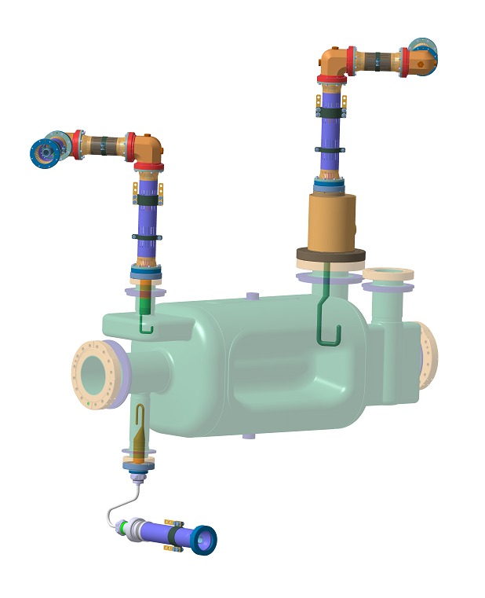
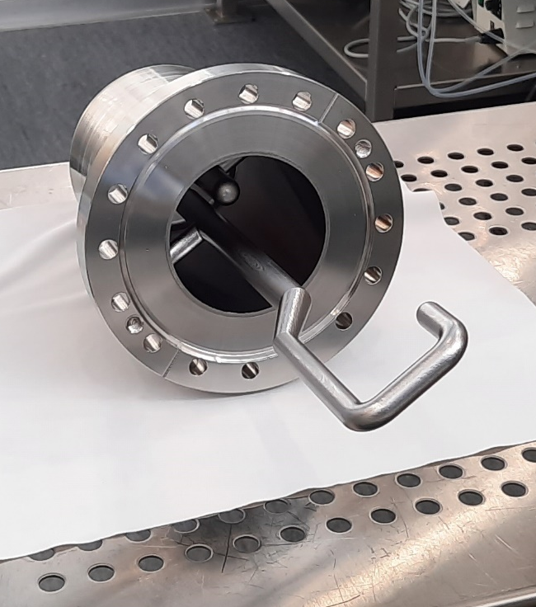
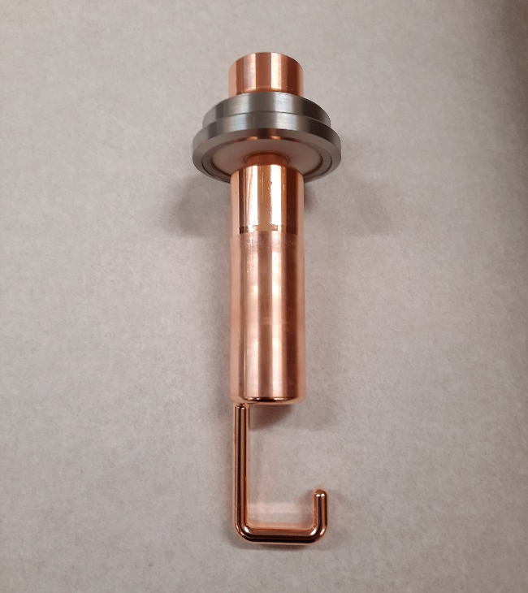
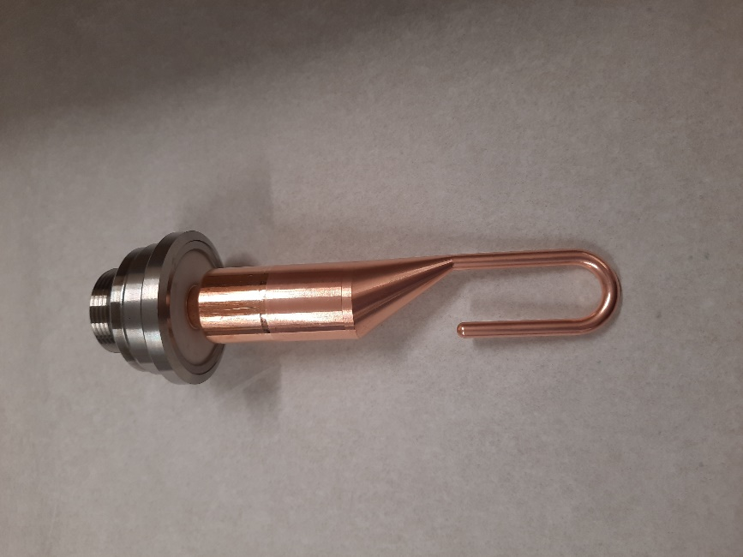
RFD HOM couplers
V-HOMC
Damps HOMs with high Z_{⊥v} and Z∥
100 W_{p} range
H-HOMC
Damps HOMs with high Z_{⊥h} and Z∥
kW_{p} range
Field Antenna (FA)
Couples 1 W of the 400 MHz signal.
H-HOMC
V-HOMC
FA
… with huge thanks to our colleagues in EN-MME!

Slide 5
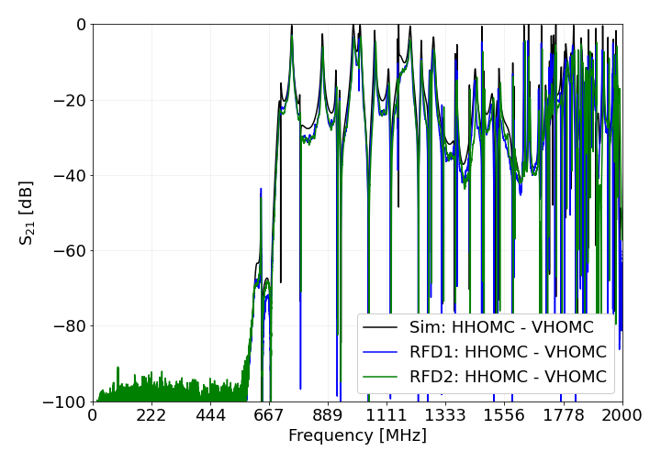
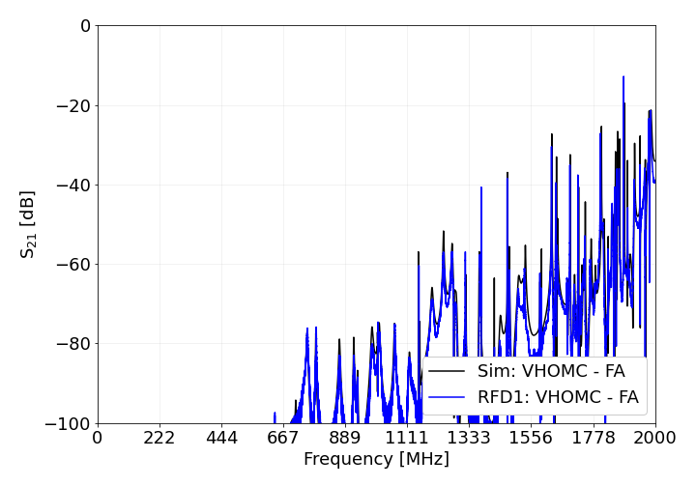
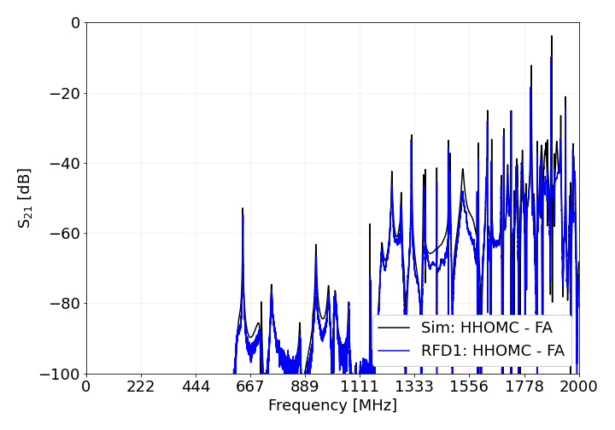
Transmission measurements
EDMS 260982 / 2488318
S₂₁ measurements taken between the ancillaries. Agrees very well with simulations!
No measurements with Field Antenna for RFD #2 [1].

Slide 6
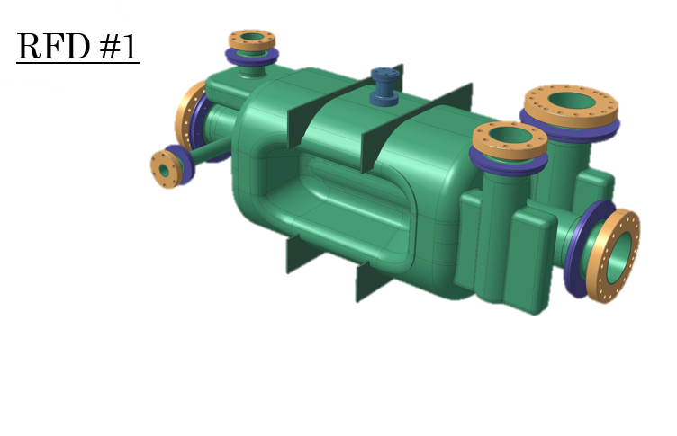
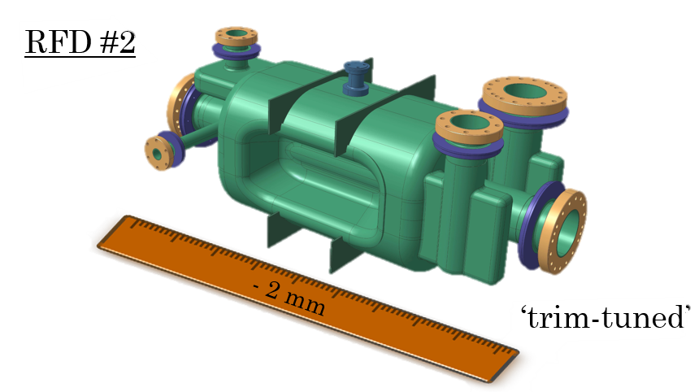
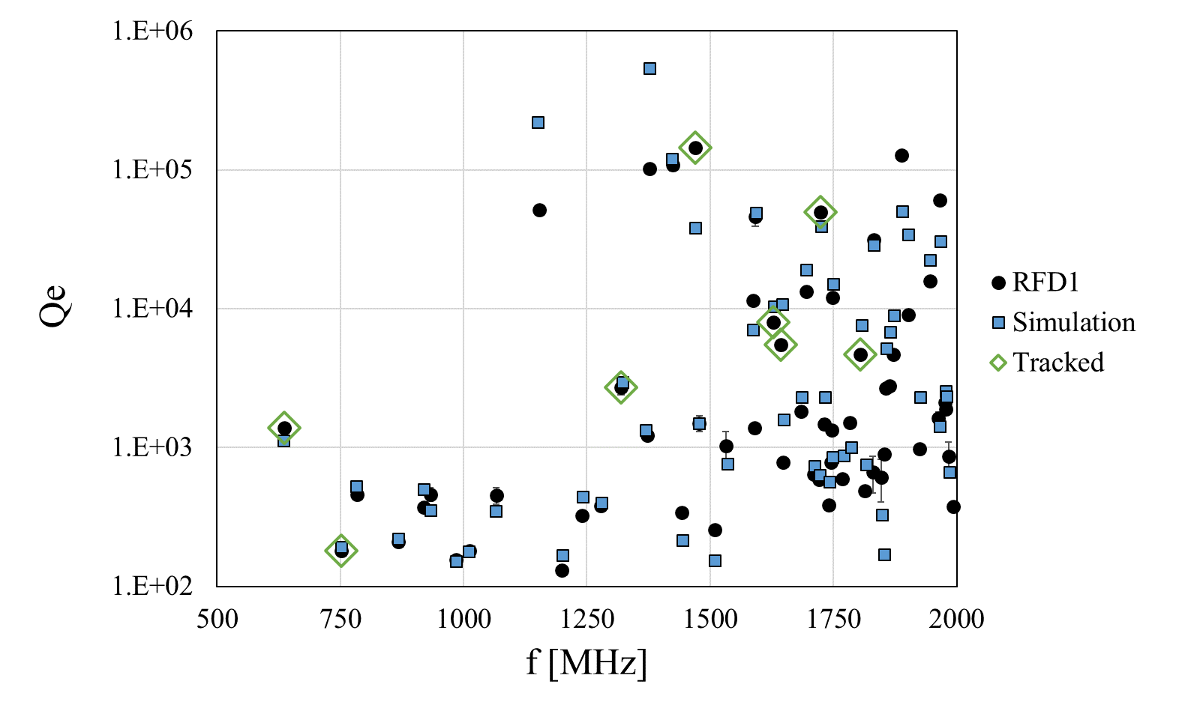
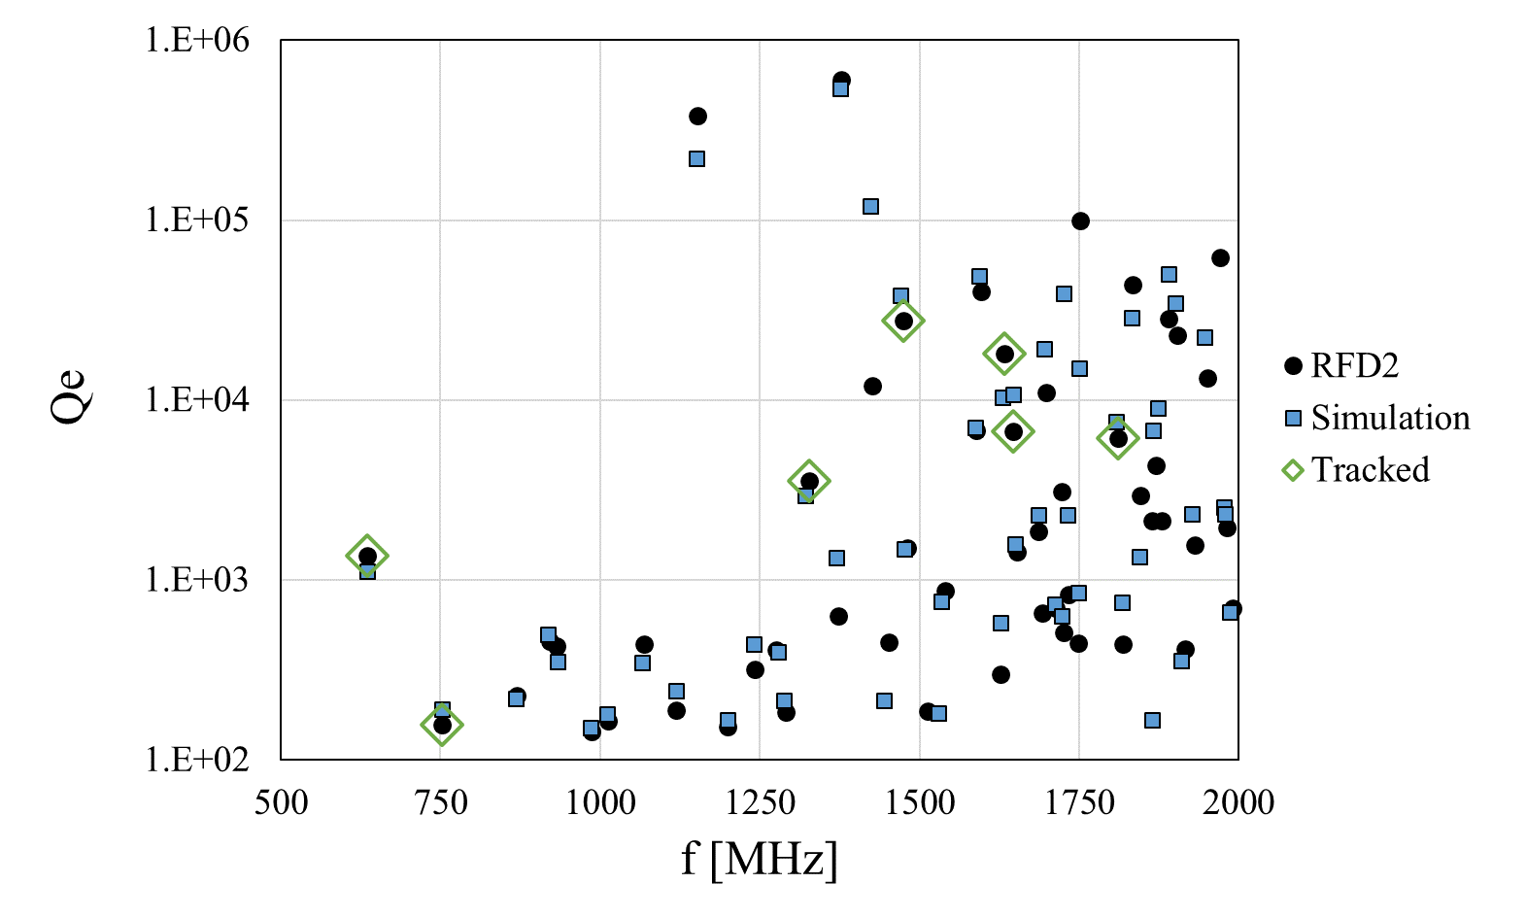
HOM measurements
EDMS 260982 / 2488318

Slide 7
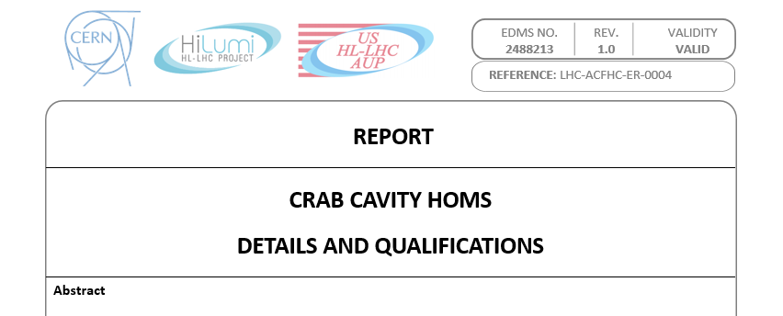
Acceptance criteria (concerning WP2)
Crab Cavity HOMs: Details and Qualifications
Measure modes over 10 A line – transmit information to WP2
Report high power mode characteristics to WP2 if outside range

Slide 8

HOM measurements: Mode over I_{oct} = 10 A
Mode over 10 A threshold: 1322 MHz
RFD1 Q_{e}: −10 % wrt simulated value
RFD2 Q_{e}: +20 % wrt simulated value

Slide 9
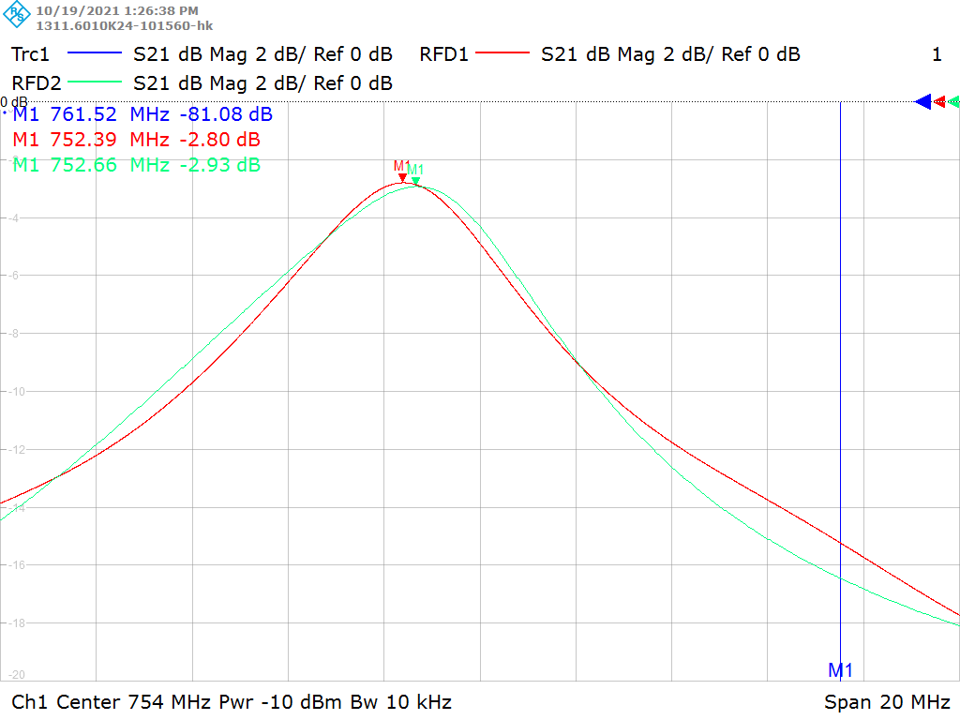
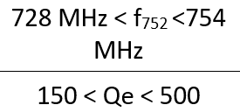
HOM measurements: High power mode
… ✓ Inside range!
19th bunch spacing harmonic = 761.52 MHz
EDMS 2488213

Slide 10
Conclusions
RFD an DQW impedance spectra
SPS RFD HOM measurements presented to fulfil acceptance criteria.
f vs Q
Mode over threshold
High power mode: within specs!

Slide 11
Questions from our side
Could you evaluate the HOM power estimation with SPS beam as a function of frequency (second opinion)? – this impacts the RF connectors we will use.

Slide 12
Back-up slides

Slide 13
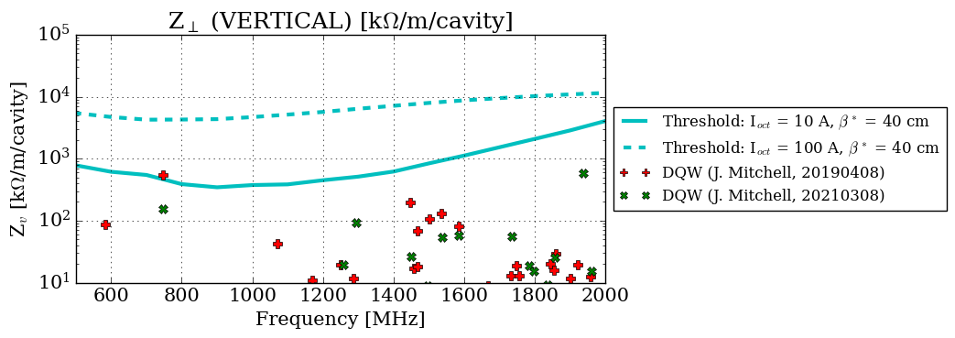
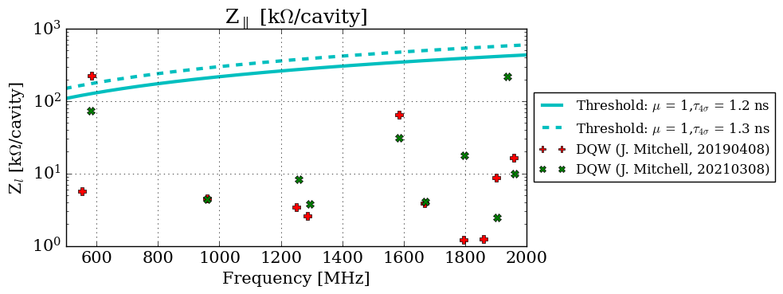
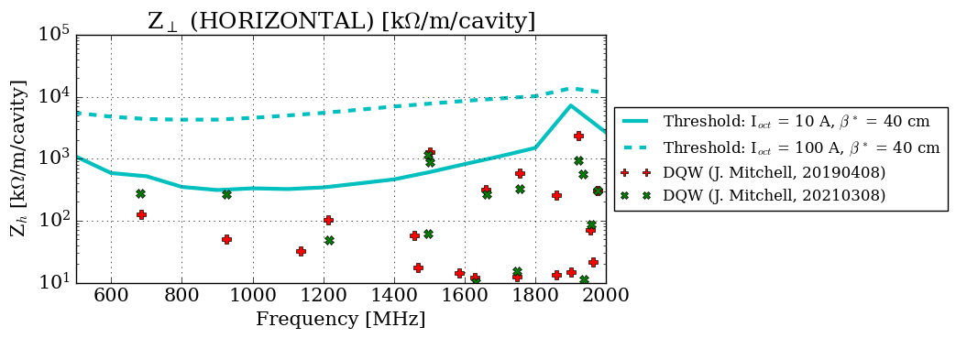
DQW Impedance Spectra Evolution

