Slide 1

Addendum to WISArD proposal
Ph. Alfaurt, P. Ascher, D. Atanasov, B. Blank,
F. Cresto, L. Daudin, X. Fléchard, A. Garcia, M. Gerbaux,
J. Giovinazzo, S. Grévy, J. Ha, T. Kurtukian-Nieto, E. Liénard,
D. Melconian, M. Nasser, M. Pomorski,
M. Roche, N. Severijns, S. Vanlangendonck,
M. Versteegen, D. Zakoucky
CEN Bordeaux-Gradignan, LPC Caen, ISOLDE/CERN,
KU Leuven, NPI Rez, Texas A&M, U. Washington
Request: 10 shifts to complete beam time

Slide 2
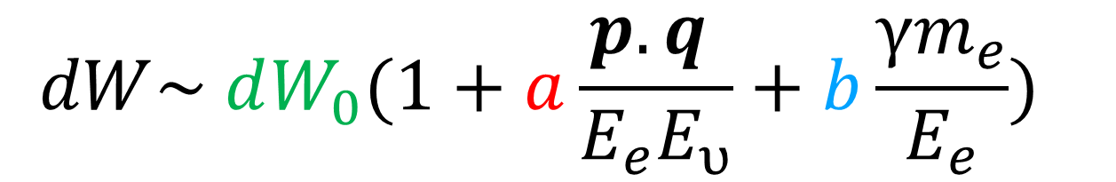


• • • Beta-decay observables
beta-neutrino
angular correlation
coefficient
Fierz
interference
term
phase-space
factor
Pure Fermi transitions Correlation Parameters
SM: Vector current
Preferred emission angle: θ = 0°
Maximum recoil energy

Slide 3
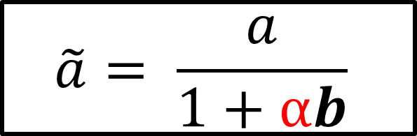
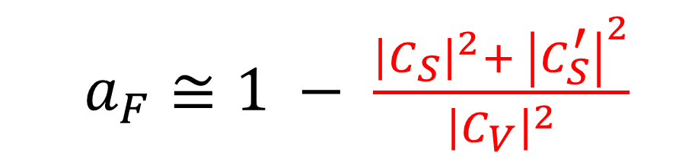
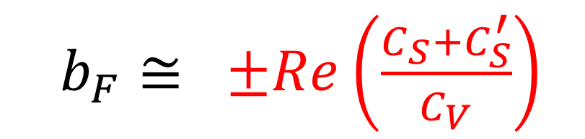
• • • Beta-decay observables
Sensitivity to NP
beta-neutrino
angular correlation
coefficient
Fierz
interference
term
phase-space
factor
Pure Fermi transitions Correlation Parameters
SM: Vector current
Preferred emission angle: θ = 0°
Maximum recoil energy
NP: Scalar current
Preferred emission angle: θ = 180°
Minimum recoil energy

Slide 4
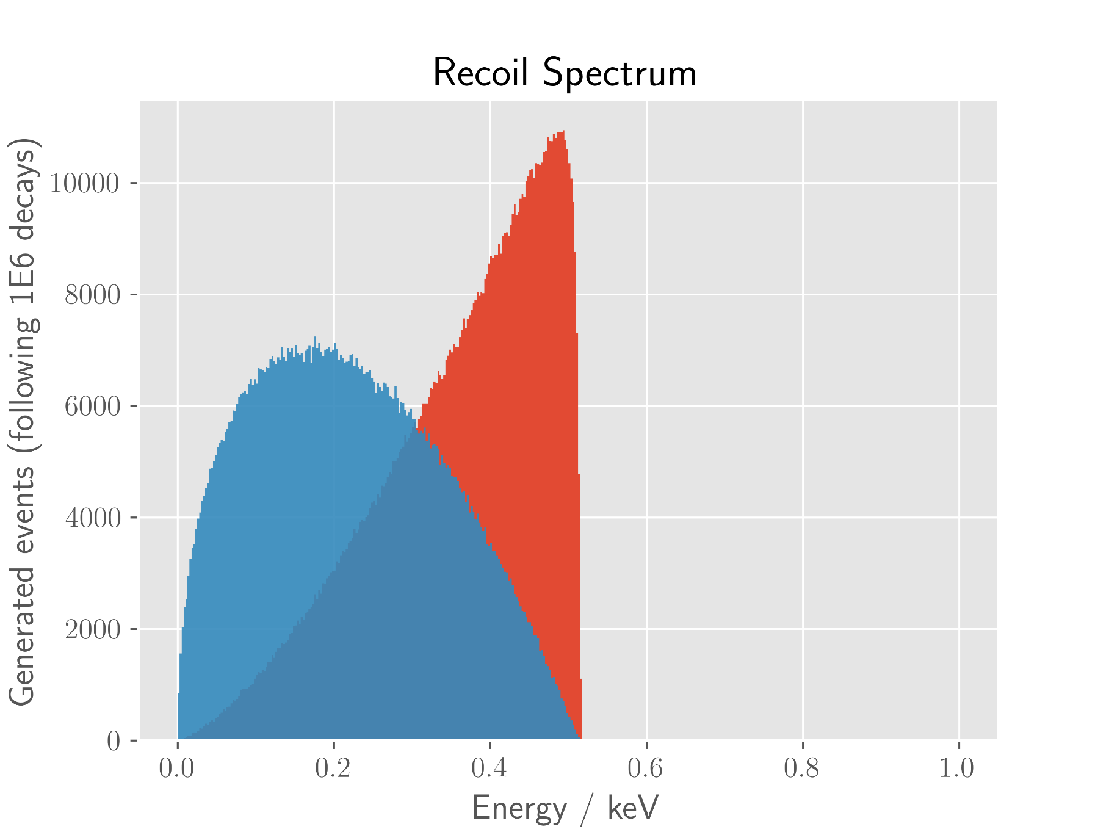
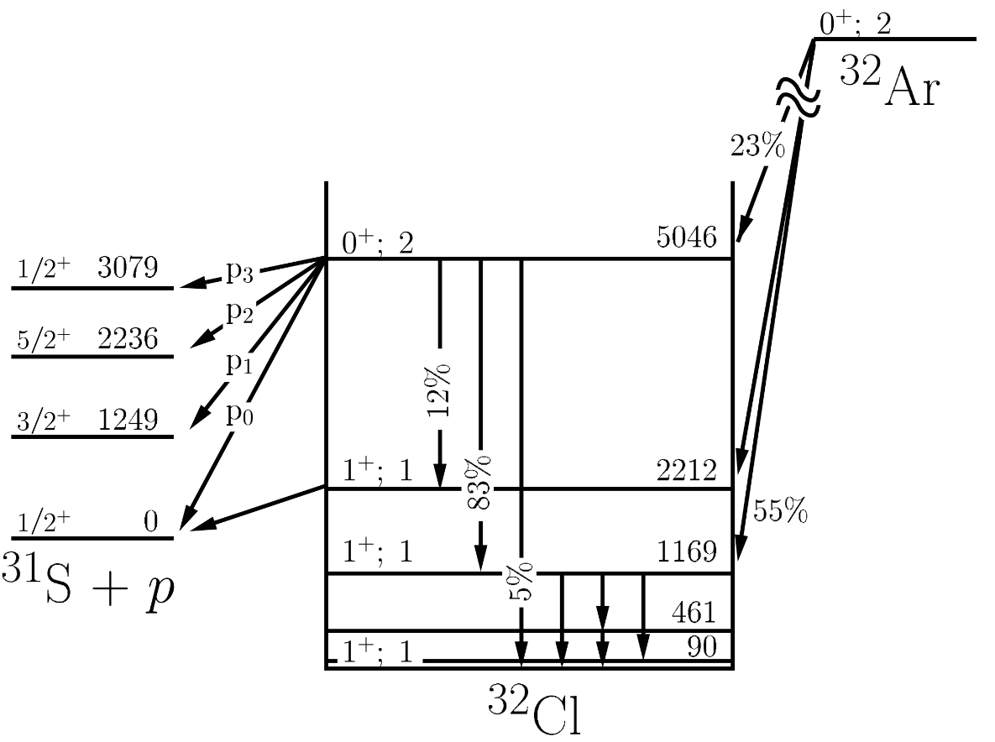
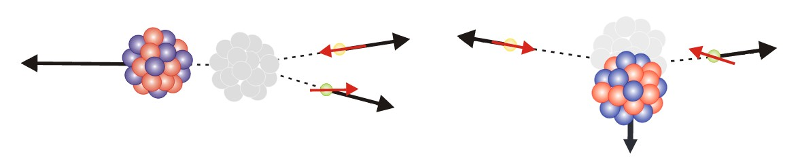
• • • Recoil determination for ³²Ar → ³²Cl
³²Ar decays by β-decay to ³²Cl
Recoil energy ~ hundreds eV
Scalar
Vector

Slide 5
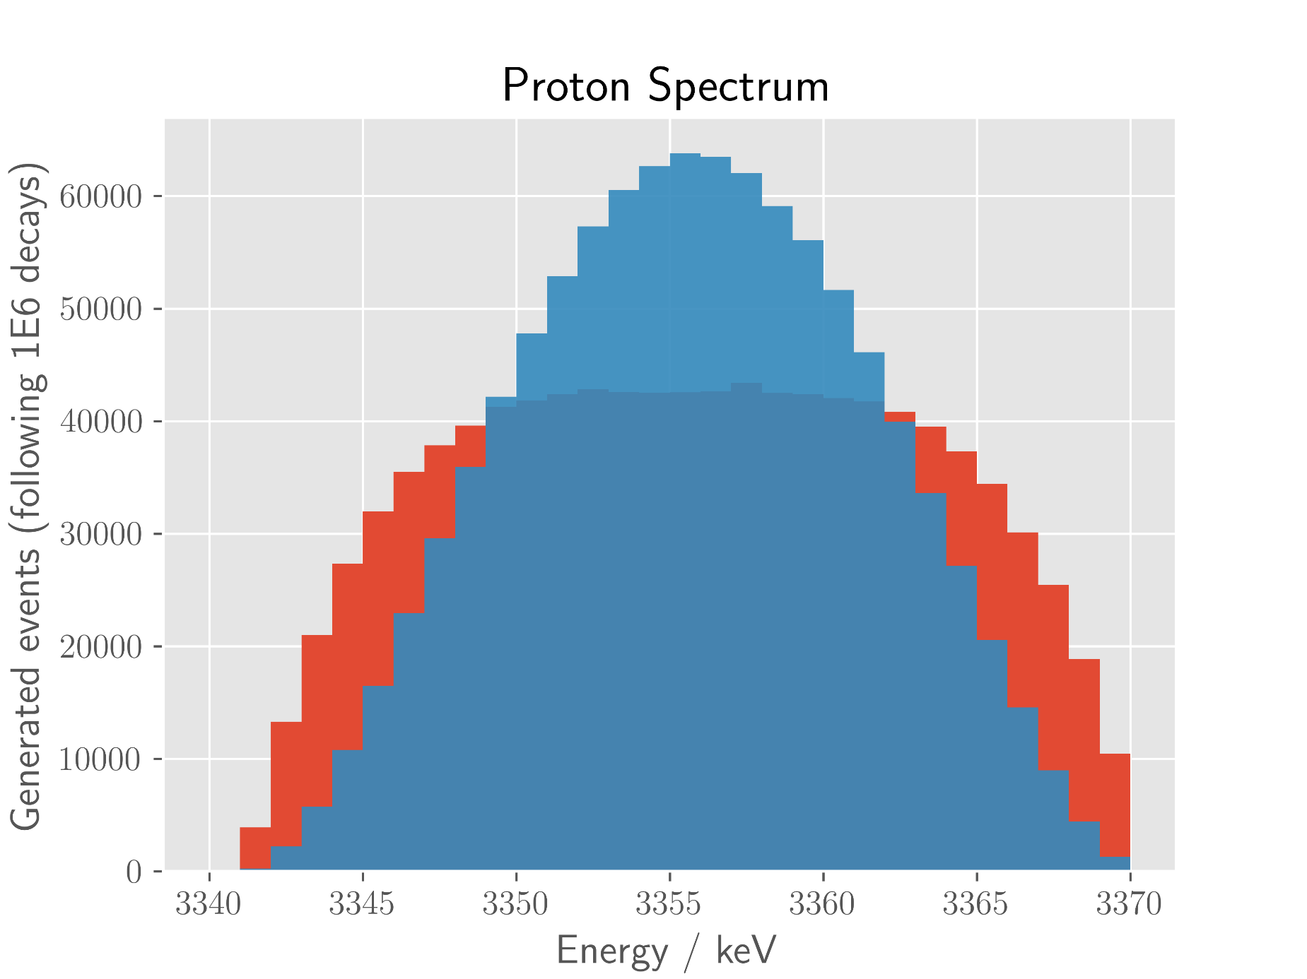
• • • Kinematic broadening: ³²Ar → ³²S → ³¹S + p
³²Ar decays by β-decay to ³²Cl which subsequently decays by proton emission to ³¹S
Recoil energy ~ hundreds eV
Protons energies ~ several MeV
The energy of the emitted protons is subject to kinematic shift due to the recoiling daughter nucleus
Scalar
Vector

Slide 6
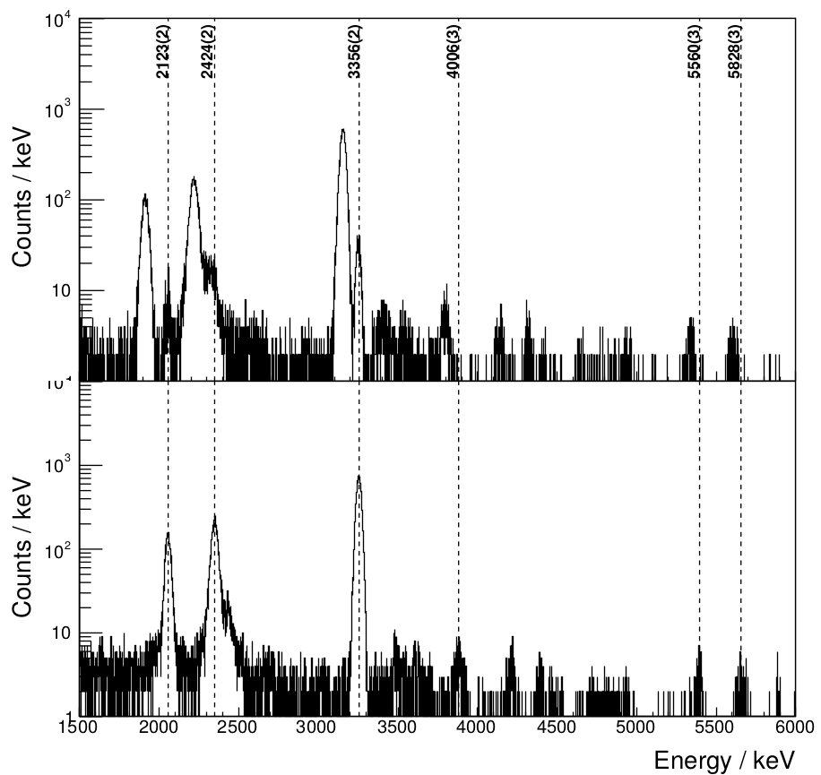
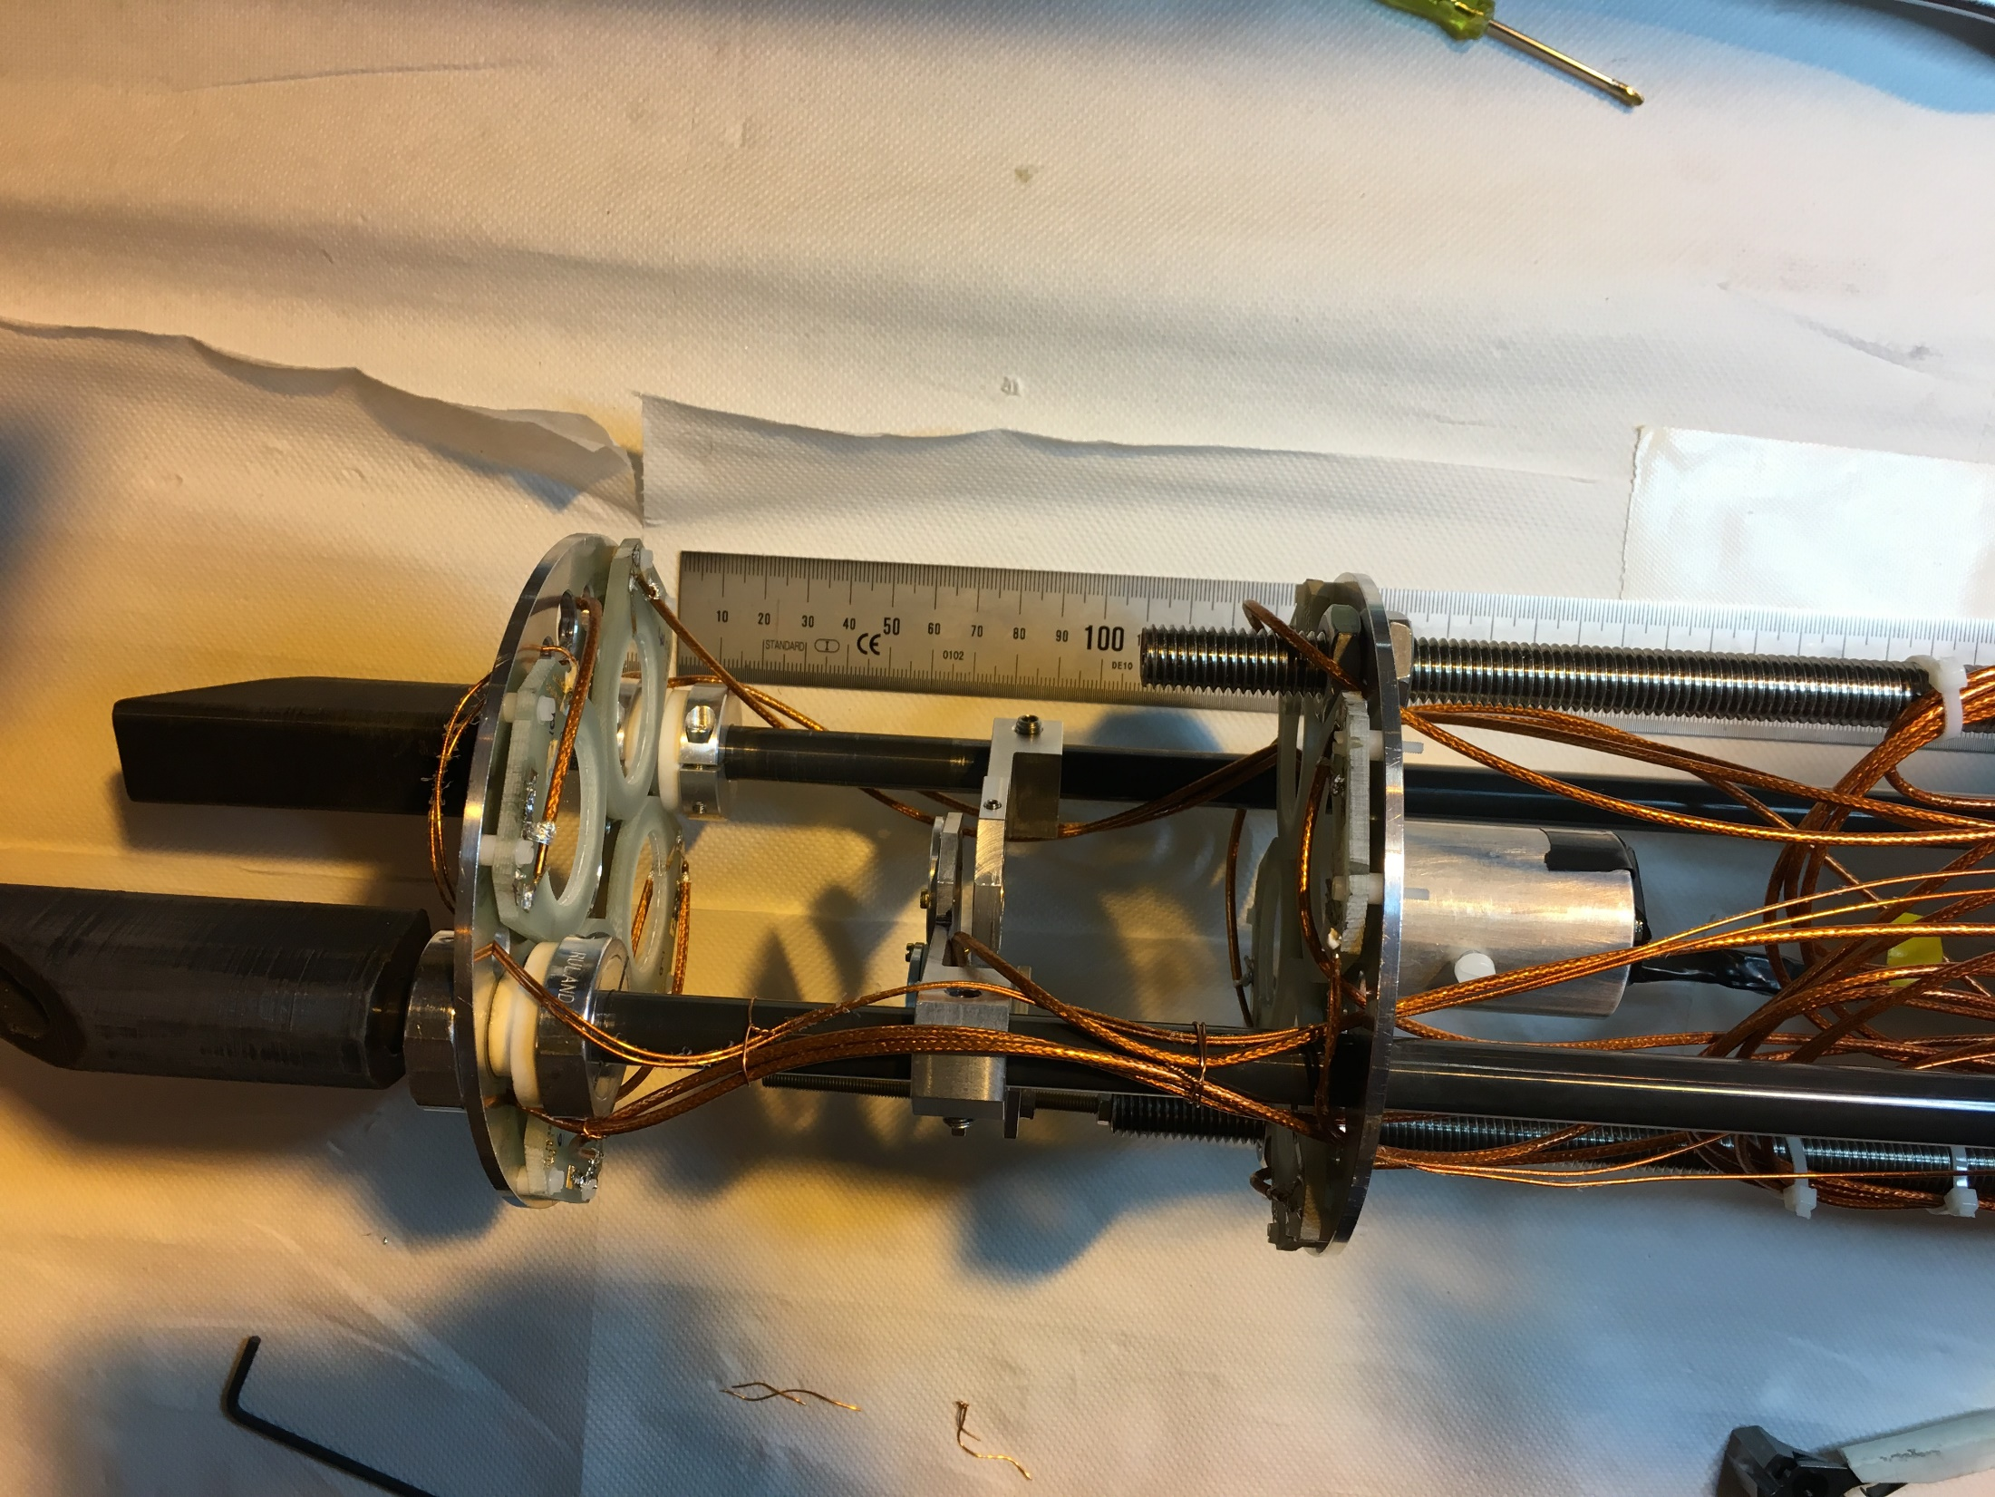
• • • WISArD 2018: ³²Ar → ³²S → ³¹S + p
Proof of Principle:
detection setup
in 4T magnet
Upper detectors
Beta detector
+
SiPM
proton
detectors
planes
Catcher
Lower detectors
³²Ar

Slide 7
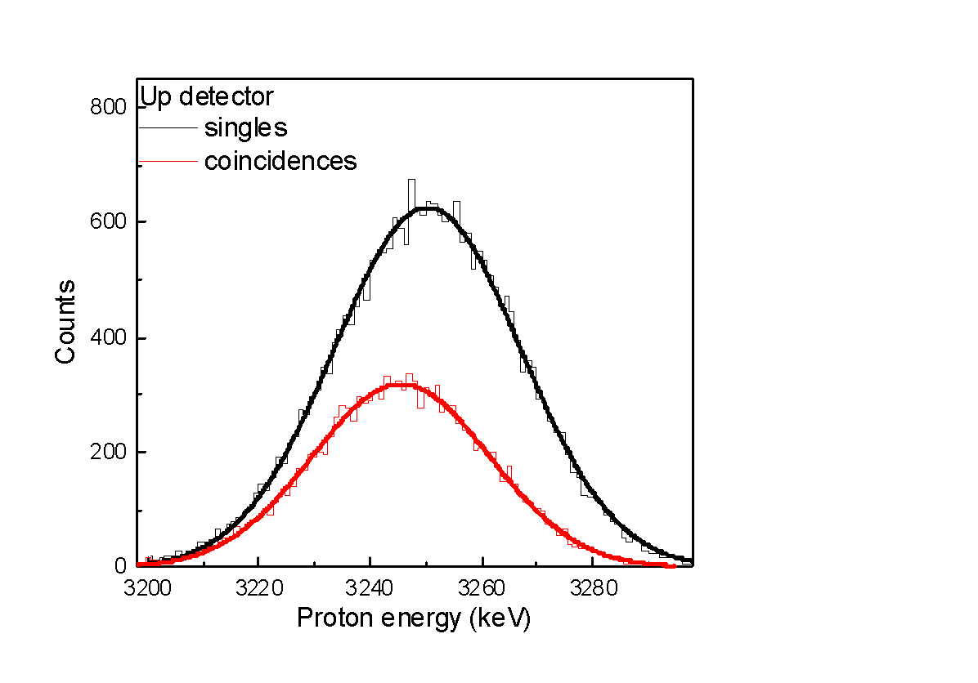
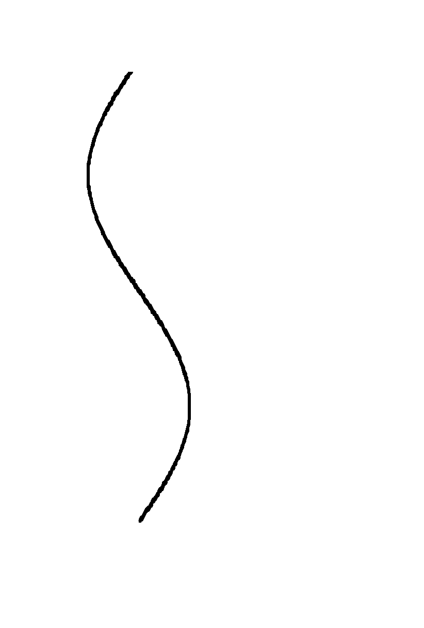
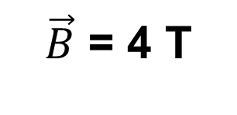
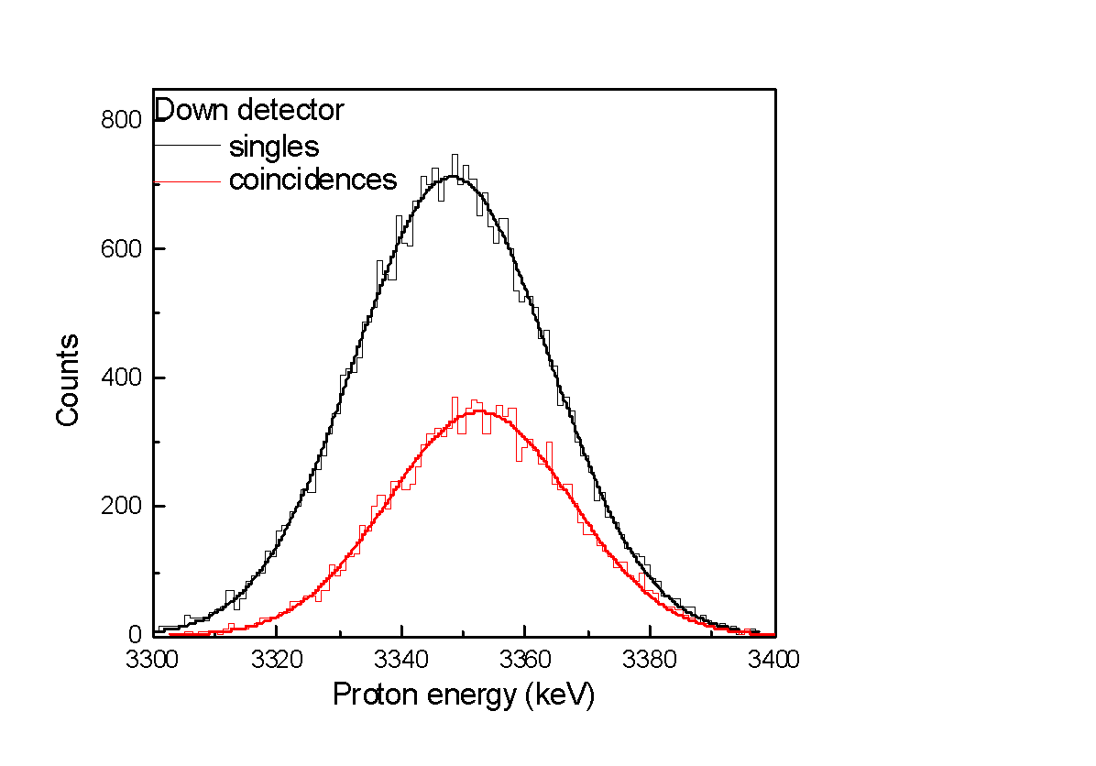
• • • WISArD 2018: ³²Ar → ³²S → ³¹S + p
p
Scintillator
Si1U
Si2U
p
β⁺
Catcher
p’
p’
³²Ar⁺
Si1D
Si2D

Slide 8
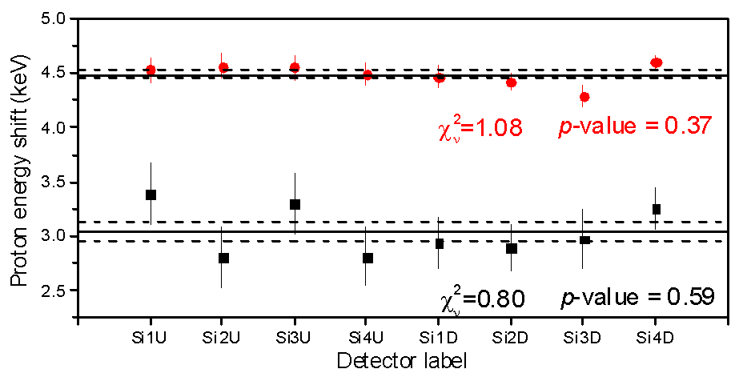
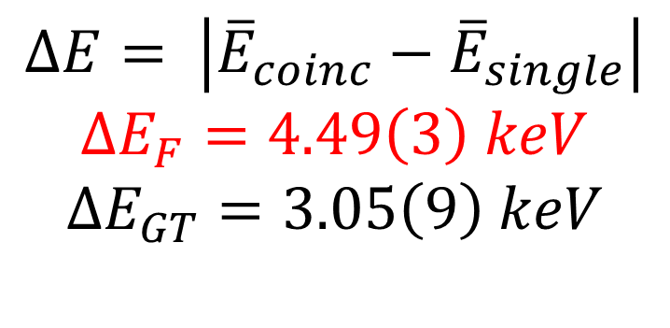
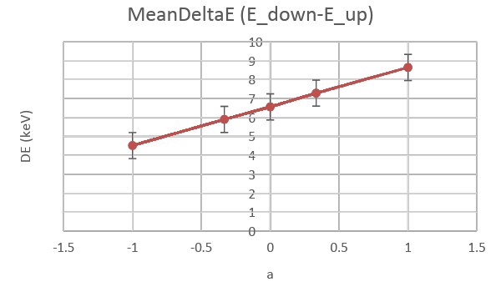
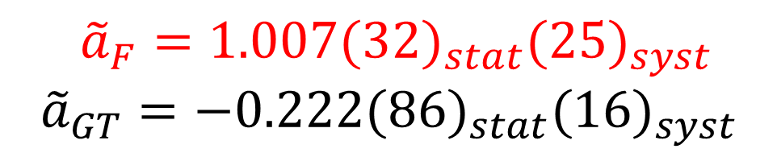
• • • WISArD 2018: ³²Ar → ³²S → ³¹S + p
Weighted average
energy shifts
Monte Carlo
simulations
Extracted modified
correlation β-υ

Slide 9
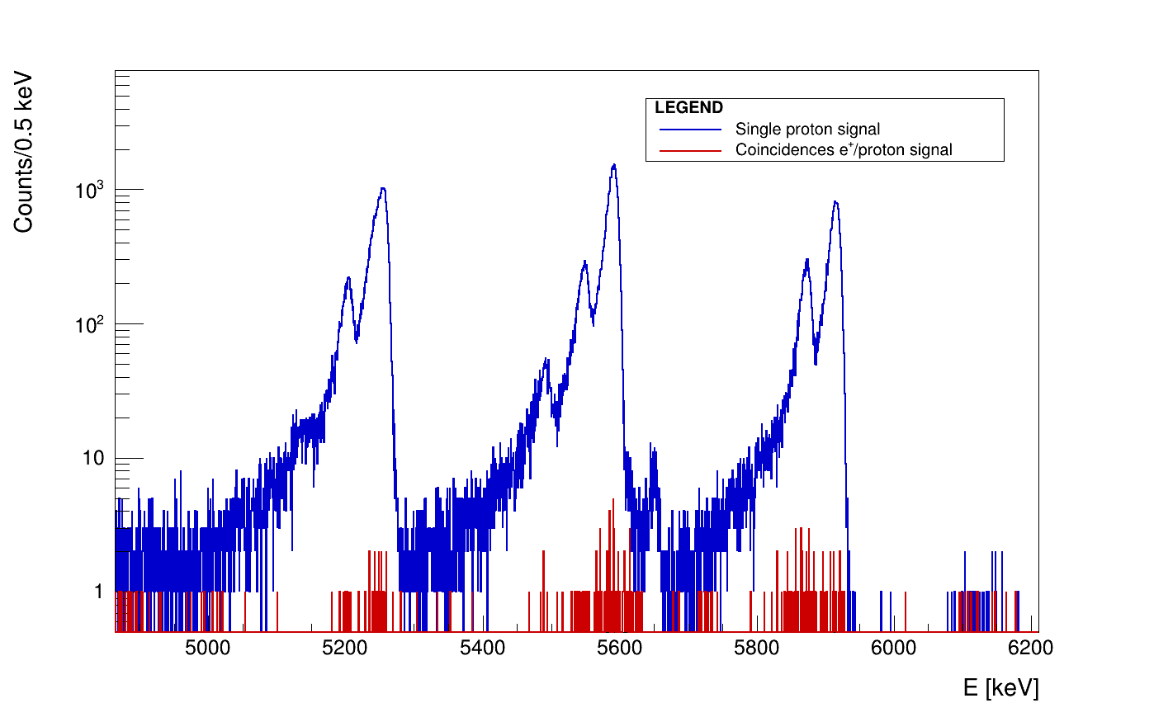
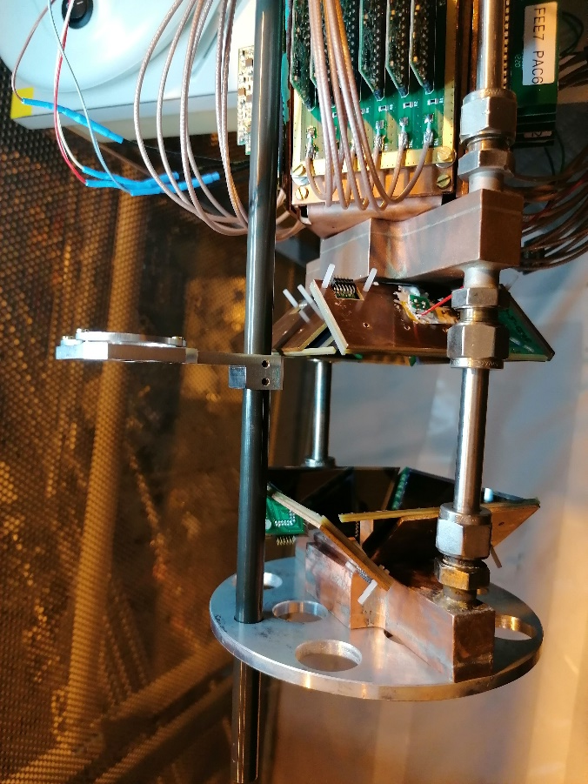
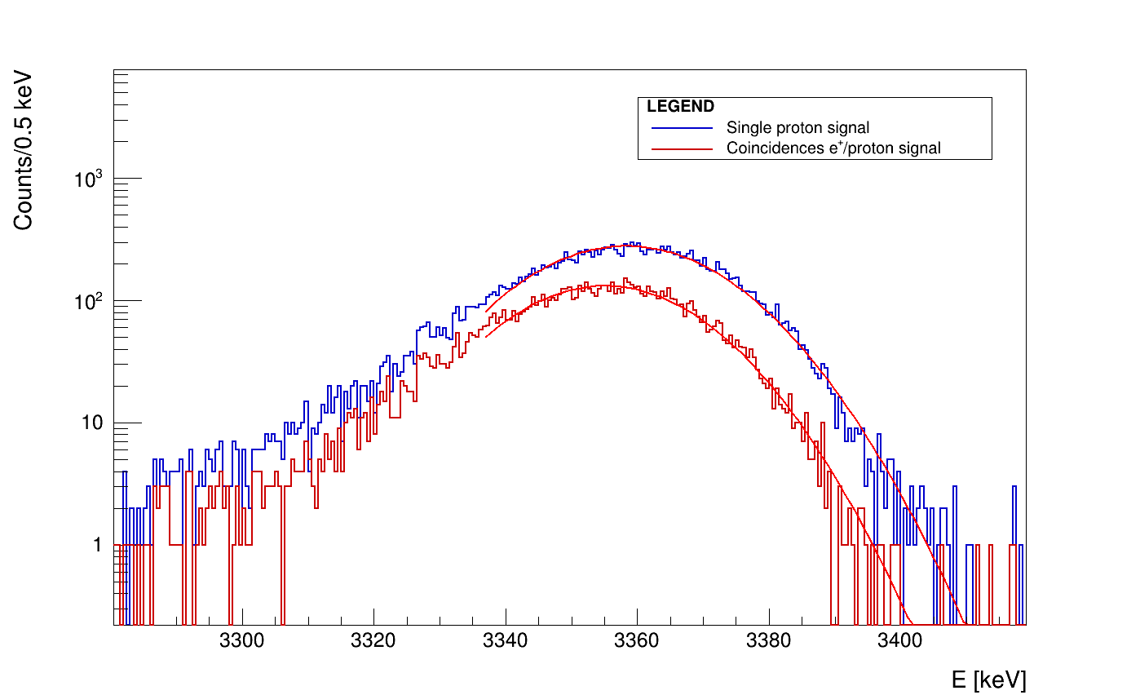
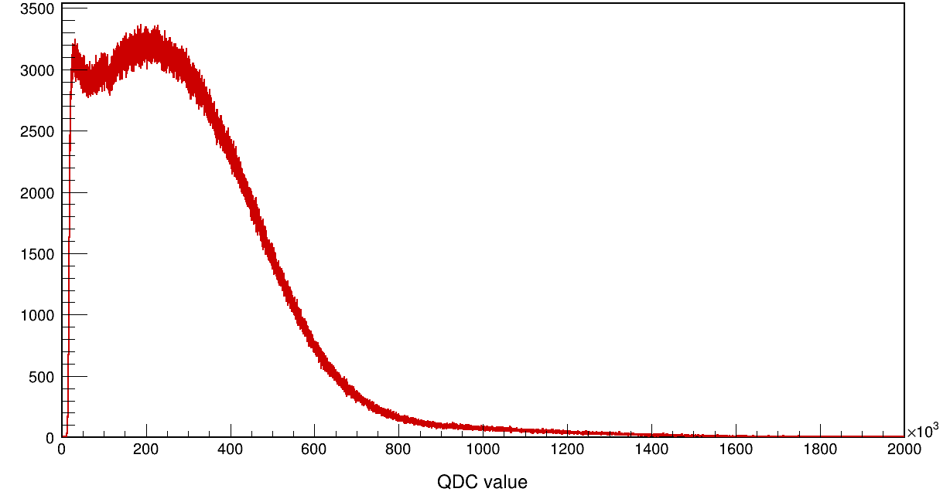
• • • WISArD 2021: ³²Ar → ³²S → ³¹S + p
triple-α source
triple-α source
Test: October 2021, 10 shifts
New detection setup:
new silicon
preamps
new beta detector
+
9 SiPM + preamps
³²Ar: IAS
new silicon strip proton
detectors
Shift: 3.25(25) keV
β spectrum
new MCP beam position detector
All equipment worked more or less… still upgrades

Slide 10
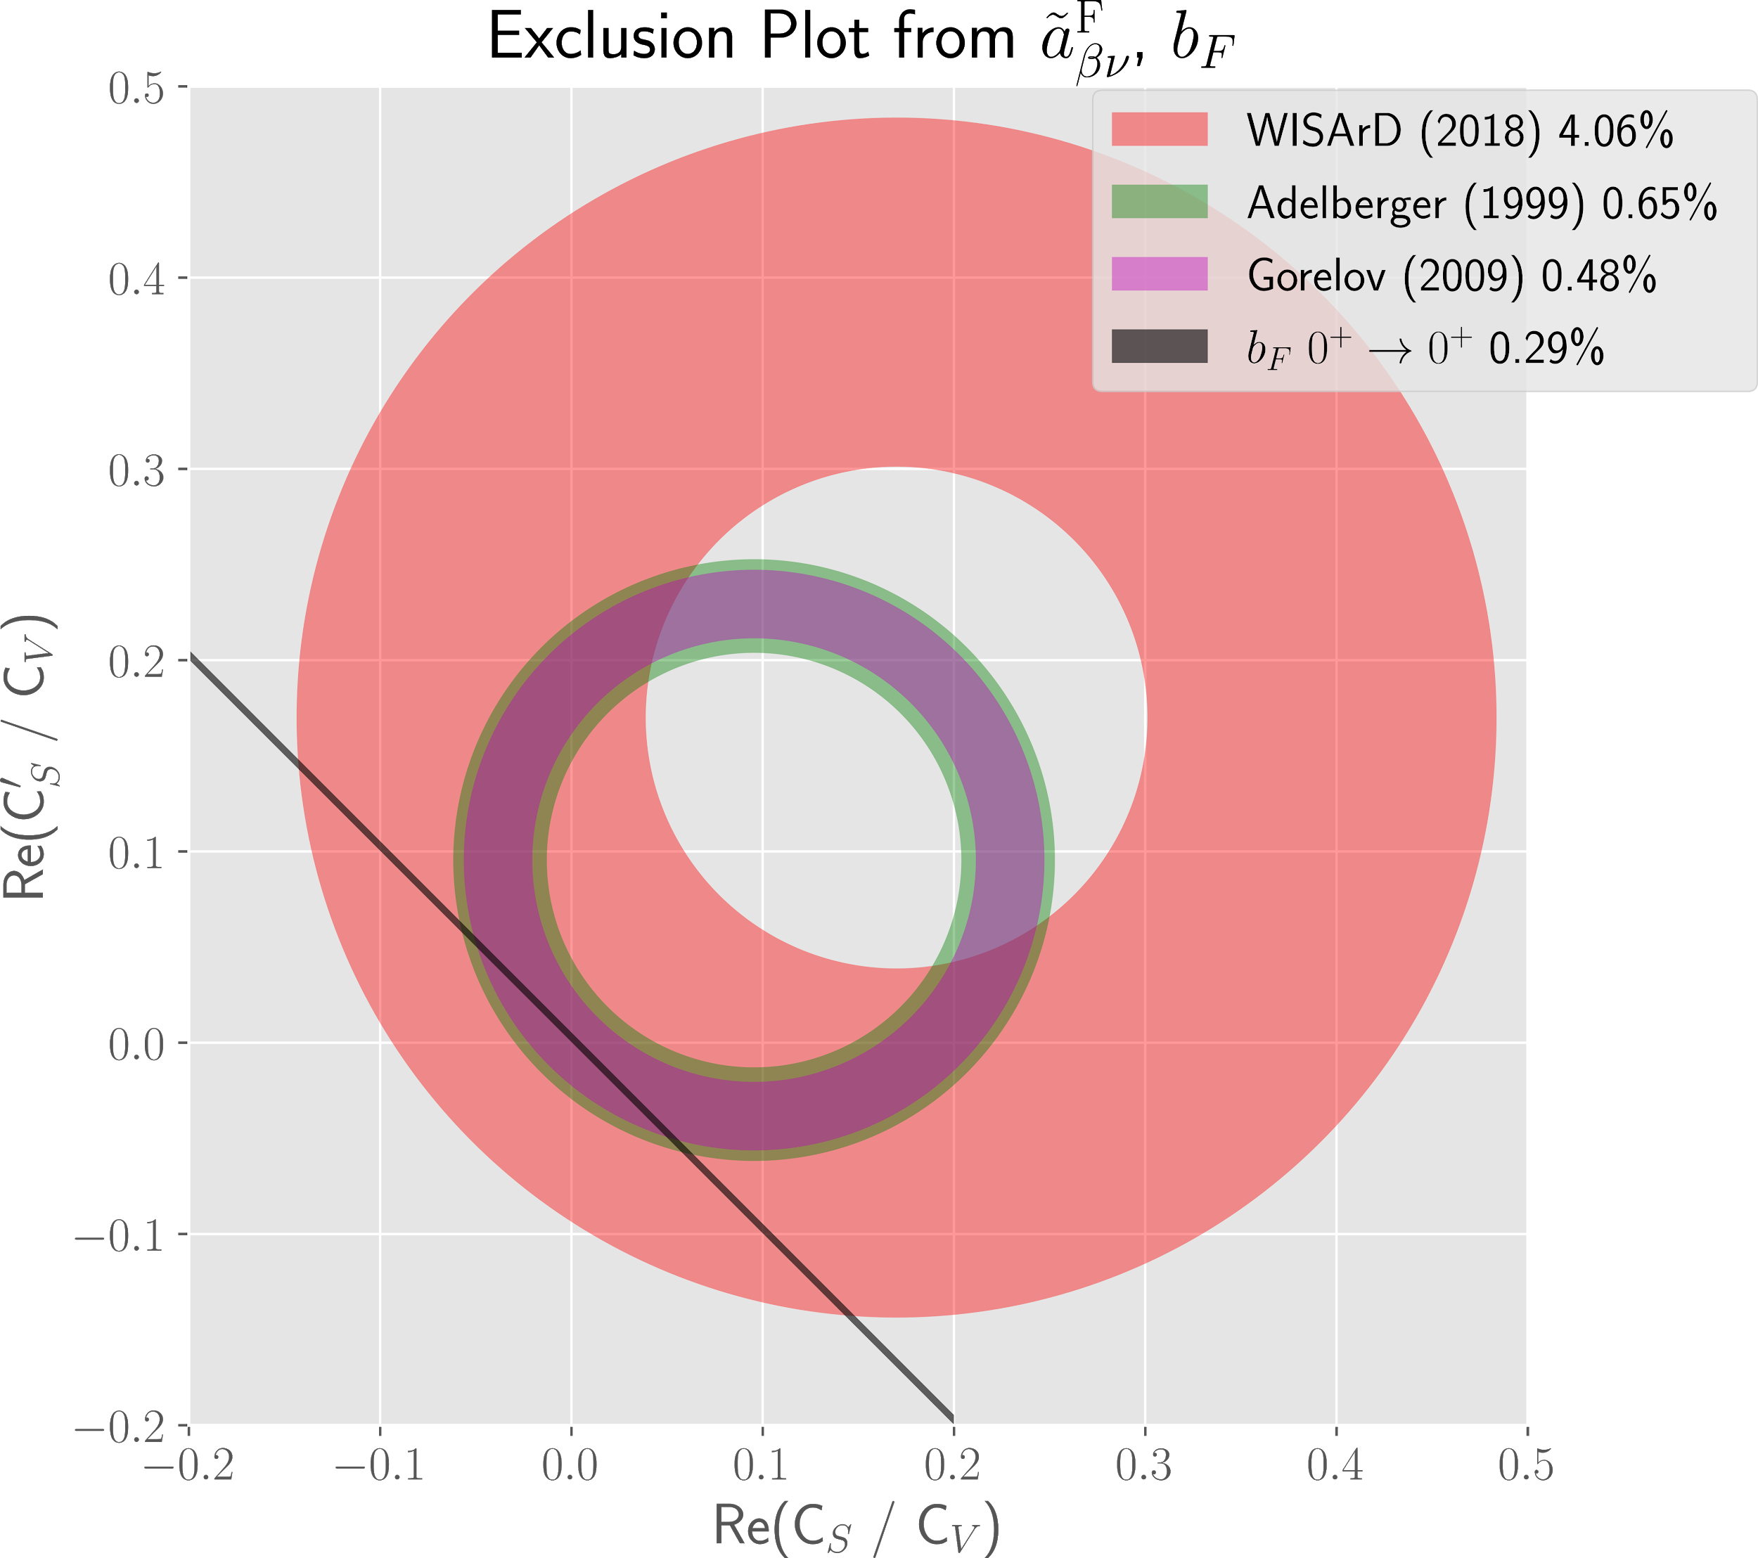
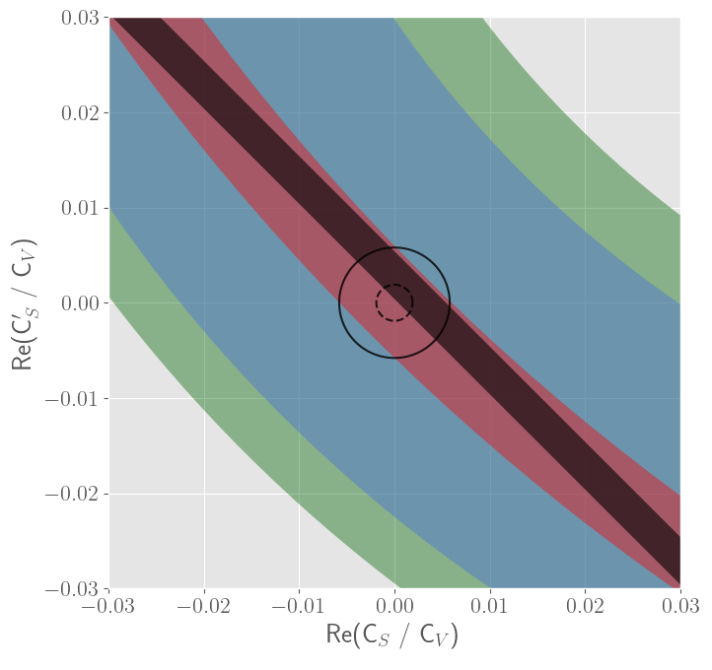
• • • Weak-interaction exclusion plots
10/2018: Proof-of-principle for WISArD
11/2020: INTC accepts proposal with 24 shifts
10/2021: WISArD test with 10 shifts
02/2022: Request of 10 shifts to complete beam time
2018 2022

