Slide 1

Single-particle behaviour towards doubly-magic ²⁴O - ²⁷Na(d,p)²⁸Na in inverse kinematics
D.K.Sharp¹, S.J.Freeman¹, S.A.Bennett¹, F.Browne², P.A.Butler³, W.N.Catford⁴, J.Chen⁵, D.Clarke¹,
L.P.Gaffney³, K.Garrett¹, C.R.Hoffman⁵, B.P.Kay⁵, Th.Kröll⁶, M.Labiche⁷, I.Lazarus⁷, R.Lubna⁸, P.T.MacGregor¹, B.Olaizola², R.D.Page²,R.Raabe⁹, S.Reeve¹, T.L.Tang¹⁰, and K.Wimmer¹¹
¹University of Manchester, ²CERN, ³University of Liverpool, ⁴University of Surrey, ⁵Argonne National Laboratory, ⁶Technische Universität Darmstadt, ⁷STFC Daresbury Laboratory, ⁸FRIB, ⁹KU Leuven, ¹⁰Florida State University, ¹¹GSI.
Requested shifts: 15 shifts
Beam: ²⁷Na at 10 MeV/u
Target: Deuterated polyethylene (CD₂)_{n}
Installation: ISOLDE Solenoidal Spectrometer
INTC meeting, February 9th 2022
Notes:
1

Slide 2
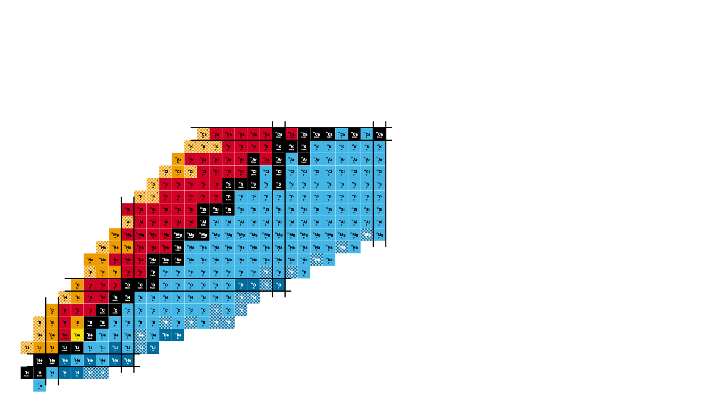
Changing nuclear structure in light neutron-rich nuclei
N=16 shell closure
N=32,34 sub-shell closures in Ca isotopes
“Bubble nucleus”
N=20 Island of Inversion

Slide 3
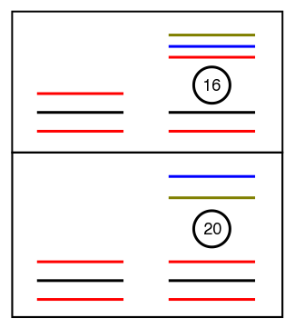
Changes in shell-closures – NN interaction
In the oxygen isotopes, the N=20 shell gap has been shown to disappear with the emergence of an N=16 shell gap in ²⁴O.
This weakening shell gap also plays an important role in other regions, such as IOI
²⁴O
Along N=16, πd_{5/2} is emptying. Different overlaps with νd_{3/2}, νf_{7/2} and νp_{3/2} results in different monopole shifts.
Z=8
³⁰Si
p_{3/2}
Changes in ESPE’s provide details on relative strengths of interactions.
f_{7/2}
d_{3/2}
s_{1/2}
Z=14
d_{5/2}
T. Otsuka et. al., Eur. Phys. J. A 15, 151–155 (2002)
protons
neutrons

Slide 4
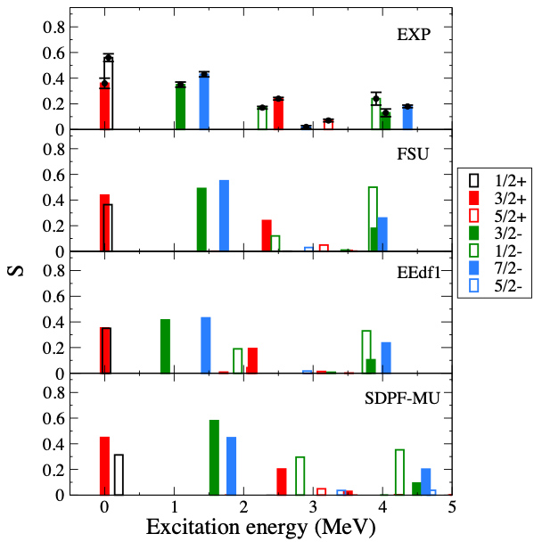
Previous measurements – 28Mg(d,p)
This collaboration has made previous measurements of states in ²⁹Mg (ISS) and ³⁰Al (HELIOS).
Investigated changes in single-particle centroids along N=17 and benchmarked new interactions that have been developed to better describe negative-parity intruder states near and into the IOI.
Data past Z=12 are needed, where changes in neutron occupancies are predicted by calculations, as well as differences in relative energies of orbitals.
PT. MacGregor et al., PRC 104, L051301 (2021).

Slide 5
Probing single-particle properties – transfer reactions
Whilst nuclei in this region have been characterized by several different probes, details on single-particle properties are lacking.
Measurements of the single-particle properties along N=16 (or one neutron outside) provide details on the behaviour of the orbitals that define the shell gaps.
Extracted SFs can impose further constraints on calculations in addition to energies of levels.
Transfer reactions are ideal probe of SP properties.
Extract excitation energies of states, angular momentum of state, spectroscopic factor.
Centroid of SP strength – related to effective SPE’s.
Relative occupancies/vacancies of relevant orbitals.
Use of solenoid technique results in clean identification of populated states and study fragmentation of SP strength in ²⁸Na up to and beyond S_{n}.

Slide 6
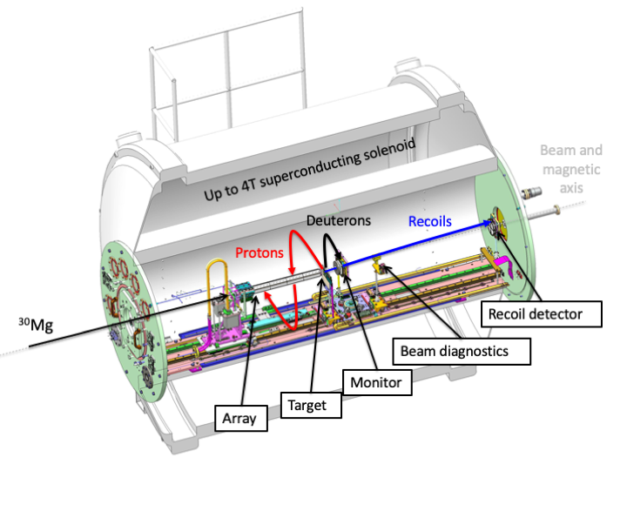
ISOLDE Solenoidal Spectrometer set up
2T field. Array-to-target 10cm.
Silicon recoil detectors at rear of magnet.
Annular silicon detector – monitor for absolute normalization.
Beam diagnostics – FC and zero-degree detector.
²⁷Na
Beam energy of 10 MeV/u.
CoM angular coverage for protons 10-40 degrees.
Expect <50% ²⁷Al contamination – reaction of interest selected using recoil detectors.

Slide 7
Simulations
SIMULATED
6⁻
3+
2+, 2⁻
4⁺
4⁻
5⁻
2⁺
2⁻
3⁺
3⁻
3⁻
2⁺
3⁺
1⁻
1⁺
1⁺
A. Pepailleur, et al., PRC. 92 054309 (2015).
²⁸Na has been studied through a combination of beta-decay and in-beam gamma-ray spectroscopy.
This data combined with SM calculations using FSU interaction has been used to simulate expected excitation energy.
Simulated spectrum shown given a proton current of 1.3uA. FWHM 120 keV.
Yields for most negative-parity states should be sufficient for measurement.

Slide 8
Angular distributions
Simulated
Primary goal is to identify negative-parity states from even-parity ones.
  Negative-parity are populated by either 𝓁=1 or 3 transfer.
  Positive-parity 𝓁=0 or 2.
  Distributions are therefore a linear combination of up to two distributions.
With expected level of statistics, parities of states can be differentiated from even-parity.
Contributions of each 𝓁 determined at ~5% level.

Slide 9
Proposed measurements
Propose measurement of ²⁷Na(d,p)²⁸Na reaction at 10.0 MeV/u using the ISOLDE Solenoidal Spectrometer (ISS)
States of interest are intruder states from above the valence shell. Neutron-adding reactions ideal probe for studying single-particle properties of these states.
Combined with existing data on ³⁰Al and ²⁹Mg provides systematic picture of evolution of single-particle structure in N=17 isotones.
Request a total of 15 shifts for ²⁷Na(d,p) at 10.0 MeV/u preferred option – using stripping foils to remove ¹²C⁴⁺.
Assuming 3x10⁵pps expect >115 counts a day in the whole array for states of interest. Aim is for <8% statistical error on absolute cross sections for negative-parity states.
Whilst maximum expected Al contamination is within acceptable limits there are ways of reducing this.
Goals
Confirm parity of states and obtain centroids of SP strength.
Investigate changes in neutron occupancies and centroids along N=17.
Probe changes in SP behaviour along N=17 isotones in odd and even nuclei.
Benchmark new interactions.

Slide 11
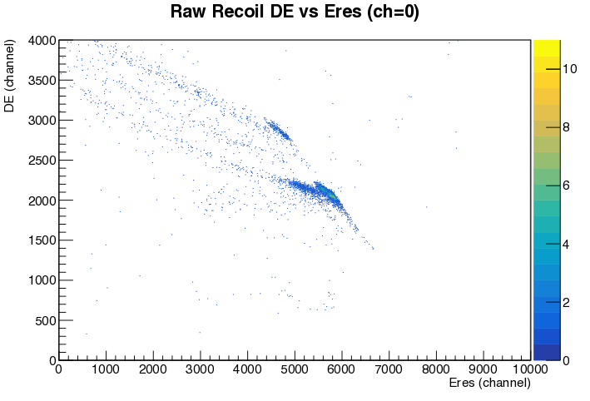
Recoil detection
Silicon recoil detectors used for ²⁸Mg(d,p)²⁹Mg
Resolution sufficient to identify ²⁸Mg and ²⁹Mg – as well as reactions on ²⁸Si.
²⁹Si
²⁹Mg
²⁸Mg

Slide 13
²⁹Al(d,p)³⁰Al - preliminary
(6⁻)
(5⁻)
Preliminary
(4⁻)
3⁺
3⁺
Few 10⁴pps.
Low statistics but resolution sufficient to identify suspected negative-parity states.
Angular distributions for strongest states – currently under analysis

