Slide 1
n_TOF Technical Report at the 69th INTC Meeting
Oliver Aberle, SY-STI-TCD
09/02/2022

Slide 2
Outlook
Main activities during YETS 2021/22:
  Modifications in the FTN line
  Update on NEAR
  Visit ASN/OFSP

Slide 3
FTN line
RP discovered a hot(s) spot end of August
Location identified and confirmed in the center of the first dipole
Beam size measured with the new SEM at the end of the line
Discrepancy with post-LS2 beam size and applied settings
Dedicated meeting series launched in September (https://indico.cern.ch/event/1080293)

Slide 4
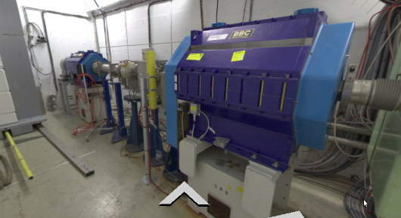
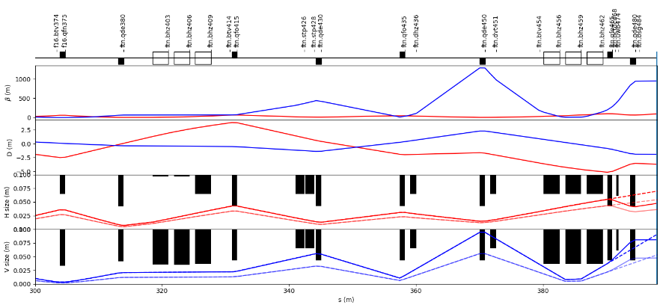
Improvement proposal
presented by Matthew Alexander Fraser and Yann Dutheil
Removal of quadrupoles 465 & 480
Removal or displacement upstream of the other aperture limitations such at BCT
New vacuum chambers needed
Replacement of the last 3 dipoles for larger aperture ones as they will be the next aperture limit

Slide 5
Conclusion
Optics of FTN and evolution of the beam size on target is understood
The implementation and tuning of new optics is demonstrated
Efficiency of steering improved using beam loss and optimizer
Proposed actions (timeline to be discussed):
Incoherence between optics DB, magnet DB and CCD on vacuum chamber sizes for the quadrupole, used round apertures of 86mm here
Short term solution: removal of equipment downstream the last dipoles and handover steering optimizer to OP for steering on target
  This should give us some margin in the vertical plane to increase the V beam size
Longer term solutions: installation of instrumentation, trajectory correctors and review of transfer line design
  Aim at removing dispersion at target and increase aperture to improve operational margin for beam loss with independently powered quadrupoles
  Prepare larger aperture dipoles for installation in the future to remove vertical aperture bottleneck

Slide 6
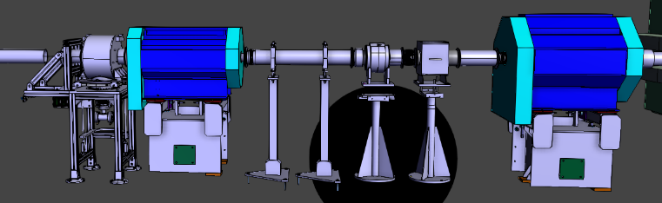
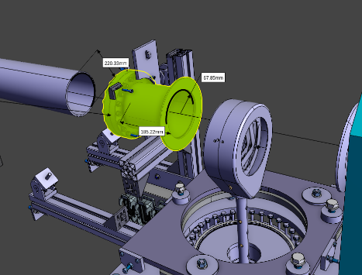
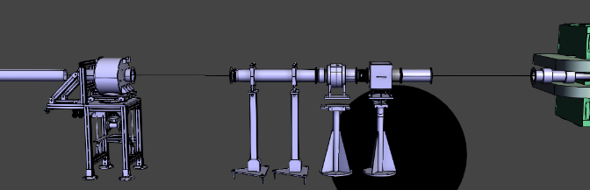
480
465
new chamber
new chamber

Slide 7
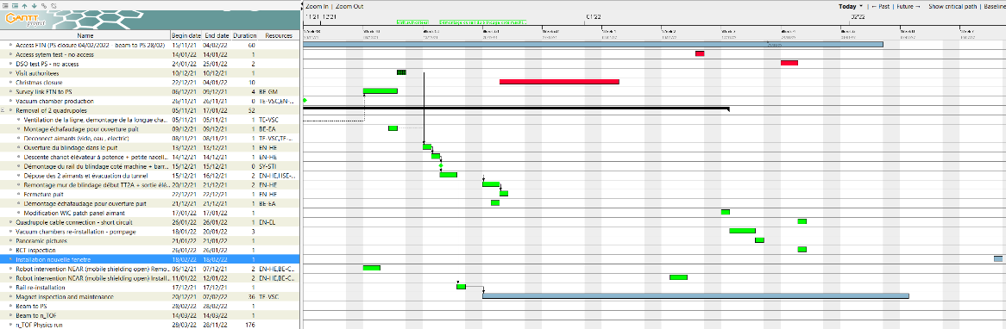
FTN line
2 Quadrupoles removed and replaced by new vacuum chambers
Conditions for beam recovered (shielding in place, pit closed, vacuum restored…)

Slide 8
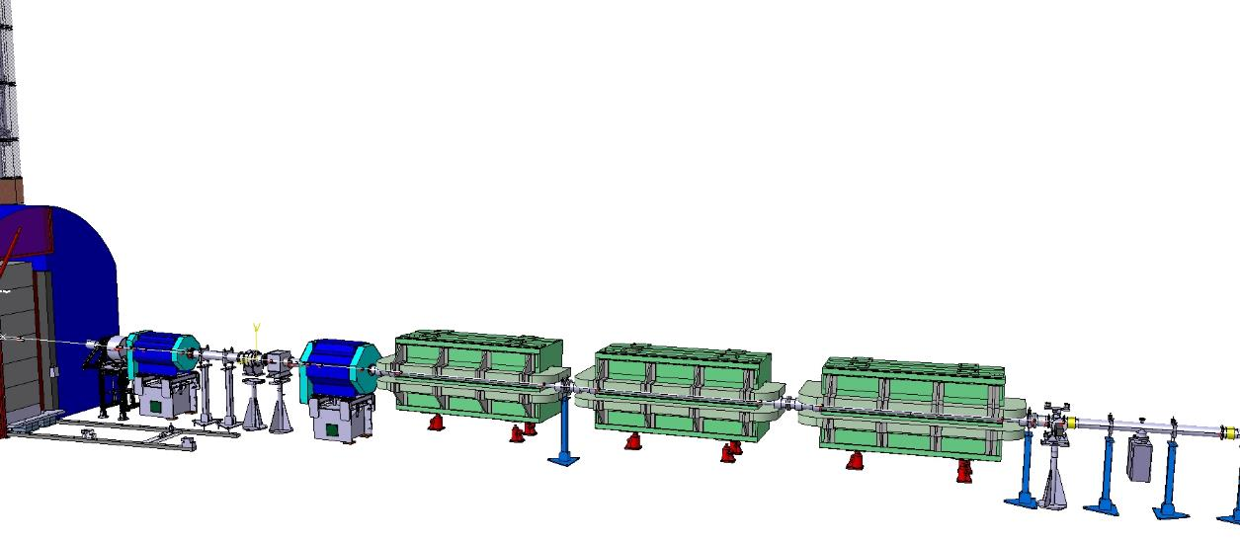
FTN line (proton line upstream of n_TOF target)
Pit opened, pit shielding moved to surface
Shielding in the U-turn
Vacuum vented, quadrupoles disconnected
Rail removed for mobile crane
Removal and transport of the two quadrupoles
Vacuum replacement chambers already machined, ready before Christmas
Window material ordered
Machining, welding and assembly could happen in January/early February
Re-installation of the shielding and closure of the pit before PS DSO test
Installation of the new window takes a few hours plus vacuum intervention.

Slide 9
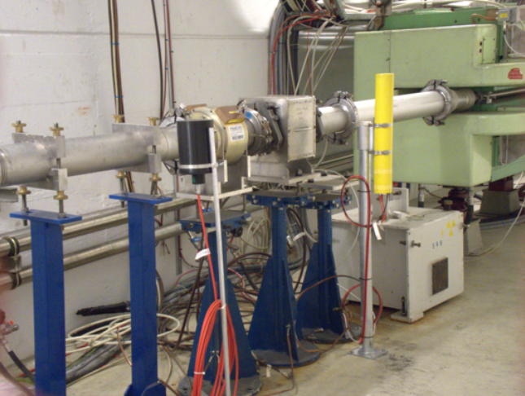
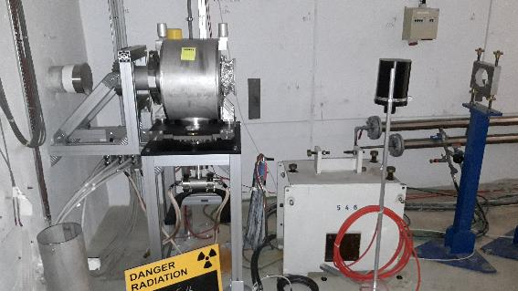
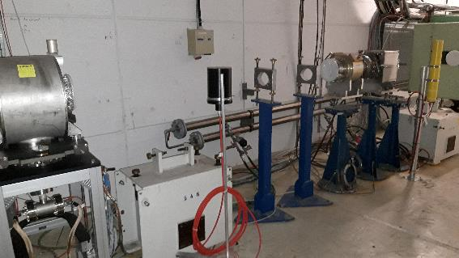
FTN line (proton line upstream of n_TOF target)
Vacuum replacement chambers already machined, ready before Christmas
Window material ordered
Machining, welding and assembly could happen in January/early February
Re-installation of the shielding and closure of the pit before PS DSO test
Installation of the new window takes a few hours plus vacuum intervention.

Slide 10
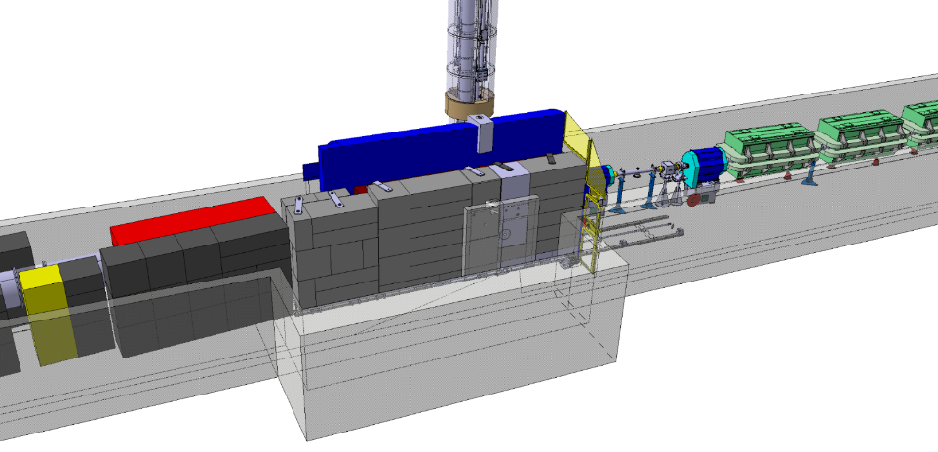
n_TOF target shielding and NEAR
Third Generation n_TOF Spallation Target and Vertical Neutron Beam Line
EDMS TOF-TAR-EC-0001
Mobile part
Reconfiguration of the last elements in the FTN line

Slide 11
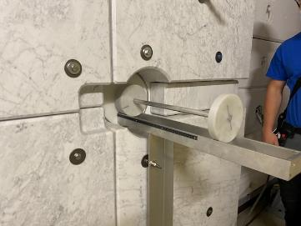
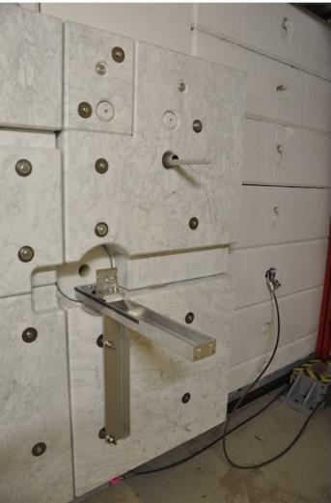
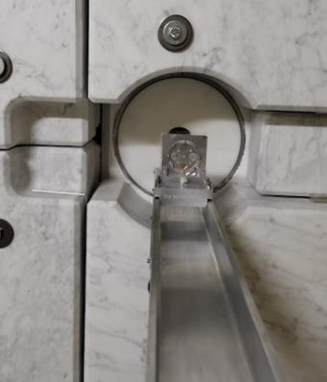
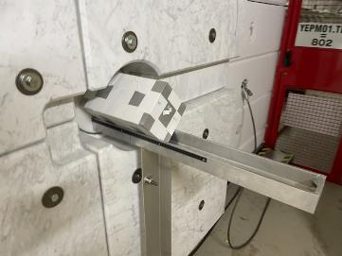
n_TOF NEAR
No change on support – waiting for Letter Of Intent (LOI) feed-back

Slide 12
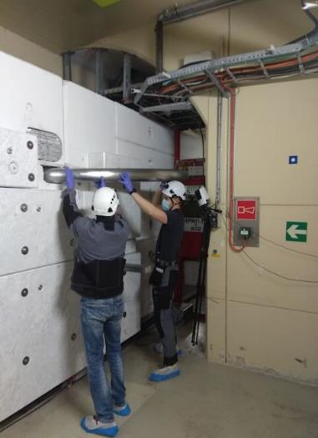
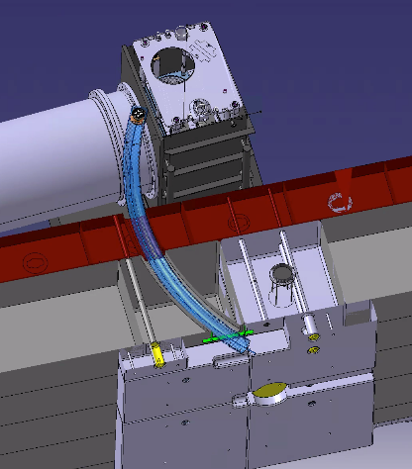
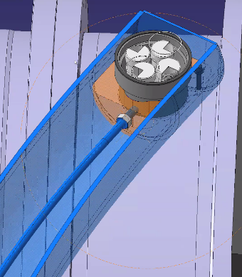
Rabbit 2 pipe installed
Access to samples possible during operation (short access)

Slide 13
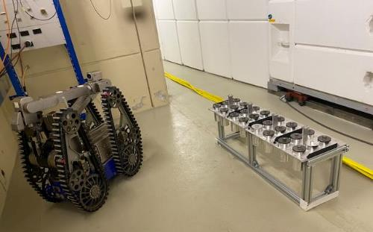
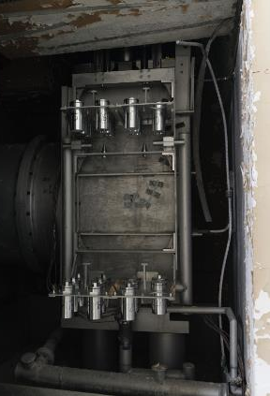
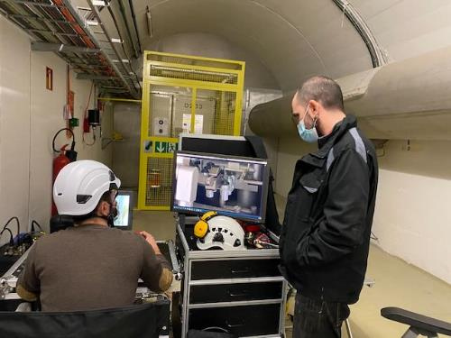
R2M samples ready for 2022 irradiation
“Design development and implementation of a neutron irradiation station at the n_TOF NEAR facility at CERN”
by M. Ferrari et al. under preparation
Acknowledgements
AP Bernardes, O.Fjeld, M.Ferrari, D.Senajova SY-STI, JF.Gruber HSE-RP, L.R.Buonocore, L.Barbosa Pina Pereira, E.Romagnoli, C.Veiga Almagro BE-CEM

Slide 14
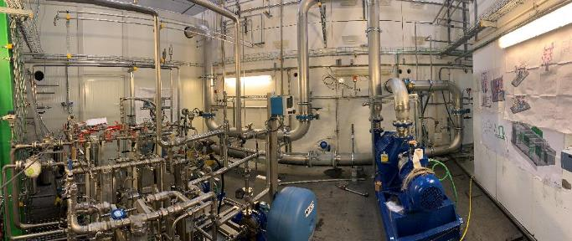
Target #3 cooling and moderator station
Visit ASN/OFSP 10th December
Major efforts from CV to develop the technology to match the specifications and RP requests (EDMS 2068336)
F. Dragoni
Under pressure room for filters (RP)
Moderators (2x)
Charcoal + HEPA filters
N₂ compressor
This Photo by Unknown Author is licensed under CC BY-NC

Slide 15
Visit ASN/OFSP 10th December
Implementation of the ASN-OFSP safety recommendations in EAR2
New safety file includes modifications implemented during LS2 EMDS 2604713 - n_TOF Target Facility Safety Overview
Visit of the target area and the cooling station
Recommendations given, details to come
Safety file for EAR1 to be produced 2022
Consolidation of the gas system in EAR2 - completed
Consolidation of the alignment system – ongoing
Upgrade of the n_TOF electronics laboratory - completed
DAQ upgrade
Consolidation and R&D program for detectors - ongoing

Slide 16
Conclusions
Target performance as expected!
Cooling and moderator stations up and running - ASN-OFSP comments
New permanent magnet and second collimator work well
NEAR has started activity, projecting for next years
New Ge detector installed
Ready for beam after YETS 2021/22
FTN line needs still tuning – modifications implemented

