Slide 1
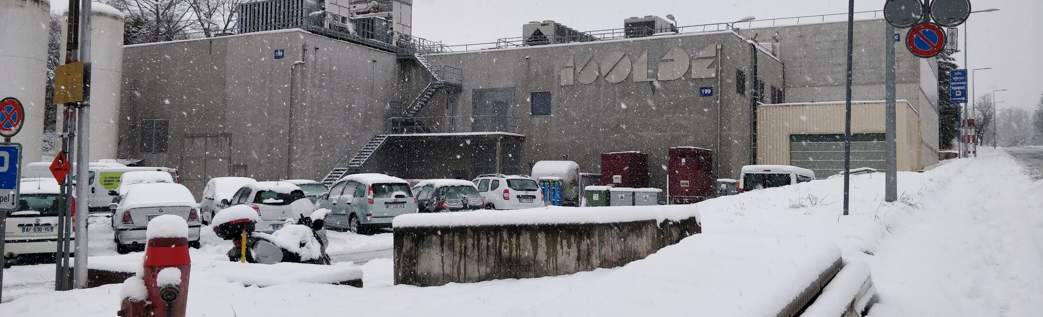
INTC 69: ISOLDE coordinator presentation
Final Summary of 2021
2022 planning
Around the hall: new setups
CERN access
Training

Slide 2
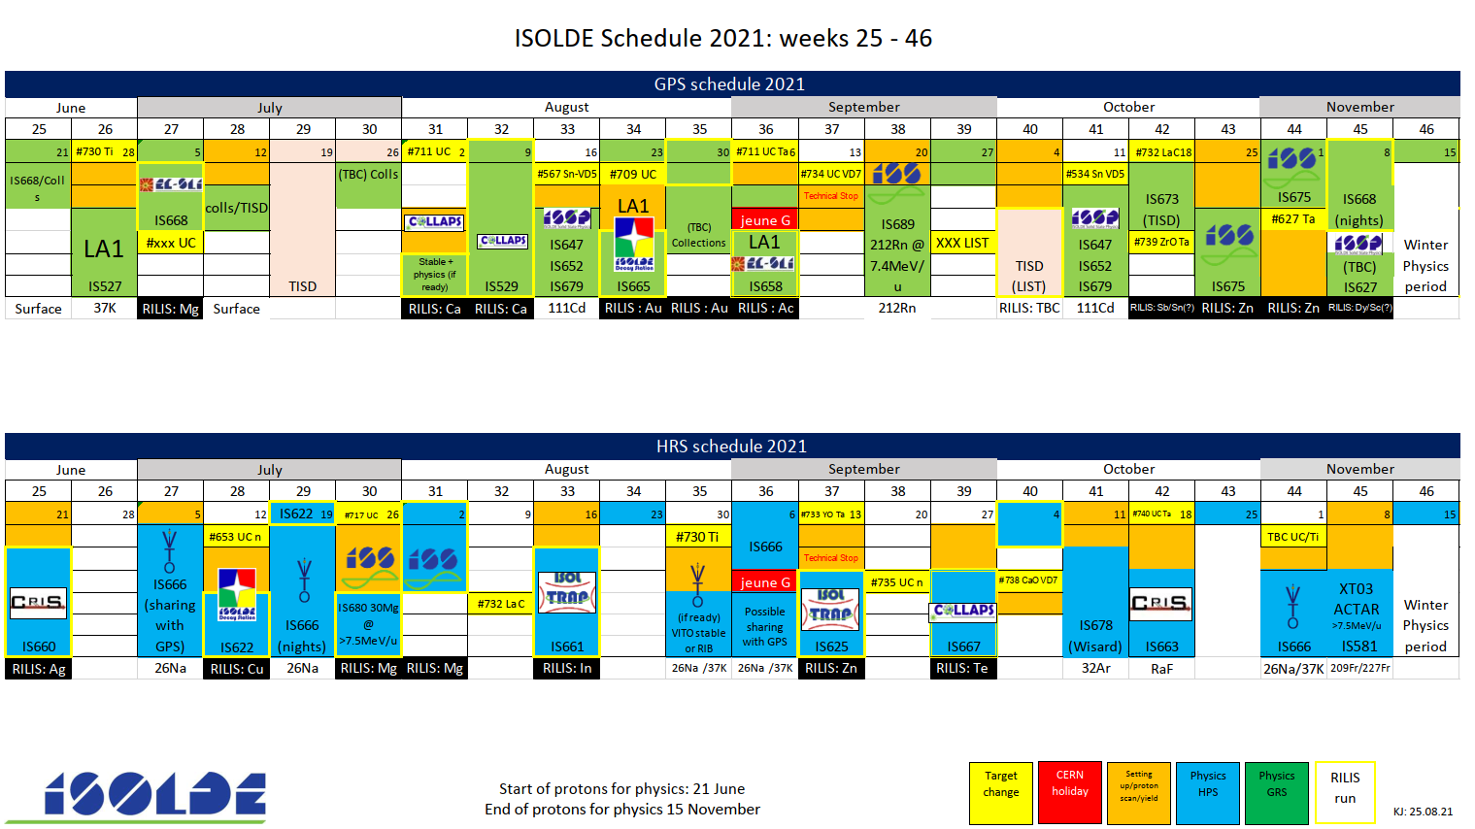
Published schedule till W35
145.5 scheduled shifts
IS701: Pb

Slide 3
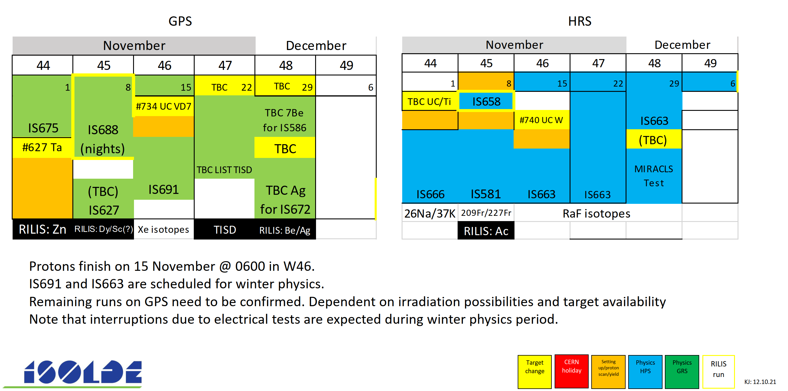
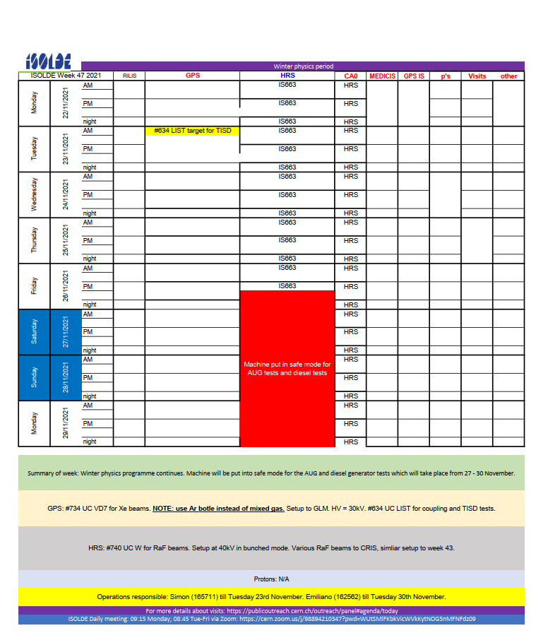
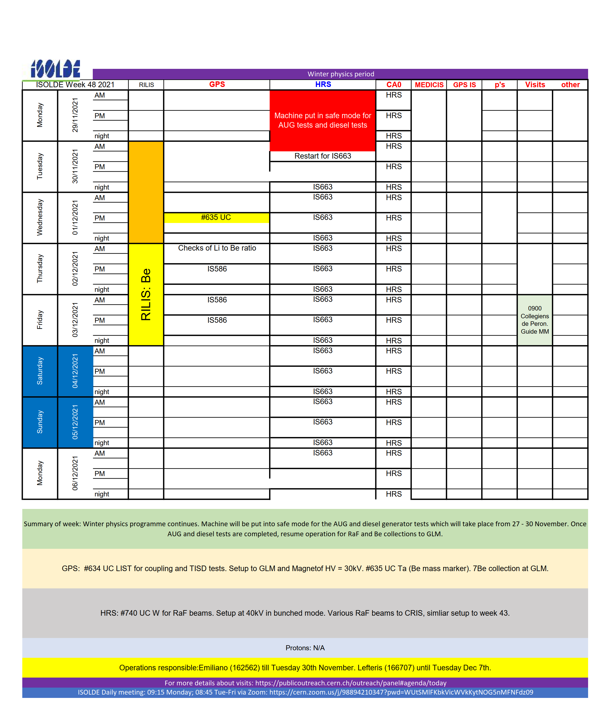
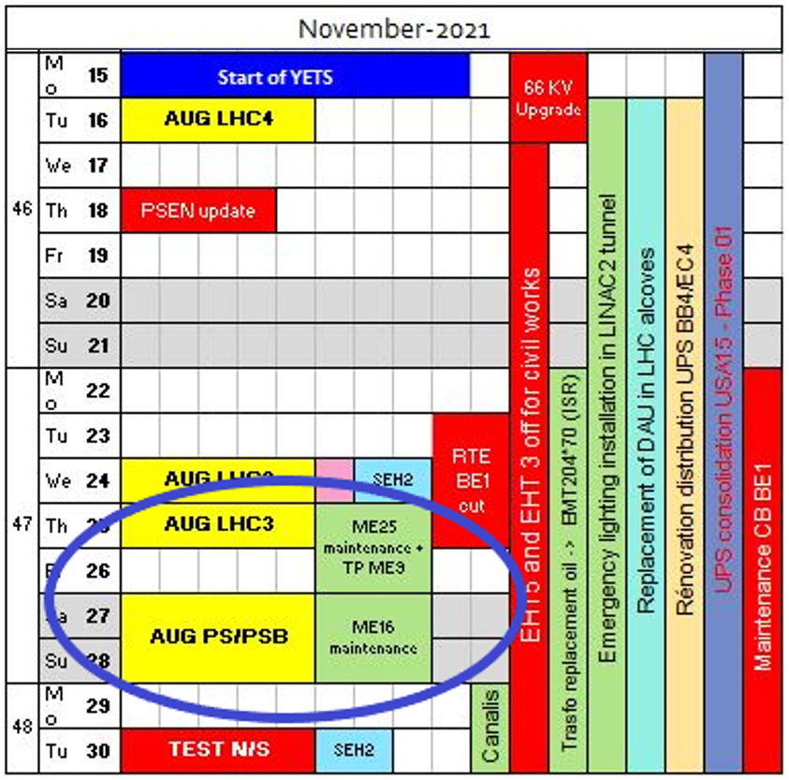
Winter physics period
Resuming the machine/run after the AUG cuts was quite painful.
CRIS were finally able to continue, a lot of effort from the technical teams.
On the limit of being worthwhile…2022 Winter Physics may depend on when the AUG tests are…

Slide 5
Row Labels | Sum of Shifts remaining after 2021 till end of Run3 | Count of Count
biophysics | 9.5 | 1
COLLAPS | 39 | 4
Collections: 108Ag | 30 | 1
Collections: 163Ho | 5 | 1
CRIS | 86.5 | 7
Gandalph | 8 | 1
Gandalph/CRIS | 6 | 1
HIE ISOLDE | 493 | 32
ISS | 97 | 9
Miniball | 275 | 17
Prototype | 0 | 1
SEC | 23 | 1
XT03 | 23 | 1
XT03: Actar | 21 | 1
XT03: Corset | 12 | 1
XT03: Edinburgh | 42 | 1
IDS | 159.5 | 14
IDS/ISOLTRAP | 6 | 1
ISOLTRAP | 43 | 5
Medical physics | 11 | 2
MIRACLS | 17 | 1
SSP | 97.5 | 11
TAS | 53 | 4
TISD | 31 | 7
TISD/IDS | 9 | 1
Travelling Setup | 10 | 2
Travelling Setup; ECSLI | 0 | 1
VITO | 14 | 1
WISARD | 14 | 1
Grand Total | 1142 | 99
ISOLDE backlog before this meeting
Most difficult part of backlog is HIE ISOLDE and Miniball in particular.
Summary of INTC 69
https://indico.cern.ch/event/1112243/

Slide 6
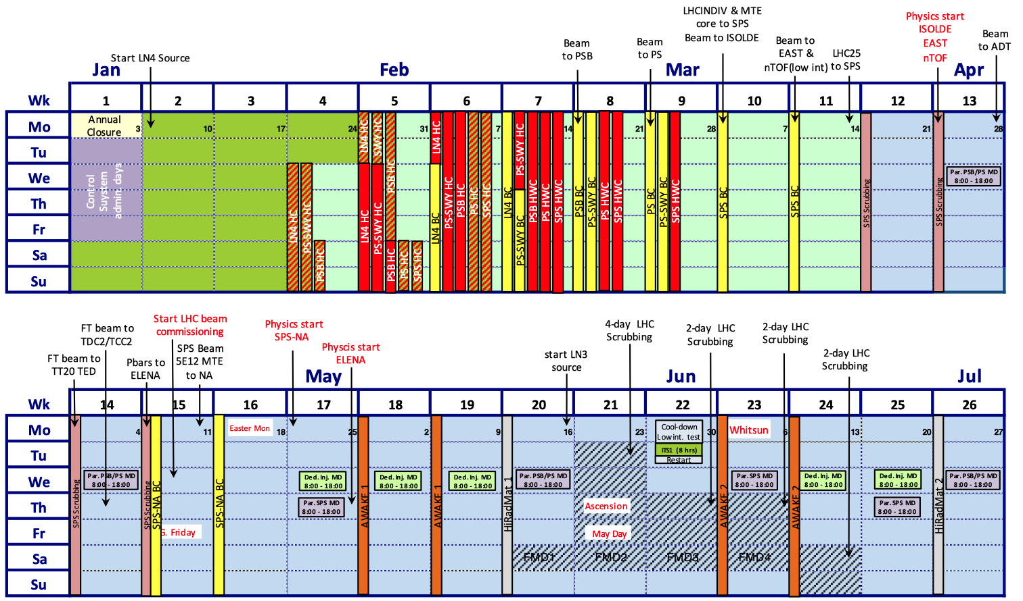
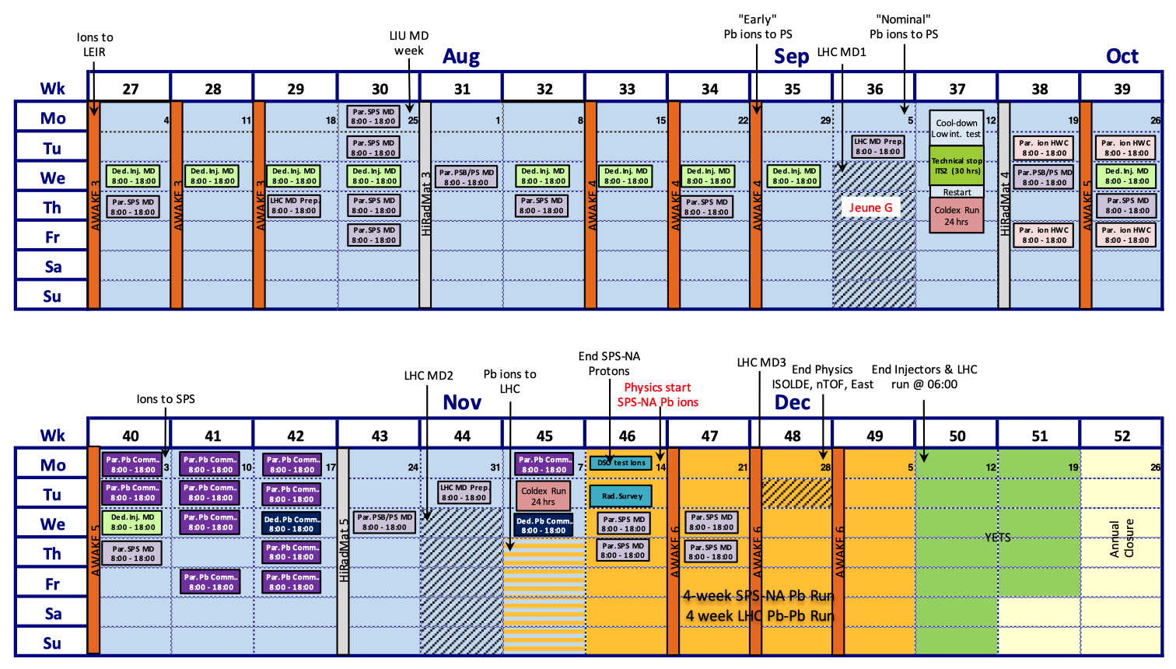
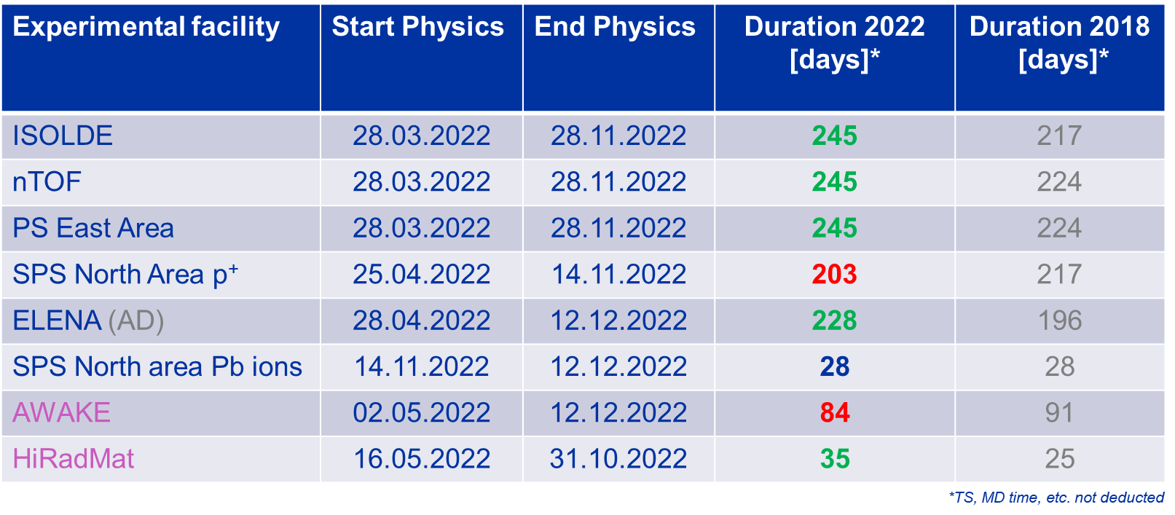
Draft Accelerator schedule for 2022
Update of the YETS schedule
Further optimisation requested by Research Board in favour of NA62 and NA64e
ISOLDE physics start: March 28th
End of protons, not necessarily of physics: November 28th
(but short period for winter physics).
245 days of physics
Also very high demand throughout the complex. Number of supercycles could be limited at times.
In discussion with PS/SPS coordinator on how best to balance the request for protons.

Slide 7
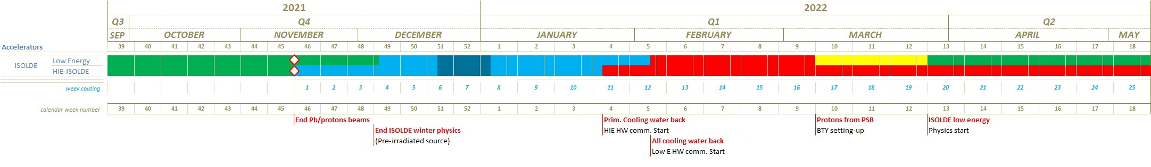
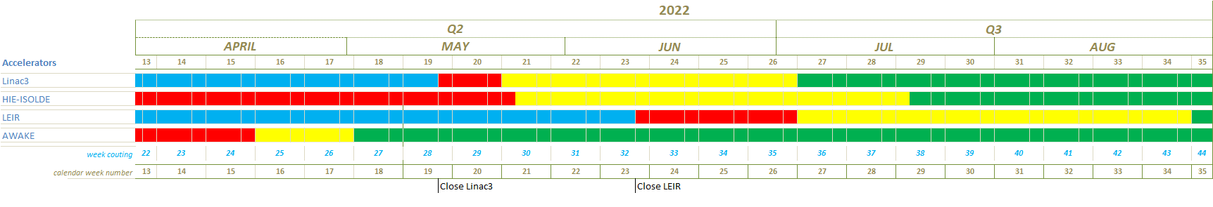
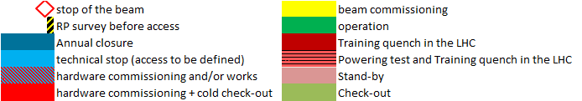
ISOLDE commissioning programme in 2022
Low energy start
HIE ISOLDE start
245 days for physics but, only ~131 days for HIE-ISOLDE. Could even be shorter if AUG tests are around early Dec
The annual warm-up of the cryoplant is very limiting.

Slide 8
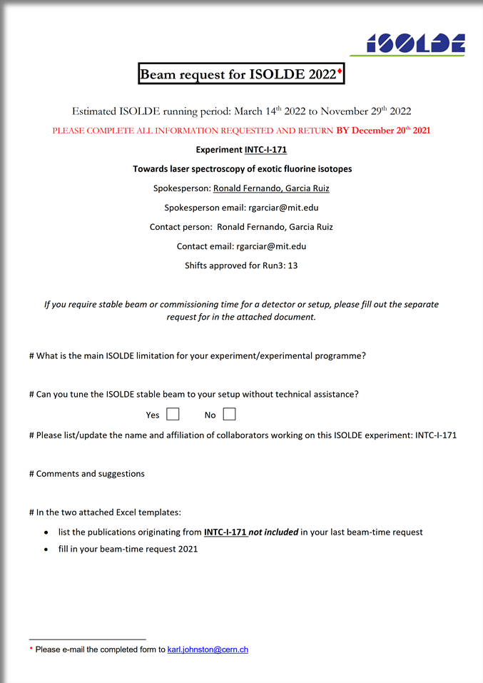
Beam requests for 2022
Beam requests were received before Christmas.
As can be seen: very high demand
Miniball will be back in 2022, but no T-REX this year.
Almost 50% of the shift request for HIE ISOLDE but only 50% of the running period possible.

Slide 9
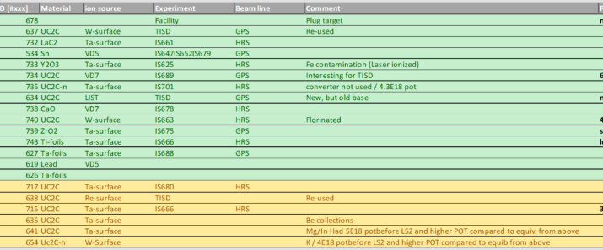
Initial plan/limitations for 2022
Discussions ongoing with various groups for the first weeks of the schedule. Covid contaminations and recovery from operations have affected some groups.
Also, delivery of components have delayed some plans.
First draft is being discussed with first groups.
Again, like 2021, first weeks will favour local groups due to covid issues.
Planning for first ~10 weeks will be released soon.
Then updated through the year: up to HIE ISOLDE period; then mid Autumn then end of year, including winter physics if this is possible.
Some supply issues also affecting targets: limited number of bases in stock, to be shared with Physics, development and MEDICIS.
Good stock of used targets for some of the early runs.
Some «exotic» units expected e.g. quartz lines. Required for some of the physics runs, but also to allow for transfer of expertise. Upcoming retirement of target experts.

Slide 10
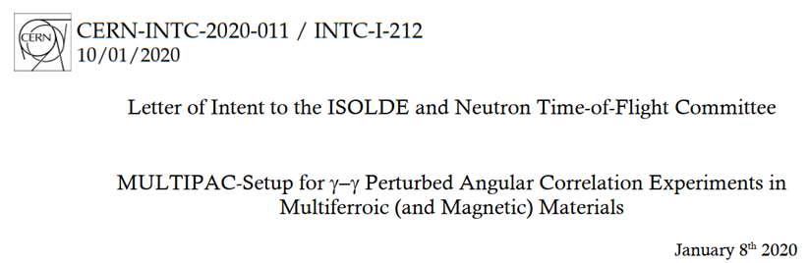
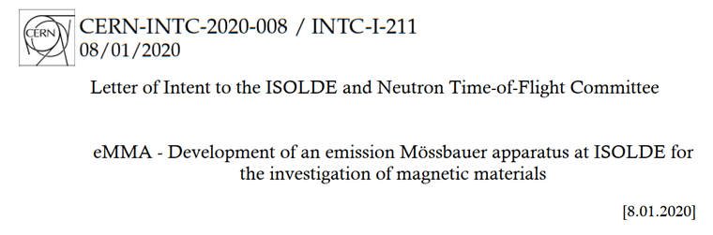
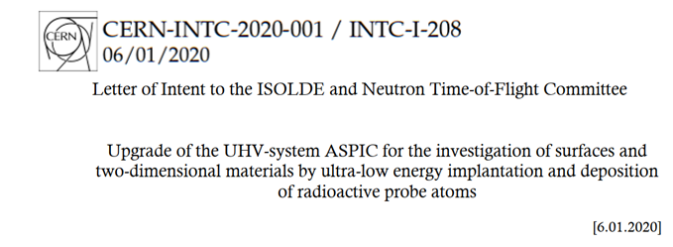
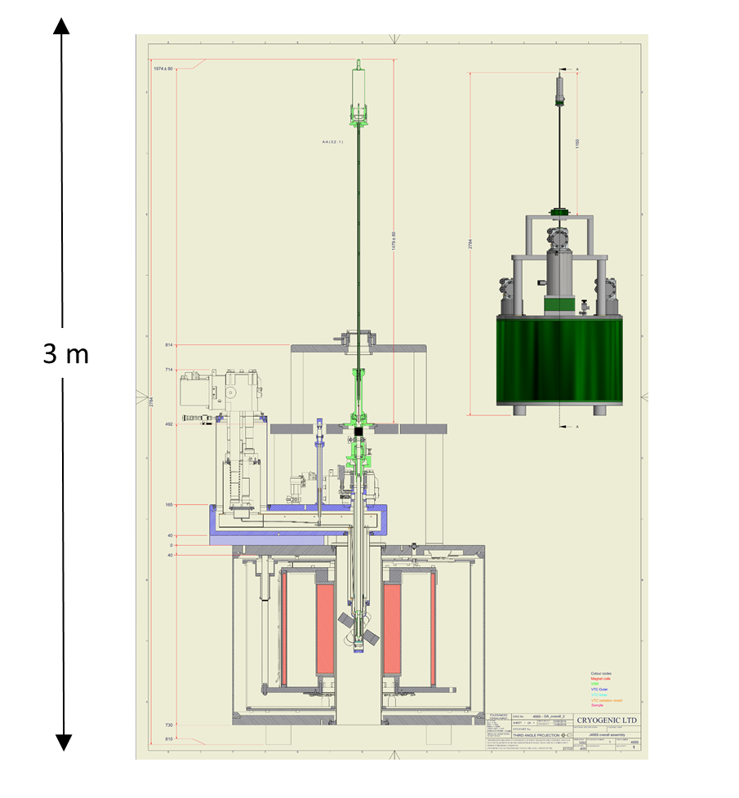
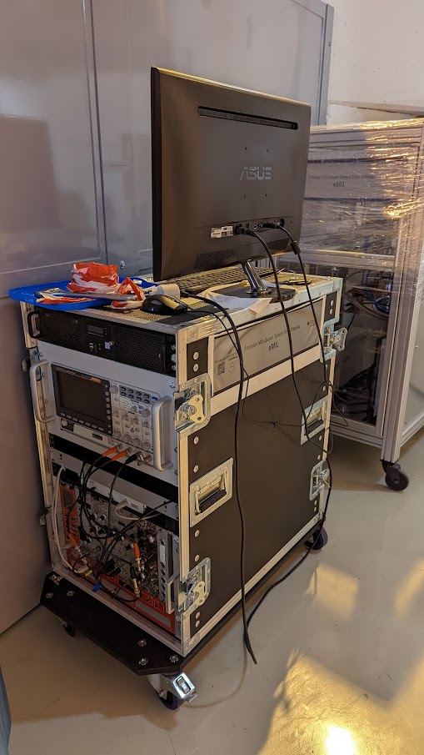
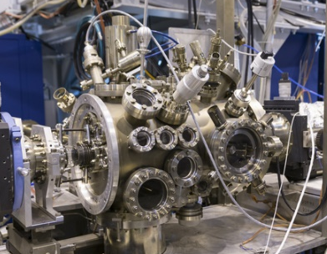
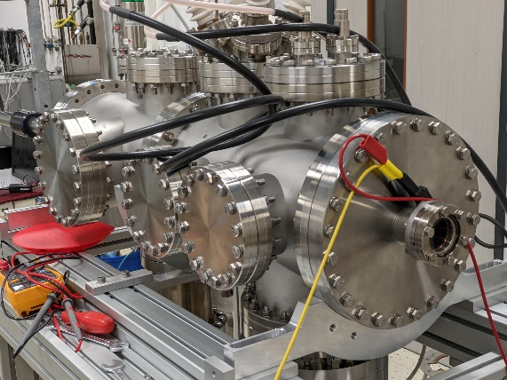
Follow-up on call for LOIs:Feb 2020 (Space in the hall)
Modified surface science setup: temporary @LA2 an option when MIRACLS leaves, but would benefit from more permanent installation.
Multipac magnet: April 2022
Will go to 275 for testing. Longer term?
New Mossbauer setup(s): no space issues

Slide 11
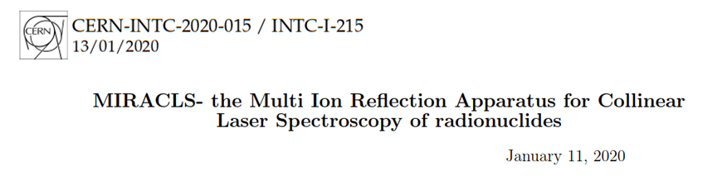
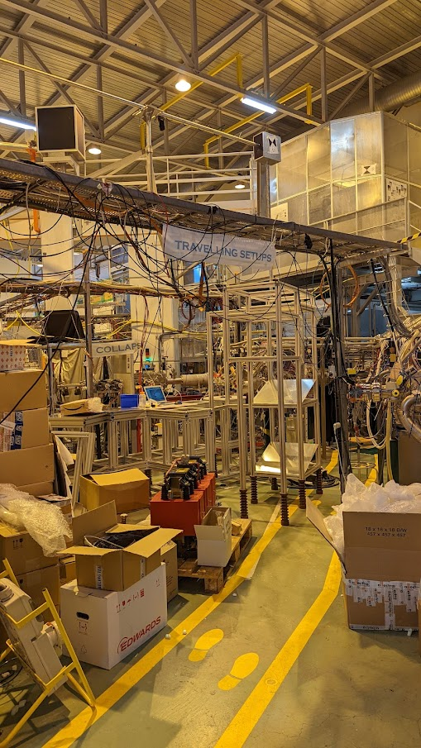
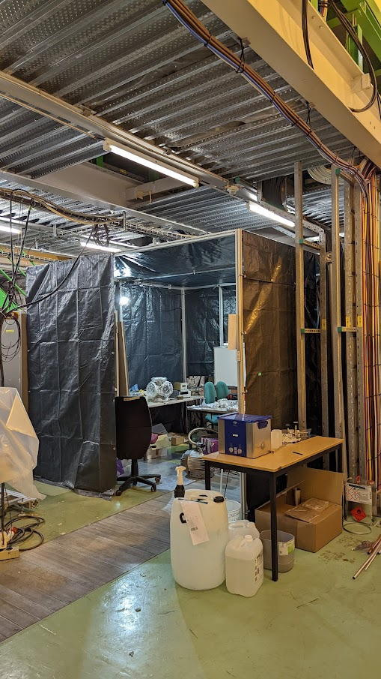
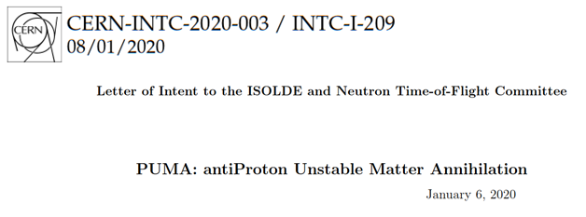
MIRACLS installation at LA2 and old NICOLE space. PUMA installation also being closely followed.

Slide 12
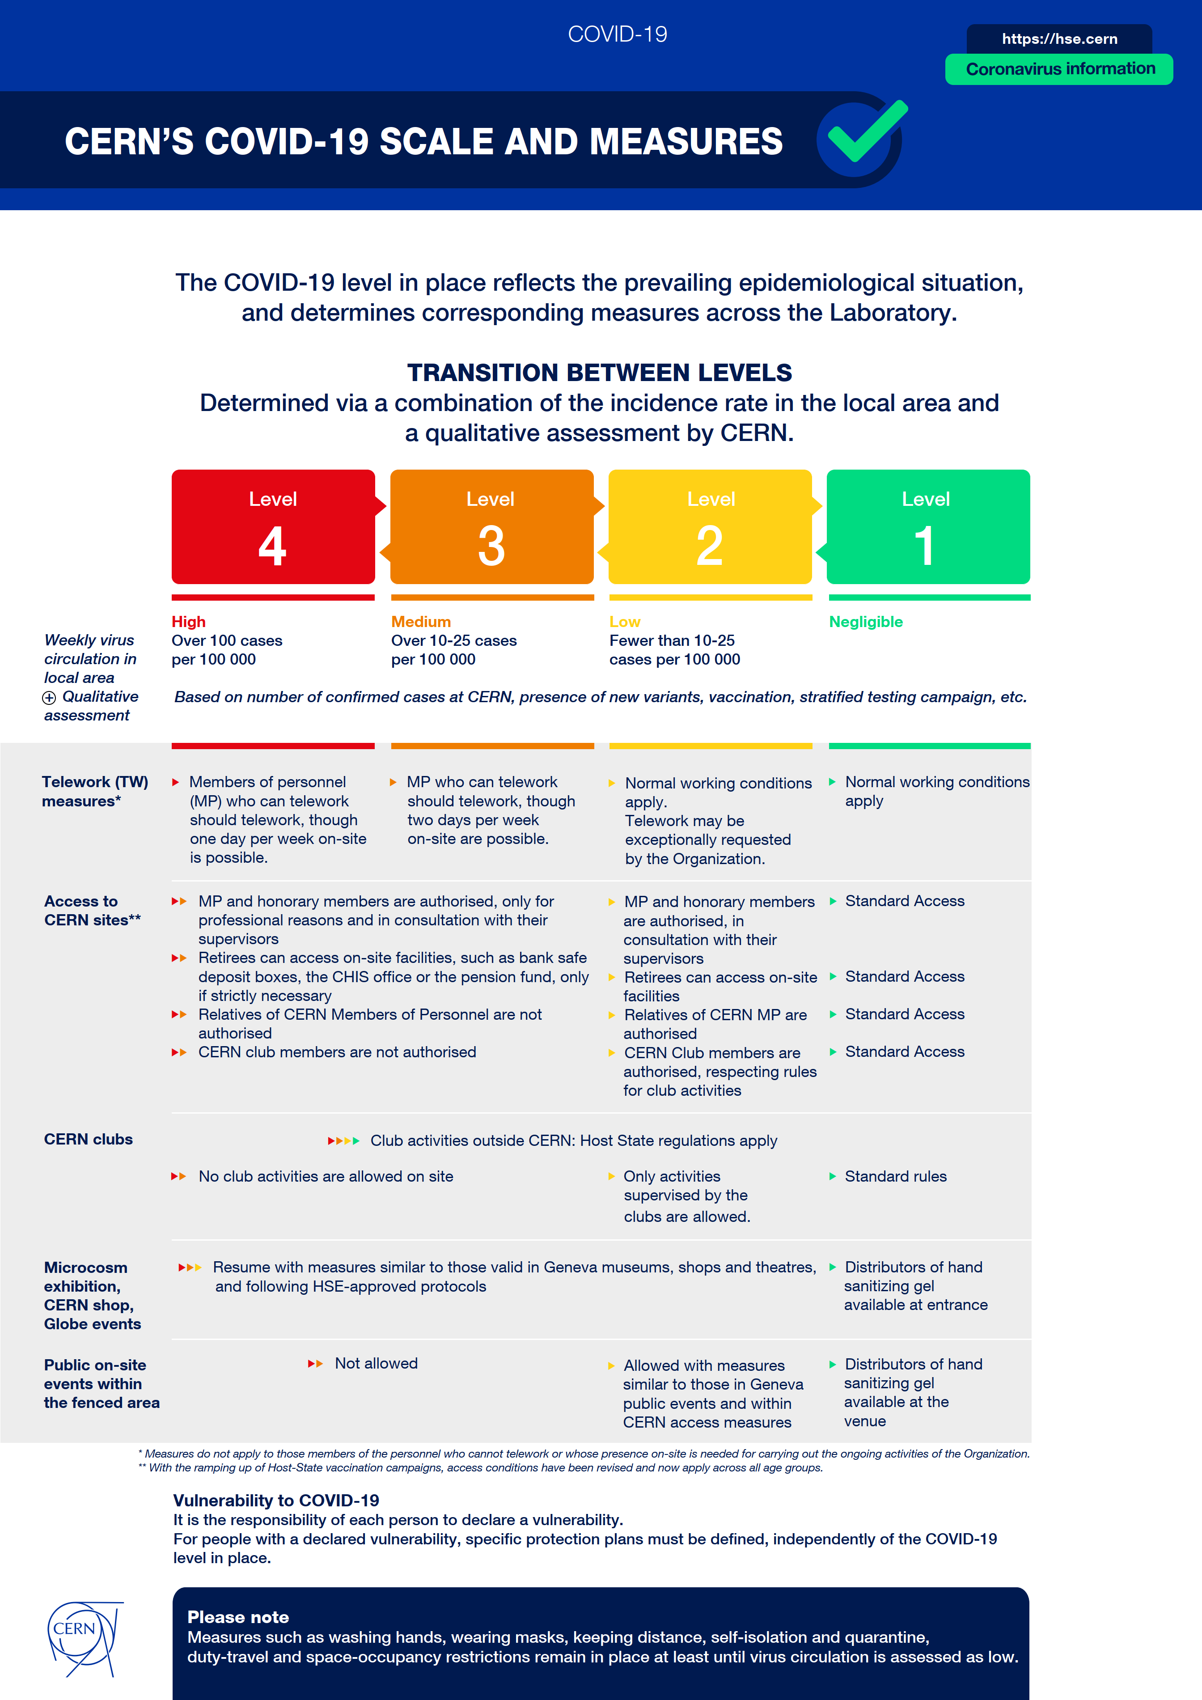
CERN currently in level RED
Masks and proximeters mandatory.
Remote meetings still favoured.
Hse.cern

Slide 13
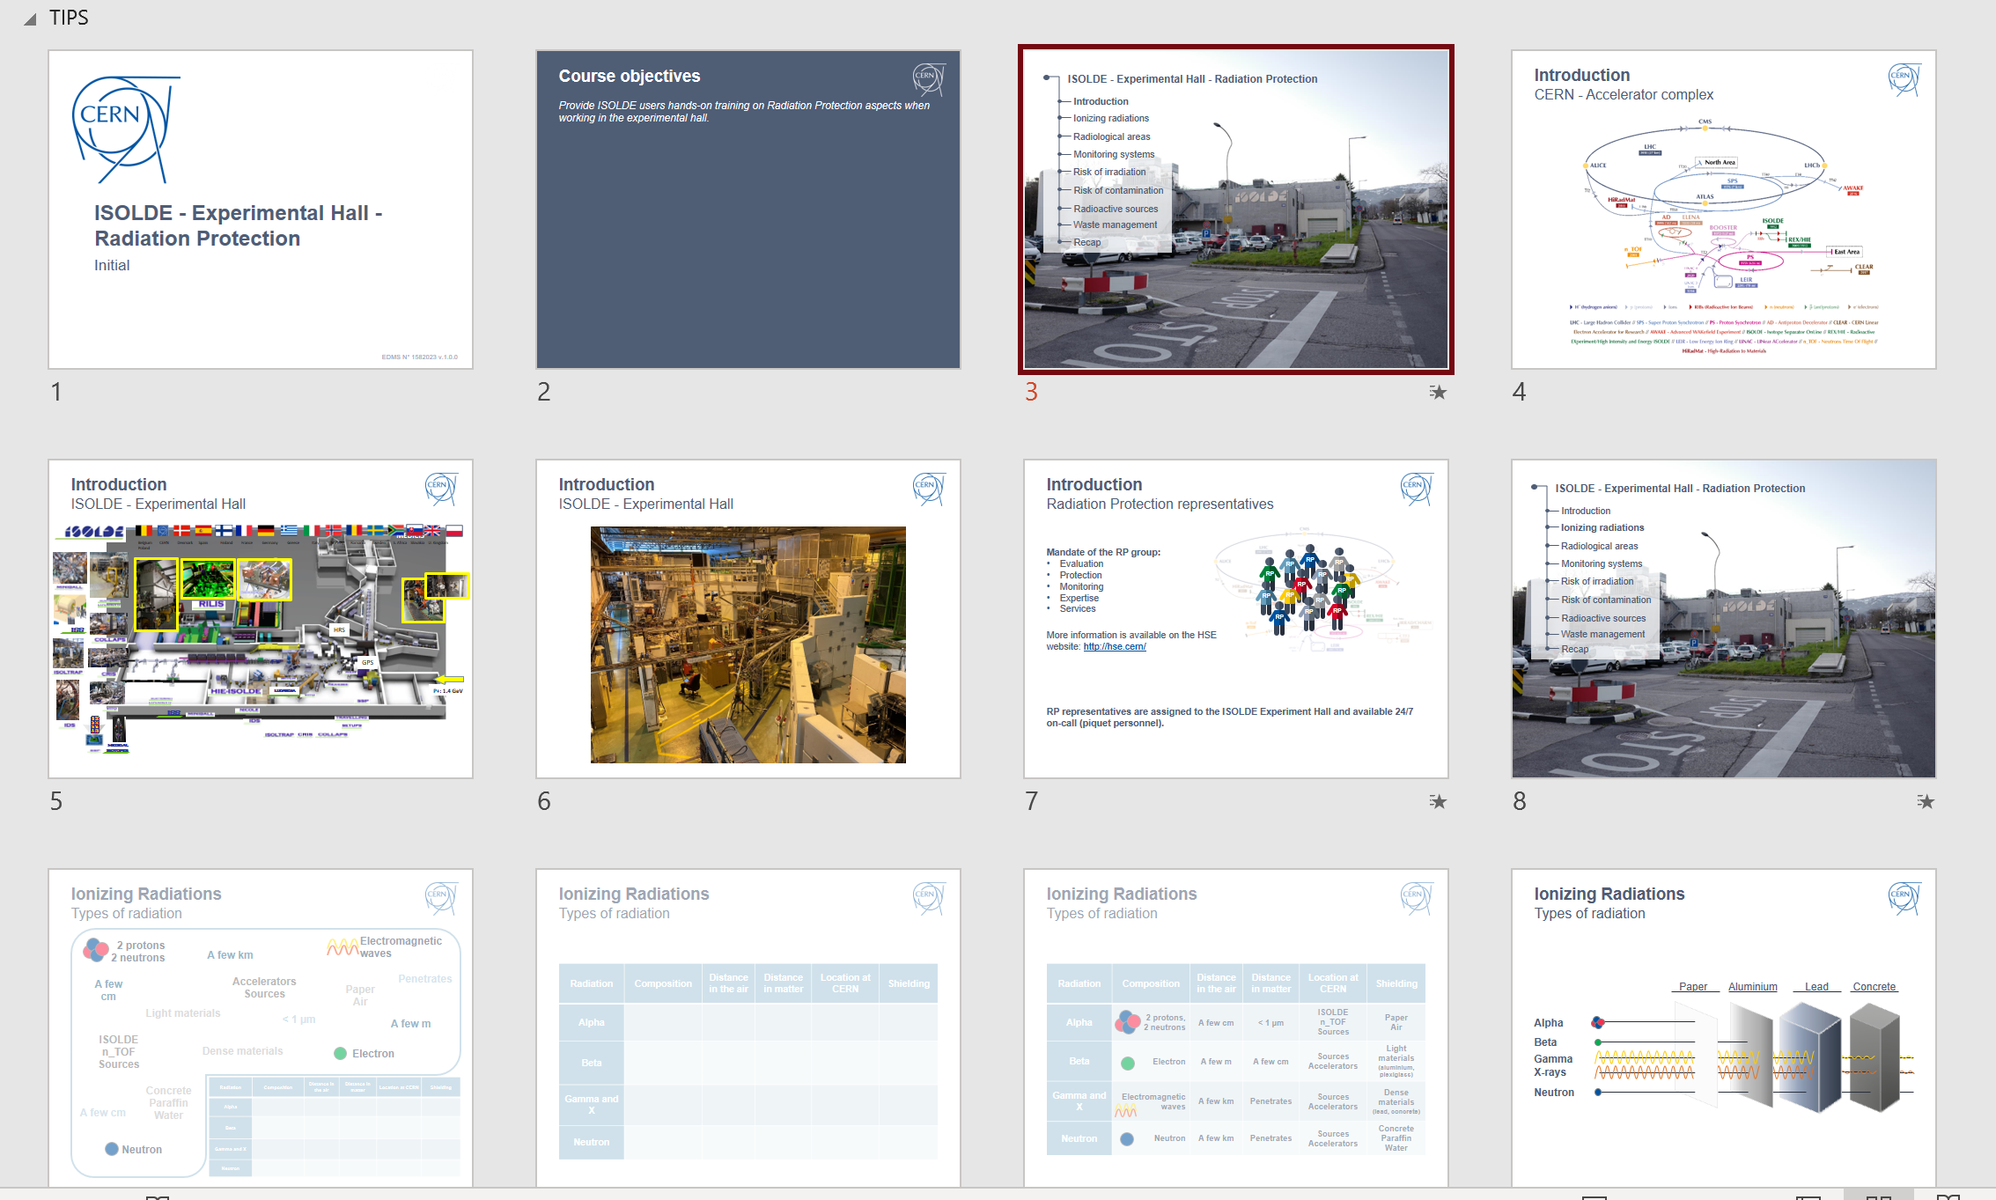
Training
In addition to the (ever-growing) number of online courses…
Hands-on RP and Electrical training
15 day deadline before scheduled course is cancelled. (has led to issues last year)
New EP-wide electrical course for all users/staff who need to work in an experimental area.
Both will take place on Tuesday:
  EP course 0830 till 1230
  RP course 1400 till 1630
Availability of Electrical course not very stable. Taking all online courses will grant electrical training ranks (for the moment at least). Long term users based at CERN should take it when possible.
In LMS:
ISOLDE - Experimental Hall - Radiation Protection - Handling (Covid-19)
Electrical Safety - Working in EP experiments
Ad hoc sessions are available, but (especially in running period!!) are difficult to manage.
A lot of new local representatives e.g. VITO, WISARD, Miniball etc. Some required training e.g. crane/cryo courses are difficult due to covid restrictions.
Mini-separator course for locals to be organised in March. Videos for external users to be released before running period.

