Slide 1
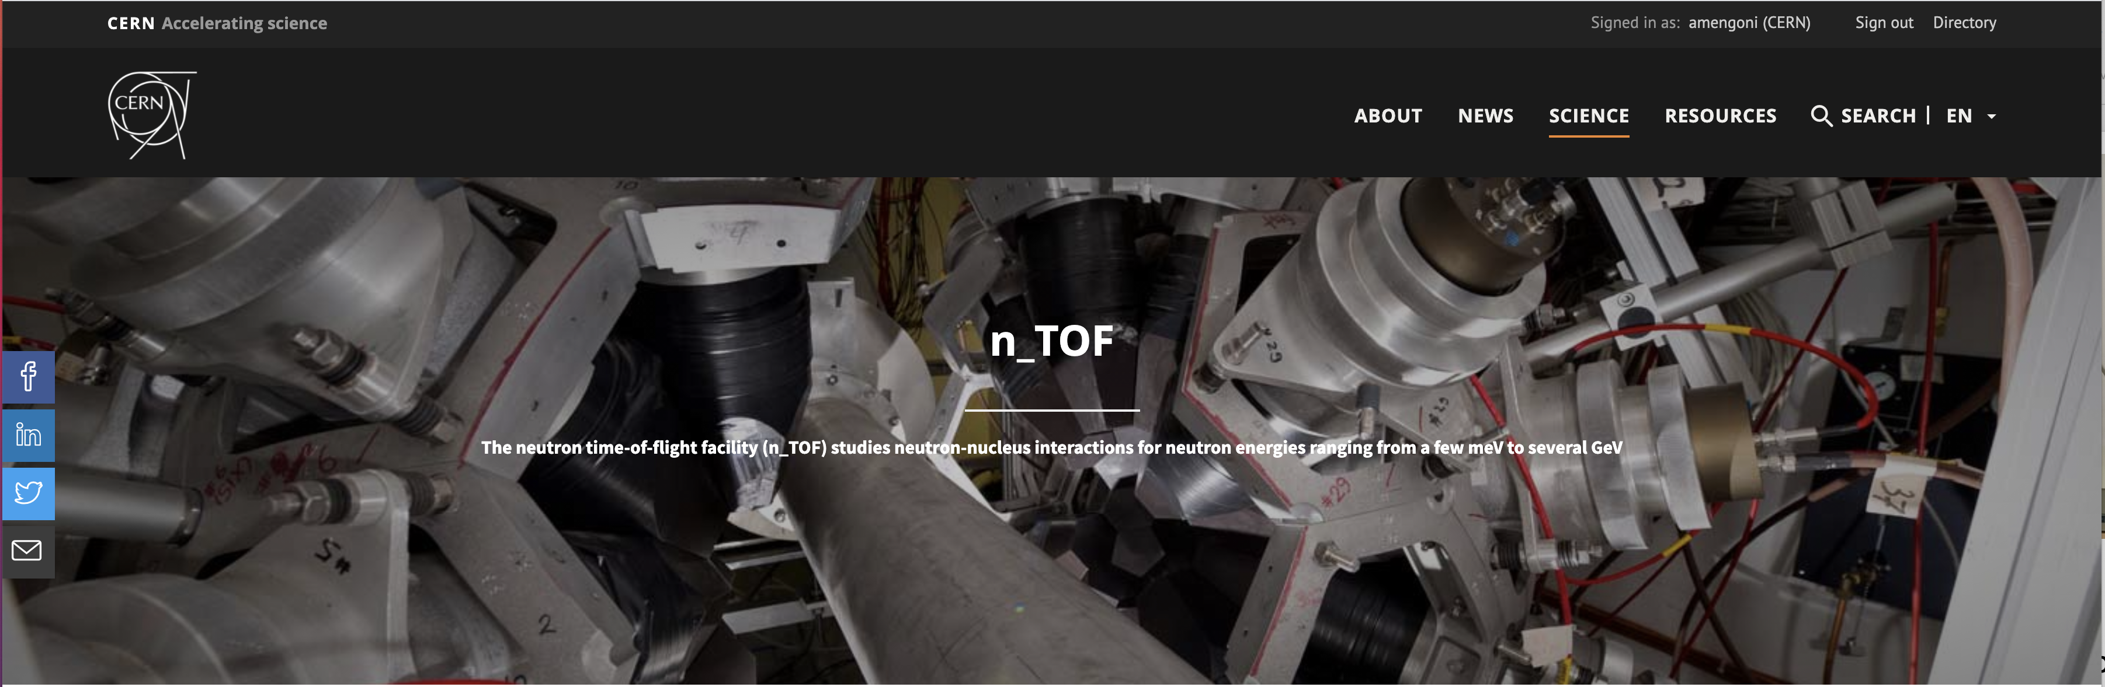

Plan of activities in 2022
Alberto Mengoni
on behalf of the n_TOF Collaboration
www.cern.ch/n_TOF

Slide 2
n_TOF @ CERN
20 GeV/c proton beam
From the PS accelerator
Two experimental areas (EAR)
Horizontal flight path
EAR1 at 200 m
Vertical flight-path
EAR2 at 20 m
Both beam lines with
1st collimator
halo cleaning, initial beam shaping
Filter station
Sweeping magnet
2nd collimator for beam shaping
+ the NEAR Station
Notes:
With greater accuracy

Slide 3
Plan of measurements: 2022 run
reaction | field of interest | note | experimental area | INTC proposal
⁹⁴Nb(n,𝛾) | – anomalies in pre-solar grains – strong contributor to the long-term radiotoxicity amongst FP | radioactive sample t_{1/2} = 20 ka | EAR2 | INTC-P-577
⁷⁹Se(n,𝛾) | – s-process thermometer – strong contributor to the long-term radiotoxicity among FP | radioactive sample t_{1/2} = 300 ka | EAR1 & EAR2 | INTC-P-580
^{94,95,96}Mo(n,𝛾) | – s-process AGB stars, SiC grains – FP, fuel alloys | stable samples (*) | EAR1 | INTC-P-569
¹⁶⁰Gd(n,𝛾) | – s-processing in AGB stars – radioisotope (¹⁶¹Tb) production for theranostics | stable samples | EAR1 | INTC-P-437-ADD-1
^{50,53}Cr(n,𝛾) | – criticality safety (major element in stainless steel) | stable samples | EAR1 | INTC-P-588
continue…
(*) part of a EU H2020 nuclear data project

Slide 4
Plan of measurements: 2022 run
reaction | field of interest | note | experimental area | INTC proposal
²³⁹Pu(n,𝛾) and 𝛼-ratio | – advanced nuclear technologies | radioactive sample t_{1/2} = 24.1 ka (*) | EAR1 | INTC-P-567
²⁴³Am(n,f) | – contributes to production of ²³⁹Pu (by 𝛼 + 𝛽⁻ decays) | radioactive sample t_{1/2} = 7364 a | EAR1 & EAR2 | INTC-P-566
NN scattering | – isospin symmetry breaking | detector and setup developments | EAR2 | INTC-I-220
n + ³He | – X17 (dark photon?, fifth force?) | detection tests developments | EAR2 | INTC-I-233
(n,lcp) | – DDX measurements | detection tests and developments | EAR1 | INTC-I-221
^{nat}Fe + others | – HPGe detection system for (n,n’) measurements | detection tests developments | EAR1 | INTC-I-230
(*) part of a EU H2020 nuclear data project

Slide 5
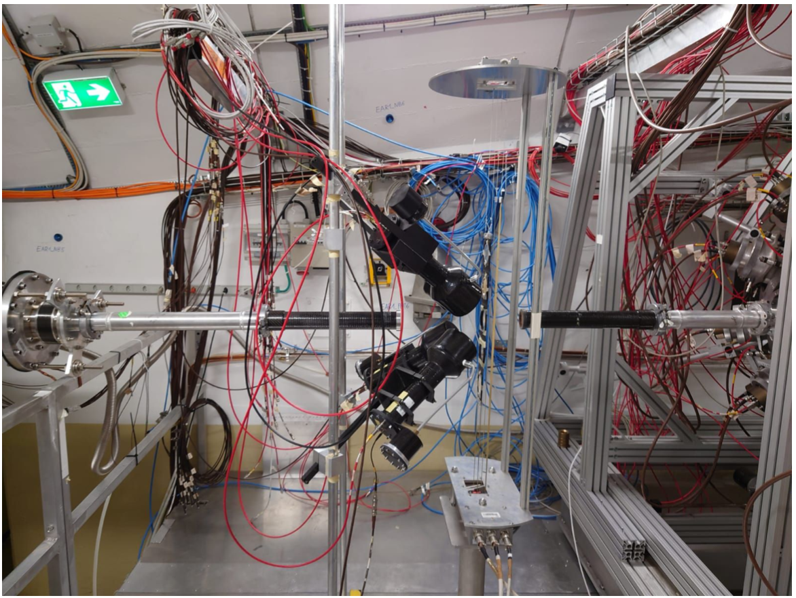
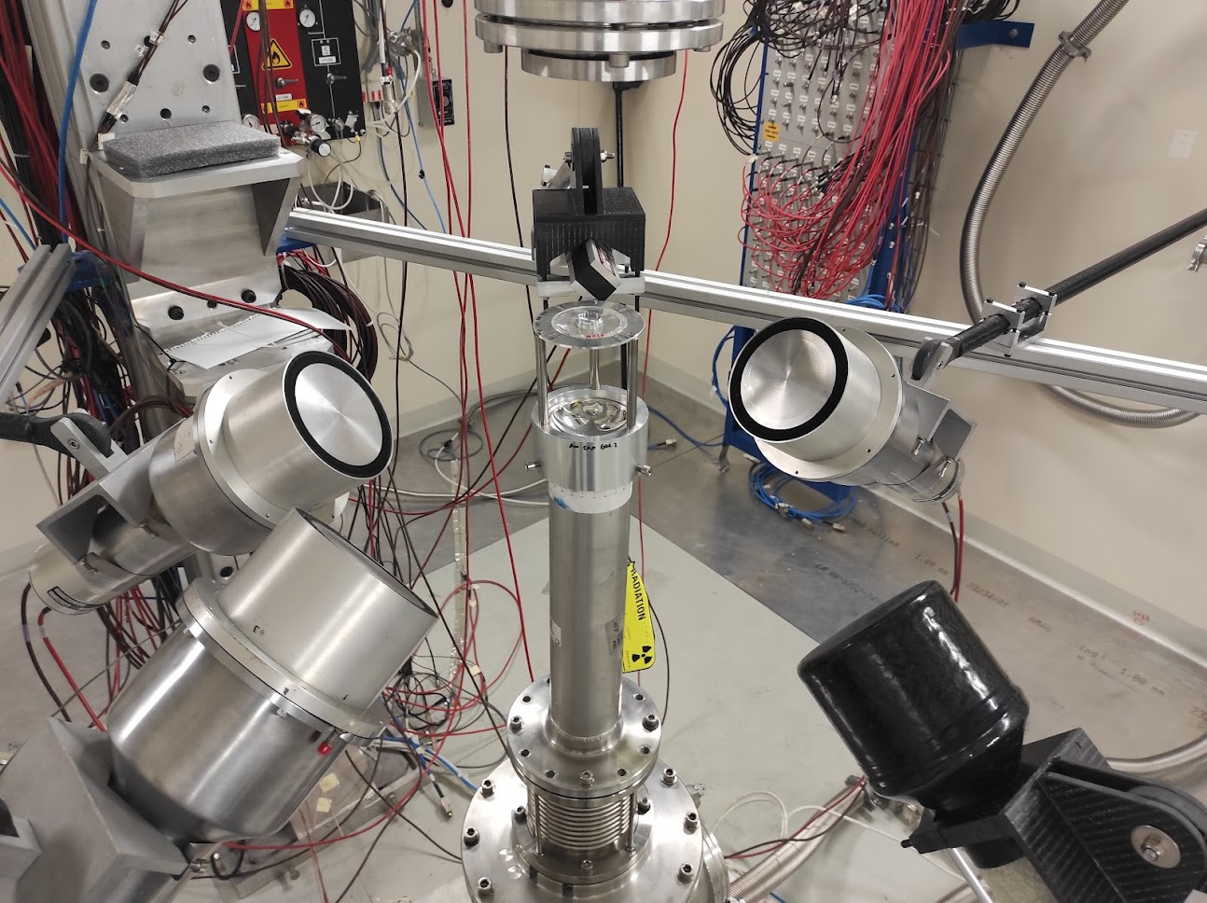
¹⁶⁰Gd(n,𝛾)¹⁶¹Gd: proposed setup
EAR1 typical setup
EAR2 typical setup

Slide 6
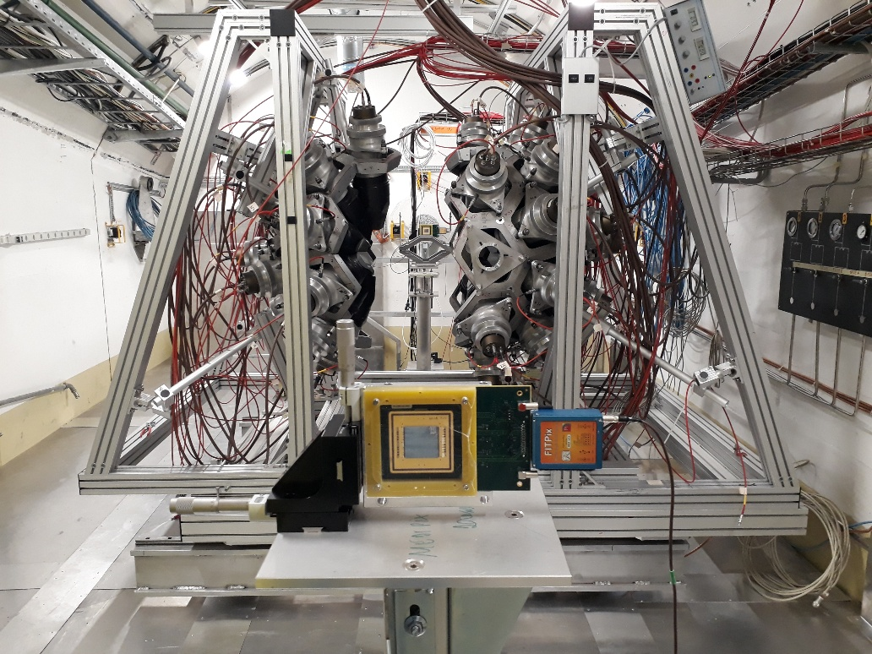
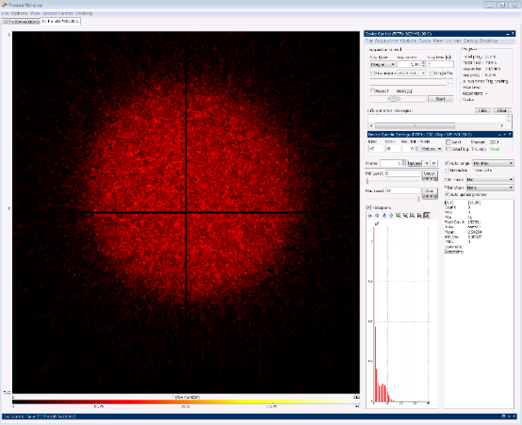
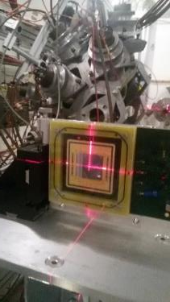
Measurements with the Total Absorption Calorimeter
EAR1
Beam profile and position
2-Quad Timepix has been used for beam alignment
and for flux measurement in Phase-2021

Slide 7
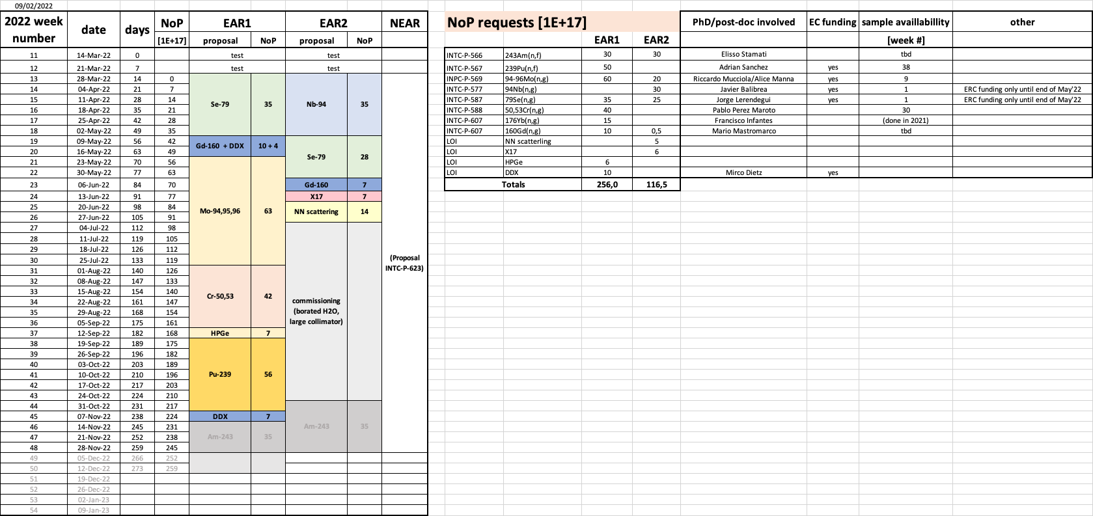
Plan of measurements: 2022 run

Slide 8
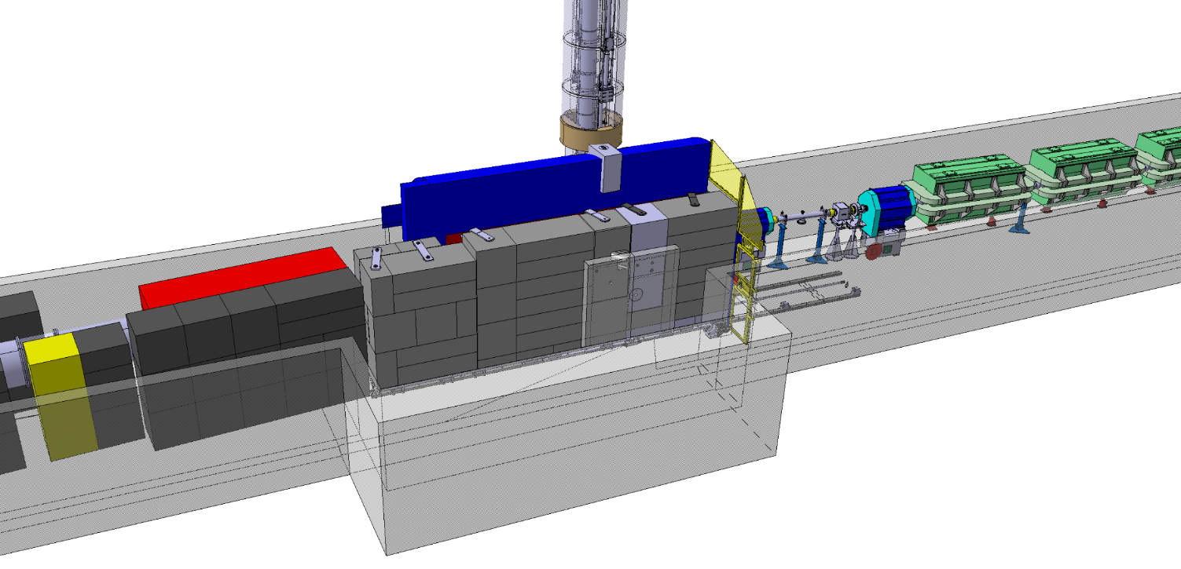


The NEAR Station
during the design studies of the new shielding around the target station the opportunity for a new near-target experimental area appeared
(NEAR station)
NEAR Station area
Measurements for technical and engineering developments
Irradiation of non-metallic materials + SEE (R2M & R2E projects)
Measurements of MACS by activation for nuclear astrophysics
Fusion-related measurements (cross sections, not irradiation)
Measurements of decay rates of long-lived isotopes

Slide 9
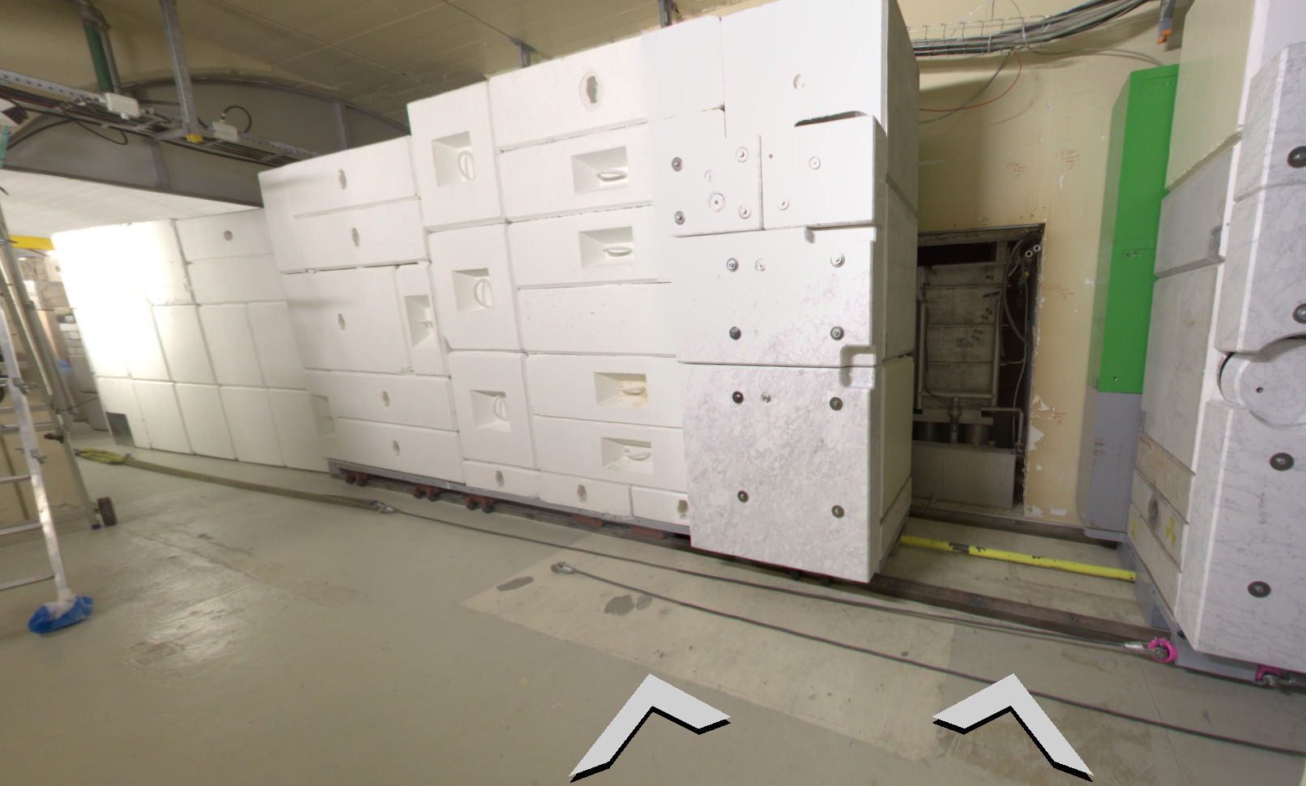
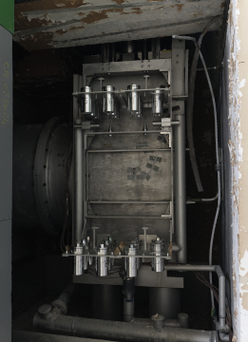
NEAR Station (inner area)
irradiation positions
inside the shielding
n_TOF target area shielding OPEN
n_TOF target (pool)

Slide 12
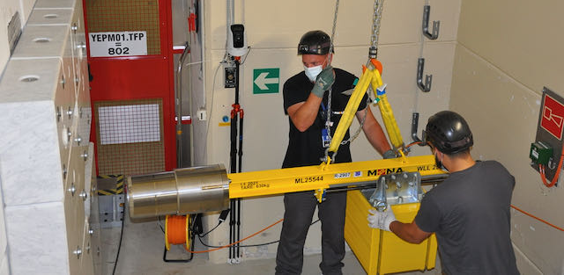
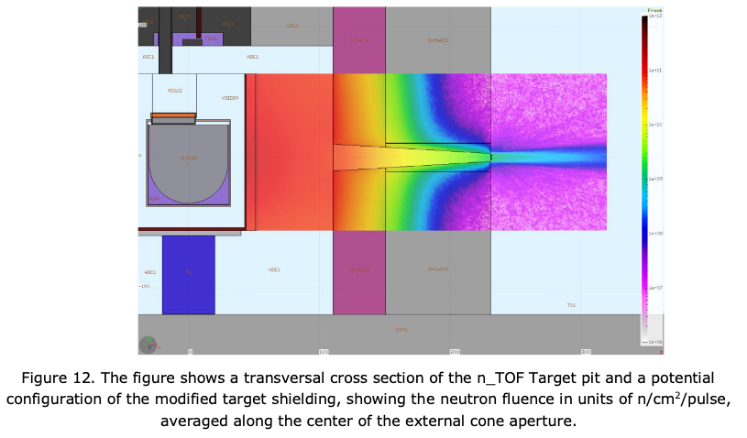
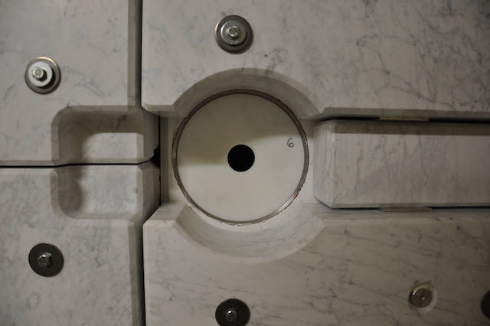
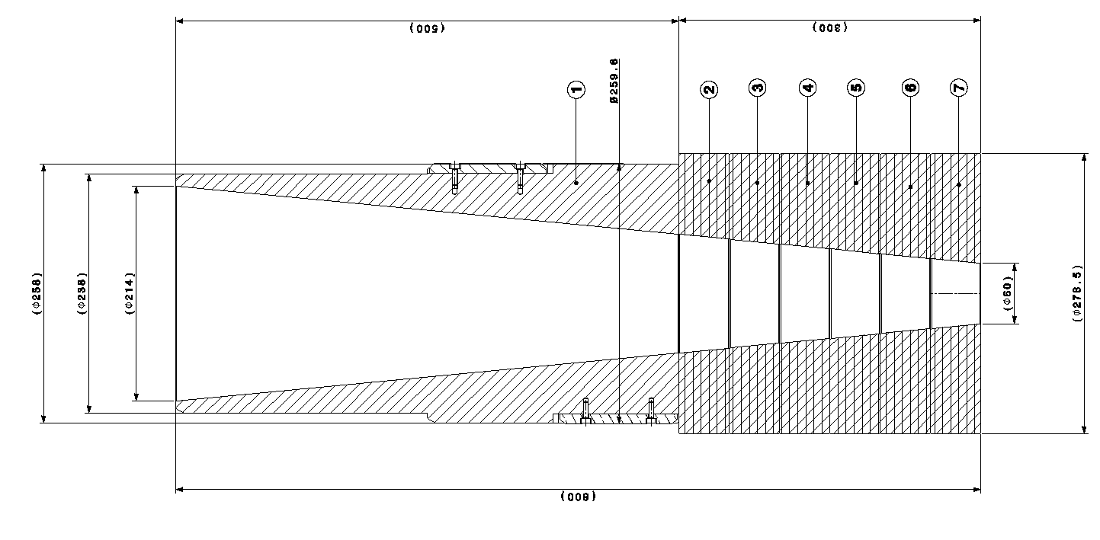
NEAR Station (outer area)
5E8 n/cm2/pulse
(outside the shielding)

Slide 13
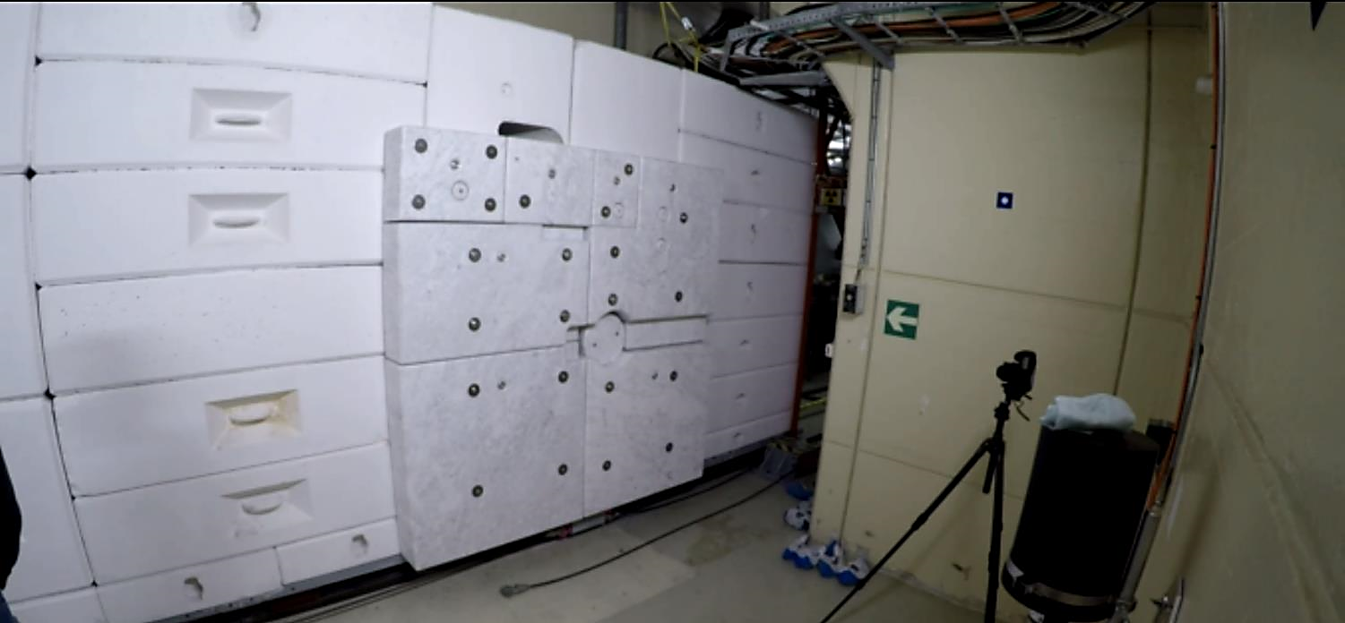
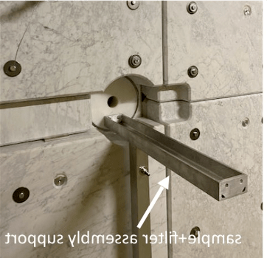
NEAR Station (outer area)
n_TOF target area shielding CLOSED
neutrons
Sample + filter assembly support
See INTC proposal P-623
Neutron capture cross section measurements by the activation method
at the n_TOF NEAR Station
Alice Manna (Universita e INFN, Bologna, IT),
Elisso Stamati (University of Ioannina, GR),
Gianpiero Gervino (INFN, Torino, IT)

Slide 14
NEAR Station (outer area)
Multi-foil activation analysis (MAM)
Measurements performed during commissioning
(CERN-INTC-2020-073, INTC-I-222)
Analysis performed by M Mastromarco, INFN & University of Bari

Slide 15
The n_TOF
Collaboration
C. Domingo-Pardo⁷
R. Dressler²³
Q. Ducasse²⁴
E. Dupont⁹
I. Durán¹⁶
Z. Eleme²⁵
B. Fernández-Domínguez¹⁶
A. Ferrari¹
P. Finocchiaro³
V. Furman²⁶
K. Göbel²⁷
R. Garg²²
A. Gawlik⁵
S. Gilardoni¹
I. F. Gonçalves²⁸
E. González-Romero²
C. Guerrero¹⁸
F. Gunsing⁹
H. Harada²⁹
S. Heinitz²³
J. Heyse³⁰
D. G. Jenkins¹³
A. Junghans³¹
F. Käppeler³²
Y. Kadi¹
A. Kimura²⁹
I. Knapová³³
M. Kokkoris²¹
Y. Kopatch²⁶
M. Krtička³³
D. Kurtulgil²⁷
I. Ladarescu⁷
C. Lederer-Woods²²
H. Leeb⁸
J. Lerendegui-Marco¹⁸
S. J. Lonsdale²²
D. Macina¹
A. Manna^{34,35}
T. Martínez²
A. Masi¹
C. Massimi^{34,35}
P. Mastinu³⁶
M. Mastromarco¹
E. A. Maugeri²³
A. Mazzone^{10,37}
E. Mendoza²
A. Mengoni³⁸
V. Michalopoulou^{21,1}
P. M. Milazzo³⁹
F. Mingrone¹
J. Moreno-Soto⁹
A. Musumarra^{3,40}
A. Negret⁴¹
R. Nolte²⁴
F. Ogállar⁴²
A. Oprea⁴¹
N. Patronis²⁵
A. Pavlik⁴³
J. Perkowski⁵
L. Persanti^{10,14,19}
C. Petrone⁴¹
E. Pirovano²⁴
O. Aberle¹
V. Alcayne²
S. Amaducci^{3,4}
J. Andrzejewski⁵
L. Audouin⁶
V. Babiano-Suarez⁷
M. Bacak^{1,8,9}
M. Barbagallo^{1,10}
S. Bennett¹¹
E. Berthoumieux⁹
J. Billowes¹¹
D. Bosnar¹²
A. Brown¹³
M. Busso^{10,14,15}
M. Caamaño¹⁶
L. Caballero-Ontanaya⁷
F. Calviño¹⁷
M. Calviani¹
D. Cano-Ott²
A. Casanovas¹⁷
F. Cerutti¹
E. Chiaveri^{1,11}
N. Colonna¹⁰
G. Cortés¹⁷
M. A. Cortés-Giraldo¹⁸
L. Cosentino³
S. Cristallo^{14,19}
L. A. Damone^{10,20}
P. J. Davies¹¹
M. Diakaki^{21,1}
I. Porras⁴²
J. Praena⁴²
J. M. Quesada¹⁸
D. Ramos-Doval⁶
T. Rauscher^{44,45}
R. Reifarth²⁷
D. Rochman²³
Y. Romanets²⁸
C. Rubbia¹
M. Sabaté-Gilarte^{18,1}
A. Saxena⁴⁶
P. Schillebeeckx³⁰
D. Schumann²³
A. Sekhar¹¹
A. G. Smith¹¹
N. V. Sosnin¹¹
P. Sprung²³
A. Stamatopoulos²¹
G. Tagliente¹⁰
J. L. Tain⁷
A. Tarifeño-Saldivia¹⁷
L. Tassan-Got^{1,21,6}
Th. Thomas²⁷
P. Torres-Sánchez⁴²
A. Tsinganis¹
J. Ulrich²³
S. Urlass^{31,1}
S. Valenta³³
G. Vannini^{34,35}
V. Variale¹⁰
P. Vaz²⁸
A. Ventura³⁴
D. Vescovi^{10,14}
V. Vlachoudis¹
R. Vlastou²¹
A. Wallner⁴⁷
P. J. Woods²²
T. Wright¹¹
P. Žugec¹²

Slide 16
The n_TOF
Collaboration
¹European Organization for Nuclear Research (CERN), Switzerland
²Centro de Investigaciones Energéticas Medioambientales y Tecnológicas (CIEMAT), Spain
³INFN Laboratori Nazionali del Sud, Catania, Italy
⁴Dipartimento di Fisica e Astronomia, Università di Catania, Italy
⁵University of Lodz, Poland
⁶Institut de Physique Nucléaire, CNRS-IN2P3, Univ. Paris-Sud, Université Paris-Saclay, F-91406 Orsay Cedex, France
⁷Instituto de Física Corpuscular, CSIC - Universidad de Valencia, Spain
⁸TU Wien, Atominstitut, Stadionallee 2, 1020 Wien, Austria
⁹CEA Irfu, Université Paris-Saclay, F-91191 Gif-sur-Yvette, France
¹⁰Istituto Nazionale di Fisica Nucleare, Sezione di Bari, Italy
¹¹University of Manchester, United Kingdom
¹²Department of Physics, Faculty of Science, University of Zagreb, Zagreb, Croatia
¹³University of York, United Kingdom
¹⁴Istituto Nazionale di Fisica Nucleare, Sezione di Perugia, Italy
¹⁵Dipartimento di Fisica e Geologia, Universita’ di Perugia, Italy
¹⁶University of Santiago de Compostela, Spain
¹⁷Universitat Politècnica de Catalunya, Spain
¹⁸Universidad de Sevilla, Spain
¹⁹Istituto Nazionale di Astrofisica - Osservatorio Astronomico di Teramo, Italy
²⁰Dipartimento di Fisica, Università degli Studi di Bari, Italy
²¹National Technical University of Athens, Greece
²²School of Physics and Astronomy, University of Edinburgh, United Kingdom
²³Paul Scherrer Institut (PSI), Villigen, Switzerland
²⁴Physikalisch-Technische Bundesanstalt (PTB), Bundesallee 100, 38116 Braunschweig, Germany
²⁵University of Ioannina, Greece
²⁶Joint Institute for Nuclear Research (JINR), Dubna, Russia
²⁷Goethe University Frankfurt, Germany
²⁸Instituto Superior Técnico, Lisbon, Portugal
²⁹Japan Atomic Energy Agency (JAEA), Tokai-mura, Japan
³⁰European Commission, Joint Research Centre, Geel, Retieseweg 111, B-2440 Geel, Belgium
³¹Helmholtz-Zentrum Dresden-Rossendorf, Germany
³²Karlsruhe Institute of Technology, Campus North, IKP, 76021 Karlsruhe, Germany
³³Charles University, Prague, Czech Republic
³⁴Istituto Nazionale di Fisica Nucleare, Sezione di Bologna, Italy
³⁵Dipartimento di Fisica e Astronomia, Università di Bologna, Italy
³⁶Istituto Nazionale di Fisica Nucleare, Sezione di Legnaro, Italy
³⁷Consiglio Nazionale delle Ricerche, Bari, Italy
³⁸Agenzia nazionale per le nuove tecnologie (ENEA), Bologna, Italy
³⁹Istituto Nazionale di Fisica Nucleare, Sezione di Trieste, Italy
⁴⁰Dipartimento di Fisica e Astronomia, Università di Catania, Italy
⁴¹Horia Hulubei National Institute of Physics and Nuclear Engineering, Romania
⁴²University of Granada, Spain
⁴³University of Vienna, Faculty of Physics, Vienna, Austria
⁴⁴Department of Physics, University of Basel, Switzerland
⁴⁵Centre for Astrophysics Research, University of Hertfordshire, United Kingdom
⁴⁶Bhabha Atomic Research Centre (BARC), India
⁴⁷Australian National University, Canberra, Australia

Slide 17
The End

