Slide 1
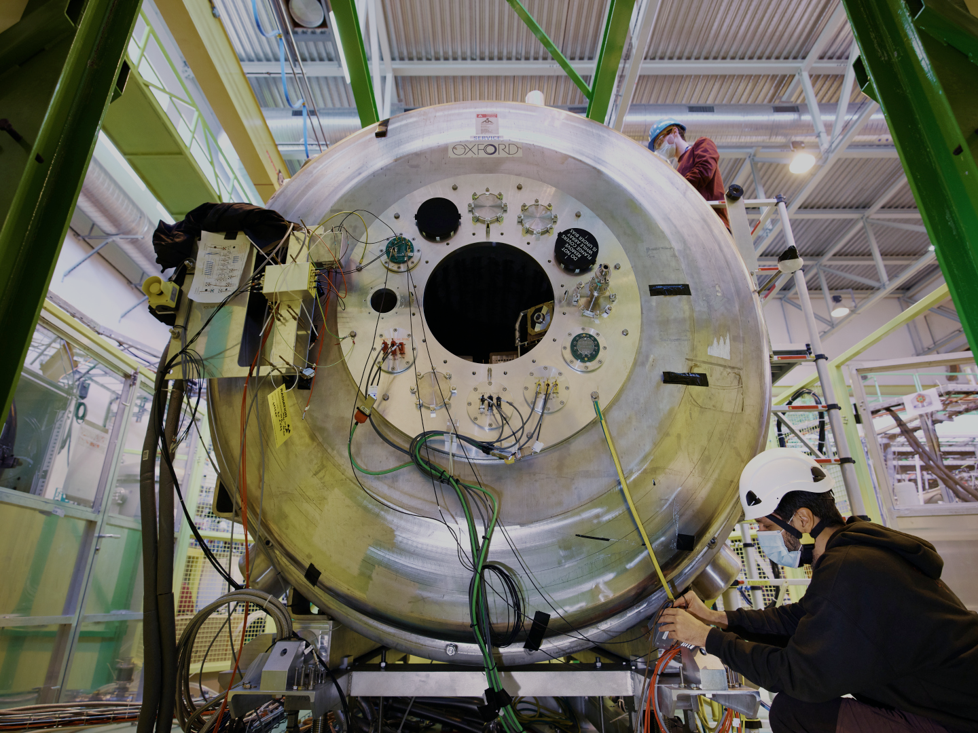





Transfer reactions on the neutron-rich krypton isotopes
Liam Gaffney
69th INTC Meeting Meeting – CERN

Slide 2
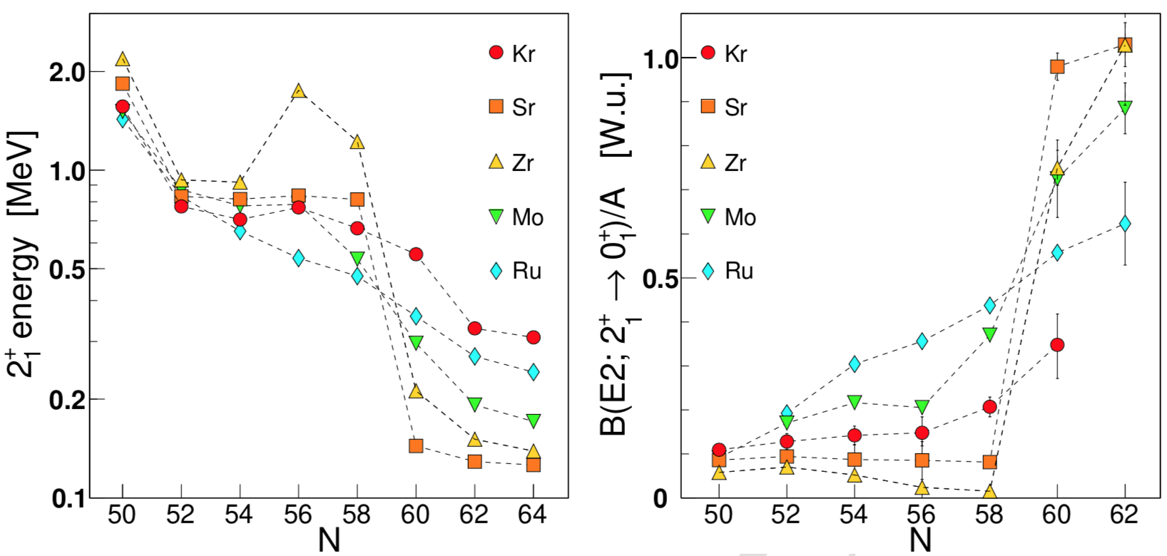
Onset of deformation at N=60
³ P.E. Garrett, M. Zielińska, and E. Clément, Prog. Part. Nucl. Phys. 163, 103931 (2021).
Sr and Zr show rapid and dramatic onset of deformation at N=60.
Smooth increase for the Kr isotopic chain¹.
Low-lying intruder configurations → shape coexistence^{2,3}
¹ M. Albers, et al., Phys. Rev. Lett. 108, 062701 (2012).
² J.E. García-Ramos and K. Heyde, Phys. Rev. C 100, 044315 (2019).

Slide 3
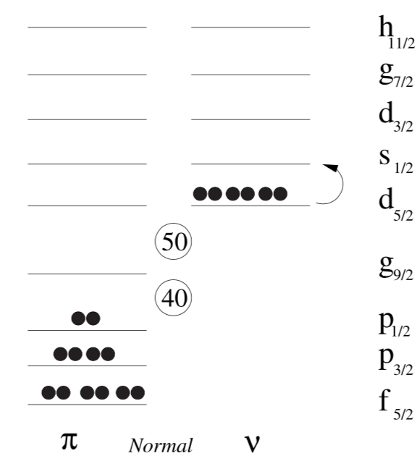
Deformation-driving orbitals
N = 57
N = 59
N = 61
N = 56
Proton excitations across Z = 40 to πg_{9/2} orbital.
  Ground-state configuration at N = 60.
Filling neutron orbitals lowers energy of πg_{9/2}.
  Large overlap of πg_{9/2} and νg_{7/2}… (lesser extent νh_{11/2})
  Tensor force¹ → Type-II shell evolution²
Close proximity of νs_{1/2}, νd_{3/2}, νg_{7/2}, νh_{11/2} orbitals.
  Enhanced quadrupole interaction from coherent contributions of configurations → deformation
¹ P. Federman and S. Pittel, Phys. Lett. B 69, 385 (1977).
² T. Togashi, Y. Tsunoda, T. Otsuka, and N. Shimizu, Phys. Rev. Lett. 117, 172502 (2016).

Slide 4
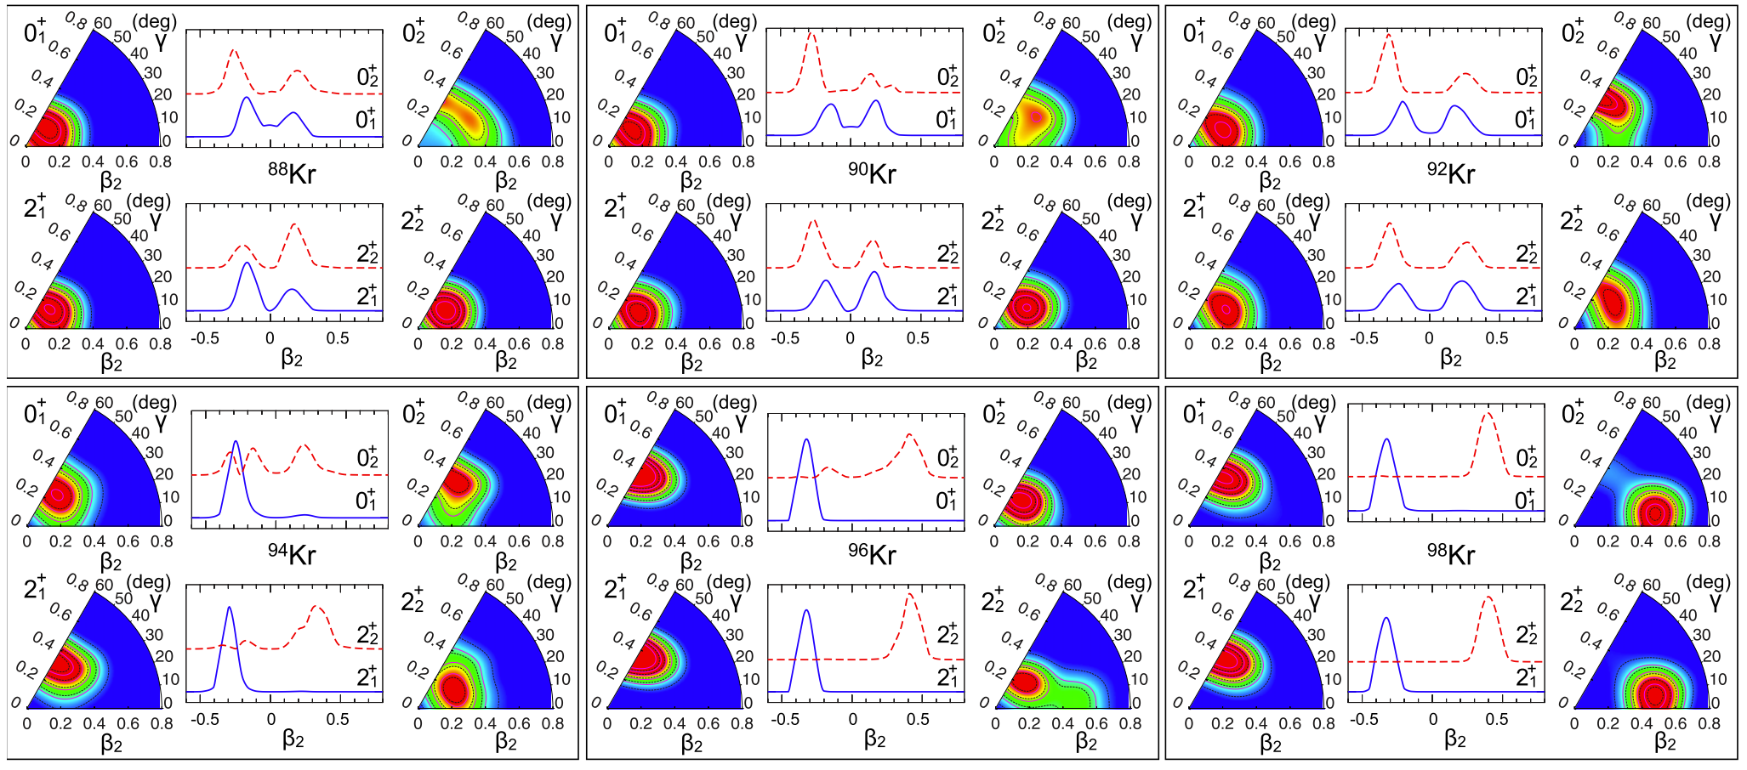
The neutron-rich krypton isotopes
Evolution of shape change is not as dramatic as Zr and Sr, but occurs smoothly.
Mean-field based models¹ and IBM “mapping”^{2,3} show configuration mixing.
  Not present in Zr and Sr…
How do the single-particle orbitals and their occupancies evolve in the Kr isotopes?
¹ T.R. Rodríguez, Phys. Rev. C 90, 034306 (2014).
² K. Nomura, et al., Phys. Rev. C 96, 034310 (2017).
³ R.-B. Gerst, et al., Phys. Rev. C 105, 024302 (2022).

Slide 5
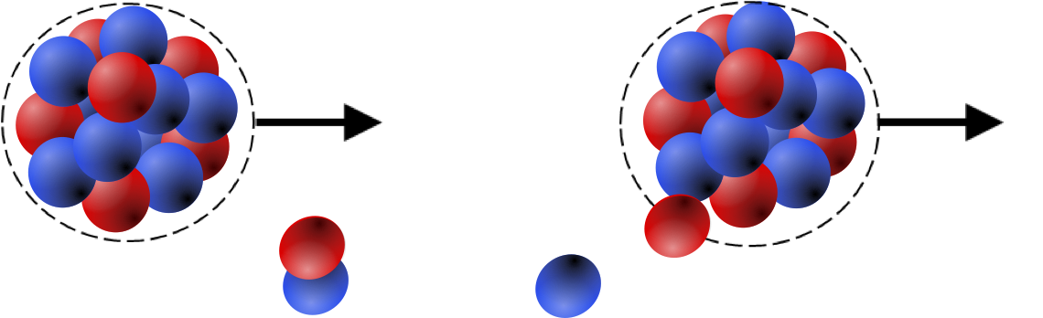
Odd-mass Kr isotopes
¹ T. Rząca-Urban, et al., Phys. Rev. C 95, 064302 (2017).
² G. Lhersonneau, et al., Phys. Rev. C 63, 034316 (2001).
³ R.-B. Gerst, et al., Phys. Rev. C 105, 024302 (2022).
Energy gap of νd_{3/2} - νg_{7/2} is reduced with increasing N.
Occupancy of each orbital drives change in πg_{9/2} energy.
  νg_{7/2} and νh_{11/2} most important.
7/2⁺
Lowest energy states for ν orbitals: d_{5/2}, s_{1/2}, d_{3/2} , g_{7/2}
dashed lines are unidentified states
1/2⁺
3/2⁺
Use one-neutron transfer:
Determine 𝓁 of the states.
Relative occupancies of key orbitals.
Identify fragmentation of SP strength.
Determine centroid – related to ESPEs.
5/2⁺
⁹¹Kr
⁹³Kr
⁹⁵Kr
⁹⁷Kr
But we have collectivity and fragmentation!
Unidentified h_{11/2} states?

Slide 6
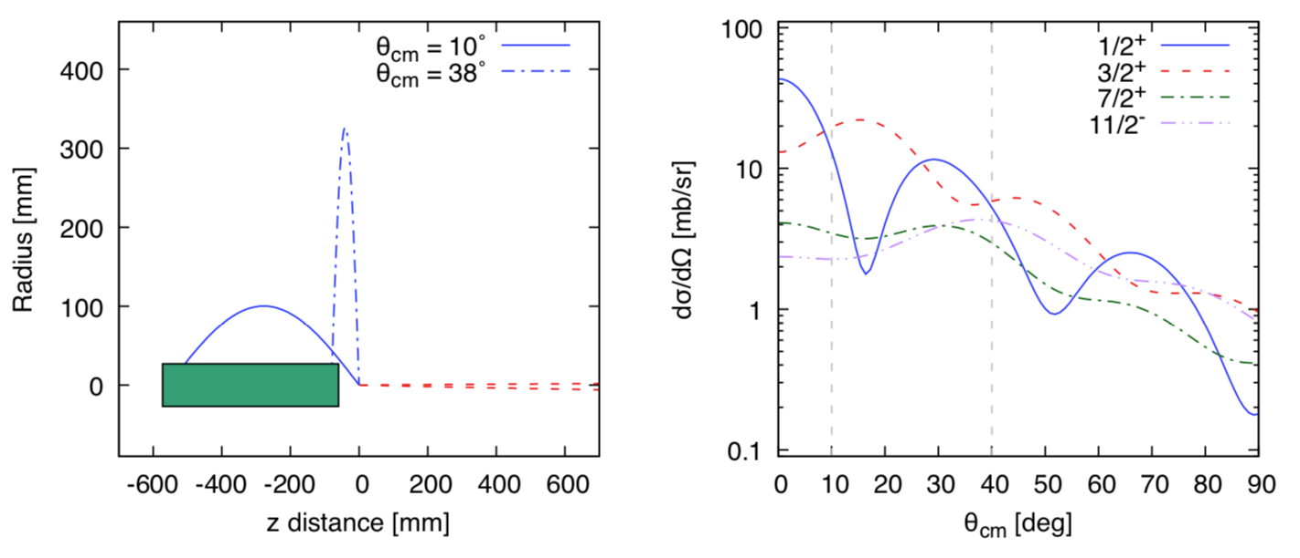
Transfer reactions at ISS - ^{92,94}Kr(d,p)
“Standard” setup with new array, plus gas recoil detector.
Kinematics with array at 60 mm and magnetic field = 2.05 Tesla.
Maximum possible beam energy from HIE-ISOLDE ~7.5 MeV/u.
DWBA calculations with Ptolemy + global optical model parameters^{1,2}.
Monitor detector for (d,d) normalisation → extraction of C²S
z distance proportional to θ_{CM}
No kinematic compression!
Array coverage
Direct Ex measurement
No problem with isomeric states!
¹ H. An and C. Cai, Phys. Rev. C 73, 054605 (2006).
² A.J. Koning and J.P. Delaroche, Nucl. Phys. A 713, 231 (2003).

Slide 7

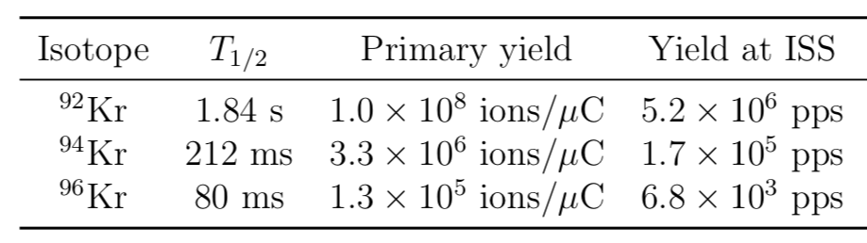
Beam intensity and availability
Experience from runs in 2009, 2010 (REX) and 2018 (HIE).
Requires Mo-free ion source to reduce contaminants.
^{92,94}Kr otherwise “easy”, but ⁹⁶Kr has short half-life (80 ms).
  Synchronisation of TRAP and EBIS, plus T1 timing in analysis.
  Extra shift requested to test this for future feasibility.
  TAC comments inline with expectations and proposed plan.
10 shifts for physics
10 shifts for physics
1 shifts for EBIS tests

Slide 8
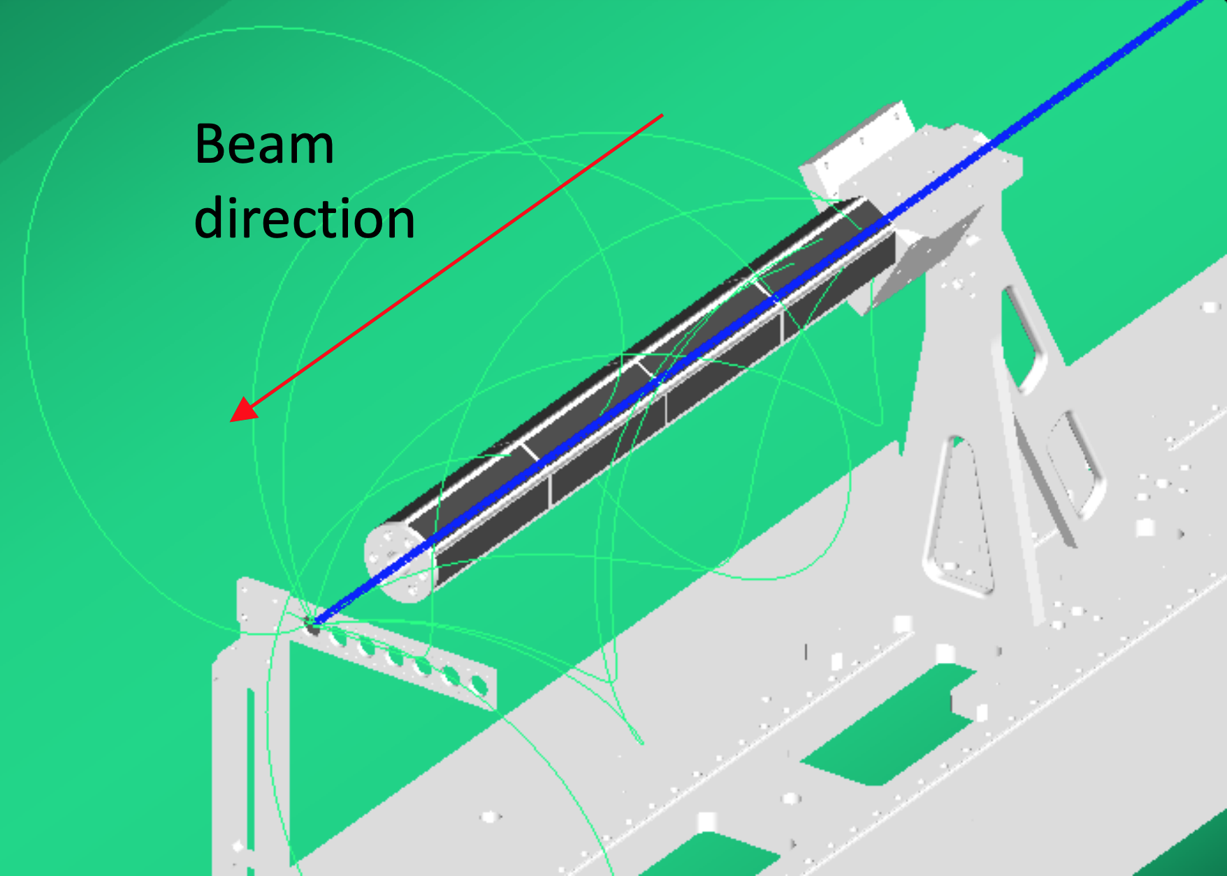
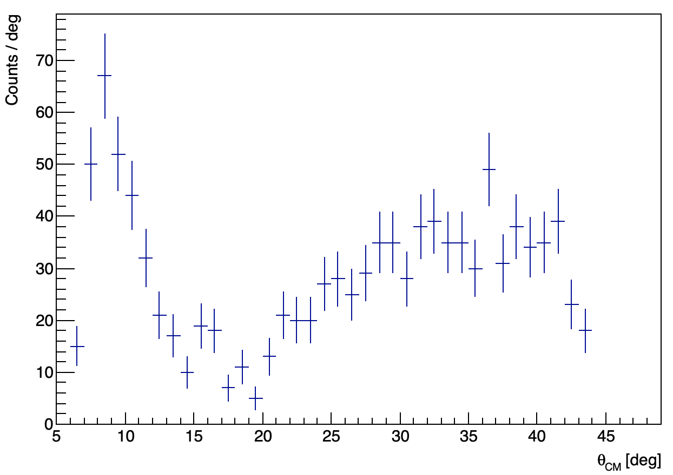
Realistic Simulations - ^{92,94}Kr(d,p)
Aim to be sensitive to C²S > 0.1 in g_{7/2} state.
Identification of unobserved h_{11/2} state at C²S > 0.1.
Fragmentation of strength expected in higher-lying states.
⁹²Kr
C²S = 0.1
NPTool: A. Matta et al. J. Phys. G 43, 045113 (2016)
ISS implementation: M. Labiche (STFC Daresbury)
d_{3/2}
⁹²Kr
g.s. distribution – s_{1/2}
s_{1/2}
g_{7/2}

Slide 9
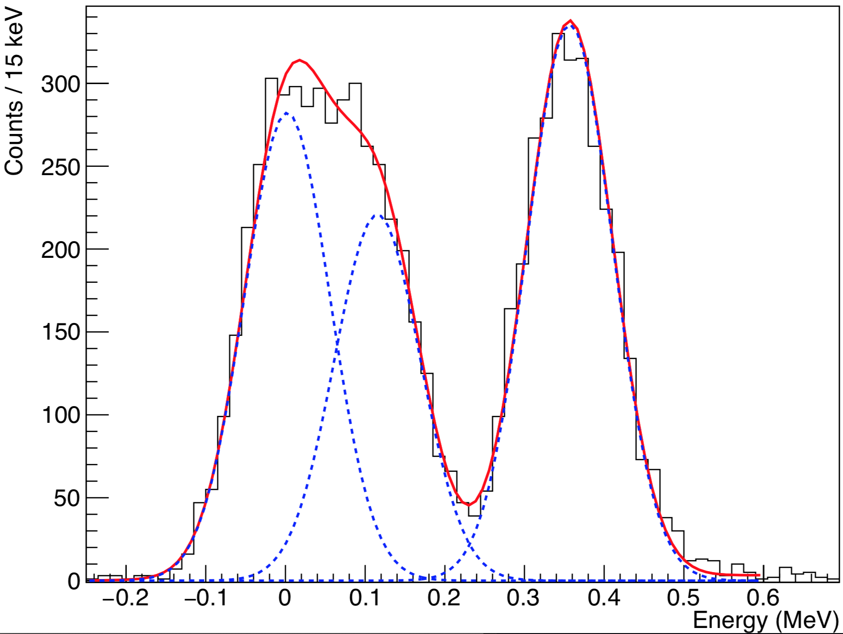
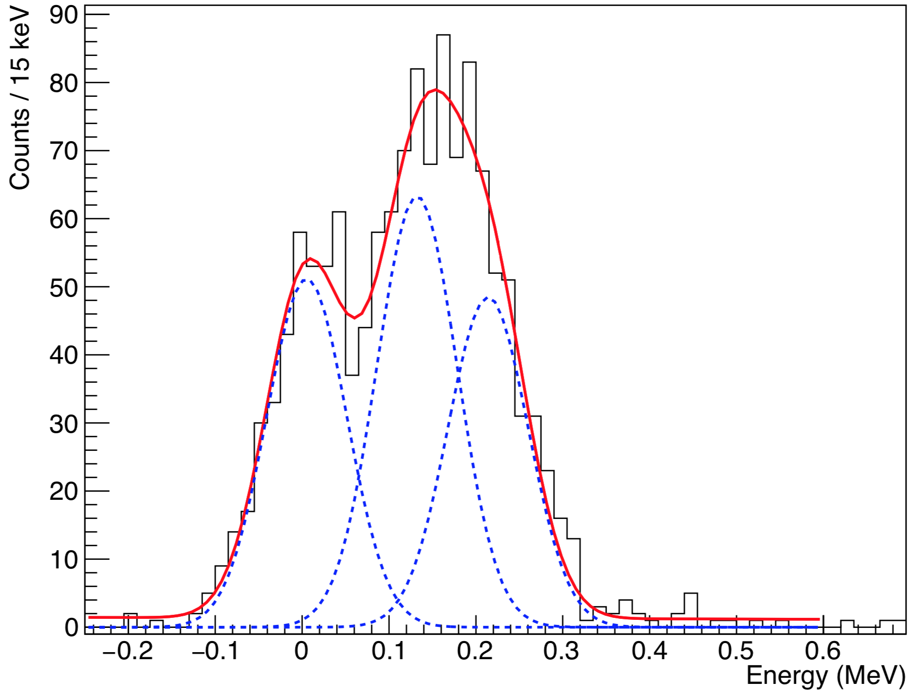
Realistic Simulations – ^{92,94}Kr(d,p)
s_{1/2}
C²S = 0.3
d_{3/2}
C²S = 0.1
⁹²Kr
d_{3/2}
C²S = 0.1
⁹⁴Kr
s_{1/2}
C²S = 0.3
g_{7/2}
C²S = 0.6
g_{7/2}
C²S = 0.6
Varying C²S to see effect on doublet fitting.
Fitted peak width ~120 keV with 0.1 mg/cm² CD₂ target.

Slide 10
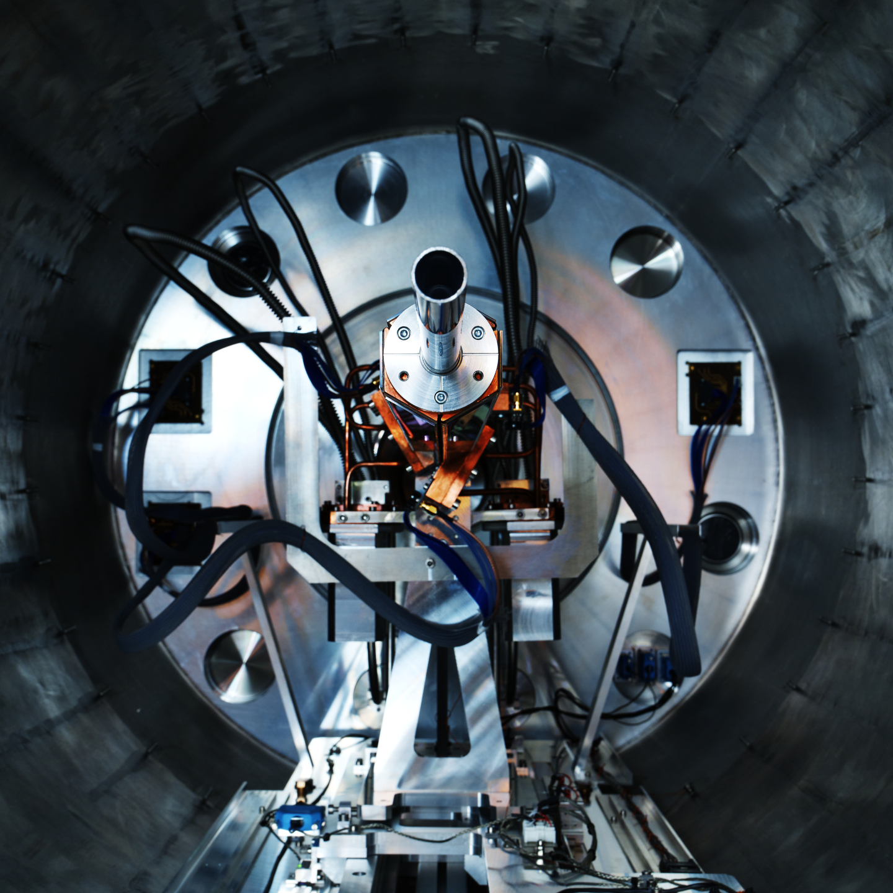
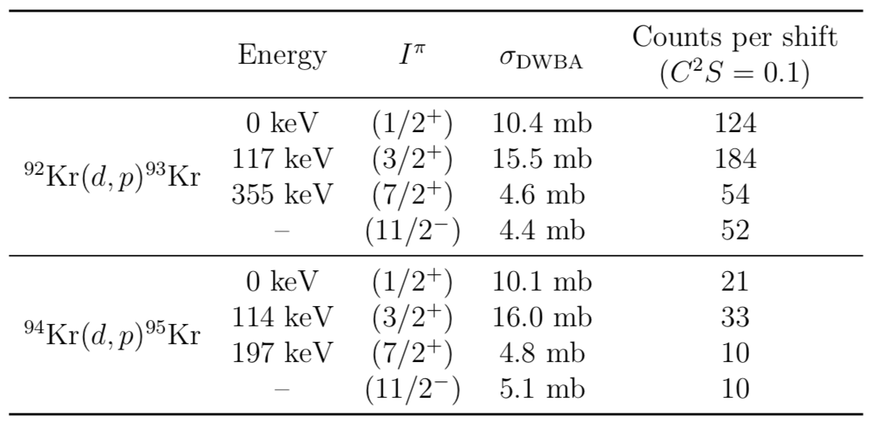
Summary and beam time request
^{92,94}Kr(d,p) at ISS to map single-particle strength towards N = 60.
  Smooth onset of deformation.
0.1 mg/cm² CD₂ target
10 shifts
~500 counts
10 shifts
~100 counts

Slide 11
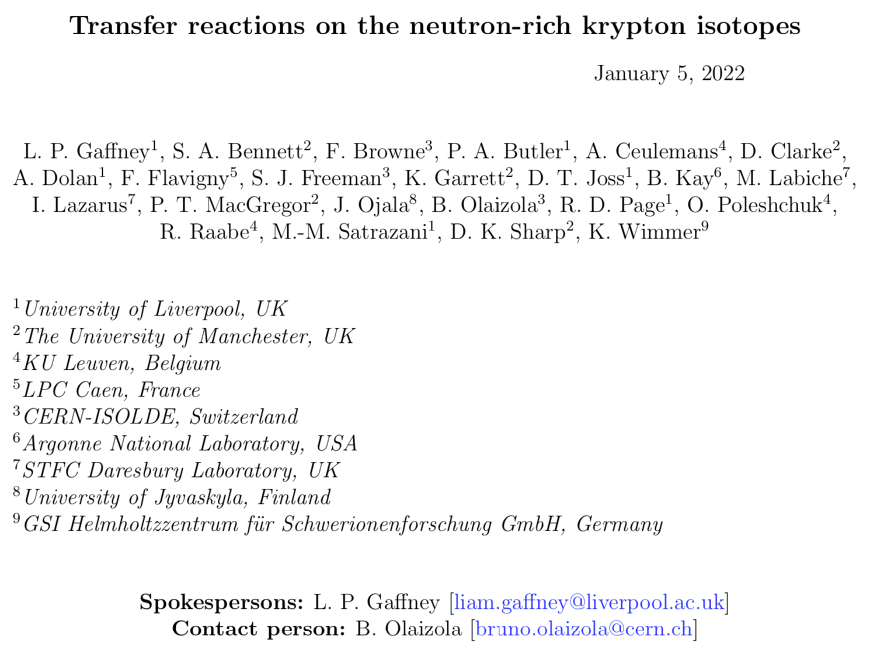
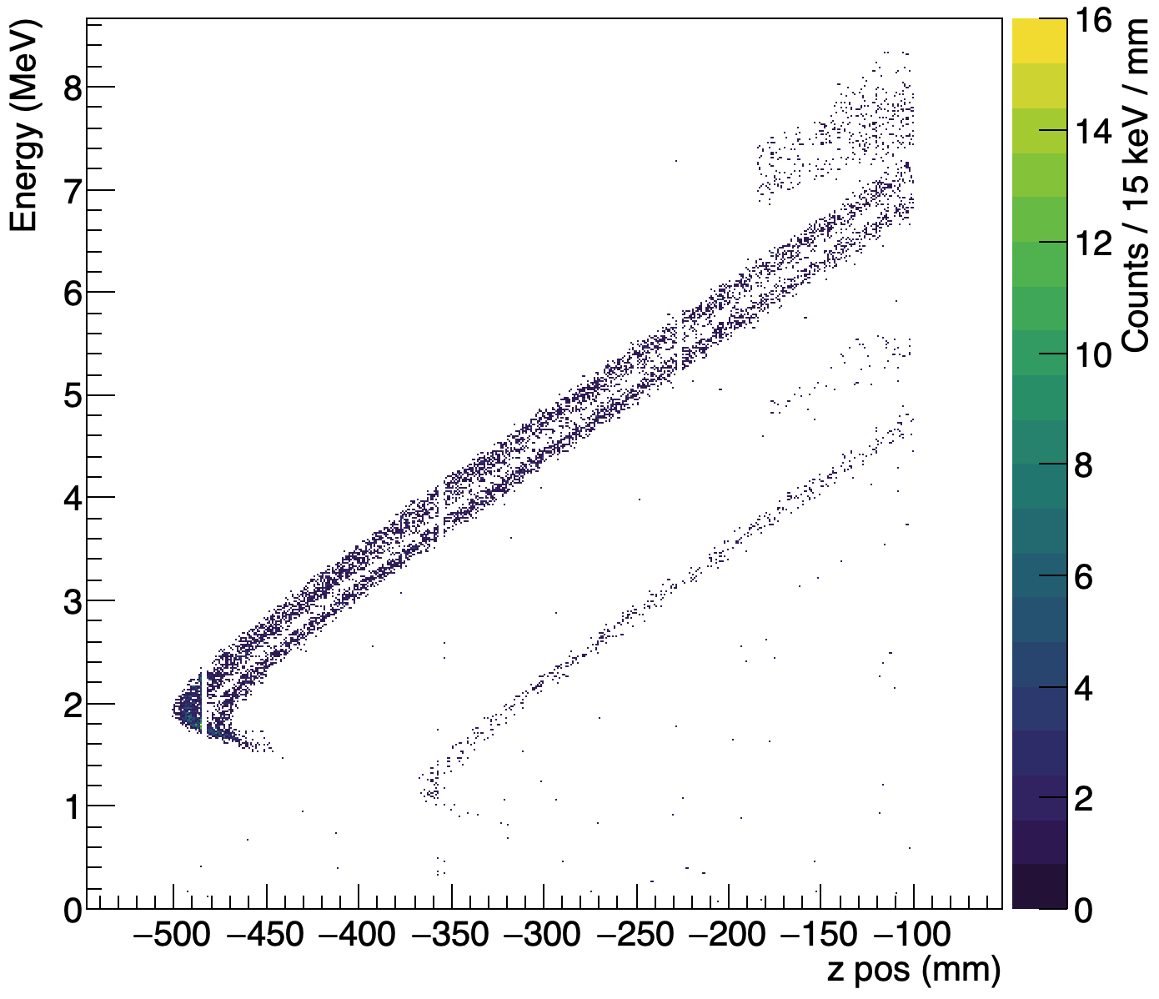
Thank you!

Slide 12
Backup slides will follow…

Slide 13
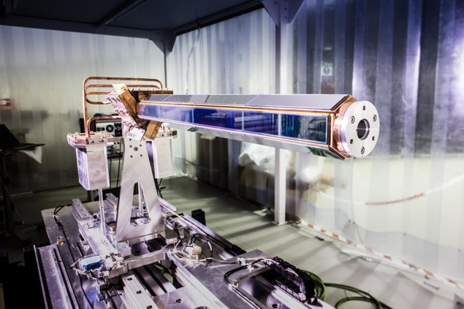
ISS on-axis silicon array

Slide 14
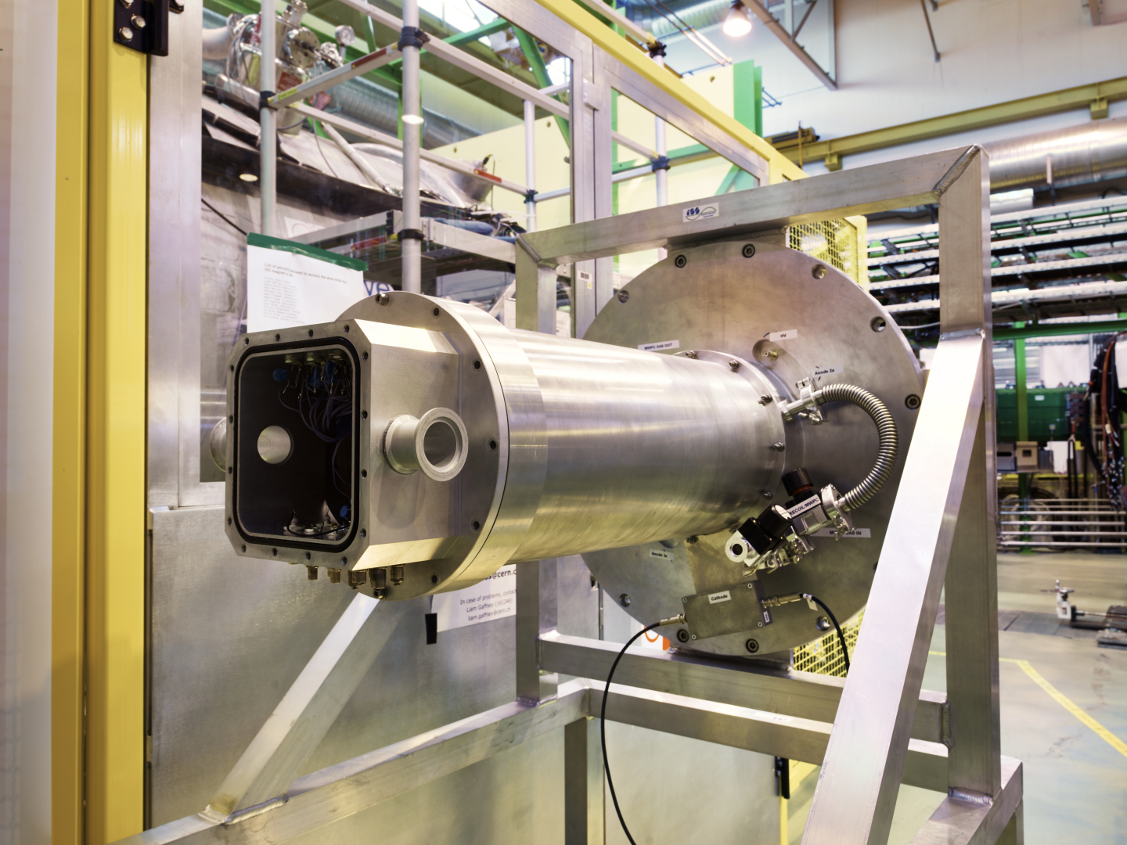
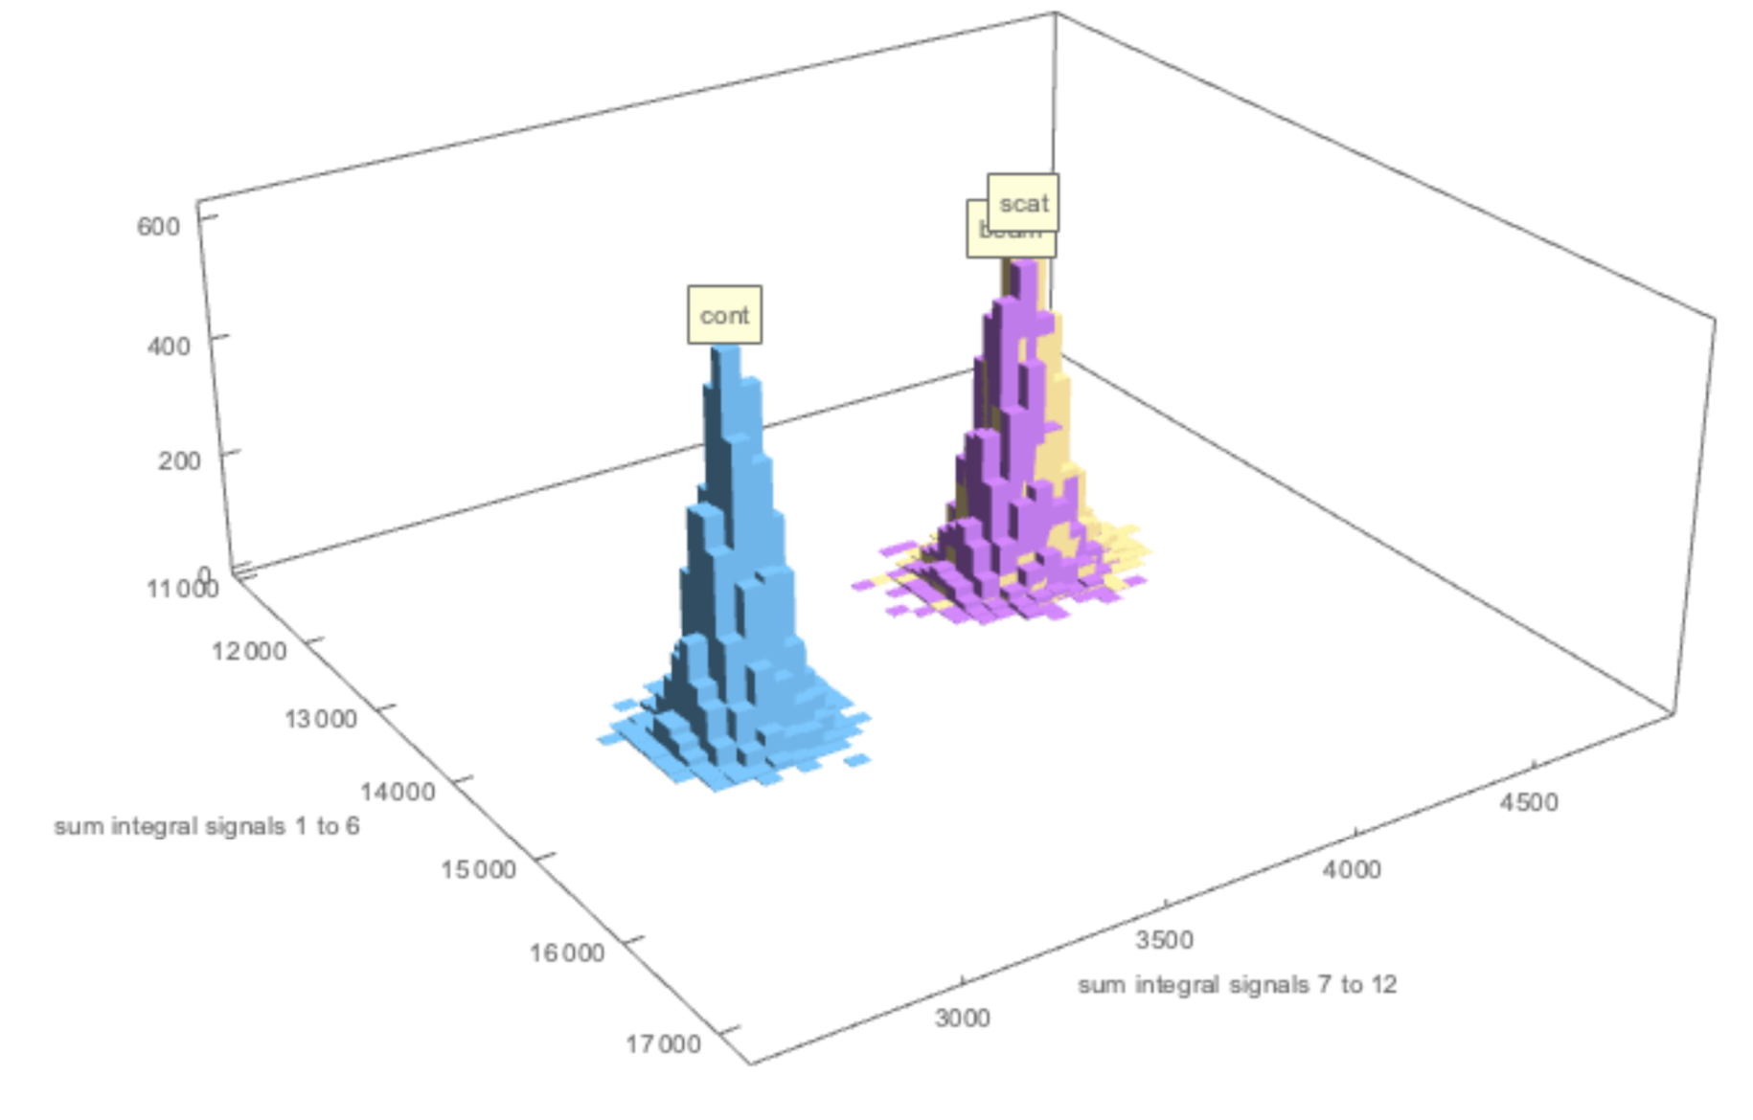
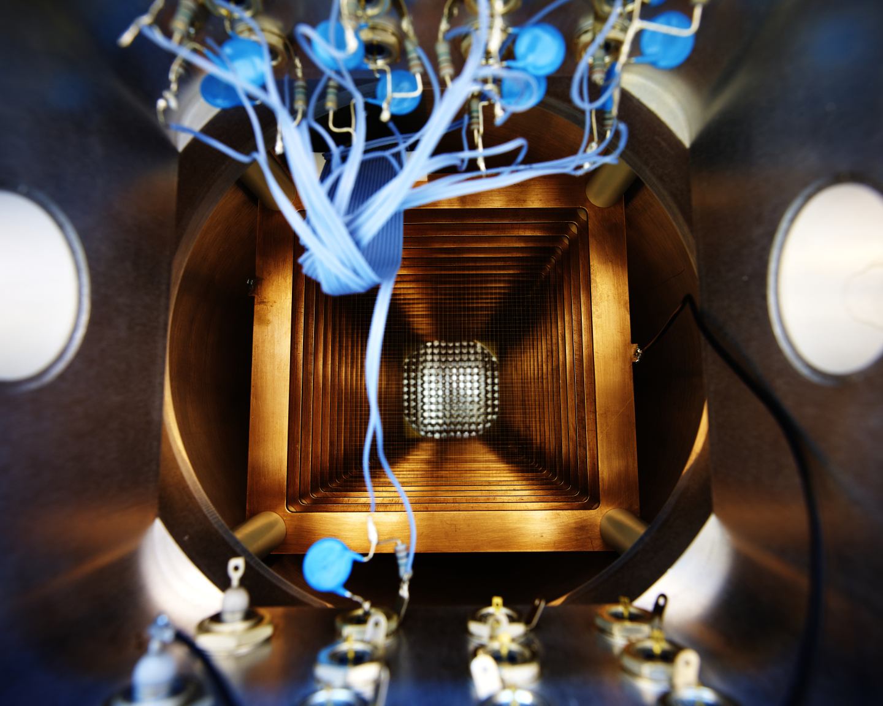
Gas ionisation detector
Built, delivered and tested with beam in 2021.
Blocker required to reduce direct/scattered beam.
Trigger validation from array to reduce data rate, plus fast shapers (upgrades).
⁹³Rb g.s. kinematics: E_{p} = ⁹³Kr + 2.5 MeV
⁹²Kr
⁹³Kr
⁹²Rb

Slide 15
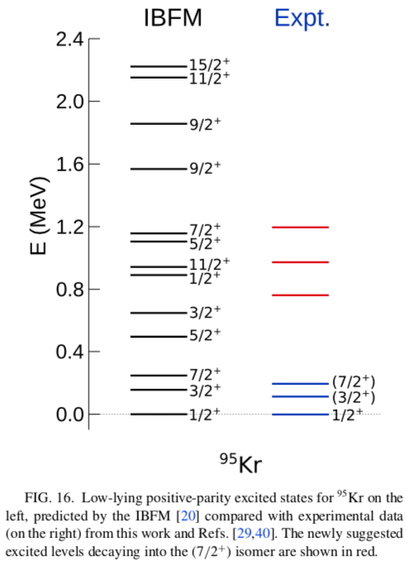
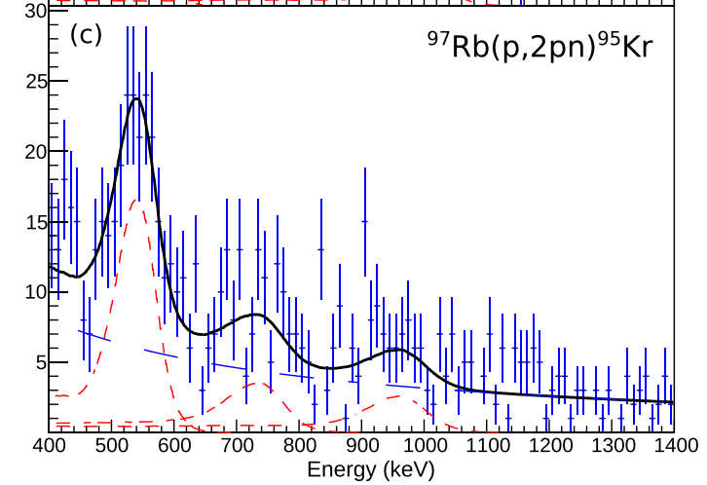
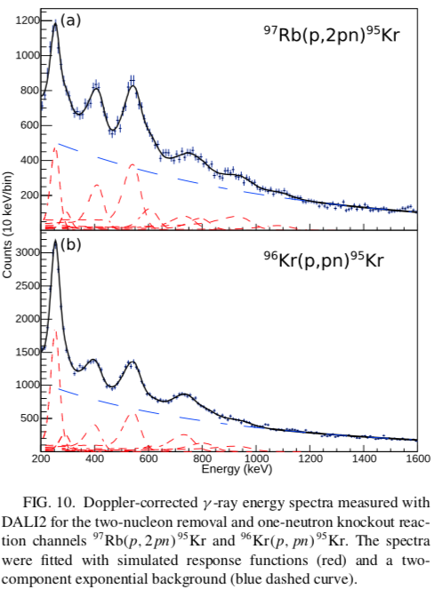
Recent results – ⁹⁵Kr
¹ R.-B. Gerst, et al., Phys. Rev. C 105, 024302 (2022).
Most recent results for ⁹⁵Kr.
  γ-ray spectroscopy with DALI2@RIBF¹.
Isomeric nature of (7/2⁺) state.
  Prompt-delayed correlations
Likely populated also in ⁹⁴Kr(d,p)
→ 𝓁 assignments
Transitions feed (7/2+) state
Limit of previous spectroscopy

Slide 16
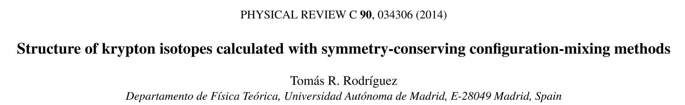

Slide 17
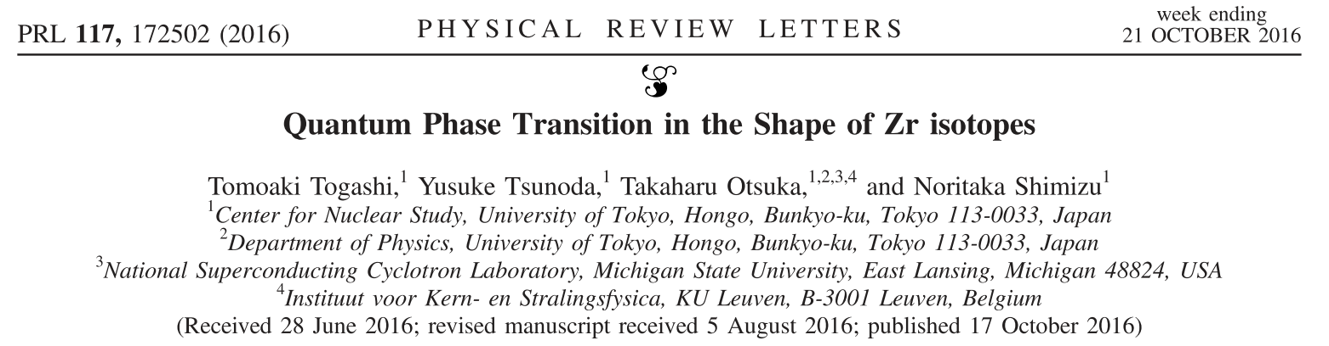
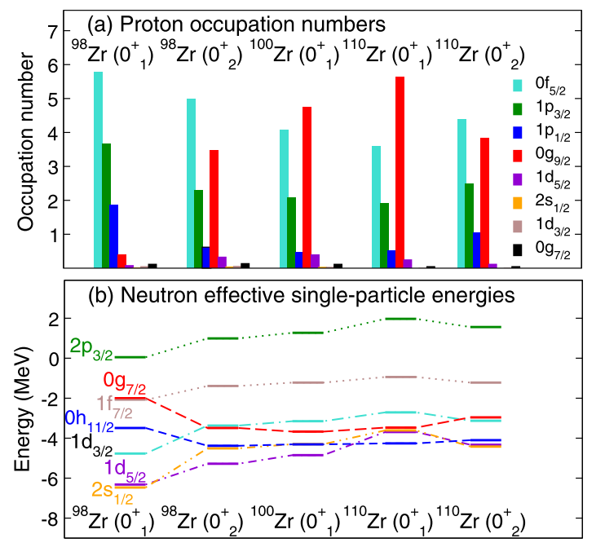
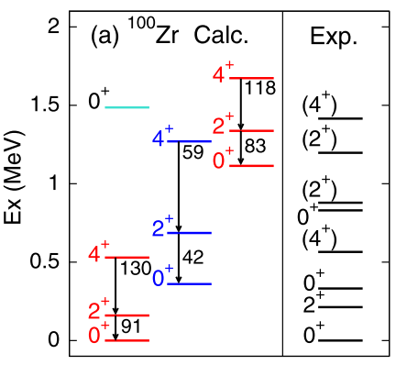
T. Togashi, Y. Tsunoda, T. Otsuka, and N. Shimizu
Phys. Rev. Lett. 117, 172502 (2016).

Slide 18
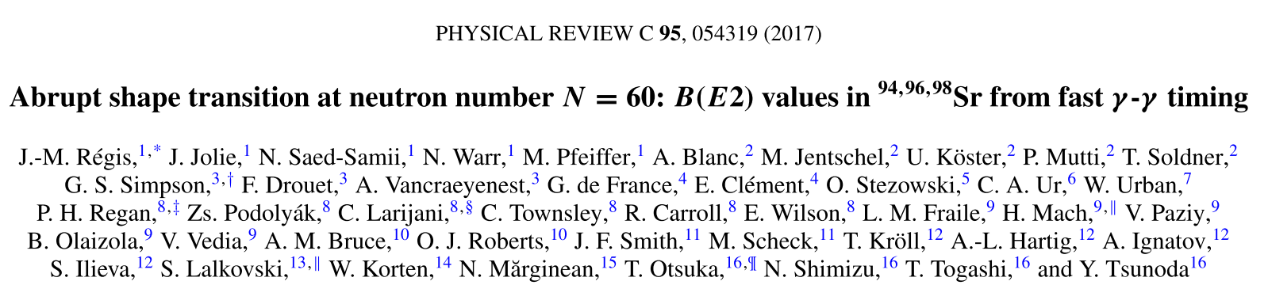
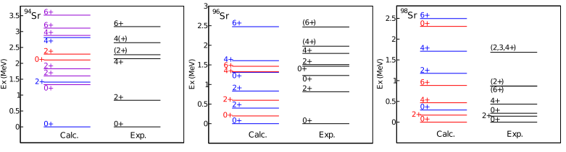

Slide 19
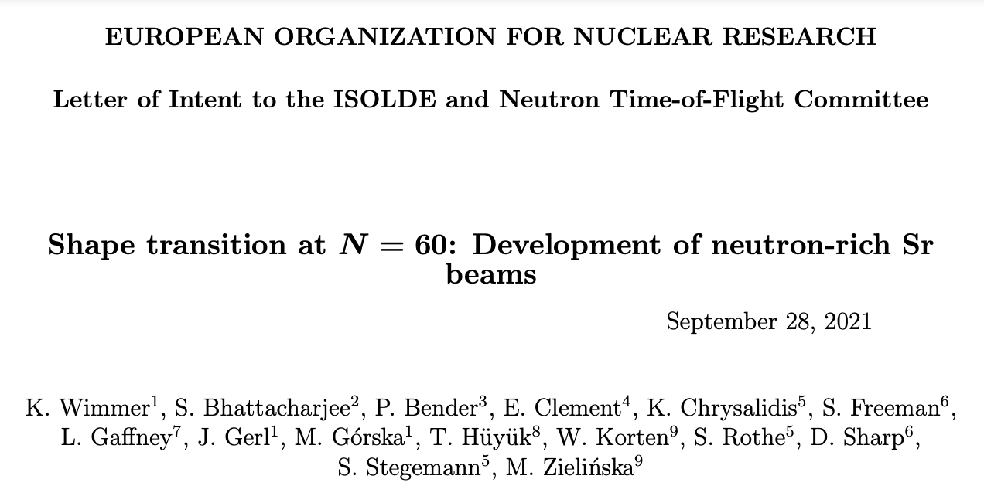
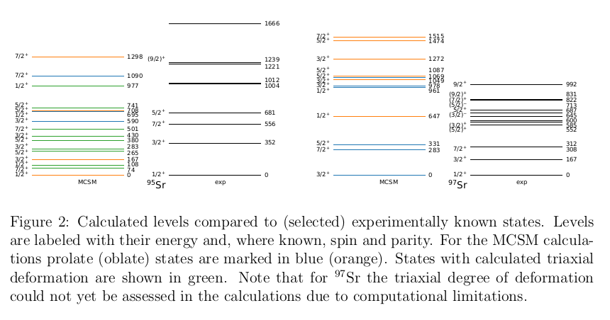

Slide 20
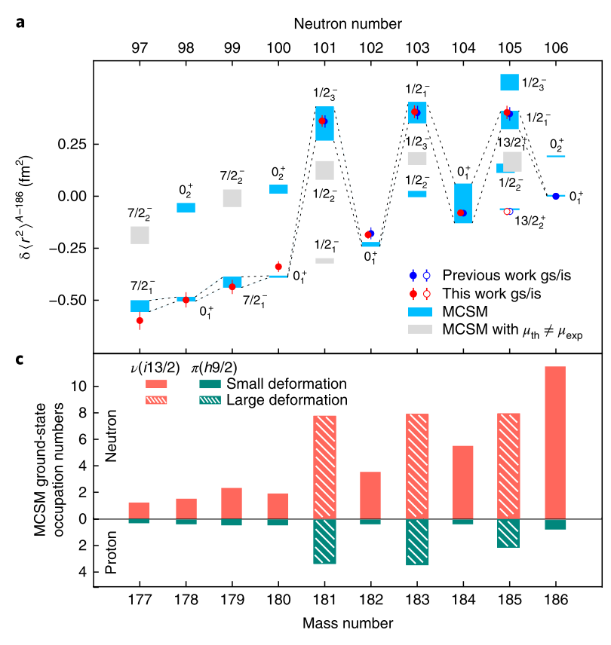
Analagous mechanism
Hg isotopes
Large-scale MCSM calculations in n-deficient Hg isotopes.
Occupancy of νi_{13/2} changes along with πh_{9/2}.
Fine energy balance of orbitals and odd-neutron shifts energy enough to change configuration of the ground state.
Can be probed with 1-neutron transfer from even-mass → confirm with small spectroscopic factors for corresponding states.
¹ B.A. Marsh, et al., Nature Physics 14, 1163 (2018).

Slide 21
DWBA
d_{3/2} max. ⇔ g_{7/2} min.
  And vice versa…
  Doublet fitting made easier.
s_{1/2} max. lower than range.
  No problem as 2nd max. in range.
h_{11/2} requires max. energy.
  Difficult to get definitive 𝓁.

Slide 22
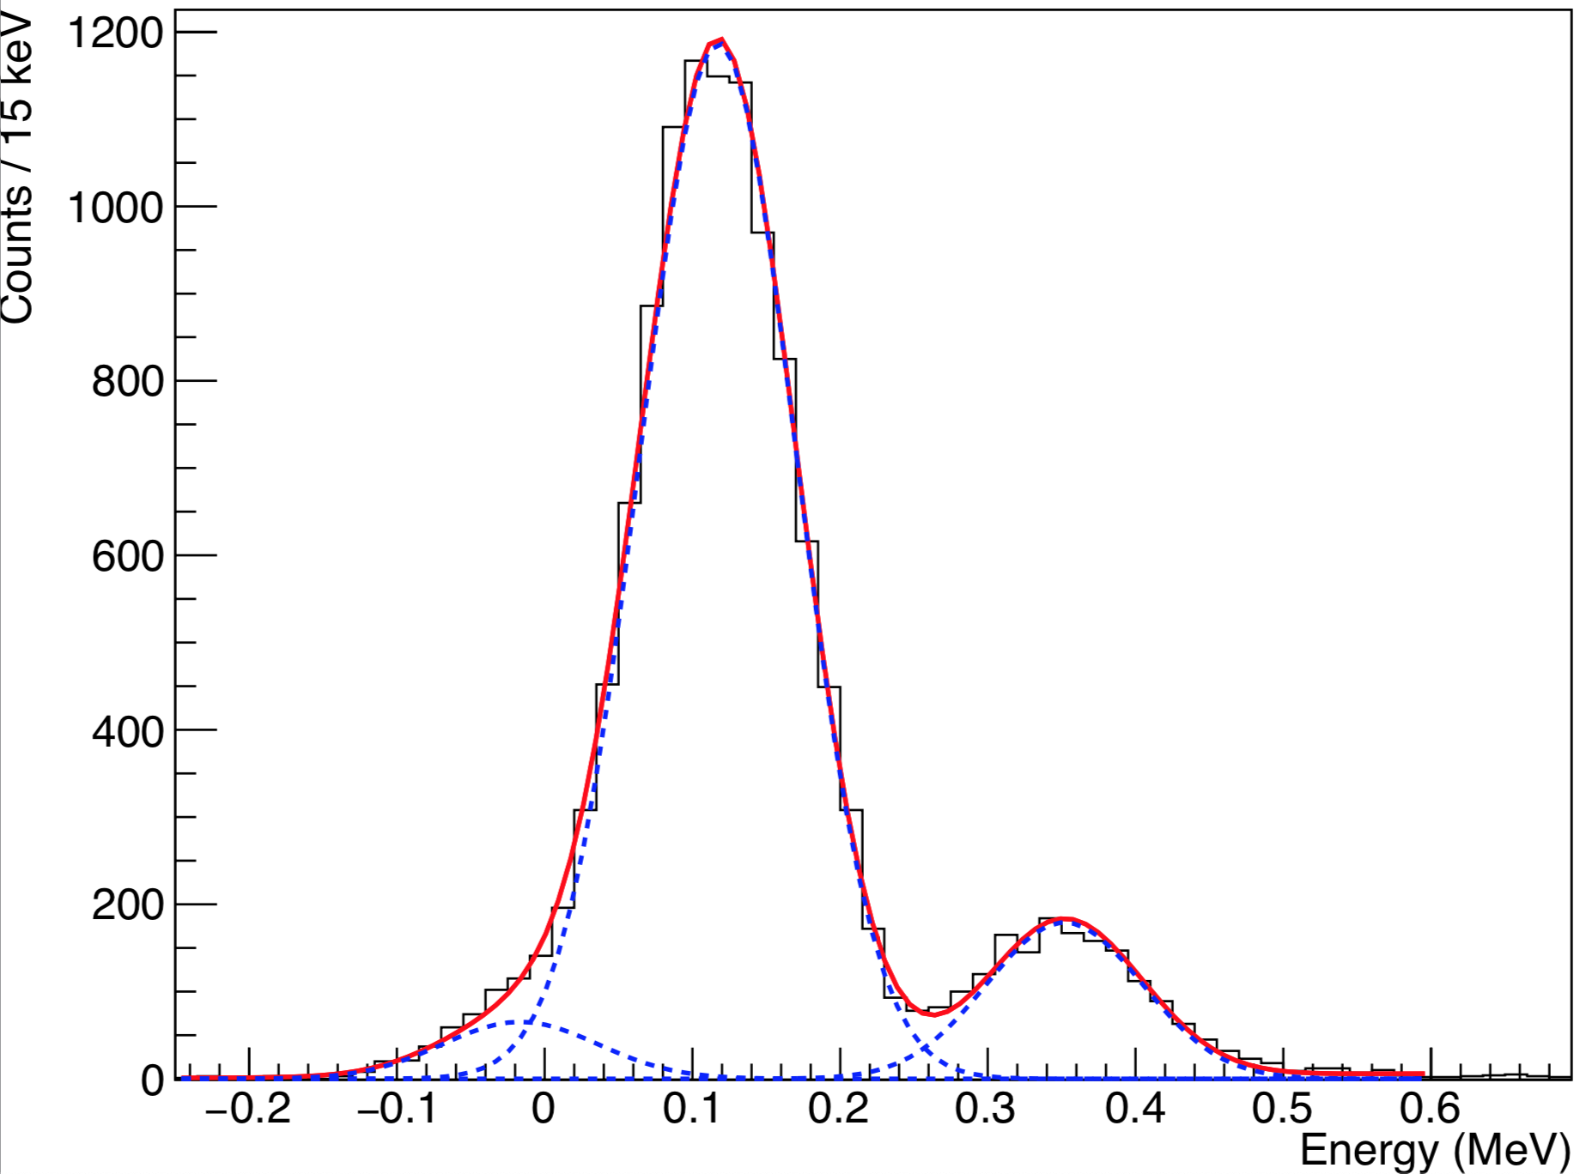
Realistic Simulations - ⁹²Kr(d,p)
⁹²Kr
s_{1/2}
C²S = 0.3
d_{3/2}
C²S = 0.1
⁹²Kr
d_{3/2}
C²S = 0.6
g_{7/2}
C²S = 0.6
s_{1/2}
C²S = 0.1
g_{7/2}
C²S = 0.3
Varying C²S to see effect on doublet fitting.

Slide 23
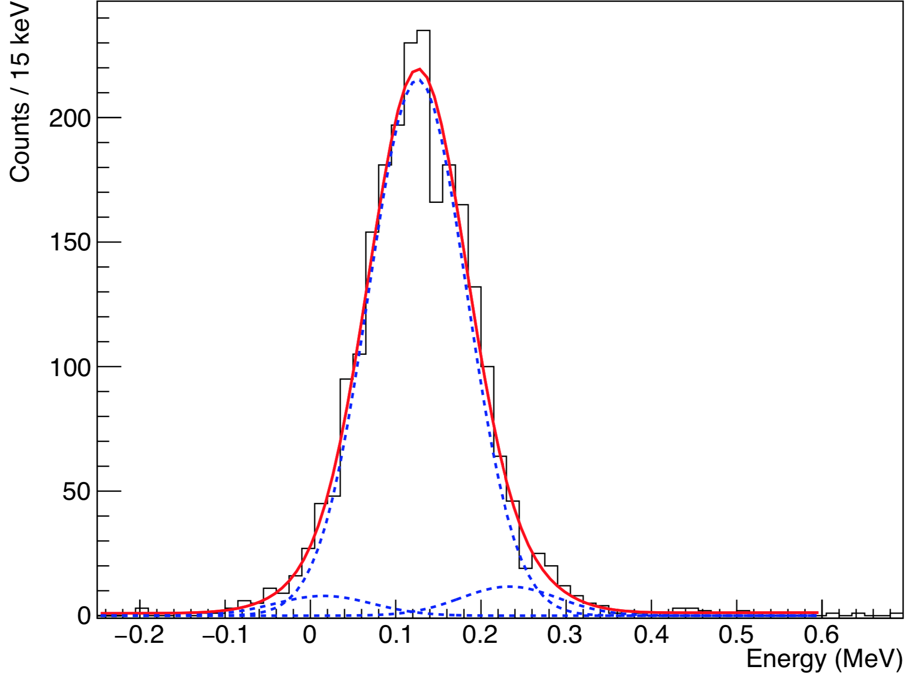
Realistic Simulations - ⁹⁴Kr(d,p)
⁹⁴Kr
d_{3/2}
C²S = 0.1
⁹⁴Kr
d_{3/2}
C²S = 0.6
s_{1/2}
C²S = 0.3
g_{7/2}
C²S = 0.6
s_{1/2}
C²S = 0.1
g_{7/2}
C²S = 0.3
Varying C²S to see effect on doublet fitting.

Slide 24
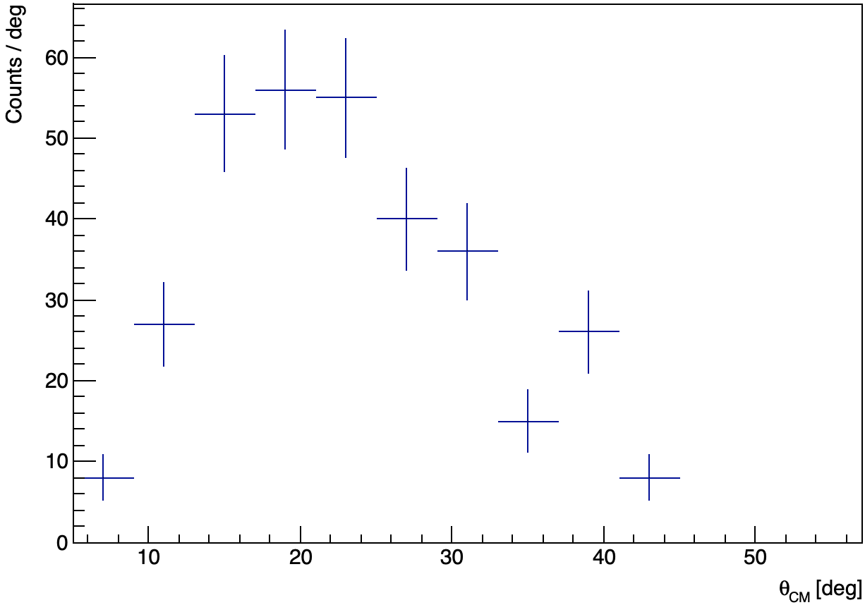
Combined DWBA distributions – ⁹⁴Kr
Combined Doublet distribution
C²S(d_{3/2}) = 0.1; C²S(g_{7/2}) = 0.6

Slide 25
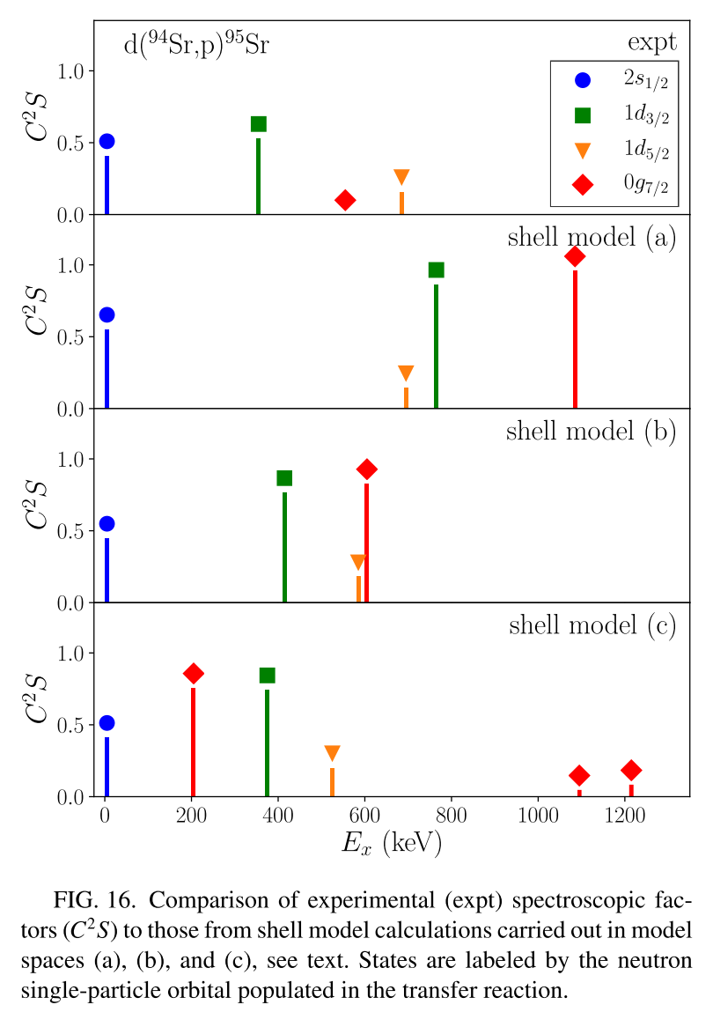
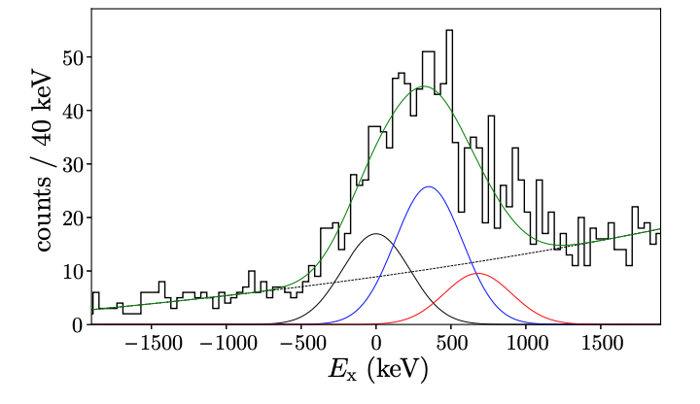
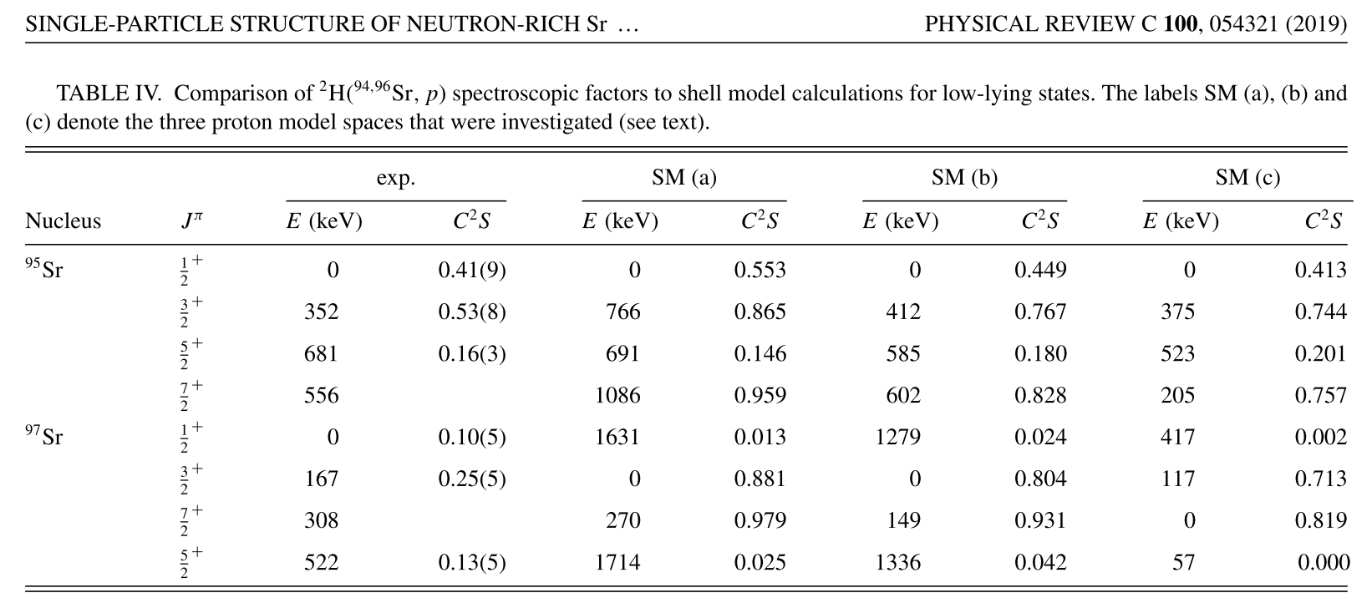
⁹⁴Sr(d,p)⁹⁵Sr

Slide 26
