Slide 1



High-sensitivity Nuclear Magnetic Resonance with laser-polarized metal ions:
technique development and first biological applications
Oct 2018 – April 2022
Katarzyna Dziubińska-Kühn
ISOLDE, CERN
Institut für Analytische Chemie, Universität Leipzig
27.04.2022
Notes:
1

Slide 2
Outline
Liquid-state β-detected NMR
  beamline design
  principles
2018: ²⁶Na - magnetic moment and absolute shieldings
2018 – 2021: beamline upgrades
2021 – now: β-detected NMR in 4.7 T
Notes:
2

Slide 3
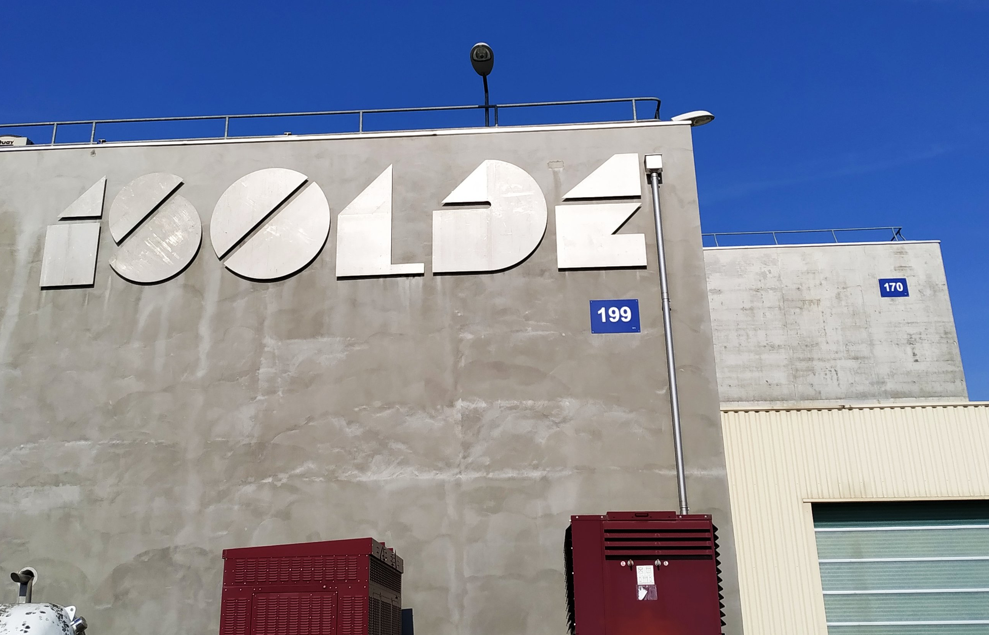
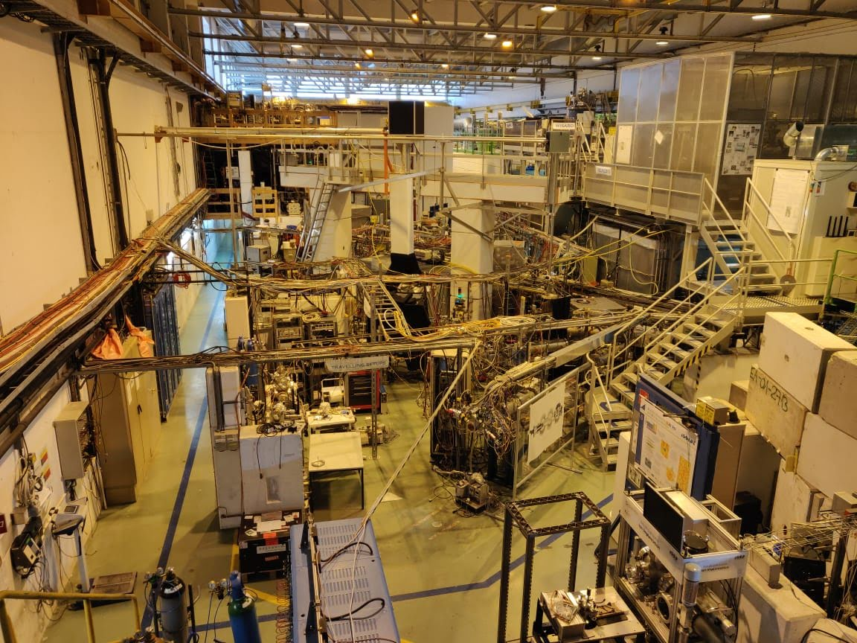
ISOLDE (Isotope Separator On Line facility)
1.4 GeV proton beam (PSB) → radioactive beams
> 1300 isotopes and > 70 elements
credit: M. Jankowski
Notes:
3

Slide 4
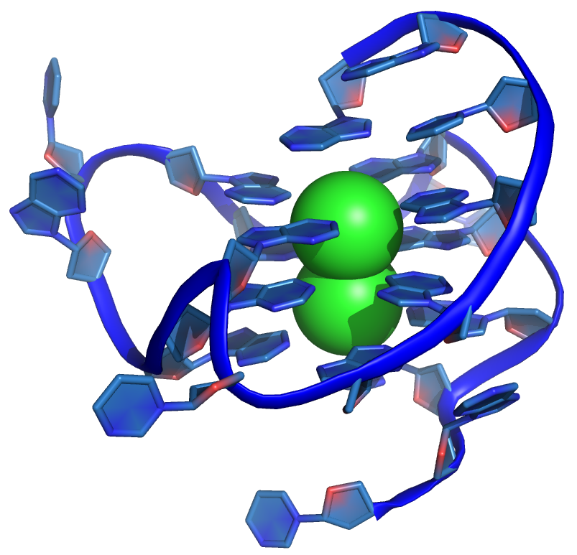
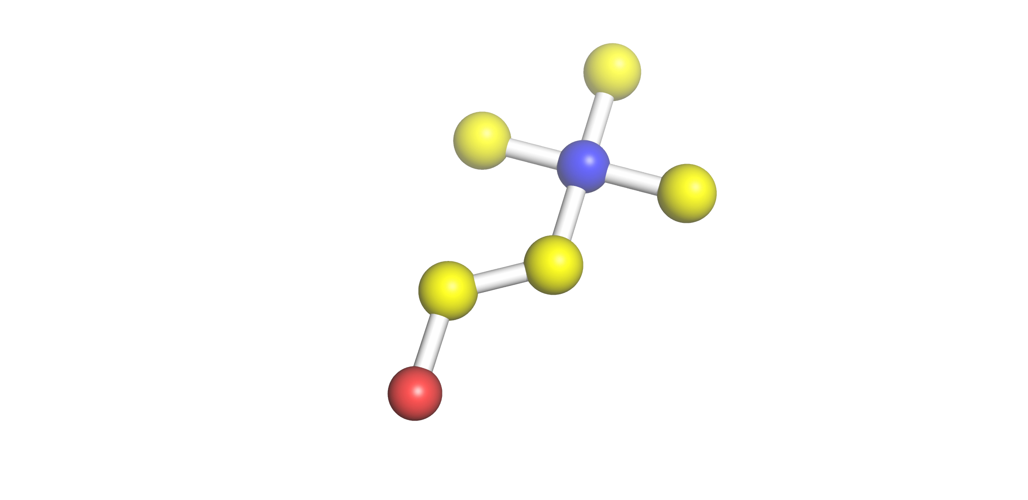
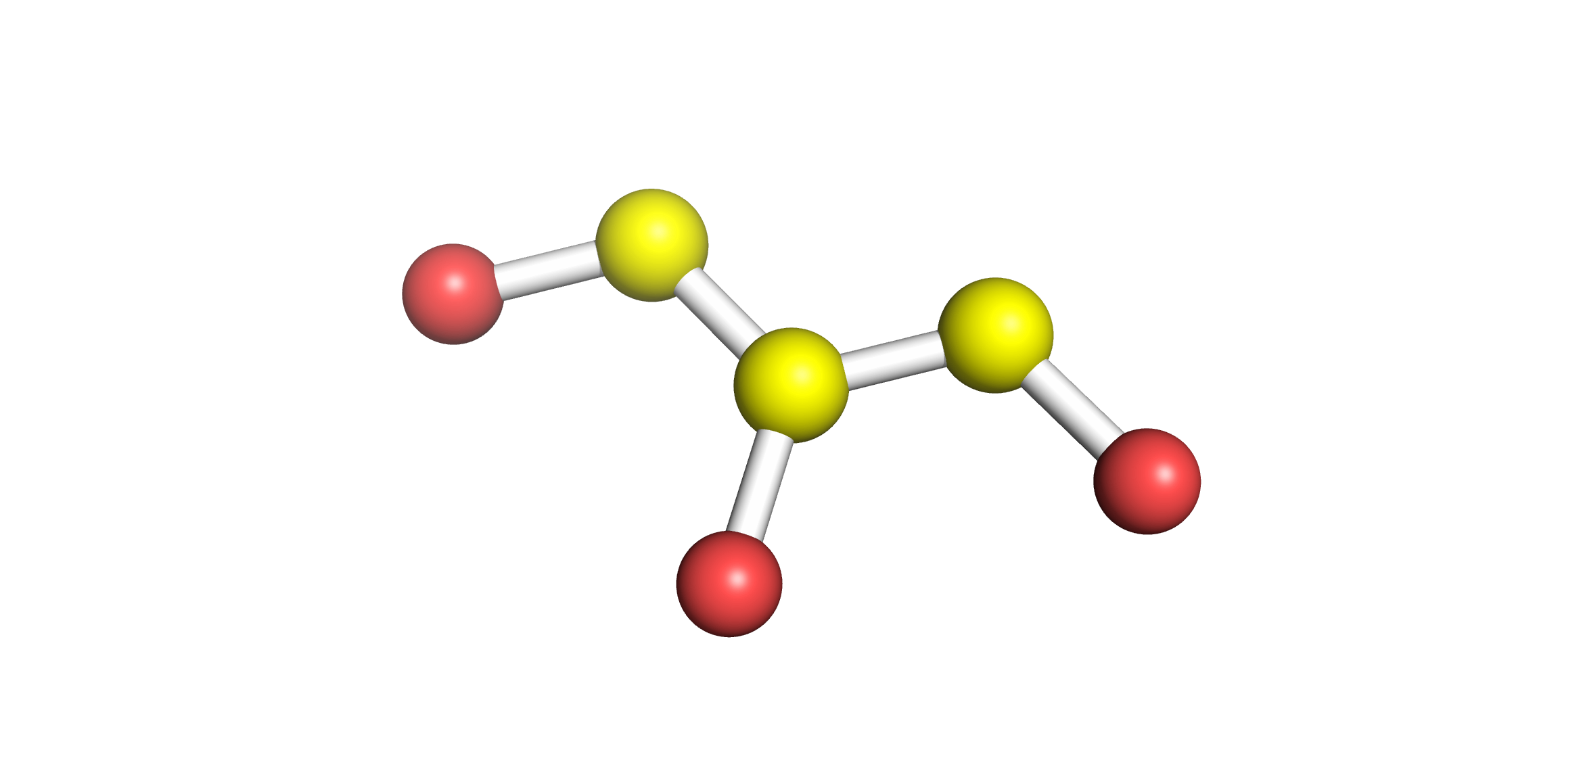
β-detected magnetic resonance at CERN
M
M
M
M
method:
nuclear physics
observable:
analytical chemistry
application:
time-resolved biology
credit: M. Jankowski, B. Karg
Notes:
4

Slide 5
β-detected magnetic resonance at CERN
2018 - 2022
M
M
M
M
method:
nuclear physics
observable:
analytical chemistry
application:
time-resolved biology
credit: M. Jankowski, B. Karg
Notes:
5

Slide 6
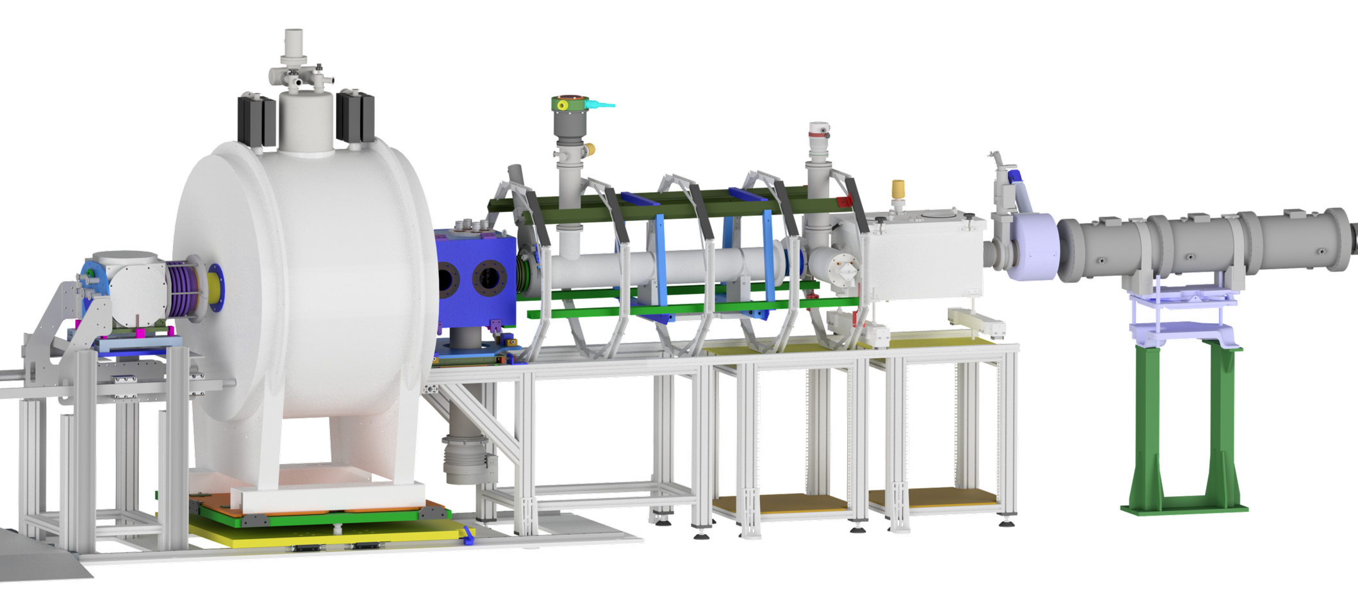
VITO beamline at ISOLDE
credit: M. Jankowski

Slide 7
VITO beamline at ISOLDE
laser
beam focusing
ions from ISOLDE
credit: M. Jankowski

Slide 8
VITO beamline at ISOLDE
neutralisation
laser
beam focusing
atoms
ions from ISOLDE
credit: M. Jankowski

Slide 9
VITO beamline at ISOLDE
Optical Pumping
neutralisation
laser
beam focusing
atoms
ions from ISOLDE
credit: M. Jankowski

Slide 10
VITO beamline at ISOLDE
β-detectors
Optical Pumping
neutralisation
laser
beam focusing
atoms
ions from ISOLDE
credit: M. Jankowski

Slide 11
VITO beamline at ISOLDE
β-detectors
4.7 T magnet
Optical Pumping
neutralisation
laser
beam focusing
B
atoms
ions from ISOLDE
credit: M. Jankowski

Slide 12
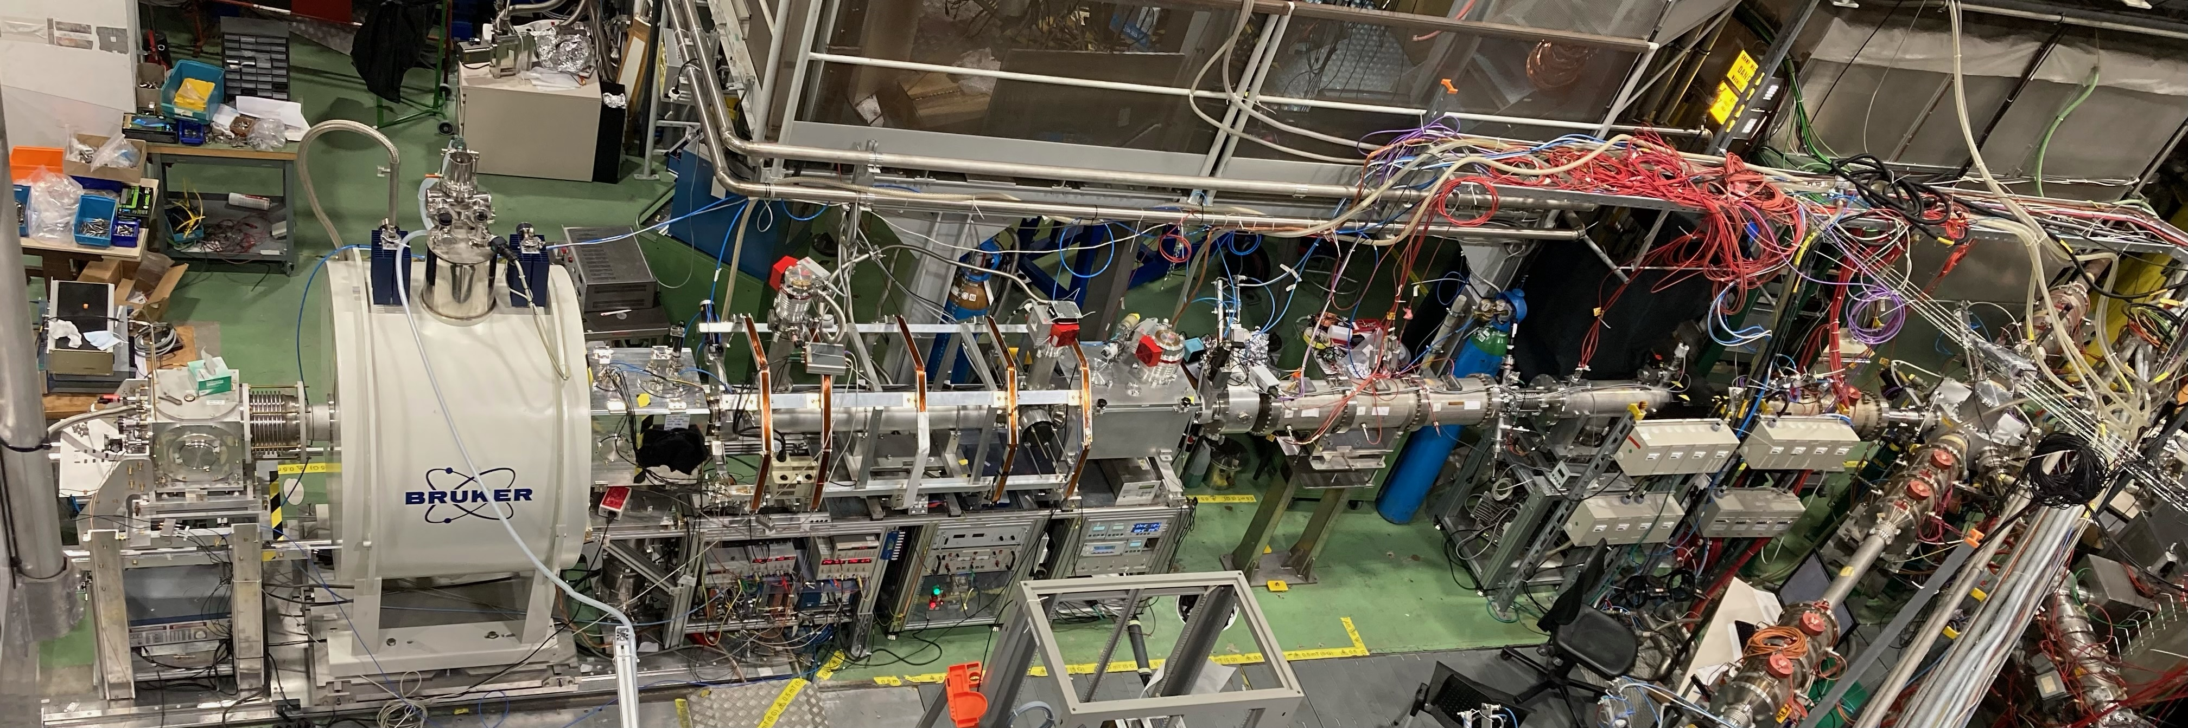
VITO beamline at ISOLDE
beam
credit: M. Piersa-Silkowska
Notes:
12

Slide 13
Liquid-state β-detected NMR
beam
-3
-2
-1
0
1
2
3
m_{F}
m_{F}
-2
-1
0
1
2
polarize spins

Slide 14
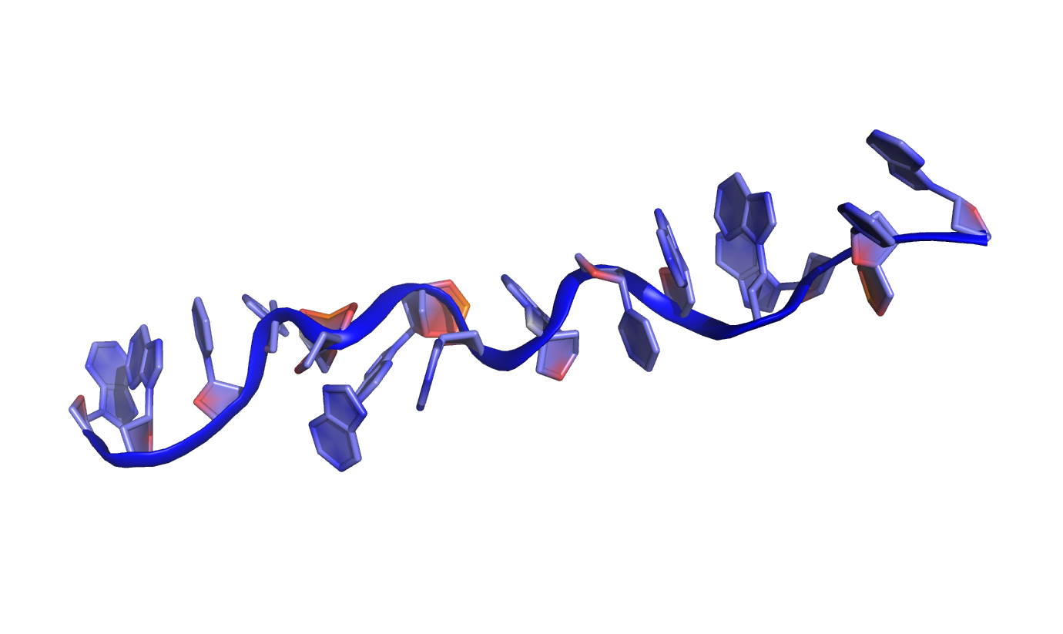
Liquid-state β-detected NMR
beam
M
M
M
M
-3
-2
-1
0
1
2
3
m_{F}
M
M
m_{F}
-2
-1
0
1
2
implant
polarize spins

Slide 15
Liquid-state β-detected NMR
beam
M
M
β⁻
M
M
-3
-2
-1
0
1
2
3
m_{F}
β⁻
β⁻
M
M
β⁻
β⁻
β⁻
β⁻
β⁻
m_{F}
-2
-1
0
1
2
detect
implant
polarize spins

Slide 16
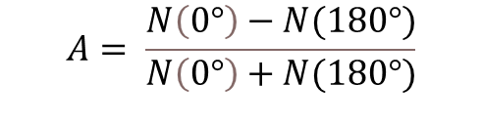
Liquid-state β-detected NMR
B
beam of radioactive atoms
°
°
°
β⁻
°
°
°
°
°
β⁻
β⁻
off resonance
β⁻
Asymmetry (%)
RF coil
$$A= \frac{N\left(0°\right)−N(180°)}{N\left(0°\right)+N(180°)}$$
Radiofrequency (MHz)
M. Jankowski et al., in preparation
Notes:
16

Slide 17
Liquid-state β-detected NMR
B
on resonance
β⁻
β⁻
beam of radioactive atoms
°
°
°
°
°
°
°
°
°
°
off resonance
°
°
Asymmetry (%)
°
°
RF coil
°
°
β⁻
β⁻
°
$$A= \frac{N\left(0°\right)−N(180°)}{N\left(0°\right)+N(180°)}$$
Radiofrequency (MHz)
M. Jankowski et al., in preparation
Notes:
17

Slide 18
Liquid-state β-detected NMR
B
on resonance
beam of radioactive atoms
°
°
°
°
°
°
°
β⁻
°
°
°
°
°
°
°
°
°
β⁻
β⁻
°
°
off resonance
°
°
off resonance
β⁻
Asymmetry (%)
°
°
RF coil
°
°
°
$$A= \frac{N\left(0°\right)−N(180°)}{N\left(0°\right)+N(180°)}$$
Larmor frequency
Radiofrequency (MHz)
M. Jankowski et al., in preparation
Notes:
18

Slide 19
Liquid-state β-detected NMR
B
on resonance
beam of radioactive atoms
°
°
°
°
°
°
°
β⁻
°
°
°
°
°
°
°
°
°
β⁻
β⁻
°
°
off resonance
°
°
off resonance
β⁻
Asymmetry (%)
°
°
RF coil
°
°
°
$$A= \frac{N\left(0°\right)−N(180°)}{N\left(0°\right)+N(180°)}$$
Larmor frequency
Radiofrequency (MHz)
short-lived radioisotopes of alkali metals: ²⁶Na, ³⁷K
physics
chemistry and biology
measuring magnetic moments with ppm accuracy (e.g. ²⁶Na)
information about chemical environment → chemical reactions
M. Jankowski et al., in preparation
Notes:
19

Slide 20
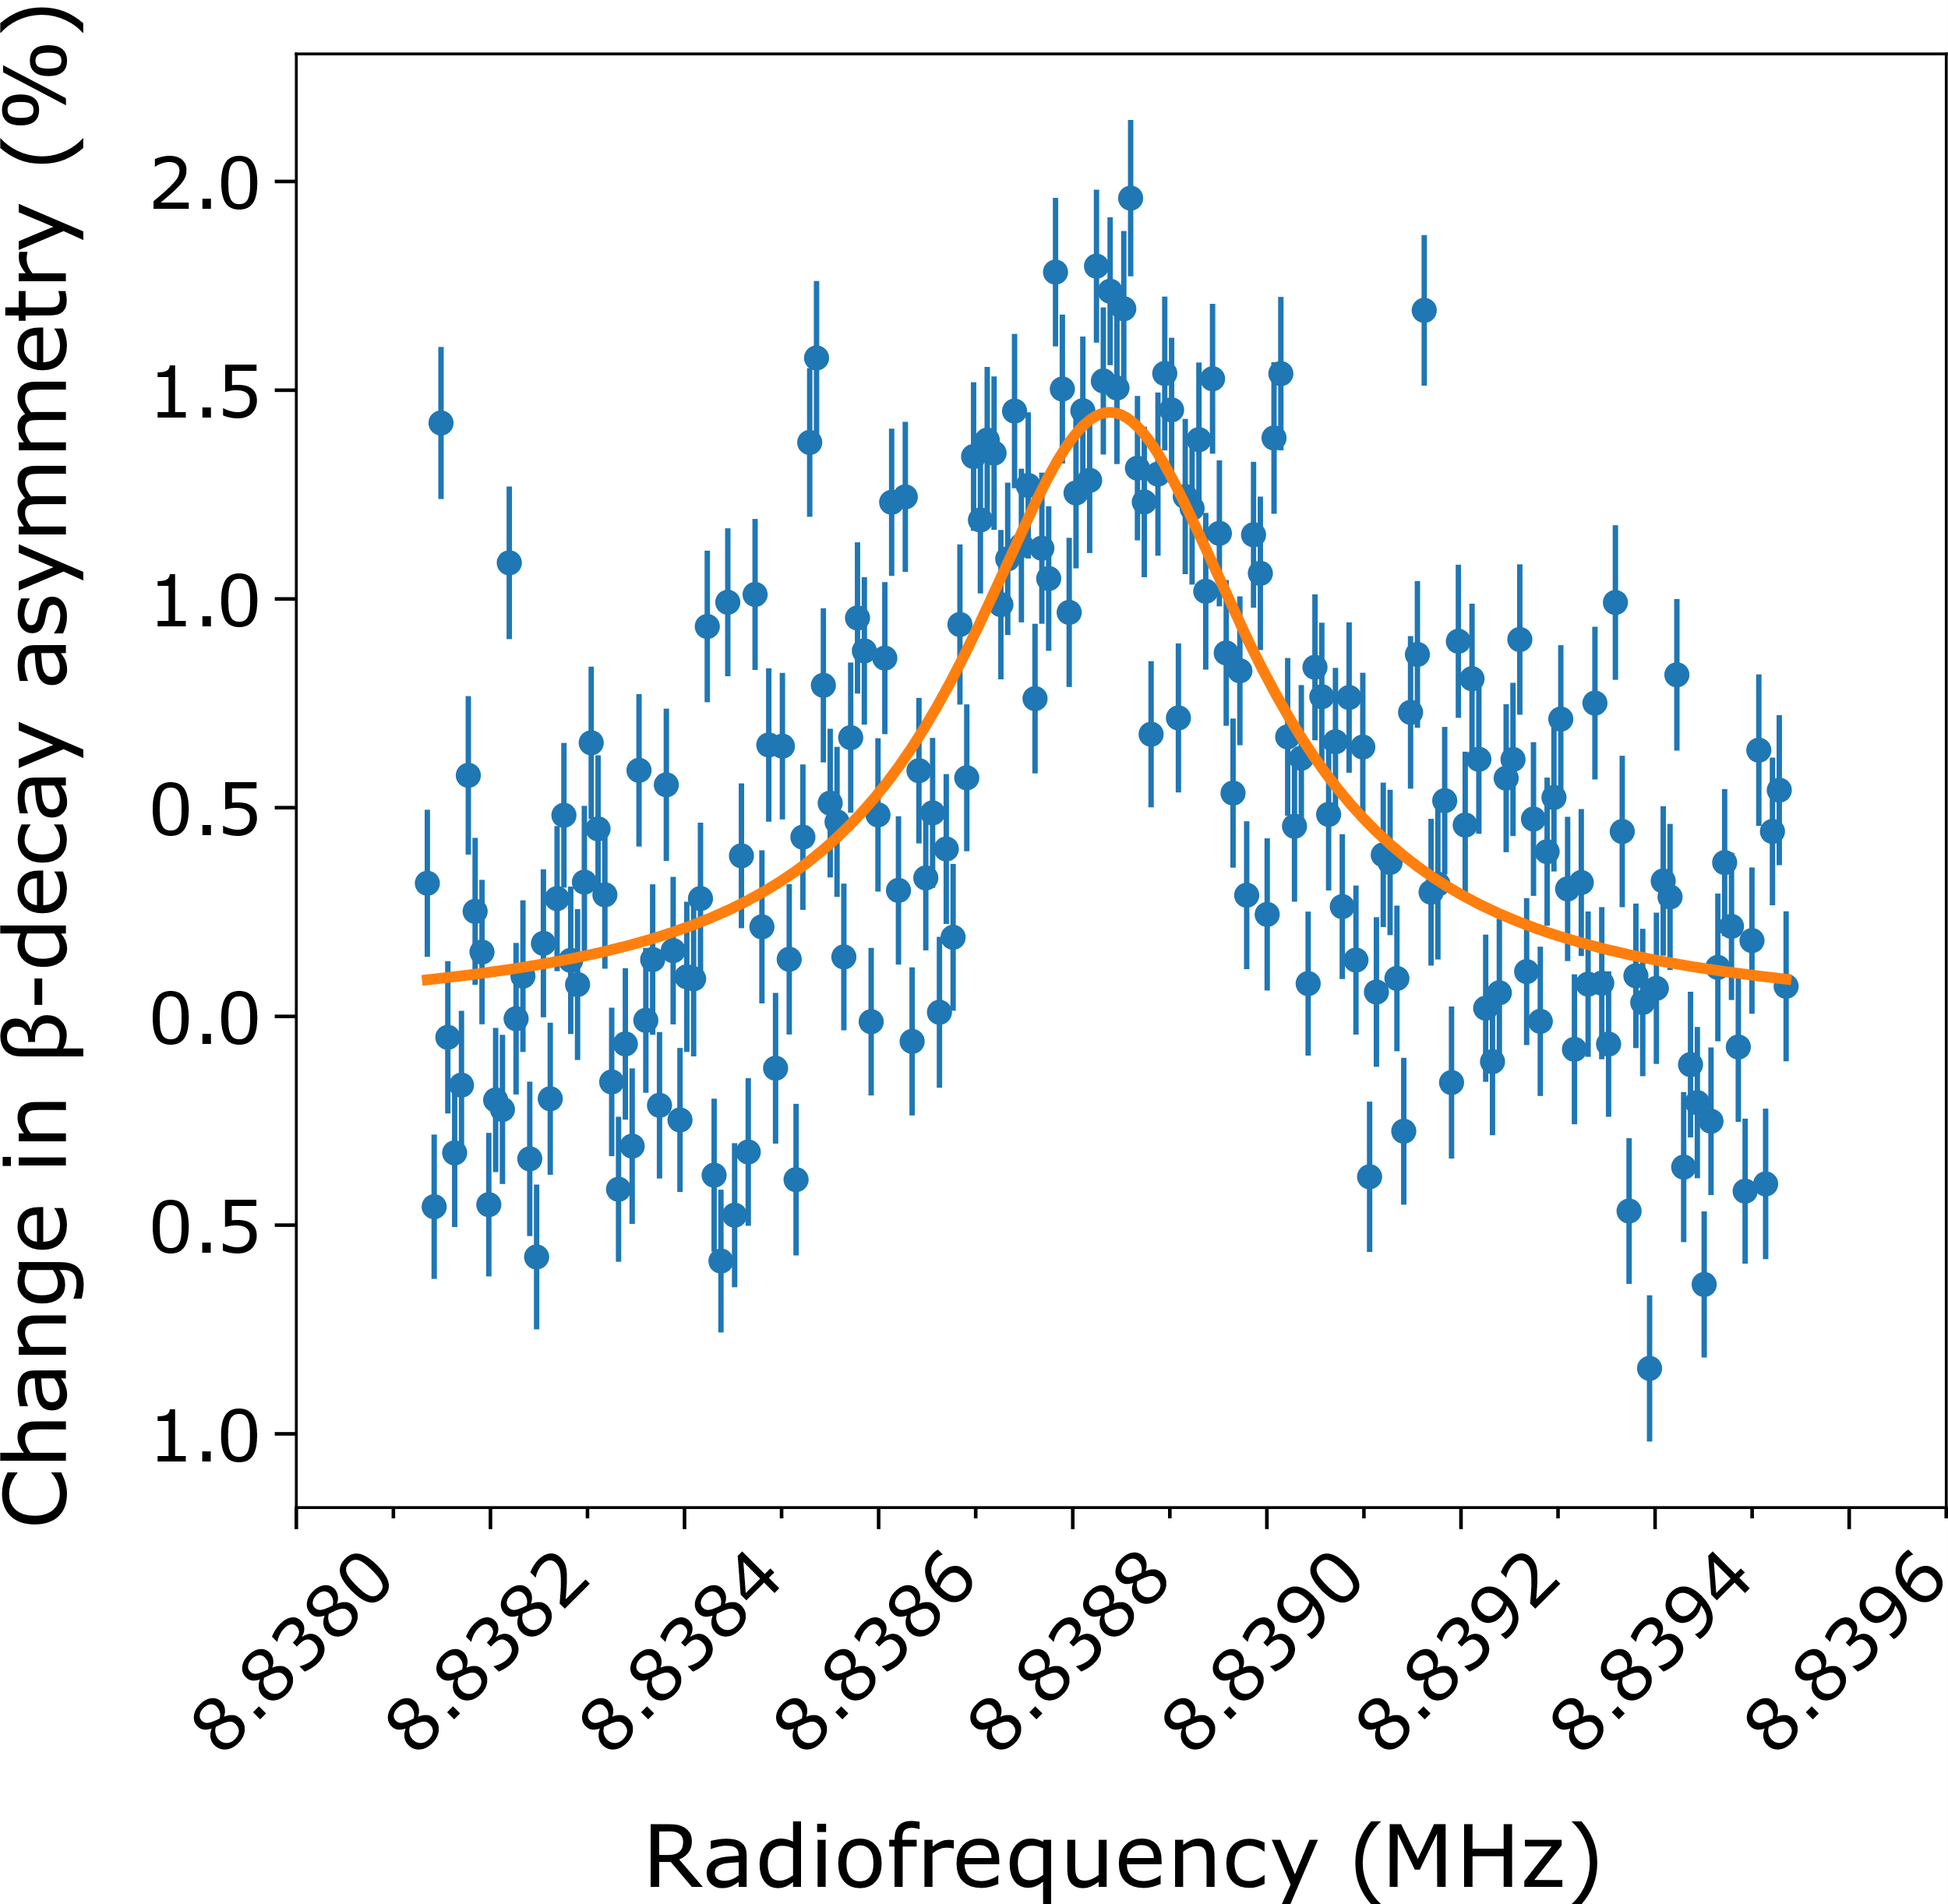
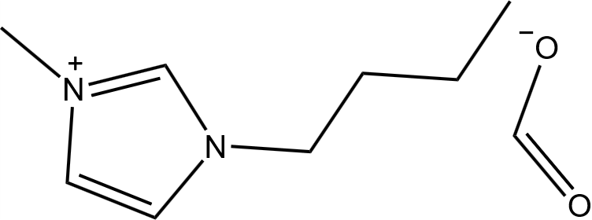
²⁶Na magnetic moment and absolute shielding
1.2 T
beam
BMIM-HCOO
Harding et al., doi: 10.1103/PhysRevX.10.041061v
Notes:
20

Slide 21
²⁶Na magnetic moment and absolute shielding
1.2 T
β-NMR
sample
beam
beam
¹H NMR
sample (H₂O)
BMIM-HCOO
Harding et al., doi: 10.1103/PhysRevX.10.041061v
Notes:
21

Slide 22
²⁶Na magnetic moment and absolute shielding
1.2 T
β-NMR
sample
beam
beam
¹H NMR
sample (H₂O)
μ_{26Na} = 2.851(2)
F. T. et al., Phys. Rev. C 25, 2756 (1982)
μ_{26Na} = 2.849390(20)
BMIM-HCOO
Harding et al., doi: 10.1103/PhysRevX.10.041061v
Notes:
22

Slide 23
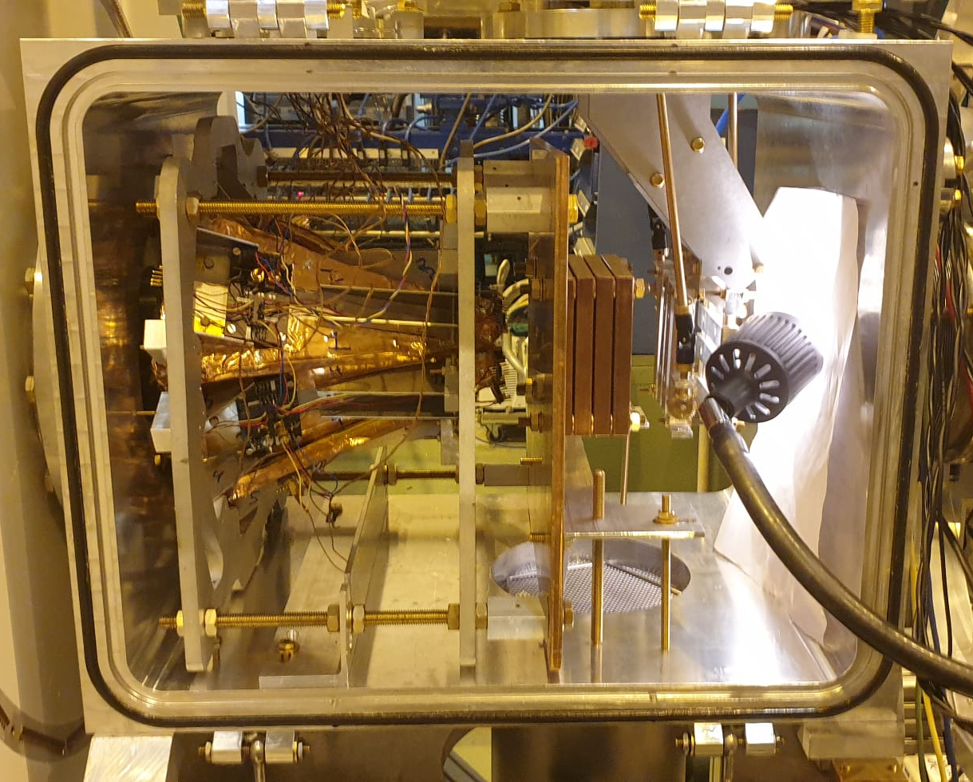
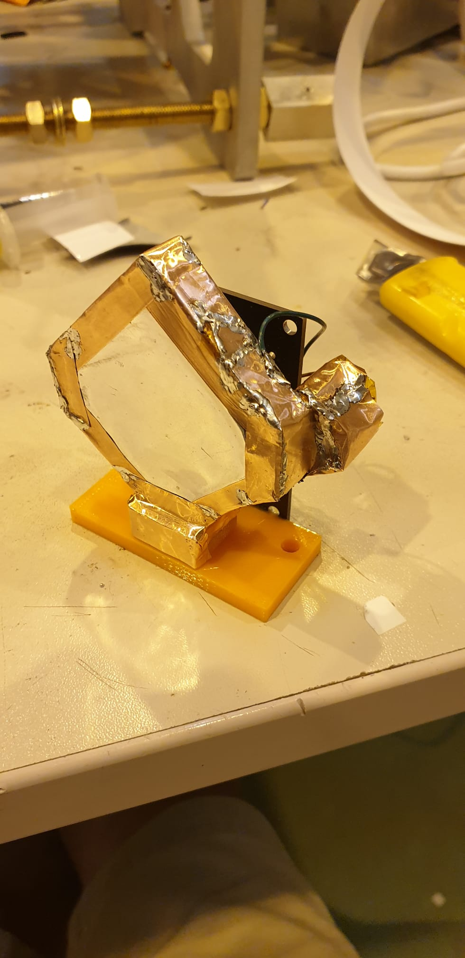
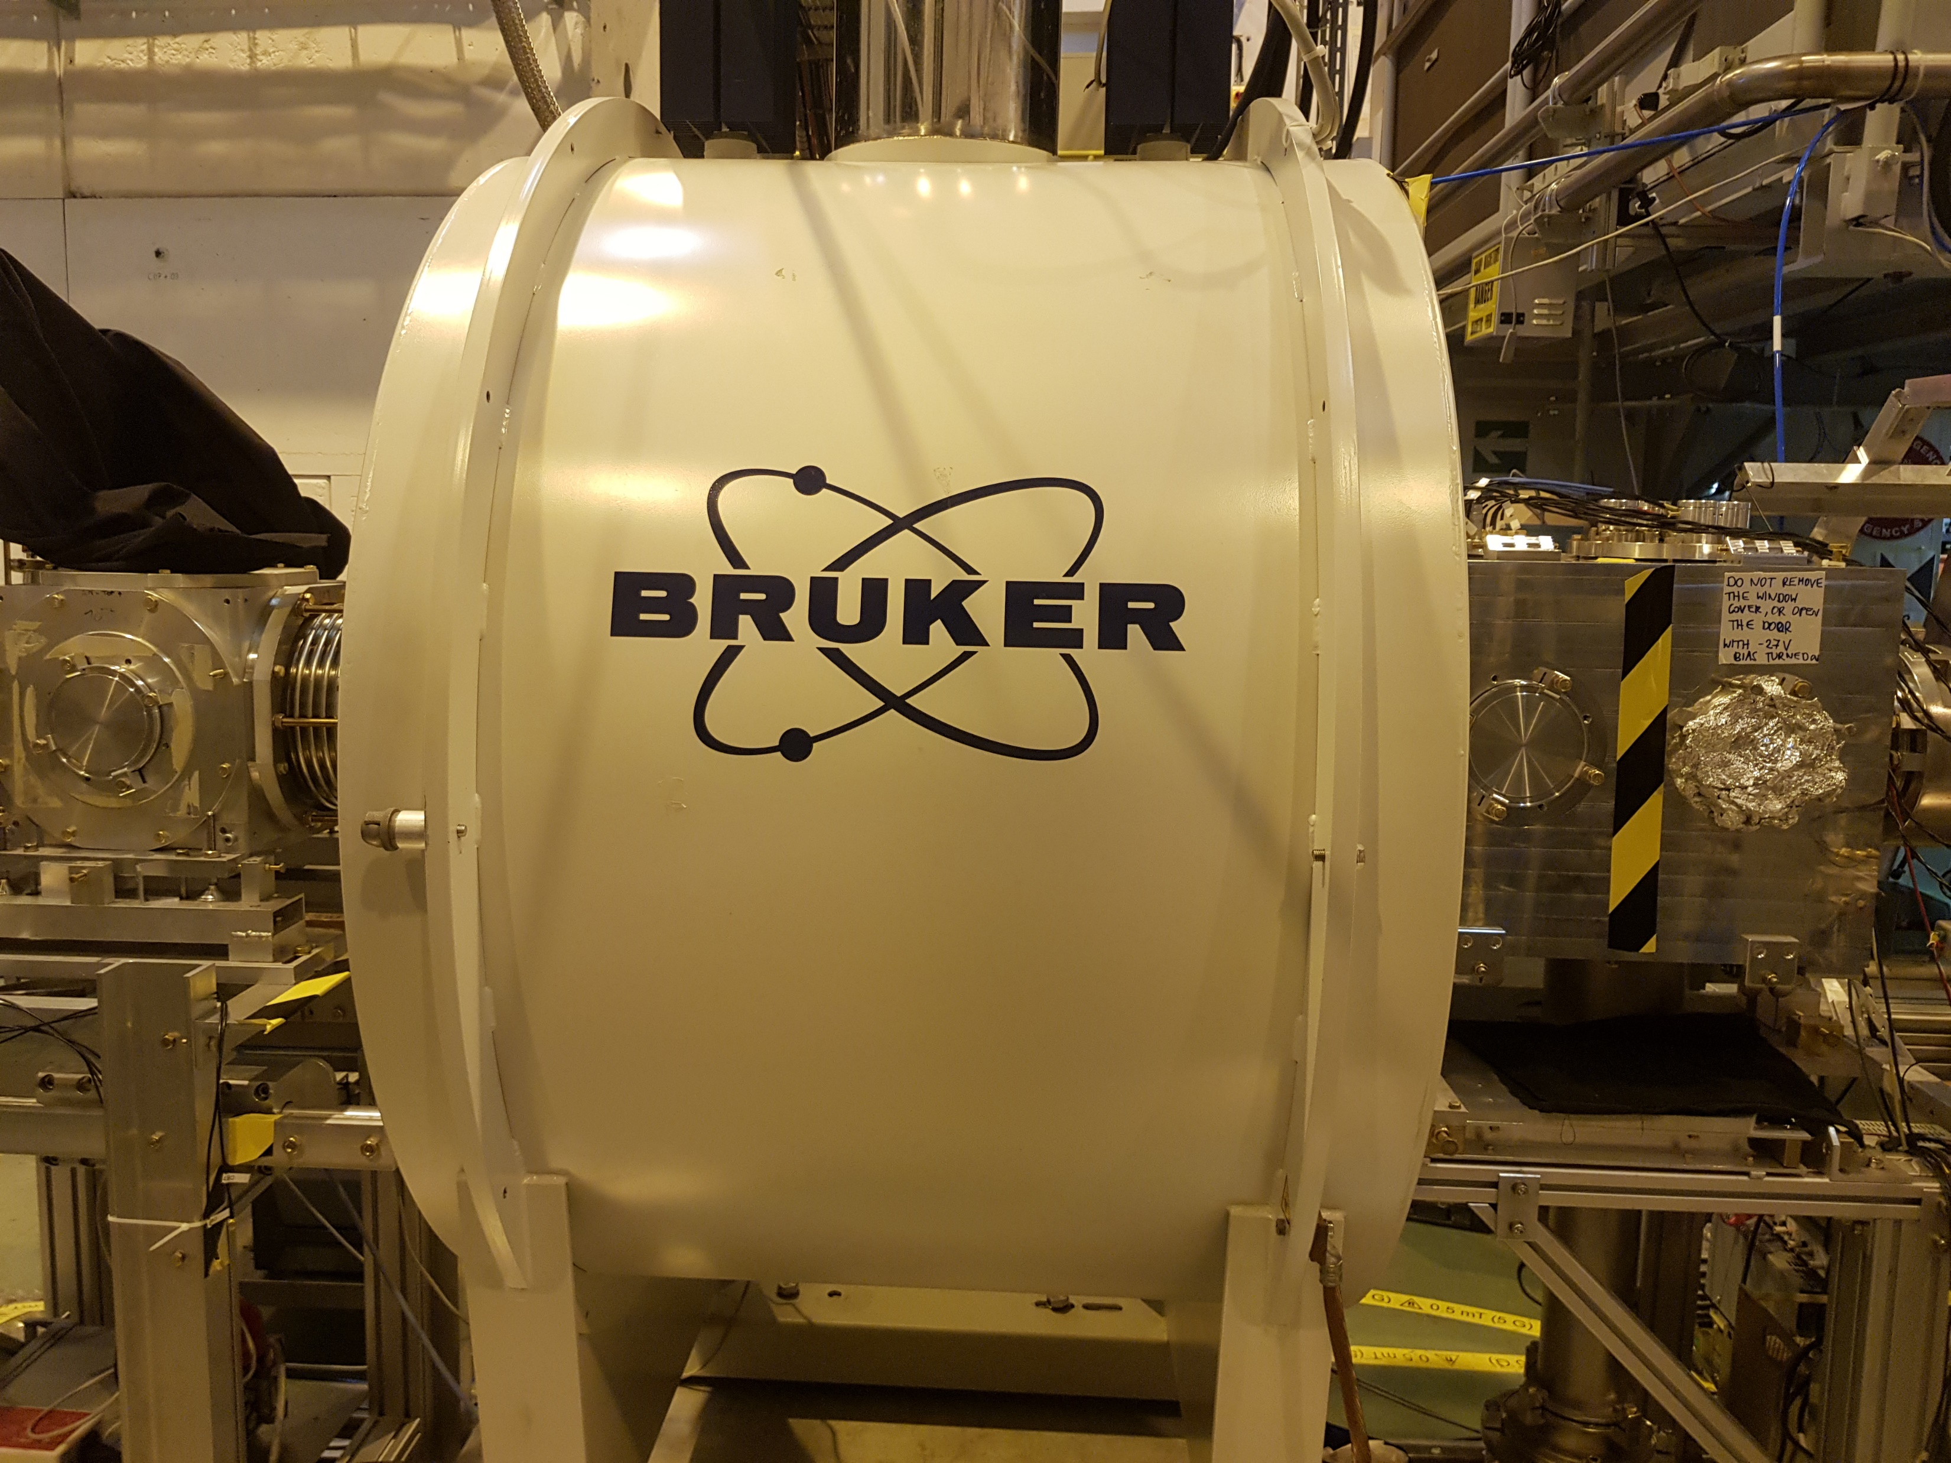
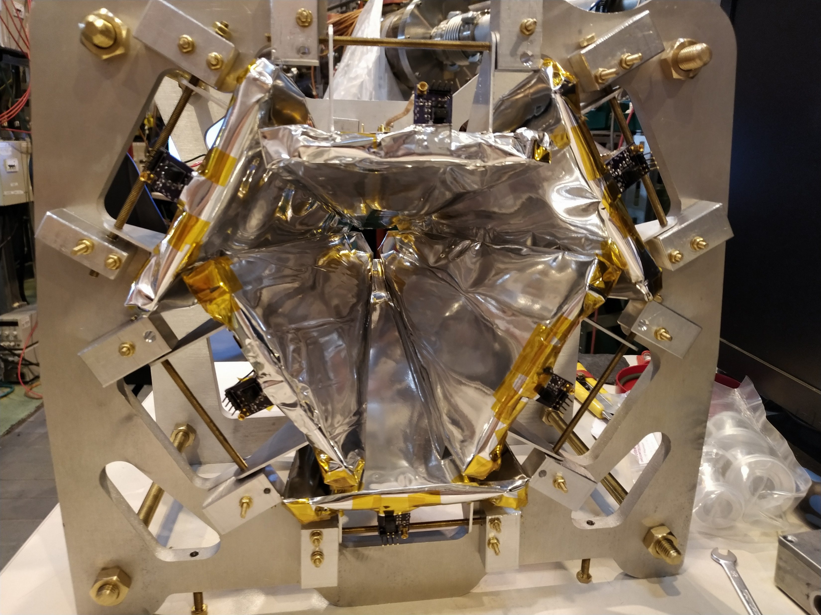
2018 – 2021 beamline upgrade
B
credit: M. Myllymäki, S. Warren, M. Madurga Flores
Notes:
23

Slide 24
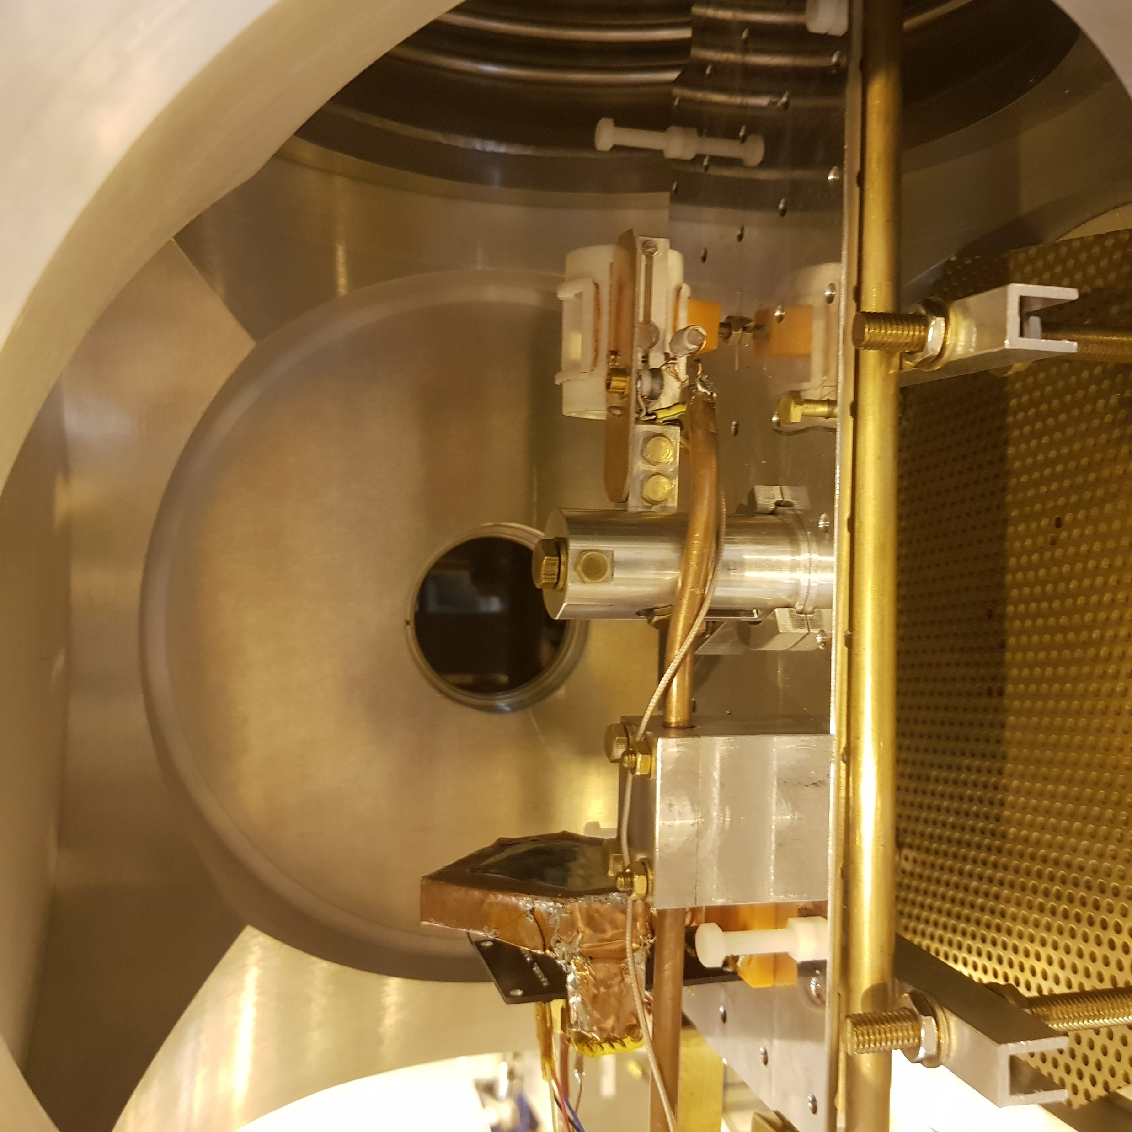
Sample carriage
β-detector
RF coil + sample
M. Jankowski et al., in preparation
Notes:
24

Slide 25
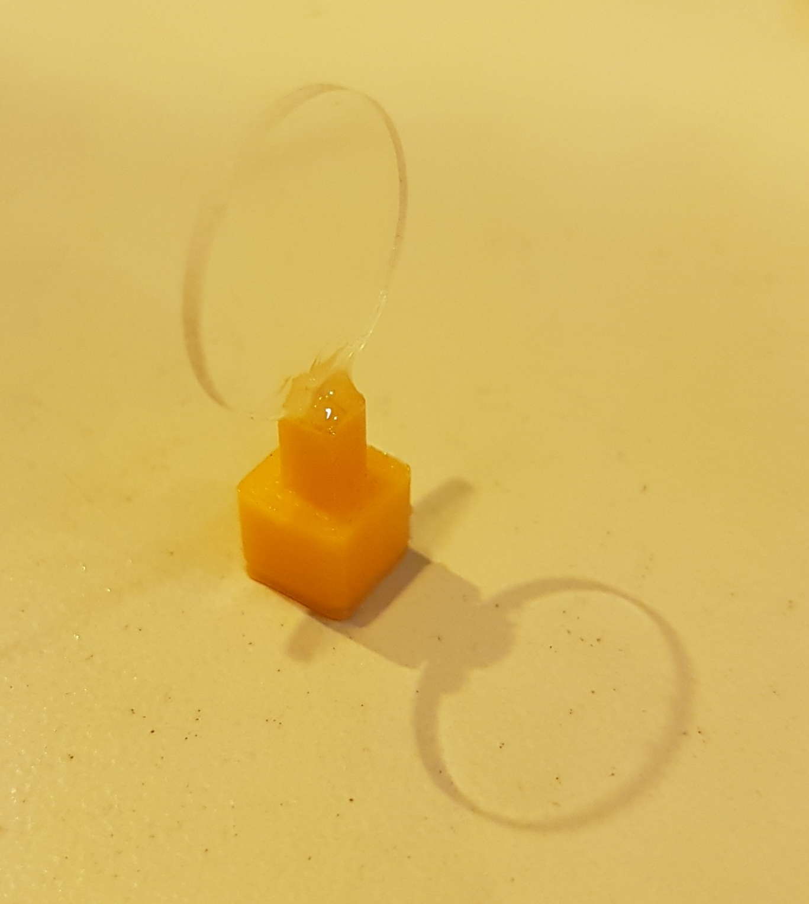
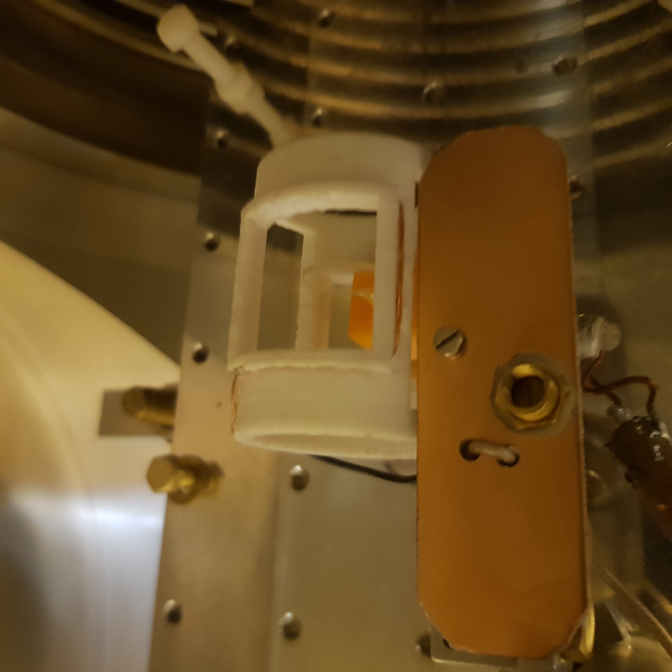
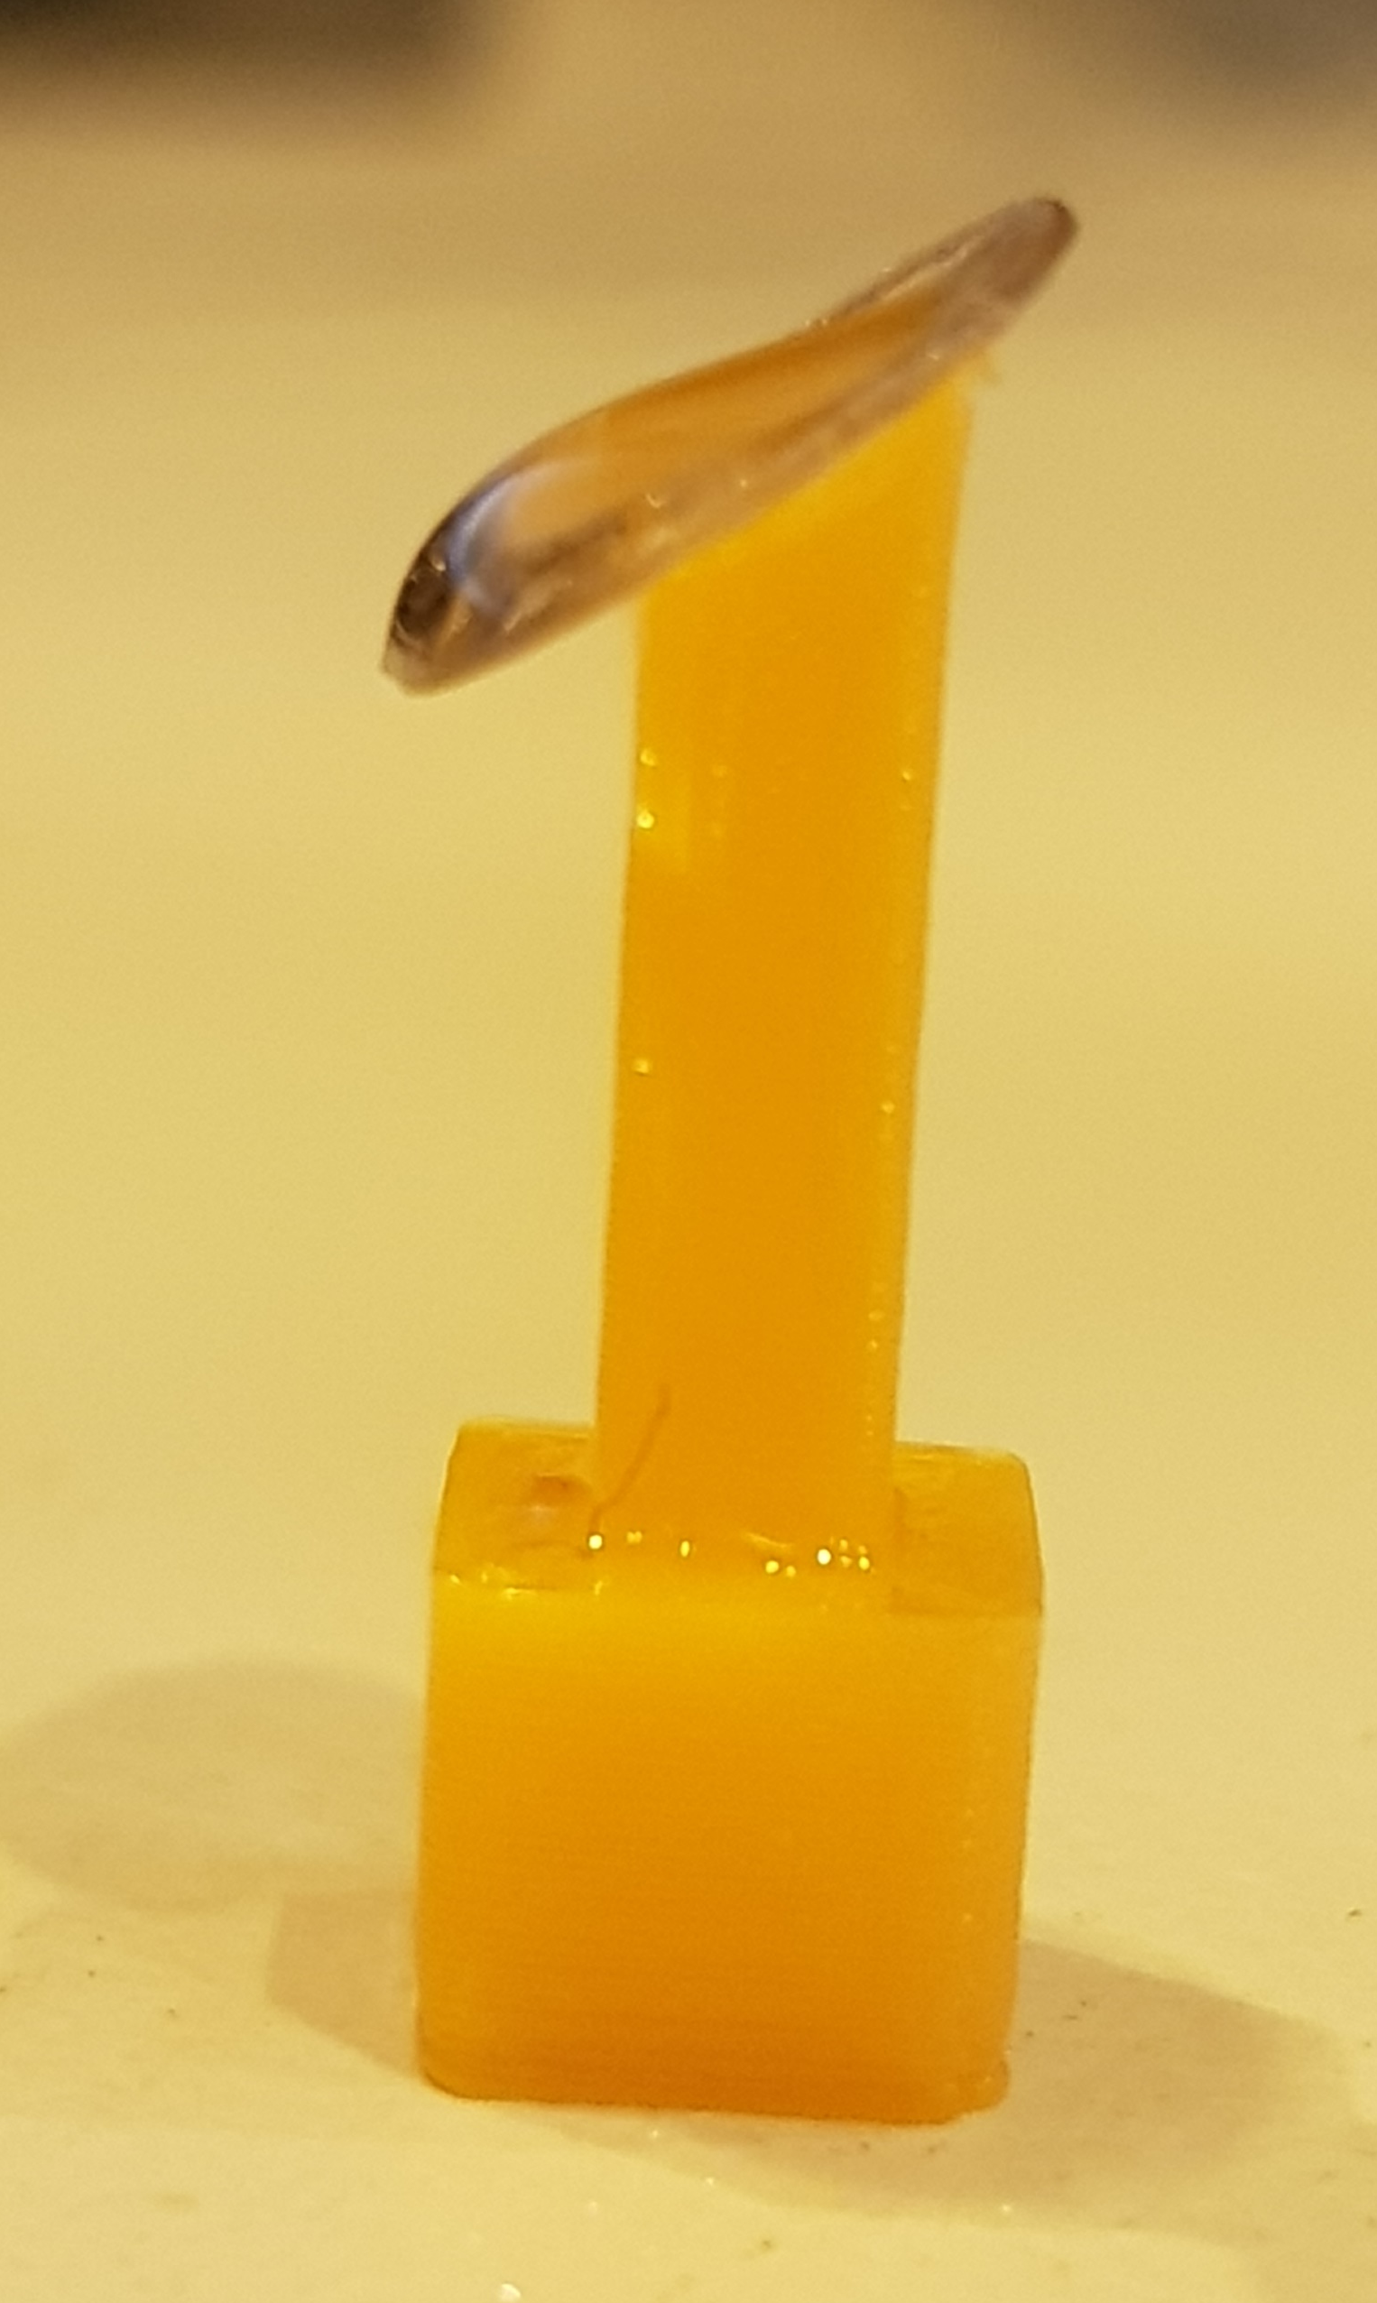
Sample carriage
β-detector
RF coil + sample
sample
solid state
(e.g. crystal)
liquid droplet
M. Jankowski et al., in preparation
Notes:
25

Slide 26
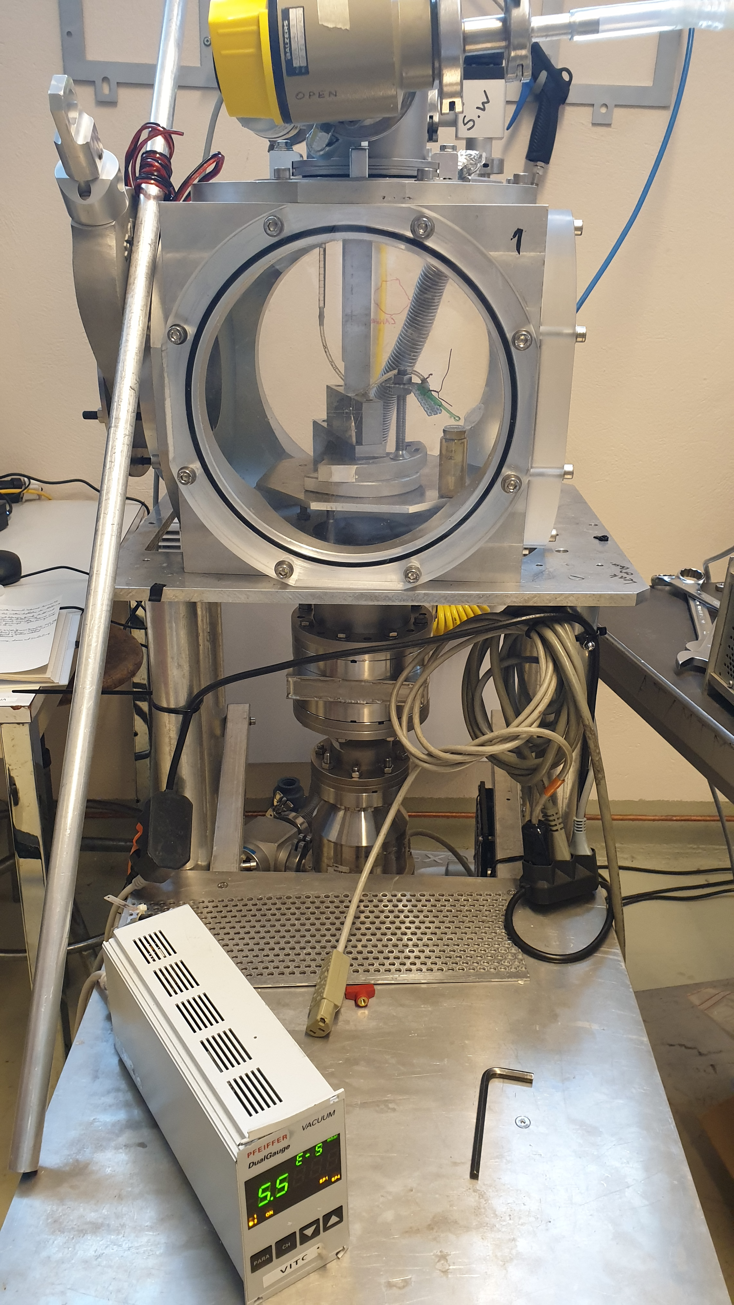
Vacuum studies
10⁻³ – 10⁻⁵ mbar
credit: T. Treczoks
Notes:
26

Slide 27
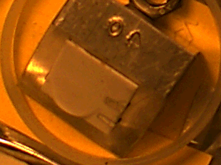
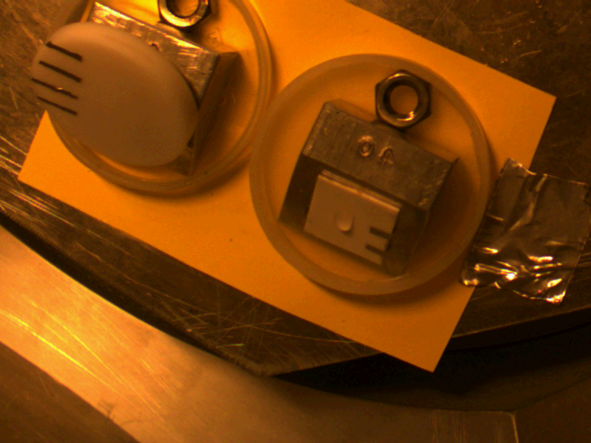
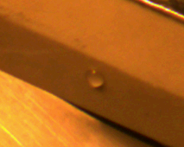
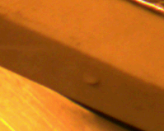
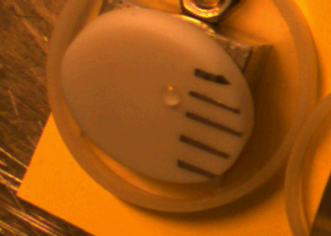
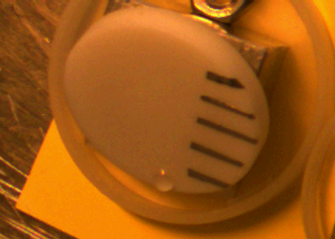
Vacuum studies
Sample holders:
  adhesion
  magnetic susceptibility
  size, angle
Samples reproducibility:
  purification (pre-degassing)
  volume (surface tension)
  time-resolved stability (high vacuum)
  hygroscopicity
degassing
not-degassed
pre-degassed
sample aging
adhesion
0 min
13 min
0 h
7 h
10⁻³ – 10⁻⁵ mbar
credit: T. Treczoks
Notes:
27

Slide 28
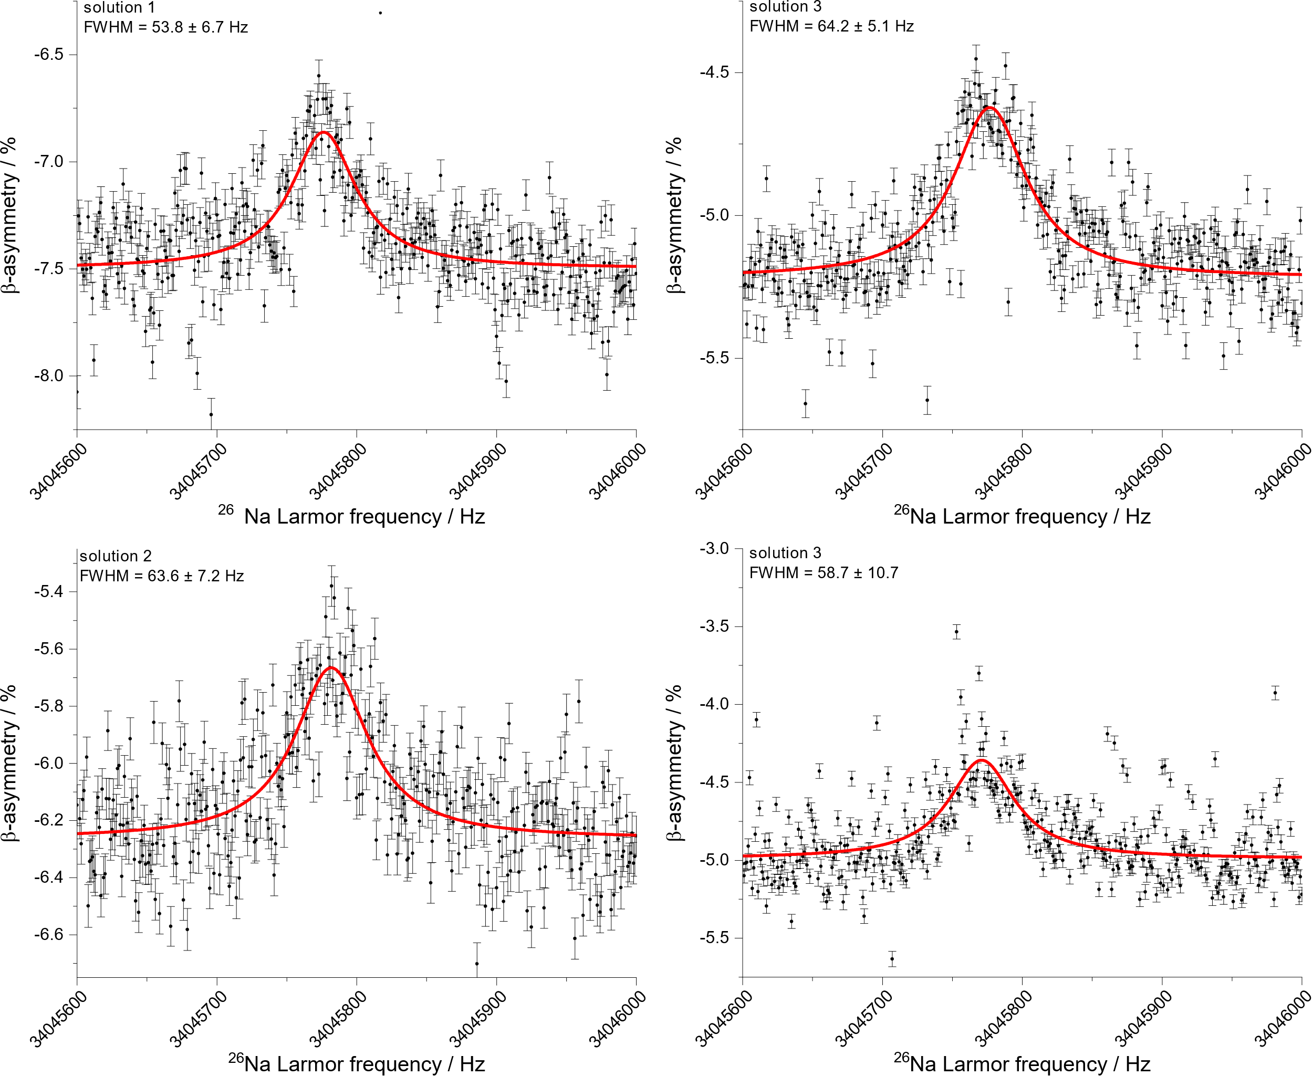
²⁶Na β-detected NMR in 4.7 T
high reproducibility
34045777 Hz
34045782 Hz
Dziubinska-Kuehn et al., in preparation
Notes:
28

Slide 29
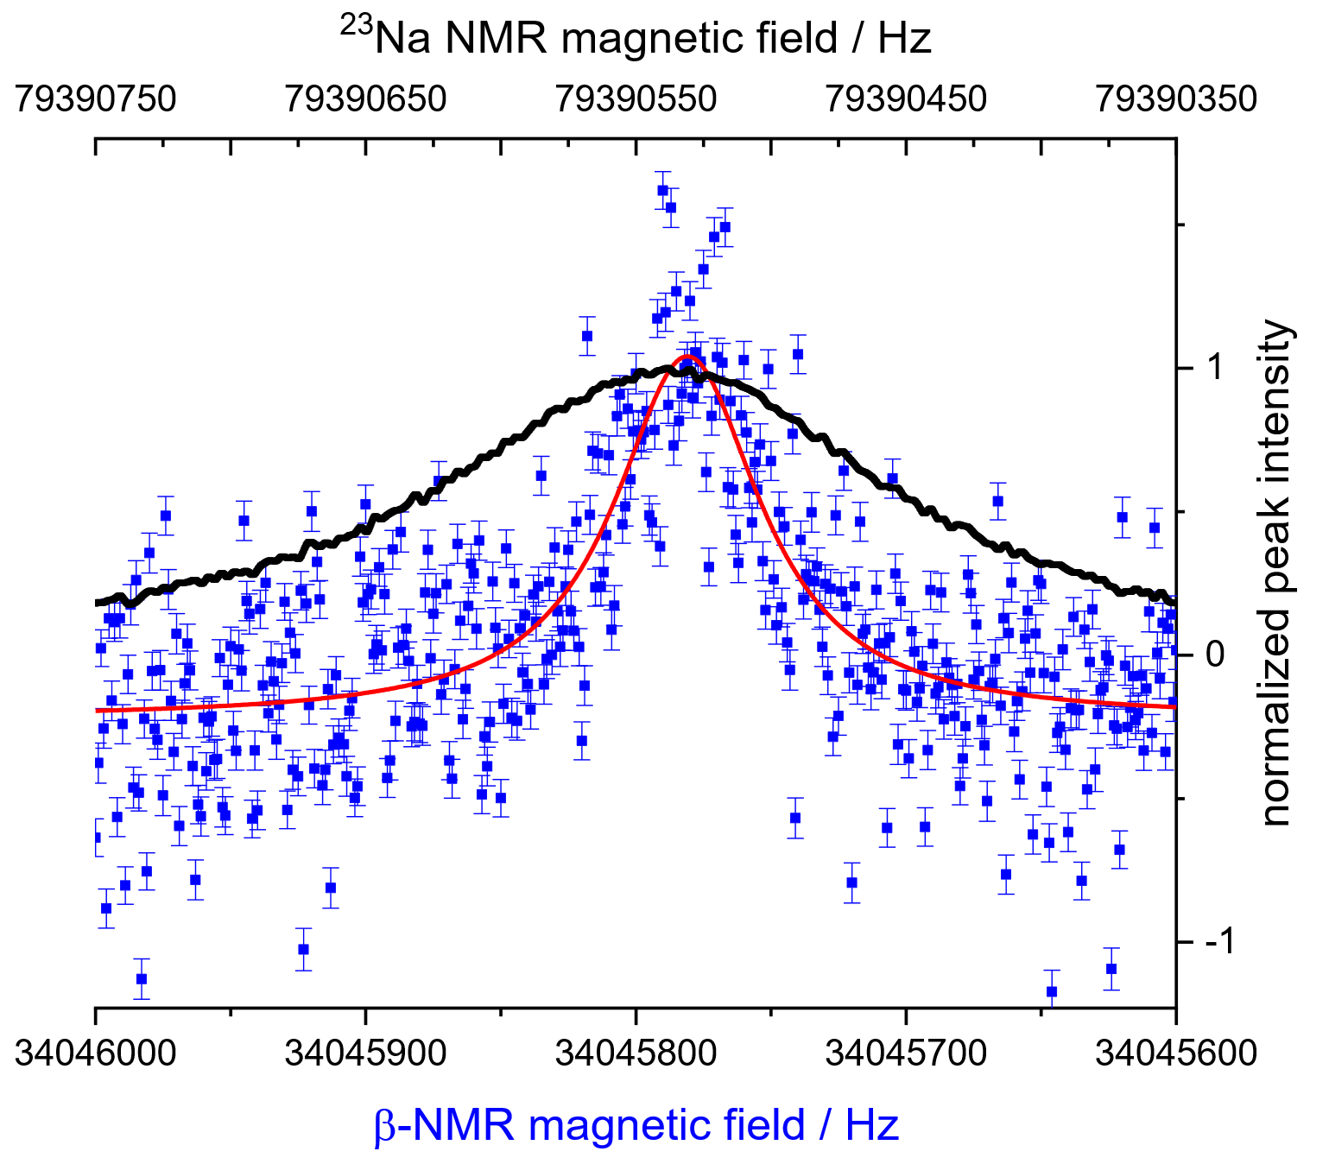
²⁶Na β-detected NMR in 4.7 T
high reproducibility
34045777 Hz
²³Na NMR in 7.05 T
FWHM = 230 ± 1 Hz
²⁶Na β-NMR in 4.7 T
FWHM = 54 ± 6 Hz
34045782 Hz
Dziubinska-Kuehn et al., in preparation
Notes:
29

Slide 30
²⁶Na β-detected NMR in 4.7 T
high reproducibility
34045777 Hz
²³Na NMR in 7.05 T
FWHM = 230 ± 1 Hz
²⁶Na β-NMR in 4.7 T
FWHM = 54 ± 6 Hz
34045782 Hz
comparable chemical environment, smaller B
4 x narrower resonances
Dziubinska-Kuehn et al., in preparation
Notes:
30

Slide 31
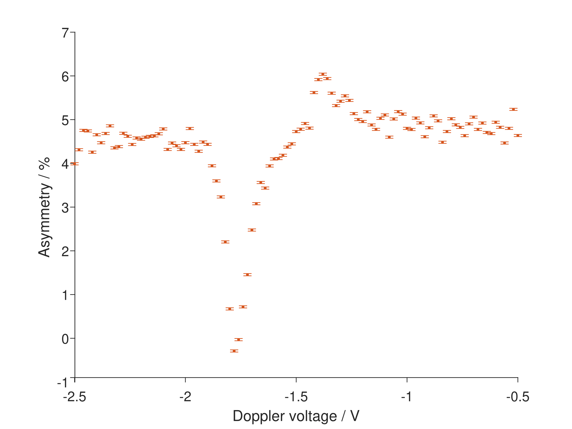
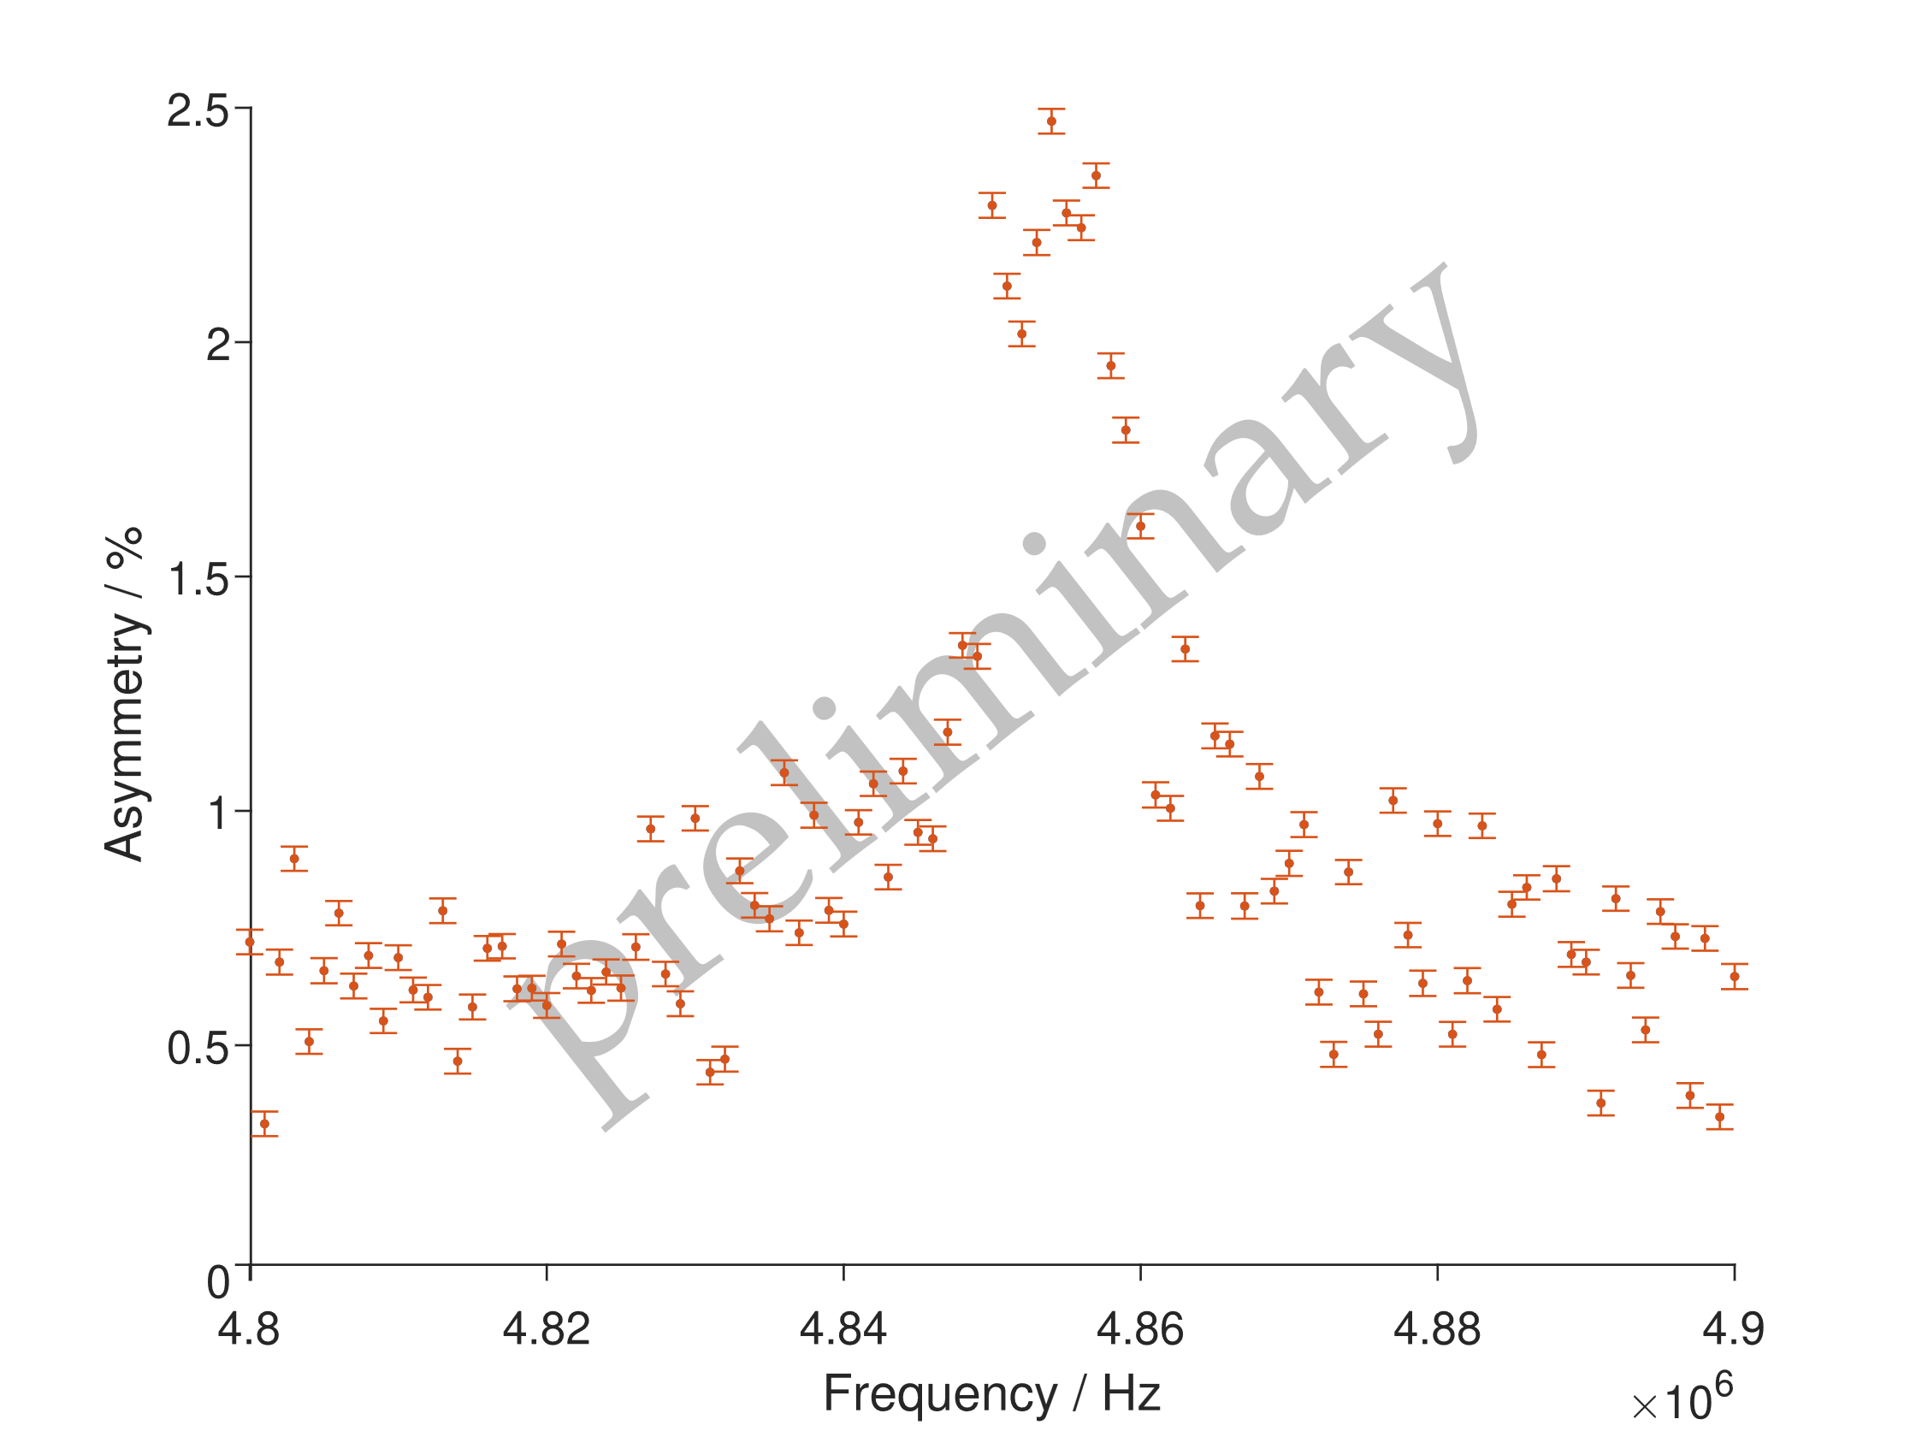
³⁷K β-detected NMR in 4.7 T
hyperfine structure in KBr
solid-state β-NMR in KBr
credit: M. Jankowski
Notes:
31

Slide 32
Summary and outlook
First liquid-state β-NMR results for ²⁶Na
Benchmarking beamline with 4.7 T magnet
    Sample and holders → reproducibility
    Liquid-state β-NMR with 4 x narrower resonances
    in comparison with stable isotopes
Chemical evaluation of Larmor frequencies → biology applications
Further alkali-metal isotopes to try, e.g. ⁴⁹K
Notes:
32

Slide 33
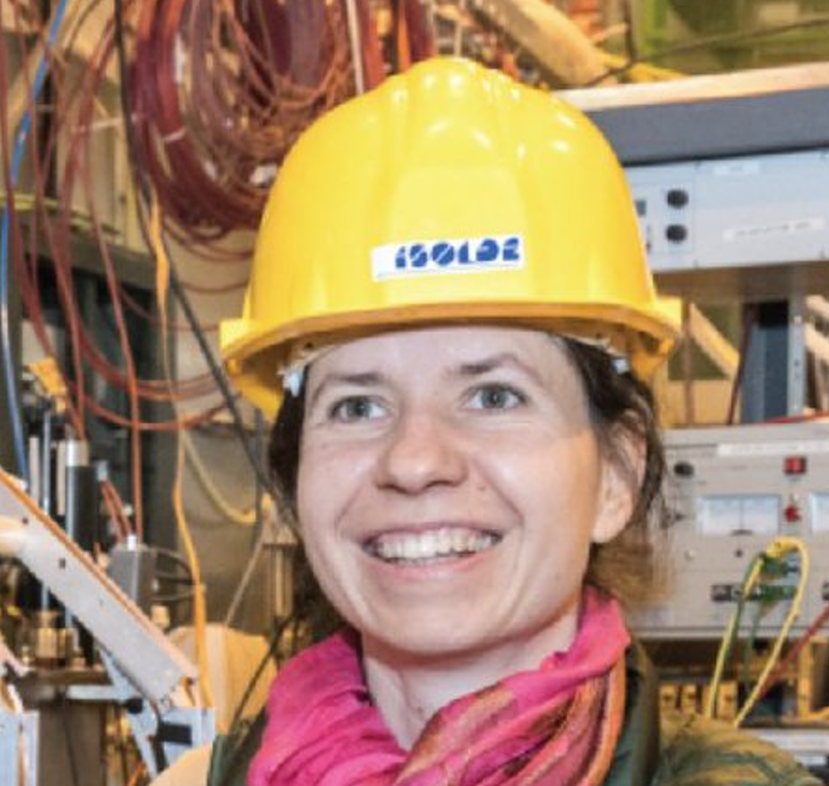


Acknowledges
Dr Magdalena Kowalska
Prof. Jörg Matysik
ISOLDE, CERN
Institute of Analytical Chemistry, Leipzig University
BetaDropNMR collaboration
A. Antusek, N. Azaryan, M. Baranowski, M. Bissell, M. Chojnacki, A. Gerami, A. Hurajt, M. Jankowski, R. Jolivet, B. Karg, M. Kozak, K. Kulesz, M. Maddah, M. Madurga Flores, J. Matysik, I. Michelon, G. Neyens, M. Pupier, T. Treczoks, A. Skrzypczak, J. Viger-Gravel, J. Wolak, D. Zakoucky and M.Kowalska
This work has been sponsored by the Wolfgang Gentner Programme of the German Federal Ministry of Education and Research (grant no. 05E15CHA)
Notes:
33

Slide 34
Backup slides
Notes:
34

Slide 35
Optical Pumping
Total atomic spin F (interaction between electron spin and nuclear spin)
Resonant transfer of atomic spins from one hyperfine level to another (from ground state to excited state), followed by the spontaneous emission.
-3
-2
-1
0
1
2
3
3
m_{F}
E
3p ²P_{3/2}
2
1
0
I=3/2
3s ²S_{1/2}
2
Sodium D₂: λ = 589 nm
1
m_{F}
-2
-1
0
1
2
Fine structure
Hyperfine structure
Magnetic sublevels m_{F} electron cyclic pumping
Type of laser polarization can select the transition (here: m_{F}= +1)
Atomic spins are predominantly in the ground state with highest magnetic sublevel m_{F}
Notes:
35

Slide 36
Nuclear Magnetic Resonance
B > 0, I ≠ 0, (2I + 1)
E
β
E
hν = Eβ - Eα
α
I = ½, spherical
I ≥ 1, quadrupolar
RF
RF
RF
RF
NMR spectrum
NMR spectrum
Notes:
36

Slide 37
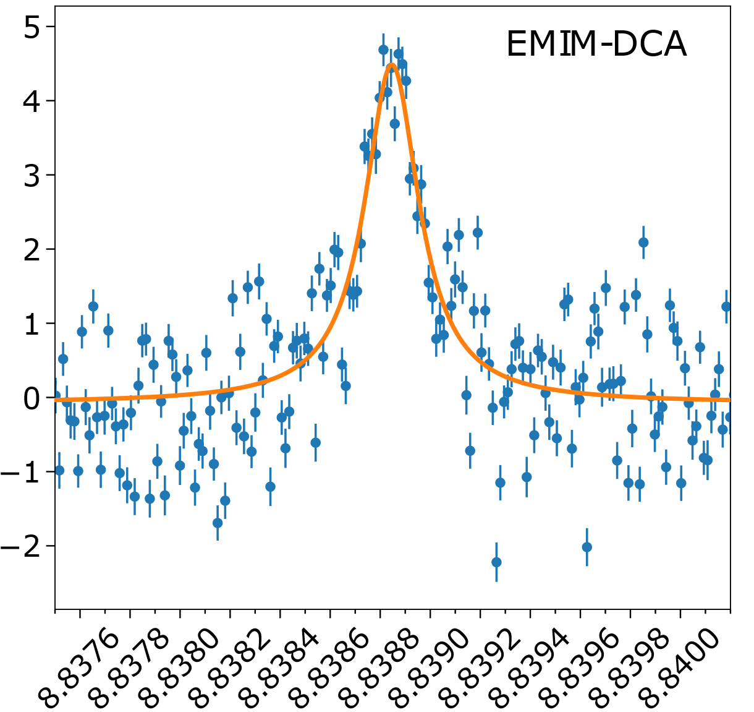
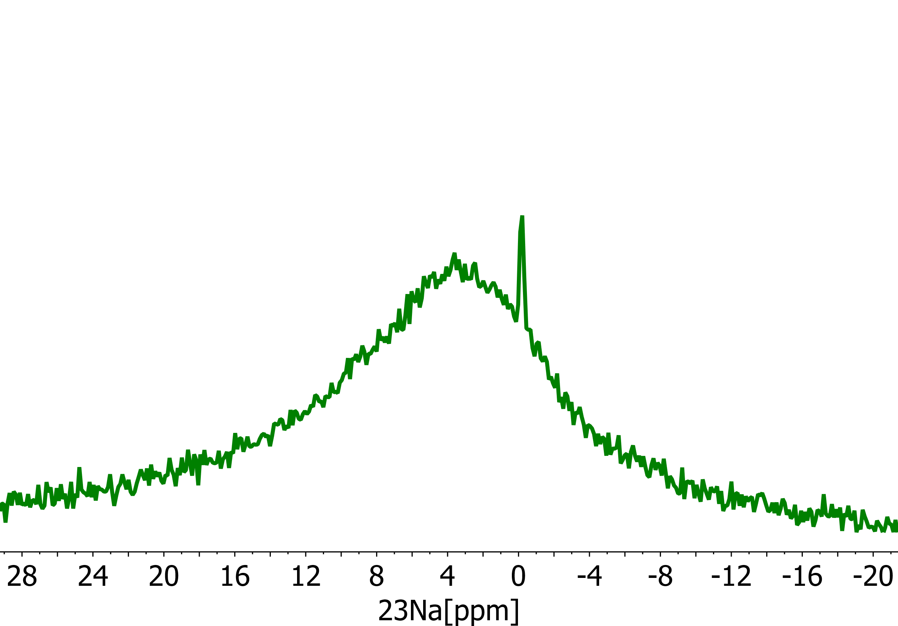
The great data analysis challenge
NaCl + Ionic Liquid = ↓
NaCl
+ H₂O
+ Ionic Liquid
degassing
β particles in the spin direction
β-NMR
water cluster
radiofrequency [MHz]
single atoms implanted into the liquid
high vacuum environment
high vacuum (10⁻⁵ mbar)
20
16
12
8
4
0
-4
-8
²³Na NMR [ppm]
Harding et al., Phys. Rev. X 10, 041061 (2020), doi: 10.1103/PhysRevX.10.041061
Notes:
37

Slide 38
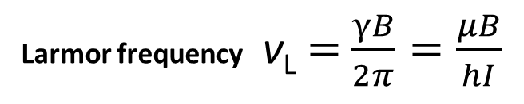
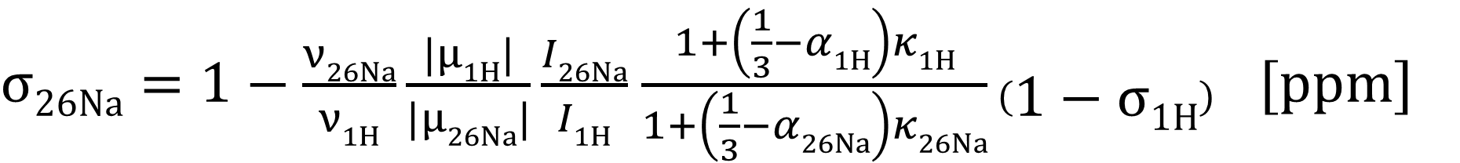
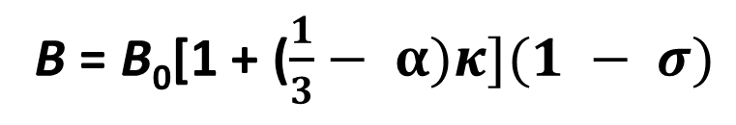
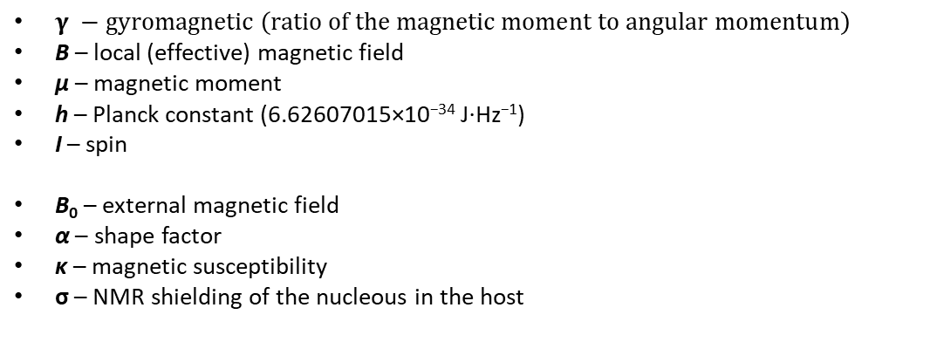
Absolute shielding formula
$γ −gyromagnetic \left(ratio of the magnetic moment to angular momentum\right)$
B – local (effective) magnetic field
μ – magnetic moment
h – Planck constant (6.62607015×10⁻³⁴ J⋅Hz⁻¹)
I – spin
B₀ – external magnetic field
α – shape factor
κ – magnetic susceptibility
σ – NMR shielding of the nucleous in the host
Larmor frequency ν_{L} $=$ $\frac{γB}{2π}=\frac{μB}{hI}$
B = B₀[1 + ($\frac{1}{3}− α)κ](1 − σ)$
$σ26Na=1−\frac{ν26Na}{ν1H}\frac{|μ1H|}{|μ26Na|}\frac{I26Na}{I1H}$ $\frac{1+\left(\frac{1}{3}−α1H\right)κ1H}{1+\left(\frac{1}{3}−α26Na\right)κ26Na}\left(1−σ1H\right) [ppm]$
Harding et al., Phys. Rev. X 10, 041061 (2020), doi: 10.1103/PhysRevX.10.041061
Notes:
38

Slide 39
Backup slides
Notes:
39

