Slide 1
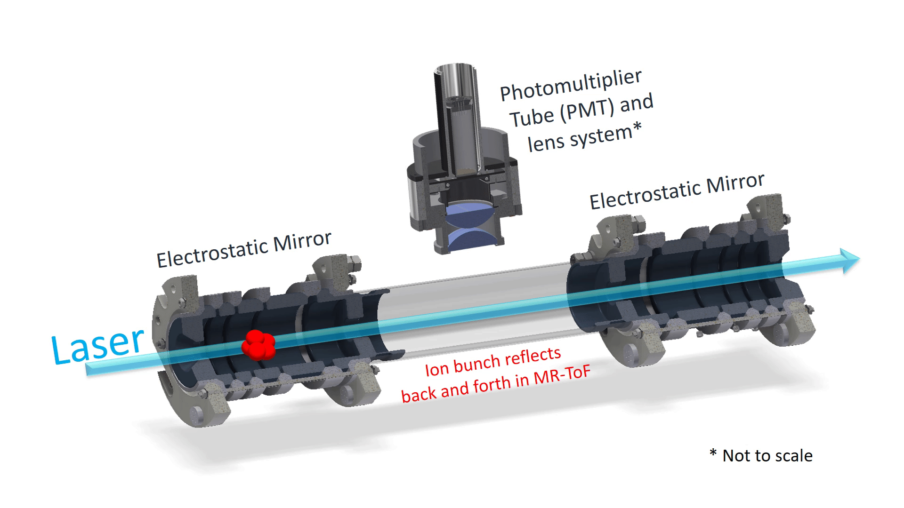


The Multi Ion Reflection Apparatus for Highly Sensitive Collinear Laser Spectroscopy
Outlook:
Introduction
MIRACLS technique
measurements of nuclear ground state properties of very exotic nuclides
  Results of proof-of-principle experiment
  Design&simulations of new device
high-precision measurements of the electron affinity of negative ions
Franziska Maria Maier
CERN PhD student, Universität Greifswald, Germany

Slide 2
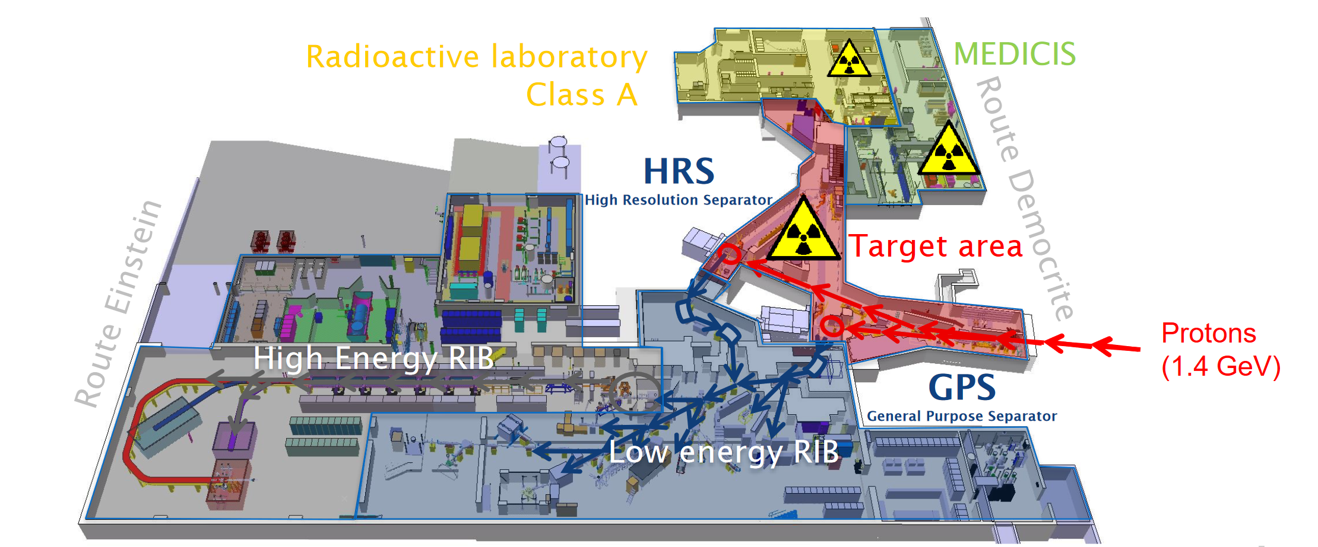
ISOLDE: Factory for Radioactive Ion Beams
Ca. 90% of the speed of light
https://ep-news.web.cern.ch/content/many-faces-isolde

Slide 3
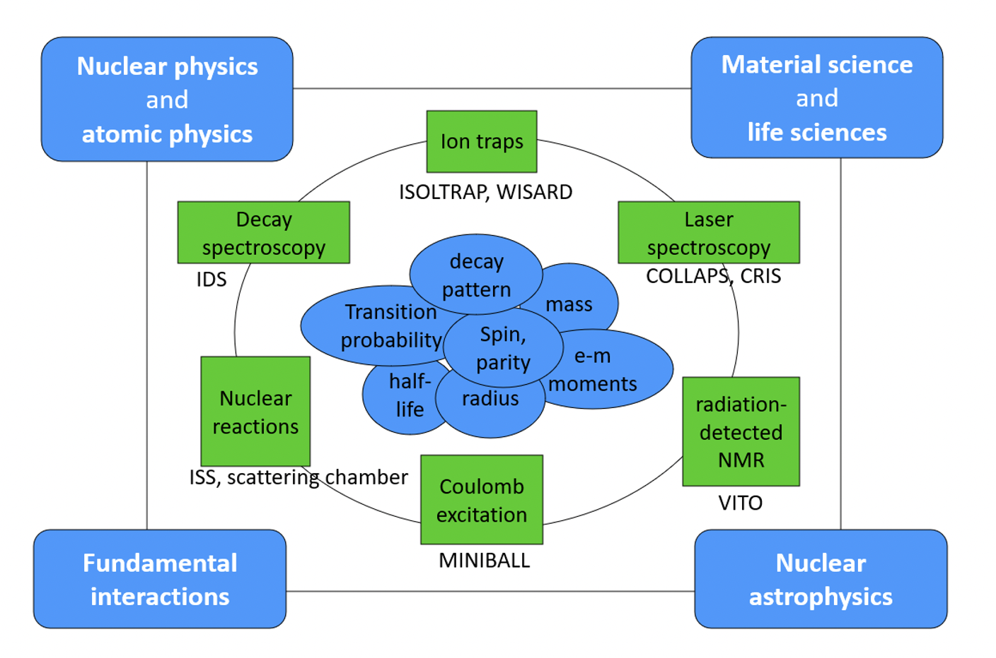
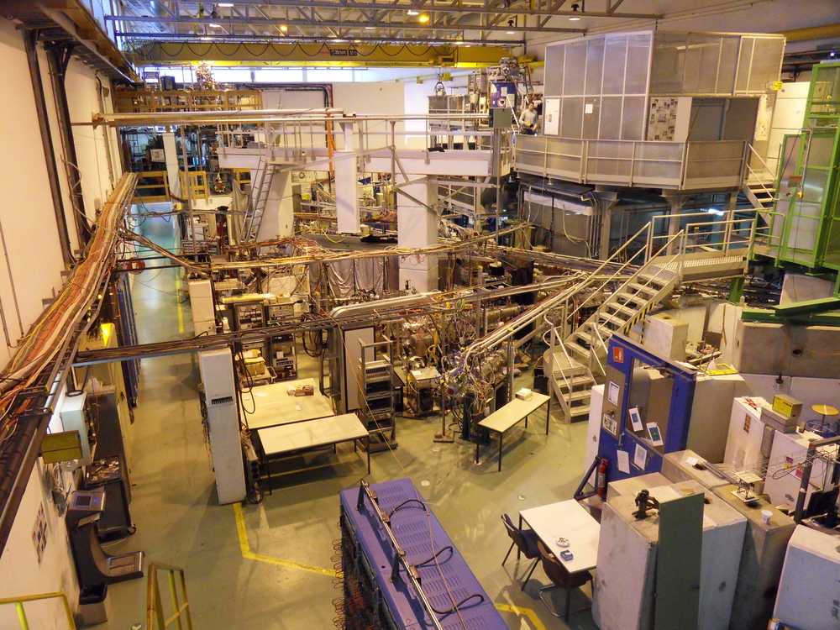
ISOLDE
https://ep-news.web.cern.ch/content/many-faces-isolde

Slide 4
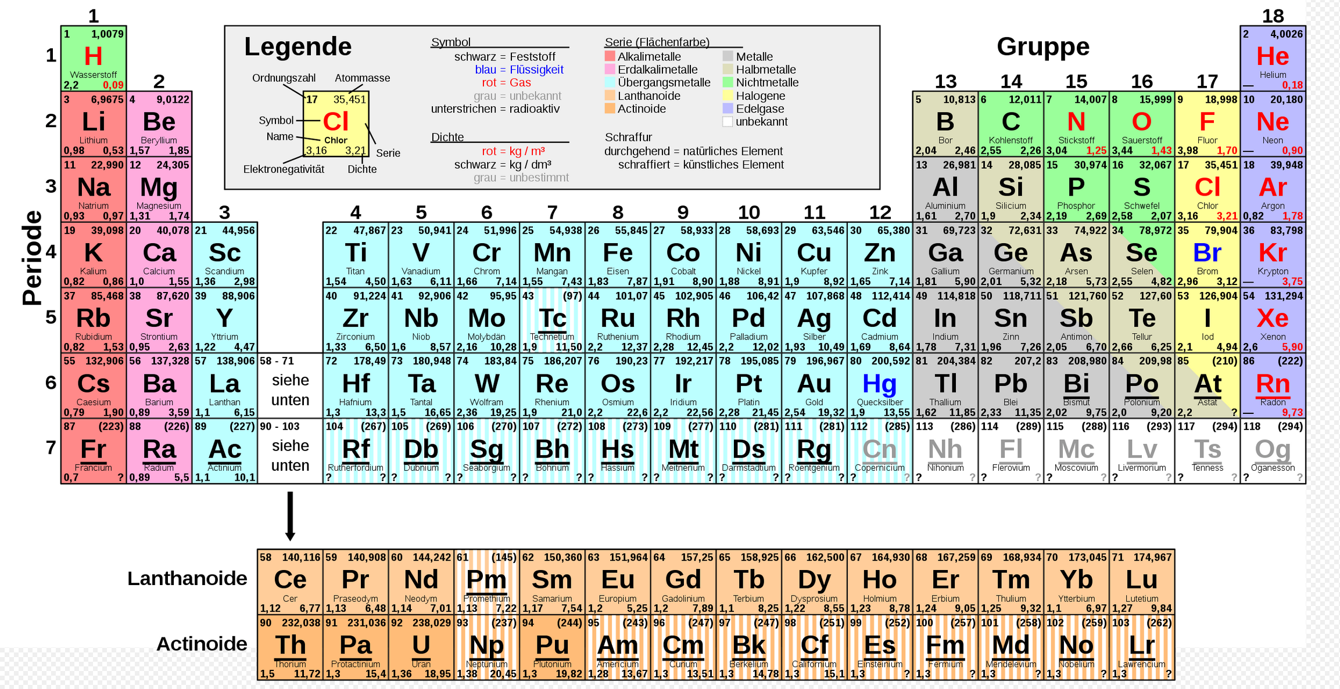
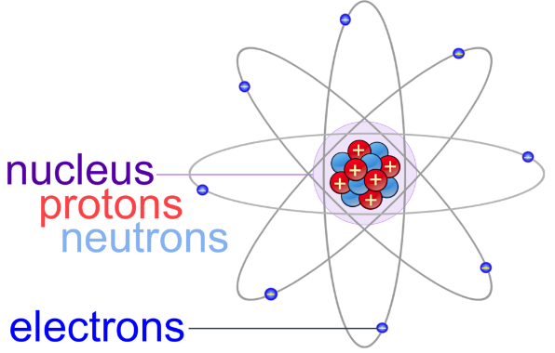
Production of Radioactive Nuclides @ ISOLDE
~1000 different isotopes
~75 different elements
Half-life: 1 ms – stable

Slide 5
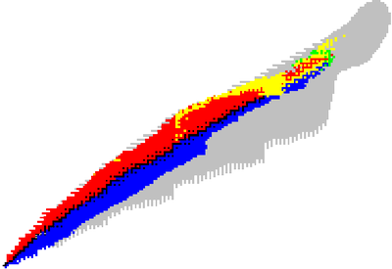
Production of Radioactive Nuclides @ ISOLDE
~1000 different isotopes
~75 different elements
Half-life: 1 ms – stable
Number of protons
Number of neutrons

Slide 6

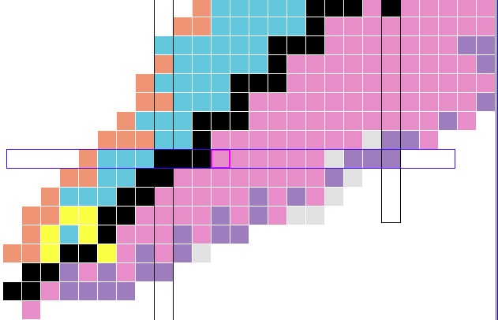
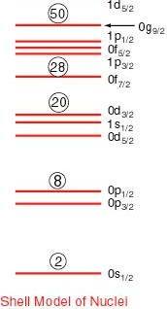

Nuclear Shell Structure
Maria Goeppert Mayer
J. Hans D. Jensen
Nobel Prize 1963
shell structure
& ‘magic numbers’
Nuclear chart:
N=20
protons
Z=8
N=20
disappears
N=16
appears
N=8
neutrons
studies at modern radioactive ion beam (RIB) facilities
disappearance of established shell closures
emergence of new ones
Shell Model of Nuclei
O. Sorlin, M.-G. Porquet, Prog. Part. Nucl. Phys. 61, 602 (2008)
R. Kanungo, Phys. Scr. T 152, 014002 (2013)

Slide 7
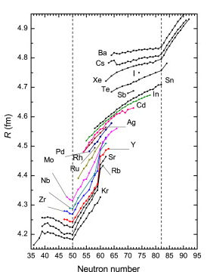
Mean square charge radius
Mean square charge radius (fm)
Shell Model of Nuclei
Number of neutrons
I. Angeli and K.P. Marinova. Atomic Data and Nuclear Data Tables, 2013.

Slide 8
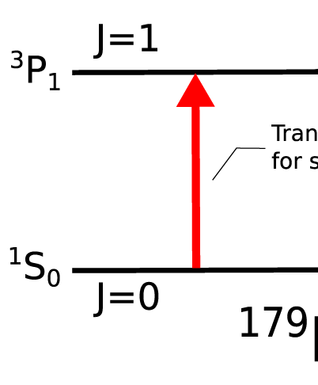




Laser Spectroscopy
Resonant excitation of (hyper)fine transitions in an atom or ion:
ionic excited state
ionic ground state
Excitation using laser photons
De-excitation: detect fluorescence photons
magnetic dipol moment 𝝁
Electric quadrupole moment Qs
rms charge radius
spin I
study nuclear structure phenomena
benchmark for modern nuclear theory
Notes:
By measuring the hyperfine structure one gets information about nuclear ground state properties, that then are an important benchmark for modern nuclear theory.

Slide 9
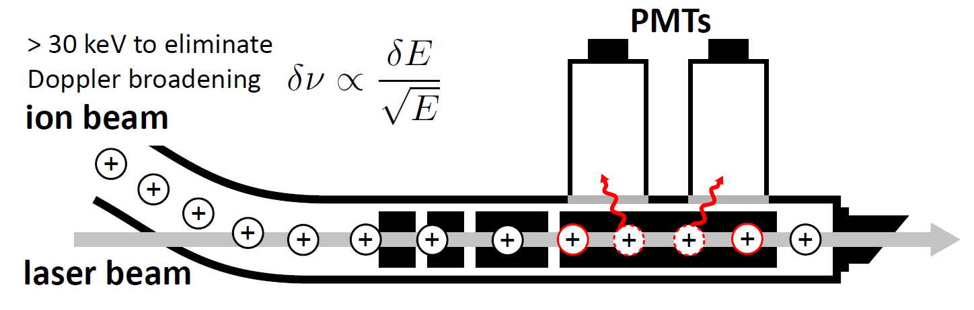
Laser Spectroscopy
ionic excited state
ionic ground state
Excitation using laser photons
De-excitation: detect fluorescence photons
Fast beams:
reduce Doppler spread
K. Blaum et al., Phys. Scr. T152, 014017 (2013)
P. Campbell et al., Prog. Part. and Nucl. Phys. 86, 127-180 (2016)
R. Neugart et al., J. Phys. G: Nucl. Part. Phys. 44, 064002 (2017)

Slide 10

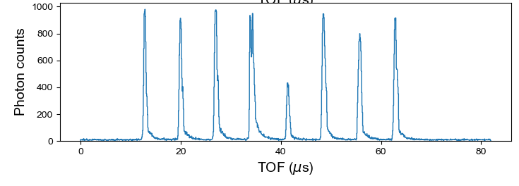
Collinear Laser Spectroscopy known for high resolution
Conventional fluorescence based CLS is limited to short observation times
Ejection from Paul trap
Ejection from MR-ToF
Conventional
CLS
MIRACLS improvement
Shown here only for 7 revolutions
Can be trapped for up to 1000s rev.

Slide 11
Collinear Laser Spectroscopy known for high resolution
Conventional fluorescence based CLS is limited to short observation times
Injection into MR-ToF
Ejection from MR-ToF
Conventional
CLS
MIRACLS improvement
Shown here only for 7 revolutions
Can be trapped for up to 1000s rev.
Increased observation time
→ gain in sensitivity by 1-2 orders of magnitude
More exotic nuclides accessible

Slide 12
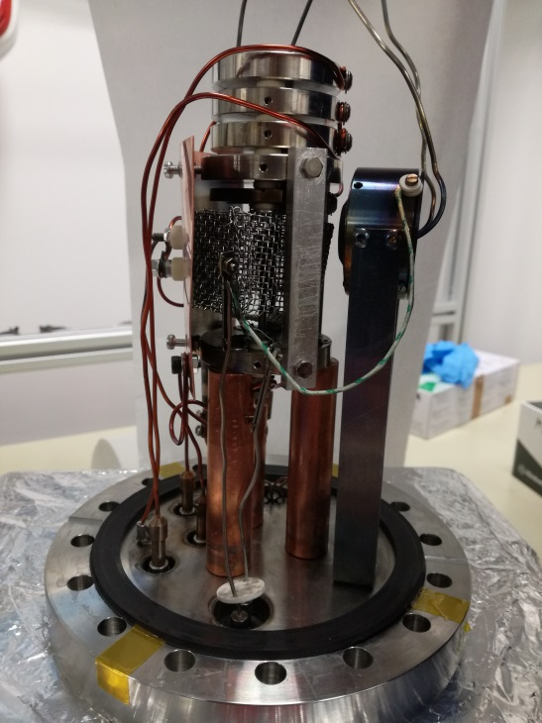
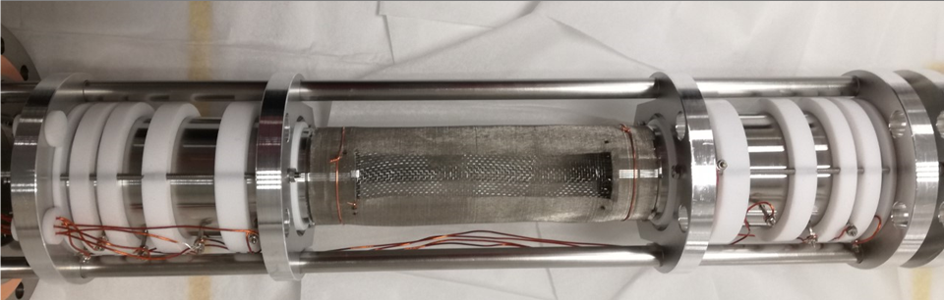
Proof-of-principle experiment
modified existing 1.5-keV MR-ToF device
  demonstrate potential of the technique
  investigate systematic effects
  validate simulations for future 30-keV device
Offline ion source:
1.5-keV MR-ToF device:

Slide 13
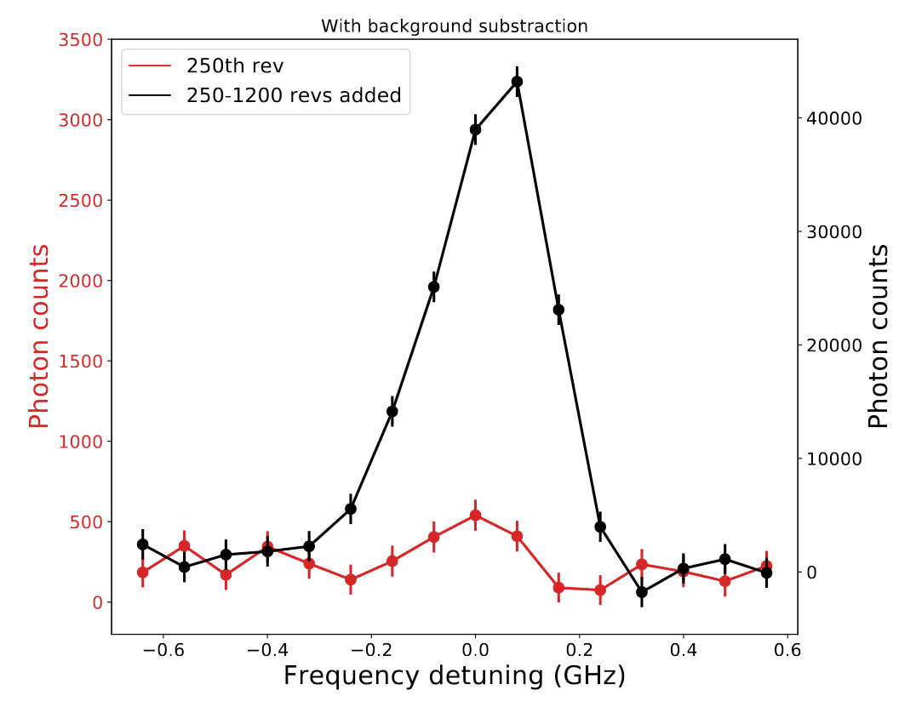
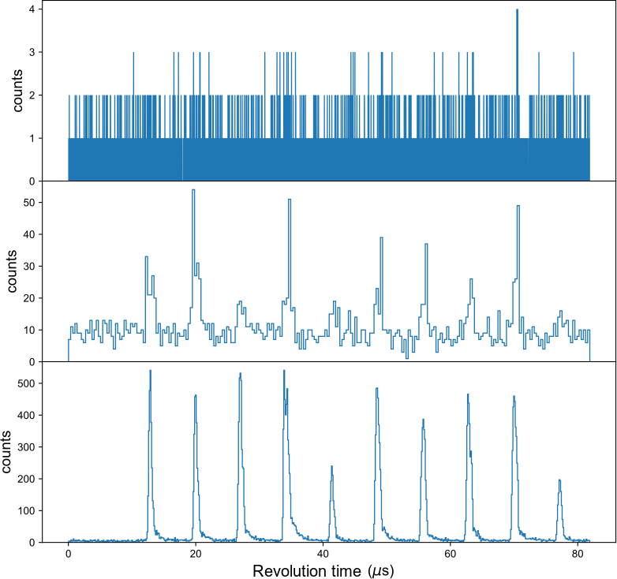
Improvement in Signal
3
2
1
3
1
Different
laser frequencies
2
1
2
3
13

Slide 14

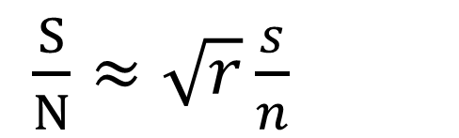
Expected Improvement Factors
 | ISOLDE YIELDS
³⁴Mg | 140 ions/µC
⁹⁸Cd | 10 ions/μC
⁹⁸Cd
$\frac{S}{N}≈\sqrt{r}\frac{s}{n}$
r = #revolutions
⁹⁶Cd
²⁰Mg
³⁴Mg
¹³¹Cd
¹³²Cd
optimal storage time:
ttrap ≈ 1.8 T1/2

Slide 15
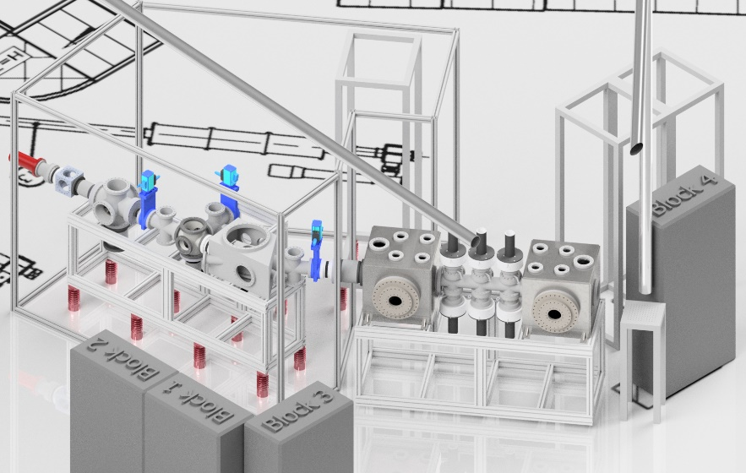
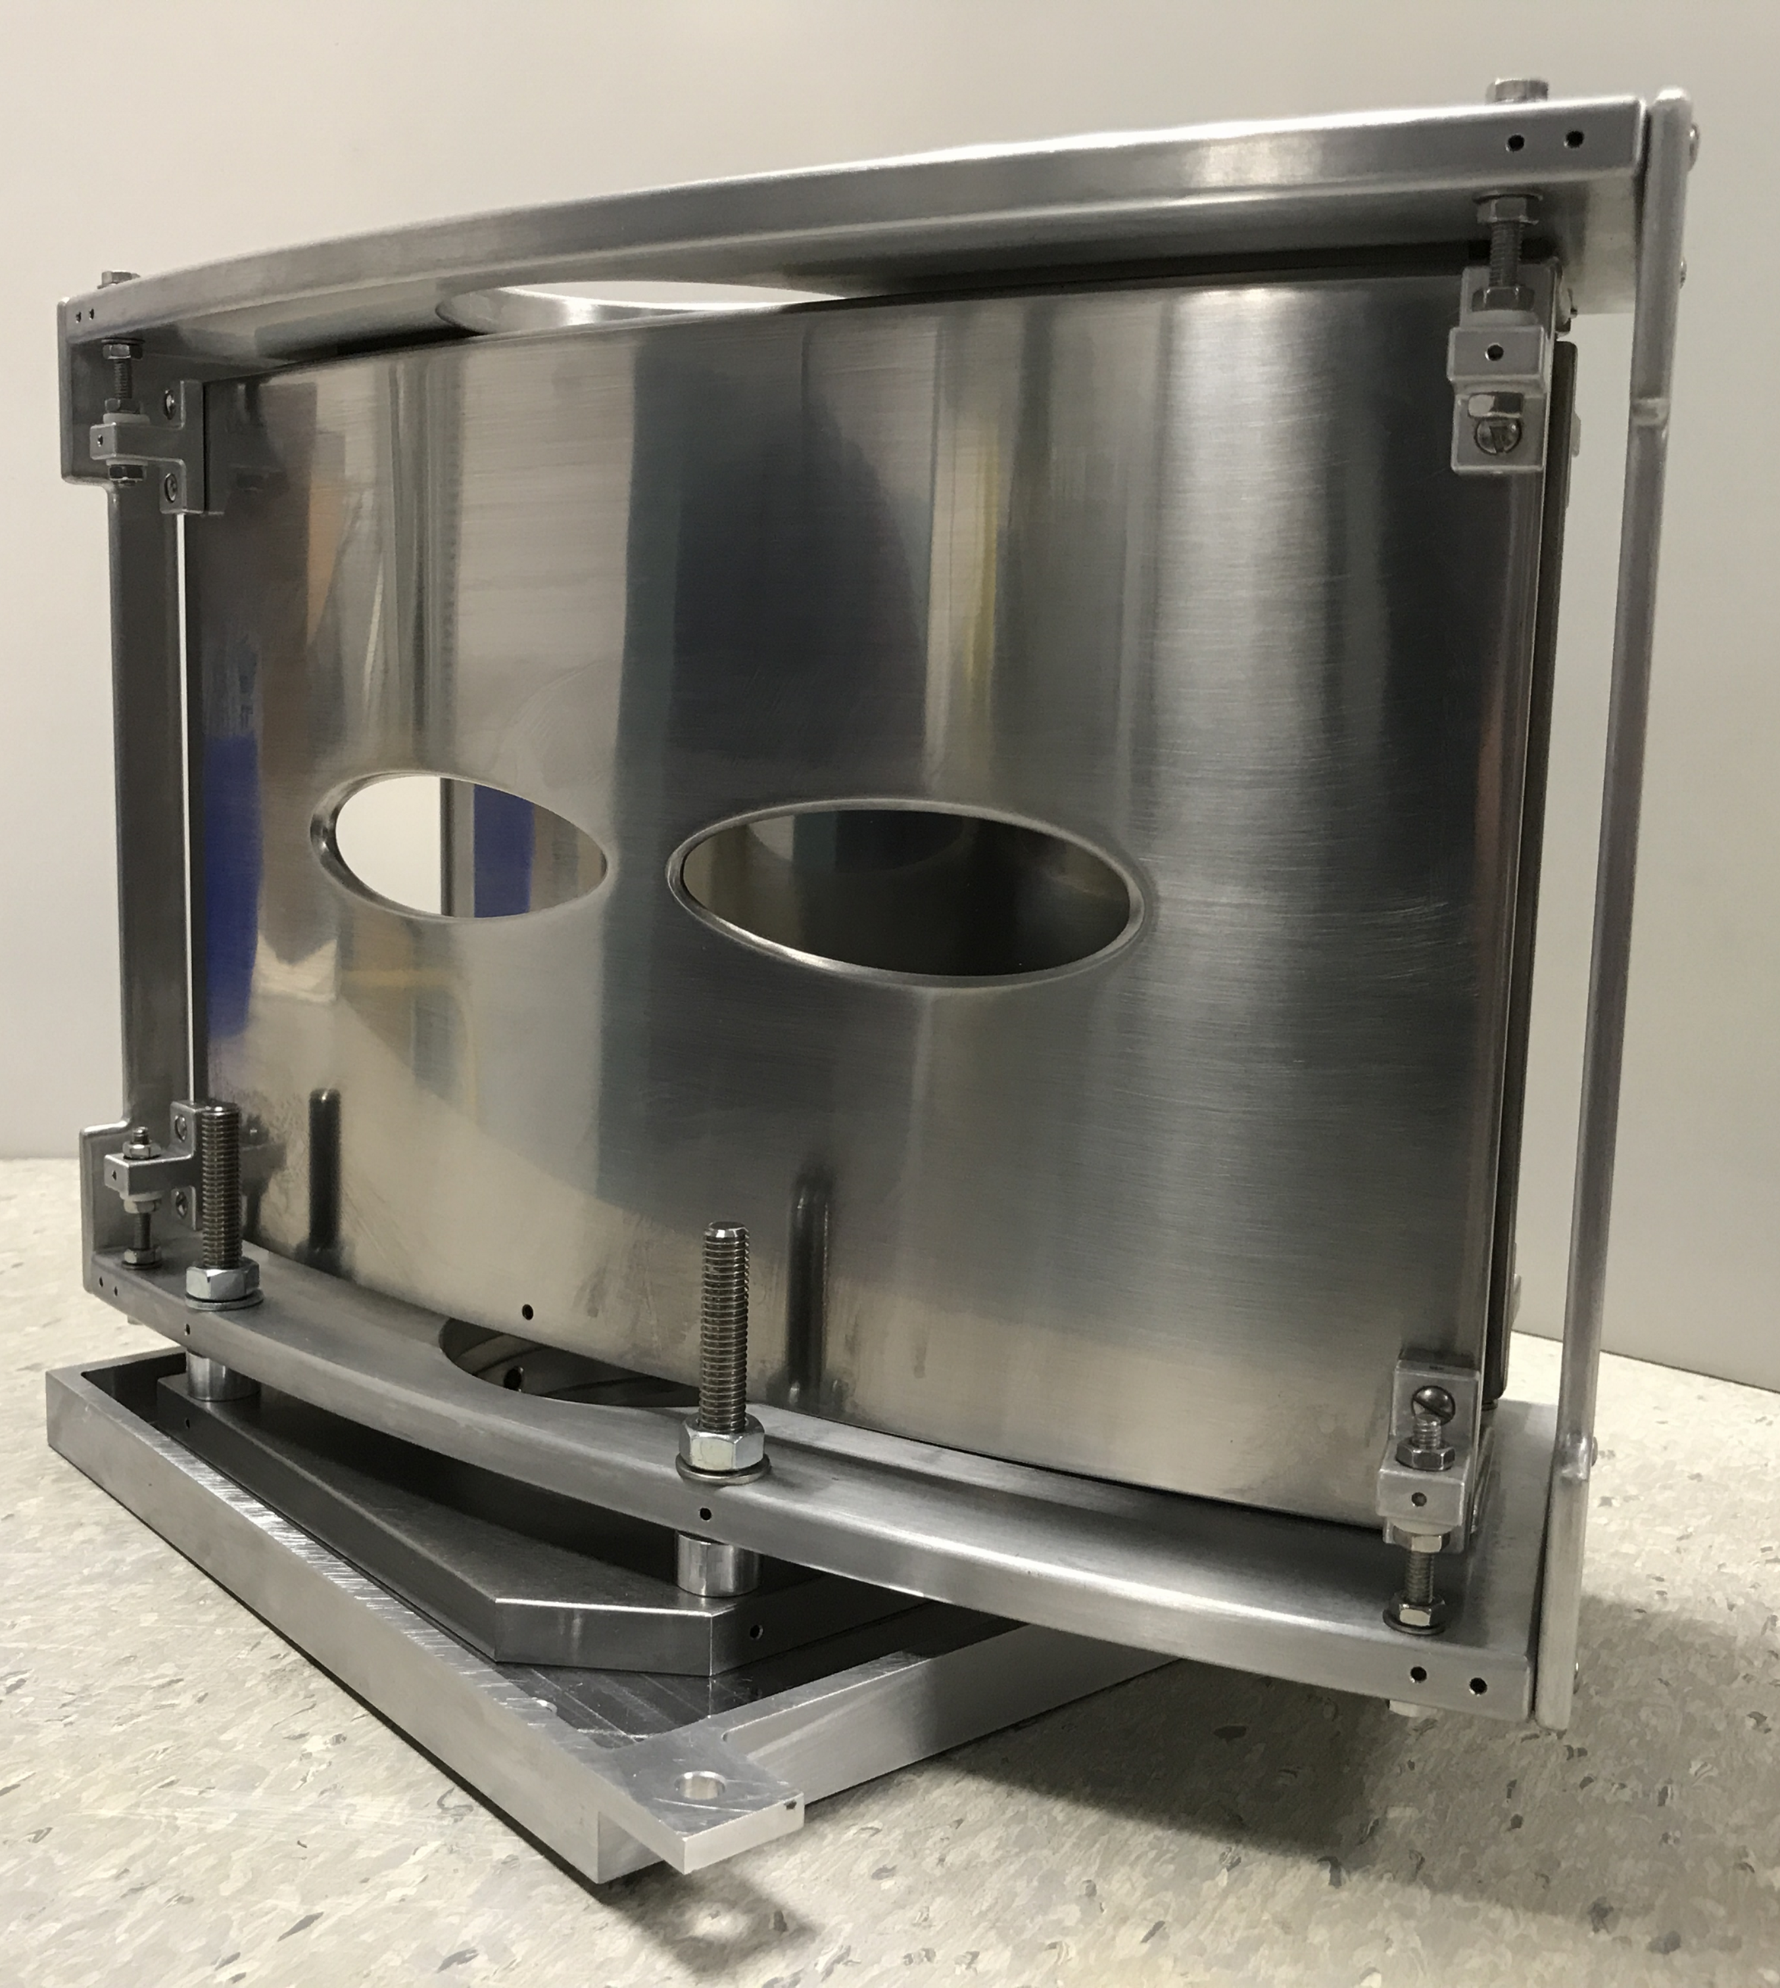
From PoP Towards First Online Operation
High-resolution MIRACLS:
… unprecedented 30-keV MR-ToF device
… minimize the Doppler broadening
… higher vacuum
… reduced stray light
… designed for CLS
Paul trap
Transfer line including 30°-bender
MR-ToF device

Slide 16
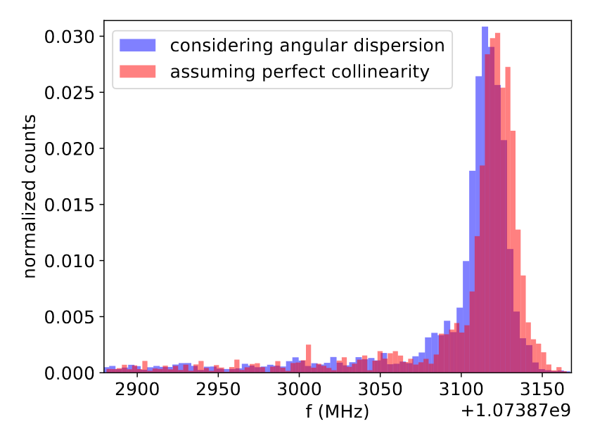
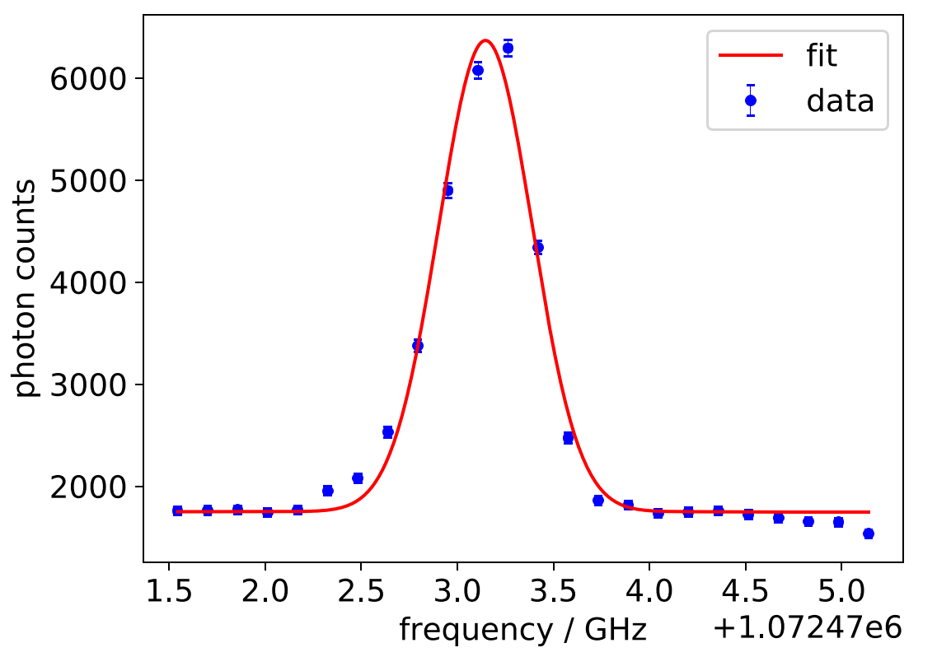
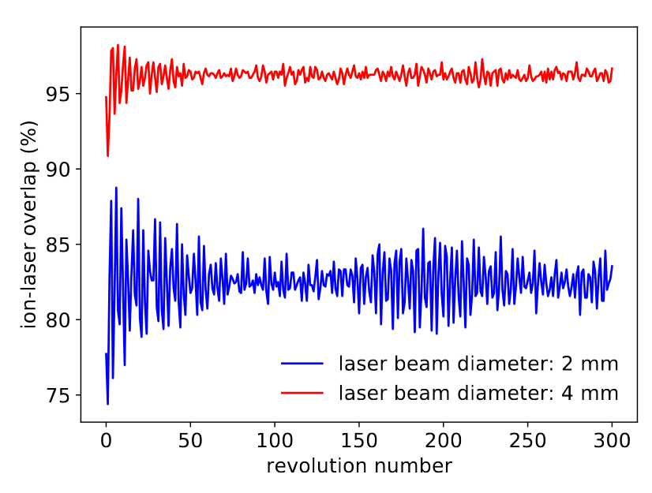
From PoP Towards First Online Operation
PoP experiment: 1.5-keV MR-ToF device
Online Operation: 30-keV MR-ToF device
1.5 keV to 30 keV
< 22.5 MHz
573(7) MHz

Slide 17
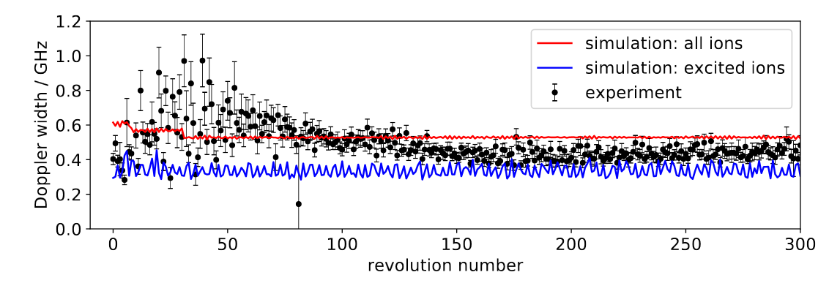
From PoP Towards First Online Operation
PoP experiment: 1.5-keV MR-ToF device
Online Operation: 30-keV MR-ToF device
1.5 keV to 30 keV
< 22.5 MHz
573(7) MHz
Simulation approach benchmarked against PoP experiment:
F. Maier et al., Hyperfine Interact. 240, 54 (2019)

Slide 18
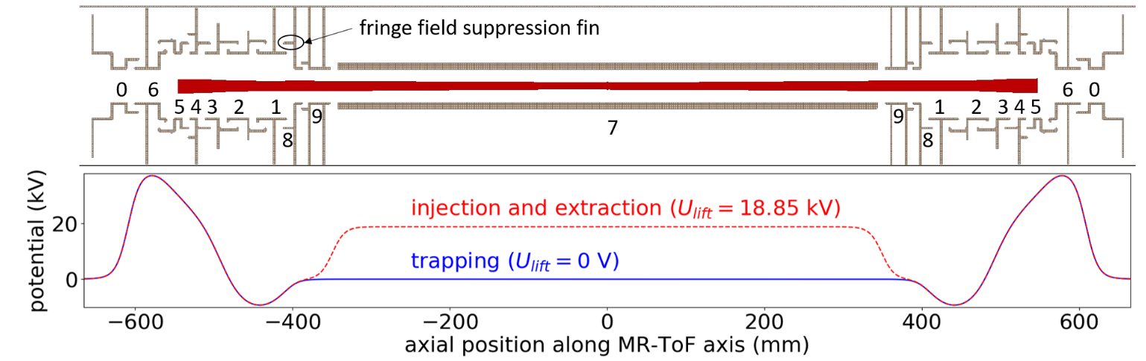
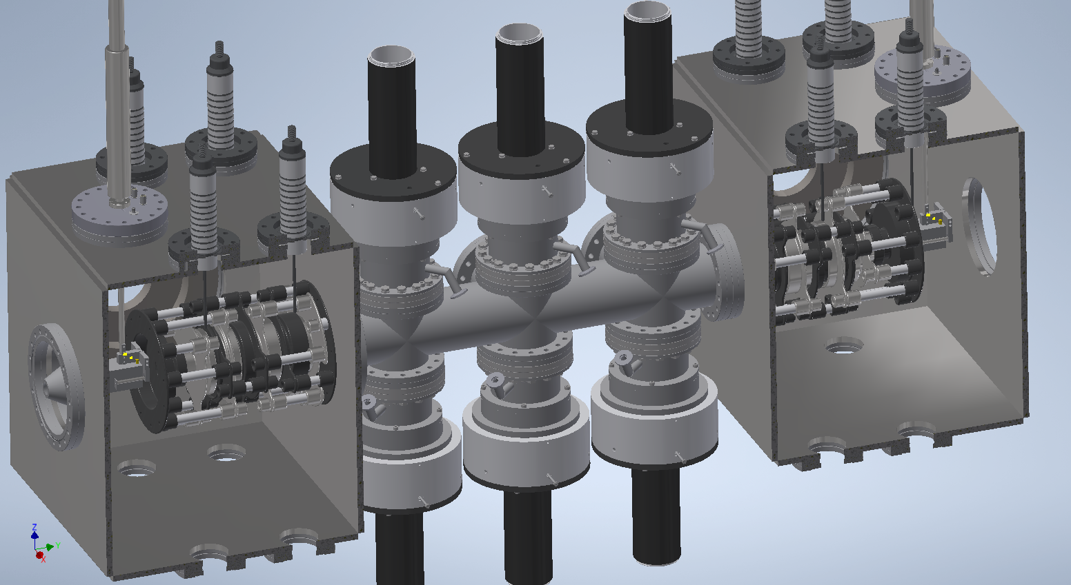
30-keV MR-ToF Device for CLS
PMT
PMT
simulation and design phase finished
Ready to build
PMT
Central Drift tube
mirror
mirror
PMT
PMT
PMT
1.6 m

Slide 19
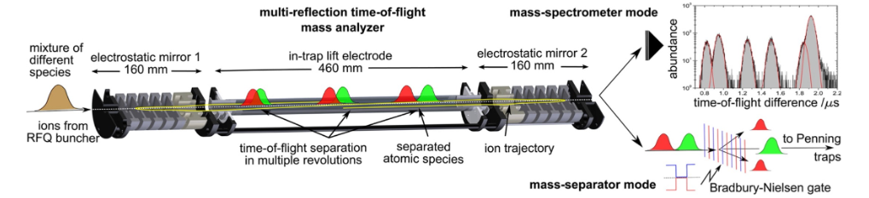


30-keV MR-ToF Device for Mass Separation
Problem: Space charge effects.

Slide 20
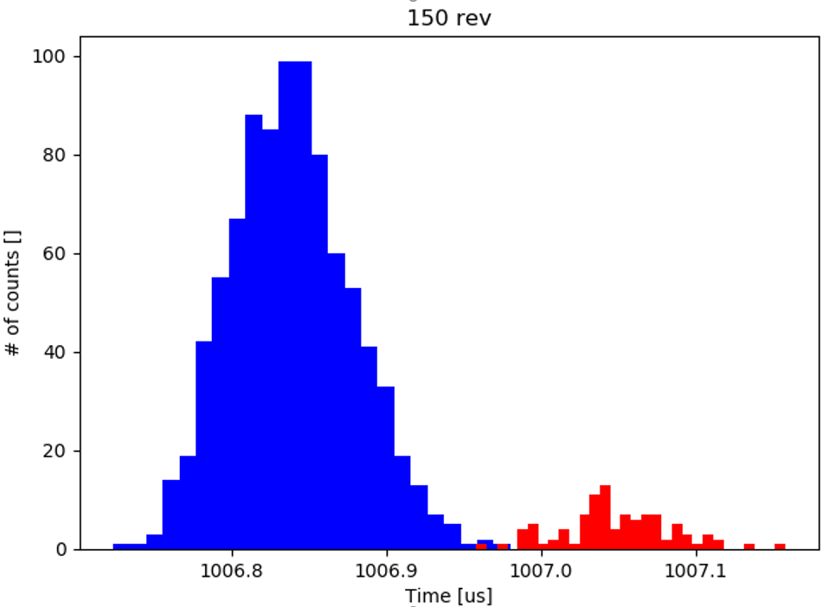
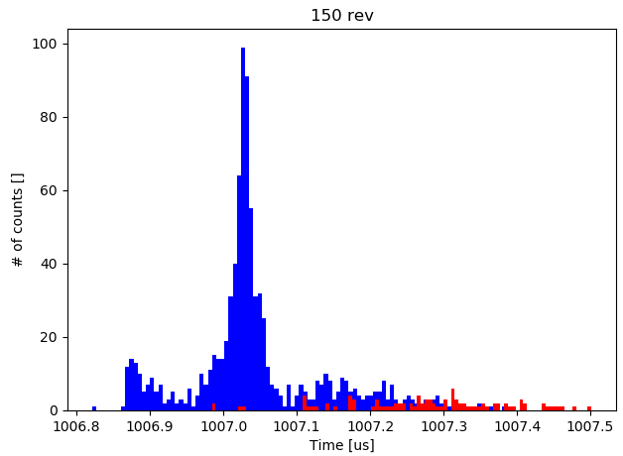
30-keV MR-ToF Device for Mass Separation
Non-interacting ions
25,000 interacting ions
24 u
24 u
24.0096 u
24.0096 u
A 30-keV MR-ToF device has a factor 15 higher ion flux compared to a 1.5 keV MR-ToF device.
More ions can be mass separated in a given time.

Slide 21
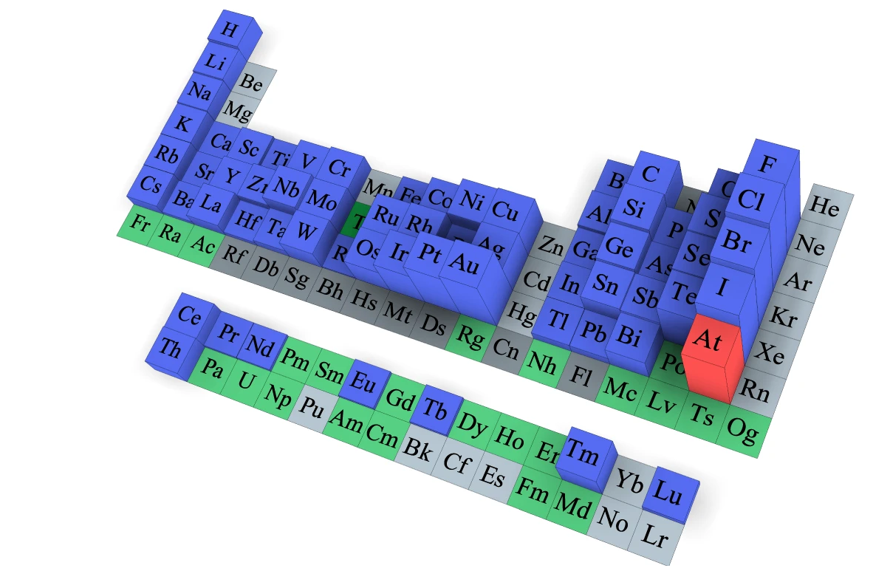

Photodetachment Studies in an MR-ToF Device
Goal:
Electron affinity measurements: high resolution → fundamental sciences (extraction of rms charge radii)
        high sensitivity → design molecules for e.g. cancer therapy
Stable isotopes measured with modest precision
Predicted to form stable negative ions, but not measured so far
Do not form a stable negative ion according to theory
Not studied at all neither in theory nor in experiment
Leimbach, D., Karls, J., Guo, Y. et al. The electron affinity of astatine. Nat Commun 11, 3824

Slide 22
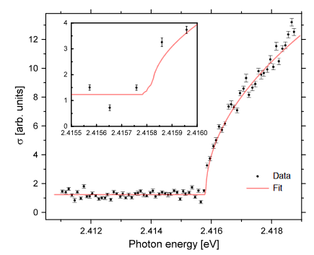
Photodetachment Studies in an MR-ToF Device
Goal:
Electron affinity + isotope shift in electron affinity between Cl^{35,36,37}
Laser-photodetachment-threshold spectroscopy of neg. Cl ions
electron
laser
ion
atom
Threshold scan of photodetachement of astatin
Leimbach, D., Karls, J., Guo, Y. et al. The electron affinity of astatine. Nat Commun 11, 3824

Slide 23
Photodetachment Studies in an MR-ToF Device
Goal:
Electron affinity + isotope shift in electron affinity between Cl^{35,36,37}
Laser-photodetachment-threshold spectroscopy of neg. Cl ions
Increased efficiency due to reprobing same ion bunch in MR-ToF device
Employing narrow-band continuous-wave lasers
Higher precision
electron
laser
ion
atom
Threshold scan of photodetachment of Astatine
Leimbach, D., Karls, J., Guo, Y. et al. The electron affinity of astatine. Nat Commun 11, 3824

Slide 24
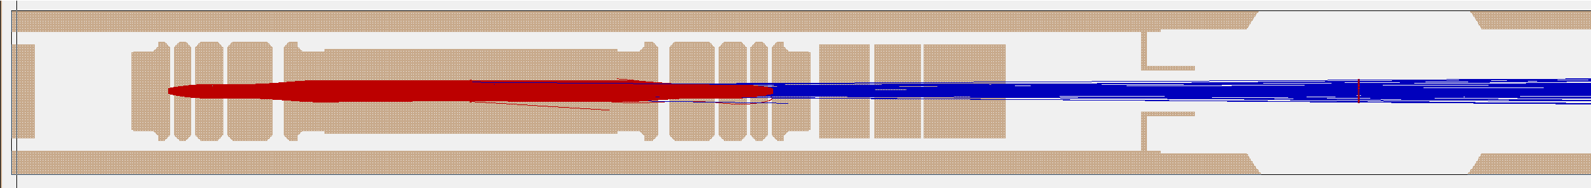
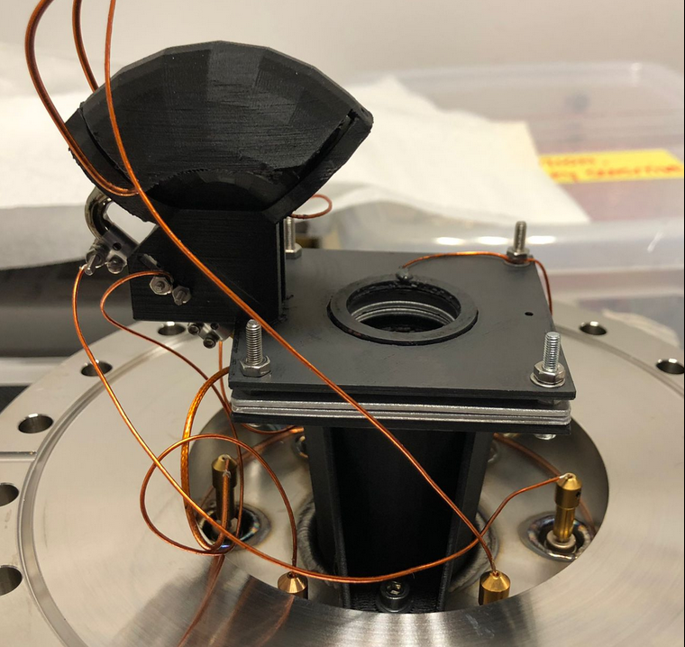
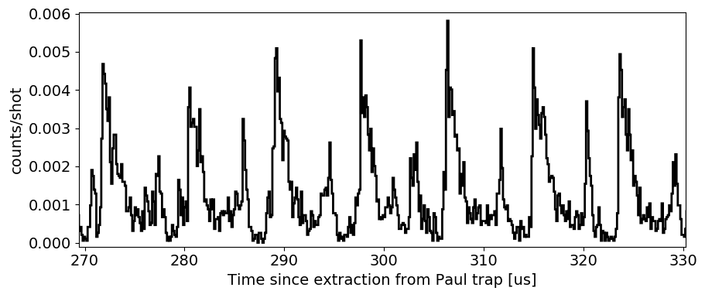
Detection of Neutral Atoms
ions
neutrals
Neutralization through residual gas collisions →
Measurement of neutrals on a neutral particle detector
Cl³⁵
Cl³⁵
Cl³⁵
Cl³⁵
Cl³⁵
Cl³⁵
Cl³⁵
Cl³⁷
Cl³⁷
Cl³⁷
Cl³⁷
Cl³⁷
Cl³⁷
Cl³⁷
Next step: get laser system ready for photodetachment studies

Slide 25

Conclusions
… same ion bunch can be probed for thousands of times
... increased observation time
... increased experimental sensitivity
→ measurements of nuclear ground state properties of very exotic nuclides
→ high-precision measurements of the electron affinity of negative ions
F. Maier et al., Hyperfine Interact. 240, 54 (2019)
S. Lechner et al., Hyperfine Interact. 240, 95 (2019)
S. Sels et al., Nucl. Instr. Meth. Phys. Res. B 463, 310 (2020)
V. Lagaki et al., Acta Physica Polonica Series B 51, 571 (2020)
V. Lagaki et al., NIMA, 1014, 165663 (2021)

Slide 26

Thanks!
F. Maier^{1,3}, P. Fischer³, H. Heylen¹, C. Kanitz^{1,2}, V. Lagaki^{1,3}, S. Lechner^{1,4}, E. Leistenschneider¹, P.Plattner^{1,5}, S. Sels¹, M. Vilen¹, F. Wienholtz⁶, W. Nörtershäuser⁶, L. Schweikhard³, S. Malbrunot-Ettenauer¹
  ¹ Experimental Physics Department, CERN, CH-1211 Geneva, Switzerland
  ² Friedrich-Alexander-Universität Erlangen-Nürnberg, D-91054 Erlangen, Germany
³ Institut für Physik, Universität Greifswald, D-17487 Greifswald, Germany
⁴ Technische Universität Wien, A-1040 Wien, Austria
⁵ Universität Innsbruck, A-6020 Innsbruck, Austria
⁶ Institut für Kernphysik, TU Darmstadt, D-64289 Darmstadt, Germany
Collaboration partners for the photodetachment studies: M. Au (CERN), U. Berzinsh (U. Latvia), R. Blakey (CERN), D. Hanstorp (U. Gothenburg), D. Leimbach (U. Gothenburg), M. Nichols (U. Gothenburg), M. Reponen (JYFL), S. Rothe (CERN), J. Warbinek (GSI)
Visit: cern.ch/miracls

