Slide 1
Introduction to CERN KT
Giovanni Anelli
Giovanni.anelli@cern.ch
07.03.2022

Slide 2
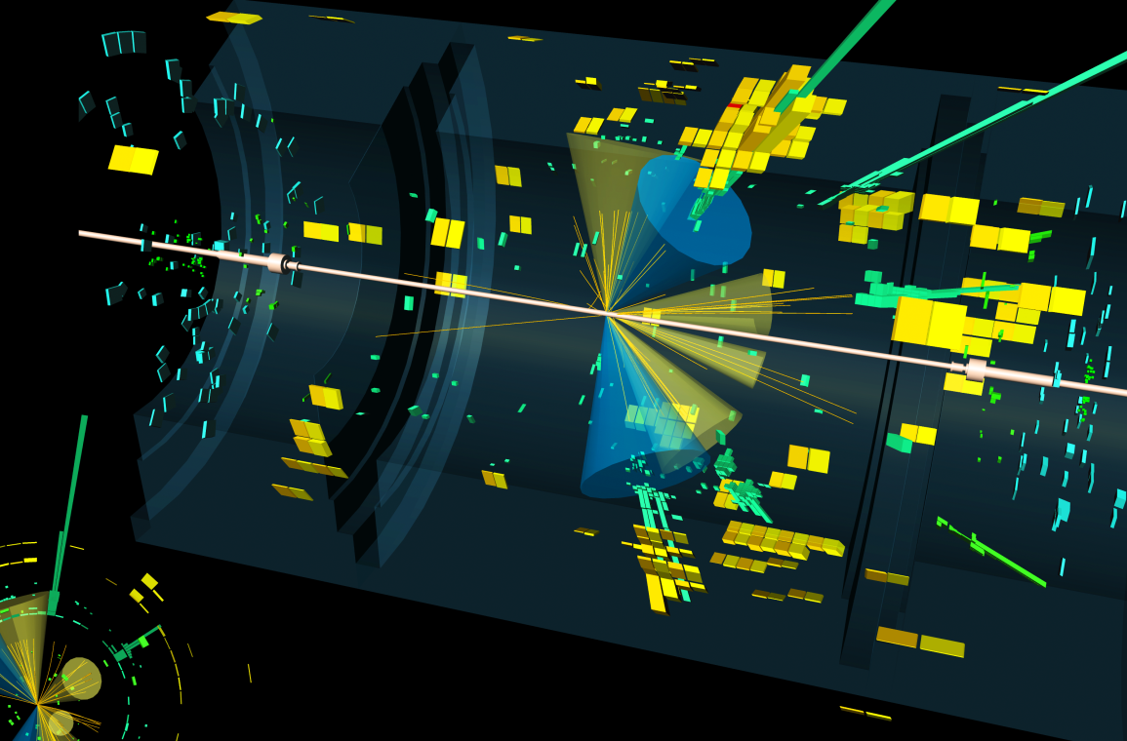
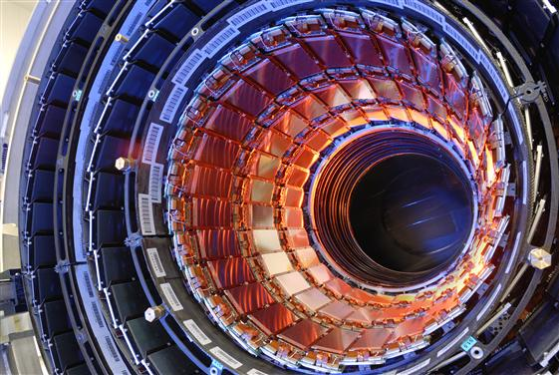

Training
CERN’s Mission
Science
Technology
Collaboration
Notes:
CERN’s mission extends beyond science: it also aims to advance the frontiers of technology, to train the next generation of scientists and engineers, and to bring nations together.
Science, technology, training and collaboration are the 4 main pillars of CERN.
All these have a positive impact on society.
Additional resources:
https://home.cern/about/who-we-are/our-mission

Slide 3
KT’s Mission
Maximise the technological and knowledge return to society, in particular through Member States industry
Promote CERN as a centre of excellence for technology and innovation
Demonstrate the importance and impact of fundamental research investments
Notes:
The Knowledge Transfer group at CERN aims to engage with experts in science, technology and industry in order to create opportunities for the transfer of CERN’s technology and know-how.
The ultimate goal is to accelerate innovation and maximise the global positive impact of CERN on society. This is done by promoting and transferring the technological and human capital developed at CERN.
The CERN KT group promotes CERN as a centre of technological excellence, and promotes the positive impact of fundamental research organisations on society.
Additional resources:
https://kt.cern/about-us

Slide 4
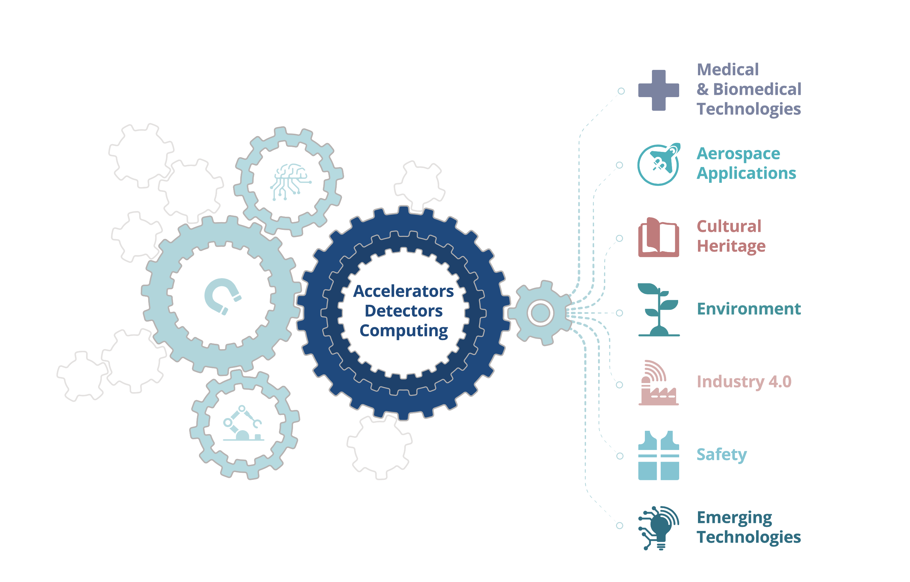
From CERN Technologies...
… to Society
Notes:
CERN's expertise builds broadly on three technical fields: accelerators, detectors and computing.
Behind these three pillars of technology, lies a great number of areas of expertise: from cryogenics to ultra-high vacuums, from particle tracking and radiation monitoring to superconductivity and many more.
These technologies, and the human expertise associated with them, translate into positive impact on society in many different fields, including Medical & Biomedical Technologies, Aerospace Applications, Cultural Heritage, Environment, Industry 4.0, Safety and Emerging Technologies.
Additional resources:
https://kt.cern/cern-technologies-society

Slide 5
Knowledge Transfer Tools
Notes:
CERN actively invests in many activities to accelerate the innovation process. The CERN Knowledge Transfer group provides advice, support, training, networks and infrastructure to ease the transfer of CERN's know-how to industry and eventually to society. These activities are all fundamentally based on CERN's Open Innovation strategy, and reach out to CERN personnel, industry, entrepreneurship and research collaborators.
Additional resources:
https://kt.cern/activities-services

Slide 6
KT Framework
Spin-Off
Policy
(2018)
Medical
Applications
Strategy Paper
(2017)
Patent
Policy
(2019)
Software
Dissemination
Policy
(2017)
IP Policy
(2010; 2020)
. . .

Slide 7
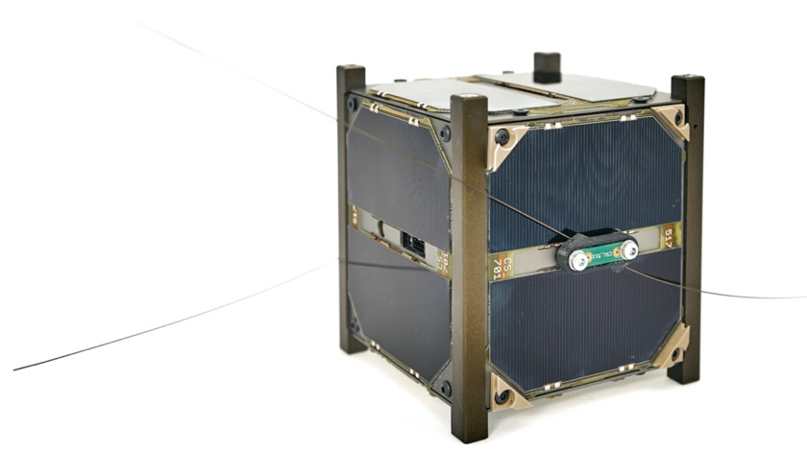
Aerospace Applications
CELESTA
First full satellite
tested at CHARM
Notes:
CHARM, a unique facility at CERN to test electronics in complex radiation environments, tested its first full spacecraft in July 2018: CELESTA (CERN matchup and radon Experiment Student sAtellite). The micro-satellite was initially tested under a range of radiation conditions that it can expect to encounter in space. During the last day, the shilling was removed to test the tolerance of the platform to high particle fluxes. The satellite worked reliably and demonstrated its ability to manage radiation-induced errors autonomously. The payload, based on CERN RadMon technology, confirmed its very high sensitivity even to low fluxes and overall outstanding performances.
Additional resources:
https://kt.cern/article/first-full-satellite-tested-cern’s-charm-facility-0
https://kt.cern/kt-fund/projects/celesta-cubesat-demonstrator-radmon-and-charm-applications

Slide 8
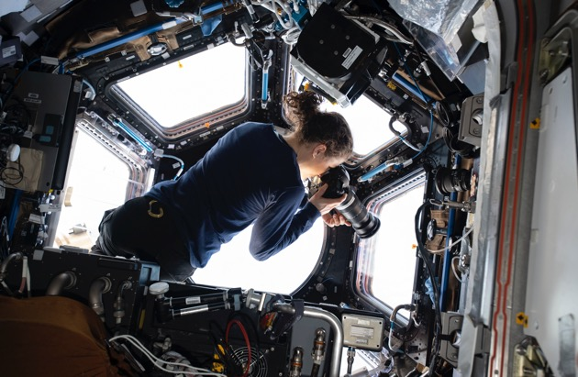
Aerospace Applications
NASA
Radiation monitoring in NASA’s Orion vehicle and at the International Space Station
Image: NASA
Notes:
CERN has a lot in common with space missions; both deal with extremely harsh environments that have overlapping technological requirements. Derived from the CERN hosted Medipix2 Collaboration, Timepix is being utilised for radiation monitoring in NASA’s Orion vehicle and at the International Space Station
Additional resources:
https://kt.cern/article/nasa-cern-timepix-technology-advances-miniaturized-radiation-detection
https://kt.cern/technologies/medipix2

Slide 9
Cultural Heritage
InsightART
Measuring the DNA of your art
Image: InsightART
Notes:
How can you tell the difference between a masterpiece and a masterful forgery? At CERN, the Medipix Collaborations have been developing state-of-the-art particle imaging and detection readout chips since the 1990s. Now, they are being used by a new start-up to bring about a revolutionary improvement in the field of art authentication and restoration. InsightART, a subsidiary of the Medipix collaboration spin-off company Advacam, has adopted the technology to perform spectral X-ray scans of a wide range of fine art objects.
Additional resources:
https://kt.cern/sites/knowledgetransfer.web.cern.ch/files/file-uploads/other/knowledge-transfer-brochure.pdf
https://kt.cern/article/particle-detectors-meet-canvas
https://kt.cern/startups/advacam-sro

Slide 10
Cultural Heritage
MACHINA
A compact transportable accelerator for art examination
Notes:
Technologies from particle physics continue to find applications in cultural heritage, particularly in the art field. Museums, art galleries, auction houses, art restorers and other art experts may now benefit from the use of particle accelerators to study heritage works.
CERN and INFN are collaborating on a common project called MACHINA, which stands for Movable Accelerator for Cultural Heritage In-situ Non-destructive Analysis.
The MACHINA device can be used by museums and businesses that do not have the resources to access larger facilities. Its small size also means that it can be transported to fixed artworks, or those too delicate to be moved. In April 2018, the project was launched at the Opificio delle Pietre Dure (OPD) in Florence, one of the world’s leading institutes in art restoration.
Additional resources:
https://kt.cern/article/new-small-scale-accelerator-help-study-heritage-artworks-0
https://kt.cern/technologies/high-frequency-compact-linear-proton-accelerator

Slide 11
Medical and Biomedical Technologies
Mars Bioimaging
First 3D colour X-ray of a human using CERN technology
Image: Mars Bioimaging
Notes:
Medipix is a family of read-out chips for particle imaging and detection. The original concept of Medipix is that it works like a camera, detecting and counting each individual particle hitting the pixels when its electronic shutter is open. This enables high-resolution, high contrast and very reliable images, making it unique for imaging applications, in particular in the medical field.
In 2018, the start-up MARS Bioimaging produced the first 3D colour X-ray of a human by using a breakthrough colour medical scanner based on the Medipix3 technology developed at CERN by the Medipix3 Collaboration. With respect to traditional black-and-white X-ray scans, colour X-rays can distinguish parts of the body which have similar density but are made of different materials. With this technology, doctors can access new diagnostic information and will have the opportunity to use next generation contrast agents to detect cancer.
Additional resources:
https://kt.cern/article/first-3d-colour-x-ray-human-using-cern-technology
https://kt.cern/technologies/medipix3

Slide 12
Medical and Biomedical Technologies
CERN-MEDICIS
New tools for precision medicine
Notes:
CERN-MEDICIS (Medical Isotopes Collected from ISOLDE) is a one-of-a kind infrastructure designed to produce a new generation of non-conventional radioisotopes with potential applications in precision medicine and theranostics. The development of innovative radiopharmaceuticals is in fact strongly connected to the availability of novel types of radioisotopes that are not readily produced by traditional methods. MEDICIS aims to increase the range of radioisotopes available for biomedical research, thanks to its unique set-up that includes an irradiation station on a high-energy proton beam and a radioisotope mass-separation beam-line. Since December 2017, MEDICIS has been providing innovative radioisotopes to biomedical research centres.
Additional resources:
https://kt.cern/technologies/medicis
https://kt.cern/sites/knowledgetransfer.web.cern.ch/files/file-uploads/other/knowledge-transfer-brochure.pdf

Slide 13
Medical and Biomedical Technologies
Therapeutic Particles
Cutting-edge solutions for advanced cancer radiotherapy
Image: CNAO
Notes:
Since the 1990s, CERN has applied its core expertise to develop cutting-edge solutions for advanced cancer radiotherapy. The Laboratory has contributed, together with the TERA Foundation and INFN, to the design of the medical accelerator for the ion therapy centre CNAO in Italy, and to the construction of the one for MedAustron in Austria (based on the CNAO design). More recently, CERN has licensed its innovative Radio-Frequency Quadrupole technology to ADAM S.A., which is developing a new generation of linac-based proton therapy systems. CERN is now focusing its efforts on novel technologies and pioneering concepts for next-generation ion therapy machines – from linacs to superconducting magnets, gantry systems, as well as flash radiotherapy.
Additional resources:
https://kt.cern/sites/knowledgetransfer.web.cern.ch/files/file-uploads/other/knowledge-transfer-brochure.pdf
https://kt.cern/success-stories/cnao-treating-cancer-ions-2011
https://kt.cern/success-stories/medaustron
https://kt.cern/article/using-cern-magnet-technology-innovative-cancer-treatment-0

Slide 14
HIL Applied Medical is developing a new class of ultra-compact, high performance proton therapy systems. CERN provided consultancy on magnet design for proton beamlines to HIL (2019 and 2020). The consultancy has contributed to, among other things, the definition of technical requirements and selection of third parties for system development.

Slide 15
ImmunoBrainCheckpoint (IBC) and CERN collaborating since 2019 to develop novel therapies that target the immune system and trigger brain repair to help combat neurodegeneration using agent based modelling. IBC today partner in the BioDynaMo consortium.

Slide 16

CEVA and CERN working on machine learning, aiming to make neural networks run faster and more efficiently. Two years collaborations successfully completed and currently extension of project in preparation.

Slide 17




How to collaborate with CERN
Start a company based on CERN technology or know-how
Service & Consultancy
Licensing
R&D Collaborations
Find out more at kt.cern/collaborate
Notes:
Whether you work in a large company, an SME or a start-up, we can help you tap into CERN technology or know-how or help you identify solutions based on CERN's area of expertise. Each case is unique and there are many potential ways to collaborate. If you are unsure how to benefit from CERN, we are here to help you discover if there is a fit between your needs and our expertise and services.
Start a company based on CERN technology or know-how
CERN encourages the creation of spin-off companies, and gives support to CERN personnel and external entrepreneurs wanting to establish a company in one of CERN’s Member States.
Service & Consultancy
CERN’s expertise and cutting-edge infrastructures represent a unique opportunity for industry and academia in need of a specific high-tech service. CERN experts are available to provide professional advice or specific studies to your business.
Licensing
CERN grants licenses to commercial and academic partners for the exploitation of its technologies. All CERN technologies available for licensing can be found at kt.cern/technologies
R&D Collaborations
CERN has a well-established tradition of collaboration with research institutes. R&D projects can be developed in CERN’s many areas of expertise. You are invited to contact CERN’s Knowledge Transfer group to discuss how to establish an R&D collaboration.
Additional resources:
https://kt.cern/industry

Slide 18

Find out more at kt.cern

Slide 19
Extra Slides

