Slide 1

DFM in WP6a
A. Ballarino
DFM Detailed Design Review, CERN, 18/12/2022

Slide 2
WP6a Cold Powering System
WP9
Cryogenics
WP17 – WP6b
RT Cables
Power Converters
4
Current Leads (DFLH)
T2≤50 K
Interface to WP3
Nb-Ti to Nb-Ti
HTS
DFHX/DFHM
T1≤17 K
MgB₂ to HTS
3
DFH
WP3 - Magnets (λ-plate with Nb-Ti)
1
DF
λ-Plate
2
SC Link (DSL)
LHe
4.2 K
MgB₂
Nb-Ti – 1.9 K
MgB₂ to Nb-Ti
Nb-Ti to Nb-Ti
DFX/DFM

Slide 3
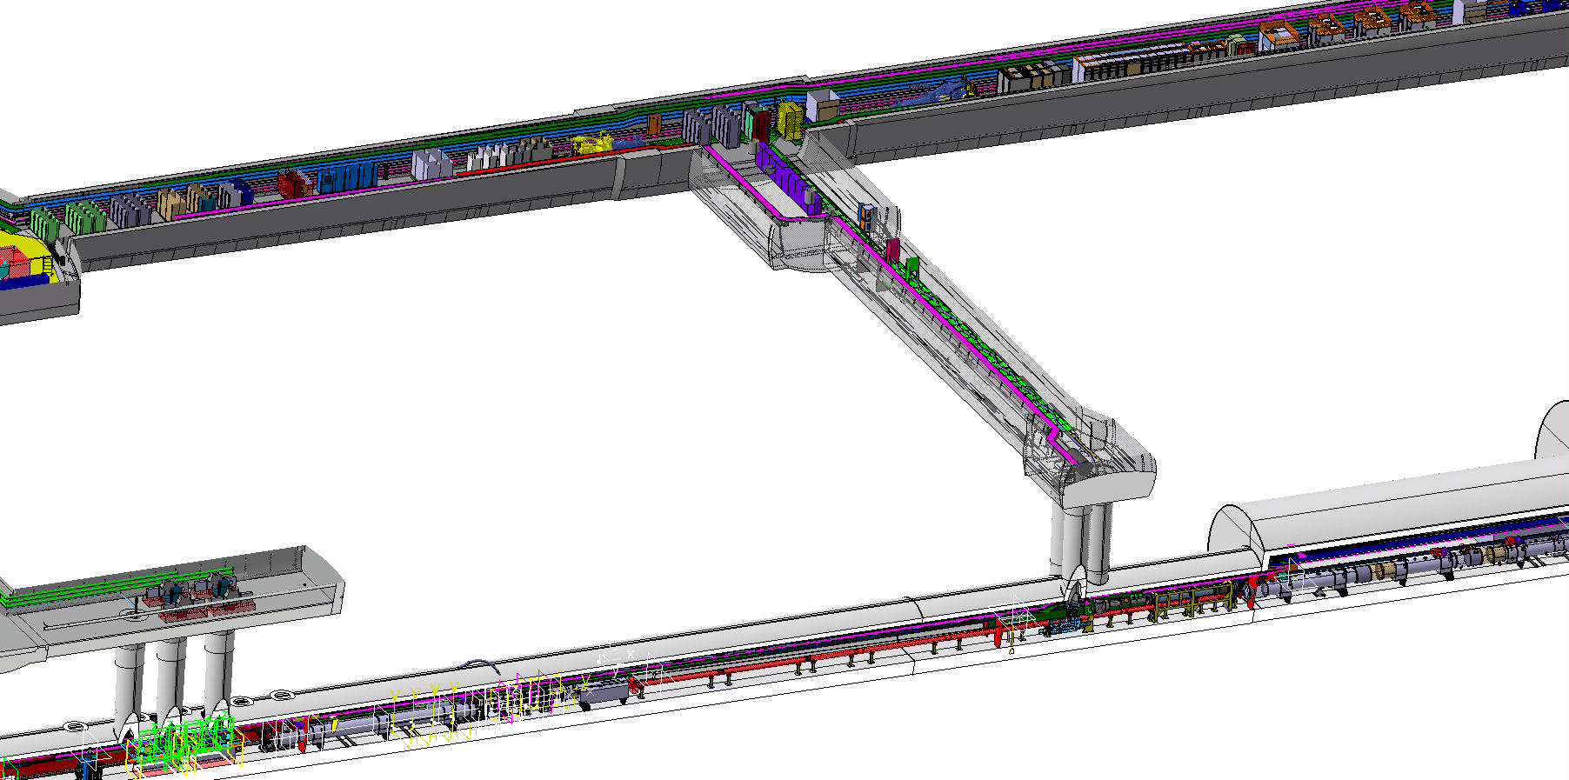
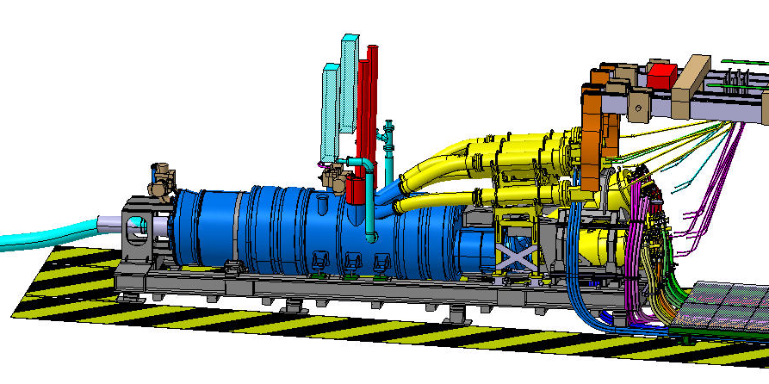
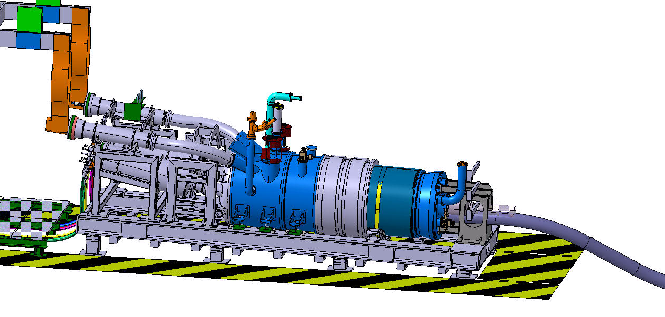
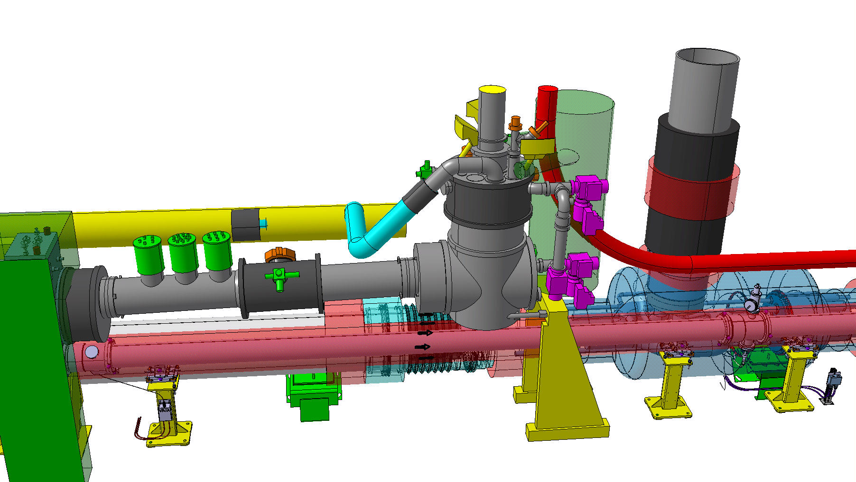
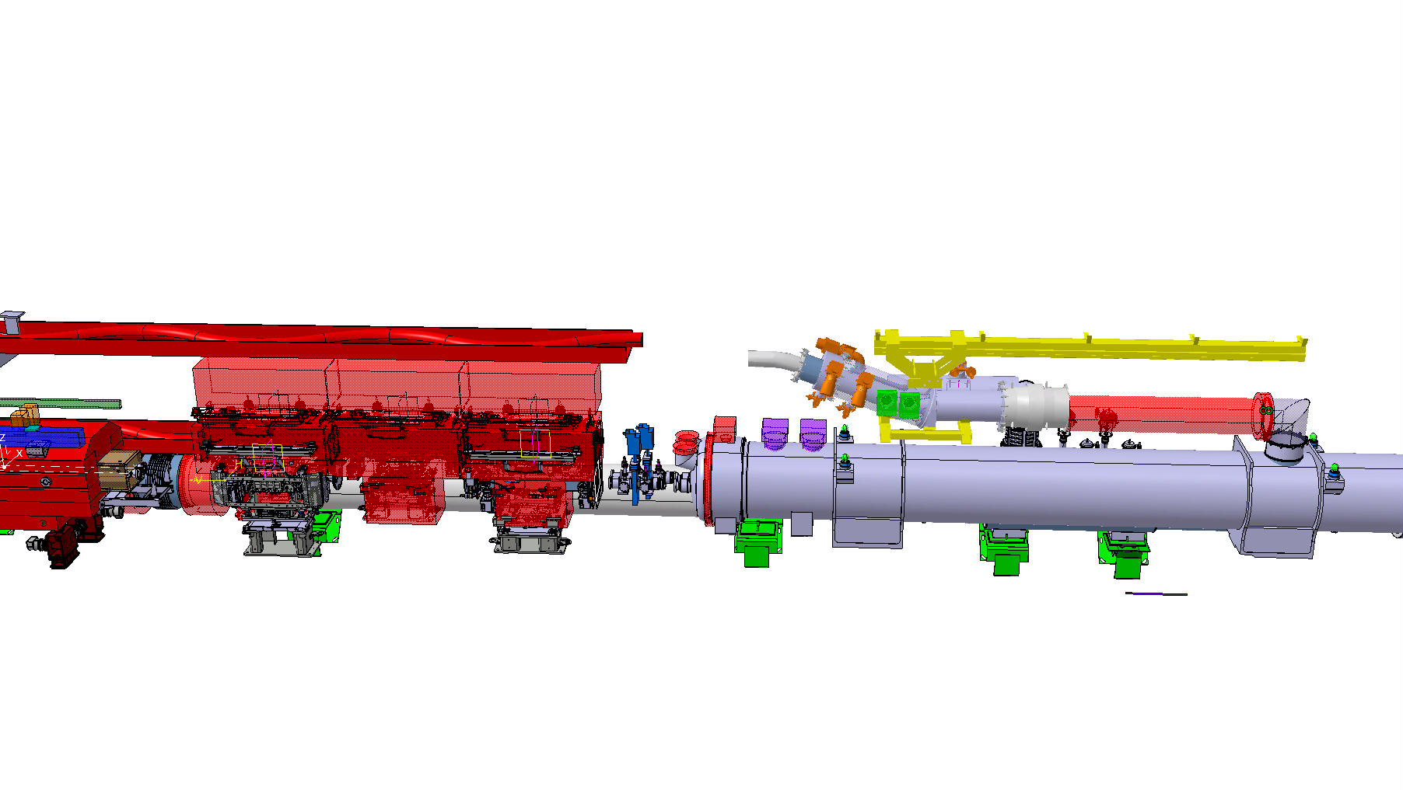
WP6a configuration in the LHC underground
DFHX
DFHM
UR Gallery
DFX
LHC Tunnel
DFM

Slide 4
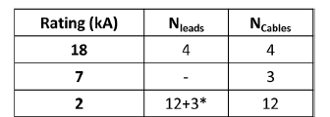
DFM for the Matching Sections
Triplets
Matching Sections
Rating (kA) | N_{leads} | N_{cables}
13 | 2 | 2
0.6 | 8 | 8
D2 and its correctors
The DFMs are part of the Cold Powering Systems that power the Matching Sections

Slide 5
Production of DFMs
Construction of five DFM cryo-modules, via UK 2 Collaboration Agreement, by Southampton University (SOTON). Detailed design done by CERN
Five cryo-modules: one pre-series unit (also spare for HL-LHC) and four series units
No DFM test in nominal cryo/electrical conditions in the WP6a baseline. But recent studies for the test bench dedicated to the series tests (series DFH+SC Links to be tested in SM-18, Cluster F2) consider the DFM as potential cryostat for the SC Link termination in LHe
The cryostats are installed in the LHC tunnel – where the Nb-Ti cables of the SC Link are connected to the Nb-Ti cables passing through the λ plate
Availability: at the installation in the tunnel (+ 1 unit for the series test)

Slide 6
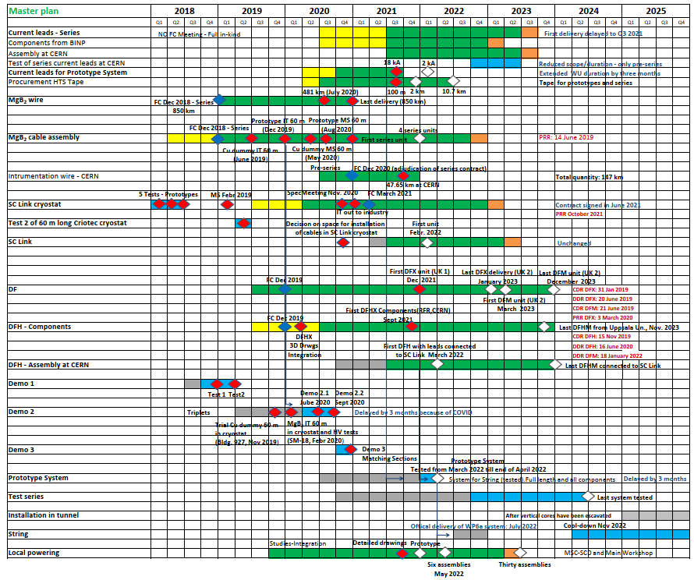


DFM in WP6a Master Schedule
Presented at Cost&Schedule Review 2021
March 2023 - Dec 2023

Slide 7
Thanks for your attention !

